Slide 1


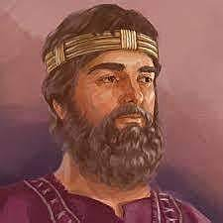
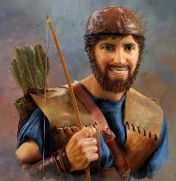



Killer Bees, or Honey Bees?
Introductory Study from
1 Samuel 14
(Dawn Day)

Slide 2




Why another “dawn” day study?
The truth of the “dawn day” commencement was lost
a long time ago – about the time the exiles returned
from Babylon changing it to the “sunset/evening”
commencement. Rome made changes to “midnight.”
History books speak of day commencements as being
at 6 PM every day. Over recent years some claim
Yahuah’s day begins at sunrise or noon. In the last 10
years this truth is being restored according to creation
and Torah, so you can experience the …
Sweetness of Dawn!
Every Single Day of the Week!

Slide 3
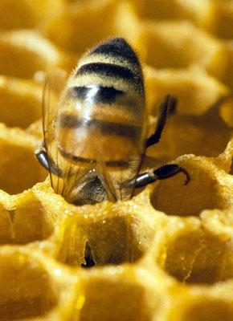
This Scripture testimony has been preserved for us since 365 years
after Moses.
At that time King Saul was leading Israel according to all the Torah Commands.
What does that have to do with
a honey bee?

Slide 4
Commitment!
The 3 main characters are King Saul, his son Jonathan and one armour bearer.
Just as this honey bee is committed and “all in” what does that have to do with a study on day-start?

Slide 5
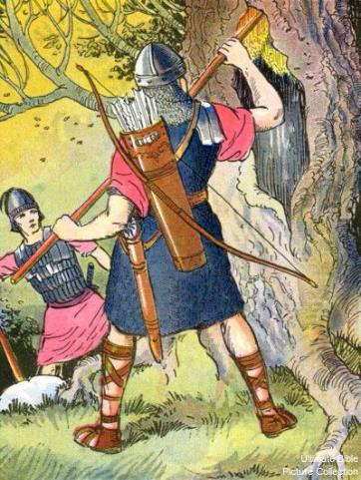
Yonathan’s life was at stake as
soon as he tasted some honey
which was strictly against a
COMMAND of King Saul
that he knew nothing about!
What does that have to do with any day-start?

Slide 6
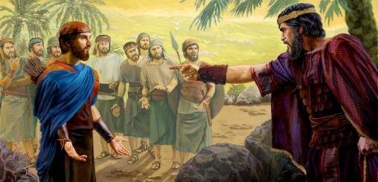
This COMMAND
of King Saul was given
in the Light Season.
The violation was discovered
“after the sun had set.”
Sunset Theory
declares …
After the sun has set,
a new day begins! ??

Slide 7
If Sunset Theory is correct,
then by default, this story takes place over the period of two days!
However, the Premier Witness of 1 Samuel 14 claims there is only ONE DAY involved.
1 Sam 14:1 And it came to be ONE DAY that Yonathan son
of Sha’ul said to the young man who bore his armour, “Come, and let us go over to the outpost of the Philistines which is on the other side.” But he did not inform his father.
PLUS, there are 6 more confirmations that the “day” is singular, not including a new day after the sunset!

Slide 8


Dawn
Samuel confirms all of these events are found in one day!
Yonathan and his armour bearer exterminated 20 men on this early morning!
The battle continued through the Light Season.
Yonathan ate honey late in
the Light Season.
Saul’s lot fell on Yonathan after the sun had set.
Sunset
Saul’s command: Do not eat food until evening!
Was this the next “day”?
How will sunset theory keep all of these events within one 24 hour cycle?

Slide 9


The question: Is this testimony in 1 Samuel
based upon the Torah statutes?
Do we
need to “bee”
Torah Observant?

Slide 10
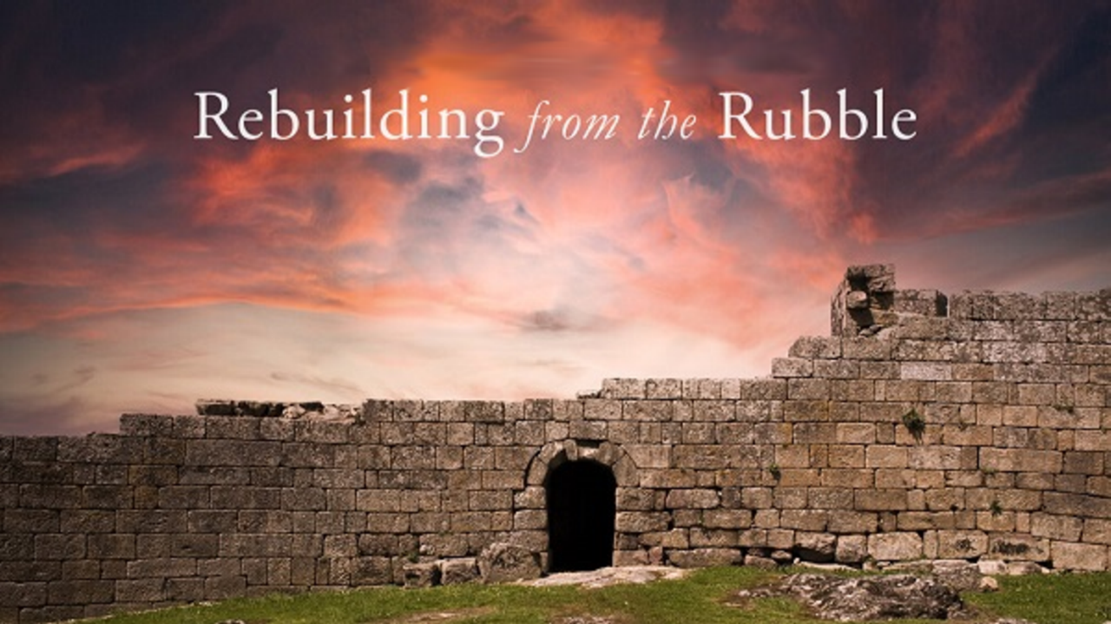


If you enjoyed this short introduction …
Plan to see the full study in detail!
And: Sign up with Covenant Calendar Club
for the Friday & Shabbat Zoom Meetings
(including live discussion)
Thank-you!
Shalom!
https://studythecalendar.com/sign-up/

