Slide 1


²³ And the Lord spake unto Moses, saying,
²⁴ Speak unto the children of Israel, saying, In the seventh month, in the first day of the month, shall ye have a sabbath, a memorial of blowing of trumpets, an holy convocation.
²⁵ Ye shall do no servile work therein: but ye shall offer an offering made by fire unto the Lord.
²⁶ And the Lord spake unto Moses, saying,
²⁷ Also on the tenth day of this seventh month there shall be a day of atonement: it shall be an holy convocation unto you; and ye shall afflict your souls, and offer an offering made by fire unto the Lord.
²⁸ And ye shall do no work in that same day: for it is a day of atonement, to make an atonement for you before the Lord your God.
²⁹ For whatsoever soul it be that shall not be afflicted in that same day, he shall be cut off from among his people.
³⁰ And whatsoever soul it be that doeth any work in that same day, the same soul will I destroy from among his people.
³¹ Ye shall do no manner of work: it shall be a statute for ever throughout your generations in all your dwellings.
³² It shall be unto you a sabbath of rest, and ye shall afflict your souls: in the ninth day of the month at even, from even unto even, shall ye celebrate your sabbath.
233 words … 13 words = 1/2 % 0.055%
9 words = 0.038%
32: 33 words … vss 13 words: in the ninth day of the month at even, from even unto even 39% (61%)
32 33 words … vss 9 words: in the ninth day of the month at even 27% (73%)
Calculating
Atonement
Correctly
Notes:
4.17b 81 slides Calculating Atonement Correctly Website: Youtube:
For those that have viewed the introductory video for Yom Kippur Commencement, we trust this full study will have many more answers to any questions that revolve around the proper commencement of the most solemn set-apart Shabbat of the year. As the Dawn Day commencement for the worship statutes (and every other day of the year) gains acceptance the world over, there are still questions about the definite time for Yom Kippur's commencement. Because of the last 9 words in Lev 23:32 " ... from evening to evening you shall celebrate your Sabbath" ... even some "Dawn Day Keepers" feel that Yahuah has made this "ONE sunset exception" for all His worship statutes. So what is it about verse 32 that produces this challenge? Well, it seems to be the mention of "the 9th day at even/evening." Do note there is something very important that commences at the evening of the 9th day. Is it the commencement of the 10th day, or something else? Enjoy the full study to see exactly how simple this really is and from now on you can know how to commence Yom Kippur with no lingering questions.
1.32 Calculating Atonement Correctly TA – done Apr 15/21 940 -
Calculating Atonement Correctly. (Blurb for Mario)
Does the yearly Atonement Sabbath start on Tishri 9 at the evening twilight as we have been taught for years?
In Lev 23:27, Yahuah made an anchoring statement. Yahuah identified Tishri 10 as the one and only day of Atonement. Yahuah then between Lev 23:28-32, referenced Tishri 10 another 6 times leading up to and including verse 32.
Are we to believe that in verse 32(b) Yahuah changed His mind, reversed His decision and announced that instead the Sabbath of Atonement started on Tishri 9 instead? Did Yahuah provide us with a reason for the "instant controversial and uncharacteristic switcheroo"!!
Where in the Scriptures can we read about this amendment to the Tishri 10 Atonement declaration?
What if what Yahuah was actually declared as starting on the evening of Tishri 9 was not the actual Sabbath day of Atonement?
What if the event commanded to start on Tishri 9 at evening was likened to "an accessory" which facilitates and accentuates Yahuah's desired atmosphere and conditions us for the HIGHLY SOLEMN SABBATH of Atonement starting at Dawn?
In this study, you will see clearly why starting the Atonement Sabbath at the EVENING of Tishri 9 causes a 48 hour Sabbath of Atonement! And we know clearly that this was not commanded by Yahuah! So why have we been taught to start the Sabbath day of Atonement at the evening of Tishri 9?
If Atonement day is in fact an anomaly and is totally different in it's pattern from the other Mo-edim (Feast) patterns, where do we find this explanation in the Scriptures?
Friends, it is HIGH TIME that we understand the correct way to become IN COVENANT with our Creator and observe the Festival of Atonement on Yahuah's Calendar - the Covenant Calendar that the Hebrew nation agreed to 3 times before it was ratified in blood at Mt Sinai!
What do you say? We invite you to join us on Covenant Calendar Club for an extremely interesting and revealing evening investigating the commands of Yahuah, concerning the Tishri 10 Sabbath of Atonement.

Slide 2

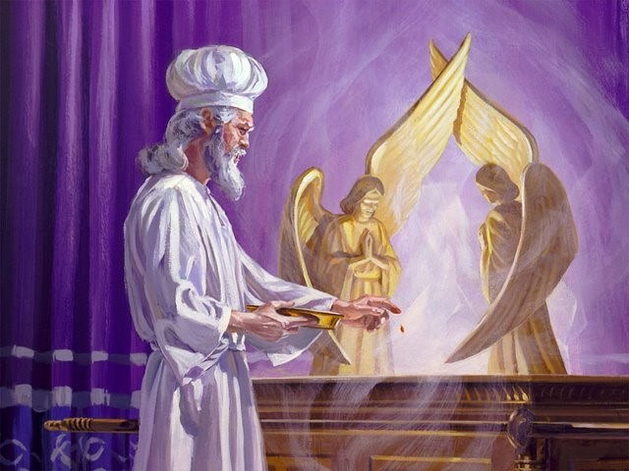
Yom Kippur
(Day of
Atonement)
The most solemn Sabbath of the year!

Slide 3


When it comes to
“day-start” the Question
is Always the Same
Since when does the day not begin
with “sunset” or “evening” anymore?
It’s a Good Question!
There is an Answer!
This study we will attempt to sharpen
our Bible study skills through finding
the answer to this popular question
for those that do not know!

Slide 4

But … for those that do
know when the day begins –
they too may have this challenge:
You just invested a lot of time and effort to understand the day-start beginning with the first day of creation. You can even explain it really well. Then … along comes your Sabbath pastor & he’s not interested in your new understanding.
Next you hear these words: “… from even
unto even, shall ye celebrate your Sabbath”!
Most know about “even” from their Gen 1 study.
But … most don’t know how to answer this challenge with satisfaction. Let’s find answers!

Slide 5
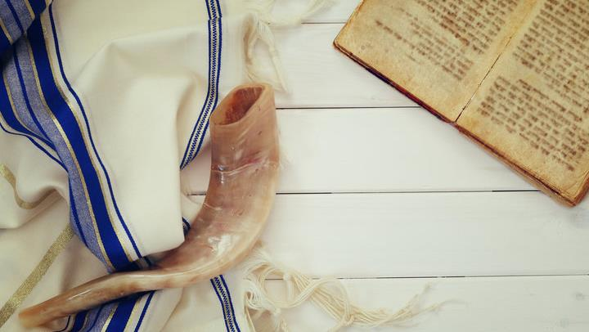
Questions for Atonement
2. What two characteristics that begin the
Atonement Sabbath
by the evening of Tishri 9 cause it to take part
on two days? Would a “false mixture” and tradition have an effect?
1. When does the actual Sabbath Day of Atonement begin and when does it end??
3. What are we commanded to begin on the evening of Tishri 9?

Slide 6
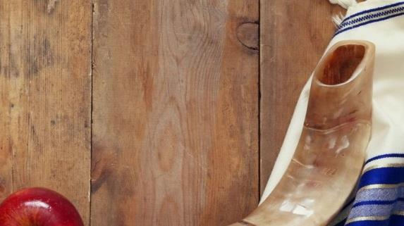
Malachi 3:6 declares Yahuah does not change.
Creation week declares all days begin at Dawn.
Many feast calendars, AND FEAST KEEPERS declare Day of Atonement Sabbath begins at the dusk of sunset on the 9th day.
Another Question
Where is Yahuah’s Scriptural exemption to commence His Day of Atonement at “another time” other than what He has declared no less than a total of 7 times in Lev 23:27 – 32 alone?

Slide 7

Final Questions
Is it possible that you have heard it said that the weekly Sabbath begins at sunset and then Lev 23:32 is referenced for support?
Have you ever questioned why Yahuah never informed us why
He waited from creation until Mosheh received the instructions from the top of Mt Sinai (approx. 2500 years later) to explain the perimeters of the 7th Day Sabbath?
Have you ever seen a text where Yahuah stated one fact,
then changed His mind and delivered an opposing command –
both within one text?
These are some questions that we will be looking at very closely in this study.

Slide 8
Some Feast Teachers Claim there are 4 main Scriptures that assure everyone the weekly & annual Sabbaths always begin at sunset/evening!
They claim these 4 witnesses:
Many theologians differ & also claim:
every day begins with sunset;
Or they claim every day of the week begins in the morning, but only the worship statutes begin at sunset.
Some also claim that every day begins in the morning with the “break of day” … but … Day of Atonement is the one exception that begins at sunset the
day before.
Gen 1:5
Neh 13:19
John 20:1
Favorite Lev 23:32 (and only 9 words of the verse at that)!

Slide 9
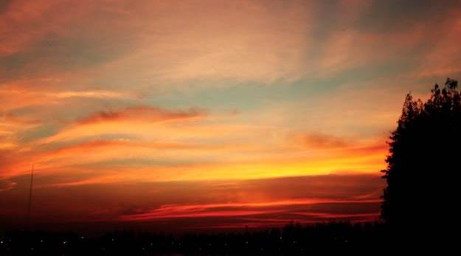



Lev 23:32[b] is the main Bible
text that is used to support the
“day” beginning at sunset:
With a total of only 9 words …
“From evening to evening, you
shall celebrate your Sabbath.”
[NKJV]
Remember :
Lev 23:26-32 has a total of 230+ words.
The last 9 words of the Atonement content are used
to determine the day-start for ALL yearly Sabbaths.
That’s only 3% of the words used to establish a doctrine!

Slide 10
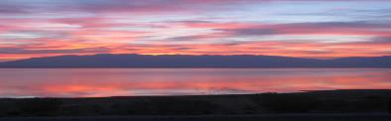

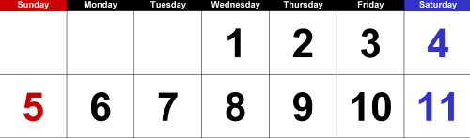
The foundation of Sunset Theory claims
each new day begins at sunset/evening!
Example with Dawn Day Timing
#1a
To illustrate this concept for Day of Atonement, Sunset Theory claims the 10th day begins at evening of the 9th day!
Exactly, where is the “evening” of the 9th day?
Question:
Is there any day that has more than ONE “evening”?
Therefore:
Sunset on the 8th day …
Ushers in the “evening/ereb” of the 9th day
according to Sunset Theory!

Slide 11



Time to consider the next step:
Dawn Timing
#1b
Now that we have located the evening of the 9th day,
find the full 24 hour span of the cycle to the next sunset.
Is this correct?
9TH DAY
Sunset 8th day
Sunset on the 9th day …
“even/ereb” 9th day
Ushers in the “evening/ereb”
of <10th ???> day?
OR: is this really a 2nd “evening” of the 9th day?

Slide 12

To be fair to Sunset Theory let’s consider the only other option that could work!
Example with Sunset Timing
#2a
We are looking for the commencement and placement of the 10th day according to Sunset Theory! Next, we must find:
Exactly, where is the “evening” of the 9th day?
Review Question:
Are we sure every day has only
ONE “evening”
– not two?
Therefore:
Sunrise: 8th day
Sunset: 8th day
Ushers in evening: 9th day
Next …

Slide 13
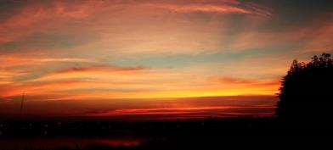
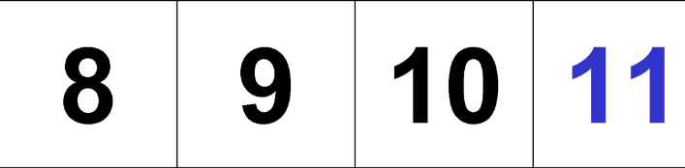

Where is the “evening” of the 9th day
so we can observe Yom Kippur
(the 10th day) on time?
Example with Sunset Timing
Expanded View
#2b
Ushers in evening: 9th day
This is the ONLY placement for the “evening” of the 9th day.
Why?
Because sunset on the 9th day ushers in the evening of the
10th day as Sunset Theory demands!
Sunset: 8th day
Lev 23:32(c) says:
… in the ninth day of the month at even, from even unto even, shall ye celebrate your sabbath.
Question:
Where is “even to even” on this calendar, and is that where Yom Kippur is celebrated?
²³ And the Lord spake unto Moses, saying,
²⁴ Speak unto the children of Israel, saying, In the seventh month, in the first day of the month, shall ye have a sabbath, a memorial of blowing of trumpets, an holy convocation.
²⁵ Ye shall do no servile work therein: but ye shall offer an offering made by fire unto the Lord.
²⁶ And the Lord spake unto Moses, saying,
²⁷ Also on the tenth day of this seventh month there shall be a day of atonement: it shall be an holy convocation unto you; and ye shall afflict your souls, and offer an offering made by fire unto the Lord.
²⁸ And ye shall do no work in that same day: for it is a day of atonement, to make an atonement for you before the Lord your God.
²⁹ For whatsoever soul it be that shall not be afflicted in that same day, he shall be cut off from among his people.
³⁰ And whatsoever soul it be that doeth any work in that same day, the same soul will I destroy from among his people.
³¹ Ye shall do no manner of work: it shall be a statute for ever throughout your generations in all your dwellings.
³² It shall be unto you a sabbath of rest, and ye shall afflict your souls: in the ninth day of the month at even, from even unto even, shall ye celebrate your sabbath.
233 words … 13 words = 1/2 % 0.055%
9 words = 0.038%
32: 33 words … vss 13 words: in the ninth day of the month at even, from even unto even 39% (61%)
32 33 words … vss 9 words: in the ninth day of the month at even 27% (73%)
Sunset: 9th day
Ushers in evening: 10th day!
This is the ONLY section that is “even to even” for
celebration??
Therefore, we have a huge problem
as this section is NOT the 10th day!

Slide 14






Sunset Timing
#2b
Has this been one confusing exercise?
Have you noticed that no matter what we tried, it didn’t seem that the 10th day had any recognition from “even to even”?
Either we’re missing
a lot of important information, or Yahuah’s day cannot begin with sunset/evening!
It’s time
to find out!

Slide 15
Leviticus 23:27-32 delivers to us: #1 – A Premier Statement of timing –
The 10th day of the 7th month.
Lev 23:27(a) “On the TENTH DAY of this seventh month is
The Day of Atonement.
There can be no mistake that Yahuah wants us to understand that
the 10th of Tishri is the APPOINTED TIME.
Then we see 6 additional reference points indicating that Tishri’s 10th cycle
of the 7th month, is the one and only cycle of the year determined by Yahuah to be
THE DAY of Atonement Shabbat.
Ultimately, Who gave this definitive statement of timing for the Day of Atonement?
Lev 23:26 And יהוה [Yahuah] spoke to Mosheh, saying,

Slide 16
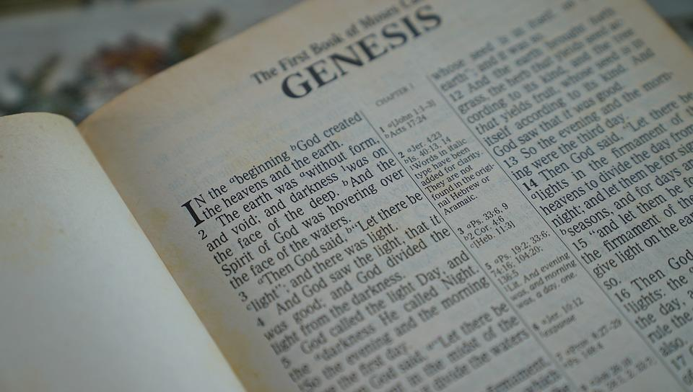
The commencement and termination
of this solemn festival is
FIRMLY ANCHORED
in the Creation account.

Slide 17


.
What qualifies the CALIBER of this cycle?
Lev 23:27 “On the TENTH DAY of this seventh month is
The Day of Atonement.
Can we safely assume from this text, that the 9th of Tishri is ALSO a
set-apart convocation?
Where in the Scriptures do we find a similar or otherwise statement declaring the 9th of Tishri as a Qodesh Convocation?
WHERE????????????
It shall be a SET-APART GATHERING for you.

Slide 18

.
The Premier Point of Assertion:
(#1 of 7 solid references
to Day of Atonement)
Lev 23:27(a) “On the TENTH DAY of this seventh month is The Day of Atonement.
Let’s look at the last 6 reference points indicating the 10th cycle of Tishri.
Please note very carefully the SINGULAR form of text used to describe – The Day of Atonement as opposed to a plural effect – The Day(S)
(of Atonement). This makes it very difficult to rationalize the Day of Atonement starting on the 9th cycle of the month and ending on the 10th cycle of the month. That would involve TWO cycles of the month!

Slide 19

.
Again - The Premier Statement – Lev 23:27 (b)
Lev 23:27 “On the TENTH DAY of this seventh month is
The Day of Atonement.
shall be a SET-APART GATHERING for you.
2nd Reference Point!
IT

Slide 20
.
Reference #3 – Lev 23:28 (a)
And you do no work on THAT SAME DAY,
Lev 23:27 “On the TENTH DAY of this seventh month…
Reference #4 – Lev 23:28 (b) for IT is the Day of Atonement,
to make atonement for you before יהוה your Elohim.
9th ?

Slide 21
.
Reference #5 – Lev 23:29
“For any being who is not afflicted on THAT SAME DAY, he shall be cut off from his people.
Reference #6 – Lev 23:30
“And any being who does any work on THAT SAME DAY, that being I shall destroy from the midst of his people.
Lev 23:27 “On the TENTH DAY…

Slide 22
.
Reference Point #7– Lev 23:32 (a)
“IT is a Sabbath of rest to you, and you shall afflict your beings.”
Yes, this “it” word is once again referencing the 10th cycle of Tishri.
A Summary
Thus far Yahuah has declared by a Premier Statement (Lev 23:27a)
and then referenced directly to the same - 6 additional times - that
the SINGLE cycle of Atonement is on Tishri 10.
There has been zero mention of Tishri 9 up to this point.

Slide 23
.
We now come to what has previously been a very controversial part of the text –
Lev 23:32 (Part b).
We have already been THOROUGLY informed of the “what” – (Tishri 10)!
Now we are about to learn of the “how” and most interestingly –
the “WHEN” – of the “how”!
Lev 23:32 (a) “It is a Sabbath of rest to you,
and you shall afflict your beings. (WHEN should one begin?)
(b) On the ninth day of the month at evening …”

Slide 24
.
The – “How” –
Lev 23:32 (a) “It [Tishri 10] is a Sabbath of rest to you,
and you shall afflict your beings.
What we are “to DO” is to afflict our souls!
This study has no intention of delving into the meaning of the word “afflict” in this session.
Our focus for this study is about – the timing of the affliction.
The pertinent question then is –
What time of the cycle and date of the month should this AFFLICTION COMMENCE?

Slide 25
.
Question: When Yahuah indicates the 9th cycle of the month
- “at evening,” - exactly what part of the 24 hour cycle is this?
Before we can determine what the celebration theme for the Festival of Atonement is, we need to establish exactly when this “evening” time is.
The Hebrew word for evening is <ereb> - ע ר ב ..
Let’s look at some definitions for this word.
A Hebrew English Lexicon by John Parkhurst (1762)
Evening - ע ר ב
“The evening air from the western or darkened part of the heavens
begins to mix with the day, which mixture continues till night, when the
day is overpowered the darkness prevails and the mixture of daylight ceases.
Gen i.5, xxiv.11.”

Slide 26
.
A Hebrew Lexicon by W. H. Barker (1776) (page 148)
Evening - ע ר ב
to mix, mingle: the evening, when darkness mixes with the light, to be darkened, obscured, the woof: to be intermixed with the warp, a mixed multitude, swarm, the willow - it being of a mixed colour, pale on one side and green on the other, the weft, evening.
Etymological Dictionary of the Hebrew Language: <ereb> - ע רב,
(some definitions apply to Light), to set (said especially of the sun), to enter, to go in, to go down, it became evening, it grew dark, sunset, evening, mixed, to mix, was mixed, was mingled, mixture, woof.
Question: What is “woof”? Let’s check the Webster’s Dictionary first and then the Strong’s Concordance.
Answer: Woof = to weave, the threads that cross the warp, the weft.

Slide 27
.
Strong’s H6154 – Woof, Mixed multitude, Mingled people - ע רב: <ereb>; or
ereb; (ay'-reb); (1 Kings 10:15), from H6148; the web (or transverse threads of cloth); also a mixture, (or mongrel race): KJV - Arabia, mingled people, mixed (multitude), woof.
H6148 `arab; (aw-rab'); a primitive root; to braid, i.e. intermix; technically, to traffic (as if by barter); also or give to be security (as a kind of exchange): KJV - engage, (inter-) meddle (with), mingle …
Note: The variety of meanings for H6154 strongly suggests …
“a mixing/mingling.” That’s because, in Hebrew, H6154 is a family word
with H6153 [even/evening] - meaning there will be strong similarities.

Slide 28
Understanding More About Mixings
H6153 ereb* - a length of time (*specific to after the sunset in which a mixing of light and darkness occurs)
H6150 arab* - mixing of light and darkness – dusk (2nd prime root)
(very specific of the twilights)
*H6150 definitely links to ereb/dusk twilight.
H6148 arab* - mixing (generalized mixings) (1st prime root)
animals, insects, cake mix, cement, fruit & vegetable, braiding,
and even mixture of light and darkness, etc.
*H6148 definitely includes & links to boqer/morning twilight.

Slide 29
.
What two specific time frames are identified when this verb with a mixing effect is applied to a 24 hour cycle? Are the two twilights the only options?
When does the light and darkness form a mixing action?
Is it somewhere after the direct sunlight has been removed following the
heat of the Light Season?
Note: the qualifier for pointing to the pre-sunrise mixture of light and darkness is not seen in these verses of Leviticus 23:27-32!
Therefore we will not be looking to Dawn (break of day/boqer)!
The - ע ר ב : <ereb> (evening MIXTURE) is after the sunset has occurred,
thus allowing the mixing of soft sunlight with the ensuing darkness.
The absence of direct sunlight allows the MIXTURE effect needed to
fulfill the Hebrew definitions.

Slide 30



.
Here is our pertinent text again to refresh our memories.
Lev 23:32 (a) “It is a Sabbath of rest to you,
and you shall afflict your beings.
(b) On the ninth day of the month at evening ...”
We will now examine charts for the portion of the 24 hour cycle where
light mixes with darkness.
The full purpose of this chart is to expose the exact location of the mixing of light with darkness (evening/ereb) factor for the 9th cycle of the month.
The erroneous Sunset Theory teaching that Atonement Sabbath starts
directly before (or after) the sunset will be exposed soon.
Does the Sabbath of Atonement begin on the 9th EVENING of the month,
or can it possibly be something else that starts there?
It’s time to investigate!

Slide 31

On the next slide is a statement showing the results of starting the Atonement Sabbath at sunset of Tishri 9.
It exposes the situation which occurs when starting the Atonement Sabbath on the evening of the ninth of Tishri.
We will then examine why this unique situation would, (or would not) exist and see if there is Scriptural support for either scenario.
Note where the green oval sits.
This is an area where a HUGE problem exists!

Slide 32


Summary of Atonement Days according to Sunset Theory.
Question: How can Tishri 9 be a Preparation Day for the Sabbath of Atonement
on Tishri 10, and a Sabbath day as well??
Atonement Day(s) of Sunset Theory?
Sunset
Sunset of the 8th cycle
After sunset on the 8th; ereb begins the 9th.
Tishri 9 – begins at this
“even/ereb” mixture of
light & darkness
Sunset
9TH
8 |  | Tishri 9 Preparation | Tishri 9 Preparation |  | Tishri 10 Atonement Sabbath | Tishri 10 Atonement Sabbath
Remember: In Sunset Theory, the 9th day will begin with the ereb right after sunset on the 8th day! That is the ONLY placement for the ereb of the 9th!

Slide 33

Summary of Atonement Days according to Sunset Theory.
Question: How can Tishri 9 be a Preparation Day for the Sabbath of Atonement
on Tishri 10, and a Sabbath day as well??
Atonement Day(s) of Sunset Theory?
Sunset
Tishri 9 - “Even” mixture of light & darkness
“Even” of Tishri 10 - Atonement Day
Sunset
Sunset
24 HRS of Affliction
2nd 24 HRS of Affliction
24 HRS of Sabbath
2nd 24 HRS of Sabbath
8 |  | Tishri 9 Preparation/Sabbath (???) | Tishri 9 Preparation/Sabbath (???) |  | Tishri 10 Atonement Sabbath | Tishri 10 Atonement Sabbath
(2?) Atonement Day(s) (?) – 48 hours – Tishri 9 & 10 – Scriptures? Atonement Affliction – 48 hours – Scriptures?

Slide 34
.
Sunset Theory Review!
Please note the location of the 9th cycle evening (after sunset - coloured brown
for identification purposes) on the left side of the chart.
The sunset of the 8th day occurs; the mixture
of light and darkness commences, initiating
the evening mixture of the 9th of Tishri
– all 24 hours of the 9th begin right here!
Sunset changes the “day” here! (???)
Sunset
Sunset
8th
9th of Tishri
9th of Tishri
There can be only be ONE evening mixture per 24 hour period!!
It is at this point that some declare the
start of Atonement Sabbath Day! (~?~?~!)

Slide 35
.
Yom Kippur begins here? … on the “even” of the 9th?
Sunset Theory –
Tishri 9th!
The Sunset,
of the 8th, ushering in
the evening of Tishri 9,
is declared by many as
being the start of the
Atonement Sabbath!
Sunset changes the “day” here! (???)
Sunset
Sunset
8th
9th of Tishri
9th of Tishri
That is 24 hours of Atonement - BEFORE - Tishri 10 even begins!
Would that be the FIRST OF TWO DAYS for Atonement celebration?

Slide 36
.
Sunset Theory! Tishri 10th!
Location of the
9th cycle SUNSET. Notice what
happens next!
Sunset changes the “day” here! (???)
Sunset
Sunset
9th
10th of Tishri
10th of Tishri
Here the sunset has triggered the start of the 10th of Tishri.
At this point, there has ALREADY BEEN 24 hours of Atonement day –
IF -
THE EVENING OF THE 9TH STARTS ATONEMENT DAY!
Does Yahuah require 2 week days/ 48 hours of Atonement affliction?

Slide 37
The Common Mistake
In Sunset Theory it is common to reckon the evening twilight BEFORE the sunset, allowing the usage of Tishri 9 for the start of the Day of Atonement.
One Sunset Theory cycle
Sunset Dawn Sunset Dawn
DIRECT SUNLIGHT PREVENTS A LIGHT/DARKNESS MIXTURE HERE! The Hebrew definitions cannot be fulfilled here! Declaring an evening here, VOIDS YAHUAH’S WORD! The ereb (evening twilight MIXTURE) - NORMALY - cannot occur before the sunset!
HOWEVER … - Yahuah’s Twilight Mixing of Light/Darkness is here!
Tishri 9
Tishri 9
Tishri 10

Slide 38
Does Tishri 9 exclusively have TWO EVENINGS?
One Sunset Theory cycle
Sunset Dawn Sunset Dawn
But man, in order to prevent a 48 hour Atonement Sabbath, defies the Hebrew definitions of the word – EREB – (A MIXING EFFECT.) Man desires to place the 2ND ereb (mixture) of Tishri 9, PRIOR TO SUNSET
WHERE THE DIRECT RAYS OF SUNLIGHT PREVENT ANY DARKNESS
FROM MIXING WITH THE LIGHT OF DAY!
Yahuah’s Tishri 9th Twilight Mixing of Light/Darkness is here after a sunset!
Look at this carefully! Is it correct
to apply TWO EVENING MIXTURES in ONE 24 hour period?
Tishri 9
Tishri 9
Tishri 10

Slide 39
When man defies the Hebrew word definitions, is he at the same time DEFYING YAHUAH’S COVENANT OF THE DAY AND THE COVENANT OF THE NIGHT?
Jer 33:20
When man declares darkness occurs before sunset,
is this a confusion of Yahuah’s Covenant of the day?

Slide 40

A Complicated Problem Needing a Solution!
If sunset theory wants to have Tishri 10 as the Day of Atonement then
“this theory” has no choice but to claim that Tishri 9 has two evenings like this:
An “evening” after the sunset of Tishri 8 that BEGINS the 9th day …
and an “evening mixture of light and darkness” PRIOR TO AND DURING
the sunset on Tishri 9 to END the 9th day.
Sunset Theory would then be demanding TWO EVENINGS, BACK TO BACK
split by a sunset!
Who ever heard of
any day having
2 evenings?
Notes:
Kelowna Jan 20/19 … Okanagan Lake by Catherine Hutchins

Slide 41
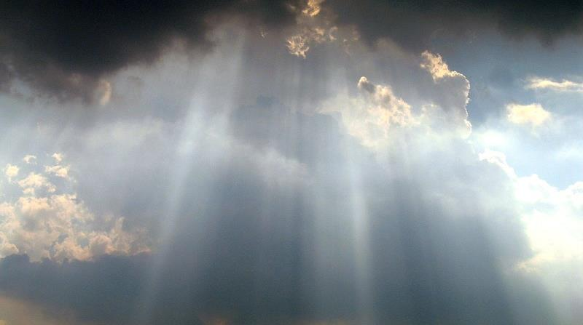
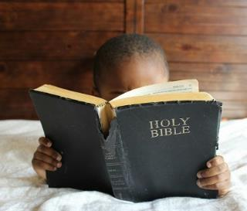

A Solution to the Problem!
Yahuah’s Covenant Calendar requires Tishri 9 to need only
1 evening (not 2) to honor the celebration guidelines
for Tishri 10!
Next, we will be examining every segment of verse 32 for
a complete understanding of the true context of this verse.

Slide 42

There are 2 times when, by Divine intervention, it became dark during the time when the sun was high in the sky!
When the plague of darkness blackened Egypt and Pharaoh’s heart!
When at Golgotha with Yahusha nailed to the stake, it became dark from the 6th hour from Dawn, until the 9th hour from Dawn.
How often have you seen darkness
take over the sky when the sun is still directly shining on the land?

Slide 43
It makes no sense whatsoever to have the Day of Atonement
start at sunset. By default of Sunset Theory characteristics,
total misalignment with Genesis 1 and Yahuah’s Statutes becomes inevitable.
The questions then are –
A) When does Tishri 10 begin?
B) What commences in the evening of Tishri 9?
We are told to come to Yahusha as little children
(ready to learn from an uncluttered platform).
Matt 18:3 And said, Verily I say unto you, Except ye be converted, and become as little children, ye shall not enter into the kingdom of heaven.

Slide 44

Let’s put on our “little children hats” ☺ and look at what
the Scriptures declare for
the start of Tishri 10 –
The Day of Atonement!

Slide 45

Covenant Calendar Count for – Tishri 9!
Please note the 9th of Tishri morning arab (twilight mixture) before the sunrise!
The sunset of the 9th of Tishri occurs and the ereb (evening twilight mixture period) ushers in the Night Season of the 9th.
WHAT ELSE does this ereb initiate???
Tishri 9 starts at break of Dawn (per Gen 1 – Creation).
Dawn
Sunrise
Sunset
8th
9th of Tishri
9th of Tishri
There is an extremely important aspect that is very
specifically actuated by the evening mixture of Tishri 9.
However, we will continue by looking at the timing of
Tishri 10 according to Yahuah’s Covenant Calendar!

Slide 46
Covenant Calendar Count for – Tishri 10!
Note: the 10th of Tishri morning arab (twilight mixture) BEFORE the sunrise!
Tishri 10 starts at break of Dawn (per Gen 1 – Creation).
Atonement Shabbat begins at the first light of Dawn and lasts until the following Dawn!
A FULL 24 hours for Tishri 10 Shabbat!
Dawn
Sunrise
Sunset
9th
Tishri 10th - Atonement
10th of Tishri

Slide 47
Covenant Calendar Count for – Tishri 10!
Note: the 10th of Tishri morning arab (twilight mixture) BEFORE the sunrise!
Tishri 10 starts at break of Dawn (per Gen 1 – Creation).
Atonement Shabbat begins at the first light
of Dawn and lasts until the following Dawn!
A FULL 24 hours for Tishri 10 Shabbat!
Dawn
Sunrise
Sunset
9th
Tishri 10th - Atonement
10th of Tishri
The actual physical Shabbat of
Atonement day begins exactly as
every other day since creation with the eyelashes of Dawn!
Job 3:9!

Slide 48
When does the Shabbat of Tishri 10 - END?
Lev 23:27 – On the tenth day of this seventh month is Yom Ha’ Kippurim
(Day of Atonement). It shall be a qodesh gathering for you. …
Tishri 10 starts at
break of Dawn
(per Gen 1 – Creation).
Day, “Yowm” not only means the Light Season but it also defines the 24 hour cycle. ***
When Yahuah desires to be PRECISE about
INDIVIDUAL time related identities, HE INFORMS US!
Thus saith [Yahuah]; If ye can break MY COVENANT of the day,
and MY COVENANT of the night, and that there should not be
day and night in their season … (Jer 33:20).

Slide 49
Why then do we NOT see -
On the TENTH LIGHT SEASON {PRECISION and ACCURACY} of this seventh month as Yom Ha’Kippurim (Day of Atonement)…
It
shall be a QODESH GATHERING to you?
Dawn
Sunrise
Sunset
Why did Yahuah NOT GRASP this GOLDEN OPPORTUNITY to define with absolute precise accuracy, LIGHT SEASON ONLY perimeters
of the Atonement Shabbat? (What about the other Shabbats?)
Why did Yahuah not define with blinding accuracy that the Atonement Shabbat ended with the next LIGHT SEASON?
9th
Tishri 10th - Atonement

Slide 50

Why is it that in Genesis 1,
Day One ended at Dawn
Day Two ended at Dawn
Day Three ended at Dawn
Day Four ended at Dawn
Day Five ended at Dawn
Day Six ended at Dawn
Day SEVEN ended at Dawn
Matt 28:1 – the Shabbat ended at Dawn
Exo 12:10,11; Luke 23 – The “Preparation Day” ended at Dawn
Remember: Atonement Shabbat (as every other Shabbat) has a
“ 24 hour REST PERIOD” from ALL THE WORLD’S ACTIVITIES!
Why do we NOT find Yahuah’s instruction to end the Shabbat at the end of ereb twilight? Why do we not find this specific pattern anywhere in the Scriptures?
What gives us the right to claim the Atonement Shabbat ends at ereb twilight just because the Atonement observation theme (affliction) does?
P
E
RF
E
C
T
P
A
T
T
E
R
N
OK! Let’s move on to a very interesting section of Lev 23:32!

Slide 51
Lev 23:32 (b)
On the NINTH day of the month AT EVENING … (<ereb>)
Yahuah commands SOMETHING to happen!
What is it?

Slide 52
We have observed charts with Sunset’s Theory claim for Atonement day to begin after sunset on the 8th day ushering in the 9th of Tishri with ereb.
On the charts, we have seen … by default, the Sunset Theory
Atonement day will stretch over a period of 48 hours!
Is it becoming quite clear that many have not understood
the Scriptures correctly?
What other meaning could there possibly be that will find alignment with the Scriptures beginning in the evening (of the 9th after sunset) prior to the start of Tishri 10 at dawn daybreak?
Let’s look at the Scriptures once again -
It must be something that is integrally connected with Atonement day!

Slide 53
Lev 23:32 (a) It is a Shabbat of rest to you, and you shall afflict your beings.
The Shabbat of the 10th day of Tishri (Lev 23:27) has been referenced
for the 7th time. We are then told of the type of theme – named as an affliction - by which we are to conduct ourselves within this ultimately important cycle. Then comes the second part of the verse –
Lev 23:32 (b) On the NINTH DAY OF THE MONTH AT EVENING [EREB]…
We have just been informed of the starting point for
this commanded AFFLICTION!

Slide 54
The time to begin our personal “AFFLICTION” (before Shabbat)
is with the – ereb – of the 9th cycle.
(the evening twilight — the light and darkness mixture by definition)
Remember, the 9th day has only ONE ereb/evening!
In terms of Shabbat timing - there is no place in this Torah passage or anywhere else in Scripture, that would indicate the Feast of Atonement has a different commencement time than other worship statutes.
The Shabbat for Feast of Atonement
always begins at exactly the same
as every other cycle — at …
DAWN!

Slide 55
After the sun has set on the 9th cycle of Tishri — the 7th month,
the evening timing, (which is the proper beginning of the
Affliction OBSERVATION THEME ), ushers in and signals the soon arrival of the Shabbat of Atonement which begins
at the inception of BOQER TWILIGHT.
Consider very carefully the Words as
they have been preserved by Yahuah.
The Hebrew words within verse 32 (or any other verse) never
indicates the Shabbat of Atonement begins at sunset just because the word “evening/ereb” is present and connected in context to only the 9th day.
To claim otherwise is a full misconstruing of the Words of Yahuah!
But there is more after checking some definitions!

Slide 56
Understanding More About
<ereb/dusk/evening> & <arab/dawn/morning>
H6153 ereb - the main definition is dusk.
[When applied to “the affliction” of 24 hours,
this would be understood as “even to even” or
<ereb to ereb>. This will be seen in the study.]
H6150 arab - the main definition is – dusk (of the two twilights)
H6148 arab - the main definition is mixing (when applied to a
twilight, it links to the morning/boqer twilight, not dusk)
[The 24 hours of “dawn to dawn” would be understood
as <arab to arab>. This term is not used for Yom Kippur.]
These terms are not to be confused with <beyn ha arbayim>.

Slide 57
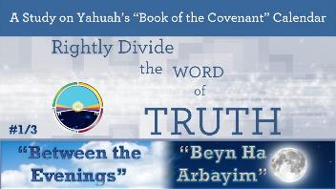
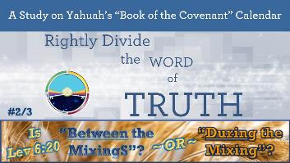
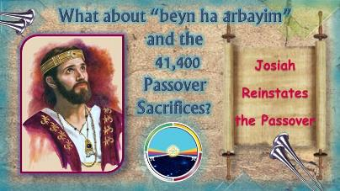
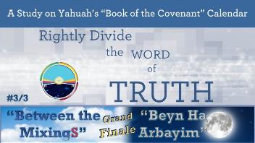
See the following studies
to understand
<ben ha arbayim>
or
<between the evenings/
between the mixings>
https://studythecalendar.com/series-2-stepping-stones/
https://studythecalendar.com/4-14-king-josiah-reinstates-the-passover/
This term is not linked to Yom Kippur!

Slide 58
Lev 23:32 (c) … from [ereb] evening to [ereb] evening …
By Hebrew definition – that is:
From the MIXING of light and darkness, after the sun has set, until 24 hours later when, once again, the sun has been removed from our sight and the light and darkness MIXTURE commences.
In other words – Yahuah’s APPLIED CELEBRATION THEME for the Set-Apart Feast of Atonement begins with an evening MIXTURE and ends at the next evening MIXTURE. These are the time parameters for the observation theme only – nothing added and nothing taken away.
Let the HEBREW WORDS THAT ARE WRITTEN PREVAIL.

Slide 59
Lev 23:32
(d)
… you OBSERVE YOUR SHABBAT.
The KJV uses – celebrate – here. There is no way this phrase can be construed to say – your Sabbath of Atonement starts here, not according to the written words. When the Premier Statement with the 6 additional references to the 10th of Tishri for the Atonement Shabbat are considered, it becomes clear that this phrase points to the theme implied by which TO REGARD the Atonement Shabbat.
This (approx.) 12 hours from Evening until Dawn, is a preparatory time to prepare our hearts & minds for the Actual Atonement Shabbat.
This is a “celebration” to Yahuah, and for Yahuah!

Slide 60
#1: A Closer Look at the Word “Celebrate”
The word "celebrate" is used only three times in the Old Testament. In Lev 23:32 "celebrate" is H7673.
H7673 is used 71 times in the Old Testament - 1 time as "celebrate" - other usages are: rest, cease, be still,
& keep. The first usage is in Gen 2:2 where Yahuah "rested" on the Sabbath day - by ceasing from His work.
#1: Lev 23:32 It shall be unto you
a sabbath of rest, and ye shall afflict
your souls: in the ninth day of the month at even, from even unto even, shall ye celebrate [H7673] your sabbath. KJV
Celebrate H7673 shabath (shaw-bath'); a primitive root; to repose, i.e. desist from exertion; used in many implied relations (causative, figurative or specific): KJV - (cause to, let, make to) cease, celebrate, cause (make) to fail, keep (sabbath), suffer to be lacking, leave, put away (down), (make to) rest,
rid, still, take away.
The bundle of Hebrews words around H7673 have these definitions:
H7674 shebeth (sheh'-beth); from H7673; rest, interruption, cessation: KJV - cease, sit still, loss of time.
H7676 shabbath (shab-bawth');
intensive from H7673; intermission,
i.e (specifically) the Sabbath: KJV - (+every) sabbath.
H7677 shabbathown (shab-baw-thone'); from H7676; a sabbatism or special holiday: KJV - rest, sabbath.
As you can see, the context of H7673 "celebrate" is NOT the
happy-clappy time that is associated with today's popular definition of this word.

Slide 61
#2 & #3: A Closer Look at the Word “Celebrate”
#2 Lev 23:41 [Sukkot Feast] And ye shall keep it a feast unto Yahuah seven days in the year. It shall be a statute for ever in your generations: ye shall celebrate [H2287] it in the seventh month. KJV
Celebrate H2287 chagag (khaw-gag');
a primitive root [compare H2283, H2328]; properly, to move in a circle, i.e. (specifically) to march in a sacred procession, to observe a festival;
by implication, to be giddy:
KJV - celebrate, dance, (keep, hold) a (solemn) feast (holiday), reel to and fro.
#3 Isa 38:18 For the grave cannot praise thee, death can not celebrate [H1984] thee: they that go down into the pit cannot hope for thy truth. KJV
Celebrate H1984 halal (haw-lal');
a primitive root; to be clear (orig. of sound,
but usually of color); to shine; hence,
to make a show, to boast; and thus to
be (clamorously) foolish; to rave; causatively, to celebrate; also to stultify: KJV - (make) boast (self), celebrate, commend, (deal, make), fool (-ish, -ly), glory, give [light],
be (make, feignself) mad (against), give in marriage, [sing, be worthy of] praise, rage, renowned, shine.
Now that we understand the word “celebrate” in the context of Day of Atonement means
to desist from work, be quiet and solemn on this highest qodesh Shabbat of the year,
we next need to know when this Shabbat begins and ends so we will be in full accord with Torah.
Let’s look at this concept in a chart format and see if it upholds the statutes.

Slide 62
.
Covenant Calendar Count – Tishri 9!
Note the 9th of Tishri morning arab (twilight mixture) before the sunrise!
Tishri 9 has a normal Preparation
Light Season. Here we perform normal
life’s duties providing it does not fall
on the weekly 7th day Sabbath.
Tishri 9 starts at break
of Dawn (per Gen 1 – Creation).
Dawn
Sunrise
Sunset
8th
Tishri 9 Light Season
Tishri 9 Night Season
Tishri 9 starts at Dawn and ends at Dawn.
Dawn [arab] to Dawn [arab] – a full 24 hours!
It always contains two twilight mixtures …
one before Sunrise and one after the Sunset.

Slide 63
.
Covenant Calendar Count – Tishri 10!
Note the 10th of Tishri morning arab (twilight mixture) Light before the sunrise!
Tishri 10 starts at break
of Dawn (per Gen 1 – Creation).
Atonement Shabbath begins at the first light of Dawn and lasts until the following Dawn!
A FULL 24 hours for Tishri 10 Shabbat!
Dawn
Sunrise
Sunset
9th
Tishri 10th - Atonement
10th of Tishri
The simplicity created by Yahuah is awesome!
But what about the “EVEN TO EVEN” starting on the 9th of Tishri???

Slide 64
.
Covenant Calendar Count – Tishri 9!
From Even …
Lev 23:32 (b) – On the ninth day of the month at evening, from EVENING TO EVENING, you OBSERVE your Shabbat.
Tishri 9 starts at break of Dawn as per
Gen 1 - Creation.
Dawn
Sunrise
Sunset
to Even.
8th
Tishri 9 Preparation
Tishri 9 - Night Season
Preparation day for Day of Atonement
is Tishri 9. We have been given a very special and specific command of the requirement in place when the sun sets.
The timing for this command
is always AFTER THE SUNSET;
not before sunset as rabbinical teachers often demand and expect others to believe.

Slide 65
.
Covenant Calendar Count Tishri 9 – Preparing for Atonement Sabbath!
From Even (Ereb 9th) to Even (Ereb 10th)
Dawn
Dawn
Sunrise
Sunset
Sunrise
Sunset
8th
Tishri 9
Tishri 9
Tishri 10 A/S
Tishri 10 A/S
Atonement Sabbath begins at Dawn!
Lev 23:32 – On the ninth day of the month at evening,
from EVENING TO EVENING, you
your Shabbat.
OBSERVE [affliction] & CELEBRATE
[RESPECT]

Slide 66
.
From Even (Ereb 9th) to Even (Ereb 10th)
Tishri 9 – Prepare for Atonement Sabbath!
Sunset
Sunset
Dawn
Dawn
Sunrise
Sunrise
8th
Tishri 9
Tishri 9
Tishri 10 A/S
Tishri 10 A/S
Covenant Calendar Count
Lev 23:32 – EVENING TO EVENING,
24 hours (ONLY) of Affliction Observation!

Slide 67
.
From Dawn (Ereb 10th) to Dawn (Ereb 11th)
Atonement Sabbath!
Dawn
Dawn
24 hours for Tishri 9
from Dawn to Dawn.
Dawn
Sunrise
Sunset
Sunrise
Sunset
8th
Tishri 9
Tishri 9
Tishri 10 A/S
Tishri 10 A/S
24 hours ONLY
of Atonement
Shabbath!
Lev 23:27 – On the TENTH day of the month is Yom ha’Kippurim [Day of Atonement].
It shall be a QODESH gathering for you.

Slide 68
.
The Observation
& The Shabbat!
Torah Guidelines:
Theme Observation – Evening to Evening
Atonement Shabbath – Dawn to Dawn
24 hours ONLY of Atonement Shabbath!
Dawn
Dawn
Dawn
Sunrise
Sunset
Sunrise
Sunset
8th
Tishri 9
Tishri 9
Tishri 10 A/S
Tishri 10 A/S
24 hours of Atonement Thematic Observation.
Reminder: This study is NOT about HOW to observe the Atonement celebration, but focuses specifically on TIMING! ☺

Slide 69

What have we learned about Sunset Theory today?
Each new day begins after the sun has set.
After sunset of the 8th day, the “even” of
the 9th day begins.
Tradition then teaches: at THAT “even”
of the 9th is the commencement of the
10th day for Yom Kippur AND the affliction.
Next, a huge conflict arises as the 10th
day cannot begin in 2 different places and also claim 24 hours over 3 different dates.
In fact, these Sunset Theory rules are impossible to chart according to the instructions given in Lev 23:32!
Huge Problem!
9TH DAY
Where is the 10TH DAY to be placed?
Affliction: even to even of the 9th
9th Day of ‘Even’ Begins the 10th Day
This sunset on the 9th ushers in the “even” of the 10th???

Slide 70

There’s another item that must be addressed:
The passage of Lev 23:26-32 has been carefully considered and we now know for certain these 230+ words are fully addressing ONLY Yom Kippur based on the “Dawn day-start” of Gen 1 given 2550+ years in advance.
QUESTION #1: Why is it that leaders can’t teach the truth of the commencement of Yom Kippur insisting the 10th day begins with sunset/evening on the 9th day?
QUESTION #2: Why is it that the majority of Sabbath keepers twist the context of Yom Kippur verses to determine ALL other feast and weekly Shabbats begin at sunset?
QUESTION #3: Why is it the majority of Sabbath keepers use an erroneous context of Yom Kippur to say every day begins with sunset.
Friends, isn’t that an awful lot to hang
on ONE verse?!

Slide 71





Friends, have you thought about this?
Affliction is a command for every Day of Atonement!
There is no weekly or annual Affliction command for every other set-apart statute!
In fact, to insist on such an Affliction command would be transgressing Torah!

Slide 72

Let’s consider one more illustration ~
Yahuah gave the best instructions in clear, simple terms per Gen 1. All days begin at dawn!
Review: The “affliction celebration” begins on the 9th at evening/ereb.
Then: one’s soul is “afflicted” 12 hours before Atonement begins at dawn/boqer.
Next: the last 12 hours of affliction continues through the Light Season of the Sanctuary services on Atonement Sabbath – ending the affliction at evening on the 10th day.
“Affliction” is fulfilled in 24 hours from ‘even to even’ <9th ereb to 10th ereb> [TWO dates]!
Day of Atonement on the 10th is fulfilled on ONE date in 24 hours from ‘dawn to dawn.’
The Solution!
9TH DAY
10TH DAY
Affliction
The 8th day is not involved in any way.

Slide 73



Have you
noticed …
The 24 hour
(affliction) “celebration” is
from the evening of Tishri 9 to evening
of Tishri 10.
The 24 hour solemn “observation” is from
the dawn of Tishri 10
to dawn of Tishri 11.
… there are 2 things
to understand about
this Day of Atonement Study?

Slide 74
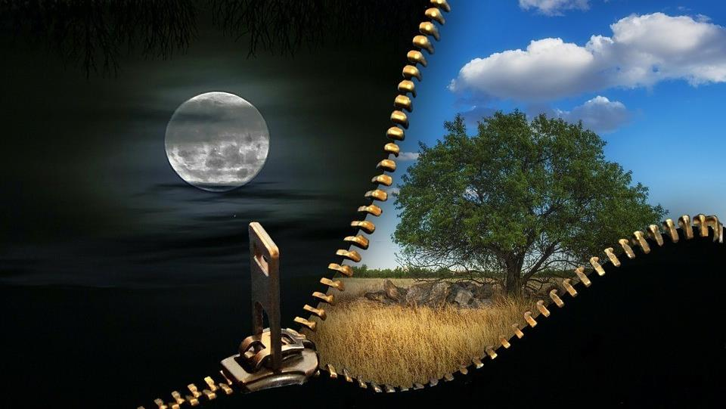
The complete “celebration” for
Yom Kippur involves TWO Night Seasons, and ONE Light Season.
You’ve now seen how the “affliction” is a connecting link between the 9th day
& the 10th day.
In conclusion let’s do a short review.

Slide 75

Three Simple Study Techniques
Remember the basics from Gen 1 when
reading the Yom Kippur passage;
2. Read all the content carefully for the 7 verses;
3. Pay attention to the context – to fully
determine what belongs to the 10th day
and what belongs to the 9th day.

Slide 76




Two Strict Requirements
Pay attention to Yahuah’s 2 strict requirements for Day of Atonement (exception: sacrifices).
Both requirements are repeated 3 times;
Note where both requirements are found;
Determine the timeframe of each requirement.
Plan to mark your Bible so you can teach this truth from your Bible!

Slide 77
Two Strict Requirements
Repeated 3 Times Each
F
I
N
A
L
“the soul shall do no work”
Found in:
vs 28, 30, 31.
Timeframe: 24 hrs.
on the full 10th day,
7th month;
(dawn to dawn).
“afflict your soul”
Found in:
vs 27, 29, 32.
Timeframe: 24 hrs.
12 hrs. 9th day (dusk to dawn);
12 hrs. 10th day
(dawn to dusk).
Obedience
to both requirements was called
“celebrating” the
Day of Atonement.
R
E
V
I
E
W

Slide 78

A Word from Yahuah
OBEY H8085 shama` (shaw-mah'); a primitive root; to hear intelligently
(often with implication of attention, obedience, etc.; causatively, to tell, etc.).
Exodus 19:5 Now therefore, if ye will obey my voice indeed, and keep my covenant, then ye shall be a peculiar treasure
unto me above all people …

Slide 79

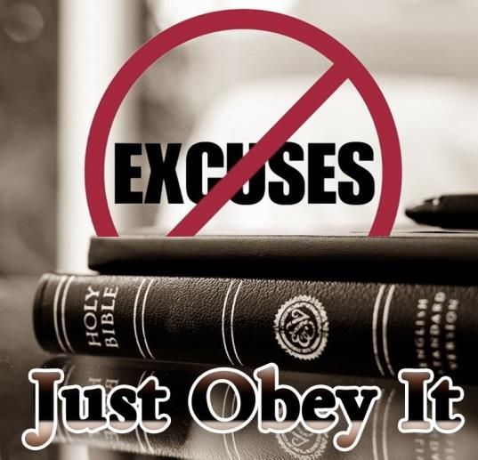
.
We have just seen Yahuah’s simple instructions of how He laid out the requirements for the “affliction” on the 9th day and Atonement on the 10th day.
What you do with this information is in your hands.
The Hebrew word – ע.מ.ש. – shama – means to hear intelligently. But that is not all!
The full meaning is to HEAR with the intention to OBEY AND ACT ACCORDINGLY.
May each one enjoy their studies on Yahuah’s
day-start as outlined in His Covenant Calendar – take this information to heart and receive the blessings that are waiting to be given.
The End
79

Slide 80
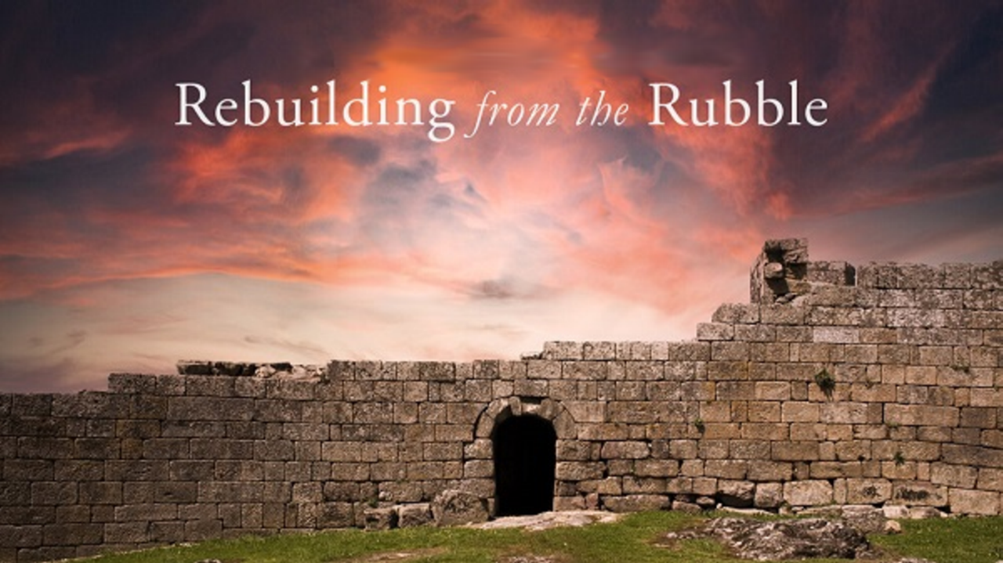


If you enjoyed this study today …
Please Join Us Live Each Week
Sign up with Covenant Calendar Club
for the Friday & Shabbat Zoom Meetings
(including live discussion)
https://studythecalendar.com/sign-up/

Slide 81


If you need assistance with this information, please send your questions to
Timothy Astleford & Charlene Fortsch:
questions@studythecalendar.com
www.studythecalendar.com
Thank-you!
Shalom!

Slide 82
Bible Marking Workshop
for Day of Atonement
(Lev 23:26-32)

Slide 83



Lev 23:26-27
Of High Importance:
Read all the words
to discern context!
 | Content of Verse | Context of Verse
26 | And Yahuah spake unto Moses, saying, | A command is being given to Moses. It will be regarding the Day of Atonement.
27 | Also on the tenth day of this seventh month there shall be a day of atonement it shall be an holy convocation unto you; and ye shall afflict your souls, (humbleness and meditation, etc.) and offer an offering made by fire unto Yahuah. | Date: 10th Day of the 7th Month. (Gen 1 declares the commencement moment for this day as “dawn.”) Name: Day of Atonement Celebration. Status: Holy Sabbath just as the weekly Sabbath. *1st Requirement for Observation: “afflict your soul” *This is the 1st mention. Sacrifices Required: (Will not be addressed as the sacrifices have been fulfilled.)
Vs 27a: 10th day
Premier Entry
#1 of 7
Vs 27c: 10th day
#2 of 7… “it”
Vs 27d: Affliction
[1st Requirement]
1st mention of 3

Slide 84
Lev 23:28-29
 | Content of Verse | Context of Verse
28 | And ye shall do no work in that same day: For it is a day of atonement, to make an atonement for you before Yahuah your Elohim. | *2nd Requirement for Observation: “shall do NO work” *This is the 1st mention of 3. Context is: 10th Day of the 7th Month - Day of Atonement. Purpose: Atonement for man’s sins.
29 | For whatsoever soul it be that shall not be afflicted in that same day, he shall be cut off from among his people. | *1st Requirement for Observation: “afflict your soul” **This is the 2nd mention of 3 where the 1st requirement is emphasized! Consequence for disobedience to the 1st requirement: that person would not be part of the genealogy of the Messiah.
Vs 28a: NO Work
[2nd Requirement]
1st mention of 3
Vs 28b: 10th day
#3 of 7
“that same day”
Vs 28c: 10th day
#4 of 7 “it”
Vs 29: Affliction
[1st Requirement]
2nd mention of 3
Vs 29: 10th day
#5 of 7
“that same day”

Slide 85
Lev 23:30-31
 | Content of Verse | Context of Verse
30 | And whatsoever soul it be that doeth any work in that same day, the same soul will I destroy from among his people. | *2nd Requirement for Observation: “shall do NO work” **This is the 2nd mention of 3 where the 2nd requirement is emphasized! Consequence for disobedience to the 2nd requirement: that soul will be destroyed.
31 | Ye shall do no manner of work: it shall be a statute for ever throughout your generations in all your dwellings. | *2nd Requirement for Observation: “shall do NO work” ***This is the 3rd mention of 3 where the 2nd requirement is emphasized! Status of Requirement: a statute to be observed forever in all generations.
Vs 30a: NO Work
[2nd Requirement]
2nd mention of 3
Vs 30b: 10th day
#6 of 7
“that same day”
Vs 31: NO Work
[2nd Requirement]
3rd mention of 3

Slide 86
Lev 23:32 (a, b, c)
 | Content of Verse | Context of Verse
32 a. b. | It shall be unto you a sabbath of rest, | Date: Context for “IT” is from vs 27 as the 10th Day of the 7th Month. Context: “IT” refers to the set-apart Day of Atonement Shabbat.
 | HUGE Change of Context Right Here! | Context IS all about AFFLICTION!
c. | and ye shall afflict your souls: | *1st Requirement for Observation: “afflict your soul” ***This is the 3rd mention of 3! So far in verse 32 the context is a required “affliction” on Day of Atonement, but there’s more!
Vs 32a: 10th day
#7 of 7 “it”
* * * * * * *
Vs 32a: Affliction
[1st Requirement]
3rd mention of 3

Slide 87
Lev 23:32 (d, e)
 | Content of Verse | Context of Verse
32 d. e. | in the ninth day of the month at even, (of the 9th day the “affliction of one’s soul” begins.) | When? The affliction begins on the 9th day (of the 7th month); [The context for this phrase is STILL “affliction” in preparation for Day of Atonement IN 12 hours.] What time on the 9th day? The context for affliction – begins at “even” – the time of dusk twilight.
Don’t forget the “affliction” context to
avoid all defaults
to a sunset commencement as many have been taught!

Slide 88

Lev 23:32 (f, g)
Q: What percentage of words in vs 32 referred to the context of “affliction”?
 | Content of Verse | Context of Verse
32 f. g. | from even unto even, shall ye celebrate [desist from work; be still & quiet] your Sabbath. | Length of time for “affliction requirement” - The context has not changed from affliction – it lasts 24 hours from the “even” of the 9th day until the “even” on the 10th Day of Atonement. Declaration: affliction of one’s soul begins 12 hours in advance for the celebration of Atonement Shabbat.
²³ And the Lord spake unto Moses, saying,
²⁴ Speak unto the children of Israel, saying, In the seventh month, in the first day of the month, shall ye have a sabbath, a memorial of blowing of trumpets, an holy convocation.
²⁵ Ye shall do no servile work therein: but ye shall offer an offering made by fire unto the Lord.
²⁶ And the Lord spake unto Moses, saying,
²⁷ Also on the tenth day of this seventh month there shall be a day of atonement: it shall be an holy convocation unto you; and ye shall afflict your souls, and offer an offering made by fire unto the Lord.
²⁸ And ye shall do no work in that same day: for it is a day of atonement, to make an atonement for you before the Lord your God.
²⁹ For whatsoever soul it be that shall not be afflicted in that same day, he shall be cut off from among his people.
³⁰ And whatsoever soul it be that doeth any work in that same day, the same soul will I destroy from among his people.
³¹ Ye shall do no manner of work: it shall be a statute for ever throughout your generations in all your dwellings.
³² It shall be unto you a sabbath of rest, and ye shall afflict your souls: in the ninth day of the month at even, from even unto even, shall ye celebrate your sabbath.
233 words … 13 words = 1/2 % 0.055%
9 words = 0.038%
32: 33 words … vss 13 words: in the ninth day of the month at even, from even unto even 39% (61%)
32 33 words … vss 9 words: in the ninth day of the month at even 27% (73%)
A: 60%
Vs 32 is
not about
a sunset
day-start!

