Slide 1
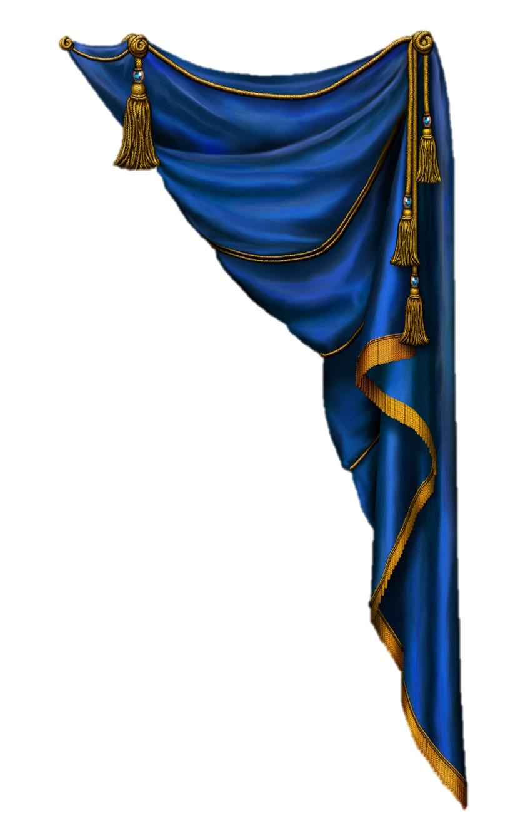
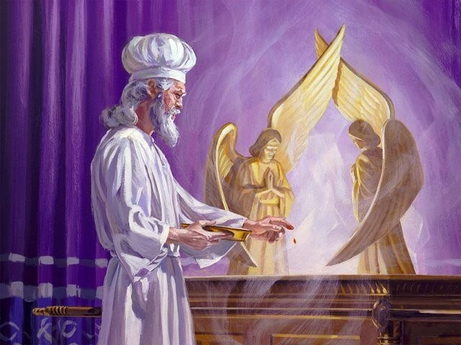

Is the Day of Atonement
(Yom Kippur)
an anomaly
by actually beginning at “evening”
after the sun has set?

Slide 2


Some Feast Teachers Claim there are 4 main Scriptures that assure everyone the weekly & annual Sabbaths always begin
at sunset/evening!
Three of these witnesses are:
Gen 1:5 (last ½ of verse)
Neh 13:19 (part of context)
John 20:1 (part of context)

Slide 3


But some people and
leaders still say this:
“Day of Atonement
is the strongest witness”
claiming this most solemn
Sabbath of the year
still begins with
the evening – because
of a few words in Lev 23:32.

Slide 4
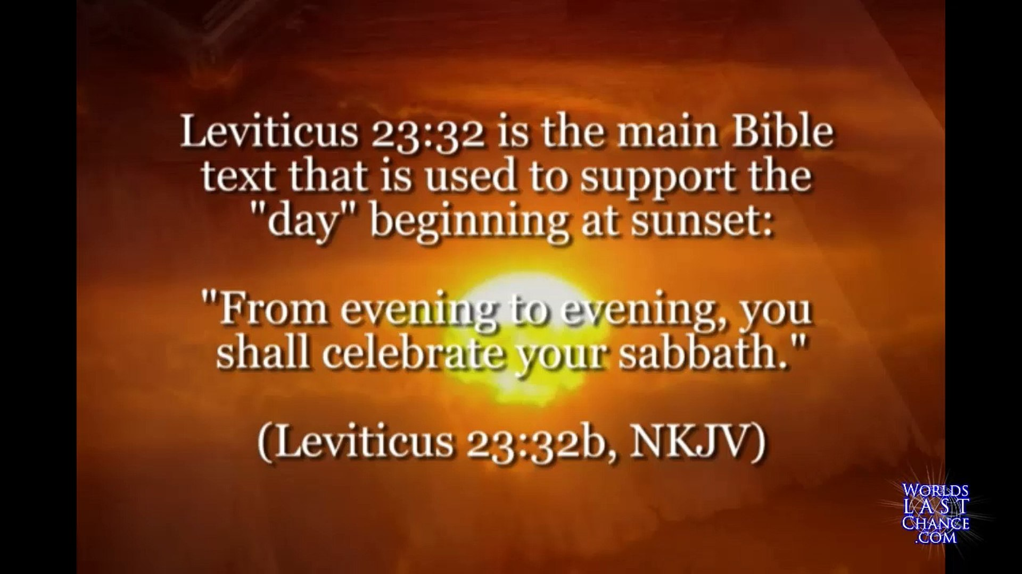



And because:
A total of only 9 words …
Remember :
Lev 23:26-32 has a total of 230+ words. The last 9 words of the Atonement content are used to determine the day-start for ALL yearly Sabbaths.
That’s only 3% of the words used to establish a doctrine!

Slide 5
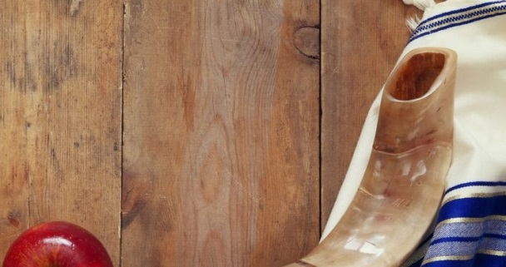
Ponder this Thought!
If around 3% of the context for
Day of Atonement establishes such an important worship statute, are we not accountable to find support for the sunset day commencement in the rest of the Scriptures, no matter what?

Slide 6
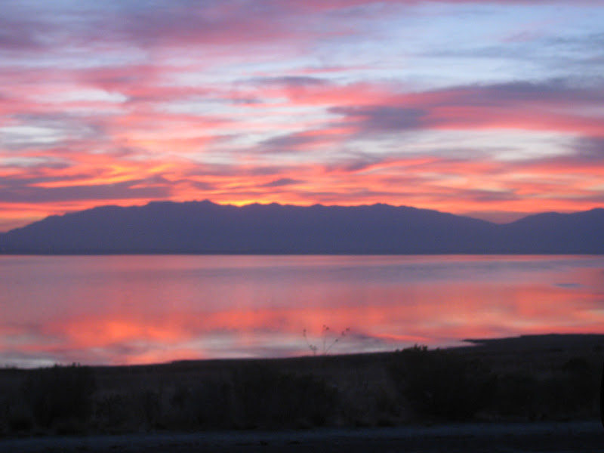

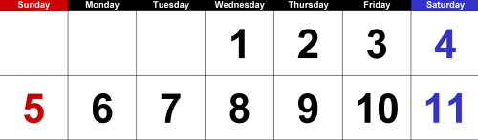
The foundation of Sunset Theory claims
each new day begins at sunset/evening!
Example with Dawn Day Timing
#1a
To illustrate this concept for Day of Atonement, Sunset Theory claims the 10th day begins at evening of the 9th day!
Exactly, where is the “even” of the 9th day?
Question:
Is there any day that has more than ONE “even/ereb”?
Therefore:
Sunset on the 8th day …
Ushers in the “even/ereb” of the 9th day
according to Sunset Theory!

Slide 7



Time to consider the next step:
#1b
Dawn Timing
Now that we have located the evening of the 9th day,
find the full 24 hour span of the cycle to the next sunset.
Is this correct?
9TH DAY
Sunset 8th day
Sunset on the 9th day …
“even/ereb” 9th day
Ushers in the “even/ereb”
of <???> day?
OR: is this really a 2nd “evening” of the 9th day?

Slide 8
.
Yom Kippur begins here? … on the “even” of the 9th?
Sunset Theory –
Tishri 9th!
The Sunset,
of the 8th, ushering in
the evening of 9th day,
is declared by many as
being the start of the
Atonement Shabbat!
Sunset changes the “day” here! (???)
Sunset
Sunset
8th
9th of Tishri
9th of Tishri
That is 24 hours of Atonement - BEFORE - Tishri 10 even begins!
Would that be the FIRST OF TWO DAYS for Atonement celebration?

Slide 9



Have you
noticed …
The passage has
about 230 words
to read for the
full context.
Content includes the 9th & 10th days.
The sunset
commencement is
based on about
3% of the content!
… some things
about Lev 23:26-32??

Slide 10

John 8:32 says:
“And ye shall
know the truth,
and the truth shall
make you free.”

Slide 11
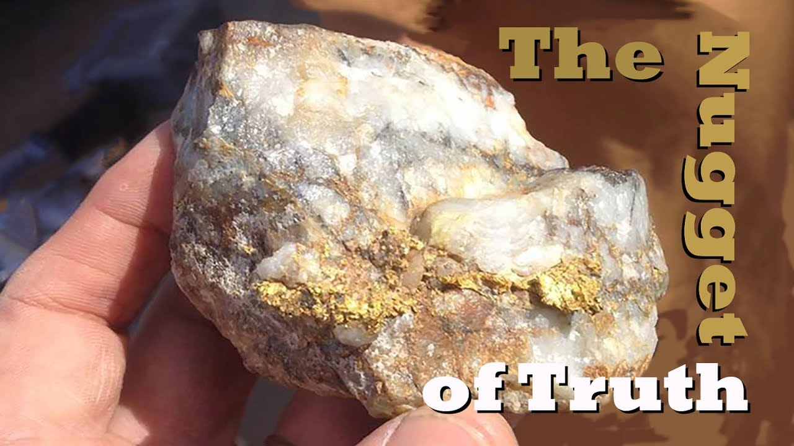
View the complete study to see what the nugget of truth is to understand “what” begins at the evening of the 9th day, and “what” begins at
the next dawn in the
full passage of Lev 23
for Day of Atonement.

Slide 12
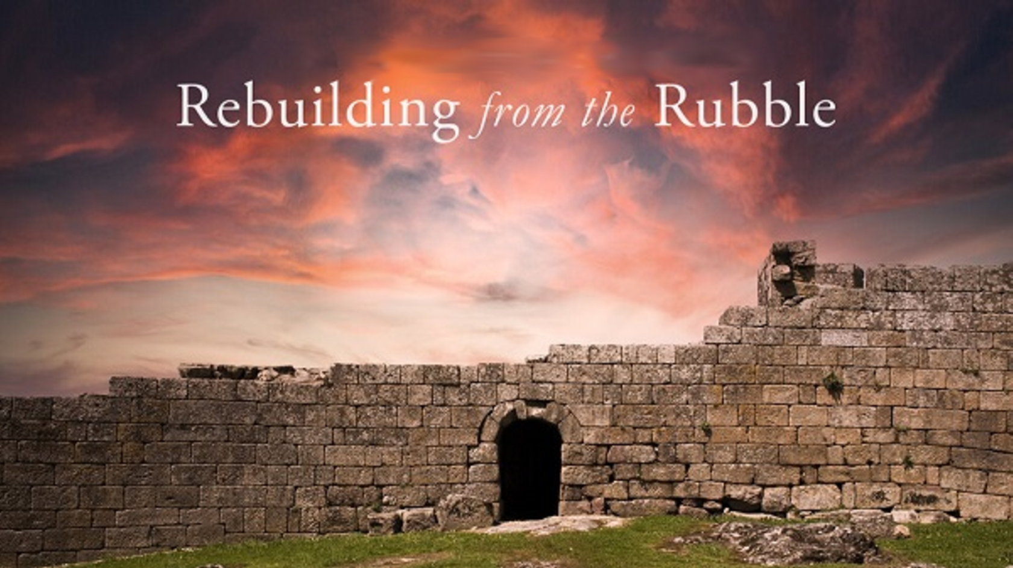


If you enjoyed this study today …
Please Join Us Live Each Week
Sign up with Covenant Calendar Club
for the Friday & Shabbat Zoom Meetings
(including live discussion)
Thank-you!
Shalom!
https://studythecalendar.com/sign-up/

