Slide 1
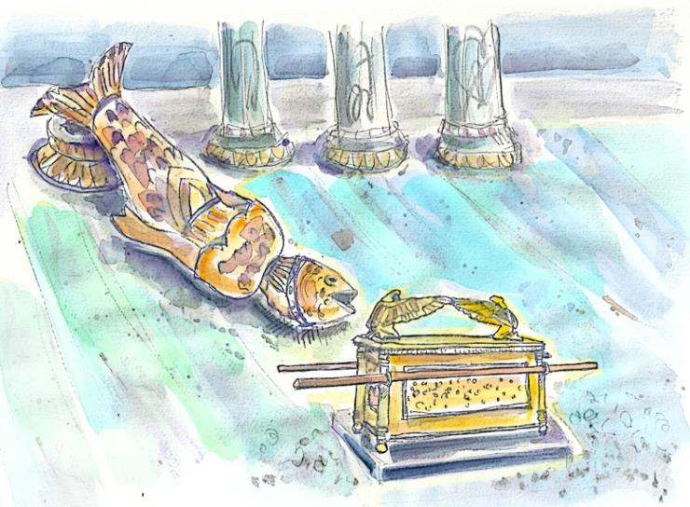

Who
Does
Dagon Represent
Today?
Sabine
Did you know this study in 1 Samuel 5 makes it clear when the day begins?
Notes:
4.16 teaser: Pagan Decapitation Discovered at Dawn [9 slides] Dec 3/21 Email Blast by Neil. Website: You-tube: ​https://youtu.be/edHzG2L9yqQ
692 views in the 1st six hours on Dec 4/21; 1100 views in 17 hrs;
Dec 3/21 Blurb: There are over 40 witnesses in the Scriptures that are very firm creation’s day(s) begin with the first dawn light – not at sunset. And while the testimony of Dagon, the fish-god, is fascinating to all ages, how many realize that this story is another witness for Yahuah’s Dawn Day commencement? Enjoy this short introduction to see what is yet to follow, as this DAWN day story has even more to offer – and – it’s all around “the threshold.”
In 6 hrs after you-tube blast: Dagon’s decapitation discovered at dawn - QUICK TEASER – 3:45 min
692 views Premiered 6 hours ago (8 AM Pacific time)
Dec 4/21 Blurb FOR FULL TEACHING: Website: You-tube:
There are over 40 witnesses in the Scriptures that are very firm creation’s day(s) begin with the first dawn light – not at sunset. And while the testimony of Dagon, the fish-god, is fascinating to all ages, how many realize that this story is another witness for Yahuah’s Dawn Day commencement? Enjoy this short introduction to see what is yet to follow, as this DAWN day story has even more to offer – and – it’s all around “the threshold.”
Who does Dagon represent today? Is there serious implications in the head and hands being cut off AT THE THRESHOLD? When considering the pagan background of Dagon, what threshold is it that this representation will be blocked from crossing at the time of the advent of Yahusha Ha Mashiach? Also, in extreme importance – WHO is the guard of The Threshold? It may not be who you think! As an introduction, this last question will be expounded more in the upcoming Priesthood studies.

Slide 2
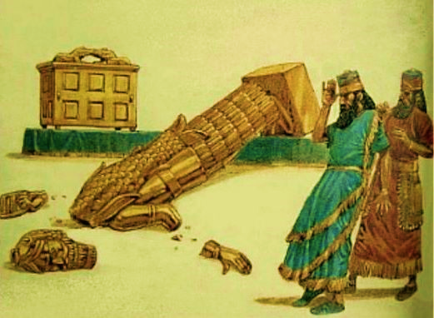
Dawn!
Are there serious implications when only the head and hands are cut off at “the” threshold of this pagan
fish-god?
Dec 2nd @ 815 pm Only 4 slides have comments – that’s all!
We are done, so see how good of a job it will be on Friday.
Melki-tsedek is the new spelling – by the way.
Who does Dagon represent today? Is there serious implications in the head and hands being cut off AT THE THRESHOLD?
When considering the pagan background of Dagon, what threshold is it that this representation will be blocked from crossing at the time of the advent of Yahusha Ha Mashiach? Also, in extreme importance – WHO is the guard of The Threshold? It may not be who you think! As an introduction, this last question will be expounded more in the upcoming Priesthood studies.
Dec 2nd @ 815 pm Who does Dagon represent today? Is there serious implications in the head and hands being cut off AT THE THRESHOLD? When considering the pagan background of Dagon, what threshold is it that this representation will be blocked from crossing at the time of the advent of Yahusha Ha Mashiach? Also, in extreme importance – WHO is the guard of The Threshold? It may not be who you think! As an introduction, this last question will be expounded more in the upcoming Priesthood studies.
What is “the” threshold? And why was the
fish portion of this god not damaged?

Slide 3
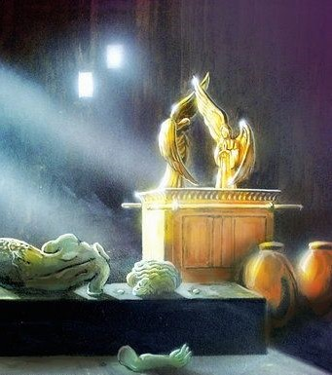
It
may
not
be
Dec 2nd @ 815 pm Who does Dagon represent today? Is there serious implications in the head and hands being cut off AT THE THRESHOLD? When considering the pagan background of Dagon, what threshold is it that this representation will be blocked from crossing at the time of the advent of Yahusha Ha Mashiach? Also, in extreme importance – WHO is the guard of The Threshold? It may not be who you think! As an introduction, this last question will be expounded more in the upcoming Priesthood studies.
Who is
the guard
of this
threshold?
who you think?

Slide 4
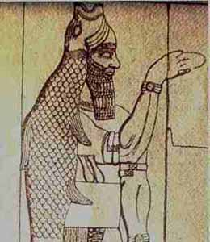
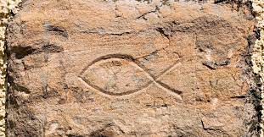
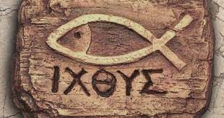
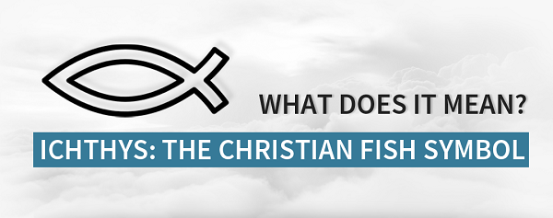
Who is Dagon?
Dec 2nd @ 815 pm Who does Dagon represent today? Is there serious implications in the head and hands being cut off AT THE THRESHOLD? When considering the pagan background of Dagon, what threshold is it that this representation will be blocked from crossing at the time of the advent of Yahusha Ha Mashiach? Also, in extreme importance – WHO is the guard of The Threshold? It may not be who you think! As an introduction, this last question will be expounded more in the upcoming Priesthood studies.
In Hebrew the word for fish is – dag.
Dagon was a pagan god of the Philistines and Phoenicia.
It is recorded they believed Dagon was the father of Baal.
Did you know this name – ICHTHYS is connected
to Dagon and modern Christianity?

Slide 5
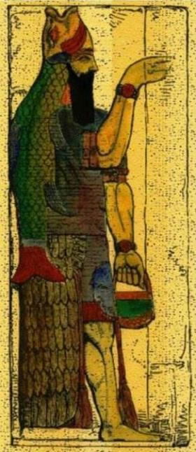
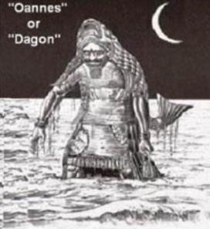
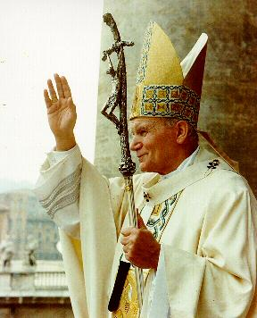
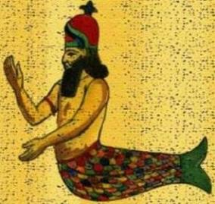
First mention of Dagon
(“our mighty one”)
is found in Judges 16.
as their “mighty god.”
Is there a WORLD system
today
that pays allegiance
to Dagon?

Slide 6

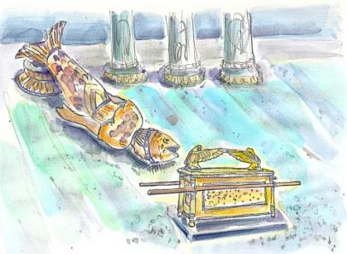
Have you ever seen an ad like this?
Dec 2nd @ 815 pm Who does Dagon represent today? Is there serious implications in the head and hands being cut off AT THE THRESHOLD? When considering the pagan background of Dagon, what threshold is it that this representation will be blocked from crossing at the time of the advent of Yahusha Ha Mashiach? Also, in extreme importance – WHO is the guard of The Threshold? It may not be who you think! As an introduction, this last question will be expounded more in the upcoming Priesthood studies.
Is there any connection
to Dagon?
Is this study all about a
Righteous “Fish Fry” or has
this story been preserved to include an important reason for our future?
Notes:
Who does Dagon represent today? Is there serious implications in the head and hands being cut off AT THE THRESHOLD? When considering the pagan background of Dagon, what threshold is it that this representation will be blocked from crossing at the time of the advent of Yahusha Ha Mashiach? Also, in extreme importance – WHO is the guard of The Threshold? It may not be who you think! As an introduction, this last question will be expounded more in the upcoming Priesthood studies.

Slide 7
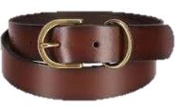
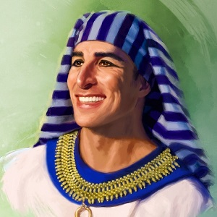
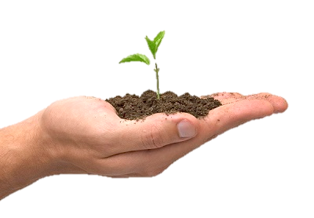
A belt?
Dec 2nd @ 815 pm Who does Dagon represent today? Is there serious implications in the head and hands being cut off AT THE THRESHOLD? When considering the pagan background of Dagon, what threshold is it that this representation will be blocked from crossing at the time of the advent of Yahusha Ha Mashiach? Also, in extreme importance – WHO is the guard of The Threshold? It may not be who you think! As an introduction, this last question will be expounded more in the upcoming Priesthood studies.
Joseph?
How will this
Study of
Dagon
connect
to:
SYNCRETISM?
A seed?

Slide 8
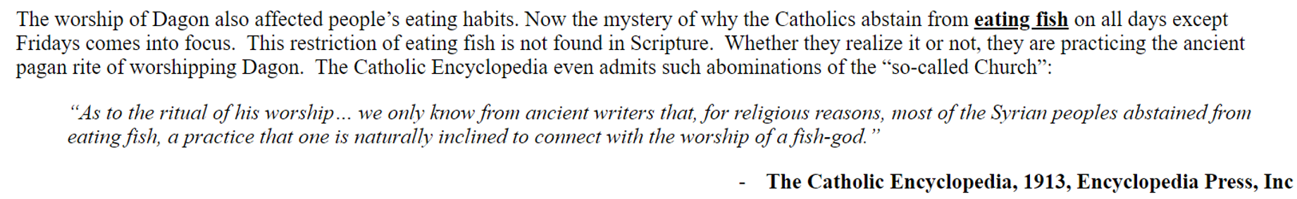
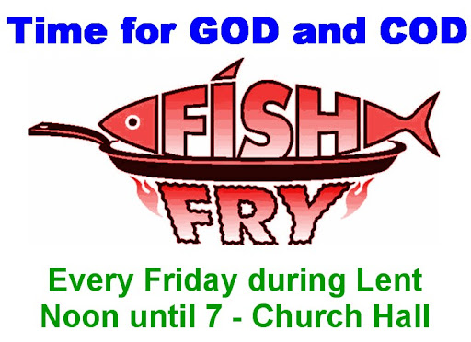
Did you know the worship of Dagon affects people’s eating habits? At Lent?
Is this why we see ads like this for
“Christian Lent”?
IS THIS the open mouth seeking whom
it may devour?

Slide 9
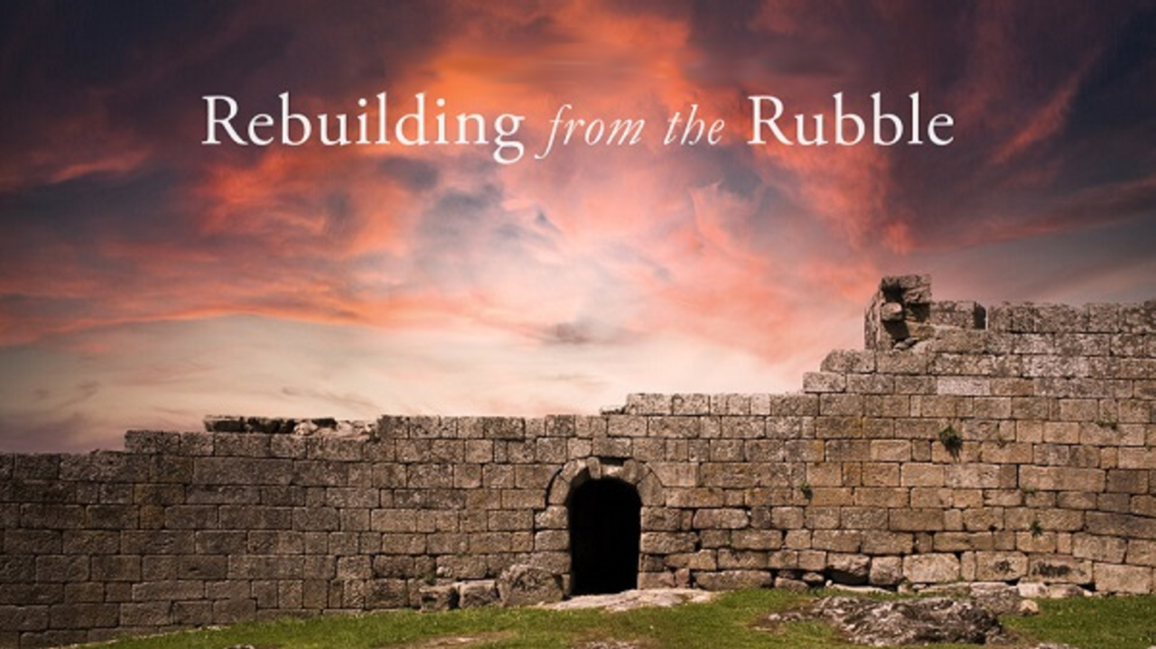


If you have questions about this story …
Plan to view the complete study
at the following link:
https://www.youtube.com/c/CovenantCalendarClub/videos
Sign up with Covenant Calendar Club
for the Friday & Sabbath Zoom Meetings
(including live discussion)
Shalom!
https://studythecalendar.com/sign-up/
9

