Slide 1
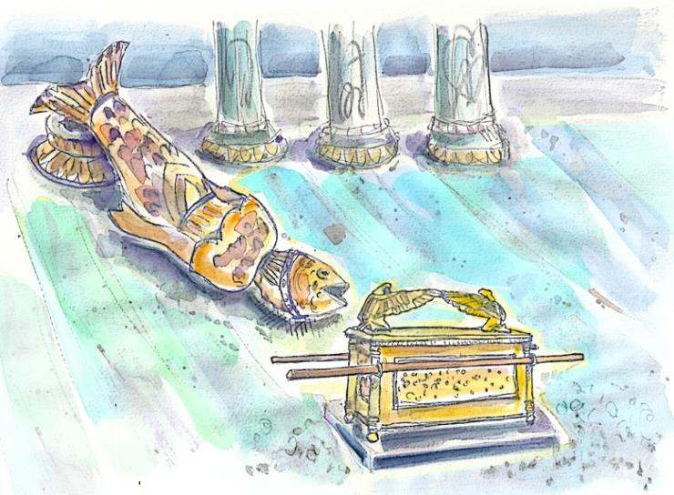

Pagan Decapitation Discovered
at
Dawn!
Sabine
Yahuah’s Systematic Disassembly of Paganism in
1 Sam 5 reveals the Dawn Day start seen in Gen 1.
Notes:
4.16 Pagan Decapitation Discovered at Dawn [ slides] TA Dec 4/21 Website: You-tube:
Who does Dagon represent today? Is there serious implications in the head and hands being cut off AT THE THRESHOLD? When considering the pagan background of Dagon, what threshold is it that this representation will be blocked from crossing at the time of the advent of Yahusha Ha Mashiach? Also, in extreme importance – WHO is the guard of The Threshold? It may not be who you think! As an introduction, this last question will be expounded more in the upcoming Priesthood studies.

Slide 2
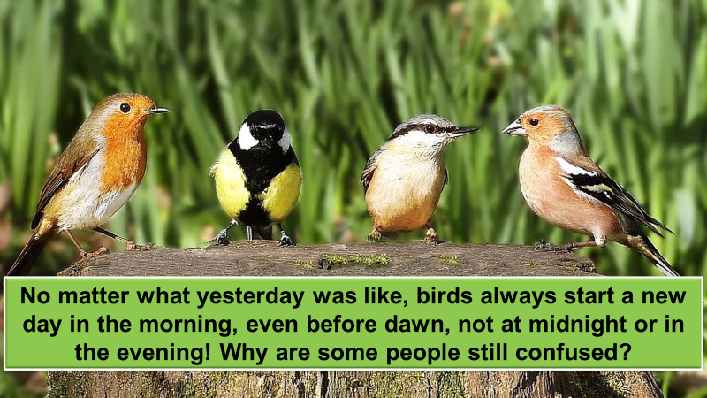
Something to Consider!

Slide 3

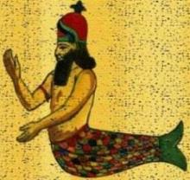
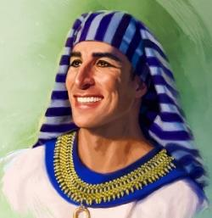
Yahuah’s End Time Message from 1st Samuel 5
Date: ~1141 BC – or 350 years after Moses
What does a Dagon study have to do with Yoseph?

Slide 4
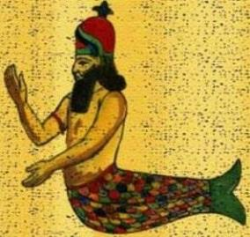

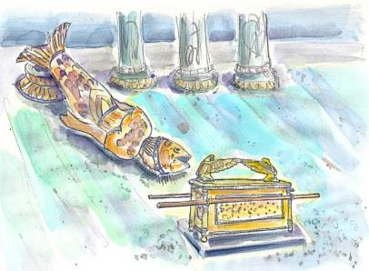
Have you ever seen an ad like this?
Is there any connection
to Dagon?
Is this study all about a
Righteous “Fish Fry”? Or was
this story preserved to expose an important revelation for our future?
Notes:
Who does Dagon represent today? Is there serious implications in the head and hands being cut off AT THE THRESHOLD? When considering the pagan background of Dagon, what threshold is it that this representation will be blocked from crossing at the time of the advent of Yahusha Ha Mashiach? Also, in extreme importance – WHO is the guard of The Threshold? It may not be who you think! As an introduction, this last question will be expounded more in the upcoming Priesthood studies.

Slide 5
Dawn!
A lifeless image does not have the capability to actually pay homage to Yahuah. Hence the visual implications then, and prophetically for - TODAY, of Dagon falling FACE DOWN before the Ark, are nothing short of absolutely astounding and profound.
Who is able to stand and defy our Majesty -
Yahusha Ha Mashiach?
WHO? NOT ONE!
Sabine

Slide 6
Getting Started
Note:
These studies try to refrain from using the word “day” that has been translated from the original Hebrew word <yowm>. The word “day” loses a massive amount of definitive correctness in its ambiguous definitions. Day can indicate 12 or 24 hours, day or night,
or both!
To understand Scripture correctly we need to be much more accurate.
Preference is given to the word “cycle” in place of day.
When quoting the Scriptures or citing the Shabbat Day you will see it.
Otherwise, cycle is the word of choice.
The 24 hour cycle will be defined below to pinpoint the two seasons.
Cycle = 24 hours containing the 2 seasons, one of light – H216 <’owr> and
one of night – H3915 <layil>.
2. Season H6256 - <‘eth>, = (approx.) 12 hour blocks of time whether it is
Light Season or Night Season.
A very important application example of “season” is found in Yerimyahu (Jer) 33:20-25.

Slide 7
The year was ~ 1141 BC. The Philistines waged war with Yisra’el and a defeat was realized. Most importantly, the Philistines captured the
Ark of the Covenant. Here is the end of chapter 4 for context -
1Sam 4:15 Now Ěli was ninety-eight years old and his eyes were so dim that he was unable to see.
1Sam 4:16 And the man said to Ěli, “I am he who came from the battle. And I fled today from the battle line.” And he said, “What was the matter, my son?”
1Sam 4:17 And the messenger answered and said, “Yisra’ĕl has fled before the Philistines, and there has been a great slaughter among the people. And your two sons have died, Ḥophni and Pineḥas, and the ark of Elohim has been captured.”
1Sam 4:18 And it came to be, when he made mention of the ark of Elohim, that Ěli fell off the seat backward by the side of the gate. And his neck was broken and he died, for the man was old and heavy. And he ruled Yisra’ĕl forty years.

Slide 8
The Ark of the Covenant: no longer in the hands of Yisra’el.
1Sa 4:19 And his daughter-in-law, Pineḥas’ wife, was pregnant, about to bear. And when she heard the news that the ark of Elohim was captured, and that her father-in-law and her husband were dead, she bowed herself and gave birth, because her pains came upon her.
1Sa 4:20 And about the time of her death the women who stood by her said to her, “Do not fear, for you have borne a son.” But she did not answer, nor did she set her heart to it.
1Sa 4:21 And she called the child Iḵaḇoḏ, saying, “The esteem has departed from Yisra’ĕl!” because the ark of Elohim was taken and because of her father-in-law and her husband.
1Sa 4:22 And she said, “The esteem has departed from Yisra’ĕl, for the ark of Elohim was taken.”

Slide 9
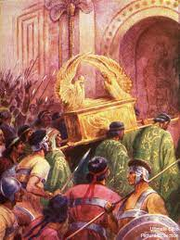
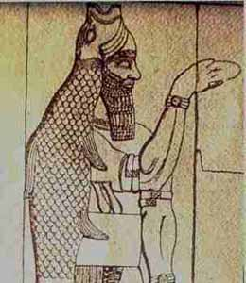
1 Sam 5 ~ Yahuah’s Ark of the Covenant was placed in the Pagan temple.
1Sam 5:1 And the Philistines took the ark of Elohim and brought it from Eḇen Haʽĕzer to Ashdoḏ,
1Sam 5:2 and the Philistines took the ark of Elohim and brought it into the house of Daḡon and set it by Daḡon.
Who is Dagon?
What WORLD SYSTEM of worship avows allegiance to
Dagon - today?

Slide 10
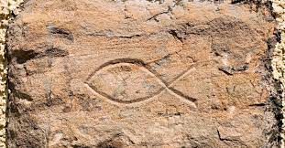
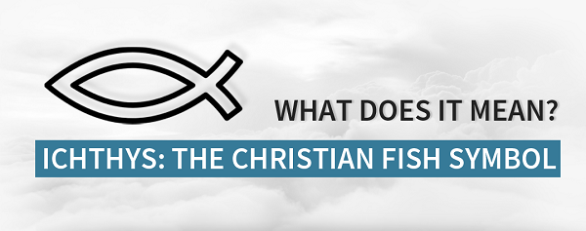
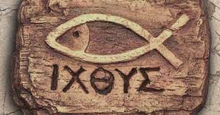
And - What about the very popular Christian Fish Symbol?.
Dagon is a pagan god of the Philistines and Phoenicia.
It is recorded they believed Dagon was
the father of Aleyan (Baal).
Note: the Hebrew word for fish is – dag.
There is more on the name – ICHTHYS – near the end.
Aleyan?

Slide 11
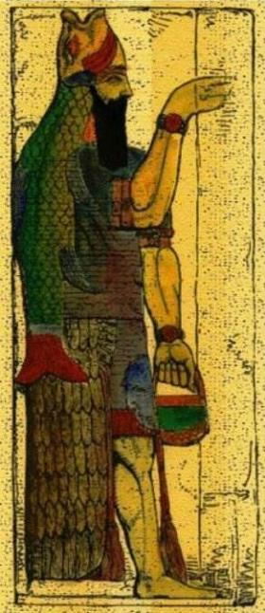
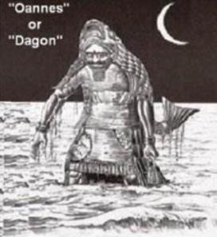
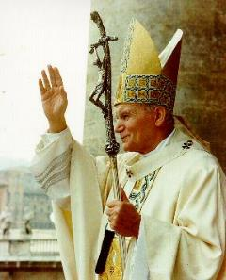
First mention of Dagon
(“our mighty one”)
is found in Judges 16.
There we read about how Samson was brought to entertain the Philistines at a festival for their
“mighty one.”
See any similarities between the two?

Slide 12
The Dagon connection - to Saul, to – “Christianity”!
1 Chron 10:10
King Saul and his sons perished in a battle with the Philistines. Saul was beheaded the following day and his head being removed, they fastened it
in the temple of Dagon along with Saul’s armor.
1Sa 31:10 And they placed his armour in the house of the Ashtaroth,
and they fastened his body to the wall of Bĕyth Shan.
Ashtoreth was a war goddess of Assyria and Babylonia. Ashtaroth/Ashtoreth (Easter) was the goddess of the Phoenicians.
She was/is the goddess of sex and fertility.
Prostitution was a rite in the temple of this no-god.
Is there a devious sexual connection that we can see today with
the modern “Christian” fellowship of Dagon and Ashtoreth?

Slide 13
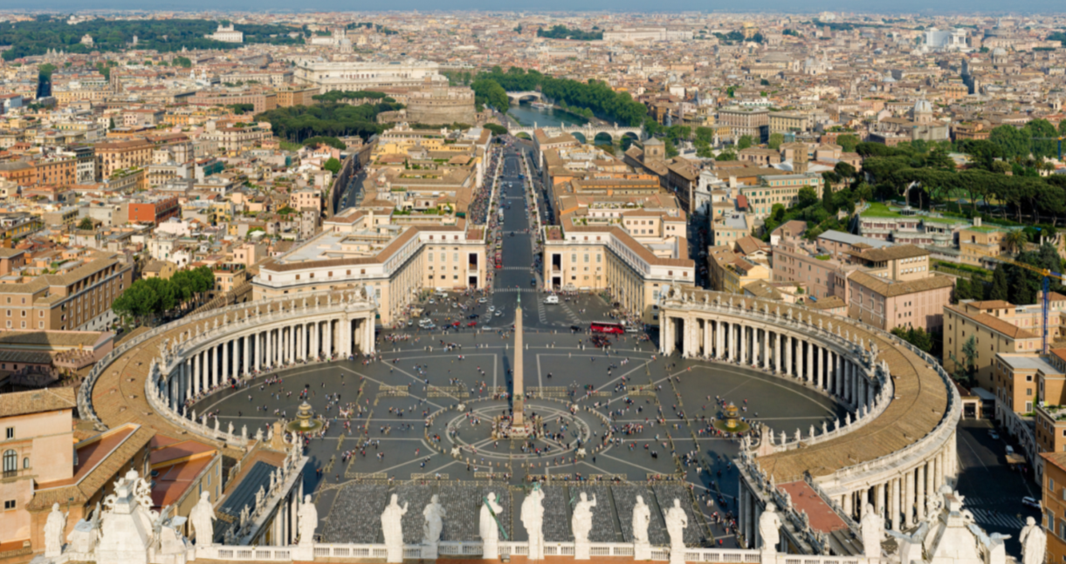
This depicts the male and female anatomy for procreation. Please also note the 8 spoke wheel insignia of Shamash, (a direct reference to Ha Sa-Tan).

Slide 14
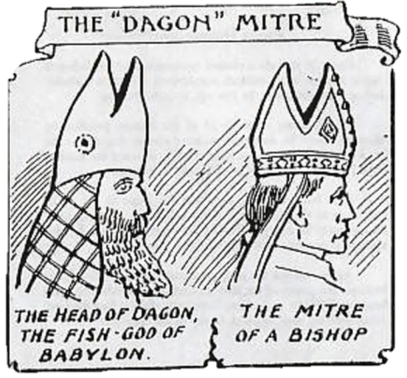
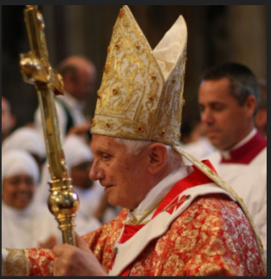
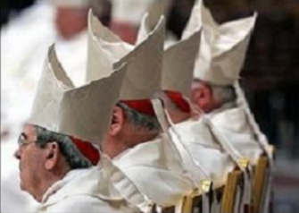

Cephering - (connecting the dots!)
Have you seen this identity before? Look closely!
Consider the
mother harlot:
Can it safely be said that Dagon is the face of modern day Christianity?
Do these two identities share the same threshold?

Slide 15
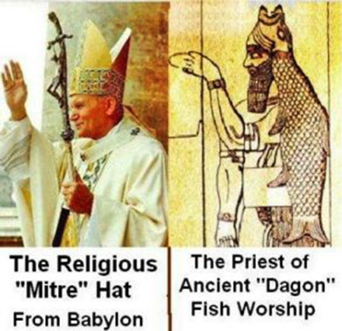
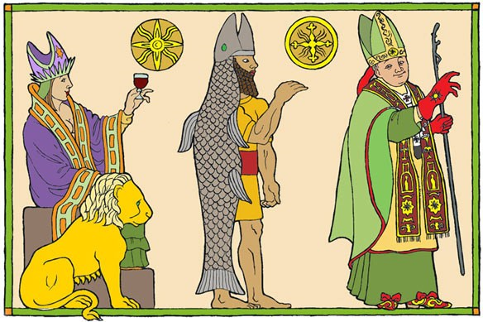
Yes, these two identities share the same threshold of paganism!
One is cloaked in “Christian” garments and a mitre hat.
The other is covered in fish scales!
There is nothing new under the sun!

Slide 16
Fish god context … Nineveh worshiped a fish god too! (A Quote)
Dagon figures into the story of Jonah, as well, although the deity is not mentioned by name in Jonah’s book. The Assyrians in Nineveh, to whom Jonah was sent as a missionary, worshiped Dagon and his female counterpart, the fish goddess Nanshe. Jonah, of course, did not go straight to Nineveh but had to be brought there via miraculous means. The transportation [Yahuah] provided for Jonah—a great fish—would have been full of meaning for the Ninevites. When Jonah arrived in their city, he made quite a splash, so to speak. He was a man who had been inside a fish for three days and directly deposited by a fish on the shores of Assyria. The Ninevites, who worshiped a fish god, were duly impressed; they gave Jonah their attention and repented of their sin.

Slide 17
Knowing who Dagon is; what happened to the idol when the
Ark of the Covenant was placed near it in the pagan temple?
1Sam 5:1 And the Philistines took the ark of Elohim and brought it from Eḇen Haʽĕzer to Ashdoḏ,
1Sam 5:2 and the Philistines took the ark of Elohim and brought it into the house of Daḡon and set it by Daḡon.
1Sam 5:3 And the Ashdoḏites rose early in the morning and saw Daḡon fallen on its face to the ground before the ark of יהוה [Yahuah]. So they took Daḡon and put it in its place again.
Moving forward -
Does it appear that there is one free Light Season between this
verse and 1 Sam 5:4? Did Dagon have one free relaxing
Light Season before the next devastating event?
Q:

Slide 18
Review
1Sam 5:3 (a) And the Ashdoḏites rose early in the morning
and saw Daḡon fallen on its face …
Is not - face to the ground, the premier position for obeisance?
Please note: The word “morning” is seen in this verse, yet the Hebrew word
Boqer (morning) is not there! Is “morning” correct or is it false?
From where did the translators receive their idea to place “morning” here
when the actual word is not written in the original Hebrew script?
Who has the authority and power to place Dagon in that position? And what could this possibly symbolize? Could this event be connected to the same pattern of idol destruction seen in the plagues of Mitsrayim (Egypt), where their supposed power and authority was vaporized?

Slide 19
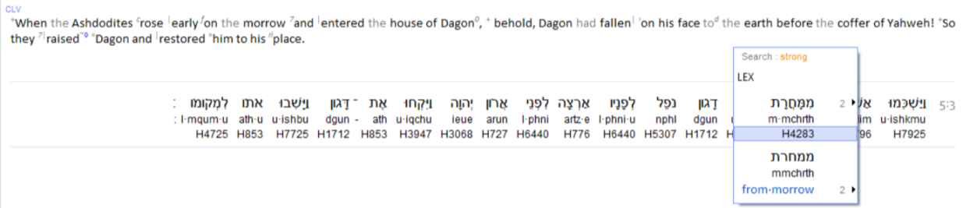
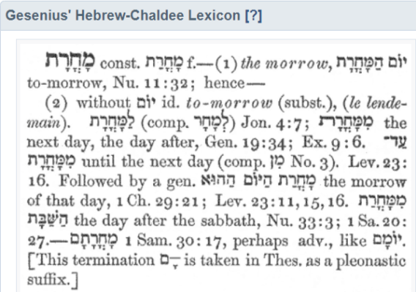
What primary word reckons time in this verse?
H4279 Machar - what does it mean?
morrow H4283 mochorath (mokh-or-awth'); or mochoratham
(1 Sam 30:17) (mokh-or-aw- thawm'); feminine from the same as H4279; the morrow or (adverbially) tomorrow: KJV - morrow, next day.
Mocharoth H4283 is from Machar H4279 and most certainly identifies a
specific point when the cycle of the week exchanges or advances to the ensuing cycle. It becomes our endeavor to determine exactly when that new cycle begins. (Prov 25:2)

Slide 20
Are we able to agree that machar - (morrow) - designates a 24 hour period that follows the immediate cycle upon mention?
next word

Slide 21
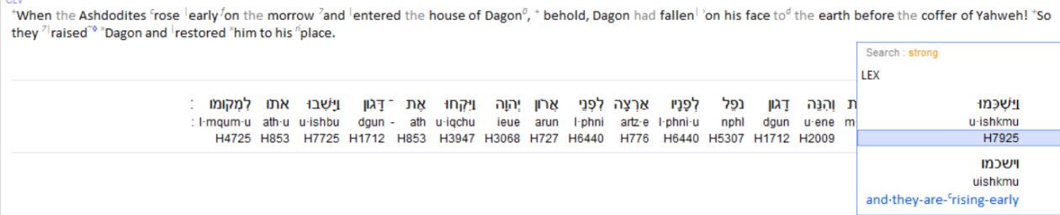
What secondary word reckons time in this verse?
H7925 Shakam - what does it mean?
It may sound silly, but a point must be made.
What identity were they “rising early on”? Did Sunset govern the cycles of the week, or was it a Dawn start cycle of 24 hours?
If they were rising early, when would that be? The sunset event triggers the beginning of the 24 hour day according to SUNSET reckoning!
What type of time reckoning applies with the Ark of the Covenant?

Slide 22
Yahuah chooses the – shakam – timeframe to speak!
Jer 7:13 And now, because ye have done all these works, saith [Yahuah], and I spake unto you, rising up early and speaking, but ye heard not; and I called you, but ye answered not. WOY
H7925
Shakam

Slide 23
Looking at - H7925 Shakam - what does it mean?
Strong’s early -- H7925; <shakam>;
a primitive root; properly, to incline (the shoulder to a burden); but used only as denominative from H7926; literally, to load up (on the back of man or beast), i.e. to start early in the morning: KJV - (arise, be up, get [oneself] up, rise up) early (betimes), morning.
Brown-Driver-Brigg’s early -- H7925; <shakam>; 1) to rise or start early a) (Hiphil)
1) to rise early, make an early start
2) early (as adverb)
Webster’s Encyclopedic Dictionary early 1) advance of something else in regards to time
a) sooner than ordinary
b) produced or happening before the usual time
2) forward
a) being at the beginning
b) first
Etymological Dictionary of the Hebrew Language (by Earnest Klein) – Early - מ.כ.ש– “shakam”
to rise early, (denominated from the same letters but with the meaning of – shoulder), original meaning - to load the back of the beast (which was done early in the morning immediately before starting the day’s journey). Whence developed the meanings to rise and do something early, whence - to rise early.

Slide 24
Reflecting on the Hebrew word definitions -
Reflecting on the definitions, can we safely say –
The Philistines placed Yahuah’s Ark of the Covenant in the
house of Dagon and arose at the beginning of the next and new 24 hour cycle, only to see Dagon face down on the ground?
Problem is, thus far we still have not been given definitive Hebrew terms on the start of the new 24 hour cycle!
When does the new cycle begin?
This brings us to the next verse!

Slide 25
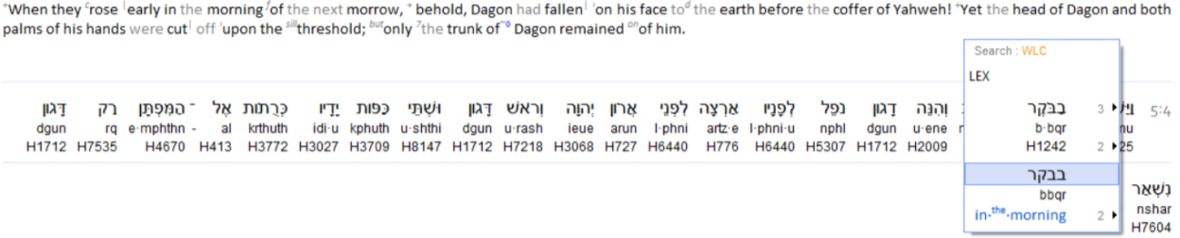
Yahuah does not fail to inform us of His design from Creation!
Do not undervalue
this Hebrew word.
Shall we consider the Tanach witness? (See Isa 8:20.)
Let’s examine further in - 1 Samuel 5:4 (a)…
And when they arose early ⁷⁹²⁵ on the morrow ⁴²⁸³
MORNING ¹²⁴²…
Who Inspired #7925 & #4283 to be repeated?
Is this repetition a form of confirmation?
What does mean?
Boqer

Slide 26
This word ב ק ר . <boqer> {morning} becomes ultra important.
Question to ponder: What on earth (pun intended) does an ox have to do
with the start of Yahuah’s 24 hour cycle?
The answer will come soon! ☺
Brown-Driver-Briggs ב ק ר. <boqer> – (H1242)
1) morning, break of day
a) morning
1) of end of night
2) of coming of daylight
3) of coming of sunrise
4) of beginning of day
5) of bright joy after night of distress (fig.)
b) morrow, next day, next morning

Slide 27
Strong’s Exhaustive Concordance:
Morning - ב ק ר . <boqer> H1242, from H1239; properly, dawn (as the break of day); generally, morning: KJV - (+)day, early, morning, morrow.
H1239 baqar; a primitive root; properly, to plough, or (generally) break forth, i.e. (figuratively) to inspect, admire, care for, consider:
KJV - (make) inquire (-ry), (make) search, seek out.
To plough? Eric Bissell who teaches Paleo-Hebrew explains the connections from the Hebrew letters to - an ox plowing a line in the soil. When the ox is shown the target on the other side of the field, it will walk forward plowing the soil in a straight line. That line of partition is separating one side from another. There is still an underlying connection, but the soil surface has been segregated by a visible demarcation, one separated from the other.

Slide 28
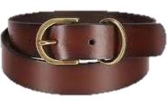
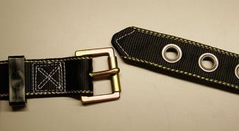
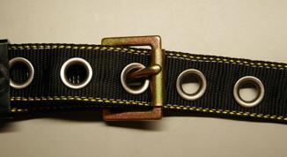
One side of the furrow belongs to one identity – the ploughed. The opposite side of the furrow, to the identity of - needing to be ploughed. Two separate objects are created by a separating action and a specific boundary.
Eric also explainsב ק ר .<boqer> by referring to a belt and buckle.
The ב ק ר . <boqer> being the buckle itself. The belt goes full circle as in the 24 hours of a cycle (day) and the <boqer> provides the separation point from one cycle to another. Yet the (belt) buckle, (boqer) also supplies the connection of one cycle to the next cycle of the week. The “boqer buckle” effectively divides asunder the 7 cycles of the week.

Slide 29
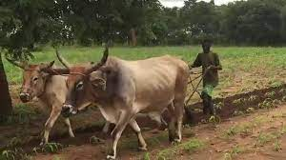
Etymological Dictionary of the Hebrew Language by Earnest Klein
Morning - ב ק ר . <boqer>
1. to cleave, to split, differentiate, to break forth (said of the dawn and of light), to abandon,
2. to cleave, to split, properly denoting the breaking through (of daylight)
3. to split, to plow,
4. the plowing animal
Hebrew English Lexicon by John Parkhurst (1762)
(quf resh) ק ר a a hole through which white light appears [as in the first rays of Dawn]
[A two letter root word in older Hebrew Lexicons.]
ב ק ר <boqer> to look upon, survey, look accurately or diligently (the root meaning)
1. look search examine
2. the morning or morning light which springeth forth upon the earth, (surveys or searcheth out all things) Gen 1:5.
a) so in Luke 1:78 it is said of the spiritual day-spring or dawn of the gospel day

Slide 30
Hebrew and English Lexicon of the Old Testament
Based on the Lexicon of William Gesenius, translated by Edward Robinson (1906)
Morning - ב ק ר . <boqer>
split, penetrate as the dawn the darkness, light through cloud rifts, morning, end of night, coming of dawn even daylight, turn of the morning, beginning of day, coming of sunrise, time of prayer, morrow, next day, tomorrow morning,
inquire, seek, divide, discern, slit, rip, distinguish, cattle, ox, herd, ploughing
In this source there are MANY textual references for these definitions.
Once again we see the dividing concept that distinguishes one identity from another. Each weekly cycle is terminated by the arrival of the dawn’s rays of light, and the new weekly cycle is ushered in, enveloped with LIGHT.
The deep inferences of LIGHT is a very extensive topic.

Slide 31
When Yahuah preserved the Hebrew nation in Egypt what presence did He use?
Ex 10:23 They did not see one another, nor did anyone rise from his place for three days, while all the children of Yisra’ĕl had LIGHT in their dwellings. (Gen 1:4 – Yahuah divided the light from the darkness!)
What does Yahusha tell us?
John 12:36 “While you have the LIGHT, believe in the LIGHT, so that you become sons of LIGHT.” These words יהושע [Yahusha] spoke, and went off and was hidden from them.
Eph 5:8 For you were once darkness,¹ but now you are LIGHT in the Master. Walk as children of LIGHT – Footnote: ¹See 2:2, 4:18, Col. 3:7.
1 Thess 5:5 For you are all sons of LIGHT and sons of the day.
We are not of the night nor of darkness.

Slide 32
Now that we understand Boqer better, let’s move on
to bringing 1 Samuel 5:4 (a) together. But first -
Let us be mindful to be children of the LIGHT (BOQER).
Let us also remember to reject the
doctrine of DARKNESS – SUNSET THEORY!

Slide 33
A REMINDER: - Yahuah defines His Start of the Cycles!
Through repetition creating affirmation, Yahuah is clear -
His Witness - 1 Samuel 5:4
And when they arose early ⁷⁹²⁵ on the morrow ⁴²⁸³
MORNING ¹²⁴²…
They arose at the very BEGINNING of the
new cycle of the week at Dawn’s first light
which is well before sunrise! ☺

Slide 34
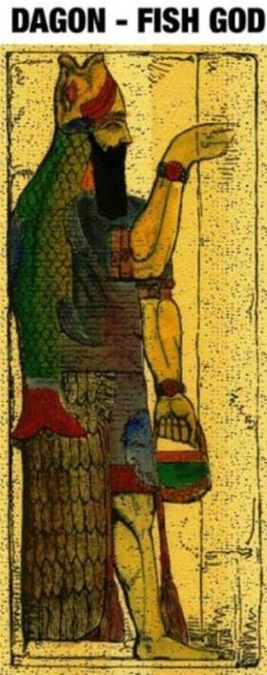
What incredible sight greeted the Philistines eyes when
they viewed the house of their mighty one??
Their mighty one was, disassembleddefeated, destroyed and humiliated
by the Creator Himself!

Slide 35
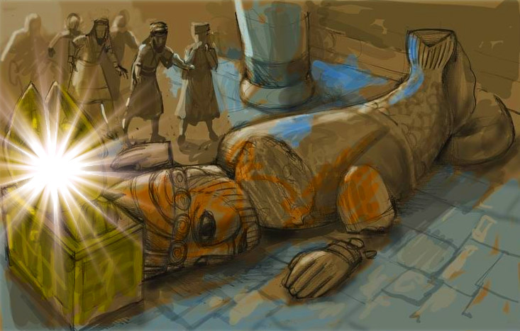

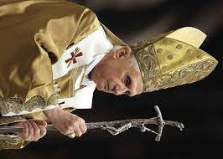
Word Picture Rules of Association!
Isa 45:23 “I have sworn by Myself, a word has gone out of My mouth in righteousness, and shall not return, so that to Me
every knee shall bow, every tongue swear.

Slide 36
Word picture exposes annihilation of (supposed) power!
What was severed? The Rosh (head) and the two hands
at the wrists.
The head: the principle base of control and authority to implement power.
The hands: the physical power and force to articulate, implement and/
or repay.
Result? The once “mighty” no-god became even less powerful than in his non-existence!

Slide 37
Today’s Immediate Implications!
This rejection of pagan systemic worship is identical to the destiny of Yericho, the city of moon worship. These pagan foundations of worship FROM ANTIQUITY, the foundation of lunar observance alongside Dagon and Ashtoreth, have been determined and REJECTED by Yahuah, for eternity!
Let’s place this record of Dagon onto charts now, and see if sunset to sunset can reckon with the documentation written in the Scriptures.

Slide 38
The First Battle with the Philistines
1Sa 4:2 And the Philistines put themselves in battle array against Yisra’ĕl. And when the battle spread, Yisra’ĕl was smitten by the Philistines, who killed about four thousand men of the army in the field.
At the erroneous idea of bringing the Ark of the Covenant to the location of battle for victory and revenge, Hophni and Phinehas, without authorization, entered the Most Qodesh place
and carried the Ark into the camp.
A deceptive spirit had entered into Hophni and Phinehas, of their own accord.

Slide 39
The Second Battle with the Philistines
Sunset Theory
1Sa 4:10 And the Philistines fought, and Yisra’ĕl was smitten, and every man fled to his tent. And the slaughter was very great, and there fell of Yisra’ĕl thirty thousand foot soldiers.
1Sa 4:17 And the messenger answered and said, “Yisra’ĕl has fled before the Philistines, and there has been a great slaughter
among the people. And your two sons have died, Ḥophni and
Pineḥas, and the ark of Elohim has been captured.”
Sunset A
#1
24 hours
Sunset B
The Ark was taken, Hophni and Phinehas were slain (1 Sam 4:11).
Night Season | Light Season of 2nd Battle
According to sunset theory, this 24 hour period ended at – Sunset!

Slide 40
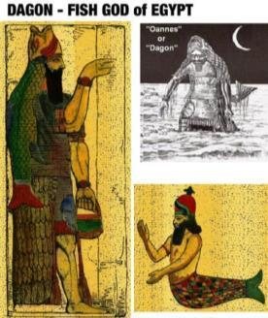
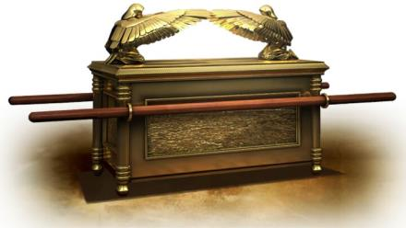
The Second Battle with the Philistines
#3 Sunset Theory
1Sa 5:1 And the Philistines took the ark of Elohim and brought it
from Eḇen Haʽĕzer to Ashdoḏ,
1Sa 5:2 and the Philistines took the ark of Elohim and brought it into the house of Daḡon and set it by Daḡon.
Sunset A
Sunset B
#1
24 hours
Night Season | Light Season of 2nd Battle

Slide 41
Very important clarification for the next slide:
From the Hebrew - to RISE EARLY – SHAKAM, by definition
is to rise at the START of a predetermined period.
With Sunset Theory, the new cycle of the week
always begins after the sun has set. Note the arrows!
Sunset A
Sunset B
Sunset C
Sunset D
#1
#2
#3
Night Season | Light Season of Battle
Let’s be aware of the ACUTE DISCONNECTS coming up, between the
Written Words from Yahuah, and the timing effects of Sunset Theory!

Slide 42
#4
Sunset Theory
The Divine Assault (#1) on the Philistine’s pagan god.
Sunset A
1Sa 5:3 When the Ashdoḏites rose early on the
morrow
The Ark of the Covenant had already been positioned beside Dagon.
and entered the house of Dagon,
behold Dagon had fallen on his face to the
earth before the coffer of [Yahuah]. So they
raised Daḡon and restored him to his place. ISA
#1
#2
Sunset B
Sunset C
Sunset D
Night Season | Light Season of 2nd Battle
MORROW of the battle begins!
This morning Dagon rests???
Early on the Morrow
According to Sunset theory, the Morrow starts after sunset!

Slide 43
#5 A
Sunset Theory
The Divine Assault (#2) on the Philistine’s pagan god.
Sunset Theory defaults to the cycle starting after the sunset. This effect causes a Light Season, specifically a Boqer (Dawn) where Dagon has NOT been disciplined by Yahuah. Is this what we read in the Scripture? ??????
#1
#2
#3
Sunset A
Sunset B
Sunset C
Sunset D
Night Season | Light Season of 2nd Battle | New Cycle (the Morrow) |  | Morrow from last cycle!
Dagon rests peacefully??
After Sunset: The 1st Morrow begins.
(1 Sam 5:3)
After Sunset: The 2nd Morrow begins.
(1 Sam 5:4)
?

Slide 44

#5 B
Sunset Theory
Supposedly, the 1st morrow began after sunset,
and Dagon had already been restored to position
on this second 24 hour period. The question is …
Did Yahuah allow Dagon one boqer (morning/Light Season) of reprieve before disjointing it before the Ark?
Sunset A
#1
#2
#3
Sunset B
Sunset C
Sunset D
Night Season | Light Season of 2nd Battle | New Cycle (the 1st Morrow) |  | Morrow from last cycle! | A 3rd Morrow??
Dagon rests peacefully??
@ Sunset: The 1st Morrow begins. (1 Sam 5:3)
Does Scripture indicate the 2nd Light Season was a REPRIEVE for Dagon?
@ Sunset: The 2nd Morrow begins.
(1 Sam 5:4)

Slide 45
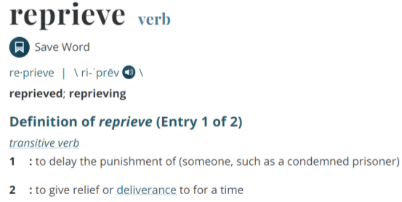
#5 C
Sunset Theory
Did Dagon received a Reprieve from Humiliation?
Or - Did Yahuah mete out justice, humiliation and defeat by locating Dagon face down, to be discovered IMMEDIATELY
at Dawn of the
following
Light Season?
Sunset A
#1
#2
#3
Sunset B
Sunset C
Night Season | Light Season of 2nd Battle | New Cycle (the 1st Morrow) |  | Morrow from last cycle! | A 3rd Morrow??
Dagon rests peacefully?
Does Scripture indicate the 2nd Light Season was a reprieve for Dagon?

Slide 46
#5 D
Sunset Theory
Does the Hebrew word “Ereb” (START OF THE SUNSET THEORY CYCLE), appear anywhere near the discovery of Dagon face down on the
FIRST or SECOND EXPOSURE?
Sunset A
#1
#2
#3
Sunset B
Sunset C
Night Season | Light Season of 2nd Battle | New Cycle (the 1st Morrow) |  | Morrow from last cycle! | A 3rd Morrow??
Dagon rests peacefully?
Does “Ereb” (evening) actually surface in 1 Samuel 5?

Slide 47
In the very next verse: Please note the REPEATED words, and most important, the addition
of a HIGHLY EXACTING
Hebrew word!

Slide 48

#6
Sunset Theory
The Divine Assault (#2) on the Philistine’s pagan god.
Did they arise “early” after Sunset, yet 12 hours later at Dawn?
Boqer is Dawn!
Sunset A
2nd
1Sa 5:4 And when they arose early on the morrow
MORNING,
#1
#2
#3
Sunset B
Sunset C
Sunset D
Night Season | Light Season of 2nd Battle | New Cycle (the Morrow) |  | Morrow from last cycle!
Dagon rests peacefully??
@ Sunset: The 1st Morrow begins. (1 Sam 5:3)
@ Sunset: The 2nd Morrow begins. (1 Sam 5:4)
When did they rise?
Early on the Sunset morrow, OR at Boqer/Dawn??

Slide 49
#7
Sunset Theory
AT WHICH EARLY POINT did they rise???
OR, next slide
Sunset C
1Sa 5:4 And when they arose early on the morrow
Boqer/Dawn!
 | The 2nd Morrow (?)
This morning Dagon rests???
Does Scripture reveal a Light Season between the risings of the Philistines where Dagon had a Light Season of rest? ??
Early is at the beginning of a set span of time. “Early” according to sunset theory
would be immediately after the sunset,
when their acclaimed 24 hour period starts.
Is this where the Philistines arose early to find their shattered pagan no god – Dagon?

Slide 50
OR
WAS IT THIS EARLY POINT when they arose?
Boqer is Dawn!
#7 Sunset Theory
1Sa 5:4 And when they arose early on the morrow
MORNING,
Sunset C
 | The 2nd Morrow (?)
This morning Dagon rests???
Boqer/Dawn!
The Philistines did NOT rise early on the morrow immediately after the sunset, AND ALSO 12 HOURS LATER – EARLY – with the EYELIDS OF DAWN (Job 38:12, 41:17) ON THE SAME 24 HOUR PERIOD! Didn’t happen!
Sunset Theory has a SERIOUS DISCONNECT HERE! HUGE!
There is a choice to be made here.

Slide 51
The choice is – either you go with the double standard confusion of sunset theory,
Babylonia
OR
you search for the
Divine Benchmark
Written by Yahuah.
It really is that simple!

Slide 52

Are we “splitting hairs” here? Absolutely!
The adversary depends on you stopping before
this point!
The End of Part 1
Let’s now restart with Yahuah’s Benchmark
as Written, beginning with Creation’s first cycle!
Boqer to Boqer! - Dawn to Dawn!

Slide 53
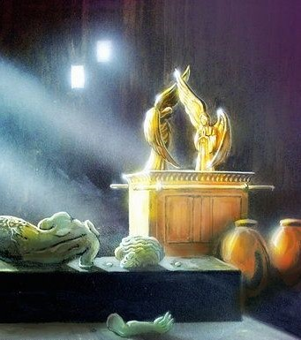

Dagon’s Decapitation Discovered
at
Dawn!
Part 2 - The Benchmark
Notes:
4.16 Pagan Decapitation Discovered at Dawn [ slides] TA Dec 4/21 Website: You-tube:
Who does Dagon represent today? Is there serious implications in the head and hands being cut off AT THE THRESHOLD? When considering the pagan background of Dagon, what threshold is it that this representation will be blocked from crossing at the time of the advent of Yahusha Ha Mashiach? Also, in extreme importance – WHO is the guard of The Threshold? It may not be who you think! As an introduction, this last question will be expounded more in the upcoming Priesthood studies.

Slide 54
Yahuah’s Benchmark! The First Battle with the Philistines
Boqer to Boqer! - Dawn to Dawn!
Review
1Sa 4:2 And the Philistines put themselves in battle array against Yisra’ĕl. And when the battle spread, Yisra’ĕl was smitten by the Philistines, who killed about four thousand men of the army in the field.
At the erroneous idea of bringing the Ark of the Covenant to the location of battle for victory and revenge, Hophni and Phinehas, without authorization, entered the Most Qodesh place and
carried the Ark into the camp.
A deceptive spirit had entered into Hophni and Phinehas, of their own accord.

Slide 55
Boqer Design #1
The Second Battle with the Philistines
1Sa 4:10 And the Philistines fought, and Yisra’ĕl was smitten, and every man fled to his tent. And the slaughter was very great, and there fell of Yisra’ĕl thirty thousand foot soldiers.
1Sa 4:17 And the messenger answered and said, “Yisra’ĕl has fled before the Philistines, and there has been a great slaughter
among the people. And your two sons have died, Ḥophni and
Pineḥas, and the ark of Elohim has been captured.”
Boqer,Dawn
A
#1
24 hours
Dawn B
Jer 33:20
Note the
Covenant Correct location of
Dawn and Sunset!
Light Season of 2nd Battle
The Ark was taken,
Hophni and Phinehas were slain
(1 Sam 4:11).
Sunset

Slide 56
Boqer Design #1 B
The Syncretism – placing the Ark beside dagon.
1Sa 5:1 And the Philistines took the ark of Elohim and brought it from Eḇen Haʽĕzer to Ashdoḏ,
1Sa 5:2 and the Philistines took the ark of Elohim and brought it into the house of Daḡon and set it by Daḡon.
Boqer,Dawn
A
#1
Dawn B
24 hours
Light Season of 2nd Battle
Sunset

Slide 57
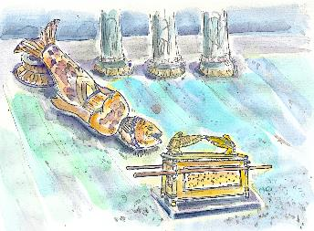
Boqer Design #2
Boqer is Dawn!
Yahuah exposes pagan falsehood!
1Sa 5:3 And the Ashdoḏites rose early in the morning and
saw Daḡon fallen on its face to the ground before the ark of יהוה [Yahuah]. So they took Daḡon and put it in its place again.
Boqer,Dawn
A
Dawn B
Dawn C
#1
#2
24 hours
Sunset
No rest for Dagon !
Light Season of 2nd Battle |  | Dagon pays obeisance
Dagon had been placed beside the Ark of the Covenant
Dagon, ON CYCLE #2, was face down to the ground before the Ark of the Covenant! It was NOT a rest cycle! There was no reprieve given!

Slide 58
Boqer Design #3
Boqer is Dawn!
Philistines arose and arrived, at - Dawn!
Boqer,Dawn
A
shakam
macharoth
1Sa 5:4 And when they arose early on the morrow
MORNING …
Dawn B
Dawn C
#1
#2
#3
24 hours
Sunset
No rest for Dagon !
Light Season of 2nd Battle |  | Dagon pays obeisance
Dagon??
Dagon placed beside the Ark of the Covenant
Dagon - face down to the ground before the Ark of the Covenant!
Note the Forward Progressive Movement of all events!
Continue to next slide -

Slide 59
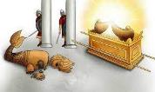
Boqer Design #4
Yahuah SHATTERS the authority of paganism!
1Sa 5:4 And when they arose early on the morrow MORNING,
and saw Daḡon fallen on its face to the ground before the ark of יהוה [Yahuah], and the head of Daḡon and both the palms of its hands cut off, on the threshold, only Daḡon itself was left of it.
Boqer,Dawn
A
Dawn B
Dawn C
#1
#2
#3
24 hours
1ST morrow
2ND morrow
Sunset
Light Season of 2nd Battle |  | Dagon pays obeisance
No rest for Dagon !
Paganism Dismembered
Dagon placed beside the Ark of the Covenant
Dagon - face down to the ground before the Ark of the Covenant!
Dagon – AGAIN, face down to the ground before the Ark of the Covenant!

Slide 60
The Syncretism – placing the Ark beside dagon.
Review
1Sa 5:4 And when they arose early on the morrow MORNING,
and saw Daḡon fallen on its face to the ground before the ark of יהוה [Yahuah], and the head of Daḡon and both the palms of its hands cut off, on the threshold, only Daḡon itself was left of it.
Head & palms, on the threshold, only Daḡon itself was left of it!!
The head - (power control center), the hands – (ability to articulate, manipulate and destroy) placed on the threshold - {Center of The Gate}.
Christianity is directly represented by Dagon, and the placement of these body parts is profound. The power and ability of “Christianity” has been rejected and refused entry to proceed through the threshold. CUT OFF from entering through the gate into The City – Heavenly Yerushalyim! Rev 22:14

Slide 61


Next Directive from Yahuah
To date, there are over 40 witnesses in the Scriptures each showing with clarity
that every day of the week begins with the “eyelashes” of dawn twilight. [Job 3:9 TS2009]
Many of the Dawn Day studies also hold the “keys” to other “gems” that would never have been found except for a deeper investigation within these special studies that were chosen by Yahuah to be saved.
This Dawn Day study on Dagon has held the same surprise.
Next, we will take a short detour to expose the “Gem” in this study to:
Investigate the word “threshold” for Dagon;
Investigate the word “threshold” for Priesthood
with a lead from the name Yoseph.
This information will only be a “seed” towards the
larger Priesthood study of Melki-tzedek.

Slide 62

Time to Consider Dagon’s Threshold
New!
What is Dagon’s Threshold?
Threshold H4670 miphtan (mif-tawn'); from the same as H6620; a stretcher, i.e. a sill: KJV - threshold.
H6620 pethen (peh'-then); from an unused root meaning to twist; an asp (from its contortions): KJV - adder.
Meaning of Dagon’s Thresholds?
Is the Hebrew definition representing the “twisted threshold of pagan no-gods”?

Slide 63
Has anyone noticed that this Dagon based belief structure in “nominal Christianity today” APPEARS SSSOOOOO close; EVEN AT THE THRESHOLD
of Righteousness!?
Having the form of, the picture of, a hint of the
righteous doctrine of salvation (although VERY twisted),
BUT IS HEAVILY ENVELOPED IN
SYNCRETISM!
We must remember that this is THE MOTHER HARLOT
to which the daughters will return when
they step over the harlot’s threshold!

Slide 64
Cut Off at the Threshold?
Why CUT OFF?
… & CUT OFF
before WHO?
Dagon’s (dragon’s) HEAD (CONTROL)
and his PALMS (hands to manipulate and articulate force, & also- INHERITANCE) -
CUT OFF - at The THRESHOLD!
WHO
Dagon/Dragon
Isa 27:1;
Rev 12,13,16, 20.
guards Yahuah’s Threshold?
Briefly: Dagon’s threshold has nothing to do with Joseph/Yoseph – H3130! Yoseph’s NAME also represents “the” keeper of the door/threshold. However, Yoseph was a Melki-tzedek Priest!
This will be expounded upon in future studies.

Slide 65
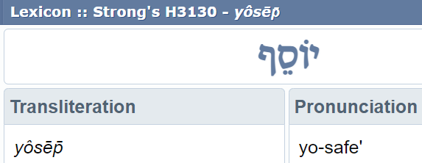
Will the Hebrew letters connect Yoseph to Yahusha the Righteous Threshold?
How can Yoseph be the keeper - for
The Threshold?
Yoseph/Joseph
We must look at the two letter root word that assists to make up Yoseph’s NAME.

Slide 66
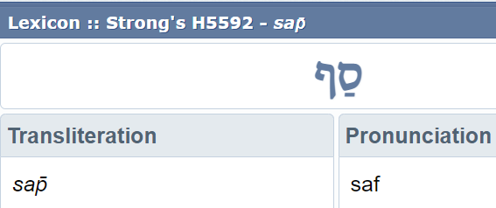
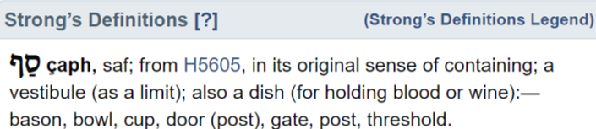
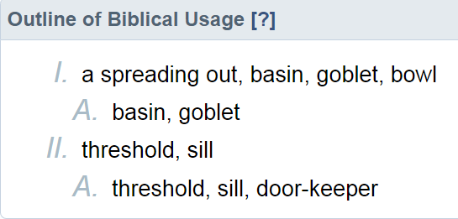
Is Yoseph PROPHECIED to GUARD the Threshold?
What hidden gem
is in this root?
A Root of Yoseph
Have you noted the 2 letter “root” and root number?
Definition of H5605
An Entrance Point into
the house!
Does this show that Yoseph is a door-keeper at/for “The” Threshold?

Slide 67
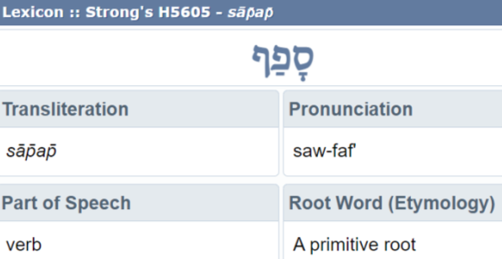
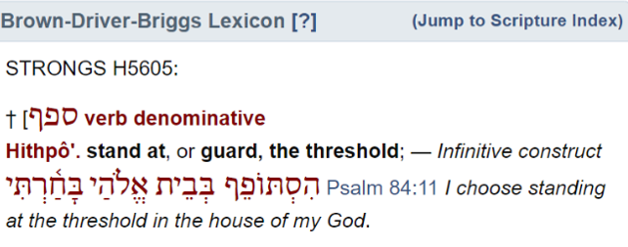
This is it!
This is what it
all reduces to!
Which Threshold should be of our highest concern?
The Gate of Revelation 22:14?
Upon finally exiting this evil earth’s threshold, WHERE DAGON MUST REMAIN, when the faithful ENTER Yahuah’s threshold of eternity,
Yoseph’s Melki-tzedek character will greet them!

Slide 68
What about Yoseph’s prophetic dream when the sun, moon and stars bowed down to him?
Do you recall how resentful Yoseph’s brothers
and father Ya’aqov were regarding the
implication of this dream that Yoseph
would be a ruler over them one day?
What kind of a “ruler” would this be?
Perhaps a Melki-tzedek King & Priest?
Did the created hosts of the heavens prophetically acknowledge Yoseph’s future position as KEEPER OF THE THRESHOLD
as his name indicates?

Slide 69
Did this dream foretell of the time when Yoseph became the KING (MELEK),
and Priest (Kohen of Tzadaca - rightousness),
for the Kingdom of Yahuah?
Was Yoseph established as - “Door Keeper” and
“Guard of Yahuah’s Threshold”?
Could Yoseph be a Melki-tzedek Kohen?
A King of Righteousness Priest?

Slide 70

Have we always read these verses in the PHYSICAL sense,
completely bypassing the deep spiritual importance of restoration that has been prophesied in Isaiah 7 times?
John 1:45 Philip found Nethanĕ’l and said to him, “We have found Him whom Mosheh wrote of in the Torah, and the prophets:
יהושע [Yahusha] of Natsareth – the son of Yosĕph.”
John 6:42 And they said, “Is not this יהושע [Yahusha],
the son of Yosĕph, whose father and mother we know?
How is it then that He says, ‘I have come down out of the heaven’?”
Could we read Yahusha - the son of Yosĕph, the KEEPER OF THE THRESHOLD
FOR YAHUAH’S KINGDOM???
Is there a seed thought being developed here?

Slide 71

Because of the root meaning of the name Yoseph we find there is a huge difference between
the “threshold of Yoseph” and
the “threshold connected to Dagon.”
Yoseph connects to the
“one who guards the door,” as the “door keeper” for Yahuah. He watches who comes across the threshold so they will not compromise the truths of Torah.
He also watches intently who dwells within the house that it will not become a place of desolation.
Dagon connects to the “asp, adder or serpent” – the one that seeks to devour, kill and destroy. Dagon’s kingdom
is twisted and wicked ever seeking to enter over the threshold of the righteous.
But, standing before the threshold of the Ark of the Covenant, Dagon was stripped of all power and authority.
Remember this seed of truth for future studies.

Slide 72
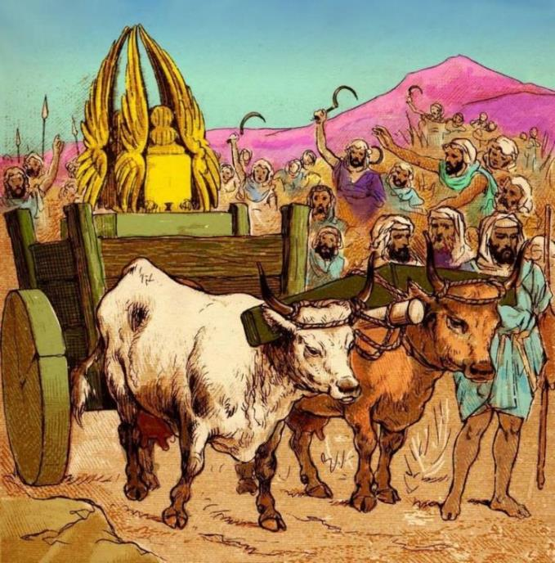
We learn that the presence of the Ark of the Covenant in the pagan cities, brought much death and many who did not die, were struck with severe health problems.
Moving Forward
1Sa 6:5 “And you shall make images of your tumours and images of your rats that ruin the land, and you shall GIVE ESTEEM to the Elohim of Yisra’ĕl.” It could be that He does lift His hand from you, from your mighty ones, and from your land.

Slide 73
1Sa 6:10 And the men did so and
took two milk cows and hitched
them to the wagon, and shut up
their calves at home.
1Sa 6:11 And they put the ark of יהוה
on the wagon, and the chest with
the gold rats and the images of
their tumours.
1Sa 6:12 And the cows went straight
for the way to Bĕyth Shemesh, and
went along the highway, bellowing
as they went, and did not turn
aside, right or left. And the princes
of the Philistines went after them
to the border of Bĕyth Shemesh.
The Solution

Slide 74
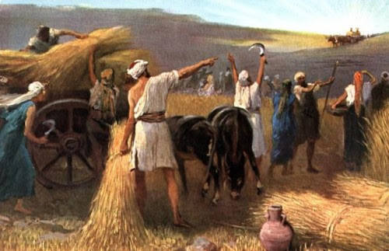
A Harvest Time!
1Sa 6:13 And they of Bĕyth
Shemesh were reaping
their wheat harvest in the
valley. And they lifted their
eyes and saw the ark, and
rejoiced to see it.
1Sa 6:14 And the wagon came
into the field of Yehoshua of
Bĕyth Shemesh and stood
there, and there was a great
stone. So they split the wood
of the wagon and offered the
cows as a burnt offering to
יהוה.

Slide 75
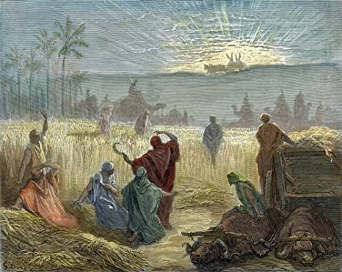
Note carefully: when the bovine pulling the Ark of the Covenant arrived in Yisra’el the people were HARVESTING THEIR WHEAT!
How long was the Ark of the Covenant in the hands of the Philistines?
1Sa 6:1 And the ark of יהוה [Yahuah] was
in the field of the Philistines for seven months.
Was it not war that began
this troublesome time?
Can we see this 7th month harvest decimates the 99 cycle Omer count? ☺

Slide 76
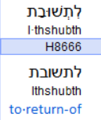
The Time For War
When did armies go out to war?
2 Ch 24:23 And it came to be,
at the turn of the year
[ה.פ.וֹ.ק.ת. – tequfah], that the
army of Aram came up
against him. And they came
into Yehuḏah and
Yerushalayim, and
destroyed all the rulers of the
people from among the
people, and sent all their
spoil to the sovereign of
Darmeseq.
2 Sam 11:1 And it came to be at the turn of the year, at the time sovereigns go out to battle, that Dawiḏ sent Yo’aḇ and his servants with him, and all Yisra’ĕl, and they destroyed the children of Ammon and besieged Rabbah. But Dawiḏ remained at Yerushalayim.
Return to what?
Return to the start of the
new year!

Slide 77
Tabernacles/ Sukkot: the time for Dwelling!
The recorded time for war was at the beginning of the year – Abib.
The Philistines captured the Ark during a war.
The Ark was in the possession of the Philistines for 7 months.
Upon the miracle of the Ark returning to Yisra’el, the people were then HARVESTING WHEAT.
It is brutally clear the 2 milk cows were acting against their natural instinct, pressing forward away from their young calves, to bring the Ark into Yisra’el.
The Two 4 legged WITNESSES voiced their concern by bellowing, all the way along the journey. They were announcing the arrival of the presence of Yahuah in the land of Yisra’el!

Slide 78
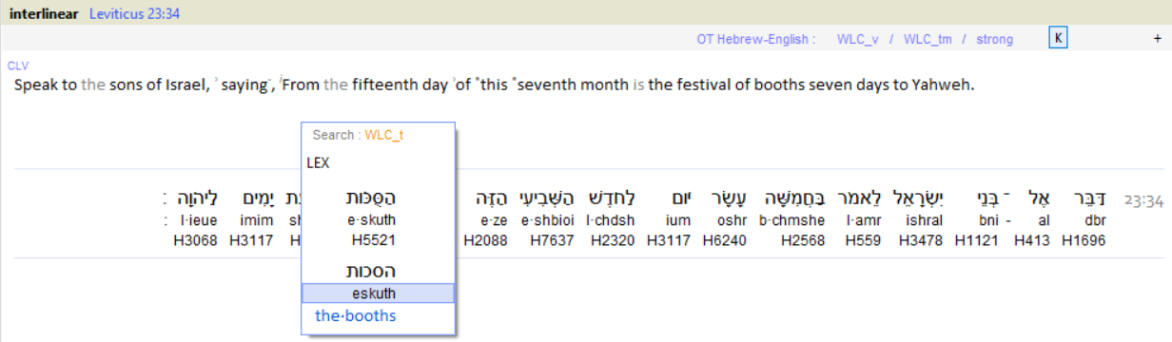
Tabernacles?- Time for Dwelling? Sukkot?
Was Yahuah establishing His RECONNECTION
with Yisra’el once again?
What does the Festival of Booths mean?
Sukkot / Tabernacles

Slide 79
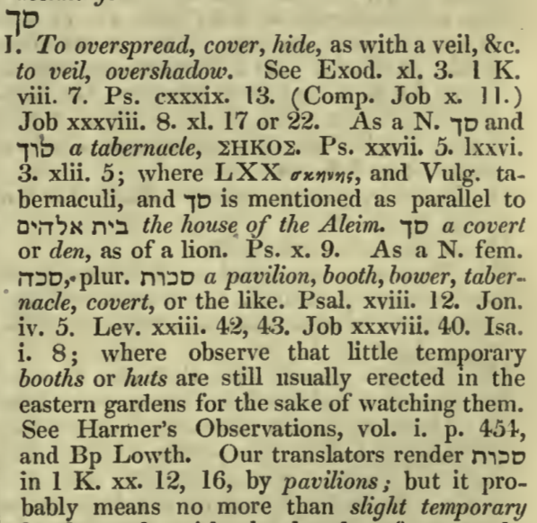
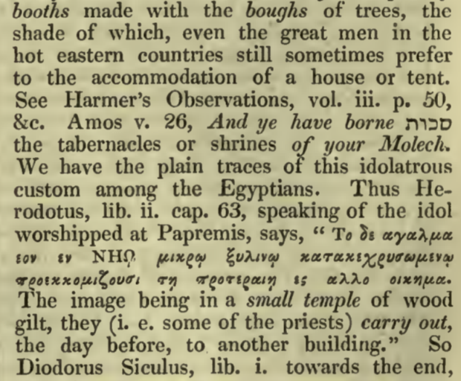
Note the 2 letter root word. Samech Kaph
What does the Festival of Booths mean?
A Hebrew Lexicon by J. Parkhurst 1762 - pg. 421
Sukkot / Tabernacles

Slide 80
Is it possible that Yahuah had decided the time of Yisra’el’s reflection on their mistake was enough, and that Yahuah wanted to re-establish His dwelling (time of Tabernacles) once again in the land of Yisra’el?
What was their mistake?
Was it placing trust and power upon a man made identity? Yes Yahuah had commanded the Ark to be constructed. Yet the Yisra’elites forgot that it was Yahuah Himself that authorized power and victory over pagan powers, and not an article constructed by man.
The ark construct in and of itself contained no power
or authority as was presumed by Yisra’el.

Slide 81
Is this testimony demonstrating a pattern?
Will Yahusha return once again
for Yisra’el at Tabernacles? (Sukkot)?
~~~~~~~~~~~~~~~~
The next few slides have internet information from
www.sabbathcovenant.com as copied from the link below. There is some pertinent information on the topic just covered.
https://www.sabbathcovenant.com/christianitythegreatdecption/TheSpiritbehindChristianity.htm
81

Slide 82

From Dagon to The Dragon
The word “dragon” comes from the word “Dagon” one of, if not the, oldest pagan gods dating back to Nimrod. Dagon evolved over time and cultures into the dragon.
This is the aerial view layout of Washington DC government areas.

Slide 83
Dagon is where the word dragon came from. When a nation conquered another nation, they would take their gods and incorporate them into their belief system. Simeramus (queen of Babylon) became Isis, who became Ishtar/Easter, who became Venus, who became Aphrodite, and finally Mary. In the same way Nimrod (King of Babylon) became Dagon became the sea serpent, then the dragon, then Neptune, then Posiedon, and then Zeus, and finally Satan. The reason Neptune carried the trident, is the same reason you see Satan with the pitch fork. The trident was the article from the Jewish Tabernacle for turning the sacrifice.
The Taneem (great sea monster Genesis 1:21) was created on the 5th day when God [Yahusha] created the fishes and the birds. The association to the goat is also in Scripture as well as in satanic worship. The goat fish Capricorn was also a direct association to Satan as well as the Hydra, the Septa (the sea Monster), and the serpent.
As I [the author] demonstrated in the second book in this series “The Mystery Religion of Babylon” Nimrod was the first false messiah ruling over the first attempt at a world government. Beginning with Nimrod in Babylon mankind began to worship leviathan (sea serpent) they called Dagon later known as The Dragon:
Job 41:1 Canst thou draw out leviathan with an hook? or his tongue with a cord which thou lettest down?
Job 41:5 In that day the Lord with his sore and great and strong sword shall punish leviathan the piercing serpent, even leviathan that crooked serpent; and he shall slay the dragon (or Taneem in Hebrew) that is in the sea.
Job 41:7 Canst thou fill his skin with barbed irons? or his head with fish spears?
H8577 Taniin
From H8565 - tan
H8577 Taniin From H8565 - tan

Slide 84




This Dragon in the Sea or DAGON the Fish God called leviathan in scripture was worshipped by those in ancient Babylon and associated with Nimrod the first High Priest of Dagon. Worship of Dagon was passed down after YHVH confused the languages and scattered humanity across the globe. It was this religion that was prevalent and continued at the time Rome destroyed Jerusalem. It was this religion of Dagon that permeated the high priestly ranks of paganism and was the foundation of The Christian Church which even today continues to wear the priestly garments of Dagon:
The etymology of the name “Satan”
is directly connected to Leviathan.
Sa-TAN and Levia-TAN both are derived from the word Taneem (sea creature) which is plural. The singular of Taneem
is TAN. Sa-TAN and Levia-TAN are simply later versions of the Taneem god Dagon later known as The Dragon.
It is Dagon the Dragon that is the spiritual source behind the Christian Churches which are based in Rome (any Sunday/Christmas/Easter/Trinity/Jesus church). The Pope and priesthood of the Catholic Church is the high priest and priests of Dagon the Dragon in disguise (not a very good disguise actually).

Slide 85

The Priests of Dagon even to this day wear the “fish hat” and dictate Christian theology world-wide including Protestant Theology from the City of Rome. Every fundamental doctrine of the Christian Church such as Sunday worship, Christmas, Easter, The Trinity, abolishment of The Law, pagan holidays, etc. were all Papal Edicts not found in scripture. They violate clear explicit commands in scripture. Rome is actually called “Babylon” in The Bible because it embodied the same Mystery Religion of Babylon.
1 Peter 5:13
  The church that is at Babylon (speaking of the church in Rome), elected together with you, saluteth you; and so doth Marcus my son …
Once we fully understand what “Christianity” actually is, what it is based on, and where it came from, then we can begin to understand why Christianity abolished the Law of YHVH, abolished His Sabbath Day, and changed the sacrifice of the Passover Lamb to the Easter Pig. Every one of the above moves (not commanded by YHVH) were made by the Pope of Rome… The High Priest of Dagon… The Dragon.
The Mitre Hat
The priests of Dagon were known by their “Mitre Hat” which resembled an open mouth
of a fish. The same exact hat is worn even today by The Pope as well as Cardinals and
Bishops. All “priests of Dagon” and the religion that surrounds them, even to this day,
is identical to that born in Babylon.
As the pagan religion of Babylon was forced upon humanity by the Roman Emperor
Constantine, the pagan aspects of worshipping Dagon, the fish god, was toned down
as to not offend other religions as each pagan religion was literally assimilated into
The Universal Church of Rome through the process of syncretism. Syncretism is the
blending of pagan religion with the worship of YHVH. It is an abomination to YHVH.

Slide 86



Not only are the ancient Priests of Dagon (Fish Worship) found wearing the mitre hat, but also the Pope and Bishops of Rome are frequently found wearing this Mitre Hat. This “clergy” system forms a pagan priest class NOT defined in The Word of YHVH but rather clearly defined in Ancient Babylon. And it is from this false class of “priests” we get every doctrine of the Christian Church.
We see the Priest of Dagon on the ancient wall drawing in every culture even as far back as the Sumerians when The Pope then served the Nephilim rulers.
There is nothing in The Word of YHVH or the historical record indicating that The Messiah Yahusha ever wore such a hat or created such a priestly High class of royalty.
  “… there are strong evidences that
  Dagon was Nimrod … All scholars
  agree that the name and worship of Dagon were imported from Babylonia.”
- The Two Babylons, Hislop, p. 215
"In their veneration and worship of Dagon, the high priest of paganism would actually put on a garment that had been created from a huge fish! The head of the fish formed a mitre above that of the old man, while its scaly, fan-like tail
fell as a cloak behind, leaving the human limbs and feet exposed.“
- Babylon and Nineveh, Austen Henry Layard, p. 343

Slide 87

"The most prominent form of worship in Babylon was dedicated to Dagon, later known as Ichthys, or the fish. In Chaldean times, the head of the church was the representative of Dagon, he was considered to be infallible, and was addressed as ‘Your Holiness’. Nations subdued by Babylon had to kiss the ring and slipper of the Babylonian god-king. The same powers and the same titles are claimed to this day by the Dalai Lama of Buddhism, and the Pope. Moreover, the vestments of paganism, the fish mitre and robes of the priests of Dagon are worn by the Catholic bishops, cardinals and popes.
- The Wine of Babylon; p. 9
ICHTYS Symbol of “The Figh”
Dagon (fish worship) is the source of the Christian symbol of the fish.
Actually it can be traced back to fish worship of Dagon and the Zodiac Sign of Pisces.
We are “told” it is because some of the disciples were “fisherman” or that Yahusha
would make us “fishers of men” among other excuses. The truth is that it is nowhere
defined in Scripture but yet… the real source of the Christian fish symbol is that of
Dagon fish worship. Just like the Mitre Hat.
Friends …
This is
SYNCRETISM!
Is Christianity just
a nice word for
PAGANISM?

Slide 88
According to Egyptian mythology, when the judges found Osiris [Nimrod] guilty of corrupting the religion of Adam and cut up his body, they threw the parts into the Nile. It was said that a fish ate one of these chunks and became transformed. Later, Isis [Semiramis] was fishing along the river bank when she fished up a half-man, half-fish. This sea creature was Dagon, the reincarnated Nimrod. And Dagon is the representation of Nimrod (of ancient Babylon) resurrecting out of the ocean depths as a half-man, half-fish.
Smith’s Bible Dictionary Dagon Fish Worship; from “Ancient Pagan and Modern Christian Symbolism”
“Dagon is the diminutive of dag, and signifies… fish… The Babylonians believed that a being, part man and part fish, emerged from the Erythraean Sea, and appeared in Babylonia in the early days of its history… Representations of this fish-god have been found among the sculptures of Nineveh. The Philistine Dagon
was of a similar character.”
- Manners and Customs of the Bible; by James Freeman
This also explains the symbol for Christianity,
the fish – the “Ichthys” which is Dagon:
Definition – “Ichthyic” – “of, pertaining to, OR
characteristic of fishes; the fish world in all its orders.”
- Oxford English Dictionary (C. E.)
ICHTHYS: IT MEANS DAGON!

Slide 89

The worship of Dagon also affected people’s eating habits. Now the mystery of why the Catholics abstain from eating fish on all days except Fridays comes into focus. This restriction of eating fish is not found in Scripture. Whether they realize it or not, they are practicing the ancient pagan rite of worshipping Dagon. The Catholic Encyclopedia even admits such abominations of the “so-called Church”:
  “As to the ritual of his worship… we only know from ancient writers that, for religious reasons, most of the Syrian peoples abstained from eating fish, a practice that one is naturally inclined to connect with the worship of a fish-god.”
- The Catholic Encyclopedia, 1913, Encyclopedia Press, Inc.
Is this why we see ads like this for “Christian Lent”?
IS THIS Dagon’s open fish mouth seeking whom
it may devour?

Slide 90

Also…
Remember in The Word of YHVH we are forbidden to have any graven images including that of a FISH or a CROSS. It is commanded to have NO GRAVEN IMAGES at all of any kind - period. YHVH forbid such idols because over time we would eventually forget their true origins and buy into lies that they are somehow symbolic of Yahusha.
With that, let us unravel the mystery that lies behind The False Religion called today “Christianity.”
Who created it, what did they believe, what is its goal?
In
Conclusion:
1) This Scripture testimony of Dagon in today’s study
was based on the clear evidence that Yahuah’s
“day-start” is at boqer/dawn – not at sunset!
2) However, the history of the name of Dagon, its related “threshold” and all that has been handed down through the ages, should encourage many to look further and deeper into other messages found within this testimony.
There is only ONE True Messiah & Priest.
The End

Slide 91



If you enjoyed this study today …
Please Join Us Live Each Week
Sign up with Covenant Calendar Club
for the Friday & Shabbat Zoom Meetings
(including live discussion)
https://studythecalendar.com/sign-up/
91

Slide 92
May Yahuah assist your desire to understand and also your decision to process any new information.
Send your questions and/or responses to –
questions@studythecalendar.com
Thank you & Shalom!
92

