Slide 1
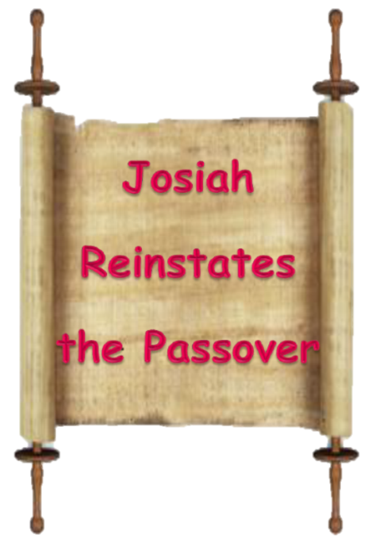
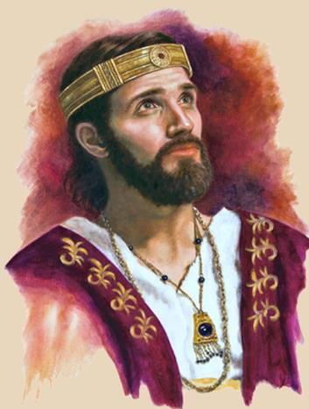
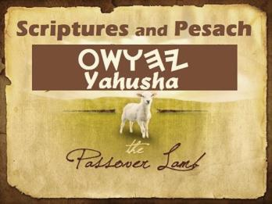


Oct 22/21: This is CF copy for the PDF – so any new corrections by Tim have to be placed here – I fixed all the italicized words already.
I got to slide 43 when Tim said he had made a bunch more changes. Wait until he sends them. NO CHANGES BETWEEN ta AND cf UP TO SLIDE 43.
This is the one to use as the final when I get the corrections done for after 43 oct 23/21
(Yoshiyahu)
2 Chronicles
34 & 35
Notes:
4.14b – Long Version - King Josiah's 41,400 Passover Sacrifices [80 slides] TA 16 Oct 2021
Website: https://studythecalendar.com/4-14-king-josiah-reinstates-the-passover/ Youtube: https://youtu.be/MwN9xytTDH8
Blurb for Josiah:
In this study - which many believed is just a simple dawn day commencement study - King Josiah's testimony has some surprises for everyone. Yes, in more ways than one King Josiah confirms (about 800 years after Moses died) that the day start is at "break of dawn [boqer]" - in fact we shall go further to say the "sunset theory" for day-start is absolutely only a theory. This is for two reasons: (1) Under King Josiah the priests are still offering Passover sacrifices (on Passover day) up UNTIL NIGHT. Obviously, sunset did not change the "day" nor the "date" from Abib 14 to Abib 15. Not one Passover sacrifice was offered on the High Shabbat of Unleavened Bread (which would be a violation of Torah).
But that is not all. There is a 2nd reason this testimony proves the dawn day start - and that is found by a very close examination of the Hebrew phrase "beyn ha arbayim" - which is written as "between the evenings" in English. This phrase is found 11 times, and found ONLY in Torah. Previous studies have shown the English should really read: "between the mixings" - but even at that many do not understand the strong implications around this phrase. You'll be in for a treat when you see how this interesting and controversial phrase unfolds the Creation day-start beautifully. Indeed, there are no idle words in Scripture. This testimony of King Josiah has been preserved for a very special reason. Come and See!

Slide 2

A TEACHING FROM 2 Chron 34 & 35
Date: ~640 BC – or 800 years after Mosheh
Visit: studythecalendar.com

Slide 3

Purpose of this Study:
To determine if the moment of sunset
changed the day of Passover observation from
Abib 14 to Abib 15
when King Yoshiyahu (Josiah) was
directing Israel! (?)
Yoshiyahu’s 41,400 Passover Sacrifices Before Night!
Reading from:
2 Chronicles
34 & 35
The Scripture quotes of choice in this writing will be from The Scriptures, unless otherwise noted.

Slide 4
Note:
These studies try to refrain from using the word “day” that has been translated from the original Hebrew word <yowm>. The word “day” loses a massive amount of definitive correctness in its ambiguous definitions. Day can indicate 12 or 24 hours, day or night, or both!
To understand Scripture correctly we need to be much more accurate.
Preference is given to the word “cycle” in place of day.
When quoting the Scriptures or citing the Sabbath Day you will see it.
Otherwise cycle is the word of choice.
The 24 hour cycle will be defined below to pinpoint the two seasons.
Cycle = 24 hours containing the 2 seasons, one of light – H216 <’owr> and one of night – H3915 <layil>.
2. Season H6256 - <‘eth>, = (approx.) 12 hour blocks of time whether it is Light Season or Night Season.
A very important application example of “season” is found in
Yerimyahu (Jeremiah) 33:20-25.

Slide 5
A look at Jeremiah 33:20 – 26(a)
“Thus said יהוה [Yahuah], If you could break My covenant with the day and My covenant with the night, so that there be not day and night in their season, then My covenant could also be broken with Dawiḏ My servant – so that he shall not have a son to reign upon his throne – and with the Lĕwites, the priests, My attendants.
As the host of the heavens is not counted, nor the sand of the sea measured, so I increase the descendants of Dawiḏ My servant and the Lĕwites who attend upon Me.’ ”And the word ofיהוה [Yahuah] came to Yirmeyahu, saying, “Have you not observed what these people have spoken, saying, ‘The two clans whichיהוה [Yahuah] has chosen have been rejected by Him’? So they have despised My people, no more to be a nation before them. Thus said יהוה [Yahuah] “If My covenant is not with day and night, and if I have not appointed the laws of the heavens and earth, then I would also reject the descendants of Ya’aqov and Dawid My servant, …

Slide 6
Very important message:
In this study the term – Dusk and/or Twilight – is used a lot! This term needs defining as to which portion in the 24 HR cycle is being addressed. There are 3 classifications of Dusk according to man’s dictionaries. Of course, in all of them, the sun is below the horizon.
Civil dusk
The time at which the sun is 6 degrees below the horizon in the evening. At this time objects are distinguishable and some stars and planets are visible to the naked eye.
Astronomical dusk
The time at which the sun is 18 degrees below the horizon in the evening. At this time the sun no longer illuminates the sky, and thus no longer interferes with astronomical observations.
Nautical dusk
Is when the sun is 12 degrees below the horizon in the evening. At this time, objects are no longer distinguishable, and the horizon is no longer visible to the naked eye.

Slide 7
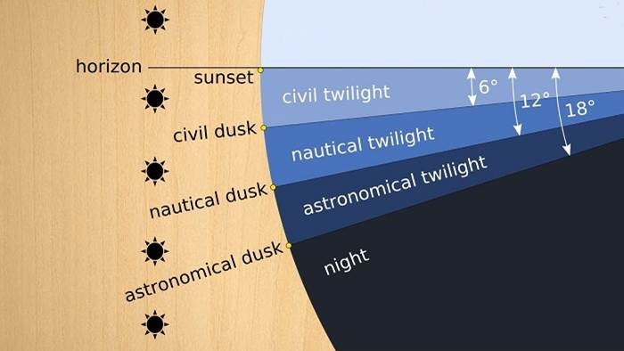

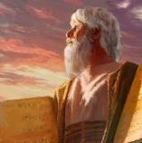

Astronomical twilight marks the day-start.
DAWN MARKER
Day Season
Horizon
Still Before Sunrise
Civil dawn/dusk
DAY
SEASON
Nautical dawn/dusk
Night Season
[No light from the sun]
Astronomical dawn/dusk
Mosheh knew this!

Slide 8
The instructions for the Passover meal (as commanded in Exodus 12:8:
“… and they shall eat the flesh in that night …”) is a direct reference to the part of the 24 hour period where no sun light exists. Where zero sun light exists is the Hebrew definition of night. So it occurs that man’s second definition of Dusk – the Nautical dusk definition – is the time the Passover meal could begin and was the time to “eat the flesh of the lamb.” Can we reasonably understand that, (because of a safety factor), it was at the Civil dusk time (or just slightly prior) when the priests in this event from 2 Chronicles, wrapped up their work of presenting all the offerings to יהוֹה [Yahuah]?
(You will note a different font, for the Hebrew letters of the name of Yahuah, than what is shown in The Scriptures.)
Let’s begin!

Slide 9
A Point to be reckoned with:
How do the Scriptures define what kind of person King Yoshiyahu
(Josiah) was?
2 Chr 34:1 Yoshiyahu [Josiah] was eight years old when he began to reign, and he reigned thirty - one years in Yerushalayim.
2 Chr 34:2 And he did what was right in the eyes of יהוה [Yahuah], and walked in the ways of his father David, and did not turn aside, right or left.
King Yoshiyahu followed the Torah impeccably - “to the letter.” There was no deviation in his leadership so far as the Torah was concerned. His example is set out as a testimony for us to examine and replicate.
There is more written to this effect –
2 Chr 34:31 And the sovereign stood in his place and made a covenant before יהוה [Yahuah], to followיהוה [Yahuah] and to guard His commands and His witnesses and His laws, with all his heart and all his
being, to do the words of the covenant that were written in this book.

Slide 10
Does Chronicles provide more details on King Yoshiyahu’s
(Josiah) intentions for Yisra’el?
2 Chr 34:32 And he made stand all who were present in Yerushalayim and Binyamin. And the inhabitants of Yerushalayim did according to the covenant of Elohim, the Elohim of their fathers.
2 Chr 34:33 And Yoshiyahu [Josiah] removed all the abominations from all the lands that belonged to the children of Yisra’ĕl, and made all who were present in Yisra’ĕl diligently serve יהוה [Yahuah] their Elohim.
All his days they did not turn away from following יהוה
[Yahuah] Elohim of their fathers.
Noting that the nation followed the Torah exquisitely; the stage is set for a clear understanding of Sovereign Yoshiyahu’s Passover celebration in 2 Chron 35 – the very next chapter.

Slide 11
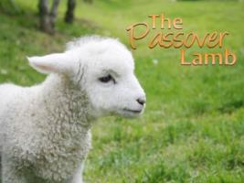
At this point we bring your attention to the chronology of events concerning the timing for the beginning and ending of the 24 HR Passover cycle, in the 35th chapter where it is very well documented.
Will the chronology follow the requirements of the Torah?
2 Chr 35:1 And Yoshiyahu performed a Passover to יהוה [Yahuah]
in Yerushalayim, and they slaughtered the Passover on the fourteenth
day of the first month.
Compare to:
Exo 12:6 And you shall keep it until the fourteenth day of
the same month. Then all the assembly of the congregation of Yisra’ĕl shall
kill it between the evenings.
Please note that the time of Passover did NOT change to the 15th of the month as sunset to sunset dogma declares!

Slide 12

2 Chr 35:2 And he set the priests in their duties and strengthened
them for the service of the House of יהוה [Yahuah].
2 Chr 35:3 And said to the Levites who were teaching all Yisra’ĕl,
who were set-apart to יהוה [Yahuah], Put the set-apart ark in
the house which Solomon son of David, sovereign of Yisra’ĕl, built. It is no longer to be a burden on your shoulders. Now serve יהוה [Yahuah] your Elohim and His people Yisra’ĕl,
2 Chr 35:4 and prepare by the fathers’ houses, according to your divisions, by the writing of David sovereign of Yisra’ĕl and by the writing of Solomon his son.
2 Chr 35:5 And stand in the set-apart place by the divisions of the fathers’ houses
of your brothers the lay people, and the portion of the father’s house of the Levites.
2 Chr 35:6 And slaughter the Passover, and set yourselves apart, and prepare
for your brothers, to do according to the word [Torah] of יהוה [Yahuah]
by the hand of Mosheh.

Slide 13

2 Chr 35:7 And Yoshiyahu gave the lay people lambs and young
goats from the flock, all for Passover offerings for
everyone present, to the number of thirty thousand,
and three thousand cattle [33,000] – these were from
the sovereign’s possessions.
The above verse is emphasized because the timeframe of the sacrifices for the Passover will certainly come into question. Will they be sacrifices for ONLY the Passover? Or will some of the sacrifices actually be slated for the feast of Unleavened Bread? (Note the word “offerings” is a supplied word.)
2 Chr 35:8 And his leaders contributed a voluntary offering to the people, to the priests, and to the Levites. Hilqiyah, and Zekaryahu, and Yehi’ĕl, leaders of the house of Elohim, gave to the priests for the Passover offerings two thousand six hundred, and three hundred cattle [2900].

Slide 14
2 Chr 35:7 And Yoshiyahu gave the lay people lambs and young
goats from the flock, all for Passover …
All sacrifices tallied, we will clearly see a multitude of sacrificial animals –
41,400 - designated specifically for Passover ONLY offerings.
Why is this being stressed? Because we are going to search for the timeframe
of when these Passover offerings ceased to be processed.

Slide 15
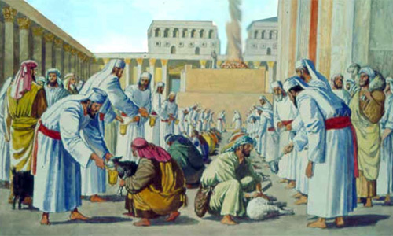
2 Chr 35:9 And Onanyahu, his brothers Shemayahu and Nethanĕ’l, and Hashabyahu and Yei’ĕl and Yozabad, chiefs of the Levites, gave to the Lĕwites for Passover offerings five thousand, and five hundred cattle [5500].
Very specifically in this verse, the cattle were distinctively designated as Passover sacrifices.
We shall see if they were indeed sacrificed upon
the hours of the Passover cycle or not.
2 Chr 35:10 And the service was prepared, and the priests
stood in their places, and the Levites in their divisions, according to the command
of the sovereign,
2 Chr 35:11 and they slaughtered the Passover. And the
priests sprinkled out of their hands, while the Levites were skinning.
2 Chr 35:12 And they removed the burnt offerings, to give them to the divisions of the fathers’ houses of the lay people, to bring to יהוה [Yahuah], as it is written in the Book of Mosheh, and the same with the cattle.

Slide 16
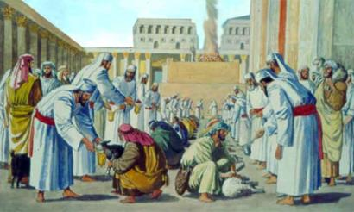
2 Chr 35:13 So they roasted the Passover offerings with fire according to the right-ruling, and they boiled the set-apart offerings in pots, and in cauldrons, and in bowls, and brought them speedily to all the lay people.
“Speedily” – was there a specific timeframe to be honoured here, that caused the urgent action? Might that timeframe command be Yahuah’s statute (Exo 12:8) to eat the Passover meal during - that night?
That night - the SAME DATE?
And just what is meant by the – “right ruling” (statutes) that pertain to the Passover?
Let’s examine verses in Exodus where all the details are recorded.

Slide 17

Exo 12:6 And you shall keep it until the fourteenth day of the same month. Then all the assembly of the congregation
of Yisra’el shall kill it - between the evenings.
Exo 12:7 And they shall take some of the blood and put it on the two doorposts and on the lintel of the houses where they eat it.
Exo 12:8 And they shall eat the flesh on that [14th] night roasted in fire with unleavened bread and bitter herbs they shall eat it.
[The preparation of sacrificing, skinning, roasting, etc., would place the Passover
meal well past the sunset hour, into the twilight mixture of evening].
Question:
#1. What night were the Passover sacrifices to be eaten?

Slide 18
More Questions
2. Do the Scriptures record the day of Passover (Abib 14 – Exo 12:6) had transitioned to Abib 15 at sunset or darkness?
What isיהוֹה [Yahuah’s] Guideline?
3. Is it possible that the finest Leader that is known to man, has found it unnecessary to inform us, not even in “fine print,” that the Passover Festival has been covertly extended - past sunset – thus overlapping into the next date and Festival, - that of Unleavened Bread?
4. Has Abba יהוֹה [Yahuah] given us the green light to adjust His statutes to suit the human Sunset Theory requirements as found in the Talmud?
Is it possible the next few verses in Exodus 12
will give us more decisive instruction and direction?

Slide 19
Exo 12:9 Do not eat it raw, nor boiled at all with water, but roasted in fire, its head with its legs and its inward parts.
Exo 12:10 And do not leave of it until morning, and what remains of
it until morning you are to burn with fire.
Why Morning? What event of the morning could possibly effect anything to do with a Passover Lamb?
Exo 12:11 And this is how you eat it: your loins girded, your sandals on your feet, and your staff in your hand. And you shall eat it in haste. It is the Passover of יהוה [Yahuah].
When was the FIRST PASSOVER LAMB slain and eaten?

Slide 20
Exo 12:6 And you shall keep it until the fourteenth day of the same month. Then all the assembly of the congregation of Yisra’el
shall kill it between the evenings (Beyn Ha Arbayim).
Definitely we see the 14th cycle of the month for Passover celebrations, but what is this “between the evenings” [BTE] about?
1st twilight
Recall: the Hebrew slaves worked until the sun set! They arrived home in the twilight mixture!
2nd twilight
Beyn Ha Arbayim: Set #2
1st twilight
Kill it between the evenings,
(twilight mixtures by definition).
Dawn
Dawn
Sunrise
Sunset
Abib 14 Light Season
(BTE Set #1)
Abib 15??? Night Season?
Q: When the Hebrew slaves arrived home after the sun had set, were they forced to break the Torah by slaying the Passover sacrifice on Abib 15?

Slide 21
Mitsrayim (Egypt)
The Hebrew slaves then slayed the Passover lamb after the sunset, from the twilight into the Night Season.
The Hebrew slaves worked until the sun set! They arrived home in the twilight mixture!
1st twilight
2nd twilight
Beyn Ha Arbayim: Set #2
1st twilight
They slew the Passover sacrifice
between the twilights (arbayim)!
Dawn
Dawn
Sunrise
Sunset
Abib 14 Light Season
(BTE Set #1)
Abib 14 !!! Night Season
According to Dawn to Dawn as written in Scripture,
what DATE was it THAT NIGHT of the PASS - OVER?

Slide 22
What about Yoshiyahu (Josiah)? When he commanded the priests to slay sacrifices through the twilight, up until the
Night Season, yet, they did sacrifice between the twilights! ☺
1st twilight
2nd twilight
Beyn Ha Arbayim: Set #2
1st twilight
Dawn
Dawn
Sunrise
Sunset
Abib 14 Light Season
(BTE Set #1)
Abib ????? Night Season
Were they slaying Passover lambs on Abib 15,
the first Shabbat of Unleavened Bread?

Slide 23
Is it possible that Passover OVERLAPS the festival of Unleavened Bread by 12 hours? What does Torah indicate?
Lev 23:5 In the first month, on the fourteenth day of the month, between the evenings, is the Passover to יהוה [Yahuah].
Lev 23:6 And on the fifteenth day of this month is the Festival of Unleavened Bread to יהוה – seven days you eat unleavened bread.
No date or festival overlap found here!
Exo 12:6 And you shall keep it until the fourteenth day of the same month. Then all the assembly of the congregation of Yisra’ĕl shall kill it between the evenings. (Beyn Ha Arbayim)
No mention of the 15th found here! What about in Numbers?

Slide 24
Num 33:3 So they departed from Rameses in the first month, [WHEN?] on the fifteenth day of the first month, on the morrow of the
Passover the children of Yisra’ĕl went out with boldness before the
eyes of all the Mitsrites [Egyptians]. The Scriptures
Num 33:3 And they departed from Rameses in the first month, on
the fifteenth day of the first month; on the morrow after the
Passover the children of Israel went out with an high hand in the sight
of all the Egyptians. (KJV)
Might Scripture be telling us that the Abib 14 Passover does NOT overlap to Abib 15 Unleavened Bread?
Will King Yoshiyahu, by his commands, agree?

Slide 25
Exo 12:12 ‘And I shall pass through the land of Mitsrayim on that night, and shall smite all the first-born in the land of Mitsrayim, both man and beast. And on all the mighty ones of Mitsrayim I shall execute judgment. I am יהוה.
Ex0 12:13 ‘And the blood shall be a sign for you on the houses where you are. And when I see the blood, I shall
PASS - OVER you, and let the plague not come on you to destroy you when I smite the land of Mitsrayim.’
6
6 Times Yahuah tells us it was Elohim Himself who did this work. It was NOT a created “ANGEL”!

Slide 26
Did Yahuah orchestrate a combined Passover/ Festival night?
Unleavened Bread
Dawn
Dawn
A rare anomaly
for His Hebrew nation?
Sunset
Abib 14 Light Season of Sacrificing | Abib 15 Night Season of Unleavened Bread
Did Yahuah concede to man’s sunset to sunset dogma?

Slide 27

Do not leave of it until morning …
OR
Did Yahuah perform for
the Hebrew nation an
Dawn of Abib 15
Dawn
Pass - Over
Sunset
?
Abib 14 Light Season of Sacrificing | Abib 14 Night Season
Passover between the mixtures!
The Exo 12:6 - Dawn to Dawn statute observance!

Slide 28

OK, for clarity, let’s go over these two verses again, only paraphrased this time according to Sunset Theory’s belief structure:
“I (יהוֹה [Yahuah]) will Passover you
on the first Sabbath Night Season of Unleavened Bread to deliver judgment
by slaying the first born.” (?????)
Can this statement be justified in terms of the written separation seen earlier in
Exo 12:12 & 13?
King Yoshiyahu will display to us
proper understanding very soon.
Exo 12:14 And this day [one single 24 hour period!] shall become to you a remembrance. And you shall observe it as
a festival to יהוה [Yahuah] throughout your generations – observe it as a festival, an everlasting law [H2708 Statute].
Questions for you:
1. Is it possible to understand “this day” [yowm – singular, not plural] refers to one singular 24 HR cycle?
2. Is it also possible to envision this single 24 HR cycle as being applied to the single cycle festival referenced in the same verse?
Note: The Festival of Unleavened Bread has multiple cycles.
3. Or shall we incorrectly apply this single 24 HR period from Exo 12:14, to the seven cycle period in the next verse as seen below?
Exo 12:15 Seven days you shall eat unleavened bread. Indeed on the first day you cause leaven to cease from your houses. For whoever eats leavened bread from the first day until the seventh day, that being shall be cut off from Yisra’ĕl.

Slide 29

Thoughts to consider:
Is there any place in Scripture where we are told that - to eat leavened bread before the Passover meal is to invite a penalty of death? In Exo 12:8 (below), it is fairly clear to see that it is understood the people were already eating leavened bread, prior to the Passover meal, by the command - to specifically eat unleavened bread.
Exo 12:8 And they shall eat the flesh on that night, roasted in fire – with unleavened bread and
with bitter herbs they shall eat it.
Please contrast this thought to the textual statement in Exo 12:15 which claims any person that
eats leavenedbread on the first cycle of Unleavened Bread is to be “cut off.”
Is there a possibility of a separating difference between these two cycles of Passover Abib 14 and Unleavened
Bread Abib 15? Is this in alignment with the separate cycle concept we just read as recorded in Lev 23:5-6
and also Num 33:3? Continuing with the statute segment in Exodus 12:
Exo 12:16 And on the first day is a set-apart gathering, and on the seventh day you have a set-apart
gathering. No work at all is done on them, only that which is eaten by every being,
that alone is prepared by you.
Question to ponder: (Set-Apart is comparable to Holy.)
Scriptures do not claim Passover Day to be a Set-Apart gathering, yet here it is proclaimed that indeed, “the first day” of Unleavened Bread is a Set-Apart gathering. That would be a Rest day on the first cycle of this festival. Have you ever
seen in Scripture where Passover is deemed a Sabbath of any kind? This is just one more point of separation found between the Passover of Abib 14 and the Unleavened Bread Festival which begins on Abib 15.

Slide 30
Exo 12:17 And you shall guard the
Festival of Unleavened Bread [Abib 15 - 21],
for on this same day I brought your divisions out of the land of Mitsrayim. And you shall guard this day throughout your generations, an everlasting law.
Exo 12:18 “In the first month, on the fourteenth day of the month, in the evening, you shall eat unleavened bread until the twenty-first day of the month in the evening.”
Now that we have completed a refresher
on the “right ruling” (guidelines/statutes)
of the Passover and the separation of it from the Festival of Unleavened Bread, let
us go back to King Yoshiyahu and see if his commands to Yisra’el actually follow, and/or align, with the Torah.
For comparison purposes, we’ll now pick up with the verse that we departed from earlier, regarding the account of Passover with King Yoshiyahu.
2 Chr 35:13 So they roasted the Passover offerings with fire according to the right-ruling, and they boiled the set-apart offerings in pots, and in cauldrons, and in bowls, and brought them speedily to all the lay people.
Pay attention to the next verse –
2 Chr 35:14 And afterward they prepared for themselves and for the priests, because the priests, the sons of Aaron, were offering burnt offerings and fat - UNTIL NIGHT. So the Levites prepared for themselves and for the priests, the sons of Aaron.
Now let’s get to one of the points in this study. As we are well aware, there is a space of time after the sunset which is called twilight where the sunlight mixes with the onset of darkness. This “mixture” is one of the actual definitions of ערב ereb (evening), also denoted as “dusk.” In 2 Chron 35:14, the sun had set and twilight was passing as the Priests were slaughtering and Levites were preparing the Passover meal after dusk [which is also after sunset]. Nautical dusk is by man’s definition, the beginning of darkness.
According to Sunset Theory, the cycle of the month had changed at the moment of sunset - to Abib 15, which is the first Shabbat
(or Set-Apart gathering) of the Festival of Unleavened Bread.

Slide 31
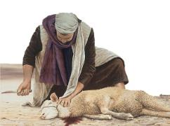
What were the Levites doing?
Were they really preparing the Passover Meal portions for the Aharonic priests, (who were busy preforming the Passover Sacrifices) on the first Shabbat of the Unleavened Bread Festival - a Rest cycle??
Dawn
Scripture tells us they observed according to Right Ruling. So was it acceptable to
sacrifice and eat the Passover meal on the
1st Shabbat night cycle of Unleavened Bread?
Did not the Scriptures say that the leftovers of the lamb had to be processed and burned before the morning [of Unleavened Bread]?
Sunset
Unleavened Bread???
Abib 14 Light Season of Sacrificing | Abib 15 Sabbath Night of Unleavened Bread
A Sunset to sunset dogma night?

Slide 32
Statements/Questions:
Were these Passover Meal Portions (by Scriptural declaration) being prepared for the priests to be eaten on Abib 15 – the Unleavened Bread Feast???
Please review Exodus 12:6-8 again for clear answers (on slide 17).
POINT: By Scriptural documentation given in Exodus 12, the Passover Portions were to be eaten on the same cycle as the sacrifices were performed –
which was – Abib 14.
We know very well that the sacrifices
were specifically for Passover.
This is precisely documented through three witnesses in:
2 Chr 35:7 And Yoshiyahu [Josiah] gave the lay people lambs and young goats from the flock,
all for Passover offerings for everyone present, to the number of thirty thousand, and three thousand cattle [33,000] – these were from the sovereign’s possessions.
2 Chr 35:8 And his leaders contributed a voluntary offering to the people, to the priests, and to the
Levites. Hilqiyah, and Zekaryahu, and Yehi’ĕl, leaders of the House of Elohim, gave to the priests for the Passover offerings two thousand six hundred, and three hundred cattle [2,900];
2 Chr 35:9 and Konanyahu, his brothers Shemayahu and Nethanĕ’l, and Hashabyahu and Yehi’ĕl and Yozabad, chiefs of the Levites, gave to the Levites for Passover offerings five
thousand, and five hundred cattle [5,500].
Review

Slide 33
Now let’s directly question:
What were the priests ofיהוֹה [Yahuah] doing offering Passover Sacrifices on the first Shabbat of Unleavened Bread?
According to Sunset Theory:
What happened to the divine command for the Passover sacrifice to be delegated to only Passover day on Abib 14?
Will it pleaseיהוֹה [Yahuah] if we worship Him in the fashion of our choice,
IGNORING HIS STATUTES?
Is this not what Cain had in mind when he brought the fruit of the land for a sacrifice?
We hope this thought pattern of the day starting at Dawn and ending at Dawn will get much clearer as we examine King Yoshiyahu’s mandate to sacrifice the lambs UNTIL DARKNESS! That is long after the sun had set! What did King Yoshiyahu know about the Passover ending? Did he understand the Torah?
Cain!

Slide 34
Stage #1 of - Sunset Theory’s Version of Josiah’s Massive Passover
2 Chr 35:1 And Yoshiyahu performed a Passover to יהוה in Yerushalayim, and they
slaughtered the Passover on the fourteenth day of the first month.
2 Chr 35:2 And he [Yoshiyahu] set the priests in their charges, …
2 Chr 35:13 And they roasted the passover with fire according to the
ordinance: but the other holy offerings sod they in pots, and in caldrons,
and in pans, and divided them speedily among all the people.
Dawn
Sunset
Sunset Theory does not consider the twilights as part of the Light Season
as Yahuah declared in Genesis 1!
Stage #2 next
Dawn
Abib 14 Light Season

Slide 35
Stage #2 of - Sunset Theory’s Version of Josiah’s Massive Passover
2 Chr 35:14 And afterward they made ready for themselves, and for the priests: because the priests the sons of Aaron were busied in offering of burnt offerings and the fat UNTIL NIGHT; therefore the Levites prepared for themselves, and for the priests the sons of Aaron.
Did the sunset change the date, or not?
Dawn
Sunset
Dawn
Stage #3 next
Abib 14 Light Season

Slide 36
Stage #3 of - Sunset Theory’s Version of Josiah’s Massive Passover
2 Chr 35:14 … the priests … of Aaron … offering … burnt offerings and
the fat UNTIL NIGHT; …
Were the priests sacrificing Passover lambs AFTER THE SUNSET which changed the Passover festival DATE to that of Abib 15 - Unleavened Bread? These donated and designated lambs specifically for the Passover festival, slaughtered on the Unleavened Bread Sabbath, were they still authentic sacrifices fulfilling the Torah’s statutes as per Yahuah’s requirements?
Dawn
Sunset
Dawn
Yet, Scripture tells us King Yoshiyahu acted according to the commandments!
What is wrong here?
Abib 14 Light Season | Abib 15 Night Season Unleavened Bread Sabbath ????
36

Slide 37
NOTE:
These priests were sacrificing according to the Torah, they,
by Scriptural account of Yoshiyahu and Yisra’el, were NOT DEVIATING TO THE RIGHT OR LEFT OF THE TORAH!
Therefore, Sunset Theory’s descriptive Charts, of the observance of Passover in 2 Chronicles 35, is not acceptable!
Why is the sunset to sunset description incorrect?
Because: the priests ofיהוֹה {Yahuah} would never offer designated Passover Sacrifices to their Creator and Elohim
on any Feast cycle other than that which the Torah indicates as acceptable.

Slide 38
What does Deut 16:7 indicate for Passover?
Deut 16:7 And thou shalt roast and eat it in the place which Yahweh
[Yahuah] thy Elohim shall choose: and thou shalt turn in the
morning, and go unto thy tents. Word of Yahweh
Why Morning (Boqer?)
According to Genesis 1 and all of the Scripture, the Dawn starts the new cycle. The Festival of Unleavened Bread is certainly no different! The Passover lamb was to be eaten and the remains burned (processed and placed out of sight) before the Dawn started the 1st Shabbat, the Festival of Unleavened Bread!
The Passover was NOT TO BE CARRIED OVER ONTO THE NEXT FESTIVAL.
Just as the Scriptures reveal, Passover is Abib 14, Unleavened Bread is Abib 15. No Festival dates are to be confused with each other! Never!

Slide 39
Let’s review this verse again and take careful note of the context that follows the command for the Dawn following Abib 14 – Passover!
Deut 16:7 And thou shalt roast and eat it in the place which Yahweh
[Yahuah] thy Elohim shall choose: and thou shalt turn in the
morning, and go unto thy tents. Word of Yahweh
Abib 14 ends at Dawn! Then immediately proceeding, the very next verse, Yahuah begins explaining details on the Festival of Unleavened Bread!
Deut 16:8 Six days thou shalt eat unleavened bread: and on the seventh day shall be a solemn assembly to Yahweh [Yahuah] thy Elohim: thou shalt do no work therein. Word of Yahweh

Slide 40

Question:
According to the understanding of Sunset Theory, what would be the reason forיהוֹה [Yahuah] to command the Israelites to return to their tents at <boqer> (morning - Dawn)?
Is it possible Sunset Theory distorts and negates this command as irrelevant, by commanding them to return to their tents in the morning?
The pertinent question now arises …
What action did King Yoshiyahu
command for the Passover sacrifices?
Did King Yoshiyahu command to sacrifice the Passover lambs well into the twilight time of Abib 15, Festival of Unleavened Bread by sunset theory standards? Or was King Yoshiyahu working on Dawn to Dawn principles?

Slide 41
Dawn
Dawn
Before we begin: Clarifying the timeframes.
Step 1
Notice where it ends!
One 24 hour cycle - Dawn to Dawn
1st twilight
2nd twilight
1st twilight
Sunrise
Sunset
ereb
Light Season | Night Season
arab
arab

Slide 42
Term Preparatory Slide
H 6148 arab - mixing (generalized) {1st prime root}
animals, flies, cake mix, cement, fruit bowl, vegetable platter etc.
H 6150 arab - mixing of light and darkness – dusk
{2nd prime root} very specific of the twilights
H 6153 ereb - a length of time (specific to after the sunset in which a mixing of light and darkness occurs)

Slide 43
Dawn
Dawn
Identified by the event’s description
a - Mixing.
Clarifying the twilight mixture with Hebrew terminology.
Step 2
Identifies the span of time between sunset and darkness.
1st twilight Arab
(verb) mixing
2nd twilight H6153 Ereb
dusk - a set period (of mixing)
1st twilight
Sunrise
Sunset
Light Season | Night Season
arab
arab
ereb

Slide 44
Dawn
More Clarification with the twilight mixture Hebrew terminology.
Dawn
Step3
1st twilight Arab
(verb) mixing
2nd twilight H6153 Ereb
noun – a set period of mixing,
Sunrise
Sunset
1st twilight
Between the Mixtures #1
Prim root H6148 Arab Plural
Between the Mixtures #2
Prim root H6148 Arab Plural
Light Season | Night Season
arab
arab
ereb

Slide 45
Dawn
Clarifying the “greater” Beyn Ha Arbayim twilight mixture terminology.
Dawn
Step 4
1st twilight Arab
(verb) mixing
2nd twilight H6153 Ereb
dusk, a set period of mixing
Sunset
Sunrise
1st twilight
Beyn Ha Arbayim - Between the arab Mixtures
H6148 - after boqer arab up to boqer arab
Morning Twilight Mixture
Morning Twilight Mixture
Light Season | Night Season
arab
arab
ereb

Slide 46
H6153 Ereb, a noun, identifies the twilight mixture timeframe after the sun has set through the word translated as - dusk.
H6150 & H6148 [2 primitive roots] Arab, are verbal descriptions of the mixing action during both the twilight mixtures.
Now that the terminology has been shown, we are ready to move forward with Yoshiyahu’s sacrificing information.
For further study interest, note the facts below -
Beyn ha arbayim (“between the evenings”) is used only 11 times – all in Torah. The time of these activities are listed as:
To slay the Passover sacrifice on Abib 14 (Exo 12:6; Lev 23:5; Num 9:3, 5, 11);
The people would eat quail (Exo 16:12);
Time of the evening sacrifice (Exo 29:39, 41; Num 28:4, 8);
When Aaron would light the lamps (Exo 30:8).

Slide 47
Dawn
Stage #1
Dawn
Questioning Yoshiyahu’s (Josiah’s) sacrifice timeframe.
Scripture records that Yoshiyahu sacrificed after the sunset, through the twilight mixture up until the Night Season.
It also records that
Yoshiyahu acted in FULL ACCORDANCE with the Torah. We read that
he sacrificed the lambs – beyn ha arbayim – between the evenings –
between the arab mixtures - as per statute in Exo 12:6. (41,400 offerings)
Sunset
Torah states it was still Abib 14!
arab
arab
Abib 14 Light Season of Sacrificing | Abib 14 Night Season
ereb
Beyn Ha Arbayim

Slide 48
Dawn
Stage #1B
Dawn
Yoshiyahu sacrificed WITHIN a twilight mixture!!
When Yoshiyahu sacrificed through until the Night Season,
did he break Yahuah’s command for – Beyn Ha Arbayim –
BETWEEN the mixtures?
It was this twilight that Yoshiyahu’s priests sacrificed through!
arab
arab
Sunset
Torah states it was still Abib 14!
Abib 14 Light Season of Sacrificing | Abib 14 Night Season
Sacrificing here is within a twilight, not between! ??

Slide 49
What about – Beyn Ha Arbayim – between the evenings (mixtures)?
Stage # 1C
From Dawn twilight mixture to before the sunset twilight mixture is Beyn Ha Arbayim - Set #1!
There are here, 2 sets of Beyn ha Arbayim – between the mixtures (evenings)! Both are correct according to Hebrew definition and Torah example!
Dawn
Dawn
Yet from the mixture after sunset, to the twilight mixture at Dawn, IS ALSO BEYN HA ARBAYIM!
arab
Sunset
arab
Between the Mixtures #1!
Between the Mixtures #2!
Abib 14 Light Season of Sacrificing | Abib 14 Night Season
ereb

Slide 50
Between the twilight mixtures is - NOT DURING THEM!
Stage # 1D
Dawn
How is it then that Yoshiyahu could sacrifice through the EREB (twilight), into the night season, and still not break the Torah’s statutes?
Has the Torah made provision for ereb sacrificing?
Dawn
arab
Sunset
arab
Between the mixtures #1!
Between the mixtures #2!
Abib 14 Light Season of Sacrificing | Abib 14 Night Season Twilight Sacrificing???
ereb

Slide 51
Is there Torah permission to slaughter the Passover Lamb in the ereb (evening)?
Stage
# 1E
Dawn
Deut 16:6 But at the place where יהוה your Elohim chooses to make His Name dwell, there you slaughter the Passover in the evening, at the going down of the sun, at the appointed time you came out of Mitsrayim.
Dawn
arab
Sunset
arab
Between the mixtures #1!
Between the mixtures #2!
Abib 14 Light Season of Sacrificing | Abib 14 Night Season Twilight Sacrificing???
ereb

Slide 52
Yes, Torah granted ereb (evening) sacrifices of the Passover Lamb.
Stage # 1F
Dawn
When Yoshiyahu commanded the priests to slaughter through the twilight after sunset, and up until the Night Season, he was fully within the Torah’s guidelines!
Praise Yahuah!
Dawn
arab
Sunset
arab
Between the mixtures #1!
Between the mixtures #2!
Abib 14 Light Season of Sacrificing | Abib 14 Night Season Twilight Sacrificing!!!
ereb

Slide 53
Will King Yoshiyahu (Josiah) uphold the Covenant Calendar?
Stage # 2
We read that Yoshiyahu commanded his priests to sacrifice up to the NIGHT SEASON. That is past sunset!
Could Yoshiyahu sacrifice Passover lambs on the Festival of Unleavened Bread – Abib 15 Shabbat,
and still be in accordance with Torah?
Dawn
Dawn
arab
arab
Sunset
Or must specified Passover offerings be sacrificed
only on Abib 14?
Abib 14 Light Season of Sacrificing | Abib 14 Night Season
Torah! ☺
ereb
Is it possible that Yoshiyahu needed the twilight season to sacrifice all 41,400 offerings?

Slide 54
King Yoshiyahu (Josiah) sacrifices past sunset, until the night!
Stage # 3
2 Chr 35:14 And afterward they made ready for themselves, and for the priests: because the priests the sons of Aaron were busied in offering of burnt offerings and the fat until night; therefore the Levites prepared for themselves, and for the priests the sons of Aaron.
Dawn
Dawn
Did Yoshiyahu know the sunset did not change the date nor the Festival?
Sunset
arab
Abib 14 Light Season of Sacrificing | Abib 14 Night Season
Torah! ☺
ereb
arab

Slide 55
Stage #4
Do not leave of it until morning …
Note – the priests slaughtering the sacrifices UNTIL NIGHT COULD NOT EAT THEIR PASSOVER MEAL UNTIL AFTER THE SUNSET! WERE THEY IN CONTEMPT OF THE TORAH? Or was their Abib 14 Night Season Passover meal “THAT NIGHT” acceptable to
Yahuah, His statutes and Torah?
Dawn of Abib 15
Pass - Over
Dawn
Exo 12:8
Sunset
arab
Abib 14 Light Season of Sacrificing | Abib 14 Night Season Passover Meal
ereb
TORAH’S Dawn to Dawn statute observance!

Slide 56
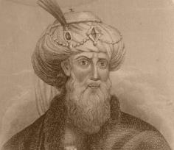
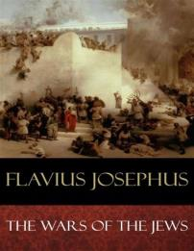
What if - King Yoshiyahu commanded to -
Stage #5
  "So these high priests, upon the coming of their feast which is called
  the Passover, when they slay their sacrifices, from the ninth hour to the eleventh, [3 pm to 5 pm Roman time] but
  so that a company not less than ten belong to every sacrifice . . . and many of us are twenty in a company, found this number of sacrifices was two hundred and fifty six thousand five hundred [256,500] which, upon
  the allowance of no more than ten that feast together, amounts to two million seven hundred thousand
  and two hundred persons that
  were pure and holy."
(Note: Some historians quote 270,000 Passover sacrifices/day.)
Slaughter the Passover offerings starting after Dawn twilight and to continue until after the sunset, into the twilight mixture and to the darkness of Abib 14 Night Season?
Dawn
Dawn
Passover sacrifices slain up to Passover Night!
arab
arab
Sunset
Abib 14 Light Season of Sacrificing | Abib 14 Night Season & Passover Meal
ereb
Again, we see Yoshiyahu’s perfect Torah observance!

Slide 57
Stage #5A
Approximating - Passover Sacrifice Calculations!
Dawn
Dawn
(1 Year) Josephus recorded approximately 256,500 lambs slain. In 12 hours, that is 21,375 lambs/hr – or – 365 lambs per minute!
What timeframe was needed for this slaughter?
Sunset
arab
Would starting at noon work? NOT!
Beyn Ha Arbayim!
arab
Abib 14 Light Season of Sacrificing | Abib 14 Night Season & Passover Meal
ereb
Try not to think too long of the vast river of blood!

Slide 58
Stage #6
What if King Yoshiyahu, the priests and people -
Ate their Passover meal in the darkness of Abib 14 Night Season? Could Exo 12:6 be reckoned here? And what if they burned the lamb carcasses and placed them out of sight before the Dawn of Abib 15 Unleavened Bread - as written in Exo 12:10?
Dawn
arab
Statutes fulfilled!
Dawn
arab
Sunset
Abib 14 Light Season of Sacrificing | Abib 14 Night Season & Passover Meal
ereb
The Dawn to Dawn statute observance!

Slide 59
Stage #7
What if we applied this information to -
Exo 12:14 And this day shall be unto you for a memorial; and ye shall keep it a feast to [Yahuah] throughout your generations; ye shall keep it a feast
by an ordinance for ever.
Dawn
Dawn
arab
Was Yoshiyahu obedient?
Sunset
What about Yahusha?
arab
Abib 14 Light Season of Sacrificing | Abib 14 Night Season & Passover Meal
ereb
Did Yahusha observe - Dawn to Dawn?

Slide 60
Stage #8
The account of our MelekTzedek Kohen Ha Gadol!
Yahusha was sentenced by Pilate and nailed to the tree.
WHEN THE SUN WAS DOWN, TWILIGHT, Yoseph requested the body of Yahusha, Matt 27:57,58.
Dawn
Mark 1:32, 15:42,43
Luke 23: 53,54
Preparation of the Passover Night Season; Preparing The Body and placement in the tomb.
Dawn
“It has been accomplished.”
3rd hr.
Mark 15:26
6th - 9th hr. Mark 15:33
Sunset
Darkness
Abib 14 Wed. Crucifixion
“THE” Sacrifice of all time.
Abib 14 Night Season In the tomb before morning!
Exo 12:10
Mark 15: 42-47
The Dawn to Dawn statute observance by Yahusha!

Slide 61
Stage #9
The MelekTzedek Kohen Ha Gadol fulfilled His Statutes!
Dawn
Yoshiyahu exemplified
Dawn to Dawn.
Yahusha’s LIFE ILLUSTRATED
the Pattern as per - Torah!
Dawn
arab
arab
Abib 14 Passover! | Abib 14 Night Season Passover !
ereb
Yahusha wrote it, Yahusha executed it!

Slide 62
What will happen if Yoshiyahu has attempted to observe Passover according to Sunset Theory?
Remember, that would mean - Beyn Ha Arbayim would take on the different meaning; written as Beyn Ha “Erebayim”! Interesting enough, “Erebayim” is not a Scriptural word!
But let’s look at the concept and see if Sunset Theory can justify itself through when Yoshiyahu sacrificed 41,400 Passover sacrifices!

Slide 63
Why “sunset” and “erbayim” cannot fulfill Torah Statutes!
Stage 1 Babylonia
The sunset to sunset day commencement must stem
from the mixture of “ereb” to the next “ereb.” [H6153 to H6153]
“ereb to ereb” is plural which would be written as erbayim.”
Is there such a phrase as beyn ha erbayim in Torah? NO!
The Torah phrase of celebration is not beyn ha erbayim, but beyn ha arbayim – indicating this phrase only aligns with the dawn day commencement! Why? Because the dawn day begins with the arab [H6148] mixture and
extends up to the next arab mixture!
Sunset
Sunset
ereb
ereb
Dawn
Abib 14 Passover! | Abib 14? Day Season Passover?
arab
Dawn to Dawn statutes only align with beyn ha arbayim!

Slide 64
Stage 2 Babylonia
Problem with Sunset to Sunset! HUGE!
Did Yoshiyahu sacrifice 41,400 sacrifices beyn ha “erebayim”? Sacrificing in the night season starting with the first “erebayim” (sunset twilight), roast, and eat the Passover meal THAT NIGHT, (same date) and burn the remains before morning (Boqer/Dawn)?
Exo 12:6-10
Sunset
Sunset
ereb
ereb
Dawn
Abib 14 Passover! 41,400 sacrifices slain? | Abib 14 Day Season Passover?
arab
Yoshiyahu could not facilitate this foolish sunset belief!

Slide 65
Stage 3 Babylonia
Problem with Sunset to Sunset!
Exo 12:6-10 commands the Paschal Lamb was to be sacrificed on the 14th, between the mixings, and eaten on that very same night. It also stipulates that the remains of the sacrifice must be burned (to be removed out of sight) on that very same night.
Boqer/Morning is the exquisite separation event that points to the Shabbat of Unleavened Bread starting at Dawn according to the Scriptures beginning in Genesis 1.
The problems with Sunset to Sunset are huge!
Sunset
Sunset
ereb
ereb
Dawn
Abib 14 Passover! | Abib 14? Day Season Unleavened Bread?
arab
Dawn to Dawn statute can only align with beyn ha arbayim!

Slide 66
In the original Passover – Mitsrayim (Egypt)
Stage 4 Babylonia
Dawn
Sunset
Sunset
The command to slay, roast and eat in the
same night, burn the remains, before
morning {BOQER}, is possible if using a
very narrow scope!
ereb
ereb
Abib 14 Passover! | Abib 15 Day Season
arab
Do the Math! 41,400 slayings at night = 4140/hr. Safety Issues??

Slide 67

Wait! Is there a command to sacrifice in the Night Season anywhere in the Scriptures????
Stage 5 Babylonia
Sunset
Sunset
ereb
Dawn
ereb
Abib 14 Passover! | Abib 15 Day Season
arab
41,400 slayings - at night???

Slide 68

Yoshiyahu has brilliantly revealed the Sunset to Sunset impossibility!
Stage 5 Babylonia
Dawn
Sunset
The Yoshiyahu account reveals
with absolute certainty the
impossibility of Sunset Theory.
Oh the IMPOR TANCE of Yoshiyahu!!!! !!!!!!!!!!
Sunset
ereb
ereb
Abib 14 Passover!
41,400 offerings slain?
 | Abib 14 Day Season
arab

Slide 69


Think about it! 41,400 Passover Sacrifices offered before the Night Season! The duties were completed after the sun had set, during dusk.
This is incredible to say the least!
Do the math: Approximately 12 hours from sunrise to onset of night = slayings of 3450/hr (or 57/min). 1) This is much safer during the Day Season than the Night Season. 2) There is time to eat the lamb.
3) There is time to dispose of the left-overs before boqer! 4) Everything is Torah Observant!
Let’s recall the command from Mosheh concerning the final minutes of the Passover Night Season. The remains of the sacrificial lamb were to be properly disposed of before <boqer> morning/Dawn – (Exo 12:10). Now the question arises again: why did Mosheh say – “… and thou shalt turn in the morning [boqer/dawn],
and go unto thy tents”? Deut 16:7
One explanation is found in John 19:14. What title was given to the festival?
John 19:14 And it was the PREPARATION of the PASSOVER, and
about the sixth hour: and he saith unto the Jews, Behold your King.
John named it the Preparation of the Pesach (Passover). PREPARATION!
Preparation is the description of the festival!
What basic preparations were to be accomplished?

Slide 70
When does the Passover Festival end, and - Preparation for what?
The Passover festival was PREPARING for the Unleavened Bread festival!
Starting at Dawn, the people were to PREPARE the Pascal lamb for sacrifice, it was to be placed on a spit and roasted!
Passover - historic psychological PREPARATION for the Ultimate Sacrifice at Golgotha.
Yahuah had people already PREPARED for the next festival by commanding unleavened bread to be present and eaten at the Night Season Passover meal!
The Passover Meal was also PREPARED.
Ultimately, Passover was and is, a PREPARATION for our Mashiach to return once again, to engage with His children in fulfilling Yahusha’s Last Supper Promise to drink of the pure grape juice once again.
Matt 26: 29
At what point were the 1st two points finalized? Mosheh commanded the people to
return to their tents at Dawn. The reason for the 24 hours of the Passover cycle ceased their context – AT DAWN! It was and still is, AT DAWN – that the next
Festival of Unleavened Bread begins. Abib 15 - New Festival, New celebration, New context.

Slide 71
Yoshiyahu made a covenant with Yahuah, to live by the Torah standard.
It is also documented that Yoshiyahu was a righteous man who did not deviate to the right nor to the left of the Torah.
Again, it is recorded, that Yoshiyahu commanded the priests to sacrifice the lambs that were specified for Passover only, up until the Night Season, past the sunset.
Questions we need to carefully ponder:
Is it possible that we can reckon Yoshiyahu’s actions with Torah’s statutes?
Did Yoshiyahu live up to the standard recorded of him in the Scriptures?
Is there a specific reason why this testimony was preserved in the Tanach?
Did Yahuah want us to pay attention to a very unusual situation?
Could Yahuah have wanted another extremely clear witness that –
the sunset DOES NOT change the cycle of the week in His Kingdom?

Slide 72


To be clear:
Yoshiyahu commanded the Passover lambs to be sacrificed well past the sunset marker that is claimed by most, to change the cycle of Abib 14 to Abib 15!
Did Yoshiyahu accept the Scriptures acclamation that Abib 14 Passover, does not overlap into the Abib 15 festival of Unleavened Bread? No? Yes?
Sunset did not change Abib 14 to Abib 15 in the account of Yoshiyahu sacrificing 41,400 offerings within one 24 hour cycle.
Are you beginning to see why these simple Scripture testimonies are so important?
No idle words in Scripture!

Slide 73
The striking separation between Abib 14 (Passover)
and Abib 15 (Unleavened Bread) is brilliantly clear in the Torah.
It is fulfilled PERFECTLY through Yahuah’s Dawn Design! ☺
Returning to their tents was the final act of the Passover Festival.
Dawn arrived/arrives ushering in the one and only High Shabbat: the first Annual Shabbat of the year, the first of the Festival of Unleavened Bread.
At the convergence of Dawn, the new 24 HR cycle – Abib 15, then commences in exact accordance with the Torah, exemplified by the example within the Passion week of Yahusha Ha Mashiach.

Slide 74
Now let’s look at a few very interesting points made.
1. The Passover Portions for the priests were eaten according to statute requirements – AFTER DUSK ON Abib 14.
2. The Passover Sacrifices were all completed after the sunset up until night (nautical dusk) - which was still Passover Abib 14.
3. The Passover Meal was eaten during the Night Season
on Abib 14 – according to the Torah.
4. Any Passover lamb left-overs were to be burned before the Night Season
of Abib 14 ended – according to the Torah.
All these points are – according to the Torah. No deviation whatsoever!
Yes, again, Dawn Design delivers perfect Scriptural alignment.
Clearly, DAWN commences Yahuah’s Shabbats, Feasts and Festivals – ALL OF THEM! No exceptions!

Slide 75
Yoshiyahu delivers to us one more ultra important point!
Did you notice in this study that every part of the 24 hour period has been commissioned with a
specifically designated event -
EXCEPT ONE!?
Which one, and … WHY?

Slide 76

Did Yahuah RESERVE the Boqer for a purpose?
Have we OVERLOOKED the morning twilight mixture>
the ARAB mixture of the BOQER (morning) ?
Why has it thus far been untouched?
Dawn
arab
Sunset
Abib 14 Light Season of Sacrificing | Abib 14 Night Season & Passover Meal

Slide 77
A Boqer/Arab purpose! (?)
Did Yahuah RESERVE the Boqer Arab (Dawn Mixture) specifically for the daily sacrifice?
Could Yahuah have wanted to impress upon us
the importance of OUR DAILY LIVING SACRIFICE?
Our SPIRITUAL BREAKFAST TO NOURISH OUR CYCLES?
Dawn
arab
Sunset
Abib 14 Light Season of Sacrificing | Abib 14 Night Season & Passover Meal

Slide 78

Will you consider the evidence put forth from the Scriptures in this study?
Will you consider the evidence from the other 40+ studies in this series of Dawn Design?
And what about the “untapped” Dawn witnesses in the Gospels alone?
Will you consider putting away the traditions received from our fathers?
If so, just ask for the studies.
Does following the Torah interest you?
The End

Slide 79
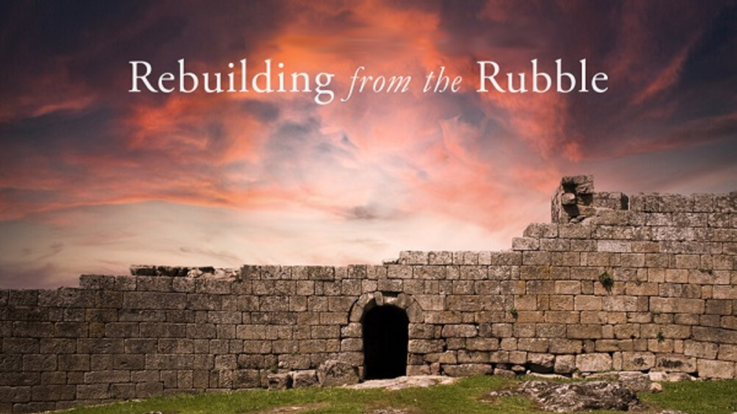


If you enjoyed this study today …
Please Join Us Live Each Week
Sign up with Covenant Calendar Club
for the Friday & Sabbath Zoom Meetings
(including live discussion)
https://studythecalendar.com/sign-up/

Slide 80
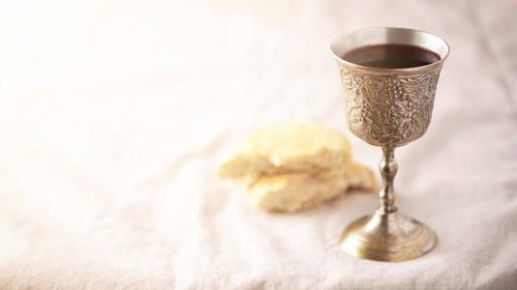
May Yahuah assist your desire to understand and also your decision to process any new information.
Send your questions and/or responses to –
questions@studythecalendar.com
Thank you & Shalom!

