Slide 1

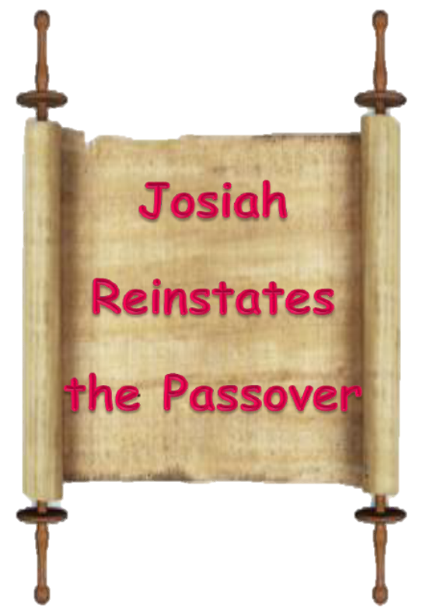
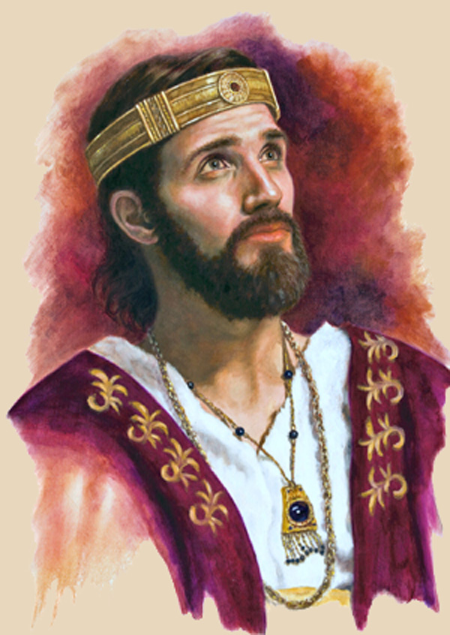

A Study Coming Soon From
Covenant Calendar
Club
2 Chronicles
34 & 35
Notes:
The title is: 4.14a King Josiah's 41,400 Passover Sacrifices [7 slides] TA 16 Oct 2021 Website: Youtube: https://www.youtube.com/watch?v=01Kc0B59eh8
Blurb:
This is a study coming soon from Covenant Calendar Club to help further your understanding about Yahuah's extremely important commencement of every day - the dawn commencement, not the sunset commencement. But there is more ...
Did you know that these 41,400 Passover sacrifices were not all offered on the Light Season of Abib 14? Why did King Josiah have the priests sacrificing up until the night? If sunset actually turns the day date from Abib 14 to Abib 15, was he not in violation of Torah by offering Passover Sacrifices past the sunset of Abib 14? This is about 800 years after Moses died. Did King Josiah (who followed the laws of Moses) get things mixed up? But there's more ... the phrase "between the evenings" is actually from the Hebrew "beyn ha arbayim" ... which just happens to have a lot of impact in this study, as it does 11 times in the Torah. Will "beyn ha arbayim" support the commencement of the day through dawn twilight or sunset? Come and see what is in this awesome Scripture testimony!

Slide 2






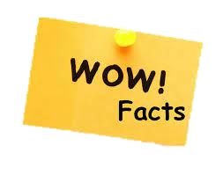

King Josiah’s testimony about
“when the day begins” is just
one of about 40 Scripture
testimonies?
There is not one idle word in
Scripture?
Does that not mean that every
testimony, and especially the story
of King Josiah, must be carefully
preserved for something very
special for everyone to learn?

Slide 3



King Josiah offered 41,400
Passover lamb sacrifices right
up to the Night Season of
Abib 14?
This event was about 800
years after Moses died?

Slide 4

Passover sacrifices were
never offered on Abib 15?
Sunset did not change the
Abib 14 “day” to Abib 15,
[the High Sabbath of Unleavened
Bread]?

Slide 5

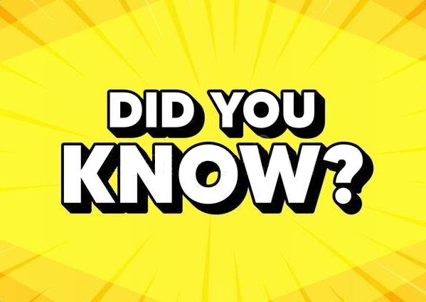
The testimony of King Josiah
is going to break open a very
interesting insight into the
Hebrew phrase “beyn ha arbayim”?
“beyn ha arbayim” is Hebrew for
“between the eveningS” or better
phrased as “between the mixingS”?

Slide 6
“beyn ha arbayim” is actually the
Hebrew phrase that will declare
with complete precision every new
day from Yahuah begins with the
break of Dawn Twilight?
And now,
more …

Slide 7


If you’re curious to see how this works …
Please Join Us Live Next Week
Sign up with Covenant Calendar Club
for the Friday & Sabbath Zoom Meetings
(including live discussion)
Shalom!
https://studythecalendar.com/sign-up/

Slide 8

A TEACHING FROM 2 Chron 34 & 35
Date: ~640 BC – or 800 years after Moses
Visit: studythecalendar.com

Slide 9

Joe Brown’s Lazy Dog jumpesNew Bunny Trail on Lunar
King Josiah’s 41,000 Passover Sacrifices
Joe Brown’s Lazy Dog jumpesNew Bunny Trail on Lunar
Joe Brown’s Lazy Dog jumpesNew Bunny Trail on Lunar
Extended to the Night Season?
Joe Brown’s Lazy Dog jumpesNew Bunny Trail on Lunar

