Slide 1
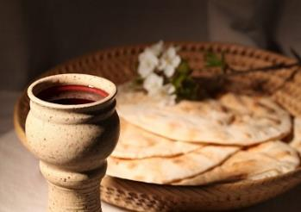
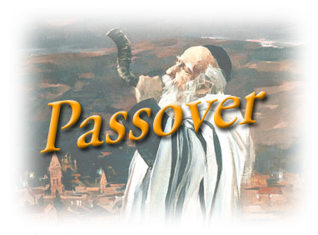
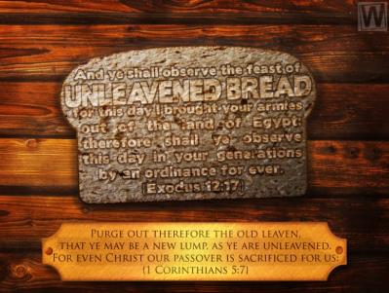
Two Months, Two Passover Feasts!
Two Unleavened Bread Festivals?
Numbers 9
Notes:
Sept 3-4 2021: Festival of ULB in the 2nd month: Website: You-tube:
Taught by Charlene and Eddie
Edit 8: New slides are 55-56 and a few new things in and around that area. I had less interruptions today, but still it took the whole day to get this historical information pulled together. I found the DATES bring things into perspective and help us to see just what was going on. Anyway, Friday morning I can examine any new suggestions, and then we have to give what we have.
Just received many suggestions/corrections from Eddie. They have been incorporated with comment boxes. Also one new slide has been added per her request.
My goodness, has this study changed from what it started out to be. Very interesting, and we should not be surprised anymore, as this always happens. Again, it sure is a wonder how a calendar study can pull so many things together.
Tim & Eddie – your turn – and hope this meets with your approval. Charlene Sept 2nd 445 pm

Slide 2
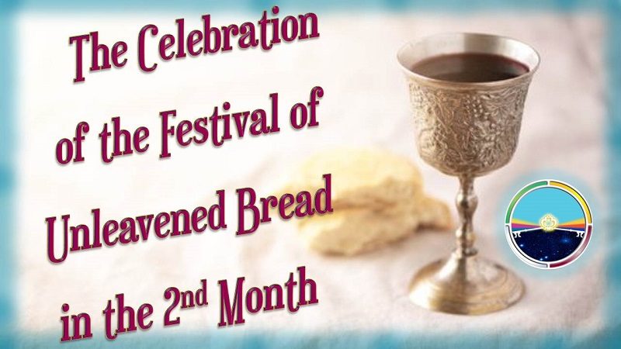
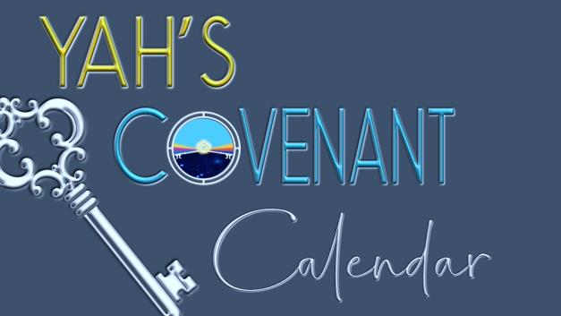
An important & lingering question is: a) If we miss the 1st month Passover, do we celebrate Passover in the 2nd month? b) Should we also celebrate the 7 days of ULB?
This study from Numbers 9 was written by Moses
about 1490 BC.
Comparisons will be made to the time of King Hezekiah
(2 Chron 30) around 726 BC.
This was before the
10 northern tribes of Israel were scattered.

Slide 3

Why is this such an important question about the 2nd month Passover and celebration of the Unleavened Bread Festival? b) Is it a “salvational” issue?
NOTE: As many around the world discover the covenant commands of Yahuah’s calendar, they prepare to honor those commands.
Email questions are something like this:

Slide 4

“We missed the Covenant Calendar Passover because we were on the lunar calendar. Since discovering the moon has nothing to do with the Covenant month count, shall we celebrate the Passover in the
2nd month? Also, do we celebrate the 7 days of Unleavened Bread Festival?”
At this time the Covenant Calendar study on Numbers 9
was not completed.
This study will provide the full answer – perhaps with a surprise.

Slide 5
Will Two Passover Feasts {to include eating unleavened bread}
INSTIGATE the Celebration of …
Two Unleavened Bread Festivals in Two Months?
This is another day-start study that has its roots in the Exo 12 Passover from Egypt.
First: a short review of the DAWN day-start before opening the study questions
for this topic of a second Passover celebration in the second month.
Review of Day-start Terminology:
One complete cycle is the 24-hour day.
The term “season” distinguishes the TWO timeframes comprising of the
Light Season and Night (dark) Season.
5

Slide 6

This study will be divided into FOUR major parts:
Part A: Review of the commencement time for the Passover day, the Passover meal, and the Unleavened Bread Festival in the 1st month (referred to as Abib).
  From Elohim’s instructions in the Scriptures that directly pertain to the Passover, do we see the new 24-hour cycle beginning at Dawn or Sunset (Dusk)? Why ask this question? If we are going to observe the Passover correctly, we want to be sure we start
  on time – not early and not late.
Part
A
6

Slide 7

Part B: Passover & the Unleavened Bread Festival
in the 2nd month.
  The second Passover also has the command to eat unleavened bread with the Passover meal
  (Num 9:11).
  Does this command to eat unleavened bread
  at the Passover meal give reason to believe a second Unleavened Bread Festival must begin the following day?
Part
B
7

Slide 8

Part C: Hezekiah’s Unleavened Bread Festival in the 2nd month.
(2 Chronicles 30)
  King Hezekiah did not perform the Passover and
  Unleavened Bread Festival during the 1st month.
  Did he lead the people to observe two Festivals
  of Unleavened Bread (v 23) in the 2nd month after the
  performance of the 2nd month Passover? 1) Why did he do this?
  2) Was that decision within the Torah guidelines?
  3) Was King Hezekiah misleading Yahuah’s people?
  Today, some believe that we should be keeping the
  Passover ONLY in the second month, no matter what.
  Does/Will the Torah support this practice?
Part
C
8

Slide 9

Part D: Will be the Revelation of a Surprise.
Will the surprise have something
to do with a command in Numbers 9?
Will it matter “who” uttered the command - & why?
Will the surprise have something
to do with King Hezekiah?
Was King Hezekiah allowed to institute a new command and be outside the boundaries of Torah?
Part
D
9

Slide 10

Part A: Passover Commencement for the Day & Meal
What is the Traditional Belief among most Feast-keepers for the Commencement Time of Passover?
Most Believers that observe the weekly Sabbath,
annual Sabbaths and non-Sabbath feast days,
calculate the beginning of these feasts to commence
at the “sunset moment” from the previous cycle.
Although many insist and believe that this is
not confusing, invariably it is always confusing.
How can this be?
10

Slide 11
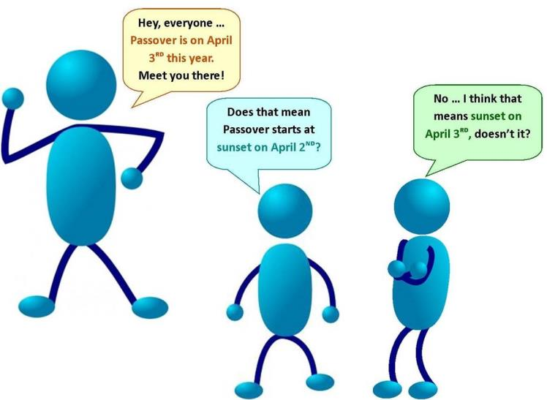



The Passover Commencement Riddle
[The Riddle] Let’s use the example of April 3 for Passover on the Roman calendar.
Everyone is agreed that April 3 is Passover, but the two questions that always need to be answered are:
  Does Passover begin at sunset on April 2nd?
  Or … does Passover begin at sunset on April 3rd?
Passover is on
April 3rd this year. Meet you there!
Does that mean Passover begins
at sunset
on April 2nd?
No … I think
that means sunset
on April 3rd, doesn’t it?
11

Slide 12

The Sunset Passover Commencement Confusion
[Two Confusing Answers?] Prevalent in traditional understanding today is the belief that every Festival of Passover begins at the sunset moment
at the close of the 13th Light Season, in the 1st month.
(On the Roman calendar, that would mean sunset of April 2nd for an April 3rd Day Season Passover.)
How many have experienced this trouble as well?
You have heard the “sunset” answer, but there is always someone who asks again just to make doubly sure.
In that case, we need to solve the “Passover commencement riddle” before we can address the issue of the commencement for the Festival of Unleavened Bread.
12

Slide 13
That “Passover commencement riddle” was solved in the Exodus 12 study. (If you have not seen it, please make arrangements to receive your own copy.)
The Exodus 12 study is also based on the definition of the Dawn Design.
But first, let’s review the Dawn Design again.
This order, by Divine design, was declared for the earth through the blueprint of Zion, the heavenly city of Yahuah. Yahusha implemented this plan for us on the first day of creation (Gen 1:1-5). Then He declared every 24-hour cycle to include a full Light Season and Night (dark) Season. This Order initiates every new cycle with DAWN, (NOT Sunrise or SUNSET). The Order is also authenticated through simple testimonies of awe-inspiring Scripture accounts.
DAWN is PRESERVED and Illustrated countless times!
THIS DIVINE INSTITUTION IS CURRENTLY BEING RESTORED!!
Next: Chart #1 (of 2) will demonstrate how the Passover commencement
is to be discerned in either the 1st or 2nd month.
13

Slide 14
Chart #1 of 2 for Passover Commencement at Dawn (1st Month)
Note these Definitions for all Charts: Cycle = Light and Night (dark) Seasons (24-hour time segment)
Season = Light or Night Season (each time segment varies in time)
(Note: Read the boxes in numerical order. Table is not to scale.)
“Between the evenings”
1. 14th cycle of 24 hours begins and ends with Dawn.
6. Dawn begins the 15th cycle.
 |  | Passover (Light Season) |  | Passover (Night Season) |  | (15th Light Season)
2. Sanctuary Sacrifice of Lamb
at DUSK
(not 3 PM).
Exo 12:6
3. Passover meal begins after DUSK:
“eat the flesh in that
night …”
Exo 12:8
4. Yahusha labels this Night Season with the Divine TITLE of PASSOVER.
It is: Passover … ONE FEAST, One Dawn to Dawn 24 hour cycle, which culminates later in the Night Season according to Genesis 1!
5. Leave none of
the lamb’s remains until the morning.
Exo 12:10
Now that you have had a moment to enjoy the chart,
let’s do a brief review from the Exodus 12 study along with some additional Scriptures.
14
Notes:
July 27/21: rec’d from Eddie – ready to go.

Slide 15
The Passover meal will be eaten “between the evenings” on the 14th cycle of the month.
Leviticus 23:5 In the fourteenth (day) of the first month at even
is YAHUAH’S PASSOVER.
  (Also see Exo 12:18 In the first month, on the fourteenth day of the month in the evening,*
  you shall eat unleavened bread, until the twenty-first day of the month in the evening [TS 2009].)
at even is H6153 <`ereb> a) dusk; b) evening tide [of the day];
c) to grow dusky at sundown; d) night.
The Passover meal continues through the “night hours” of the 14th day of the month.
Exo 12:8 And they shall eat the flesh in that NIGHT (H3915 <layil>), roast with fire,
and unleavened bread; and with bitter herbs they shall eat it.
night is H3915 <layil> a) night as opposed to day; b) of gloom, protective shadow.
The Passover Lamb “leftovers” must be disposed of
before “morning” of the 15th day of the month.
* “in the evening” is to be understood as “between the evenings” or the Night Season timeframe.
15

Slide 16
If any part of the lamb is “left over,” Exo 12:10 states this:
“Do not leave any of it until the next day.”
Whatever is not eaten that night must be burned before morning.” (NLT)
  (See TLB: Exo 12:10 Don't eat any of it the next day;
  if all is not eaten that night, burn what is left.)
Deut 16:4 And no leaven should be seen with you in all your border for seven days,
neither should any of the meat which you slaughter in the evening on the first day
stay all night until the morning. (TS2009)
morning H1242 <boqer> 1) morning, break of day
a) morning
1) of end of night
2) of coming of daylight
3) of coming of sunrise
4) of beginning of day
5) of bright joy after night of distress (fig.)
b) morrow, next day, next morning
16

Slide 17
The Scriptures are very clear …
… that once DAWN APPEARS, there better not be any lamb leftovers!
Why?
  Type = Lamb leftovers had to be “out of sight” and disposed of before “dawn.”
  Anti-type = the Messiah must be “out of sight” and buried before
  the arrival of “dawn.”
DAWN ushers in a new 24-hour cycle that is separate >>>
from the Passover celebrations during its Night Season.
Dawn is no longer the 14th day of the month but the >>>
Dawning of the 15th “new 24-hour cycle!”
17

Slide 18
Review:
Activities preparing for the complete Passover begin at Dawn on the 14th cycle.
Evening Sanctuary Sacrifices were at “even/ereb/dusk” in Torah (unwarranted change to the traditional 9th hour, or 3 pm Roman time, in the Gospels.) {Luke 23:44-46/Mark 15:34-37}
Passover meals are to be eaten between the evenings/between the twilights,
“in that night” [of the 14th cycle]. {Exo 12:8; Num 9:3}
It is commanded to eat unleavened bread with the Passover meal.
{Exo 12:8/Num 9:3, & 11}
Any “Passover sacrifice leftovers” are to be burned before the arrival
of DAWN on the 15th cycle. {Exo 12:10; Num 9:12}
Both the 1st and 2nd month Passovers will use the full 24 hours of the
14th cycle to complete all divine commands.
See again, Exo 12:10 & Num 9:12 for understanding the phrase “until the morning.”
18

Slide 19
Question: regarding the Passover Festival in the 1st month …
Can Scripture prove that the Festival of Unleavened Bread starts at the same time as the eating of the Passover meal with the Abib 14 sunset moment?
According to the prevalent Sunset Theory, this “sunset moment” is the beginning of Abib 15!
Read the words in the following box. Have you heard this unusual line of reasoning (from the “sunset believers”) for justifying Passover falling on two, separate 24-hour cycles of the month? (eg: the 13th/14th or 14th/15th.)
“It is very obvious that Passover is the start of the Festival of Unleavened Bread on the night of Abib 14 because: 1) the Passover meal is commanded to be eaten with unleavened bread; 2) Abib 15 begins with sunset!”
If you have heard this line of reasoning, then hopefully you know by now that this is directly opposed to the Scriptural evidence because everything to do with Passover is found within only ONE, 24-HOUR CYCLE— not two!
19

Slide 20
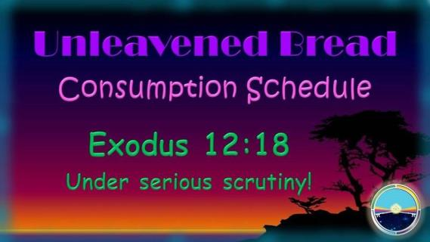
Therefore, a partial conclusion is summarized in these initial review points:
The command to consume unleavened bread during the Passover meal of the “Night Season” is not a command that commences the 7-day Festival of Unleavened Bread.
The Festival of Unleavened Bread cannot begin until the DAWNING of the 15th of Abib.
Yahuah does give a full 24-hour cycle to the Passover Day that does not infringe on the beginning festival hours of Unleavened Bread.
https://studythecalendar.com/exodus-12-unleavened-bread-consumption-schedule/
Now that the foundation for the Passover in the 1st Month has
been established, it’s time to ask the next question:
Does every pattern of “Passover with the Unleavened Bread Festival”
in the 1st month repeat in the exact same pattern in the 2nd month?
20

Slide 21
Part B: 2nd Month Passover & Unleavened Bread Festival
CLARIFICATION OF TERMINOLOGY FOR DEFINITIONS OF FEASTS & FESTIVAL TERMS
“Passover Day,” “Passover Feast” and “Passover Festival” are terms that are used quite interchangeably. All three of these terms can be used to designate only ONE
24-hour cycle of THE Passover DAY itself … OR … these terms can be understood to mean the full EIGHT 24-hour cycles of this springtime Festival (including the Feast/Festival of Unleavened Bread and Wave Sheaf /First Fruits).
(* The term “Passover” is also used to describe the Passover Sacrifice which is not connected to a “timeframe.”)
“Feast of Unleavened Bread” is another term that is used loosely, or indiscriminately.
It can designate the first meal (at the actual Passover) eaten with unleavened bread on the 14TH of the 1st month … OR … the term can be understood to describe the SEVEN DAYS of the Festival of Unleavened Bread.
21

Slide 22
  Luke 22:1 says: “Now the feast of unleavened bread drew nigh, which is called the Passover.”
  In the context of this verse, Luke appears to be referring to the Passover meal as the
  “festival of unleavened bread” but the context is the Passover feast as “the” unleavened bread feast.
  Of course, this Passover DAY is also the first 24-hour cycle of the eight-day springtime festival,
  but the specific Festival of Unleavened Bread is a full seven days in length.
  However, unleavened bread is eaten on all eight (8) days.
  Fact: The “eating of unleavened bread” at the Passover ereb/evening meal does not command
  the “festival” of Unleavened Bread to begin at that time— as the sunset day-start promotes.
  QUESTION #1: Does the command to eat unleavened bread at the meal of the Passover in the 2nd month
  also command another seven-day “Festival of Unleavened Bread” to follow the 2nd Passover in the 2nd month??
  In other words: If one misses the full Passover Festival of the 1st month, are the instructions for the
  1st month Passover exactly the same for the celebration of the Passover in the 2nd month(?) – AND
  are we supposed to celebrate another seven days of “Unleavened Bread” in this 2nd month?
  QUESTION #2: Some feel the only Passover to be celebrated today is always and only the Passover
  of the 2nd month, no matter what. Will these instructions be located in the Torah?
  (Perhaps Part C regarding Hezekiah will have answers for this question.)
22

Slide 23
PREPARATION FOR THE REST OF THE STUDY
This part of the study is going to demonstrate a unique difference between the festivals celebrated in the
1ST MONTH, and the 2ND MONTH.
The celebration of the Passover in the second month was a provision for those to partake,
only if they missed the Passover in the first month (Num 9:6-12) due to the following circumstances:
IF they were ceremonially unclean due to touching a dead body;
IF they were travelling … or on a long journey. (See Num 9:10.)
Passover Similarities:
Both Passovers were on the 14th day of the month, accompanied with the eating of unleavened bread.
Both Passover meals could be called “a feast of unleavened bread.”
Passover Differences:
The first Passover was followed by the seven-cycle Festival of Unleavened Bread, with its two Unleavened Bread Sabbaths.
Will the rest of this study (and Part C) reveal that a seven-day/cycle Festival of Unleavened Bread does NOT FOLLOW the second Passover?
The Passover Festival [on Abib 14] and the Unleavened Bread Festival [Abib 15] are closely connected.
Therefore, it is extremely important to know how to calculate the “starting point” for the first yearly Passover Festival in order to know how to calculate the “starting point” for the Festival of Unleavened Bread.
That part of the exercise is complete, and we are now ready to concentrate on the Passover for the 2ND month.
23

Slide 24
Traditional Belief of Feast-Keepers for the Additional Festival of Unleavened Bread
Texts pertaining to the eating of unleavened bread for any Passover meal are found in Exo 12:8, 15, & 18; Deut 16:3 & Num 9:3, 11.
All instructions are the same except the instructions found in Numbers 9 – where we find the commands given are specifically for a “Second Passover being celebrated in the Second Month.”
Yes, indeed many claim:
“Any unleavened bread eaten at any Passover meal
is proof that the Festival of Unleavened Bread begins with the
Passover meal – whether it is eaten in the 1st OR 2nd month.”
So, if Yahusha has changed any of the requirements for the second Passover from the original pattern found in the first Passover, then we should expect notification of such changes according to Amos 3:7. (“Surely Elohim will do nothing, but he revealeth his secret unto his servants the prophets.”)
In this study, we will be watching to see if such instructions do exist!!
24

Slide 25

It is very significant that Yahusha,
in His infinite mercy and desire to save mankind, gave another opportunity, under certain conditions, to participate in the observance
of the Passover in the 2nd month.
The Scriptures show unleavened bread was a definite requirement for the Passover meals in both months. But, did the presence of unleavened bread ALWAYS necessitate the observance
of a second 7-cycle celebration for the
Festival of Unleavened Bread in the 2nd month?
25

Slide 26
In the verses of Num 9:1-12, we want to pay careful attention to the context and grammar to see if anything
can be detected that commands another seven-day celebration for the Festival of Unleavened Bread.
Does the command really exist?
Does the eating of unleavened bread with ANY Passover meal, dictate or demand the celebration
of the seven, full, 24-hour cycles of the Festival of Unleavened Bread?
Will the Scriptural example effectively ELIMINATE THE FOUNDATION for making the following claim, or not?
HERE’S THE CLAIM:
According to Sunset Theory, the “sunset moment” begins the new day.
Many assume the 2nd Passover follows the exact pattern as the 1st Passover celebrating the Unleavened Bread Festival for the seven (7) days.
It seems that the “eating of unleavened bread” in the 2nd Passover
has become the command to celebrate a
second Festival of Unleavened Bread in the 2nd month from days 15-21.
Remember that lingering question:
  Does every pattern of the “Passover and Unleavened Bread Festival” in the 1st month repeat in the exact same pattern in the celebration of the Passover for the 2nd month?
26

Slide 27
That question now leads into the next part of the study as the foundation for the Passover
in the 2nd month has now been established.
At this point, it would be best to read the Scriptural account for the specifics of the second Passover celebration in Numbers 9:1-14 for a comprehensive view of what is going to be discussed next.
Numbers 9:1-12 [KJV]: Instructions for “The Second Passover”
1 And Yahuah spake unto Moses in the wilderness of Sinai, in the first month of the second year
after they were come out of the land of Egypt, saying,
2 Let the children of Israel also keep the passover at his appointed season.
3 In the fourteenth day of this month, at even, ye shall keep it in his appointed season:
according to all the rites of it, and according to all the ceremonies thereof, shall ye keep it.
4 And Moses spake unto the children of Israel, that they should keep the passover.
5 And they kept the passover on the fourteenth day of the first month at even in the wilderness of Sinai:
according to all that Yahuah commanded Moses, so did the children of Israel.
Next: A problem arises for Abib Passover participation.
27

Slide 28
And there were certain men, who were defiled by the dead body of a man, that they could not keep the passover
on that day: and they came before Moses and before Aaron on that day.
And those men said unto him, We are defiled by the dead body of a man: wherefore are we kept back,
that we may not offer an offering of Yahuah in his appointed season among the children of Israel.
And Moses said unto them, Stand still, and I will hear what Yahuah will command concerning you.
Solution to Problem: A new law is formed AFTER the Book of the Covenant commands were given.
And Yahuah spake unto Moses, saying,
10 Speak unto the children of Israel, saying, If any man of you or of your posterity shall be unclean by reason of a dead
body, or be in a journey afar off, yet he shall keep the Passover unto Yahuah.
TWO Solutions … for (1) “uncleanness” or (2) a “long journey.”
11 The fourteenth day of the second month AT EVEN they shall keep it, and eat it with unleavened bread and bitter herbs.
12 They shall leave none of it unto the morning, nor break any bone of it: according to all the ordinances of the passover
they shall keep it.
13 But the man that is clean, and is not in a journey, and forbeareth to keep the passover, even the same soul shall be cut off
from among his people: because he brought not the offering of Yahuah in his appointed season, that man shall bear his sin.
14 And if a stranger shall sojourn among you, and will keep the passover unto Yahuah; according to the ordinance of the
passover, and according to the manner thereof, so shall he do: ye shall have one ordinance, both for the stranger, and
for him that was born in the land.
28

Slide 29
Did you notice Numbers 9 does not mention a seven-day Festival of Unleavened Bread in the second month?
The unleavened bread is eaten at the Passover meal in the 2nd month, but there seems to be a deafening silence regarding the seven-cycle Festival of Unleavened Bread during the 2nd month from the 15th – 21st.
This obvious silence should be speaking and getting our attention!
What are your answers to the following four perceptions or misconceptions?
Yahusha ordered the Festival of Unleavened Bread to begin with sunset … True? False?
Yahusha required the celebration of a second Festival of Unleavened Bread … True? False?
The eating of unleavened bread at the second Passover meal automatically ushered in another
Festival of Unleavened Bread … True? False?
According to Sunset Theory – as the sunset ushers in the 15th day the Passover ends and the
Festival of Unleavened Bread begins … True? False?
(Note: Does the Passover Festival end at sunset, even if the Passover meal is still in progress? Yes? No?)
The answers to the – True or False - questions are in this study with a basic search! ☺
29

Slide 30
The term Sunset Theory has been mentioned several times. What does this really mean?
What is a theory? (Webster’s 1828 note: only the first definition applies.)
THEORY, n. 1. Speculation; a doctrine or scheme of things, which terminates in speculation or contemplation,
without a view to practice.
Note: If the sunset-day commencement cannot be found in Torah or the rest of Scripture,
then there is no “view to practice” – it is merely speculation.
The passages from Numbers 9:10-12 are in need of a closer review!
Speak unto the children of Israel, saying, If any man of you or of your posterity shall be unclean by reason of a dead body, or be in a journey afar off, yet he shall keep the Passover unto Yahuah.
11 The fourteenth day of the second month AT EVEN they shall keep it, and eat it with unleavened bread and bitter herbs.
12 They shall leave none of it unto the morning, nor break any bone of it: according to all the ordinances of the passover
they shall keep it.
Let’s define “ordinances” to be sure of the meanings. We’ll compare H2706 with H2708:
Ordinances - H2706 choq (khoke); from H2710; an enactment; hence, an appointment
(of time, space, quantity, labor or usage): …
Now compare to “ordinances” as H2708: Ordinances - H2708 chuqqah (khook-kaw');
feminine of H2706, and meaning substantially the same.
30

Slide 31
Conclusion: The “ordinances” of vs 12 as masculine H2706 relate to Yahuah’s ordinances, or His appointed times that are to be honored according to His instructions.
The “ordinances” as H2708 belong to the Bride – she is instructed to keep the exact same appointed times – and to guard them. The Passover in the second month also qualifies as an “ordinance” to be kept, upon certain conditions such as uncleanness, or delay from a long journey.
The context of Verse 10 is … Keep the Passover, after dusk, or – in the NIGHT SEASON!!!
Yahusha declares the TIMING with His voice, to Moses, in Num 9:11>
      The fourteenth day <yowm> of the second month Between the Evenings (DARKNESS)
      they shall keep it, and eat it …
(See Exo 12:8 >> night = <layil>!)
What specific time was the second-month Passover meal to be eaten?
“After even – or – in the night!”
That’s the same pattern found in Exo 12:8 and Lev 23:5, addressed earlier.
31

Slide 32

Remember Num 9:12 reinforces this truth:
The full 14th cycle of 2nd month stretches to dawn of the 15th cycle giving the people the full Passover Night-Season to take care of the Passover Lamb leftovers.
Num 9:12 of the New Living Translation states this: “They must not leave any
of the lamb until the next morning, and they must not break any of its bones.
They must follow all the normal regulations concerning the Passover.”
(This includes “no adding” and “no taking away” of any Torah commands as found in Deut 4:2; 12:32.)
Remember – if any part of the lamb is “left over,” Exo 12:10 had the first explicit instructions: “Do not leave any of it until the next day. Whatever is not eaten
that night must be burned before morning.” (New Living Translation)
{Recall the Type/Antitype comparison given earlier!}
32

Slide 33

-
Now let us put these points together for a summary of the 2nd Passover. Yahusha’s voice states:
Passover Festival: could be observed in the 2nd month
Passover Requirements: Missed the 1st Passover due to being unclean or on a journey
Passover Sacrifice at Sanctuary: Offered at the “evening twilight”
Passover Meal: Begins “between the evenings” on the 14th cycle (<yowm>)
Passover Food: Unleavened Bread is commanded to be eaten with the lamb
Passover Lamb left-overs: dispose of before the morning of the 15th
Witness: Yahusha declares the details of the second
PASSOVER NIGHT SEASON ON THE 14TH OF THE 2ND MONTH [is the same as the 1st month]!
For the Second Passover,
THERE WAS ONLY ONE DIFFERENCE!
Numbers 9 does not mention the
2nd Passover is followed by another
7-day Festival of Unleavened Bread!
Because this is so,
that raises further questions.
33

Slide 34

Question #1: CAN WE identify a minimum of 2-3 witnesses from the Scriptures that will assure us Yahusha has NOT given a definite command to celebrate the Festival of Unleavened Bread IMMEDIATELY FOLLOWING the 2nd Passover Festival?
Question #2: If there is another festival of seven days of Unleavened Bread, would that change the Omer count and the specific appointed times of all feast Sabbaths & Festivals to follow?
Following are seven witnesses that can be found. All of them mention:
      “Abib” (or the “first month”)
      The command to “eat unleavened bread,” either …
        for “seven days” … OR …
        from “the 15th to the 21st day of the first month.”
34

Slide 35
Take note in the 7 witnesses below if there is an extra command given regarding
the eating of unleavened bread for a seven-day festival in the second month.
Exo 12:2, 15, 18 This month shall be unto you the beginning of months: it shall be the first month of the year to you.
¹⁵ Seven days shall ye eat unleavened bread … ¹⁸ In the first month, on the fourteenth day of the month at even,
ye shall eat unleavened bread, until the one and twentieth day of the month at even.
Exo 13:4, 6 This day came ye out in the month Abib. ⁶ Seven days thou shalt eat unleavened bread …
Exo 23:15 Thou shalt keep the feast of unleavened bread: (thou shalt eat unleavened bread seven days,
as I commanded thee, in the time appointed of the month Abib …)
Exo 34:18 The feast of unleavened bread shalt thou keep. Seven days thou shalt eat unleavened bread,
as I commanded thee, in the time of the month Abib: for in the month Abib thou camest out from Egypt.
Lev 23:5-6 In the fourteenth day of the first month at even is Yahuah’s passover. ⁶ And on the fifteenth day
of the same month is the feast of unleavened bread unto Yahuah: seven days ye must eat unleavened bread.
Deut 16:1, 3, 8 Observe the month of Abib, and keep the passover for…
    in the month of Abib Yahuah thy
    Elohim brought thee forth out of Egypt by night. ³ … seven days shalt thou eat unleavened bread …
    ⁸ Six days thou shalt eat unleavened bread: and on the seventh day shall be a solemn assembly
    to Yahuah thy Elohim …
Num 28: 16, 17 And in the fourteenth day of the first month is the passover of Yahuah.
¹⁷ And in the fifteenth day of this month is the feast: seven days shall unleavened bread be eaten.
35

Slide 36
Let’s review how Numbers 9 is laid out:
Numbers 9 Requirement for Second Passover: Consequence for being unclean for First Passover
Num 9:3-6 In the fourteenth day of this month, at even, ye shall keep it in his appointed season: according to all the
rites of it, and according to all the ceremonies thereof, shall ye keep it.
⁴ And Moses spake unto the children of Israel, that they should keep the passover.
⁵ And they kept the passover on the fourteenth day of the first month AT EVEN in the wilderness of Sinai:
according to all that Yahuah commanded Moses, so did the children of Israel.
⁶ And there were certain men, who were defiled by the dead body of a man, that they could not keep the passover on
that day …
Numbers 9 Solution for Participating in the Second Passover:
Num 9:9-12 And Yahuah spake unto Moses, saying, ¹⁰ Speak unto the children of Israel, saying, If any man of you
or of your posterity shall be unclean by reason of a dead body, or be in a journey afar off, yet he shall keep the passover
unto Yahuah.
¹¹ The fourteenth day of the second month at even they shall keep it, and eat it with
unleavened bread and bitter herbs.
¹² They shall leave none of it unto the morning, nor break any bone of it:
according to all the ordinances of the passover they shall keep it. (See Exo 12:8 for “at even,” eating timing!)
Next: Chart #2 lays out the requirements for Passover in the 2nd month.
36

Slide 37
Chart #2 of 2 2nd Month Passover Dawn Format
“Between the Evenings”
2nd Month Passover for 24 Hours
Dawn begins the 14th cycle.
Dawn begins the 15th cycle.
 |  | Passover (Light Season) |  | 2nd Month Passover (Night Season) |  | (15th Light Season)
5. Leave none of
the lamb’s remains until the morning.
Num 9:12 Exo 12:10
As each new cycle begins with DAWN; Zion’s style is accurate & simple!
1. Passover sacrifice slain in the 2nd month
& 14th day
DURING DUSK.
Prepare to eat
the lamb
when roasted.
a) Unleavened Bread & bitter herbs are eaten with the Passover lamb
on this Passover night of the 14th day.
b) There is no claim that the ULB Festival begins at ‘even’ with this Passover meal.
It’s easy to calculate when the 15th cycle begins, whether in the 1st or 2nd month.
The traditions of the Sunset Theory cannot be supported with Scriptural proof.
37
Notes:
July 27/21: rec’d from Eddie – ready to go.

Slide 38
Numbers 9 Conclusion thus far:
Keep the Second Passover or FACE JUDGMENT!
Num 9:13-14 … cut off if you did not keep the Passover, even with the
alternate arrangements.
Forming a semi-conclusion on the matter:
There are seven very well-defined and specific witnesses that proclaim the requirement for observing the Festival of Unleavened Bread for seven days following the Passover in the 1st month.
However, there is not one word about observing the Festival of Unleavened Bread, or eating unleavened bread for another seven days following the
second Passover in the 2nd month.
Therefore, in the 2nd month, only the Passover (meal) was observed,
with the command to eat unleavened bread and bitter herbs.
38

Slide 39
The Scriptures reveal this very important fact:
Yahusha did not give a command to keep the Festival of Unleavened Bread in the 2nd month.
Yet Yahusha gave very definite instruction
to eat the Passover meal in the 2nd month
WITH Unleavened Bread.
39
39

Slide 40
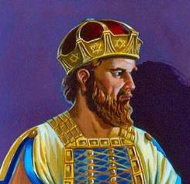
It is well to remember:
When we choose to serve Yahusha in everything,
we also seek to be in alignment with Him in all areas,
even if they seem small and insignificant.
But what about King Hezekiah?
Scripture documents very well he had a huge, successful Passover in the second month, followed “WITH” two sets
of seven-day celebrations? Festivals of Unleavened Bread?
This investigation will demonstrate an interesting outcome …
40

Slide 41
Part C: Hezekiah’s Unleavened Bread Festival in the 2nd Month
New Found Gem #1 in this Study for the Clarity of the 2nd Month Passover Celebrations:
It may seem there is a controversy between Numbers 9 and 2 Chronicles 30 because the celebration
of the seven-day Festival of Unleavened Bread was indeed recorded & kept in the 2nd month under the leadership of King Hezekiah.
1490 BC (one year after the Mt Sinai Covenant was given): (#1) Numbers 9 does NOT prescribe
the celebration of a seven-day Festival of Unleavened following the Passover in the 2nd month;
(#2) neither does the text mention any details about a Feast of Unleavened Bread following a
2nd month Passover; (#3) nor does it address any circumstance that might warrant TWO
consecutive seven-day Festivals of Unleavened Bread.
725 BC: 2 Chronicles 30 has the history of King Hezekiah about 775 years after Moses died and roughly 235 years after the Passover of King Solomon (960 BC). Were two Festivals of Unleavened Bread observed by King Hezekiah? Was King Hezekiah in violation of Torah commands?
41

Slide 42
Proponents of the positions of: (a) the “second Passover also” or (b) the “second Passover only” cite the following as the basis for their conclusions:
  “Remember, we’re all just doing our best!” NO ONE is really able to truly obey the moedim instructions
  today in “keeping” His annual Feasts and Set-apart days in earnest, anyway.
  The best one can do is “remember” or “memorialize” the festivals until Messiah returns and fully restores.
  BECAUSE OF THIS, believers should be gracious in recognizing that “we all see in part, dimly.”
  “… or be in a journey afar off …” (Num 9:10): Proponents apply the impediment of being “away on a journey” to themselves (Ephraim, the northern kingdom, prodigal sons …), characterizing the scattering— or the exile— of Israel as a prophetic “long journey.” Does the text support this view? Is there some compromise?
  Precedent for 2nd Passover APPLYING SPECIFICALLY to NORTHERN KINGDOM: 2 Chronicles 30 is offered
  as a proof – or support text – for the employment of the second Passover provision for those of
  the northern kingdom who have “escaped” from their captors “and are left.” (vs 6)
  The argument declares, “If we are Ephraim, and this gracious invitation was extended from Yahuah to
  the northern kingdom through Sovereign Hezekiah THEN, why would it not apply to us NOW (today)?”
  “… according to all the ordinances of the Passover they shall keep it” (Num 9:12): Proponents read this to mean, or include, the Festival of Unleavened Bread, which they view as inextricably tied to the Passover.
  This study has already shown that this understanding is erroneous and not supported by Scripture – but – there is much more!
42

Slide 43
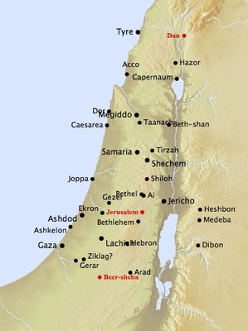
We have read what Numbers 9 has to say. It is now time to carefully compare the testimony of 2 Chronicles 30.
1 And Hezekiah sent to all Israel and Judah, and wrote letters also to Ephraim and Manasseh, that they should come to the house of Yahuah at Jerusalem, to keep the passover unto Yahuah Elohim of Israel.
2 For the king had taken counsel, and his princes, and all the congregation in Jerusalem, to keep the passover
in the second month.
3 For they could not keep it at that time, because
the priests had not sanctified themselves sufficiently,
neither had the people gathered themselves together
to Jerusalem.
4 And the thing pleased the king and all the congregation.
5 So they established a decree to make proclamation throughout all Israel, from Beer-sheba even to Dan, that they should come to keep the passover unto Yahuah Elohim of Israel at Jerusalem: for they had not done it
of a long time in such sort as it was written.
43

Slide 44
2 Chronicles 30
6 So the posts went with the letters from the king and his princes throughout all Israel and Judah, and according to the commandment of the king, saying, Ye children of Israel, turn again unto Yahuah Elohim of Abraham, Isaac, and Israel, and he will return to the remnant of you, that are escaped out of the hand of the kings of Assyria.
7 And be not ye like your fathers, and like your brethren, which trespassed against Yahuah Elohim of their fathers, who therefore gave them up to desolation, as ye see.
8 Now be ye not stiffnecked, as your fathers were, but yield yourselves unto Yahuah, and enter into his sanctuary, which he hath sanctified for ever: and serve Yahuah your Elohim, that the fierceness of his wrath may turn away from you.
9 For if ye turn again unto Yahuah, your brethren and your children shall find compassion before them that lead them captive, so that they shall come again into this land: for Yahuah your Elohim is gracious and merciful, and will not turn away his face from you, if ye return unto him.
44

Slide 45
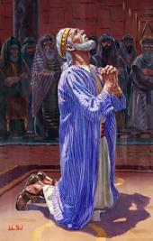
2 Chronicles 30
10 So the posts passed from city to city through the country of Ephraim and Manasseh even unto Zebulun: but they laughed them to scorn, and mocked them.
11 Nevertheless divers of Asher and Manasseh and of Zebulun humbled themselves, and came to Jerusalem.
12 Also in Judah the hand of Elohim was to give them
one heart to do the commandment of the king and of
the princes, by the word of Yahuah.
13 And there assembled at Jerusalem much people
to keep the feast of unleavened bread in the
second month, a very great congregation.
14 And they arose and took away the altars that were in Jerusalem, and all the altars for incense took they away,
and cast them into the brook Kidron.
15 Then they killed the passover on the fourteenth day
of the second month: and the priests and the Levites were ashamed, and sanctified themselves, and brought in the burnt offerings into the house of Yahuah.
16 And they stood in their place after their manner, according to the law of Moses the man of Elohim: the priests sprinkled the blood, which they received of the hand of the Levites.
17 For there were many in the congregation that were not sanctified: therefore the Levites had the charge of the killing of the passovers for every one that was not clean,
to sanctify them unto Yahuah.
18 For a multitude of the people, even many of Ephraim, and Manasseh, Issachar, and Zebulun, had not cleansed themselves, yet did they eat the passover otherwise than it was written.
But Hezekiah prayed for them, saying,
The good Yahuah pardon every one
19 That prepareth his heart to seek Elohim, Yahuah Elohim of his fathers, though he be
not cleansed according to the purification
of the sanctuary.
45

Slide 46
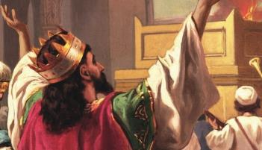
2 Chronicles 30
20 And Yahuah hearkened to Hezekiah, and healed the people.
21 And the children of Israel that were present at Jerusalem kept the feast of unleavened bread seven days with great gladness: and the Levites and the priests praised Yahuah day
by day, singing with loud instruments unto Yahuah.
22 And Hezekiah spake comfortably unto all the Levites that taught the good knowledge of Yahuah: and they did eat throughout the feast seven days, offering peace offerings,
and making confession to Yahuah Elohim of their fathers.
23 And the whole assembly took counsel to keep another seven days: and they kept another seven days with gladness.
24 For Hezekiah king of Judah did give to the congregation a thousand bullocks and seven thousand sheep; and the princes gave to the congregation a thousand bullocks and ten thousand sheep: and a great number of priests sanctified themselves.
25 And all the congregation of Judah, with the priests and the Levites, and all the congregation that came out of Israel, and the strangers that came out of the land of Israel, and that dwelt
in Judah, rejoiced.
26 So there was great joy in Jerusalem: for since the time of Solomon the son of David king of Israel there was not the like in Jerusalem.
27 Then the priests the Levites arose and blessed the people: and their voice was heard, and their prayer came up to his holy dwelling place, even unto heaven.
46

Slide 47
Just “who” was King Hezekiah?
Let’s gather some facts from the passage in 2 Kings 18?
3 And he [King Hezekiah] did that which was right in the
sight of Yahuah, according to all that David his father did.
4 He removed the high places, and brake the images,
and cut down the groves …
5 He trusted in Yahuah the Elohim of Israel; so that
after him was none like him among all the kings of Judah,
nor any that were before him.
6 For he clave to Yahuah, and departed not from
following him, but kept his commandments, which
Yahuah commanded Moses.
Definitely, King Hezekiah is given
high credentials – for following all the commands of Yahuah – in fact more
than any other king.
Question: So why is King Hezekiah celebrating the seven days of Unleavened Bread following the second-month Passover when this is not instructed in the Torah of Numbers 9?
And was it two Festivals of Unleavened Bread in a row?
Are there Scriptural reasons?
47

Slide 48
  At that time … the priests had not sanctified themselves sufficiently (v 3).
  In other words, they were not purified for the 1st month Passover; the text also says the people had not gathered themselves to Jerusalem, which was presently the designated place for corporate celebration, observance and worship – so it was missed completely for these reasons.
  … for they had not done it of a long time (v 5).
  Israel had gone so long without a Passover celebration; they were not going to miss out again.
  (So far they are following the prescribed ordinances of Torah.)
  … the hand of Elohim was to give them one heart to do the commandment of the king
  (v 12) to keep the feast of unleavened bread in the second month (v 13).
  For a multitude of the people, even many of Ephraim, and Manasseh, Issachar, and Zebulun, had not cleansed themselves, yet did they eat the passover otherwise than it was written. (v 18) Everyone usually killed their own Passover lamb for each household, but this
  time the priests did it because the people were not cleansed.
  Verse 18 is interesting – because it also says they celebrated “otherwise [or “contrary to”] of what
  was written.” They knew they were adding to the Torah command by attending Passover without first being purified.
  But this time, it was in awe and holy worship for not being able to celebrate for such a long time.
48

Slide 49
Let’s note some documentation by John before we examine the word “otherwise.”
    John 11:55 And the Jews' passover was nigh at hand: and many went out of the country up to
    Jerusalem before the passover, to purify themselves. KJV
    Is there an “anti-type” example here?
    We are always “unclean” until we accept Yahusha’s sacrifice in our place to cover us and cleanse us.
  Note how the word “otherwise” is written in 2 Chron 30:18 and how it shows something
  about the context of the verse.
  It is defined in the Hebrew as:
    otherwise H3808 lo' (lo); (Deut 3:11); a primitive particle;
    not (the simple or abs. negation); by implication, no; often used with other particles …
    “In other words” …
      … they kept the Passover, not as it was written. Or: Passover was kept without personal purification!
      … they may have kept the days of Unleavened Bread twice in a row, which is not written in
      Numbers 9 for the second-month Passover.
      The king, leaders, priests and people did not follow the exact Torah commands for the
      second-month Passover.
49

Slide 50

What is the full conclusion of the matter for Parts A, B, and C?
Sunset Theory destroys Yahuah’s schedule for the Passover festival in both the first or second month. Why?
It is not acceptable to be partaking of the Passover meal on the first Sabbath (first day) of Unleavened Bread.
All commands for Passover are celebrated during the 24 hours of the Passover day.
While it is certainly true that our knowledge (and observance) is yet imperfect (1 Cor 13:12), that reality should not be used as an excuse to confuse, or dismiss, what may be readily gleaned and literally understood from His revealed Word.
    The secret things belong to Yahuah our Elohim, but the things revealed belong to us and to
    our children forever, so that we may follow all the words of this Torah (Deut 29:29).
  It is the glory of Elohim to conceal a matter and the glory of kings to search it out (Prov 25:2).
A plain and comprehensive reading of the text relating to the second-Passover provision is possible.
Moreover, we would do well to remember that “narrative” is not “prescriptive” … or … an everlasting command!
The account in 2 Chron 30 describes a unique and isolated event, the specific circumstances of which neither apply
to us, nor exist today (we are the “temple” of Elohim {1 Cor 6, 2 Cor 6, Eph 2}; Messiah is the once-for-all offering
{Heb 10}; circumcision of the heart is our cleansing and our purification {Psa 51, Rom 2, Eph 2}; etc. …).
Hezekiah’s second Passover is indicative (a telling) …
not imperative (like a new everlasting command or set of instructions).
50

Slide 51

Wrapping Up the Conclusion for Part C
If one was unable to partake of the Passover celebration in the first month for excused Numbers-9 reasons,
the Most High graciously extended a *second chance* to celebrate the Passover day in the second month.
There is no Torah command to celebrate the seven days of Unleavened Bread in the second month.
There is no Torah command to celebrate the Passover during BOTH the 1st AND 2nd month nor during ONLY the second month.
Proponents of these views hyperbolize or spiritualize the LITERAL, physical “journey” accommodated
in Numbers 9:10 AND in 2 Chronicles 30:3.
One might argue that the logical conclusion of this defense is the disqualification from celebrating
the Passover at all as they REMAIN away from/outside the Land during even the second Passover.
(Many agree, actually, but maintain they feel it’s more appropriate, under present circumstances,
to celebrate the second Passover in the second month RATHER than the first Passover in the first month. These should be lovingly encouraged, or reminded, to consider the severity of Num 9:13.)
51

Slide 52
  “Hezekiah prayed for the people … ‘Yahuah pardon every one that prepareth his heart to seek Elohim, Yahuah Elohim of his fathers, though he be not cleansed according to the purification of the sanctuary.’ And Yahuah hearkened to Hezekiah, and healed the people.” (vss 18-20) Hezekiah asked Yahuah to pardon each one that could not be purified on time so their worship would be acceptable.
  The whole assembly took counsel to keep another seven days: and they kept another seven days with gladness (vs 23). This verse may be speaking of a second round of the Festival of Unleavened Bread being kept immediately following the first.
  Then the priests the Levites arose and blessed the people: and their voice was heard, and their prayer came up to His holy dwelling place, even unto heaven (vs 27).
  Did you notice these prayers ascended to the courts of heaven? Obviously the people were accepted – all their celebrations were accepted even though the extra celebrations were not commanded in Torah, especially in Numbers 9 for the second-month Passover celebration.
Soon we will compare King Hezekiah’s testimony to:
King Solomon, King Jeroboam and King Josiah.
52

Slide 53
Well, that settles that!
We all know by now what the requirements were for the 2nd month Passover.
But does that mean that the 2nd month Passover is to be celebrated today under these same conditions?
Is there a chance we could have missed something important?
What about: The Proponents that believe we can still
celebrate the 2nd Passover “also” or the 2nd Passover “only”?
Are they correct – or possibly misguided?
Part D: Is the Celebration of the Passover in the 2nd Month part of Everlasting Covenant?
There is a New Found Gem #2 in this Study for these questions that will have to be answered by the requirements found in the Melchizedek Priesthood study!
53

Slide 54
Consideration of a Newly Discovered Set of Facts:
The everlasting blood-ratified Covenant of the Melchizedek Priesthood
is found between the pages of Gen 1:1 to Exo 24:11.
Nothing can be added or removed from this Covenant.
Exo 23:14-17 confirms: “Three times thou shalt keep a feast unto me in the year.” These are listed as (1) Feast of Unleavened Bread (including Passover and
Wave Sheaf); (2) Feast of Harvest (Shavuot/Pentecost); and (3) Feast of Ingathering
at the end of the year.
Lev 23 follows AFTER Exo 24:11 with more detail on the Covenant feasts
found in Exo 23. Four times it is mentioned these are statutes “for ever
throughout your generations in all your dwellings.” (See vss 14, 21, 31, 41.)
The new stipulation for a 2nd month Passover does not list this requirement
for keeping the 2nd month Passover as a perpetual command throughout
all our generations, IF one becomes “unclean” or is on a “long journey.”
It’s time to examine the historical comparison of four kings and their unique ways of celebrating various feasts - King Solomon, King Jeroboam, King Hezekiah & King Josiah.
54

Slide 55
Take note of these facts and where the testimony of King Hezekiah fits into this Old Testament History!
Date 1491 BC … Exo 20-23 – In the original covenant, the 1st month Passover
is part of the ‘everlasting covenant’ repeated at Mt Sinai.
Date 1490 BC
Numbers 9
Moses inquires of Yahuah for a solution to those that could not celebrate the
1st month Passover. Yahuah added an additional law for this special request.
Date 972 BC
1 Kings 8:65-66 & 2 Chron 7:9-10
King Solomon kept Tabernacles in the
7th month, two times back to back.
There was no displeasure from Yahuah.
Will King Jeroboam, King Hezekiah & King Josiah
find the same favor with Yahuah?
55

Slide 56
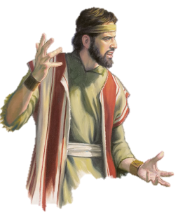
Date 944 BC
1 Kings 12:32-33 (No mention in 2 Chronicles) Apostasy 28 years later!
Jeroboam from the northern kingdom - devised of his own heart the alternate timing
for the Feast Tabernacles in the 8th month & 15th day.
There is no mention that King Jeroboam asked Yahuah about this change to the 8th month
(EVEN IF the harvest in the north was a month later). (1 Kings 12:27 - he changed the date because he did not want his people going south to the Jerusalem 7th month feast.)
In 1 Kings 13 the altar split apart according to Yahuah's sign because of
Jeroboam's outright disobedience. This prophetic sign came true immediately!
Certainly, Yahuah regarded Jeroboam’s decision as an utmost abomination!
Date 725 BC 219 years later 2 Chron 30 Hezekiah's 2nd month Passover - followed
the "allowable" instructions for a 2nd month celebration given to Moses by Yahuah - even though the circumstances were not directly related to being "unclean" (through the dead), but due to being unsanctified in time for the 1st month Passover.
No displeasure from Yahuah is recorded.
Date 623 BC 102 years later 2 Kings 23 & 2 Chron 25
In 2 Kings 22:8 Hilkiah found the Book of the Law. In 2 Kings 23:21, Josiah kept the 1st month Passover as it was written in the Book of the Covenant. Then it says in vs 24 Josiah put away all the abominations in the land according to the words of the law which were written in the BOOK that Hilkiah the priest found - that must have been the Book of the Law. This is the testimony of where they slew the Passover lambs into the night.
No displeasure from Yahuah is recorded.
56

Slide 57
What else should we take into consideration?
The stipulations for the Numbers 9 Passover is NOT an everlasting covenant command.
Remember: No laws could be added to, or removed from the Covenant words written
on the tables of stone that had come from the Book of the Covenant (Deut 4:2; 12:32).
Remember: Num 9:6 – there were certain men that were defiled by a dead body.
They were not allowed to participate in the 1st month Passover.
Therefore, they asked Moses what they were to do.
Remember Moses’ reply in Num 9:8 … “Stand still, and I will hear what Yahuah will
command concerning you.” In other words: Moses requested instruction from Yahuah
on this situation which in turn created a “new law” within the Book of the Law.
This means: there was no former stipulation given within the everlasting covenant,
or the “Book of the Law.”
Remember Yahuah’s reply in Num 9:10-11?
The people could celebrate the Passover on the 14th day of the 2nd month: (1) IF they were unclean … AND/or (2) IF they were on a long journey.
Did you notice: Moses did not ask for an exemption for being on a “long journey” – but Yahuah added it for the people anyway.
Remember: No laws could be added or removed from the everlasting Covenant laws,
but it was different for the temporary laws included in the Book of the Law.
57

Slide 58
A few more things for consideration …
Remember: the temporary laws given and recorded in the Book of the Law extended only until Yahusha uttered the words “It is finished.”
At that point (1) the Aaronic priesthood, (2) the instructions for the sanctuary and (3) all the sacrifices and oblations were ended.
Remember: In John 4:21 & 23 Yahusha answered the question of the
woman at the well when she wondered about where they were to worship.
He declared: “… the hour is coming when you shall neither on this mountain
[in Samaria], nor in Jerusalem, worship the Father … But the hour is coming, and now is, when the true worshippers shall worship the Father in spirit and truth ...”
What is the Conclusion of the Whole Matter?
58

Slide 59
And … What is the Surprise for Part D?
#1. We no longer are under the temporary laws for ritual cleansing from contact with the dead. In Yahusha we are all “clean” as “kings and priests” under His kingdom and dominion.
#2. Therefore, there is no more need
for a requirement to keep the Passover in the 2nd month if you are on a long journey. Just stop and keep the Passover wherever you are at!
Part
D
59

Slide 60




So What is the Surprise for New Proponents Today?
There is no reason to keep the 2nd month Passover – ALSO!
There is no reason to keep the 2nd month Passover – ONLY!
There is no reason to keep the 2nd month Passover – EVER!
That is … WHEN you are engaging
Covenant Calendar with Yahusha!
Since the greatest Passover of the Universe we are completely under the perfect everlasting, blood ratified Covenant Laws …
60

Slide 61



Have you heard it said ~
Covenant Calendar is
not a salvational issue
This might be a good time to rethink that position to be sure you’re on the
salvational path!
61

Slide 62
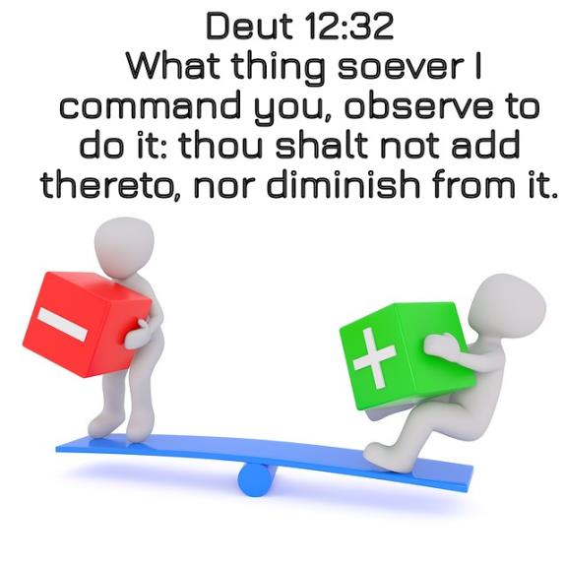
A Significant Reminder:
When we choose to serve Yahusha in everything, we also seek to be in alignment with Him in all areas, even if they seem small
and insignificant.
The End!
62

Slide 63
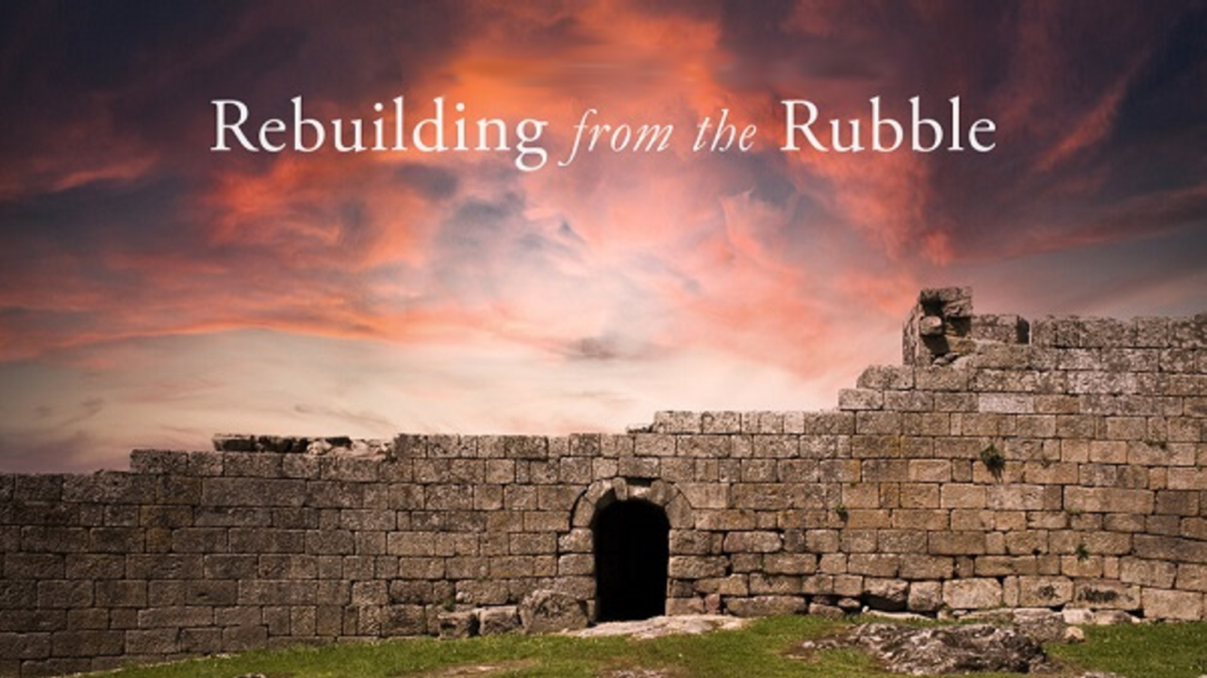

If you enjoyed this study today …
Please Join Us Live Each Week
Sign up with Covenant Calendar Club
for the Friday & Sabbath Zoom Meetings
(including live discussion)
https://studythecalendar.com/sign-up/
63

Slide 64
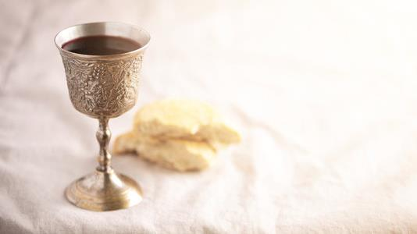
May Yahuah assist your desire to understand and also your decision to process any new information.
Send your questions and/or responses to –
questions@studythecalendar.com
Thank you & Shalom!
May Yahuah bless you greatly with wisdom,
peace and courage.
Send your questions and/or responses to –
questions@studythecalendar.com
Thank you & Shalom!
64

