Slide 1
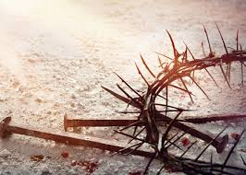


Yahusha’s
Crucifixion Year
Was it Year
CE 28? CE 30?
or
Covenant Calendar
Year 31?
The Detailed Edition!
Part 1 of 2
Notes:
4.10 July 24/21: Website: Youtube:
Blurb for Website with Questions:
With many different calendars all laying claim to a specific year of the crucifixion, which ones can ALSO claim full and complete alignment with the words of the Scripture? Better yet, which calendars can reveal total compliance and timing fulfillment with each and every text of the Passion Week?
Which of these can accomplish a step by step pathway of the Lunar Calendar Passover of the Jews, and also, the Torah based Dawn to Dawn Passover of the Covenant, and still produce meticulous alignment with the Messianic Testament (New Testament) documentation?
And if these proclaimers of the Faith can achieve a suitable CE year with the Scriptural midst of the week (Wed) crucifixion as precisely detailed in the Scriptures, can they also,
find precise alignment with the crucial 12 hour offset which pinpoints the accurate CE year of the crucifixion by
defining the two different Passovers, of the two separate calendars as specifically recorded by Matthew and John?
Which of the years from CE 26 to CE 34 cannot apply?
What makes the CE year of the crucifixion so incredibly blinding brilliant, that it cannot be mistaken?
Apr 10/21 Tim felt he needed to teach this today since Stacey is ill – Apr 10th. This is the last edit from mar 10th on the moon phases. The teaching went very good considering Tim had not
seen this since Mar 10th. The CCC panel were well pleased and saw what was going on. This needed to be taught after LWM’s bashing the last 3 weeks. Charlene.

Slide 2

Background Information
With many different calendars all laying claim to a specific year of the crucifixion, which ones can ALSO claim full and complete alignment with the words
of the Scripture?
Better yet, which calendars can reveal total compliance and timing fulfillment with each and every text of the Passion Week?
Which of these can accomplish a step by step pathway to show the Lunar Calendar’s Passover of the Jews, and also, the Torah based Dawn to Dawn Passover of the Covenant, and still produce meticulous alignment with the documentation in the Messianic Testament (New Testament)?
And if these proclaimers of the Faith can achieve a suitable CE year in alignment with the Scriptural ’midst of the week’ (Wed) crucifixion as precisely detailed in
the Scriptures, can they also:
Find precise alignment with the essential 12 hour offset which pinpoints the accurate CE year
of the crucifixion?
How? Can they define the two different Passovers, of the two separate calendars as specifically recorded by Matthew and John?
Which of the years from CE 26 to
CE 34 cannot (and will not) apply?
What makes the CE year of the crucifixion so incredibly and blinding brilliant, that it cannot be mistaken?

Slide 3
Important Information
Please note the word – cycle. You will see it consistently in these studies.
We choose to use – cycle – in the place of – “day”.
Basically: “Day” has multiple meanings; either just the Light Season, or
the 24 hour cycle of the light and the night seasons combined.
This can create GREAT CONFUSION for timing purposes.
Hence, when you see – Cycle – please be certain these studies reference a
FULL 24 HOUR PERIOD which is
DAWN TO DAWN
according to the Scriptures.

Slide 4


This is a TEACHING FROM:
Approximate dates to consider: 26-34 CE
www.studythecalendar.com

Slide 5
This “year old male” command from Yahuah,
is a prerequisite
The Mashiach must fulfill
with perfection.
The Principle!
Was Yahusha a -
Lamb of the first year
- in CE 30?
Let the lamb be a perfect one, a year old male. Exodus 12:5 (a)

Slide 6


What year was the crucifixion?
Matt 26:3 Then the chief priests, and the scribes, and the elders of the people came together at the court of the high priest, who was called Qayapha,
Matt 26:4 and plotted to seize יהושע by trickery and kill Him.
Matt 26:5 But they said,
“NOT AT THE FESTIVAL
lest there be an uproar among the people.”

Slide 7
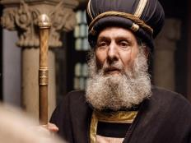

When Yahusha was still hanging on the tree -
Exactly what DATE of the month was it according to their
LUNAR CALENDAR? ???
Was the DATE still - Lunar Abib 13 – and
“NOT AT - their festival?”
Matt 26:5

Slide 8
John 19:40 Then they took the body of יהושע, and bound it in linen wrappings with the spices, as was the habit of the Yehuḏim for burial.
- 19:41 And at the place where He was impaled there was a garden, and in the garden a fresh tomb in which no one had yet been laid.
- 19:42 There, then, because of
the Preparation Day of the Yehuḏim,
they laid יהושע, because the tomb was near.
Why this particular announcement?
Had not John already announced in John 19:14 that
the Preparation started at Dawn, the sixth hour ??
(That is – the 6th hour from midnight – as in – Roman Reckoning?!)

Slide 9
What was the timeframe of John’s proclamation for the – “Preparation of the Yahudim?”
Wasn’t it AFTER THE SUNSET – in the
NIGHT SEASON of PREPARING
YAHUSHA for BURIAL?
Matt 27:57, 58;
Mark 15:42, 43;
Luke 23:53, 54;
John 19:38-42
What reason caused John to announce a 2nd Preparation [day] at
TWO SEPARATE - AND DISTANT - TIMES – (being approx. 12 hours apart,)
with the 2nd Preparation being SPECIFIED AS – “of the Yahudim?”
What is John REVEALING about their sunset event?

Slide 10


Is it possible there were
TWO CALENDAR TYPES
of the PREPARATION CYCLE occurring partially & simultaneously at
Yahusha’s Crucifixion?
John 19:38-42
Calendars under review will be:
CE 26-27-28-29; 31-32-33-34

Slide 11
The Yahudim stated clearly that they would not capture Yahusha at the Festival [or the Festival of their Passover]. Shall we give them credit that according to their lunar/SUNSET calendar, that they solidly held firm to their words?
If they did not capture Yahusha at “the” Passover Festival (according to sunset theory and the lunar calendar)
- and they completed crucifying Him in that ensuing Lunar Abib 13 Light Season,
- is it possible that John is announcing their sunset event had changed the Lunar Abib 13
to Abib 14 - at the SUNSET EVENT?
Is it possible that Abib 14, on their Lunar/Sunset Passover, was OFFSET by 12 hours from – the DAWN start of Yahuah’s Covenant Calendar?

Slide 12

CE 26
CE 27
CE 28
CE 29
Shaneh
WHICH YEAR will ESTABLISH the EXCEPTIONAL 12 HOUR OFFSET?
CE 30
CE 31
CE 32
CE 33
CE 34
Four different scenario’s will be examined for all calendar years searching for this 12 hour offset!

Slide 13

This study is going to compare several different calendars for placement of Abib 14 using:
Covenant Calendar
Lunar based (before & after) Tequfah [equiNOX] dates
Lunar & Enoch based calendars (before & after) equiLUX dates
The comparisons will always follow the same order.
Important Note: The New Year
always begins the day after the
Tequfah even though some teach the New Year begins ON the day
of Tequfah. These comparisons will also be noted to insure every option has been considered to eliminate “being off” a one day count.

Slide 14

Deut 31:18 But I will surely hide my face in that day, because of all the euill [evil], which they shall commit, in that they are turned vnto other gods.
Deut 31:19 Now therefore write ye this song for you, and teach it the children of Israel: put it in their mouthes, that this song may be my witnesse against the children of Israel.
Deut 31:20 For I will bring them into the land (which I sware vnto their fathers) that floweth with milke and honie, and they shall eate, and fil them selues, and waxe fat: THEN SHALL
THEY TURNE VNTO OTHER GODS, AND SERUE
THEM, & contemne [scorn] me, & breake my couenant.
Geneva 1587

Slide 15

AND SERVE THEM
Could this include the Hebrew nations various calendar allegiances?
What about US - TODAY?

Slide 16

There is an on going question among many calendar teachers –
which year was it when Yahusha died?
Combining the Scriptural foundation of Covenant Calendar,
with the astronomical charts and historical calendar records,
has provided an accurate reckoning to pinpoint the
EXACT YEAR of the Crucifixion.
The very fact that the Covenant Calendar dating of Abib 14 and the Lunar System of dating Abib 14, was offset by 12 hours from each other is a monumental pillar in this determination!

Slide 17
1st Step!
Determining and Understanding an extremely important
Principle!

Slide 18

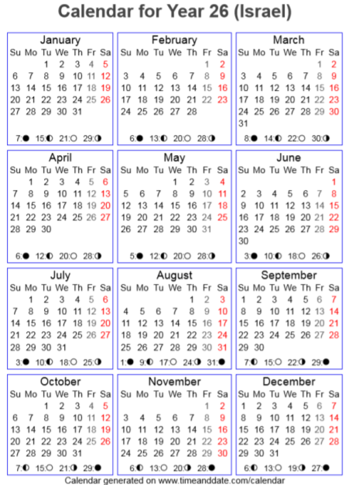
On the next slide, note the listed times of the Tequfah for CE 26. They are near midnight.
What effect does this factor have?

Slide 19
The Tequfah dates are recorded
on Roman Reckoning.
Midnight changes the date on man’s calendars.
Yahuah’s date exchange occurs at the first light of Dawn!
Gen 19:14 – 23/ 32:23 – 31.
Let’s look at the profound effect this difference has. The outcome may be insignificant in CE 26!
However the result
FURTHER ON IN THIS STUDY is MONUMENTAL!

Slide 20


CE 26 – Chart #1
Remember this timing principle!
UTC
Tequfah
The Tequfah timing is registered with GMT – Greenwich Mean Time / Coordinated Universal Time (Standard Time).
This means the time frame must be adjusted to Yisra’el, Jerusalem time. To do this adjustment, 2 hours must be added.
Therefore the time of the Tequfah was 1:23 AM! This means
Rome’s MIDNIGHT MARKER had passed by and consequently the Gregorian DATE in Jerusalem time, changes to Mar 23!
Q – Did Yahuah’s Covenant Calendar date change with it?

Slide 21
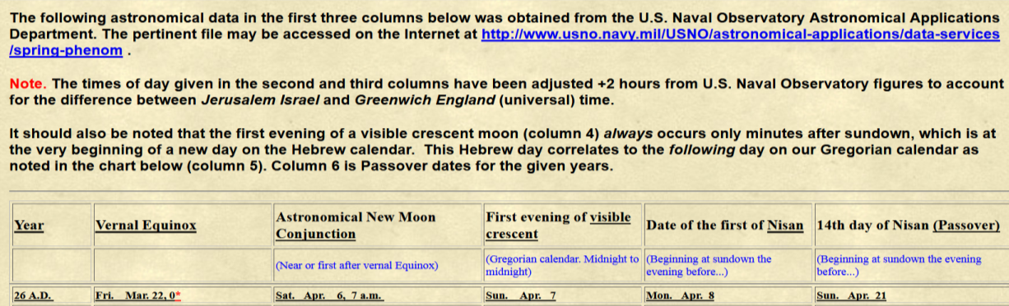
CE 26 – Chart #2
Observation notes for
Chart #2 Year 26
The asterisk denotes Midnight.
Has this time been loosely rounded off?

Slide 22
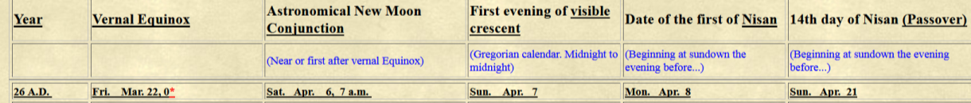

CE 26 – Chart #2 cont.
Tequfah
The US Naval authority declares this has already been adjusted for Jerusalem time!
Yet there is a 1.5 hour difference from chart #1!
Which chart will provide dependable evidence?

Slide 23
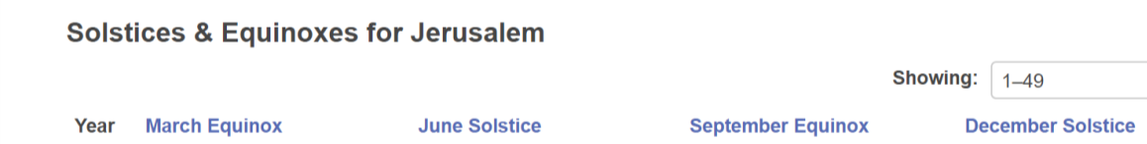

CE 26 – Chart #3
Tequfah
Local Mean Time @ Jerusalem
The Tequfah timing is registered with LMT – Local Mean Time – already adjusted to Jerusalem time. The Roman midnight marker has been passed and consequently the Gregorian date –
in Jerusalem time, is recorded as - Mar 23!
It is MUCH LATER than the last two charts!!! ???
Does Yahuah’s Covenant Calendar agree with changing the date at midnight?
Remember Roman Reckoning as recorded in the Scriptures?
See Matthew 27:19/ John 19:14/ 20:1.

Slide 24
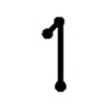

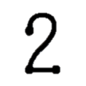
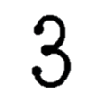
According to Genesis 1 {Dawn to Dawn} this Tequfah date is -
Tequfah
Tequfah
Tequfah
Local Mean Time @ Jerusalem
- still Mar 22 (Gregorian) !

Slide 25

No, the midnight mark has no bearing on
Yahuah’s Timeclock.
The question then is:
Will there be a SIGNIFICANT FACTOR effecting the year of CE 34?
AND WHAT ABOUT
CE 30?
(CE 30 will be seen in part #2!)

Slide 26

Step #2
Implementing Yahuah’s Dawn to Dawn midnight marker
“Pass-over Principle”! ☺
And - searching for the 4th cycle Crucifixion -
COMBINED WITH the Scriptural
12 HOUR OFFSET
Festival of the Jews!

Slide 27
First to be considered is the Lunar Abib 14
dating as placed on the Gregorian calendar.
Second, is to look for the Scriptural 12 hour offset
as a result of their sunset day start.
Third, to seek for the Lunar Abib 14 date to be
one Gregorian cycle following the …
Covenant Calendar Abib 14 Passover
on the 4th cycle.
Remember: The Gregorian date will, according to the Talmud, start with the previous sunset!

Slide 28
According to historic documentation by Julian Morgenstern declaring that the Jews used the crescent moon before the Tequfah, we will look for their lunar based Passover pattern.
Please note that this rule was not written in stone but fluctuated according to their desired yearly calendar results!
Again: What is the baseline purpose of this exercise?
To align the Scripture of John 19:42 (& Matt 26:5), where John records that on the very cycle of Abib 14 CC, after the sun had set, when Yahusha was being buried, it was ALSO –
“… the Preparation of the Yehudim, they laid Yahusha, because the tomb was near.” John 19:42 b
This 12 hour offset timing factor must be realized
in determining the correct year of the crucifixion.

Slide 29
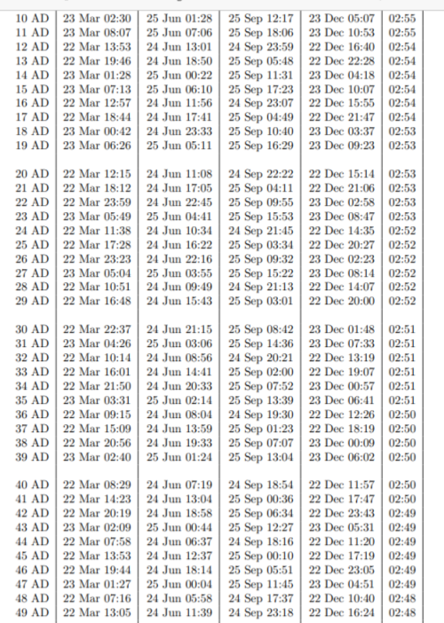

What is UT? According to Time and Date.com UT is -
As a time standard reflecting the mean solar time at the prime meridian in Greenwich, UK, UT1 is a successor of the original version of Greenwich Mean Time (GMT). Before UTC was introduced as the world time standard in 1972, GMT was a solar time standard that also acted as a reference point to determine local times worldwide. Today, GMT is a common time zone deriving its local time from UTC.
This is the main chart we will
use in this research!

Slide 30
First up, CE 26!
Let’s begin! ☺
Does Yahuah’s Dawn to Dawn Covenant effect the Tequfah Timing?

Slide 31
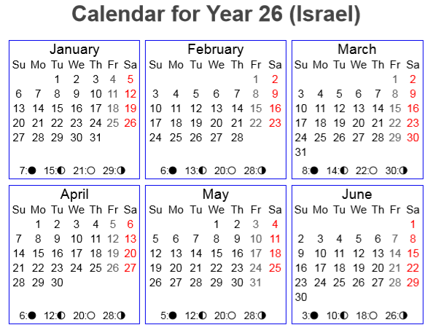
Note: “C.C.” = Covenant Calendar
C.C. - Looking for Yahusha’s Crucifixion
on a 4th Cycle!
CC Abib 14 Passover
Tequfah
UT
14th on a 6th Cycle! ?
Mar 23 1:23 AM Yisra’el Time
Adjusted to Israel Time – 1:23 AM Mar 23! However Yahuah does not recognize the Roman midnight changeover!
Tequfah remains on Mar 22!
Passover 6th Cycle

Slide 32


Note: “C.C.” = Covenant Calendar
C.C. - Yahusha’s Dawn to Dawn retains Mar 22!
CC Abib 14 Passover
Tequfah
UT
Is the cycle of the Tequfah sign the first cycle of the year – the NEW YEAR day?
14th on a 6th Cycle!?
Passover – on a Preparation/6th Cycle in CE 26
Note: If the Mar 22 Tequfah was the NEW YEAR day, then CC Abib14 would have been on “April 4th - a 5th cycle!”
CE 26 cannot support a 4th cycle crucifixion!

Slide 33

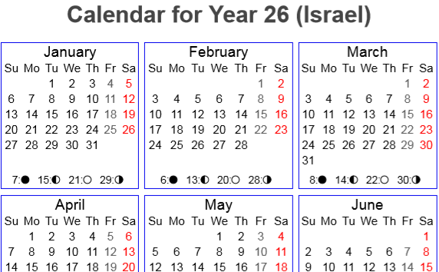
The Lunar View
The Lunar Based Passover
of CE 26 would have been the
1st cycle of the week,
on the 24th of March (Gregorian.)
CE 26 -there is NO possibility of finding a compatible 12 hour offset with the Covenant Calendar as written in John 19:42 & Matt 26:5.
Sliver Moon
Conjunction
New Moonth day!
Tequfah
UT
Mar 23 1:23 AM Yisra’el Time
From New Moonth day, there are 26 cycles to the Abib 14 the 6th cycle – CC !
CC Pesach
The next sliver moon (Apr 8) would be AFTER C.C. Passover making that Lunar Passover calculation MUCH later!

Slide 34
Some well known “lunar calendar” ministries declare an
EQUI-LUX & Sliver reckoning IS TO BE USED for year start rather than the
EQUI-NOX (Tequfah) of the Scriptures!
Do note that if the sliver moon appears ON the date of EQUI-LUX that moon is considered a valid sliver moon – and also
the NEXT day is the new LUX day.
It’s time now to consider
if there are any possibilities around the equiLUX timing for “moon” and
“non moon” calendars
[eg: Lunar
& Enoch].
And …
Some Enoch calendar followers use the day after the Equilux as the 1st cycle of the year. Evidence sample seen on next slide.

Slide 35
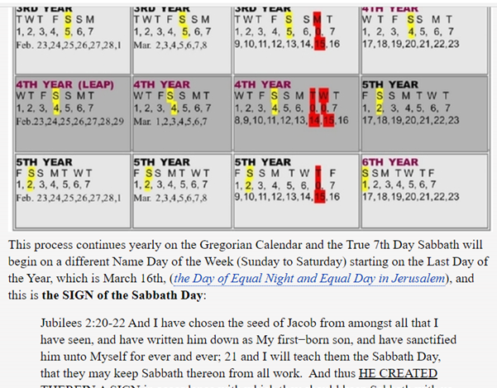
Enoch Calendar - ENOCH CALENDAR - The Book of Enoch Reveals The Enoch Calendar (webs.com).
“Enoch” is acclaimed to follow the Equilux! Note the equal light and equal night statement, meaning - from sunrise to sunset. One problem that belies here is the removal of the twilight seasons from the Light Season as Covenanted by Yahuah in Genesis 1.
Jer 33:20

Slide 36
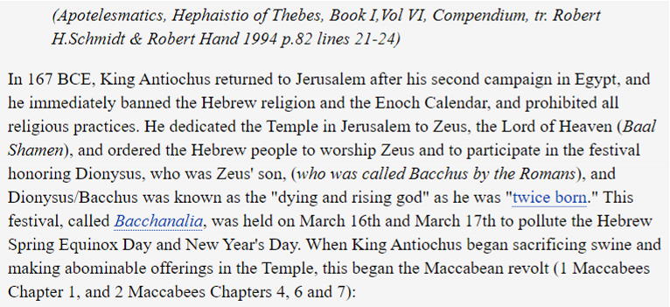
Let’s view an Enoch Calendar promo slide.
Not all Enoch followers go by the Equilux, but some do! Please note the direct link to paganism.
Evidence needed to accept this!
*
*
The Equilux chart slide is coming soon !

Slide 37
*
Yahuah’s Tequfah (Equinox) – March 19 – 22 Gregorian!
Jas 1:17 Euery good giuing, and euery perfect gift is from aboue, and commeth downe from the Father of lights, with whome is no variablenes, neither shadow of turning. Bishops 1568
Please note that Ya’aqov (James) is referencing the Tequfah.
March 16/17 is most certainly not the Tequfah!
Mar 16/17 is the time of the EquiLUX
(meaning - from light {sunrise} to night {sunset})!
There is a massive difference! HUGE!
Big Problem:
On Mar 16/17 there will still be a CURVED SHADOW LINE!

Slide 38



An Equilux SHADOW? ???
*
Jas 1:17 b … the Father of lights, with whome is no variablenes,
NEITHER SHADOW OF TURNING. Bishops 1568
Question: Where is this SHADOW to be
measured in the “Equilux equation?”
In proceeding, we will be documenting the Equilux DATE in Jerusalem as starting at sunset March 16th and ending
at sunset on the 17th of March.
All following Equilux slides will be formatted in this respect.
The Enoch info is greatly mistaken on the Tequfah event!

Slide 39
A Qualification problem with the - Equilux.
One insurmountable problem with the Equilux is that the
twilight mixings are NOT considered part of the Light Season
as written in Genesis.
Man rejects Yahuah’s decision to place the Ereb {evening}
and Arbayim/Boqer {twilights} as Light;
instead, man relegates both twilights to the Night Season!
This glaring factor alone eliminates the Equilux
from being a Scriptural doctrine.
However, let’s prove the Equilux waters anyhow.
*

Slide 40

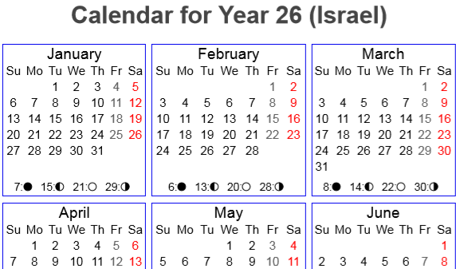
Enoch’s Jerusalem EQUILUX View
Equilux Abib 14 is on a 1st Cycle
of the Week.
Problem: Passover a wrong cycle, and it is far too early to secure Scripture’s 12 hour offset with either the Covenant Calendar or the lunar calendar of the Jews!!
A Double EQUILUX FAILURE!
New
Lux-Month day!
Equilux
Tequfah
UT
Mar 23 1:23 AM Yisra’el Time
CC Pesach
Remember: Enoch does not use a moon to begin the month.

Slide 41
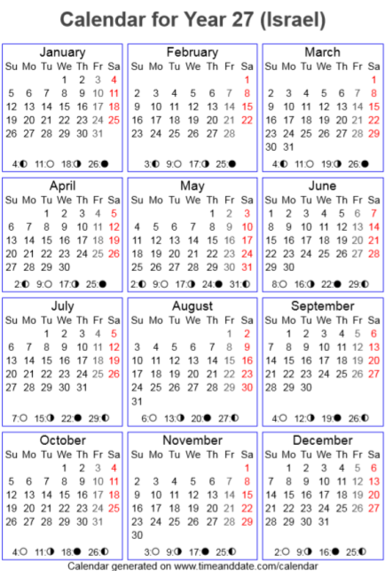
Next up, CE 27! same exercise! ☺
2nd Slide – looking for the lunar Passover. ☺

Slide 42
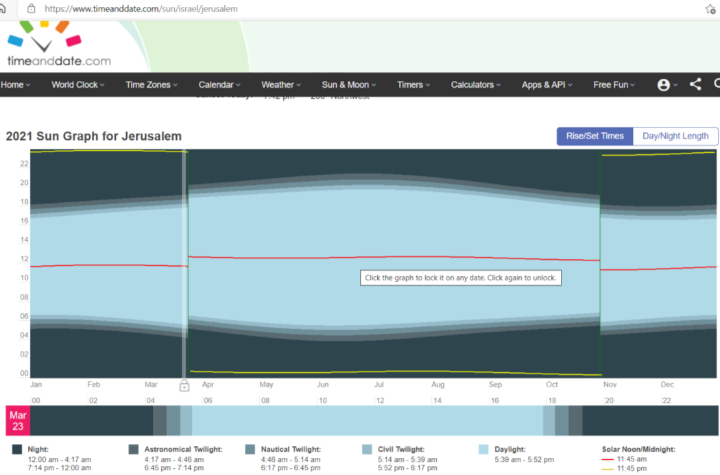
Important info for the next slide!
Look in the red box to note the
timing of Dawn on March 23!
This line slides providing indication of exact timing of the physical aspects of the 24 hour cycle. At this point we see the exact time of the Astronomical Twilight in Yerushalayim.
This gives us the precise timing of Dawn and the cycle of the month
according to Yahuah!
Astronomical Twilight at boqer Mar 23rd:
4:17 AM
42

Slide 43
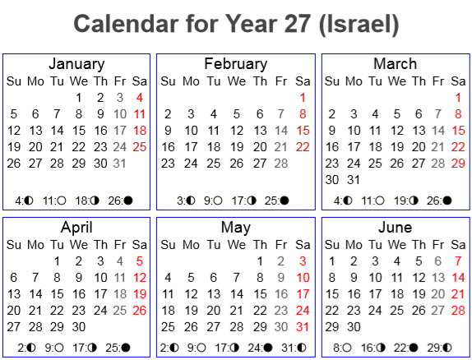

C.C. - Looking for Yahusha’s Crucifixion
on a 4th Cycle!
C.C. Abib 14 Passover
Tequfah
UT
Yerushalayim Adj. 7:04 AM
ATTENTION! Since the Tequfah is recorded past the point of Dawn, according to the Torah, and the Gregorian, the Tequfah remains on March 23! Covenant Calendar Passover was on a 1st cycle of the week!
Genesis 1 – Dawn to Dawn! ☺
14th on a 1st Cycle! !

Slide 44

Tequfah Sign, as the NEW YEAR day? ???
Dawn to Dawn has authority over the Gregorian!
C.C. Abib 14 Passover
Tequfah
UT
Adj. 7:04 AM
If the Mar 23 Tequfah was the NEW YEAR day, then CC Abib 14 would have been on “April 5th - a 7th cycle!” In CE 27, there is no 4th cycle Passover, nor any chance of a 12 hour offset to reflect the Scriptural account!
14th on a 1st Cycle! ?

Slide 45
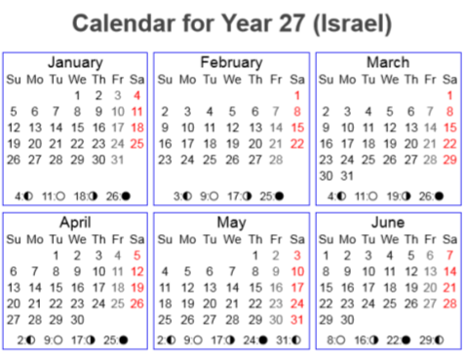
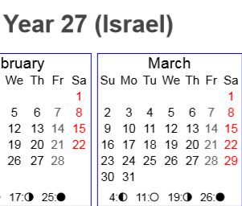

The Lunar View
C.C. Abib 14 Passover
Sliver Moon
New Moonth day!
From New Moonth day, there are 14 cycles to the 11th, the 6th cycle!
Conjunction
CE 27: The Lunar Passover would have been, in Gregorian terms, on the 11th of April,
a 6th cycle of the week.
Again; no possibility of finding a compatible
12 hour offset with the
Covenant Calendar.
Sliver Moon
Tequfah

Slide 46
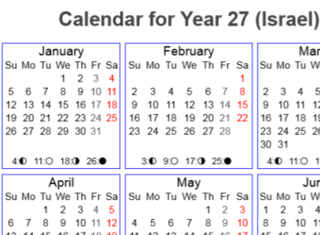
Enoch’s Jerusalem EQUILUX View
C.C. Abib 14 Passover
Dawn adjusted Tequfah
Equilux
New
Lux-Month day!
Enoch Equilux Abib 14 is on a
2nd Cycle of the Week.
Problems are: Not a 4th cycle, and it is far too early to secure Scripture’s 12 hour offset with either the Covenant Calendar or the lunar calendar of the Jews!!
A Double EQUILUX FAILURE!

Slide 47
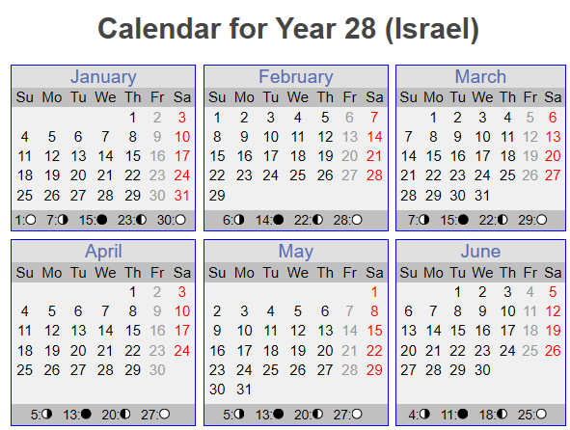

Next up, CE 28! same exercise! ☺

Slide 48
In the last few years there has been an
explosion of calendars that all claim to
be the correct Festal Calendar of Yahuah.
Most of these calendars over the last 60-70+
years used the moon that FOLLOWS the equi-NOX.
However, with this explosion of calendars, many are now saying the “equi-NOX” is pagan – right from the belly of Rome. Therefore a new calculation has been devised
for their Festal calendars to use the moon “on” or “following” the Mar 17th “equi-LUX.”
Have you heard of this before?
48

Slide 49

This tends to create an interesting problem at the present time for ministries that claim
Apr 28th in CE 28 is the year of the crucifixion.
This Apr 28th calculation is based on the moon following the “equi-NOX” even though their current calculation for the Festal calendar uses the moon following the “equi-LUX” – usually about Mar 17th. This is a huge conflict!
Let us obligate ourselves to check out “what in the world is going on” with the idea that the year/end can be around either the “equi-NOX” or the “equi-LUX.”
Let it be known: the year-start can follow only ONE
or the OTHER, but never BOTH, AND do remember: YAHUAH DOES NOT CHANGE!

Slide 50

C.C. Looking for Yahusha’s Crucifixion
on a 4th Cycle!
C.C. Abib 14 Passover
Tequfah
UT
12:51 PM Yisra’el Time
Note: CE 28,
CC Abib 14 –
on a 2nd cycle of the week!
14th on a 2nd Cycle!?
No 4th cycle crucifixion here!

Slide 51

Tequfah Sign, as the NEW YEAR day? ???
Still searching for Yahusha’s Crucifixion
on a 4th Cycle!
C.C. Abib 14 Passover
Tequfah
UT
12:51 PM Yisra’el Time
14th on a 2nd Cycle!?
Note: If the Mar 22 Tequfah was the NEW YEAR day, then CC
Abib 14 would have been on “April 4th, a 1st cycle!!” That means –
CE 28 - no possibility of a Midst of the Week Crucifixion &
NO POSSIBILITY OF A 4th CYCLE 12 HOUR OFFSET WITH THE YAHUDIM!

Slide 52
CC Abib 14 Passover
The Lunar Sliver View BEFORE the Tequfah
New Moonth day!
Conjunction
Sliver Moon
From New Moonth day, there are 14 cycles to the 31st,
a LUNAR 4th cycle Passover!
Tequfah
This exposes ANOTHER COMPLETE LUNAR FAILURE with no alignment of a
12 hour offset between the two calendars - as documented in Matt 26:5 and also as written even clearer in John 19:42!

Slide 53
Please notice the late dating on the chart (below) that is provided for our research purposes concerning CE 28. Because of this late factor, we will be viewing this late dating and also we will look closely at the
equi-LUX factor immediately after.
Note the lateness of the chart information! (Apr 13 – LONG AFTER the Tequfah.)

Slide 54
CE 28 is a very popular year for the crucifixion – with a very late date.
CC Abib 14 Passover
The Lunar Sliver View AFTER the Tequfah.
The Late Factor.
Tequfah
This sliver moon follows the conjunction, not
as the normal 2
days later!
12 hour offset??
Sliver Moon
New Moonth day!
Conjunction
From New Moonth day, there are 14 cycles to the 28th,
the LUNAR 4th cycle Passover!

Slide 55


Next up –
CE 28 –
looking for
Abib 14 - according to -
Equi-lux!

Slide 56
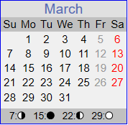

Enoch’s Jerusalem EQUILUX View
CC Abib 14 Passover
New
Lux-Month day!
Equilux
Tequfah
Equilux Abib 14 is on a
4th Cycle of the Week.
Problem: It is far too early to secure Scripture’s 12 hour offset with the Covenant Calendar!!
ANOTHER EQUILUX FAILURE!
An Equilux based Abib 14, 4th cycle Passover.
(This is identical to the sliver moon before the Tequfah reckoning,
in this year.)

Slide 57
CE 28 Summary – CC Passover – 2nd Cycle.
#1 Lunar Conjunction BEFORE Tequfah – Covenant Calendar Passover the 2nd Cycle, and the Lunar Passover were about
4-5 cycles apart depending on the count!
#2 Lunar Conjunction AFTER Tequfah – Passover 4th Cycle.
The Covenant Calendar Passover and the Lunar Passover
were 23-24 cycles apart depending on how one counts!
CE 28: in considering FOUR different Passover timing scenarios,
it is once again, IMPOSSIBLE to reckon them with the
Scriptural 12 hour offset as written in John 19:42 & Matt 26:5!

Slide 58

CE 28 is a very popular year for the crucifixion according to lunar calendars.
Notice that both lunar calculations show
a 4th cycle Abib 14/Passover (Mar 31st & Apr 28th)!
Yet still, even with the two 4th cycle calculations,
CE 28 cannot find alignment with the
Scripture documentation!
The Equilux option added NOTHING,
BUT ALSO FAILED MISERABLY.

Slide 59
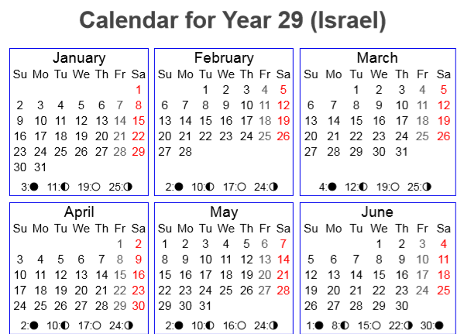
Next up, CE 29! same exercise! ☺
The following slides – looking for the lunar Passover …
… and UTLIMATELY, the 12 hour Festal offset for Scripture alignment! ☺

Slide 60

Tequfah Sign, as the NEW YEAR day? ???
CC Looking for Yahusha’s Crucifixion
on a 4th Cycle!
CC Abib 14 Passover
Tequfah
UT
6:48 PM Yisra’el Time
14th on a 3rd Cycle!?
Note: If the Mar 22 Tequfah was the NEW YEAR day, the CC Abib 14 would have been on
“April 4th - a - 2nd cycle!”
Again, no midst of the week crucifixion this year!

Slide 61
A Lunar View
Conjunction
Sliver Moon
From New Moonth day, there are 14 cycles to the 20th; the lunar Passover on the 1st cycle!
New Moonth day!
Look! The lunar Passover would have been before the Tequfah event, and LONG before Abib 14 of the Covenant Calendar!
What would happen if the next crescent moon was chosen AFTER the Tequfah? Let’s try it!
Tequfah

Slide 62
A Lunar View
Conjunction
Sliver Moon
From New Moonth day, there are 14 cycles to the 20th; the lunar Passover on the 1st cycle!
New Moonth day!
Look! The lunar Passover would have been before the Tequfah event, and LONG before Abib 14 of the Covenant Calendar!
What would happen if the next crescent moon was chosen AFTER the Tequfah? Let’s try it!
Tequfah

Slide 63
The 2nd Lunar View
Problem! A Lunar Passover on the
18th [a 2nd cycle], is LONG AFTER the Covenant Calendar Pesach.
It was on Apr 5th, the 3rd cycle in
the 1st week of the same
Gregorian month!
Again! No
4th cycle mark, and - no possibility of aligning the 12 hour Festal offset as spoken into by John 19:42, & Matt 26:5.
Tequfah
Conjunction
Sliver Moon
New Moonth day!
From New Moonth day, there are 14 cycles to the 18th, the 2nd cycle!
63

Slide 64
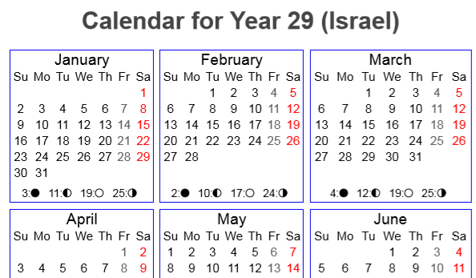
Enoch’s Jerusalem EQUILUX View
Equilux
Enoch Equilux Abib 14 is on the
5th Cycle of the Week.
Problems are: It is far too early to secure Scripture’s 12 hour offset with the Covenant Calendar.
And it is certainly not possible with the Lunar calendar of the Jews either!
A Double - EQUILUX FAILURE!
New
Lux-Month day!
Tequfah
CC Abib 14 Passover
64

Slide 65

CE 30!
same exercise? ☺
Let’s look at
CE 31 – 34 first!
Same Results?

Slide 66
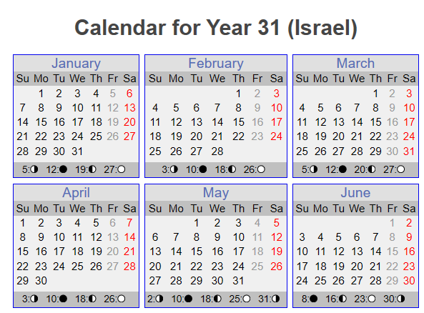
Next up,
CE 31! same exercise! ☺
Will these years from 31
to 34 reveal alignment?
What about the 12 hour Festal offset?

Slide 67

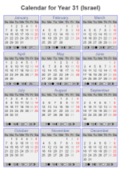
Tequfah Sign, as the NEW YEAR day? ???
Still searching for Yahusha’s Crucifixion on a 4th Cycle!
CC Abib 14 Passover
Tequfah
UT
14th on a 6th Cycle!
6:26 AM Yisra’el Time
Note: If the Mar 23 Tequfah was the NEW YEAR day, the CC Abib 14 would have been on
“April 5th - a 5th cycle!” Again, no chance of finding Yahusha’s midst of the week crucifixion.
But we will continue with the lunar search!

Slide 68
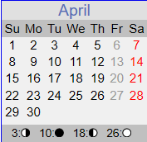
The 1st Lunar View
14th on a 6th Cycle!
See how close the Lunar Passover was
to the Tequfah,
only 5 cycles away!
CC Passover was still
9 more cycles in the future! There is certainly no possibility of the
12 hour Festal offset
as documented by
John 19:42 & Matt 26:5 in CE 31!
Sliver Moon
CC Abib 14 Passover
Conjunction
New Moonth day!
Tequfah
UT
6:26 AM Yisra’el Time
From New Moonth day, there are 14 cycles to the 28th, the lunar Passover on a 4th cycle – THAT STARTS AT SUNSET of the 3rd cycle, the evening BEFORE!
Next

Slide 69
A 2nd Lunar View - After Equinox
14th on a 6th Cycle!
Using the Lunar Passover after the Tequfah,
moves the Lunar Passover almost 3 weeks later!
There is absolutely no possibility of the
12 hour Festal offset as documented by
John 19:42 & Matt 26:5 in CE 31!
CC Abib 14 Passover
Tequfah
UT
Conjunction
Sliver Moon
6:26 AM Yisra’el Time
Recall: CC Pesach was on a 6th cycle!
New Moonth day!
From New Moonth day, there are 14 cycles to the 26th,
the lunar Passover on a 5th cycle – THAT STARTS AT SUNSET
of the 4th cycle, the evening BEFORE!
Next

Slide 70
Enoch’s Jerusalem EQUILUX View
Equilux
New
Lux-Month day!
CC Abib 14 Passover
6:26 AM Yisra’el Time
Tequfah
Lunar Abib 14
Enoch Equilux Abib 14 is on the 7th Cycle of the Week.
Problems are: It is far too early to secure
Scripture’s 12 hour offset with the Covenant Calendar.
14th on a 6th Cycle!
Next
And it is certainly not possible with the
Lunar calendar of the Jews either!
Another - Double - EQUILUX FAILURE!

Slide 71
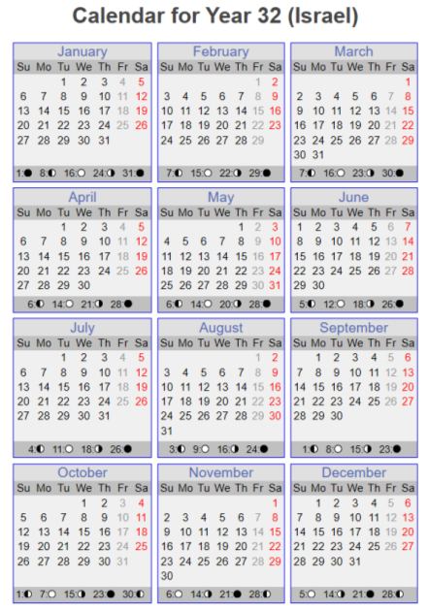
Next up,
CE 32!

Slide 72
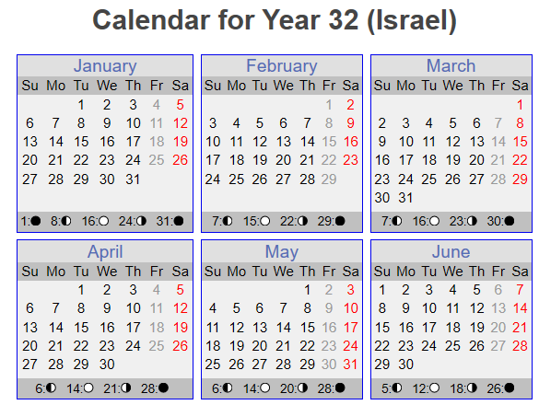

Tequfah Sign, as the NEW YEAR day? ???
What cycle was
CC Abib 14 in CE 32?
CC Abib 14 Passover
Tequfah
UT
12:14 PM Yisra’el Time
14th on a 7th day Shabbat!
Note: If the Mar 22 Tequfah was the NEW YEAR day, the CC Abib 14 would have been on “April 4th - a 6th cycle!” Again, no chance of finding a midst of the week crucifixion!
72

Slide 73

Lunar View #1
Please note that if the sliver was on Mar 2, (from the Feb 29th conjunction and the only sliver before Tequfah), the lunar
Abib 14 would be on Mar 16th,
5 cycles, BEFORE the Tequfah!
First note the Feb 29th conjunction & the count to Mar 16th Abib 14.
Tequfah
Conjunction
Sliver Moon
New Moonth day!
Next note the March sliver on the day after the conjunction. It does not follow the usual pattern.
CC Pesach
There is certainly
no possibility of fulfilling
the 12 hour Festal offset mentioned in John 19:42
& Matt 26:5 in - CE 32!
CC Passover was
9 cycles earlier!
From New Moonth day,
there are 14 cycles to the
Lunar Abib 14th, the 2nd cycle!

Slide 74

Chart For Lunar View #2
Once again – not even a remote opportunity for a
12 hour Festal offset as spoken into by
John 19:42 &
Matt 26:5 in - CE 32!
CC Passover was
9 cycles earlier!
Another Lunar FAILURE.
Conjunction as per naval chart, note double asterisks!
Tequfah
Sliver Moon as per chart!
New Moonth day!
CC Pesach
From New Moonth day,
there are 14 cycles to the
Lunar Abib 14th, the 2nd cycle!

Slide 75
Spotting on the 2nd Evening - Lunar Sliver View #3
When the 2nd evening sliver option is considered, the Lunar Abib 14 lands upon a 3rd cycle! That is 10 cycles following the
CC PASSOVER!
Sorry!
No Scriptural 12 hour offset here!
Conjunction as per naval chart, note double asterisks!
Tequfah
Sliver Moon
second evening!!
New Moonth day!
CC Pesach
From New Moonth day,
there are 14 cycles to the
Lunar Abib 14th, the 3rd cycle!

Slide 76
Enoch’s Jerusalem EQUILUX View
New
Lux-Month day!
Tequfah
Equilux
Enoch Equilux Abib 14 is on the
2nd Cycle of the Week.
Problems are: It is far too early to secure Scripture’s 12 hour offset with the Covenant Calendar.
And it is certainly not possible with the Lunar calendar of the Jews either!
Another - Double - EQUILUX FAILURE!
CC Pesach

Slide 77
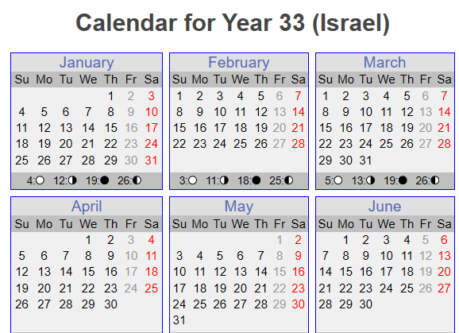

Next up, CE 33! same exercise! ☺
Please don’t get weary yet. We’re almost done!

Slide 78

Tequfah Sign, as the NEW YEAR day? ???
US Naval Chart
What about CE 33?
Tequfah
CC Abib 14 Passover
UT
6:01 PM Yisra’el Time
Note: If the Mar 22 Tequfah was the
NEW YEAR day, the CC Abib 14 would have been on “April 4th - a 7th day Shabbat!”
CE 33 - no chance of finding a
midst of the week crucifixion!
14th on a 1st Cycle?

Slide 79

A Lunar View
CE 33 – the lunar dating will not support a 4th cycle Festival connection.
Daniel 9:27 -
“Midst of the Week” prophecy could not be fulfilled here! Also, neither Matthew 27:5 nor John 19:42 find alignment here!
Sliver Moon
Conjunction
New Moonth day!
Tequfah
CC Pesach
From New Moonth day,
there are 14 cycles to the
Lunar Abib 14th, the 7th cycle!

Slide 80
Enoch’s Jerusalem EQUILUX View
New
Lux-Month day!
Equilux
Tequfah
Equilux Abib 14 is on the
3rd Cycle of the Week.
Problems are: It is far too early to secure Scripture’s 12 hour offset with the Covenant Calendar.
Neither is the Equilux option capable of producing the Scriptures 12 hour offset
with the Jews Lunar Passover!
Another - Double –
EQUILUX FAILURE!
CC Pesach

Slide 81


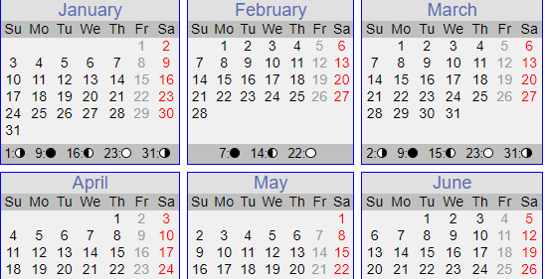
Next up, CE 34! same exercise! ☺
In Part #1, this is the last year we are going to examine. In part #2 we investigate CE 30!

Slide 82

UT
CC Abib 14 Passover
Tequfah
CC Abib 14 is on a 2nd Cycle of the Week.
No Midst of the week for Crucifixion here!
11:50 PM Yisra’el Time
IF the Mar 22 Tequfah was the NEW YEAR day, then CC Abib 14 would have been on “April 4th - a 1st cycle!”
No improvement here!

Slide 83
The 1st Lunar View
New Moonth day!
Conjunction
Sliver Moon
CC Abib 14 Passover
Tequfah
Lunar Abib 14 is on a
5th Cycle of the Week. It would start on the 4th cycle at sunset!
Problem is - way too early to be close to the 12 hour offset!

Slide 84
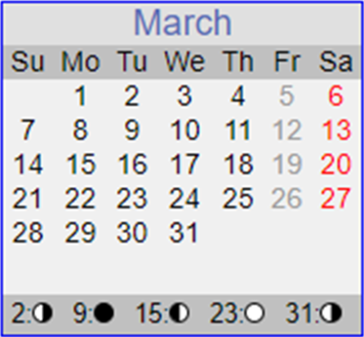
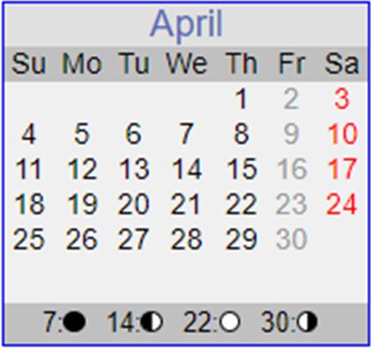
The 2nd Lunar View AFTER Equinox
CC Abib 14 Passover
Conjunction
Sliver Moon
Tequfah
New Moonth day!
Shall we look at the Equilux?
Lunar Abib 14 is on a 6th Cycle of the Week.
It would start on the 5th cycle at sunset!
Problem: - WAY TOO LATE to align with a 12 hour offset!

Slide 85
Enoch’s Jerusalem Equilux View
New
Lux-Month day!
CC Abib 14 Passover
Equilux
Tequfah
Enoch Equilux Abib 14 is on a 4th Cycle of the Week. ☺ Problems are: it is way too early to find a CC 12 hour offset, and no 12 hour synch possible with the lunar system either!
Double EQUILUX FAILURE - AGAIN!
Notes:
Not finished from Mar 10th, but Tim wanted to give this on Apr 10th since Stacey could not do her PPT – in the hospital.
Haven’t finished checking the moon cycles yet, but let it go and see what happens.
Slide 128 will be ok right now.

Slide 86
#1 Word Summary for Part 1 (8 Calendar Years)
Covenant Calendar Summary
Covenant Calendar marks Passover 14 from the day following the tequfah of – six times on Mar 22nd; two times on Mar 23rd – placing Passover on either Apr 4th or 5th each year. Does this not sound like an appointed time for the moedim?
Not ONE Passover in the 8 Calendar Years falls on [Wed] “midst of the week” – therefore, not one of these years qualifies for Yahusha’s final Passover!

Slide 87
#2 Word Summary for Part 1 (8 Calendar Years)
Lunar Passover Calculation Before and AFTER Tequfah
Before Tequfah: There is a great spread of New Moonth Day dates
from Mar 7th to Mar 22nd. Passovers range from Mar 20th to Apr 5th.
CE 31 is one year that has a [Wed] “midst of the week” Passover – and interestingly enough most Feast
camps teaching a Friday cross,
use CE 31 as the year of Yahusha’s Passover, when indeed there is no way to find a Lunar Friday Passover in CE 31!
AFTER Tequfah: There is another great spread of New Moonth Day dates from March 23rd to
Apr 13th with Passovers ranging from Apr 11th to Apr 28th.
Interestingly enough, there is one Wednesday Passover in CE 28, a very popular year.

Slide 88
#3 Word Summary for Part 1 (8 Calendar Years)
Equilux Passover Calculations
Equi-lux is always on Mar 17th, and Passover is always on Mar 31st.
Years CE 28 & 34 both had a Wed. Passover.
While the Equi-lux calculation has the attributes of the same yearly appointed times for the moedim, none of the calculations can satisfy the “12 hour offset” found in the Gospel Account.
Out of every calculation
for these three additional popular feast calendars, NOT ONE YEAR COULD PRODUCE THE “12 HOUR OFFSET” as documented between John 19:42 and Matt 26:15.

Slide 89
Table Summary for Part 1 (8 Calendar Years)
Covenant Calculation
CE 26: Tequfah Mar 22 FRI Passover Apr 5
CE 27: Tequfah Mar 23 SUN Passover Apr 6
CE 28: Tequfah Mar 22 MON Passover Apr 5
CE 29: Tequfah Mar 22 TUE Passover Apr 5
CE 31: Tequfah Mar 23 FRI Passover Apr 6
CE 32: Tequfah Mar 22 SAB Passover Apr 5
CE 33: Tequfah Mar 22 SUN Passover Apr 5
CE 34: Tequfah Mar 22 MON Passover Apr 5
Lunar Calculation: Before
CE 26: New Moonth Day Mar 11 SUN Passover Mar 24
CE 27: Homework!
CE 28: New Moonth Day Mar 18 WED Passover Mar 31
CE 29: New Moonth Day Mar 7 SUN Passover Mar 20
CE 31: New Moonth Day Mar 15 WED Passover Mar 28
CE 32: New Moonth Day Mar 3 SUN Passover Mar 16
CE 33: New Moonth Day Mar 22 SAB Passover Apr 4
CE 34: New Moonth Day Mar 12 THU Passover Mar 25
Lunar Calculation: After
CE 26: Homework!
CE 27: New Moonth Day Mar 29 FRI Passover Apr 11
CE 28: New Moonth Day Apr 15 WED Passover Apr 28
CE 29: New Moonth Day APR 5 MON Passover Apr 18
CE 31: New Moonth Day Apr 13 THU Passover Apr 26
CE 32: New Moonth Day Apr 1 MON Passover Apr 14
CE 33: New Moonth Day Mar 22 SAB Passover Apr 4
CE 34: New Moonth Day Apr 10 FRI Passover Apr 23
Equi-LUX Calculations
CE 26: New LUX Day Mar 18 SUN Passover Mar 31
CE 27: New LUX Day Mar 18 MON Passover Mar 31
CE 28: New LUX Day Mar 18 WED Passover Mar 31
CE 29: New LUX Day Mar 18 THU Passover Mar 31
CE 31: New LUX Day Mar 18 SAB Passover Mar 31
CE 32: New LUX Day Mar 18 MON Passover Mar 31
CE 33: New LUX Day Mar 18 TUE Passover Mar 31
CE 34: New LUX Day Mar 18 WED Passover Mar 31
Out of every calculation NOT ONE YEAR COULD PRODUCE the “12 HOUR OFFSET”!
89

Slide 90

The End of Part 1
To be continued in
Part 2!
… where a very careful and detailed examination will be given to CE30!

Slide 91
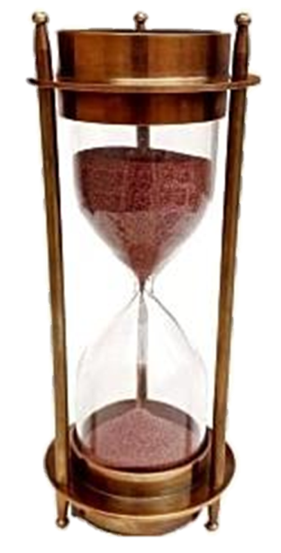

Yahuah marks the sands of time.
Questions & Comments can be sent to Timothy Astleford:
questions@studythecalendar.com
Web: www.studythecalendar.com
Thank –you & Shalom!

