Slide 1


Slide 2


Slide 3

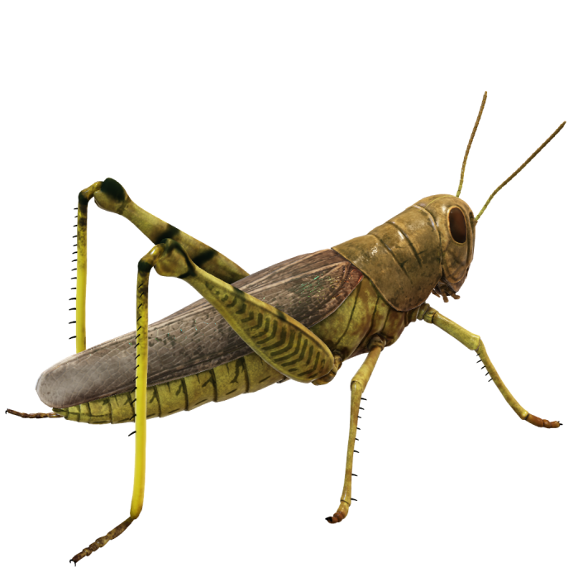
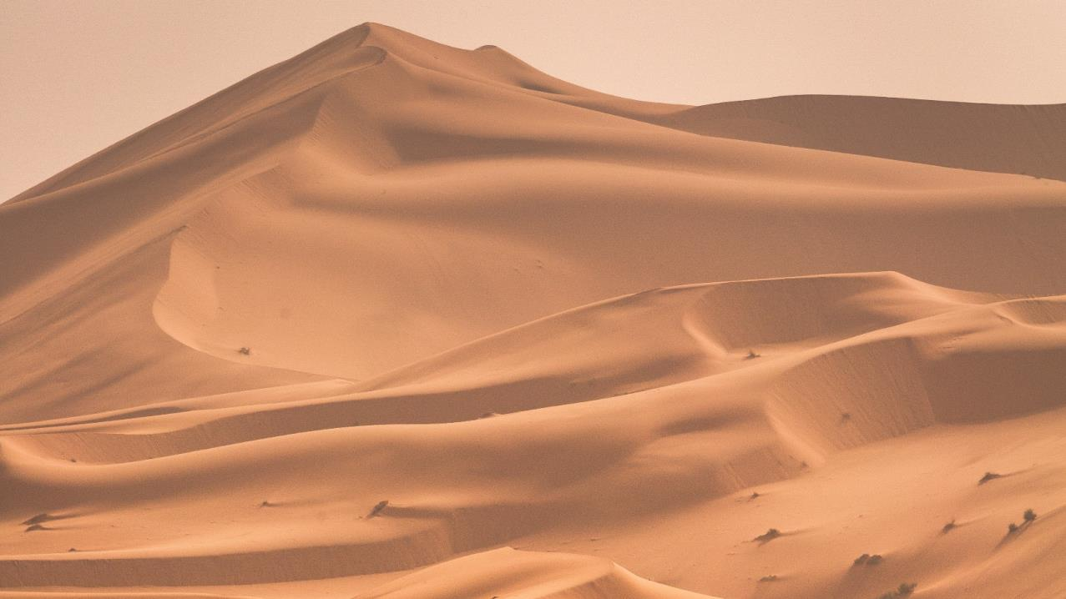
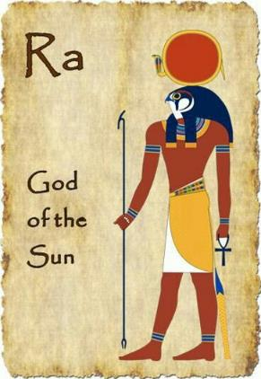
What do locusts have to do
with the sun-god Ra?
3
3

Slide 4
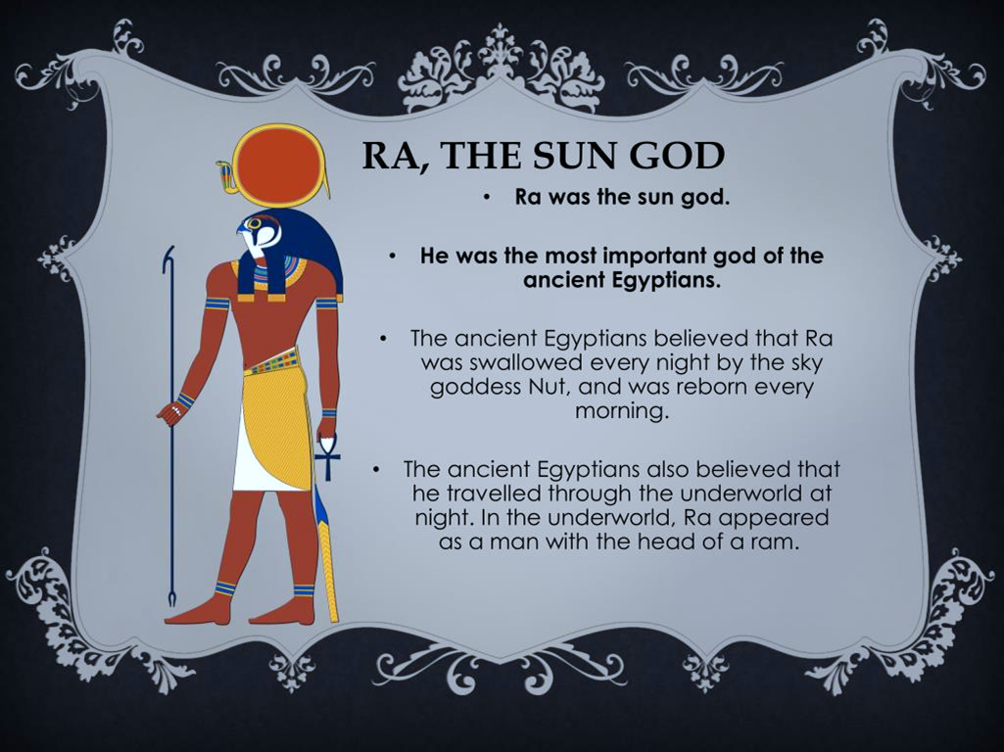
4

Slide 5
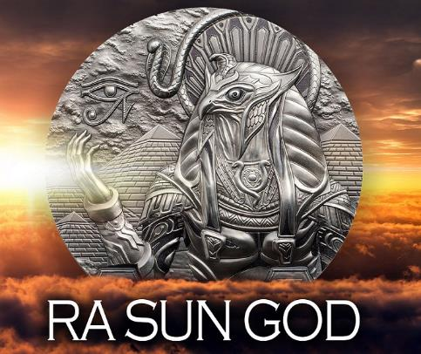
Pharaoh’s Pun – Ra Is Before You
In Exodus 10:10, Pharaoh says to Moses and Aaron, during one of their ongoing exchanges, literally “see,
for there is evil before you,” or more idiomatically “look, you are up to no good.” The Hebrew word <raʿ> “evil” is the name of the Egyptian sun-god Ra, the head of the pantheon.
In this bilingual pun, made possible
by this linguistic occurrence, not only does Pharaoh deny the request of the Israelites to worship their Elohim, but he also states, as it were, “that Ra
[the false sun god] is before you.”
Exo 10:10 And he said unto them, Let YAHUAH be so with you, as I will let you go, and your little ones: look to it; for evil [7851: ra`]
is before you.
5

Slide 6
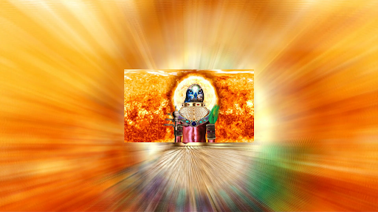
Strong’s: H7451 רָע ra‘ Orig: from 7489 (Ra); bad or (as noun) evil (natural or moral):-- adversity, affliction, bad, calamity, + displease(-ure), distress, evil(- favouredness), man, thing), + exceedingly, X great, grief(-vous), harm, heavy, hurt(-ful), ill (favoured), + …
mark, mischief
(-vous), misery, naught(-ty), noisome, + not please, sad(-ly), sore, sorrow, trouble, vex, wicked(-ly, -ness, one), worse(-st), wretchedness, wrong.
(Incl. feminine raaah; as adjective or noun.). H7489
Adj; 1) bad, evil; 1a) bad, disagreeable, malignant.
6

Slide 7
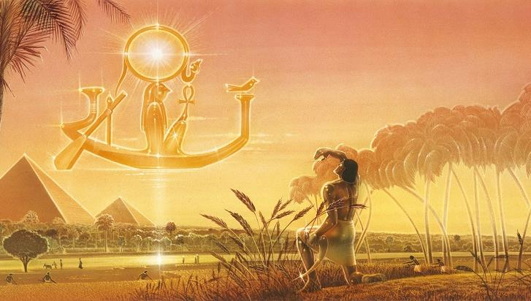
Yahuah responds to this arrogance in the next three plagues: #8, locusts, which blot out the [false] sun god in midday (see 10:15); #9, darkness, (some believe was a sandstorm), which darkens the skies for three days (see 10:22); and #10,
the death of the firstborn at midnight, the darkest part of the night, when Ra is most distant from shining (see 12:29).
7

Slide 8

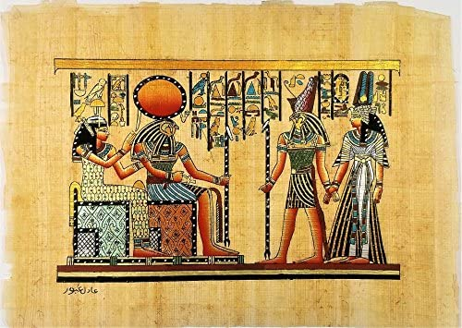
Given the cultural context of ancient Egypt, the perceptive ancient Hebrew reader would have realized the connection between Pharaoh’s impudent statement in Exo 10:10 and the subsequent narrative.
The focus was on the worst possible chain of events for
the Egyptian nation ~ the disappearance of their omnipresent [false] sun-god Ra!
8

Slide 9
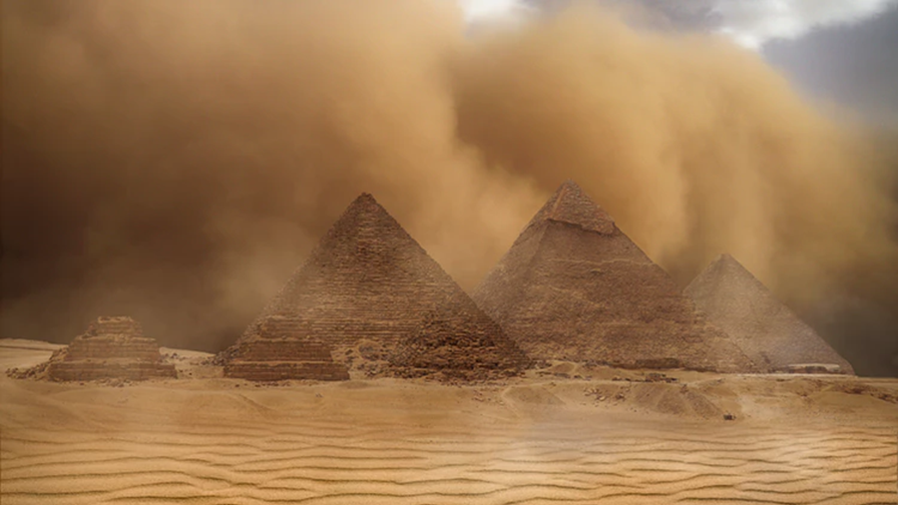
Exo 10:5 And they (locusts) shall cover the face^{H5869} of the earth, that one cannot be able to see the earth: and they shall eat the residue of that which is escaped, which remaineth unto you from the hail, and shall eat every tree which groweth for you out of the field: (KJV)
H5869
עין
‛ayin
ah'-yin
Probably a primitive word; an eye (literally or figuratively); by analogy a fountain
(as the eye of the landscape): - affliction, outward appearance, + before, + think best, colour, conceit, + be content, countenance, + displease, eye ([-brow], [-d], -sight), face, + favour, fountain, furrow [from the margin], X him, + humble, knowledge, look, (+ well), X me, open (-ly), + (not) please, presence, + regard, resemblance, sight, X thee, X them, + think, X us, well, X
Locusts: Blotting Out the Sun (False sun-god Ra)
The Eye of the Land and the Eye of Ra
Playing on this motif, in 10:15, the text states that the locusts covered “the eye of the whole land,”[3] a rare idiom in Hebrew, but one very much at home in the Egyptian language. This Hebrew phrase most likely is an adaptation of the Egyptian expression ir.t rʿ, literally, “the eye of Ra,” used to designate the sun and, by extension, Egypt too.
9
57

Slide 10
Locusts are instruments of the wrath of Yahuah and His judgement (Exo10:4-19;
Deut 28:38,42;
2 Chron 7:13;
Psa 78:46; 105:34;
Nah 3:15-17).
Yahuah says, “I will give you back what you lost to the swarming locusts,
the hopping locusts,
the stripping locusts, and the cutting locusts.
It was I who sent this great destroying
army against you.
Joel 2:25 (NLT)
“Solitary Desert Locust adults usually fly at night whereas ~
gregarious adults (swarms)
fly during the day.”
Yahuah must deal with sin, but when His people repent, they find abundant blessings that more than compensate for what was lost in
the judgment.
His grace abounds.
Nah 3:17 Your guards are like locusts, your officials like swarms of locusts that settle in the walls on a cold day-
but when the sun appears, they fly away;
and no one knows where. (NIV)
10
10

Slide 11
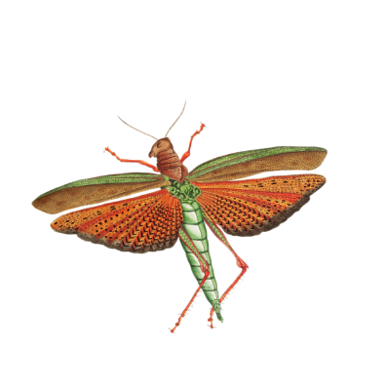
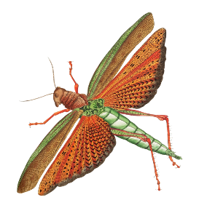
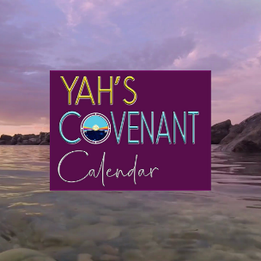
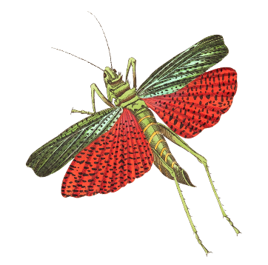
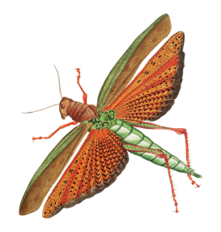
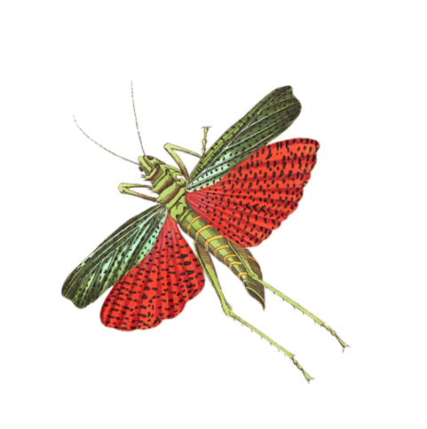

In preparation for Part 2
let’s review Exodus 10:1-14
remembering the
words of the
prophets!
Myriads of Ravaging Locusts
11

Slide 12

Exodus 10
1 And Yahuah said unto Moses, Go in unto Pharaoh: for I have hardened his heart, and the heart of his servants, that I might shew these my signs before him:

Slide 13

Exodus 10
2 And that thou mayest tell in the ears of thy son, and of thy son's son, what things
I have wrought in Egypt, and my signs which I have done among them; that ye may know how that I am Elohim.

Slide 14

Exodus 10
And Moses and Aaron came in
unto Pharaoh, and said unto him,
Thus saith Yahuah Elohim of the Hebrews, How long wilt thou refuse
to humble thyself before me?
let my people go, that they may serve me.

Slide 15

Exodus 10
4 Else, if thou refuse to
let my people go, behold,
to morrow will I bring the locusts into thy coast:

Slide 16

Exodus 10
5 And they shall cover the face of the earth, that one cannot be able to see the earth: and they shall eat the residue of that which is escaped, which remaineth unto you from the hail, and shall eat every tree which groweth for you out of the field:

Slide 17

Exodus 10
6 And they shall fill thy houses, and the houses of all thy servants, and the houses of all the Egyptians; which neither thy fathers, nor thy fathers' fathers have seen, since the day that they were upon the earth unto this day. And he turned himself, and went out from Pharaoh.

Slide 18

Exodus 10
7 And Pharaoh's servants said unto him, How long shall this man be a snare unto us?
let the men go, that they may serve Yahuah their Elohim: knowest thou not yet that Egypt is destroyed?

Slide 19

Exodus 10
8 And Moses and Aaron were brought again unto Pharaoh: and he said unto them, Go, serve Yahuah your Elohim: but who are they that shall go?

Slide 20

9 And Moses said, We will go with our young and with our old, with our sons and with our daughters, with our flocks and with our herds will we go; for we must hold a feast unto Yahuah.
Exodus 10

Slide 21

Exodus 10
10 And he said unto them, Let Yahuah be so with you,
as I will let you go, and your little ones: look to it; for evil
is before you.

Slide 22

Exodus 10
11 Not so: go now ye that are men,
and serve Yahuah; for that ye did desire.
And they were driven out from Pharaoh's presence.

Slide 23

12 And Yahuah said unto Moses, Stretch out thine hand over the land of Egypt for the locusts, that they may come up upon the land of Egypt, and eat every herb of
the land, even all that the hail hath left.
(Notice what happens next!)
Exodus 10

Slide 24
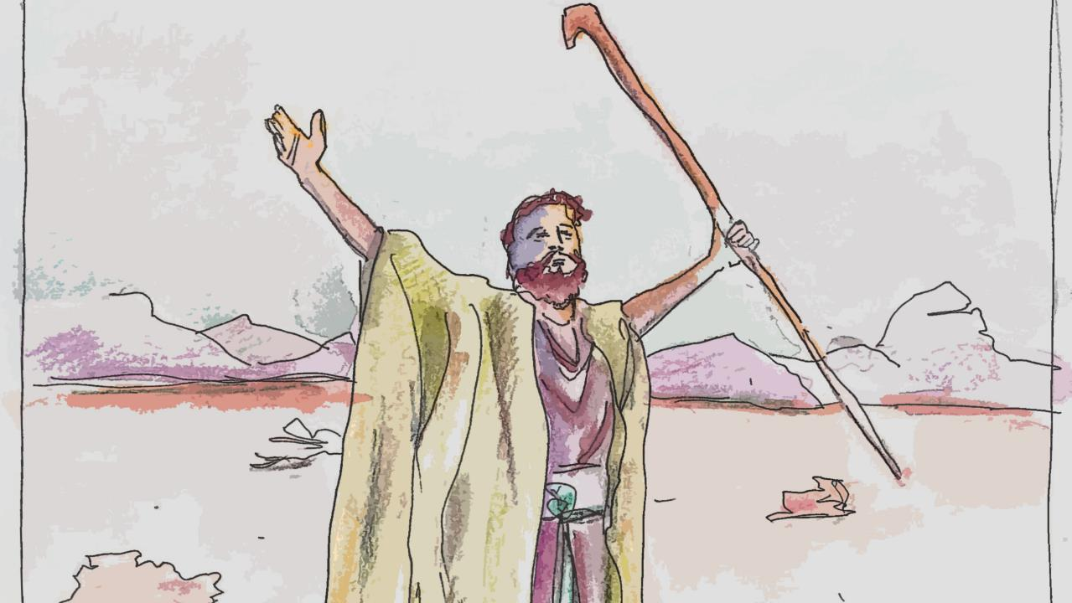
13 And Moses stretched forth his rod over the land of Egypt, and Yahuah brought an east wind upon the land
all that day,
and all that night;
and when it was morning,
the east wind brought the locusts.
Exodus 10

Slide 25

Exodus 10
14 And the locusts went up over all the land of Egypt, and rested in all the
coasts of Egypt: very grievous were they;
before them there were no such locusts
as they, neither after them shall be such.

Slide 26


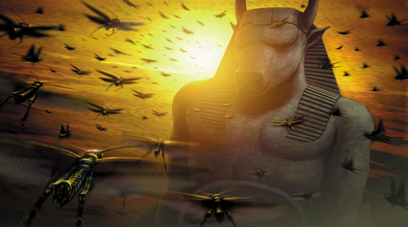
Beginning the thorough
investigation of the Plague:
Just what do the Locusts know?
8th

Slide 27
Which option will the locusts prove true?
Is doubling back in time Scriptural?
BACKWARDS
MOVEMENT?
SUNSET THEORY
FORWARD
PROGRESSIVE MOVEMENT
DAWN FORMAT

Slide 28
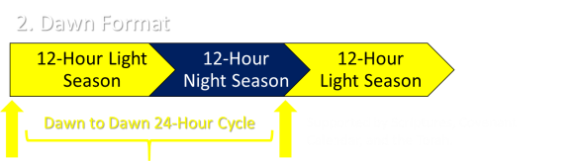

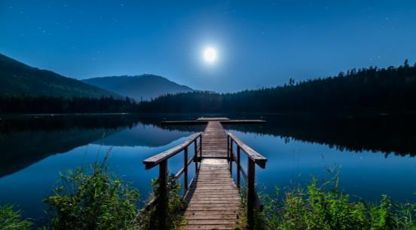
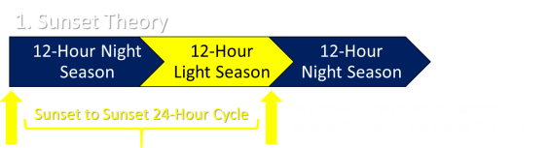

Do you observe your Sabbaths beginning with sunset as most sabbath-keeping believers do, or do you observe your sabbaths starting at dawn, in alignment with THE inspired Scriptures?
An Important Question:
Caution: before you choose one of the options from the diagrams below, be advised that Covenant Calendar has over 30 calendar studies confirmed from the testimonies of inspired Scriptures that unmistakably
expose one of the 24-hour cycles as TRUTH. Your choice will either…
1
2
1. Place you in alignment with your creator;
2. OR…place you in complete opposition to your Creator, Yahusha Ha Mashiach.
Next: Locust infestation of Plague #8 will be demonstrated through a Sunset Theory format.
Will the details of Exodus 10 lay out in a
Forward Progressive movement?

Slide 29

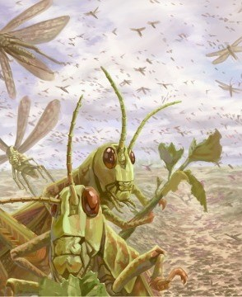
QUESTION:
Please carefully examine these
next verses.
Can you find where
the 24 hour Cycle
changed from
one point of time to
the Next New
24 hour Cycle?

Slide 30


Review -
Investigation of
Plague #8: Locusts
Exo 10:4 Else, if you refuse to let my people go, behold, tomorrow [H4279 mâchâr; maw-khar] will I
bring the locusts into your coast:
Exo 10:5 And they shall cover
the face of the earth, that one cannot be able to see the earth: and they shall eat the remnant
of that which is escaped, which remains unto you from the hail, and shall eat every tree which grows for you out of the field:
Exodus 10: 4 & 5

Slide 31

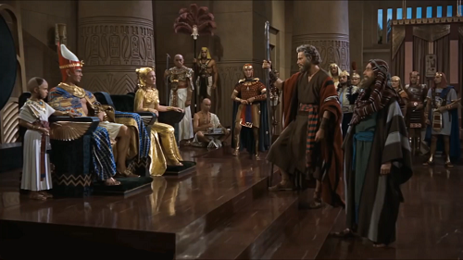
Exo 10:12 And YAHUAH said unto Mosheh [Moses], Stretch out your hand over the land of Mitsrayim [Egypt] for the locusts, that they may come up upon the land of Mitsrayim, and eat every herb of the land, even all that the hail has left.
Investigation of
Plague #8: Locusts
Exo 10:13 And Mosheh stretched forth his rod over the land of Mitsrayim, and YAHUAH brought an east wind upon the land all that day, and all that night; and when it was morning, the east wind brought the locusts.
Exodus 10:12 & 13

Slide 32
ANSWER:
A 2nd 24 hour Cycle is referred to in verse 4 using the word
“to-morrow.” IMPORTANT:
By default, there are TWO separate
24 hour Cycles
found between verses 4 & 13.
(Don’t miss this detail.)
QUESTION: Where in these verses did you
find the
24 hour Cycle changed from one point of time to the
Next New
24 hour Cycle?
Why is BOQER seen in verse #13? What heavy effect does this word contain?

Slide 33
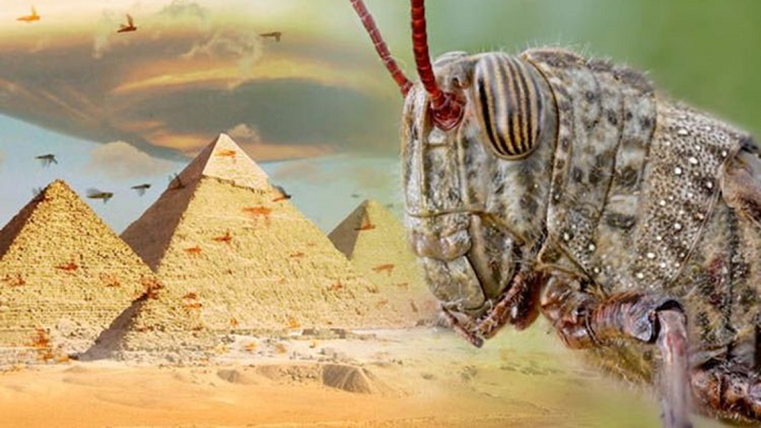

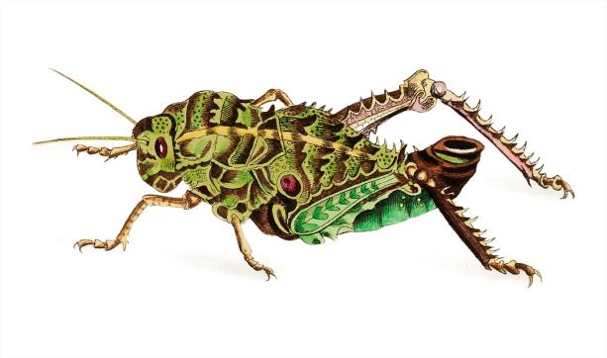
The command of verse 4 was:
“… if thou refuse to let my people go, behold, TO MORROW will
I bring the locusts into thy coast.”
to morrow -- H4279; machar; properly, deferred, i.e. the morrow; usually (adverbially) tomorrow; indefinitely, hereafter:
(KJV) - time to come, tomorrow.

Slide 34
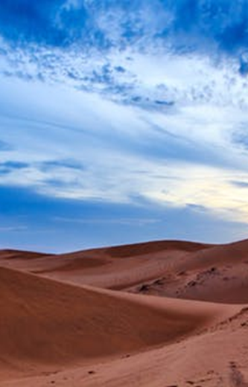
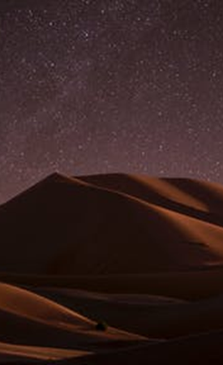
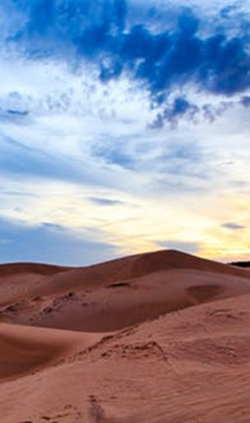
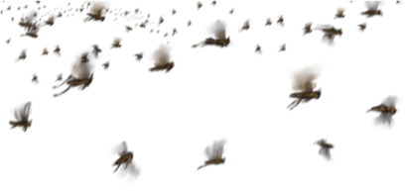
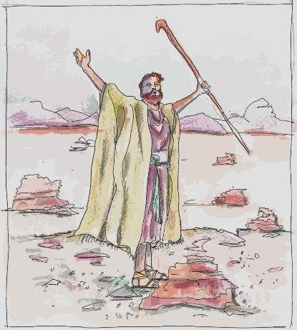
Exo 10:13 … and YAHUAH brought an east wind upon the land all that day,
and all that night;
and when it was morning, the
east wind brought
the locusts.”
Next: Time to Consider
Hebrew Definitions

Slide 35
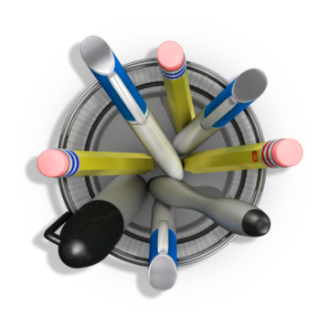

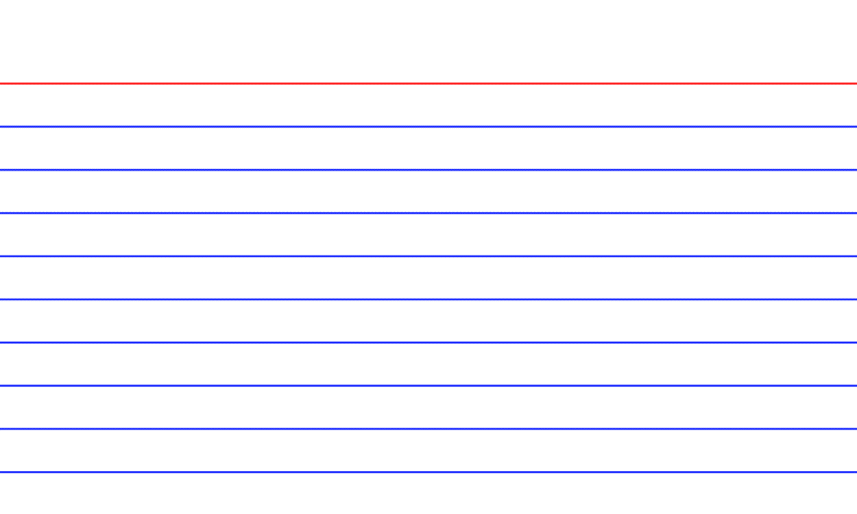




Day H3117 yowm
from an unused root meaning
[1] to be hot; a day (as the warm hours),
whether literal from sunrise to sunset
[Day Season only], or
[2] from one sunset to the next [24 hr cycle],
or
[3] figurative (a space of time defined by an
associated term), [often used adverb].
?
Night H3915 layil
from the same as H3883; properly, a twist (away of the light), i.e. night; figuratively, adversity: (KJV) - ([mid-])
night (season).
  Note: The Gen 1 study will show with exact detail how the “dawn before sunrise” and the
  “dusk after sunset”
  belong to only the
  Day Season hours. Hence, all that day, will include the dusk moments right up to the Night Season.

Slide 36
morning H1242 boqer
from H1239; properly, dawn (as the break of day); generally, morning: KJV - (+)day, early, morning, morrow, end of night, coming of daylight, coming of sunrise, beginning of day, bright joy after night of distress (fig.), morrow, next day, next morning

Slide 37



Let’s consider some facts:
In Scripture a “Day Light Season”
is considered to be the hours of the
day AND it was a time for “work.”
(Neh 4:21 So we laboured in the work: and half of them held the spears from the rising of the morning till the stars appeared. )
Moses had Divine instructions to appear before Pharaoh “(very) EARLY
in the morning” for Plagues #1, #4,
and #7. The patterns of Moses’ arrival before Pharaoh will be examined next.

Slide 38
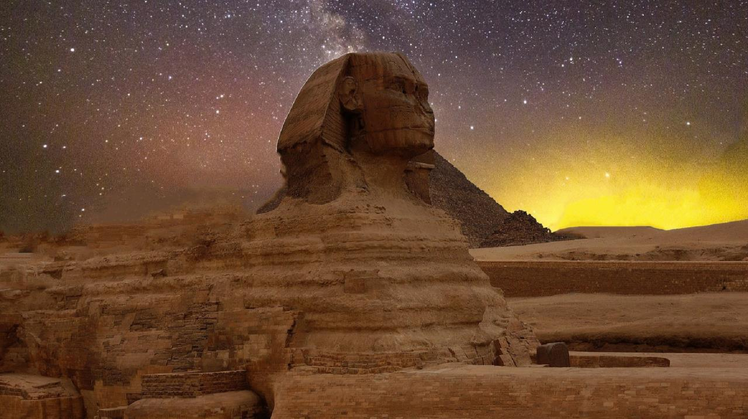
A Thought to Ponder: The following information will demonstrate a pattern through three witnesses of when Moses approaches Pharaoh – basically it was: in the morning
or EARLY in the morning!
Plague #1 - Blood: Exo 7:15 Get thee unto Pharaoh in the morning; lo, he goeth out unto the water; and thou shalt stand by the river's brink against he come; and the rod which was turned to a serpent shalt thou take in thine hand.
    No written record of Moses before Pharaoh [early or very early] in the morning for plagues #2 and #3.
Plague #4 - Flies: Exo 8:20 And [Yahuah] said unto Moses, Rise up early in the morning, and stand before Pharaoh; lo, he cometh forth to the water; and say unto him, Thus saith [Yahuah], Let my people go, that they may serve me.
    No written record for plagues #5 and #6 of Moses before Pharaoh [early] in the morning.
Plague #7 - Hail: Exo 9:13 And Yahuah said unto Moses, Rise up early in the morning, and stand before Pharaoh, and say unto him, Thus saith Yahuah the Elohim of the Hebrews, Let my people go, that they may serve me.
Did you see the patterns for “morning”?
38

Slide 39
Plague #8 - Locusts: Exo 10:1 And [Yahuah] said unto Moses, Go in unto Pharaoh:
(There is no written record for the specific time Moses met with Pharaoh for plague #8
as either “early” or “very early in the morning.)
Plague #9 - Darkness: No written record of Moses before Pharaoh [early] in the morning for plague #9; Pharaoh commands Moses to never return.
  Have you noticed the pattern?
  There’s enough written evidence for
  us to know that Moses was “taking care
  of business” in the morning hours.
  Does this pattern continue for
  Plague #10?
Plague #10 - Death of Firstborn at Midnight:
Exo 12:29 And it came to pass, that at midnight
[Yahuah] smote all the firstborn in the land
of Egypt.
  No written record of Moses before Pharaoh; the last plague falls at Midnight – not morning!
  By the 10th Plague, the pattern has changed.
  Plagues 1-9 occurrences were
  commanded in the morning hours
  of the day.
  Plague 10 falls at midnight – the
  darkest part of the 24 hour cycle.
Moses addressed every conflict in the “morning”!
39

Slide 40
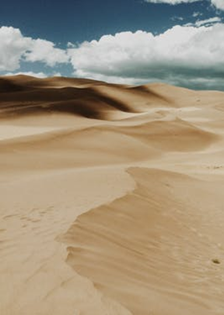


Let’s consider some facts:
It is very likely that Moses and Aaron spoke with Pharaoh in the (boqer) morning for Plagues #2, #3, #5, and #6 since on
three other days it was either “early”
or “very early” in the morning (boqer).
The events in Exodus 10:13 are for Plague #8, the Locusts! This verse does NOT tell us if Moses appeared before Pharaoh either: a) “early in the morning” or; b) “very early in
the morning.”
When do you suppose Moses was before Pharaoh?

Slide 41
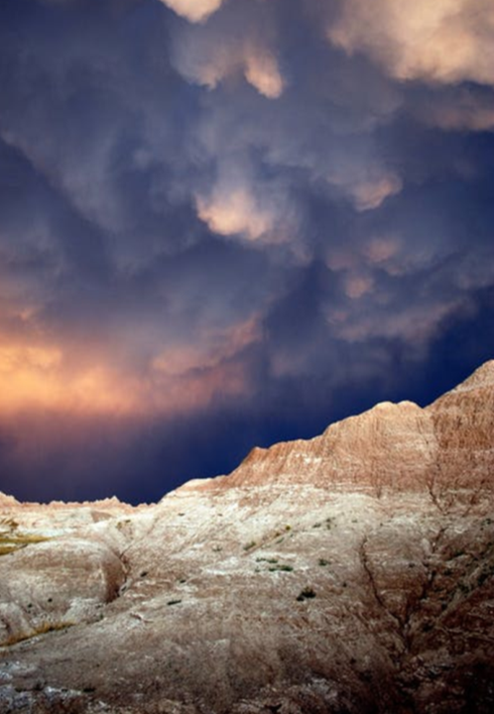


Let’s consider some facts:
However: the verse does say when Moses stretched out his rod, an east wind blew “ALL THAT DAY.” (NOT just “part” of the day, but “ALL” of it.)
The hours of the Day Light Season definitely
include “the morning” hours, and very likely the “very early morning hours” as part of the day.
The wind continued to blow “ALL THAT NIGHT.” (This is not to be confused with “ALL THE NEXT NIGHT” which would designate a new
24 hour cycle of time.) This means the wind
blew throughout the Night Season that was connected to the (SAME 12 hour) DAY SEASON. Don’t miss this point!

Slide 42
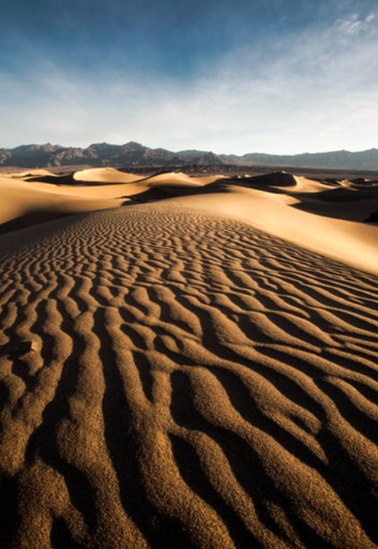


Let’s consider some facts:
Moses stated the locusts would arrive on the NEXT Day/Light Season by using the word
“to-morrow.”
Moses did not consider the approaching “Night Season” was to begin “the next day.” Scripture
is totally silent about any interpretation for the beginning of a new CYCLE at sunset. (Remember, in Sunset Theory - Sunset is the moment when the Light (OWR) Season proceeds to the Night (LAYIL) Season.
Only the absence of light is assured to us through the phrase - “ALL that NIGHT” (layil).

Slide 43
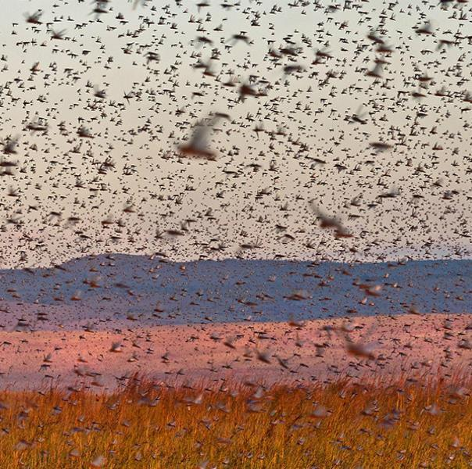
With Sunset Theory every “tomorrow” begins at sunset! THAT is perceived to be
the beginning of “a” new day.
But … NO LOCUSTS were to be found at that time!!
12 hours passed before the clouds of locusts showed up! Why? Moses declared the locusts would arrive on the “to-morrow” (machar).

Slide 44
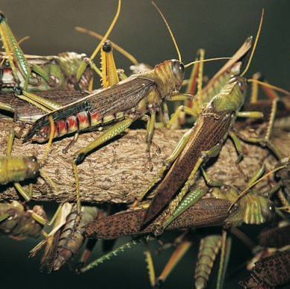

That’s why we do NOT read
of a 12 hour delay in the locusts’ arrival. IT IS VERY NOTEWORTHY that Yahuah acknowledges His own Divine Law (TORAH) where DAWN begins the new cycle.
Would you agree?
The locusts’ natural clock
was correct.
Who instructed them?
Yahuah!
44

Slide 45
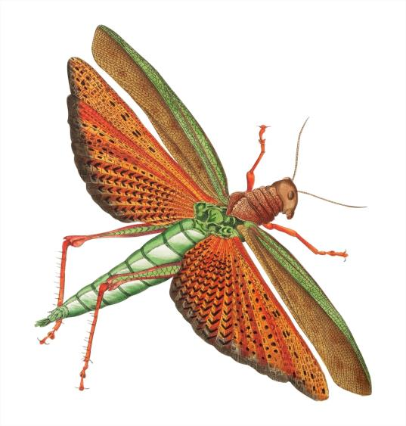
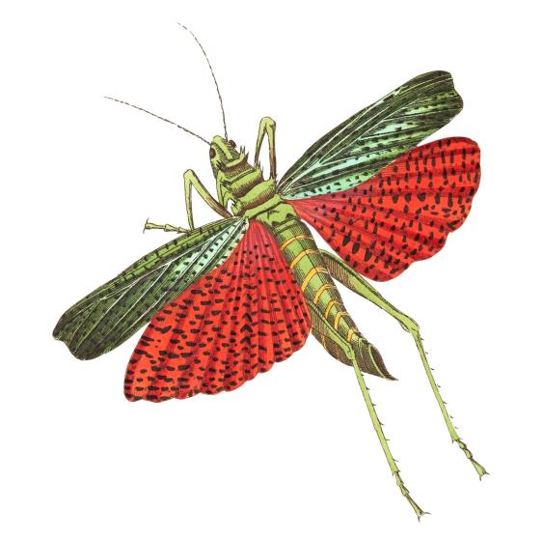
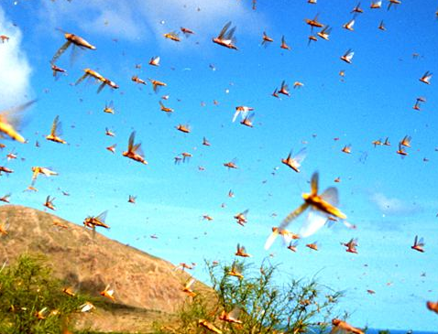
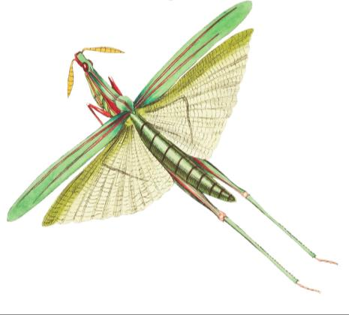
The Locusts Arrive
Yes, they arrived
exactly on time just
as Moses prophesied.
What day?
On the “to-morrow” (machar).
What Time?
At “morning” (boqer),
or at … Dawn:
the beginning of the
next 24 hour cycle!
The “to morrow”!

Slide 46
On the next slide, we will be looking closely at the Sunset Theory style of reckoning time. The question is -
Will this reckoning provide Forward Progressive Movement
through the stories of the Scriptures? Let’s apply the words
of the Scriptures to charts and see the end results!
FORWARD
PROGRESSIVE MOVEMENT
DAWN FORMAT

Slide 47
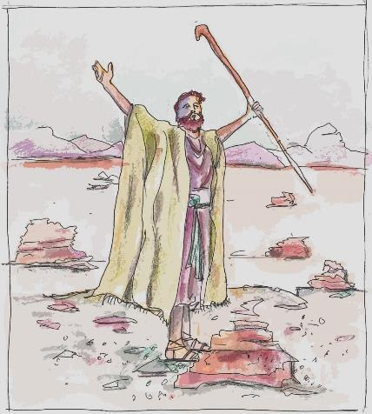
Sunset Theory Chart #1
Sunset
Sunset’s “tomorrow” begins here!
Night Season #1 | Light Season #1 | Night season #2 | Light Season #2
AND ALL
THAT NIGHT!
Exo 10:13
#1 Mosheh delivered the instructions early in the
morning -
#2 And Mosheh stretched forth his rod over the land
of Mitsrayim, and Yahuah brought
an east wind
upon the land
ALL THAT DAY
?
?
Which Cycle,
#1 or #2,
does this “NIGHT of WIND” belong to?
Tomorrow
I will bring the locusts into
thy coast …
Exo10:4

Slide 48
Sunset Theory Chart #1
Pharaoh rejected Mosheh’s request, here!
Night Season #1 | Light Season #1 | Night Season #2 | Light Season #2
WIND ALL THIS NIGHT?
Was Mosheh’s writings retroactive,
pointing to the previous Night Season of wind?
Will identifying a Light Season and then an event in
a Night Season previous, be proper and accurate, according to the Hebrew definitions?
Perhaps Mosheh’s Scriptural documentation using the HIGHLY SPECIFIC words MACHAR (v:4) &
BOQER (v:13) are ERRONEOUS?
What about the Forward Progressive Movement?

Slide 49
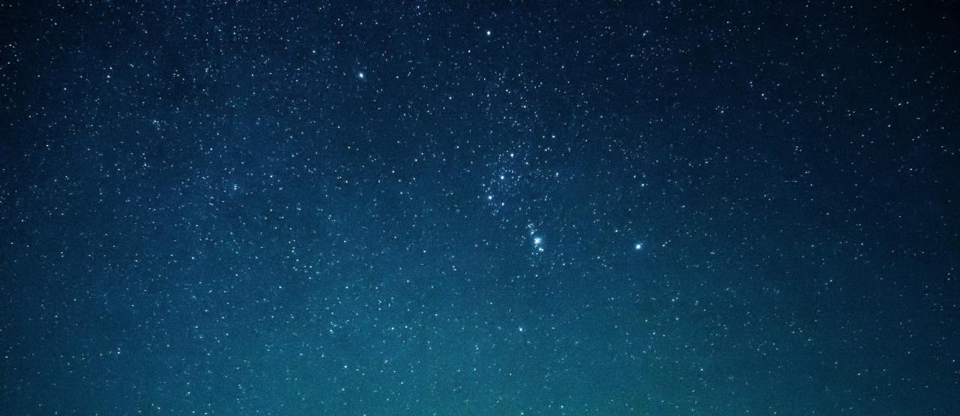
Forward Progressive Movement
Is NOT possible with Sunset Theory
NO, this is backwards!

Slide 50

The Sunset PROBLEM #1
How can the chart show the
MORNING arrival of the locusts – without passing through the
Night Season of cycle #2 first?
By Hebrew definition of – Machar, the locusts arrived on the morning after the Light Season that Mosheh prophesied them to arrive!
Machar, categorized time FOLLOWING the previous
24 hour cycle!
Night Season #1 | Light Season #1 | Night Season #2 | Light Season #2

Slide 51

The Sunset {DEFINITION} PROBLEM:
1. The wind blew
ALL that Light
Season (yowm),
Where does Night Season #2 fit in?
3. And the locusts
arrived the
NEXT MORNING!
2. and ALL that
Night Season …
Machar, categorized time FOLLOWING the previous
24 hour cycle!
Night Season #1 | Light Season #1 | Night Season #2 | Light Season #2

Slide 52
Sunset PROBLEM #2
The wind blew ALL that Light Season (yowm),
Again - By Hebrew definition of – Machar, the locusts arrived on the morning after the Light Season that Mosheh prophesied them to arrive!
Machar, categorized time FOLLOWING the previous
24 hour cycle!
What about this “NEXT” night?
Night Season #1 | Light Season #1 | Night Season #2 | Light Season #2

Slide 53

OOPS!!!
Machar categorized time FOLLOWING the previous
24 hour cycle begins here - ACCORDING TO SUNSET THEORY!!
Sunset PROBLEM Con’t
The wind blew ALL that Light Season (yowm),
There is a full and total void of Hebrew word(s) and or definitions that indicate this Night Season “#2” was the next and beginning of a sequential and separate 24 hour period.
and ALL that Night Season …
Night Season #1 | Light Season #1 | Night Season #2 | Light Season #2

Slide 54

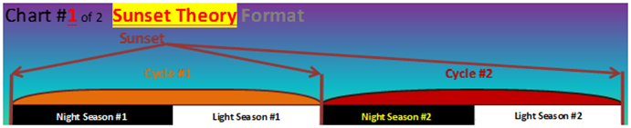
Note where Cycle #2 Night Season is located on the chart.
At that position [on this Sunset Theory Chart] this Night Season does NOT belong to the Scriptural account of “that day” which is connected to Cycle #1 that records the event of Moses stretching out his rod.
And the wind blew all that day
AND ALL THAT NIGHT!??

Slide 55

Sunset’s DEFINITION PROBLEM
On the Sunset Theory chart,
Night Season #2 follows the morning conversation Moses had with Pharaoh during the morning hours of Cycle #1. (Neh 4:21)
(This SIDESTEPS Scriptural
word definition alignment.)
?
Night Season #1 | Light Season #1 | Night Season #2 | Light Season #2

Slide 56
Sunset’s DEFINITION PROBLEM
The word Machar – {TOMORROW) GIVES FULL EXCLOSURE to a categorized time frame which follows a specific point of commencement. The locusts arrived at the beginning of the MACHAR – “TOMORROW,” – arriving with the morning light!
?
Night Season #1 | Light Season #1 | Night Season #2 | Light Season #2

Slide 57
A Locust Fact:
Mosheh informed Pharaoh the locusts would arrive on
the next new CYCLE by using the explicit
Inspired Word of <machar>
[“to morrow” - to be exact] –
a future separate cycle still to come.
Sunset Theory cannot align with the words of the Scriptures!
?
Night Season #1 | Light Season #1 | Night Season #2 | Light Season #2

Slide 58
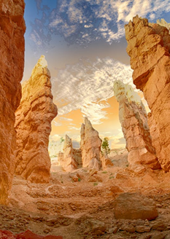
After Moses conversed with Pharaoh in the morning, his Inspired response was:
Exo 10:13 And Mosheh [Moses] stretched forth his rod over the land of Mitsrayim [Egypt], and YAHUAH brought an east wind upon the land
all that day, and all that night …
Is this possibly one 24 hour period?

Slide 59
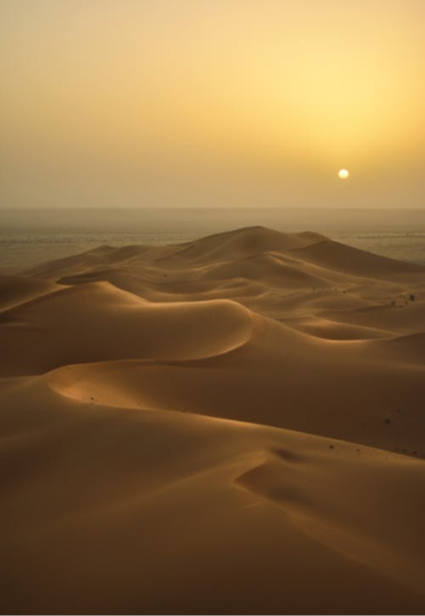

Reader Friend: Here’s where the problem enters the controversial equation.
The problem is with “the wind.”
The Reason: because it “blew all night” which belonged to “all that day.”
Question: The phrase … “all that night” … is it directly referencing
Night Season #1 or Night Season #2? Only one choice is available. Which is it?
{Let’s PROCEED CAREFULLY!}

Slide 60
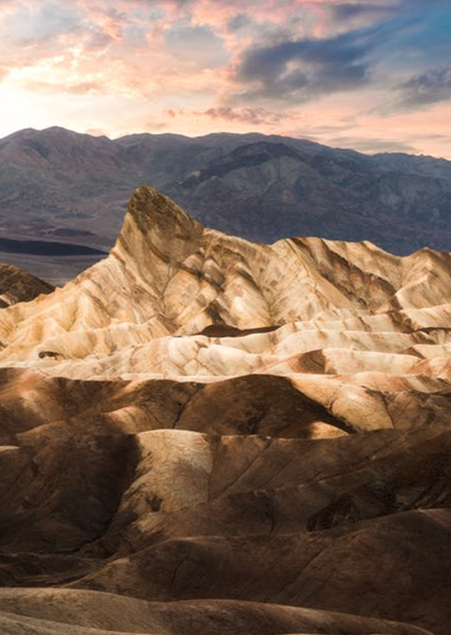

Machar ~ the NEXT CYCLE!
Mosheh warns Pharaoh!
Is “Machar” HERE?
  OPTION #2? “all that night” belongs to Night Season #2. If this is so, you have just DEFAULTED to the NEXT 24 hour period – CYCLE #2 – which >>
  No longer qualifies the “night wind” to be in the same 24 hour segment of time as the light season [or morning] of moses’
  Prophetic LOCUST announcement.
Will the Locust’s testimony influence your thoughts?

Slide 61
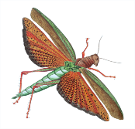
Sunset’s DEFINITION Collapse
Mosheh stretched forth his rod in the morning, to bring in the wind ALL that day, AND …
So let’s look closer at the Hebrew words!
?
Night Season #1 | Light Season #1 | Night Season #2 | Light Season #2

Slide 62
















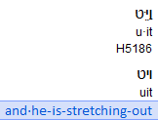
Sunset’s DEFINITION Collapse pt.1
Has there been any Hebrew indication of an exchange in the 24 hour period yet? If not, when does the fully exposed transition of the
24 hour period reveal itself - by Hebrew definition?
?
?
Night Season #1 | Light Season #1 | Night Season #2 | Light Season #2

Slide 63
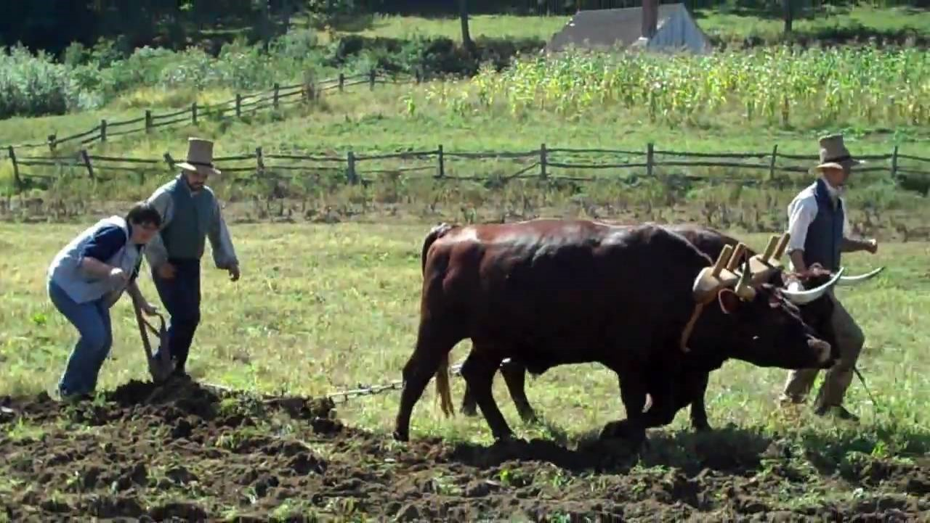
Next word - Boqer
What types of PARTITION do these oxen create?

Slide 64
BOQER =
One Paleo definition
an ox pulling a plow
Division, Separation, Parting
Virgin ground
Plowed Field

Slide 65
Sunset’s DEFINITION Collapse pt.2
This is a completed description of the Light
Season and the Night Season events.
The Ox has accomplished his dividing duty FOUND WITHIN the NEXT HEBREW word – BOQER.
?
?
Night Season #1 | Light Season #1 | Night Season #2 | Light Season #2

Slide 66








Sunset’s DEFINITION Collapse pt.3
Will the locusts arrive BEFORE the separation of the 24 hour cycles?
Or, will the locusts arrive
AFTER - the Ox’s DIVISION?
The Ox has accomplished the dividing duty FOUND WITHIN this HEBREW word – BOQER –
which then brought – LOCUSTS!
?
?
Night Season #1 | Light Season #1 | Night Season #2 | Light Season #2

Slide 67



Sunset Tradition - to full Hebrew Alignment
What action is needed to place this locust story back into full alignment with the Hebrew words and definitions?
A Dawn To Dawn – RESTORATION!
Night season must FOLLOW, not lead!
Boqer
MACHAR
(TOMORROW)
ALL that day,
ALL that night!
Night Season #1
Light Season #1
Night Season #2
Light Season #2

Slide 68


The further we investigate,
the more we find Sunset Theory
is infested with anti-Scriptural ailments.
Why?
To re-emphasize, IT IS IMPOSSIBLE
to insert the information from Exo 10:13 onto a
Sunset Theory Chart.
Easy!
The
Inspired Word simply does not support
Sunset Theory.

Slide 69


Dawn: Zion’s New Day Order
Yahuah’s Divine Institution is
currently being restored!
Let’s have another look shall we?

Slide 70

Who told Mosheh
to write <machar> (“to morrow”) and <boqer> (“morning”) when prophesying this advance timing for the arrival of the locusts?
See Exo 10:1
AND YAHUAH said unto El-Mosheh,
Go in unto Phar`oh.
70

Slide 71





Dawn to Dawn & the Locusts! Exo 10
Light Season #1 | Night Season #1 | Light Season #2 | Night Season #2
Boqer: Mosheh
spoke to Pharaoh – Tomorrow, (cycle #2)
I will bring locusts within your borders.
Exo 10:4
BOQER {morning} came, and the east wind BROUGHT
THE LOCUSTS!
Exo 10:13 (c)
And Mosheh
stretched forth his rod over the land of Mitsrayim, and Yahuah brought an east wind upon the land all that DAY … Exo 10:13 (a)
and all that NIGHT.
Exo 10:13 (b)

Slide 72
Exo 10 Dawn to Dawn & Locusts!
Light Season #1 | Night Season #1 | Light Season #2 | Night Season #2
Boqer!
Tomorrow,
{def. - the day which follows
the present},
THE LOCUSTS WILL ARRIVE!
Declared by Mosheh!
Exo 10:4
BOQER; THE LOCUSTS, having received their Appointed Time instructions from THE CREATOR, arrived with perfect punctuality in
the morning, (that is) when the ox
had reckoned time with the plow!
(Paleo Hebrew) Exo 10:13

Slide 73


Forward Progressive Movement

Slide 74
Backwards Movement
Traditions of Men
Sunset Theory
You Must
Order
Order NOT possible
CHOOSE
Dawn Format
Word of TRUTH
Forward Progressive Movement
74

Slide 75


Let us remember the very strong counsel given in Jer 33:20, 21, 25, 26:
20 Thus says YAHUAH; If ye can
break my covenant of the day, and
my covenant of the night, and that
there should not be day and night in their season;
21 Then may also my covenant be broken with David my servant, that he should not have a son to reign upon his throne; and with the Leviyiym the priests, my ministers.
25 Thus says YAHUAH; If my covenant be not with day and night, and if I have not appointed
the ordinances of heaven and earth;
26 Then will I cast away the seed of Ya`aqov, and David my servant, so that I will not take any of his seed to be rulers over the seed of Avraham, Yitschaq, and Ya`aqov: for I will cause their captivity to return,
and have mercy on them.

Slide 76

Season - H6256 <`eth>; from H5703; time, especially now, when, etc.:
KJV - after, [al-] ways, certain, continually, evening, long, (due) season, so [long] as, [even-, evening, noon-] tide, ([meal-]), what) time, when.
Bottom Line: If we break the Father’s covenant of day and night, He will break His covenant with us.
Where do you stand with Yahusha Ha Mashiach and His Covenant?
How is your faith today?
…On a Rock or Quicksand?
The End
76

Slide 77



Covenant Calendar Club
Facebook Page
www.facebook.com/covenantcalendarclub
Facebook Group
www.facebook.com/groups/CovenantCalendarClub
YouTube Channel
www.youtube.com/c/CovenantCalendarClub

Slide 78






questions@studythecalendar.com www.studythecalendar.com/resources
OR www.covenantcalendar.club
Questions
If you need assistance with this information, please send your questions to Timothy Astleford or Charlene Fortsch.
78

