Slide 1

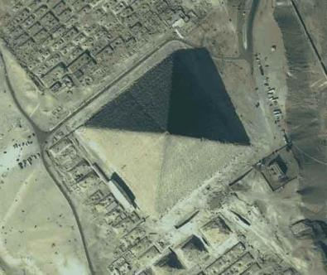
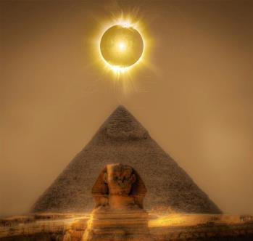
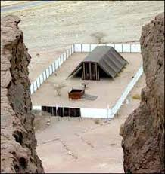
Acts 7:22
Mosheh’s Wisdom &
Yahuah’s Tequfah

Slide 2

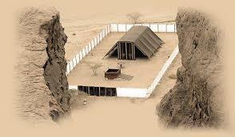
A TEACHING FROM:
Approx. Date:
1490 BC
www.studythecalendar.com

Slide 3


Tequfah – first? or last?
1. Is the Tequfah the FIRST cycle of the year?
What does Mosheh reveal?
2. What does the lunar calendar reveal about its own count?
3. What can we learn from “The Cloud”?

Slide 4
The FIRST CYCLE ,
THE FIRST MONTH
The 2nd year, THEY -
On
did what?

Slide 5


This is one of
those studies
where it is
good to …
It just may be your key to knowledge
& understanding.
5

Slide 6
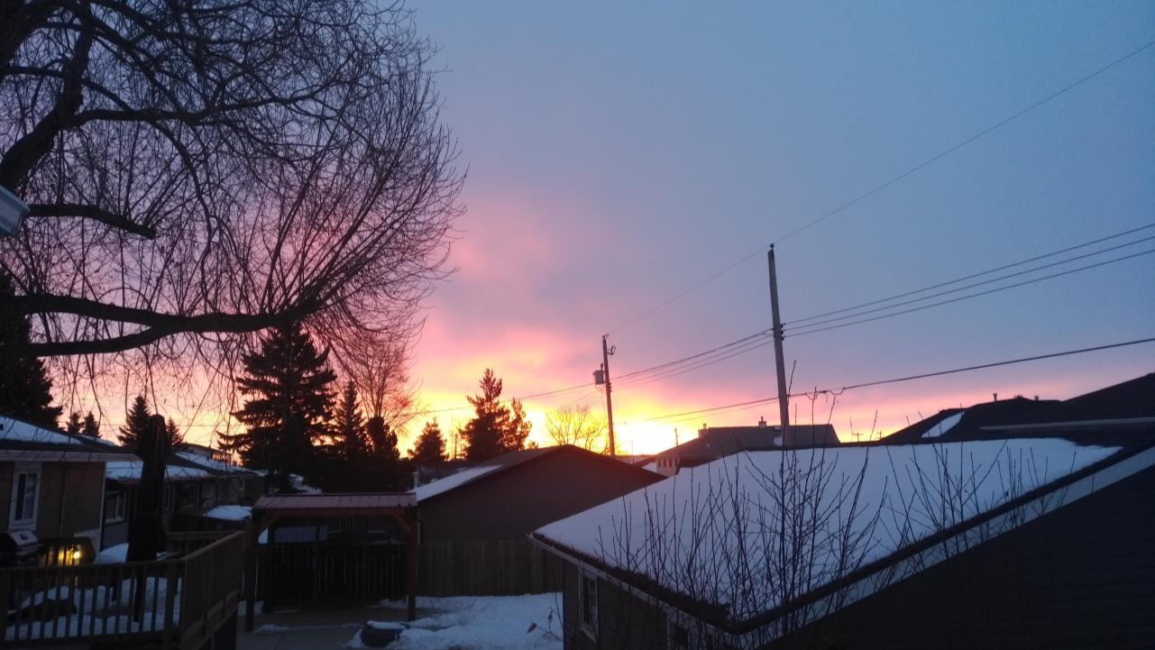
What date is the Tequfah?
Is it the first day of the year? Or the last?
Let’s look to Yahuah’s LIGHT.
What did Mosheh reveal through the Blood Ratified MelekTzedek Covenant?
6

Slide 7
Timeline From the YEAR of the Exodus
Where does the Tequfah belong?
Cycles of the Week
Cycles of the Month
Cycles of the Year
New Year Cycle. The 4th cycle of the week, was the 1st cycle of the 1st month as seen in the Exodus account, (beginning with Exo 12).
Tequfah – the 360th cycle of the year!
4th 1
5th 2
6th 3
7th 4
1st 5
2nd 6
3rd 7
4th 8
5th 9
6th 10
7th 11
1
2
3
4
5
6
7
8
9
10
11
… On the tenth day of this month each one of them is to take for himself a lamb … Exo 12:3
And you shall keep it until the fourteenth day … Exo 12:6

Slide 8
Cycles/ Week
Cycles/ Month
Cycles/ Year
Before the sunset, Mosheh had declared to them – … See the deliverance of Yahuah TODAY …
Exo 14:13
The Yisra’elites then crossed the Red Sea on the Preparation evening/night. Exo 14:21, 22
1st 12
2nd 13
3rd 14
4th 15
5th 16
6th 17
7th 18 1st 19
2nd 20
3rd 21
4th 22
5th 23
6th 24
7th 25
1st 26
2nd 27
3rd 28
4th 29
5th 30
12
13
14
15
16
17
18
19
20
21
22
23
24
25
26
27
28
29
30
Month
#1
PASSOVER Mitsrayim
Sukkot exit Mitsrayim
Etham
Pi Ha Hiroth/ Red Sea
Salvation Visualized!
1
2
3
4
5
6
7
8
9
10
11
12
13
14
Omer Count
Pattern Begins
… and the sea returned to its usual flow, at the break of day, with the Mitsrites fleeing into it … Exo 14:27
What profound revelation will the 2nd month reveal?
1
Thus Yahuah saved Yisra’el that DAY … Exo 14:30 (Abib 17 - Yowm is singular!)
6th 1
7th 2
31
32
2
The sunset failed to change the day!

Slide 9
Cycles/ Week
Cycles/ Month
Cycles/ Year
Month #2
1st 3
2nd 4
3rd 5
4th 6
5th 7
6th 8
7th 9 1st 10
2nd 11
3rd 12
4th 13
5th 14
6th 15
7th 16
1st 17
2nd 18
3rd 19
4th 20
5th 21
6th 22
7th 23
33
34
35
36
37
38
39
40
41
42
43
44
45
46
47
48
49
50
51
52
53
Month #2
The children of Yisra’el CAME INTO (TRAVELED) the Wilderness of Sin on the FIFTEENTH DAY OF THE SECOND MONTH. Exo 16:1
Have you noticed, the very specific cycle of the week that the 15th of the 2nd month was? It was a Preparation cycle and the next cycle was the
7th day Shabbat!

Slide 10
Cycles/ Week
Cycles/ Month
Cycles/ Year
The 15th of the second month
was a Preparation day.
What effect does this Scriptural revelation have upon the
Lunar Sabbath calendar which DEMANDS EACH AND EVERY
2ND SABBATH OF THEIR MONTH, ALWAYS, & WITHOUT EXCEPTION, MUST FALL UPON THE 15TH OF EVERY MONTH?
Is there a conflict of calendar here? Who is your authority?
Torah or the moon?
1st 3
2nd 4
3rd 5
4th 6
5th 7
6th 8
7th 9 1st 10
2nd 11
3rd 12
4th 13
5th 14
6th 15
7th 16
1st 17
2nd 18
3rd 19
4th 20
5th 21
6th 22
7th 23
33
34
35
36
37
38
39
40
41
42
43
44
45
46
47
48
49
50
51
52
53
Month #2
The children of Yisra’el CAME INTO (TRAVELED) the Wilderness of Sin on the FIFTEENTH DAY OF THE SECOND MONTH. Exo 16:1

Slide 11
Cycles/ Week
Cycles/ Month
Cycles/ Year
Month #2
Again -
1st 3
2nd 4
3rd 5
4th 6
5th 7
6th 8
7th 9 1st 10
2nd 11
3rd 12
4th 13
5th 14
6th 15
7th 16
1st 17
2nd 18
3rd 19
4th 20
5th 21
6th 22
7th 23
33
34
35
36
37
38
39
40
41
42
43
44
45
46
47
48
49
50
51
52
53
Month #2
The children of Yisra’el CAME INTO (TRAVELED) the Wilderness of Sin on the FIFTEENTH DAY OF THE SECOND MONTH. Exo 16:1
Note that Scripture provides us with a specific
DATE !
Accuracy is paramount!
Next Verse
Exo 16:2 And all the congregation of the children of Yisra’ĕl grumbled against Mosheh and Aharon
in the wilderness.

Slide 12
Cycles/ Week
Cycles/ Month
Cycles/ Year
Month #2
Again -
1st 3
2nd 4
3rd 5
4th 6
5th 7
6th 8
7th 9 1st 10
2nd 11
3rd 12
4th 13
5th 14
6th 15
7th 16
1st 17
2nd 18
3rd 19
4th 20
5th 21
6th 22
7th 23
15
16
17
18
19
20
21
22
23
24
25
26
27
28
29
30
31
32
33
34
35
33
34
35
36
37
38
39
40
41
42
43
44
45
46
47
48
49
50
51
52
53
Month #2
The children of Yisra’el CAME INTO (TRAVELED) the Wilderness of Sin on the FIFTEENTH DAY OF THE SECOND MONTH. Exo 16:1
3
In Exo 16:2 the CONGREGATION (H5712 Edah) were assembled (not traveling on the Shabbat) and were complaining heavily to Mosheh! Exo 16:2
4
Will the Omer Count be a witness to this Shabbat Assembly?
5

Slide 13
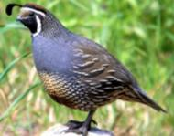
Cycles/ Week
Cycles/ Month
Cycles/ Year
Month #2
*
On that Shabbat Assembly: “… See I am raining bread … IN ORDER TO TRY THEM whether they will walk in My Law or not!” Exo 16:4 Yahuah was about to provide them with His CO-ACTIVE TRIAL which required their participation!
1st 3
2nd 4
3rd 5
4th 6
5th 7
6th 8
7th 9 1st 10
2nd 11
3rd 12
4th 13
5th 14
6th 15
7th 16
1st (1) 17
2nd (2) 18
3rd (3) 19
4th (4) 20
5th (5) 21
6th (6) 22
7th 23
15
16
17
18
19
20
21
22
23
24
25
26
27
28
29
30
31
32
33
34
35
33
34
35
36
37
38
39
40
41
42
43
44
45
46
47
48
49
50
51
52
53
REPEATED SLIDE
Month #2
3
I have heard the grumblings
of the children of Yisra’el.
Speak to them, saying, Between the evenings you are to eat meat … Exo 16:12(a)
4
… and IN THE MORNING you are to be satisfied with bread. And you shall know that I am Yahuah your Elohim. Exo 16:12(b) See also Exo 16:14 & Num 11:9.
5

Slide 14
Cycles/ Week
Cycles/ Month
Cycles/ Year
Month #2
1st 3
2nd 4
3rd 5
4th 6
5th 7
6th 8
7th 9 1st 10
2nd 11
3rd 12
4th 13
5th 14
6th 15
7th 16
1st (1) 17
2nd (2) 18
3rd (3) 19
4th (4) 20
5th (5) 21
6th (6) 22
7th 23
15
16
17
18
19
20
21
22
23
24
25
26
27
28
29
30
31
32
33
34
35
33
34
35
36
37
38
39
40
41
42
43
44
45
46
47
48
49
50
51
52
53
REPEATED SLIDE
And it came to be that quails came up THAT EVENING and covered the camp … Exo 16:13(a)
Month #2
3
… and in the morning (Boqer) the dew lay all around the camp. Exo 16:13(b)
And the layer of dew went up, and see, on the surface of the wilderness, was a small round substance, as fine as frost on the ground. Exo 16:14
… “What is it?” … And Mosheh said to them, “It is the bread which Yahuah has given you to eat.”
Exo 16:15
4
MANNA – Gather it SIX days, but on the seventh which is the Shabbat, there is none!
Exo 16:26
5

Slide 15
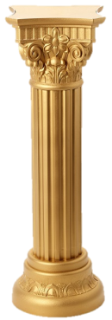

The Command, was to gather manna for SIX cycles (days) to achieve gathering the double portion on the Preparation!
Unless 5 cycles of gathering had been accomplished first, the double portion on the Preparation could not be fulfilled. The Manna Week cannot start in mid week as some calendars (and some lunar ones) require.
Covenant Calendar achieves these timing appointments perfectly. These Scriptural appointments are how Covenant Calendar was realized (formed).
There are other calendars (lunar) which declare that the 15th of this second month was a Shabbat, which conflicts with the Scripture’s documentation!
For the Yisra’elites to be fully tested on their obedience, a complete
6 cycles of picking manna MUST have been fulfilled
before the Shabbat could occur.
The Manna week is one of the foundational pillars within the Covenant.
It is also a central stabilizing base within the Calendar of Yahuah.
The Covenant will be agreed to 3 times by the Hebrew nation, before
it is ratified in blood and sealed with the Covenant meal on the Mount!
Manna

Slide 16
“If they will walk in My Law or not.” ?
Now -
How could it be - Law? Mt Sinai and the receiving of the Stone Tablets, had not happened yet! The Aharonic Priesthood within the Levitical tribe was not even commissioned yet! How can the Torah ALREADY be the guideline of Yahuah to test the Yisra’elites?
What Law was there that existed before Mt Sinai?
In Exodus 18 we find that Mosheh was teaching the Hebrew nation.
What was it that Mosheh was teaching from?
Where was Mosheh receiving his instructions from?

Slide 17

Exo 18:16 “When they have a matter, they come to me,
and I rightly rule between one and another,
and make known the laws of Elohim and His Torot.”
(statutes H2706, and Laws H8451)
Clearly, Mosheh knew about Yahuah’s Order of Righteousness which existed long before creation.
It was these same statutes and laws that in a short time, Mosheh would write down in the Book of the Covenant even BEFORE receiving the Tablets from Yahuah on the Mount!
Please note: the Book of the Law, - the Aharonic Priesthood,
the Temple services and the substantial increase of
sacrifices with oblations, did not exist yet!

Slide 18
Cycles/ Week
Cycles/ Month
Cycles/ Year
Month #2
Forward to -
1st 3
2nd 4
3rd 5
4th 6
5th 7
6th 8
7th 9 1st 10
2nd 11
3rd 12
4th 13
5th 14
6th 15
7th 16
1st (1) 17
2nd (2) 18
3rd (3) 19
4th (4) 20
5th (5) 21
6th (6) 22
7th 23
15
16
17
18
19
20
21
22
23
24
25
26
27
28
29
30
31
32
33
34
35
33
34
35
36
37
38
39
40
41
42
43
44
45
46
47
48
49
50
51
52
53
REPEATED SLIDE
And they laid it up till morning as Mosheh commanded. And it did not stink and no worm was in it.
And Mosheh said “Eat it TODAY for TODAY is a SHABBAT to Yahuah, today you do not find it in the field.” Exo 16:24-26
So the people RESTED ON THE SEVENTH DAY. Vs. 30
Month #2
Tomorrow is a rest, a Shabbat Qodesh to Yahuah. That which ye bake, bake.
That which you cook, cook … Exo 16:23
3
And on the
6th day they gathered twice as much bread.
Exo 16:22
4
*
5

Slide 19
Cycles/ Week
Cycles/ Month
Cycles/ Year
Month #2
Please notice which cycle of the week and month that Mosheh spoke these words!
1st 3
2nd 4
3rd 5
4th 6
5th 7
6th 8
7th 9 1st 10
2nd 11
3rd 12
4th 13
5th 14
6th 15
7th 16
1st (1) 17
2nd (2) 18
3rd (3) 19
4th (4) 20
5th (5) 21
6th (6) 22
7th 23
15
16
17
18
19
20
21
22
23
24
25
26
27
28
29
30
31
32
33
34
35
33
34
35
36
37
38
39
40
41
42
43
44
45
46
47
48
49
50
51
52
53
REPEATED SLIDE
“Tomorrow is a rest, a Shabbat Qodesh to Yahuah.” The 22nd was NOT A LUNAR SHABBAT!
Month #2
And Mosheh said “Eat it TODAY for TODAY is a SHABBAT to Yahuah, today you do not find it in the field.” Exo 16:24-26
We might note with intensity that the Lunar Shabbat requirement of the 22nd is annihilated right here,
by Mosheh’s decree!
3
4
*
5

Slide 20
Cycles/ Week
Cycles/ Month
Cycles/Year
In the THIRD month after the children of Yisra’el had come out of Mitsrayim, ON THIS *DAY they CAME INTO the Wilderness of Sinai. Exo 19:1
DAY, not – date!
1st 24
2nd 25
3rd 26
4th 27
5th 28
6th 29
7th 30
36
37
38
39
40
42
42
43
44
45
46
47
48
49
54
55
56
57
58
59
60
Month #2
Month #2
DAY –
NOT DATE!
6
Month #3
1st 1
2nd 2
3rd 3
4th 4
5th 5
6th 6
7th 7
1st 8
2nd 9
3rd 10
4th 11
5th 12
6th 13
7th 14
61
62
63
64
65
66
67
68
69
70
71
72
73
74
*
Month #3
Go to the people and qadosh them TODAY AND TOMORROW.
For on the third day Yahuah shall come down upon Mount Sinai before the eyes of all the people.
Exo 19:10 & 11
1
2
7
Shavuot!
3
50

Slide 21
Cycles/ Week
Cycles/ Month
Cycles/ Year
1st 24
2nd 25
3rd 26
4th 27
5th 28
6th 29
7th 30
36
37
38
39
40
42
42
43
44
45
46
47
48
49
54
55
56
57
58
59
60
Month #2
Month #2
REPEATED SLIDE
Month #3
6
1st 1
2nd 2
3rd 3
4th 4
5th 5
6th 6
7th 7
1st 8
2nd 9
3rd 10
4th 11
5th 12
6th 13
7th 14
61
62
63
64
65
66
67
68
69
70
71
72
73
74
And it came to be on the third day in the morning, that there were thunders and lightenings, and
a thick cloud on the mountain.
And the sound of a ram’s horn very loud, and all the people who were in the camp trembled.
Exo 19:16
Month #3
1
2
7
Shavuot!
3
50
Lev 23:16
Fulfilled.

Slide 22
Mosheh has received the MelekTzedek Order of Righteousness written on Tablets. With this Priesthood, shouldn’t there be a meeting place from which to conduct this Covenant? Did Yahuah have a plan for the raising of the Tabernacle?
Was there a VALID REASON to wait until a SPECIFIC CYCLE of the Year to lay out the foundation for setting up the Wilderness Tabernacle?
Our answer will come near
the end of this study.

Slide 23
Please note that the term Tent of Meeting from here on will be referencing the Wilderness Tabernacle. It will not be referencing Mosheh’s meeting place where he instructed the people prior to Mt Sinai.

Slide 24
Cycles/ Week
Cycles/ Month
Cycles/ Year
1st 24
2nd 25
3rd 26
4th 27
5th 28
6th 29
7th 30
36
37
38
39
40
42
42
43
44
45
46
47
48
49
54
55
56
57
58
59
60
Month #2
Month #2
REPEATED SLIDE
Month #3
6
1st 1
2nd 2
3rd 3
4th 4
5th 5
6th 6
7th 7
1st 8
2nd 9
3rd 10
4th 11
5th 12
6th 13
7th 14
61
62
63
64
65
66
67
68
69
70
71
72
73
74
The time is here, to expose the FALSE – extended by 49,
or – the 99 cycle
count of the Omer
which in reality ends up at …
Month #3
1
2
7
Shavuot!
(1)
(2)
(3)
(4)
(5)
(6)
(7)
3
50

Slide 25
Cycles/ Week
Cycles/ Month
Cycles/ Year
(8)
(9)
(10)
(11)
(12)
(13)
(14)
(15)
(16)
(17)
(18)
(19)
(20)
(21)
(22)
(23)
(24)
(25)
(26)
(27)
(28)
1st 15
2nd 16
3rd 17
4th 18
5th 19
6th 20
7th 21
1st 22
2nd 23
3rd 24
4th 25
5th 26
6th 27
7th 28 1st 29
2nd 30
75
76
77
78
79
80
81
82
83
84
85
86
87
88
89
90
Month #3
Month #3
LET’S KEEP COUNTING TO SEE WHERE THESE EXTRA
49 DAYS EXTEND TO!
So far, we have 28 extra counting days past Omer #50.
3 x 30 =
3rd 1
4th 2
5th 3
6th 4
7th 5
91
92
93
94
95
Month #4
Month #4

Slide 26
Cycles/ Week
Cycles/ Month
Cycles/ Year
Month #4
(29)
(30)
(31)
(32)
(33)
(34)
(35)
(36)
(37)
(38)
(39)
(40)
(41)
(42)
(43)
(44)
(45)
(46)
(47)
(48)
(49)
1st 6
2nd 7
3rd 8
4th 9
5th 10
6th 11
7th 12
1st 13
2nd 14
3rd 15
4th 16
5th 17
6th 18
7th 19 1st 20
2nd 21
3rd 22
4th 23
5th 24
6th 25
7th 26
96
97
98
99
100
101
102
103
104
105
106
107
108
109
110
111
112
113
114
115
116
The 49th cycle of the 2nd Omer count; the 7th completed week of the FALSE OMER COUNT has been accomplished!
What is next?
Month #4

Slide 27
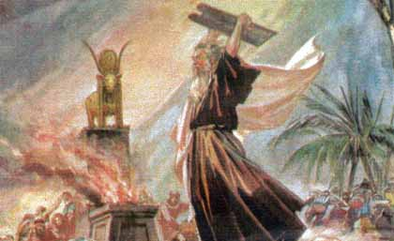
Cycles/ Week
Cycles/ Month
Cycles/ Year
The erroneously extended Omer Count dogma accurately achieves identifying the exact cycle when Mosheh came down from the Mount.
He shattered the Tablets illustrating his contempt after witnessing the
Festival of the Golden Calf!
1st 27
2nd 28
3rd 29
4th 30
Month #4
Month #4
117
118
119
120
4 x 30 =
5th 1
6th 2
7th 3
1st 4
2nd 5
3rd 6
4th 7
5th 8
6th 9
7th 10 1st 11
2nd 12
3rd 13
4th 14
5th 15
6th 16
7th 17
121
122
123
124
125
126
127
128
129
130
131
132
133
134
135
136
137
FALSE OMER COUNT #99/50
Month #5
Month #5

Slide 28
Mosheh shattered the sapphire tablets illustrating the obvious fracture the base revelers had forcefully imposed upon
Yahuah’s Covenant.
28

Slide 29
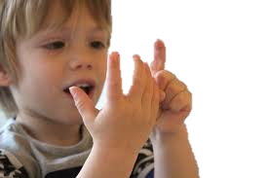
Cycles/ Week
Cycles/ Month
Cycles/ Year
1st 18
2nd 19
3rd 20
4th 21 5th 22
6th 23
7th 24
1st 25
2nd 26
3rd 27
4th 28
5th 29
6th 30
138
139
140
141
142
143
144
145
146
147
148
149
150
FOR THE NEXT SEVERAL SLIDES WE’RE GOING TO KEEP COUNTING YAHUAH’S CALENDAR
TO THE
12TH MONTH
& 360TH DAY.
Month #5
Month #5
5 x 30 =
7th 1 1st 2
2nd 3
3rd 4
4th 5
5th 6
6th 7
7th 8
151
152
153
154
155
156
157
158
Month #6
Month #6

Slide 30

Cycles/ Week
Cycles/ Month
Cycles/ Year
1st 9
2nd 10
3rd 11
4th 12 5th 13
6th 14
7th 15
1st 16
2nd 17
3rd 18
4th 19
5th 20
6th 21 7th 22 1st 23
2nd 24
3rd 25
4th 26
5th 27
6th 28
7th 29
159
160
161
162
163
164
165
166
167
168
169
170
171
172
173
174
175
176
177
178
179
Month #6
Month #6

Slide 31

Cycles/ Week
Cycles/ Month
Cycles/ Year
Month #6
Month #6
1st 30
6 x 30 =
180
2nd TRUMPETS 1
3rd 2
4th 3 5th 4
6th 5
7th 6
1st 7
2nd 8
3rd 9
4th ATONEMENT 10
5th 11
6th 12 7th 13 1st 14
2nd SUKKOT 15
3rd 16
4th 17
5th 18
6th 19
7th 20
181
182
183
184
185
186
187
188
189
190
191
192
193
194
195
196
197
198
199
200
Psa 90:12 Teach us to number our days, And let us bring the heart to wisdom.
Month #7
Month #7
Month #7

Slide 32
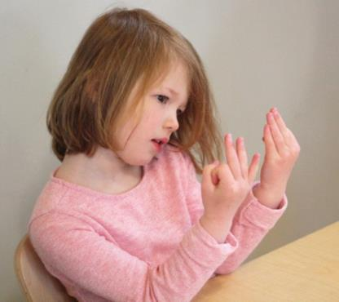
Cycles/ Week
Cycles/ Month
Cycles/ Year
1st 21
2nd Shemini Atzeret 22
3rd 23
4th 24
5th 25
6th 26
7th 27
1st 28
2nd 29
3rd 30
201
202
203
204
205
206
207
208
209
210
Month #7
Month #7
7 x 30 =
4th 1
5th 2
6th 3 7th 4 1st 5
2nd 6
3rd 7
4th 8
5th 9
6th 10
7th 11
211
212
213
214
215
216
217
218
219
220
221
Month #8
Month #8

Slide 33
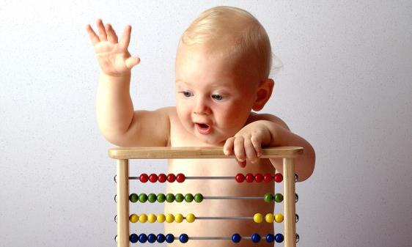
Cycles/ Week
Cycles/ Month
Cycles/ Year
1st 12
2nd 13
3rd 14
4th 15
5th 16
6th 17
7th 18
1st 19
2nd 20
3rd 21 4th 22
5th 23
6th 24 7th 25 1st 26
2nd 27
3rd 28
4th 29
5th 30
222
223
224
225
226
227
228
229
230
231
232
233
234
235
236
237
238
239
240
Month #8
Month #8
8 x 30 =
Month #9
6th 1
7th 2
241
242
Month #9

Slide 34

Cycles/ Week
Cycles/ Month
Cycles/ Year
1st 3
2nd 4
3rd 5
4th 6
5th 7
6th 8
7th 9
1st 10
2nd 11
3rd 12 4th 13
5th 14
6th 15 7th 16 1st 17
2nd 18
3rd 19
4th 20
5th 21
6th 22
7th 23
243
244
245
246
247
248
249
250
251
252
253
254
255
256
257
258
259
260
261
262
263
Month #9
Month #9

Slide 35

Cycles/ Week
Cycles/ Month
Cycles/ Year
1st 24
2nd 25
3rd 26
4th 27
5th 28
6th 29
7th 30
264
265
266
267
268
269
270
Month #9
Month #9
9 x 30 =
1st 1
2nd 2
3rd 3 4th 4
5th 5
6th 6 7th 7 1st 8
2nd 9
3rd 10
4th 11
5th 12
6th 13
7th 14
271
272
273
274
275
276
277
278
279
280
281
282
283
284
Month #10
Month #10

Slide 36

Cycles/ Week
Cycles/ Month
Cycles/ Year
1st 15
2nd 16
3rd 17
4th 18
5th 19
6th 20
7th 21
1st 22
2nd 23
3rd 24 4th 25
5th 26
6th 27 7th 28 1st 29
2nd 30
285
286
287
288
289
290
291
292
293
294
295
296
297
298
299
300
Month #10
Month #10
10 x 30 =
3rd 1
4th 2
5th 3
6th 4
7th 5
301
302
303
304
305
Month #11
Month #11

Slide 37

Cycles/ Week
Cycles/ Month
Cycles/ Year
1st 6
2nd 7
3rd 8
4th 9
5th 10
6th 11
7th 12
1st 13
2nd 14
3rd 15 4th 16
5th 17
6th 18 7th 19 1st 20
2nd 21
3rd 22
4th 23
5th 24
6th 25
7th 26
306
307
308
309
310
311
312
313
314
315
316
317
318
319
320
321
322
323
324
325
326
Month #11
Month #11

Slide 38

Cycles/ Week
Cycles/ Month
Cycles/ Year
1st 27
2nd 28
3rd 29
4th 30
327
328
329
330
Month #11
Month #11
11 x 30 =
5th 1
6th 2
7th 3
1st 4
2nd 5
3rd 6 4th 7
5th 8
6th 9 7th 10 1st 11
2nd 12
3rd 13
4th 14
5th 15
6th 16
7th 17
331
332
333
334
335
336
337
338
339
340
341
342
343
344
345
346
347
Month #12
Month 12

Slide 39
Recent teachings have surfaced that declare the Tabernacle was raised on a normal cycle of the week. The declaration is made that because the Tabernacle was raised (unacceptable WORK by man’s standards) that it had to be a weekly cycle and that the Tequfah was on the very day it was raised. The reasoning given is that the Tequfah shadow was used to orientate the Tabernacle accurately.
Most certainly the Tequfah Shadow Light was used to orient the foundation of the Tabernacle. Let’s look at it shall we?
Exo 40:17 Thus was the Tabernacle reared vp the first day of the first moneth in the seconde yeere.
Geneva

Slide 40

What physical reason caused Yahuah to command the Tent of Meeting to be raised on the 1st cycle of the
2nd year?

Slide 41

Why did Yahuah wait until the year end to PREPARE – {stake out the foundation} - for the
Tent of Meeting?
41

Slide 42
Why was there only one highly specific cycle of the Shaneh (year) upon which the foundation for the Dwelling Place could be accurately oriented?
*
Gen 1:14
42

Slide 43
Could this factor tie in with the
TEQUFAH SHADOW LIGHT?
Would the Tequfah render pertinent information for laying the Wilderness Tabernacle FOUNDATION on the last cycle of the year?
Might the TEQUFAH shadow have corresponded appropriately on a PREPARATION
cycle - IMMEDIATELY BEFORE raising
the Tent of Meeting ?
43

Slide 44
Have we been noticing that Yahuah purposely organizes the Preparation days perfectly –
being immediately before
VERY IMPORTANT EVENTS?
Is there a Preparation lesson to be learned here?

Slide 45


Cycles/ Week
Cycles/ Month
Cycles/ Year
Tequfah is the last cycle of
the year - 360!
On this PREPARATION, Mosheh staked out the measurements on the ground according to
the Shadow Light for proper
Tent of Meeting orientation.
1st 18
2nd 19
3rd 20
4th 21
5th 22
6th 23
7th 24
1st 25
2nd 26
3rd 27 4th 28
5th 29
6th 30
348
349
350
351
352
353
354
355
356
357
358
359
360
Month #12
Month 12
A Preparation!
Tequfah!
12 x 30 =
The importance of orienting the Dwelling Place accurately is clearly understood from Solomon’s Temple. The orientation was specifically to determine the cycle of the Tequfah.
The Light of the sun on the Tequfah cycle, was to enter into the Qodesh Place.
We understand this from Solomon’s Temple with the two entrance pillars of Yakin and Boaz.

Slide 46
Cycles/ Week
Cycles/ Month
Cycles/ Year
Tequfah is the last cycle of the year - 360! On this PREPARATION, Mosheh staked out the measurements on the ground according to the Shadow Light for proper Tent of Meeting orientation.
1st 18
2nd 19
3rd 20
4th 21
5th 22
6th 23
7th 24
1st 25
2nd 26
3rd 27 4th 28
5th 29
6th 30
348
349
350
351
352
353
354
355
356
357
358
359
360
Month #12
Month 12
A Preparation!
Tequfah!
12 x 30 =
Next Cycle, Yahuah’s Shabbat - Raise the Tabernacle!
Exo 40:2
Yahuah’s Work: Raise the Tent of Meeting, on His Premier Mo-ed!
New Year Cycle #1
7th 1 1st 2
2nd 3
3rd 4
4th 5
5th 6
6th 7
7th 8
1
2
3
4
5
6
7
8
Month #1
Month #1 Year #2

Slide 47
Just as the Shewbread was commanded to be renewed on Shabbat morning,
the Tabernacle was commanded to be
raised up on the Shabbat.
This was the commanded will of Yahuah.
His Works of Righteousness -
to be done by man, on HIS SHABBAT!
NO PROBLEM HERE!
47

Slide 48
Cycles/ Week
Cycles/ Month
Cycles/ Year
1st 18
2nd 19
3rd 20
4th 21
5th 22
6th 23
7th 24
1st 25
2nd 26
3rd 27 4th 28
5th 29
6th 30
348
349
350
351
352
353
354
355
356
357
358
359
360
Month 12
Is not the 6th Cycle a
PREPARATION?
Be PREPARED is what the Scriptures teach
“through and throughout”
Yahuah’s Word, from
beginning to end!
Do you think Mosheh understood this?
REPEATED SLIDE
Month #12
Tequfah!
7th 1 1st 2
2nd 3
3rd 4
4th 5
5th 6
6th 7
7th 8
1
2
3
4
5
6
7
8
Month #1
Month #1 Year #2

Slide 49
Cycles/ Week
Cycles/ Month
Cycles/ Year
Month 12
1st 18
2nd 19
3rd 20
4th 21
5th 22
6th 23
7th 24
1st 25
2nd 26
3rd 27 4th 28
5th 29
6th 30
348
349
350
351
352
353
354
355
356
357
358
359
360
REPEATED SLIDE
Mosheh might have arranged for someone to pick his double portion of manna on that Preparation cycle. That way, he and other men could PREPARE THE FOUNDATION MEASUREMENTS of the Tabernacle by the
Tequfah Shadow Light.
Month #12
Tequfah!
Tequfah!
7th 1 1st 2
2nd 3
3rd 4
4th 5
5th 6
6th 7
7th 8
1
2
3
4
5
6
7
8
Month #1
Month #1 Year #2

Slide 50
Cycles/ Week
Cycles/ Month
Cycles/ Year
Mosheh was not on a knee jerk scramble to raise the Tabernacle as the Shadow event WAS OCCURRING!!
Yahuah is
ALL ABOUT PREPARATION!
Mosheh PREPARED THE FOUNDATION according to the Tequfah Shadow.
Next cycle, the Shabbat, Mosheh was fully prepared and acted with precision on the plans made the previous cycle, ON THE TEQUFAH!
1st 18
2nd 19
3rd 20
4th 21
5th 22
6th 23
7th 24
1st 25
2nd 26
3rd 27 4th 28
5th 29
6th 30
348
349
350
351
352
353
354
355
356
357
358
359
360
Month 12
Month #12
REPEATED SLIDE
Tequfah!
7th 1 1st 2
2nd 3
3rd 4
4th 5
5th 6
6th 7
7th 8
1
2
3
4
5
6
7
8
Month #1 Year 2
Month #1 Year #2

Slide 51
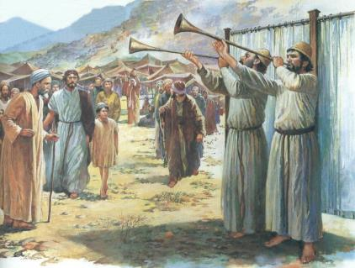
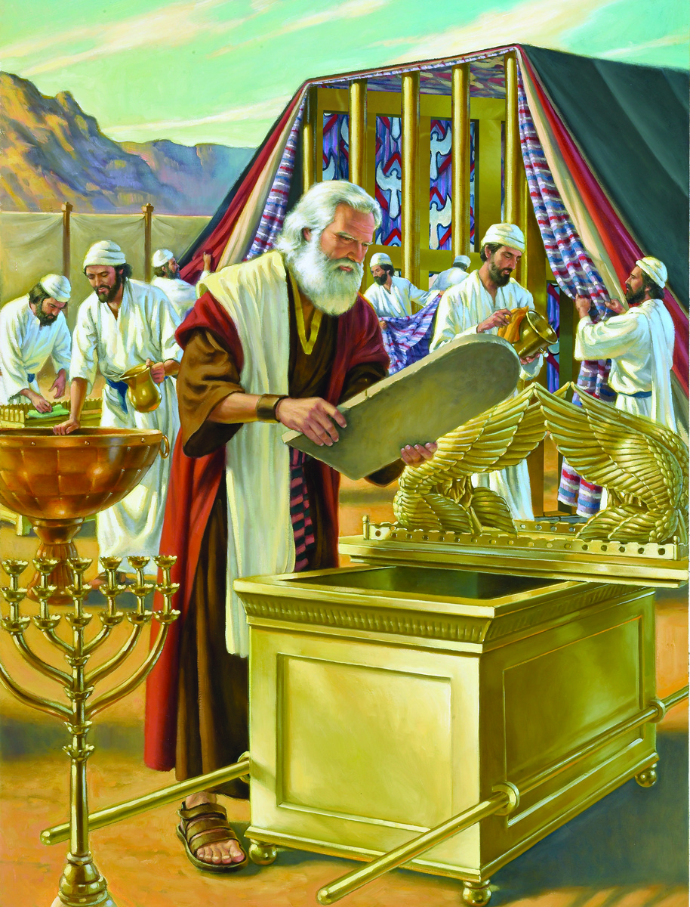
Exo 40:2 “On the
first day of the
first month,
you are to raise up
the Dwelling Place of
the Tent of Meeting.
Exo 40:16 And Mosheh did according to all that יהוה had commanded him, so he did.
Exo 40:17 And it came to be in the first month of the second year, on the first day of the month, that the Dwelling Place was raised up.

Slide 52
You might say, this one example does not prove anything because the Scriptures demand two or three witnesses - at the least!
Be certain that there are multiple Tequfah witnesses coming very soon! ☺
Meanwhile, let’s continue our search to see
what else happens in the 2nd year.
52

Slide 53
We have highlighted one
sledge hammer effect to the
Lunar Shabbat calendar (Slides18 &19). Would it be interesting
to view another?
Real Soon?
53

Slide 54
Cycles/ Week
Cycles/ Month
Cycles/ Year
1st 9
2nd 10
3rd 11
4th 12
5th 13
6th 14
7th 15
1st 16
2nd 17
3rd 18 4th 19
5th 20
6th 21
7th 22 1st 23
2nd 24
3rd 25
4th 26
5th 27
6th 28
7th 29
9
10
11
12
13
14
15
16
17
18
19
20
21
22
23
24
25
26
27
28
29
Look! Shabbat on the 15th, 22nd, and 29th exactly as the Lunar Shabbat Calendar requires!
Can we expect the same FIXED MO-EDIM next month - as the Lunar Shabbat requirement demands?
Month #1 Year 2
Month 1
Passover
*
U/B
Yahuah declares of His Patterns – “… I shall not change …”
(Mal 3:6)
Will Yahuah’s Pattern change
with the Shabbat next month?
*
*

Slide 55
Cycles/ Week
Cycles/ Month
Cycles/ Year
1st 30
30
Month #1 Year 2
HHHMMM! The Shabbat Pattern here is different than the FIXED
8th, 15th, 22nd, & 29th
LUNAR REQUIREMENT! !!!!!!!
Is it possible that the FIXED LUNAR SHABBAT REQUIREMENT did not
originate from Yahuah?
2nd 1
3rd 2
4th 3
5th 4
6th 5
7th 6
1st 7
2nd 8
3rd 9 4th 10
5th 11
6th 12
7th 13
1st 14
2nd 15
3rd 16
4th 17
5th 18
6th 19
7th 20
Month 2
31
32
33
34
35
36
37
38
39
40
41
42
43
44
45
46
47
48
49
50
Month #2 Year 2
*
*
Count on it!
*

Slide 56
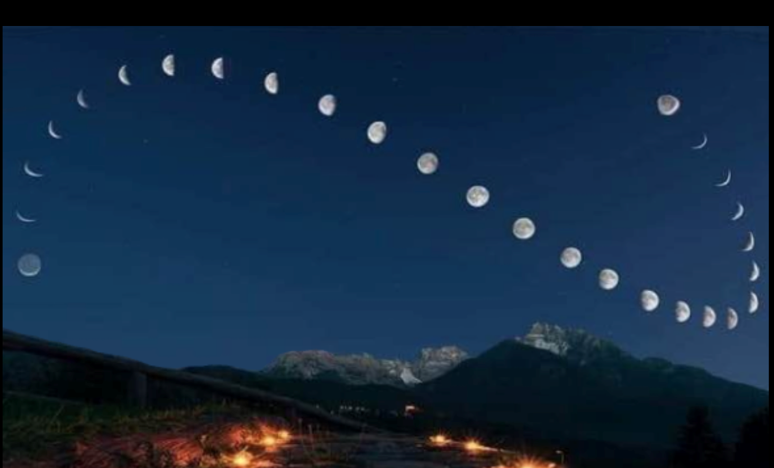


Where are the sequential
28 - 29.5 moon phases?
27th! conjunction
Moving forward with a “lunar look” from – a Numbers 10 study about -
Yahuah’s Cloud!

Slide 57
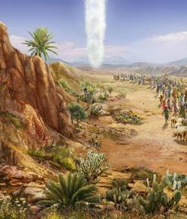
Function of the Cloud
Num 9:19 Even when the cloud lingered many days
above the Dwelling Place, the children of Yisra’ĕl
guarded the Charge of יהוה, and did not depart.
Num 9:20 And so it was, when the cloud was above the Dwelling Place a few days: according to the command of יהוה they camped, and according to the command of יהוה they would depart.
Num 9:21 And so it was, when the cloud dwelt only from evening until morning: when the cloud was taken up in the morning, then they departed. Whether by day or by night, whenever the cloud was taken up, they departed.

Slide 58
The Shabbat of Yahuah
The Shabbat of Yahuah requires a REST
from our servile work processes.
We have just learned that on Yahuah’s Shabbat, we can preform the work of Righteousness as Yahuah so commands us.
Did Yahuah also have the Yisra’elite nation travel on the Shabbat, looking for a resting place?

Slide 59
The Three Cycle Journey
Num 10:33 So they set out from the mountain of יהוה [Yahuah] on a journey of three days. And the ark of the covenant of יהוה [Yahuah] went before them for the
three days’ journey, to seek out a resting place for them.
Will this very specific three cycle journey support
the lunar Shabbat calendar?
Or will the lunar system AGAIN be exposed as a false doctrine?

Slide 60
Cycles/ Week
Cycles/ Month
Cycles/ Year
Function of the Cloud
1st 30
30
Month #1 Year 2
Before we continue,
A REMINDER:
The Lunar Sabbath Calendar demands their Sabbaths on the 8th, 15th, 22nd, and 29th of their lunar phase calculated months.
2nd 1
3rd 2
4th 3
5th 4
6th 5
7th 6
1st 7
2nd 8
3rd 9 4th 10
5th 11
6th 12
7th 13
1st 14
2nd 15
3rd 16
4th 17
5th 18
6th 19
7th 20
Month 2
31
32
33
34
35
36
37
38
39
40
41
42
43
44
45
46
47
48
49
50
Month #2 Year 2
Num 10:11 And it came to be on the twentieth day of the second month, in the second year, that the cloud was taken up from above the Dwelling Place of the Witness.

Slide 61

Cycles/ Week
Cycles/ Month
Cycles/ Year
Month #1 Year 2
1st 21
2nd 22
3rd 23
4th 24
5th 25
6th 26
7th 27
1st 28
2nd 29
3rd 30
Month 2
51
52
53
54
55
56
57
58
59
60
1
The three cycles of travel included the 21st, 22nd, and 23rd cycles of the month.
They were already in a resting place, and Yahuah wanted them to find another resting place.
This was an exercise in obedience.
Would Yahuah then have them travel
on the 7th day Sabbath, looking for a resting place when they already had one?
Is it possible that the 22nd of this month was not Yahuah’s Shabbat?
2
3
Not a
FIXED Shabbat according to Yahuah!
Month #2 Year 2
4th 1
5th 2
6th 3
7th 4
1st 5
2nd 6
3rd 7
4th 8
5th 9
6th 10
7th 11
61
62
63
64
65
66
67
68
69
70
71
What impact does this have on
the Lunar Shabbat calendar?

Slide 62
The first cycle of the second year, was a Shabbat.
The command was to raise up the Dwelling Place of Yahuah.
Thus they carried out the command of Righteousness.
Here, in the wilderness, the cloud lifted and the nation of Yisra’el had to pack up their belongings, burden their pack animals and
pack up the Tent of Appointment. Woman, children and men had to walk three days with their personal burdens, and move their livestock, to find another resting place!
Was moving their personal residences an act of righteousness
on the 22nd – on a supposed Lunar Shabbat?
Where do we find a written example of the Hebrew nation travelling on a Shabbat?
The End

Slide 63

DON’T LET TRADITION “BOX” YOU IN!
May Yahuah bless you greatly with wisdom, peace
and courage.
Shalom!
Send your questions and/or responses to –
questions@studythecalendar.com

Slide 64



!
X
D
E
E
P
E
T
C

Slide 65

!
X
D
E
E
P
E
T
C

Slide 66
!
E
X
P
E
C
T
E
D
!
X
P
E
C
T
E
D
E

Slide 67
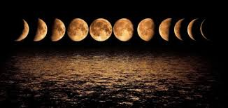
Moving forward with a “lunar look” from – a Numbers study with
Yahuah’s Cloud!
67

