Slide 1
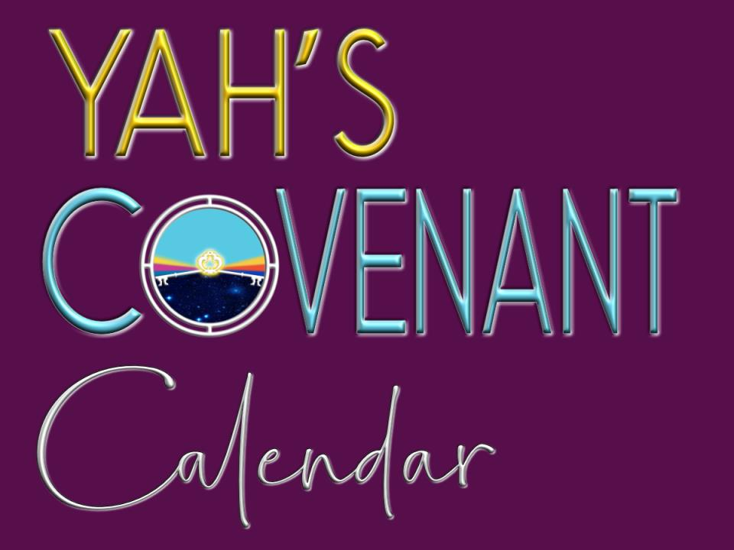

Slide 2
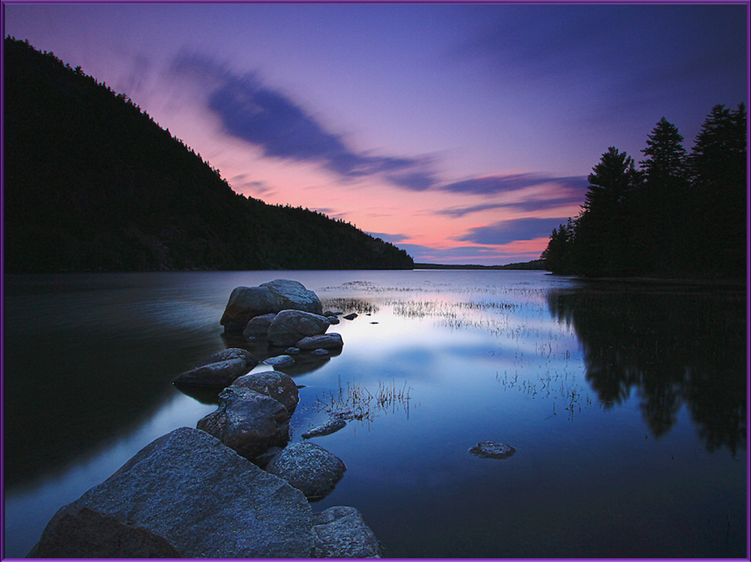

When Does the Day Begin?
(Part 2)
(According to the Torah)

Slide 3

When Does the Day Begin?
(According to You?)

Slide 4
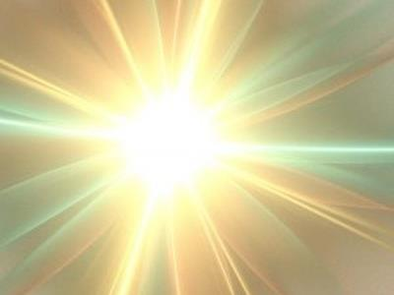

When Does the Day Begin
according to
?

Slide 5
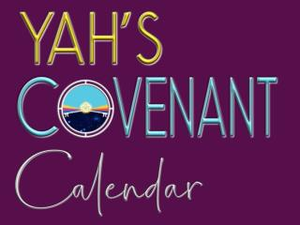
Yahuah is Light.
He is never
referred to as “darkness” in Gen 1.
On the 1st day of creation
(in vs 1)
the earth was illuminated with Yahuah’s Light.

Slide 6
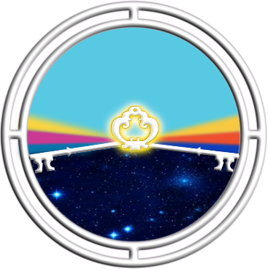
“Light” began the first 24 hour cycle – on the 1st day
until “Light” appeared again to begin the second 24 hour cycle.
Everything about
Yahuah’s day-start
is from “light” to “light.”

Slide 7
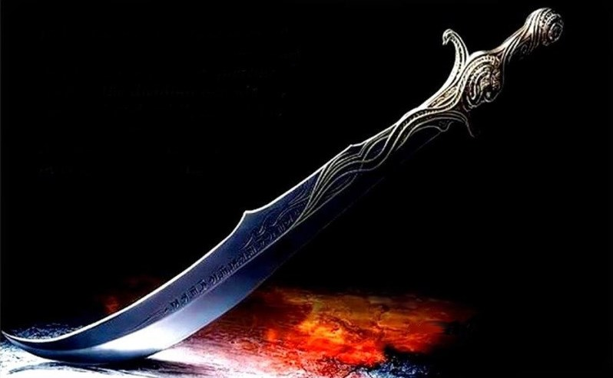
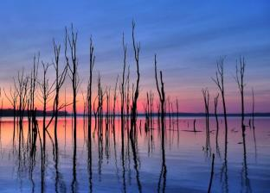
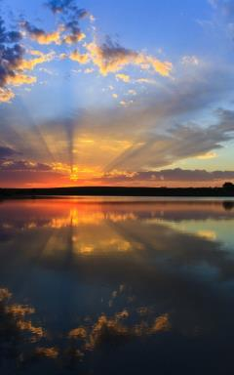
If Yahuah’s day-start is with “light” then ~
why do most Sabbath keepers begin their day with the sunset?

Slide 8
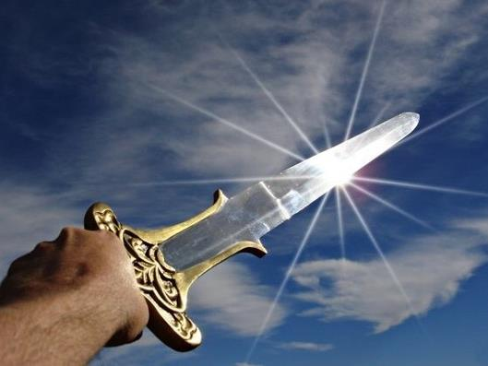
That is the question that needs an answer for this topic!
This issue
started in the
beginning before the verse of Genesis 1:1.

Slide 9

In heaven, before Gen 1:1, Lucifer usurped worship rightly belonging
to only Yahuah.
Being cast to this earth, the plan of Yahuah’s enemy has not changed.
There is one way Satan has accomplished his goal through an interesting deception.

Slide 10
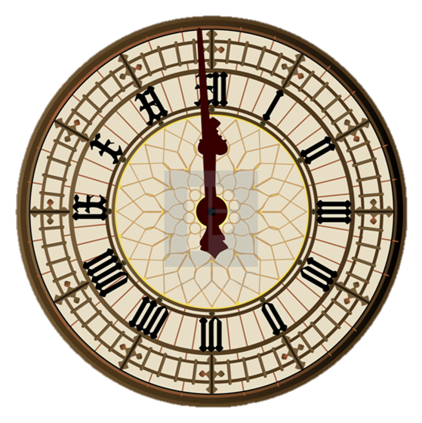
How? Satan has stolen worship due to the Creator by changing Yahuah’s calendar used to find
His weekly & annual worship statutes.

Slide 11
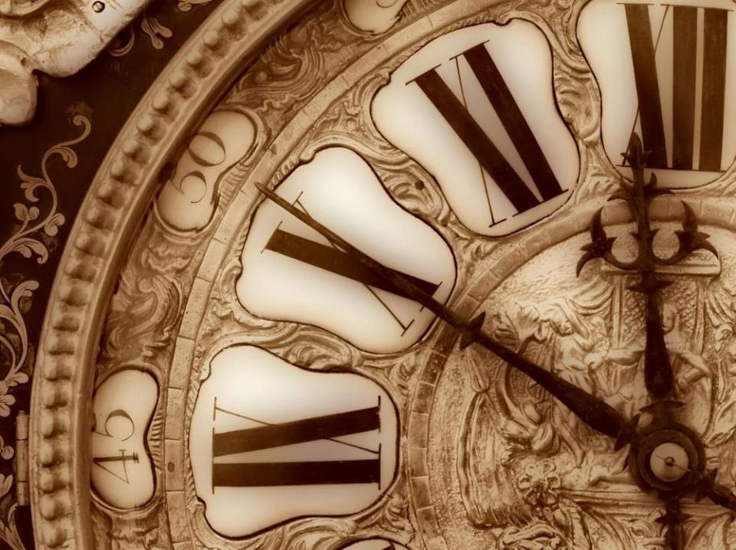
But that is not all
he has changed.
He has even changed
when the day begins for
Yahuah’s worship statutes.
11

Slide 12
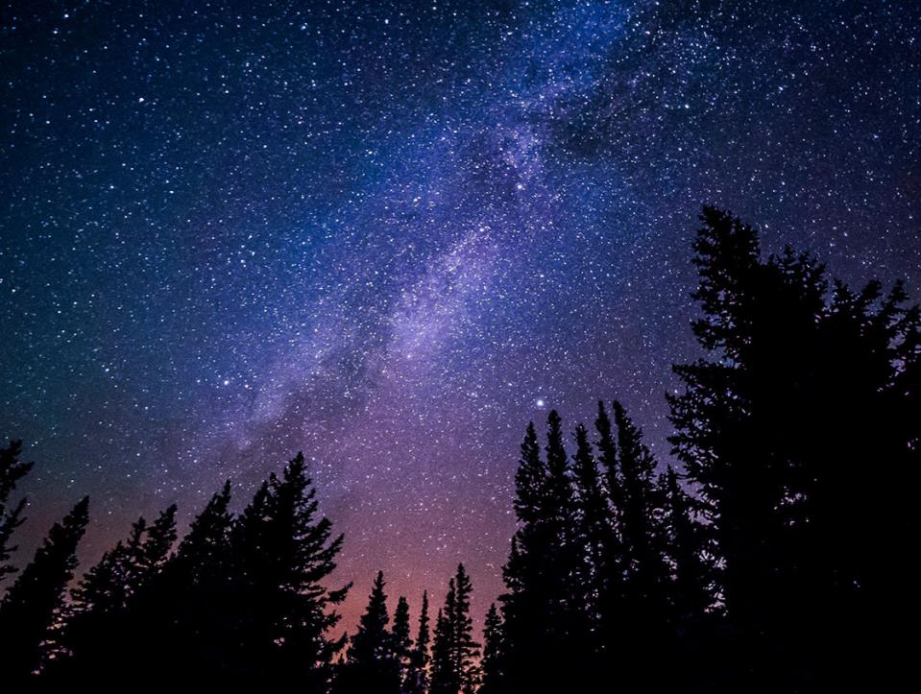
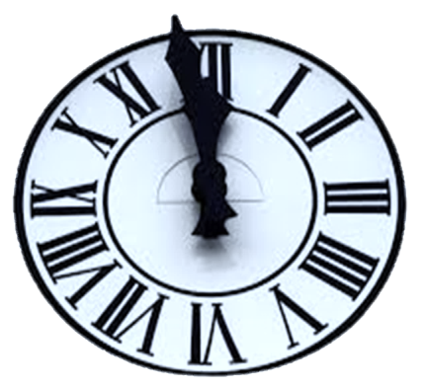
The modern 24 hour “day”
begins at midnight.
This is known as the civil
Roman Reckoning of time
as found in the Gospels.
[See Matt 27:19.]
12

Slide 13
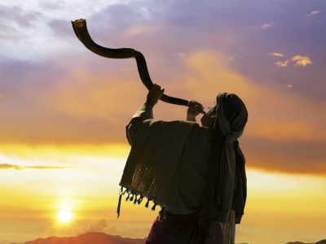
Jews and most
“feast-keeper” Sabbatarians
begin their Sabbath
Friday evening at sunset.

Slide 14
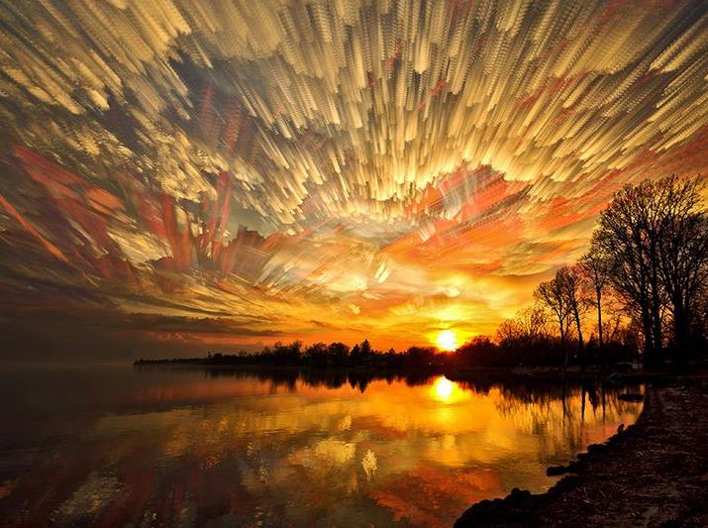
Julian Morgenstern
The Ancient Calendars of Israel (pg 103)
Remember, the weekly Sabbath is the premier flagship
of Yahuah’s festivals (Lev 23:2-8). Note there is a massive amount of information thoroughly exposed in the Scriptures
which is succinctly summed up as follows:
“To Period IIa [approx. 700 -300 BC], belong those processes which practically completed the EVOLUTION of Calendar III as a perfect, or approximately perfect luni-solar calendar, viz., the CHANGE in the system of reckoning the day, the RE-DATING of the festivals to begin at sunset, and with this the final and complete fusion of the Passover and Mazzot festivals, as recorded in Exo 12:18, the NEW SYSTEM of months of alternately thirty and twenty-nine days each and the NEW SYSTEM of intercalation.” [Changed from Torah’s Dawn to Dawn, and the Mazzaroth/Tequfah Light based calendar reckoning.]

Slide 15
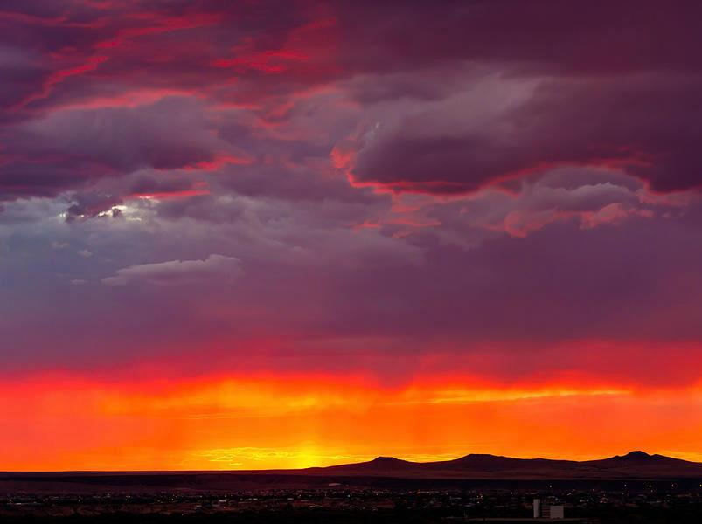


However, Scripture reveals when the day begins and
it is neither midnight, noon,
sunset, evening or sunrise!
Let’s start with
an introduction first
of literal events before
moving to definitions.
Literal Event
Definitions
15

Slide 16
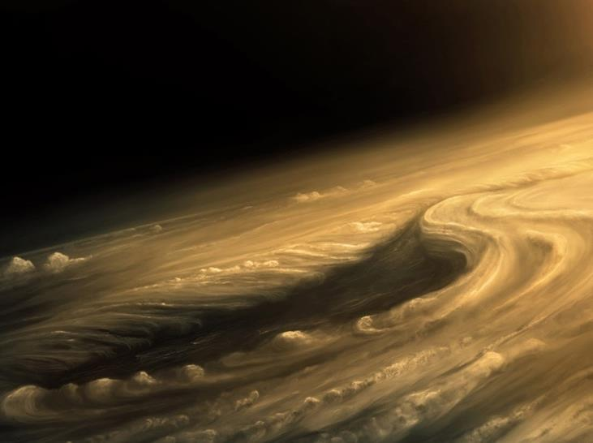
Creation’s restoration began after the earth became
[H1961 eithe - “came to be”]
void, formless & dark.
(Gen 1:2a)
This “darkness” is <choskek H2822> not <layil/night H3915>.
Literal Event

Slide 17
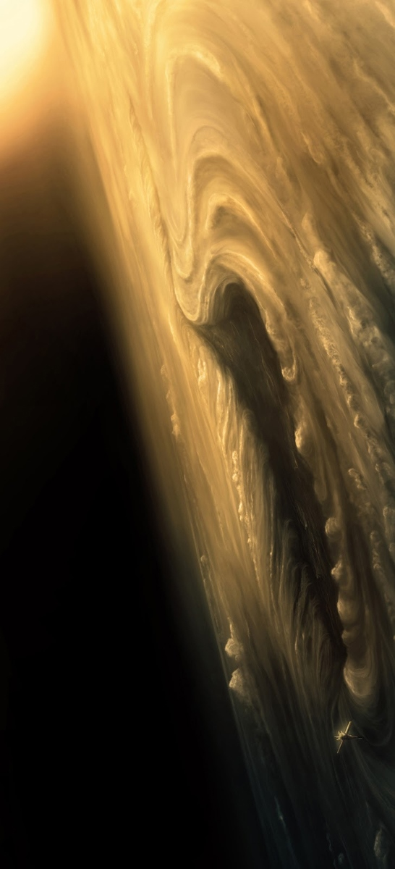
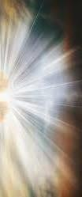
“And the
Ruach moved
upon the face
of the waters.”
(Gen 1:2b)
“And there was
[or - “came to be”]
Light <`owr>.”
(Gen 1:3b)
Literal Event

Slide 18
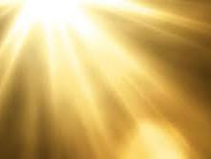
The restoration* of the
Creation week began
when our Creator said,
“Let there be light.”
Nothing started
with darkness!
*Ps 104:30 Thou sendest forth thy spirit, they are created:
and thou RENEWEST the face of the earth. KJV
Literal Event

Slide 19
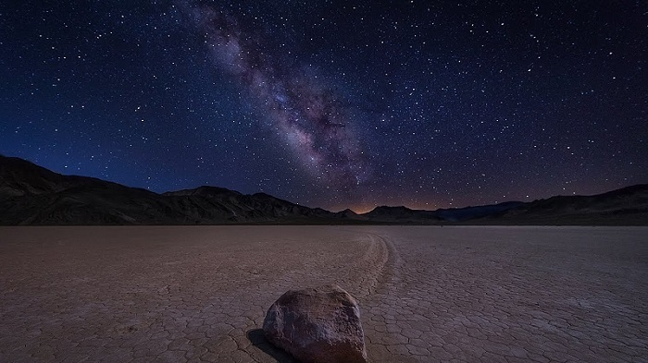
The first day of the first week could NOT begin with
< choshek> darkness,
nor could it begin with
evening <ereb/H6153>.
Remember:
In vs 1, Day One began with the Light of Yahuah’s presence.
Definitions

Slide 20
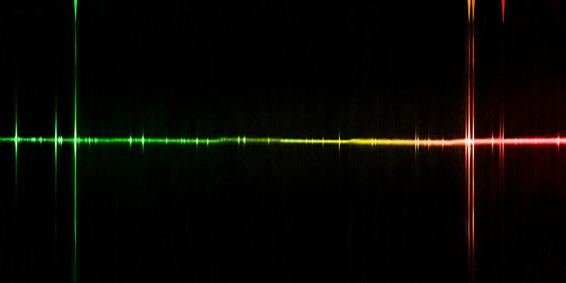
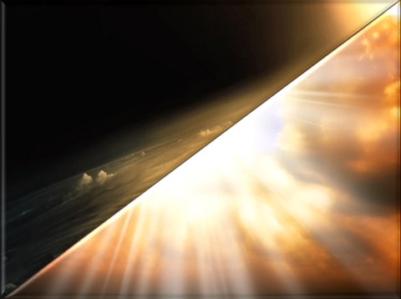
“And [then] … Yahuah divided the light from the darkness.”
(Gen 1:4)
Literal Event

Slide 21
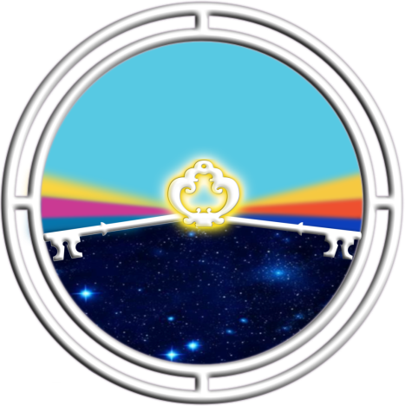
“Yahuah called the light* …
And
the
darkness*
He called
Day*
Night*
Definitions
(Gen 1:5a)
* These are “definitions” for calendar terms.
Literal Event

Slide 22


This was the first covenant given
on the 1st day of Creation, called
the “covenant of the day and the covenant of the night.”
Definition
Day
Night
(Jer 33:20-25)

Slide 23
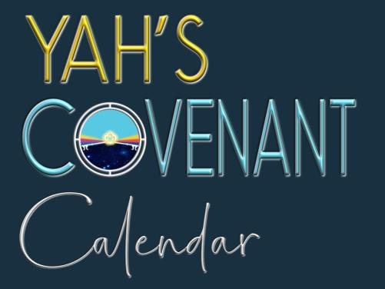
This is a very special covenant
and the beginning of:
This calendar is completely
based on “light”
just as Yahuah is “Light”!
Definition

Slide 24



Before we go any further let’s examine some charts that will diagram the outline for day-start in Yahuah’s Creation Week.

Slide 25
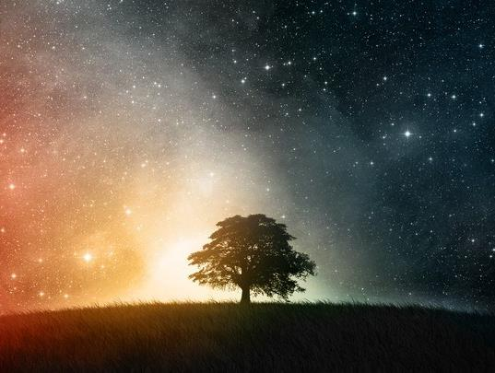


Special Attention for Genesis 1 verse 5!
Two Concepts of Gen 1:5
Gen 1:5 is the most important verse in the creation week for establishing two different concepts that must not be confused.
Concept A
Gen 1:5
Definitions of Terms
Concept B Gen 1:5
The Literal Events
What is the
next step?

Slide 26
Two Concepts of Gen 1:5
Let’s expand Concept A and Concept B.
Concept A Gen 1:5
Definitions of Terms
Concept B Gen 1:5
Order of Literal Events
Genesis 1:5
provides the Scriptural definitions needed to correctly establish the proper day-start.
The order of the literal events for the “day-start” in vs 5
[on the 1st day of creation], are very different from the “day-start” on following days.
Let’s expand Concept A further.

Slide 27
Gen 1 Definitions for day-start
Special Attention to Concept A
Definitions will help us understand the full literal meaning of day-start in Genesis 1.
Concept A
Gen 1:5
Definitions of Terms
Light <`owr> & Day <yowm>
Darkness <choshek> & Night <layil>
Evening <ereb> & Morning <boqer>
[Twilight <nesheph>]
As needed the definitions will be given.
Next: Let’s expand Concept B further.

Slide 28
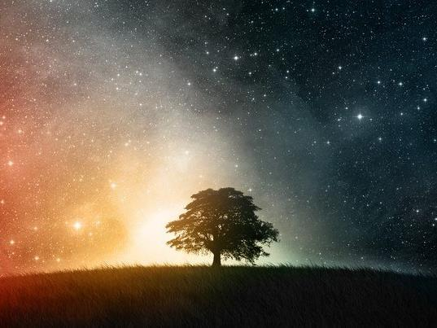


Two Concepts of Gen 1:5
Special Attention to Concept B
Concept A Gen 1:5
Definitions of Terms
Concept B Gen 1:5
Order of Literal Events
Gen 1:5 also provides the Scriptural definitions needed to properly establish the proper day-start.
The literal event in verse 5 for
the “day-start” [on the 1st day of creation], is very different from
the “day-start” on following days.
#1
Day 1 of Creation
Day begins with Yahuah’s `owr LIGHT
#2-3-4
Days 2, 3, & 4 of Creation
Days begin with Yahuah’s boqer light
#5
Day 5 of Creation and forward
Days begin with the sun’s boqer light
Definition
When all these concepts are fully explained, THEN Gen 1:5 comes into clear focus.
Literal Event

Slide 29
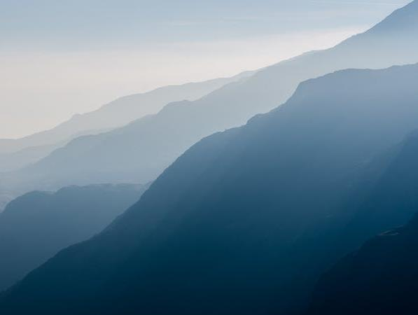
Gen 1 Definitions for day-start
Getting Started with Concept A
Concept A
Gen 1:5
Definitions of Terms
Day <yowm/H3117>
i) the warm [12] hours of the day season;
ii) the full 24 hour cycle of day and night
Darkness <choshek/H2822>
i) literally very obscure & contaminated darkness understood first in Gen 1:2
Light <`owr/H216>
i) illumination after daybreak
Night <layil/H3915>
i) a twist away of the light
Evening <ereb/H6153> i) dusk
Morning <boqer/H1242> i) dawn
[Twilight <nesheph/H5399>]
i) dusk ii) dawn
Definition

Slide 30
The word “day” is often misunderstood by most people.
When Moses wrote the
book of Genesis, he totally understood this word “day.”
In Genesis, Yahuah defined the word “day” as including both twilight transition times,
of evening and morning.
Definition

Slide 31
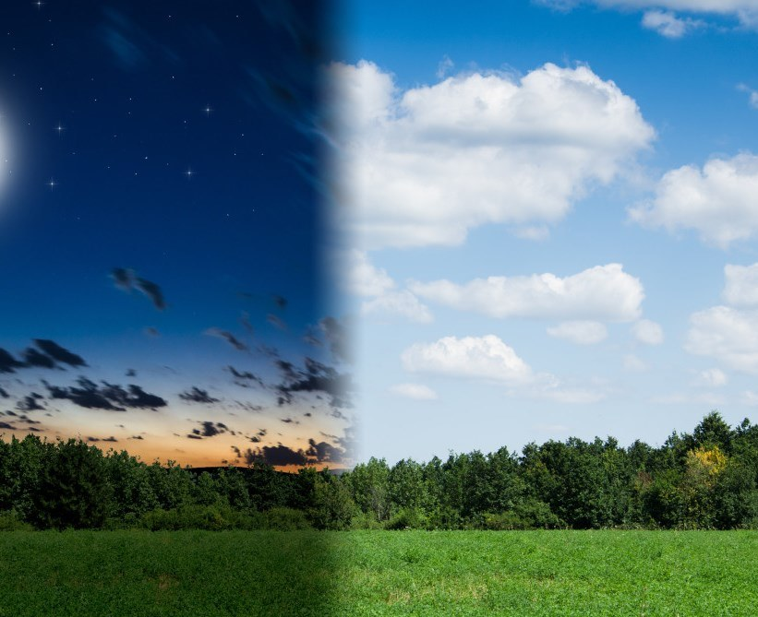
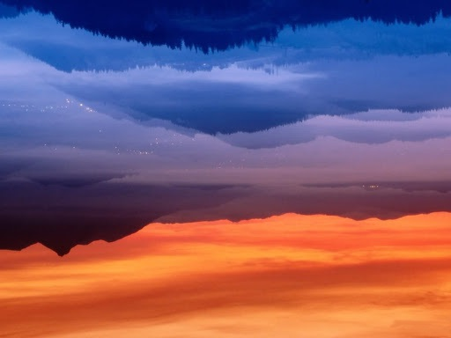

1st Definition for “day/yowm” is:
the warm hours of the day
to be hot [Day Season]
In other words:
From the beginning
of morning to the
end of evening
[or about 12 hours
or 12 segments
of time.]
Definitions
2nd Definition for
“day/yowm” is the:
full 24 hour cycle
including the
Day Season and
the Night Season.
A Full 24 Hour Cycle
Day Season
Night Season

Slide 32
The word “day/yowm” can be
a confusing word to many.
According to Hebrew #3117 there are two main definitions for “DAY” in the Festal Calendar study
(that will include twilights).
Definitions

Slide 33
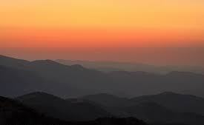
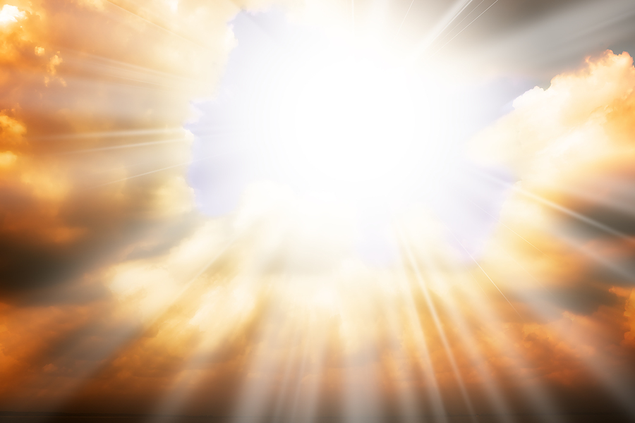
When Yahuah separated the
light from the darkness,
He called the light “Day”
and then …
He defined that “day”
as being made up of
both the evening
and the morning.
Literal Event
Both the evening
& morning twilights
are “mixtures” of
“light” and “darkness.”
That’s why they belong to
the “day” ~ the Light Season.
Definitions
The “Night” has no “light” from the Light Season.

Slide 34
What is a “twilight”?
In Part 1 we discovered:
It is a mixture of
“light” with “darkness.”
Definitions

Slide 35
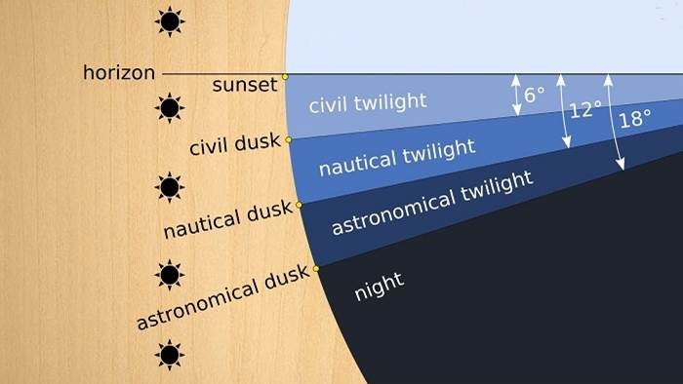

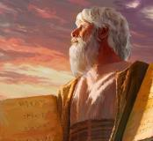
Astronomical twilight marks the day-start.
Day Season
DAWN MARKER
Horizon
Still Before Sunrise
Civil dawn/dusk
DAY
SEASON
Nautical dawn/dusk
Night Season
[No light from the sun]
Astronomical dawn/dusk
Definitions
Moses knew all this!

Slide 36
Now that we know the morning and evening twilights belong to the “day” how long is this day?
12 hours? or 24 hours?
Definition

Slide 37
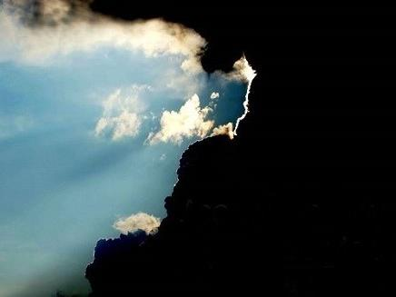
Definitions of Creation Terms in Gen 1:5
Gen 1:5a
“And the light He
called day …”
“… and the darkness
He called Night.”
(Gen 1:5b)
A Full 24 Hour Cycle
DAY SEASON
NIGHT SEASON
Definitions

Slide 38
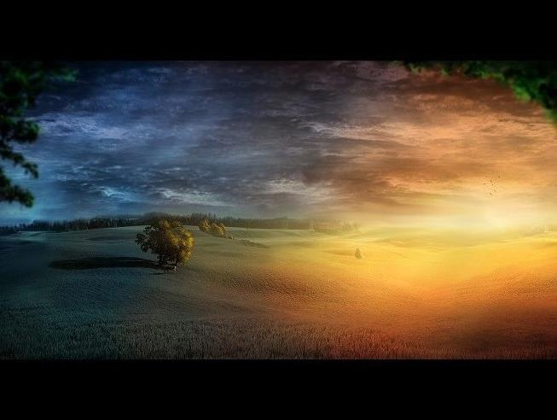
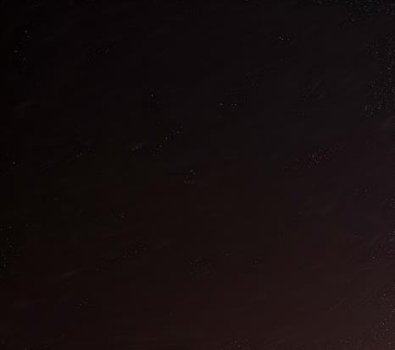
Yahuah’s Creation Term Definitions [con’t]
Light Phase 1* [first 12 hours of creation had occurred]
“… and there
came to be
evening* …”
1st Night Season
Literal Event
[the ONLY TWILIGHT within this Light Season]
DAYLIGHT SEASON INCLUDES ANY TWILIGHT.
Only the 1st Day of creation had just one twilight.
Following the 1st Light Season, the evening twilight arrived.
[On Day 2 the pattern changes & contains two twilights.]
Definitions
* Light Phase 1 of the day-start equation
defines ONLY the 12 hour Day Season.

Slide 39
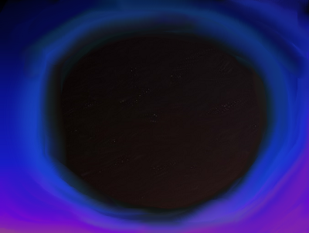
Yahuah’s Creation Term Definitions
Light Phase 2* [the final 12 hours came - AFTER the ereb twilight]
“… and there
came to be
evening* …”
At the end
of the first night
{with boqer/dawn} the
first 24 hour day ends.
One 12 Hour Light Cycle
One 12 Hour Night Cycle
Literal Event
“… one [24 hr] day.* ”
DAY SEASON
(with ONE TWILIGHT)
NIGHT
SEASON
Definitions
* Phase 2 of the day-start equation adds the Night Season finalizing the full 24 hour cycle.

Slide 40
Yahuah’s Creation Term Definitions
“… and
the darkness
He called
Night.”
(Gen 1:5b)
Evening
TWILIGHT
Morning
TWILIGHT
Definition
ALSO CALLED THE NIGHT SEASON

Slide 41
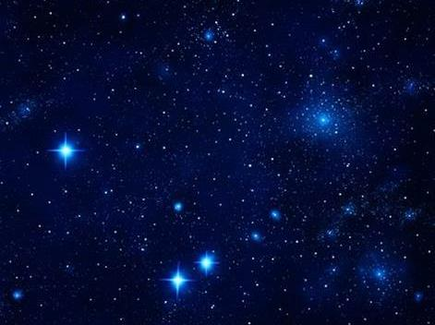
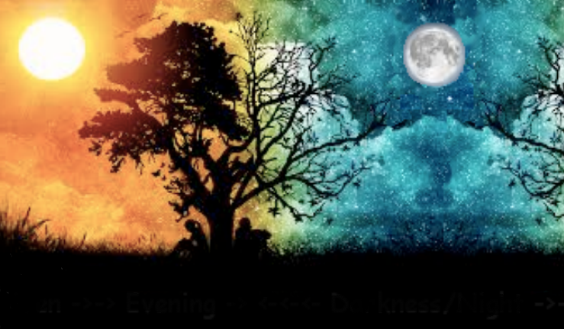
Day One is completed for
Literal Definitions & Events
up to the end of night.
Literal Event
Definition
We are now ready to examine the Literal Events on other days with Concept B.

Slide 42
Literal Events of Concept B
Concept A Gen 1:5
Definitions of Terms
Concept B Gen 1:5
Order of Literal Events
The order of the literal events
for the “day-start” in verse 5 [on the 1st day of creation], is very different from the “day-start” on following days.
Getting Started with the order of events for Concept B
#1
Day 1 of Creation
Day begins with Yahuah’s `owr LIGHT
#2-3-4
Days 2, 3, & 4 of Creation
Days begin with Yahuah’s boqer light
#5
Day 5 of Creation and forward
Days begin with the sun’s boqer light
Literal Event

Slide 43

Each definition in Gen 1:5
is of utmost importance.
The Scriptures have provided the definitions for its calendar terms.
Concept A: Defined the terms
of day, night, evening & morning.
Note: Gen1:5 has another purpose.
Concept B: To give the correct
order of events as they occurred.
Definitions
Literal Event

Slide 44
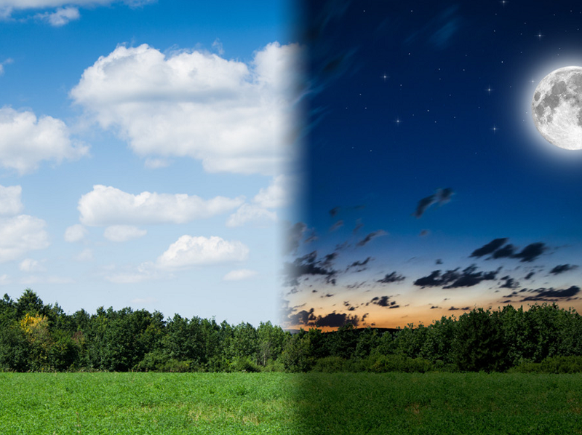
Purpose #1[a]:
Correct Order of Events
for the “Yowm Seasons”
Day Season comes first …
… and Night Season follows.
Literal Event
Definitions

Slide 45
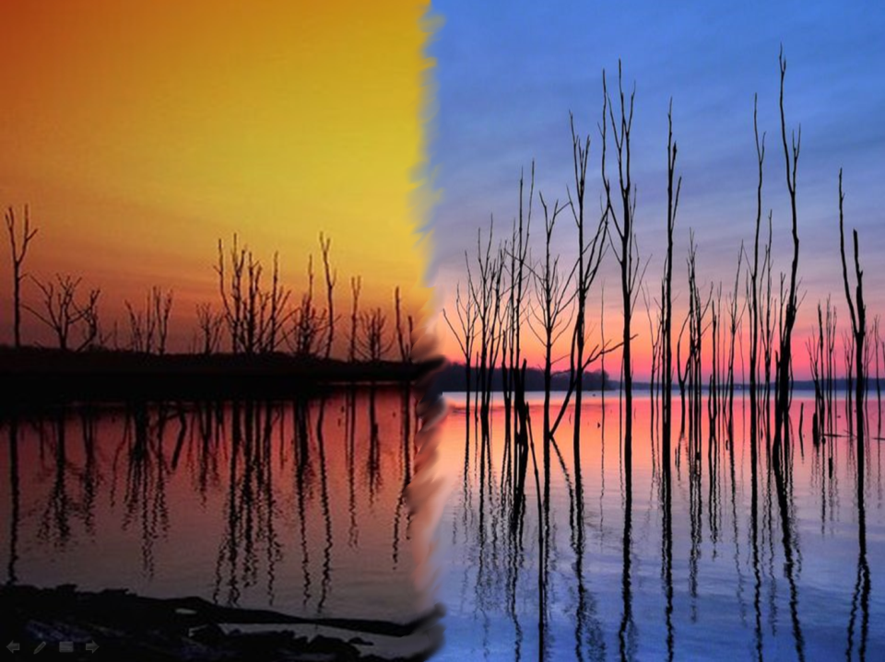
Purpose #1[b]:
Correct Order of Events
for the “Twilight Season”
(on Day One ONLY!)
Following the 1st Light Season of creating,
the 1st Evening arrived … [then night passed]
(Note: at the inception of the first morning twilight,
(that being - BOQER of Light Season #2 ),
this Boqer separating action divided
the 1st 24 hour cycle from the new 2nd 24 hour cycle.)
… and then creation’s 1st morning
twilight (Cycle #2) commenced.
Day #1
Literal Event
Definitions

Slide 46
What else do twilights achieve?
Twilights will always transition:
The Day Season to the Night Season
and/or
The Night Season to the Day Season.
Definitions
Literal Event

Slide 47
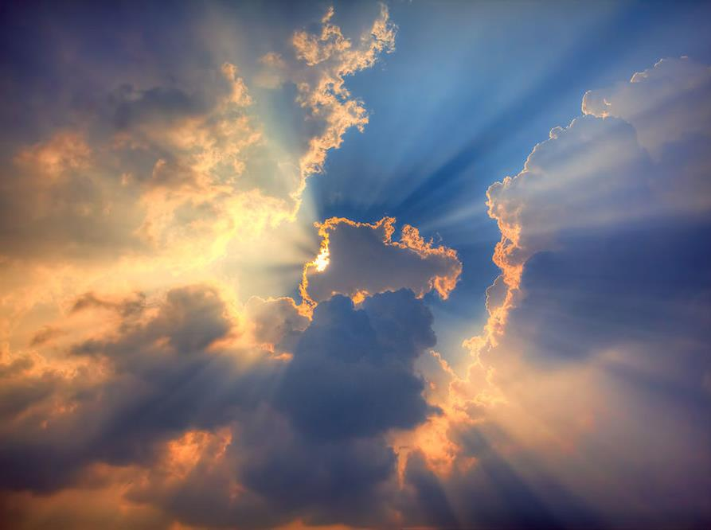
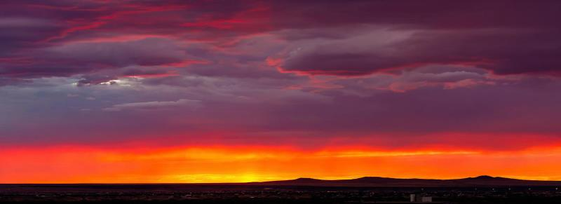
Light was brought forth first
(on Day One) and Light
began the first 24 hour cycle.
Day #1
Literal event
Evening twilight followed
12 hours later.
Evening cannot arrive first as there must be “Light” first to mix with the ensuing “darkness” – the only way a twilight can be produced.
Definitions
Question: How can evening begin a new day
after the passing of the first 12 LIGHT hours?

Slide 48
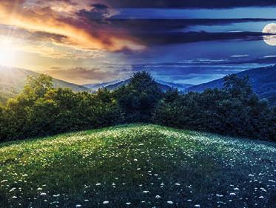
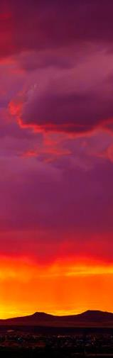
Gen 1:5 Summary for Day One ONLY
Yahusha’s Light
Began
the Day
The End of Darkness
Completed ~
Evening
Twilight
Followed
Definitions
Literal Event
The First Full 24 Hour Cycle

Slide 49
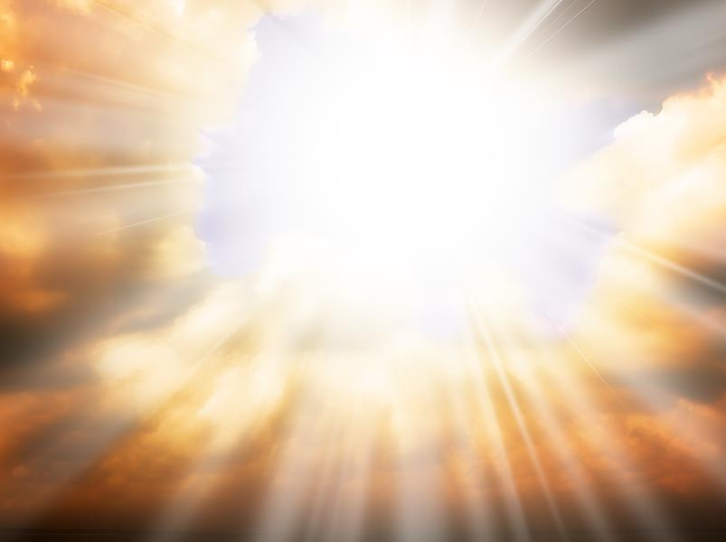
Why has all this information
been given for Day One ONLY?
Answer:
Because Day One began with
a special Pure Light,
{that of Yahusha}
not a morning twilight.
Definitions
Literal Event
This detail will be examined soon according to definitions.

Slide 50
Yahuah’s Creation Term Definitions [con’t]
Light Phase 1* - first 12 hours of
Day #2
Ending
Day #1
The Dawn [boqer] Light, determines the
end of night;
&, the end of the 1st day.
“… and there
came to be
morning* …”
Literal Events
Next, the 2nd DAYLIGHT SEASON will contain two twilights.
[Only the 1st Day has just one twilight; evening arriving first.]
Beginning with Day Season 2, the morning twilight arrives first.
Day Season #2 begins with “boqer light” not “`owr light.”]
Definitions
* Phase 1 of the 2nd Day Season begins with Boqer Light; ends when evening is over.

Slide 51
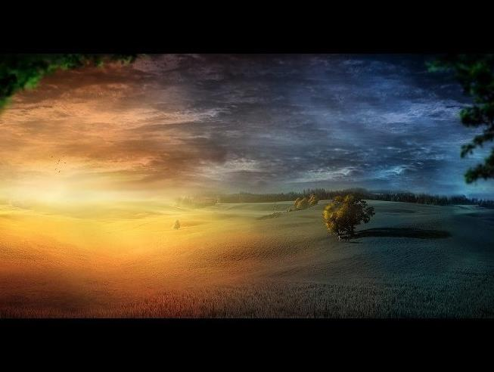
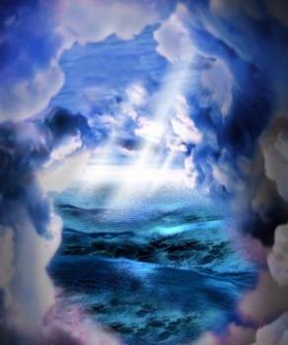
Yahuah’s Creation Term Definitions [con’t]
Final 12 hours of Light Phase 2*
Day #2
“… and there
came to be
evening* …”
“… and there
came to be
morning* …”
Division of
the Waters
2nd DAYLIGHT SEASON
CONTAINS BOTH TWILIGHTS
(through to the point of the dusk ending!)
Definitions
* Light Phase 2: Night Season of the 2nd day ends the 2nd cycle of 12 hours at - morning.

Slide 52
Answer:
Because Day Two began with
a special morning twilight ~ or
boqer Light,
~ not `owr.
Why has
all this information been given
for Day Two?
Evening
Twilight
Followed
This detailed explanation is coming.

Slide 53
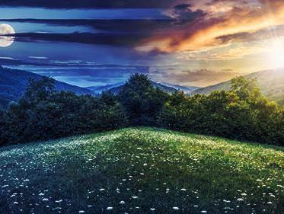


Day #3
Day #2
Plants
Brought
Forth
The new
Morning
Twilight separates each
24 hour cycle!
After evening:
Darkness
follows.
(Night Season)
The final 12 hours of
the 24 hour cycle
on Day Two.
[3rd Day]
Light
Season
Literal event

Slide 54
Days 2 & 3
both began
with the morning/boqer twilight. Why is this important to know?
Another Question:
Will Day Four also begin
with the same morning / boqer twilight ~ or
by another option?
Evening
Twilight
Followed
One of the Day 4 twilights will be unique!

Slide 55

Day #4
“… and there came to be morning* …”
* What kind of morning “light” was this?
Was it from the greater light, the sun?

Slide 56

Did our Creator arrive on Day 4 with the same “boqer/light*” as on days 2 & 3?
Day #4
Yes! Then Yahuah
commissioned the Two
Great Lights in the expanse of the sky - TO SEPARATE
& DISTINGUISH - the
day from the night.
[See Gen 1:14-19.]
Sun & Stars
* Day 4 morning light was
not provided by the sun! Why?

Slide 57
Yahuah’s Creation Term Definitions [con’t]
Light Phase 1* [first 12 hours]
Day #4
will have a similar pattern as Day 1.
“… and there
came to be
morning* …”
“… and there
came to be
evening* …”
Sun & Stars
commissioned
The EVENING of Day 4 has the very 1st twilight marked by the sun.
Definitions
* Light Phase 1: Of special importance the evening twilight marks the “midst of the week.”

Slide 58
Yahuah has Several Special Covenants
in the Creation Week
Day #1
Covenant of the Day and of the Night
[ereb was marked by THE SON through <`owr> light]
Day #6
Covenant of Marriage
Day #7
Covenant of the Sabbath
Day #4
Covenant of our Salvation
[ereb was marked by the sUn through <boqer> light]
The Day 4 evening twilight is the first twilight marked by the sUn in the creation week.

Slide 59

Yahuah’s Creation Covenants
Link to Calendar Studies
Day #4
also has a very special
“midst of the week” covenant –
making it a very unique day – linking with prophetic calendar studies.
The marker for this covenant can only be found when the “day” begins with “light”- not “sunset or evening.”
Just what happened on the midst of the creation week that is so notable, and also includes another covenant?

Slide 60

Yahuah’s Covenant of Salvation
Day #4
Will this Day 4 covenant have
a solid application to the timing
of Yahusha’s crucifixion from
the prophecy of Daniel 9:27?
And if it does, is that a special message from our Creator right “in the midst of the first week” of creation?
On Day 4 does THE Son, with
the sUn, have a “midst of the week” marker for our salvation?
Next: The Creation Week Chart
compliments the Dan 9:27 Messianic prophecy.

Slide 61

Counting out the “midst of the week”
Dan 9:27 And he shall confirm the covenant with many
for one week: and in the MIDST of the week he shall cause the sacrifice and the oblation to cease …
1. Sacrifices completed by
the 11th hour [Josephus].
11th Hr
12th Hr
2. The 12th hour also fulfills
the Dan 9:27 prophecy.
1st Cycle | 2nd Cycle | 3rd Cycle
4th Light Season Abib 14
4th Night Season Abib 14
5th Cycle | 6th Cycle | Sabb.
Dawn of U/B
6th Hr
According to the
day-start at DAWN …
Ereb (the 12th hour from DAWN)
- on the 4th cycle - is the exact “midst of the week.”
Salvation marker with this evening twilight.

Slide 62




Commencing with Day 5 of creation,
the sUn’s light has been commissioned
to usher “in and out” every
subsequent twilight.
Now, it’s time to
put this all together
in a summary!

Slide 63

Every day-start of Yahuah’s calendar is about Light!
One “type” of “light” is very unique & special.
<`owr H216> is first defined as Illumination – not a luminary
in the sky. This refers
specifically to Yahuah
supplying all the light
before the sky light-givers
were brought forth.
Day 1 began with
Yahuah’s LIGHT
defined as <`owr>.
Definitions

Slide 64

In the Creation Week there are
3 different types of day-starts.
ALL 3 types begin with “light.”
Literal Event
Definitions
Day 1 began with
Yahuah’s LIGHT and then
a restoration of Light
followed.
Day One “Light”
<`owr H216> was never mixed with darkness
for day-start
in Gen 1:1.

Slide 65

Days 2, 3 and 4 of Creation began
with another form of “light”
not supplied by the sun.
Literal event
Definitions
The day-start of “light”
for days 2, 3 & 4 is
a mixture of “light/darkness”
called <boqer H1242>, or morning.
On these 3 days
the <boqer> light mixture
was provided by Yahuah.

Slide 66


Since Day 5 of Creation
the mixture of boqer/morning “light”
is commissioned by the sun.
Literal Event
Definitions
<boqer H1242> is also known as “dawn,”
“morning twilight”
or
“breaking of the day.”
<boqer> is always a
mixture of “light/darkness”
before sunrise.

Slide 67



Creation Week Summary for Day-start
Every 24 hour cycle begins with “light” and ends when
night <layil> is over.
Day One
Light through Night ~
`owr through layil
Days 2-3-4
Light through Night ~
< boqer through layil>
Ever Since Day 5
Light through Night ~
<boqer through layil>
<boqer>
without
the sun.
<boqer>
commissioned
by the sun.
Literal Event
Definitions

Slide 68
Summary of Concepts A/B
Concept A Gen 1:5
Definitions of Terms
Concept B Gen 1:5
Order of Literal Events
The definitions of every calendar term assists in understanding the literal events in creation week, and two very important covenants from Yahusha. These covenants are closely tied to markers of our salvation springing forth from “LIGHT.”
The literal events of days 1-5 follow
the perfect “order” for each day-start
with “light.” The literal events also
point out the special evening marker on the 4th day of creation for our salvation.
#1
Day 1 of Creation
Day begins with Yahuah’s `owr LIGHT*
#2-3-4
Days 2, 3, & 4 of Creation
Days begin with Yahuah’s boqer light
#5
Day 5 of Creation and forward
Days begin with the sun’s boqer light
The order of the literal events of creation week cannot be understood without knowing the proper definitions.
Definitions
Literal Event

Slide 69


Confusion reigns when claiming Yahuah’s day
begins at midnight,
sunset, evening, noon or sunrise ~
joining together
what He has separated!

Slide 70

You can step free of all errors and traditions!

Slide 71






Now that the dawn day-start is completely understood from the days of CREATION,
the events around Yom Kippur and the crucifixion absolutely have full clarity.
(Details of
Yom Kippur
and Passover
are given in
Part 1 of
this study.)
Dawn of the 10th

Slide 72

Psa 19:1 The heavens are proclaiming the esteem of Ěl; and the expanse
is declaring the work of His hand.
From Yahuah
~ to His Bride ~
From dawn to dawn!

Slide 73

Yahuah’s “yoke is easy and His burden is light,” just as in the:
Every day begins with “light”!
(Matt 11:30)
The End

Slide 74

Questions on
day-start?
questions@studythecalendar.com
www.studythecalendar.com

