Slide 1
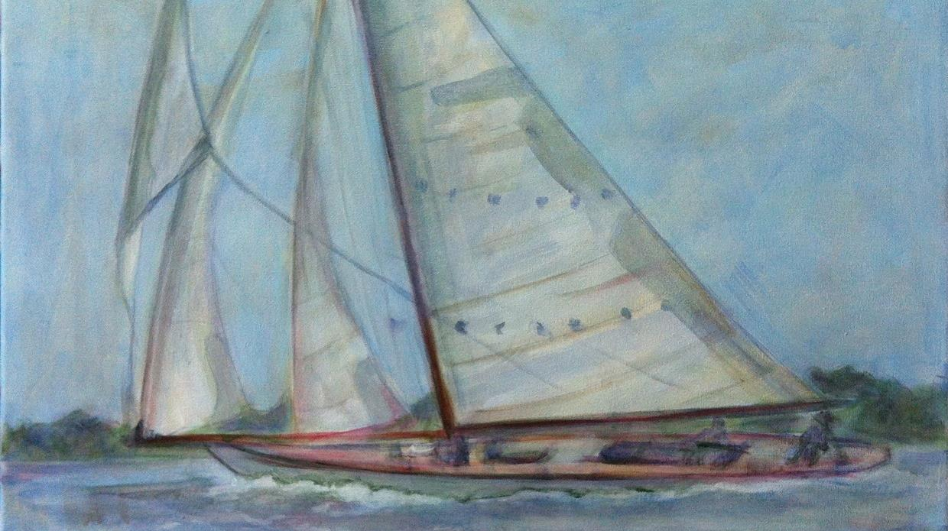

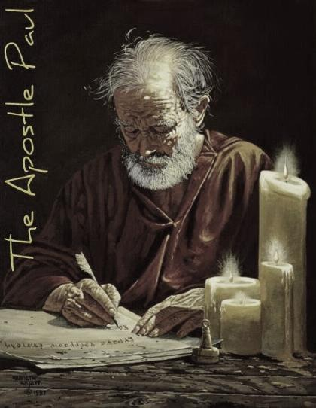
Paul’s Pentecost Appointment at Jerusalem
and the Battle
of the Calendars
A 3 Part Study
Notes:
Oct 21: 10 min – started and that’s about all. 1.07 MB
Nov 11: 1030 AM -

Slide 2
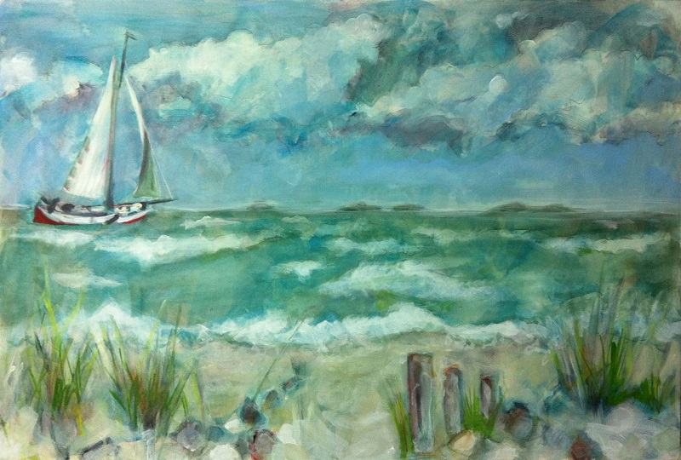

Nov 28: up to slide 22 – 6 hrs..
Nov 29: slide 31 – 9 hrs.
Nov 30: 1130 am 32-37 by 330 (4 hrs.) start at 38. updated Dennis U.
Dec 3/20: 10 am #38 – up to slides 46-50 at 1015 pm & use Acts 20 document
Dec 4 Friday 115 pm … researching acts 21:26
Dec 25/20 Friday 1130 AM – do corrections on PPT and THEN see if I can get the 12 days figured out. Mark kendall and paul slide 44? 200 pm – ready to start charting the months now.
Dec 26/20: 800 am … Etesian winds – to 8 pm
Dec 27/20 530 pm … start building omer trips on charts cut & paste at table. Moses Calendar??
Dec 28/20 1 pm to 530 … cracked the study open – just to put into PPT now. Yeah! E to TA and DU.
Dec 30/20 730 am – 930 pm … about 12 hours full time today. Letter to dennis & Tim on slide 2 for edit going to dennis on thurs pm.
Dec 31/20 start at slide 84 – sivan – 3rd month 600 am-730; 1100 – 100 pm – finally found a map of roman roads that paul would have travelled on. Most only walked 3 mph – need to change that too.
Finished at midnight at slide 99 – now to do a huge proof read and get everything in order. I long 18 hr day, but almost done. Emailed TA and DU what’s up next. 18 hrs. of work today.
Jan 1/21 630 -930. 1030 am – 1230 pm [gen. proof read to slide 67 – ready to print for big proofing and see if the wind, and cloud information should be moved to the beginning. EAT/break 1320- - 1) change out zif-sivan? 2) check for god & lord 3) take off bkgds; 4) Index has to be organized; 5) travel time by horses – note that this is not really needed as Paul was just being transported with his items. 6) remove underlines; 7) animation; 8) move the wind cloud information to the beginning; 9)
Jan 14/21: Final edit hopefully 1015 am; troubles with PPT at 1 pm. 4 pm: bkgds fixed to 510 pm; start at slide 18 next
Jan 15/21: worked about 6 hrs. and got a lot of stuff pulled together to places. Jan 16th: 3 hrs. and finished the basics – just to check now.
Slides 53 & 57 finished ready to check with RF … then print and check everything. 830 & 4 pm Sabbath. 5 Hrs. with RF; finish at 220 am. Email to Tim for editing.
Sunday jam 17/21 – tim likes the study … 1 pm: edit 6 for cf; worked from noon to 10 pm. Added 75-78 and fixed slide 27. Started some animation – got charts 70-74 done. TA said it was hard to follow the 1st time without animation. Wants to expand to floating WS problems – and debunking Enoch. Emailed at 10 pm Jan 17/21.
Jan 18/21 – getting too long – have to split into 3 parts, but barrel through and teach all at once and have Neil break up into 3 parts for the web. 12 full hours today to get into a good final state and email to tim at 10 pm … ready to print and proof – pick out tim’s slides and do pronunciation of towns
Jan 19/21: Tim did not understand Tuesday passover – designed new slide #77 to lock down that truth. New slide at 112. Emailed to Tim 830 pm. Jan 20/21 Wed: got anim. Checked as far as 63; email to tim to have a look, and I’ll finish later. Added new slide 83 and added subtitle to slide 1. rec’d back fro TA 730 pm.
Jan 21/21: added new slide at 114 and adjustments to #8. TA is home today – maybe we’re done now. 150 pm
Jan 22/21: Completely done at 145 pm with a huge careful go-through. Added slide 84 to cinch the battle of the calendars at 2:15 pm. May Yahuah bless as we’re ready to go. Jan 23 – last min. changes on slide 84 for Rashbi
Mitulene (mit-oo-lay'-nay)*** Chios (khee'-os) Trogyllium Pronunciation: troh-GOOL-lee-on
Miletos (mil'-ay-tos) Mnason (mnah'-sohn)
Jan 23/21: 8pm … had to correct slides 73-113 … all the roman months were off by 2 days. Huge mistake. Ask Neil if he can put in the new slides.
A TEACHING FROM:
Special compliments and credits to
Covenant Calendar Members
who did the initial work-up for
this study in Acts some time ago.
Their contribution was helpful &
very much appreciated!
Conclusion of Joshua’s Sickle Teaching

Slide 3


Acts Research Project
Section |  | Slides
1 | Purpose of this Study | 5-9
2 | Review of Omer Count from Former Studies | 10-11
3 | Overview of Paul’s Journey’s | 12-14
4 | How This Study Was Researched | 15-16
5 | How This Study Will Be Conducted | 17-20
6 | Maps: Paul’s Journey & Distances | 21-22
7 | General Background Information on Travelers | 23-24
8 | Geography of Locations & Secret of Gulf of Latmus | 25-49
9 | Acts 20-24 Journey Events & Meteorology Lesson | 50-62
10 | Charting Paul’s Journey to Jerusalem for Pentecost | 63-118
CATEGORY OF DISCUSSION
Part 1
Part 2
Part 3

Slide 4


Major Calendar Puzzle Pieces in Paul’s Journey
Mitylene
Ephesus
Every
piece of this calendar puzzle is important, but these four are of extreme importance that will lead to a Covenant Calendar
The Gulf of
Latmus &
Paul’s
Nazarite Vow
Miletus
Crunch!
PUTTING IT ALL TOGETHER

Slide 5

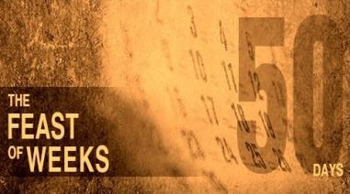
What is the Purpose of this Study?
Section #1:
In the return trip of Paul’s 3rd journey he was
determined to arrive at Jerusalem for Shavuot that year.
We know the Omer Count begins with Wave Sheaf / First Fruits.
WAVESHEAF – OMER COUNT #1
PENTECOST – OMER COUNT #50
The Joshua Series is another witness from the OLD Testament that completely aligns with the Torah guidelines written by Moses to verify an Omer Count of only 50 days.
The search in this study is to determine if Luke and Paul’s testimony in Acts will be
in alignment with Torah & Joshua showing the exact length of the Omer count.
Will Luke & Paul need 50 days, or 99 days to reach Jerusalem in time for Pentecost?

Slide 6

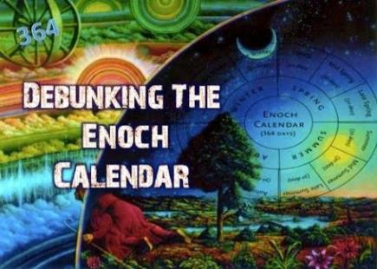
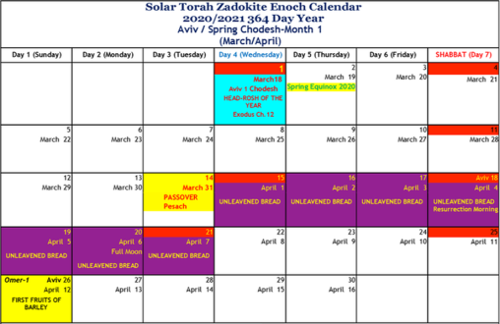
#1 Enoch’s
Wave Sheaf Delay of ONE full week!
When any errors are found within any festal calendar,
it is automatically labeled
by Torah as a counterfeit.
The Enoch calendar places
Wave Sheaf OUTSIDE the Passover Festival week.
This also alters the Omer count to Pentecost/Shavuot.
ANY error is 1 to many!

Slide 7

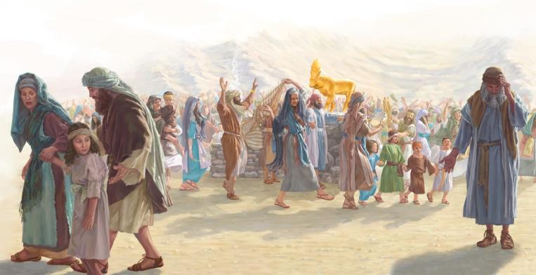
#2 Another Faulty
Omer Count
In Part 4 we found some keep a
99 day Omer count
Extension
of 49 days!
~ honoring the
golden calf!

Slide 8



Omer Count ~ 50 days? or 99 days?
We’re at the point where a decision must be made!
One thing is sure ~ Pentecost was still being observed by
the followers of Yahusha
about 30 years
after the crucifixion.
Some say the date of
Acts 20-24 is 59-60 AD.
We shall see!
The witnesses in this study are Luke & Paul. Luke recorded every detail, including Paul’s testimony – that relates specifically to calendar timing. The following instruction from Paul was given about
7 years after Acts 20-24. Please take note as
to exactly what Paul is conveying to his audience:
Phil 3:17; 4:9 [NKJV] Brethren, join in following my example, and note those who so walk, as you have us for a pattern. [Paul & Luke for sure.] 4:9 The things which you learned and received and heard and saw in me, these do,
and the Elohim of peace will be with you.
Paul’s Counting Example
Will this be more than an Omer Count study?

Slide 9

There are
“Three” Passover Pillars that Establish
Patterns in Covenant Calendar
YAHUSHA
JOSHUA
MOSES
These are “three”
solid witnesses.
What about Noah’s Calendar Clues?

Slide 10
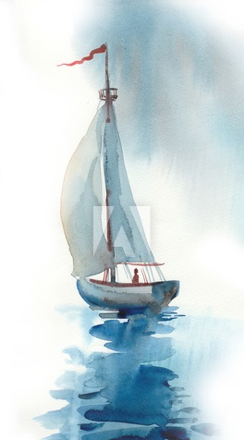
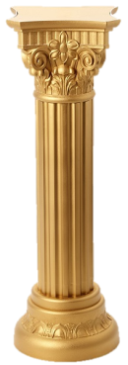

#2 REVIEW of Omer Counts from Former Studies
Moses’ Exodus / Egypt is the FIRST Passover template in Scripture:
  Exo 12 – 1st Month: Passover (14th) in this great year was on
  the 3rd cycle (Tues); Sabbath was the 18th; Wave Sheaf on the
  19th beginning the pattern of the Omer Count (1st cycle/Sun.).
  Exo 16 – 2nd Month: The Manna Week stabilizes the full Omer Count.
  Exo 19 – 3rd Month: Shavuot/Omer #50: 8th Day (1st cycle/Sun).
  And a 99 day count – reaching to the Golden Calf (1st cycle/Sun)!
Joshua tells us exactly how to determine the Wave Sheaf date
to arrive at the correct Torah Omer count after Moses died!
Joshua observed Passover on Shabbat that year!
Yahusha’s Omer Count must align with Torah/Moses & Joshua:
  Crucifixion – 1st Month: Passover (14th) in this great year was on
  the 4th cycle (‘midst of the week’ {Wed}). Sabbath was the 17th;
  Wave Sheaf on the 18th beginning the Omer Count (1st cycle/Sun).
  2nd Ascension of Yahusha occurred on the 40th day of the Omer count.
  This is the 27th day of the 2nd month [& 2nd yr.] – exactly the same “date”
  that Noah left the ark, and a pattern of when Yahusha left this earth.
  Acts 2 Pentecost [fully come] was 10 days later – only a 50 day Omer count.
Manna
Here are 3 witnesses.
Is there a 4th witness
with Paul’s adventures?
10

Slide 11



Section #2: Review [con’t]
Hermeneutic Rule
Expanding the 3rd Witness: Yahusha’s ministry through the Covenant Calendar of the Gospels upholds the witnesses in Torah and Joshua for a 50 day Omer Count. Let’s examine a few verses:
  Acts 1:3-4 Yahusha seen of men for 40 days
  after His ascension.
  Acts 1:5 Yahusha commanded the assembly to wait in Jerusalem … “not many days” to receive His baptism.
  Deut 16:9 [Torah Instructions] From the time
  the sickle is put forth to the grain, the count for
  7 weeks begins – THEN the 50th day of Shavuot.
  Acts 2:1 “When the day of Pentecost was fully come” the assembly were anointed by the Ruach.
  The assembly waited 10 days qualifying as a time of “not many days” … whereas, another 49 or 50 days would not qualify for “not many days.”
In the presence of 2-3 witnesses
a truth is established.
  Matt 18:16 [Yahusha] … that in the mouth
  of two or three witnesses every word may
  be established.
  2 Cor 13:1 [Paul] …In the mouth of two or three witnesses shall every word be established.
Basically, the Omer Count of 50 days to Shavuot is already established!
Is there any reason to look for a 4th witness?

Slide 12
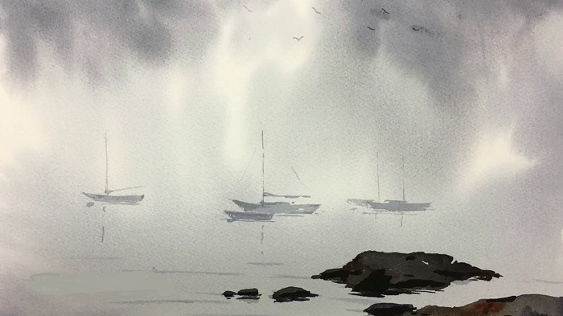
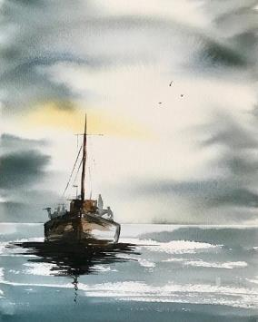
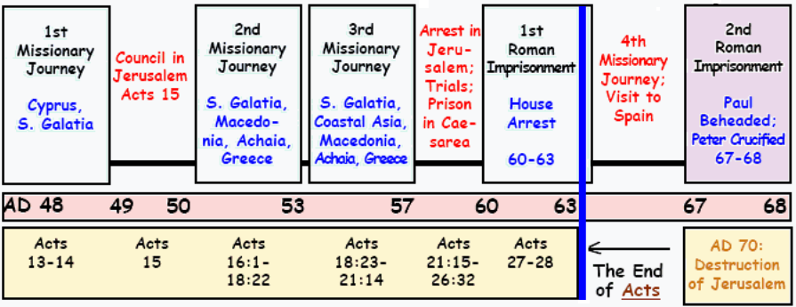
Section #3: Overview of Paul’s Missionary Journeys
Paul’s plans to get to Jerusalem for Pentecost include only
his return trip of the 3rd journey.

Slide 13
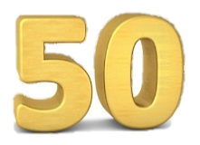
Section #3: Overview [con’t]
Luke’s Record of Paul’s 3rd Journey
Paul knew this was the last time he would see the assemblies he had labored for, yet he was in a hurry.
  Acts 20:3-12: Paul had an “all night” sermon at Troas.
  Acts 20:13-38: Paul had an urgent farewell with the elders of Ephesus in Miletus. Why not Ephesus?
  Acts 21:10-11: Paul urged not to go to Jerusalem
  to be bound and delivered to the Romans.
  Acts 21:13: Paul declares he is ready to die for Yahusha.
If the Omer Count is really 99 days, would Paul need to feel such urgency to get to Jerusalem at a certain time?
Is this study so important that it will be Paul’s last chance
to establish a particular Omer Count for once and for all?
Will this witness root Covenant Calendar deeper in Torah?

Slide 14
PAUL SAID, “IF POSSIBLE” HE WANTED TO BE
AT JERUSALEM FOR PENTECOST.
The reason Paul said "if possible," is because gaining passages on ships was uncertain, not to mention the possibility of unfavorable winds and other delays that might occur, or having to depend on someone else.
Having reached Tyre and Caesarea, it is evident that:
  Paul had a prosperous journey
  he had found ships without having to wait too long
  there were favorable winds etc.
  he was well ahead of schedule because he stayed seven days
  at Tyre and many days at Caesarea.
  This he would not have done, had he not made good time.

Slide 15
Section #4: How This Study Was Researched
Acts 20-24 contains the details for this study, although there will be information gathered from other parts of Luke’s writings in Acts.
An understanding of the geographical area is absolutely necessary.
  Differentiate between cities/towns and provinces.
  Overview of the geographical areas through a variety of maps.
  Why? Part of the geographical area has had considerable changes from “then” until “now.”
There is an urgency of time to arrive at Jerusalem before Pentecost.
Timing decisions will be made accordingly.
Weather elements will affect the sailing times.
The winds needed for sailing change with the seasons.
Paul is sailing during the Omer Count and spring weather conditions.

Slide 16
Section #4: How This Study Was Researched [con’t]
Some ships will carry cargo for “short sail” delivery to local places;
other ships will make longer hauls to remote places.
  Which ships will Paul try to board for the return of his 3rd journey?
  Will Paul board a ship if it is too close to the Sabbath?
  Or will he stay with a congregation for the Sabbath?
Different methods of travelling are found in this study:
by sailing and walking.
  By ship: reasonable estimates will be made according
  to weather elements for the spring.
  On foot: reasonable estimates will be made according
  to foot travel of approx. 3-4 mph.

Slide 17

Section #5: How This Study Will Be Conducted:
When Luke gives specific calendar details
they will be followed.
  [e.g.: 1) same day 2) next day 3) the day after – or –
  the following day.]
Care will be taken to observe the weekly Sabbaths – noting that necessary “ship trips” will not be scheduled beginning with the Sabbaths depending
on the dates of the month, length of travel, etc.
However, some of the travels by sea are very long. When this is the case there will be times of travel
on sea during the Sabbath.
The best estimates for sea travel [from one destination
to another] will be given considering distances, local weather and type of conditions for that time of the year, etc.
17

Slide 18
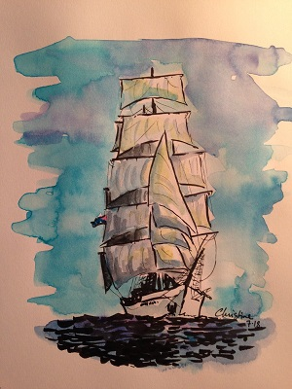
Section #5: Distance & Time Calculations
Many say Paul’s trip to Jerusalem needed at least a
99 day Omer count because:
  the trip is way over 1100 miles/1760 kms
  there were many lengthy stops and some delays.
This study will count the time and distances according
to reasonable data including:
  walking times of approximately 3-4 mph with belongings
  reasonable times of “waiting” to find new sailing arrangements.
  Sailing times according to the wind speeds in April and May:
    the winds in the 1st month (Apr) are about: 7.5 mph/8.5 km
    the winds in the 2nd month (May) are about: 9 mph/14.5 km
    the winds usually come up at dawn and die down with sunset;
    many times a ship can be becalmed all night.
    Therefore, sea captains would generally not sail at night,
    unless they knew there would be winds, which could often
    be understood by cloud formations.
18

Slide 19
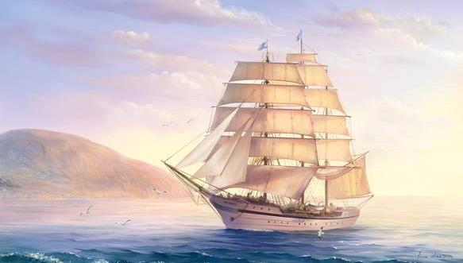
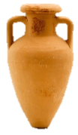
What kind of ships would Paul be sailing on?
Acts does not give any information about
the kind of ships the Apostles embarked on during their sea journeys. In addition to small coastal vessels, ancient literature mentions the existence of large ships with the capacity of as many as six hundred passengers or more. Very different were the many small boats, that sailed along the coasts, coming into harbor each night.
Such boats, hopping from one port to the other, collected any kind of available passenger or merchandise.
On such coastal boats merchants, exiles, prostitutes or priests, all traveled together. As they made zigzags between islands and the mainland, the traveling merchants would be collecting timber from Phoenicia, copper and wine from Cyprus, amphorae [a tall ancient Greek or Roman jar with two handles and a narrow neck] from Rhodes and Samos or grain mills from Cos.
Such boats did not have a schedule. When the captain decided that his business was done and the wind was favorable he would send one of the crew to announce in the streets and taverns of the port that he was soon leaving.
By the time darkness fell, unless he reached a port, he usually found a sheltered shallow bay and dropped anchor or beached his ship.

Slide 20
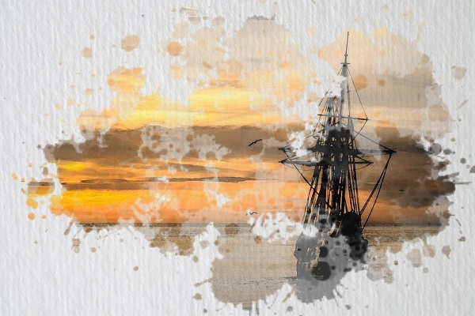

Reasonable assessments
of time will be made
for each detail –
i) not to force an Omer count of 50 to fit
Torah requirements,
ii) nor to extend times unnecessarily to reach
to an Omer 99 count.

Slide 21
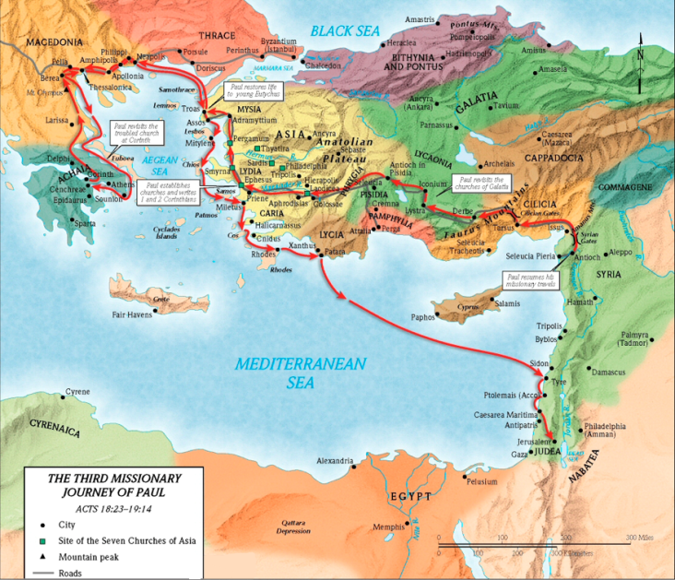
Section #6: Map of Paul’s 3rd Journey
Note the cities, towns and provinces on this trip.
Note the difference of travel
on land and travel by sea.
Returning back to Jerusalem
by sea was likely much quicker.
Before reading Luke’s account and charting the Omer count journey on the calendar months, we will gather some information on each stop between Philippi & Jerusalem to aid in the calculation of time needed for this urgent trip.
Still the question is: Is there any possible way Paul needed a full 99 days to be on time for this festival?
21

Slide 22
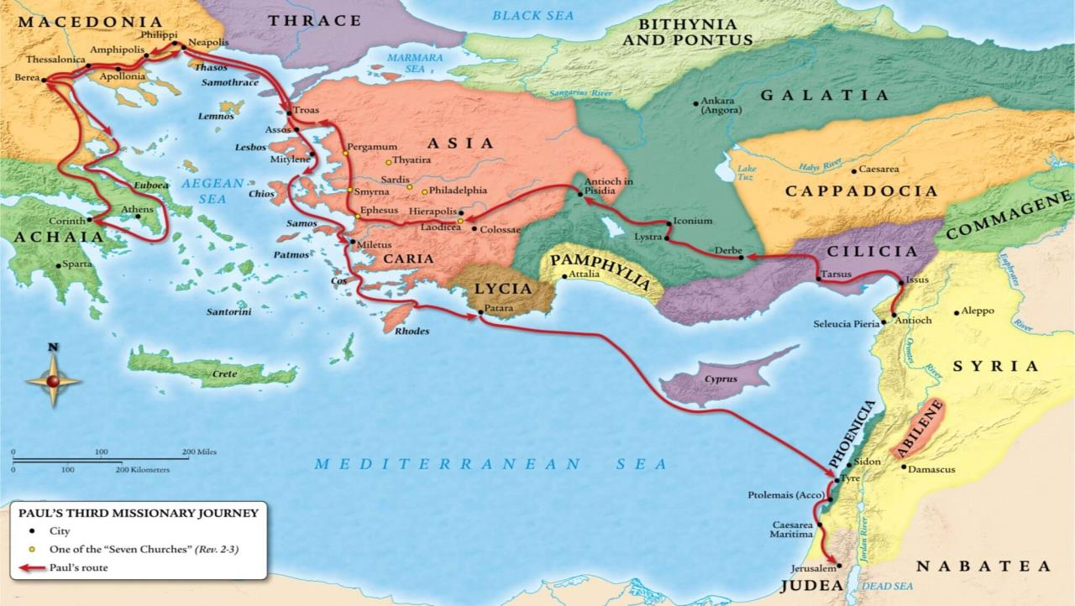
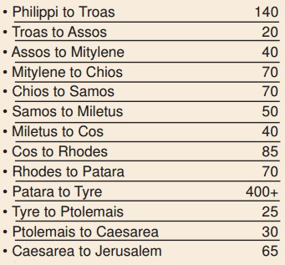
Philippi to Jerusalem
~ 1100+ Mi /1760 km
Section #6: Approximate Distances
After 3 months in Corinth Paul planned to sail to Syria. When he discovered a plot to waylay
him on the voyage, he decided to return
through Macedonia, retracing his steps back to Philippi.
The
Levant

Slide 23
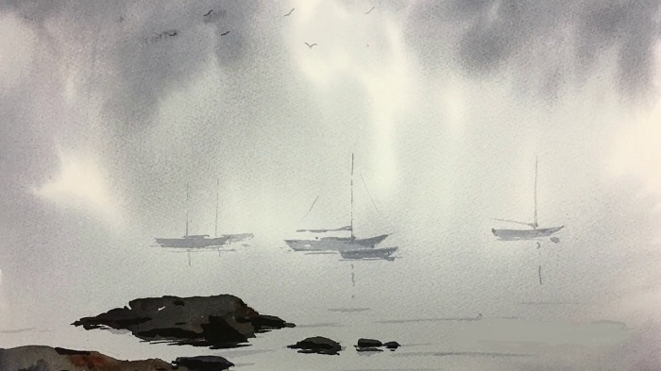
Section #7: General Background Information
In the book of Acts, Luke is the author – writing to Theophilus and other
“first readers” of that time.
  Theophilus & readers have an understanding of that part of
  the Roman empire that we do
  not have such as:
  Sailing times of either short stops or long hauls (& which ship to catch);
  weather restrictions
  location of local assemblies.
Note of Interest for this Study:
Paul bypasses Ephesus (which was
likely a stop he could have made) and then later when at Miletus, Paul sends for the elders of Ephesus to come down
to Miletus to see him.
  This is a very interesting part of the study, especially with his urgency
  & determination to get to Pentecost.
  Would Theophilus understand Paul’s reasoning for this, when Ephesus would have been an easy stop?
  The Ephesus/Miletus details are important in this study.

Slide 24
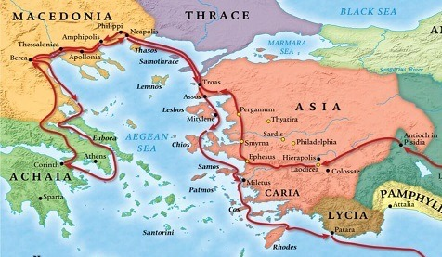
Section #7: General Background Info on Travelers
There are nine (9) companions traveling with Paul to Jerusalem (Acts 20:3b-12) as representatives from various assemblies:
From Macedonia:
  Luke: Philippi
  Sopater: Berea
  Aristarchus & Secundus: Thessalonica
From Asia:
  Gaius: Derbe
  Timothy: Lystra
  Tychicus* & Trophimus*: Ephesus*
  Onesimus: Colossae
  [escaped slave of Philemon]
Lystra
Derbe
The End of Part 1

Slide 25
Nov 28: up to slide 22 – 6 hrs..
Nov 29: slide 31 – 9 hrs.
Nov 30: 1130 am 32-37 by 330 (4 hrs.) start at 38. updated Dennis U.
Dec 3/20: 10 am #38 – up to slides 46-50 at 1015 pm & use Acts 20 document
Dec 4 Friday 115 pm … researching acts 21:26
Dec 25/20 Friday 1130 AM – do corrections on PPT and THEN see if I can get the 12 days figured out. Mark kendall and paul slide 44? 200 pm – ready to start charting the months now.
Dec 26/20: 800 am … Etesian winds – to 8 pm
Dec 27/20 530 pm … start building omer trips on charts cut & paste at table. Moses Calendar??
Dec 28/20 1 pm to 530 … cracked the study open – just to put into PPT now. Yeah! E to TA and DU.
Dec 30/20 730 am – 930 pm … about 12 hours full time today. Letter to dennis & Tim on slide 2 for edit going to dennis on thurs pm.
Dec 31/20 start at slide 84 – sivan – 3rd month 600 am-730; 1100 – 100 pm – finally found a map of roman roads that paul would have travelled on. Most only walked 3 mph – need to change that too.
Finished at midnight at slide 99 – now to do a huge proof read and get everything in order. I long 18 hr day, but almost done. Emailed TA and DU what’s up next. 18 hrs. of work today.
Jan 1/21 630 -930. 1030 am – 1230 pm [gen. proof read to slide 67 – ready to print for big proofing and see if the wind, and cloud information should be moved to the beginning. EAT/break 1320- - 1) change out zif-sivan? 2) check for god & lord 3) take off bkgds; 4) Index has to be organized; 5) travel time by horses – note that this is not really needed as Paul was just being transported with his items. 6) remove underlines; 7) animation; 8) move the wind cloud information to the beginning; 9)
Jan 14/21: Final edit hopefully 1015 am; troubles with PPT at 1 pm. 4 pm: bkgds fixed to 510 pm; start at slide 18 next
Jan 15/21: worked about 6 hrs. and got a lot of stuff pulled together to places. Jan 16th: 3 hrs. and finished the basics – just to check now.
Slides 53 & 57 finished ready to check with RF … then print and check everything. 830 & 4 pm Sabbath. 5 Hrs. with RF; finish at 220 am. Email to Tim for editing.
Sunday jam 17/21 – tim likes the study … 1 pm: edit 6 for cf; worked from noon to 10 pm. Added 75-78 and fixed slide 27. Started some animation – got charts 70-74 done. TA said it was hard to follow the 1st time without animation. Wants to expand to floating WS problems – and debunking Enoch. Emailed at 10 pm Jan 17/21.
Jan 18/21 – getting too long – have to split into 3 parts, but barrel through and teach all at once and have Neil break up into 3 parts for the web.
Paul’s Pentecost Appointment
at Jerusalem
and the Battle
of the Calendars
Part 2 of 3
Notes:
Oct 21: 10 min – started and that’s about all. 1.07 MB
Nov 11: 1030 AM -

Slide 26

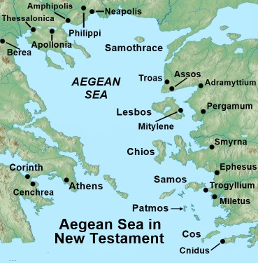
Section #8: Locations: i) Philippi
This study begins in Philippi as Paul is now determined to get to Jerusalem for Pentecost.
In Philippi, Paul met up with Luke and observed the full Passover festival.
The two then set sail to Troas [140 miles – 5 day trip] where they meet up with the other 8 traveling companions on their way to Jerusalem from various assemblies.
The various representatives were bringing monetary gifts to the persecuted assembly
in Jerusalem.
Sailing from Greece to Syria was more favorable beginning in April as the gentle winds blew from the NE after the winter storms subsided.
Monsoons - a seasonal prevailing wind in the region of South and Southeast Asia, blowing from the southwest between May and September bringing rain (the wet monsoon), or from the northeast between October and April (the dry monsoon ).

Slide 27

ii) Troas [140 miles from Philippi by sea]
Known as "old Constantinople."
This is a chief point of arrival and departure
for those who went by sea between Macedonia
and the western Asiatic districts;
It was connected by good roads with other
places on the coast and in the interior.
Paul & Luke sailed from Philippi to Troas
in 5 days and stayed at Troas seven days.
It was here Paul restored Eutychus to life after
he fell asleep & had fallen from the third loft.
Paul had two voyages between Troas and Philippi.
  Acts 16:11-12 - accomplished in two days [~5 yrs. Prior];
  Acts 20:6 - accomplished in five days.
These sailing details are valuable here. One ship
could have had more cargo,
or stronger head winds.

Slide 28

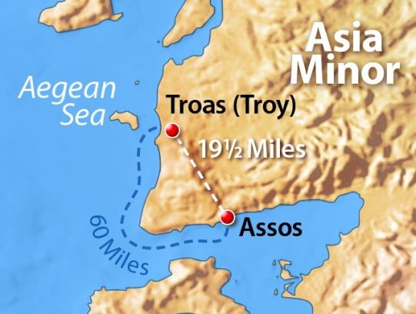

iii) Assos [20 miles (land) 60 miles (sea)]
Seven miles from the island Lesbos;
20 miles from Troas by land, and
about sixty miles from Troas by sea.
While Luke and the others took the
longer 60 mile trip around Cape Lectum (Acts 20:13-14), Paul walked (6+ hrs.)
overland 20 miles from Troas to Assos
on the morrow (vs 7).
Acts 20:14 does not indicate if Paul met with an assembly of local believers.
Thus Paul was able to join the ship to Mitylene without difficulty – likely
in the mid-afternoon to set sail with
the day winds.
Question: Why would Paul choose to walk to Assos to board the ship, rather than sail? Would this have anything to do with him spending
as much time as possible with the Troas Assembly – for the last time?

Slide 29
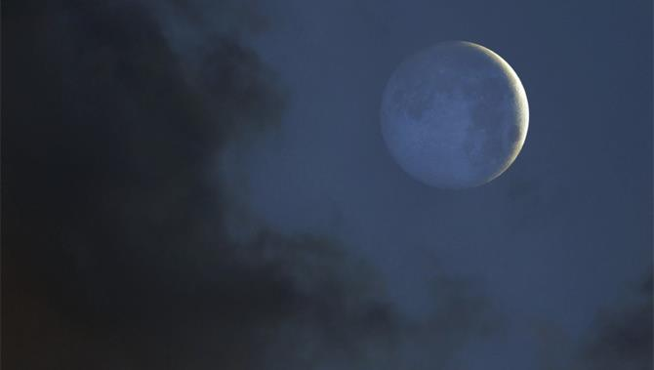
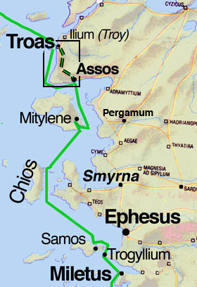


iv) Mitylene [40 miles by sea from Assos]
S.E. side, of the island Lesbos.
The ship likely stopped here for the night.
The day wind blew from the N.W. at this time
of the year. The harbor of Mitylene would
shelter ships from these winds.
Things to consider:
if there are no winds to sail
if it’s the time of a dark moon (as some declare)
if the sky is cloudy - there would not be sufficient
night light to navigate the intricate passages to
the south. It would have been safer to wait for
daylight before leaving for Chios.
The question is: Was there a dark moon or not? We shall see!

Slide 30


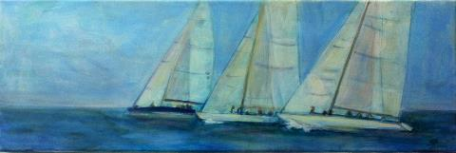
v) Chios [70 miles by sea from Mitylene]
Paul's vessel passed Chios on his last voyage to Jerusalem (Acts 20:15), from Luke's expression, "we came the following day over against Chios."
This is a journey of 70 miles which is a full day of sailing with favorable winds.
(Remember: Acts 16:11 records a sailing distance from Troas to Neapolis in two days. The distance is approximately 140 miles.)
It is likely on this occasion, Paul did not land, but only passed the night in the ship while anchored.

Slide 31

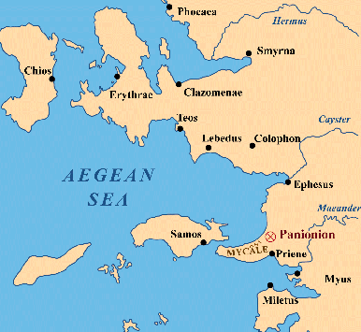
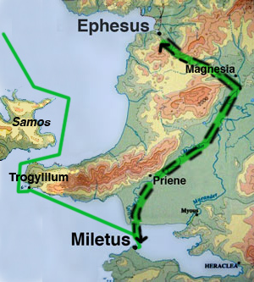
vi) Samos [70 miles by sea from Chios]
Samos is situated at the mouth of the
bay of Ephesus, between the cities of EPHESUS and MILETUS.
Incidentally, the topographical notices
given by Luke are most exact!
Paul touched here but
spent the night at the
anchorage of Trogyllium.
Many of these coastal ports
would receive a short stop
for cargo and passengers.

Slide 32
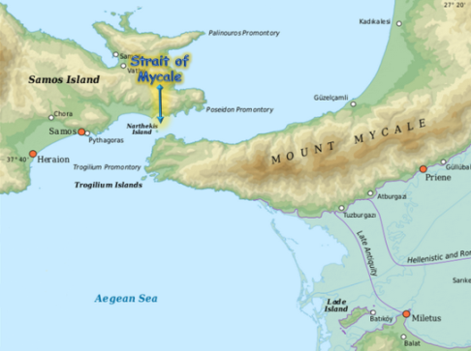
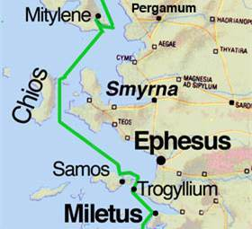
vii) Trogyllium [4-5 miles by sea to Samos]
TROGYLLIUM was about 20 miles
(32 Km) south of Ephesus.
The strait of Mycale is scarcely one mile across with a very rapid current.
The navigation of this coast is intricate.
It can be gathered from Acts 20:15,
with subsequent notices of the days
spent on the voyage, that the voyage
was likely done under cloudy dark skies – this can be checked out with the events
of what happens at Mitylene.
This darkness was the occasion of
the ship's stay in a sheltered spot
at Trogyllium.
How are we to be sure it was dark?

Slide 33


vii) Trogyllium [con’t]
As mentioned:
Paul touched at Samos but spent the night at the anchorage of Trogyllium in the strait between Samos and the extremity of the ridge of the Mycale mountain range on the mainland.
Paul’s next plans were to proceed to Miletus, having passed by Ephesus without touching there.
Question: Why did Paul choose
not to stop at Ephesus when he
had sailed so close?

Slide 34
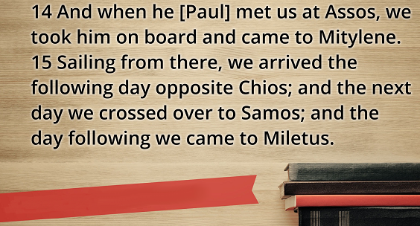

vii) More on Trogyllium [con’t]
“ … we arrived at Samos, and tarried
at Trogyllium …”
Acts 20:15b
Note: According to Acts 20:15 [KJV], the ship in which Paul was on, tarried at Trogyllium. Several of the early manuscripts omit the words, "tarried at Trogyllium."
Yet, whether the words belonged to the text or not, Paul evidently passed the promontory [a point of high land that juts out into a large body of water], and probably stopped there.

Slide 35
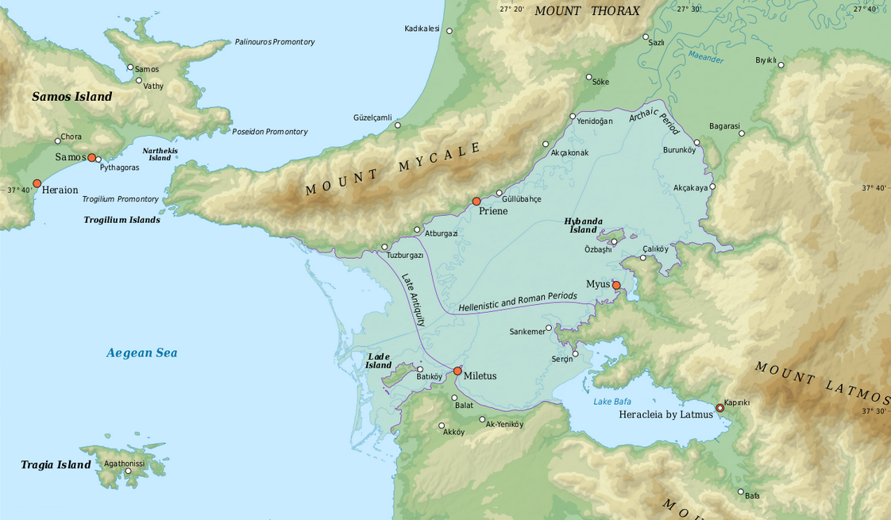
vii) Sailing into Trogyllium [con’t]
Strait of
Mycale
Ahead of Paul's ship the Mycale Mountains loom some 1800+ feet
[610 m] overhead, with their highest peak soaring to 3700+ feet [1237 m]. Paul's ship would have been forced to turn westward to sail around Mycale, entering the narrow Strait of Mycale [4000 feet/1300 m wide] that separated Asia Minor from the island of Samos.
After passing through this strait, the ship probably stopped for food and water at Samos' main port.
After replenishing the provisions, the ship next attempted to sail around Mycale.
Why do we say “attempted”?
Trogyllium Port
Bible atlases are split regarding the ship's route, whether it went west of Samos through open seas or followed the somewhat longer route along the coastline of Asia Minor through the Strait of Mycale.
Three factors favour the coastal route:
(1) the open sea is more risky in the event of a storm
(2) coasting vessels tend to stay close to ports and
(3) the port of Samos was on the southeastern corner of the island toward Asia Minor. The inside route would therefore be the safest and quickest.

Slide 36
vii) Attempted Sailing into Trogyllium [conclusion]
Strait of
Mycale
Thus, there would have been reason for Luke to write: they 'tarried at Trogyllium' [Acts 20:15]. The failure of the winds would have delayed the arrival of the apostolic party at Miletus by perhaps half a day.
The question is: did they stay overnight in Trogyllium and proceed to Miletus “the next day”?
Answer: Acts 20:15 confirms
that is exactly what happened.
Therefore: the possible added words of 'tarried ("stayed") at Trogyllium'– compliment the
words of: “…the next day we came to Miletus.”
Trogyllium Port
Remember: The KJV and many other texts add the words: 'tarried ("stayed" NKJV) at Trogyllium.' It is not known if this reading is original.
However, a significant geographical reference of the area may be noteworthy. After sailing around the south eastern tip of Samos Island,
it is very likely there were no winds to allow them to sail further that day.
Trogyllium is only about 4-5 miles south, at which place the captain would have found a place to anchor. This is the case even today.

Slide 37
What About Modern Day Literature?
After Trogyllium, the next stop for Paul was Miletus.
This part of the study is a primary focus specifically related to the geography and history of this area due to the events that happen between Miletus and Ephesus – AND – the journey of the elders.
Important Note: Modern day literature will not be reliable enough to break open some details.
The following points must be remembered as some areas in this study are very tricky to understand for the details between Miletus & Ephesus:
The landscape, seascape, and general environmental concerns will be logically considered next.
Consideration will also be given to routes, plains, mountains and the ways through them.
Bodies of water and the passages across them will be examined closely.
An understanding of the physical environment [at that time] is not only useful but essential when one is
trying to understand any ancient
city in the Acts study.

Slide 38
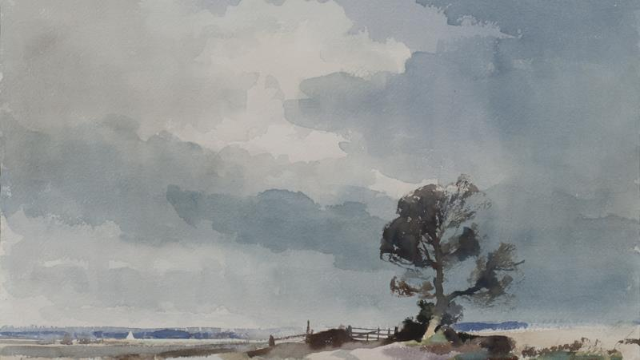

What About Modern Day Literature? [con’t]
The big question for this study is: “Why did Paul not stop at Ephesus
if he wanted
to see the
elders?”
A simple paraphrase of Acts 20:15-17 – the text in question:
From there we sailed on the following day and arrived
offshore of Chios.
And the next day we approached Samos
and tarried at Trogyllium,
and the day after we came to Miletus.
  For Paul had decided to sail past Ephesus, so that he might not lose time in Asia. For he was hurrying to be in Jerusalem, if possible, on the day of Pentecost.
From Miletus Paul sent a {messenger} to Ephesus to summon the local elders. And when they [the elders] came to him …[?]
Acts 20:15-17

Slide 39



viii) The Gulf of Latmus
One reason Paul decided to bypass Ephesus was because of his unwillingness to be delayed in Asia. But,
there is more!
Strait of
Mycale
Trogyllium Port
Gulf of
Latmus
Upon leaving Trogyllium [on the following day], Paul's ship entered
the Gulf of Latmus and continued
its journey to Miletus.
In Paul’s day the Gulf of Latmus separated Priene from Miletus.
Take note of Lake Bafa.

Slide 40
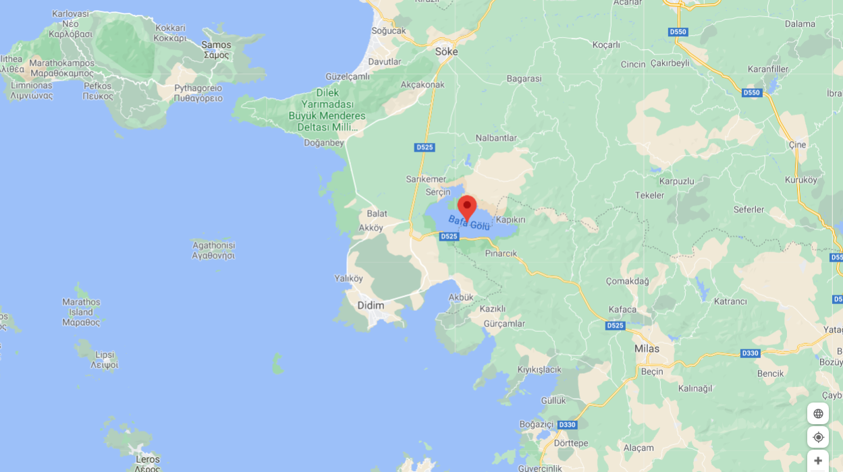
A Modern Map of the Aegean Sea Today
Priene ?
Trogyllium Port
Where is the Gulf of Latmus?
Miletus ?
Lake
Bafa
Today, this gulf separating Miletus from Priene is strangely absent on most modern biblical maps of western Asia Minor.
Because of minimal tidal action in the Aegean Sea, the mouths of the Maeander Rivers have progressively carried large amounts of silt from the mountains over the centuries. This silt emptied into the Gulf of Latmus moving progressively southwards and eastwards towards the Aegean Sea.

Slide 41
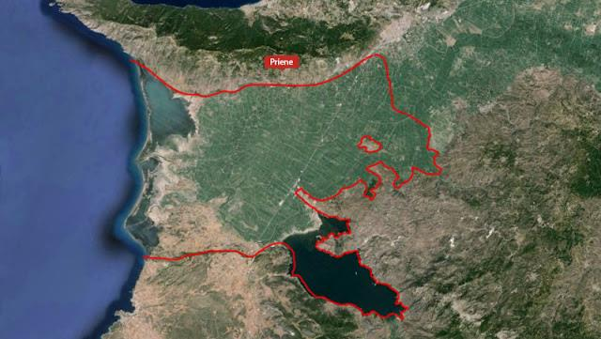
Modern Google Earth Map
Priene
Where is
the Gulf
of Latmus?
Miletus
Lake Bafa

Slide 42
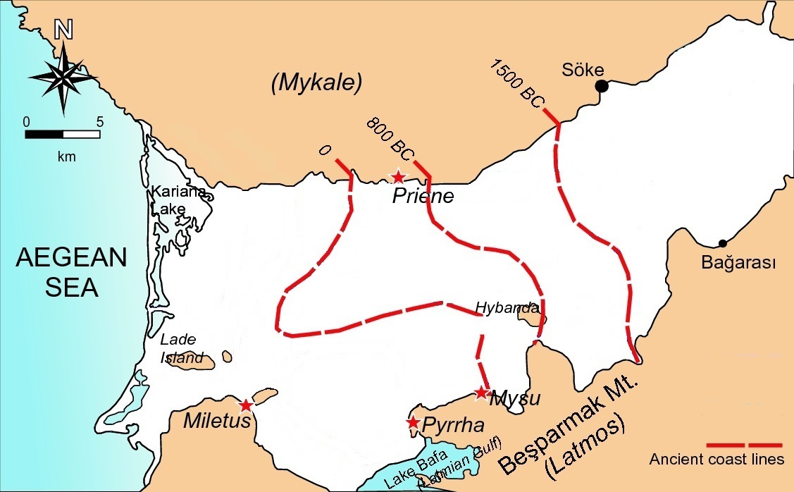
viii) What Happened to The Gulf of Latmus? [con’t]
Strait of
Mycale
Over the years the coastline
has changed significantly as can be seen by the red broken lines [with dates].
By the 1st century CE, Priene was landlocked.
Gulf of
Latmus

Slide 43

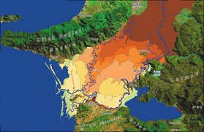
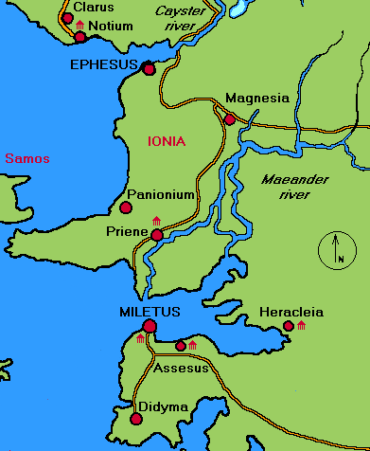
The geography of Paul’s day will affect the timing of his travel towards Jerusalem.
viii) The Secret of the Gulf of Latmus [con’t]
Remember, because of silting over many centuries, the shoreline has moved progressively toward the coast eventually land-locking Miletus.
Priene
Land locked
today!
Gulf of Latmus?
Gulf of Latmus
Miletus
Lake Bafa

Slide 44
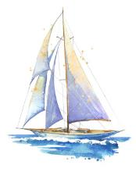

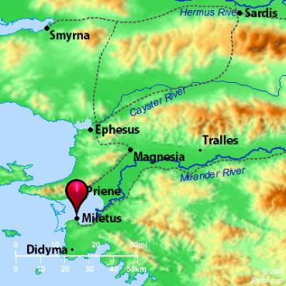
ix) Miletus/Ephesus [45 miles by sea from Trogyllium; 38 miles one way to Ephesus]
After leaving Trogyllium, the ship arrived the next day at Miletus. Luke did not explain why Paul changed his mind and decided to stop at Miletus ~ when he was in such a hurry from the onset.
From Miletus Paul sent 2 messengers across the Gulf of Latmus to Ephesus to summon the elders.
Road travel had the advantage of predictability as waiting for another ship and favourable winds would cause an unpredictable delay of time. [Remember: the ship had already been delayed at Trogyllium.]
There is a road distance around Lake Bafa of approximately
63 miles between Ephesus and Miletus.
By crossing the Gulf of Latmus the distance is about 38 miles.
Given the need to reach Ephesus and get back to Paul promptly,
the Gulf of Latmus route was undoubtedly chosen.
The journey for the two messengers from Miletus to Ephesus would have been at least 2 LONG days. Allow 1 day to collect the elders and at least another 2 LONG days to return to Miletus.
We are not told how much time Paul spent with the elders before leaving.
Questions: Why did Paul sail past Ephesus if he wanted to meet with the elders thus causing a delay of at least 5 days in Miletus?
Was he not in a hurry to get to Jerusalem for Pentecost?
Gulf of Latmus

Slide 45

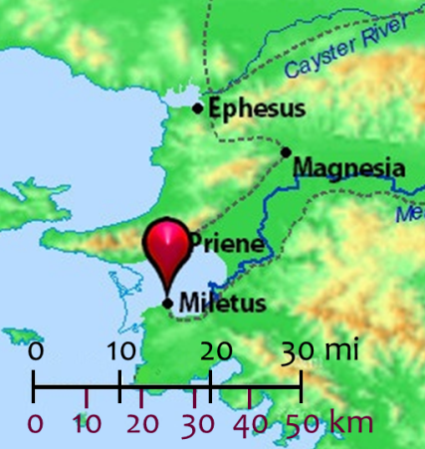
ix) Ephesus Circuit to Miletus [con’t]
Questions: Again, why did Paul sail past Ephesus?? What was the original hurry?
Now why this delay? How will this affect his journey during the Omer Count?
Here are some reasons for consideration:
If Paul would have stopped at Ephesus, would it be too long
of a wait for another ship to be going his direction - Jerusalem?
Or, was his ship going to be docking longer in Miletus – allowing time for him to send 2 messengers to Ephesus – even if 5+ days
of foot travel are needed for the return trip?
Or, would his personal visit to Ephesus have delayed him too
long as all his friends and local assemblies would have wanted to see him – especially since his message was he would likely not see them ever again? Or …
Landing at Ephesus' harbour with its direct access to the commercial agora, where the silversmiths were centered,
could that possibly reignite the situation that had forced
Paul to quickly leave Ephesus just months before? (Acts 19)
Somehow, Paul came to feel that he must communicate with the elders of Ephesus one final time because he felt the possibility of death awaited him in Jerusalem (Acts 20:38). The elders accompanied Paul
to the ship after his messages for them.
Gulf of Latmus

Slide 46
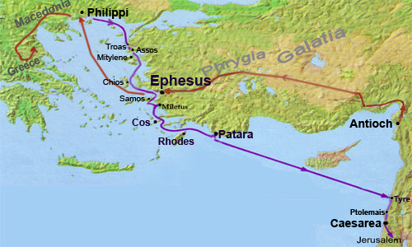
x) Cos [40 miles by sea from Miletus]
Ship departure from Miletus was likely at dawn with the day winds … coming with a straight course to Cos. The ship likely had cargo to drop or pick up; passengers would have waited.
xi) Rhodes [85 miles by sea from Cos]
A large island of the Aegean sea and part of the natural shipping route from Greece to Palestine, the ship would have stopped to load or unload cargo. The NW winds must have been in their sailing favor to accomplish 85 miles from Cos to Rhodes by the next day.
No details are given that Paul left the ship.
xii) Patara [70 miles by sea from Rhodes]
A city on the S.W. shore of Lycia, opposite Rhodes (Acts 21:1-2).
Because of its excellent harbor, many of the coast trading ships stopped at Patara.
Here Paul found a ship going to Tyre in Phoenicia, and in this ship his voyage was completed.

Slide 47

xiii) Tyre [400+ miles/640+ km by sea from Patara]
It could be possible to accomplish this trip from Patara to Tyre in 2 days during the summer months when the monsoon winds are strong for sailing day AND night.
But, in early May the winds will be about
10 mph only during the day time hours.
This would calculate to approx. 4+ days
for arrival at Tyre.
There was no stop scheduled for Cyprus.
The
Levant
The Levant is a term in geography that refers to an area in the Middle East which includes the historic areas of Lebanon, Jordan, Palestine, Israel and Syria.

Slide 48
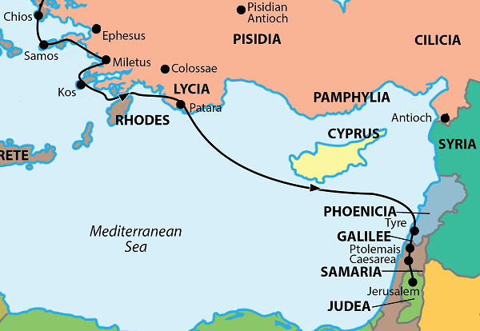

xiv) Ptolemais
[25 miles/40 km by sea from Tyre]
A seaport in northern Palestine between Tyre and Caesarea.
Paul visited Ptolemais for one day on his return to Jerusalem at the end of his third missionary journey (Acts 21:7).
xv) Caesarea
[30 miles/50 km by land from Ptolemais]
It was on the high road between Tyre & Egypt; a little more than a days’ journey from Joppa on the S. (Acts 10:24), less than a day from Ptolemais on the N. (Acts 21:8.)
Paul's journey from Ptolemais (Acts 21:8) was accomplished within the day.
Question: Have you noticed that even though Paul was in a hurry to get to Jerusalem on time for Pentecost, he has made several stops of varying lengths? Soon we’ll discover the Omer Count!

Slide 49
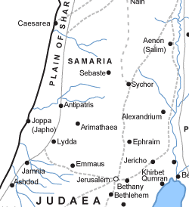

xvi) Jerusalem (Finally!)
[65 miles/105 km by land from Caesarea]
Paul does arrive at Jerusalem,
but was he on time for Pentecost?
(We will soon see when all the stops are charted on the calendar.)
xvii) Back to Caesarea
[65 miles/105 km by land from Jerusalem]
In short order Paul finds himself being escorted by Roman soldiers to Caesarea over a period of two days (Acts 23:31-32); this was by way of Antipatris under orders of the commander. It has been ascertained, however, that the road by Antipatris was a bit shorter - a point of some importance in reference to the night-journey of Acts 23.
End of Section 8 for Locations

Slide 50
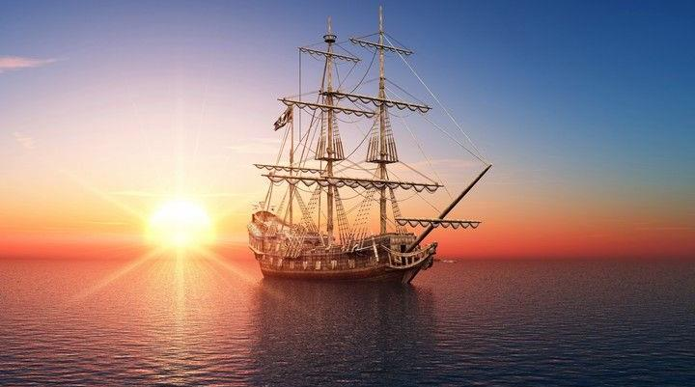

Section #9:
Acts 20-24 &
Meteorology Lesson
Before we begin to chart the Omer count on the calendar, we will take a brief look at only the necessary verses in Acts 20-24 as a backdrop for this important study.

Slide 51

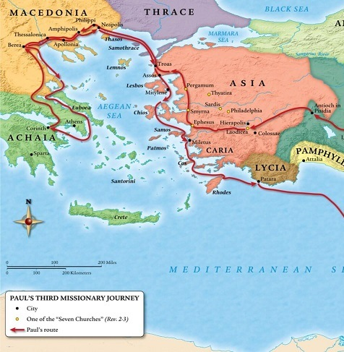
Section #9: Acts 20:1-5
Journeys in Greece
1 And after the uproar was ceased [at Ephesus], Paul called unto him the disciples, and embraced them, and departed for to go into Macedonia.
2 And when he had gone over those parts, and had given them much exhortation, he came into Greece,
3 And there abode three months. And when the Jews laid wait for him, as he was about to sail into Syria, he purposed to return through Macedonia.
4 And there accompanied him into Asia Sopater of Berea; and of the Thessalonians, Aristarchus and Secundus; and Gaius of Derbe, and Timotheus; and of Asia, Tychicus and Trophimus. [Don’t forget Luke was there too.]
5 These going before tarried for us [Paul & Luke] at Troas.
In the last part of Acts 19 there was a riot at Ephesus because Paul was turning the people away from the worship of their god Diana. This is likely the reason
he chose not to re-visit the city on his return to Jerusalem!

Slide 52
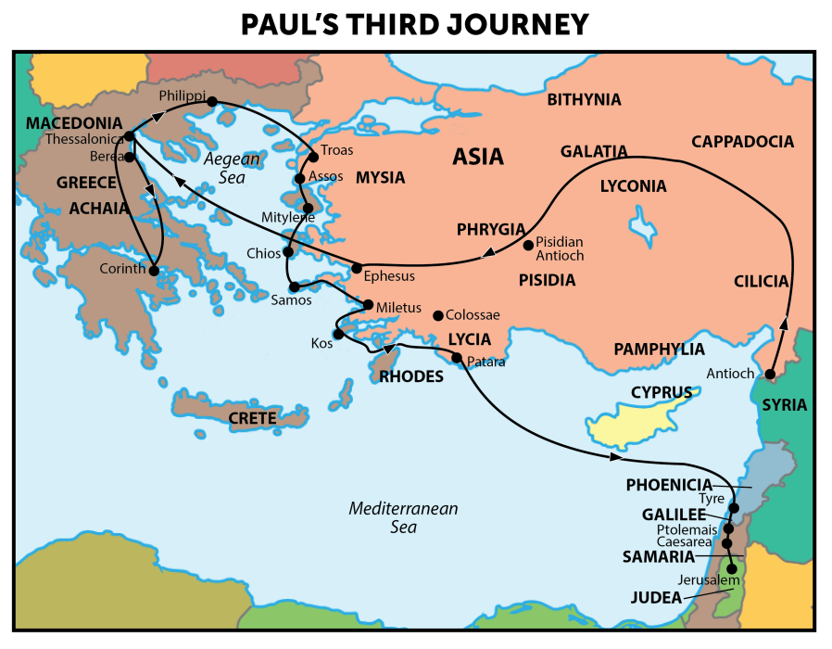
Paul’s intent was to observe Pentecost
in Jerusalem at the
end of his third missionary journey.
To track his travels from Passover and the Days of Unleavened Bread to Pentecost
we need to know his whereabouts during
this period.
Luke’s detail in
the chapters of
Acts 20-24 gives
that account.
The Omer count picks up here.
52

Slide 53
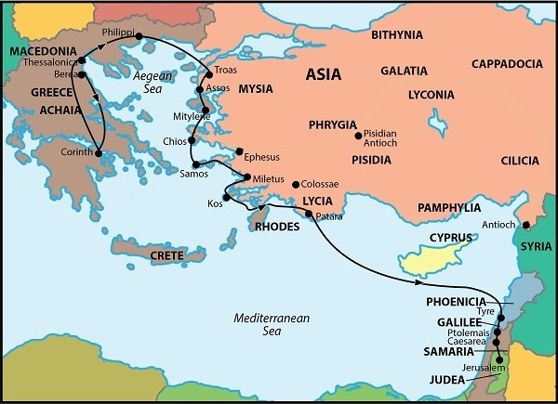
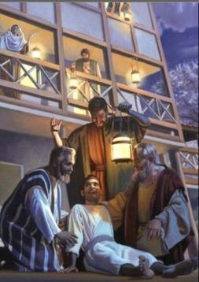
i) Philippi to Troas
20:6 And we sailed away from Philippi after the days of unleavened bread, and came unto them to Troas in five days; where we abode seven days. [See note.*]
7 And upon the first day of the week, when the disciples came together to break bread, Paul preached unto them, ready to depart on the morrow [G1887; the day after]; and continued his speech until midnight.
Eutychus Restoration Event [Acts 20:8-12]
11 When he therefore was come up again, and had broken bread, and eaten, and talked a long while, even till break of day, so he departed [by foot vs 13 – the others sailed].
*Note: Vs 6 says “after the days of unleavened bread” … not
“many days after...”
This information will be carefully charted.
53

Slide 54
ii) Troas to Miletus
20:13 And we went before to ship,
and sailed unto Assos, there intending
to take in Paul: for so had he appointed,
minding himself to go afoot.
14 And when he met with us at Assos,
we took him in,
and came to Mitylene.
15 And we sailed thence, and came
the next day over against Chios; and
the next day we arrived at Samos, and
tarried at Trogyllium; and
the next day we came to Miletus.
16 For Paul had determined to sail by Ephesus, because he would not spend the time in Asia:
for he hasted [an urgency], if it were possible for him, to be at Jerusalem the day of Pentecost.
17 And from Miletus he sent to Ephesus, and called the elders of the church.
Ephesus Elders Summoned to hear Paul’s last words of Farewell [Acts 20:18-38]
20:38 Sorrowing most of all for the words which he spake, that they should see his face no more. And they [the elders from Ephesus] accompanied him unto the ship.
54

Slide 55


iii) Cos [Coos] to Tyre
21:1 And it came to pass, that after we were gotten from them, and had launched,
we came with a straight course unto Coos,
and the day following unto Rhodes,
and from thence unto Patara:
2 And finding a ship sailing over unto Phenicia,
we went aboard, and set forth.
3 Now when we had discovered Cyprus,
we left it on the left hand,
and sailed into Syria,
and landed at Tyre: for there the ship was to unlade her burden.
4 And finding disciples, we tarried there seven days:
who said to Paul through the Spirit,
that he should not go up to Jerusalem.
5 And when we had accomplished those [7] days, we departed and went our way; and they all brought us on our way, with wives and children, till we were out of the city: and we kneeled down on the shore, and prayed.
21:6 And when we had taken our leave one of another, we took ship; and they returned home again.
Take Note: No rush to get to Jerusalem yet!
55

Slide 56

iv) Tyre to Jerusalem
21:7 And when we had
finished our course from Tyre,
we came to Ptolemais, and saluted the brethren,
and abode with them one day.
8 And the next day we that were of Paul's company departed, and came unto Caesarea:
and we entered into the house of Philip
the evangelist,
which was one of the seven;
and abode with him.
9 And the same man had four daughters,
virgins, which did prophesy.
10 And as
we tarried there [with Philip in Caesarea] many days,
there came down from Judaea a certain prophet,
named Agabus.
Agabus Warns: Don’t Go To Jerusalem!
[Acts 21:11-14]
15 And after those days we packed up and went up to Jerusalem. [NKJV for this verse only.]
16 There went with us also certain of the disciples of Caesarea, and brought with them one Mnason of Cyprus, an old disciple, with whom we should lodge.
56

Slide 57


v) Arrival at Jerusalem (in time for Pentecost?)
21:17 And when we were come to Jerusalem,
the brethren received us gladly.
18 And the day following Paul went in with us unto James; and all the elders were present.
19 And when he had saluted them, he declared particularly what things Elohim had wrought among the Gentiles by his ministry.
Elders at Jerusalem Urge
Paul to Take a Vow
[Acts 21:20-25]
Paul’s work with the Gentiles may have rendered him “unclean” to enter the temple for worship.
The leaders urged Paul to take a vow so others would know he had not forsaken Moses’ commands.
This vow involved: 1) joining four men that were completing their vow;
2) a cleansing ritual on the 3rd and 7th days;
3) paying for the many sacrifices;
4) shaving their heads as part of the requirement and burning the hair with
the peace offering.
The Vow Requirements
23 Do therefore this that we say to thee:
We have four men which have a vow on them;
24 Them take, and purify thyself with them, and be at charges with them, that they may shave their heads: and all may know that those things, whereof they were informed concerning thee, are nothing; but that thou thyself also walkest orderly, and keepest the law.
57

Slide 58

v) At Jerusalem for Purification in the Temple
Paul’s Nazarite Vows in the Temple [Acts 21:28- 22:29]
21:26 Then Paul took the men, and the next day purifying himself with them entered into the temple, to signify the accomplishment of the days of purification,
until that an offering should be offered for every one of them.
27 And when the seven days were almost ended,
the Jews which were of [Ephesus] Asia, when they saw him in the
temple, stirred up all the people, and laid hands on him, [Because] …
Paul brought the converted Gentile, Trophimus an Ephesian, into the temple;
The Jews of Ephesus felt this act polluted the temple;
They angrily removed Paul from the temple and shut the doors – in the event the temple was polluted, no one else would be allowed to enter.
Paul is Arrested in the Temple [21:28- 22:29] & The Sanhedrin Divided [22:30 & 23:1-9]
22:30 On the morrow, because he would have known the certainty wherefore he was accused of the Jews, he [chief captain] loosed him from his bands, and commanded the chief priests and all their council to appear, and brought Paul down, and set him before them.
58

Slide 59

v) Romans Plan to Move Paul out of Jerusalem
Paul Rescued by Roman Soldiers from Great Dissension and
a Plot to Kill Paul the Next Day [Acts 23:10-22]
10 And when there arose a great dissension, the chief captain, fearing lest Paul
should have been pulled in pieces of them, commanded the soldiers to go down,
and to take him by force from among them, and to bring him into the castle.
11 And the night following the Master stood by him, and said, Be of good cheer,
Paul: for as thou hast testified of me in Jerusalem, so must thou bear witness also at Rome.
12 And when it was day, certain of the Jews banded together, and bound themselves
under a curse, saying that they would neither eat nor drink till they had killed Paul.
[Paul’s nephew was able to get this message delivered to those in charge of Paul’s well being.]
Paul Sent to Felix at Caesarea With a Letter [Acts 23:23-24]
23 And he [chief captain] called unto him two centurions, saying, Make ready two hundred soldiers to go to Caesarea, and horsemen threescore and ten, and spearmen two hundred,
at the third hour of the night [approx. 9 PM Roman time];
24 And provide them beasts, that they may set Paul on, and bring him safe unto Felix
the governor.
59

Slide 60



Horses ~
How long can they run?
Horses can run at a fast pace or galloping without stopping for about 2 miles until fatigue sets in.
At a slower pace, horses can travel for as long as
20 miles in one day at a walk or a trot.
The speed of a horse depends on the terrain and the weight that it is carrying. Generally, if the horse is carrying a rider with an average weight on a rather plain ground, it can take around 8 to 9 hours to cover 20 miles. This is considering the fact that the horse is mostly trotting and walking with a few gallops.
These Roman horses were not used for speed, but for protection and
to transport Paul.

Slide 61
vi) From Jerusalem to Antipatris to Caesarea
23:31 Then the soldiers, as it was commanded them, took Paul, and brought him by night to Antipatris.
32 On the morrow they [the soldiers] left the horsemen to go with him [Paul], and returned
to the castle:
33 Who, when they came to Caesarea, and delivered the epistle to the governor, presented Paul also before him.
34 And when the governor had read the letter,
he asked of what province he was.
And when he understood that he was of Cilicia;
35 I will hear thee, said he, when thine accusers
are also come. And he commanded him to be
kept in Herod's judgment hall.
Antipatris, is on an ancient
Roman road about 40-42 miles
or 65 km from Jerusalem. It’s about another 35 miles/55 km
to Caesarea.
61

Slide 62
vii) High Priest Arrives From Jerusalem
24:1 And after five days Ananias the high priest descended with the elders, and with a certain orator named Tertullus, who informed the
governor against Paul.
2 And when he was called forth, Tertullus began
to accuse him, saying, Seeing that by thee we
enjoy great quietness, and that very worthy deeds are done unto this nation by thy providence,
3 We accept it always, and in all places,
most noble Felix, with all thankfulness.
4 Notwithstanding, that I be not further tedious unto thee, I pray thee that thou wouldest hear us
of thy clemency a few words.
5 For we have found this man a pestilent fellow,
and a mover of sedition among all the Jews throughout the world, and a ringleader of the
sect of the Nazarenes:
24:6 Who also hath gone about to profane the temple: whom we took, and would have judged according to our law.
7 But the chief captain Lysias came upon us, and
with great violence took him away out of our hands,
8 Commanding his accusers to come unto thee: by examining of whom thyself mayest take knowledge of all these things, whereof we accuse him.
9 And the Jews also assented, saying that these things were so.
10 Then Paul, after that the governor had beckoned unto him to speak, answered, Forasmuch as I know that thou hast been of many years a judge unto this nation, I do the more cheerfully answer for myself …
Paul has more to say – we’ll find out later in Part 3!
62

Slide 63
Paul’s Pentecost Appointment at Jerusalem
Nov 28: up to slide 22 – 6 hrs..
Nov 29: slide 31 – 9 hrs.
Nov 30: 1130 am 32-37 by 330 (4 hrs.) start at 38. updated Dennis U.
Dec 3/20: 10 am #38 – up to slides 46-50 at 1015 pm & use Acts 20 document
Dec 4 Friday 115 pm … researching acts 21:26
Dec 25/20 Friday 1130 AM – do corrections on PPT and THEN see if I can get the 12 days figured out. Mark kendall and paul slide 44? 200 pm – ready to start charting the months now.
Dec 26/20: 800 am … Etesian winds – to 8 pm
Dec 27/20 530 pm … start building omer trips on charts cut & paste at table. Moses Calendar??
Dec 28/20 1 pm to 530 … cracked the study open – just to put into PPT now. Yeah! E to TA and DU.
Dec 30/20 730 am – 930 pm … about 12 hours full time today. Letter to dennis & Tim on slide 2 for edit going to dennis on thurs pm.
Dec 31/20 start at slide 84 – sivan – 3rd month 600 am-730; 1100 – 100 pm – finally found a map of roman roads that paul would have travelled on. Most only walked 3 mph – need to change that too.
Finished at midnight at slide 99 – now to do a huge proof read and get everything in order. I long 18 hr day, but almost done. Emailed TA and DU what’s up next. 18 hrs. of work today.
Jan 1/21 630 -930. 1030 am – 1230 pm [gen. proof read to slide 67 – ready to print for big proofing and see if the wind, and cloud information should be moved to the beginning. EAT/break 1320- - 1) change out zif-sivan? 2) check for god & lord 3) take off bkgds; 4) Index has to be organized; 5) travel time by horses – note that this is not really needed as Paul was just being transported with his items. 6) remove underlines; 7) animation; 8) move the wind cloud information to the beginning; 9)
Jan 14/21: Final edit hopefully 1015 am; troubles with PPT at 1 pm. 4 pm: bkgds fixed to 510 pm; start at slide 18 next
Jan 15/21: worked about 6 hrs. and got a lot of stuff pulled together to places. Jan 16th: 3 hrs. and finished the basics – just to check now.
Slides 53 & 57 finished ready to check with RF … then print and check everything. 830 & 4 pm Sabbath. 5 Hrs. with RF; finish at 220 am. Email to Tim for editing.
Sunday jam 17/21 – tim likes the study … 1 pm: edit 6 for cf; worked from noon to 10 pm. Added 75-78 and fixed slide 27. Started some animation – got charts 70-74 done. TA said it was hard to follow the 1st time without animation. Wants to expand to floating WS problems – and debunking Enoch. Emailed at 10 pm Jan 17/21.
Jan 18/21 – getting too long – have to split into 3 parts, but barrel through and teach all at once and have Neil break up into 3 parts for the web.
and the Battle
of the Calendars
Part 3 of 3
Notes:
Oct 21: 10 min – started and that’s about all. 1.07 MB
Nov 11: 1030 AM -

Slide 64


Introduction to Section #10: Charting Paul’s Journey
So far we have considered necessary information on:
Many maps of Paul’s 3rd journey;
Individual locations and reasonable distances between Philippi to Jerusalem;
Reasonable calculations for walking, waiting times and sailing conditions for various ports, etc.
Acts 20-24 testimony was read to bring everything together for the fine calendar details.
Next: A short lesson on Meteorology for this trip.
Then it is time to chart the Omer Count on the calendar months according to the timing details.
Note: Nothing about this return trip to Jerusalem has been purposely advanced to assure a 50 Day Omer Count due to Paul’s urgency to be in Jerusalem “if at all possible” for Pentecost.
What will the Omer Count actually be?

Slide 65

Before Setting Sail With Paul …
We must understand this journey to Jerusalem. Paul and his travelling companions would
have had to know some basic knowledge and information before planning this trip, if they wanted to be “on time” for Pentecost.
The following information from the web is on weather patterns of the Aegean & Mediterranean Seas, along with verification from Captain Buddy Jones, our local
sea captain for 66 years.
65
Notes:
1.18 mb

Slide 66


Paul’s 2nd Journey
Paul’s 3rd Journey
140 miles Troas to Neapolis
Acts 16:11 [2 days]
11 Therefore loosing from Troas,
we came with a straight course to Samothracia, and the next day to Neapolis. [70 miles/day with strong wind]
140 miles Neapolis to Troas
Acts 20:6 [5 days]
6 And we sailed away from Philippi after the days of unleavened bread, and came unto them to Troas in
five days. [28 miles/day with mild wind]
66

Slide 67

Acts 20 & Linkage to Meteorology
Paul’s return to Jerusalem on his 3rd trip uses many sailing vessels that depend
on the winds for movement from port to port. During portions of this spring trip,
the winds in this area of the earth are called Etesians.
Definition of Etesians: This is the English word for the Greek word Meltemi.
The Etesians are strong annual prevailing winds that blow from the North
over large parts of: a) Greece b) Aegean Sea c) Mediterranean Sea.
Note: The wind experienced at any given location is highly dependent on
local topography.
Time of Year for Etesians: These winds occur from the END of May to October; very strong winds in June/July. (Winter winds are not Etesians.)
During a strong Etesian, the trough may extend relatively far to the west beyond Rhodes and even to Crete forming a closed “low pressure” resulting in almost calm winds at Rhodes.

Slide 68
Acts 20 & Linkage to Meteorology [con’t]
Time of the Day for Etesians: These winds mostly blow during the day from 8 AM to 8 PM and are strongest about 2 PM. Often these winds die quickly after sundown,
to return at dawn. Under the influence of the sea breeze during the day, the Etesians become stronger locally, as is the case in the coastal area of Northern Crete.
Length of Etesians: Occasionally, winds on the 1st day that blow all night can often continue to blow for many days – up to 10 days.
Speed of Etesians: These winds are usually moderate, however, they might reach gale-like force over off-shore areas, reaching their maximum wind speeds around early afternoon.
Force/Intensity of Etesians: The winds are weaker in May & can reach an intensity
of Force 6. By the very end of May the intensity can be Force 7 and can reach
Force 8 for a few hours during the hot hours of the day.

Slide 69
Beaufort Wind Force | Wind Average | Speed Range [1 knot = 1.15 mph]
Force 2 [Light] | 5 knots 6 mph 9 km/h | 4-6 knots 4-7 mph 6-11 km/h
Force 3 [Gentle] | 9 knots 10 mph 16 km/h | 7-10 knots 8-12 mph 12-19 km/h
Force 4 [Moderate] | 13 knots 16 mph 24 km/h | 11-16 knots 13-18 mph 20-28 km/h
Force 5 [Fresh] | 19 knots 22 mph 34 km/h | 17-21 knots 19-24 mph 29-38 km/h
Force 6 [Strong] | 24 knots 28 mph 44 km/h | 22-27 knots 25-31 mph 39-49 km/h
Force 7 [Strong] | 30 knots 35 mph 56 km/h | 28-33 knots 32-38 mph 50-61 km/h
Force 8 [Gale] | 37 knots 43 mph 68 km/h | 34-40 knots 39-46 mph 62-74 km/h
From about
mid-May to October the winds become stronger – being the strongest
in the hot summer months.
While sailing from
[early April] Unleavened Bread dates to Pentecost at the end of May,
the winds may be around
Force 3 IF
they are blowing at all.
69

Slide 70

Nature Determines Arrival of Etesian [con’t]
Strong Etesian winds do not occur
in April/Abib or early May
for really good sailing.
7) By the high season of the Etesian (July…) a Meltemi
is heralded by: i) scattered altocumulus or orographic clouds a day before arrival; ii) a sudden drop in humidity; iii) and a rise
in atmospheric pressure.
It could be that by mid-May
of Paul’s homeward journey,
some of the navigating was determined by clouds,
indicating Etesians are coming - affecting the sailing time.
DIRECTION & LOCAL WINDSPEEDS IN KNOTS FOR GREECE (FOR SHIPPING) [1 Knot = 1.15 mph]
LOCATION | APRIL | MAY | JUNE
Samos Sea (Samos) | NW [Light] 9.4 knots = 10 mph | NW [Light] 7.8 knots = 9 mph | NW [Gentle] 9.4 knots = 11 mph
Rhodes Sea (Kos-Rodos) | WNW [Gentle] 13.6 knots = 15.5 mph | WNW [Moderate] 13.0 knots = 18.5 mph | NW [Moderate] 13.0 knots = 15 mph
Note: for the open Mediterranean Sea we will use an average
of 10 mph wind speed for the beginning of May.

Slide 71




Orographic Clouds & Arrival of Etesian [con’t]
Orographic clouds develop in response to the forced lifting of air by the earth’s topography (e.g.: mountains). Initially, stable air encounters a mountain, is lifted upward and cools through expansion as it rises.
Orographic Cloud Formation

Slide 72




Altocumulus Clouds & Arrival of Etesian [final]
Altocumulus clouds usually form by convection in an unstable layer aloft, which may result from the gradual lifting of air in advance of a cold front.
The presence of altocumulus clouds on a warm and humid summer morning is commonly followed by thunderstorms later in the day.
Captain Jones confirms: sea captains know how to read the clouds in the sky for their sailing days & what to expect.
Altocumulus Clouds Formation

Slide 73
Section #10: Sailing With Paul to Jerusalem
These are a few things that need to be considered before we can begin to chart the details given to us by Luke about this return journey back to Jerusalem.
Along with the Scriptures that have been read, we are now ready to chart the details on the Covenant Calendar, beginning with the Passover Spring Festival.
A Note of Interest: Luke has given details in “puzzle fashion” so that we can know exactly when the days of Unleavened Bread ended.
Let’s chart the Omer Count
on calendar months!
73
Notes:
1.18 mb

Slide 74


1st Month ~ Abib ~ Leaving Philippi for Troas
1st Cycle [Sun] | 2nd Cycle [Mon] | 3rd Cycle [Tues] | 4th Cycle [Wed] | 5th Cycle [Thurs] | 6th Cycle [Fri] | 7th Cycle [Sabbath]
Abib 12 Apr 3 | Abib 13 Apr 4 | Abib 14 Apr 5 Passover Location: Philippi | Abib 15 Apr 6 1st Feast Sabbath of Unleavened Bread (the only High Sabbath) | Abib 16 Apr 7 #2 ULB | Abib 17 Apr 8 #3 ULB | Abib 18 Apr 9 #4 ULB
Abib 19 Apr 10 Wave Sheaf & #5 ULB Begin Omer Count #1 | Abib 20 Apr 11 #6 ULB Omer #2 | Abib 21 Apr 12 #7 ULB & 2nd Feast Sabbath of ULB Omer #3 | Abib 22 Apr 13 Destination: Troas Omer #4 | Abib 23 Apr 14 Omer #5 | Abib 24 Apr 15 Omer #6 | Abib 25 Apr 16 Omer #7
DAYS: 1 2 3 4
20:6 And we sailed away from Philippi
AFTER the days of unleavened bread,
and came unto them to Troas in five days …
74
Notes:
1.18 mb

Slide 75

DAYS: 1 2 3 4
1st Month [Abib] to 2nd Month [Zif]
1st Cycle [Sun] | 2nd Cycle [Mon] | 3rd Cycle [Tues] | 4th Cycle [Wed] | 5th Cycle [Thurs] | 6th Cycle [Fri] | 7th Cycle [Sabbath]
Abib 19 Apr 10 Wave Sheaf Omer #1 | Abib 20 Apr 11 Omer #2 | Abib 21 Apr 12 #7 ULB Omer #3 | Abib 22 Apr 13 Omer #4 | Abib 23 Apr 14 Omer #5 | Abib 24 Apr 15 Omer #6 | Abib 25 Apr 16 Omer #7
Abib 26 Apr 17 Arrival: Troas Omer #8 | Abib 27 Apr 18 Troas Day 1 [Abide 7 days] Omer #9 | Abib 28 Apr 19 Troas Day 2 Omer #10 | Abib 29 Apr 20 Troas Day 3 Omer #11 | Abib 30 Apr 21 Troas Day 4 Omer #12 | Zif 1 Apr 22 Troas Day 5 Omer #13 | Zif 2 Apr 23 Troas Day 6 Omer #14
DAY #5
20:6 … and came unto them to Troas in five days;
where we abode seven days [including Abib 27-Zif 3].
75
Notes:
1.18 mb

Slide 76



2nd Month ~ Zif
1st Cycle [Sun] | 2nd Cycle [Mon] | 3rd Cycle [Tues] | 4th Cycle [Wed] | 5th Cycle [Thurs] | 6th Cycle [Fri] | 7th Cycle [Sabbath]
Abib 26 Apr 17 Omer #8 | Abib 27 Apr 18 Omer #9 | Abib 28 Apr 19 Omer #10 | Abib 29 Apr 20 Omer #11 | Abib 30 Apr 21 Omer #12 | Zif 1 Apr 22 Omer #13 | Zif 2 Apr 23 Omer #14
Zif 3 Apr 24 Acts 20:7 Paul’s sermon all night long till dawn in Troas ready to depart on the morrow; Eutychus & his excitement. Troas Day 7 Omer #15 | Zif 4 Apr 23 Omer #16 | Zif 5 Apr 24 Omer #17 | Zif 6 Apr 25 Omer #18 | Zif 7 Apr 26 Omer #19 | Zif 8 Apr 27 Omer #20 | Zif 9 Apr 28 Omer #21
20:7 And upon the first day of the week,
when the disciples came together to break bread,
Paul preached unto them, ready to depart on the morrow; and continued his speech until midnight.
[Eutychus’ accident & raised back to life]
Vs 11: [Paul] talked a long while, even till break of day …
VERY Important Note: The calendar detail that this event occurred on the 1st day of the week, is the information that cements the 3rd cycle [Tues] Passover of 57 AD!
Let’s count out these 12 days to be sure!
76
Notes:
1.18 mb

Slide 77




DAYS: 1 2 3 4
Abib 14 ~ Zif 3
Establishing the Passover Weekly Cycle
1st Cycle [Sun] | 2nd Cycle [Mon] | 3rd Cycle [Tues] | 4th Cycle [Wed] | 5th Cycle [Thurs] | 6th Cycle [Fri] | 7th Cycle [Sabbath]
Abib 12 Apr 3 | Abib 13 Apr 4 | Abib 14 Apr 5 Passover At Philippi | Abib 15 Apr 6 1st ULB Sabbath | Abib 16 Apr 7 #2 ULB | Abib 17 Apr 8 #3 ULB | Abib 18 Apr 9 #4 ULB
Abib 19 Apr 10 #5 ULB Wave Sheaf Omer #1 | Abib 20 Apr 11 #6 ULB Omer #2 | Abib 21 Apr 12 #7 ULB Omer #3 Left the next day | Abib 22 Apr 13 Omer #4 | Abib 23 Apr 14 Omer #5 | Abib 24 Apr 15 Omer #6 | Abib 25 Apr 16 Omer #7
Abib 26 Apr 17 Omer #8 | Abib 27 Apr 18 Omer #9 Troas Day 1 | Abib 28 Apr 19 Omer #10 Troas Day 2 | Abib 29 Apr 20 Omer #11 Troas Day 3 | Abib 30 Apr 21 Omer #12 Troas Day 4 | Zif 1 Apr 22 Omer #13 Troas Day 5 | Zif 2 Apr 23 Omer #14 Troas Day 6
Zif 3 Apr 24 Omer #15 Troas Day 7 Paul preaches all night; prepares to depart Troas at morn. | Zif 4 Apr 25 Omer #16 Paul walks to Assos | Zif 5 Apr 26 Omer #17 | Zif 6 Apr 27 Omer #18 | Zif 7 Apr 28 Omer #19 | Zif 8 Apr 29 Omer #20 | Zif 9 Apr 30 Omer #21
12
11
10
9
8
7
6
5
4
3
2
DAY #5
1
Let’s work the count backwards:
From Omer #15 - 1st day of the week, count back 7 days to Omer #9 (Troas visit).
From Omer #9 - count back 5 sailing days to Wednesday Omer #4.
Omer #3: #7 ULB & final day of Spring Festival honored, leaving at morn.
Passover that year was on the 3rd cycle [Tues].
Is there proof the year really was 57 AD? And why?
77
Notes:
1.18 mb

Slide 78


2nd Month ~ Zif
1st Cycle [Sun] | 2nd Cycle [Mon] | 3rd Cycle [Tues] | 4th Cycle [Wed] | 5th Cycle [Thurs] | 6th Cycle [Fri] | 7th Cycle [Sabbath]
Abib 26 Apr 17 Omer #8 | Abib 27 Apr 18 Omer #9 | Abib 28 Apr 19 Omer #10 | Abib 29 Apr 20 Omer #11 | Abib 30 Apr 21 Omer #12 | Zif 1 Apr 22 Omer #13 | Zif 2 Apr 23 Omer #14
Zif 3 Apr 24 Acts 20:7 Paul’s sermon all night long till dawn in Troas ready to depart on the morrow; Eutychus & his excitement Troas Day 7 Omer #15 | Zif 4 Apr 25 Paul on foot from Troas to Assos ~ the others sail. Pick up Paul & sail to Mitylene [40 miles]. Omer #16 | Zif 5 Apr 24 Omer #17 | Zif 6 Apr 25 Omer #18 | Zif 7 Apr 26 Omer #19 | Zif 8 Apr 27 Omer #20 | Zif 9 Apr 28 Omer #21
20:11-13 [Paul] talked a long while, even till break of day … so he departed [by foot – the others sailed].
Walking: 20 mi @ 3 mph = 6.5 hrs.
Approx. arrival at Assos = Noon
Sailing: 60 mi @ 7.5 mph = 8 Hrs.
Approx. arrival at Assos = 2 PM
20:14 [Paul] met with us at Assos, we took him in & came to Mitylene.
Next: It appears the ship just stopped for a short while & carried on through
this dangerous passage 5.5 Hrs. before the winds would die down at sunset.
78
Notes:
1.18 mb

Slide 79

The
Mitylene
Moon of Omer #16
Paul is boarding the ship on Omer #16 from Assos to sail to Mitylene.
At this point it is very crucial to know what’s happening with this sail!
Remember, many say this was a night of a dark moon.
Was it, or not? How can we know?
We will further the investigation right now. There may be some surprises!
79

Slide 80



57 AD Facts
Placement Year of 3rd Journey
We now know Paul’s calendar year had
a 3rd cycle [Tues] Passover – exactly the same as the Exodus year of Moses. This is
a Pillar Calendar year!
After a huge search,
57 AD is the ONLY
year that qualifies – NOT 58-63 AD.
Tequfah: Mar 22nd
MOSES
Mar 22: Tequfah [Covenant Cal.]
Mar 23: Abib 1 Apr 5: Abib 14
Apr 10: Wave Sheaf & Omer #1
Apr 25: Mitylene & Omer #16
57 AD qualifies on many different levels, not just one!

Slide 81
Follow the 57 AD Facts
Where was the Mitylene moon?
Mar 23: Abib 1
Apr 5: Abib 14
Apr 10: Wave Sheaf
& Omer #1
Apr 25: Mitylene
& Omer #16
Apr 22: conjunction
Apr 24: 1st sliver
Conclusion Covenant
Calendar: Mitylene
[25th] did have quite a
dark moon on Omer #16.
Tequfah: Mar 22nd
MOSES
Note: Many commentators declare it was a dark moon for Paul at Mitylene. How would they know this without following Covenant Calendar?
Would you believe the commentators without any detailed evidence?

Slide 82

57 AD Lunar Calendar Facts
Where was the Mitylene moon?
Mar 24: conjunction
Mar 26: 1st sliver moon
Apr 8: 1/14 Fri Passover
Apr 9: 1/15 ULB &
7th day Shabbat
Apr 10: 1/16 [married to Wave Sheaf &] Omer #1
Apr 22: conjunction
Apr 24: 1st sliver
Apr 25: 2nd sliver-Mitylene
& Omer #16
Conclusion: Mitylene did
have a pretty dark moon
on the Lunar Calendar!
Tequfah: Mar 22nd
LUNAR
Let’s examine this on a large scale so we can “SEE” exactly what is happening between the Covenant Calendar
& Lunar Calendar in 57 AD.
Is this enough evidence to prove the lunar calendar is true?

Slide 83

Where was the Mitylene moon on Omer #16 [Apr 25]?
Covenant
Tequfah: Mar 22nd
LUNAR
Conclusion: Mitylene did have
a pretty dark moon on Omer #16!
Amazingly, the lunar festal calendar
arrives at exactly the same conclusion
as the Covenant Calendar for the placement
of Wave Sheaf & the #16 Omer Count.
Both align with the overnight stay at Mitylene!
Is it evident there was a battle between the calendars here?

Slide 84

Absolutely!
Links for the Joshua Wave Sheaf study (Parts 1 & 2) that shows the lunar calendar has Wave Sheaf “married” to Abib 16 in the year of 160 AD with the death of Rashbi:
Part 1: https://youtu.be/gsRRgw0Z5eg
Part 2: https://youtu.be/ogeqPXFyql0

Slide 85



57 AD Israel Calendar
Dark Mitylene moon on 2 Calendars?
Tequfah: Mar 22nd
MOSES
LUNAR
This puzzle is a calendar cruncher that can only be solved by …
These are very different festal calendars coming to the exact same conclusion for Omer #16. Is more discussion needed?
The Blood-Ratified Covenant Calendar! How?

Slide 86
2nd Month ~ Zif
Let’s return to this study!
1st Cycle [Sun] | 2nd Cycle [Mon] | 3rd Cycle [Tues] | 4th Cycle [Wed] | 5th Cycle [Thurs] | 6th Cycle [Fri] | 7th Cycle [Sabbath]
Abib 26 Apr 17 Omer #8 | Abib 27 Apr 18 Omer #9 | Abib 28 Apr 19 Omer #10 | Abib 29 Apr 20 Omer #11 | Abib 30 Apr 21 Omer #12 | Zif 1 Apr 22 Omer #13 | Zif 2 Apr 23 Omer #14
Zif 3 Apr 24 Acts 20:7 Paul’s sermon all night long till dawn in Troas ready to depart on the morrow; Eutychus & his excitement. Troas Day 7 Omer #15 | Zif 4 Apr 25 Paul on foot from Troas to Assos ~ the others sail. Pick up Paul & sail to Mitylene [40 miles]. Omer #16 | Zif 5 Apr 26 70 mi from Mitylene to arrive at Chios the NEXT day. Omer #17 | Zif 6 Apr 25 Omer #18 | Zif 7 Apr 26 Omer #19 | Zif 8 Apr 27 Omer #20 | Zif 9 Apr 28 Omer #21
20:15a we sailed thence and came the next day over against Chios …
Sailing: 70 mi to Chios @ 7.5 mph = 9.5 Hrs.
This is an “all day” sail from dawn to sunset.
Mitylene had a
pretty dark moon!
86
Notes:
1.18 mb

Slide 87


2nd Month ~ Zif
1st Cycle [Sun] | 2nd Cycle [Mon] | 3rd Cycle [Tues] | 4th Cycle [Wed] | 5th Cycle [Thurs] | 6th Cycle [Fri] | 7th Cycle [Sabbath]
Abib 26 Apr 17 Omer #8 | Abib 27 Apr 18 Omer #9 | Abib 28 Apr 19 Omer #10 | Abib 29 Apr 20 Omer #11 | Abib 30 Apr 19 Omer #12 | Zif 1 Apr 20 Omer #13 | Zif 2 Apr 21 Omer #14
Zif 3 Apr 24 Acts 20:7 Paul’s sermon all night long till dawn in Troas ready to depart on the morrow; Eutychus & his excitement. Troas Day 7 Omer #15 | Zif 4 Apr 25 Paul on foot from Troas to Assos ~ the others sail. Pick up Paul & sail to Mitylene [40 miles]. Omer #16 | Zif 5 Apr 26 70 mi from Mitylene to arrive at Chios the NEXT day. Omer #17 | Zif 6 Apr 27 70 mi from Chios to arrive at Samos & tarry at Trogyllium the NEXT day. Omer #18 | Zif 7 Apr 26 Omer #19 | Zif 8 Apr 27 Omer #20 | Zif 9 Apr 28 Omer #21
20:15b the next day we arrived at Samos and [5 miles later] tarried at Trogyllium [dark sky].
Remember: 70 mi to Samos @ 7.5 mph = 9.5 Hrs. was an “all day” sail from dawn to sunset.
87
Notes:
1.18 mb

Slide 88
2nd Month ~ Zif
1st Cycle [Sun] | 2nd Cycle [Mon] | 3rd Cycle [Tues] | 4th Cycle [Wed] | 5th Cycle [Thurs] | 6th Cycle [Fri] | 7th Cycle [Sabbath]
Abib 24 Apr 17 Omer #8 | Abib 25 Apr 18 Omer #9 | Abib 26 Apr 19 Omer #10 | Abib 27 Apr 20 Omer #11 | Abib 28 Apr 21 Omer #12 | Zif 1 Apr 20 Omer #13 | Zif 2 Apr 21 Omer #14
Zif 3 Apr 24 Acts 20:7 Paul’s sermon all night long till dawn in Troas ready to depart on the morrow; Eutychus & his excitement. Troas Day 7 Omer #15 | Zif 4 Apr 25 Paul on foot from Troas to Assos ~ the others sail. Pick up Paul & sail to Mitylene [40 miles]. Omer #16 | Zif 5 Apr 26 70 mi from Mitylene to arrive at Chios the NEXT day. Omer #17 | Zif 6 Apr 27 70 mi from Chios to arrive at Samos & tarry at Trogyllium the NEXT day. Omer #18 | Zif 7 Apr 28 45 mi from Trogyllium & arrive the NEXT day at Miletus. Omer #19 | Zif 8 Apr 27 Omer #20 | Zif 9 Apr 28 Omer #21
20:15c the next day we came to Miletus.
Sailing: 45 mi to Miletus @ 7.5 mph = 6 Hrs. Leaving at dawn = noon arrival.
88
Notes:
1.18 mb

Slide 89



2nd Month ~ Zif
1st Cycle [Sun] | 2nd Cycle [Mon] | 3rd Cycle [Tues] | 4th Cycle [Wed] | 5th Cycle [Thurs] | 6th Cycle [Fri] | 7th Cycle [Sabbath]
Abib 26 Apr 15 Omer #8 | Abib 27 Apr 16 Omer #9 | Abib 28 Apr 17 Omer #10 | Abib 29 Apr 18 Omer #11 | Abib 30 Apr 21 Omer #12 | Zif 1 Apr 22 Omer #13 | Zif 2 Apr 23 Omer #14
Zif 3 Apr 22 Acts 20:7 Paul’s sermon all night long till dawn in Troas ready to depart on the morrow; Eutychus & his excitement Troas Day 7 Omer #15 | Zif 4 Apr 23 Paul on foot from Troas to Assos ~ the others sail. Pick up Paul & sail to Mitylene [40 miles] Omer # 16 | Zif 5 Apr 24 70 mi from Mitylene to arrive at Chios the NEXT day Omer #17 | Zif 6 Apr 25 70 mi from Chios to arrive at Samos & tarry at Trogyllium the NEXT day Omer #18 | Zif 7 Apr 28 Arrive at Miletus about noon; [2?] delegates ferry 10 mi to Priene; then walk ~10 mi further this day ~5+Hrs! Omer #19 | Zif 8 Apr 29 Omer #20 | Zif 9 Apr 30 Omer #21
20:16 Paul sailed past Ephesus, because he would not spend time in Asia: for he hasted,
if it were possible
for him
to be at Jerusalem the day of Pentecost.
Crossing of the
Gulf of Latmus the distance to Ephesus is about 38 miles.
Estimated Walk of ~20 mi @ 4mph
[~5+ Hr] – approx. arrival in Ephesus the afternoon or evening
of the
6th cycle -
with mountain terrain etc.
Paul’s delegates meet with the Ephesian elders and prepare for the 2 day walk back to Miletus for one last visit with Paul.
89
Notes:
1.18 mb

Slide 90
2nd Month ~ Zif
1st Cycle [Sun] | 2nd Cycle [Mon] | 3rd Cycle [Tues] | 4th Cycle [Wed] | 5th Cycle [Thurs] | 6th Cycle [Fri] | 7th Cycle [Sabbath]
Zif 3 Apr 24 Omer #15 | Zif 4 Apr 25 Omer #16 | Zif 5 Apr 26 Omer #17 | Zif 6 Apr 27 Omer #18 | Zif 7 Apr 26 Omer #19 | Zif 8 Apr 27 Omer #20 | Zif 9 Apr 28 Omer #21
Zif 10 May 1 Omer #22 | Zif 11 May 2 Omer #23 | Zif 12 May 3 Omer #24 | Zif 13 May 4 Omer #25 | Zif 14 May 3 arrive at Miletus about noon; [2?] delegates leave for Ephesus by ferry Omer #26 | Zif 15 May 4 Omer #27 | Zif 16 May 5 Omer #28
2nd day arrival & Paul’s time with the elders was limited. He has much to share before he boards the ship for the next days’ sail.
21:1a And it came to pass, after we were gotten from them, and had launched …
This is the first of 2 days of walking to meet with Paul one last time – about 20 [of 38] mi. (6+ Hrs.
@ 3-4 mph).
Prepare to sail to Cos at dawn.
Gulf of Latmus
90
Notes:
1.18 mb

Slide 91

2nd Month ~ Zif
1st Cycle [Sun] | 2nd Cycle [Mon] | 3rd Cycle [Tues] | 4th Cycle [Wed] | 5th Cycle [Thurs] | 6th Cycle [Fri] | 7th Cycle [Sabbath]
Zif 3 Apr 24 Omer #15 | Zif 4 Apr 25 Omer #16 | Zif 5 Apr 26 Omer #17 | Zif 6 Apr 27 Omer #18 | Zif 7 Apr 28 Omer #19 | Zif 8 Apr 29 Omer #20 | Zif 9 Apr 30 Omer #21
Zif 10 May 1 Omer #22 | Zif 11 May 2 Omer #23 | Zif 12 May 3 Sail 40 mi from Miletus to arrive at Cos. Omer #24 | Zif 13 May 4 85 mi from Cos to arrive at Rhodes the following day. Omer #25 | Zif 14 May 5 Omer #26 | Zif 15 May 4 Omer #27 | Zif 16 May 5 Omer #28
2nd day arrival & Paul’s time with the elders was limited for so much he needed to tell them before he boards the ship for the next days’ sail.
21:1b we came with a straight course unto Cos and the day following unto Rhodes.
This is the first of 2 long days of walking to meet with Paul one last time – about 16-17 hours.
40 / 7.5 mph
= 5.5 Hrs.
Anchor for the night.
85 / 7.5 mph
= 11.5 Hrs.
Anchor for the night.
91
Notes:
1.18 mb

Slide 92



2nd Month ~ Zif
1st Cycle [Sun] | 2nd Cycle [Mon] | 3rd Cycle [Tues] | 4th Cycle [Wed] | 5th Cycle [Thurs] | 6th Cycle [Fri] | 7th Cycle [Sabbath]
Zif 3 Apr 24 Omer #15 | Zif 4 Apr 25 Omer #16 | Zif 5 Apr 26 Omer #17 | Zif 6 Apr 27 Omer #18 | Zif 7 Apr 28 Omer #19 | Zif 8 Apr 29 Omer #20 | Zif 9 Apr 30 Omer #21
Zif 10 Apr 29 Omer #22 | Zif 11 Apr 30 Omer #23 | Zif 12 May 1 Omer #24 | Zif 13 May 2 Omer #25 | Zif 14 May 5 70 mi from Rhodes to Patara & arrive the following day. Omer #26 | Zif 15 May 6 Omer #27 | Zif 16 May 7 Omer #28
21:1c and from thence [Rhodes] unto Patara.
500+ mi. left!
Will Paul arrive
in time for
Pentecost
or not?
Because of Patara’s location, this was likely a huge shipyard for
sea traffic from east & west.
70 / 7.5 mph
= 9.5 Hrs.
Anchor for the night.
92
Notes:
1.18 mb

Slide 93

2nd Month ~ Zif
1st Cycle [Sun] | 2nd Cycle [Mon] | 3rd Cycle [Tues] | 4th Cycle [Wed] | 5th Cycle [Thurs] | 6th Cycle [Fri] | 7th Cycle [Sabbath]
Zif 3 Apr 24 Omer #15 | Zif 4 Apr 25 Omer #16 | Zif 5 Apr 26 Omer #17 | Zif 6 Apr 27 Omer #18 | Zif 7 Apr 28 Omer #19 | Zif 8 Apr 29 Omer #20 | Zif 9 Apr 30 Omer #21
Zif 10 Apr 29 Omer #22 | Zif 11 Apr 30 Omer #23 | Zif 12 May 1 Omer #24 | Zif 13 May 2 Omer #25 | Zif 14 May 5 70 mi from Rhodes to Patara & arrive the following day. [anchor at night] Omer #26 | Zif 15 May 6 Find a ship to Phoenicia; Sail ~10 Hr/ day towards Cyprus with stronger winds on open sea. Omer #27 | Zif 16 May 7 Winds die down at sunset. Set sail at dawn for ~10 Hrs. & very close to Cyprus. Omer #28
21:2-3a finding a ship sailing over to Phoenicia, we went aboard,
and set forth,
[towards Cyprus for 250 miles].
250 mi
A ship to Phoenicia likely
found evening of Omer #26.
Prepare to leave Omer #27 – 250 mi
till they pass Cyprus on the left.
The day winds increase now to ~10 mph .
150 mi
10 Hrs. @
10 mph
= 100 miles
10 Hrs. @
10 mph
= 100 miles
93
Notes:
1.18 mb

Slide 94
2nd Month ~ Zif
1st Cycle [Sun] | 2nd Cycle [Mon] | 3rd Cycle [Tues] | 4th Cycle [Wed] | 5th Cycle [Thurs] | 6th Cycle [Fri] | 7th Cycle [Sabbath]
Zif 10 May 1 Omer #22 | Zif 11 May 2 Omer #23 | Zif 12 May 3 Omer #24 | Zif13 May 4 Omer #25 | Zif 14 May 5 Omer #26 | Zif 15 May 6 Omer #27 | Zif 16 May 7 Omer #28
Zif 17 May 8 Again, winds die down at sunset. Set sail at dawn for ~10 Hrs. & pass Cyprus on the left about 11 AM. Omer #29 | Zif 18 May 8 Set sail at dawn for ~10 Hrs. for total of 400 mi. Arrival at Tyre the next day. Omer #30 | Zif 19 May 9 Omer #31 | Zif 20 May 9 Omer #32 | Zif 21 May 10 Omer #33 | Zif 22 May 11 Omer #34 | Zif 23 May 12 Omer #35
21:3b passing Cyprus
on the left [in the forenoon] …
250 mi
200 of the 400 + miles
have been covered on
Omer #27 & 28 with stronger winds. There’s 200+ miles to arrive at Tyre.
150 mi
10 Hrs. @
10 mph
= 100 miles
10 Hrs. @
10 mph
= 100 miles
94
Notes:
1.18 mb

Slide 95

2nd Month ~ Zif
1st Cycle [Sun] | 2nd Cycle [Mon] | 3rd Cycle [Tues] | 4th Cycle [Wed] | 5th Cycle [Thurs] | 6th Cycle [Fri] | 7th Cycle [Sabbath]
Zif 10 May 1 Omer #22 | Zif 11 May 2 Omer #23 | Zif 12 May 3 Omer #24 | Zif13 May 4 Omer #25 | Zif 14 May 5 Omer #26 | Zif 15 May 6 Omer #27 | Zif 16 May 7 Omer #28
Zif 17 May 6 Again, winds die down at sunset. Set sail at dawn for ~12 hrs. & pass Cyprus on the left about 8 AM. Omer #29 | Zif 18 May 7 Set sail at dawn for ~4 hrs. & dock at Tyre around 10-11 AM completing 400+ miles. Omer #30 | Zif 19 May 10 Ship arrives & unloads cargo at Tyre; disciples are found; they tarry at Tyre for 7 days. Omer #31 | Zif 20 May 11 Tyre Day 2 Omer #32 | Zif 21 May 12 Tyre Day 3 Omer #33 | Zif 22 May 13 Tyre Day 4 Omer #34 | Zif 23 May 14 Tyre Day 5 Omer #35
DAYS: 1 2 3 4 5 [of 7]
21:3c … and landed at Tyre: for there the ship was to unlade her burden. 21:4-5 And finding disciples, we tarried at Tyre seven days.
There are only 20 days left till Pentecost.
Question: If Paul was in such a hurry, why did he tarry in Tyre for 7 days once in The Levant?
10 Hrs. @
10 mph
= 100 miles
10 Hrs. @
10 mph
= 100 miles
95
Notes:
1.18 mb

Slide 96
2nd Month ~ Zif
1st Cycle [Sun] | 2nd Cycle [Mon] | 3rd Cycle [Tues] | 4th Cycle [Wed] | 5th Cycle [Thurs] | 6th Cycle [Fri] | 7th Cycle [Sabbath]
Zif 17 May 8 Omer #29 | Zif 18 May 9 Omer #30 | Zif 19 May 10 Omer #31 | Zif 20 May 11 Omer #32 | Zif 21 May 12 Omer #33 | Zif 22 May 13 Omer #34 | Zif 23 May 14 Omer #35
Zif 24 May 15 Counsel is given to Paul to NOT go up to Jerusalem, but to save his life. Paul is ready to go. Omer #36 | Zif 25 May 16 Friends go with Paul & companions to the ship for dawn sailing to Ptolemais the next day. Omer #37 | Zif 26 May 17 25 miles from Tyre to Ptolemais; 9 AM arrival & stay with the brethren one day. Omer #38 | Zif 27 May 18 Omer #39 | Zif 28 May 19 Omer #40 | Zif 29 May 18 Omer #41 | Zif 30 May 19 Omer #42
21:5b … and when we accomplished those [7] days, we departed and went our way. Omer #37
21:7 … we came to Ptolemais … abode with the brethren one day. Omer #38
DAYS #6 #7
25 miles @
10 mph
= 2.5 Hrs.
96
Notes:
1.18 mb

Slide 97

2nd Month ~ Zif
1st Cycle [Sun] | 2nd Cycle [Mon] | 3rd Cycle [Tues] | 4th Cycle [Wed] | 5th Cycle [Thurs] | 6th Cycle [Fri] | 7th Cycle [Sabbath]
Zif 17 May 8 Omer #29 | Zif 18 May 9 Omer #30 | Zif 19 May 10 Omer #31 | Zif 20 May 11 Omer #32 | Zif 21 May 12 Omer #33 | Zif 22 May 13 Omer #34 | Zif 23 May 14 Omer #35
Zif 24 May 15 Counsel is given to Paul to NOT go up to Jerusalem & save his life. Paul is ready to go. Omer #36 | Zif 25 May 16 Friends go with Paul & companions to ship for dawn sailing to Ptolemais the next day. Omer #37 | Zif 26 May 17 25 miles from Tyre to Ptolemais; 9 AM arrival & stay with the brethren one day. Omer #38 | Zif 27 May 18 30 miles from Ptolemais to Caesarea the next day; 4 PM arrival leaving at dawn. Omer #39 | Zif 28 May 19 Omer #40 | Zif 29 May 20 Omer #41 | Zif 30 May 21 Omer #42
21:8 … the next day we departed and came to Philip’s house and abode with him. Omer #39
21:10 … we tarried there [with Philip in Caesarea] many days. Omer #39 - #42
DAYS: … 1 2 3
Note: The next stop is Jerusalem – 65 miles.
This is at least a 3 day walk from Caesarea.
After Sabbath fellowship the travellers leave on the 1 ^{st} cycle to avoid Sabbath travel.
25 miles @
10 mph
= 2.5 Hrs.
30 miles @
3 mph
= 10 Hrs.
97
Notes:
1.18 mb

Slide 98


Which roads did Paul travel from
Caesarea to Jerusalem?
There are many
different routes from
Caesarea to Jerusalem.
For this study, we will use the calculations of the route most travelled with a distance of 65-70 miles.
At a pace of an average walk of 3 mph, this last leg of the journey is at least
3 days for a total of about 21.5 Hrs. of walking (or 7 Hrs./day).
Caesarea to Antipatris
Antipatris to Bethel
Bethel to Jerusalem
There may have been friends along the way for their night lodging if they were not near one of the map locations.
In just a few days Paul will be travelling
this same road again with a Roman guard.

Slide 99
3rd Month ~ Sivan
1st Cycle [Sun] | 2nd Cycle [Mon] | 3rd Cycle [Tues] | 4th Cycle [Wed] | 5th Cycle [Thurs] | 6th Cycle [Fri] | 7th Cycle [Sabbath]
Zif 24 May 15 Omer #36 | Zif 25 May 16 Omer #37 | Zif 26 May 17 Omer #38 | Zif 27 May 18 Omer #39 | Zif 28 May 19 Omer #40 | Zif 29 May 20 Omer #41 | Zif 30 May 21 Omer #42
Sivan 1 May 22 Pack & leave Caesarea for Jerusalem – 65-70 miles, 7+ Hrs/day for 3 days. Day 1 of 3! Omer #43 | Sivan 2 May 23 Enroute to Jerusalem – 7+ Hrs/day walking. Day 2 of 3! Omer #44 | Sivan 3 May 24 Arrive at Jerusalem – 7+ Hrs/day walking. Day 3 of 3! * * * Meet with the brethren & gladly received! Omer #45 | Sivan 4 May 25 Omer #46 | Sivan 5 May 26 Omer #47 | Sivan 7 May 27 Omer #48 | Sivan 8 May 28 Omer #49
Surprise ~ on the following day!
Paul urged to join
4 men
in their Nazarite vow!
21:18 And the following day
Paul went in with us unto James;
and all the elders were present.
Note: According to the best of calculations, Paul did arrive in Jerusalem on Omer Count #45, well before the 50 ^{th} cycle Omer count.
Question: But, was Paul actually
“in” Jerusalem for Pentecost?
Did he have the right count?
99
Notes:
1.18 mb

Slide 100





Why was Paul having difficulty in Jerusalem?
James & the elders were very
happy with Paul’s report of his ministry with the Gentiles.
However, other Asian Jews that
were attending Jerusalem for Pentecost were circulating
rumors that Paul was teaching
many to ignore the decisions
of the Acts 15 council.
James & the elders felt that if
Paul would join the 4 men that
were finishing their Nazarite vow
& pay their sacrificial expenses –
that this would prove that he had not forsaken some important principles.
Not only that, but some felt
that because Paul had been in
Gentile territory for such a long period of time, this may have rendered him as “unclean” to enter the temple for worship.
Joining the 4 men in this Nazarite
vow would provide the necessary cleansing to render Paul as purified.
This purification is over a 7 day period, with cleansings on day 3 and day 7, along with the required sacrificial offerings, and the cutting of one’s
hair ending the Nazarite vow.

Slide 101


3rd Month ~ Sivan
1st Cycle [Sun] | 2nd Cycle [Mon] | 3rd Cycle [Tues] | 4th Cycle [Wed] | 5th Cycle [Thurs] | 6th Cycle [Fri] | 7th Cycle [Sabbath]
Zif 24 May 15 Omer #36 | Zif 25 May 16 Omer #37 | Zif 26 May 17 Omer #38 | Zif 27 May 18 Omer #39 | Zif 28 May 19 Omer #40 | Zif 29 May 20 Omer #41 | Zif 30 May 21 Omer #42
Sivan 1 May 20 Omer #43 | Sivan 2 May 21 Omer #44 | Sivan 3 May 22 Omer #45 | Sivan 4 May 23 Omer #46 | Sivan 5 May 26 Omer #47 | Sivan 6 May 27 Omer #48 | Sivan 7 May 28 Omer #49
21:26 Paul took the men & the NEXT day [Omer #47]
purifying himself with them entered into the temple to
signify the accomplishment of the days of purification,
until an offering should be offered for every one of them.
On the NEXT day!
Paul entered the temple to make arrangements for all requirements.
Day 1 of 7
The men stay at the temple all 7 days to avoid defilement.
On the
3rd Day: sprinkling of waters of purification before Shavuot.
DAY: 1 2 3 (of 7)
Nazarite Vow
Day 2 of 7
Nazarite Vow
Day 3 of 7
101
Notes:
1.18 mb

Slide 102

The Nazarite Vow at Jerusalem
When it came to the Nazarite Vow, each one could fix the length
of time for their vow – usually 30 days and no more than 100 days.
At the feast of Pentecost, (Acts 21:23-26), Paul took on himself the Nazarite vow as recommended by James and the elders as given in the following description:

Slide 103
Options for a Nazarite Vow
"The ceremonies involved took a longer time than Paul had at his disposal, but the law permitted a man to share the vow if he could
find companions who had gone through the prescribed ceremonies,
and who permitted him to join their company.
This permission was commonly granted if the new comer paid all the fees required from the whole company (fee to the Levite for cutting the hair and fees for sacrifices), and finished the vow along with the others. Four Jewish Christians were performing the vow, and agreed to admit Paul to their company, provided he paid their expenses.

Slide 104
Paul Joined this Nazarite Vow
Paul consented, paid the charges, and when the last seven days of the vow began he went with them to live in the temple, giving the usual notice to the priests that he had joined in regular fashion, was a sharer
with the four men, and that his vow would end with theirs.
Nazarites retired to the temple during the last period of seven days, because they could be secure there against any accidental defilement.”
(Lindsay’s Acts)

Slide 105


3rd Month ~ Sivan
1st Cycle [Sun] | 2nd Cycle [Mon] | 3rd Cycle [Tues] | 4th Cycle [Wed] | 5th Cycle [Thurs] | 6th Cycle [Fri] | 7th Cycle [Sabbath]
Sivan 1 May 22 Omer #43 | Sivan 2 May 23 Omer #44 | Sivan 3 May 24 Omer #45 | Sivan 4 May 25 Omer #46 | Sivan 5 May 26 Omer #47 | Sivan 6 May 27 Omer #48 | Sivan 7 May 28 Omer #49
Sivan 8 May 29 | Sivan 9 May 30 | Sivan 10 May 31 | Sivan 11 June 1 | Sivan 12 May31 | Sivan 13 June 1 | Sivan 14 June 2
21:27 And when the seven days were almost ended, the Jews which were of [Ephesus] Asia, when they saw him [Paul] in the temple,
stirred up all the people, and
laid hands on him [because] …
Paul had brought converted Gentile, Trophimus [an Ephesian], into the temple;
The Jews of Ephesus felt this act may have polluted and defiled the temple;
They angrily removed Paul from the temple and shut the doors – in the event the temple was polluted, no one could enter.
Their intentions to kill Paul were foiled by
the Roman captain.
Omer
Paul arrested when the
7 days
were
almost ended!
Paul & 4 Men are in the temple the 4th day!
Paul & 4 Men are in the temple the 5th day!
Paul & 4 Men are in the temple the 6th day!
Nazarite Vow
Day 4 of 7
Nazarite Vow
Day 5 of 7
Nazarite Vow
Day 6 of 7
Nazarite Vow
Day 7 of 7
DAYS #4 #5 #6 #7
105
Notes:
1.18 mb

Slide 106

3rd Month ~ Sivan
1st Cycle [Sun] | 2nd Cycle [Mon] | 3rd Cycle [Tues] | 4th Cycle [Wed] | 5th Cycle [Thurs] | 6th Cycle [Fri] | 7th Cycle [Sabbath]
Sivan 1 May 22 Omer #43 | Sivan 2 May 23 Omer #44 | Sivan 3 May 24 Omer #45 | Sivan 4 May 25 Omer #46 | Sivan 5 May 26 Omer #47 | Sivan 6 May 27 Omer #48 | Sivan 7 May 28 Omer #49
Sivan 8 May 29 | Sivan 9 May 28 | Sivan 10 May 29 | Sivan 11 May 30 | Sivan 12 June 2 | Sivan 13 June 3 | Sivan 14 June 4
[22:30] On the morrow … the Roman commander freed Paul from his bondage to appear before the Sanhedrin council.
23:10 And when there arose a great dissension, the commander, fearing lest Paul might be pulled to pieces by them, commanded the soldiers to go down and take him by force from among them and bring him into the barracks.
23:11 And the night following
[Paul has a vision from Yahusha that all is well].
23:12 And when it was day,
[the Jews made a vow to kill Paul].
23:23 [Paul is moved with 200 soldiers;
70 horsemen; 200 spearmen Sabbath night.]
Omer
Jews plot to kill Paul.
Acts 23:12
Paul arrested when the
7 days were almost ended!
Paul appears in council with the chief priests; placed in secure Roman custody.
Acts 22:30 & 23:10
Rome moved Paul at 3rd hr of night enroute to Ceasarea ~ 1st stop Antipatris.
Acts 23:23
Paul & 4 Men are in the temple the 4th day!
Paul & 4 Men are in the temple the 5th day!
Paul & 4 Men are in the temple the 6th day!
Paul is promised protection
in a night vision.
Acts 23:11
Nazarite Vow Day 4 of 7
Nazarite Vow Day 5 of 7
Nazarite Vow Day 6 of 7
Nazarite Vow Day 7 of 7
DAYS #4 #5 #6 #7
106
Notes:
1.18 mb

Slide 107

Rome’s Seriousness About Paul’s Protection
Upon discovery that Paul’s life was in danger, plans were made immediately to move out at the 3rd night hour [9 PM] with 200 soldiers; 70 horsemen; 200 spearmen for safety of Paul and night protection. They reached Antipatris by morning [40 mi to the Roman destination]. Even at 4 mph, this would have been a 10 hour journey.
107

Slide 108



When did Paul arrive at Caesarea?
[Acts 23:32] On the morrow
[15th cycle; 3rd month] the soldiers left
the horsemen to continue with Paul to Caesarea the last 25-30 miles,
as they returned to the castle.
In Caesarea Paul was to stand
trial before governor Felix.
Question: What does all of this information have to do with the matter of whether or not Paul
was in Jerusalem for Pentecost
on the Omer 50 count?
Don’t we already know he was there, in fact even in the temple?

Slide 109


3rd Month ~ Sivan
1st Cycle [Sun] | 2nd Cycle [Mon] | 3rd Cycle [Tues] | 4th Cycle [Wed] | 5th Cycle [Thurs] | 6th Cycle [Fri] | 7th Cycle [Sabbath]
Sivan 8 May 29 | Sivan 9 May 30 | Sivan 10 May 31 | Sivan 11 June 1 | Sivan 12 June 2 | Sivan 13 June 3 | Sivan 14 June 4
Sivan 15 June 5 | Sivan 16 June 6 | Sivan 17 June 7 | Sivan 18 June 8 | Sivan 19 June 9 | Sivan 20 June 10 | Sivan 21 June 11
Omer
On this day [Sun] Paul continued his journey with the Roman guard to Caesarea ~ 25+ miles.
[23:34-35] And when the governor [Felix] read the letter … he told Paul
he will hear the case when his accusers also come.
2 days needed to send a messenger back to Jerusalem to call for the accusers.
Ananias receives the message to come to Caesarea for Paul’s trial.
Ananias also needs
2 days to travel to Caesarea to appear before Felix with his accusers.
(He would have faster travel by day.)
DAYS #1 #2 #3 #4 #5
109
Notes:
1.18 mb

Slide 110
3rd Month ~ Sivan
1st Cycle [Sun] | 2nd Cycle [Mon] | 3rd Cycle [Tues] | 4th Cycle [Wed] | 5th Cycle [Thurs] | 6th Cycle [Fri] | 7th Cycle [Sabbath]
Sivan 8 May 29 | Sivan 9 May 30 | Sivan 10 May 31 | Sivan 11 June 1 | Sivan 12 June 2 | Sivan 13 June 3 | Sivan 14 June 4
Sivan 15 June 5 | Sivan 16 June 6 | Sivan 17 June 7 | Sivan 18 June 8 | Sivan 19 June 9 | Sivan 20 June 10 | Sivan 21 June 9
Omer
[24:5-6] Paul was accused of profaning the temple.
On this day [Sun] Paul continued his journey with the Roman guard to Caesarea ~ 25+ miles.
2 days needed to send a messenger back to Jerusalem to call for the accusers.
Ananias receives the message to come to Caesarea for Paul’s trial.
Ananias also needs 2 days to travel to Caesarea to appear before Felix with his accusers.
(He would have faster travel
by day.)
Ananias arrives;
the case proceeds before Shabbat; the accusations are given!
WHAT HAPPENS NEXT?
HOW DOES PAUL ANSWER?
DAYS #1 #2 #3 #4 #5
110
Notes:
1.18 mb

Slide 111


On the 20th cycle [day]
of the 3rd Month
24:17 "After an absence of several years, I came to Jerusalem to bring my people gifts for the poor and to present offerings.
24:18 I was ceremonially clean when they found me in the temple courts doing this. There was no crowd with me, nor was I involved in any disturbance.
24:19 But there are some Jews from the province of Asia
[the Jews of Ephesus], who ought to be here before you
and bring charges if they have anything against me.
24:20 Or these who are here should state what crime
they found in me when I stood before the Sanhedrin. (NIV)
Note:
Paul was ceremonially clean when he was IN the temple 12 days ago.
111

Slide 112


It is now time
to count
where Paul was
12 days ago!
112

Slide 113


3rd Month ~ Sivan
Let’s count the 12 days!
1st Cycle [Sun] | 2nd Cycle [Mon] | 3rd Cycle [Tues] | 4th Cycle [Wed] | 5th Cycle [Thurs] | 6th Cycle [Fri] | 7th Cycle [Sabbath]
Sivan 8 May 29 | Sivan 9 May 30 | Sivan 10 May 31 | Sivan 11 June 1 | Sivan 12 June 2 | Sivan 13 June 3 | Sivan 14 June 4
Sivan 15 June 5 | Sivan 16 June 6 | Sivan 17 June 7 | Sivan 18 June 8 | Sivan 19 June 9 | Sivan 20 June 10 | Sivan 21 June 11
12
11
10
9
8
7
6
Omer
5
4
3
2
1
[24:5-6] Paul was accused of profaning the temple.
On this day [Sun] Paul continued his journey with the Roman guard to Caesarea ~ 25+ miles.
24:11 Because that thou mayest understand, that there are yet
but twelve days since I went up
to Jerusalem for to worship.
Ananias arrives;
the case proceeds before Shabbat; the accusations are given!
Was Paul profaning the temple 12 days ago?
Let’s see!
DAYS #1 #2 #3 #4 #5
113
Notes:
1.18 mb

Slide 114

12 days ago, Paul had been cleansed with the purification waters in case there was any accidental defilement.
He was NOT profaning the temple!
Paul was worshipping in the temple on
day
of the
It is NOT possible for this testimony by
Luke & Paul to justify
a 99 day Omer Count!
Omer Count!
It’s not the end yet!

Slide 115

Phil 3:17; 4:9 [NKJV] Brethren, join in following my example, and note those who so walk, as you have us for a pattern. [Paul & Luke for sure.]
4:9 The things which you
learned and received and heard and saw in me,
these do,
and the Elohim of peace
will be with you.
Paul’s Counting Example
Luke & Paul ask:
“Has this been more
than a simple
Omer Count study?”
Will the following counsel from Paul have more meaning now?
Was Paul also conveying to his audience to follow his example in calendar timing for
Yahuah’s worship statutes?
Do you think he was serious about this?

Slide 116

Luke (as a physician) and Paul (as an honor student of the Torah) were the two most qualified apostles to witness and write of this calendar account. They recognized what was happening in year 57 AD & followed the promptings of the Ruach to make sure this account was recorded with every necessary detail. If they were not following the specifics of Yahuah’s Covenant Calendar, there would have been no need to take care and record such a degree of detail and accuracy. However, the calendar events are not recorded in a way that is easy to break open. This is one huge calendar puzzle – following the pattern of the calendar puzzle clues found in the Gospels by all four writers. There must have still been dissension around the correct calendar to be kept for honoring Yahuah’s Festivals.
It’s very obvious that the “lunar calendars” of the day had a strong presence, or Luke would not have taken care to record these details for “no good reason.” Yes, it is true, there is not one idle word in Scripture. The question begs to be asked, “Who would have ever thought this simple ship trip would contain so many clues to support, enhance and declare the Covenant Calendar as Yahuah’s calendar? Few at most! This study is completely capable of debunking so many huge counterfeits in a variety of other calendars just as the Joshua studies have done. The details are in this study for each individual to check for themselves. The question is: “How many will take the time to ‘look and see’ and really do it”? The following 2 slides will help to “put everything together” for this interesting calendar study.

Slide 117

Exposure of Two Calendars in the Gospel Account
https://youtu.be/30bpR-l1k-E
Today’s study is a companion study to “#3.17 – Closing Minutes of the Matt 28:1 Shabbat” presented Jan 1/21.
The #3.17 study proved the lunar calendar that was being used in Judea during Yahusha’s Passion week
was offset from the Covenant Calendar only 12 hours
later according to John’s records!
Only the Covenant Calendar can explain: 1) all the details of the Passion week using Dawn day-start
with the year-start on the day AFTER Tequfah;
2) the 4th cycle Passover; 3) proper alignment for the preparation of the fragrant spices; 4) the Sabbath resurrection; then the Wave Sheaf placement [within the Passover Festival] on the 1st cycle to house the 1st Ascension.

Slide 118

The Debunking by a Ship Trip
The following is a short list of counterfeits that are exposed:
Wave Sheaf married to a floating Abib 16 is invalid.
Wave Sheaf on the 1st cycle cannot be outside the Passover week. Eg: Enoch’s Wave Sheaf on Abib 26 is outside of the Days of Unleavened bread. For Enoch clarity, Luke would have had to record their departure was “many days AFTER unleavened bread.” The record is silent about this.
Debunks the moon-month year start.
Debunks the year start beginning ON the Tequfah.
Proves the lunar calendar at that time had completely transitioned to using the moon AFTER the equinox, not any moon BEFORE the equinox (approx. 45 years earlier).
Proves the year had to be 57 AD as it is the only year closely associated with the lunar calendar to declare a dark moon on Omer #16. No other calendar year can break open this puzzle within the reasonable timeframe of 58-63 AD.
This study shows Covenant Calendar is beginning to really crunch other components of counterfeit calendars.

Slide 119

Epilogue for Acts 20-24
With Luke’s care to amazing details of this event, it is impossible for Pentecost to
be at any 99 day Omer count!
As an honor student of the
Torah, Paul does know how
to calculate the Omer count according to Moses & Yahusha.
This 4th witness is about 27
years AFTER the crucifixion
also acknowledging all the
spring festivals were still
being honoured and kept.
This witness
is exactly the
same calendar
count as Exo 12!
Luke & Paul ask:
“Are there
any further questions?”
The End

Slide 120


Thank-you for being here!
May Yahuah give you wisdom and understanding as you count out His Omer
and HOPEFULLY seek to totally understand
His Blood-ratified Covenant Calendar.
Send your questions & comments to:
questions@studythecalendar.com
120

Slide 121




Covenant Calendar Tuesday Passover
Mar 22 equinox on all years listed.
CC Passover on
Apr 5th Passover each yr.
The CC pattern continues:
Moses yr. – Yahusha yr. –
Skip yr. – Joshua yr.
Paul’s Trip was 57 AD
Moon after Equinox:
57 AD: Mar 26 (Apr 8 Fri PO)
58 AD: Apr 13 (Apr 26 WED PO)
59 AD: Apr 3 (Apr 16 Mon PO)
60 AD: Mar 22? (Apr 4 Fri PO) that is IF they count the sliver ON the equinox. If only after the equinox, then it will be like this:
60 AD: Apr 21 (May 4 Sun PO)
No Moon Patterns Evident!
Covenant Calendar Wednesday Passover
Covenant Calendar Thursday Passover
Covenant Calendar Sabbath Passover

Slide 122

Covenant Calendar Tuesday Passover
Mar 22 equinox on all years listed.
CC Passover on
Apr 4th on all years.
The CC pattern continues:
Moses yr. – Yahusha yr. –
Skip yr. – Joshua yr.
Paul’s Trip was 58 AD
Moon after Equinox:
58 AD: Apr 13 (Apr 26 WED PO)
59 AD: Apr 3 (Apr 16 Mon PO)
60 AD: Mar 22? (Apr 4 Fri PO) that is IF they count the sliver ON the equinox. If only after the equinox, then it will be like this:
60 AD: Apr 21 (May 4 Sun PO)
61 AD: Apr 11 (Apr 24 Fri PO)
No Moon Patterns Evident!
Covenant Calendar Thursday Passover
Covenant Calendar Friday Passover
Covenant Calendar Sabbath Passover

