Slide 1


Laban’s Quenched Rage Confirms Creation
Gen 31

Slide 2

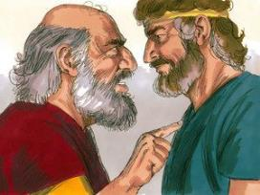
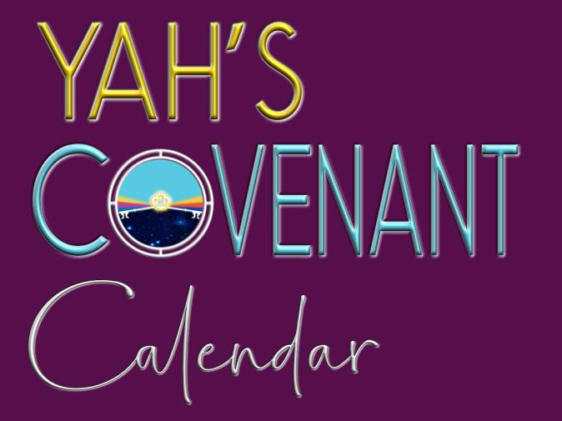
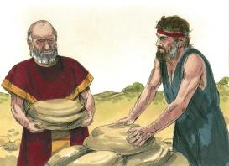
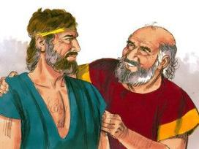
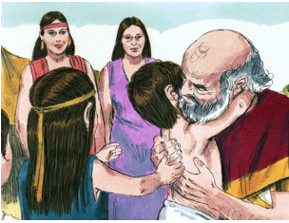
A TEACHING FROM Gen 31 &
Visit: studythecalendar.com

Slide 3
A Spiritual Darkness Reveals Yahusha’s
Dawn to Dawn
LIGHT!

Slide 4
Laban’s BlindNESS reveals
Yahusha’s LIGHT!
It was this blind ambition which plainly laid out Yahuah’s cycle schedule set forth at creation.
Gen 31 - Speckled and Streaked Blessings brilliantly expose the start of
Yahuah’s cycles and - His Shaneh!

Slide 5
Yahuah caused Ya’aqov {Jacob} to be very prosperous while serving his father-in-law Laban. That very blessing aroused agitating friction among the sons of Laban, and they suggested to Laban that Ya’aqov was taking advantage of
the situation.
Laban who served gods made by human hands, was highly susceptible to their influence. He initially disregarded that Ya’aqov served the Elohim of Hosts {Tze’va’ot},
the One and only - Almighty.

Slide 6
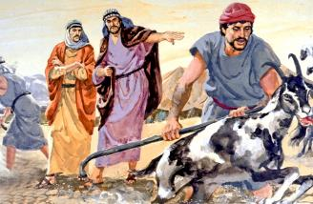
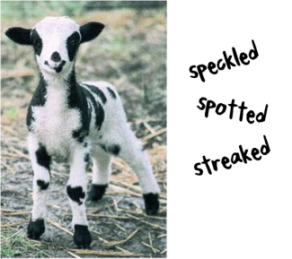
Laban had become agitated towards Ya’aqov (Jacob).
And then – Gen 31:3 –
And יהוה [Yahuah] said to Yaʽaqoḇ,
“Return to the land of your fathers and
to your relatives. And I am with you.”
Ya’aqov gathered his family and explained to them how it was that Yahuah caused the live stock to flourish in colourful specifications creating a separate and fully distinguishable flock from that
of Laban and his family. This factor birthed the contention between Ya’aqov and Laban’s family.

Slide 7
What caused the hard sentiment in this event?
Gen 31:11 “And the Messenger of Elohim spoke to me in a dream, saying, ‘Yaʽaqoḇ.’ And I said, ‘Here I am.’
Gen 31:12 “And He said, ‘Lift your eyes now and see, all the rams which leap on the flocks are streaked, speckled, and mottled, for I have seen all that Laḇan is doing to you.
Gen 31:13 ‘I am the Ěl of Bĕyth Ěl, where you anointed the standing column (Gen 28:18) and where you made a vow to Me. Now rise up, get out of this land, and return to the land of your relatives.’ ”
Gen 31:14 And Raḥĕl and Lĕ’ah answered and said to him, “Do we still have any portion or inheritance in our father’s house?
Gen 31:15 “Are we not reckoned by him as strangers? For he has sold us, and also entirely consumed our silver.

Slide 8
Gen 31:16 “For all the wealth which Elohim has taken from our father are ours and our children’s. Now then, do whatever Elohim has told you.”
Gen 31:17 So Yaʽaqoḇ rose and put his sons and his wives on camels,
Gen 31:18 and he drove off all his livestock and all his possessions which he had acquired, his property of the livestock which he had acquired in Paddan Aram, to go to his father Yitsḥaq in the land of Kenaʽan.
Gen 31:19 And when Laḇan had gone to shear his sheep, Raḥĕl stole the house idols that were her father’s.
Gen 31:20 And Yaʽaqoḇ deceived Laḇan the Aramean, because he did not inform him that he was about to flee.

Slide 9
Gen 31:21 And he fled with all that he had. And he rose up and passed over the river, and headed toward the mountains of Gilʽaḏ.
Gen 31:22 And on the third day Laḇan was told that Yaʽaqoḇ had fled.
Laban was justifiably upset that his offspring had left without notice, the flocks in contention were removed, and most importantly (to Laban), his gods of wood and stone had vanished at the same time.
Laban was hot with anger at being deceived and had full intentions
of bringing forth justice of his own determination.
How do we know this?

Slide 10
Gen 31:23 Then he took his brothers with him and pursued him for seven days’ journey, and he overtook him in the mountains of Gilʽaḏ.
This was an intense chase! Please note that Yahuah knew very well of Laban’s deeper EVIL intentions.
Gen 31:24 But in a dream by night Elohim came to Laḇan the Aramean, and said to him, “Guard yourself, that you do not speak to Yaʽaqoḇ either good or evil.”
Note carefully this - dream by night (H3915 Layil).
The TIMING of this dream will become paramount for understanding Yahuah’s seven
Dawn to Dawn cycles which formulate a completed week.

Slide 11
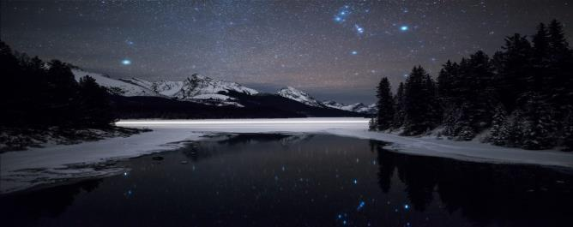
The time frame of Yahuah’s communication (in a dream)
to Laban.
Now to read the narration that took place between Laban and Ya’aqov.
Night - #H3915 <layil>
1) night
a) night (as opposed to day)
b) of gloom, protective shadow (fig.)

Slide 12
Gen 31:25 Then Laḇan overtook Yaʽaqoḇ. Now Yaʽaqoḇ had pitched his tent in the mountains, and Laḇan with his brothers pitched in the mountains of Gilʽaḏ.
Gen 31:26 And Laḇan said to Yaʽaqoḇ, “What have you done, that you have deceived me, and driven my daughters off like captives taken with the sword?
Gen 31:27 “Why did you flee secretly and deceive me, and not inform me, and I would have sent you away with joy and songs, with tambourine and lyre?
Gen 31:28 “And you did not allow me to kiss my sons and my daughters. Now you have been foolish to do this.

Slide 13
Laban speaks directly, to Ya’aqov
Gen 31:29 (a) “It is in the power of my hand to do evil to you, but the Elohim of your father spoke to me …
Laban, who had sunk into idol worship, understood clearly exactly who Yahuah is. Further on, Laban did show a good measure of respect for the Elohim of Ya’aqov.
Laban knew he could physically overpower and destroy Ya’aqov.
Yet because Laban had witnessed the power of Yahuah through the prosperity in numbers of Ya’aqov’s flock, Laban knew he had best listen to the dream given to him.

Slide 14
WHEN did Yahuah “speak” to Laban
Gen 31:29 (a) “It is in the power of my hand to do evil to you, but the Elohim of your father spoke to me …
Laban and Ya’aqov were speaking in the Light Season immediately following the (H3915) Night Season of the dream.
How do we know this? Let’s look at the Hebrew word for ‘yesternight.’
YESTERNIGHT
Geneva (1587), KJV 1611
& Bishops (1568)
H570 Emesh
… LAST NIGHT, …
DAWN
Yahuah gave the dream to Laban.
Laban related Yahuah’s dream factor to Ya’aqov - in the Light Season.

Slide 15
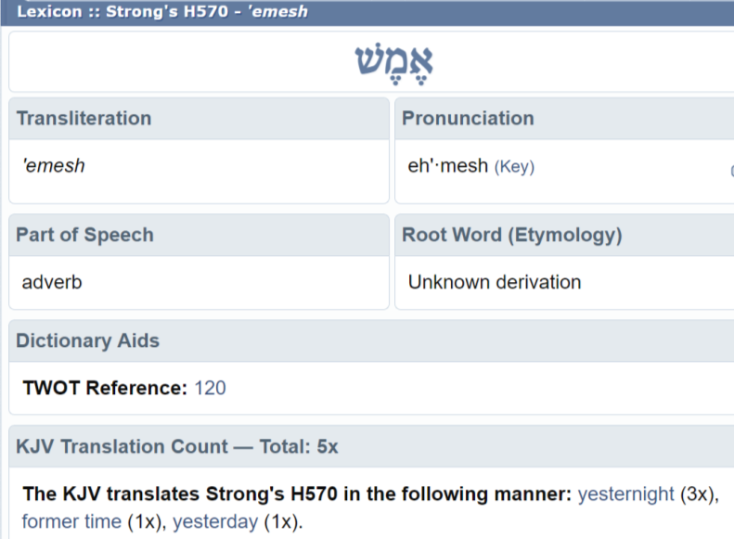
This is taken from the Blue Letter Bible online app.
Notice that the word emesh was originally translated as
YESTERNIGHT.

Slide 16
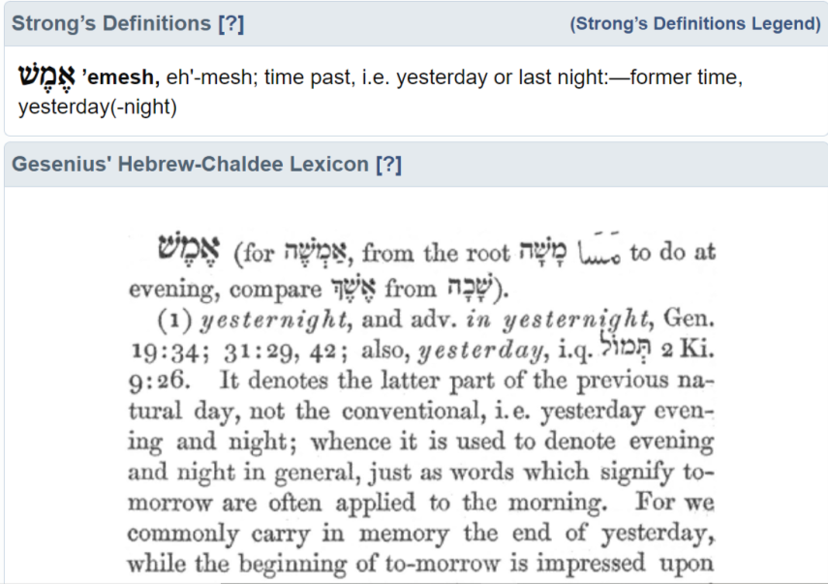

Slide 17
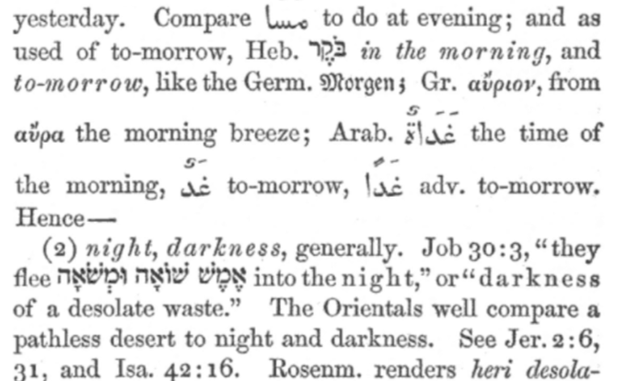
Gesenius illustrates and compares “emesh.”

Slide 18
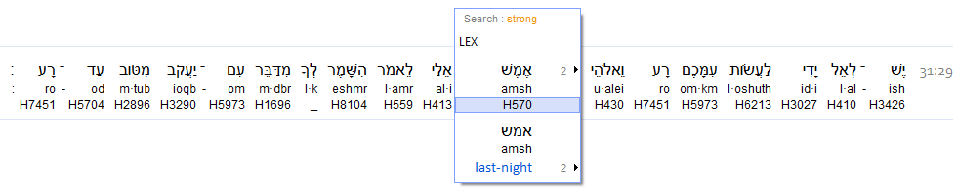
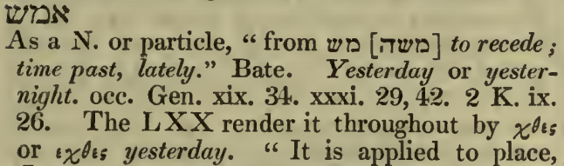
What does the Hebrew look like?
Interlinear Scripture Analyzer
Genesis 31:29
A Hebrew Lexicon, by John Parkhurst
(1762)

Slide 19
John Parkhurst references the texts of Gen 19:34, 31: 42 and
2 Kings 9:26 in his definition of the word H570 Amsh.
Interestingly, these texts also show a context of a separate time frame other than when the speaking was done.
Yes, Strong’s shows definitions also, yet they are not as clarifying.

Slide 20
yester - Old English geostran "yesterday," from Proto-Germanic *gester- (source also of Old High German gestaron, German gestern "yesterday," Old Norse gær "tomorrow, yesterday," Gothic gistradagis "tomorrow"), originally "the other day" (reckoned from "today," either backward or forward), from PIE root *dhgh(y)es- "yesterday" (source also of Sanskrit hyah, Avestan zyo, Persian di, Greek khthes, Latin heri, Old Irish indhe, Welsh doe "yesterday;" Latin hesternus "of yesterday").
Note that “the other day” strongly indicates a 24 hour period
SEPARATE FROM THE EXISTING ONE!
Yesternight, will reflect this meaning in realizing - the previous 24 hour period, other than which is spoken on the present one.
What does “yester” mean?
Online Etymological Dictionary

Slide 21


INclusive
Why do we say
“today” and “tonight”
but not
“yesternight”?
Yesternight in American English
(ˈjɛstərˌnaɪt )
NOUN, ADVERB Archaic (on)
the night before today;
last night
EXclusive

Slide 22
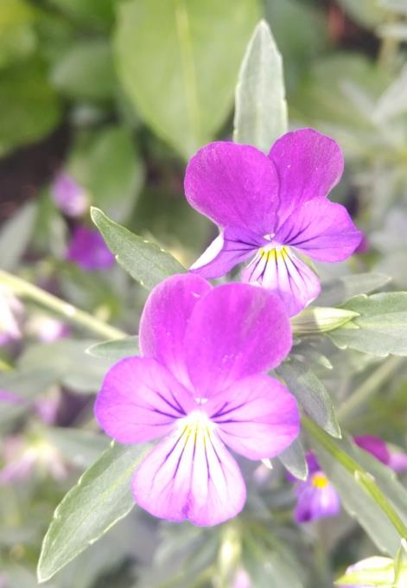
“Yester” does NOT support
an inclusive meaning.
Yester
indicates having been distinguished as separate!

Slide 23
WHERE is the Cycle Separator?
Gen 31:29 (a) “It is in the power of my hand to do evil to you,
but the Elohim of your father spoke to me …
Laban spoke to Ya’aqov (Jacob) on this present Light Season.
This Night Season was a DIFFERENT
(and on a PREVIOUS)
weekly cycle!
Yesternight
DAWN
Yahuah gave a dream to Laban. | Laban related Yahuah’s dream factor to Ya’aqov.
What Divine institution separated, divided and distinguished these two different cycles of the week? Have we yet realized right from creation week, that the DAWN was, AND STILL IS,
the separating point of reckoning - according to Yahuah?

Slide 24



And the Consensus is - ??
This 24 hour cycle was finished at the point of the first light above the dark horizon. Dawn brings the light of the next cycle!
Yahuah provided the Boqer (Dawn) at Creation, for determining the cycles of the week.
“Amsh” Yesternight
Dawn - Divider!
Yahuah gave a dream to Laban. | Laban related (spoke) Yahuah’s dream factor to Ya’aqov.
On the former Night Season which was the previous 24 hour cycle, Yahuah issued protection for Ya’aqov, in the form of a dream.
Recall ch. 31:2 (c) … And I am with you! ☺

Slide 25
What was laban’s major darkness?
Gen 31:30 “And now you have gone because you greatly long for your father’s house, but why did you steal my mighty ones?”
Ya’aqov consequently declares this –
Gen 31:32 “With whomever you find your mighty ones, do not let him live. In the presence of our brothers, see for yourself what is with me and take it with you.” For Yaʽaqoḇ did not know that Raḥĕl had stolen them.
Laban was incensed that “his gods” had been removed from his house!
Worshipping pagan gods, and graven images, was Laban’s evil darkness
and he desperately wanted them back!

Slide 26
Interestingly, Laban did have a certain level of respect for his daughter – Rachel. When she declared her situation as that of the monthly time of a lady, Laban did not force her to stand up.
Whether this time was the truth or not, we do not know.
Once again, Yahuah protected Ya’aqov from severe grief.
Yahuah is in the business of bringing forth good results out of many very awkward situations. ☺
In verses 36 to 41 the intense feelings between Laban and Ya’aqov were voiced passionately.
Lets examine verse 42!

Slide 27
Ya’aqov speaks a second witness: A Confirmation!
Gen 31:42 “Unless the Elohim of my father, the Elohim of Aḇraham and the Fear of Yitsḥaq, had been with me, you would now have sent me away empty-handed. Elohim has seen my affliction and the labour of my hands, and rendered judgment LAST NIGHT.”
H570 Amsh
“Amsh” Yesternight
Creation’s Boqer, the “daily belt buckle!”
Dawn - Divider!
Ya’aqov concludes his defense toward Laban.
Night of Laban’s Dream

Slide 28
Ya’aqov’s Witness Confirms Genesis 1!
VERY NOTEWORTHY!
Ya’aqov did NOT consider the previous Night Season as integral with the Light Season of high contention dialogue with Laban!
Ya’aqov spoke of the dream night as being separated and divided by the Boqer (Dawn) light, exactly as Yahuah stipulated at creation!
The light season of contentious conversation was -
“Amsh” Yesternight
Night of Laban’s Dream
Separated from the dream
night, by the Dawn!

Slide 29
Laban, recalling Yahuah’s command in the dream, decides to lead out and diffuse the situation -
Gen 31:43 And Laḇan answered and said to Yaʽaqoḇ, “These daughters are my daughters, and these children are my children, and this flock is my flock, and all that you see is mine. But what shall I do today to these, my daughters or to their children whom they have borne?
Now we come to an extremely important portion of this event.

Slide 30
The Covenant!
The 4 Scriptural Components of an Everlasting Covenant
1. The Proposal
2. The Acceptance
3. The Anointing (a blood sacrifice)
4. The Sealing Meal together
Gen 31:44 “And now, come, let us make a covenant, you and I, and it shall be a witness between you and me.”
Note this word! ☺

Slide 31
The Covenant!
The 1st Scriptural Component of their Covenant –
1. The Proposal (vs 44)
Gen 31:44 “And now, come,
let us make A COVENANT, you and I,
and it shall be a witness between you and me.”
Note that even Laban recognized the authority of the Ancient Suzerain Treaty system of that era. This is the same type of agreement that Yahuah met Abram with, on his level.

Slide 32
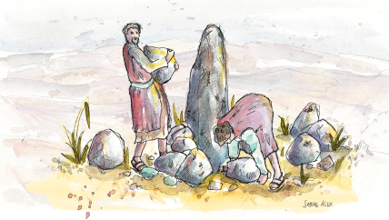
The Covenant!
The 2nd Scriptural Component of their Covenant.
2. The Acceptance (vs 45)
Gen 31:45 So Yaʽaqoḇ took a stone and
set it up as a standing column.
Ya’aqov recalled the words of Yahuah – And I am with you (31:3) and he immediately accepted Laban’s (#1) Proposal.
Gen 31:46 (a) And Yaʽaqoḇ said to his brothers, “Gather stones.” And they took stones and made a HEAP, …

Slide 33

Ya’aqov wrestled with Yahusha (Gen 32), after which he made
a vow and then raised a commemorative stone
and anointed it. Once again on account
of the covenant, Ya’aqov raised up a stone
column to permanently witness the
blood covenant event and location,
with Laban.

Slide 34

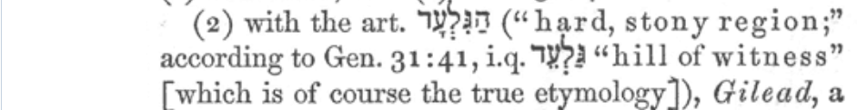
We will be returning to the last part of verse 46 soon, but we need to look at the narration of this event first.
Gen 31:47 And Laḇan called it Yeḡar Sahaḏutha,
but Yaʽaqoḇ called it Galʽĕḏ.
Gen 31:48 And Laḇan said, “This HEAP is a
witness between you and me today.”
That is why its name was called Galʽĕḏ.

Slide 35
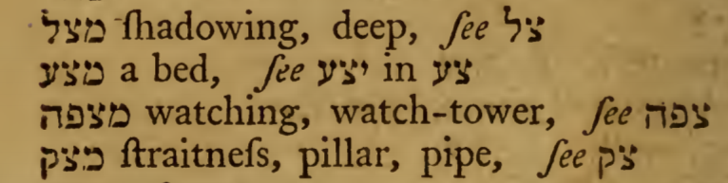
Gen 31:48 (b) … That is why its name was called Galʽĕḏ,
Gen 31:49 also Mitspah, because he said, “Let יהוה [Yahuah] watch between you and me when we are out of each other’s sight.
Have you noticed that even though Laban worshipped graven images, in this verse, he consented full authority to Yahuah in observing the future interactions between him and Ya’aqov!
Can this picture be summarized as – syncretism by Laban? Is there more evidence of syncretism? Paganism and some Divinity?
A Hebrew Lexicon by W. H. Barker.
1776

Slide 36
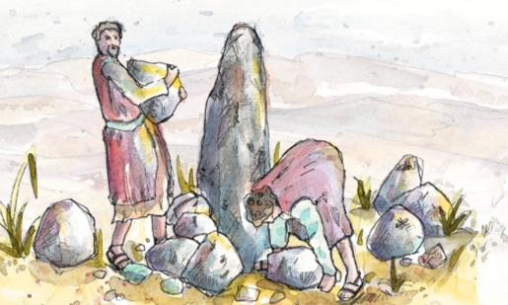
Laban defines more Covenant details; between him and Ya’aqov –
Gen 31:50 “If you afflict my daughters, or if you take other wives besides my daughters, although no man is with us; see, Elohim
is witness between you and me!”
Gen 31:51 And Laḇan said to Yaʽaqoḇ,
“See this heap and see this standing
column, which I have placed between
you and me.
Gen 31:52 “This heap is a witness, and this standing column is a witness, that I do not pass beyond this heap to you, and you do not pass beyond this heap and this standing column to me, for evil.

Slide 37
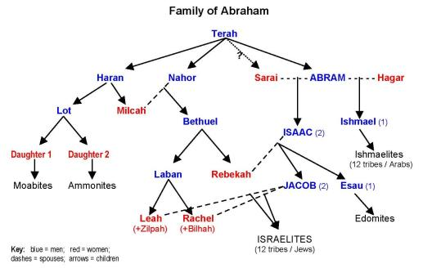
Laban speaks his final Covenant statement.
Gen 31:53 “The Elohim of Aḇraham, the Elohim of Naḥor,
and the Elohim of their father rightly rule between us!”
And Yaʽaqoḇ swore by the Fear of his father Yitsḥaq. (Isaac)
Ya’qov clarified his oath by the Elohim (Yahuah) of his father Isaac so there could be no mistake upon whom his allegiance was given.
Here, Laban divided authority unto Yahuah alongside the no-gods associated with Terah, to be the Watchmen between these two men forming their Covenant.
But WHY Terah? Recall that Terah was a vender of graven images!

Slide 38
And what of the Covenant being formed? Is there more?
We have seen the first two components! What is the third?
3. The Anointing (a blood sacrifice – vs 54)
Gen 31:54 (a) And Yaʽaqoḇ brought an offering on the mountain …
Once again, this is an Ancient Suzerain type treaty which has the
4 components identical to the one Yahuah commanded to Abram. Yahuah integrated the ultimate type of authority which Abram recognized at that time.
Yahuah “met Abram” where he was at, psychologically.
This blood Covenant between Laban and Ya’aqov was no different!

Slide 39
3. The Anointing (a blood sacrifice – vs 54)
Gen 31:54 (a) And Yaʽaqoḇ brought an offering on the mountain …
This sacrifice was ALSO divided into two halves. The two men were required by the type of official treaty that it was, to walk between the two halves of the blood sacrifice!
This treaty ALSO had a death penalty for the one who chose to violate the treaty!
HOW DO WE KNOW THIS SACRIFICE WAS SPLIT
the same as Yahuah’s Covenant as given to Abram?

Slide 40
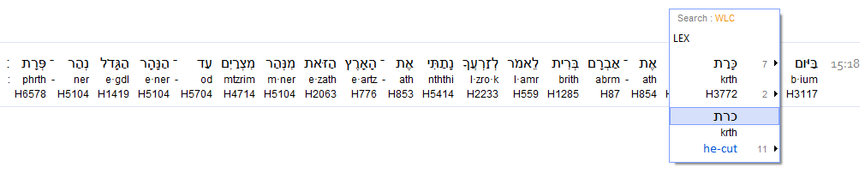
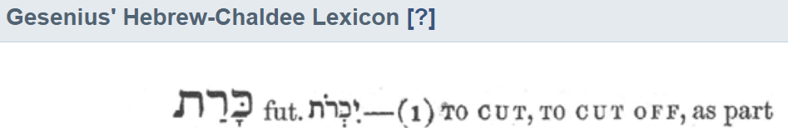
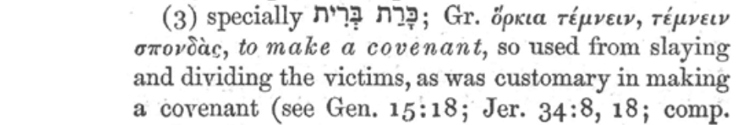
Inter Linear Scripture Analyzer Gen 15:18
Check which word was used in the Covenant
with Abram!

Slide 41
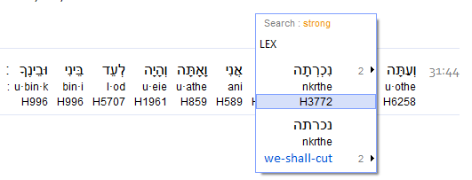
Laban spoke -
Gen 31:44 “And now, come, let us make (H3772) a covenant, you and I, and it shall be a witness between you and me.”
The sacrifice was to be divided in half to facilitate the two men passing between the two halves.
Gen 31:44 (Laban)
We see the same word (H3772) Karat being used in this Covenant, the FOUR identical Components recorded, and the full authority given to Yahuah by Ya’aqov.
This pattern clearly shows this Covenant also was split and contained the death penalty for the one who broke it.

Slide 42

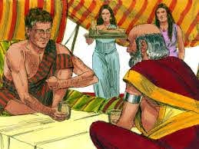

We have seen 3 of the Scriptural Components:
1. The Proposal (vs 44)
2. The Acceptance (vs 45)
3. The Anointing (a blood sacrifice – vs 54)
$$֍$$
4. The Meal of Confirmation
For the 4th segment, we must view the last part of Gen 31: 46 for the 1st witness of Component #4.
Gen 31:46 And Yaʽaqoḇ said to his brothers,
“Gather stones.” And they took stones and made
a heap, and they ATE there on the heap.
As in the Covenant with Abram, there was also a sealing meal here! What about the 2nd Meal Witness of Laban and Ya’aqov?

Slide 43

Gen 31:54 And Yaʽaqoḇ brought an offering on the mountain, and called his brothers to eat bread. And they ate bread and spent
the night on the mountain.
They ATE BREAD!
There is our 4th Component of the Ancient Suzerain Covenant!
Abram had one, Laban and Ya’aqov had one and the next MAJOR one would be at Mt Sinai!
Yet Abram’s Covenant had a 400 year timeline (Gen 15:13) built within the Covenant, spoken by Yahuah, until the Meal of Confirmation was eaten at the Passover in Mitsrayim (Egypt).
Now; the Covenant investigation between Laban and Yaʽaqob has been completed. What about Dawn to Dawn?
$$֍$$

Slide 44
Gen 31:54 And Yaʽaqoḇ brought an offering on the mountain, and called his brothers to eat bread. And THEY ATE bread and
SPENT THE NIGHT ON THE MOUNTAIN.
DAWN
When was the dream?
24 hours Dawn to -
Laban furiously
chased Ya’aqov.
Yahuah gave a stern warning
in a dream to Laban.
“Amsh” Yesternight
The next 24 hour
cycle arrived!
DAWN
Ya’aqov & Laban hash out the heated contentions and a
decision is made to CUT a Covenant of peace. 4 Components recorded, the Sealing Meal is eaten. They stay THE NIGHT
on the mountain.
Ya’aqov and Laban “campout”!
When did
Laban arise
to leave?

Slide 45
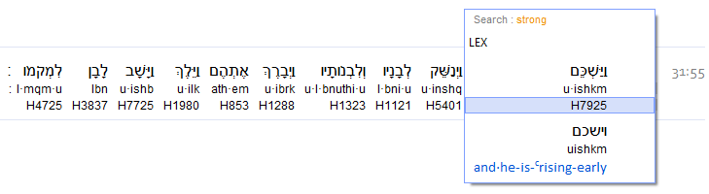
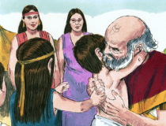
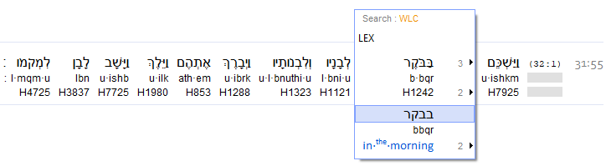
Gen 31:55 And Laḇan ROSE UP EARLY IN THE MORNING, and kissed his sons and daughters and blessed them.
And Laḇan left and returned to his place.
We know that when Mosheh arose early to converse with Pharaoh, it was Boqer, at the break of Dawn!
Is Laban’s timing the same?
ISA Gen 31:55

Slide 46



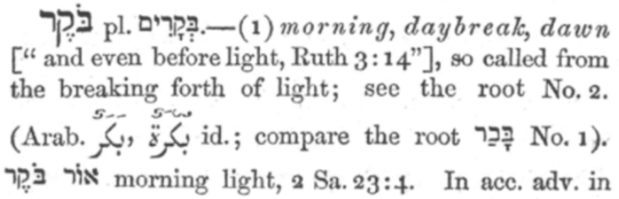
What does Boqer indicate, what are the definitions?
A Hebrew Lexicon by
J. Parkhurst 1762
At what point does the light BREAK FORTH through the darkness of the night? Are there other definitions that describe Dawn?

Slide 47

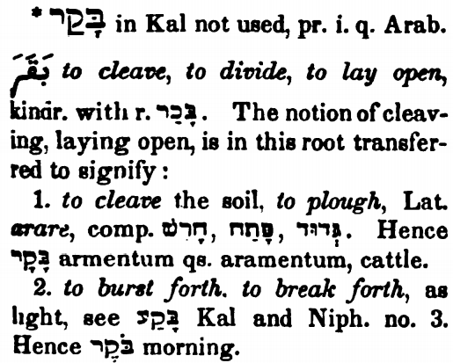
Can we see that the boqer means to divide, separate, split apart, lay open as in distinguishing different identities?
The Dawn period of the 24 hour cycle is the ONLY 24 hour portion that contains these definitions!
The Dawn is like a belt buckle! The 24 hour cycle fulfills a complete circuit and then is split apart by the ox pulling a plow!
Gesenius

Slide 48

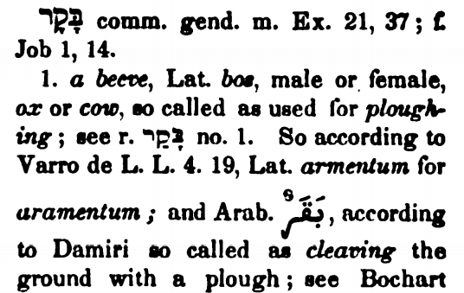
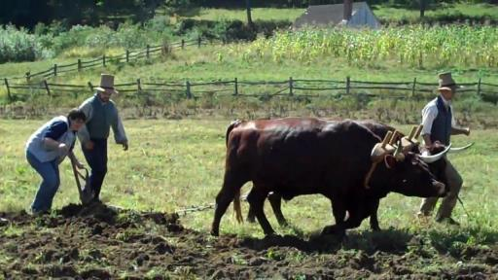
Dawn’s Light Breaking Forth!
Dawn is likened to an ox & plow.
One side is completed, the next portion is to be conquered!
48

Slide 49
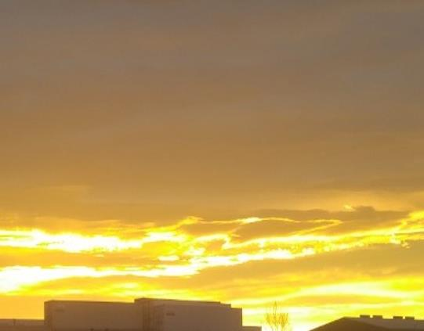
What part of DAWN/ Boqer have we
missed in the last 2,700 years?
WHO TAUGHT US THAT THE BOQER HAD NO IMPORTANCE? WHO?
“You have removed the key of knowledge!”
Luke 11:52
49

Slide 50
Ya’aqov and Laban’s contentious day which turned into a Covenant of Peace started at Dawn.
For the ensuing Night Season of camping on the mount, there are no Hebrew words that indicate in any way shape or form, of a separation action. There are no Hebrew definitions that would distinguish the Night Season as on a separate 24 hour period from the Light Season.
Laban arose at BOQER/DAWN, the BREAK OF THE DAY where there are many various evidences and equal examples (read also Gen 32:24,26,31), and the very beginning of the new cycle of the week, to begin his journey home.

Slide 51


May Yahuah bless, guide and give you wisdom and understanding to set up your pillars for Him.
Send your questions & comments to:
tim@studythecalendar.com

Slide 52



