Slide 1


Start at slide 13

Slide 2

Declaring the END
From the Beginning
Applying Daniel 4 Timeline Principles
Counting out Daniel’s Timelines
in Chapters 7, 8 & 9
By:
Charlene
Fortsch
Notes:
In this last section on Dan 4, we’re going to be looking into some really deep things that I’d like you to consider – and – I hope you’ll find the information interesting and useful.
Question: have the theologians fooled us with their sneaky switches and glitches?

Slide 3

A Word of Prayer
Notes:
Prayer before we begin:
Father as we come before you today – each and every one of us, including those that are dear and far away – we petition once again that your presence will enlighten our understanding of yet another new set of concepts from the pen of Daniel.
Again, anoint our eyes to see, our ears to hear and understand Uour truths.
Fill our cups to the brim so we have many things to share.
We pray in your son’s name, AMEN!

Slide 4
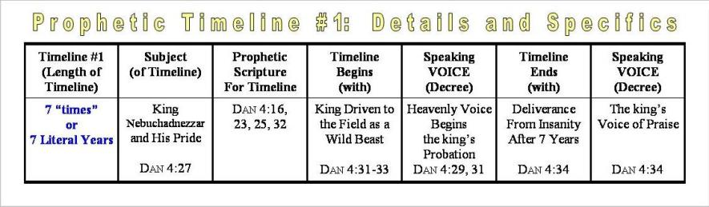
Daniel 4 lays down the guidelines of how to work with prophetic timelines – whether “symbolic” or “literal” especially for Daniel & Revelation.
These principles also apply to Yahusha’s prophetic Messianic timeline – the only sign He gave that determines He is the true Messiah.

Slide 5
Daniel 7:25
“1260”

Slide 6






Daniel 7: Symbolic Beasts/Horn
Notes:
** For the timelines in Dan 7, 8, & 9 -- I want you to note: that if the “event has already occurred” there will also be a “date” attached to the timeline.
Dan 4 gives the “prophecy student” all these important guidelines.
This information is all in the Daniel book, but let’s just try a few sample timelines from Daniel to see how this works.
Dan 7 has a timeline given in “prophetic terminology” instead of prophetic numerals.
The “time, times and dividing of time” calculates to 1260 years.
Most of us know the beginning and ending dates are 538 to 1798.
However, now you know there has to be beginning and ending voices – or decrees – that begin and end the timeline. Well, that’s easy enough to find.
1c We know Justinian gave a decree in 533 AD that the Bishop of Rome could have legal jurisdiction over the Imperial Roman territory since the new capitol was moved to Constantinople.
The took effect in 538 when the Roman Little Horn uprooted 3 of the Barbarian tribes that were causing her trouble.
This began the 1260 year timeline that affected God’s people.
2c It was Napoleon’s speaking voice in 1798 – when he took Pope Pius VI off his throne that ended this timeline.
Wonderful things then happened ... Bible societies sprang up – and many could now have a Bible to read and study.
Hence the study of prophecy soon began to open up – ushering in the Great teachings of the soon 2nd Coming.

Slide 7

Daniel 7:25 1260 Year Timeline
The Little Horn Will Persecute for 1260 Years
And he [Papal Little Horn] shall speak great words against the most High, and shall wear out the saints of the most High, and think to change times and laws: and they [Yah’s saints] shall be given into his hand
until a time and times and the dividing of time.
This is a prophetic symbolic timeline expressed in “prophetic terminology” rather than numerals.
Notes:
** For the timelines in Dan 7, 8, & 9 -- I want you to note: that if the “event has already occurred” there will also be a “date” attached to the timeline.
Dan 4 gives the “prophecy student” all these important guidelines.
This information is all in the Daniel book, but let’s just try a few sample timelines from Daniel to see how this works.
Dan 7 has a timeline given in “prophetic terminology” instead of prophetic numerals.
The “time, times and dividing of time” calculates to 1260 years.
Most of us know the beginning and ending dates are 538 to 1798.
However, now you know there has to be beginning and ending voices – or decrees – that begin and end the timeline. Well, that’s easy enough to find.
1c We know Justinian gave a decree in 533 AD that the Bishop of Rome could have legal jurisdiction over the Imperial Roman territory since the new capitol was moved to Constantinople.
The took effect in 538 when the Roman Little Horn uprooted 3 of the Barbarian tribes that were causing her trouble.
This began the 1260 year timeline that affected God’s people.
2c It was Napoleon’s speaking voice in 1798 – when he took Pope Pius VI off his throne that ended this timeline.
Wonderful things then happened ... Bible societies sprang up – and many could now have a Bible to read and study.
Hence the study of prophecy soon began to open up – ushering in the Great teachings of the soon 2nd Coming.

Slide 8
Understanding
“time, times & dividing of time”
Symbolic Term [in prophetic terminology] | Application [in numerals] | Symbolic Time | Literal Conversion 1 day = 1 year
Time | 1 year | 360 days | 360 years
Times | 2 years | 720 days | 720 years
Dividing of time | ½ year | 180 days | 180 years
Total | 3 ½ yrs. | 1260 days | 1260 years
On the historical level of application, this prophetic symbolic timeline represents 1260 year reign of the
Little Horn. When did this timeline begin, and end?
Notes:
** For the timelines in Dan 7, 8, & 9 -- I want you to note: that if the “event has already occurred” there will also be a “date” attached to the timeline.
Dan 4 gives the “prophecy student” all these important guidelines.
This information is all in the Daniel book, but let’s just try a few sample timelines from Daniel to see how this works.
Dan 7 has a timeline given in “prophetic terminology” instead of prophetic numerals.
The “time, times and dividing of time” calculates to 1260 years.
Most of us know the beginning and ending dates are 538 to 1798.
However, now you know there has to be beginning and ending voices – or decrees – that begin and end the timeline. Well, that’s easy enough to find.
1c We know Justinian gave a decree in 533 AD that the Bishop of Rome could have legal jurisdiction over the Imperial Roman territory since the new capitol was moved to Constantinople.
The took effect in 538 when the Roman Little Horn uprooted 3 of the Barbarian tribes that were causing her trouble.
This began the 1260 year timeline that affected God’s people.
2c It was Napoleon’s speaking voice in 1798 – when he took Pope Pius VI off his throne that ended this timeline.
Wonderful things then happened ... Bible societies sprang up – and many could now have a Bible to read and study.
Hence the study of prophecy soon began to open up – ushering in the Great teachings of the soon 2nd Coming.

Slide 9
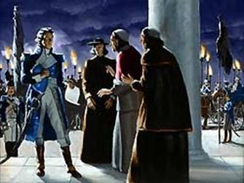
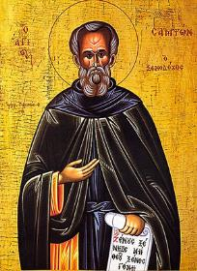
Daniel 7 Timeline of 1260 Years
“time, times, dividing of time”
Beginning Speaking Voice:
Roman emperor
Justinian wrote
a decretal letter
in 533 which took
effect in 538 giving
the popes the complete ecclesiastical & political “power, seat & great authority” over the
Roman imperial kingdom.
Ending Speaking Voice:
Berthier [through Napoleon] entered Rome Feb 1798 & proclaimed a republic by removing Pope Pius VI from his Vatican seat in Rome.
The Papacy was DEAD.
Notes:
** For the timelines in Dan 7, 8, & 9 -- I want you to note: that if the “event has already occurred” there will also be a “date” attached to the timeline.
Dan 4 gives the “prophecy student” all these important guidelines.
This information is all in the Daniel book, but let’s just try a few sample timelines from Daniel to see how this works.
Dan 7 has a timeline given in “prophetic terminology” instead of prophetic numerals.
The “time, times and dividing of time” calculates to 1260 years.
Most of us know the beginning and ending dates are 538 to 1798.
However, now you know there has to be beginning and ending voices – or decrees – that begin and end the timeline. Well, that’s easy enough to find.
1c We know Justinian gave a decree in 533 AD that the Bishop of Rome could have legal jurisdiction over the Imperial Roman territory since the new capitol was moved to Constantinople.
The took effect in 538 when the Roman Little Horn uprooted 3 of the Barbarian tribes that were causing her trouble.
This began the 1260 year timeline that affected God’s people.
2c It was Napoleon’s speaking voice in 1798 – when he took Pope Pius VI off his throne that ended this timeline.
Wonderful things then happened ... Bible societies sprang up – and many could now have a Bible to read and study.
Hence the study of prophecy soon began to open up – ushering in the Great teachings of the soon 2nd Coming.

Slide 10
After Daniel 7:25 – Then What?
After 1260 years [1798], it is time for the
Little Horn system to come under judgment.
Rev 14:7 Fear Yahuah, and give glory to him; for the hour of his judgment is come:
Dan 7:26 But the judgment shall sit…
John 5:22 For the Father … hath committed all judgment unto the Son:
1 Peter 4:17 For the time is come that judgment must begin at the house of Elohim:
Rom 14:10 … for we shall all stand before
the judgment seat of Christ.
Dan 7:27 [Eventually] … the kingdom and dominion … shall be given to the people
of the saints of the most High …
Notes:
** For the timelines in Dan 7, 8, & 9 -- I want you to note: that if the “event has already occurred” there will also be a “date” attached to the timeline.
Dan 4 gives the “prophecy student” all these important guidelines.
This information is all in the Daniel book, but let’s just try a few sample timelines from Daniel to see how this works.
Dan 7 has a timeline given in “prophetic terminology” instead of prophetic numerals.
The “time, times and dividing of time” calculates to 1260 years.
Most of us know the beginning and ending dates are 538 to 1798.
However, now you know there has to be beginning and ending voices – or decrees – that begin and end the timeline. Well, that’s easy enough to find.
1c We know Justinian gave a decree in 533 AD that the Bishop of Rome could have legal jurisdiction over the Imperial Roman territory since the new capitol was moved to Constantinople.
The took effect in 538 when the Roman Little Horn uprooted 3 of the Barbarian tribes that were causing her trouble.
This began the 1260 year timeline that affected God’s people.
2c It was Napoleon’s speaking voice in 1798 – when he took Pope Pius VI off his throne that ended this timeline.
Wonderful things then happened ... Bible societies sprang up – and many could now have a Bible to read and study.
Hence the study of prophecy soon began to open up – ushering in the Great teachings of the soon 2nd Coming.

Slide 11
Daniel 8:14
“2300” follows this judgment.

Slide 12


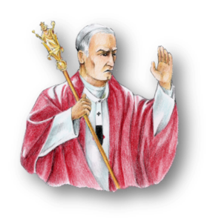
Daniel 8: Symbolic Horns/King
Notes:
** For the timelines in Dan 7, 8, & 9 -- I want you to note: that if the “event has already occurred” there will also be a “date” attached to the timeline.
Dan 4 gives the “prophecy student” all these important guidelines.
This information is all in the Daniel book, but let’s just try a few sample timelines from Daniel to see how this works.
Dan 7 has a timeline given in “prophetic terminology” instead of prophetic numerals.
The “time, times and dividing of time” calculates to 1260 years.
Most of us know the beginning and ending dates are 538 to 1798.
However, now you know there has to be beginning and ending voices – or decrees – that begin and end the timeline. Well, that’s easy enough to find.
1c We know Justinian gave a decree in 533 AD that the Bishop of Rome could have legal jurisdiction over the Imperial Roman territory since the new capitol was moved to Constantinople.
The took effect in 538 when the Roman Little Horn uprooted 3 of the Barbarian tribes that were causing her trouble.
This began the 1260 year timeline that affected God’s people.
2c It was Napoleon’s speaking voice in 1798 – when he took Pope Pius VI off his throne that ended this timeline.
Wonderful things then happened ... Bible societies sprang up – and many could now have a Bible to read and study.
Hence the study of prophecy soon began to open up – ushering in the Great teachings of the soon 2nd Coming.

Slide 13
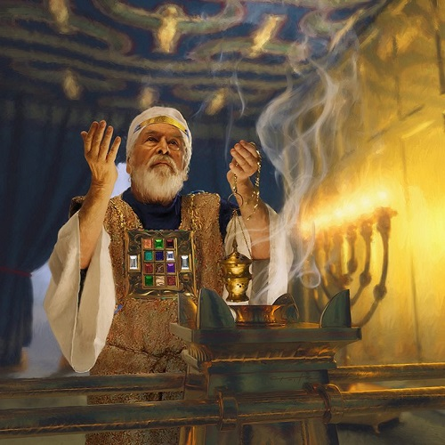
Daniel 8 Timeline of 2300 Days
And he [the vs 13 saint] said unto me,
Unto two thousand and three
hundred days; then shall the
sanctuary be cleansed.
What sanctuary?
This is also a prophetic
symbolic timeline because
the vision contains symbolic
“horns” and a symbolic title of
“waxed exceeding great”
interpreted as the papal Roman
“king of fierce countenance”
following the “little horn” power.
Notes:
Dan 8 has a timeline given in the prophetic numeral of 2300 days.
Remembering the calculation principle, this timeline converts to 2300 years – or – you can also count 2300 “days of atonement” – one for each year.
Most of us know the beginning and ending dates are 457 BC to 1844.
Let’s find the speaking voices:
1c Artaxerxes gave a decree in 457 BC for the re-building of the city of Jerusalem, its wall, and its temple.
2c In Dan 9 Gabriel explained to Daniel that 2300 years later, judgment would begin from the courts of heaven.
Of course, this voice would have been a Divine Decree – and a judicial decree as well. Dan 7:10 & Dan 8:14 are some texts.

Slide 14
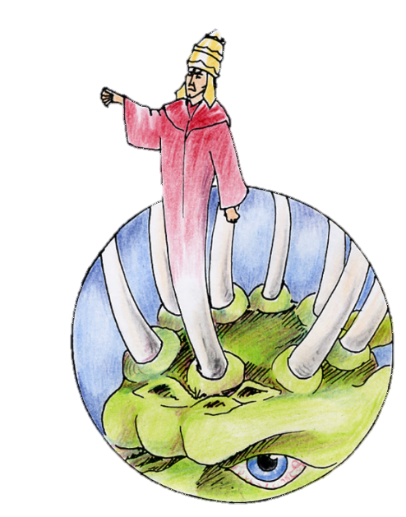
Understanding
“two thousand three hundred days”
Symbolic Term [in prophetic terminology] | Application [in numerals] | Symbolic Time | Literal Conversion 1 day = 1 year
Two thousand three hundred days | 2300 | 2300 days | 2300 years
On the historical level of application, this prophetic symbolic timeline includes the timeframe of the 1260 year reign of the Little Horn [ending in 1798] AND the timeframe of the rising papal “king of fierce countenance.”
Question: Just when did this 2300 year timeline begin, and end?
Notes:
** For the timelines in Dan 7, 8, & 9 -- I want you to note: that if the “event has already occurred” there will also be a “date” attached to the timeline.
Dan 4 gives the “prophecy student” all these important guidelines.
This information is all in the Daniel book, but let’s just try a few sample timelines from Daniel to see how this works.
Dan 7 has a timeline given in “prophetic terminology” instead of prophetic numerals.
The “time, times and dividing of time” calculates to 1260 years.
Most of us know the beginning and ending dates are 538 to 1798.
However, now you know there has to be beginning and ending voices – or decrees – that begin and end the timeline. Well, that’s easy enough to find.
1c We know Justinian gave a decree in 533 AD that the Bishop of Rome could have legal jurisdiction over the Imperial Roman territory since the new capitol was moved to Constantinople.
The took effect in 538 when the Roman Little Horn uprooted 3 of the Barbarian tribes that were causing her trouble.
This began the 1260 year timeline that affected God’s people.
2c It was Napoleon’s speaking voice in 1798 – when he took Pope Pius VI off his throne that ended this timeline.
Wonderful things then happened ... Bible societies sprang up – and many could now have a Bible to read and study.
Hence the study of prophecy soon began to open up – ushering in the Great teachings of the soon 2nd Coming.

Slide 15


Two Questions to Ponder
Which sanctuary needs cleansing of Dan 8:14?
A ‘building’?
A ‘people’?
What does the cleansing of an heavenly sanctuary have to do with the prophetic events happening around Yahuah’s people on earth in Daniel 8?
Notes:
Dan 8 has a timeline given in the prophetic numeral of 2300 days.
Remembering the calculation principle, this timeline converts to 2300 years – or – you can also count 2300 “days of atonement” – one for each year.
Most of us know the beginning and ending dates are 457 BC to 1844.
Let’s find the speaking voices:
1c Artaxerxes gave a decree in 457 BC for the re-building of the city of Jerusalem, its wall, and its temple.
2c In Dan 9 Gabriel explained to Daniel that 2300 years later, judgment would begin from the courts of heaven.
Of course, this voice would have been a Divine Decree – and a judicial decree as well. Dan 7:10 & Dan 8:14 are some texts.

Slide 16

Full Context of Daniel 8: kingdoms
All of the events in Daniel’s 3rd vision surround the pagan kingdoms of this world and Yahuah’s people on earth.
Daniel does not randomly use 1-2 verses to describe a separate heavenly event when there is so much happening around His people on the earth.
Notes:
Dan 8 has a timeline given in the prophetic numeral of 2300 days.
Remembering the calculation principle, this timeline converts to 2300 years – or – you can also count 2300 “days of atonement” – one for each year.
Most of us know the beginning and ending dates are 457 BC to 1844.
Let’s find the speaking voices:
1c Artaxerxes gave a decree in 457 BC for the re-building of the city of Jerusalem, its wall, and its temple.
2c In Dan 9 Gabriel explained to Daniel that 2300 years later, judgment would begin from the courts of heaven.
Of course, this voice would have been a Divine Decree – and a judicial decree as well. Dan 7:10 & Dan 8:14 are some texts.

Slide 17
Daniel 8 Context for ‘sanctuary’
Dan 8:12-13 And an host [peoples] was given him [“king of fierce countenance”] … and it cast down [ALL] the truth to the ground; and it practised, and prospered.
Host - H6635 tsaba'; from H6633; a mass of persons … especially reg. organized for war (an army); by implication, a campaign, literally
or figuratively (specifically, hardship, worship): KJV - appointed time, (+)army, (+)battle, company, host, service, soldiers…
13 Then I heard one saint speaking, and another saint said unto that certain saint which spake, How long shall … the sanctuary and the host to be trodden under foot?
Sanctuary - H6944 qodesh; from H6942; a sacred place or thing; rarely abstract, sanctity: KJV - consecrated (thing), dedicated (thing), hallowed (thing), holiness, (X most) holy (X day, portion, thing), saint, sanctuary.
Notes:
Dan 8 has a timeline given in the prophetic numeral of 2300 days.
Remembering the calculation principle, this timeline converts to 2300 years – or – you can also count 2300 “days of atonement” – one for each year.
Most of us know the beginning and ending dates are 457 BC to 1844.
Let’s find the speaking voices:
1c Artaxerxes gave a decree in 457 BC for the re-building of the city of Jerusalem, its wall, and its temple.
2c In Dan 9 Gabriel explained to Daniel that 2300 years later, judgment would begin from the courts of heaven.
Of course, this voice would have been a Divine Decree – and a judicial decree as well. Dan 7:10 & Dan 8:14 are some texts.

Slide 18

Full Context of Daniel 8: sanctuary
Daniel declares “a sanctuary” will be cleansed after 2300 days.
The cleansing process begins for Yahuah’s ‘sanctuary’ of Saints when the 2300 days end!
Notes:
Dan 8 has a timeline given in the prophetic numeral of 2300 days.
Remembering the calculation principle, this timeline converts to 2300 years – or – you can also count 2300 “days of atonement” – one for each year.
Most of us know the beginning and ending dates are 457 BC to 1844.
Let’s find the speaking voices:
1c Artaxerxes gave a decree in 457 BC for the re-building of the city of Jerusalem, its wall, and its temple.
2c In Dan 9 Gabriel explained to Daniel that 2300 years later, judgment would begin from the courts of heaven.
Of course, this voice would have been a Divine Decree – and a judicial decree as well. Dan 7:10 & Dan 8:14 are some texts.

Slide 19

Understanding the 2300 Timeline
The judgment shall sit after the
Little Horn is uprooted [Dan 7:26 ].
All judgment is committed
unto the Son [John 5:22 ].
The hour of His
judgment is come
[Rev 14:7 ].
When the 2300 day/years end, then judgment must begin at
the house of Elohim to begin
the cleansing process & find
His Bride [1 Peter 4:17 ].
Notes:
Dan 8 has a timeline given in the prophetic numeral of 2300 days.
Remembering the calculation principle, this timeline converts to 2300 years – or – you can also count 2300 “days of atonement” – one for each year.
Most of us know the beginning and ending dates are 457 BC to 1844.
Let’s find the speaking voices:
1c Artaxerxes gave a decree in 457 BC for the re-building of the city of Jerusalem, its wall, and its temple.
2c In Dan 9 Gabriel explained to Daniel that 2300 years later, judgment would begin from the courts of heaven.
Of course, this voice would have been a Divine Decree – and a judicial decree as well. Dan 7:10 & Dan 8:14 are some texts.

Slide 20
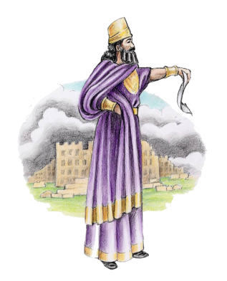
Understanding the 2300 Timeline
Once Yahuah’s people were released from their 70 year captivity under Babylon, Artaxerxes [of Medo-Persia] issued a Decree to rebuild the city
of Jerusalem, the wall and the temple for Yahuah’s people to worship their Elohim.
This decree is connected to Yahuah’s “sanctuary on earth” and took effect in 457 BC extending to 1844 AD.
Total Timeline: 2300 Years
457 BC + 1 [for zero year] + 1843 years = 1844 AD
Notes:
Dan 8 has a timeline given in the prophetic numeral of 2300 days.
Remembering the calculation principle, this timeline converts to 2300 years – or – you can also count 2300 “days of atonement” – one for each year.
Most of us know the beginning and ending dates are 457 BC to 1844.
Let’s find the speaking voices:
1c Artaxerxes gave a decree in 457 BC for the re-building of the city of Jerusalem, its wall, and its temple.
2c In Dan 9 Gabriel explained to Daniel that 2300 years later, judgment would begin from the courts of heaven.
Of course, this voice would have been a Divine Decree – and a judicial decree as well. Dan 7:10 & Dan 8:14 are some texts.

Slide 21
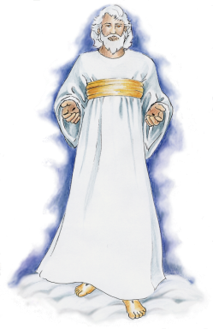
Daniel 8 Timeline of 2300 Years
At the end of the 2300 years timeline, Yahuah’s “symbolic sanctuary” on this earth was
to enter into being cleansed.
In the timeframe of the mid-1800s, Yahuah selected a wide group of people to be part of this cleansing process and to restore all truth before the
end of time.
Beginning Speaking Voice:
Artaxerxes’ Decree to rebuild the city, the wall and the temple took effect in
457 BC.
Ending Speaking Voice:
Yahuah’s Voice from the heavenly courts in 1844 proclaimed judgment would begin. [John 5:22; Rev 14:7, etc.]
Notes:
Dan 8 has a timeline given in the prophetic numeral of 2300 days.
Remembering the calculation principle, this timeline converts to 2300 years – or – you can also count 2300 “days of atonement” – one for each year.
Most of us know the beginning and ending dates are 457 BC to 1844.
Let’s find the speaking voices:
1c Artaxerxes gave a decree in 457 BC for the re-building of the city of Jerusalem, its wall, and its temple.
2c In Dan 9 Gabriel explained to Daniel that 2300 years later, judgment would begin from the courts of heaven.
Of course, this voice would have been a Divine Decree – and a judicial decree as well. Dan 7:10 & Dan 8:14 are some texts.

Slide 22

Daniel 9
“2300”
Many timelines are given in response to Daniel’s prayer for release from bondage.

Slide 23

Daniel 9 Timelines
Dan 9:23-27 At the beginning of thy supplications the commandment came forth,
and I am come to shew thee; for thou art greatly beloved: therefore understand
the matter, and consider the vision [of Daniel 8 & 2300 day/years timeline].
24 Seventy weeks are determined upon thy people and upon thy holy city, to finish the transgression, and to make an end of sins, and to make reconciliation for iniquity, and to bring in everlasting righteousness, and to seal up the vision and prophecy, and to anoint the most Holy.
25 Know therefore and understand, that from the going forth of the commandment to restore and to build Jerusalem [Artaxerxes’ Decree of 457 BC] unto the Messiah the Prince shall be seven weeks, and threescore and two weeks [7 + 62 = 69 wks]: the street shall be built again, and the wall, even in troublous times.
26 And after threescore and two weeks [62 wks] shall Messiah be cut off, but not for himself: and the people of the prince that shall come shall destroy the city and the sanctuary; and the end thereof shall be with a flood, and unto the end of the war desolations are determined.
27 And he shall confirm the covenant with many for one week: and in the
midst of the week [1/2 week] he shall cause the sacrifice and the oblation to cease,
and for the overspreading of abominations he shall make it desolate, even
until the consummation, and that determined shall be poured upon the desolate.
Notes:
Dan 9 also gives a timeline of 70 weeks, which calculates to 490 literal years.
Most of us know the beginning and ending dates are 457 BC and 34 AD.
Let’s find the speaking voices:
1c Again, this timeline begins with the voice of Artaxerxes in 457 BC.
In Dan 9 Gabriel explained to Daniel that the nation of Israel had a probation of 490 years to share the gospel message.
That 490 years ended in 34AD when the leaders of the nation chose to stone God’s missionaries, thus silencing the gospel message.
Do you know what the ending voice was?
2c It was a voice that spoke through the official legal body to take legal action and stone Stephen.
Acts 7 says: They cried out with a LOUD voice ... And they stoned Stephen.

Slide 24
Revealing the Daniel 9 Timelines
Symbolic Term [in words] | Application [in numbers] | Symbolic Time | Literal Conversion 1 day = 1 year
Seventy weeks | 7 x 70 = 490 | 490 days | 490 years
Seven weeks | 7 x 7 = 49 | 49 days | 49 years
[Threescore [20 = one score] & two weeks] | 60 + 2 = 62 [3 score = 60] | 62 x 7 = 434 days | [434 years]
Seven weeks & Threescore [20 = one score] & two weeks | 7 60 + 2 = 62 Total = 69 weeks | 7 x 7 = 49 days 62 x 7 = 434 days Total = 483 days | 49 years + 434 years = 483 years
One week [70th week] | 1 x 7 = 7 | 7 days | 7 years
Midst of the [70th] week | 7 / 2 = 3½ | 3½ days | 3½ years
All of these timelines are connected to the Daniel 8:14 timeline of 2300 days/years for the purpose of pinpointing the:
Exact timing that begins Yahusha’s ministry
Exact timing of Yahusha’s death
Exact timing of when judgment would come against the corrupt leadership with the stoning of Stephen. The Aaronic leadership are no longer witnesses for Yahuah.
Notes:
** For the timelines in Dan 7, 8, & 9 -- I want you to note: that if the “event has already occurred” there will also be a “date” attached to the timeline.
Dan 4 gives the “prophecy student” all these important guidelines.
This information is all in the Daniel book, but let’s just try a few sample timelines from Daniel to see how this works.
Dan 7 has a timeline given in “prophetic terminology” instead of prophetic numerals.
The “time, times and dividing of time” calculates to 1260 years.
Most of us know the beginning and ending dates are 538 to 1798.
However, now you know there has to be beginning and ending voices – or decrees – that begin and end the timeline. Well, that’s easy enough to find.
1c We know Justinian gave a decree in 533 AD that the Bishop of Rome could have legal jurisdiction over the Imperial Roman territory since the new capitol was moved to Constantinople.
The took effect in 538 when the Roman Little Horn uprooted 3 of the Barbarian tribes that were causing her trouble.
This began the 1260 year timeline that affected God’s people.
2c It was Napoleon’s speaking voice in 1798 – when he took Pope Pius VI off his throne that ended this timeline.
Wonderful things then happened ... Bible societies sprang up – and many could now have a Bible to read and study.
Hence the study of prophecy soon began to open up – ushering in the Great teachings of the soon 2nd Coming.

Slide 25

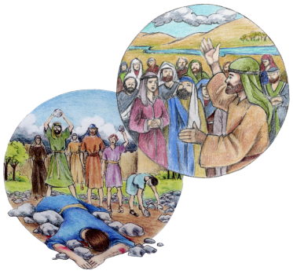
Daniel 9 Timeline of 70 Wks / 490 Yrs
25 Know therefore and understand,
that from the going forth of the commandment to restore and
to build Jerusalem …
24 Seventy weeks are
determined upon thy people
and upon thy holy city …
Total Timeline: 490 Years
Beginning Speaking Voice: Artaxerxes’ Decree to rebuild the city, wall and temple took effect in 457 BC.
Ending Speaking Voice:
Voice of Jewish Leaders in 34 AD cried out to stone Stephen and silence him forever [Acts 7:57].
457 BC + 1 [for zero year] + 33 years = 34 AD.
25
Notes:
Dan 9 also gives a timeline of 70 weeks, which calculates to 490 literal years.
Most of us know the beginning and ending dates are 457 BC and 34 AD.
Let’s find the speaking voices:
1c Again, this timeline begins with the voice of Artaxerxes in 457 BC.
In Dan 9 Gabriel explained to Daniel that the nation of Israel had a probation of 490 years to share the gospel message.
That 490 years ended in 34AD when the leaders of the nation chose to stone God’s missionaries, thus silencing the gospel message.
Do you know what the ending voice was?
2c It was a voice that spoke through the official legal body to take legal action and stone Stephen.
Acts 7 says: They cried out with a LOUD voice ... And they stoned Stephen.

Slide 26
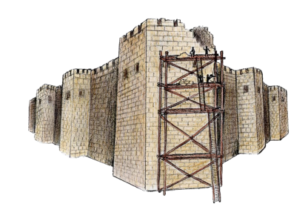
Daniel 9 Timeline of 7 Wks / 49 Yrs to Rebuild the
City Wall
Ending Speaking Voice:
Date: 408 BC [49 years later]
Neh 12:27 And at the dedication of the wall of Jerusalem they sought the Levites ... To keep the dedication with gladness, both with thanksgivings and with singing.
Beginning Speaking Voice:
Artaxerxes’ Decree to rebuild the city wall took effect in 457 BC.
Notes:
OK, this is our last one – but it’s a little harder, so see if you can figure it out ...
Dan 9 had a timeline for the rebuilding of the temple wall – to be completed in 7 prophetic weeks, or 49 literal years.
Again, the beginning and ending dates are 457 BC to 408 BC.
1c Artaxerxes’ voice gives the decree to begin the reconstruction.
The wall was completed in 408 BC as foretold.
But what was the speaking voice to end the timeline?
2c Here it is: Neh 12:27 And at the dedication of the wall of Jerusalem they sought the Levites ... To keep the dedication with gladness, both thanksgivings and with singing.
If this is kind of new for you, there’s a lot more help in the Daniel book.

Slide 27
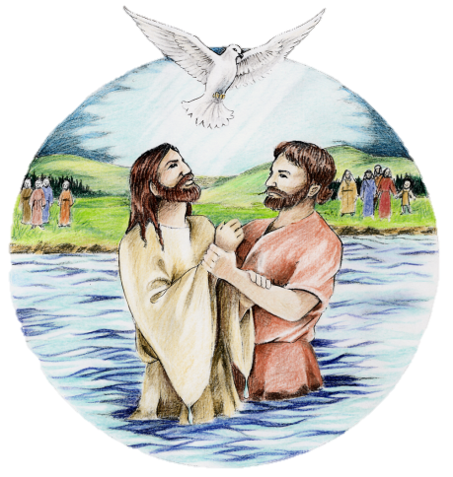
Daniel 9 Timeline of the 69 Weeks
Symbolic Timeline: 69 Weeks (or 434 literal years)
Beginning Speaking Voice:
Dan 9:25 from the going
forth of the commandment [decree] to restore and to
build Jerusalem.
Application for the Beginning Voice of 69 weeks:
In the year 457 BC Artaxerses issued a third decree (by legislative voice) to rebuild Jerusalem. This was carried out by Ezra (Ezra 7:11-26).
Note: The 69 weeks began with the same event as the
7 weeks.
Ending Speaking Voice:
Acts 10:38 Yahuah anointed Yahusha of Nazareth with the
Ruach and with power.
Matt 3:16-17 And Yahusha, when he was baptized … the heavens were opened unto him … 17 And lo
a voice from heaven, saying, This is my beloved Son, in whom I am well pleased.
Application for the Ending Voice of
69 symbolic weeks or 434 literal years:
Yahuah’s voice was a proclamation of this great event when Yahusha was anointed with baptism.
Date: To be announced with Passion Study.
Notes:
OK, this is our last one – but it’s a little harder, so see if you can figure it out ...
Dan 9 had a timeline for the rebuilding of the temple wall – to be completed in 7 prophetic weeks, or 49 literal years.
Again, the beginning and ending dates are 457 BC to 408 BC.
1c Artaxerxes’ voice gives the decree to begin the reconstruction.
The wall was completed in 408 BC as foretold.
But what was the speaking voice to end the timeline?
2c Here it is: Neh 12:27 And at the dedication of the wall of Jerusalem they sought the Levites ... To keep the dedication with gladness, both thanksgivings and with singing.
If this is kind of new for you, there’s a lot more help in the Daniel book.

Slide 28

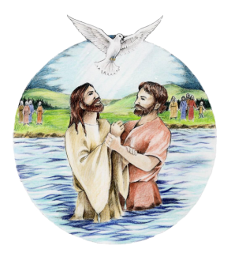

Daniel 9 Timeline of “1 Wk” / 70th Week
Beginning of 70th week: Saviour’s Baptism
Beginning Speaking Voice for timeline:
Matt 3:16-17 And Yahusha ... was baptized ...
He saw the Spirit of Elohim descending like a dove. And lo a voice ... Saying, This is my beloved Son
in whom I am well pleased.
Date: To be announced with Passion Study.
Ending of 70th week: Stoning of Stephen
Ending Speaking Voice for timeline:
Acts 7:54, 57, 59 When they heard these things ... they cried out with a loud voice ...
And they stoned Stephen.
Date: 34 AD
Notes:
Let’s try another timeline just to give you some practice:
This time we’ll look at the 70th week only.
The Event was the Saviour’s Baptism.
1c The Beginning speaking voice for the timeline is confirmed in Matt 3: 16-17 where it is written: And Jesus ... Was baptized ... He saw the Spirit of God descending like a dove. And lo a voice ... Saying, This is my beloved Son in whom I am well pleased.
And, we have the date of 27AD.
There’s also speaking voices to end the timeline of the 70th week.
The Event is the Stoning of Stephen – the same ending as for the 490 years.
2c The scripture is Acts 7: – When they heard these things [“they” being the Jewish leaders of the day] – they cried out with a lout voice ... And they stoned Stephen.
The date is 34AD – and at that point in time, probation is closed for the Jewish people “as a nation” – now the gospel will go to the gentiles through another avenue.
And, we all know that at this very event, Saul was present – who later became known as Paul – and also is known as one of the most dedicated workers for the gospel.

Slide 29
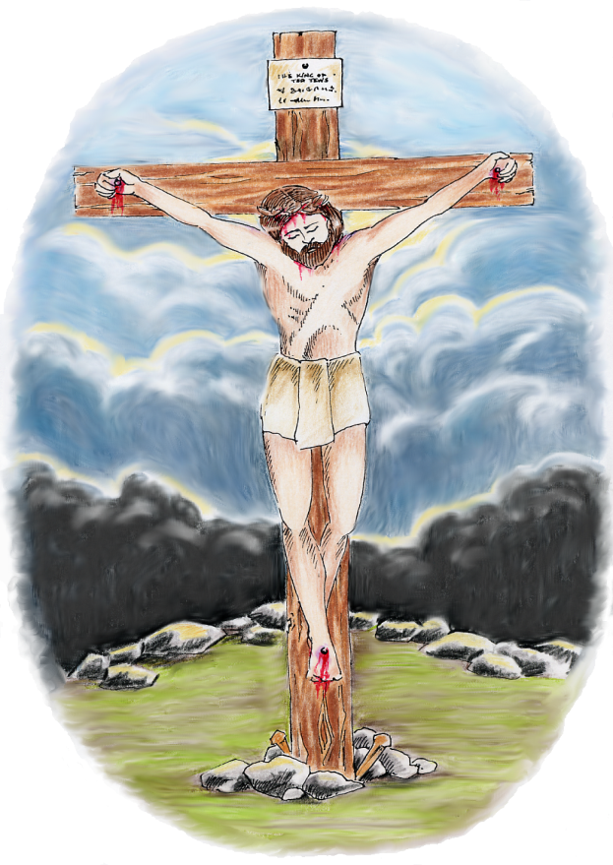
Daniel 9 Timeline of “midst” of the 70th Week
[“midst” of the last 7 years of the 490 year timeline]
Beginning of 70th wk:
Yahusha’s Baptism
Speaking Voice:
Matt 3:16-17 This is my Beloved Son…
Ending of 70th wk:
Stephen’s Death
Speaking Voice:
Acts 7:54, 57, 59
… the leaders cried out against Stephen and stoned him.
Midst of 70th wk:
Yahusha’s Death
Speaking Voice:
[What is it & where is the Scripture?]
Notes:
Let’s try another timeline just to give you some practice:
This time we’ll look at the 70th week only.
The Event was the Saviour’s Baptism.
1c The Beginning speaking voice for the timeline is confirmed in Matt 3: 16-17 where it is written: And Jesus ... Was baptized ... He saw the Spirit of God descending like a dove. And lo a voice ... Saying, This is my beloved Son in whom I am well pleased.
And, we have the date of 27AD.
There’s also speaking voices to end the timeline of the 70th week.
The Event is the Stoning of Stephen – the same ending as for the 490 years.
2c The scripture is Acts 7: – When they heard these things [“they” being the Jewish leaders of the day] – they cried out with a lout voice ... And they stoned Stephen.
The date is 34AD – and at that point in time, probation is closed for the Jewish people “as a nation” – now the gospel will go to the gentiles through another avenue.
And, we all know that at this very event, Saul was present – who later became known as Paul – and also is known as one of the most dedicated workers for the gospel.

Slide 30
The Daniel 9 Timelines & the Gospel Timeline of:
“3 days & 3 nights”
What does Daniel 4 have to do with calculating & understanding how to begin & end Yahusha’s timeline of “3 days and
3 nights”?
In the Gospels, is there “another” timeline similar to “3 days/3 nights”?
What could Artaxerxes’ decree have to do with the most important Messianic timeline of
the Scriptures?
All this and more to be revealed
in the Passion Study!
Notes:
OK, this is our last one – but it’s a little harder, so see if you can figure it out ...
Dan 9 had a timeline for the rebuilding of the temple wall – to be completed in 7 prophetic weeks, or 49 literal years.
Again, the beginning and ending dates are 457 BC to 408 BC.
1c Artaxerxes’ voice gives the decree to begin the reconstruction.
The wall was completed in 408 BC as foretold.
But what was the speaking voice to end the timeline?
2c Here it is: Neh 12:27 And at the dedication of the wall of Jerusalem they sought the Levites ... To keep the dedication with gladness, both thanksgivings and with singing.
If this is kind of new for you, there’s a lot more help in the Daniel book.

Slide 31

May
all of Your
Timeline
studies be
abundantly
blessed
as you apply
principles
from Daniel!
Notes:
In closing I pray that all of your studies will be abundantly blessed, that the Lord will fill your cup full to overflowing – which in turn will assist you in sharing with others, so they may have the blessings just as you have had today.

Slide 32

The End
Charlene Fortsch
Email:
Charlene @studythecalendar.com
Phone: 250 742-2388 [PST]
Notes:
Do you feel like you’ve just crossed another great big bridge? Well friend, you marched right across and have finished. I trust you’ve learned a lot today, and I hope the information that you have received here serves your studies well.
Please bow your heads with me:
Our dear kind Heavenly Father – how we do thank you for the simple ways in which Daniel has chosen to teach us some very important concepts – for hiding our marching orders in Daniel’s book.
Help each and every one of us to receive your wisdom, and be able to discern pure simple truths, without being misled, or deceived, by anyone.
We thank You for Your love, care and protection, in Your Son’s blessed and holy name – Amen!

