Slide 1

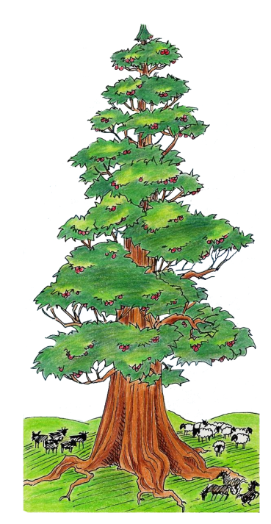

Slide 2


To Libby
June 30/20
#4 of 8
Declaring the END
From the Beginning
Notes:
For Terra Bella – Oct 2011
Dan 4 Part 2 [of 3] – A Closer Look at Timelines

Slide 3

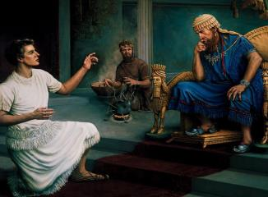
#4 Declaring the END
From the Beginning
Daniel 4
Part 2 [of 3]
A Closer Look At Timelines
By: Charlene Fortsch
Notes:
As I mentioned last time, we’re all locked into a time bubble on this earth – and it’s the prophecies – and timelines – that show us the way out of this predicament.
Most prophecy students just love working with timelines. So if you are one of those people, I think you’ll enjoy this presentation today.
Once again -- Daniel has some interesting things to tell us.

Slide 4

A Word of Prayer
Notes:
Father as we come before you today – each and every one of us, including those that are dear and far – we petition once again that your presence will enlighten our understanding of yet another new set of concepts from the pen of Daniel.
Again, anoint our eyes, ears and understanding to your truths.
Fill our cups to the brim so we have many things to share.
We pray in your son’s name, AMEN!

Slide 5

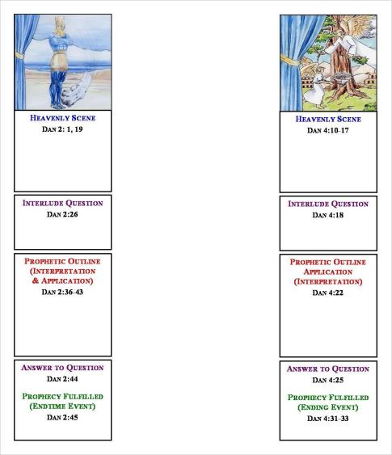
Review for Daniel 4 ~ Part1
Forward
Progressive
Movement
Structure Of Daniel
The Structural Components of the vision in Chapter 4
are exactly the same as Daniel’s other
four visions.
The Pattern is Simple
Forward Progressive Movement is evident
Dan 2
Dan 4
Notes:
Just a brief review of the last section where we found: [JUST READ ...]
The structural components of the vision in chapter 4 are exactly the same as Daniel’s other 4 visions.
The pattern is simple and easy
And the Forward Progressive Movement is very evident.

Slide 6
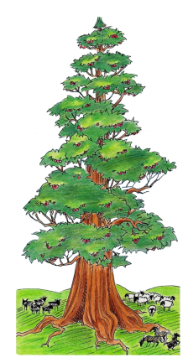
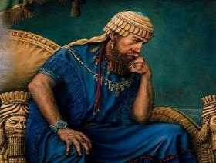

Review for Daniel 4 ~ Part1
Similes &
Metaphors
Similes and metaphors are part of literal language, not symbolic language.
Similes compare by using words such as “like” or “as.”
Metaphors compare by using phrases.
King Nebuchadnezzar is compared to a tree.
Notes:
We also found that similes and metaphors are part of literal language, not symbolic language.
Similes compare by using words such as “like” or “as.”
Metaphors compare by using phrases.
King Nebuchadnezzar is compared to a literal tree.
We didn’t find anything in the vision that connected to symbolism.
But, we did find how everything about the great tree related to King Nebuchadnezzar.

Slide 7


Review for Daniel 4 ~ Part1
Prophecies
of Ezekiel
Ezekiel wrote about Jehoichin, Assyria’a king, and the Egyptian Pharaoh being compared to cedar trees – that were cut down!
Daniel had these prophecies of Ezekiel about 20 years before King Nebuchadnezzar’s dream.
He knew the application for this Babylonian king.
Notes:
Prophecies of Ezekiel
Ezekiel wrote about Jehoichin, -- also -- Assyria’s king and the Egyptian Pharaoh being compared to cedar trees – they were all cut down!
Daniel had these prophecies of Ezekiel about 20 years before King Nebuchadnezzar’s dream.
He knew the application for this Babylonian king – with one slight difference – he’s restored to his kingdom after 7 years.
Therefore, Daniel did not need an interpretation through a vision, a dream, or from an angel messenger.

Slide 8

“Declaring the end from the beginning ...”
Isa 46:9, 10 Remember the former things of old: for I am Yahuah, and there is none else ...
10 Declaring the end from the beginning, and from ancient times the things that are not yet done, saying, My counsel shall stand, and I will do all my pleasure:
Notes:
Isaiah speaks of this concept of “declaring the end from the beginning” 7 times in his book.
Does that repetition tell you anything?
So ... before we delve into a new part of our study, let’s read these verses together:
-- [read]
Now: Let’s see if this section gives us any clues about the timeframe of Daniel 12.

Slide 9


Understanding Timelines
4) Prophetic Terminology?
or Prophetic Time?
Prophetic Key #22
Whether a prophecy is written with symbolic or literal language, ALL timelines contained in any prophecy are always prophetic time!
Notes:
Now we’re ready to look at Point #4 which addresses another two very important terms: prophetic terminology and prophetic time.
Have you ever wondered why Daniel 4 is the first chapter and the first vision in his book that addresses timelines?
Before any “timelines are given that involve God’s people” - Daniel uses Chapter 4 to teach some very important concepts.
Before we unravel these next 2 prophetic terms, let’s look at Prophetic Key #22 as it’s very important.
1c Whether a prophecy is written with symbolic or literal language, ALL timelines contained in the prophecy are prophetic time!

Slide 10

What is Prophetic Terminology?
Three phrases from Daniel & Revelation:
1. Dan 7:25 … time, times, dividing of time
2. Dan 12:7 … time, times, and a half
3. Rev 12:14 … time, times, and half a time
What’s the first thing you
think of when you see this
type of wording?
Question:
"... one day = one year!"
Notes:
Now … maybe you’re asking the question: What is prophetic terminology?
1c Let’s consider 3 phrases from Daniel and Rev. that you may be familiar with:
… 1. Dan 7:25: … time, times, dividing of time
… 2. Dan 12:7: … time, times, and a half
… 3. Rev 12:14: … time, times and half a time
2c Question: … What’s the first thing you think of when you see this type of wording? For those that are new to prophecy, perhaps nothing comes to mind.
… But, for those that have some understanding of prophecy, these phrases are recognized as having something to do with prophetic time.
… Let’s ask the question again …
3c What’s the first thing you think of when you see this type of wording?
4c For some, … the first thought that might come to mind is this: In prophecy, one day = one year in prophetic time? Let’s see if that’s the right answer …

Slide 11
That’s Not The Right Answer!
This phrase:
"... one day = one year ..."
Is a Prophetic Rule …
~ Not ~
Prophetic Terminology!
Notes:
Sorry! But, that’s not the right answer!
(automatic)
This phrase: “… one day = one year …” is a
Prophetic Rule …
Not ~ Prophetic Terminology!
Now, that might be confusing for some, so let’s look at this a little further …

Slide 12
The Correct Answer Is …
These three phrases …
1. Dan 7:25 … time, times, dividing of time
2. Dan 12:7 … time, times, and a half
3. Rev 12:14 … time, times, and half a time
… are Prophetic Terminology which indicate that a timeline is contained within a (symbolic or literal) prophecy.
Prophetic Key #22 Whether a prophecy is written with symbolic or literal language, ALL timelines contained in the prophecy are always prophetic time.
Notes:
Let’s find the correct answer:
These three phrases:
Dan 7:25 … time, times, dividing of time … and
Dan 12:7 … time, times and a half … and also …
Rev 12:14 … time, times and half a time … in all three of these phrases we are dealing with …
1c Prophetic terminology which indicates that a timeline is contained within a prophecy.
2c Maybe it would help if we read that Prophetic Rule again. Let’s do that … “Whether a prophecy is written with symbolic or literal language, ALL timelines contained in the prophecy are prophetic time.
Now if you still don’t understand, don’t worry, as we’re going to work through this in a simple manner over the next few slides.

Slide 13
Steps for Working with Timelines
Step One: Determine if the vision contains:
a) Symbolic language
b) [or any] Literal language
Step Two:
Apply this information to the timeline:
Symbolic Visions containing Timelines:
Timeline = Prophetic Symbolic Time
Literal Visions containing Timelines:
Then ...
The Timeline = Prophetic Literal Time
Notes:
There are some steps to follow when working with timelines. They’re simple steps, and IF we follow them, everything is easier.
1c Step One: Determine if the vision contains a) Symbolic language, or b) any Literal language.
ONLY THEN … can you proceed to Step Two by applying this information to the specific timeline.
Well, how do we do this?
2c Any symbolic visions that contain a timeline – you can then determine that the specific timeline is Prophetic symbolic time.
Daniel’s book contains 2 visions that are written with completely literal language. Both visions have timelines.
3c So, then, you can determine that these specific timelines are ONLY prophetic LITERAL time.

Slide 14
a) Calculating Prophetic Literal Time
Any TIMELINE given within a LITERAL vision is always PROPHETIC LITERAL Time.
The “timeline” does NOT need to be converted.
Prophetic Key #25 Timelines contained in a literal context are to be understood as literal time. Then apply this rule:
“A prophetic day is SIMPLY one literal day.”
Notes:
First: Let’s look at how to calculate Prop Literal Time. It’s really easy … even grade school children can understand this!
1c Any TIMELINE given within a LITERAL vision is always PROPHETIC LITERAL Time.
2c The “timeline” does NOT need to be converted. Just leave it alone.
3c Let’s review Prophetic Key #25 again –maybe the rule will make a little more sense this time. “Timelines contained in a literal context are to be understood as literal time.” Then apply this rule:
4c “A prophetic day is simply one literal day.”

Slide 15


Definition of a “Day”
Strong’s - H3117; Yowm; from an unused root meaning to be hot; a day (as the warm hours), whether literal (from sunrise to sunset, [boqer to ereb-12 hrs.] or from one sunset to the next [boqer to boqer-24 hrs.]), or figurative (a space of time defined by an associated term) ...
Notes:
The Strong’s definition for “day” or “days” as used in Dan 4 and 12 is:
OT:3117 yowm; with a root meaning to be hot; a day (as the warm hours), whether literal (from sunrise to sunset, or from one sunset to the next), or figurative (a space of time defined by an associated term)
[Did you notice the first meaning of “day” is literal? – not figurative, or symbolic?
So, then, wouldn’t it stand to reason, that IF a vision has NO symbolism, the “days” are not symbolic days?
Yes, that makes much more sense, doesn’t it?

Slide 16

Finding the Timelines in Daniel 4
16 Let his heart be changed from man's, and let a beast's heart be given unto him; and let seven times pass over him.
23 Hew the tree down, and destroy it … and let his portion be with the beasts of the field, till seven times pass over him;
25 … thy dwelling shall be with the beasts of the field … and seven times shall pass over thee,
32 And they shall drive thee from men, and thy dwelling shall be with the beasts of the field: they shall make thee to eat grass as oxen, and seven times shall pass over thee, until thou know that the most High ruleth in the kingdom of men, and giveth it to whomsoever he will.
Notes:
Now that we understand how to interpret any prophetic timeline, let’s get back to the 7 year timeline of Daniel 4.
Remember, this timeline has to do with events surrounding the king – not God’s people.
And … something very different happens with this timeline that you never see happen with any timelines around God’s people.
Do you know what that is?
Well, just keep this in mind, because I’m going to tell you about it under Point #5.
Let’s read the verses that contain the 7 year timeline – noted in Daniel’s language as “7 times.”
1c 16 Let his heart be changed from man's, and let a beast's heart be given unto him; and let seven times pass over him.
23 Hew the tree down, and destroy it … and let his portion be with the beasts of the field, till seven times pass over him;
25 … thy dwelling shall be with the beasts of the field … and seven times shall pass over thee,
32 And they shall drive thee from men, and thy dwelling shall be with the beasts of the field: they shall make thee to eat grass as oxen, and seven times shall pass over thee, until thou know that the most High ruleth in the kingdom of men, and giveth it to whomsoever he will.

Slide 17
Dan 4 is Written in Literal Language
The prophetic term for this timeline (vs 16, 23, 25, 32) is identified as:
“times” – Strong’s OT:5732; a set time; technically, a year.
Daniel 4 is a Literal Vision, therefore the timeline is:
"seven times"
1 time = 1 year
The 7 times = 7 literal years.
Prophetic Literal Time
Notes:
It’s already been well established in the last 4 points that Dan 4 is written in literal language.
1c The prophetic term for this timeline (vs 16, 23, 25, 32) is identified as:
“seven times”
2c “times” – Strong’s OT:5732; a set time; technically, a year. … so that means:
1 time = 1 year.
3c Daniel 4 is a Literal Vision, therefore the timeline is:
Prophetic Literal Time … NOT symbolic time!
4c Therefore … 7 times = 7 literal years. … Now, isn’t that easy? I do hope that these concepts are clear and logical for you …

Slide 18
b) Calculating Prophetic Symbolic Time
Any TIMELINE given within a SYMBOLIC vision is most often PROPHETIC SYMBOLIC Time.
Then the “timeline” MUST BE converted
to understand how much literal time is involved.
Prophetic Key #24 Timelines contained in a symbolic context are to be understood as symbolic time. Then apply this rule: The timeline must be decoded with the Year/day Computation Principle.
Notes:
Now, let’s look at how to calculate prophetic symbolic time … it’s also easy pretty easy.
1c Any TIMELINE given within a SYMBOLIC vision is most often PROPHETIC SYMBOLIC Time.
2c Then the “timeline” MUST BE converted to understand how much literal time is involved.
3c Prophetic Key #24 Timelines contained in a symbolic context are to be understood as symbolic time. Then apply this rule: The timeline must be decoded with the Year-day Computation Principle. (…just as the symbolic gold head had to be interpreted to a literal kingdom)

Slide 19
Establishing Some Facts
1. This book on Daniel is written on the level of “historicism.” It’s the entry level of understanding Daniel’s prophecies, based on past historical fact. This holds true for the understanding of timelines as well.
2. There are many studies in Daniel now based on the recent and more current world events ~ not necessarily historical events. This could be termed the 2nd level of Daniel’s prophecies,
which are NOT
addressed in this book.
3. The 2nd level of interpretation has
its foundation in the
1st level of “historicism.” The two levels should never be mixed together. Remember
to keep them separate.
4. Understanding these concepts means that when one advances to understanding Daniel in the 2nd level ~ then
it would also stand to reason that there would not be time for some very long timelines to run their full course.
Notes:
But, before I go any further, let’s just review a few things that I’ve mentioned before.
1c This book on Daniel is written on the level of “historicism.” It’s the entry level of understanding Daniel’s prophecies, based on past historical fact. This holds true for timelines as well.
2c Second – there are many studies in Daniel now based on recent and current events – not necessarily ONLY historical events. I call this a 2nd level of Daniel’s prophecies, which are not addressed in this book.
3c The 2nd level has its foundation in Historicism, but never should the two levels be mixed together. Keep them separate.
4c Understanding these concepts, means that when one advances to understanding Daniel in the 2nd level – then it would also stand to reason that there would not be time for some very long timelines to run their full course.
-- With that in mind, let’s see how to decode symbolic timelines based on the – historicism – the first level of prophecy

Slide 20
Year/day Computation Principle
Prophetic Key #24 Timelines contained in a symbolic context must be decoded with the Year/day Computation Principle as defined by two Scriptures.
1. Eze 4:6 … thou shalt bear the iniquity of the house of Judah forty days: I have appointed thee each day for a year.
2. Num 14:34 After the number of the days in which ye searched the land, even forty days, each day for a year ... even forty years …
However: There are exceptions!
Notes:
To convert a symbolic timeline we use the “year-day Computation Principle.”
1c First, let’s review Prophetic Key #24 “Timelines contained in a symbolic context must be decoded with the Year-day Computation Principle as defined by 2 Scriptures.”
2c 1. Eze 4:6 … thou shalt bear the iniquity of the house of Judah forty days: I have appointed thee each day for a year.
3c 2. Num 14:34 After the number of the days in which ye searched the land, even forty days, each day for a year ... even forty years …
4c However: There are exceptions that I will share with you right now!

Slide 21
What is this exception?
Prophetic Key #28
The grammatical language (whether literal or symbolic) determines the context of a passage of verses.
Context
Is King!
Notes:
Prophetic Key #28 helps us to understand this exception –
The grammatical language (whether literal or symbolic) determines the context of a passage of verses.
1c This means that Context is King!
Let’s finish reading the rule ...

Slide 22
The Exception Is ...
“Context is KING”
Prophetic Key #28 ... This context determines how to interpret “time” or a “timeline” within that passage, EVEN WHEN THERE ARE SYMBOLS PRESENT!
The verse, or passage, MUST BE interpreted in the context in which it is written.
The grammar cannot be removed ~ OR ~ moved about at the whim of the reader.
To do so is a direct violation of the interpretation of Scripture.
Notes:
... This context determines how to interpret “time” or a “timeline” within that passage, EVEN WHEN THERE ARE SYMBOLS PRESENT!
-- The verse, or passage MUST BE INTERPRETED IN THE CONTEXT IN WHICH IT IS WRITTEN.
The grammar cannot be removed – or – moved about at the whim of the reader.
To do so is a direct violation of the interpretation of Scripture.
So the Exception is WHEN, Context is KING!
Understanding this concept properly requires us to remember our English lessons from high school again.
And I’m talking about verbs, regarding – past, present, or future tense. Remember?
We’ll look at 2 examples today ...

Slide 23

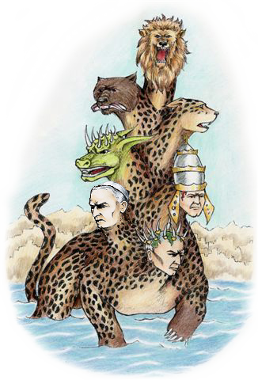




John borrows
symbolism
from Daniel 7
Revelation has exceptions!
Notes:
Revelation 2 has exceptions.
In Rev 13 John borrows symbolism from the book of Daniel.
I’m just going to give you a peek at what some of these symbolic beasts may have looked like, so when we read the verses in Rev 13 you will see the connection.
1c First there was a winged lion – which we’ve already likened to Babylon.
2c Then a bear with 3 ribs …
3c Then a winged, 4 headed leopard …
4c and a dreadful beast, likened to a dragon.
5c If you put them all together, just maybe they would look something like this …
We understand that all of these beasts must receive literal interpretation in Dan 7.
But, for now, let’s look at the Rev 13 verses.
We will find that John borrowed his symbolism from Dan 7, but in Rev 13 he includes an interesting timeline.

Slide 24

Revelation's Exception!
1 And I stood upon the sand of the sea, and saw a beast rise up out of the sea, having seven heads and ten horns, and upon his horns ten crowns …
2 And the beast which I saw was like unto a leopard, and … a bear, and … a lion …
3 And I saw one of his heads as it were wounded to death;
[Past tense; Date: 1798]
and his deadly wound was healed: [Future tense; Date: ? ]
and all the world wondered after the beast.
[Future tense; Date: ? ]
Notes:
Let’s read the verses together from Rev 13: 1, 2, 3, & 5.
1 And I stood upon the sand of the sea, and saw a beast rise up out of the sea, having seven heads and ten horns, and upon his horns ten crowns …
2 And the beast which I saw was like unto a leopard, and …a bear, and … a lion …
3 And I saw one of his heads as it were wounded to death;
1c [This is Past tense; We know from history the papal head was wounded in 1798 by Napoleon. So, in your Bible, you could pencil in the date 1798 right at the end of this phrase.]
2c [continuing on…] and his deadly wound was healed: [that has to be Future tense because this hasn’t happened yet; Right now the wound is in the healing stages but it’s not totally healed yet! So, we have NO Date.]
3c and all the world wondered after the beast. [this is also Future tense because not ALL the world has wondered after the beast yet; As yet, there is NO Date for this verse!]

Slide 25
Revelation's Exception!
1 And I stood upon the sand of the sea, and saw a beast rise up out of the sea, having seven heads and ten horns, and upon his horns ten crowns …
2 And the beast which I saw was like unto a leopard, and … a bear, and … a lion …
3 And I saw one of his heads as it were wounded to death;
[Past tense; Date: 1798]
and his deadly wound was healed: [Future tense; Date: ? ]
and all the world wondered after the beast.
[Future tense; Date: ? ]
5 And there was given unto him a mouth speaking great things and blasphemies; [Future tense; Date: ? ]
… and power was given unto him to continue
[for a timeline of] forty and two months.
[Future tense; Date: ? ]
Notes:
Now, let’s look at verse 5. And there was given unto him a mouth speaking great things and blasphemies; [This future event is based on the patterns of Papal activity from the Dark Ages.]
1c … and power was given unto him to continue [for a timeline of] forty and two months. [Since verse 3 moved the context into the future,
2c and we also know that prophecy follows the rule of “Forward Progressive Movement” – then it’s easy to understand this timeline must run in the Future.
[We don’t know the date yet!]

Slide 26

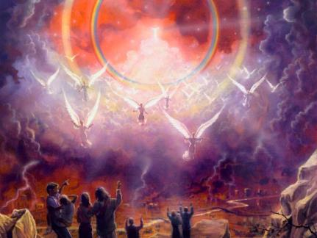
Rev 13 Exception!
Symbolic Beast
Future Context
Is King!
No Time for
a 1260 year
Timeline!
42 Month
Literal Timeline
Notes:
Let us all understand, during the last scenes of earth’s history, time will be short.
The proper endtime application for Rev 13 is in the near future.
The composite beast is definitely symbolic.
1c But there is not enough time to convert the 42 symbolic months to a 1260 year timeline before the 2nd coming.
Why? The context has moved the events into the future.
2c The “42 month timeline” is governed by the future grammatical context – and demands to be understood as only 42 months, or 1260 days.

Slide 27
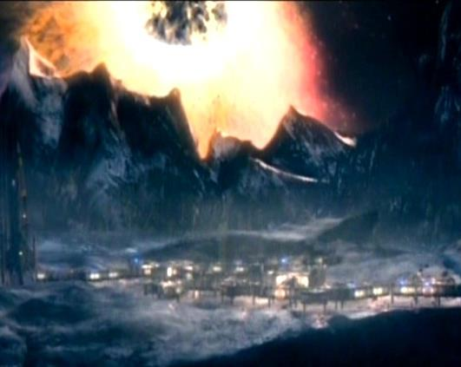

Rev 20 Timeline of 1000 Years
1 And I saw an angel come down from heaven, having the key of the bottomless pit and a great chain in his hand.
2 And he laid hold on the dragon, that old serpent, which is the Devil, and Satan, and bound him
a thousand years.
360,000
Literal Years?
Notes:
Here’s the 2nd example to consider.
1c Remember, there’s a prophetic timeline in Rev 20 designated as 1000 years – 6 times it’s mentioned!
After the 2nd Coming, Satan is bound for 1000 years on a desolate earth.
It also mentions the symbolic Composite beast of Rev 13 – which according to the rules of symbolism, the 1000 years should be a symbolic timeline.
2c How many people do you know that understand and teach that these 1000 years are symbolic time with the of 360,000 literal years?
Not many!!!

Slide 28

Rev 20 Timeline
Don’t assume that every timeline is symbolic time, whether there are symbols or not. Check the rules for calculation – then proceed.
Notes:
Why? Because we understand this 1000 years as ONLY 1000 years – definitely the first 1000 years of peace for the redeemed.
But they say? Well, it’s only a literal 1000 years because the event happens after the 2nd Coming!!
And I ask: How does that event change the rules, even when there are symbols present?
Is there something wrong with this mindset? Yes, I think so ...
Friends, the 1000 years is a literal 1000 years, because of the: 1) Context – and 2) because the last 1000 years finishes the cycle of sevens.
The earth endures 6000 years of sin, and deserves its 1000 years of Sabbath rest.
1c So many people make this mistake – whenever they find a timeline in prophecy, they automatically assume the timeline is “symbolic time” whether there are symbols or not – and proceed to calculate each symbolic day as one literal year – UNLESS – they want to do something else.
We’re going to look at that in a little bit.
Let’s learn to use the rules consistently.

Slide 29
Conclusion For Point #4
Prophetic
Terminology
Prophetic
Rule
Context is KING!
All time in prophecy is "prophetic time."
Symbolic
Time
Literal
Time
Symbolic
Language
Literal
Language
Notes:
So what is the conclusion of point #4?
I hope this information has helped you to understand the difference between prophetic terminology, and a prophetic rule and also a bit about the importance of grammatical context.
1c Remember … every timeline in prophecy is “prophetic time.”
2c And I hope you also … see the difference between … symbolic time and literal time.
3c Your homework is to figure out if the vision is written … with symbolic language or literal language. ...
4c And, please don’t forget to check the grammatical content to see if context is KING!
By now, that should be easy. If you are still having difficulty, just review this section again.
Are you ready now to look at point #5? I am!

Slide 30
Understanding Timelines
5) Repetition of Prophecy
New!
Brand
New!
Learning
does not
cease!
A NEW Prophetic Key
Yahuah does not repeat things that are of no great consequence!
New!
Notes:
OK, before going into Pt #5, let’s remember that …
Daniel 2 has NO timelines.
Chapters 7, 8, 9, & 12 all have timelines that affect God’s people in some way.
The 7 year timeline in Daniel 4 has to do with King Neb, BUT … there are very important guidelines in this chapter that help us to understand all the timelines around God’s people as well.
1c Remember, in seminar #1, we talked about the fact that learning does not cease. Well, In this section, we are going to look at …
… a NEW Prophetic Key. This is NOT in the Daniel book, as it was discovered after publication.
So you may want to write it down – in the Daniel 4 appendix, or at the front where the prophetic keys are.
Here’s the new key that is so important … The Lord does not repeat things that are of no great consequence.

Slide 31
Timelines Mentioned How Many Times?
Once!
Daniel 7: “time, times, dividing of time”
Daniel 8: “2300 days”
Daniel 9: Many timelines (e.g.: 7 weeks, 70 weeks,
69 weeks, 62 weeks, 1 week, (2) ½ week timelines)
Daniel 12: “time, times, and half a time” “1290 days” and “1335 days”
Once!
Once!
Only Once!
Notes:
We’re going to look at timelines that affect God’s people in some of Daniel’s other chapters, and see how many times they are mentioned. So put on your thinking caps!
Daniel 7: “time, times, dividing of time” – how many times is this timeline mentioned in chapter 7?
1c Once!
Daniel 8: “2300 days” -- How many times does Daniel speak of this timeline?
2c Just Once!
Daniel 9 has Many timelines – all of them extremely important as they all point to the coming of the Messiah the FIRST time. (For example: 7 weeks, 70 weeks, 69 weeks, 62 weeks, 1 week, ½ week timelines) – Are any of these timelines recorded differently by Daniel?
3c No – each one is written -- Once!
Daniel 12 has 3 timelines designated as: “time, times and half a time” -- “1290 days” and “1335 days” – How many times are each mentioned in Daniel 12?
4c Only once! Hmmm… are you noticing something that is consistent?

Slide 32
More on the Timeline of Daniel 4
Question?
~ How many times is the “seven times” timeline mentioned in Daniel 4?
1. Vs 16 (Heavenly Scene portion of Vision)
2. Vs 23 (Interpretation portion of Vision)
3. Vs 25 (Interlude Answer in the Vision)
4. Vs 32 (Fulfillment of Timeline at the end)
Answer!
~ Four Times!
Notes:
Let’s look closer at the timeline as given in Daniel 4.
I’ll ask this question,-- and if you have read Dan 4 carefully, then maybe you’ll know the answer … although you should already know the answer… from the information on the last few slides! … Here’s the question …
How many times is the “seven times” timeline mentioned in Dan 4?
You likely know the answer already …
… 4 times … This timeline is found in:
1c vs 16 – this verse is part of the heavenly scene;
vs 23 – that’s the interpretation part of the vision, a
vs 25 – this is the Interlude Answer part of the vision, &
vs 32, where the timeline is fulfilled at the end of the vision.

Slide 33
“7 times” Timeline Mentioned 4 Times?
~ This timeline has nothing to do with Yahuah’s people, only King Nebuchadnezzar.
~ Does it seem unusual that this particular timeline is mentioned 4 times, when all other timelines in Daniel’s Book (with regards to Yah’s people) are mentioned only once?
The next question ...
It should!
Notes:
Yes, the “7 times” timeline mentioned 4 times in Daniel 4 has NOTHING to do with God’s people, only King Nebuchadnezzar.
1c Now, the next question is this –
Does it seem unusual that this particular timeline is mentioned 4 times, when all other timelines in Daniel’s book (with regards to God’s people) are mentioned only once? Again, I ask: Does this seem unusual to you?
2c IT SHOULD! – seem really unusual because it is!

Slide 34
Important Hermeneutic!
Yahuah
Does not repeat things
That are of
No great consequence!
The 7 year timeline is mentioned in Daniel 4 ~ four different times ~ BECAUSE Daniel wants you to PAY ATTENTION to what is happening in this chapter.
Notes:
Maybe we just better review this important Hermeneutic as it is NOT given as a Prophetic Key in the Daniel book.
You may want to make a special note of it now – because it’s so crucial.
1c The Lord does not repeat things that are of no great consequence! [8 MR 413] So, does that mean the repetition of this timeline has a great consequence?
This Hermeneutic was discovered about 3 months after publishing. Since then, more Hermeneutic principles have been found.
[For example: Patterns of the Bible are also a strong hermeneutic.] As new hermeneutics are discovered, they must be added to the list, wouldn’t you agree?
2c The 7 year timeline is mentioned in Daniel 4 ~ four different times ~ because Daniel wants you to pay attention to what is happening in this chapter.
Is that a good enough reason? Well, maybe some of you want to find out just what is happening with this timeline in this chapter? Let me show you …

Slide 35

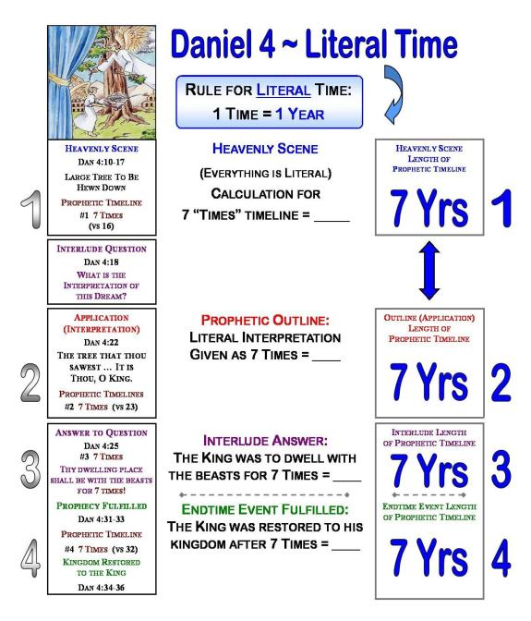
Notes:
Keep in mind that we have talked about the structural components that Daniel used to build his visions? Every vision that Daniel recorded follows this identical pattern without any exceptions.
The next 2 charts are meant to demonstrate something very interesting about the Daniel 4 timeline. So far, all the points we have considered point to the fact that this vision is complete literal.
This first chart, also portrays the vision as “literal” with a literal timeline of 7 years. So now, let’s notice just where the 7 year timeline can be found within these components.
1c The 1st time the timeline is found within the Heavenly Scene portion of the vision where the king relays the dream to Daniel.
The 2nd time the timeline is found within the Prophetic Outline portion of the vision – in the OUTLINE -- where Daniel gives the literal interpretation.
The 3rd time the timeline is found – its within the Interlude Answer where Daniel begins to answer the king’s questions about his dream.
The 4th time the timeline is found at the END of the chapter where the FULFILLMENT of the prophecy is mentioned!
2c Have you noticed: The timeline is scattered all through the chapter, each time in a different component! This is of extreme importance, as this never happens again in any visions of Daniel or Rev. Now, let’s look at the literal length of the timeline.
3c First, the rule for prophetic literal time is: 1 Time = 1 literal year.

Slide 36
This
Chart
Looks
Good!
A+
Notes:
Beginning with the HS, we’ve already determined everything about this vision is literal, therefore -- the timeline is prophetic literal time. That makes, the calculation easy – simply:
1c 7 times = 7 literal years.
Moving forward to the OUTLINE portion of the vision, we find the 7 times given the 2nd time in verse 23. And, we’ve already learned that in the OUTLINE portion of Daniel’s visions, he gives the literal interpretation.
2c So … Again, the 7 times = years.
The verses now move forward to the Interlude Answer part of the vision. In vs 25 Daniel answered the king’s question pointing out the fact that he would be as a beast in the field for 7 times.
Because Daniel already gave the literal interpretation in vs 23 of the Outline, the king knows
3c the 7 times is indeed 7 literal years.
The 4th time the timeline is mentioned is at the very end of the vision, where the vision speaks of the fulfillment. And yes indeed,
4c the 7 times [or 7 years] did pass by before the king blessed and praised the Creator God. With his voice, he was released from the consequence!
5c (Arrow) Did you notice the timeline of the last 3 components has the same interpretation as the HS?
6c (1-2-3-4) All 4 sections are in total harmony … Now … What do you think? Nice and neat!
7c Does the chart look good? Does it get an A+? Yes, it does!! On the next slide we’re going to test the opposite assumption – and see what we come up with.

Slide 37
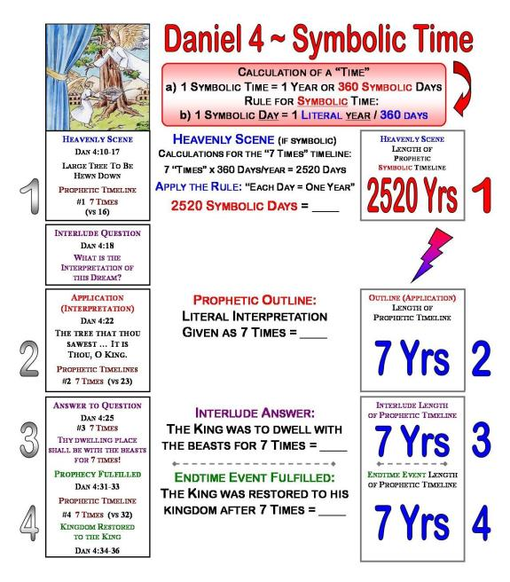
Notes:
On this chart, we’re going to assume that the vision of Daniel 4 is a symbolic vision.
That would mean that -- not only the tree and everything about the tree is symbolic, -- but that the timeline also has to be prophetic symbolic time, ok?
We already know where the 7 year timeline is found within these 4 components so we’ll just put them in as before ...1c – another good review!
2c (Arrow) Let’s review how to calculate symbolic time first. (red box)
-- 1 symbolic time = 1 symbolic year which in turn contains 360 symbolic days. Then we must apply the rule – that 1 symbolic day = 1 literal year.
3c Now, let’s look at the timeline in the Heavenly Scene, assuming this vision is symbolic. 1 “symbolic time” will have 360 symbolic days –
SO -- 7 symbolic times would have 2520 symbolic days. But, we still don’t have a calculation for literal time.
Following the rule that “one symbolic day” = “one literal year” – we now simply make that conversion.
4c [2520yrs] So, here within this “so-called” symbolic Heavenly Scene, we now find that the “7 times” timelines is really 2520 literal years!
That’s a long time. Let’s see if that answer agrees with the next 3 components …

Slide 38
Oops!
This
Chart
Fails!
D-
Notes:
I hope everyone knows by now that the OUTLINE portion of the vision is where Daniel gives the literal interpretation. Here in vs 23 he says the timeline is “7 times” long, not “2520 times [or years] long.” 9
1c So, Daniel is telling us that the 7 “times” is still 7 literal years for the literal interpretation.
In the next component we find the timeline listed in vs 25. Here Daniel answers the king’s question in literal language, and reminds him of his beast-like condition in the field for 7 “times.”
2c Again, the 7 times = 7 literal years. Daniel does not change the prophetic literal timeline into a symbolic timeline.
In the Endtime component, we find that Daniel stays consistent. The timeline is now found in vs 32. This part of the vision provides the actual fulfillment – the actual literal fulfillment! Again, the timeline is written as 7 times 3c which equals exactly 7 literal years.
4c (L Bolt) With just a quick observant look, it’s easy to see what has happened when we insist that this heavenly vision is symbolic!
5c [1 – 2 – 3 – 4] The four components of Daniel’s chapter are no longer in harmony as they were on the previous chart!
Does the chart still look good?
6c No, rather it qualifies for a D minus, doesn’t it?! Well, what else does this tell us? There’s a little more than that!

Slide 39

That means ~
Nebuchadnezzar
would have been
released from the
field around 1953!
If
Indeed...
568 BC + 2520 Yrs = AD 1953
Notes:
If indeed the 7 times timeline of Daniel 4 is contained within a symbolic vision,
That means ! Nebuchadnezzar would have been released from the field in 1953!
That’s within my lifetime – what about yours?

Slide 40

Secrets
The tree is NOT symbolic;
neither is the timeline!
Riddles
X
Puzzles
The “secret” of
Daniel 4 is the
placement of the
“7 times” timeline
within the Heavenly
Scene portion
of the vision.
This Chart
Exposes the
Error!
Notes:
Where is the problem anyway? Is it OUR problem? Or is it Daniel’s problem?
1c No it’s our … problem, and it’s right here – within the Heavenly Scene portion of the vision. We’ve made a mistake!
2c The tree along with the rest of the vision is NOT symbolic, and neither is …
3c … the timeline. Very specifically Daniel demonstrates in the last 3 components (of his structure) that the 7 times is a literal 7 years.
4c Now, don’t forget that Daniel’s book is written with riddles, secrets and puzzles. What’s happening here is ONE of those puzzles that we need to investigate. I call it a glitch – a noteworthy predicament, if you please.
What is the glitch?
5c It’s the 7 yr timeline as given within the Heavenly Scene.
For many, it S-E-E-M-S like this is a symbolic vision, with a literal timeline.
But, remember, that nowhere in Daniel’s book does he mix symbolic visions with literal timelines.
6c Do you see how this chart exposes the error?!

Slide 41

X
The tree is NOT symbolic;
neither is the timeline!
In Chapter 12,
Daniel repeats
this “secret"
pattern again
using ONE of the
timelines.
In the Heavenly Scene, a symbolic tree would demand the timeline to be symbolic as well.
The placement of this timeline was crucial!
Notes:
So … IF a timeline would not have been tucked within the Heavenly Scene component, then it would be really easy to forget those English rules that literal language uses similes and metaphors.
It would be so easy to say that the tree was symbolic, and the following 3 timelines were literal. Why?
1st: In prophetic visions many do not recognize the similes and metaphors in literal language.
1c [symbolic tree] As a consequence, it would have been very easy to say this tree was a symbolic tree, rather than a literal tree.
2nd: Because the literal interpretation about the tree & the last 3 timelines is given in the OUTLINE verses -- where the literal interpretation is always given.
2c Daniel placed the 7 year timeline right in the Heavenly Scene on purpose … very deliberately! Why? Because he wants you to pay attention.
If indeed the tree really was symbolic, then the timeline has to be symbolic time as well. And, that just doesn’t work with the rest of the chapter, because Daniel does not interpret the timeline as 2520 years!
3c [text] The placement of this timeline was crucial to make sure you follow the rules of decoding prophecy.
But why does he want you to pay attention to his deliberate glitch in chapter 4? OK, Today I’ll tell you why
4c … Because he uses this very same glitch in Daniel 12 – with one of the timelines!!!
And for many of you, that might come as a really big surprise!

Slide 42
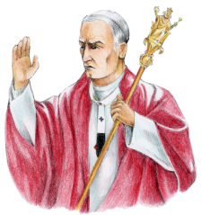
Some interpret Daniel’s “kings” as “literal kings” ... but ...
assume the timelines are symbolic time!
No Blessings!
2 Disappointments!
1260
1798
1290
1798
1335
1843?
Notes:
Compare 87 with 115 charlene
New Slide: Let me illustrate: demonstrate the glitch
I showed you the glitch in Dan 4 was the timeline contained within the Heavenly Scene portion of the vision – but what is the glitch in Dan 12?
1c [text, arrow, 1335] The 4th vision is about literal kings, but the problem arises when the timelines are assumed as symbolic time in a literal vision.
Remember -- When Daniel writes a vision in completely literal language, the timelines contained therein will be LITERAL time! Always!
2c But there’s even more problems with the 1335 timeline.
3c There has been a very strong attempt to force these 3 timelines into symbolic time.
The theologians have managed to work both the 1260 and 1290 timelines to end at the 1798 date, which is attached to significant historical events.
But … here the 1335 timeline presents the glitch.
The 1335 day timeline simply will not fit with the historical events and dates. In fact, it’s OUT of “sinq” by quite a bit.
4c I don’t have time today to do the whole study with you, but basically it’s this – nothing significant happened in 1843 that would be considered a “blessing.”
5c In fact, it was quite the opposite – there was a lot of trouble, frustration, and disappointment – when this timeline did not come to fruition, as the people had hoped.
1844 was a significant date, as that was the ending of the 2300 year timeline.
However, even if the 1335 timeline would have reached to 1844, there still was no blessing. In fact that year presented the people with 2 more disappointments!
Friends, it’s just better to calculate the timelines Daniel’s way, and stay consistent with his rules.

Slide 43

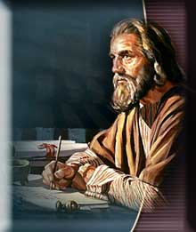
Daniel Has Everything Right!
If Daniel had recorded the 1335 timeline as 1336, this pattern would have been hidden!
This would have presented
all kinds of problems!
Notes:
Yes, we can trust Daniel because he has everything right!
If Daniel had recorded the 1335 timeline as 1336, the glitch would have been hidden.
1c In an historic application, 1336 would have reached very nicely to 1844 – a significant prophetic date.
This would have presented all kinds of problems. Think about that for a bit!

Slide 44
The tree is NOT symbolic;
neither is the timeline!
Notes:
If Daniel would not have written the 7 year timeline at the beginning, we may not have discovered his rule of:
Literal prophecies have literal timelines.
This is where Daniel develops the Isa 46 concept of declaring the END from the Beginning ... Do you now see how he has hidden gems of hermeneutics in chapter 4 so you can understand just why the Dan 12 timelines are really in the future?
In this series I’m just showing you SOME of the reasons from Daniel. There are many more listed in the Daniel book – which you will find when you follow his format through each and every chapter in the book – in order the way he intended it to be done.
Now, we’re ready to look at the summary for this section on the next slide.

Slide 45

Using Our Logic and Common Sense
If the Daniel 4 timelines would have been symbolic, King Nebuchadnezzar would have been released from his “field of duty” (2520 years later) about 1953!
Daniel explains exactly how to work with timelines in this chapter. If any part of these many concepts are misunderstood, it will be absolutely impossible to understand the “timeframe” of the Daniel 12 timelines, and several timelines in Revelation.
Again, Daniel has used repetition to teach a simple, but important concept.
Always remember:
The NEW Prophetic Key: Yahuah does not repeat things that are of no great consequence.
New!
This Vision is Literal!
Notes:
You know, sometimes the best thing for all of us to do is to use our logic and our common sense …
If the Daniel 4 timelines would have been symbolic, then we know that King Nebuchadnezzar would not have been released from his “field of duty” until around 1953! – that’s about 2520 years later.
1c But Daniel explains to us how to work with timelines in this chapter – exactly! And, if any one of these many concepts are misunderstood, it will be nearly impossible to understand the “timeframe of the Daniel 12 timelines, and several timelines in Revelation as well.
2c Again, Daniel has used a lot of repetition just to teach a very simple, but important concept. Did you see that?
3c And always remember: The NEW Prophetic Key: that, The Lord does not repeat things that are of no great consequence. Can you see how He gave this timeline in every portion of the vision – all those 4 structural components? -- so there would be no question as to whether this timeline it is a literal or symbolic timeline? It’s very clear, isn’t it?!
So, What is the final conclusion for this section?
4c Once again the vision is literal, so the timeline has to be prophetic literal time. –
Oh friend I hope you can see how crucial it is to understand this new hermeneutic -- (chuckle) I was so excited to find this one.
And I’m so happy to share it with you today. It’s one of the most important rules of everything we are talking about in this study.
So always remember, if there’s no symbolism in the vision, the timelines can never ever be symbolic time ... they will always be literal time... and you won’t be fooled! [the end of this lecture]

Slide 46
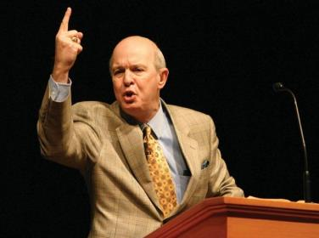
#5 Declaring the END
From the Beginning
Daniel 4
Part 3 [of 3]
Sneaky Switches & Glitches
By:
Charlene
Fortsch
Notes:
That ends the 2nd part of the Daniel 4 study today. But, you just might be wondering what to expect next?
In this last section we’re going to be looking into [what I call] some sneaky switches and glitches. I hope you’ll find the information interesting and useful.

Slide 47

The End
Charlene Fortsch
Email:
charlene@studythecalendar.com
Phone: 250 742-2388 [PST]
Notes:
Do you feel like you’ve just crossed a great big bridge? Well friend, you have.
Let’s just give a word of thanks ...
Father, for many, we have covered a lot of new information and I just ask that you would help each one to retain their new knowledge.
Thank you for the wonderful blessings that prophecy has given to your people all through the ages.
May we never forget these tremendous truths as we travel through the last days of earth’s history –
-- where our longing to meet our Saviour is indeed a reality, rather than the blessed hope.
We ask these favors in the name of your Son, Amen!

