Slide 2
When Does the Day Begin?
(According to the Torah)

Slide 3
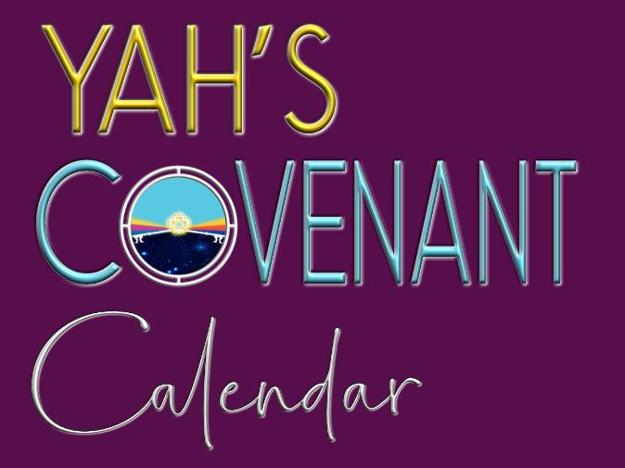
When Does the Day Begin according to
Note to Charlene upon completion:
Send to barb dowling and evelyn martin, chris faifer, walter tschopep, etc.
Manny & Barb working on a spanish PPT – 5/15/20
?

Slide 4
When Does the Day Begin?
(According to You?)

Slide 5
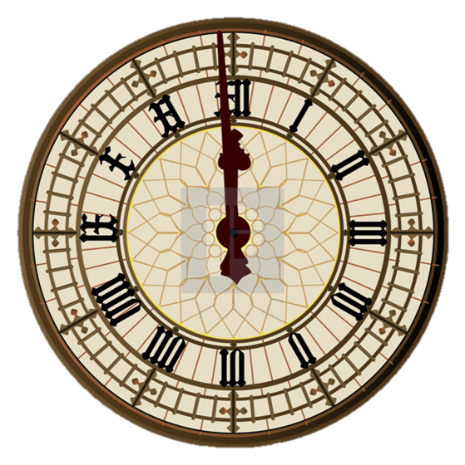
Lucifer, Yahuah’s enemy, has stolen the worship due to the Creator by changing the calendar used to find Yahuah’s worship statutes.

Slide 6
But that is not all he has changed. He has even changed when the day begins for Yahuah’s worship statutes.
6

Slide 7
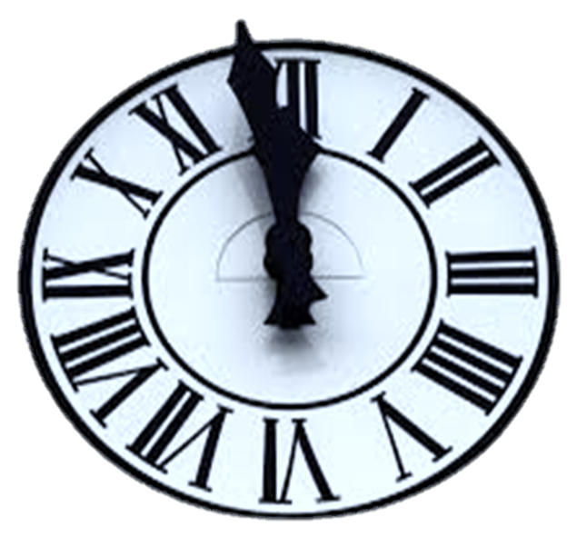
The modern 24 hour “day” begins at midnight.
7

Slide 8
Jews and most “feast-keeper” Sabbatarians begin their Sabbath Friday evening at sunset.

Slide 9
However, Scripture reveals when the day begins and it is neither midnight, sunset or sunrise!
9

Slide 10
Creation’s restoration began after the earth became void, formless & dark.
(Gen 1:2a)

Slide 11
“And the Ruach moved upon the face of the waters.”
(Gen 1:2b)
“And there was light.” (Gen 1:3b)

Slide 12
The restoration* of the
Creation week began when the Creator said,
“Let there be light.”
Nothing started with darkness!
*Ps 104:30 Thou sendest forth thy spirit, they are created:
and thou renewest the face of the earth. KJV

Slide 13
The first day of the first week could NOT begin with darkness, nor could it begin with evening.

Slide 14
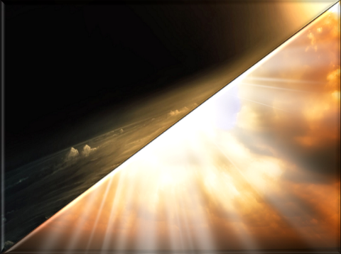
“And … Yahuah divided the light from the darkness.”
(Gen 1:4)

Slide 15
“Yahuah called the light* …
And the darkness* He called
Day*
Night*
(Gen 1:5a) * These are “definitions” for calendar terms.

Slide 16
This was the first covenant given on the 1st day of Creation, called
the covenant of the day and the covenant of the night.
Day
Night
(Jer 33:20-25)

Slide 17
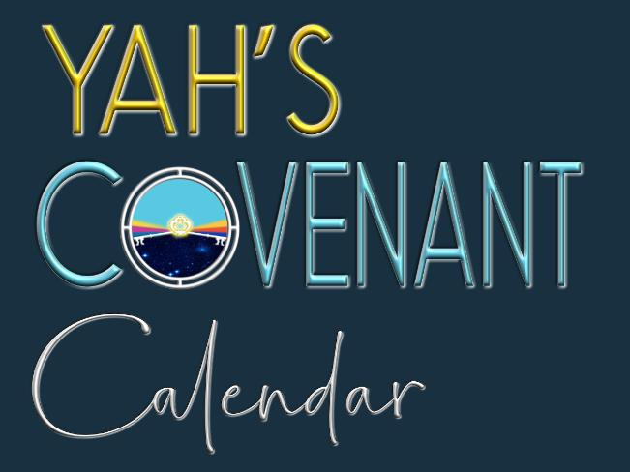
This is a very special covenant and the beginning of:

Slide 18
When Yahuah separated the light from the darkness, He called the light “Day” and then …
He defined that “day” as being made up of both the evening and the morning.
Both the evening & morning twilights are “mixtures” of “light” and “night.” That’s why they belong to the “day” ~ the Light Season.
The “Night” has no “light” from the Light Season.

Slide 19
When Moses wrote the book of Genesis, he totally understood the word “day.”
In Genesis, Yahuah defined the word “day” as including both twilight transition times, of evening and morning.

Slide 20
What is a “twilight”?

Slide 21
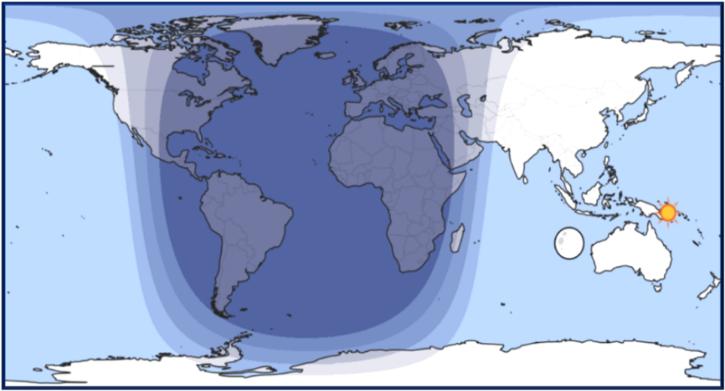
All twilights belong to the Day Season.
Night Season
Day Season
Civil dawn/dusk
Nautical dawn/dusk
Astronomical dawn/dusk

Slide 22
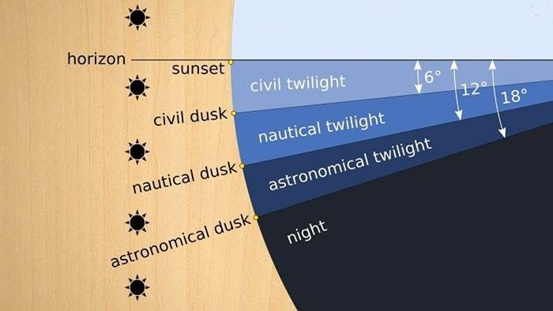
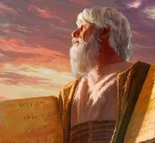
Astronomical twilight marks the day-start.
Day Season
DAWN MARKER
Horizon
Still Before Sunrise
Civil dawn/dusk
DAY
SEASON
Nautical dawn/dusk
Night Season [No light from the sun]
Astronomical dawn/dusk
Moses knew this!

Slide 23
Now that we know the morning and evening twilights belong to “the day” how long is this day?
12 hours? or 24 hours?

Slide 24
The word “day/yowm” can be a confusing word to many.
According to Hebrew #3117 there are two main definitions for “DAY” in the Festal Calendar study.

Slide 25
Gen 1:5a
“And the light He called day …”
“… and the darkness He called Night.”
(Gen 1:5b)
A Full 24 Hour Cycle
DAY SEASON (with TWILIGHTS)
NIGHT SEASON

Slide 26
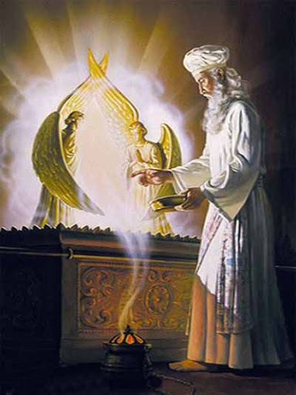
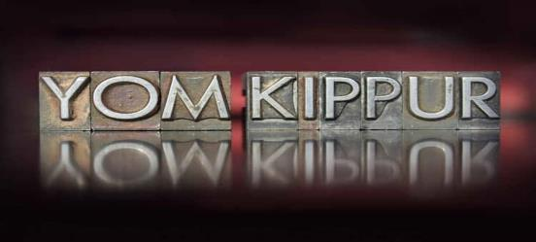
These definitions are important in order to understand the timeframe for Yom Kippur.

Slide 27
If the day began at midnight, or at sunset, would Moses have given the following instructions for Day of Atonement in Lev 23?

Slide 28
Lev 23:32[c] is the main Bible text that is used to support the “day” beginning at sunset.
“… from even unto even, shall ye celebrate your Sabbath.”
Is the text really saying the “day” begins with sunset?

Slide 29
No! The text says nothing of sunset!
However … when the text is “read in context” it becomes very clear this thought cannot be applied to every day, and certainly not to the seventh-day Sabbath.

Slide 30
Lev 23:26-32 contains Yahuah’s instructions regarding Day of Atonement.

Slide 31
If every day began at evening, Yahuah would not have needed to tell the Israelites to begin their observation of Yom Kippur the evening before.

Slide 32
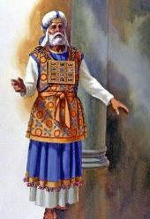
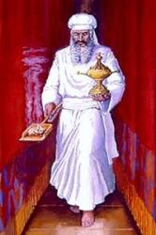
Does the day of Yom Kippur span the two calendar dates of
the 9th day and the 10th day?

Slide 33
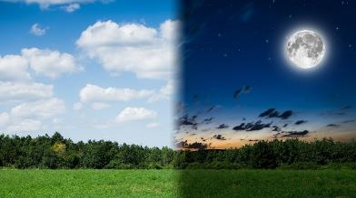
9th
10th
Between the 9th and the 10th days, there are 48 hours.
What combination of 24 hours would belong to Yom Kippur?

Slide 34
vs 27: “On the tenth day of the seventh month there shall be a day of atonement … vs 32a It shall be unto you a Sabbath of rest …”
10th

Slide 35
vs 32 [b] “… and ye shall afflict your souls:
[beginning when?]
9th
vs 32 [c] “… in the ninth day of the month at even …”

Slide 36
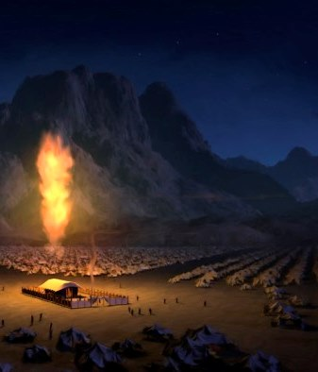
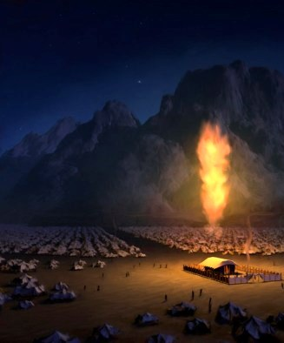
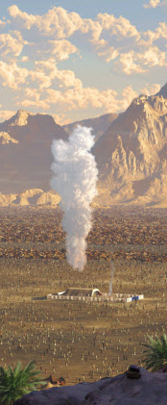
9th
10th
Duration of affliction?
vs 32 [c] “… from even …”
vs 32 [d] “… unto even …”
The length of affliction is
a full 24 hours from the “even” of the 9th to the “even” of the 10th.

Slide 37
9th
10th
What is the requirement of this affliction?
vs 32 [e] “… shall ye celebrate your Sabbath.”
vs 32 [c/d] “… from even unto even …”
What is this word “celebrate” referring to?

Slide 38
9th
10th
In the Strong’s “celebrate” is defined as #7673:
to repose;
desist from exertion;
to rest and be still.
Part of the “affliction” is one of quietness, stillness and rest.
For 24 hours from the “even of the 9th to the even of the 10th” this “affliction” is called “a celebration.”

Slide 39
9th
10th
The context of vs 32 is about Yah’s commanded “affliction” ~ for Yom Kippur ~ not about when any Sabbath day begins including !
The first 12 hours of “affliction” is intended to prepare us for the hours of !

Slide 40
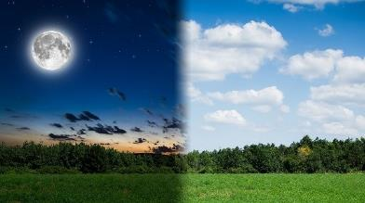
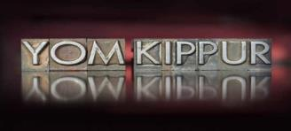
9th
10th
Let’s compare the opposite scenario when the day begins with evening. Will this apply to:
?

Slide 41
9th
10th
If the day begins at evening, Moses would have simply been told:
“Day of Atonement is on the tenth day of the seventh month.”
Moses said nothing!

Slide 42
Does that information reveal when the “24 hour day” ends?
Day begins with the coming of light.

Slide 43
The “9th day of the month at even” is a continuation of the 9th including the “sunset & twilight mixture” carrying on through the Night Season, ending at morning [boqer].
The foundation of the creation week is demonstrated in Lev 23:32 like this:

Slide 44
Evening does not begin the day of the
Neither does evening begin any other day, including the seventh-day Sabbath.
9^{th.}

Slide 45
The sun was given to rule over the day!
(Ps 136:8)

Slide 46
Every 24 hour day begins with the arrival of light and …
… the Day Season component [of the 24 hours] is over when there is no longer enough light for the sun to rule that portion [thus evening ends & the stars appear].

Slide 47
Centuries later the Saviour asked, “Are there not twelve hours in the day?”
(John 11:9)

Slide 48
No one argued with Him (because the context is not about the day-start in this verse).
Most everyone knew the day began with the coming of light.

Slide 49
The hours of the day were divided evenly into twelve parts as shown on a sundial.
Hours were longer in the summer, and shorter in the winter, but each day had only 12 hours, or “12 divisions” of light.

Slide 50
What about the:
Gospel accounts of the crucifixion, burial and resurrection of Yahusha?
Is there any support for the day beginning at dawn?

Slide 51
“In the end of the Sabbath, as it began to dawn toward the first day of the week, came Mary Magdalene …”
(Matt 28:1) KJV

Slide 52
The first day of the week did not begin until light began to grow in the eastern sky.

Slide 53
Likewise, the evening after the crucifixion, the [ULB*] Sabbath did not begin at sunset.
[ULB* - Unleavened Bread Sabbath always follows Passover.]

Slide 54
The Scriptures clearly state that the priests and rulers did not want the bodies to remain on the cross over the [ULB] Sabbath.

Slide 55
“The Jews therefore, because it was the preparation, that the bodies should not remain upon the cross on the Sabbath day, (for that Sabbath day was an high day,) besought Pilate that their legs might be broken and that they might be taken away.”
(John 19:31)

Slide 56
“Then came the soldiers, and brake the legs of the first, and of the other which was crucified with him. But when they came to … Yahusha, and saw that he was dead already, they brake not his legs.”
(John 19:32-33)

Slide 57
Death by crucifixion generally took several days. The whole point of breaking the legs, was to hasten the victim’s death so they could be taken off their crosses before the Sabbath began at dawn the next day!
Note Mark 15:42.
“Now when evening had come, because it was [still] the Preparation Day, that is, the day before the Sabbath …”

Slide 58
“Joseph of Arimathea, a prominent council member, who was himself waiting for the kingdom of Yahuah, coming and taking courage, went in to Pilate and asked for the body of Yahusha.”
(Mark 15:43)

Slide 59
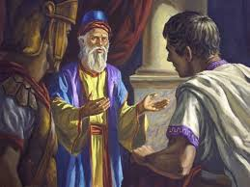
Pilate did not believe Yahusha could die so quickly from a process that typically took several days.
Next he sent for the centurion to confirm Yahusha’s death. (Mark 15:44-45)
“Then Pilate commanded the body to be given to him.”
(Matt 27:58)

Slide 60
Calculate the amount of time this may have taken to summon the centurion from Golgotha and wait for his arrival.
Timeframe:
It is “evening” [after sunset] and the night is approaching.

Slide 61
Once Joseph received permission to have Yahusha’s Body, what did he do next?
“And he [Joseph] bought fine linen …”
(Mark 15:46a)

Slide 62
If the [ULB] Sabbath began at “even” would an upright man such as Joseph be purchasing linen during this time?

Slide 63
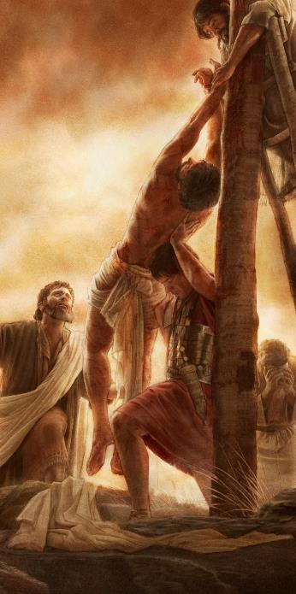
Events thus far since Yahusha’s death:
Evening had come
Joseph asks Pilate for the Body of his Master
A centurion has to confirm Yahusha has died
Joseph purchases linen
Then:
Joseph removed Yahusha from His post.
(Mark 15:46b)

Slide 64
“And there came also Nicodemus, which at the first
came to Yahusha by night …”
(John 19:39a)

Slide 65
“… and brought a mixture of myrrh and aloes, about an hundred pound weight.”
(John 19:39b)

Slide 66
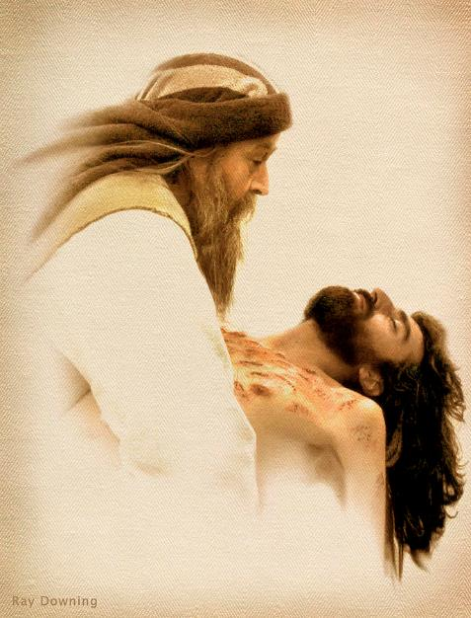
“Then took they the body of Yahusha, and wound it in linen clothes with the spices as the manner of the Jews is to bury.”
(John 19:40)
Remember: Yahusha’s Body would have been washed first!
How long would this take?

Slide 67
To bury Yahusha according to the custom of the Jews is a very lengthy process that took the entire night.

Slide 68
“Now in the place where He was crucified there was a garden, and in the garden a new tomb in which no one had yet been laid.”
(John 19:41) NKJV

Slide 69
“So there they laid Yahusha, because of the Jews' Preparation Day, for the tomb was nearby.”
(John 19:42) NKJV

Slide 70
The work of burying the Saviour finished just as the [Unleavened Bread] Sabbath began to dawn.

Slide 71
“And he [Joseph of Arimathea] took it down, and wrapped it in linen, and laid it in a sepulchre that was hewn in stone, wherein never man before was laid.”
(Luke 23:53)

Slide 72
“And that day was the preparation [Passover day], and the Sabbath drew on.”
(Luke 23:54)

Slide 73
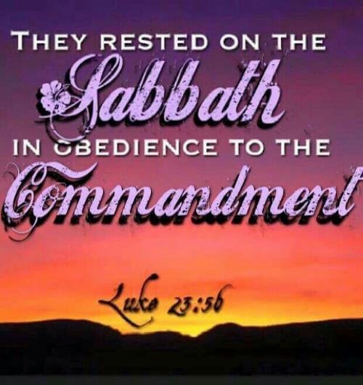
And that day was the preparation [Passover day], and the Sabbath drew on.”
Luke 23:54
Luke goes on to say:

Slide 74
The phrase translated ‘drew on’ in this text is the Greek word #2020 <epiphosko>.
The definition is startling:
‘to begin to grow light: - begin to dawn.’
It is a form of #2017 <epiphauo>, which means:
‘to illuminate … give light.’

Slide 75
Because they waited until the evening, to commence the process of seeking permission to receive the Body, taking it down, cleaning and wrapping it, etc., this took both Joseph & Nicodemus most of the night hours to complete this task.

Slide 76
It is easy to discern this duty was not finished until just before the [ULB] Sabbath began ~ as it started to grow light.
This “anti-type” aligns with the Exodus 12 “type” for the disposal of the passover lamb before the morning/boqer twilight breaks forth.

Slide 77
Remember: LIGHT came FIRST from our Creator!
This is first found in Genesis 1:1.
Then remember …

Slide 78
The next thing Yahuah did after creating <bara> light in Gen 1:1 was
to divide
&
restore
the light from the <choshek> darkness that “came to be” in Gen 1:2[a].

Slide 79
Yahuah then named the two different parts that He had separated.
The light part He called “Day.”
The dark part He called “Night.”
It is a principle of Scripture that:

Slide 80
Yah

Slide 81
“… let no man separate.”
Mark 10:9
Likewise …

Slide 82
What Yahuah has separated, no man should join together!

Slide 83
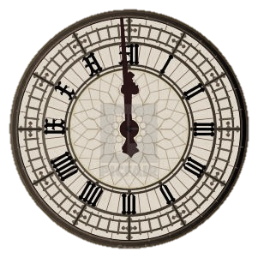
Claiming the day begins at midnight ...
or at sunset ~
joins together what our Creator has separated!

Slide 84
When Satan was cast out of heaven, he had a different plan, to usurp worship from Yahuah.

Slide 85
He would change the day of worship, or change the time of worship. Either one will do, if not both!

Slide 86
Lucifer boasted that he would “change times and laws.” (Dan 7:25) By changing the day of worship from Sabbath to Sunday ~ and by changing
when the day begins, he has stolen worship that rightfully belongs to our Creator.

Slide 87
Friends, before the time of the end will be realized, every divine institution of Yahuah’s Torah must be restored!
That includes the correct day of the weekly Sabbath, and the correct time to begin Yahuah’s Sabbaths – all of them!

Slide 88
Yahuah’s remnant people will stand before the world as reformers to RESTORE every end time truth around Yahuah’s worship statutes. This will include the annual Sabbaths!

Slide 89
Yahuah’s remnant will clearly teach
these restored precepts
of the everlasting Covenant.
The waste places will be built up and the breaches will be RESTORED!
Isa 58:12

Slide 90
Acts 3:21 speaks of restoration. “He must remain in heaven until the time comes for Yahuah to restore everything, as he promised long ago through his holy prophets.” (NIV)

Slide 91
Step free of error and tradition!

Slide 92
Join the growing number of truth-seekers around the world who are restoring the true weekly Sabbath “day” & the Sabbath “day-start”!

Slide 93
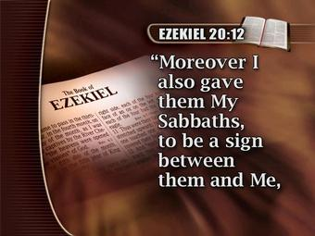
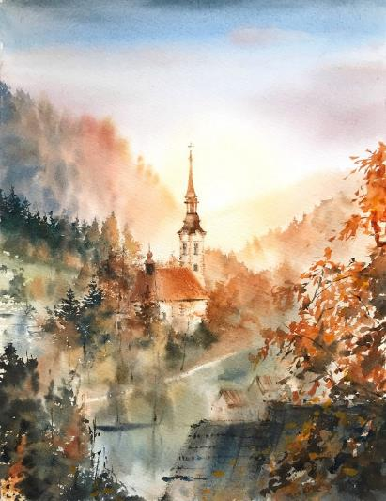
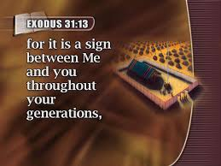

Slide 95
Yahuah’s appeal to us is to:

Slide 97
Yahuah’s “yoke is easy and His burden is light,” just as in the:
Every day begins with “light”!
(Matt 11:30)

Slide 98
From Yahuah ~ to the Bride ~
From dawn to dawn!
The End

Slide 99
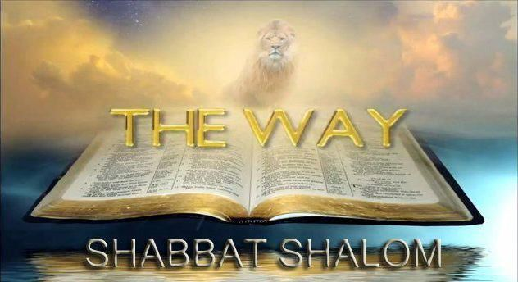
Questions?
questions@studythecalendar.com
www.studythecalendar.com

