Slide 1
2021 Covenant Calendar Workshop
Learn how to build the Covenant Calendar for your area of residence.

Slide 2
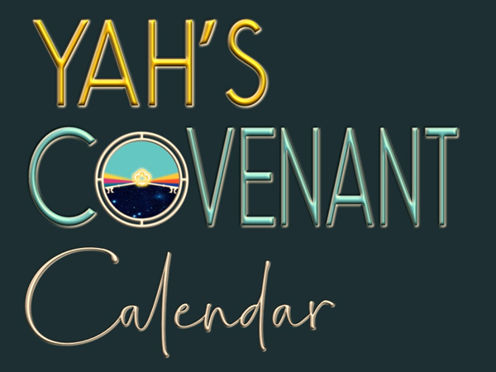
A TEACHING FROM
Visit: studythecalendar.com

Slide 3
2021 March Equinox in Universal Coordinated Time is on Saturday, March 20 at 09:37 AM UTC
Note: UTC is always standard time.
When the Sun Crosses the Equator Something Special happens.
The March equinox [tequfah] marks the moment when the sun’s ecliptic path crosses the celestial equator. This is an imaginary line in the sky above the Earth's equator, from south to north.
This happens on March 19, 20, or 21 every year.
Equinox time zones for the 2021 Covenant Calendar workshop are:
Pacific
Mountain
Central Standard Time
Central Daylight Time
Eastern
Atlantic
United Kingdom [area of UTC Marker]
Germany
Israel & South Africa
India
West Australia
New Zealand

Slide 4
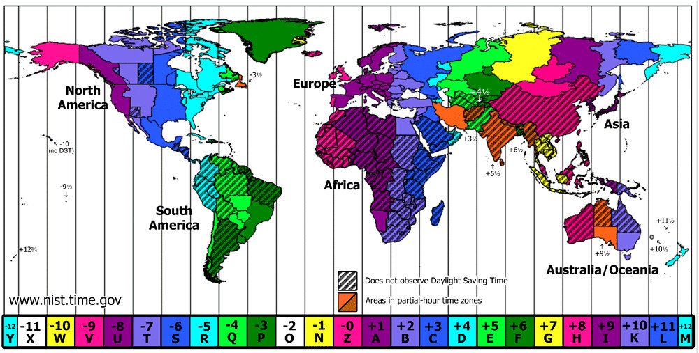
2021 March Equinox in Universal Coordinated Time is on Saturday, March 20 at 09:37 AM UTC
Time zones west of UTC are earlier than UTC time.
Time zones east of UTC are later than UTC time.
Note:
United Kingdom Germany & Israel do NOT change to Daylight time until AFTER the equinox.

Slide 5
2021 March Equinox in is on Saturday, March 20 at 09:37 AM UTC
[Standard Time]
Note:
United Kingdom, Germany & Israel do NOT change to Daylight time until AFTER the equinox.
Place / Timezone | Web Equinox Estimate
1. BC: Pacific | Daylight time: Sat 2:37 am
2. AB: Mountain | Daylight Time: Sat 3:37 am
3. SK/AZ: Central Standard | No Daylight Time; [GMT -6] Sat 3:37 am
4. MB: Central | Daylight time: Sat 4:37 am
5. ON/QU: Eastern | Daylight time: Sat 5:37 am
6. Maritimes: Atlantic | Daylight time: Sat 6:37 am
7. United Kingdom [& UTC] | 2021 March 20th Sat 9:37 am
8. Germany: CEST till Mar 29 | [GMT +1] Sat 10:37 am
9. Israel & South Africa [ST] | [GMT +2] Sat 11:37 am
10. India: IST | [GMT +5½] Sat 3:07 pm
11. W Australia: AWST | [GMT +8] Sat 5:37 pm
12. New Zealand: NZDT | [GMT +12] Sat 10:37 pm
The trickiest part of this project is to pinpoint which “day” the shadow will be observed as a “straight line” OR “no shadow” depending on the measuring device being used.

Slide 6
Points to Consider:
Equinox is on Mar 20th @ 2:37 AM – this is the Roman “date & time.”
Covenant Calendar: the date is still Mar 19th UNTIL boqer twilight.
Vancouver boqer occurs at 5:26 AM – where the Covenant Calendar date then changes to Mar 20th. Question:
Was the shadow seen on the Roman Calendar of Mar 19th during the day? Or:
Will the shadow be seen on the Roman Calendar of Mar 20th in the hours after boqer [that are also on Mar 20th]? Consideration:
At this point all we can attempt is a good “guesstimate” UNTIL we can actually observe the shadow.
Place / Timezone | Web Equinox Estimate
1. BC: Pacific | Daylight time: Sat 2:37 am
2. AB: Mountain | Daylight Time: Sat 3:37 am
3. SK/AZ: Central Standard | No Daylight Time; [GMT -6] Sat 3:37 am
4. MB: Central | Daylight time: Sat 4:37 am
5. ON/QU: Eastern | Daylight time: Sat 5:37 am
6. Maritimes: Atlantic | Daylight time: Sat 6:37 am
7. United Kingdom [& UTC] | 2021 March 20th Sat 9:37 am
8. Germany: CEST till Mar 29 | [GMT +1] Sat 10:37 am
9. Israel & South Africa [ST] | [GMT +2] Sat 11:37 am
10. India: IST | [GMT +5½] Sat 3:07 pm
11. W Australia: AWST | [GMT +8] Sat 5:37 pm
12. New Zealand: NZDT | [GMT +12] Sat 10:37 pm
IF the shadow is observed in the UK on March 20th – then the Pacific time zone should also see the shadow on the Day Season of Mar 20th.

Slide 7
MORE Points to Consider:
2021 is a very tricky year for calculating the Covenant Calendar for those in the northern hemisphere–west of the UTC /United Kingdom – because the equinox “time of occurrence” happens during the darkest period of the Night Season.
Therefore, let’s build the Covenant Calendar the best we can, THEN check the shadow in the spring of 2021.
If the shadow is seen ON Mar 20th – THEN, Mar 21st is the first day of the new year.
If the shadow is either a day before, or day later, the Covenant Calendar will need to be adjusted accordingly.
Place / Timezone | Web Equinox Estimate
1. BC: Pacific | Daylight time: Sat 2:37 am
2. AB: Mountain | Daylight Time: Sat 3:37 am
3. SK/AZ: Central Standard | No Daylight Time; [GMT -6] Sat 3:37 am
4. MB: Central | Daylight time: Sat 4:37 am
5. ON/QU: Eastern | Daylight time: Sat 5:37 am
6. Maritimes: Atlantic | Daylight time: Sat 6:37 am
7. United Kingdom [& UTC] | 2021 March 20th Sat 9:37 am
8. Germany: CEST till Mar 29 | [GMT +1] Sat 10:37 am
9. Israel & South Africa [ST] | [GMT +2] Sat 11:37 am
10. India: IST | [GMT +5½] Sat 3:07 pm
11. W Australia: AWST | [GMT +8] Sat 5:37 pm
12. New Zealand: NZDT | [GMT +12] Sat 10:37 pm
For the purpose of this exercise, we will mark our best supposition as: Mar 20th = “tequfah” Mar 21st = 1st day of the new yr.
Important note: Every time zone has the tequfah within ONE 24 hr. period.

Slide 8
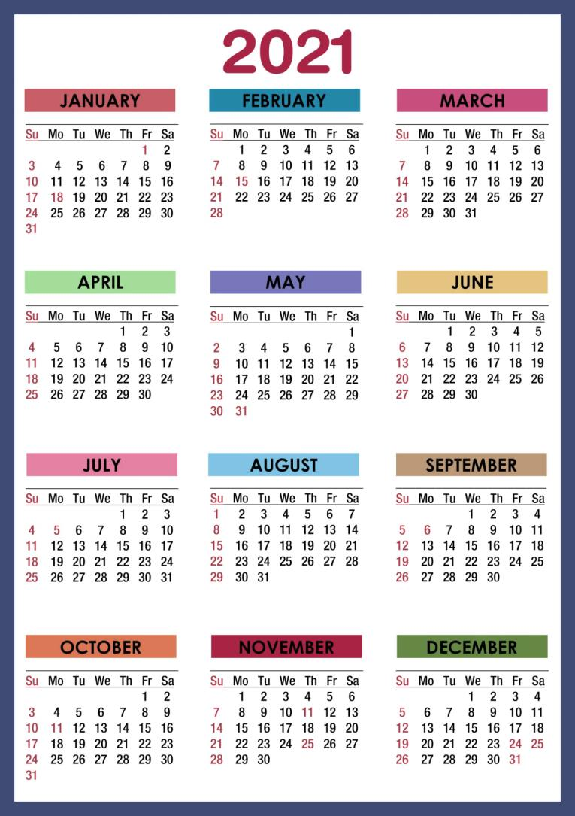
It’s time to build Yahuah’s Covenant Festal Calendar
Mark March 20th [Shabbat] as tequfah/equinox.
Spring Feasts
It’ time to build Yahuah’s Covenant Calendar
Mark March 21st as the 1st day of the 1st month.

Slide 9
Passover
Spring Feasts
March 21st is the 1st day of the 1st month.
Count 14 days to Passover.

Slide 10
Feast of Unleavened Bread
1st Feast of Unleavened Bread Shabbat is on the 15th day ~ 1st month.
The Feast of ULB is 7 days.
Mark the last day of the feast on the 21st day of the 1st month.
It is also a Feast Shabbat!
Spring Feasts

Slide 11
Festival of the Wavesheaf
The Wavesheaf is always marked as the day following the weekly Shabbat “within” the week of the Passover Festival.
Wavesheaf is NOT a Shabbat.
Spring Feasts

Slide 12
Count out Months 2 & 3 [30 days each]
The next festival to be marked is Shavuot / Pentecost.
Count out Months 2 and 3 first ~ beginning with Mar 21st as the 1st day of the 1st month.
Spring Feasts

Slide 13
Feast of
Shavuot [or Pentecost] is the 50th day from Wavesheaf.
This will be in the 3rd month.
Spring Feasts

Slide 14
Count out Months: 4 – 5 – 6 – 7 [30 days each]

Slide 15
Fall Feasts
Feast of Trumpets
Feast of Trumpets Shabbat is on the 1st day of the 7th month.
After this, get ready to count to 10 for the next festival.

Slide 16
Fall Feasts
Yom Kippur [Day of Atonement]
The 10th day of the 7th month as Yom Kippur is the most qodesh, solemn Shabbat of the year.
The “affliction of one’s soul” begins at ereb on the 9th day of this 7th month for 24 hours to the next ereb.

Slide 17
Fall Feasts
Feast of Tabernacles
The 15th day of the 7th month is the 1st Shabbat of this feast.
Count out days 15 - 21.

Slide 18
Fall Feasts
The Last Great Day
The Last Great Day of this feast is on the 22nd day of the 7th month.

Slide 19
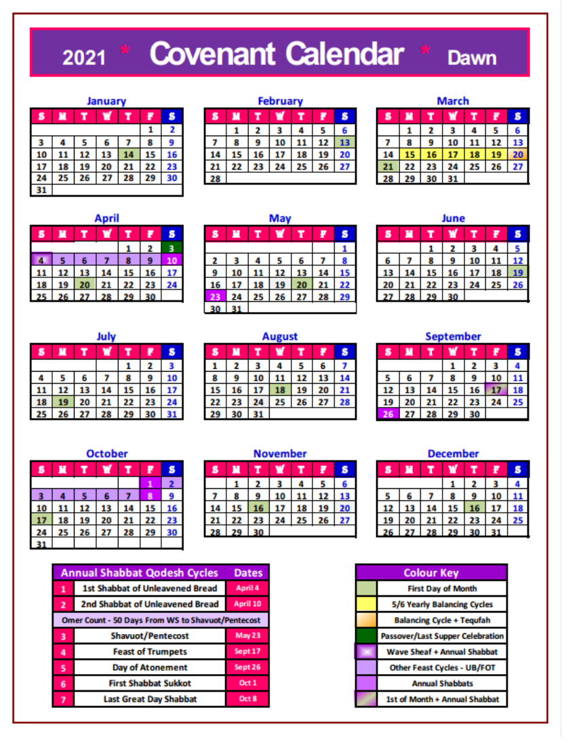
The 2021 Covenant Calendar Dates

Slide 20
The 2021 Calendar is now counted out!
Any necessary adjustments will be made at tequfah!
The End
questions@studythecalendar.com

