Slide 1


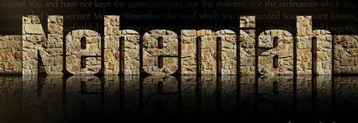
July 15th: fixing up this PPT for the final one for CCC website, since I lost the original. This one has all the original animation I put in, plus the ccc slides. 31 is fixed – 39 is not, I can’t remember what Tim did. But, I fixed the other stuff. 1030 pm.
Last minute edits from me:
Tersia wants this for her friend antionette that is doing a study on Neh on Wed – she hopes Miss A will see the logic of DAWN, so I’ll send it to her – I think it is about finished anyway. Certainly nothing of great concern I don’t think. I did some animation so I could send Tersia the animated PPT … so do check the animation to make sure it is as you want … especially the underlining on all the quote images.
Dressed up slides 6, 36, 37 and 40 … and a few comment boxes on some grammar changes I made.
That’s all from me … the rest is yours till I hear back from you.
Charlene 315 pm July 8th
Closes
the Gates!

Slide 2
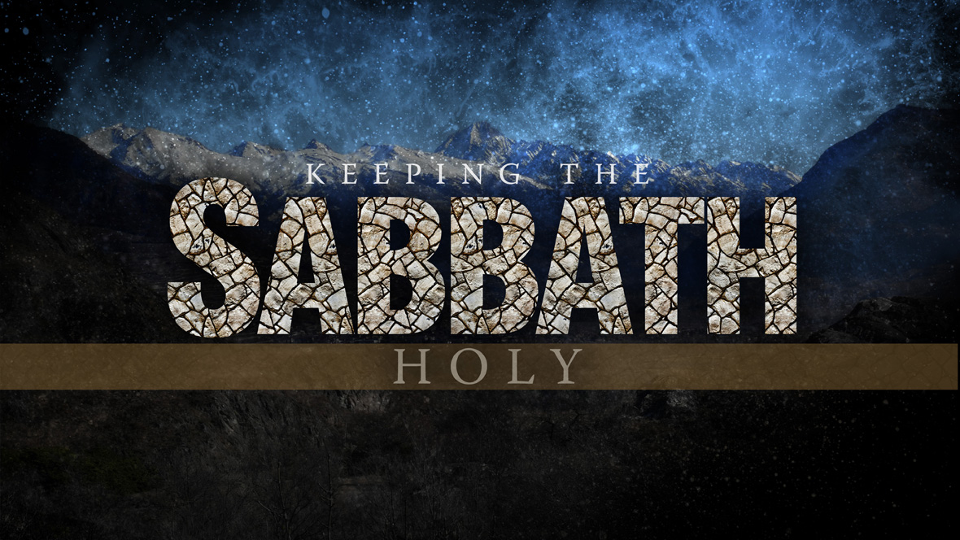
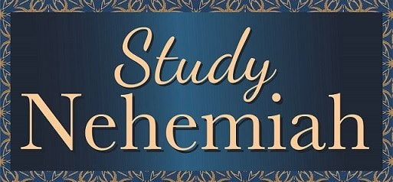
There are four popular Scriptures used to teach how to be …
keeping the
… from sunset to sunset!
Gen 1:5[b]
Lev 23:32[c]
John 20:1
And for sure …
13:19

Slide 3
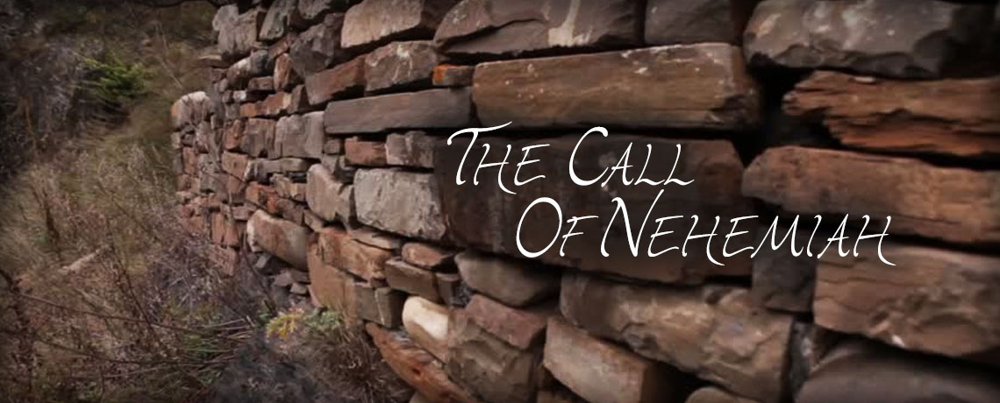
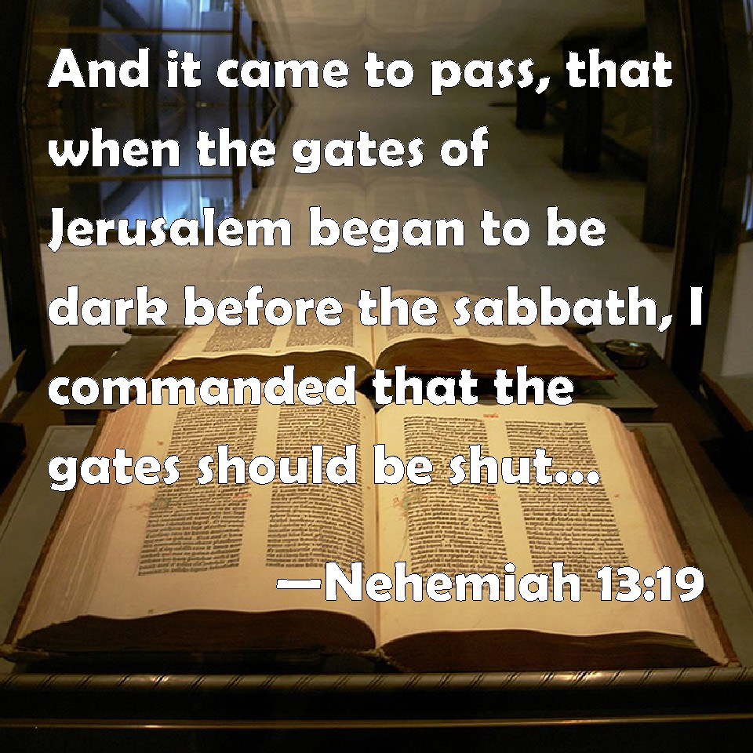
What was the purpose of:
?
… to inform the people
of a sunset Sabbath?

Slide 4
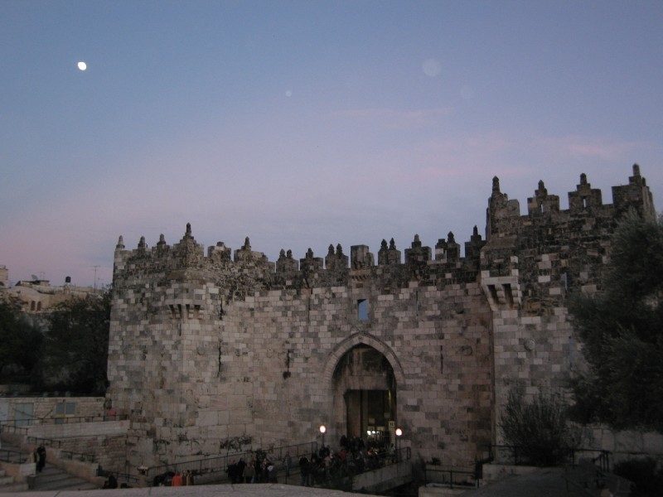
Nehemiah’s Command
Closes the
Gate
NO!
On - Sunset
to Sunset Sabbaths!

Slide 5
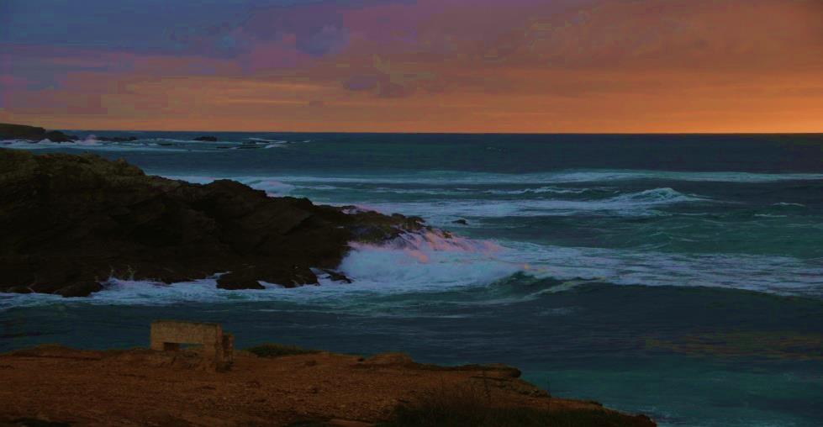
Ereb (Twilight), on the Water.
When the evening Ereb (Twilight) mixture has descended upon the earth –
WHERE IS THE VISIBLE SUN LOCATED?
5

Slide 6
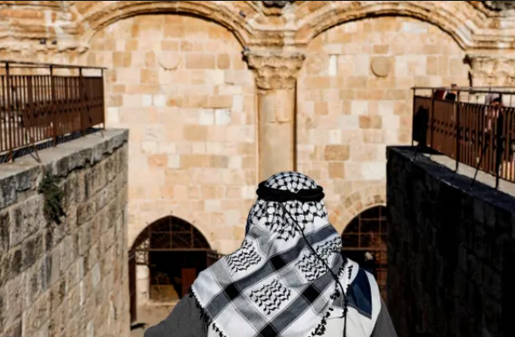
Nehemiah 13:19
And when the portes of Hierusalem
began to be darke
in the euening
before the Sabbath,
I commaunded to shut the gates,
and charged that they should not
be opened till after the Sabbath:
and some of my seruauntes set I
at the gates, that there shoulde
no burthen be brought in on
the Sabbath day. Bishops 1568
6

Slide 7
Nehemiah 13:15-22 contains a very interesting message that clearly reveals exactly when the 24 hour cycle DOES NOT START!
This particular selection of verses is perpetually cited in an attempt to prove the 24 hour cycle starts at sunset.
With reference to the sun having direct rays of light in the sky - the question becomes –
  What specific time frame does Nehemiah’s documented ereb (evening) fulfill within
  Yahuah’s 24 hour period?
7

Slide 8
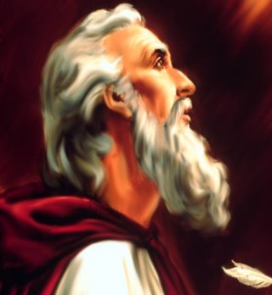

More questions for thought:
Does Nehemiah 13:19 really expose what is claimed;
(that sunset starts every Sabbath?)
Will Nehemiah 13:19 prove sunset is Yahuah’s intended design
for the start of His 24 hour cycle from creation?
Does the twilight mixture of light and darkness arrive
before the sunset?
What do the Scriptures indicate about the
time frame for closing the gates of cities?
8

Slide 9

The 2 questions we need very defined answers for are -
Is the phrase - “as it began to be dark” specifically identifying the enlarging of shadows from direct sunlight - before sunset?
        OR
Was - “as it began to be dark” - an actual absence of direct sunlight, after sunset?
This study will make very certain that you clearly understand the
difference of meaning between these two questions.
9

Slide 10
There are only 2 locations of this word צל ל וֹ -- H6751 - <tsalal> {translated as - “getting dark”}, in Scripture.
So let’s look at some definitions.
צל ל וֹ -- H6751 - <tsalal> (because Strong’s is so popular, let’s begin there.)
צ צָלַל
H6751 tsalal (tsaw-lal'); a primitive root [identical with H6749 through the idea of hovering over (compare H6754)]; to shade, as twilight or an opaque object:
KJV - begin to be dark, shadowing.
צ צָלַלH6749 Primitive Root
tsâlal, tsaw-lal'; a primitive root; properly, to tumble down, i.e. settle by a waving motion:—sink. Compare H6750, H6751. Strong’s
10

Slide 11
צָלַלH6750 a primitive root [rather ident. with 6749 through the idea of vibration]; to tinkle, ie. rattle together (as the ears reddening with shame, or teeth chattering with fear): - quiver, tingle Strong’s
Gesenius Hebrew Chaldee Lexicon. צ צָלַל tsâlal, H6751 -
to be rolled down, to roll oneself. [Gesenius then references
Judges 7:13 and the round cake of barley bread which rolled down
the slope in the Midyanite’s dream.]
11

Slide 12

Gesenius continues: The verb occurs once, in Exodus 15:10, “they are rolled down like lead.” To be hid, to disappear.
(The Arabic – is to perish, to be hid, to disappear. IV pass, to be buried, all from the idea of tumbling downwards.)
The question now is, speaking of the darkness mentioned in Nehemiah 13:19, can we see a connection of meaning in this specific darkness making a downward course to ground level?
Was the darkness of Nehemiah “tumbling down a slope”?
Where was this darkness originating from?
Was this darkness progressively being pressed downwards?
If so, could it be a celestial event caused the downward force?
Or - was this darkness from a physical obstruction -
(shadows) already on the ground, and RISING?
12

Slide 13
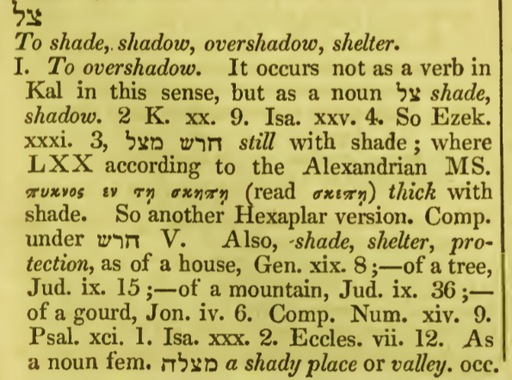
A Hebrew Lexicon by J Parkhurst (1773) צל.
Note: Parkhurst indicates clearly that this word can indicate a shadowing from a physical blockage of light.
But if we look closely (in the blue box) we do not see any clue of Nehemiah’s documentation there.
But what about the next part
of his writings?
13

Slide 14
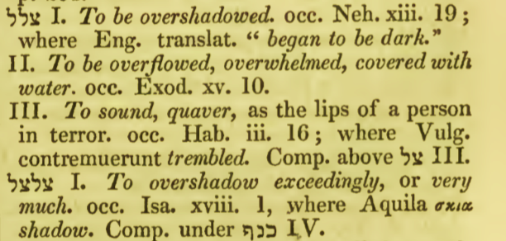

A Hebrew Lexicon by J Parkhurst (1773) צל.
Note: Parkhurst indicates clearly that in Nehemiah’s application, the darkness was not derived from a physical obstruction to the sunlight.
Instead Parkhurst declares the darkness of Nehemiah 13:19 as an all enveloping darkness. Nehemiah’s recorded darkness derived from the absence of direct sunlight. The orb of the sun was no longer visible in the area!
There was no physical obstruction
to the direct sunlight.
The direct sunlight just did not exist
at this point in time of
Nehemiah’s recording.
14

Slide 15
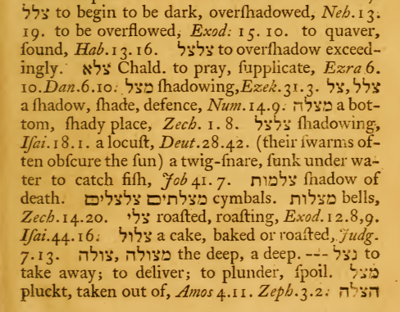
A Hebrew Lexicon
by W H Barker (1763) pg. 169.
Once again we see the thought pattern of an overall darkening effect – “overflowed.”
It was darkness produced by
an absence of direct sunlight.
As with J. Parkhurst,
W. H. Barker also gives Scriptural examples of shadows produced
through physical obstruction
to direct sunlight.
However Nehemiah’s documentation does not fit this category.
An overshadowing indicates a complete covering of darkness, not interspersed shadows stretching out.
15

Slide 16
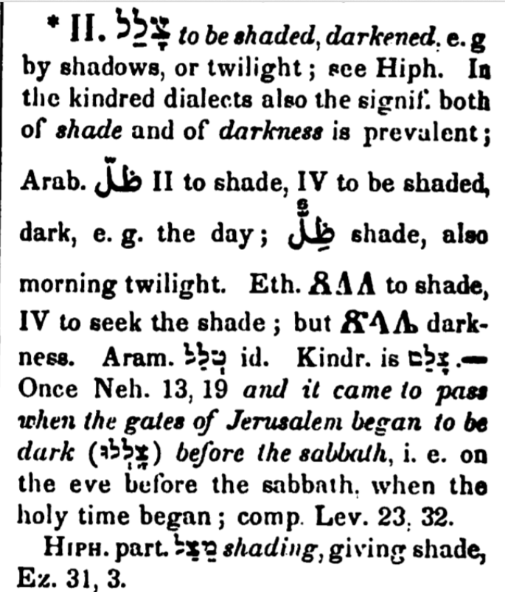
A Hebrew Lexicon
by Gesenius
pg. 913
Note how Gesenius acknowledges the shadow definition, and then continues on to describe the condition as it is written in Nehemiah 13:19.
But then note the traditional contamination in the reference
to Lev 23:32!
16

Slide 17

The צל ל וֹ -- H6751 - <tsalal> {translated as - “getting dark” in the only other Scripture where this word is used} – as in – Ezekiel 31:3 is in relation to the shadows cast from a large cedar tree consisting of a lesser quantity of light.
Eze 31:3 See, Ashshur was a cedar in Leḇanon, fair branches and forest
shade, and of high stature. And its top was among the thick foliage.
In this term – forest shade – we see the Hebrew word צל ל וֹ -- H6751 - <tsalal>.
Here, the context marks the substantially mature cedar boughs which provided a physical restraint to the sunlight reaching the ground area.
17

Slide 18
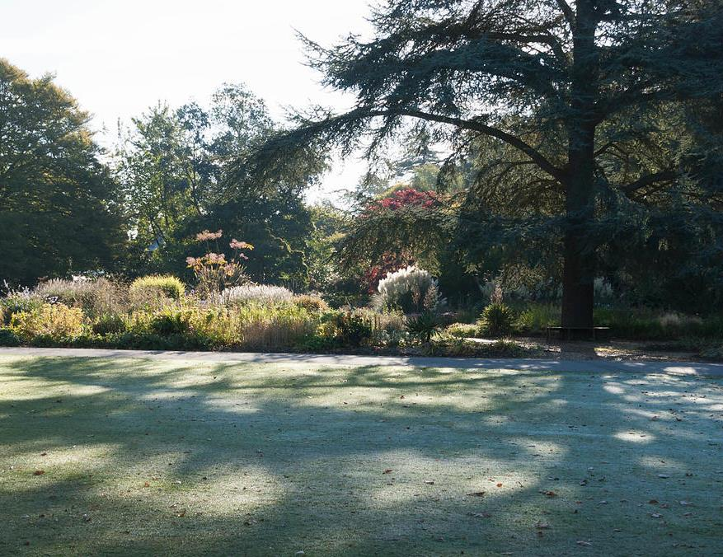
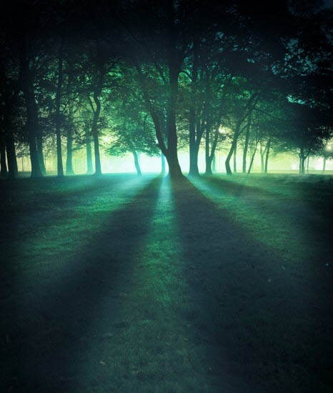
In the situation of the boughs physically restricting the light of the sun, this restriction caused a dim light mixture. The cedar boughs caused a partial absence of light; hence a reduced light quotient was produced from a physical restriction imposed upon DIRECT SUNLIGHT.
In these pictures we recognize the 3rd definition of the word -
צל ל וֹ -- H6751 - <tsalal>
to be or become or grow dark
(Qal) to become or grow dark
                (Hiphil) to shadow
18

Slide 19
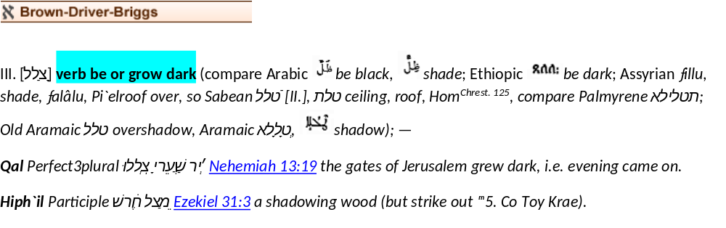
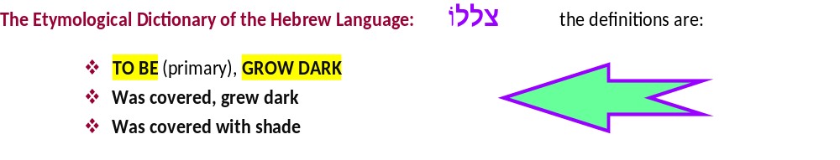
19

Slide 20
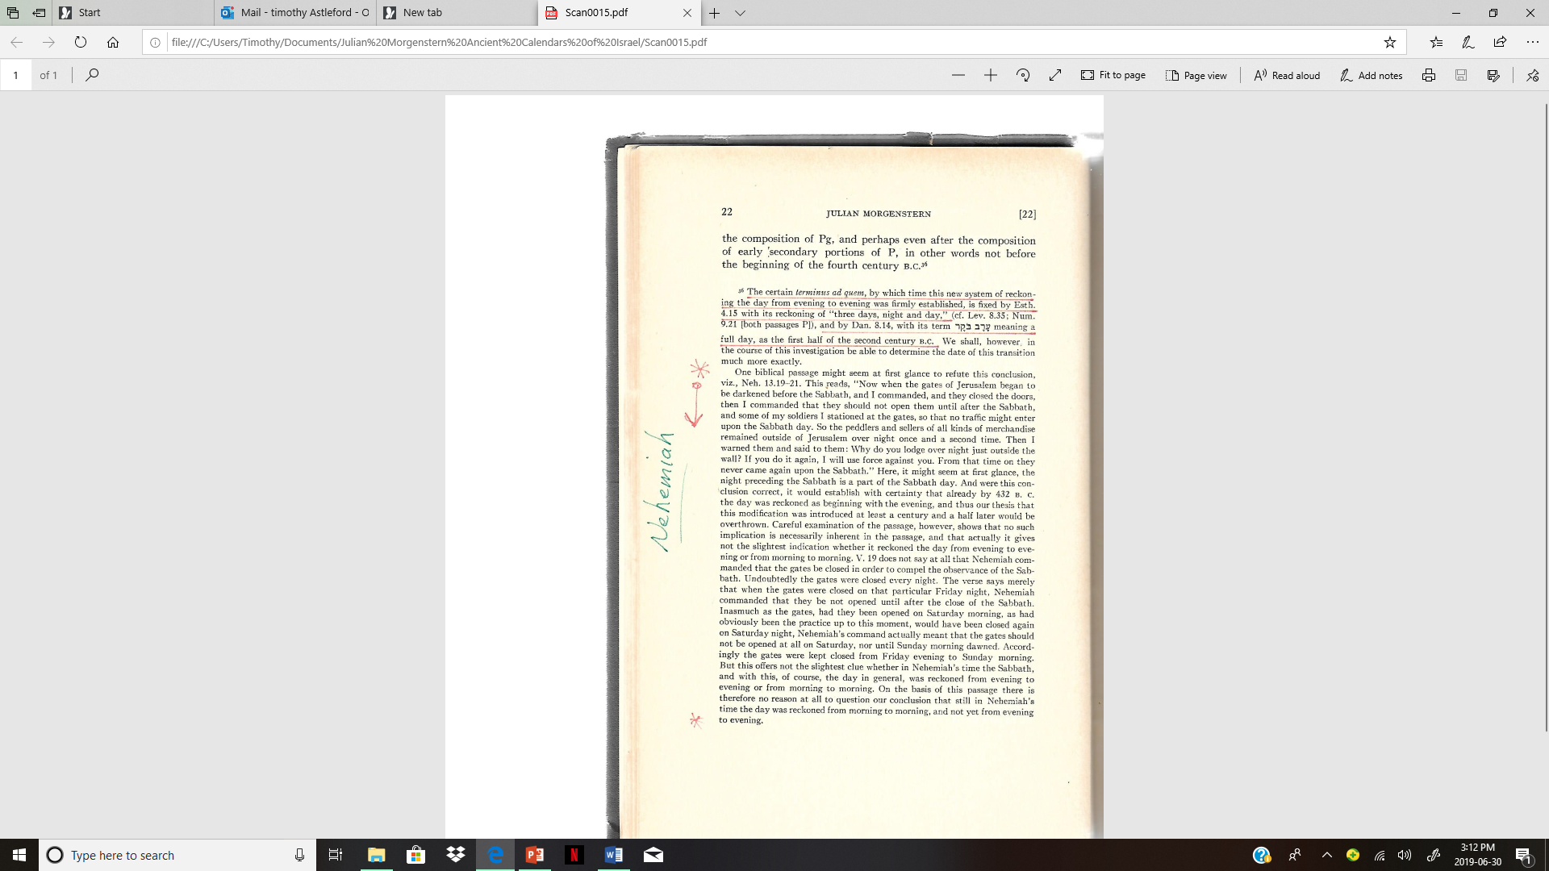
Julian Morgenstern’s thoughts about Nehemiah 13:19 are
as follows –
(pg. 22, Ancient Calendars of Israel, Hebrew Union College, 1935)
Con’t …
20

Slide 21
Morgenstern continues:
21

Slide 22

Please note that Covenant Calendar does not fully agree
with the conclusion as given by Julian Morgenstern.
It is very clear this passage from the Scriptures indicates without doubt the start of the Sabbath begins at Dawn.
There will be a closer look at this in the upcoming charts.
There the details will be examined thoroughly for the implications of events at the moment darkness envelopes the land.
22

Slide 23
What about the root word?
The primitive root of this word is – H6749 <tsalal> and has the meaning of “being submerged.” To submerge is the action to envelope in a substance.
(Qal) to sink, be submerged BLB
Question: When the sun is low and the shadows are getting long, are we correct in saying that the shadows are submerging the land?
Submerging indicates a total coverage. Yet when the shadows from a sun [that is low on the horizon] are stretched out, it can hardly be said that the shadows are submerging the land!
23

Slide 24
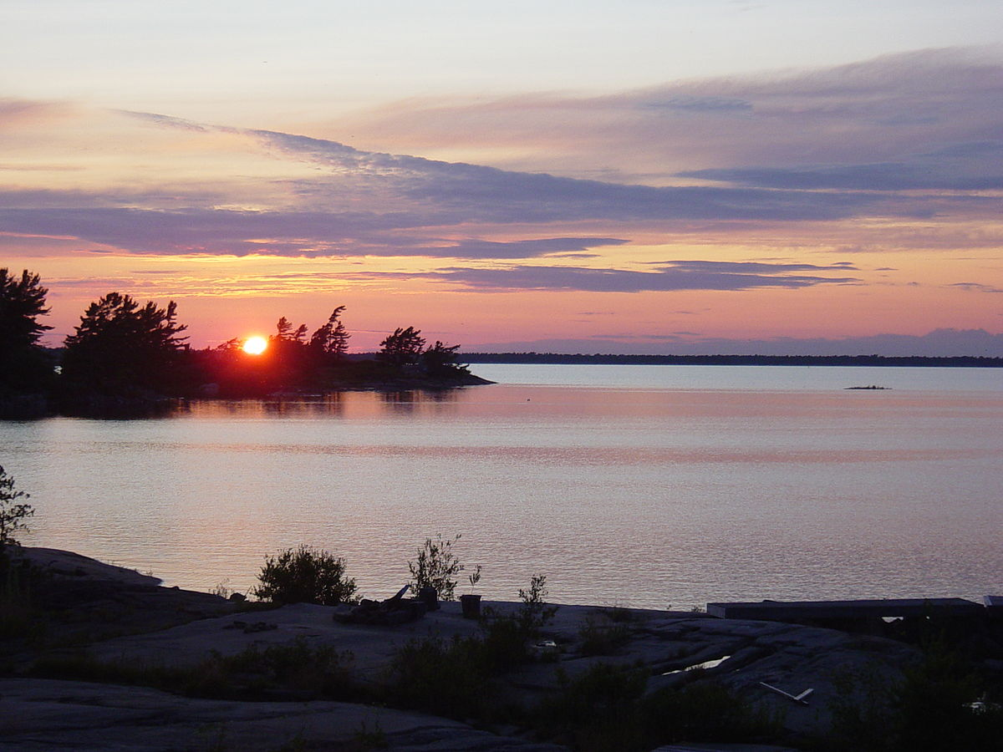
In this picture the sun is low on the horizon.
Are the shadows submerging the land?
24

Slide 25
This can only occur when the sun is beyond the visible horizon.
EDHL pg. 548
צל ל -- <tsalal>
To sink, plunge; to settle, to clear,
Qal) To be or grow dark , was covered with shade, grew dark,
(in the Bible occurring only in Neh 13:19 in the form of צל ל וֹ ).
Hiph) covered with shade, overshadowed
(in the Bible occurring only in Eze 31:3 in the form of the part).
צל ל -- <tsalal>
A physical obstruction to sunlight!
25

Slide 26
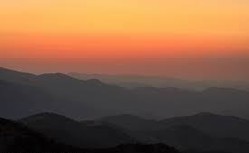
The sun is beyond the horizon.
Are the shadows submerging the land now?
26

Slide 27
The questions now will be:
What does this event with Nehemiah look like on a time chart?
Where was the sun’s position in relation to the gates of Jerusalem?
When is the Sabbath in relation to the darkness that is settling on Jerusalem?
Ultimately:
Did Nehemiah command the gates to be closed BEFORE or AFTER SUNSET?
Was Nehemiah’s command to close the gates considered:
(a) “guarding the Sabbath” OR
(b) BREAKING THE 4TH COMMANDMENT?
?
27

Slide 28
Chart #1 of 4. Nehemiah’s Command to Close the Gate – When?
Close the Gate (Sunset Theory!)
It was the Preparation; before the Sabbath.
The sunset event occurred and the twilight began. Had darkness instantly settled over the land?
Can darkness possibly come before the sunset?
The Twilight Mixture enveloped the surrounding area and darkness was imminent.
Light Season, Cycle #6 | Sabbath Night, Cycle #7 (?)
The next slide will have some
new questions. Please remember this side of the slide.
The Twilight Mixture was fulfilled and the Sabbath Darkness (?) began here, WELL AFTER THE SUNSET!
28

Slide 29
Chart #2 of 4. Nehemiah’s Command to Close the Gate – When?
Close the Gate (Sunset Theory!)
Did Nehemiah command the gates to be closed prior to the sunset, CONTRARY TO WHAT THE SCRIPTURES DECLARE; to avoid breaking the {Sunset} Sabbath statute?
The sunset event commenced the “Sabbath twilight” at this point - according to traditional
Sunset Theory.
Twilight Mixture time
lapse until darkness.
“As it began to get DARK BEFORE the Sabbath”! ???
Light Season, Cycle #6 | Sabbath Night, Cycle #7 (?)
The Twilight Mixture was fulfilled and the Sabbath Darkness began! ???
What about -
29

Slide 30
Chart #3 of 4. Nehemiah’s Command to Close the Gate – When?
Close the Gate (Sunset Theory!)
At the end of the twilight, (when the darkness actually began), and in accordance to Scriptural documentation, did Nehemiah command the gates to be closed and consequently break the {Sunset} Sabbath statute which by tradition came
into effect at the moment
of sunset?
The sunset event commenced the “Sabbath twilight” - according to traditional Sunset Theory.
Twilight Mixture time
lapse until darkness.
Light Season, Cycle #6 | Sabbath Night, Cycle #7
The Twilight Mixture was fulfilled and the Sabbath Darkness began!
Traditional Sabbath begins at sunset!
30

Slide 31

If Nehemiah commanded the gates to be closed at darkness (after twilight as dusk encounters night), then did Nehemiah break the Sabbath which started at sunset, according to Sunset Theory?
Question #1
31

Slide 32
Question #2
Would Nehemiah, who is known for
re-establishing the Commands of Yahuah, intentionally break the Sabbath?
32

Slide 33

Question #3
Is there ANOTHER ANSWER that
will sufficiently fulfill the Torah;
fulfill Nehemiah’s documentation, AND -
ALSO ELIMINATE
THE CONTAMINATION?
33

Slide 34
Chart #4 of 4. Nehemiah’s Command to Close the Gate – When?
Dawn to Dawn Format!
It was the Preparation; before the Sabbath.
The Twilight Darkness Mixture enveloped the surrounding area.
Darkness was imminent.
The sunset event occurred,
& a twilight mixture began.
NOTE what NIGHT SEASON it was - STILL! The sunset had not changed the date, nor day!
The Preparation, Cycle #6 | Preparation Night, Cycle #6
Nehemiah commanded to close the gate as darkness fell, approx. 1o hours before the Sabbath began!
The Twilight Mixture was fulfilled; it was - Night & STILL,
BEFORE the Sabbath!
34

Slide 35

Question #4
Another question must be asked:
What was Nehemiah’s mindset on a full
working Light Season?
The answer is found in: Nehemiah 4:21 …
So we labored in the work and half of them held spears from the rising of the morning until the stars appeared. (KJV)
Stone Edition Tanach - from the rising of the dawn until the emergence
of the stars.
For the 6 working days of the week, Jerusalem’s gates were closed during dusk!
35

Slide 36

Some thoughts to ponder!
When the stars are appearing that is no longer DUSK, but the last part of twilight giving way
to night, or total darkness. The gates would then have been closed after everyone was INSIDE the gates and this certainly would have been
after sunset, and long into the evening.
This gives even more evidence that on the 6th Cycle (Fri) with the gates being shut earlier was indeed
an exception - Nehemiah had to get the traders OUT of the city to stop the buying and desecrating of the Sabbath - come Dawn!
36

Slide 37
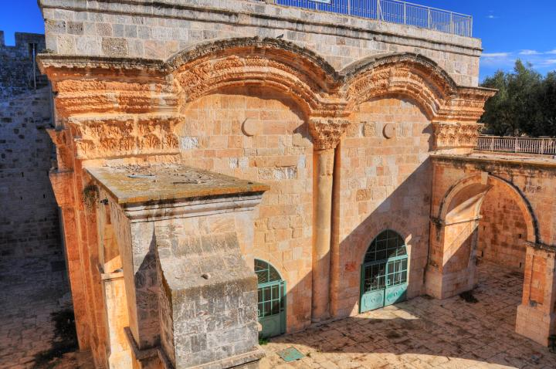
Question #5
Do we have any more information on the practice of when the gates were to be
closed in other parts of Scripture?
Yahoshua (Josh) 2:5 And it came to pass about the time of the shutting of the gate, when it was dark, that the men went out: whither the men went, I wot not, pursue after them quickly; for ye shall overtake them.
The practice in this time was to shut the gates of the city
when darkness had commenced.
Closing the gates offered
protection for the citizens.
37

Slide 38
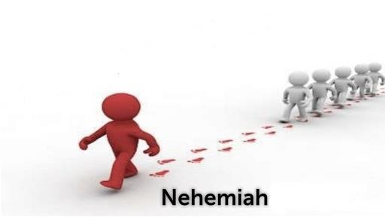
Be an Example ~
Follow Nehemiah’s
Footsteps
WHY?
13:19
38

Slide 39
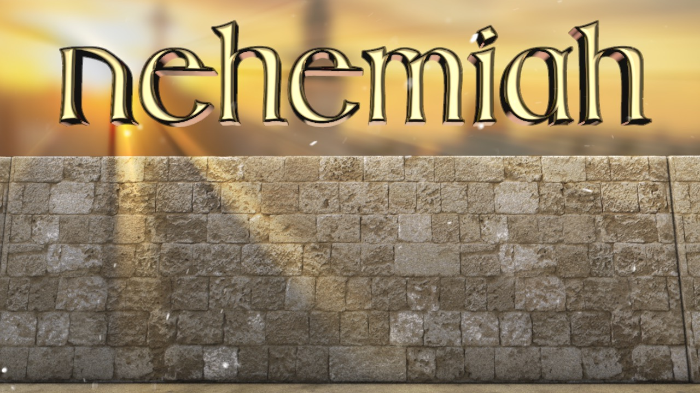
taught the people according to the Laws of Moses as
given by Yahuah.
That included the DAWN day-start!
39

Slide 40
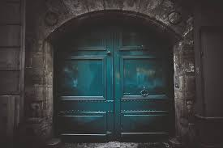
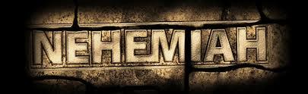
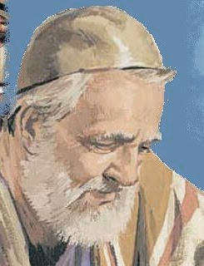
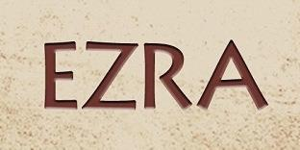
Neh 8:8-9 So they read in the book in the
law of Yahuah distinctly, and gave the sense, and caused them to understand the reading.
9 And Nehemiah … and Ezra the priest the scribe,
and the Levites that taught the people, said unto all
the people, This day is holy unto Yahuah your Elohim;
mourn not, nor weep. For all the people wept,
when they heard the words of the law.
Neh 8:14 And they found written in the law which Yahuah had commanded by Moses …
Neh 13:1 On that day they read in the book of Moses in the audience of the people …
The Laws of Moses are Supreme!
The End
40

Slide 41
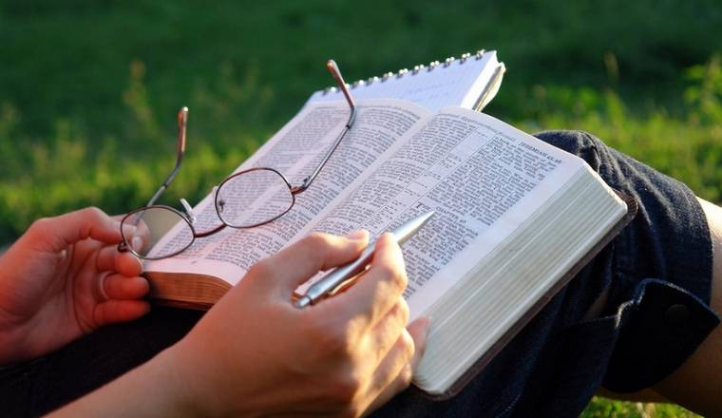

Your questions and comments are welcome.
Send them to:
Timothy Astleford or Charlene Fortsch
tim@studythecalendar.com
charlene@studythecalendar.com
41

Slide 42
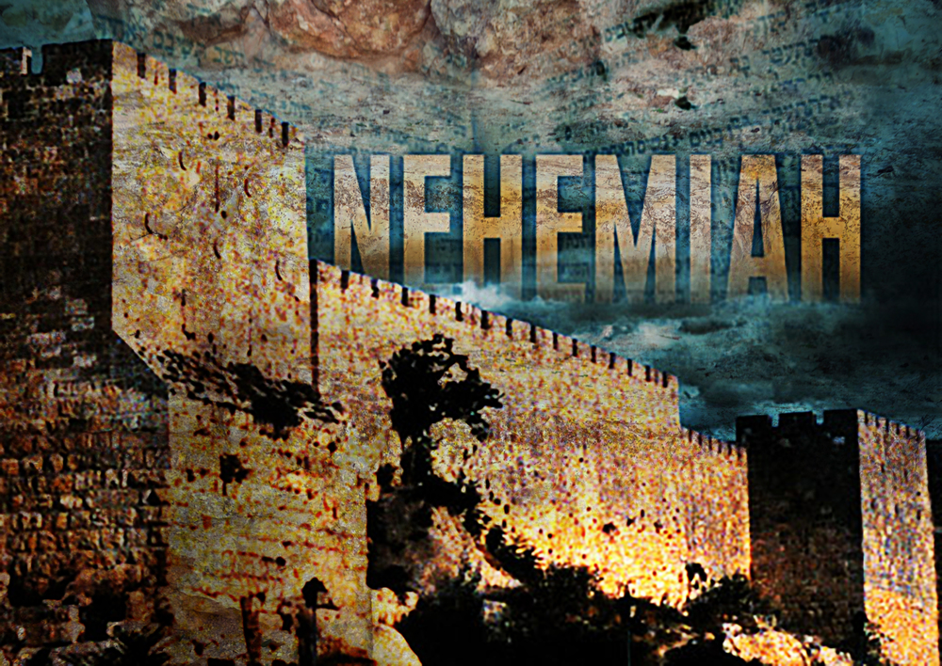
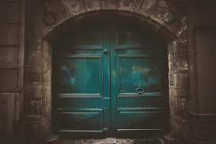
Covenant Calendar Club
Presents
Closes
12 July 2019
Before sunset?
or
After sunset?
the Gates!
Notes:
Emailed 1230 pm July 7/19

Slide 43
For several weeks now, at Covenant Calendar Club, we have been working on the term “evening” – a cornerstone word for the whole calendar study. Why? Because many have been taught that Gen 1:5, Lev 23:32 and John 20:1 all support the day-commencement as being at the moment of sunset which ushers in the “evening” of the day. Thorough studies have been completed on these three Scriptures revealing the truth of the DAWN day commencement..
Neh 13:19 is the 4th strongest text used to demand the Sabbath(s) begin at sunset when it begins to get dark. This week will unravel this “so-called” challenge to see if what we have been taught is actually so.
Now, Nehemiah is a very interesting character not only for who he was, but for the timeframe of this incredible witness. You see, this Old Testament witness is the last witness before this history closes. There is ample evidence that Nehemiah taught “calendar” according to the Laws of Moses in Torah. Did Nehemiah get something mixed up? Is he a credible witness for the day-start of Covenant Calendar or not? If you’ve been wondering about this, now is the time to “come and see” the truth of the matter on July 12/19 (the 24th day of the 4th month)!

Slide 44
Covenant Calendar Club
Presents
Closes
Before sunset?
or
After sunset?
the Gates!

