Slide 1


Secular Historical Quotes for the
Day Commencement in the Morning

Slide 2
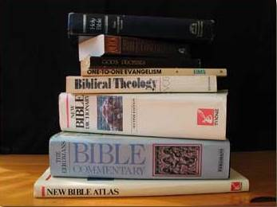
Secular Historical Quotes Regarding the Commencement of Yahuah’s days/Sabbaths
Color Code for Tim & readers
TIM
Stacy
Benedict
April
What do some well-known Commentators Understand
about the Morning Day-start?

Slide 3

INTRODUCTION
All emphasis has been supplied for the purpose of learning.
Note: Thus far the Scriptures have been thoroughly examined from which should come all understanding on Yahuah’s commencement of His day. It is always best to trust in the plethora of Scriptural evidence.
However for those that are interested in outside thoughts on how, when and why this change of the order of the day came about,
please read the following with caution, as it is difficult to truly document the validity of any of these writings. It is interesting that although these comments come from a wide variety of commentators who may not agree on many points of doctrine, they do agree that the Scriptural day begins at first light in the morning. Even though hundreds of pages from commentaries could be supplied from either viewpoint – each one would have to be tested by the Scriptures and not man's tradition, Talmud or any other historical source.
Caution: Many commentators use the term “sunrise” rather than morning twilight – which is constantly an ever confusing issue.

Slide 4

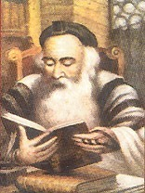
Rabbinical Commentaries
Shmuel ben Meir (c.1085 - c.1158), also known as Rashbam learned from his grandfather Rashi. Rashbam was a biblical commentator and Talmudist with his commentary on the Torah renowned for its stress on the plain meaning (peshat) of the text.
Rashbam's Genesis (commentary on Genesis 1:1-2:3)
To remind the Jewish people of the reason for the observance of the Shabbat as described in the Ten Commandments, Moses told the story of creation: At the time when the upper heavens and the earth had already been created, a long or a short time before the acts related in Genesis,

Slide 5
2. the earth as we know it was completely empty, for water covered it up to the upper heavens. Darkness that was not night was over the depths, and there was no light in the heavens. A wind blew across the waters.
3. Elohim said, "Let there be light" to correct the lack of light, and there was light.
4. Elohim looked at the light and saw that it was beautiful.
Elohim divided the light into a unit of twelve hours and the darkness into a unit of twelve hours.
5. Elohim named the newly-formed unit of twelve hours of light "day" and the newly-formed unit of twelve hours of darkness "night," and they have been so called ever since, day always preceding night. Daylight turned to evening as its light faded; then, morning broke as the morning star signaled the end of night. The first of the six days of creation referred to in the Ten Commandments was, thus, completed and the second day began.

Slide 6
6. Elohim said, "Let there be an expanse in the middle of the waters which reach from the surface of the earth up to the upper heavens to divide the waters in half."
7. Elohim made the expanse and divided the waters below the expanse from the waters above the expanse; and it has been so ever since.
8. Elohim named the expanse "heaven" and it has been so called ever since. Daylight turned to evening as its light faded; then, morning broke as the morning star signaled the end of night. The second of the six days of creation referred to in the Ten Commandments was, thus, completed and the third day began.
9. Elohim said, "Let the wind which is destined to split the Reed Sea cause the waters which are below the heaven to gather together to one place. And let the earth, which had been created together with the heavens on, or before, the first day yet before the light but had been hidden under the water, appear"; and it has been so ever since.

Slide 7
10. Elohim named the dry land "earth" and the gathered waters Elohim named "seas," and they have been so called ever since. Elohim looked at the dry land and the seas and saw that they were beautiful.
11. Elohim said, "Let the earth grow plant life, each type of plant reproducing with its own seed, and fruit trees which make their own fruits and which contain seeds of their own kind from which to grow other trees"; and it has been so ever since.
12. The earth brought forth plant life, plants with seed according to their kinds, and trees which have fruit which contain their seeds according to their kinds. Elohim looked at the plant life and saw that it was beautiful.
13. Daylight turned to evening as its light faded; then, morning broke as the morning star signaled the end of night. The third of the six days of creation referred to in the Ten Commandments was, thus, completed and the fourth day began.

Slide 8
14. Elohim said, "Let there be bodies of light in the expanse which is below the upper heavens to signal the actual division of day from night, which is sunset and the appearance of the stars, and night from day, which is sunrise. Let them also be used to indicate miraculous signs, to calculate the holidays and the calendar, to mark the beginning and end of day and night, and to delineate the four seasons of the year.
15. Let them also be bodies of light in the expanse which is below the upper heavens to be a source of light for the earth"; and it has been so ever since.
16. Elohim made the two large bodies of light, the larger to rule the day and the smaller to rule the night together with the stars.
17. Elohim put them in the heaven which is below the upper heavens to give light to the earth,

Slide 9
18. to rule during the day and the night, and to signal the beginning of day with the rising of the sun and the beginning of night with the setting of the sun and the appearance of the stars. Elohim looked at the heavenly bodies and saw that they were beautiful.
19. Daylight turned to evening as its light faded; then, morning broke as the morning star signaled the end of night. The fourth of the six days of creation referred to in
the Ten Commandments was, thus, completed and the
fifth day began.
20. Elohim said, "Let the waters swarm with crawling living beings and let the birds, whose origin is in the water but whose growth takes place on land, fly above the earth, across the expanse which is below the upper heavens."

Slide 10
21. Elohim created the great water animals mentioned in the prophets and Job -- Leviathan, the Straight Snake, and the Crooked Snake -- and all the creeping animals which the water had swarmed, each according to its kind, as well as the birds, each according to its kind. Elohim looked at the water animals and the birds and saw that they were beautiful.
22. Elohim blessed them, as Elohim blessed all animals, saying, "Be fruitful and multiply. Fill the water in the seas and let the birds multiply on the land."
23. Daylight turned to evening as its light faded; then, morning broke as the morning star signaled the end of night. The fifth of the six days of creation referred to in the Ten Commandments was, thus, completed and the sixth day began.

Slide 11
24. Elohim said, "Let the earth bring forth living beings according to their kinds -- domestic animals, creeping things, and wild animals, each according to its kind"; and it has been so ever since.
25. Elohim made the wild animals of the land according to their kinds, the domesticated animals according to their kinds, and the creeping things of the land according to their kinds. Elohim looked at the land animals and saw that they were beautiful.
26. Elohim addressed the angels whose creation, together with that of hell and the heavenly chariot, was not described, for Moses wanted to speak only of matters of this world at the giving of the Ten Commandments. Elohim said, "Let us make humanity in our angelic image, like us in wisdom. The humans shall rule the fish of the sea, the birds of the heaven, the domestic animals, and all the earth, as well as the creeping things which creep over the earth."

Slide 12
27. Elohim created humanity in the angelic image; in the image of the angels, Elohim created humanity; Elohim included the woman in the man and separated them later.
28. Elohim blessed them and Elohim said to them, "Be fruitful and multiply. Fill the earth and conquer it. Rule over the fish of the sea, the birds of the heaven, and over all creeping animals of the earth."
29. Elohim said, "I give you all seed-bearing plants which are on the earth, and all trees that have seed-bearing fruits shall be food for you
30. and for all the wild animals of the earth, and for all the birds of the heaven, and for all the creeping things which are alive -- all green plants as food"; and it was so, until the flood of Noah.

Slide 13
31. Elohim looked at each of Elohim's works and actions to see if there was something that needed correction but Elohim saw that they were all beautiful and proper. Daylight turned to evening as its light faded; then, morning broke as the morning star signaled the end of night.
The sixth of the six days of creation referred to in the Ten Commandments was, thus, completed and the seventh day began.
1. The heavens and the earth, and all that was created with them, were finished.
2. On the seventh day, Elohim finished the work Elohim had done. Elohim rested on the seventh day from all the work which Elohim had done.

Slide 14
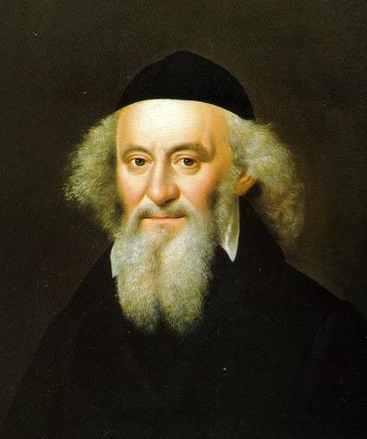
3. The Shabbat was blessed with all goodness because Elohim had provided for the needs and sustenance of all Elohim's creatures. Elohim sanctified the seventh day because,
on it, Elohim rested from all the work which
Elohim had created and done.
CONCLUSION:
Rashbam is, thus, of the
opinion that the day begins
and ends in the morning.
This is over 860 years ago!

Slide 15

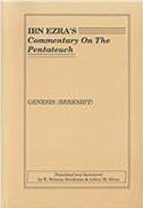
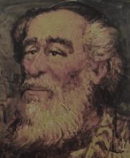
Ibn Ezra's Comments on Genesis
1:5. By naming the light "day" and the darkness "night."
The diurnal sphere revolved once, day blended into evening and night blended into dawn, day one.
1:31. Elohim understood that all that Elohim had created was very good. The diurnal sphere revolved once, day blended into evening and night blended into dawn, the sixth day from day one.
[9] The days of creation thus begin and end at daybreak, not at evening.
[10] At the end of the day, there was an evening and then a morning, day one.

Slide 16

Who Is Ibn Ezra?
(1092-1176 AD)
Ibn Ezra occupies a unique role among medieval commentators in that his commentary has been cited by mainstream Orthodoxy, but his works exhibit a reluctance to reconcile Biblical passages through midrashic exegesis. Thus, in his commentary Ibn Ezra adhered to
the literal sense of the texts, avoiding Rabbinic allegory and Kabbalistic interpretation.
Indeed, Ibn Ezra is claimed by proponents
of the higher biblical criticism of the Torah
as one of its earliest pioneers.
Over 840 years ago Ibn Ezra tried to restore Creation’s
day-start!

Slide 17

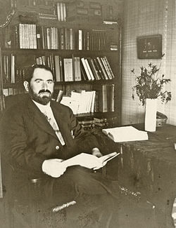
RABBINICAL ESSAYS
BY JACOB Z. LAUTERBACH
HEBREW UNION COLLEGE PRESS, CINCINNAT, 1951. pp. 446 - 451 [with notes]
Before we proceed to describe the ceremonies of the entrance of the Sabbath we must ascertain the exact time of her appearance, that is, at what time of the day the arrival of the Princess Sabbath was expected.
This will help us to understand better certain features in the arrangements for welcoming her. As the Sabbath is the seventh day of the week and extends over one whole day, a brief discussion of the development of the Jewish system of reckoning the day is necessary to determine the time of the coming in and the going out of the Sabbath. There can be no doubt that in pre-exilic times the Israelites reckoned the day from morning to morning.

Slide 18
The day began with the dawn and closed with the end of the night following it, i.e, with the last moment before the dawn of the next morning. The very description of the extent of the day in the biblical account of creation as given in Gen 1:5 presupposes such a system of reckoning the day, for it says: "And it was evening and it was morning, one day." This passage was misunderstood by the Talmud, though significantly enough when the Tosefta cites in proof Esth. 4:16 where the order occurs, but does not cite the passage in Genesis or was reinterpreted to suit the later practice of a different system. But it was correctly interpreted by R. Samuel b. Meir (1100-1160) when he remarked, "It does not say that it was night time and it was day time which made one day; but it says
'it was evening,' which means that the period of the day time came to an end and the light disappeared. (con.t)

Slide 19
And when it says 'it was morning,' it means that the period of the night time came to an end and the morning dawned. Then one whole day was completed. There are many more indications in the Pentateuch pointing directly or indirectly to the mode of reckoning the day from morning to morning. To mention but a few such indications; when prescribing that a Thanksgiving offering must be consumed on the very same day on which the sacrifice is slaughtered, the Law states "on the same day it shall be eaten, ye shall leave none of it till the morning" [52] which directly indicates that the day comes to an end on the next morning. [53]
And when in special case, as e.g., in regard to the Day of Atonement, where the Law wishes to make the fasting on it stricter than on any other fast day so as to include also the preceding night, (con.t)

Slide 20
the Law specifically states that it should begin with part of
the preceding day and therefore expressly says:
"And ye shall afflict your souls in the ninth day of the month
at even, from even to even shall ye keep your Sabbath.”
This indirectly but unmistakably points to a mode of
reckoning the day from morning to morning. In post-exilic times, however, probably not later than the beginning of the Greek period, a change in the system of reckoning the day was made, and the day was reckoned as extending from
the preceding to the following evening. As might be expected, such a radical innovation was not immediately generally accepted. It took some time before it entirely supplanted the older system. In certain spheres of the population the older system continued to be in use, either exclusively or side by side with the newer system. (con’t)

Slide 21
Thus in the Temple service the older system continued all through the time of the existence of the second Temple, and there the day was reckoned from morning to morning, or as the Talmud [57] puts it [Hebrew quoted] "In sacrificial matters the night follows rather than precedes the day." [58] In some circles [59] or among some Jewish sects [60] the older system continued and the Sabbath was observed from Saturday morning to Sunday morning for those groups, as for the people of the time prior to the introduction of the new system, the night following the Sabbath and not the night preceding it formed part of the Sabbath, and the morning of Saturday -- not Friday evening -- marked the entrance of the Sabbath. (con’t)

Slide 22
But the majority of the people, following the teachings of the Halakah [61] reckoned the day from evening to evening and the entrance of the Sabbath for them came after the sunset of Friday or on Friday evening. All the arrangements for welcoming the Sabbath and the ceremonies connected with it were set for Friday evening.
NOTES ON THE ABOVE TEXT on pages 447 – 451.
[52] Lev. 22.30; see also Lev. 7.15.
[53] For further proofs see Morgenstern, loc, cit., to which I will add one point from the Passover legislation in Ex.12 which is not pointed out there. The law in Ex. 12 prescribes that the Paschal lamb be slaughtered on the fourteenth day of the month and eaten at the following night and that nothing be left till the next morning (verses 6-I0). (con’t)

Slide 23
The Rabbis of the Talmud who nowhere allude to and probably no longer knew of the earlier mode of reckoning the day felt the difficulty in the phrase: "Ye shall afflict your souls on the ninth day," and when commenting on it they say: "But are we to fast on the ninth day?" (Yoma 81b, R. H. 9a, b). A very sound objection indeed. For if the day had in Bible times been reckoned from evening to evening, as it was in Talmudic times, then the phrase: "In the ninth day of the month at evening" contains a contradiction in terms, for
the evening is already part of the tenth day. Besides the special injunction "from even unto even shall ye keep your Sabbath" would be entirely superfluous, for any other day also extends from evening to evening. (con’t)

Slide 24
And we are told that on the very same day, i.e., the fourteenth of the month God brought out the children of Israel from the land of Egypt (ibid., verse 5I ). And in verse 42 of the same chapter we read as follows: "It is a night of watching unto the Lord for bringing them out of Egypt.” Now then, if they came out at night that is, in the night following the fourteenth day, and it is said on the very same day, that is on the fourteenth day, they were brought out, it clearly indicates that the night following the fourteenth day is still part of that day.

Slide 25
The Talmudic explanation that the meaning of the passage: "Ye shall afflict your souls on the ninth day" is to say who eats on the ninth day performs a Jewish religious duty and it is accounted to him as if he had fasted both on the ninth and tenth days (ibid., loc. cit.) is, of course, a homiletical subterfuge. The fact is that the Rabbis of the Talmud no longer knew or would not acknowledge that in ancient times there was another mode of reckoning the day according to which the evening preceding the tenth day still belongs to the ninth day. In the case of the Day of Atonement the Law especially prescribes that the fast be observed in a new manner, covering part of the ninth and part of the tenth days.
[55] 'See also H. J. Bornstein in Ha Tekufah V1, 254 and 303 ff, and especially 313.

Slide 26
From Morgenstern, op.cit,. p. 179, note. Also "Three Calendars of Ancient Israel," in Hebrew Union College Annual X (Cincinnati, 1935); 146, note 236.
The fact that the Samaritans also reckon the day from evening to evening would not be any argument against the fixing of this period for the innovation. For, in the first place we do not know the exact date the Samaritans finally and absolutely separated from the Jews. Furthermore they may have accepted Jewish practices even after the separation, may independently of the Jews, have interpreted the passage in Lev. 23.32 "From even to even shall you keep your Sabbath" to apply to every Sabbath and Holiday and not only to the Day of Atonement.

Slide 27
In my paper referred to above (note 47) I expressed the idea, which was accepted by Morgenstern ("The Sources of the Creation Story" op. cit., p. 179, note) that the statement in the Talmud (b. Ber. 33a) that the men of the Great Synagogue instituted the ritual of Kiddush and Habdalah, also points to the time of the beginning of the Greek period for the innovation of the system of reckoning the day from evening to evening, since the ceremonies of Kiddush and Habdalah are now observed on Friday evening and Saturday night respectively.
(con’t)

Slide 28
I would, however; now qualify this idea somewhat to the extent we must understand the Talmudic statement to refer to the last generation of the men of the Great Synagogue, who lived after the beginning of the Greek period.
It is however, possible that the reference is to the earlier Men of the Great Synagogue yet this would not necessitate the fixing of the date for the innovation of the system in reckoning the day before the Greek period. For the Talmudic statement only says that
they instituted a ritual for consecrating the Sabbath at its entrance and for marking its distinction from the week days at its going out but does not say when the coming in and going out of the Sabbath at the time when these rituals were first introduced, took place. According to the Talmud (ibid., loc cit.) some changes as to when or where the ritual of the Habdalah should be recited were made even during the period of the Men of the Great Synagogue.
It is therefore not impossible that another change in the time for reciting these rituals also took place during the period of the Men of the Great Synagogue. (con’t)

Slide 29
When the older generation of that period first instituted these rituals they may have been recited at Sabbath morning and at Sunday morning respectively. Then, when the reckoning of the day was changed the times for reciting these rituals were correspondingly shifted to Friday and Saturday night respectively. (See below note 58.) Sabbath as the passage in Neh. 13:19-21 does not necessarily prove that already at the time of Nehemiah, the night preceding the Sabbath was part of the Sabbath as assumed by Bornstein (op. cit., p 305). See Morgenstern, "Three Calendars of Ancient Israel," op. cit., P 22, note 36.
[57] Hul. 83a.
[58] This simply means that in the sanctuary the conservative priests persistently held on to the older practice though in all other spheres of life it had been abolished or changed. The fact that in the Temple service the night followed the day is another support for the theory that the innovation was introduced in the period of the Men of the Great Synagogue (see note 56). (con’t)

Slide 30
For had it [sunset day] been introduced earlier in that period in the time of Ezra and Nehemiah, before the Temple was rebuilt and the sacrificial cult restored, it would have been introduced into the Temple service also. The Temple may have been slow in admitting changes in practices that were continuously observed but when the service was instituted anew and everything reorganized there would have been no reason to go back to a practice which had been observed in pre-exilic times, but discontinued for a time and changed. [59] According to the Talmud (p. Ned. 8.1 [40d]) even among the common people the older system continued and in the popular language [~Hebrew quoted~] the day included the following and not the preceding night.
See commentary [Hebrew] ad loc. and cf. also Bornstein, op. cit, P 311. (con’t)

Slide 31
Likewise the author of the Gospel according to Matthew has preserved the older system, for we read there 28.1 - "In the end of the Sabbath, as it began to dawn towards the first day of the week." So according to him the Sabbath extended towards the dawn of Sunday morning.
[60] Benjamin of Tudela (second half of the twelfth century) reports about
a certain Jewish sect on the island of Cyprus whose members observed the Sabbath from Saturday morning to Sunday morning, or as he puts it, who desecrated the night preceding but kept holy the night following the Sabbath day. See [Hebrew Quoted] L. Griinhut, I (Frankfurt a. M., 1904) p. 23. According to S. A, Poznanski in his introduction to Eliezer of Beaugency's commentary to Ezekiel and the twelve minor prophets" (Waraw, 1913), P 43. Ibn Ezra's attack in his [Hebrew] (Kerem Hemed V [Prague 1839], 115 ff.) was directed not against R. Samuel b. Meir and his interpretation of Gen. 1:5, but against those heretical sects who drew practical conclusions from this interpretation and observed the Sabbath from morning to morning. cf, also Bornstein, op cit., 304. (con’t)

Slide 32
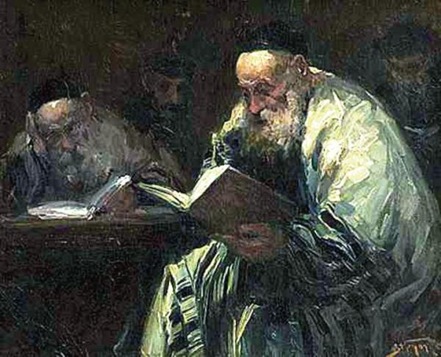
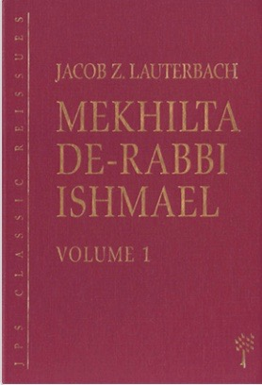
But even among those who followed the Halakah allusion to the continuance of the
older system and traces of an extension of
the Sabbath rest to the night following
Saturday are to be found.
Thus in commenting on the different expressions [Hebrew] used respectively in connection with the commandments about the Sabbath in the two versions of the Decalogue (Ex. 20:8 and Deut. 5:12) the Mekilta says: " 'Remember' and 'Observe.' Remember it before it comes and observe it after it has gone."
(Mekilta de R. Ishmael Bahodesh VII [ed. Lauterbach, II, 252.) (con’t)

Slide 33
LAUTERBACH’s Conclusion
How to remember the Sabbath before it comes is well illustrated there (ibid., P 253), but no illustration is given as to how the Sabbath is to be observed after it is gone. Instead of such an illustration there is added the remark about the conclusions which the teachers
drew from the interpretation of the word "observe" as meaning "observe it after it has gone.” This remark reads: [Hebrew quoted] hence the teachers said:
"We should always increase what is holy by
adding to it some of the non-holy."
But no illustration of the observance of
the Sabbath after it has gone is
given in the Mekilta.

Slide 34

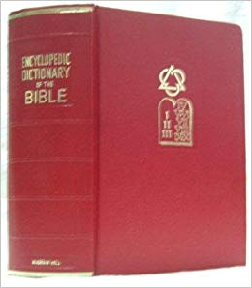
Encyclopedic Dictionary of the Bible, p. 497.
"...The night time is considered as belonging to the preceding period of daylight. From this there developed the meaning of "day" in the sense of the cycle made up of one period of daylight and one period of darkness,
or according to our modern reckoning, twenty-four hours ... from the natural viewpoint the twenty-four hour day begins at sunrise ... however, beside this conception there arose another idea of the twenty-four hour day, according to which this daily period began at sunset.
It was no doubt the lunar calendar of the Jews which gave rise to this viewpoint ... although the earlier computation did not die out completely, the custom
of considering the day as beginning at sunset became general in later Jewish times ..."

Slide 35

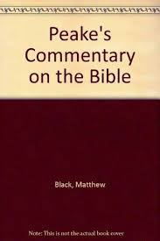

Peake's Commentary on the Bible, p. 136.
"...To the Light He gives the name Day,
to the Darkness the name Night...
Thus the work of the first day, reckoned probably from morning to morning, is accomplished. The period of Light is followed by Evening and Darkness,
which comes to an end with the next morning when the second day begins..."

Slide 36

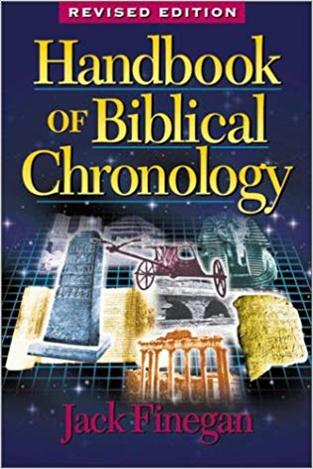
The Handbook of Biblical Chronology, Jack Finegan, pp. 7-8.
"In the Old Testament the earlier practice seems to have been to consider that the day began in the morning. In Gen. 19:34, for example, the "morrow" (ASV) or "Next Day" (RSV) clearly begins with the morning after the preceding night..."

Slide 37

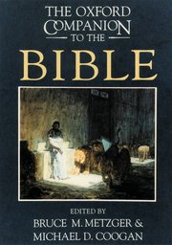
Oxford Companion to the Bible p. 744
"...In earlier traditions a day apparently began at sunrise (e.g., Lev. 7:15-17; Judg. 19:4-19)... later its beginning was at sunset and its end at the following sunset...this system became normative...and is still observed in Jewish tradition, where for example,
the sabbath begins on Friday evening at sunset and ends Saturday at sunset..."

Slide 38

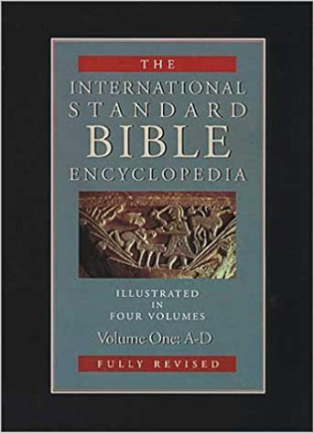
International Standard
Bible Encyclopedia
  "That the custom of reckoning the day as beginning in the evening and lasting until the following evening was probably of late origin is shown by the phrase "tarry all night" (Jdg 19:6-9); the context shows that the day is regarded as beginning in the morning; in the evening the day "declined," and until the new day (morning) arrived it was necessary to "tarry all night" (compare also Num 11:32).

Slide 39


The Itinerary of R. Benjamin of Tudela, ix, 5-8, ed. Gruhut-Adler, (1904), p. 23.
"...It is also interesting that according to the Karaite historian Al-QirqisanI (ca. 975 CE), the dissident Meswi al-Okbari (ca. 850 CE) broke from traditional Rabbinical Judaism in an attempt to get back to the original religion and began the reckoning of the day from sunrise.
Handbook of Chronology,
op.cit., p. 8.
"Among the Greeks the day was reckoned
from sunset to sunset..."

Slide 40

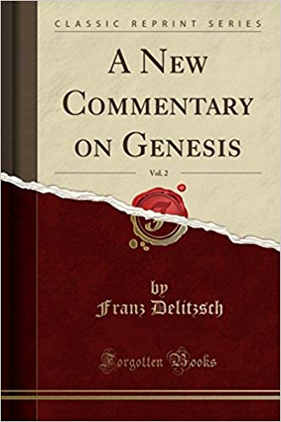
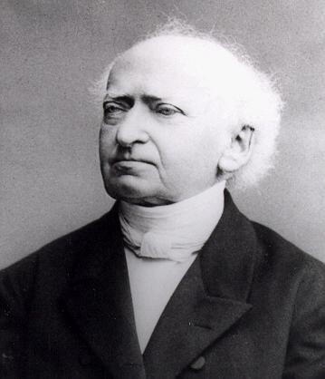
Delitzsch in Dillmann's
Commentary on Gen 1:5
"Among the ancient Israelites, as among the Greeks, the day was reckoned from sunset to sunset.
This was the custom also of the Gauls and ancient Germans, and was probably connected originally with
the cult of the moon. There is, however, evidence that this was not the custom at all times..."

Slide 41
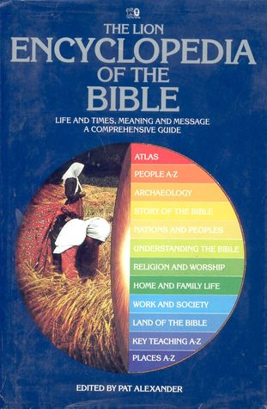
The Lion Encyclopedia of the Bible p. 163
"...Early in the old testament period, when Canaan was under Egypt's influence, the day started at sunrise... later, perhaps under Babylonian influence, the calendar seems to have changed. The day began at moonrise (1800 hrs) and a whole day became an evening and a morning..."

Slide 42

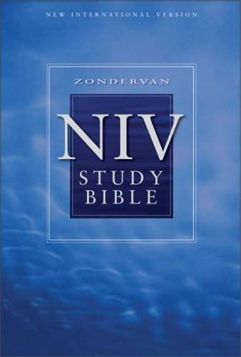
NIV Study Bible p. 707
"...The Israelites, like the Babylonians, counted their days from sunset
to sunset..."

Slide 43
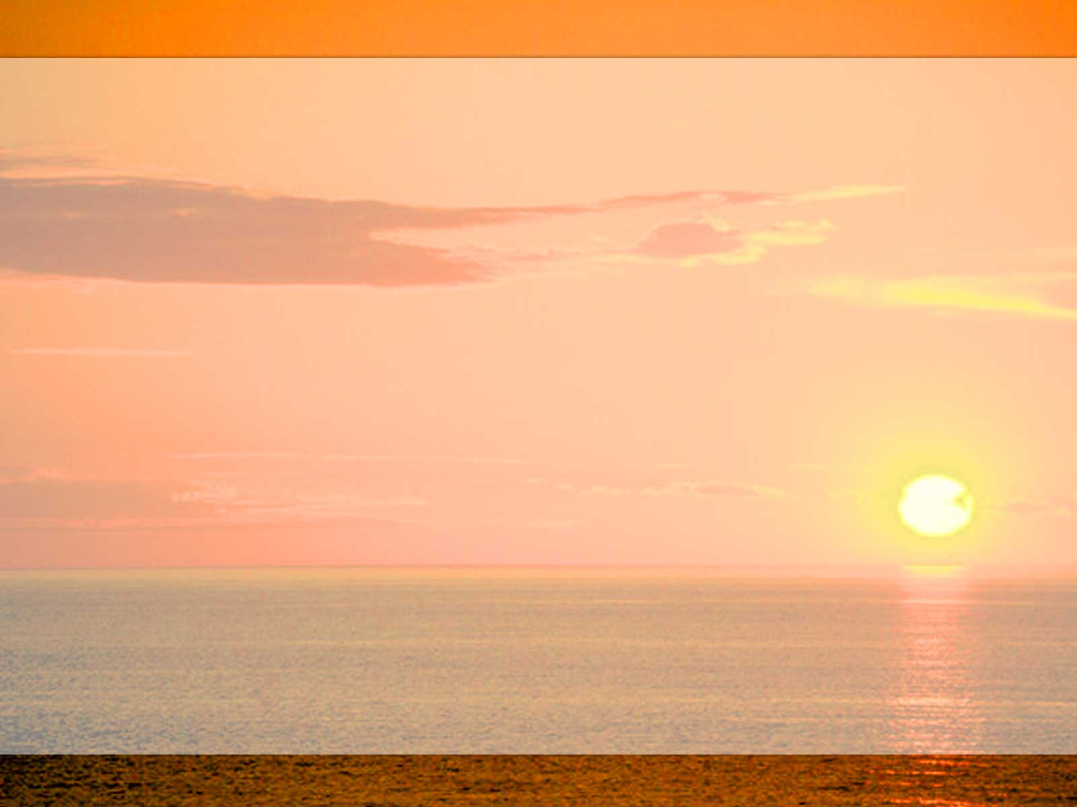
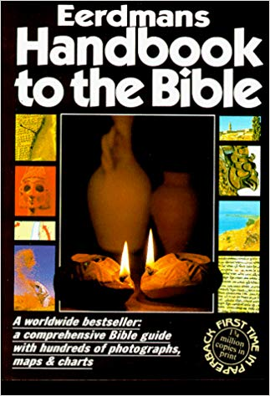
Eerdman's Handbook to the Bible
“We know little about the old Israelite calendar, apart from the laws of the festivals. But the Mishnah (the collection of Jewish law made at
the end of the 2nd century AD) fully describes the system which the Jews had worked out under Babylonian influence...”

Slide 44

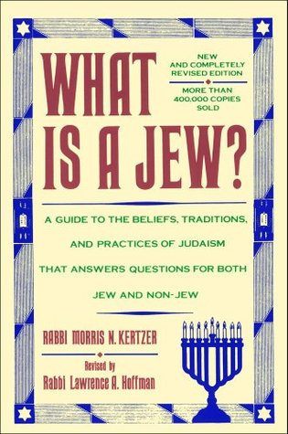
What is a Jew?
Rabbi Morris N Kertzer p. 108
"When the Jews returned to Palestine after their Babylonian exile (516 B.C.E.) they brought back with them the Babylonian astronomy and way of reckoning time…"

Slide 45

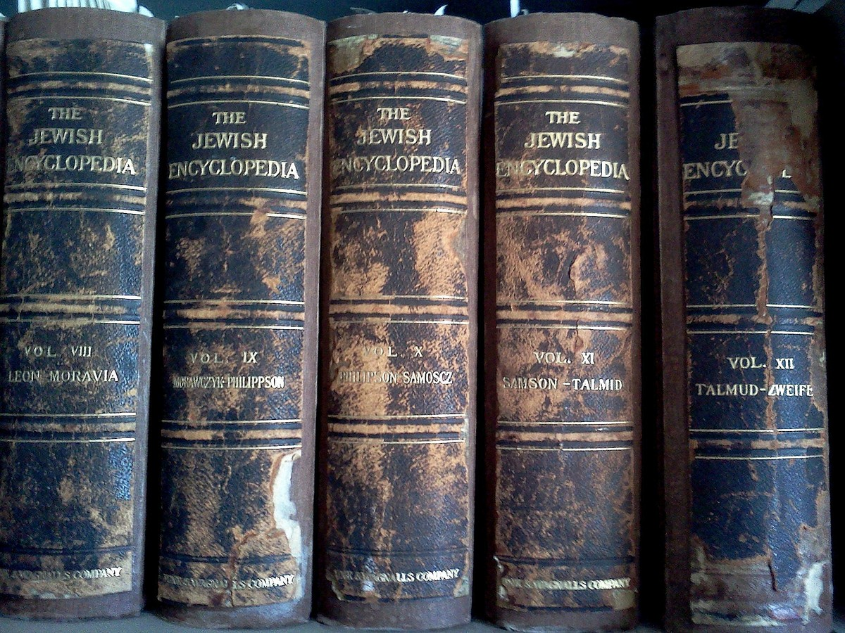
Jewish Encyclopedia p. 591-597
"In order to fix the beginning and ending of the Sabbath-day and festivals and to determine the precise hour for certain religious observances it becomes necessary to know the exact times of the rising and setting
of the sun. According to the strict interpretation of the Mosaic law,
every day begins with sunrise and ends with sunset...

Slide 46

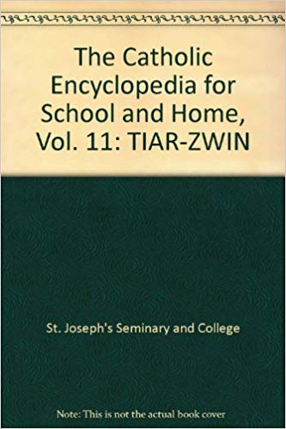
New Catholic Encyclopedia
Volume 11, p. 1068
"Days were reckoned from morning to morning... Following the reign of King Josia
(c. 640-609), and especially after the Babylonian exile a number of significant and enduring changes occurred in the Israelite calendar showing that the Jews gradually adopted the Babylonian calendar of the time...the seven day week persisted despite its failure to divide evenly either the month or the year. The day however, was counted from evening to evening, after the Babylonian fashion..."

Slide 47

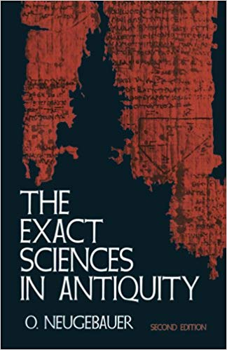
Exact Sciences in Antiquity
O. Neugbauer, p. 106
"So far as we know, the Babylonian calendar was at all periods truly lunar ... the month began with the evening when the new crescent was for the first time again visible shortly after sunset. Consequently, the Babylonian day
also begins in the evening ..."

Slide 48

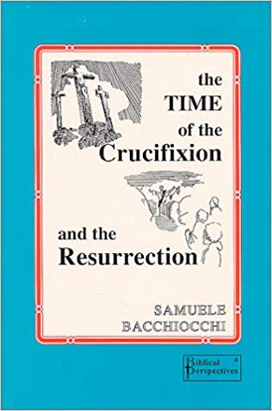
The Time of the Crucifixion and the Resurrection,
Samuele Bacchiocchi, Ch 5
"...Numerous scholars have argued for the existence in Bible times of a sunrise method of day reckoning...the evidence for the sunrise reckoning is significant and cannot be ignored..."

Slide 49
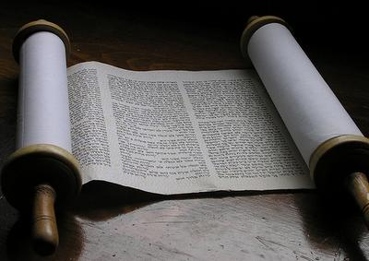
Commentary on the Old Testament
The First Book of Moses, p. 51.
"The first evening was not the gloom, which possibly preceded the full burst of light as it came forth from the primary darkness, and intervened between the darkness and full broad daylight. It was not till after the light had been created, and the separation of the light from the darkness had taken place, that evening came … It follows from this, that the days of creation are not reckoned from evening to evening, but from morning to morning..."

Slide 50

The Sources of the Creation Story
Gen 1:1- 2:4, pp. 169-212.
"In early Jewish practice,... it seems to have been customary to reckon the day from sunrise to sunrise, or, rather, from dawn to dawn. Thus the law for the "praise-offering" (Lev. 7:17 (pt) specifies that this sacrifice must be eaten on the day upon which it is offered, and that nothing may be left until morning. The repetition of the law in Lev. 22:30... is even more explicit: "On that very day (when it was sacrificed) it shall
be eaten; ye shall not leave anything of it until morning.” Clearly the next morning is here reckoned as belonging
to the next day, and not the same day as the preceding evening and night. In other words, the day is reckoned
here from sunrise to sunrise... (con’t)

Slide 51
“Likewise in Exod. 16:19f...the manna was given to the people in the morning, just at dawn and before the sun had become warm (16:21).
It was to be eaten only on the day upon which it was gathered; nothing was to remain over until the next morning; that which did so became foul. Here, too, the day seems to have been reckoned from dawn to dawn...
From Matt. 28:1 it may be inferred that the practice of reckoning the day from sunset to sunset was not universal in Israel, but in certain circles the older practice continued for several centuries...It is manifest that the day is still reckoned here from dawn to dawn. This is also the implication of the parallel passage, Mark 16:1f...Luke 23:56b-24:1 seems to imply the same... (con’t)

Slide 52
“Finally, it is significant that in the second Temple, throughout its entire existence, the practice seems to have been in all ritual matters to reckon the day from dawn to dawn, and not according to the later practice, from sunset to sunset...even the rabbis, who, themselves, reckoned
the day from sunset to sunset, and refused to admit the legitimacy of any other practice, or rather, absolutely ignored all divergent practice, none the less had to admit the validity of the interpretation of Lev. 7:15...the day was
at one time reckoned from sunrise to sunrise... [dawn]
The earlier practice, which continued until the time of the secondary strata of the Priestly code, was to reckon the day from dawn to dawn...
The later practice was to reckon the day from sunset to sunset... (con’t)

Slide 53
“It is impossible to tell exactly when this change in the mode of reckoning the day took place in Israel, and
what causes brought it about. Possibly it may have had something to do with the introduction of the lunar calendar instead of the solar, for the lunar calendar naturally presupposes a reckoning of the day from nightfall to nightfall...
It was probably coincident with the revision of the festival calendar, which took place in the period after the time of Ezra, and was, in all probability, the work of the soferim or of the Great Synod in the fourth century B.C. This may also be inferred from the statement in the Talmud (Berachoth 33a) that the men of the Great Synod instituted the ceremonies of Kiddush and Havdalah, the solemn sanctification of the Sabbath on Friday eve, and
its equally solemn ushering out on Saturday eve, in other words, … (con’t)

Slide 54
“… ceremonies specifically marking the beginning and close of the Sabbath as at sunset.
These were ceremonies for the Jewish home instead of the Temple. This, coupled with the fact that in the second Temple the old system of reckoning the day from dawn to dawn continued to be observed, as we have seen, may perhaps indicate that this entire innovation was the work of an anti-priestly group or party in the Great Synod ..."

Slide 55

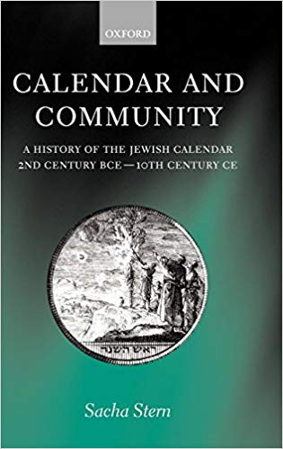
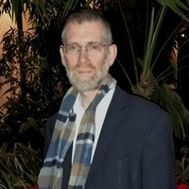
Calendar and Community by Sacha Stern,
A History of the Jewish Calendar
2nd Century BCE to 10th Century CE
  Note: Loosing the truth of the DAWN day is largely due to the fact
  that the Jewish people exchanged the Solar Calendar for the pagan Lunar Calendar. In Sacha Stern’s book, Calendar and Community,
  he describes an historical approach to the evolution of the Jewish calendar over the course of about 1100 years. This was when
  the calculated luni-solar Jewish calendar (that is in use today)
  was definitely established.
Who is Sacha Stern?
Sacha Stern is Professor of Rabbinic Judaism and Head of Department at
the UCL [Univ. College London] Department of Hebrew and Jewish Studies. He holds many degrees in a variety of studies. He has also studied in Yeshivot in Israel. Before joining UCL [Univ. College London] in 2005, he was Lecturer in Jewish Studies at Jews' College, London and then Reader in Jewish Studies at SOAS (School of Oriental and African Studies).

Slide 56

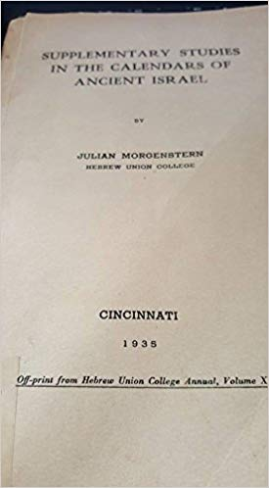
Supplementary Studies in The Calendars of Ancient Israel, pp. 1-148
"A new stage in the investigation of the
problem of the calendar of ancient Israel
was marked by the appearance of a learned article by E. Koenig in 1906 ... He maintains that
two distinct calendars were current in ancient Israel. The first, a solar calendar... This solar calendar was well adapted to the conditions of the simple, agricultural life which the Israelites lived during the first period of their sojourn in Palestine. It reckoned the day from sunrise... (con’t)

Slide 57
Supplementary Studies in The Calendars of Ancient Israel (con’t)
“The second calendar was a luni-solar year ... The day now came quite naturally to be reckoned from sunset ... This second calendar was obviously based upon Babylonian models and was adopted under direct Babylonian influence at about 600 B.C., when Babylonian religion and general culture began to affect with steadily increasing force the Jewish exiles in Babylonia and, through those of them who return from exile, the Jews who had remained in Palestine. (con’t)

Slide 58
“This broadly sums up Koenig's conclusions...
...the time of the transition from the reckoning of the
day as beginning with morning to the reckoning of it
as beginning with evening...
...that in the earlier calendar and in the literature which records this the day was reckoned from the morning, presumably from sunrise, while in the later calendar and the literature pertaining thereto the day was reckoned from the evening ... [the sacrifice] must be eaten upon the
day upon which it is sacrificed, and that nothing of it must be allowed to remain over until morning. Obviously the implication here is that the next morning is no longer a
part of the day upon which the sacrifice was offered,
but mark the beginning of the next day...”

Slide 59
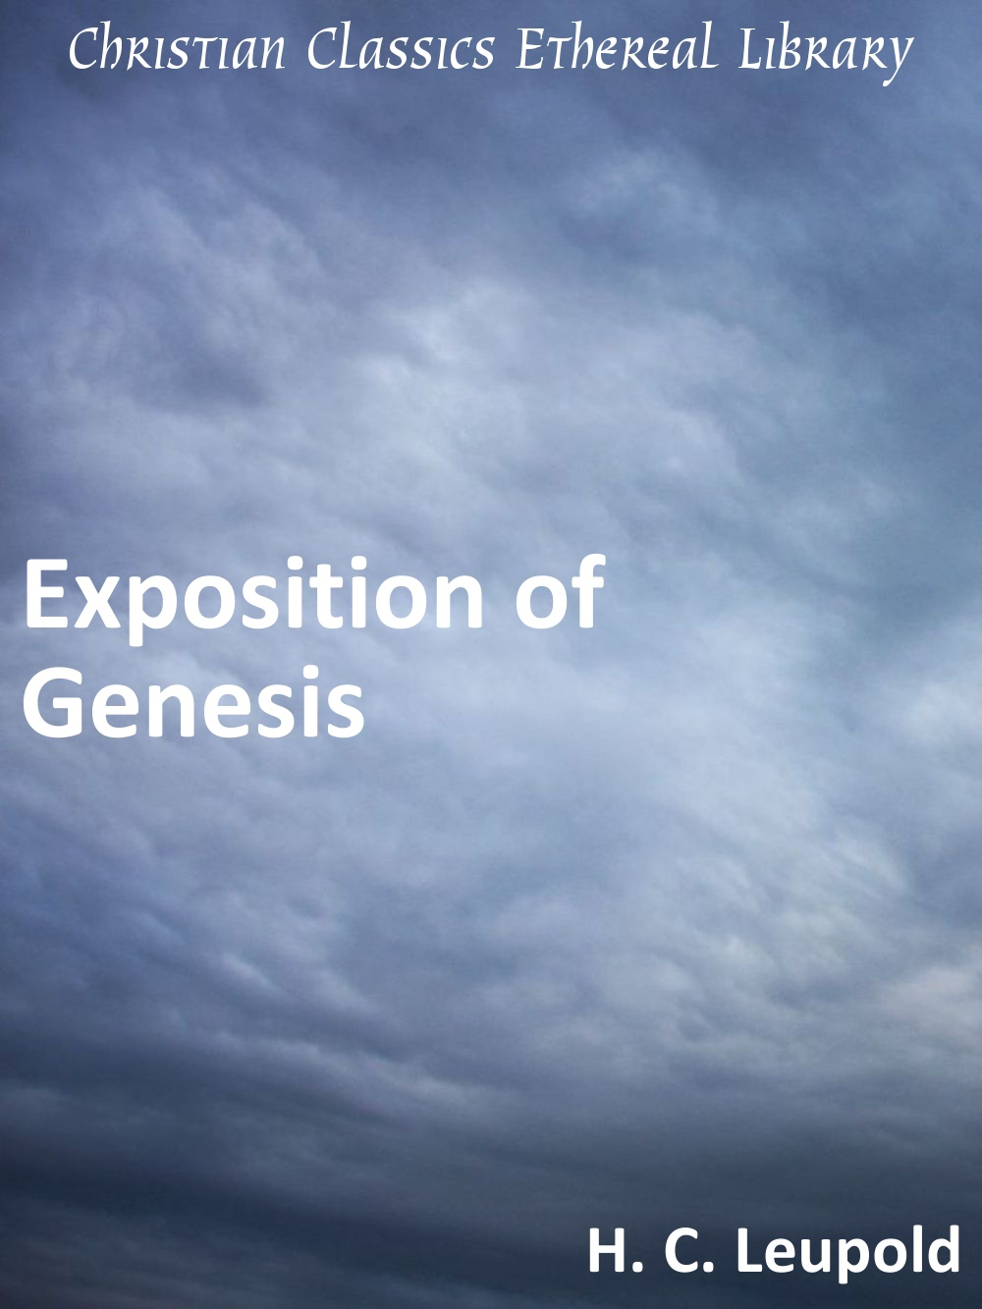
Exposition of Genesis
C. H. Leupold, Vol. 1, pp. 57-58.
[Noted Hebrew scholar C. H. Leupold explains:]
The verse [Gen. 1:5], however, presents not
an addition of items but the conclusion of a progression. On this day there had been the creation of heaven and earth in the rough, then the creation of light, the approval of light, the separation of day and night. Now with evening the divine activities ceased: they are works of light not works of darkness. The evening (‘erebh), of course, merges into night, and the night terminates with morning. [con’t]

Slide 60

Exposition of Genesis
C. H. Leupold, [con’t]
But by the time morning is reached, the first day is concluded, as the account says succinctly, ‘the first day,’ and everything is in readiness for the second day’s task. For ‘evening’ marks the conclusion of the day, and ‘morning’ marks the conclusion of the night. It is these conclusions, which terminate the preceding, that are to be made prominent."
Leupold’s point is simply that after
each day’s creative activity there
followed "evening" and when "morning"
arrived another day of creative activity
began.

Slide 61
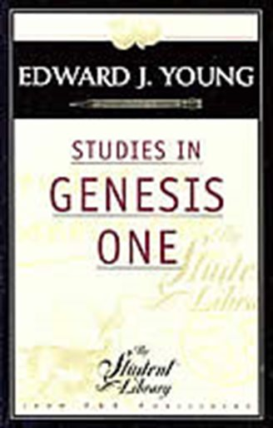
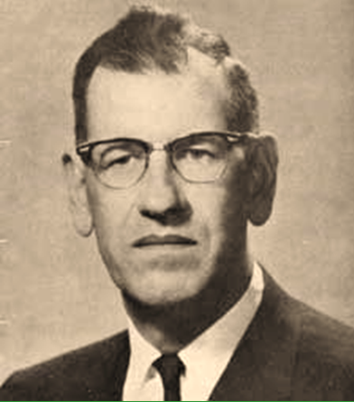
Studies in Genesis One, p. 89.
Edward J. Young
Westminster Theological Seminary
Edward Young, (professor of the TaNaK at Westminster Theological Seminary) summarizes the Hebrew text as follows:
When the light was removed by the appearance of darkness, it was evening, and the coming of light brought morning, the completion of a day. The days therefore,
are to be reckoned from morning to morning.
Therefore, we may conclude that since a new day began on the morning of each of the six days of creation week,
it would follow that God sanctified the Sabbath on the morning of the seventh day (not on the evening of the sixth day). Thus, the first Sabbath (Gen. 2:1-3) began in the morning rather than in the evening.

Slide 62
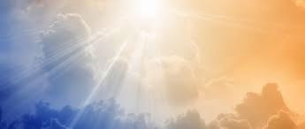
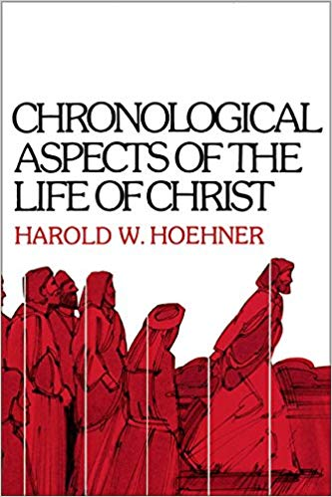
Chronological Aspects of the Life of Christ
Harold W Hoehner pp. 87, 88.
However Rabbinic tradition on this subject is in fact mixed. Harold Hoehner demonstrates from the Mishnah that there were actually two systems of reckoning a day at the time of the Messiah: [con’t]

Slide 63
The Galileans and Pharisees used the sunrise-to-sunrise reckoning whereas the Judeans and Sadducees used the sunset-to-sunset reckoning... This view not only satisfies the data of the Synoptics and the Gospel of John, it is also substantiated by the Mishnah. It was the custom of the Galileans to do no work on the day of the Passover while the Judeans worked until midday [the footnote reference is to Mishnah : Pesahim iv.5]. Since the Galileans’ day began at sunrise they would do no work on the entire day of the Passover. On the other hand the Judeans’ day began at sunset and they would work the morning but not the afternoon.

Slide 64


Note; if one is to lean heavily on the testimony of rabbinic tradition, he will be confronted with the question:
Which rabbinic tradition should be followed?

Slide 65

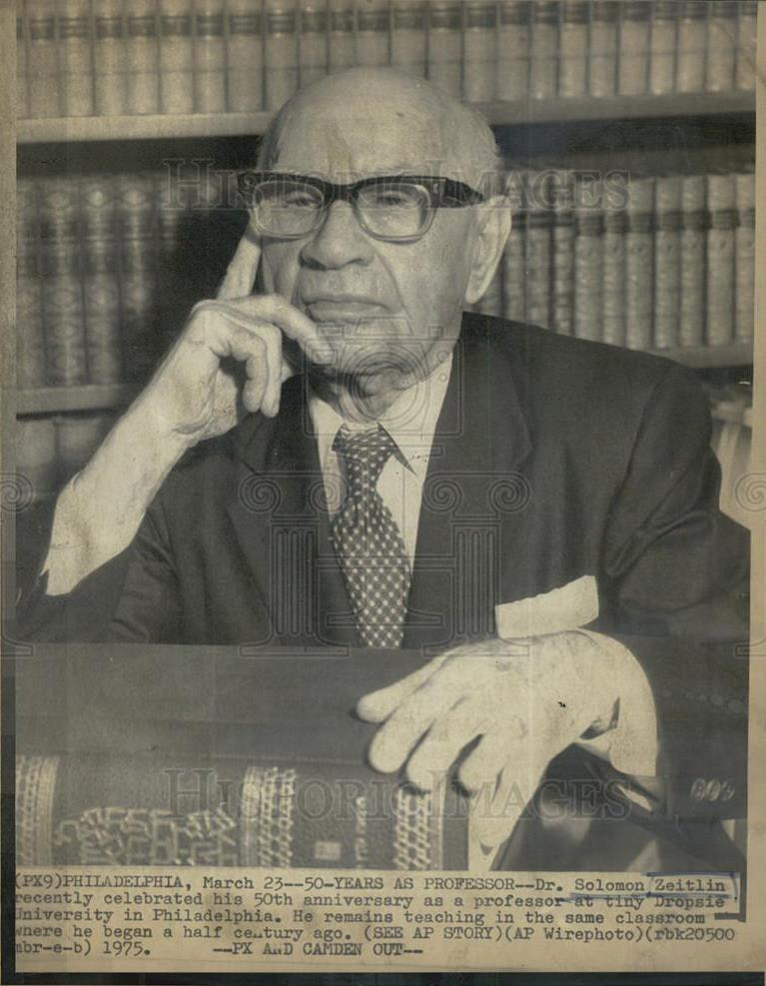
"The Second Day of the Holidays in the Diaspora," JQR, XLIV, Solomon Zeitlin,
(The Dropsie College For Hebrew and Cognate Learning, Philadelphia, 1953-1954), p. 183-193.
'... In Deut. 28:66 in the so-called Masoretic text, the reading is, "night and day." However, the Septuagint and the Targum according to Jonathan have "day and night. “Hence,
the so-called Masoretic text here is faulty.
In Jer. 14:17 our text has "night and day"; the Septuagint and the Pesikta R. have "day and night.”
The reading in the so-called Masoretic text again is faulty... (con’t)

Slide 66

(con’t) It is clear that when God created
the light and it
went down, then
the darkness (night) came, and when
the light appeared again, that
constituted
one day.
(con’t)
It would be very good if one studied about the Masoretic text
and the style of belief of the people that wrote it to be sure of any hidden agenda.

Slide 67
The solar calendar was used by the Hebrews before the time of the Restoration. Later there was substituted for
the solar calendar a lunar-solar calendar... Previously the year had begun with the spring. In the new calendar
the new year began with the autumn ... the day began with the sunset or when the stars became visible.
This change of calendar aroused great protest among
the Jews. The author of the book of Jubilees expressed
his opposition in very strong words.
See S. Zeitlin, The Book of Jubilees, pp. 13-15; idem;
The Zadokite Fragments, pp. 15-17.
The author of the book of Jubilees complained that those "who will make observations of the new moon" will go wrong as to the beginnings of the Sabbaths... The author protested that by a change from a solar to a lunar calendar the Sabbath would be disturbed, and the
holy part of the Sabbath would be profaned and the profaned part of the day would be made holy.'

Slide 68

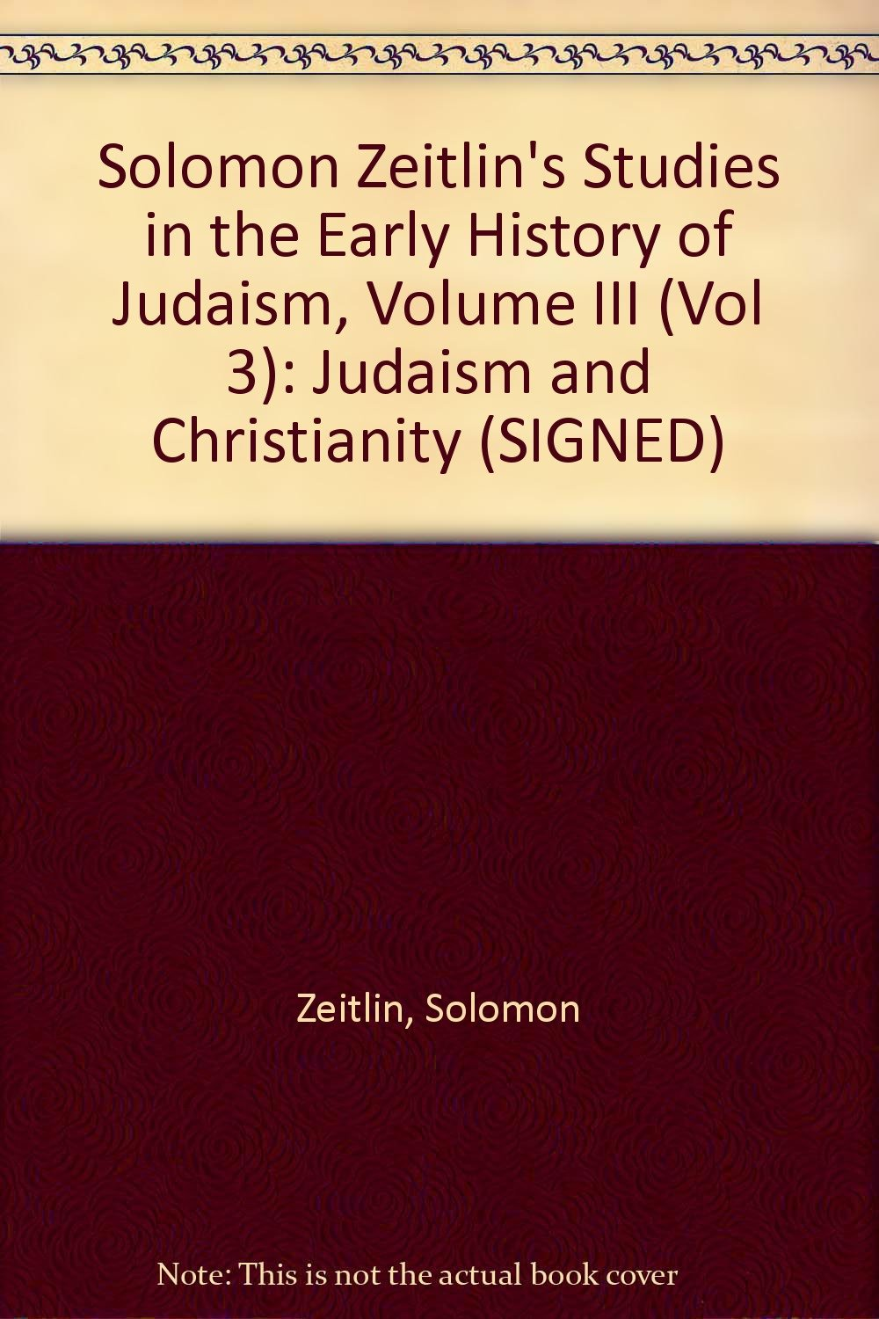
"Some Stages of the Jewish Calendar" in "Solomon Zeitlin's Studies in the
Early History of Judaism” by Solomon Zeitlin,
(KTAV Publishing House, Inc., New York, 1973), pp.183-193.
'... We know also that in the first three centuries of
the present era, the early Christians had not yet separated themselves from the Jews and still kept their festivals according to the Jewish calendar.
...This is to say that the month had thirty days, which means, again, that the calendar of the Bible was a solar one. In a solar calendar, the day could not have started from the evening, according to the current practice in the Jewish calendar, but from sunrise; and that is the meaning of the verse, "there was evening and there was morning, the first day," that is to say, from sunrise to sunrise constituted one day, divided into two parts - day and night.

Slide 69
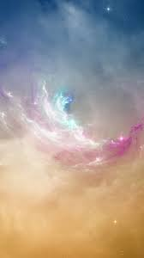
"The Book of Jubilees," JQR, XXX,
Solomon Zeitlin,
(The Dropsie College For Hebrew and Cognate Learning, Philadelphia, 1939-1940), pp. 13-15.
'Furthermore, the author protects vigorously against the change from the solar to a solar-lunar calendar...
This proves that the Book of Jubilees was written at the time when the calendar was changed from solar to solar-lunar time, and some Jews opposed this innovation... and they will confound all the days,
the holy with the unclean, and the unclean day
with the holy; for they will go wrong as to the months
and sabbaths and feasts and jubilees... How can we otherwise account for the author's forceful arguments against the change of calendar, if we should assume that the book was written during the Maccabean period? The calendar had already been changed centuries earlier and had long ago become a dead issue.'

Slide 70

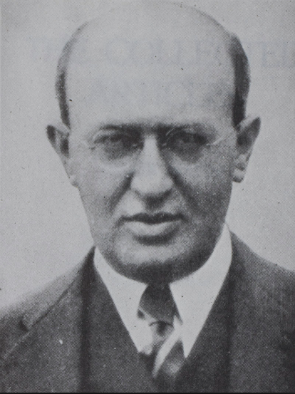
"The Observance of the Sabbath and the Festivals in the First Two Centuries of the Current Era according to Philo, Josephus, the New Testament, and the Rabbinic Sources” by Jacob Mann, in "The Collected Articles of Jacob Mann,"
(M. Shalom Ltd., Israel, 1971), pp. 433-532.
'... In Jamnia it was the duty of the Nassi to preach on every Sabbath... At the beginning
of the second century we hear of sermons delivered also on Friday night...'

Slide 71

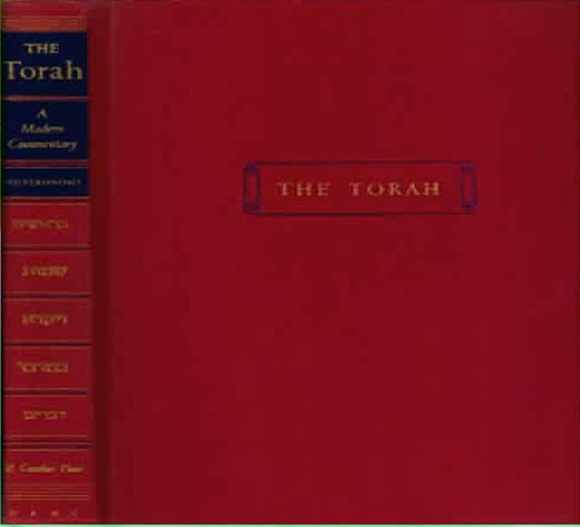
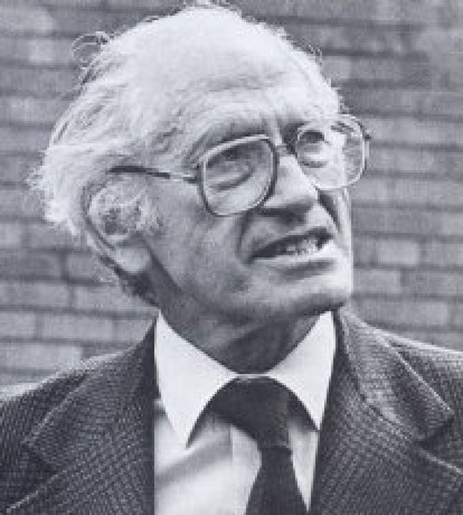
"The Torah - A Modern Commentary,"
Edited by W. Gunther Plaut,
(Union of American Hebrew Congregations, New York, 1981), pp. 920-930
At what point did the civil day begin? There is some evidence that at one time the day was reckoned from sunrise to sunrise. But before the close of the biblical period, it had become standard to reckon the day from sunset to sunset, and this has been Jewish practice ever since...
... The language of verses 5 and 6 suggests that
the evening when this sacrifice was performed
was considered part of the fourteenth day and
that the fifteenth - the Matzah festival - did not
begin until the next morning...

Slide 72
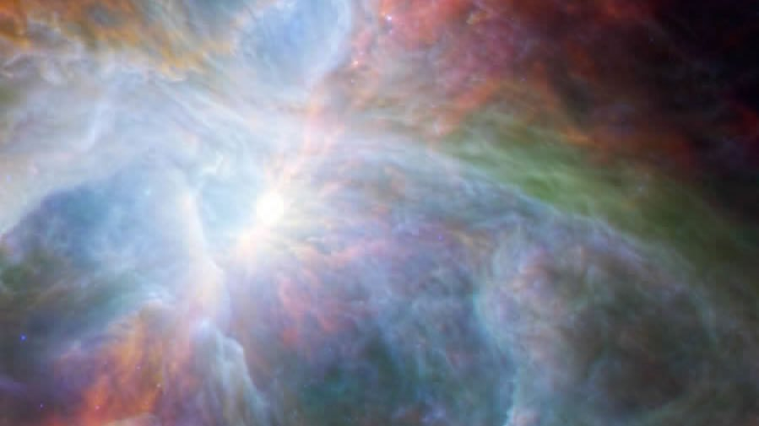
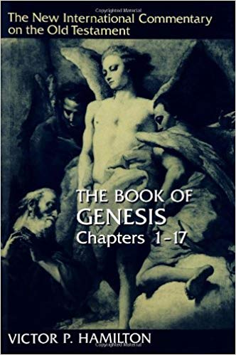
"The Book of Genesis -
Chapters 1-17,” Victor P. Hamilton
(William B. Eerdmans Publishing Company,
Grand Rapids, Michigan, 1990), pp. 118-121.
'5 The fact that evening is placed before morning throughout this chapter is not a foolproof indication that the Old Testament reckons a day from sunset to sunset. There is some evidence that strongly suggests that the day was considered to begin in the morning at sunrise. For example, this view is supported by the fact that when the Old Testament refers to a second day the time reference is the morning (Gen. 19:33-34; Judg. 6:38; 21:4). Similarly, the phrase "day and night" is much more frequent than "night and day." Thus it seems likely that this refrain in Genesis refers not to the computation of a day but rather to the "vacant time till the morning, the end of a day and the beginning of the next day.” '

Slide 73

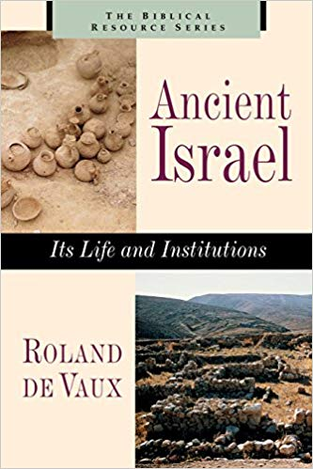
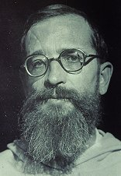
"Ancient Israel - Its Life and Institutions,“
Roland de Vaux, O.P., tr. John McHugh,
(McGraw-Hill Book Company, Inc., New York, rpr.1965), pp. 180-183
‘As everywhere, the basic unit is the solar day. The Egyptians reckoned it from one morning to the next and divided it into twelve hours of day time and twelve of night; the hour varied in length with the latitude and the season... (con’t)

Slide 74
In Israel, the day was for a long time reckoned from morning to morning. When they wanted to indicate the whole length of a day of twenty-four hours, they said "day and night" or some such phrase, putting the day first... This suggests that they reckoned the day starting from the morning and it was in fact the morning, with the creation of light, that the world began… time too, began on a morning... "There was an evening and there was a morning, the first, second, etc., day"; this phrase, however, coming after the description of each creative work (which clearly happens during the period of light), indicates rather
the vacant time till the morning, the end of a day
and the beginning of the next work. (con’t)

Slide 75
[de Vaux gives some examples.]
Nehemias … to prevent the merchants breaking the sabbath, orders the gates of Jerusalem to be shut at nightfall, before the sabbath, and not to be opened till after the sabbath (Neh 13:19). [And then de Vaux adds this contradiction…:] Here the day seems to begin at sunset.
... According to Lev 7:15 and 22:30, the meat of sacrifices must be eaten the same day, not leaving anything to be eaten to the morning of the next day. Had the day begun in the evening the wording would have ordered the meat to be eaten before the evening... All this presumes that the day began in the morning.
The change of reckoning must therefore have taken place between the end of the monarchy and the age of Nehemiah. One could date it more precisely if it were certain that in Eze 33:21-22 the evening and the morning of v. 22 both applied to the fifth day of
v. 21. This would bring us to the beginning of the Exile; unfortunately the text is not explicit.'

Slide 76

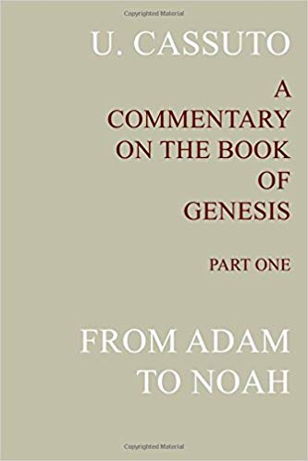
"A Commentary on the Book of Genesis,"
Part I, U. Cassuto, tr. Israel Abrahams,
(The Magnes Press, The Hebrew University, Jerusalem, 1944), pp. 28-29.
[And there was evening and there was morning, one day]
When day-time had passed, the period allotted to darkness returned (and there was evening), and when night-time came to an end, the light held sway a second time (and there was morning), and this completed the first calendar day (one day), which had begun with the creation of light.
... An examination of the narrative passages of the Bible makes it evident that whenever clear reference is made to the relationship between a given day and the next, it is precisely sunrise that is accounted the beginning of the second day... [Question: Where was the sunrise on Day 1 and 2 for the top paragraph?] So, too, in Lev. xxiii 32, with regard to the Day of Atonement ... thus the evening before the tenth is called the ninth of the month. (con’t)

Slide 77
It will thus be seen that throughout the Bible there
obtains only one system of computing time: the day is considered to begin in the morning; but in regard to the festivals and appointed times, the Torah ordains that they shall be observed also on the night of the preceding day. [Question: Does it?] This point is explicitly emphasized whenever a certain precept has to be observed particularly at night, like the eating of unleavened bread on the night of Passover and fasting on the evening of the Day of Atonement. [Question: Does it really?]
In the case of the Sabbath and the other festival days, however, there was no need to stress that work was prohibited on the night preceding, since agricultural tasks (and it is specifically these that the Torah has in mind) are performed only by day. There is no discrepancy, therefore, in our verse at all.

Slide 78


"The Talmud” - The Steinsaltz Edition,
Rabbi Adin Steinsaltz
(The Israel Institute for Talmudic Publications,
Random House. Inc., New York, 1989), p. 281
'[Hebrew text] Day. In Hebrew, as in many other languages, this word has two meanings: (1) A unit of time lasting twenty-four hours, and (2) daytime as distinct from night time. The Halakhic "day" of twenty-four hours usually begins at nighttime with the appearance of three medium-sized stars ([Hebrew text]); hence, according to the Talmud, the day follows the night rather than the other way round. An exception occurs, however, with regard to the laws of the Temple service. In this case the day is considered to begin in the morning (at dawn or at sunrise), and hence as far as these laws are concerned the night follows the day.’

Slide 79
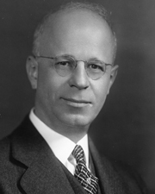
1935 Supplementary Studies in the Calendars of Ancient Israel, Julian Morgenstern.
Hebrew Union College Annual Volume X; p. 3; Cincinnati.
He [E. Konig 1906] maintains that two distinct calendars
were current in ancient Israel. The first a solar calendar was identical practically with that of the Phoenicians and the Canaanite predecessors of Israel in Palestine. This solar calendar was well adapted to the conditions of the simple, agricultural life which the Israelites lived during the first period of their sojourn in Palestine. It reckoned the day from sunrise and the year from an appropriate date in the fall.
It employed the old Canaanite-Phoenician names of the months. These were solar months of apparently thirty days each. The Asif, later the Sukkot, festival came at the end of the year. [con’t]

Slide 80
The second calendar was
a luni-solar year, which operated with lunar months alone and in consequence must have had some system of intercalation by which the lunar and the solar years were harmonized.
These lunar months were designated at first by ordinal numbers, first month, second month, etc., but eventually the Babylonian names, Nisan, Iyyar, etc, were equated with and frequently substituted for them.
A luni-solar year naturally necessitated increased cognizance of the moon and its phases. The day now came quite naturally to be reckoned at sunset, and the day of the full moon in each month came to play an increasingly important role in the calendar organization, so that the Passover-Mazzot festival[s] and the Sukkot festival
were transformed from
their original moments of celebration to the full moons of the first and seventh month respectively.
[con’t]

Slide 81
At first the New Year's Day continued to be celebrated upon V11/10, but later upon V11/1; eventually, however, the New Year's Day was transferred to I/1. This latter system of dating and celebrating the New Year's Day, however, did not supplant the older method of celebrating this important festival upon V11/1. For quite a long period both systems seemed to have existed simultaneously; eventually, however, the latter system succumbed to the older system,
and ever since the New Year's Day has been observed in the Jewish calendar upon the first of Tishri. This second calendar was obviously based upon the Babylonian models and was adopted under direct Babylonian influence at about 600 BC., when Babylonian religion and general culture began to affect with steadily increasing force the Jewish exiles in Babylonia and, through those of them who returned from the exile, and the Jews who remained in Palestine.

Slide 82
1935 Supplementary Studies in the Calendars of Ancient Israel, Julian Morgenstern.
Hebrew Union College Annual Volume X; p. 5; Cincinnati.
Sanctuary and the Equinox
That it was possible under the system of Calendar 1
to determine exactly the dates of the spring and fall equinoxes, I have shown conclusively in M11.
These were the two days in the year upon which the first rays of the rising sun shone straight through the eastern gate of the Temple of Jerusalem, opened for this specific moment, and down the long isle of the Temple into the [Dalet Beit Yod Resh] or holy of holies at
its western end. This institution made it possible to determine the exact length of the solar year with almost mathematical precision …

Slide 83
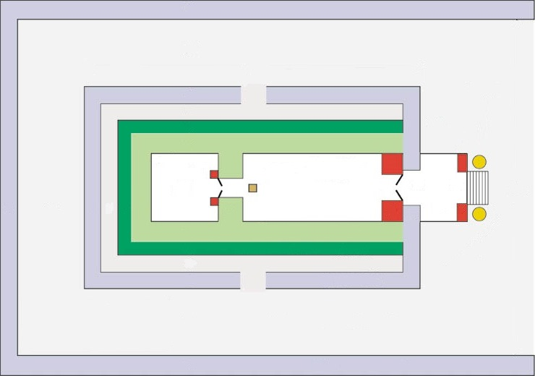
Sanctuary Design Determines Equinox
Priests had their backs to the sun – except in Ezekiel 8!
Summer
Solstice
Jachin
Equinox
Light
Boaz
Winter
Solstice
Sanctuary Always Faced East with 2 Pillars at the Front
Why would Yahuah design His Sanctuary to receive these “lights” if “equinox” is completely linked to paganism?

Slide 84



Note: Now is the time to understand as much as possible of Yahuah’s Covenant Calendar. As the internet increases with information, each one needs to have the tools to discern the truth from any error, great or small. In future presentations, secular historical quotes will also
be offered for the <choshek> month and the <shaneh> year.
Be prepared with good discernment.
The End

Slide 85

All Questions & Comments
are welcome. Send to:
Tim Astleford or
Charlene Fortsch
tim@studythecalendar.com
charlene@studythecalendar.com

