Slide 1
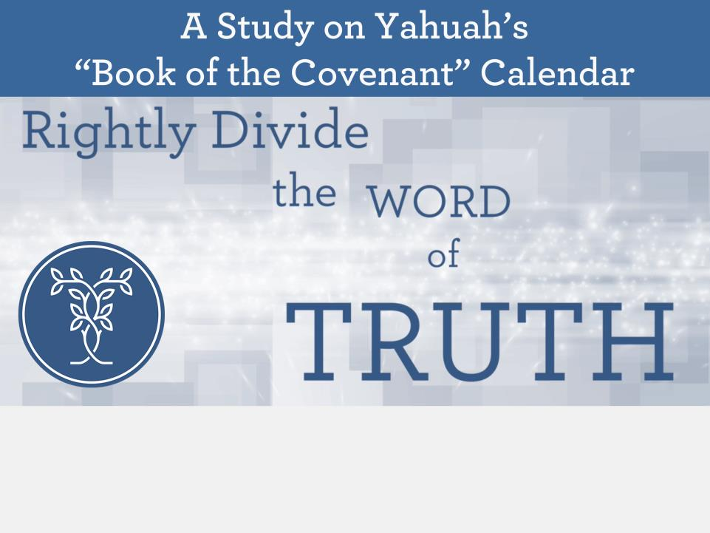
Corrections for PDF done on June 21/19 AFTER CCC.
17: twlight - spelling
82: context statement for the 9th day.
87: added “sunset [even]”
Nov 8/20: #22 & 23 – corrected H4811 to 4891 for ‘mischar.’
Grammar 101 (Parts 2 & 3)
for the Hebrew “evening”
Notes:
2019 edition: May20th to June 20th – very hard to pull together.

Slide 2




Proverbs 1:2-6 adapted to Covenant Calendar Attributes
One purpose of calendar studies is
to teach you wisdom and discipline,
help you recognize good advice, and understand sayings with deep meaning.
Through these studies many will
receive instruction in discipline and
good conduct.
The Covenant Calendar study will groom
an inexperienced person to be clever
and teach the new people how to be resourceful.
Covenant Calendar studies can even add to the knowledge of wise men
and give guidance to the educated,
so that each one can under- stand the hidden meanings
of Yahuah’s calendar to solve the riddles and the problems that sages raise.
Modified from NLT & TEV
2
Notes:
Prov 3:1-4 … remembering and keeping Yah’s law .. Finds favour and good understanding in the sight of Yah and man.

Slide 3

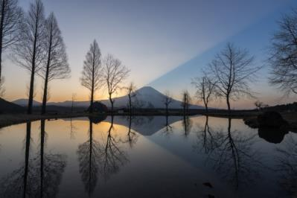
Gen 1:5
“Yahuah called the light Day, and the darkness he called Night.
[And especially for understanding the last part of the phrase …]
And the evening and the morning were the first day.”
Grammar
Grammar
Lessons Part 2
Lessons
Does “evening” really mean
“sunset”?

Slide 4


In Grammar 101 (Part 1 – Gen 1:5)
A Hebrew dictionary is needed to compare and check if the English
word is the best choice.
There can be opposite definitions listed for the same word in any language. Learn to discern the correct content/context to select the proper definition for any word in Scripture.
(Gen 1:3 is the key verse for day-start.)
Gen 1:5 is a key verse for definitions
of Day, Night, Evening & Morning twilights (not day-start).
Gen 1:5 has ALL components in the correct order for every 24 hour cycle.
Twilights are safeguards to never look to the sun for day commencement.
R
E
V
I
E
W

Slide 5
Grammar 101 (Part 2) Gen 1:5
Other definitions for Day
Extra work on Morning
Extra work on Night
(including “qualifiers”)
Other definitions for Evening
Extra work on primitive roots
for Evening
A look at “between the eveningS”
(singular & plural forms)
Placements and positions of
“between the eveningS”
Is “evening” defined as afternoon?
Grammar 101 (Part 3) Lev 23:26-32
Examination and use of “evening”
for Yom Kippur / Day of Atonement

Slide 6
Section #1:
Other Definitions
for DAY
<yowm> H3117
The word “day” is
often a very confusing word and always needs careful consideration.
Day (Season) = 12 hours (Light Season) Day (Cycle) = 24 hours

Slide 7

“Day” <yowm> Other Definitions
R
E
V
I
E
W
Strong’s day H3117 yowm;
[1st definition – 12 hour Day Season]
  from an unused root meaning to be hot;
  a day (as the warm hours), whether literal
  (from sunrise to sunset,)
[Note: Strong’s should have said from dawn to dusk according
to the 1st Hebrew definitions for morning and evening.]
[2nd definition – 24 hour Cycle of Day Season & Night Season]
  from one sunset to the next;
[Note: Strong’s is incorrect in calculating the commencement of the day with sunset. He should have said from “one day-break to the next.”]
[3rd definition where one day equals 1 year, in prophecy.]
  or figurative (a space of time defined by an associated term).
There are other definitions for DAY
that do not apply to Gen 1:5.
7

Slide 8

R
E
V
I
E
W
1st usage of a word in the Scriptures,
most often takes the 1st definition.
Light/Day
Evening/Morning
1st used in Gen 1:5a.
1st definition is the
“warm hours” or
12 hour Day Season.
Light [owr] is called DAY.
2nd use of DAY in
Gen 1:5b aligns with
the two twilights,
linking them to the
Day Season.
1st usage in Gen 1:5b, after Day Season has been determined.
1st definition is correct as “dusk” and “dawn.”
Both terms are twilights.
Evening and Morning have light; both belong
to the Day Season.
For Review: Let’s chart this information.

Slide 9

Large Components of the Day
Gen 1:5a
1st: there are 2 major divisions to divide the 24 hour cycle in half.
12 hrs. Day
12 hrs. Night
R
E
V
I
E
W
1. Light is
called DAY
2. Darkness is called NIGHT
Notice: Everything about
creation week started here
with Day-Light.

Slide 10
Small Components of the Day
DAY
#2 Morning
twilight
#1 Evening
twilight
R
E
V
I
E
W
NIGHT
The twilight components are small slivers of transition between the light and night.
Evening twilight was placed 12 hrs.
before the 1ST Morning twilight.
The Gen 1:5 “order” is correct!

Slide 11
Proper Order of All Components
R
E
V
I
E
W
Light came 1^{st:} (called: DAY)
4^{th:} Morning twilight
follows
[ends the 1st day & begins the 2nd day]
2^{nd:} Evening twilight follows
3^{rd:} Night follows
evening
In modern terms
Gen 1:5b would read this way:
And the dusk twilight, and the dawn twilight
belong to the [day] – the warm part,
or the 12 hour Day Season.

Slide 12


Night as Compared to Twilight
R
E
V
I
E
W
Light came 1st (called: DAY)
4th Morning twilight
2nd Evening twilight
3rd Night follows
evening
OH? …
OK!!
Night is the absence of LIGHT.
Twilight contains LIGHT.
That’s why twilights are reckoned
as part of the “day” or DAY Season!

Slide 13


I will go before you and make the crooked places straight.
Isa 45:2
Lest We Forget
Many are reluctant to enter into a new calendar study due to the lingering controversy.
It is crucial to keep in mind that
ALL things must be proven from Scripture...no matter who taught us originally.
It is not disrespectful to learn that a prior teacher
was mistaken ... Scripture says the crooked places
will be made straight.
Few have had a clear path to Yahuah’s truths. He tells us to study and grow in knowledge.
One option: be open minded enough to accept that what you've been taught may not be correct~then study it out.

Slide 14




A Good Motivational Boot!
1st Note:
The majority of Festival Calendars follow a sunset day commencement.
2nd Note:
Since ereb/evening is
the cornerstone of the Covenant Calendar study, a thorough study easily removes many
questionable
calendars.
3th Note:
The study of Covenant Calendar may be easier than you realize with a bit of motivation. Enjoy!

Slide 15
Section #2:
Extra work on
“morning”
<boqer> H1242.
In Gen 1 the word “morning” has basically one definition.

Slide 16
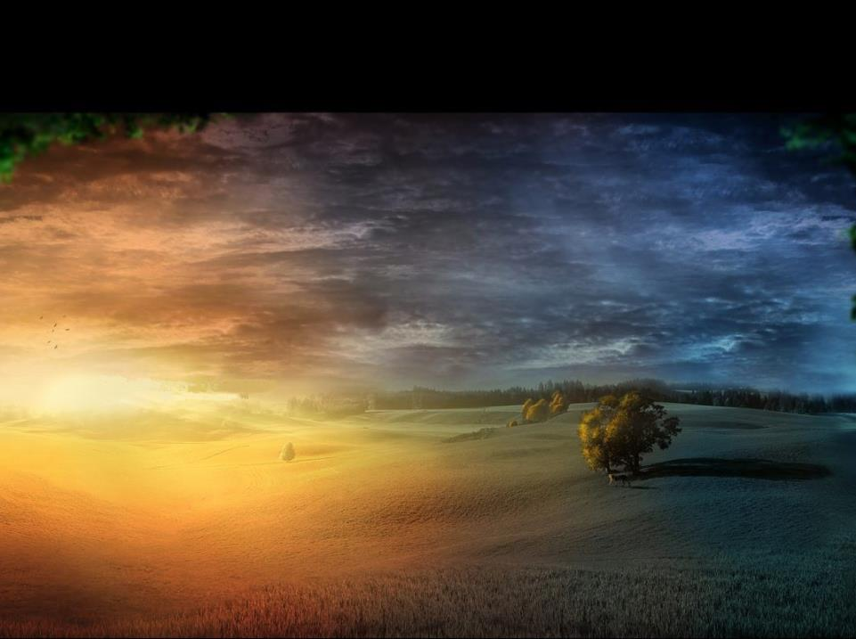
Morning Definition
(in the Creation Week)
What is that basic definition for morning?
Morning H1242 <boqer> dawn, break of day
(<boqer> is always morning twilight.)
There are other Hebrew words and numbers
to be considered for “morning.”

Slide 17
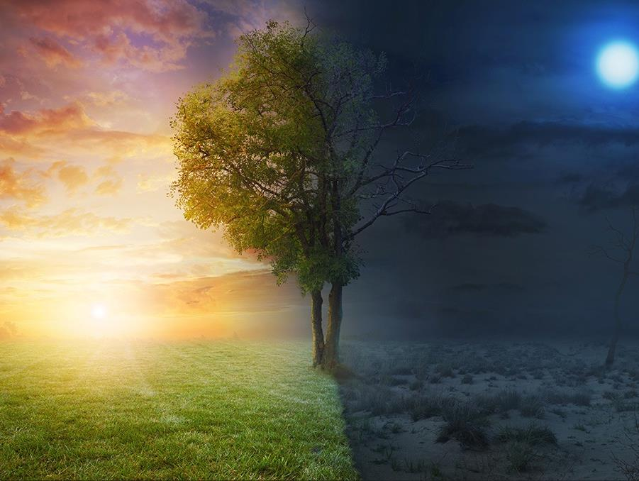
After the Creation Week the word
Morning Aligns with several other Hebrew Numbers
1. In Strong’s “morning” has 210 hits using a total of 10 other Hebrew Word numbers.
A further look at these other Hebrew Word numbers may yield a clue as to why boqer was used first.

Slide 18





A question on Morning:
Gen 1:3: Yahuah said, “Let there be light <owr>.” Here H216 is first defined as “light for the 12 hr. Day Season.”
Light H216 <owr> illumination, bright, clear, day, light, morning.
Remember, there was NO twilight on THE 1st day.
Morning H7837 <shachar> dawn, break of day.
Note: <shachar>
is a twilight!
Why isn’t <shachar> used for Gen 1:5
in place of <boqer> H1242?

Slide 19








Morning: 210 Scriptures
?
?
1242 is NOT PR;
216 is NOT PR; 215 can be used for break of day and this did not happen on the 1st day. It can also be used for light at night like “pillar of fire” and lightning, etc.
H1242 boqer [215 {Englishman’s}] Gen 1:5
[literally] dawn; break of day.
Why is the first Hebrew word used for morning <boqer H1242> not listed as the primitive root? (Answ: That would be the action word, but morning is a noun.)
There is another Hebrew word for morning <shachar H7837> that is also defined as “dawn” in Gen 19 … so why is this word not used in Gen 1:5 instead of boqer? (A: shachar can be used figuratively and literally. It was not used in Gen 1 to prevent the possibility that the figurative application would have been used rather than the literal.)
The first time <shachar H7837> is used in Gen 19 is not until approximately 1900 BC. Would that not establish <boqer H1242> as a solid “literal” definition and application for the morning light to be that of “dawn” for day-start?
<owr H216> is used as LIGHT on the first day of creation. The primitive root is H215. Why is H215 not used in Gen 1:3 instead of H216? (Answ: One of the interpretations for H215 is “break of day.” The <owr H216> LIGHT in Gen 1:3 was not “break of day” but rather what we would describe as the morning light of forenoon or the early part of the day ending at noon.)
<nesheph H5399> can apply to dawn twilight. Why is this <nesheph> not used for “morning” in Gen 1:5? (Answ: the first definition is dusk twilight, not dawn twilight.)
?
?
H7837 shachar [25 {Englishman’s}] Gen 19:15
(literal or fig.) dawn; early light; whence riseth.
?
?
H7836 [p.r.] shachar [12 {Englishman’s}] Job 7:21
dawn; to seek early; start a task early.
?
H7925 shakam [65 {Englishman’s}] 1 Sam 17:16
to start early in the morning with a burden.
?
H216 owr [123 {Eng}] Neh 8:3 1st used in Gen 1:3 as “light.”
forenoon of Day Season [not dawn twilight].

Slide 20
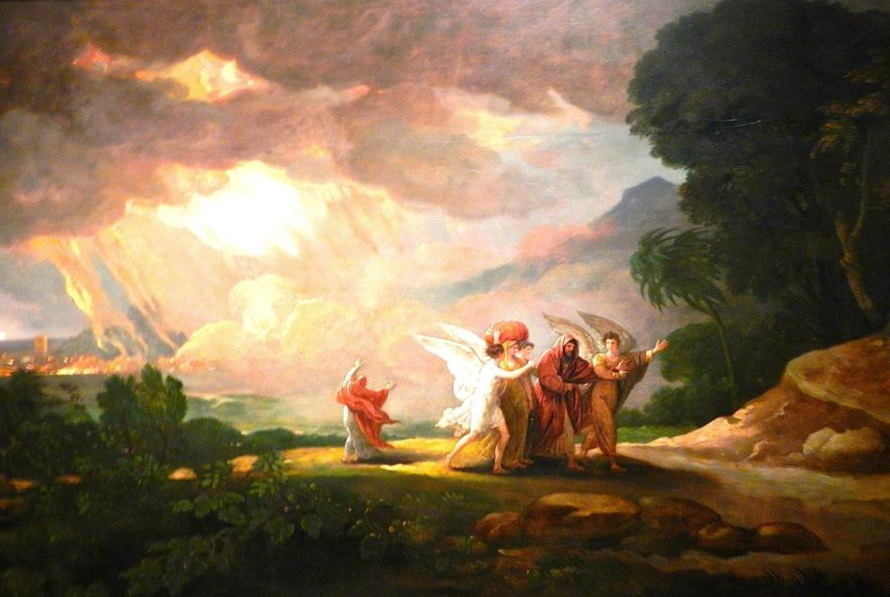
Questions around <shachar>
Question 1: Why isn’t <shachar H7837/36> [twilight]
used for Gen 1:5 in place of <boqer H1242> [twilight]?
Morning H7837 <shachar>; from H7836; dawn (literal, figurative or adverbial): KJV - day (-spring), early, light, morning, whence riseth.
Job 41:18 By his neesings a light doth shine, and his eyes are like the eyelids of the morning.
Psalms 139:9 If I take the wings of the morning, and dwell in the uttermost parts of the sea;
First usage of H7837 & H7836:
Job 7:21
… for now shall I sleep in the dust; and thou shalt seek me in the morning [H7836], but I shall not be.
Gen 19:15 And when the morning [H7837] arose, then the angels hastened Lot, saying, Arise, take thy wife, and thy two daughters, which are here; lest thou be consumed in the iniquity of the city.
Job 41:18 By his neesings a light doth shine, and his eyes are like the eyelids of the morning. H7837
Psalms 139:9 If I take the wings of the morning, and dwell in the uttermost parts of the sea;

Slide 21
Questions around <owr>
Question 2: Is <owr H216> ever defined as
morning for the “dawn” light or “break of day”?
[LIGHT - Gen 1:3] H216 owr; from H215; illumination or (concrete) luminary (in every sense, including lightning, happiness, etc.):
KJV - bright, clear, day, light (-ning), morning, sun.
First usage of <owr H216> as morning:
Neh 8:3 And he read therein before the street that was before the water gate
from the morning [H216] until midday,
before the men and the women …
Morning <owr H216>
= light to noon
Morning <boqer H1242>
= dawn twilight
Remember, there was NO twilight on THE 1st day.
The definition of <owr> gives confirmation of this.
21

Slide 22





Morning: 210 Scriptures
?
H4891 mishchar [1 {Englishman’s}] Ps 110:3
day breaking at dawn. [From p.r. H7836 shachar.]
?
H5399 nesheph [12 {Englishman’s}] Ps 119:147
a breeze at dusk; morning dawn; twilight.
H7904 shakah [1 {Englishman’s}] Jer 5:8
roaming through lust; [as morning roams in].
H6843 tsephiyrah [3 {Englishman’s}] Eze 7:7
a turn of affairs; [as the night turns to morning].
H5053 nogah [Aramaic] [1 {English.}] Dan 6:19
dawn.

Slide 23
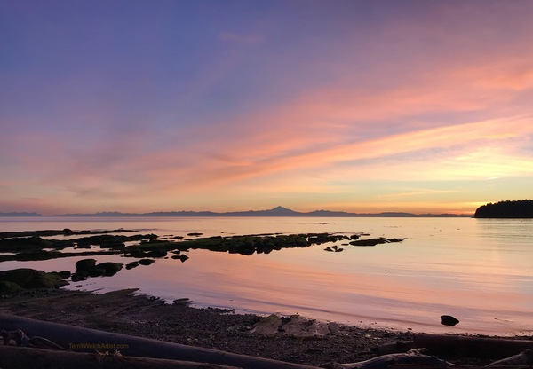
Questions around <mishchar>
Question 3: Why isn’t <mishchar H4891> [twilight]
used in Gen 1:5 rather than <boqer H1242> [twilight]?
Morning H4891 mishchar; from H7836 in the sense of day breaking; dawn: KJV - morning.
Only 1 usage of <mishchar H4891> as morning:
Ps 110:3 Thy people shall be willing in the day of thy power, in the beauties of holiness from the womb of the morning [figurative]: thou hast the dew of thy youth.
<mishchar> is not used in Gen 1:5
to avoid the possible link to a “figurative” dawn
rather than the “literal” <boqer>.
Morning H216 <owr> light to noon (Neh 8:3)

Slide 24
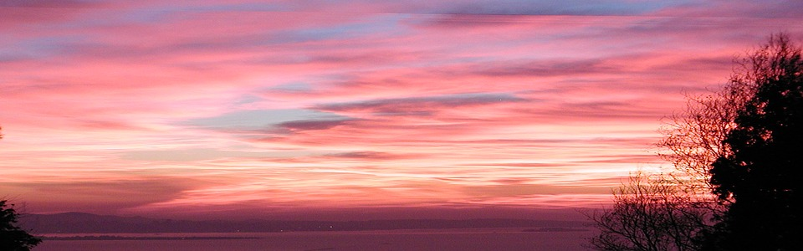

Questions around <nesheph>
Question 4: Why isn’t <nesheph H5399> [twilight]
used for Gen 1:5 in place of <boqer H1242> [twilight]?
H5399 nesheph; from H5398; properly, a breeze, i.e.
(by implication) dusk (when the evening breeze prevails):
KJV - dark, dawning of the day (morning), night, twilight.
Only 1 usage of <nesheph H5399> as morning:
Ps 119:147 I prevented the dawning of the morning, and cried: I hoped in thy word.
The first definition of <nesheph> is “dusk.”
In Gen 1:5 “morning” is a dawn twilight.
24

Slide 25
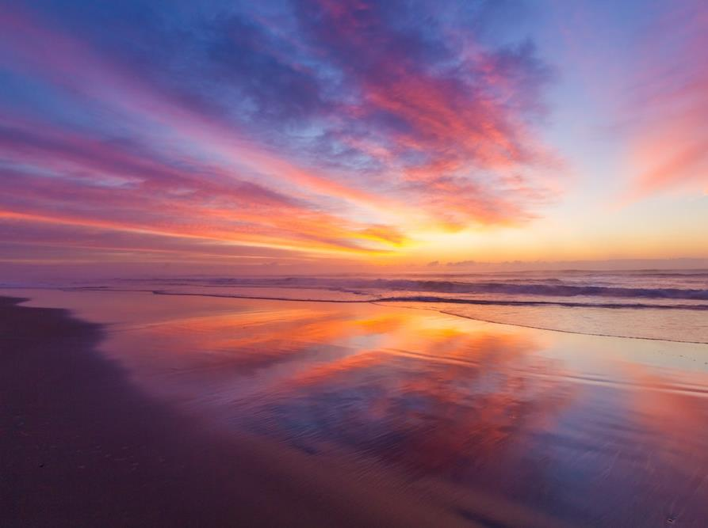
Conclusion on Morning/boqer
<boqer H1242> is the absolute best Hebrew word that could have been used (in Gen 1:5 “… and the morning …”)
as it means first & foremost – morning twilight at
the break of day.
<BOQER> NEVER MEANS:
The <owr> light of forenoon after sunrise to noon;
<boqer> is never used as a figurative application
of “dawn twilight” (like shachar/mishchar);
<boqer> is never to be confused with
the generic definition of <nesheph> twilight
that can also mean “dusk.”

Slide 26
Section #3:
Extra work on
“night”
<layil> H3915.
Need to show the difference between “night” as 3915 and ‘night’ as 6153 [ereb]. That was messy too. But 6153 has the 3rd def as night – show that too.
In Gen 1 the word “night” has basically
one definition.

Slide 27
Night Definition
(in the Creation Week)
What is that basic definition for night?
Night H3915 <layil> a twist away of light
In Gen 1, both “morning” & “night”
have just one basic definition each.
There are other Hebrew words and numbers
to be considered for “night.”

Slide 28
After the Creation Week the word Night Aligns with several other Hebrew Numbers
2. In Strong’s “night” has 245 hits using a total of
9 other Hebrew
Word numbers.
A closer look at these other Hebrew Word numbers may yield a clue as to why layil was used first.

Slide 29




Night: 245 Scriptures
H3915 layil [233 {Englishman’s}] Gen 1:5
twist away of the night; Night Season.
H3885 luwm [83 {Englishman’s}] Gen 19:2
to stop over night for the Night Season.
?
H6153 ereb [134 {Englishman’s}] Gen 49:27
dusk; day; night.
H8464 tachmac [2 {Englishman’s}] Lev 11:6
an unclean bird; night hawk.
29

Slide 30


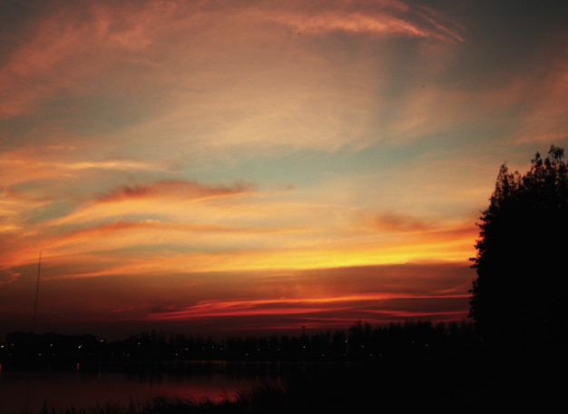
Questions around <ereb>
Question 1: <ereb/dusk H6153> does list
“night” as its last definition.
“even” H6153 `ereb; from H6150; dusk: KJV - day, even (-ing, tide), night.
Review
How can <night H3915> link to H6153?
First usage of <ereb H6153> as night:
R
E
V
I
E
W
Gen 49:27 Benjamin shall ravin as a wolf:
in the morning [1242-dawn twilight] he shall devour the prey, and at night [6153-dusk twilight towards night] he shall divide the spoil.
Night here is referring to
“dusk” as a compliment to
“dawn” twilight
in the context.
Consider “morning” as the “qualifier.”
30

Slide 31
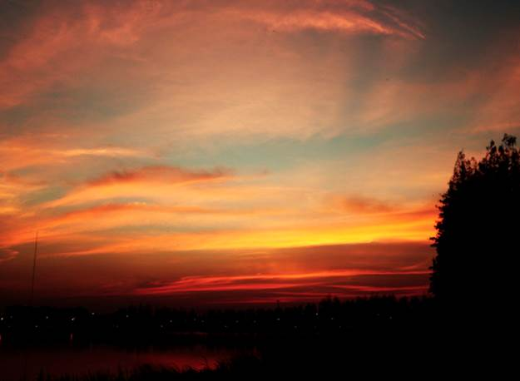
Questions around <ereb>
Question 2: Are there other places where
<night H3915> links to <ereb H6153>?
Yes! In the following verses the “dawn morning”
is part of the context as a “qualifier.”
The word “night” links H6153 to “dusk” as a compliment.
Job 7:4 When I lie down, I say, When shall I arise,
and the night [H6153] be gone? and I am full of
tossings to and fro unto the dawning of the day.
Ps 30:5 … weeping may endure for a night [H6153],
but joy cometh in the morning [H1242 dawn twilight].
Lev 6:20 This is the offering of Aaron and of his sons … half of it in the morning [1242-dawn twilight], and half thereof at night
[6153-dusk twilight towards night].
Night is referring
to the “dusk” sacrifice as a compliment to the “dawn” sacrifice.

Slide 32




Night: 245 Scriptures
?
H2822 choshek [80 {English.}] Job 26:10
destruction; death; wickedness; obscurity.
H821 ashmurah [7 {Englishman’s}] Psa 63:6
a night watch; to guard.
?
H5399 nesheph [12 {Englishman’s}] Isa 21:4
dusk twilight; until dusk is night.
H956 buwth [Aramaic] [1 {English.}] Dan 6:18
to lodge overnight.
Your homework: check Jonah 4:10.
32

Slide 33
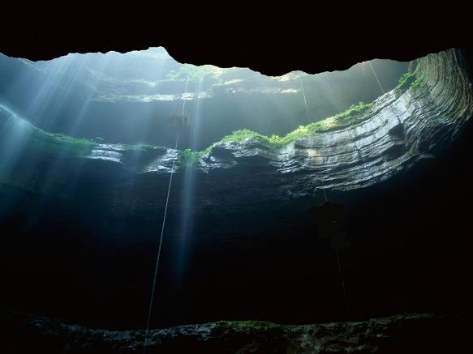
Questions around <choshek>
Question 3: How can <night H3915> be linked
to the <choshek darkness H2822> of Gen 1:2a?
First usage of <choshek/darkness H2822> as night:
Job 26:10 He hath compassed
the waters with bounds,
until the day [H216-light]
and night [H2822-darkness]
come to an end.
Night is referring to the an abyss darkness; the day refers to light, not the Day Season
Job 26:10 actually addresses flat earth! It looks to be a huge study. See Barnes’ notes below.
33
Notes:
Job 26:10
He hath compassed the waters with bounds, until the day and night come to an end.
[He hath compassed the waters with bounds] The word rendered "compassed" chaag (OT:2328), means to describe a circle-to mark out with a compass; and the reference is to the form of the horizon, which appears as a circle, and which seems to be marked out with a compass. A similar idea Milton has beautifully expressed in his account of the creation:
"Then staid the fervid wheels, and in his hand
He took the golden compasses, prepared
In God's eternal store, to circumscribe
This universe, and all created things:
One foot he centered, and the other turned
Round through the vast profundity obscure;
And said, 'Thus far extend thy bounds,
This be thy just cirrumference, O world!'"
(Paradise Lost, B. vii.)
In the passage before us, we have a statement of the ancient views of geography, and of the outer limits of the world. The earth was regarded as a circular plane, surrounded by waters, and those waters encompassed with perpetual night. This region of night-this outer limit of the world, was regarded as at the outer verge of the celestial hemisphere, and on this the concave of heaven seemed to rest. See Virgil, Geor. i. 247.
Illie, ut perhibent, aut intempesta silet nox
Semper, et obtenta densantur, nocte tenebrae;
Aut redit a nobis Aurora, diemque redicited
No maps are preserved constructed at so early an age as the time of Job; but maps have been constructed from the descriptions in Strabo, Herodotus, and others, which furnish illustrations of the prevailing views on the subject of geography in their times. The oldest geographical writer among the Romans is Mela, who lived in the reign of Claudius, and who died 54 AD In his work, De Situ Orbis, he gives a description of the world according to the prevailing views, and probably embodied the results of former investigations and discoveries. "We find him adopting, in its fullest extent, the belief of a circumambient ocean; and when he speaks of the high earth in this middle part of it, and describes the sea as going under and washing round it, we are led to believe, that he viewed the earth as a sort of cone, or as a high mountain raised by its elevation above the abyss of waters. Having made a vague division of the world into East, West, and North, he distributed it into five zones, two temperate, one torrid, and two frigid. Only the first two were habitable; and that on the South was inacessible to man, on account of the torrid regions intervening. According to this system, however, there was on that side another earth, inhabited by people whom he calls Antichthones, from their opposite position with respect to that part which we inhabit.
The form and boundaries of the known and habitable earth are thus delineated: The Mediterranean, with its branches of the Straits, the Euxine, and the Palus Moeotis; its great tributaries, the Nile and the Tanais-these combine, in his conception, to form the grand line by which the universe is divided. The Mediterranean itself separates Europe from Africa; and these continents are bounded on the East, the former by the Tanais, the latter by the Nile; all beyond or to the East of these limits was Asia." The following cut is probably a correct representation of his system, and gives the view of the world which prevailed in his time.
The ancient Arabs supposed the earth to be encompassed with an ocean. This ocean was called the "sea of darkness;" and the Northern sea was regarded as particularly pitchy and gloomy, and was called "the sea of pitchy darkness." Edrisi, a distinguished Arabic geographer of the middle ages, supposed that the land floated on the sea, only a part of it appearing above the water, like an egg, floating in the water.
A map of the world, constructed during the Crusades, and embodying the views of the world prevailing then, exhibits the world, also, as surrounded by a dark ocean on every side-mare tenebrosum-and may be introduced as an illustration of this passage in Job. It is the map of Sanudo, annexed to Bongar's "Gesta Dei per Francos." In this map, Jerusalem, according to the prevailing views, "is placed in the center of the world, as the point to which every other object is to be referred; the earth is made a circle, surrounded by the ocean, the shores of which are represented as every where nearly equidistant from that spiritual capital, the site of which is, indeed, remarkable for its relation to the three continents, Asia, Europe, and Africa. Persia stands in its proper place; but India, under the modifications of Greater and Lesser, is confusedly repeated at different points, while the river Indus is mentioned in the text as the Eastern boundary of Asia. To the North, the castle of Gog and Magog, an Arabian feature, crowns a vast range of mountains, within which, it is said, that the Tartars had been imprisoned by Alexander the Great. The Caspian appears, with the bordering countries of Georgia, Hyrcania, and Albania; but these features stand nearly at the Northern boundary of the habitable earth. Africa has a sea to the South, stated, however, to be inaccessible, on account of the intensity of the heat. The European countries stand in their due place, not even excepting Russia and Scandinavia, though some oversights are observable in the manner in which the two are connected together."
A similar view prevails among the modern Egyptians. "Of geography, the Egyptians, in general, and with very few exceptions, the best instructed among them, have scarcely any knowledge. Some few of the learned venture to assert that the earth is a globe, but they are opposed by a great majority of the 'Oolama. The common opinion of all the Moos'lims is, that the earth is an almost plane expanse, surrounded by the ocean, which they say is encompassed by a chain of mountains called Cka'f." Lane's Modern Egyptians, vol. i. p. 281. A similar view of the world prevails, also, now among the Independent Nestortans, which may be regarded as the ancient prevailing opinion in Persia, handed down by tradition. "According to their views of geography," says Dr. Grant, "the earth is a vast plain, surrounded by the ocean, in which a leviathan plays around, to keep the water in motion, and prevent its becoming stagnant and putrid; and this leviathan is of such enormous length, that his head follows his tail in the circuit round the earth! That I had crossed the ocean, where I must have encountered the monster, was a thing almost incredible."
The Nestortans, p. 100. In ancient times, it was regarded as impossible to penetrate far into the sea surrounding the earth, on account of the thick darkness, and it was believed that after sailing for any considerable distance on that sea, the light would wholly fail. In the ninth century, the Arabic historians tell us, that the brothers Almagrurim sailed from Lisbon due west, designing, if possible, to discover the countries beyond the "sea of darkness." For ten or eleven days, they steered westward; but, seeing a storm approaching, the light faint, and the sea tempestuous, they feared that they had come to the dark boundaries of the earth. They turned, therefore, south, sailed twelve days in that direction, and came to an island which they called Ganam, or the island of birds, but the flesh of these birds was too bitter to be eaten. They sailed on twelve days further, and came to another island, the king of which assured them that their pursuit was vain; that his father had sent an expedition for the same purpose; but that, after a month's sail, the light had wholly failed, and they had been obliged to return. A great amount of interesting and valuable information, on the ancient views of the geography of the world, may be seen in the Encyclopedia of Geography, vol. i. pp. 9-68. It is not easy to ascertain what were the exact views in the time of Job, but it is quite probable, from the passage before us, that the earth was supposed to be surrounded by an ocean, and that the outer limits were encompassed with deep and impenetrable darkness.
[Until the day and night come to an end] Margin, "end of light with darkness." The true meaning is, to the confines of light and darkness. To the end, or extremity takliyt (OT:8503) - perfection, completions) of the light with the darkness; that is, where the light terminates in the darkness. Where that limit was, or how the sun was supposed to pass around it, or could pass over it, without illuminating it, it is now impossible to ascertain. The prevailing views on geography and astronomy must have been very obscure, and there must have been many things which they could not pretend to comprehend or explain.
(from Barnes' Notes, Electronic Database. Copyright (c) 1997 by Biblesoft)

Slide 34
Questions around <nesheph>
Question 4: Why isn’t <nesheph H5399> [twilight]
used for Gen 1:5 in place of <night/layil H3915>?
H5399 nesheph; from H5398; properly, a breeze, i.e.
(by implication) dusk (when the evening breeze prevails):
KJV - dark, dawning of the day (morning), night, twilight.
Review
First usage of <nesheph H5399> as night:
Isa 21:4 My heart panted, fearfulness affrighted me: the night [nesheph H5399]
of my pleasure hath he turned into fear unto me.
Context: Cyrus overthrowing Babylon – this was at “night/H5399” or at the dusk/night part
of the 24 hour cycle.
(Also see: Isa 5:11; 59:10.)
34
Notes:
Job 26:10
He hath compassed the waters with bounds, until the day and night come to an end.
[He hath compassed the waters with bounds] The word rendered "compassed" chaag (OT:2328), means to describe a circle-to mark out with a compass; and the reference is to the form of the horizon, which appears as a circle, and which seems to be marked out with a compass. A similar idea Milton has beautifully expressed in his account of the creation:
"Then staid the fervid wheels, and in his hand
He took the golden compasses, prepared
In God's eternal store, to circumscribe
This universe, and all created things:
One foot he centered, and the other turned
Round through the vast profundity obscure;
And said, 'Thus far extend thy bounds,
This be thy just cirrumference, O world!'"
(Paradise Lost, B. vii.)
In the passage before us, we have a statement of the ancient views of geography, and of the outer limits of the world. The earth was regarded as a circular plane, surrounded by waters, and those waters encompassed with perpetual night. This region of night-this outer limit of the world, was regarded as at the outer verge of the celestial hemisphere, and on this the concave of heaven seemed to rest. See Virgil, Geor. i. 247.
Illie, ut perhibent, aut intempesta silet nox
Semper, et obtenta densantur, nocte tenebrae;
Aut redit a nobis Aurora, diemque redicited
No maps are preserved constructed at so early an age as the time of Job; but maps have been constructed from the descriptions in Strabo, Herodotus, and others, which furnish illustrations of the prevailing views on the subject of geography in their times. The oldest geographical writer among the Romans is Mela, who lived in the reign of Claudius, and who died 54 AD In his work, De Situ Orbis, he gives a description of the world according to the prevailing views, and probably embodied the results of former investigations and discoveries. "We find him adopting, in its fullest extent, the belief of a circumambient ocean; and when he speaks of the high earth in this middle part of it, and describes the sea as going under and washing round it, we are led to believe, that he viewed the earth as a sort of cone, or as a high mountain raised by its elevation above the abyss of waters. Having made a vague division of the world into East, West, and North, he distributed it into five zones, two temperate, one torrid, and two frigid. Only the first two were habitable; and that on the South was inacessible to man, on account of the torrid regions intervening. According to this system, however, there was on that side another earth, inhabited by people whom he calls Antichthones, from their opposite position with respect to that part which we inhabit.
The form and boundaries of the known and habitable earth are thus delineated: The Mediterranean, with its branches of the Straits, the Euxine, and the Palus Moeotis; its great tributaries, the Nile and the Tanais-these combine, in his conception, to form the grand line by which the universe is divided. The Mediterranean itself separates Europe from Africa; and these continents are bounded on the East, the former by the Tanais, the latter by the Nile; all beyond or to the East of these limits was Asia." The following cut is probably a correct representation of his system, and gives the view of the world which prevailed in his time.
The ancient Arabs supposed the earth to be encompassed with an ocean. This ocean was called the "sea of darkness;" and the Northern sea was regarded as particularly pitchy and gloomy, and was called "the sea of pitchy darkness." Edrisi, a distinguished Arabic geographer of the middle ages, supposed that the land floated on the sea, only a part of it appearing above the water, like an egg, floating in the water.
A map of the world, constructed during the Crusades, and embodying the views of the world prevailing then, exhibits the world, also, as surrounded by a dark ocean on every side-mare tenebrosum-and may be introduced as an illustration of this passage in Job. It is the map of Sanudo, annexed to Bongar's "Gesta Dei per Francos." In this map, Jerusalem, according to the prevailing views, "is placed in the center of the world, as the point to which every other object is to be referred; the earth is made a circle, surrounded by the ocean, the shores of which are represented as every where nearly equidistant from that spiritual capital, the site of which is, indeed, remarkable for its relation to the three continents, Asia, Europe, and Africa. Persia stands in its proper place; but India, under the modifications of Greater and Lesser, is confusedly repeated at different points, while the river Indus is mentioned in the text as the Eastern boundary of Asia. To the North, the castle of Gog and Magog, an Arabian feature, crowns a vast range of mountains, within which, it is said, that the Tartars had been imprisoned by Alexander the Great. The Caspian appears, with the bordering countries of Georgia, Hyrcania, and Albania; but these features stand nearly at the Northern boundary of the habitable earth. Africa has a sea to the South, stated, however, to be inaccessible, on account of the intensity of the heat. The European countries stand in their due place, not even excepting Russia and Scandinavia, though some oversights are observable in the manner in which the two are connected together."
A similar view prevails among the modern Egyptians. "Of geography, the Egyptians, in general, and with very few exceptions, the best instructed among them, have scarcely any knowledge. Some few of the learned venture to assert that the earth is a globe, but they are opposed by a great majority of the 'Oolama. The common opinion of all the Moos'lims is, that the earth is an almost plane expanse, surrounded by the ocean, which they say is encompassed by a chain of mountains called Cka'f." Lane's Modern Egyptians, vol. i. p. 281. A similar view of the world prevails, also, now among the Independent Nestortans, which may be regarded as the ancient prevailing opinion in Persia, handed down by tradition. "According to their views of geography," says Dr. Grant, "the earth is a vast plain, surrounded by the ocean, in which a leviathan plays around, to keep the water in motion, and prevent its becoming stagnant and putrid; and this leviathan is of such enormous length, that his head follows his tail in the circuit round the earth! That I had crossed the ocean, where I must have encountered the monster, was a thing almost incredible."
The Nestortans, p. 100. In ancient times, it was regarded as impossible to penetrate far into the sea surrounding the earth, on account of the thick darkness, and it was believed that after sailing for any considerable distance on that sea, the light would wholly fail. In the ninth century, the Arabic historians tell us, that the brothers Almagrurim sailed from Lisbon due west, designing, if possible, to discover the countries beyond the "sea of darkness." For ten or eleven days, they steered westward; but, seeing a storm approaching, the light faint, and the sea tempestuous, they feared that they had come to the dark boundaries of the earth. They turned, therefore, south, sailed twelve days in that direction, and came to an island which they called Ganam, or the island of birds, but the flesh of these birds was too bitter to be eaten. They sailed on twelve days further, and came to another island, the king of which assured them that their pursuit was vain; that his father had sent an expedition for the same purpose; but that, after a month's sail, the light had wholly failed, and they had been obliged to return. A great amount of interesting and valuable information, on the ancient views of the geography of the world, may be seen in the Encyclopedia of Geography, vol. i. pp. 9-68. It is not easy to ascertain what were the exact views in the time of Job, but it is quite probable, from the passage before us, that the earth was supposed to be surrounded by an ocean, and that the outer limits were encompassed with deep and impenetrable darkness.
[Until the day and night come to an end] Margin, "end of light with darkness." The true meaning is, to the confines of light and darkness. To the end, or extremity takliyt (OT:8503) - perfection, completions) of the light with the darkness; that is, where the light terminates in the darkness. Where that limit was, or how the sun was supposed to pass around it, or could pass over it, without illuminating it, it is now impossible to ascertain. The prevailing views on geography and astronomy must have been very obscure, and there must have been many things which they could not pretend to comprehend or explain.
(from Barnes' Notes, Electronic Database. Copyright (c) 1997 by Biblesoft)

Slide 35

Conclusion on Night/layil
<layil H3915> is the absolute best word that
could have been used for Gen 1:5 as it means,
first and foremost,
the Night Season once the light has twisted away.
Not one of the other Hebrew words can offer
the correct definition or context for the use of <night/layil H3915> in the creation week.

Slide 36
#36 Section #4:
Other definitions
for “evening”
<ereb> H6153
In Gen 1 the word “ereb” first refers to dusk.
H6153 has other
noun definitions
besides “evening.”

Slide 37
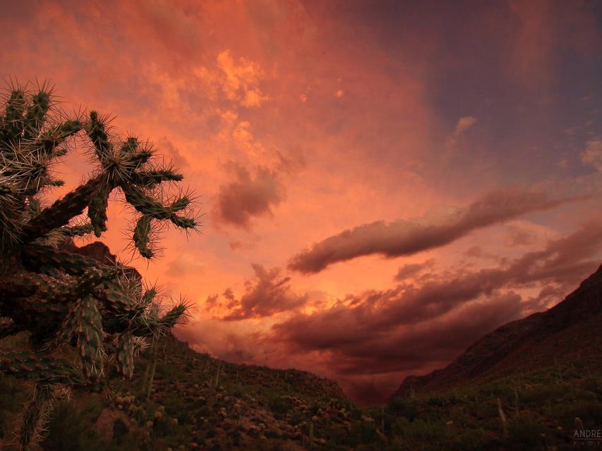
Understanding Evening
1st Definition of Evening is a “mixing” of light and night – or – dusk twilight.
There are 2 new
noun definitions that
will include the
Day & Night Seasons.
R
E
V
I
E
W
N
EW

Slide 38


Evening: 2nd Definition
[2nd definition H6153] “day”
At this point
many question
why “day”
is ever listed
as a definition
for “evening”!
Because day seems
to be opposite of
the term evening.
Because evening is defined as a “mixing
of light and night.”
However: Evening is not “the day,” but part of the
“Day Season.”
Coming up:
An examination of the phrase “between the evenings” that also qualifies for the Day Season.
Why

Slide 39

Evening: 3rd & 4th Definitions
[3rd definition H6153] even (-ing, tide)
[‘eventide’ - old English term meaning dusk "twilight.”]
[4th definition H6153] “night”
Why?
Because “night” is very different from evening;
Because “evening” is not part of the Night Season.
However … Coming up:
Another examination of
the phrase “between the evenings” that does
qualify for the Night Season.
How will “ereb” link to night?
Does “night”
sound like
a definition
for “evening”?
N
EW

Slide 40
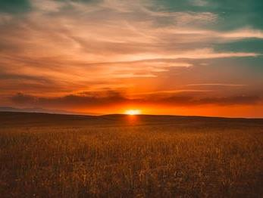
Evening H6153 Definitions
[1st def.] dusk ["twilight”] [2nd def.] “day”
[3rd def.] even (tide) ["twilight”] [4th def.] “night”
Note: Sunset [shemesh bow] is NOT
one of the definitions for <evening>.
Sunset is a point of time that ushers in <ereb>.
N
EW
“sun” H8121 shemesh; to be brilliant; the sun.
“going down” H935 bow'; a primitive root; to go or come.
“evening” H6153 is not the same as “sunset” [H8121 & H935] !
40
Notes:
Sun = 8121 going down=935

Slide 41
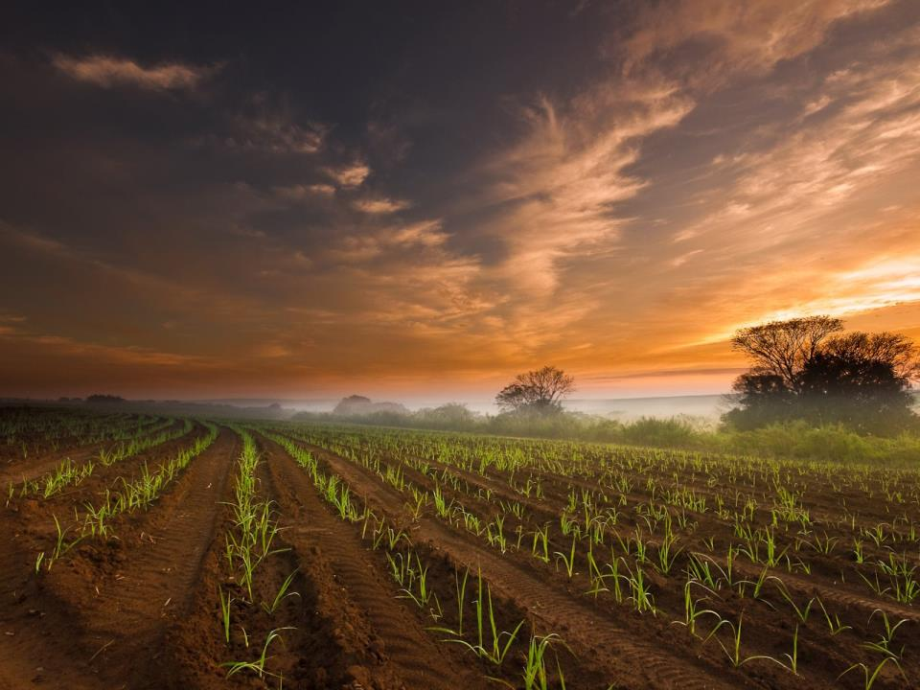

Question:
Ever wonder why there is so much emphasis
on “evening” in the Covenant Calendar study?!
“Evening” is: 1) the trickiest, most challenging term to understand correctly;
2) It is Covenant Calendar’s cornerstone!

Slide 42
#42 Section #5:
Extra work on the
primitive roots
of “evening”
<ereb> H6153
The word “evening” actually goes back to two primitive roots!

Slide 43
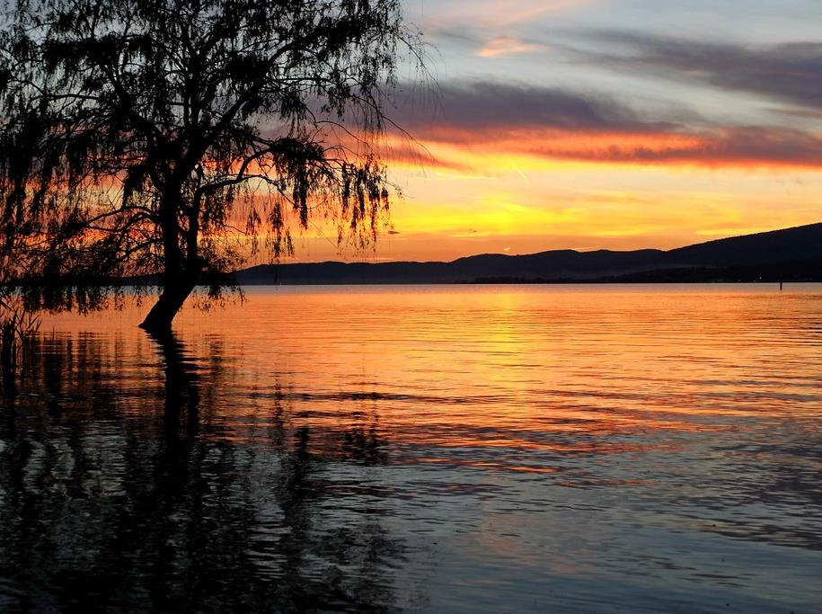

More About “primitive roots”
The first mention of “evening” in Gen 1:5 is <ereb> H6153.
HOWEVER, there are two primitive roots to be considered:
H6153 [noun] `ereb (eh'-reb); from H6150;
dusk: KJV - day, even (-ing, tide), night.
  H6150 [verb] `arab (aw-rab'); a primitive root
  [identical with H6148 through the idea of covering with a texture];
  to grow dusky at sundown:
  KJV - be darkened, (toward) evening.
    H6148 [verb] `arab (aw-rab'); a primitive root; to braid, i.e. intermix; technically, to traffic (as if by barter);
    also or give to be security (as a kind of exchange):
    KJV - engage, (inter-) meddle (with), mingle (self),
    mortgage, occupy, give pledges, be (-come, put in) surety, undertake.

Slide 44
Question:
Why are there
two primitive roots
for the word “evening”?
Answer: Because there are
two twilights
in every 24 hour cycle!
Both primitive roots are named “arab.”
Why?

Slide 45

1) H6150 “arab” aligns with evening twilight.
H6153 [noun] `ereb; from H6150; dusk: KJV - day, even (-ing, tide), night.
  H6150 [verb] `arab; a primitive root
  ([identical with H6148 through the idea of covering with a texture]);
  to grow dusky at sundown: KJV - be darkened, (toward) evening.
Duskiness described:
H6148 [verb] `arab; a primitive root; to braid, i.e. intermix; KJV - meddle (with), mingle.
Another Description
Review
How?
Twilight H5399 nesheph; properly, a breeze,
i.e. (by implication) dusk
(when the evening breeze prevails):
KJV - dark, dawning of the day (morning), night, twilight.

Slide 46


Tim 6/16/19: this is what I see … <arab H6148> is the “verb” for ALL mixings & twilights when used in the plural form for BTE – then it includes the morning twilight.
2) H6148 “arab” aligns with morning twilight.
<boqer> is always morning twilight.
Morning H1242 <boqer> dawn, break of day
Twilight <nesheph> is always a mixing.
Twilight H5399 nesheph;
properly, a breeze, i.e. (by implication) [#1] dusk (when the evening breeze prevails):
KJV - dark,
[#2] dawning of the day (morning),
night, twilight.
How does morning
& twilight align
with “arab”?
How?
H6148 [verb] `arab;
a primitive root; to
braid, i.e. intermix;
KJV - meddle (with), mingle.
H6148 defines
any kind of mixing
including <boqer> twilight.
Watch for one more condition!
The condition is going to be: arab 6148 only aligns with boqer with the phrase BTE – in the plural form, because 6148 includes ALL mixings.
Where will this lead to next?

Slide 47
Putting it all Together (H6150 & H6148)
Evening/ereb H6153
(as a noun)
Morning/boqer H1242
(as a noun)
Twilight mixing of
light and night.
Twilight at the end of
the Light Season.
Verb: dusky mixing
Twilight mixing of
night and light.
Twilight at the beginning of the Light Season.
Verb: plough; break forth
Evening/arab H6150
(as a verb/mixing)
Morning/baqar H1239
(as a verb/mixing)
<arab H6148> is the “verb” for ALL mixings & twilights.
Evening/ereb qualifies for the arab H6150 (dusky mixing).
Morning/baqar qualifies for the arab H6148 (general mixing).
Defined as: ereb arab
Defined as: boqer arab

Slide 48


Tim 6/16/19: this is what I see … <arab H6148> is the “verb” for ALL mixings & twilights when used in the plural form for BTE – then it includes the morning twilight.
You might be wondering:
This seems confusing!
Where is this leading to?
Are there any good answers?
It’s time to check another lexicon for
the next piece of information.
How?
48

Slide 49

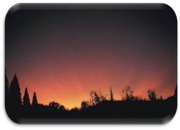
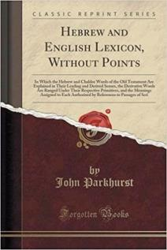


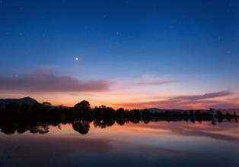
Basics of “ereb” primitive roots
FIRST
Review
ב
ר
ע
R
E
V
I
E
W
Ereb – Evening
J Parkhurst Notes: [A Hebrew Lexicon - 1762 ]
Besides the definitions of mix, mingle,
to be darkened, & duskily obscured,
he also includes the phrase:
[beyn ha arbayim]
between the eveningS;
or more literally …
between the MIXTURES.
ם
י
ב
ר
ע
ה
ן
י
ב
Does this have
anything to do
with the nouns
and verbs?

Slide 50

Beyn Ha Arbayim
ם
י
ב
ר
ע
ה
ן
י
ב
Beyn
(Between)
Arbayim
(mixtures)
Ha
(the)
Question #1:
How many “evenings/erebs” are there in 24 hours?
Question #2:
How many “mixtures/arabs” are there in 24 hours?

Slide 51
#51 Section #6:
A look at the phrase
“between the eveningS”
[“beyn ha arbayim”]
using <ereb> H6153
& <arab> H6148
A comparison of tenses:
singular & plural.
[ereb] [arab]

Slide 52
“ereb” [H6153] as a noun;
“arab” [H6150 & H6148] as a verb
NEXT!
Many definitions for arab are
descriptive action words.
Every ereb twilight is an arab “mixing.”
(noun) (verb)
Boqer/morning [the noun] identifies a “mixing”
of the Light [noun] with the Night [noun].
Arab, when it is applied to morning {boqer}, also describes the mixing of
[the action/verb]
“light and darkness” in the morning.
(Note: Every boqer is an arab only when there is a qualifier.)
BRAND
N
EW

Slide 53

“Nouns” and “Verb Tenses”
Working Together
[ereb/evening twilight] [H6150: singular arab/mixing]
[boqer/morning twilight] [H6148: plural arab/mixings]
Morning/boqer: Dawn’s 1st LIGHT
Next boqer: Dawn Begins A New Cycle
Morning action described as “arab” twilight mixture.
R
E
V
I
E
W
Sunrise
Sunset
Evening/ereb action:
“arab” twilight mixture.
Direct Sunlight
Darkness
The morning/boqer twilight qualifies for the H6148: plural arab/mixings only with the phrase “between the eveningS.”

Slide 54
#54 Section #7:
Understanding
the placement of
“between the
eveningS?”
Understanding
“arab” [H6148] is paramount for clarity on
“between the eveningS.”

Slide 55
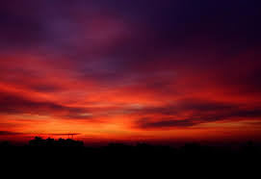
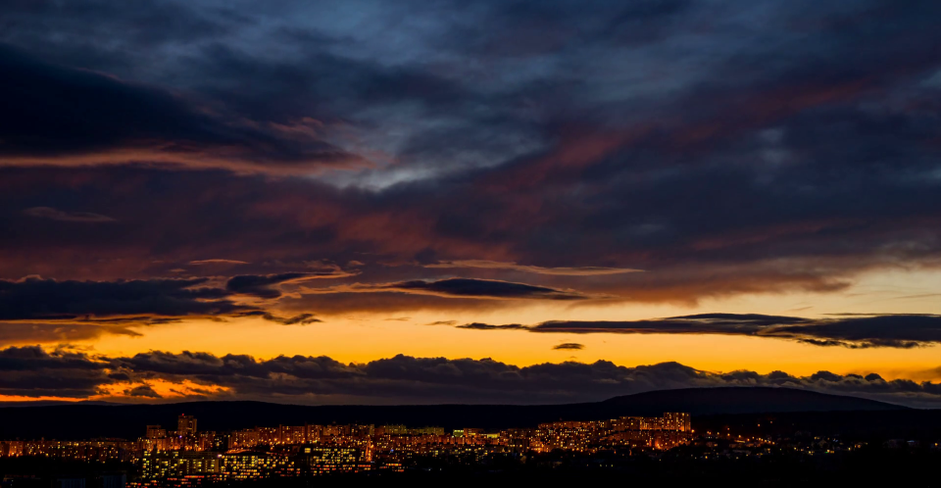
The “singular” form of “evening” <ereb> rightly claims the 1st definition as “dusk”
[the mixing of light and night].
It is always the dusk twilight.
Evening <ereb> can only claim the
2nd definition of “day” or the
4th definition of “night”
[where both components consist of no mixing]
… WHEN linked to a “qualifier”!
There will be more work
on this with Lev 6:20 in
the BTE study.
June 16/19

Slide 56
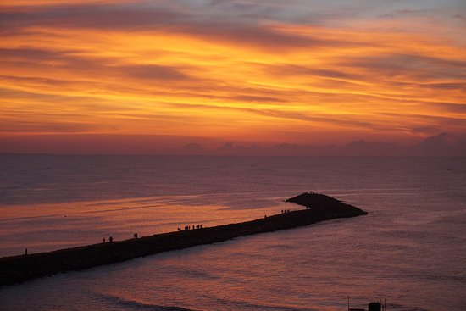
What is that qualifier?
The context of the Scripture
The term “between the eveningS.”
R
E
V
I
E
W
One “qualifier” is when the verb form of “ereb” changes from singular to plural.
Instead of only “ereb” in the verse,
the plural form of “ereb” [arab]
is present in “beyn ha arbayim” ~
or “between the eveningS.”

Slide 57


Plural form of “ereb” as
“beyn ha arbayim” ~
(“between the eveningS”)
There is only one evening
(dusk twilight) in every 24 hour cycle.
Question: How can there be
two eveningS in any 24 hour cycle?
OR: Would there be two mixingS
in any/all 24 hour cycles?
This will be demonstrated next.

Slide 58
Every 24 Hr Cycle has Two ‘arabs’
[boqer/morning arab/mixing] [ereb/evening arab/mixing]
beyn ha arbayim:
“between the mixingS”
Dawn
Dawn
Morning/boqer:“arab”
Evening/ereb:“arab”
Sunrise
Sunset
1. beyn ha arbayim
Day Season
(between the mixings)
2. beyn ha arbayim
Night Season
(between the mixings)
Direct Sunlight
Darkness
Context determines the specific beyn ha arbayim.

Slide 59

There are a total of 11 Torah Scriptures that use the phrase
“beyn ha arbayim.”
The Phrase “beyn ha arbayim” is Unique!
Watch for the full teaching on “between the evenings.”
59
Notes:
Prov 3:1-4 … remembering and keeping Yah’s law .. Finds favour and good understanding in the sight of Yah and man.

Slide 60
Section #8:
Is “evening”
<ereb> H6153
ever defined
as “afternoon”
<natah> H5186?
Is “afternoon” a
definition for
“between the evenings”?

Slide 61
Evening: Opposite Definitions
[2nd definition] day, and [4th definition] night are opposites.
Note: The 2nd & 4th defs. for evening
can be used to mean any part of the
Day Season or Night Season:
IF the qualifying phrase “between the evenings” [beyn ha arbayim] is present and context is carefully considered … or …
IF there is Divine Intervention.
Evening never takes the definition of an AFTERNOON time without a qualifying verse.
R
E
V
I
E
W
N
EW

Slide 62
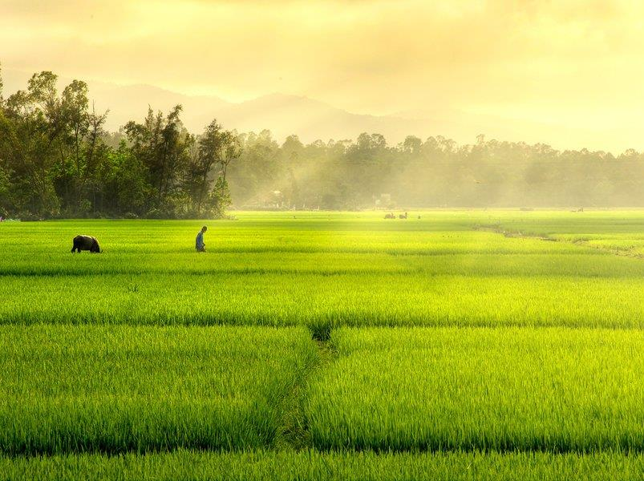
“Afternoon” H5186 <natah>
“Afternoon” is used
only once in the KJV.
Judges 19:8 And he arose early in the
morning [H1242] on the fifth day to depart:
and the damsel's father said,
Comfort thine heart, I pray thee.
And they tarried until afternoon, [H5186]
and they did eat ...
R
E
V
I
E
W
62

Slide 63
H5186: Afternoon Definition
Strong’s afternoon H5186;
to stretch or spread out;
to bend away;
bow (down)…
decline … go down, stretch (forth).
Note: The shadows of the “light of the day” begin to stretch, spread out, bend away and go down in the afternoon
when the sun passes the meridian until the shadows are overtaken by dusk.

Slide 64

Comparing
H5186: Afternoon <natah>
& H6153: Evening <ereb>
In Hebrew, these words are not related:
Through the same Hebrew Root (H5186/H6153)
Through phonetics (<natah/ereb>)
Through 1st definitions (afternoon/dusk)
That means “between the eveningS” does not always mean “afternoon.”
64

Slide 65
Grammar 101 (Part 3)
An examination
of “even to even”
in Lev 23:32[c] for
Yom Kippur or
Day of Atonement.
Will this reference of “even to even” begin
Yom Kippur at dusk?

Slide 66

Grammar
Lessons Part 3
For understanding the phrase
from Lev 23:32
“…from even unto even shall ye
celebrate your Sabbath.”
Does
“even to even”
really mean
“sunset to sunset”
in this passage?

Slide 67



Popular Verses used for Sunset Distortions
Two Torah Usages:
Gen 1:5b “And the evening and the morning were the first day.”
Lev 23:32c “… from even unto even, shall ye celebrate your sabbath.”
Two Non-Torah Usages:
Neh 13:19 “… when the gates of Jerusalem began to be dark before
the Sabbath …”
John 20:1 “The first day of the week cometh Mary Magdalene early, when it was yet dark, unto the sepulchre …”
There are 35+ Scripture witnesses for the Dawn Day that are easy to do with proper study skills.

Slide 68

Day of Atonement Challenge
Scenario:
You just invested a lot of time and effort to understand the day-start beginning with the
1st and 2nd days of creation.
You can even explain it really well.
Then:
Along comes your Sabbath pastor.
He is not interested in your new understanding.
Next you hear these words:
“… from even unto even, shall ye
celebrate your sabbath.” (Lev 23:32c)
Well, you certainly know all about
“even” from your Genesis 1 study.
BUT … you don’t know how to
answer this challenge!
Now what?
Scripture has an easy answer by following a few simple rules.

Slide 69

INTRODUCTION
In this section we are going to learn how to understand exactly when to begin Day of Atonement, and what to do with the other mandated requirements.
The Grammar 101 study is the foundation.
Remember the Grammar 101 study skills for this topic of discussion – especially the definition of “evening.”
Lev 23:26-32 Day of Atonement is one of the most controversial Scriptures used by many to demand the “Sabbath(s)” begin in the evening at sunset!
Why? Mostly because of the way we have
been taught – that “even” means “sunset.”
Of High Importance:
Read more than
9 words
to discern context!
69

Slide 70

Simple Study Techniques
Remember the basics from Gen 1;
Read all the content judiciously;
Read in context – very carefully.
So far, enough investigation has been completed on the word “evening”
to solve the Day of Atonement commencement problem.

Slide 71
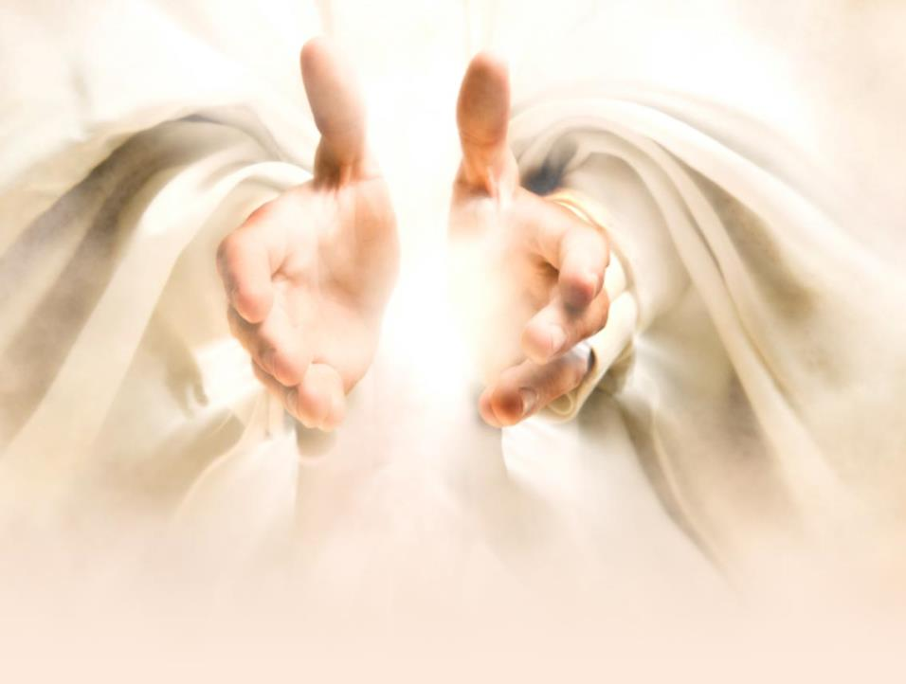
Every day since then begins with the light
of Dawn
(or boqer).
The 1st day
of creation
began with LIGHT.

Slide 72
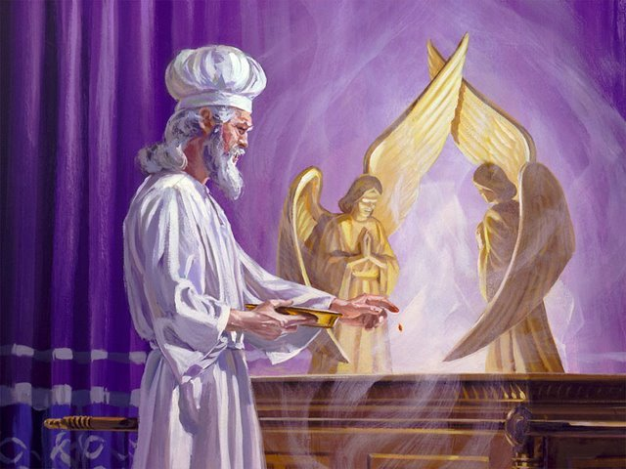
But…
What About …
Day of Atonement?
The most solemn
Sabbath of the year!?

Slide 73
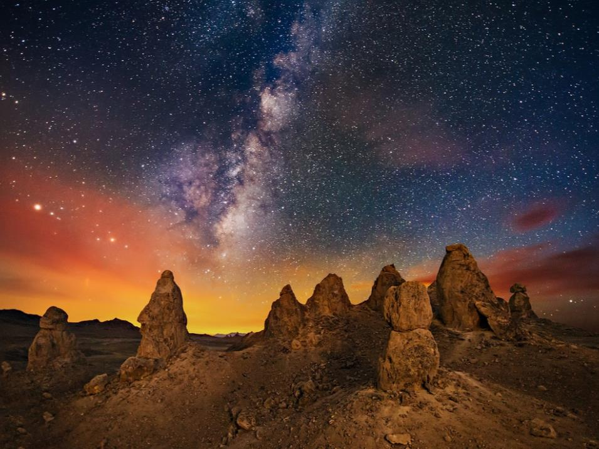
Is Lev 23:32
the Torah proof
that every
Day of Atonement (and every weekly Sabbath) begins with the
dusk of evening
at sunset?
Even if the context is
ONLY for Day of Atonement?

Slide 74

In order to understand Lev 23:32(c) we must examine …
… the full context of Lev 23:26-32 for:
the 10th day of the 7th month (Day of Atonement)
the 9th day of the 7th month (a “special” requirement)
to understand what these words really mean:
“… in the ninth day of the month at even,
from even unto even,
shall ye celebrate your Sabbath.”

Slide 75
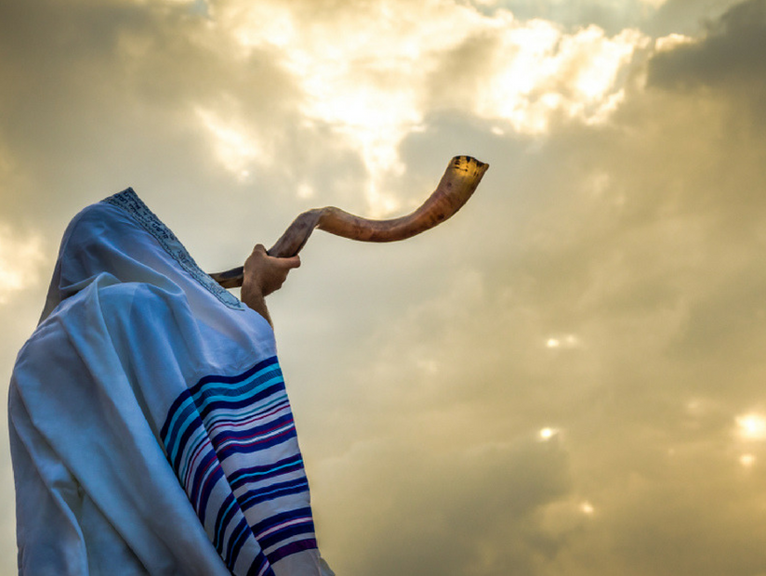
Note: This passage speaks about an
“affliction of one’s soul.”
In this study we are not addressing “what” that affliction is, but “when” it is to begin and end.

Slide 76

Three Strict Requirements
Pay attention to Yahuah’s
3 strict requirements for
Day of Atonement.
ALL are repeated 3 times;
Note where these requirements
are found;
Determine the timeframe of each requirement (9th or 10th day).
Let’s examine the Day of Atonement verses very carefully.
Remember: Day of Atonement will not change from
the 10th day of the month to the 9th day.

Slide 77
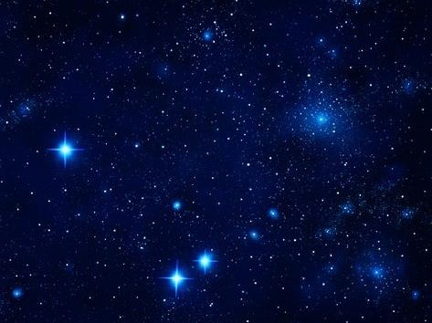
Lev 23:26-27
 | Content of Verse | Context of Verse
26
27
And Yahuah spake unto Moses, saying,
A command is being given to Moses. It will be regarding the
Day of Atonement.
Also on the tenth day of this seventh month
there shall be a
day of atonement
it shall be an holy
convocation unto you; and
ye shall afflict your souls,
and offer an offering made by fire unto Yahuah.
Date: 10th Day of the 7th Month –
1st Mention D/A - 10th day!
(Gen 1 declares the commencement moment for this day as “dawn.”)
Name: Day of Atonement Celebration – 2nd Mention D/A - still on the 10th day.
Status: Holy Sabbath [H7676] just
as the weekly Sabbath [H7676].
3rd Mention D/A - the 10th day!
*1st Requirement for Observation:
“afflict your soul”
*This is the 1st mention of 3.
3rd Requirement - Sacrifices:
(Will not be addressed as the
sacrifices have been fulfilled.)

Slide 78
Lev 23:28-29
 | Content of Verse | Context of Verse
28
29
And ye shall do no work
in that same day:
for it is a day of atonement,
to make an atonement
for you before Yahuah
your Elohim.
*2nd Requirement for Observation:
“shall do NO work”
*This is the 1st mention of 3.
4th Mention D/A-same day-the 10th.
Context is: Day of the Atonement -
5th & 6th Mention D/A on the 10th .
Purpose: Atonement for man’s sins.
For whatsoever soul it be that shall not be afflicted in that same day,
he shall be cut off from among his people.
*1st Requirement for Observation:
“afflict your soul”
**This is the 2nd mention of 3 the
1st requirement is emphasized!
7th Mention D/A – same 10th day!
Consequence for disobedience to the 1st Requirement: that person would not be part of the genealogy
of the Messiah.

Slide 79
Lev 23:30-31
 | Content of Verse | Context of Verse
30
31
And whatsoever soul it be that doeth any work in
that same day,
the same soul will I destroy from among his people.
*2nd Requirement for Observation:
“shall do NO work”
**This is the 2nd mention of 3
the 2nd requirement is emphasized!
8th Mention D/A – same 10th day.
Consequence for disobedience
to the 2nd Requirement:
that soul will be destroyed.
Ye shall do no manner of work:
It shall be a statute for
ever throughout your
generations in all
your dwellings.
*2nd Requirement for Observation:
“shall do NO work”
***This is the 3rd mention of 3 the
2nd requirement is emphasized!
Status of Requirement:
9th Mention D/A – (the 10th day)
is a statute to be observed forever
in all generations.

Slide 80

Have You Been Observant?
Have you noticed how many times Day of Atonement
has been emphasized
thus far for the 10th day
of the 7th month?
times!
Yahuah has mentioned Day of Atonement [as the 10th day] enough times thus far for us to know what the context is. There is no reason to doubt what the requirements are for this extremely important day.
However, another “day” is
going to be mentioned soon.
Why?

Slide 81
Lev 23:32 (a, b, c)
 | Content of Verse | Context of Verse
32 a. b.
c.
It
shall be unto you a sabbath of rest,
Date: Context of “IT” from vs 27 is
still the 10th Day of the 7th Month.
10th Mention for D/A on the 10th!
Context: “Sabbath of rest” [the
11th Mention for the 10th day] refers to the qodesh Day of Atonement.
Slight Change of Context Right Here!
Context moves from Day of Atonement to “affliction”!
and
ye shall afflict your souls:
*1st Requirement for Observation:
“afflict your soul”
***This is the 3rd mention of 3!
Note: Right here in verse 32 the context is a required “affliction” for Day of Atonement, but there’s more!

Slide 82
Lev 23:32 (d, e)
 | Content of Verse
32 d. e.
Context of Verse 32 has moved from the 10th day to the 9th day.
[ye shall afflict your souls]
in the ninth day of the [7th] month
at even,
(of the 9th day the “affliction of one’s soul” begins.)
What is identified on the 9th day?
It is the affliction that now begins on the 9th day (of the 7th month).
[The context for this phrase is STILL “affliction” in preparation for Day of Atonement on the 10th day.]
What time on the 9th day?
The context for affliction–begins at “even” – the time of dusk twilight.
When?
No! Yahuah did not change His mind
to begin Yom Kippur on the 9th day!
-
-

Slide 83
Lev 23:32 (f, g)
 | Content of Verse | Context of Verse
32 f. g.
from even unto even,
shall ye celebrate [H7673] your Sabbath.
Length of time for “affliction requirement”: The context has not changed from affliction – it lasts 24 hours from the “even” of the 9th day until
the “even” of the 10th day for Yom Kippur/Day of Atonement.
Declaration: affliction of one’s soul begins 12 hours in advance to be prepared for the celebration of [the12th Mention] Atonement Sabbath at “dawn – break of day” on the 10th day
of the 7th month!
H7673 shabath; a primitive root; to repose, [relax],
i.e. desist from exertion, [inactivity].

Slide 84

Two Strict Requirements
Repeated 3 Times Each
“thy soul shall do no work”
Found in:
vs 28, 30, 31.
Timeframe: 24 hrs.
on the full 10th day,
7th month;
(dawn to dawn).
“afflict your soul”
Found in:
vs 27, 29, 32.
Timeframe: 24 hrs.
12 hrs. 9th day (dusk to dawn);
12 hrs. 10th day
(dawn to dusk).
Obedience to both requirements was called
“celebrating [with inactivity] on the Day of Atonement.”

Slide 85
Day of Atonement (Dawn)
Affliction Timeframe
8th day |  |  |  | 9th Day of Preparation |  |  |  | 10th Day of Atonement |  |  |  | 11th Day
With the DAWN Format:
The 9th day of the month begins at “dawn” on the 9th day!
The “affliction” begins at “even on the 9th day.”
The “affliction” continues to the “even” of the 10th day to fulfill the 24 hour requirement.
The “affliction of one’s soul” has been in process 12 hours upon the arrival of “dawn” ON the “Day Season” of Day of Atonement. The affliction continues another 12 hours during the Sanctuary services – ending at even!
Absolutely “no work” on the 24 hours of Day of Atonement until
dawn on the 11th day.
The Most Important Requirement for “Affliction of One’s Soul”
ON the Day of Atonement is now Completely Fulfilled!
No Work Timeframe

Slide 86
Day of Atonement (Sunset)
Sunset
Affliction Timeframe
8th day |  |  |  | 9th Day of Preparation |  |  |  | 10th Day of Atonement |  |  |  | 11th Day
No Afflicting Done
(Do Not Work)
With the Sunset Theory:
The 9th day of the month actually begins at “even” on the 8th day.
The “affliction” would then begin at the [sunset] “even on the 8th day.”
The “affliction” continues from the “even” of the 8th day to “even” on the 9th day.
The “affliction requirement” is fulfilled before Day of Atonement even begins.
No “affliction of one’s soul” can occur ON the Day of Atonement!

Slide 87
Day of Atonement (Sunset)
One 24 Hour
Sunset Affliction
Timeframe
8th day |  |  |  | 9th Day of Preparation |  |  |  | 10th Day of Atonement |  |  |  | 11th Day
With the Sunset Theory day-start:
If one wishes to afflict their soul to the “even” of Day of Atonement – and they begin at sunset [even] on the 8th day of the month – their affliction will be a duration of 48 hours!
The Most Important Requirement for
“Affliction of One’s Soul” for only 24 hours spread over the 9th and 10th days causes the statutes for
Day of Atonement to be Completely Disregarded!

Slide 88

Day of Atonement Solution
The New Scenario:
Next time you are in a similar situation, you
will have the simple, truthful answer to the commencement time for Day of Atonement.
Then:
You can practice your study skills by:
Looking up those definitions!
Reading enough content!
Reading in context very carefully.
Learning by teaching!
That’s great!
Yahuah’s ways are always simple, easy and orderly!

Slide 89
With your Bible, an exhaustive concordance and good study skills,
you will be able to answer
most calendar challenges easily.
May Yahuah Bless You Abundantly!
The End
Notes:
Sept 22 p 19 work up 820 pm

Slide 90


Enjoy these beautiful mornings that usher in Yahuah’s
Creation Covenant Day!
All Questions & Comments
are welcome. Send to:
Charlene Fortsch or
Tim Astleford
charlene@studythecalendar.com
tim@studythecalendar.com

