Slide 1
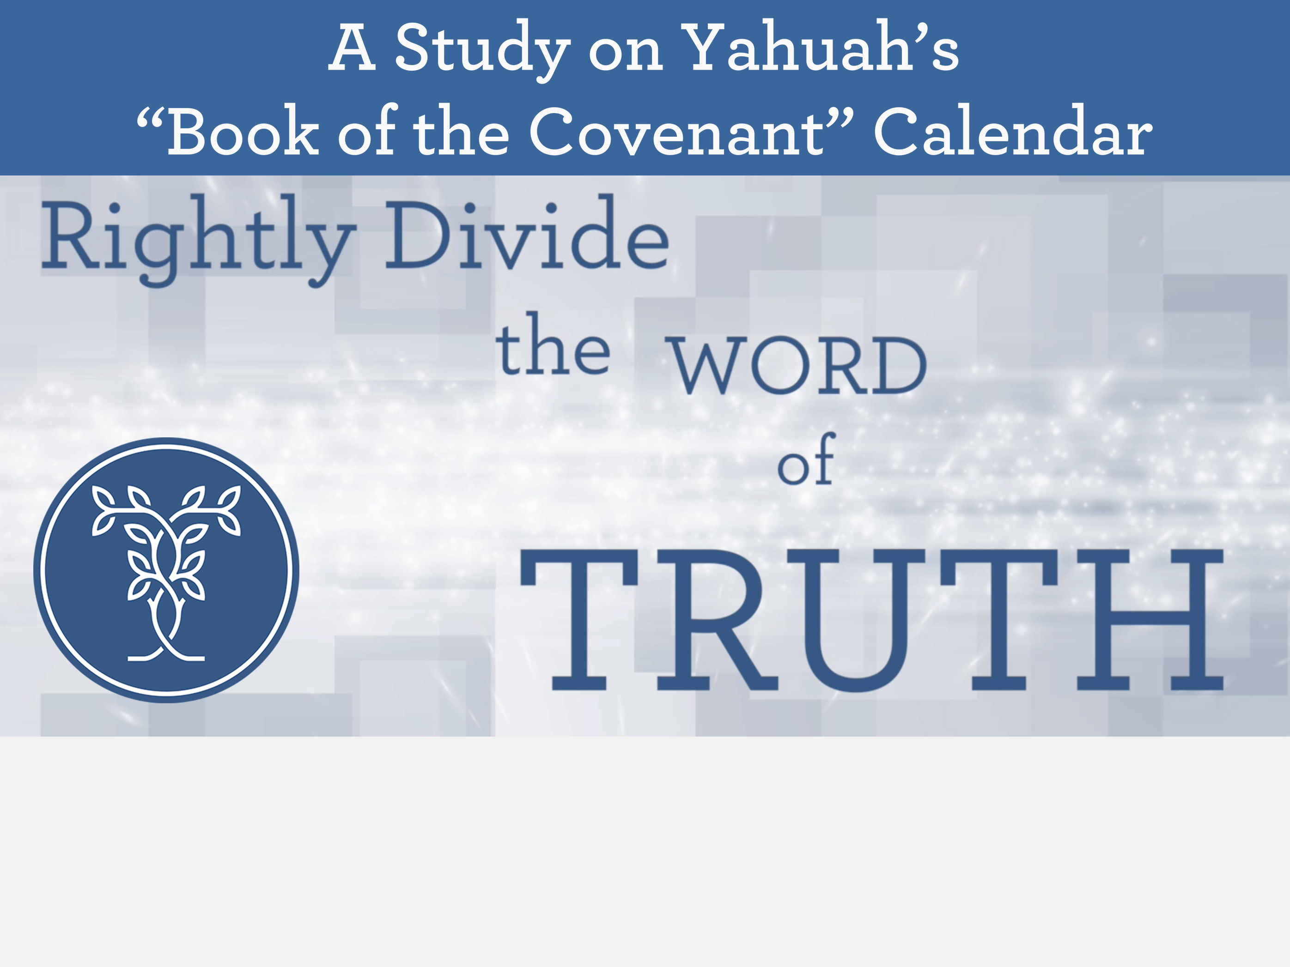

The Honour of Lepers!
Notes:
Slides for helpers on slide 2.

Slide 2
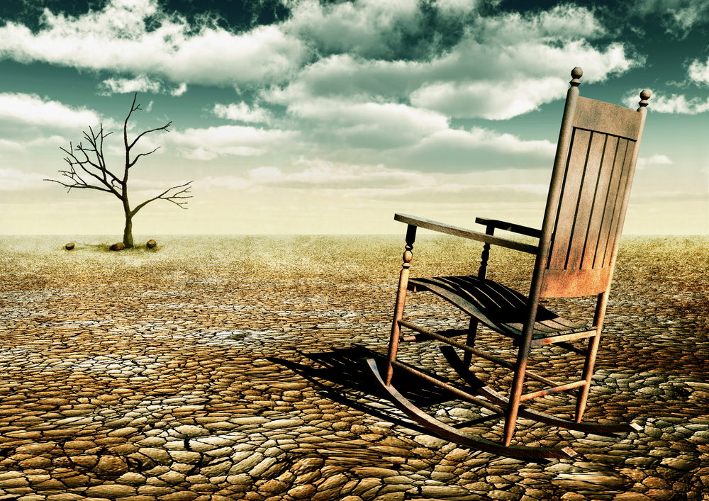
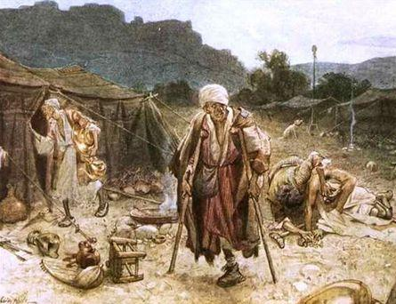
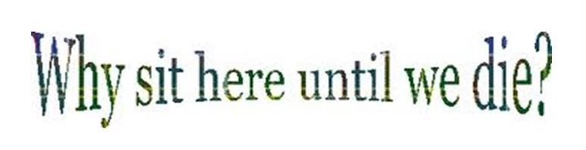
The Honour of Lepers!
May 30/18 – corrected slide 24 that had 1 Kings instead of 2 Kings.
June 1/18: complete facelift on whole ppt. Should redo charts on 28-29 when time. Old charts at the end of the ppt. See 32 for extra chart items.
Charl’s slides (12):
1-2-3-4-7-12
24-35-36-44-45-46-47 End
Becky’s slides: (12) 5-6-8- 14-15-16 38-39-40-41-42-43
King’s slides: (7) Don W 10-11 23 28-29-30-31
Elisha’s slides: (7) Walter 10-11 23 28-29-30-31
Leper Slides (8) Vivian 13 17-18-19- 32-33-34 3 7
2 Kings
Chapters
6 & 7

Slide 3

Yahuah is presenting to the minds of many, divinely appointed precious gems of truth, appropriate for our time. Yahuah has rescued these truths from the companionship
of error, and has placed them in their proper frame-work. When these truths are given their rightful position in Yahuah's great plan, when they are presented intelligently and earnestly, with reverential awe by Yahusha’s servants, many will conscientiously believe because of the weight of evidence, without waiting for every supposed difficulty (which may suggest itself to their minds), to be removed.
Words of Wisdom
3

Slide 4

Counsel from Colossians 1
Along with Paul, this is our prayer
for those that are searching
for Yahusha’s end time truths.
9 For this cause we also, since the day we heard it, do not cease to pray for you, and to desire that ye might be filled with the knowledge of his will in all wisdom and spiritual understanding;
10 That ye might walk worthy of the Master unto all pleasing, being fruitful in every good work, and increasing in the knowledge of Yahuah;
12 Giving thanks unto the Father, which hath made us meet to be partakers of the inheritance of the saints in light:
13 Who hath delivered us from the power of darkness, and hath translated us into the kingdom of his dear Son.

Slide 5

A Lesson From the Lepers
This is a very interesting Scriptural account about some lepers that were definitely not part of society. However, at the end of the story, everyone is grateful for these four beggarly lepers. You would be too.
The details in this story reveal the “new day” begins with “dawn” … not “sunset” the day before. We might feel lepers have nothing to contribute to us or society; that they are not educated, refined in culture – and certainly they don’t seem to care for others because they are so needy themselves.
As we begin our search, there may be some questions:
Would you be wondering how these four rejected lepers of society
could possibly understand when Yahuah’s new 24 hour cycle begins?
Do they have knowledge that would contribute to our understanding?
Will we choose to learn something from the lepers?
Or, will we learn something we were not expecting?

Slide 6
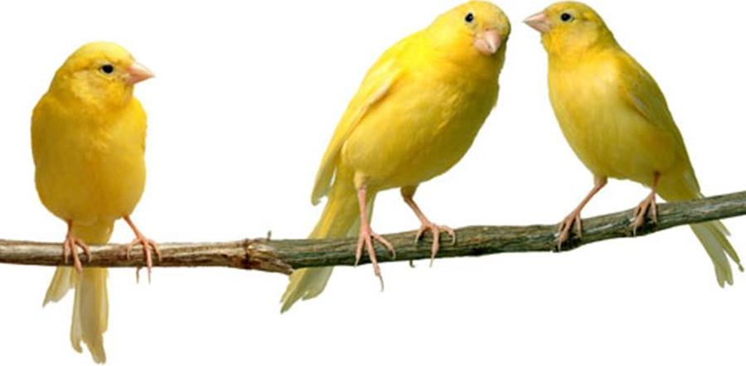
We Should Know By Now
After a thorough examination of Yahuah’s Calendar for day-start,
month-start and year-start, there should be a good understanding that
His Covenant of the Day begins with LIGHT – in the morning – the moment when night is over and the new day enters.
With over 35 Bible Testimonies, (along with the strongest witness in
the ministry of Yahusha), there shouldn’t be any reason, or need, to examine yet another “day-start” study.
However, this Leper Study has a special purpose for those aligning with the Covenant Calendar. The experience of the Lepers is one that many of us will go through in these last end times.
The lepers have
something
to teach us!

Slide 7

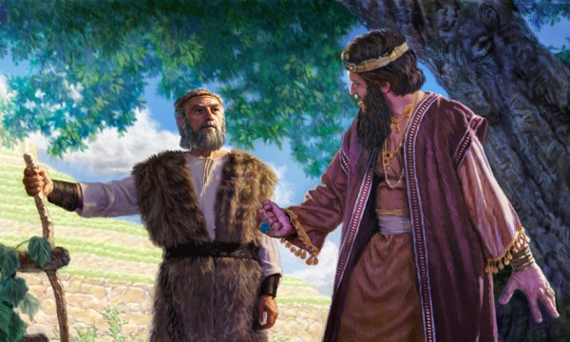
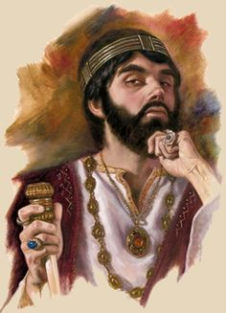
The Story Begins in 2 Kings 6:24-33
Introduction
The land of Samaria was
experiencing severe problems.
A drought had inflicted difficult
times upon the people.
Then, Benhadad of Syria, moved in with his army laying siege upon it.
Food was at a premium to say the least.
The extreme hunger was so severe people
began to eat their own children!
Samaria’s King Jehoram (son of King Ahab)
blamed everything on Elisha.
His intent was to plan, and act upon a scheme, to kill Elisha.

Slide 8
2 Kings 6:24-29 (~894 BC)
24 And it came to pass after this, that Ben-hadad king of Syria gathered all his host, and went up, and besieged Samaria.
25 And there was a great famine in Samaria: and, behold, they besieged it, until an ass's head was sold for fourscore [80] pieces of silver, and the fourth part of a cab of dove's dung for five pieces of silver.
26 And as the king of Israel [King Jehoram] was passing by upon the wall, there cried a woman unto him, saying, Help, my lord, O king.
27 And he said, If Yahuah does not help thee, whence shall I help thee? out of the barn floor, or out of the winepress?
28 And the king said unto her, What aileth thee? And she answered,
This woman said unto me, Give thy son, that we may eat him to day,
and we will eat my son to morrow.
29 So we boiled my son, and did eat him: and I said unto her on the next day, Give thy son, that we may eat him: and she hath hid her son.

Slide 9

2 Kings 6:30-31
King Jehoram’s Threat to Elisha
30 And it came to pass, when the
king heard the words of the woman,
that he rent his clothes; and he
passed by upon the wall, and the
people looked, and, behold, he had
sackcloth within upon his flesh.
31 Then he said, Yahuah do so and
more also to me, if the head of Elisha
the son of Shaphat shall stand on him this day.
  Question: Which day? A “day” that ends
  at sunset, or a “day” that ends with the break of daylight?

Slide 10
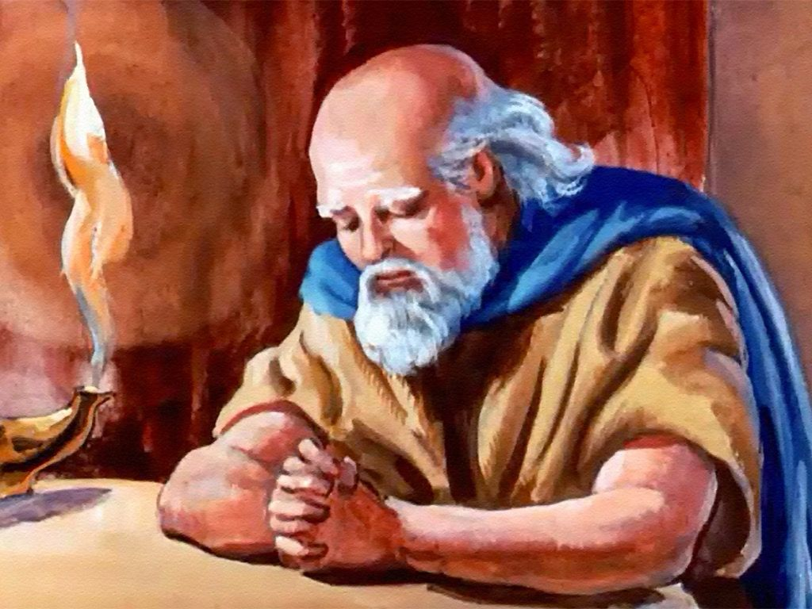
2 Kings 6:32-33
Elisha Has No Fear
32 But Elisha sat in his house [on that day], and the elders sat with him; and the king sent a man from before him: but ere the messenger came to him,
he said to the elders, See ye how this son of a
murderer hath sent to take away mine head [this day]?
look, when the messenger cometh, shut the door,
and hold him fast at the door: is not the sound of his master's feet behind him?
33 And while he yet talked with
them, behold, the messenger
[of the king] came down unto him
[this day]: and he said, Behold,
this evil is of Yahuah; why should
I wait for Yahuah any longer?

Slide 11


2 Kings 7:1
What was Elisha’s Response?
1 And Elisha said, “Hear the word of Yahuah. Thus saith Yahuah, To morrow about this time shall a measure of fine flour be sold for a shekel, and two measures of barley for a shekel, in the gate of Samaria.
2 Then a lord on whose hand the king leaned answered the man of Yahuah, and said, Behold, if Yahuah would make windows in heaven, might this thing be?
And he said, Behold, thou shalt see it with thine eyes, but shalt not eat thereof.
Question: Is King Jehoram’s referral to
“this day” the same as Elisha’s referral
to his “tomorrow”?

Slide 12

Definition for “to morrow”
“to morrow” in Hebrew is <machar>. The definitions are:
Strong’s: H4279 - <machar>
1) tomorrow, in time to come, in the future
a) tomorrow (as the day following the present day)
b) in future time
In this study we will seek answers to these questions:
When is this juncture for the next cycle exchange?
Does the cycle exchange arrive at Sunset as most
Christian Sabbath-keepers profess?
What about a cycle exchange at midnight, noon or sunrise?
Or will Dawn prove to be the Scriptural point of
the cycle exchange in this testimony?

Slide 13

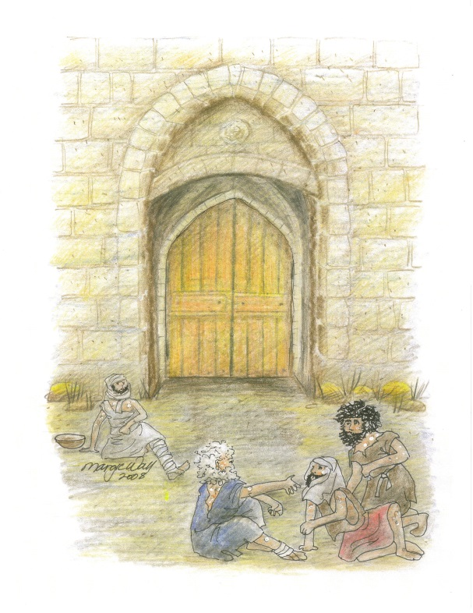
2 Kings 7:3-5
The Lepers Have a Plan
And there were four leprous men at the entering in
of the gate: and they said one to another,
Why sit we here until we die?
If we say, We will enter into the city, then the famine is in the city, and we shall die there: and if we sit still here,
we die also. Now therefore come, and let us fall
unto the host of the Syrians: if they save us
alive, we shall live; and if they kill us,
we shall but die.
And they rose up in the twilight, to go unto
the camp of the Syrians: and when they were
come to the uttermost part of the camp of
Syria, behold, there was no man there.

Slide 14
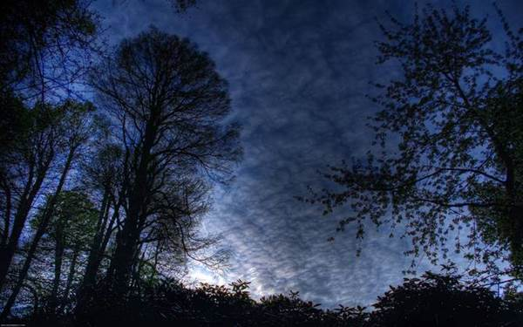
The Meaning of “twilight”
Strong’s: H5399 <nesheph> from OT:5398; properly, a breeze, i.e. (by implication) [#1] dusk
(when the evening breeze prevails): KJV - dark,
[#2] dawning of the day (morning), night, twilight.
  H5398; nashaph; a primitive root; to breeze, i.e. blow up fresh (as the wind): KJV - blow.
Etymological Dictionary of the Hebrew Language: twilight: <nesheph>
  1. to blow, to blow fiercely, 2. to become dark,
  3. evening twilight, evening, morning twilight,
  properly denotes the time of the evening breeze;
  [See Gen 3:8, when Yahuah, walked with Adam and Eve
  in the Garden of Eden.]
  4. Blowing

Slide 15
The Meaning of “twilight”
The Interlinear Scripture Analyzer translates this word as: the gloaming.
The Webster’s Encyclopedic Dictionary claims the word – gloaming – is of Scottish origin for - fall of the evening, twilight evening period.
These four definitions
designate twilight:
1st as “evening” & 2nd as “dawn.”
Will that hold true in this study?

Slide 16
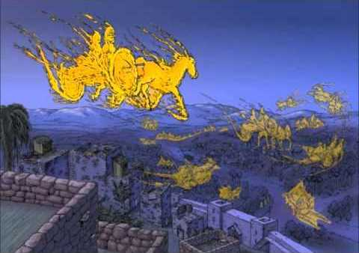
2 Kings 7:6, 7 – The Syrians Flee
And why did the Syrians flee in such terrified haste?
6 For Yahuah had made the host
of the Syrians to hear a noise of
chariots, and a noise of horses,
even the noise of a great host: and
they said one to another, Lo, the king
of Israel hath hired against us the
kings of the Hittites, and the kings
of the Egyptians, to come upon us.
  Yahuah had created a miracle that terrified the Syrians to the bone! They fled with only the clothes on their back!
7 Wherefore they arose and fled in the twilight, and left their tents, and their horses, and their asses, even the camp as it was, and fled for their life.
  Which twilight? According to the definitions,
  this can be “evening” or “morning” twilight.
  Confirmation follows in verse 12.

Slide 17
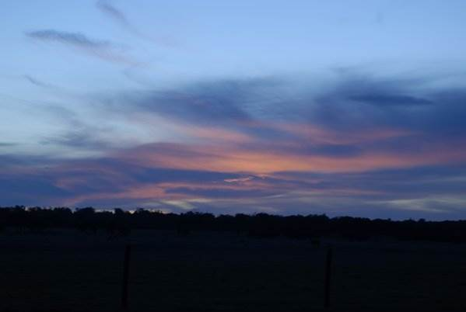
2 Kings 7:8
Miracles & Surprises for the Lepers
Upon entering the camp, the hungry lepers began feasting on all the food and stashing valuable items. However, it is very important to note the honorable thoughts of the lepers!
8 And when these lepers came to the uttermost part of the camp, they went into one tent, and did eat and drink, and carried thence silver, and gold, and raiment, and went and hid it; and came again, and entered into another tent,
and carried thence also, and went and hid it.

Slide 18
2 Kings 7:9
Lepers Avoid the Consequences
Then they said one to another, We do not well: this day is a day of good tidings, and we hold our peace: if we tarry till the morning light, some mischief [punishment] will come upon us: now therefore come, that we may go and tell the king's household.
Does it not appear the
leper’s “day” ended with
the morning light?

Slide 19
2 Kings 7:10
Lepers Share the Good News
10 So they came and called unto the porter of the city: and they told them, saying,
We came to the camp of the Syrians, and, behold, there was no man there, neither voice of man, but horses tied, and asses tied, and the tents as they were.

Slide 20
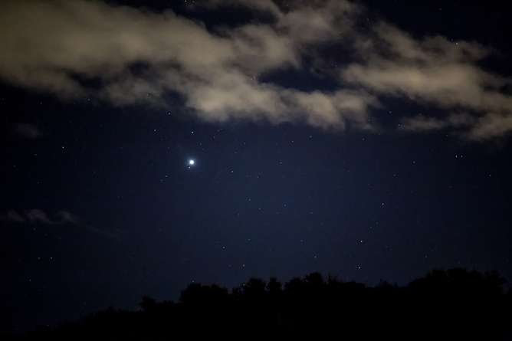
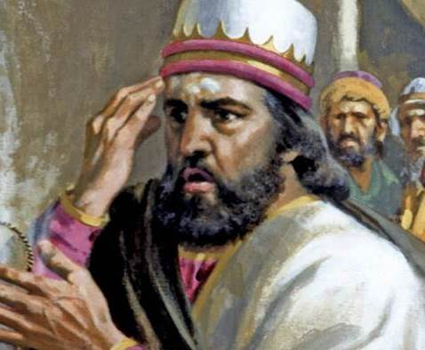
2 Kings 7:11-12
News for King Jehoram
11 And he called the porters; and they told it to the king's house within.
12 And the king arose in the night, and said unto his servants, I will now shew you what the Syrians have done to us. They know that we be hungry; therefore are they gone out of the camp to hide themselves in the field, saying, When
they come out of the city, we shall catch them alive, and get into the city.
  arose in the night [this is after the former evening “twilight”].

Slide 21
2 Kings 7:13-15
King Jehoram Investigates
13 And one of his servants answered and said, Let some take, I pray thee, five of the horses that remain, which are left in the city, (behold, they are as all the multitude of Israel that are left in it: behold, I say, they are even as all the multitude of the Israelites that are consumed:)
and let us send and see.
14 They took therefore two chariot horses; and the king sent after the host of the Syrians, saying, Go and see.
15 And they went after them unto Jordan: and, lo, all the way was full of garments and vessels, which the Syrians had cast away in their haste.
And the messengers returned, and told the king.

Slide 22
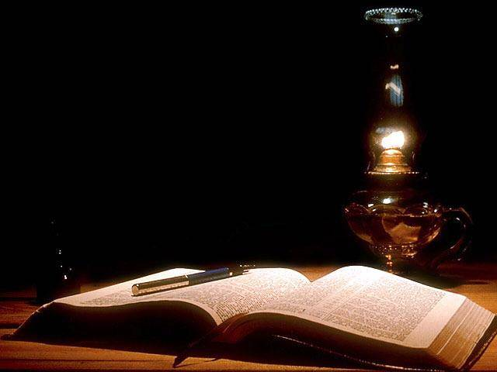
2 Kings 7:16-17 The Siege is Over!
16 And the people went out, and spoiled the
tents of the Syrians. So a measure of fine flour
was sold for a shekel, and two measures of
barley for a shekel, according to the word of
Yahuah.
17 And the king appointed the lord on whose hand he leaned to have the charge of the gate: and the people trode upon him in the gate, and he died,
as the man of Yahuah had said, who spake when the king came down to him.

Slide 23
2 Kings 7:18-20
Elisha’s Prophecy Fulfilled
18 And it came to pass as the man of Yahuah had spoken to the king, saying, Two measures of barley for a shekel, and a measure of fine flour for a shekel, shall be to morrow about this time in the gate of Samaria:
19 And that lord answered the man of Yahuah, and said, Now, behold, if Yahuah should make windows in heaven, might such a thing be? And he said, Behold, thou shalt see it with thine eyes, but shalt not eat thereof.
20 And so it fell out unto him: for the people trode upon him in the gate,
and he died.

Slide 24
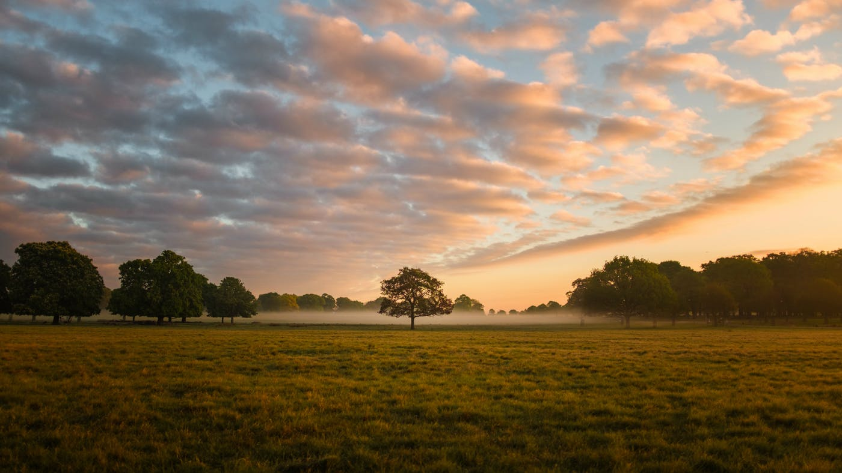


Is Everyone’s “day” on the Same Page?
Elisha’s
“day.”
King
Jehoram’s
“day.”
The Leper’s
“day.”

Slide 25
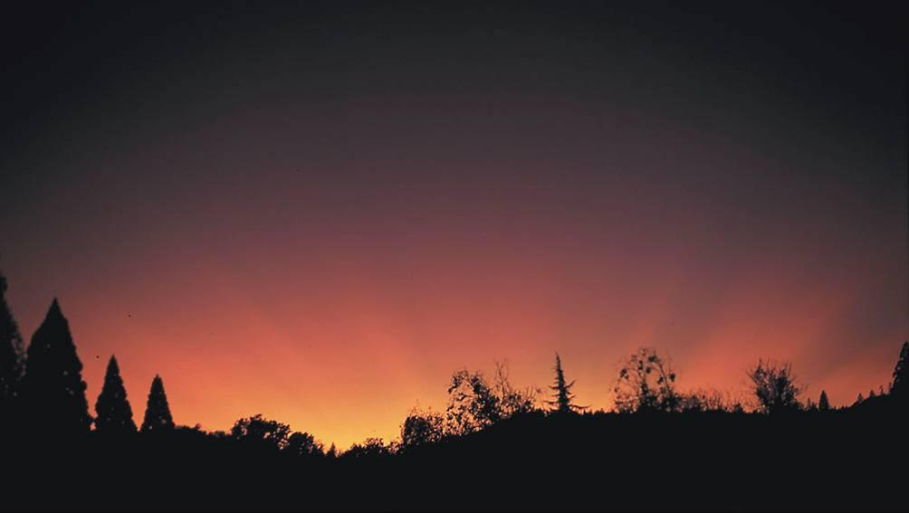
King Jehoram’s “Day”
King Jehoram was the son of the very wicked King Ahab of the northern tribes of Israel.
Most of the time the kings of Israel followed the pagan ways of worship and led the people to practice these wicked ways.
Who knows whether King Jehoram was honoring Yahuah’s “Covenant of the Day”
at this time?!
Or, will the details in this account reveal the truth about this matter?

Slide 26
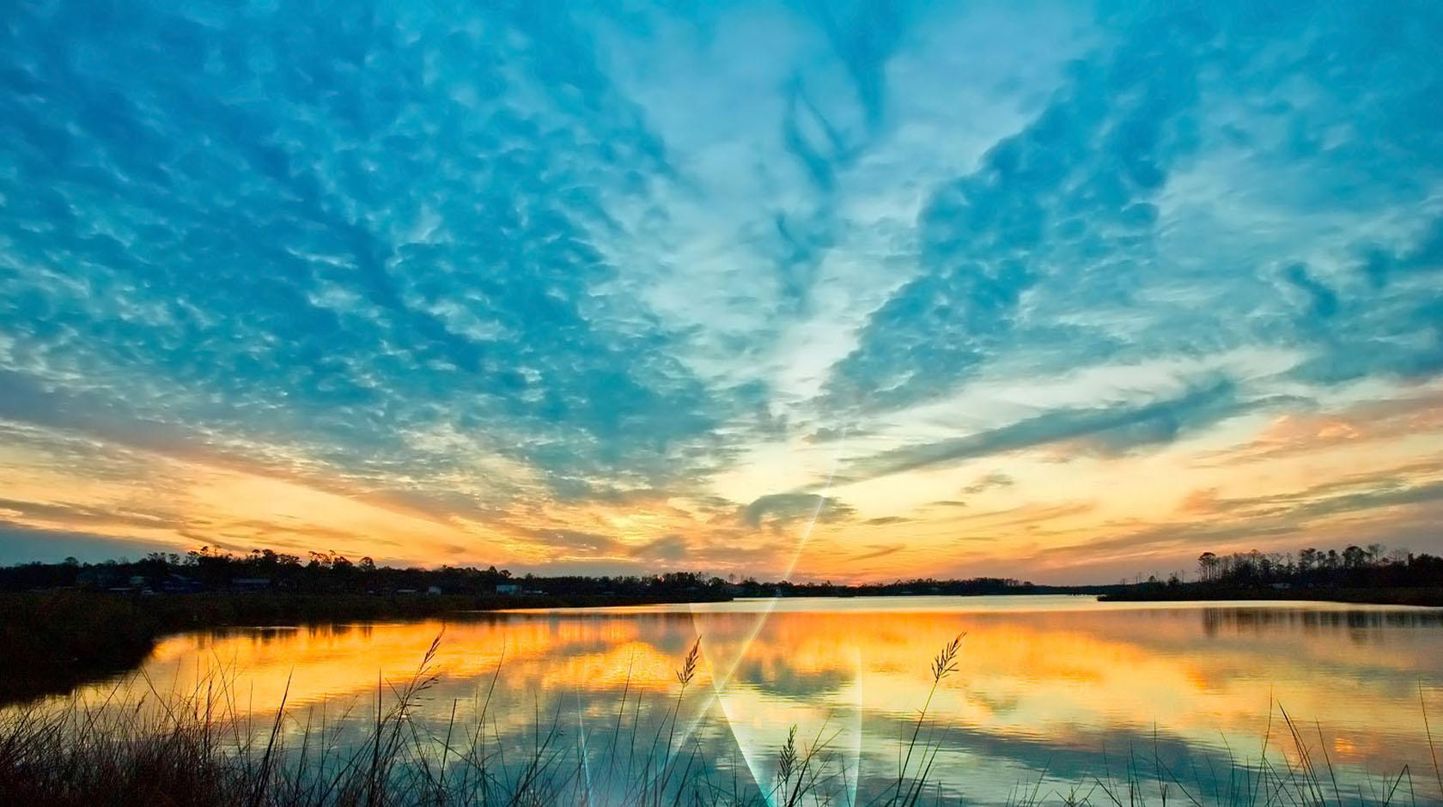
When is “King Jehoram’s day”?
The terminology around the events of
King Jehoram is given as “this day.”
2 Kings 6:26 And as the king of Israel [King Jehoram] was passing by upon the wall …
2 Kings 6:31 Then he said, Yahuah do so and more also to me, if
the head of Elisha the son of Shaphat shall stand on him this day.
  According to the context, this event is taking place during
  the Day Season hours, not the evening, or Night Season.
  Jehoram’s threat to Elisha is to be carried out on this day.
  Which day is “this day”? A “day” that ends at sunset,
  or a “day” that ends with the break of daylight.
Let’s examine the two choices:

Slide 27
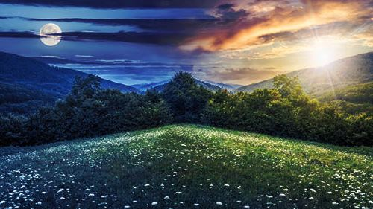
When Does “King Jehoram’s day” Begin?
At Sunset? … to the next Sunset?
Depending on when King Jehoram’s day begins, he only has so much time to
carry out
his death threat against Elisha before
“his day” ends!
With a Sunset day, the threat given during the
“Day Season” will end in less than 12 hours.
Night Season
Day Season
Or …
At Dawn? … to the next Dawn?
With a Dawn day, the threat given during the
“Day Season” can extend nearly 24 hours!
Day Season
Night Season
27

Slide 28

When is Elisha’s “Day”?
The terminology around the events of Elisha
is given as “tomorrow.”
2 Kings 6:32 But Elisha sat in his house [on that “same day” of the king’s proclamation], and the elders sat with him … he said to the elders, See ye how this son of a murderer hath sent to take away mine head [this day]? Look, when the messenger cometh, shut the door, and hold him fast at the door …
2 Kings 6: 33 And while he [Elisha] yet talked with them,
behold, the messenger came down unto him [this day] …
2 Kings 7:1 And Elisha said, “Hear the word
of Yahuah. Thus saith Yahuah, To morrow
about this time shall a measure of fine flour
be sold for a shekel, and two measures of
barley for a shekel, in the gate of Samaria.

Slide 29
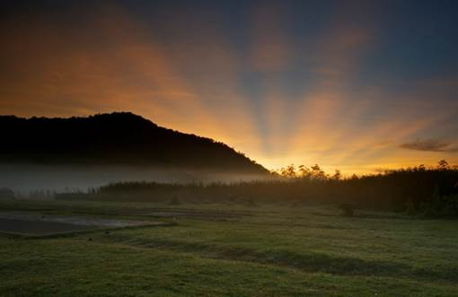

Prophet Elisha’s “Day”
The prophet Elisha would have kept and taught Yahuah’s Covenant Laws including the Laws of Moses and the Covenant of the Day. (See Jer 33:20-26.)
He would have understood the day begins with morning <boqer>, or the first light
that breaks the day.

Slide 30


When Did Elisha’s “Day” Begin?
Dawn
Dawn
Sunset
1st DAY Season
1st NIGHT Season
2nd DAY Season
1. King Jehoram
threatens Elisha’s
life before
this day is over.
2 Kings 6:31
2. Elisha is not
worried as the “day”
is not over until the
morning light.
1 Kings 7:1
There is a Forward Progressive Movement of the verses and the events.

Slide 31
Where is “tomorrow” for Elisha?
Dawn
Dawn
Sunset
1st DAY Season
1st NIGHT Season
2nd DAY Season
3. Elisha’s prophecy
fulfilled on the
“tomorrow” about the same time on the
next day from
King Jehoram’s
original threat.
2 Kings 7:18
1. King Jehoram
threatens Elisha’s
life before
this day is over.
2 Kings 6:31
2. Elisha is not
worried as the “day” is not over until the
morning light.
2 Kings 7:1
Forward Progressive Movement of the verses and the events.
Do you think Elisha may have the “last word”?

Slide 32
The Leper’s “Day”
The Lepers were from Samaria, ruled by King Jehoram.
We do not know the length of time they were living outside the city gate.
If the people of Samaria were following King Jehoram’s ways, including how he honored the
“day-start” – is it possible the Lepers
were following the same pattern?
Or, were the Lepers practicing
an alternative “day-start”?
Or, does it matter?
Note: The Lepers will have the
clues to solve this whole mystery!

Slide 33


When is the Leper’s “Day”?
The terminology around the events of the Lepers
is given as “twilight” and “morning light.”
2 Kings 7:5 And they [the Lepers] rose up in the twilight, to go unto
the camp …
2 Kings 7:7 Wherefore they [Syrians] arose and fled in the twilight …
[they] fled for their life.
2 Kings 7:8 And when these lepers came to the uttermost part of
the camp [after the evening twilight!], they [found the
camp deserted]!
2 Kings 7:9 Then they said one to another, We do not well: this day
is a day of good tidings … if we tarry till the morning
light, some mischief will come upon us …
There is more information in the Scriptures
for the Lepers
than for the King, or for Elisha.

Slide 34
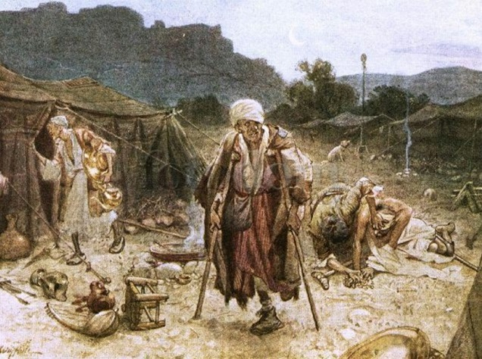
The next slide charts the major timed events of the King, Elisha and Lepers.
This calendar testimony
must demonstrate the
Forward
Progressive
Movement of:
#1 The verses from:
1 Kings 6:31
2 Kings 7:5, 8-10
2 Kings 7:12-15
2 Kings 7:16 & 18
#2 The events of the
next 24 hours from:
Day 1 Light Season
Twilight (dusk)
Night of Day 1 (to …)
Tomorrow of
Day 2 (about the
same time as Day 1)

Slide 35

Forward Progressive Movement
1. King Jehoram threatens Elisha’s life before this day is over.
2 Kings 6:31
2. Leper’s rise up at ereb twilight.
2 Kings 7:5
3. Syrians fled AT twilight.
2 Kings 7:7
4. Leper’s enter the Syrian camp after twilight.
[2 Kings 7:8] It’s deserted! They have a feast on food & treasures then remember their good tidings must be shared with those in the city before the morning light to avoid mischief [punishment](vs 9)!
Dawn Sunset Dawn
Tomorrow Begins Here
Dawn is the cycle exchange for the Lepers.
 | 1st Day Season |  | 1st Night Season |  | 2nd Day Season
5. Leper’s go to the porter of the city during the night to share the good news. 2 Kings 7:10
6. King Jehoram arose in the night to investigate the report. It was true!
2 Kings 7:12-15
This is between the
two twilights.
Did his day end
at the past sunset,
or it will end with the morning light?
7. City people spoil Syrian camp.
2 Kings 7:16
Keeper of the gate is trampled.
2 Kings 7:17
8. Elisha’s prophecy fulfilled
on the “tomorrow” about the same time he said it would be
“on the next day” from King Jehoram’s original threat.
2 Kings 7:18
Remember:
All verses & events must move forward in an orderly manner!

Slide 36
Everyone wants to know if
King Jehoram was using a sunset day commencement!
The next chart will attempt
to demonstrate the
Forward Progressive
Movement according to
a sunset day-start.

Slide 37
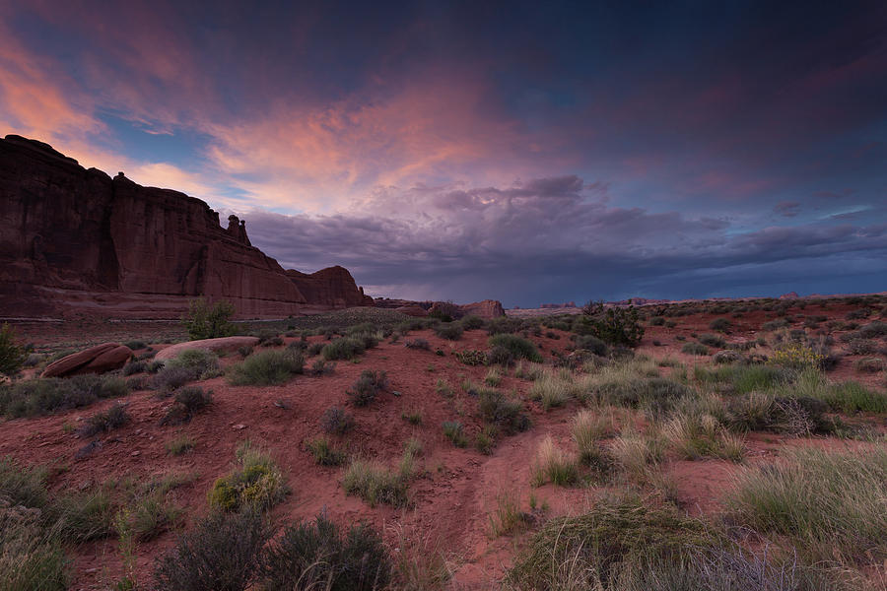


Did the King honor a sunset day?
1. It was during the Day Season that King Jehoram threatened Elisha
he would lose his head before
this day was over.
2. This means Elisha has about 9 hours to live before the 24 hour day ends at sunset.
3. If King Jehoram’s threat is to be completed, he must act quickly!
#1 Sunset
Begins New Day
Dawn #2 Sunset Dawn
Begins Tomorrow
 | #1 Night Season |  | Day Season |  | #2 Night Season
4. If it is Night #1, this is before the king’s anger at Elisha or any of the story events!
Everything is backwards.
Night follows sunset!
Which “night” did
the King rise up
to investigate the
leper’s report?
5. If it is Night #2 there has been a cycle change. It’s not the “same day” anymore and Elisha is still around.
The events move forward, but do not remain on the
“same day.”

Slide 38
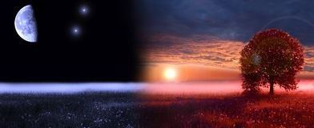
Did the King honor a sunset day?
1. It was during the Day Season that King Jehoram threatened Elisha
he would lose his head before
this day was over.
2. This means Elisha has about 9 hours to live before the 24 hour day ends at sunset.
3. If King Jehoram’s threat is to be completed, he must act quickly!
#1 Sunset
Begins Tomorrow
Dawn #2 Sunset Dawn
 | #1 Night Season |  | Day Season |  | #2 Night Season
The events in this day-start testimony do not recognize a sunset day commencement!
Neither did King Jehoram!
4. If it is Night #1, this is before the king’s anger at Elisha or any of the story events!
Everything is backwards.
Night follows sunset!
Which “night” did
the King rise up
to investigate the
leper’s report?
5. If it is Night #2 there has been a cycle change. It’s not the “same day” anymore and Elisha is still around.
The events move forward, but do not remain on the
“same day.”

Slide 39
Re-worded the original slide – information does not match the new slides.
When Did the Leper’s “Day” Begin?
1. King Jehoram threatens Elisha’s life before this day is over.
2. Leper’s enter the Syrian camp
after dusk twilight. It’s deserted!
They have a feast on food & treasures!
Dawn Sunset Dawn
Tomorrow Begins Here
 | 1st Day Season |  | 1st Night Season |  | 2nd Day Season
3. Leper’s remember all their good tidings must be shared with those in the city before the morning light to avoid mischief [punishment].
4. King Jehoram arose in the night to investigate the report. It was true!
This is between the
two twilights.
It is impossible for
his day to end at the former sunset. There are no Scriptural details for this.
5. Elisha’s prophecy fulfilled on the “tomorrow” about the same time “on
the next day” from
King Jehoram’s original threat.
The record of events show the Leper’s new day arrives at dawn!

Slide 40
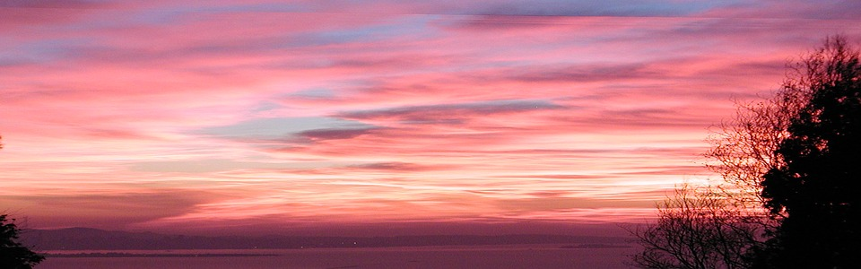
Was Everyone on the Same Page?
1. King Jehoram knew the day did not end at sunset, because Elisha was still unharmed 24 hours later.
3. The Lepers found the food and treasures long after “twilight.” The Lepers knew the morning light changed the cycle. To avoid punishment they
called for the king [that night] on the same day.
Dawn Sunset Dawn
Tomorrow Begins Here
 | 1st Day Season |  | 1st Night Season |  | 2nd Day Season
2. Elisha told the king about this time tomorrow, everything will change.
Elisha knew the “tomorrow” began with the morning light ushering in the next day.
4. Elisha’s prophecy was fulfilled on the “tomorrow” just as he had prophesied.
Yes! Definitely, King Jehoram, the Lepers
and Elisha the Prophet understood
each new day arrives at dawn!
See if this slide needs changes.
Notes:
This story in 2 Kings 7 is about 182 years before King Hezekiah.

Slide 41


ALL Honored Yahuah’s Covenant
Elisha’s
“day.”
King
Jehoram’s
“day.”
With the
break of daylight!
The Leper’s
“day.”

Slide 42
Forward Progressive Movement
2 Kings 6:31 King Jehoram determines Elisha is to lose his head this day.
2 Kings 6:32 Elisha knew about this threat before the messenger arrived with the news.
2 Kings 6:33 King’s messenger arrives with
the dreadful threat.
2 Kings 7:1 Elisha proclaims “about this time tomorrow” [or about 24 hrs. later] a measure of fine flour will be sold for a shekel, and 2 measures of barley for a shekel.
DAY

Slide 43
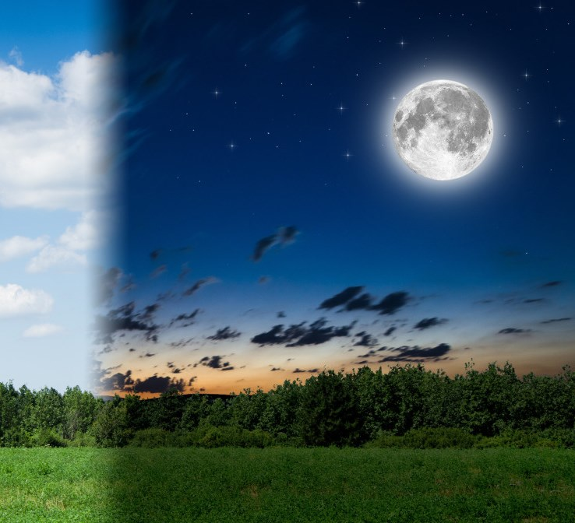
Forward Progressive Movement
2 Kings 7:3-5 Lepers at the city gate decide to search out the Syrian camp.
They left at [dusk] twilight.
2 Kings 7:6-7 Also at [dusk] twilight the Syrians fled from their camp leaving everything behind.
2 Kings 7:8 Lepers arrive at the empty Syrian camp and begin to spoil the goods of the tents (food, clothes, silver and gold) during the night.
2 Kings 7:9 Lepers realize the good tidings of this day will not last if not shared before the morning light.
DUSK

Slide 44
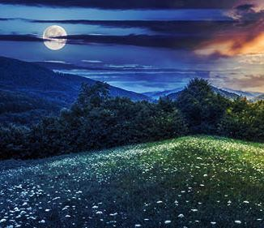
Forward Progressive Movement
NIGHT
2 Kings 7:10 The Lepers head back to Samaria and call for the porter on that night.
2 Kings 7:11-12 King Jehoram rises “in the night” to hear a report that he doubts.
2 Kings 7:13-15 The king sent servants with chariots & horses
to investigate. The report is true!

Slide 45

Forward Progressive Movement
MORNING
2 Kings 7:16 The Samaritans also went out and spoiled the tents of the Syrians. Elisha’s prophecy for the fine flour and barley is fulfilled.
2 Kings 7:17 About 24 hours later [from 2 Kings 6:31] the gate keeper is trampled & dies fulfilling Elisha’s prophecy.

Slide 46

Some of the Facts for the Lepers:
The Lepers Found Bread in Their Time
Times were tough. The city was under siege.
People thought they were safe locked behind walls,
but they were starving.
The Lepers were considered “unclean” and tossed
outside the city.
The Lepers had no choice but to go and look for food or die.
When they looked, food was provided.
The “unclean Lepers” were the ones that brought the good report of “free food” to those starving inside the walls of the city.
“That day” the people were thankful for the Lepers.
Leper’s Lesson: If you get, give!

Slide 47
How Does This Testimony Relate To Us?
Yahuah’s Children Find Bread at the Endtimes
In the endtimes, we will have tough times as well.
We may be under siege in a spiritual way.
Christians feel they are safe locked behind the walls of the church.
But, many of them are starving.
Bible students that are finding newly discovered truths are often considered “unclean” and shunned by fellow church members.
These dear ones have no choice but to go and search for “living bread”
or die spiritually.
When they search, Yahuah provides them with the best “bread.”
Although labeled as “unclean” they attempt to share their treasured food
with starving souls in the church.
Unlike the story of the Lepers, many in the churches/fellowships are not
thankful for the “living bread” of the so-called unclean.
Will we be subjected to a “Leper” experience?

Slide 48

Counsel from Eph 5:11, 13
Would Honoring “sunset” be Considered Fellowship with “darkness”?
11 And have no fellowship with the unfruitful works of darkness, but rather reprove them.
13 … all things that are reproved are made manifest by the light: for whatsoever doth make manifest is light.
What does it mean to reprove others?

Slide 49

Counsel from 1 Thess 5
1 But of the times and the seasons, brethren,
ye have no need that I write unto you.
4 But ye, brethren, are not in darkness, that that day
should overtake you as a thief.
7 For they that sleep sleep in the night;
and they that be drunken are drunken in the night.
6 Therefore let us not sleep, as do others;
but let us watch and be sober.
5 Ye are all the children of light, and the
children of the day: we are not of the night, nor of darkness.
Our Lesson: If you learn, teach!

Slide 50

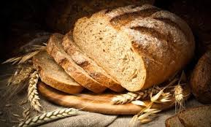
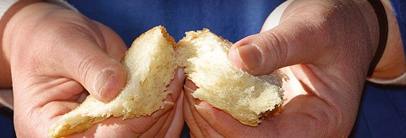
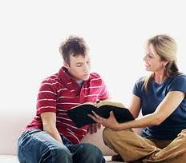
How easy is it
to share what
you have learned?
Share gently, like Yahusha, remembering everyone has a choice.

Slide 51
Share what you have found, but …
Allow the Ruach to Convict!
However do remember: When defending what one considers to be sound Biblical principles, (that are considered as fundamental articles of faith), it is important to use sound Biblical arguments that will endure the highest scrutiny.
Would the worship statutes qualify as a “fundamental article of faith” in these last days?
Does that link to following our Master completely – according to His Covenant of the Day?

Slide 52
Highest WORDS of Recommendation
1 Peter 3:15 & Col 4:6
1 Peter 3:15 But sanctify Yahuah in your hearts: and be ready always to give an answer
to every man that asketh you a reason of the
hope that is in you with meekness and fear.
Col 4:6 Let your speech be always with grace, seasoned with salt, that ye may know how ye
ought to answer every man.

Slide 53

The Final Goal: A Peculiar People
1 Peter 2:9 But ye are a chosen generation, a royal priesthood, an holy nation, a peculiar people; that ye should shew forth the praises of him who hath called you out of darkness into his marvellous light:
Isa 9:2 The people that walked in darkness
have seen a great light: (Also see Matt 4:16.)
Luke 8:17 For nothing is secret,
that shall not be made manifest;
neither any thing hid, that shall
not be known and come abroad.
Luke 12:2 For there is nothing
covered, that shall not be
revealed; neither hid,
that shall not be known.

Slide 54
Mandate For A Peculiar People
2 Timothy 2
2 And the things that you have heard from me among many witnesses, commit these to faithful men who will be able to teach others also.
7 Consider what I say, and may Yahuah
give you understanding in all things.
15 Be diligent to present yourself
approved to Yahuah, a worker who
does not need to be ashamed,
rightly dividing the word of truth.
24 And a servant of Yahuah must not quarrel
but be gentle to all, able to teach, patient,
25 in humility correcting
those who are in opposition,
if Yahuah perhaps will grant them
repentance, so that they may
know the truth … NKJV
Notes:
Final slide added mar 29th 1 pm

Slide 55
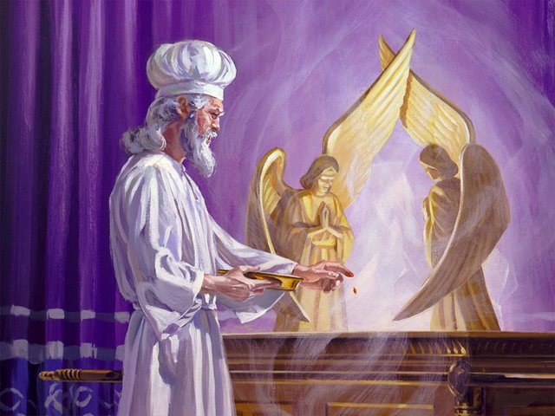
Yahuah’s Peculiar People …
Will be
“kings” and
“priests”
forever
in His
highest
Melchizedek
Priesthood!
The End

Slide 56
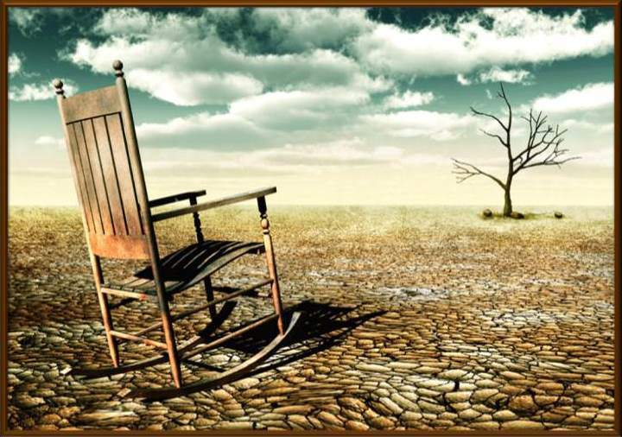

If you need assistance with this information, please send your
questions to
Charlene Fortsch or
Timothy Astleford:
tim@studythecalendar.com
charlene@studythecalendar.com
www.studythecalendar.com/resources
56

