Slide 1



Part 6
The Song of Joshua’s Sickle

Slide 2
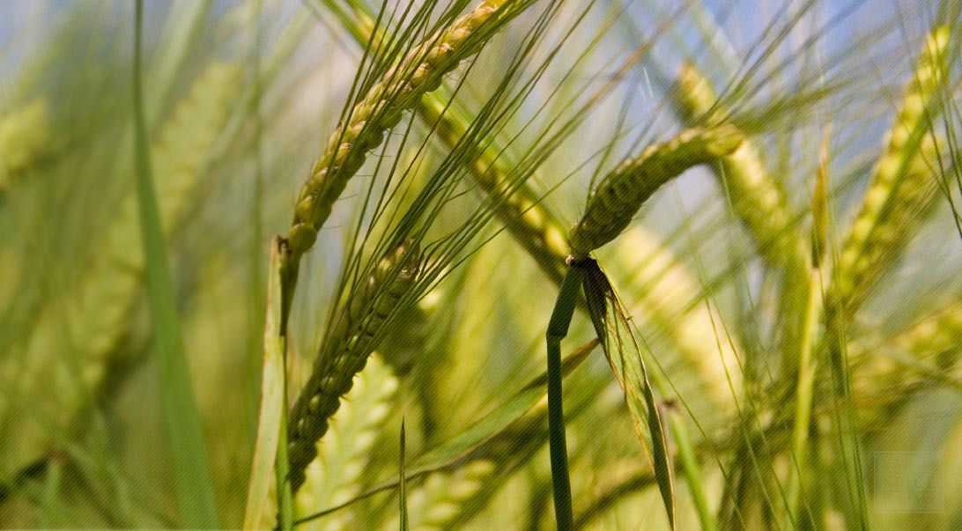

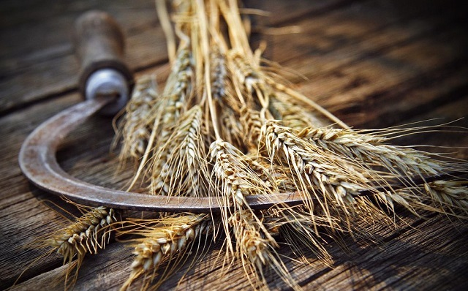
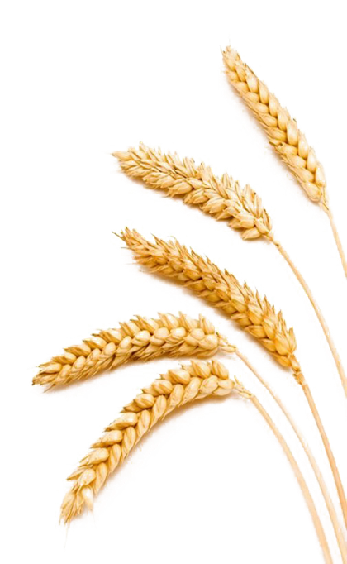
Exposing a Gospel Counterfeit Count
Enoch’s Wavesheaf Placement
Why is Enoch’s timing different from Torah
& the Gospels by
7-8 days?

Slide 3
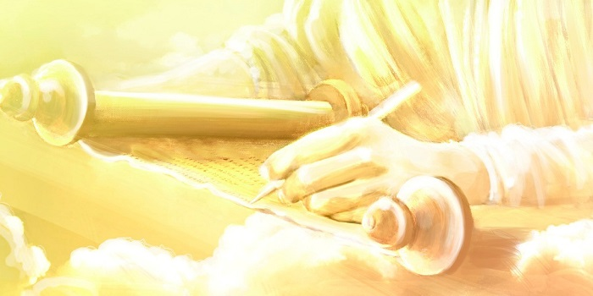


Covenant Calendar Studies Reveal Mysteries
Prov 25:2 It is the glory of Yahuah
to conceal a thing: but the honour of kings [Melek] is to search out a matter.
Remember: only truth can reveal a mystery!
Today’s mystery will be solved through a very careful look at Yahusha’s Wave Sheaf encounters.
Luke 8:10 And he said, Unto you it is given to
know the mysteries of
the kingdom of Yahuah.
It is true that many Enoch calendar keepers understand the Mystery of the Melchizedek Priesthood. Would that not include Yahusha’s Wavesheaf ceremony back to His Priesthood?
3

Slide 4
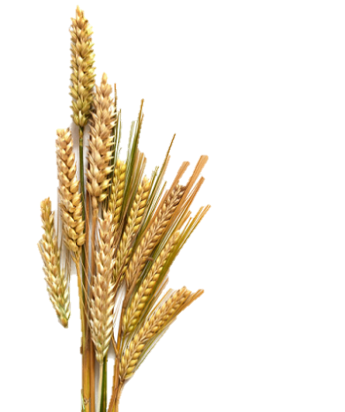

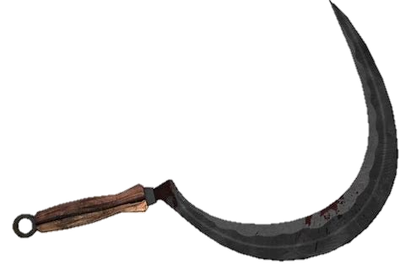
Part #6 Mapping the Discussion Topics
Section | Slides | Content of Topic
Review | 5-9 | Review of Calendar Principle: “day/date” or “locked/unlocked” #1) Review of Joshua’s Covenant Calendar (entrance into the land) #2) Review of Moses’ Covenant Calendar (departure from Egypt) #3) Review Enoch’s Calendar (in comparison to Moses)
Review | 10-18 | 12.1 Review #4: Enoch’s Delay of Wave Sheaf due to “Uncleanness” 12.2 Review #4: Enoch’s Delay of Shavuot from faulty Omer Count
13 | 19-28 | Enoch’s Plan to Devastate the Foundation of Salvation (Intro: 20-28)
13.1 | 29-34 | A Closer Look at the Passion Week Times, Dates & Twilights
13.2 | 35 | Overview of Scriptural Patterns for Passover of Egypt & Yahusha
13.3 | 36-40 | Overview for Section on Passion Events: Passover to Wave Sheaf
13.4 | 41-71 | Yahuah’s Six Post-Resurrection Appearances (5-Abib 18; 1-Abib 26)
13.5 | 72-80 | Putting It All Together (Enoch’s Abib 26th Wave Sheaf Crumbles)
13.6 | 81-85 | Conclusion: Foundation of Salvation & Enoch’s Continuous Battle

Slide 5





A “day” and/or a “date” for
calendar studies is a principle comparable to a lock.
This principle will either:
Lock a calendar (or)
Unlock a calendar.
Next: Short Review Parts 1-5

Slide 6

Joshua’s “Omer Count” Places Wave Sheaf on Abib 15
Joshua’s 1st Month
Covenant Calendar for Joshua’s 1st Month
14th – Sabbath = Passover
15th – 1st cycle [Sun] =
  Wave Sheaf [Omer Count Begins]
  1st Unleavened Bread Sabbath
3rd Month 4th Day [Sun] = Shavuot
(This specific year the
50th day was on the 4th.)
1st | 2nd | 3rd | 4th | 5th | 6th | 7th
1 | 2 | 3 | 4 | 5 | 6 | 7
8 | 9 | 10 | 11 | 12 | 13 | 14 P/O
15 W/S | 16 | 17 | 18 | 19 | 20 | 21 | Wk #1
22 | 23 | 24 | 25 | 26 | 27 | 28 | Wk #2
29 | 30
#1
REV
I
EW
Joshua’s 2nd Month
Joshua’s 3rd Month
1st | 2nd | 3rd | 4th | 5th | 6th | 7th
 |  | 1 | 2 | 3 | 4 | 5 | Wk #3
6 | 7 | 8 | 9 | 10 | 11 | 12 | Wk #4
13 | 14 | 15 | 16 | 17 | 18 | 19 | Wk #5
20 | 21 | 22 | 23 | 24 | 25 | 26 | Wk #6
27 | 28 | 29 | 30
1st | 2nd | 3rd | 4th | 5th | 6th | 7th
 |  |  |  | 1 | 2 | 3 | Wk #7
4 50th | 5 | 6 | 7 | 8 | 9 | 10
11 | 12 | 13 | 14 | 15 | 16 | 17
18 | 19 | 20 | 21 | 22 | 23 | 24
25 | 26 | 27 | 28 | 29 | 30
How will the
Wave Sheaf count compare on the Dead Sea Scroll calendar of Enoch?
End of Review (#1)
6

Slide 7
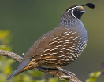
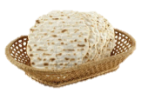
REVIEW
Yahuah’s “50 Day Omer Count” out of Egypt
Moses’ 1st Month
#2
REV
I
EW
1st | 2nd | 3rd | 4th | 5th | 6th | 7th
 |  |  | 1 | 2 | 3 | 4
5 | 6 | 7 | 8 | 9 | 10 | 11
12 | 13 | 14 | 15 | 16 | 17 | 18
19 | 20 | 21 | 22 | 23 | 24 | 25 | Wk #1
26 | 27 | 28 | 29 | 30
14th: Passover on 3rd cycle [Tues].
15th – 17th: Journey to the wilderness to worship.
17th: Red Sea Crossing the night of 6th cycle.
19th: Wave Sheaf [uncelebrated at this time].
25th: 1st Week of Omer Count completed.
Summary: 1st Month had 15 days of travel.
Moses’ 2nd Month
1st | 2nd | 3rd | 4th | 5th | 6th | 7th
 |  |  |  |  | 1 | 2 | Wk #2
3 | 4 | 5 | 6 | 7 | 8 | 9 | Wk #3
10 | 11 | 12 | 13 | 14 | 15 | 16 | Wk #4
17 | 18 | 19 | 20 | 21 | 22 | 23 | Wk #5
24 | 25 | 26 | 27 | 28 | 29 | 30 | Wk #6
15th: Arrival at Wilderness of Sin.
16th: Arrival of Quail at Sabbath evening.
17th – 22nd: First Manna Week.
Summary: 2nd Month realizes 6 completed weeks
to Omer Count #42.
7

Slide 8
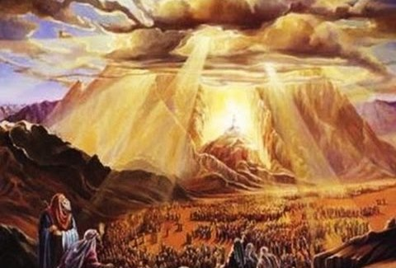
Yahuah’s “Omer Count” out of Egypt to the 50th Day
of Moses’ 3rd Month
1st | 2nd | 3rd | 4th | 5th | 6th | 7th
1 | 2 | 3 | 4 | 5 | 6 | 7 | Wk #7
8 50th | 9 | 10 | 11 | 12 | 13 | 14 | 56 Days
15 | 16 | 17 | 18 | 19 | 20 | 21 | 63 Days
22 | 23 | 24 | 25 | 26 | 27 | 28 | 70 Days
29 | 30 |  |  |  |  |  | 72 Days
1st – 6th: Omer Count #43 - #48 in the 3rd Month.
7th: 49th Day of Omer Count; 7 completed weeks.
8th: 50th Day of Omer Count Pattern at Mt Sinai [Shavuot]; Moses Receives Book of the Covenant; People accept Yahuah’s Covenant [3rd time]; Blood Ratification of Book of the Covenant and the people.
Note: Tracking every Covenant Calendar appointment of Yahuah from the 1st Month, to the 2nd Month, then to Shavuot in the 3rd Month brings the calendar count to exactly the 50th day with precision.
There is no guessing! The events of Exodus 19-24 are at the Shavuot [Pentecost] Appointed Time.
This count is definitely about the reminder of Yahuah’s everlasting instructions for a nation – not just individual patriarchal families.
End of Review (#2)
8

Slide 9




Enoch’s “Omer Count” from the Dead Sea Scrolls
#3
REV
I
EW
Enoch’s 1st Month
Enoch’s 3rd Month
1st | 2nd | 3rd | 4th | 5th | 6th | 7th
 |  |  | 1 | 2 | 3 | 4
5 | 6 | 7 | 8 | 9 | 10 | 11
12 | 13 | 14 | 15 | 16 | 17 | 18
19 | 20 | 21 | 22 | 23 | 24 | 25
26 | 27 | 28 | 29 | 30
1st | 2nd | 3rd | 4th | 5th | 6th | 7th
1 | 2 | 3 | 4 | 5 | 6 | 7 | Wk #6
8 | 9 | 10 | 11 | 12 | 13 | 14 | Wk #7
15 50th | 16 | 17 | 18 | 19 | 20 | 21
22 | 23 | 24 | 25 | 26 | 27 | 28
29 | 30
7 Days later than Moses!
Enoch’s 2nd Month
On Enoch’s calendar,
“dates” and “days” of Sabbaths and feasts never change.
Enoch’s Pentecost is always on
the 15th day of the 3rd month. There are 2 distinct reasons for this.
1st | 2nd | 3rd | 4th | 5th | 6th | 7th
26 | 27 | 28 | 29 | 30 | 1 | 2 | Wk #1
3 | 4 | 5 | 6 | 7 | 8 | 9 | Wk #2
10 | 11 | 12 | 13 | 14 | 15 | 16 | Wk #3
17 | 18 | 19 | 20 | 21 | 22 | 23 | Wk #4
24 | 25 | 26 | 27 | 28 | 29 | 30 | Wk #5
End of Review (#3)
9

Slide 10

Take note of the 3rd Month – only in CONTEXT!
Exo 19:1 In the third month -
after the children of Israel had come out of the land of Egypt …
#4
REV
I
EW
on this [same] DAY [yowm] - [Not “DATE”]
(It’s the same 24 HR cycle of the week as the actual EXIT from Mitsrayim);
- This EXIT occurred on a 4th cycle of the week!
they came to the Wilderness of Sinai [on the 4th cycle ].
The “day” they entered the wilderness was not the day of Shavuot.

Slide 11
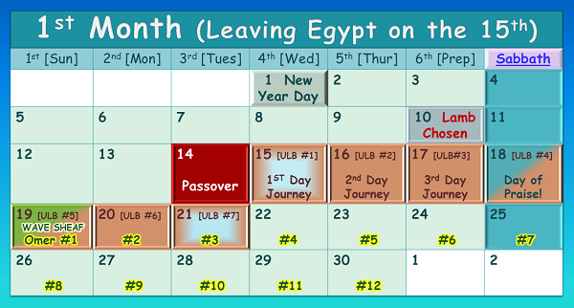

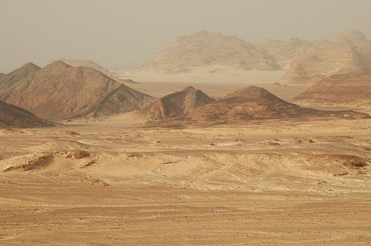
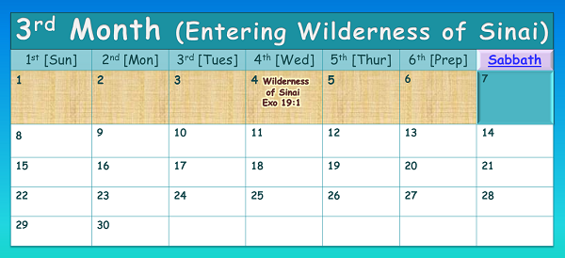

#1
The 4th cycle of the
week in the 3rd month
DOES NOT
determine, nor pinpoint
the 50th day of
Torah’s Omer Count.
Israel entered the wilderness of Sinai on the same 4th cycle of the week as they left Egypt.
Enoch! - The context of Exo 19:1 has nothing to do with the placement of Shavuot!
REV
I
EW
The Exit!
The Same DAY!
11

Slide 12

1st Reason for Enoch’s Abib 26 Count – the “15th date” as Shavuot
#1
#2
Enoch Count
The Exit!
Enoch did not pay attention to context and got detoured by the DATE of the 15th from Month 1!
The Same DAY!
Same DATE, different day!
REVIEW

Slide 13
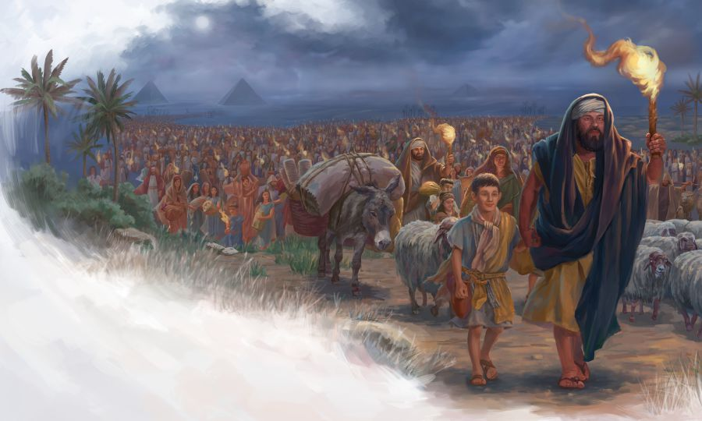
Why does Enoch declare the 50th day of their Omer count has to be on the
15th day of the 3rd month, exactly 1 week late?
In the year of the Exodus, both the Covenant Calendar and Enoch’s calendar celebrate Passover on the 3rd cycle (Tues) of the week. Yahuah’s 50 day Omer count ends
at the 8th day of the 3rd month NOT the 15th day!
End of Review (#3)
13

Slide 14


The Enoch
#4
REV
I
EW
SHAVUOT
50?
Count
directly links to an incorrect date for Wave Sheaf.
The 2nd reason for Enoch’s
non Scriptural Abib 26 count:
Yahusha needed 7 days to be cleansed?!
14

Slide 15

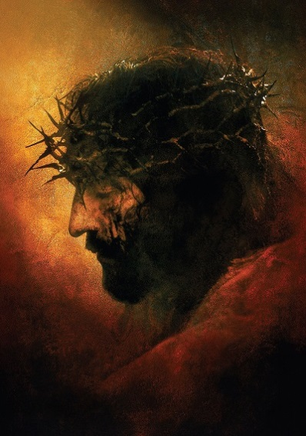
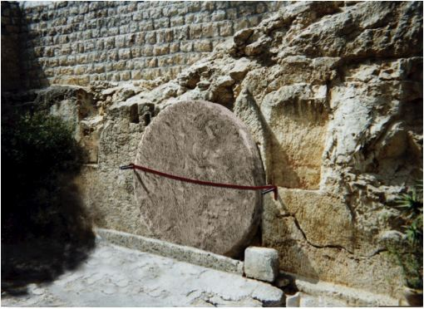
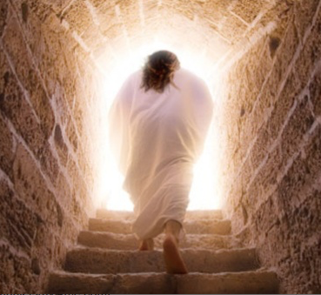
Incredibly
some say
Enoch claims
Yahusha
became “unclean” somewhere between …
Here?
Here?
Did
He?
Or here?!
15

Slide 16

If Yahusha was not “clean” could He take our filthy sins to the stake?
Yahusha was not laid in a filthy tomb was He? Did He become unclean in this resting place?
Did Yahusha’s Body see putrefaction? Did He not rise in the purest form of spotlessness according to the Psalm’s prophecy?
16

Slide 17

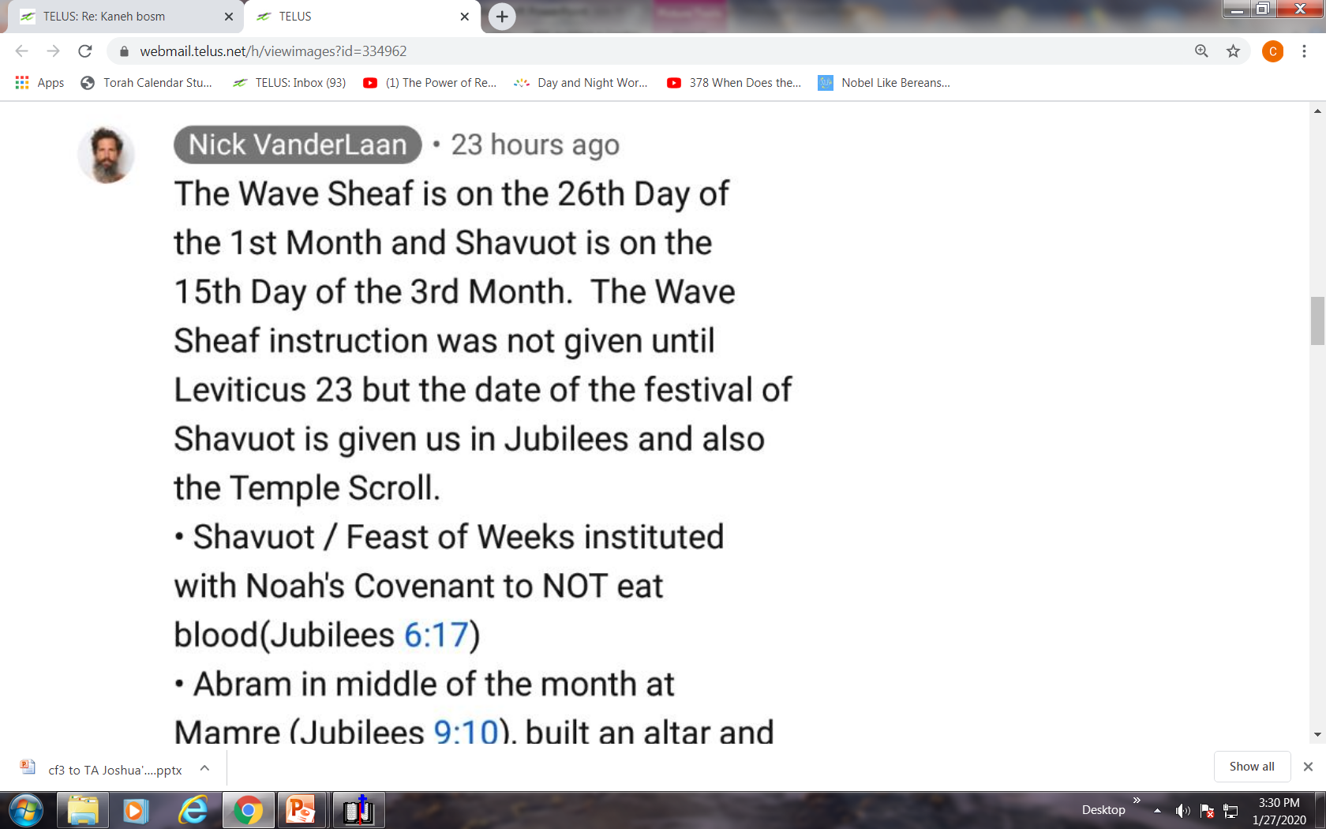
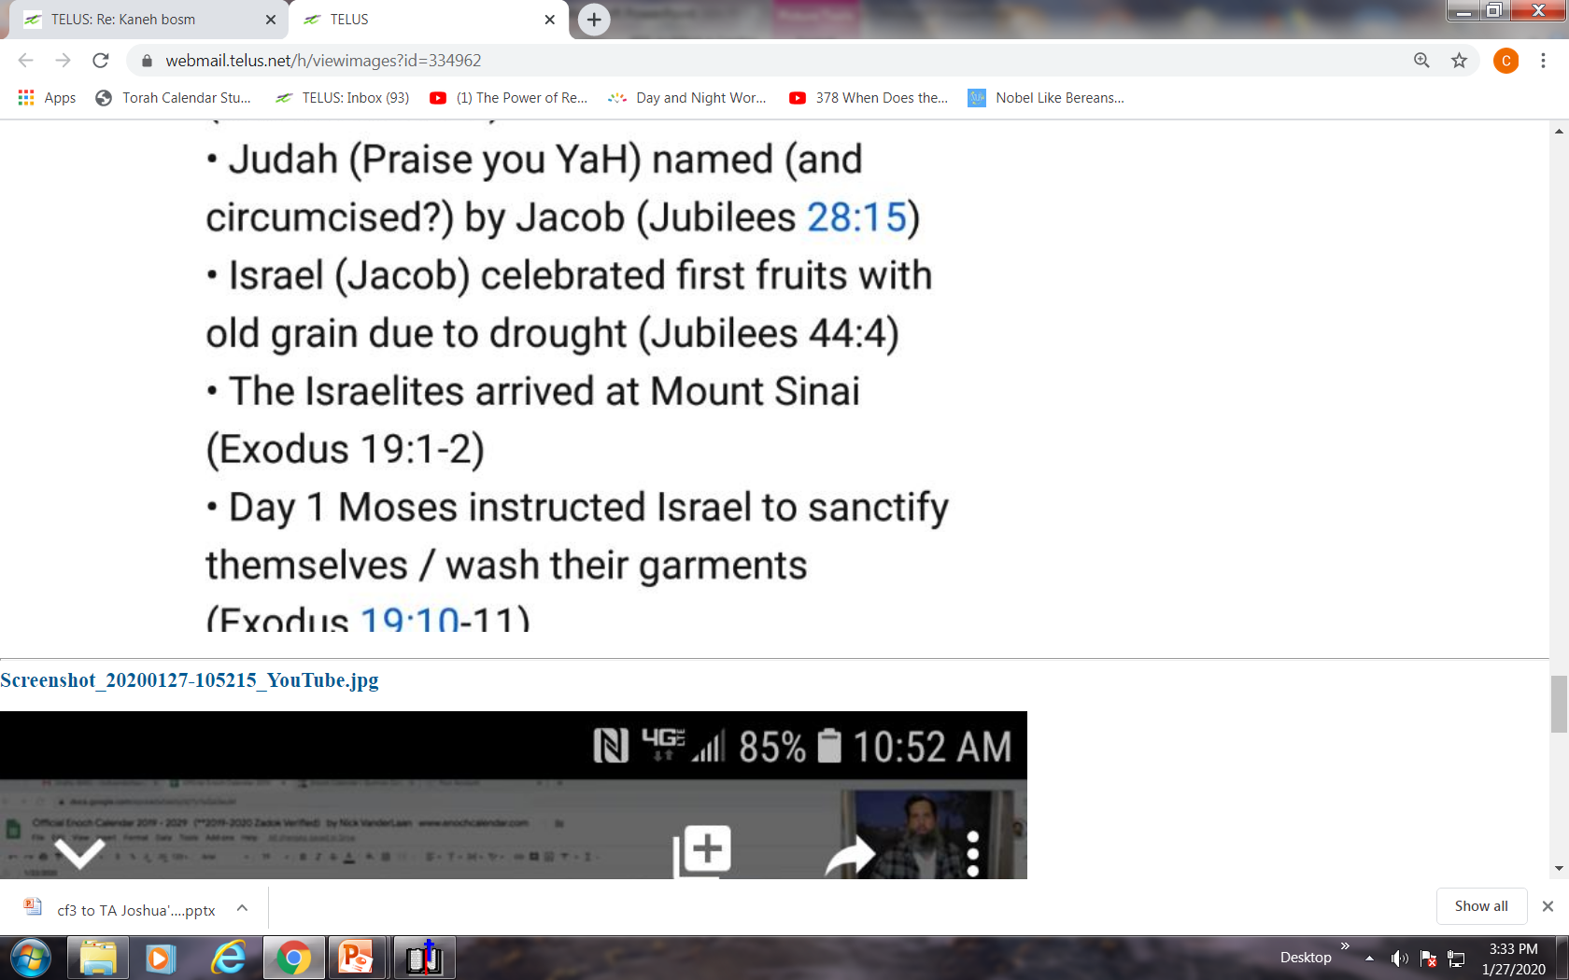

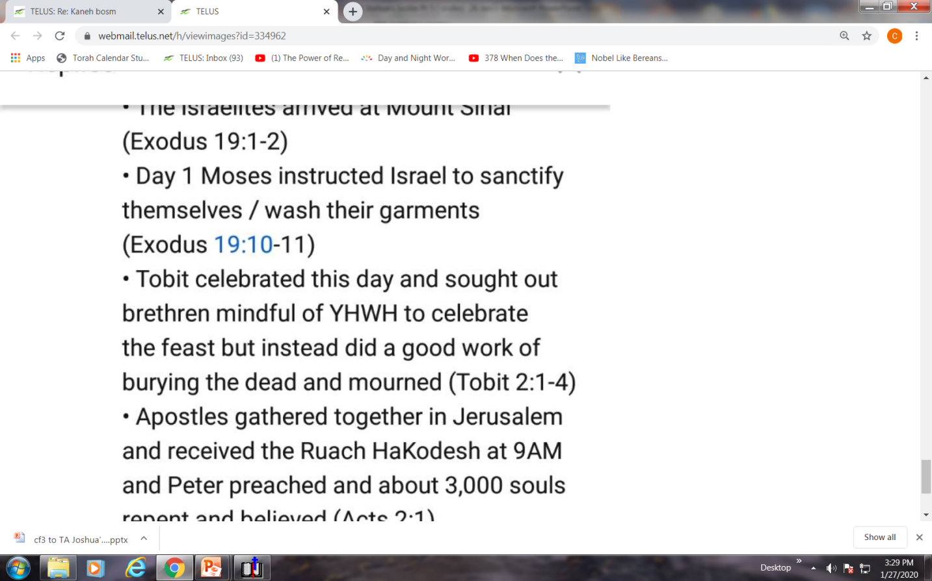
Any claim that “Yahusha was rendered unclean from touching, or BEING,
a dead body” then moves
to the next problem after
Yahusha’s Sabbath resurrection.
How could Yahusha present an
unclean offering for His
Wave Sheaf ascension the next day?
Locked DELAY?
Enoch’s 1st Month
Does Enoch delay this important
“anti-type” Wave Sheaf festival 1 full week after the resurrection (to Abib 26th), to satisfy the Dead Sea Scroll [locked] Calendar? And does Enoch …
1st | 2nd | 3rd | 4th | 5th | 6th | 7th
 |  |  | 1 | 2 | 3 | 4
5 | 6 | 7 | 8 | 9 | 10 | 11
12 | 13 | 14 | 15 | 16 | 17 | 18
19 | 20 | 21 | 22 | 23 | 24 | 25
26 | 27 | 28 | 29 | 30
… attribute the ascension found in John 20:17 to just a cordial visit to heaven?
17

Slide 18

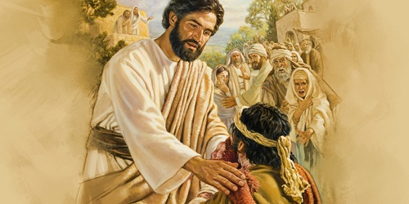
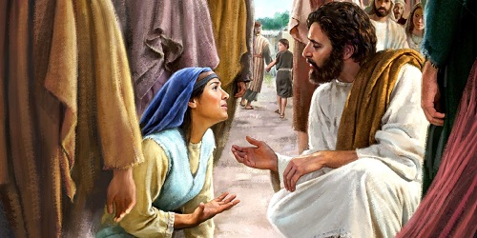
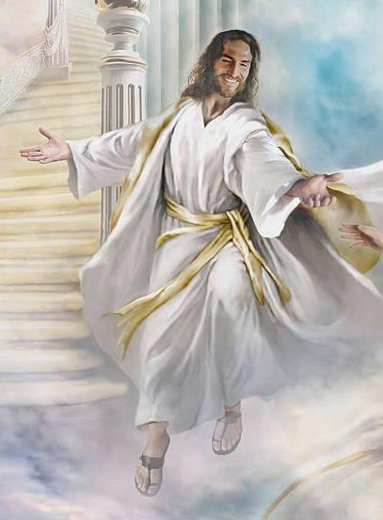
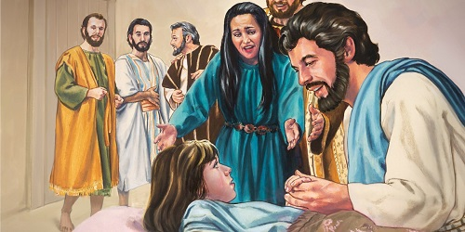
Conclusion of the Issue of “Uncleanness”
Yahusha
NEVER BECAME “unclean”
but whoever He interacted with became clean ~ and He was clean for His Wave Sheaf offering!
End of Review (#4)

Slide 19


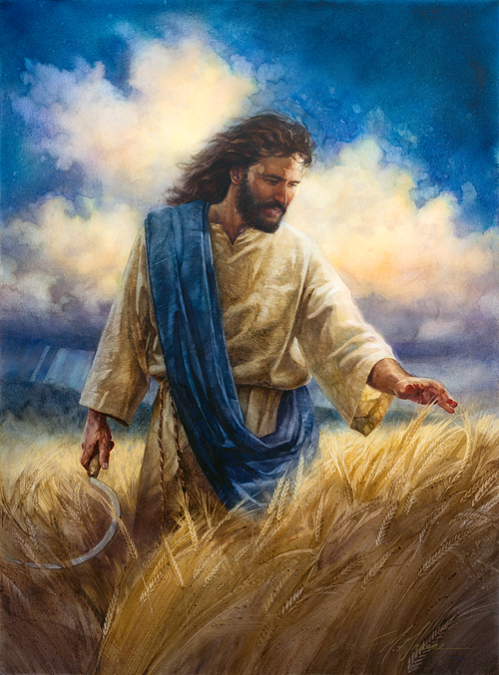
Enoch Devastates the Foundation of Salvation
Section #13
Where was Yahusha between His resurrection AND …
Is there anything in the Gospel Account to support the idea Yahusha delayed His Wave Sheaf appointment for 7-8 days?
We shall see!
Enoch’s
Wave Sheaf
of Abib 26?

Slide 20


Introduction
Must Yahusha process
7 “cleansing” cycles after His resurrection to have contact with humans? What about –
#1) His first greeting to
Mary Magdalene at the tomb while it was still dark?
#2) His next greeting with the other women after sunrise on the first cycle of the week?

Slide 21
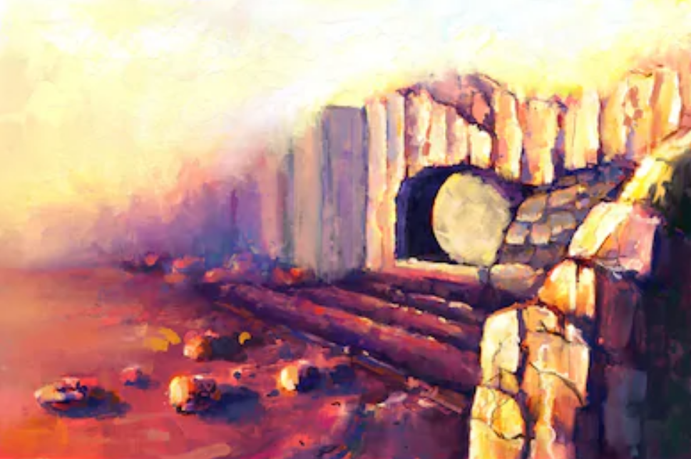
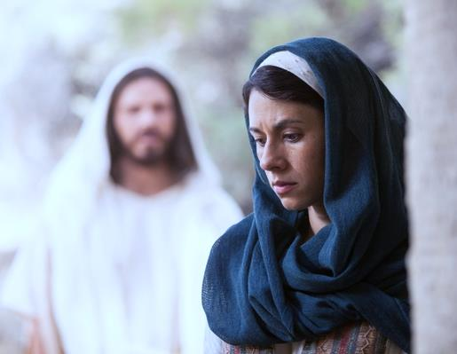
Enoch: Why would Yahusha
return to the tomb on Abib 26
(minutes before Dawn),
to greet Mary Magdalene
when He had been raised
(and living)
a week earlier?
Did He have
something to conceal?

Slide 22

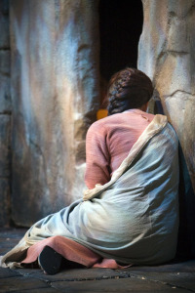

A HUGE Factor to Consider
Why would Mary
arrive at the tomb
before Dawn
~ a week later?
To embalm Him again would be much too late!
What would be
her purpose to be
a “week late”?

Slide 23

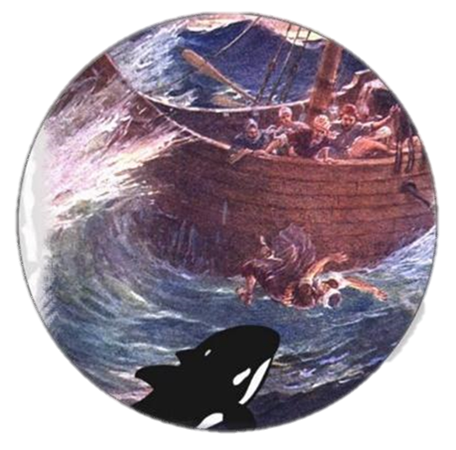
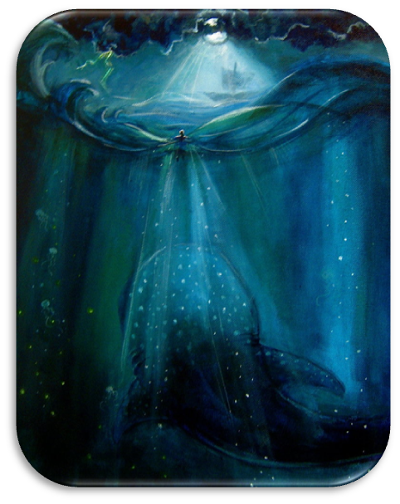
Another HUGE Factor to Consider
If no one saw
Yahusha for
3 days and 3 nights
until the same DAY of His resurrection – where then would be the proof of
Jonah’s sign?
Who would have witnessed to
this factor or prophecy?

Slide 24
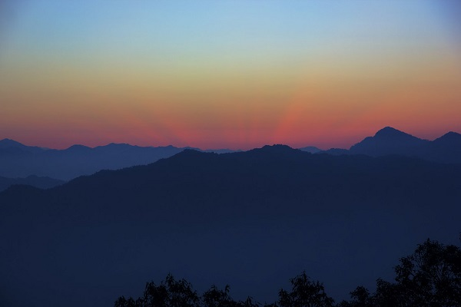
Enoch’s 1st Month
1st | 2nd | 3rd | 4th | 5th | 6th | 7th
 |  |  | 1 | 2 | 3 | 4
5 | 6 | 7 | 8 | 9 | 10 | 11
12 | 13 | 14 | 15 | 16 | 17 | 18
19 | 20 | 21 | 22 | 23 | 24 | 25
26 | 27 | 28 | 29 | 30
Was/is there
a reason to
suppress
knowledge
of these seven
“undocumented cycles”?
?
?
?
?
?
?
?
Is it possible these
7 cycles (for Yahusha
to become ritually clean)
did not even exist?
Where is Enoch's documentation of this week?

Slide 25

Why is it that
“Enoch’s 7 cycles of cleansing”
after Yahusha’s resurrection
are fully undocumented and unknown in the Scriptures,
for such an incredible time
where everything else
is fully recorded?

Slide 26
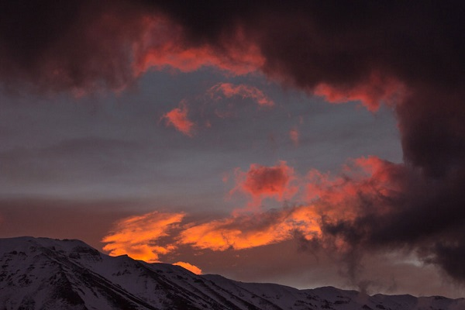


Is this in contrast to the Scriptures
which declare:
“I have spoken nothing in secret?”
Enoch!

Slide 27

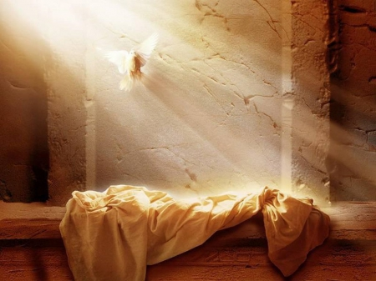

.
Was Yahusha Missing in Action?
1st (Sun) | 2nd (Mon) | 3rd (Tues) | 4th (Wed) | 5th (Thur) | 6th (Fri) | 7th (Sabb)
5 | 6 | 7 | 8 | 9 | 10 | 11
12 | 13 | 14 P/O | 15 ULB | 16 ULB | 17 ULB | 18 Ress.
19 W/S | 20 ULB | 21 ULB | 22 | 23 | 24 | 25
26 W/S | 27 | 28 | 29 | 30
Yahusha’s Passover was
not on a 3rd cycle [Tues]
as on Enoch’s calendar,
but let’s do the best we can to figure out where Yahusha was [on Torah’s count] for the 7-8 missing days between Abib 19 to the
end of Abib 26 (Monday).
Note: This “date” is obviously beyond the
“3 days & 3 nights”
of Yahusha’s prophecy.

Slide 28


Will Enoch honor Torah’s Gospel Events of:
The 3 days & 3 nights Messianic Prophecy of Yahusha,
in conjunction with Yahusha observing Torah’s Wave Sheaf
[First Fruit] feast on the 18th day of the 1st month?
The H7676 weekly Sabbath resurrection within the Passover week?
Mary Magdalene’s arrival to the tomb [the latter hours of Abib 17] long before the other ladies arrive at sunrise of Abib 18?
Torah’s Abib 18 Wave Sheaf following the resurrection day?
The 5 instances Yahusha makes an appearances to His followers between HIS resurrection day to the evening of the following day of Abib 18 Wave Sheaf? Where is Yahusha on Abib 26th?
What does Jacob’s timing of his dislocated hip have to do
with these gospel records?
What Gospel event really happened a week after
Wave Sheaf & does this have any alignment with Enoch?
What effort will be needed to find the answers to these
questions & how much more evidence is actually needed to
debunk the Enoch DEAD Sea calendar?
28

Slide 29
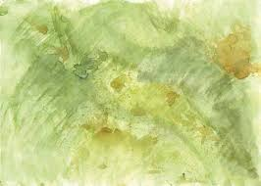
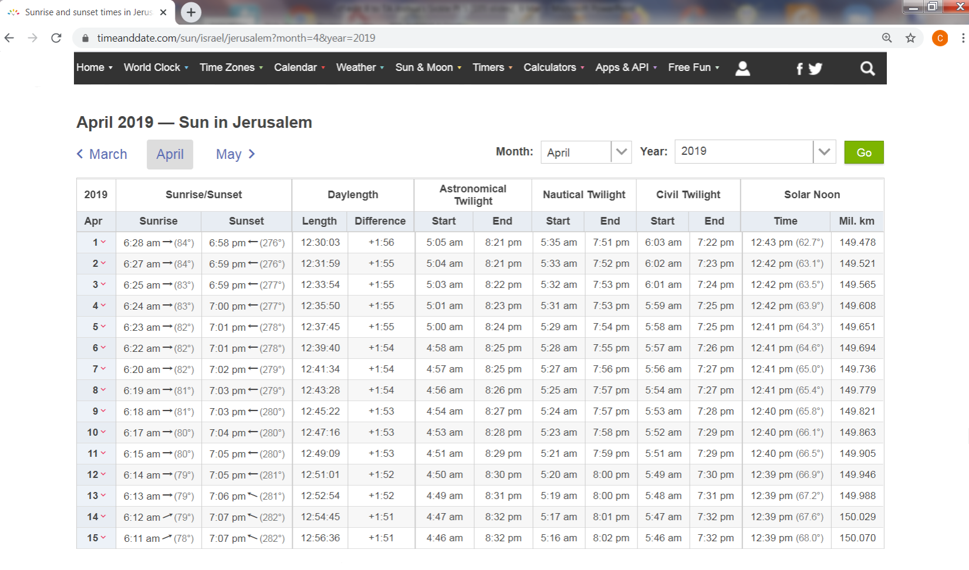
2019 has
a Wed. Passover to match the year of Yahusha’s Passover for specific astronomical
times.
Section 13.1
Time & Date Table for Jerusalem 2019 SPRING FEASTS
Sunrise/Sunset & Twilight Times
2019 Daylight saving time
in Israel began at
2:00 a.m.
on Friday,
March 29/19.
Adjust all time “back” one hour.
Passover 14th [Wed]
1st ULB 15th [Thur]
Resurrection 17th [Sabb]
Wave Sheaf 18th [Sun]
Wave Sheaf 26th - Mon
Date of Enoch
29

Slide 30

Time & Date Table for Jerusalem 2019 Wave Sheaf
The blocks in the table that are emphasized are extremely important for the next section.
Date (Daylight Time Removed) | 4th Roman Watch & Roman Date | Astronomical Twilight Day-start | Sunrise | Sunset | Astronomical Twilight Day-end
Abib 13th |  |  | 527 AM | 559 PM | 721 PM
Passover 14th |  | 4:03 AM | 5:25 AM | 559 PM | 722 PM
1st ULB Sabb.15th | Starts 3:00 AM | 4:01 AM | 5:24 AM | 600 PM | 7:23 PM
Prep. Day 16th |  | 4:00 AM | 5:23 AM | 601 PM | 7:24 PM
Sabbath Ress.17th |  | 358 AM | 5:22 AM | 601 PM | 7:25 PM
Wave Sheaf 18th | Starts 3:00 AM | 357 AM | 5:20 AM | 602 PM | 7:25 PM
Later on Abib 26th |  | 346 AM | 5:11 AM | 607 PM | 7:32 PM
“Enoch”
All times listed are according to Roman midnight time reckoning for our awareness.
All times listed exclude the “Daylight Savings Time” information.
Astronomical Twilight in the morning [boqer] is the official end of the previous day
and the beginning of the new day-start & the new Day Season.
Night following Astronomical evening [ereb] Twilight is the official end of the Day Season.
Can ‘boqer’ astronomical twilight be detected without an additional optical device?
30

Slide 31
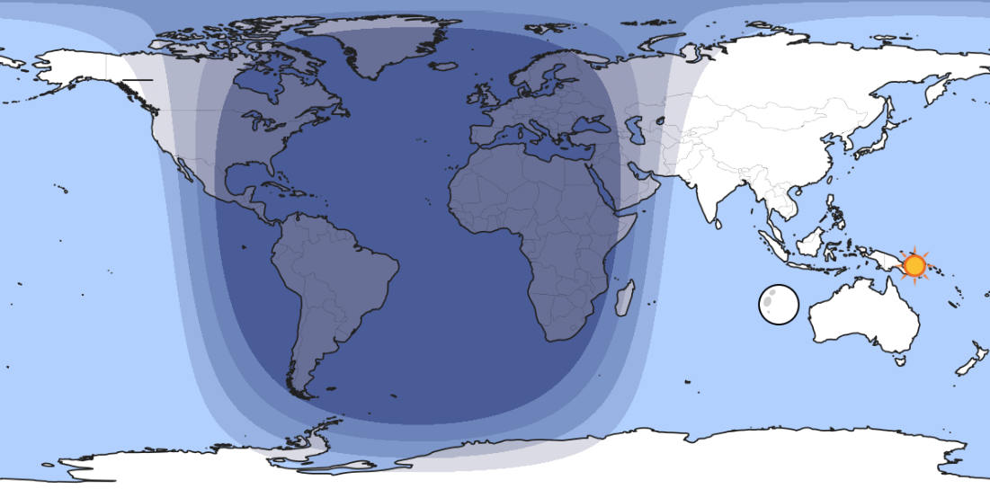


A Closer Look at TWILIGHT CATEGORIES
Night Season
Day Season
Civil dawn/dusk
All twilight components belong to the Day Season.
Nautical dawn/dusk
Astronomical dawn/dusk

Slide 32
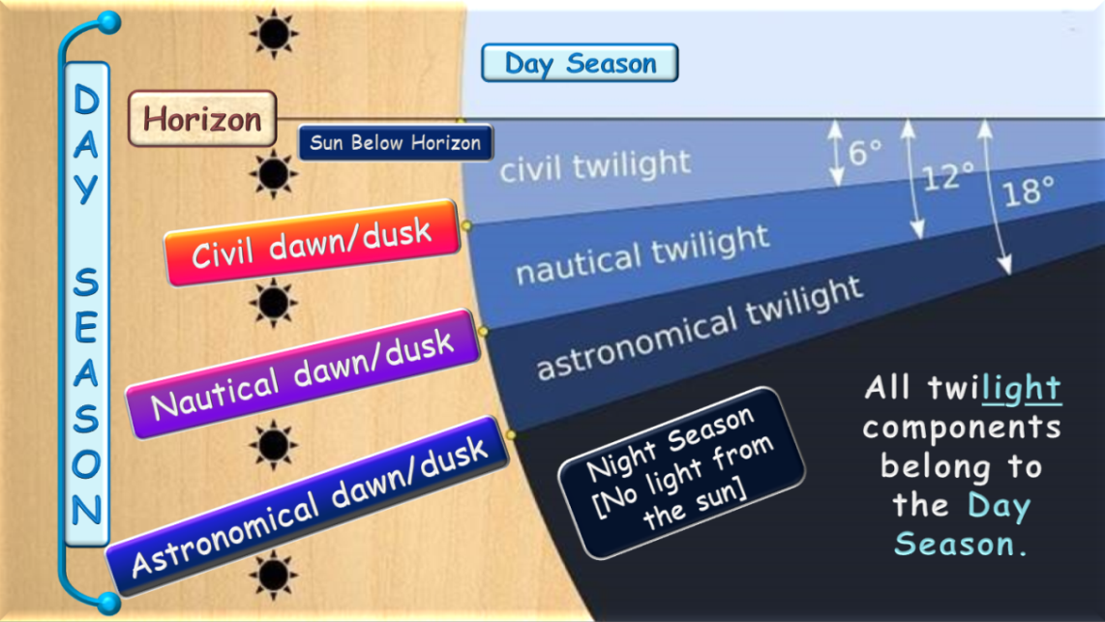
Definitions for the three recognized times of twilight:
There are three periods of twilight for a sun below the horizon:
(a) astronomical (sun is 12–18 degrees below the horizon);
begins when there is any brightening of the sky by the sun [boqer/morning];
(b) nautical (6–12 degrees below);
begins when a lookout on a vessel at sea can first see other ships with his naked eyes;
(c) civil (0–6 degrees below); begins when there is enough natural light for people to see
what they are doing outdoors without the aid of any artificial light.
These three stages are visible to the naked eye and defined by naked eye observations.
City lights might make any sign of
astronomical twilight invisible.

Slide 33
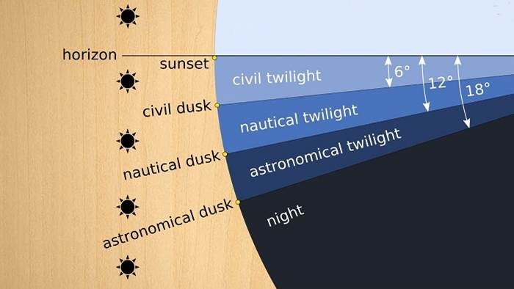

Covenant Calendar Confirmation on TWILIGHTS
Day Season
Horizon
Sun Below Horizon
Civil dawn/dusk
DAY
SEASON
Nautical dawn/dusk
All twilight components belong to the Day Season.
Night Season
[No light from
the sun]
Astronomical dawn/dusk

Slide 34
The Puzzle of Scriptural Patterns
What do “Patterns” have to do with Enoch & other cousin calendars?
What do “Patterns” have to do with other counterfeit calendars?
If indeed the claim of Enoch calendar supporters is true – that Yahusha was “unclean” and could not celebrate His Wave Sheaf until many days [7-8] later – will the Gospel testimonies debunk that theory?
Most questions have already been answered about the imposed
“uncleanness” (upon Yahusha).
Yahusha touching a dead body did
not render Him unclean!
The “burial touching” of Joseph & Nicodemus did not render Yahusha
as unclean … or did they become unclean handling His dead body?!
Events around Yahusha’s Wave Sheaf will show that He was in a state of
utmost purity!
But there are more questions:
Will Yahusha’s Wave Sheaf in the Gospels debunk the theory that Wave Sheaf is married to Abib 16 every year?
Will Yahusha’s Wave Sheaf in the Gospels debunk the theories of possible Passovers on the 5th [Thurs] & 6th [Fri] cycles?
Will the action and events around
Mary Magdalene debunk the theory
of Yahusha’s resurrection on Rome’s Sunday, the 1st cycle of the week?
How will all of these puzzle pieces
affect the Omer count?

Slide 35
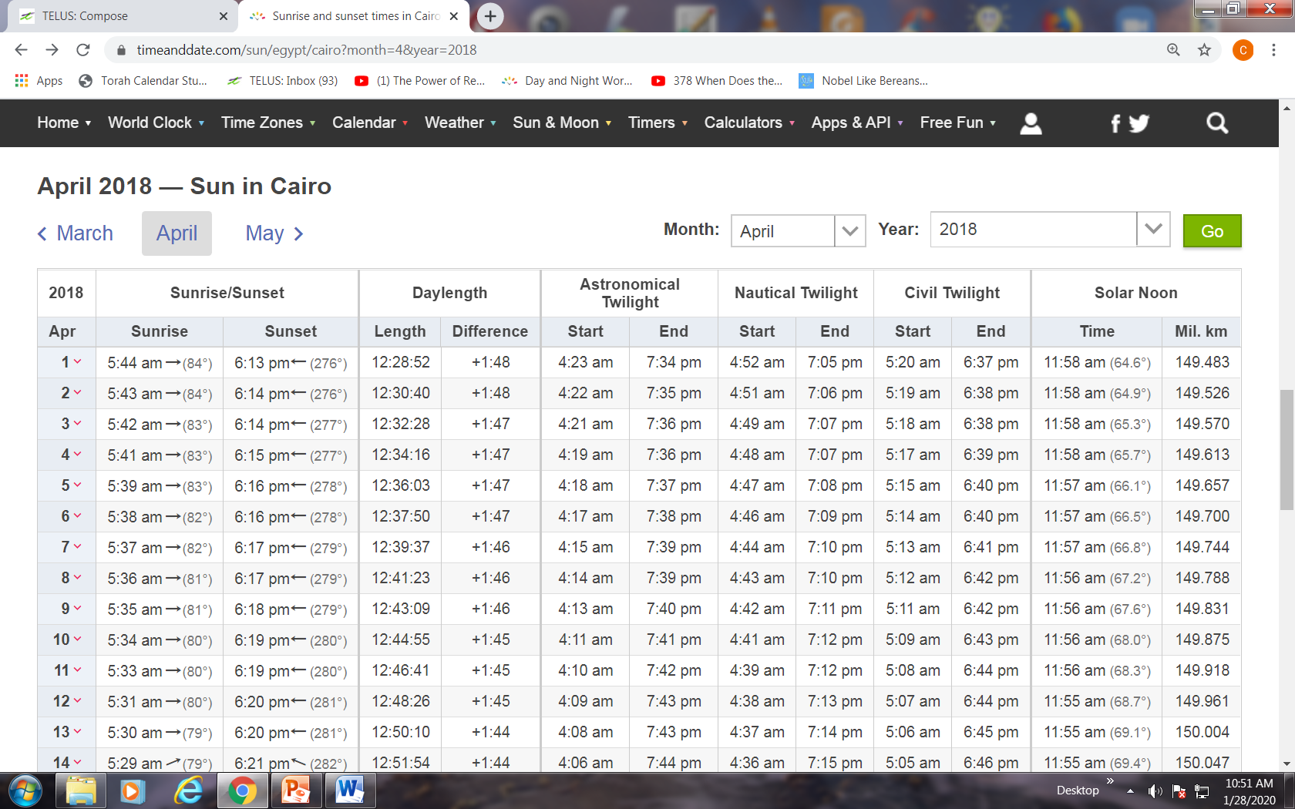
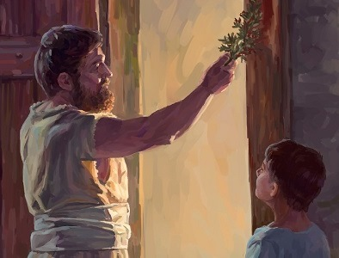
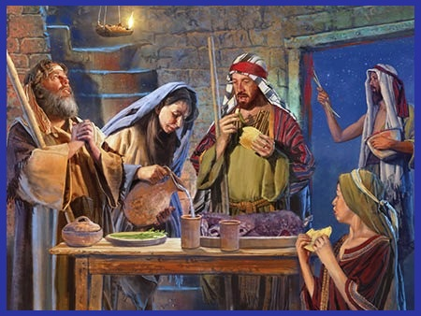
Section 13.2
Scriptural Patterns & Reasonable Assumptions
Overview #1 Egypt
Often we can understand more about “timelines” and “timeframes” when Scriptural Patterns are considered.
The Scriptures do not include every single detail for the “hour” of every event. However, “type” and “anti-type” fulfillments often provide clues that will allow for a “reasonable assumption” in other areas.
#1 Example: Egypt
It is an unreasonable assumption to assume Israel slaughtered their Passover lamb at the 9th hour (or 3:00 PM) when under hard bondage
from the Pharaoh to work from dawn to dark.
  It is reasonable to assume their lamb was sacrificed during the Night Season (“between the mixings”); 4-5 hours to roast.
  Facts: Sunset Abib 14: 6:15 PM; Night begins: 7:36 PM; Sacrifice
  & Roasting to about midnight; Eating the lamb: about 3 hours.
  Fact: Abib 15 boqer: Approximately 4:18 AM.
  Reasonable Assumption: Disposal of the Passover lamb left-overs by 3:00 AM – at least 60-75 minutes before boqer. (After that, the people were getting ready to leave Egypt at boqer [4:18 AM].)
Time for Egypt’s Passover 2018 (Tues): [No daylight time since 2014.]
Apr 4th Passover: Sunset 6:15 PM; Astron. Night begins 7:36 PM.
Apr 5th ULB Sabbath: Astronomical boqer at 4:18 AM.
How long does it take to cook lamb on a spit?
You can expect to roast a 25- to 30-pound lamb for four to five hours. The lamb can be removed from the coals when a meat thermometer inserted into the leg/shoulder registers 170 F/63 C. Allow the meat to rest for at least 15 minutes before carving.
Sep 26, 2019 – internet FAQ
Will there be similar patterns?

Slide 36


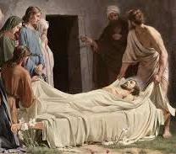
Section 13.3
Scriptural Patterns & Reasonable Assumptions
Overview #2 Passion
Israel’s Passover 2019 (Wed) (Daylight time calculation removed.)
Apr 3rd Passover: Sunset 5:59 PM; Astron. Night begins 7:22 PM.
Apr 4th ULB Sabbath: Astronomical boqer at 4:01 AM.
#2 Example: Yahusha’s Burial ~ from the stake to the final moments.
It is an unreasonable assumption to accept Yahusha was buried BEFORE sunset on His Passover day – when every single fact is carefully considered!
In fact, it is an impossibility!
  Facts: Sunset Abib 14: 5:59 PM; Joseph asked Pilate for Yahusha’s Body at evening/ereb [after sunset] (Matt 27:57, 58; Mark 1:32 & 15:42, 43 – supported by Luke 23:53, 54).
  Fact: Joseph prepares Yahusha “according to the custom of the Jews” and lays the Body in the tomb. [Consider the time factor involved – most likely several hours of passionate labor.]
  Fact: The women come to inspect for proper burial etiquette at the end of the Passover day; the ULB Sabbath draws on (Luke 23:54-55).
  Fact: Abib 15 ULB boqer: 4:01 AM.
  Reasonable Assumption: The inspection and closing of the tomb would have ended about 3:00 AM in respect for the soon-coming ULB Sabbath within the hour. (Also read Luke 23:55, 56.)
Is it reasonable to assume this pattern is similar to Exo 12?

Slide 37


Overview Section for “3 days and 3 nights”
The next section will establish with considerable detail events between the women that visited the tomb at Yahusha’s burial and then
the next time they returned to the tomb.
Astronomical
DAWN twilight timing is of
utmost importance.
Question:
Will these (NEXT) events occur 7 days AFTER Yahusha’s resurrection
as suggested by Enoch’s theory?
DAWN
NIGHT
SUNRISE

Slide 38

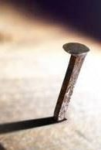

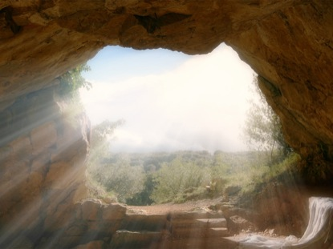

Overview
Yahusha’s Sign – “3 DAYS AND 3 NIGHTS”
Death: 4th cycle “midst of the week” & Resurrection: Sabbath
4th [Wed 14th] Passover |  |  |  |  |  |  |  | 5th [Thurs 15th] ULB Sabbath |  |  |  | 6th [Fri 16th] Prep. Day |  |  |  | 7th Day Sabbath [17th] |  |  |  | 1st [Sun 18th] Wave Sheaf
#1 #2 #3
3rd HR
357AM Boqer
At the
3rd hour:
Mark 15:25
And it was the
third hour, and they crucified him.
At the 9th Hour:
Mark 15:37 Yahusha cried with a loud voice, and gave up the Ruach.
John 19:30 “It is finished!”
Luke 23:46 “Father, into your hands I commit my spirit.”
Note: Enoch cannot agree to these events thus far because his calendar has Passover on the
3rd cycle [Tues]
every year!
9th HR
On the 7th day:
Mark 16:6 [The angel] said He is not here, He is risen.

Slide 39

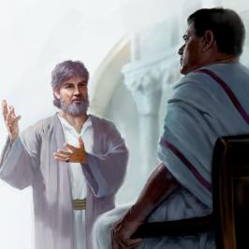
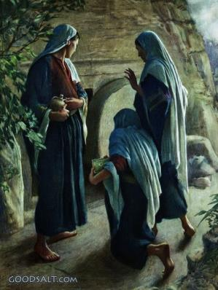
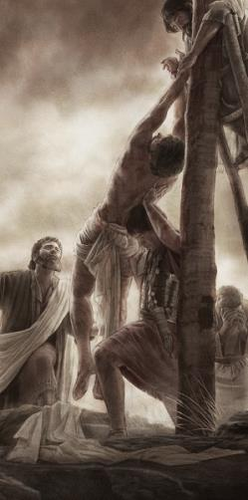
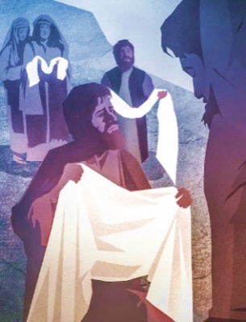
Overview
From Yahusha’s Death to Burial
Timespan between death and sealing of the tomb.
4th [Wed 14th] Passover |  |  |  |  |  |  |  | 5th [Thurs 15th] ULB Sabbath |  |  |  | 6th [Fri 16th] Prep. Day |  |  |  | 7th Day Sabbath [17th] |  |  |  | 1st [Sun 18th] Wave Sheaf
9th HR
Several women leave the tomb just before boqer of ULB Sabbath.
Question: Were any of these men
or women “unclean” from touching a dead Body, or being in this tomb?
At evening – after sunset!
Mark 15:42-43 And now when the even was come, because
it was the preparation, that is, the day before the [High] sabbath, 43 Joseph of Arimathaea, an honourable counselor, which also waited for the kingdom of Elohim, came, and went in boldly unto Pilate, and craved the body of Yahusha.

Slide 40


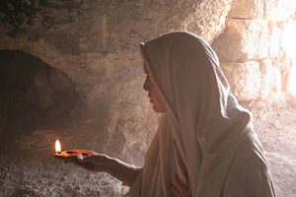
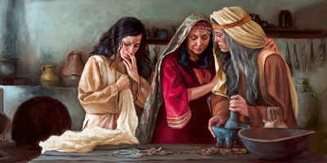
Visits of Mary Magdalene to the Tomb of Yahusha
1) Inspection at Tomb 4th Cycle 2) Mary’s Return to Tomb on 7th Cycle
Overview
4th [Wed 14th] Passover |  |  |  |  |  |  |  | 5th [Thurs 15th] ULB Sabbath |  |  |  | 6th [Fri 16th] Prep. Day |  |  |  | 7th Day Sabbath [17th] |  |  |  | 1st [Sun 18th] Wave Sheaf
Other women
did not arrive
until sunrise.
[Mark 16:2]
There are several women mentioned
in these events.
Mary Magdalene
is spoken of the most – more than the disciples.
This timeline is governed from
the time Mary Magdalene left
the tomb the
“night” of Abib 14; returning back to the tomb the
“night” of Abib 17.
Mary Magdalene arrives back at the tomb on
Abib 17 – the 4th Roman Watch of the night.
Abib 16 – Preparation Day
is the only cycle the ladies had to prepare the spices.
Just before boqer of ULB Sabbath.

Slide 41
Section 13.4
10 Post-Resurrection Appearances
Bundle of 5 Appearances from just before boqer of [Sun] Wave Sheaf to the early Night Season of Abib 18th.
1 Appearance 8 days after
Abib 18 on Abib 26th
Appearance to the “eleven” Disciples: Thomas is present this time & has a special encounter with Yahusha.
Mary Magdalene [1]: Closing hours of Sabbath Abib 17 Mary sees Yahusha
at the tomb.
Other Women [3]: Abib 18 just after sunrise three other women on their way back to the city are visited by Yahusha.
Peter [1]: Paul documents (1 Cor 15:5; Luke 24:34) that Peter was the first disciple to see Yahusha.
Emmaus men [2]: After [6:02 PM] sunset [ereb] Yahusha breaks bread with Cleopas and his friend. They travel
7 miles to see the disciples in Jerusalem.
The “eleven” Disciples [referred to as the 11 even though Thomas is not there when Yahusha arrives]: By 7:25 PM all twilight has ended. Later, Cleopas & friend join the group after traveling 7 miles on foot.
Please
Note
4 Additional Appearances up to the
40th Day of Omer Count
All
of these visits are around Sunday
Abib 18!
At the Sea of Tiberias [Galilee]: 7 disciples see Yahusha after their morning fishing trip.
Galilee Mountain: Disciples & large gathering of over 500 meet Yahusha (Matt 28:16-17; 1 Cor 15:6).
Visit to brother James (1 Cor 15:7): a former skeptic (John 7:5).
40th Day in Jerusalem: Great commission to
“the eleven” disciples before 2nd ascension
(Mark 16:15; Luke 24:49-53).
This study will concentrate on the first six appearances of Yahusha.

Slide 42

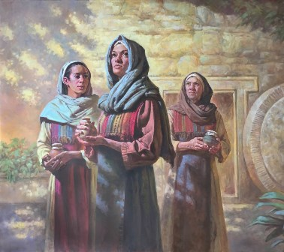



Overview
Through the Gospels, there are several
post-resurrection appearances only a few hours apart.
#1
#2
Other women with spices arrive at sunrise on
Wave Sheaf
(Matt 28:1; Mark 16:1;
Luke 24:10).
WOMEN
Mary Magdalene:
1st to the tomb before boqer of Wave Sheaf
(John 20:1-18).
Peter, seen 1st before other [10] disciples
(Luke 24:12,34; 1 Cor 15:5; also Mark 16:7).
#4
Emmaus Road: Cleopas & friend heading home
(Mark 16:12;
Luke 24:13-35).
10 disciples [called “the eleven] but Thomas was missing:
(Mark 16:14; Luke 24:36-43;
John 20:19-25).
#3
#5
MEN
Did these events occur on the Wave Sheaf of Yahusha or Enoch?

Slide 43



Introduction to Yahusha’s First Appearance on Abib 17
4th [Wed 14th] Passover |  |  |  |  |  |  |  | 5th [Thurs 15th] ULB Sabbath |  |  |  | 6th [Fri 16th] Prep. Day |  |  |  | 7th Day Sabbath [17th] |  |  |  | 1st [Sun 18th] Wave Sheaf
Note: This marker addresses
the approx. timeframe of Yahusha’s 1st appearance.
357AM Boqer
??
Enoch declares: Yahusha’s Wave Sheaf ascension was on Abib 26th - a week after His resurrection.
Mark 16:6 … the angel declares Yahusha is risen from death.
Mark 16:9 … Three verses later, Yahusha appears to Mary Magdalene just before boqer of Wave Sheaf [Abib 18th]
on the first cycle of the week.
Question for Enoch: How can there be 7-8 days
of events between verses 6 to 9 when following the context (including Type & Antitype), Torah statutes,
and full Gospel content?
John 20:17 Yahusha saith unto her, Touch me not; for
I am not yet ascended to my Father … [for Wave Sheaf].

Slide 44
Wave Sheaf Governed by the Timing of Boqer
Date (Daylight Time Removed) | 4th Roman Watch | Astronomical Twilight Day-start | Sunrise | Sunset | Astronomical Twilight Day-end
Abib 13th |  |  | 527 AM | 559 PM | 721 PM
Passover 14th |  | 4:03 AM | 5:25 AM | 559 PM | 722 PM
1st ULB Sabb.15th | Starts 3:00 AM | 4:01 AM | 5:24 AM | 600 PM | 7:23 PM
Prep. Day 16th |  | 4:00 AM | 5:23 AM | 601 PM | 7:24 PM
Sabbath Ress.17th |  | 358 AM | 5:22 AM | 601 PM | 7:25 PM
Wave Sheaf 18th | Starts 3:00 AM | 357 AM | 5:20 AM | 602 PM | 7:25 PM
Later on Abib 26th |  | 346 AM | 5:11 AM | 607 PM | 7:32 PM
Note:
The twilight, sunrise and sunset times are important for the
rest of
this study.
“Enoch”
The next set of events beginning with Mary Magdalene are very numerous and detailed, working within a very short
time space of about 57 min. from about 3AM to boqer.
Considering all the unknown distances of travel, “in and out” of the city gates ~ in the dark, etc. ~ this study will expect reasonable assumptions as to the time element.
44

Slide 45



Mary Magdalene (from about 3AM; before boqer of Wave Sheaf)
All details will be noted around Mary’s activities. Be aware of the timeframe needed in each case for John 20:1-10.
??
How easy would it be to get passage through the locked gates of Jerusalem? [Time needed?]
How far would John’s lodging be from the garden tomb? [At least 1 mile or 1.5 KM?]
How much time would be consumed to accomplish the eight points below? [Maybe 40-45 min.?]
Mary Magdalene arrived at the tomb while it was still dark.
  (Sabbath night; Roman 4th Watch/guards had been struck down; approx. 3AM Roman time.)
  This is about 3 cycles from when she was last at the tomb.
  (Did she become unclean from being in the tomb on the 14th,
  only to add to that uncleanness on her return?)
She saw the stone rolled away – but did not look inside. [3:05AM?]
Returned to the city to report to Peter & John; the Body was stolen. [3:20AM?]
Peter & John run to the tomb [time & distance factor?]. [3:35AM?]
John only LOOKS inside seeing the linens lying there.
Peter WENT inside, to see the linens with the napkin by itself.
John WENT inside; this time he “sees and believes,” but not Peter.
Peter and John return to their home (likely to where mother Mary is staying). [3:45AM?]
Matt 28:4
#1
John 20:1 Mary Magdalene arrived at the tomb with it was still dark. (Sabbath night; Roman 4th Watch; approx. 3AM Roman time.)
45

Slide 46


Mary Magdalene (about 3:50AM; before boqer of Wave Sheaf)
Continue to follow the timeframe for each point in John 20:11-17a. Remember: boqer is at 3:57 AM.
Mary lingers outside the tomb weeping, then stoops
down and looked into the tomb. [3:50AM?] John 20:11
She sees 2 angels (head & foot where Yahusha had lain). [Could it now be 3:52AM?]
The angels ask Mary why she is weeping.
Mary asks: Where is her Master?
Mary turns around and sees Yahusha;
she does not recognize Him. [3:53AM?]
He asks why she is weeping; assuming He is the
gardener, she asks again where her Master is
so she can take Him away. [3:54AM?]
#1
The timeframe: 3:57AM boqer
is approaching!
46

Slide 47


Mary Magdalene (about 3:55AM; before boqer of Wave Sheaf)
Continue to follow the timeframe for each point in John 20:11-17a. Remember: boqer is at 3:57AM.
Yahusha calls her name, and she recognizes who He is. [3:55AM?]
Yahusha instructs Mary not to cling to Him as He has not ascended heavenward.
WHY? He must remain in a pure state until “His First Fruit presentation.”
When does Yahusha have to be ready to present His Wave Sheaf? How about by boqer at 3:57AM?! SUNRISE is at 5:20AM when the women arrive with spices –
“only a” 1 hr. 23 min. window of time to observe the boqer Wave Sheaf statute!
#1
Did Mary Magdalene
and Jacob have
similar boqer
experiences?
An example of events approaching daybreak:
Gen 32:24-26 And Jacob was left alone;
and there wrestled a man with him until
the breaking of the day.
25 And when he saw that he prevailed
not against him, he touched the hollow
of his thigh; and the hollow of Jacob's thigh was out of joint, as he wrestled with him.
26 And he said, Let me go, for
the day breaketh.
Does Yahusha have to be ready to present the Wave Sheaf by 3:57AM boqer?
??
47

Slide 48



Mary Magdalene (AFTER boqer twilight 3:57AM - now Wave Sheaf)
Conclusion of John 20:17b & 18; Mark 16:10.
Yahusha instructs Mary to tell the brethren that
He is ascending to His Father (for the Wave Sheaf
Presentation). [3:56AM – one minute to boqer?]
Mary leaves to tell the disciples (Mark 16:10).
Most of the disciples did not believe (Mark 16:11)!
#1
SUNRISE is at 5:20AM when the other women arrive with spices – 1 hr. 23 min. later! (See also Luke 24:1.)
IF Mary leaves about 4:00AM to tell Peter, John and the other disciples, she won’t even meet up with the other women. There’s no indication in the Gospel account
that she is ever at the tomb with the other women.
48

Slide 49


Summary: 1st Resurrection Witness with Mary
7th Cycle – Sabbath Day [17th] RESURRECTION DAY |  |  |  | 1st Cycle [Sunday 18th] & ASCENSION WAVE SHEAF FESTIVAL
357AM Boqer
Approx. 4th
Roman Watch
300AM
The Wave Sheaf was to
be presented during boqer (twilight) – the cycle after
the weekly Sabbath.
Boqer begins at: Approx. 357AM on Abib 18th
lasting to 5:20AM.
John 20:1 The first day of the week cometh Mary Magdalene early, when it was yet dark,
unto the sepulchre …
Abib 18 ascension is
verified without a doubt.
Yet Enoch claims
Yahuah did not ascend until Abib 26.
How can this be?
Is there a 2nd witness?
Mark 16:9 [Yahusha] appeared first to Mary Magdalene, out of whom he had cast seven devils.
??
John 20:17 Yahusha saith unto her,
Touch me not; for I am not yet
ascended to my Father … [for Wave Sheaf].
Instructions:
Tell the brethren.

Slide 50




The “other women” Arrive at Sunrise
Time: 520AM Date: Abib 18th Wave Sheaf
#2
Mark 16:2 And very early in the morning the first day of the week, they came unto the sepulchre at the rising of the sun. [5:20AM!]
These women arrive early with the spices they have prepared.
“Who will roll away the stone”? Upon looking, the stone was rolled away.
They encounter several angels with the message Yahusha was risen.
The women were instructed to go tell the disciples AND Peter (Mark 16:7). (Remember, at the tomb with Mary Magdalene, John believed; Peter didn’t.)
The women left quickly, [trembling, fearful, yet amazed] not saying anything to anyone (Mark 16:8); “and did run to bring his disciples word” (Matt 28:8).
5:20AM
Sunrise
Word to Enoch: In this witness there is still no indication the date/day has changed from Abib 18 to another date.
??
50

Slide 51



The “other women” Encounter Yahusha
Matt 28:9 As they [women with spices] went to tell his disciples [& Peter],
behold, Yahusha met them saying, All Hail.
(vs 9 con’t) And they came and held Him by the feet, and worshipped Him.
Yahusha commissions them to go and tell the disciples He is risen (vs 10).
As they were going they saw some of the Roman Guard entering the city
(Matt 28:11). (Reasonable assumption: none of the Roman Guard came back to consciousness until all the activity around the tomb was over.)
The Roman Guard had nothing to report; a tall tale
had to be invented & a bribe accepted; vss 12-15.
#2
Wave Sheaf Command Fulfilled on Abib 18!
Matt 28:9 “And they came and held Him…”
??
Time: ~600AM Date: Abib 18th Wave Sheaf
Yet Enoch claims Wave Sheaf is Abib 26!
Is there a 3rd witness?
51

Slide 52


Summary: 2nd Resurrection Witness with “other women”
7th Cycle – Sabbath Day [17th] RESURRECTION DAY |  |  |  | 1st Cycle [Sunday 18th] & ASCENSION WAVE SHEAF FESTIVAL
357AM Boqer
Approx. 4th
Roman Watch
300AM
520AM Sunrise
??
Yahusha appeared first
to Mary Magdalene
but He did not allow
her to touch Him.
Instructions:
Tell the brethren.
Yahusha’s 2nd appearance [after fulfillment of Wave Sheaf requirements]
was to the women with spices that arrived at the tomb after sunrise.
This time He allowed them to touch and worship Him.
Instructions: Tell
Peter and the disciples.
Question:
When does Peter finally
find out?
#1
#2

Slide 53
A Closer LOOK with “Mary” & “the other women”
7th Cycle – Sabbath Day [17th] RESURRECTION DAY |  |  |  | 1st Cycle [Sunday 18th] & ASCENSION WAVE SHEAF FESTIVAL
357AM Boqer
520AM Sunrise
Approx. 4th
Roman Watch
300AM
Important Note #1:
At this point we will take a short break to examine
a very special window of time around the early hours of Wave Sheaf day.
Important Note #2:
The women were the
first to be met by Yahusha in His risen
state within a very
short window of time.
They were told to “tell Peter and the brethren.” Why is this so important?
#1
#2
Let’s Join “Mary”

Slide 54


A Closer LOOK at the window of time: 3:00AM to 3:57AM
Watch to 600AM
7th Cycle – Sabbath Day [17th] RESURRECTION DAY |  | 1st Cycle [Sunday 18th] & ASCENSION WAVE SHEAF FESTIVAL
 | ~300 – 357AM | **
357AM Boqer**
520AM Sunrise
4th Roman Watch
Approx. ~300AM
Here is the most important point of this study!
John 20:1 The first day of the week cometh Mary Magdalene early, when it was yet dark,
unto the sepulchre …
Yahusha positively identifies Himself with these distinctive words – (THE) I AM, ~ leaving no doubt in Mary’s mind whom she had just spoken to!
#1
Mary
Meets Yahusha
Mary calls Peter & John.
John believed; Peter didn’t!
Let’s Join “the other women”
“Say to them – I AM ASCENDING!”

Slide 55

A Closer LOOK at a window of time: “after 520AM Sunrise”
Watch to 600AM
7th Cycle – Sabbath Day [17th] RESURRECTION DAY |  | 1st Cycle [Sunday 18th] & ASCENSION WAVE SHEAF FESTIVAL
 | ~300 – 357AM | **
357AM Boqer**
520AM Sunrise
4th Roman Watch
Approx. ~300AM
John 20:1 Mary came when it was yet dark …
The women arrive at the tomb “at the rising of the sun.” Shortly thereafter
Yahusha’s 2nd appearance is to this group of women. Yahusha’s instructions are: Tell Peter and the disciples.
Is Peter informed with the other disciples?
Mary calls Peter & John.
#1
#2
John
believed; Peter didn’t!
Mary
Meets Yahusha
Let’s Join Peter…
“Say to them – I AM ASCENDING!”

Slide 56

Peter’s Encounter With Yahusha
#3
The women reported they had seen Yahusha to the eleven
[includes Peter] and to the rest, but they believed not (Luke 24:9-11).
This is the 2nd time Peter has heard Yahusha has risen to life.
Peter runs back to the tomb again for a double check (Luke 24:12);
he beheld the linen clothes as before (John 20:6 – the 1st time).
Paul records Peter’s encounter with Yahusha.
This would be sometime after he left the tomb for the 2nd time.
[24:12] Then arose Peter, and ran unto the sepulchre [the 2nd time]; stooping down, he beheld the linen clothes laid by themselves and departed, wondering in himself at that which was come to pass.
Did you know…? Yahusha met Peter first before the other 10 disciples.
Note: The events around this special Wave Sheaf day are tricky to put in order. This is just a mini-overview of Peter’s encounter with more details coming soon.
1 Cor 15:4-5 And that he was buried, and that he rose again the third day according to the scriptures: 5 And that he [Yahusha] was seen of Cephas [Peter], then of the twelve.
??
Time: ”Morning HRS after 600AM.” Date: Abib 18th Wave Sheaf
Can Enoch still claim Wave Sheaf is Abib 26?
Is there a 4th witness for another appearance on Abib 18th?

Slide 57
Summary: 3rd Resurrection Witness with Peter
7th Cycle – Sabbath Day [17th] RESURRECTION DAY |  |  |  | 1st Cycle [Sunday 18th] & ASCENSION WAVE SHEAF FESTIVAL
357AM Boqer
Approx. 4th
Roman Watch
300AM
520AM Sunrise
Yahusha’s 3rd appearance was to Peter at forenoon after he returned from the
empty tomb the 2nd time.
Peter then returned to report the good news to the others. How long did he stay with this group?
Instructions to Peter?
None are documented, but do you know what they might have been?
Yahusha appeared first
to Mary Magdalene
but He did not allow
her to touch Him.
Instructions:
Tell the brethren.
Note: Peter’s 1st visit to the tomb was early in the morning when Mary brought the news Yahusha was missing.
#1
#2
Yahusha’s 2nd appearance was to the women with spices that arrived at the tomb after sunrise.
He allowed them to touch and worship Him. Instructions: Tell Peter and the disciples.
#3

Slide 58


According to the Gospels, these next
two events are only a few hours apart.
Overview
4) The Road to Emmaus & 5) Yahusha Meets 10 Disciples
#4
#5
John 20:19
[evening of the 1st day]
John 20:19
[towards evening
of the 1st day]
It is still the same day ~ Wave Sheaf on Abib 18!
58

Slide 59


The Road to Emmaus Before Evening
The context of Luke 24 begins with sunrise on Abib 18 – Wave Sheaf day.
Encounter #4 begins in Luke 24:13 And behold, two of them went
that same day [Abib 18 – before evening in vs 29] to a village called Emmaus, which was from Jerusalem about threescore furlongs [about 7 miles/11+ KM].
#4
Cleopas and his friend discuss all the things that have happened since Passover - practically in disbelief.
Yahusha shows up as if a stranger but gives them a Scripture study.
As they near their village, they constrain Him with 3 invitations:
  Abide with us;
  For it is toward evening [very close to sunset at 6:02 PM].
  The day is far spent [and getting dark].
Yahusha reveals Himself to them by “breaking unleavened bread”
– then vanishes quickly. [This could be ereb/evening by this time.]
In the same hour they return to Jerusalem & the “the eleven” [vs 33].
This is a 7 mile journey. Reasonable assumption: leaving between 6-7 PM places them in Jerusalem between 8-9PM.
Sunset did not change the day to Abib 19th. What happens next?
59

Slide 60



Back to Jerusalem After Evening
(Luke 24:33b-34) They [the 2 Emmaus men] returned to Jerusalem, and found the eleven gathered together, and them [the women and/or other followers] that were with them [the eleven], saying “Yahusha is risen indeed and hath appeared to Simon [Peter].”
  1 Cor 15:5 He was seen of Cephas, then of the twelve [incl. Matthias].
(Luke 24:35) They [Cleopas & friend] told [the eleven] what things were done in the way, and how He was known to them in breaking of bread.
#4
As the Emmaus men find out Peter has also seen Yahusha earlier on Abib 18 - it is important to note they were now with all 11 disciples – this would include Thomas!
Time: ”Night Season” Date: Abib 18th Wave Sheaf
Will Enoch have 4 post-resurrection appearances on Abib 26?
Is there a 5th witness for yet another appearance on Abib 18th?
??

Slide 61
Summary: 4th Resurrection Witness with Cleopas & Friend
7th Cycle – Sabbath Day [17th] RESURRECTION DAY |  |  |  | 1st Cycle [Sunday 18th] & ASCENSION WAVE SHEAF FESTIVAL
357AM Boqer
520AM Sunrise
Approx. 4th
Roman Watch
300AM
602PM Sunset
They return immediately to “the eleven” in Jerusalem & discover Peter also had a visit from Yahusha.
Cleopas & friend begin their 7 mile journey home to Emmaus after a long day in Jerusalem.
A leisurely walk is
about 2 hours to home.
Question: Would they pace their walk to be home by evening?
Yahusha’s 4th appearance was to
these two men toward the evening as He conversed with them.
Around sunset, as the evening
draws on, they invite Yahusha to dine with them for the night.
They recognize Him as he breaks the bread, then disappeared
faster than He came.
#4
??
Abib 18 ascension is
verified without a doubt.
Yet Enoch claims Yahuah
did not ascend until Abib 26.
How can this be?
What is a 2nd witness?

Slide 62
Yahusha Arrives Later that Evening [Abib 18]
Conclusion: Luke has the most details of the Emmaus account in all the Gospels.
Luke 24 began with sunrise on Abib 18th [520AM] and continues his testimony
into the Night Season activities without a change in the day/cycle to Abib 19th.
Luke’s testimony picks up the next details:
#5
John 20:19
[evening of the 1st day]
[Luke 24:36] And as they [Emmaus men] thus spake, Yahusha Himself stood in the midst of them and saith unto them, Peace be unto you. 37 But they were terrified and affrighted, and supposed that they had seen a spirit.
Yahusha comforts them [only 10 disciples at this time – Thomas had left]
and invites them to touch and handle his flesh and bones. Luke 24:39
Yahusha then eats broiled fish and honeycomb before them.
John begins chapter 20 just before the boqer of Abib 18.
Notice the timing of verse 19 gives very exact details:
[John 20:19] Then the same day at evening, being the first day of the week [Abib 18 Wave Sheaf], when the doors were shut where the disciples were assembled for fear of the Jews, came Yahusha and stood in the midst, and saith unto them, Peace be unto you.
Back to Peter…

Slide 63

Peter’s Two Encounters With the Empty Tomb
& then with Yahusha (It happened like this …) NKJV
#3
Peter at the tomb the 1st time before boqer:
  John 20:1-10 records Mary Magdalene found the tomb empty; she fetches Peter and John while it is still dark; they witness the empty tomb and leave for their homes. Peter did not believe!
Mary Magdalene told Peter & John, Yahusha had risen.
  John 20:17-18 [Yahusha said to Mary:] “go to My brethren
  and say to them, ‘I am ascending to My Father…’ ”
  18 Mary Magdalene came and told the disciples that she
  had seen Yahusha, and that He had spoken these things to her.
    John recorded this, so he must have been “a witness” in the
    group of “eleven” when Mary reported the good news.
    But, remember, John “believed” when at the tomb the first time –
    he just did not understand. Peter did not believe.
The sunrise women were commissioned to tell Peter & the disciples.
  Mark 16:6-7 [The angels said:] He is risen! He is not here…
  7 But go, tell His disciples -- and Peter …
  Did the sunrise women follow these instructions?
Is it true Yahusha met Peter first before the other disciples?
Note: The events around this special Wave Sheaf day are tricky to put in order.
The next part
about Peter is
even more complex.
Look and see!

Slide 64

Peter’s Two Encounters (con’t)
#3
Luke 24:9-11 has answers:
  9 Then they [the sunrise women] returned from the tomb and
  told all these things to the eleven [this will include Peter]
  and to all the rest.
Before reading Luke 24:10 do note: [Several gospel witnesses
record many women besides Mary Magdalene did follow the instructions of Yahusha & the angels:]
  10 It was Mary Magdalene, Joanna, Mary the mother of James, and the other women with them, who told these things to the apostles. 11 And their words seemed to them like idle tales, and they did not believe them [that includes Peter].
    Also remember: In John 20:8 it is recorded: Then the other disciple [John the beloved],
    who came to the tomb first, went in also; and he saw and believed.
  Next: Luke 24:12 follows the context of verse 11, including the timeframe.
  It is an extremely important verse. All the women that had seen Yahusha,
  told all of the disciples they had seen Him, but what happened next?
  The disciples did not believe them and that includes Peter!
  Next: Peter arrives at the tomb the 2nd time [likely during the morning/’owr hours],
  after hearing the reports and witnesses of several women!
64

Slide 65
Peter’s Two Encounters (con’t & the plot thickens)
Luke 24:12 is very important.
  But Peter arose and ran to the tomb [again]; and stooping down,
  he saw the linen cloths lying by themselves; and he departed, marveling to himself at what had happened.
    Did Peter believe this 2nd time? Maybe? Maybe not!
  Between Luke 24:12 to verse 32, Luke gives many details on
  the Emmaus road experience when Yahusha appears to
  Cleopas and his friend.
    The question is: What happened back in Jerusalem
    that day while they were in transit back and forth?
    The answer is found in Luke 24:33 … it has to do with Peter.
Luke 24:32 [for context – conversation of the Emmaus men before leaving home]
  "Did not our heart burn within us while He talked with us
  on the road, and while He opened the Scriptures to us?"
#3

Slide 66

Peter’s Two Encounters (conclusion)
Luke 24:33 So they [Emmaus men] rose up that
very hour [ereb/layil] and returned to Jerusalem
[night is drawing on], and found the eleven [including Peter] and those who were with them gathered together
[Mary Magdalene & the sunrise women for sure],
34 [the women confirm] saying,
“Yahusha is risen indeed, and has appeared
to Simon [Peter]!”
  That’s the first witness that Yahusha met Peter.
  Is there a 2nd witness?
1 Cor 15:4-5 [Paul] … and that He was buried [14th], and that He rose again the third day [Sabbath-17th] according to the Scriptures, 5 and that He was seen by Cephas [Peter on-Wave Sheaf-18th], then by the twelve.
#3
Peter’s 2nd visit to the tomb is now confirmed!
Now that we know Yahusha’s
3rd appearance was
to Peter – after the women, and before
the Emmaus men,
would this be
a challenge
for Enoch?
??
Back to the Summary Chart!
66

Slide 67


Summary: 5th Resurrection Witness with Cleopas & Friend
7th Cycle – Sabbath Day [17th] RESURRECTION DAY |  |  |  | 1st Cycle [Sunday 18th] & ASCENSION WAVE SHEAF FESTIVAL
??
Enoch!
That is 5 witnesses up to, and within, the night of Abib 18th!
357AM Boqer
520AM Sunrise
Approx. 4th
Roman Watch
300AM
602PM Sunset
What about John?…
Cleopas & friend are met by Yahusha on the way back to Emmaus. He dines with them
and disappears quickly.
#5
#4
Yahusha’s 5th appearance was to the disciples as well as others that same night of Wave Sheaf day. **However: Thomas had left
before Yahusha arrived.
They return immediately to “the eleven” & hear Peter has seen their Master as well.

Slide 68


John Gives Absolute Clarity on the “day & date” for
all these events!
Remember these facts:
Luke 24:33 The 2 Emmaus men joined “the eleven”
[very likely in the ‘Night Season’ timeframe]
with their good news of Yahusha appearing to them. Peter testified Yahusha appeared to him also.
Next, something important happens before reading John 20:24.
What is it? And how will John fill in the details
for absolute clarity – yet again!
And what does this have to do with
Enoch’s Abib 26th Wave Sheaf?

Slide 69
Clarity from John 20:24
But Thomas, one of the twelve, called Didymus, was not with them when Yahusha came.
Note the next verse:
John 20:25 The other disciples therefore said unto him, We have seen the Master. But he [Thomas] said unto them, Except I shall see in his hands the print of the nails, and put my finger into the print of the nails, and thrust my hand into his side, I will not believe.
Time: ”Night Season” Date: Abib 18th Wave Sheaf
This is the 5th witness & appearance of Yahusha on Abib 18th?
Will Enoch be able to compete with this?
??

Slide 70





Any Clarity from John 20:26?
And after eight days again his disciples were within, and Thomas with them: then came Yahusha, the doors being shut, and stood in the midst, and said, Peace be unto you.
[vs 28] And Thomas answered and said unto Him, My Master and my Elohim.
Time to test the count:
Matt 28:1; Mark 16:2; Wave Sheaf Abib 18
Luke 24:1 & John 20:1
John 20:26 Add 8 days … + 8
Yahusha appears to all 11 disciples on . . . Abib 26!
Does that ring a bell with Enoch?

Slide 71



8 Days after Wave Sheaf: Abib 26
The post-resurrection
appearance is special
just for Thomas!
#6
6th
??
Does Enoch adhere to an
Abib 26 Wave Sheaf …
Because of the claim Yahusha had to
move His Wave Sheaf a week later to
go through a cleansing first, according to
Book of the Law commands – for “being around some dead person”? He was not contaminated by the tomb, as no dead
body had ever been laid there!
Six witnesses prove Yahusha was not unclean!
??
Does Enoch adhere to an
Abib 26 Wave Sheaf:
Because Yahusha met Thomas on this day?
Not likely!

Slide 72



Putting it All Together:
5 Resurrection Witnesses on Abib 18
Section 13.5
7th Cycle Sabbath Roman Watch 3AM | 1st Cycle [Sunday 18th] & ASCENSION WAVE SHEAF FESTIVAL
1st Ress. Witness
357AM Boqer
Approx. 4th
Roman Watch
300AM
520AM Sunrise
This chart is not to scale.
602PM Sunset
Only 10 Disciples
Mary’s time at
the tomb
#2
#4
#5
#1
#5) 10 Disciples & likely many others!
#1) Mary Magdalene
#3
#2) Other Women
#3) Peter
#4) 2 Emmaus Men

Slide 73




After eight [8] days from Abib 18, Thomas sees Yahusha on Abib 26.
Mini Summary: 6th Resurrection Witness for Thomas & Disciples
This chart is not to scale.
1st Cycle Abib 18th [Sun] ASCENSION | The next 8 days are amazing!
5 Ress. Witnesses | Abib 19 | Abib 20 | Abib 21 | Abib 22 | Abib 23 | Abib 24 | Abib 25 | Abib 26
Mary Magdalene
John 20:26 And after eight days again his disciples were within,
and Thomas with them: then came Yahusha, the doors being shut,
and stood in the midst, and said, Peace be unto you.
[vs 28] And Thomas answered and said unto Him, My Master and my Elohim.
#1
#2
Other Women
Many Witnesses on Abib 18
Peter
2 Emmaus
Men
??
Ponder this:
There was something very special that happened on Abib 26, but Enoch’s Wave Sheaf “date” had nothing to do with it!
#3
#4
ALL 11 Disciples
Only 10 Disciples
Doubting
Thomas
#5

Slide 74







Where is This Study Going?
There have been 5 strong witnesses to THE Divine appearances of Yahusha on Abib 18th for the
Wave Sheaf Statute.
Only Thomas is brought into the equation on the date of Abib 26.
So why does Enoch insist
Wave Sheaf is on Abib 26th
which doesn’t appear to have anything to do with having to
wait 7 days to be cleansed?
This brings us back to the calendars of Moses, Joshua
& Enoch and Torah’s 50th day
of the Omer count.

Slide 75

Covenant Calendar Count of Joshua [Wave Sheaf]
Joshua’s 1st Month
Joshua Followed Torah Calendar Statutes
With clarity Joshua declares the
Wave Sheaf is always the day
after the weekly Sabbath within
the Passover Festival week.
Wave Sheaf is the 1st day of
the Omer Count ~ [50 days
to Pentecost/Shavuot].
1st | 2nd | 3rd | 4th | 5th | 6th | 7th
1 | 2 | 3 | 4 | 5 | 6 | 7
8 | 9 | 10 | 11 | 12 | 13 | 14 P/O
15 W/S | 16 | 17 | 18 | 19 | 20 | 21 | Wk #1
22 | 23 | 24 | 25 | 26 | 27 | 28 | Wk #2
29 | 30
Wave Sheaf is never married to Abib 16.
Joshua’s 2nd Month
Joshua’s 3rd Month
REV
I
EW
1st | 2nd | 3rd | 4th | 5th | 6th | 7th
 |  | 1 | 2 | 3 | 4 | 5 | Wk #3
6 | 7 | 8 | 9 | 10 | 11 | 12 | Wk #4
13 | 14 | 15 | 16 | 17 | 18 | 19 | Wk #5
20 | 21 | 22 | 23 | 24 | 25 | 26 | Wk #6
27 | 28 | 29 | 30
1st | 2nd | 3rd | 4th | 5th | 6th | 7th
 |  |  |  | 1 | 2 | 3 | Wk #7
4 50th | 5 | 6 | 7 | 8 | 9 | 10
11 | 12 | 13 | 14 | 15 | 16 | 17
18 | 19 | 20 | 21 | 22 | 23 | 24
25 | 26 | 27 | 28 | 29 | 30
75

Slide 76
Covenant Calendar Count of Moses [Wave Sheaf]
Moses’ 1st Month
Moses’ 3rd Month
1st | 2nd | 3rd | 4th | 5th | 6th | 7th
 |  |  | 1 | 2 | 3 | 4
5 | 6 | 7 | 8 | 9 | 10 | 11
12 | 13 | 14 | 15 | 16 | 17 | 18
19 | 20 | 21 | 22 | 23 | 24 | 25 | Wk #1
26 | 27 | 28 | 29 | 30
REV
I
EW
1st | 2nd | 3rd | 4th | 5th | 6th | 7th
1 | 2 | 3 | 4 | 5 | 6 | 7 | Wk #7
8 50th | 9 | 10 | 11 | 12 | 13 | 14
15 57th | 16 | 17 | 18 | 19 | 20 | 21
22 | 23 | 24 | 25 | 26 | 27 | 28
29 | 30
Enoch’s Mistakes!
15 & 57
Moses’ 2nd Month
Moses & Yah’s Torah Calendar Statutes
The Exo 12 Passover was the
3rd cycle [Tues] identical to what
Enoch claims every single year.
Wave Sheaf is Abib 19th, not
Abib 26th as Enoch teaches.
Shavuot is the 8th day [3rd Month],
not the 15th day as Enoch teaches.
1st | 2nd | 3rd | 4th | 5th | 6th | 7th
26 | 27 | 28 | 29 | 30 | 1 | 2 | Wk #2
3 | 4 | 5 | 6 | 7 | 8 | 9 | Wk #3
10 | 11 | 12 | 13 | 14 | 15 | 16 | Wk #4
17 | 18 | 19 | 20 | 21 | 22 | 23 | Wk #5
24 | 25 | 26 | 27 | 28 | 29 | 30 | Wk #6
76
76

Slide 77

Counterfeit Count of Enoch [Wave Sheaf]
REV
I
EW
Enoch’s 1st Month
Enoch’s 3rd Month
1st | 2nd | 3rd | 4th | 5th | 6th | 7th
 |  |  | 1 | 2 | 3 | 4
5 | 6 | 7 | 8 | 9 | 10 | 11
12 | 13 | 14 | 15 | 16 | 17 | 18
19 | 20 | 21 | 22 | 23 | 24 | 25
26 | 27 | 28 | 29 | 30
1st | 2nd | 3rd | 4th | 5th | 6th | 7th
1 | 2 | 3 | 4 | 5 | 6 | 7 | Wk #6
8 | 9 | 10 | 11 | 12 | 13 | 14 | Wk #7
15 50th | 16 | 17 | 18 | 19 | 20 | 21
22 | 23 | 24 | 25 | 26 | 27 | 28
29 | 30
1 week later than Torah!
Enoch’s 2nd Month
Enoch’s Statute Violation
Wave Sheaf always follows the weekly Sabbath outside the Passover Festival.
This always places Enoch’s Pentecost
on the 15th day of the 3rd month.
Do you remember the absolute distinct reason for this?
1st | 2nd | 3rd | 4th | 5th | 6th | 7th
26 | 27 | 28 | 29 | 30 | 1 | 2 | Wk #1
3 | 4 | 5 | 6 | 7 | 8 | 9 | Wk #2
10 | 11 | 12 | 13 | 14 | 15 | 16 | W #3
17 | 18 | 19 | 20 | 21 | 22 | 23 | Wk #4
24 | 25 | 26 | 27 | 28 | 29 | 30 | Wk #5
77

Slide 78
Counterfeit Count of Enoch [Pentecost]
Enoch’s 3rd Month
Exo 19:1 In the third month, when the children of Israel were gone forth out of the land of Egypt,
the same DAY [NOT DATE] came they into the wilderness of Sinai.
1st | 2nd | 3rd | 4th | 5th | 6th | 7th
1 | 2 | 3 | 4 | 5 | 6 | 7 | Wk #6
8 | 9 | 10 | 11 | 12 | 13 | 14 | Wk #7
15 50th | 16 | 17 | 18 | 19 | 20 | 21
22 | 23 | 24 | 25 | 26 | 27 | 28
29 | 30
1 week later than Torah!
Moses’ 1st Month
1st | 2nd | 3rd | 4th | 5th | 6th | 7th
 |  |  | 1 | 2 | 3 | 4
5 | 6 | 7 | 8 | 9 | 10 | 11
12 | 13 | 14 | 15 | 16 | 17 | 18
19 | 20 | 21 | 22 | 23 | 24 | 25 | Wk #1
26 | 27 | 28 | 29 | 30
Question: Could the reason
for Enoch’s placement of Pentecost on the 15th day of the 3rd month [being 1 week late]
be due to not following the CONTEXT of Exodus 19:1?
1 week later than Torah!!
Enoch insists on the “15th date” for Pentecost! The only way for this to happen is to begin with Abib 26th.
78

Slide 79


So far, Enoch’s Abib 26 placement does align perfectly with the 15th day of the 3rd month for their 50 day Omer count to Mount Sinai.
But is Exo 19:1 looking for an Omer Count?
The Exo 19:1 Scripture is speaking of the “day” that Moses led the people out of Egypt. The verse is referring to the 4th cycle [Wed] – not the 15th “date”
of the month. While it is true the people did leave on the 15th “date” of the 1st month, the proper calendar count for the Omer must begin on the “day” after the weekly Sabbath in that Passover Festival week - or Abib 19 had they celebrated Wave Sheaf at that time. However, Enoch knows Pentecost is not to be celebrated on any “[Wed] 4th cycle.” Isn’t it interesting the “15th date” fits perfect on a 1st cycle [Sunday] in the 3rd month suiting Enoch’s Pentecost?
Question: Is it possible Yahuah designed things this way as a test for the true Wave Sheaf & Shavuot count to expose these counterfeits?
NO!

Slide 80



Torah’s Omer Count from Wave Sheaf to Shavuot
Calendar with a 3rd cycle [Tues] Passover
Omer Count 1st Month
Omer Count 3rd Month
1st | 2nd | 3rd | 4th | 5th | 6th | 7th
 |  |  | 1 | 2 | 3 | 4
5 | 6 | 7 | 8 | 9 | 10 | 11
12 | 13 | 14 | 15 | 16 | 17 | 18
19 | 20 | 21 | 22 | 23 | 24 | 25 | Wk #1
26 | 27 | 28 | 29 | 30
1st | 2nd | 3rd | 4th | 5th | 6th | 7th
1 | 2 | 3 | 4 | 5 | 6 | 7 | Wk #7
8 50th | 9 | 10 | 11 | 12 | 13 | 14 | Wk #8
15 57th | 16 | 17 | 18 | 19 | 20 | 21
22 | 23 | 24 | 25 | 26 | 27 | 28
29 | 30
Enoch’s Counting Mistake of 57 days &
Counterfeit Shavuot!
Counterfeit Wave Sheaf
Omer Count 2nd Month
The Gospel Account is very clear!
Wave Sheaf always follows the weekly Sabbath within the Passover Festival.
Yahusha’s first 5 appearances were at Torah’s Wave Sheaf-Omer Count #1.
Enoch’s 15th day of the 3rd month totals to an Omer count of 57 days!
1st | 2nd | 3rd | 4th | 5th | 6th | 7th
26 | 27 | 28 | 29 | 30 | 1 | 2 | Wk #2
3 | 4 | 5 | 6 | 7 | 8 | 9 | Wk #3
10 | 11 | 12 | 13 | 14 | 15 | 16 | Wk #4
17 | 18 | 19 | 20 | 21 | 22 | 23 | Wk #5
24 | 25 | 26 | 27 | 28 | 29 | 30 | Wk #6
80

Slide 81


Are You Amazed?
Section 13.6
Are you amazed at how clear the Torah Statutes are for honoring the Wave Sheaf and Shavuot Festivals with exact precision?
Are you amazed Joshua is so clear on the celebration of Wave Sheaf, there can
be no mistake for the correct “day”?
Are you amazed the calendar of Exo 12 &
the Gospel witnesses expose the
darkness of Enoch’s ideas so clearly?
Are you amazed at how Enoch
has attempted to remove a very
important “key” to our salvation?
#1
#2
What is the “key” that Enoch’s counterfeit calendar count has attempted to remove?
#3
#4

Slide 82



A Serious Reminder about Enoch!
Enoch’s 1 week delay of Wave Sheaf removed the very “essence & substance”
for the Anti-type event of man’s salvation!
If Wave Sheaf timing is misplaced in any way,
(our understanding of
the “essence & substance”)
stands without statute!
The
Eh-Tzem
There goes the celebration and your Salvation!
Mo-edim

Slide 83


The Worship Battle Still Rages
Isa 14:13-14 For you have said in your heart, ‘Let me go up to the heavens, let me raise my throne above the stars of El, and let me sit in the mount of appointment on the sides of the north; 14 let me go up above the heights of the clouds, let me be like the Most High.’
Right from the beginning it has been ha s.a.tan’s intent to control Yahusha’s Mo-edim. In mighty ways ha s.a.tan has achieved this very desire by:
Removing every anti-type fulfillment onto
his counterfeit schedule … thus creating:
Imposter Firstfruit teachings – with
Imposter dates for Wave Sheaf & Shavuot;
Imposter “messiah” and ultimately;
Imposter false message of Salvation.
Why?
Ultimately: ‘death’ to mankind!
83

Slide 84




Locked Falsehoods
1> New Year Day
2> Passover
3> Wave Sheaf [False Festival]
4> First-fruit [False Messiah]
5> Shavuot [no Ruach]
6> 364 cycle year count
?
A son of Ha Satan
?
Can the conflict between good & evil, between Yahusha & Satan, between truth & error be seen?

Slide 85

Enoch Misses Out!
Enoch misses OUT on the typology for “bone of our bone & flesh of our flesh,” the very “essence and substance” of our salvation. These Dead Sea Scrolls are a week late for Wave Sheaf & Shavuot!
Yahuah’s Perfect Plan through His Mo-edim
The tabernacle of old was full of image, shadow and picture, but Yahusha is full of substance.
He is not the picture, but the reality; He is not the shadow, but the substance.
He is the Creator, over all, yet He is a man – bone of our bone and
flesh of our flesh – THE VERY ESSENCE and SUBSTANCE
of the GODHEAD and MANHOOD.
This is why the Wave Sheaf Festival is so important – it has everything to do with “essence & substance” of which Enoch has tampered with greatly. Would this also include every calendar that marries Wave Sheaf to Abib 16?
The End!

Slide 86



Future studies still to be addressed:
Enoch’s attempt to use a 50 day Omer Count from an incorrect
Torah Wave Sheaf date to arrive at the 15th day of the 3rd month for their Shavuot will have more challenges to face in the following studies:
1) A thorough investigation on the Red Heifer
may provide interesting answers!
2) Paul’s witness on the timing of Yahuah’s Pentecost Count?
Was his count on Enoch’s “locked” calendar
or Yahuah’s “unlocked” calendar?
Note: Every witness must be checked for comparison and consideration!
And ~ let’s not forget about…
The End!

Slide 87


If you have Questions
&/or Comments
about this teaching,
please contact:
Timothy Astleford
tim@studythecalendar.com
calendar@torahtothetribes.com
Thank you!

