Slide 1



Part 5
The Song of Joshua’s Sickle
Notes:
Edit 12 on Mar 6th at 9 pm and sent to Tim for Sabbath.

Slide 2
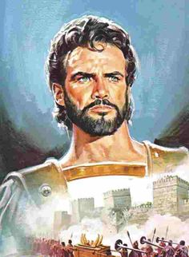
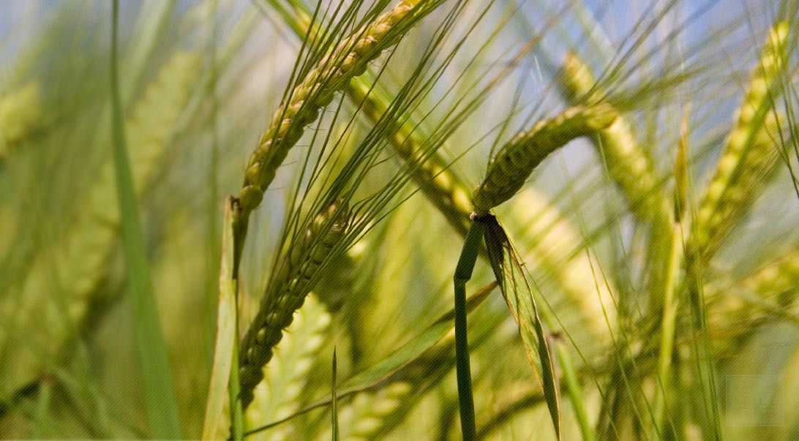

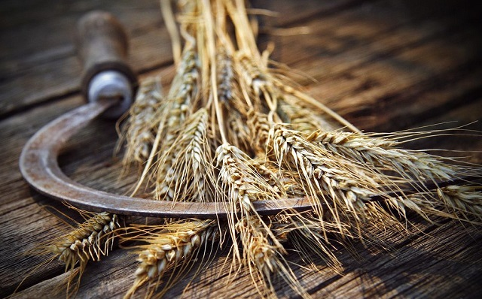
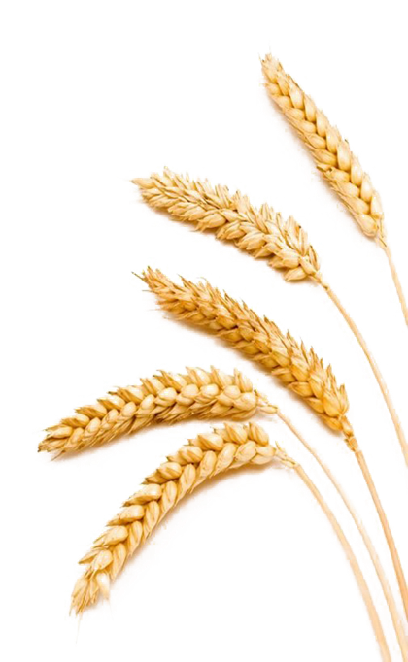

Exposing Another Counterfeit Count
Enoch’s Shavuot Count of 57?
What happened to Torah’s
50 days?

Slide 3
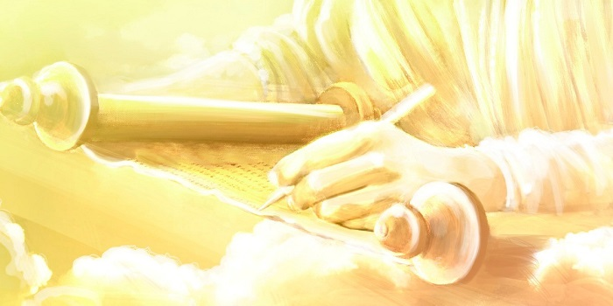


Covenant Calendar Studies Reveal Mysteries
Prov 25:2 It is the glory of Yahuah
to conceal a thing: but the honour of kings [Melek] is to search out a matter.
When a truth is found first, a mystery can be revealed!
Col 1:26 Even the mystery which hath been hid from ages and from generations, but now is made manifest
to his saints.
Today’s mystery will address
the issue of uncleanness in the
Book of the Law.
Many that hold to the Enoch calendar understand the Mystery of the Melchizedek Priesthood. But, has something important been missed along the way?
3

Slide 4
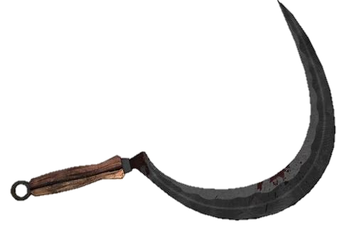
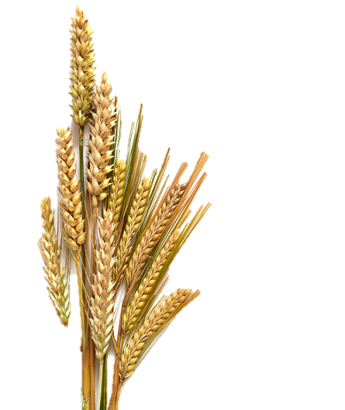

Sections for CF in part 4 – Review slides for part 3 ppt have to be added
Sections for CF in part 4 Abib 26 reasoning:
Section #11 … #1: Counterfeit Pentecost count to get to 15th day of 3rd month for pentecost;
Section #12 … #2: Yahusha had to wait a week before wave sheaf as He had touched a dead body – but bol was nailed to the cross, and what dead body did he touch; bring forward Jeanette’s slide on staying away from human touch for a whole week – from part 2;
Section #13 … Will Paul and Enoch agree on Pentecost timing? Who is within Torah guidelines?
Section #14: Summary slides that Tim has at the end.
Part #5 Mapping the Discussion Topics
Section | Slides | Content of Topic
Review | 5 | Review from Joshua’s Sickle Part 4 including “locked” or “unlocked”
Review | 6 | a) Joshua’s Torah Wave Sheaf Placement (Abib 15)
Review | 7-9 10-13 14-15 16-18 19-21 22-25 | b) Lunar-Sabbath Wave Sheaf Placement (Abib 16) c) Noah’s Flood Account: 2nd Month of Festal Year, not Civil Year d) 50 Day Omer Count to Mount Sinai Shavuot e) 99 Day Omer Count to Golden Calf Event f) Hebrew Secret for 50 Day Omer Count g) Enoch Review of Wave Sheaf to Pentecost Count [Rev. of Part 3]
12.1 | 29-33 | 1st Enoch Reason for Abib 26 Placement (“Date” takes priority)
12.2 | 33-54 | 2nd Enoch Reason for Abib 26 Placement (Issue of Uncleanness)
Does Enoch’s Omer Count of 57 days
have anything to do with “uncleanness”?
Part 4: From sickle to sheaves to Pentecost if
there is space at the bottom of the table.
For part 3: From sickle to sheaves to counting the barley
if there is space at the bottom of the table.

Slide 5



A “day” and/or a “date” for
calendar studies is a principle comparable to a lock.
This principle will either:
Lock a calendar (or)
Unlock a calendar.
Next: Seven Part Review

Slide 6

Joshua’s “Omer Count” Places Wave Sheaf on Abib 15
Joshua’s 1st Month
Covenant Calendar for Joshua’s 1st Month
14th – Sabbath = Passover
15th – 1st cycle [Sun] =
  Wave Sheaf [Omer Count Begins]
  1st Unleavened Bread Sabbath
3rd Month 4th Day [Sun] = Shavuot
(This specific year the
50th day was on the 4th.)
1st | 2nd | 3rd | 4th | 5th | 6th | 7th
1 | 2 | 3 | 4 | 5 | 6 | 7
8 | 9 | 10 | 11 | 12 | 13 | 14 P/O
15 W/S | 16 | 17 | 18 | 19 | 20 | 21 | Wk #1
22 | 23 | 24 | 25 | 26 | 27 | 28 | Wk #2
29 | 30
a)
REV
I
EW
Joshua’s 2nd Month
Joshua’s 3rd Month
1st | 2nd | 3rd | 4th | 5th | 6th | 7th
 |  | 1 | 2 | 3 | 4 | 5 | Wk #3
6 | 7 | 8 | 9 | 10 | 11 | 12 | Wk #4
13 | 14 | 15 | 16 | 17 | 18 | 19 | Wk #5
20 | 21 | 22 | 23 | 24 | 25 | 26 | Wk #6
27 | 28 | 29 | 30
1st | 2nd | 3rd | 4th | 5th | 6th | 7th
 |  |  |  | 1 | 2 | 3 | Wk #7
4 50th | 5 | 6 | 7 | 8 | 9 | 10
11 | 12 | 13 | 14 | 15 | 16 | 17
18 | 19 | 20 | 21 | 22 | 23 | 24
25 | 26 | 27 | 28 | 29 | 30
How will the
Wave Sheaf count compare on the lunar-Sabbath calendar?
End of Review (a)
6

Slide 7



Joshua’s 1st Month
Compare to -
Lunar 1st Month
**Both calendars correctly place Passover on the 14th day of the month.
1st Example
1st | 2nd | 3rd | 4th | 5th | 6th | 7th
1 | 2 | 3 | 4 | 5 | 6 | 7
8 | 9 | 10 | 11 | 12 | 13 | 14 P/O
15 | 16 W/S | 17 | 18 | 19 | 20 | 21
22 | 23 | 24 | 25 | 26 | 27 | 28
29 | 30
1st | 2nd | 3rd | 4th | 5th | 6th | 7th
1 | 2 | 3 | 4 | 5 | 6 | 7
8 | 9 | 10 | 11 | 12 | 13 | 14 P/O
15 W/S | 16 | 17 | 18 | 19 | 20 | 21
22 | 23 | 24 | 25 | 26 | 27 | 28
29 | 30
b)REV
I
EW
Sabbath Count
Sabbath Count
Both calendars have
1st ULB Sabbath on the
15th day of the 1st Month.
However, the 15th day on the Lunar Sabbath calendar is also their weekly sabbath. Therefore, Wave Sheaf must follow sabbath the 15th and is always locked to Abib 16th.
This LOCKS their counterfeit!
7

Slide 8

Joshua’s 1st Month
Again, compare to -
Lunar 1st Month
1st | 2nd | 3rd | 4th | 5th | 6th | 7th
1 | 2 | 3 | 4 | 5 | 6 | 7
8 | 9 | 10 | 11 | 12 | 13 | 14 P/O
15 W/S | 16 | 17 | 18 | 19 | 20 | 21
22 | 23 | 24 | 25 | 26 | 27 | 28
29 | 30
1st | 2nd | 3rd | 4th | 5th | 6th | 7th
 |  |  |  |  |  | 1
2 | 3 | 4 | 5 | 6 | 7 | 8
9 | 10 | 11 | 12 | 13 | 14 P/O | 15
16 W/S | 17 | 18 | 19 | 20 | 21 | 22
23 | 24 | 25 | 26 | 27 | 28 | 29
30
2nd Example
Sabbath Count
Sabbath Count
It matters not which “day of the week” the Lunar sabbath is found on, their 15th is always 1st Sabbath
of ULB; Wave Sheaf always follows on the 16th.
This is a very SERIOUS counterfeit!
8

Slide 9

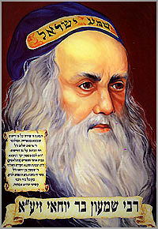

The Lunar-Sabbath Calendar has
“their” Wave Sheaf all “locked” up!
Wave Sheaf Lock!
WHEN the 15th always houses the Unleavened Bread Sabbath and
their weekly Sabbath, THEN Wave Sheaf must always be celebrated
on the 16th of their 1st month – denying Joshua’s Torah testimony.
In turn this also means:
Their Wave Sheaf is forever “locked/married” to the 16th just as many other counterfeit moon/month calendars. This now DIRECTLY links to:
The death of Rabbi Shimon bar Yochai – on
On the day of Rashbi’s death, he revealed the mystical dimension of the Torah known as the Kabbalah (a form of Jewish mysticism)!
The Occult!
&
Witchcraft!
End of Review (b)

Slide 10

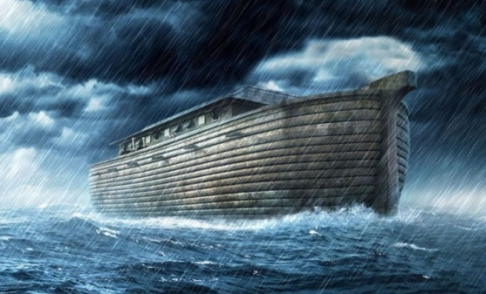

Some claim Noah’s 2nd month
is in the fall of the year!
What does this claim have to do with
any Wave Sheaf date and Omer Count?
c)
REV
I
EW
YEAR | MONTH | DAY | TEXT | COMMENT
1. 600TH | 2ND | 10TH | Gen 7:10 | Enter the Ark
2. 600TH | 2ND | 17TH | Gen 7:11 | Flood waters arrive
3. 600TH | 3RD | 27TH | Gen 7:17 | 40 days of rain
4. 600TH | (Month | Length) | Gen 7:24 Gen 8:3 | 5 months = 150 days
5. 600TH | 7th | 17th | Gen 8:4 | Ark rests on Ararat
6. 600TH | 10th | 1st | Gen 8:5 | Mountain tops are seen
7. 600TH | 11th | 10th | Gen 8:6 | Raven sent out
8. 600TH | 11th | 17th | Gen 8:10 | Dove sent out
9. 600TH | 11th | 24th | Gen 8:12 | Dove sent out again
10. 601ST | 1st | 1st | Gen 8:13 | Waters dried up
11. 601ST | 2nd | 27th | Gen 8:14 | Noah leaves ark
The last Calendar Date Clue in the Flood account was examined in comparison
to the
Omer count on six different calendars.

Slide 11
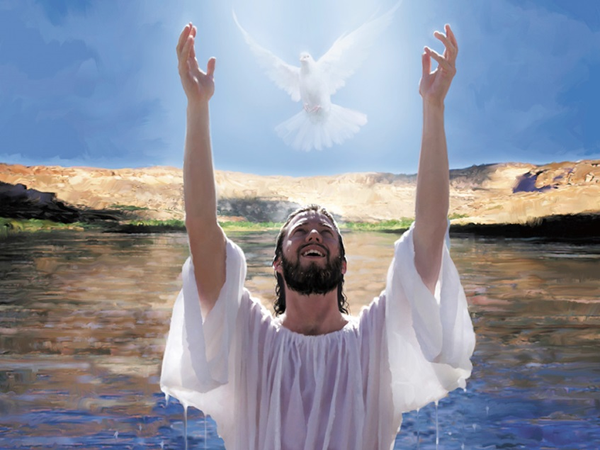
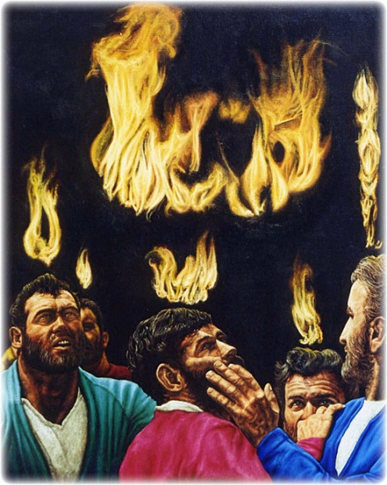
Yahusha’s Passover on His
Covenant Calendar had a sign & clue:
What was found?
Yahusha’s ministry …
From “water” to “fire”
in 70 weeks discovers a very
unique clue on one of Noah’s dates.

Slide 12
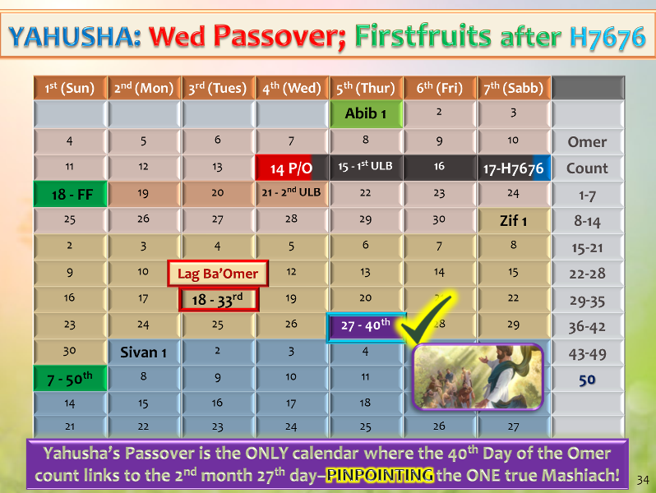

27th Day of 2nd Month:
[TRUE calendar]
Omer count #40.
27th Day of 2nd Month:
Omer count #40.
This calculation can be found
only on Yahuah’s Covenant Calendar.

Slide 13
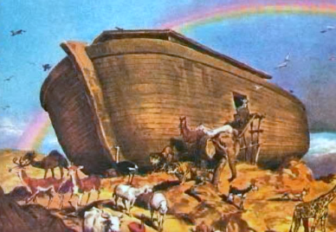
Yahusha’s passion year on the Covenant Calendar is the ONLY combination that can satisfy ALL these requirements:
4th cycle cross;
3 days & 3 nights;
Sabbath Resurrection;
1st cycle Wavesheaf … and …
This is strong evidence that Noah’s flood event began in the 2nd month of the Festal Covenant Calendar, not the fall.
houses the 40th day of the Omer count on the 27th day of the 2nd month – the day of Yahusha’s 2nd ascension.
End of Review (c)

Slide 14

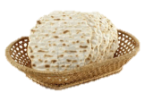
Yahuah’s “50 Day Omer Count” out of Egypt
Moses’ 1st Month
d)
REV
I
EW
1st | 2nd | 3rd | 4th | 5th | 6th | 7th
 |  |  | 1 | 2 | 3 | 4
5 | 6 | 7 | 8 | 9 | 10 | 11
12 | 13 | 14 | 15 | 16 | 17 | 18
19 | 20 | 21 | 22 | 23 | 24 | 25 | Wk #1
26 | 27 | 28 | 29 | 30
14th: Passover on 3rd cycle [Tues].
15th – 17th: Journey to the wilderness to worship.
17th: Red Sea Crossing the night of 6th cycle.
19th: Wave Sheaf [uncelebrated at this time].
25th: 1st Week of Omer Count completed.
Summary: 1st Month had 15 days of travel.
Moses’ 2nd Month
1st | 2nd | 3rd | 4th | 5th | 6th | 7th
 |  |  |  |  | 1 | 2 | Wk #2
3 | 4 | 5 | 6 | 7 | 8 | 9 | Wk #3
10 | 11 | 12 | 13 | 14 | 15 | 16 | Wk #4
17 | 18 | 19 | 20 | 21 | 22 | 23 | Wk #5
24 | 25 | 26 | 27 | 28 | 29 | 30 | Wk #6
15th: Arrival at Wilderness of Sin.
16th: Arrival of Quail at Sabbath evening.
17th – 22nd: First Manna Week.
Summary: 2nd Month realizes 6 completed weeks
to Omer Count #42.
14

Slide 15
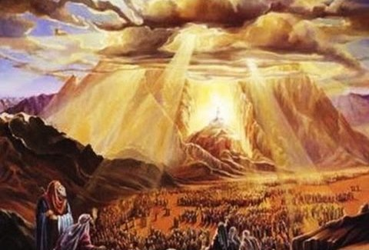
Yahuah’s “Omer Count” out of Egypt to the 50th Day
Moses’ 3rd Month
Some say there is no momentous event in the 3rd month of Exo 19-20. Would Moses agree with that?
1st | 2nd | 3rd | 4th | 5th | 6th | 7th
1 | 2 | 3 | 4 | 5 | 6 | 7 | Wk #7
8 50th | 9 | 10 | 11 | 12 | 13 | 14 | 56 Days
15 | 16 | 17 | 18 | 19 | 20 | 21 | 63 Days
22 | 23 | 24 | 25 | 26 | 27 | 28 | 70 Days
29 | 30 |  |  |  |  |  | 72 Days
1st – 6th: Omer Count #43 - #48 in the 3rd Month.
7th: 49th Day of Omer Count; 7 completed weeks.
8th: 50th Day of Omer Count Pattern at Mt Sinai [Shavuot]; Moses Receives Book of the Covenant; People accept Yahuah’s Covenant [3rd time]; Blood Ratification of Book of the Covenant & the people.
Note: Tracking every Covenant Calendar count of Yahuah from
the 1st Month, to the 2nd Month, then to Shavuot in the 3rd Month brings the calendar count to exactly the 50th day with precision.
There is no guessing that the events of Exodus 19-24 reveal
the Shavuot [Pentecost] Appointed Time Pattern.
The count is definitely about the reminder of Yahuah’s everlasting instructions for a nation – not just individual patriarchal families.
End of Review (d)
15

Slide 16
e) REVIEW from PT 4
“99 Day Omer Count” out of Egypt?
Moses’ 3rd Month
1st | 2nd | 3rd | 4th | 5th | 6th | 7th
1 | 2 | 3 | 4 | 5 | 6 | 7 | Wk #7
8 1st | 9 | 10 | 11 | 12 | 13 | 14 | 56 Days
15 | 16 | 17 | 18 | 19 | 20 | 21 | 63 Days
22 | 23 | 24 | 25 | 26 | 27 | 28 | 70 Days
29 | 30 |  |  |  |  |  | 72 Days
7th: 49th Day Omer Count at Mt Sinai [7 x 7 completed].
8th: 1st Day Omer Count to add another 50 days to 49.
Let’s track the movements of Moses in this new 1-50 count.
9th & 10th: Covenant Confirming Meal with 75 witnesses.
11th – 17th: Moses & Joshua travel further up the Mount.
18th: Moses travels alone to the top of the Mount for 40 days. The last 13 days of Month 3 are in the Mount. [Alternate Omer count now at 72 days.]
Moses’ 4th Month
1st | 2nd | 3rd | 4th | 5th | 6th | 7th
 |  | 1 | 2 | 3 | 4 | 5 | 77 Days
6 | 7 | 8 | 9 | 10 | 11 | 12 | 84 Days
13 | 14 | 15 | 16 | 17 | 18 | 19 | 91 Days
20 | 21 | 22 | 23 | 24 | 25 | 26 | 98 Days
27 | 28 | 29 | 30 |  |  |  | 99 Days
Month 4: Days 1-5 = 18 days in the Mount [77 days];
Days 6-12 = 25 days in the Mount [84 days];
Days 13-19 = 32 days in the Mount [91 days];
Days 20-26 = 39 days in the Mount [98 days];
Day 27 = 40th day of Moses in the Mount [99 days].
16

Slide 17


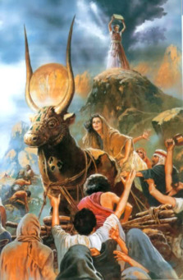
Omer Day Count #99
on the 27th Day of the 4th Month
(to align with a summer wheat harvest)
Moses returns after
being at the top of
Mt Sinai for 40 days,
only to find on this 99th Day, the children of Israel
had fallen into idolatry by worshipping the pagan trinity, while professing to
worship Yahuah.
Will you
say “no”
to 99?!

Slide 18

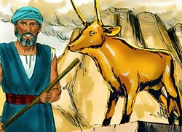
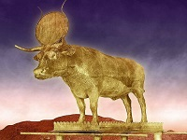
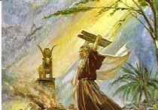
1st [Sun] | 2nd [Mon] | 3rd [Tues] | 4th [Wed] | 5th [Thur] | 6th [Prep] | Sabbath
29 #71 | 30 #72 (~June 18) | 1 #73 | 2 #74 | 3 #75 | 4 #76 | 5 #77
6 #78 | 7 #79 | 18 #80 | 9 #81 | 10 #82 | 11 #83 | 12 #84
13 #85 | 14 #86 | 15 #87 | 16 #88 | 17 #89 | 18 #90 | 19 #91
20 #92 | 21 #93 | 22 #94 | 23 #95 | 24 #96 | 25 #97 | 26 #98
27 #99 (~July 15) | 28 | 29 | 30
4th Month Events in Question
A Final
Decision
It is not feasible for a
99 Day Omer Count to be genuine for the giving of the BLOOD RATIFIED COVENANT written on the Stone Tablets!
18 Days
25 Days
Aaron’s
Calf
32 Days
99th Day
End of Review (e)
39 Days
This ‘golden calf’ actually represents the full worship of the false trinity!
Round Disc = Nimrod/Baal [sun god];
Altar = Semiramis/Ashtoreth [moon goddess]; Calf = Tammuz [false messiah]!
40th Day!

Slide 19


True Pentecost Count In Torah
Lev 23:10-11, 15-16
10 When ye be come into the land which I give unto you, and shall reap the harvest thereof, then ye shall bring a sheaf of the firstfruits of your harvest unto the priest:
11 And he shall wave the sheaf before Yahuah, to be accepted for you: on the morrow after the sabbath the priest shall wave it.
And ye shall count unto you from the morrow after the sabbath, from the day that ye brought the sheaf of the wave offering; seven sabbaths shall be complete: (Would that be 7 x 7 = 49 days for the first part of the count?)
Even unto the morrow after the seventh Sabbath [The 49th day?] shall ye number fifty days ; (Add another 50 days? eg: Could a 99 day Omer Count be true after what was discovered??)
Considering the Hebrew word for
UNTO, H5704 <ad>
ע ד
f) REVIEW
19

Slide 20

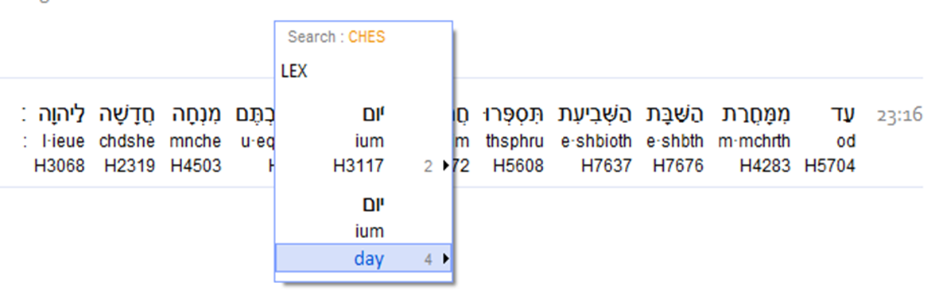
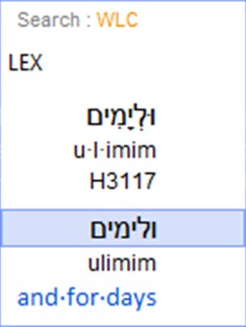
Lev 23:16 … you count fifty day.
Many
feel that
English
requires an
“S” here!
However, the original Hebrew does NOT indicate a plurality!
Lev 23:16 makes no mistake that this
precise day after the
7th completed Shabbat
is specifying ONLY ONE HIGHLY PARTICULAR
24 HOUR CYCLE!
YOWM (singular)! - Not Yowmim (plural)

Slide 21


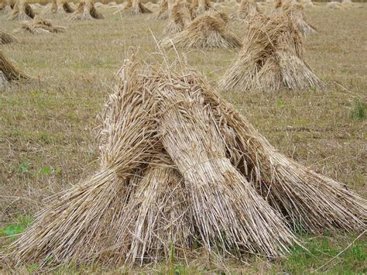


Lev 23:16 … you count
DAY FIFTY!
On the morrow after the 7th completed Sabbath …
One SPECIFIC YOWM!
End of Review (f)
Shavuot ~ Yahuah’s Harvest
according to (Hebrew) Torah statute.
21

Slide 22



Enoch’s “Omer Count”
g) Final REVIEW from PT 3
Enoch’s 1st Month
Enoch’s 3rd Month
1st | 2nd | 3rd | 4th | 5th | 6th | 7th
 |  |  | 1 | 2 | 3 | 4
5 | 6 | 7 | 8 | 9 | 10 | 11
12 | 13 | 14 | 15 | 16 | 17 | 18
19 | 20 | 21 | 22 | 23 | 24 | 25
26 | 27 | 28 | 29 | 30
1st | 2nd | 3rd | 4th | 5th | 6th | 7th
1 | 2 | 3 | 4 | 5 | 6 | 7 | Wk #6
8 | 9 | 10 | 11 | 12 | 13 | 14 | Wk #7
15 50th | 16 | 17 | 18 | 19 | 20 | 21
22 | 23 | 24 | 25 | 26 | 27 | 28
29 | 30
7 Days later than Moses!
Enoch’s 2nd Month
On Enoch’s calendar,
“dates” and “days” of Sabbaths and feasts never change.
Enoch’s Pentecost is always on
the 15th day of the 3rd month. There are 2 distinct reasons for this.
1st | 2nd | 3rd | 4th | 5th | 6th | 7th
26 | 27 | 28 | 29 | 30 | 1 | 2 | Wk #1
3 | 4 | 5 | 6 | 7 | 8 | 9 | Wk #2
10 | 11 | 12 | 13 | 14 | 15 | 16 | Wk #3
17 | 18 | 19 | 20 | 21 | 22 | 23 | Wk #4
24 | 25 | 26 | 27 | 28 | 29 | 30 | Wk #5
22

Slide 23

Moving to the 3rd Month - in CONTEXT!
Exo 19:1 In the third month -
after the children of Israel had come out of the land of Egypt …
on this [same] DAY [yowm] - [Not “DATE”]
REV
I
EW
The same 24 HR cycle of the week as the actual EXIT from Mitsrayim.
- The EXIT occurred on a 4th cycle of the week!
they came to the Wilderness of Sinai.
Now let’s APPLY this to some charts and see how it fits Scripture!

Slide 24
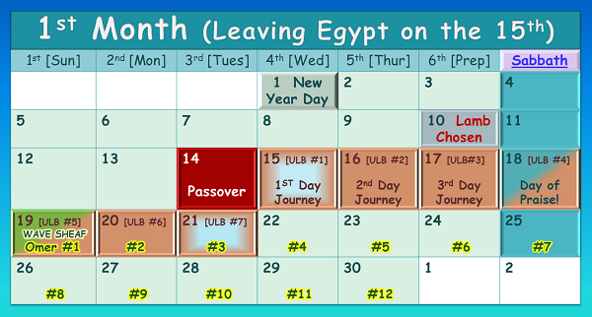

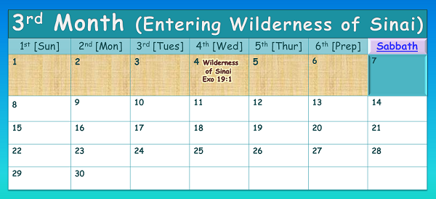


Only one set of calendars demonstrate the SAME DAY!
#1
#2
Enoch Count
The Exit!
#1 or #2 ??
The Same DAY!
Same DATE, different day!
REVIEW

Slide 25
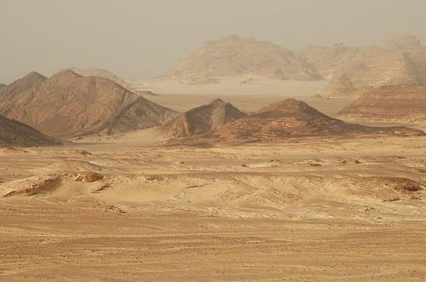
#1
REV
I
EW
The #1 example is the ONLY combination that will satisfy EVERY STATUTE requirement of this calendar puzzle.
Israel entered the wilderness of Sinai on the same 4th cycle of the week as they left Egypt.
(It was not the same “date” of the month;
specifically the 15th!)
The Exit!
The Same DAY!
End of Final Review (g)
25

Slide 26
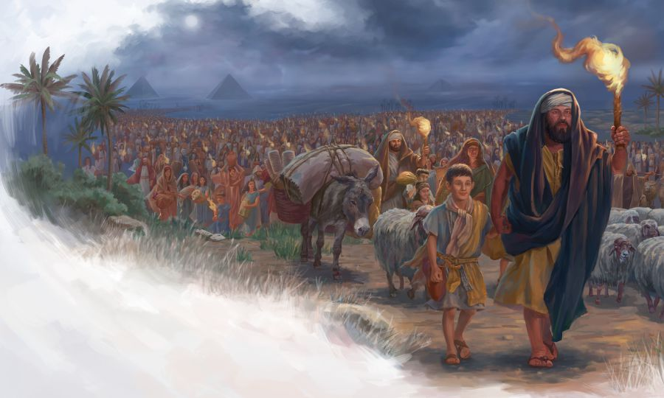

So, how can Enoch declare the 50th day of the Omer count to be on the
15th day of the 3rd month, exactly 1 week later?
In the year of the Exodus, both the Covenant Calendar and Enoch’s calendar celebrate Passover on the 3rd cycle (Tues) of the month. But, ONLY Yahuah’s 50 day
Omer count ends at the 8th day of the 3rd month.
26

Slide 27

The Enoch
Section #12
SHAVUOT
Count
The Dead Sea Scrolls use a
50 day Omer Count …
Is it the right count?
Is the date locked
on their Omer Count?
50?
OR
57?
27

Slide 28
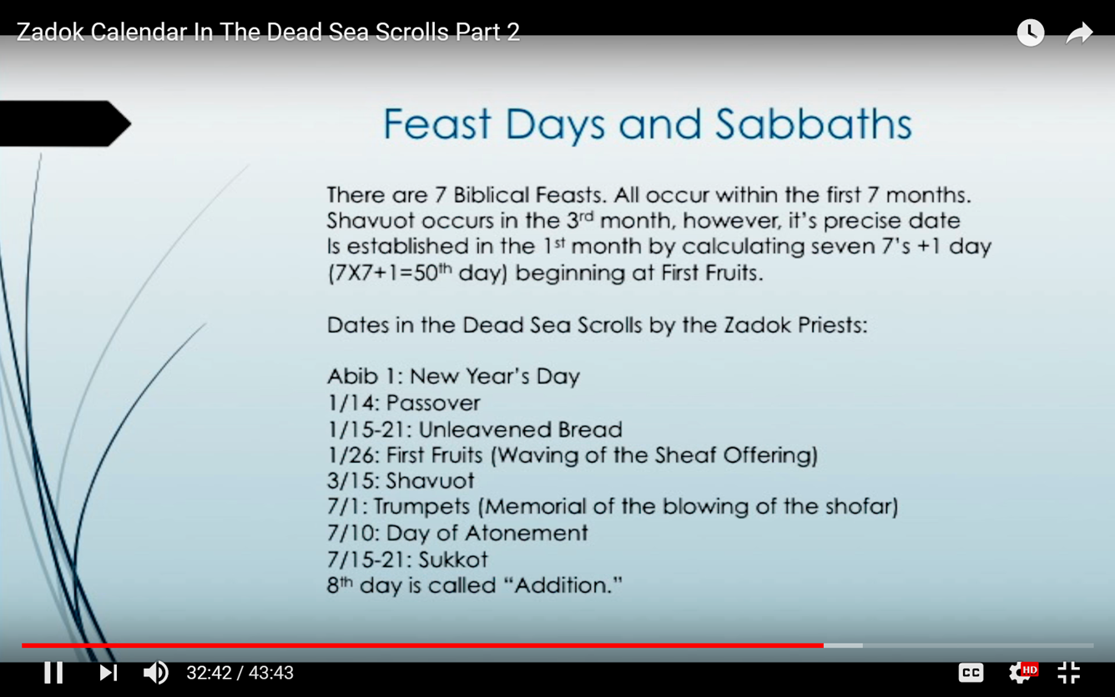
The Evidence
Review!
The Wave Sheaf & Shavuot dates are always locked on Enoch’s count!
Enoch
Zadok

Slide 29
Scrutinizing Enoch’s Requirements
There are at least 2 reasons why Enoch delays the
Omer Count by 1 full week after Covenant Calendar.
Section #12:2 Why is Enoch’s Wave Sheaf delayed
1 full week after Covenant Calendar’s timing?
If the Wave Sheaf is delayed, then obviously the Shavuot timing will be delayed an equal amount.
Section #12:1 In the case of Enoch, is there another reason why Shavuot is delayed 1 week?
In both cases it is a misreading of “content and context” and a misunderstanding of a “law” [PT 5 & 6].
Remember: a “day” and/or a “date” makes a difference!

Slide 30
Introduction to Enoch’s Locked Calendar
The placement of Shavuot will be discussed before the placement of Wave Sheaf to understand why these
“locked dates” have been deliberately chosen.
Section 12.1: Enoch’s Shavuot
Section 12.2: Enoch’s Wave Sheaf
Rightly placed on the 1st cycle of the week, following a weekly Sabbath
in this 3rd month.
Locked to the 15th “date” of
the 3rd month.
The “timing & placement” of the 50th day
in the 3rd month is also largely influenced by the dated events of the Exodus.
Rightly placed on the 1st cycle of the week, BUT - following a weekly Sabbath, not the Sabbath within the Passover Festival.
Locked to the 26th “date” of
the 1st month.
Wave Sheaf determines the termination of the 50 day Omer Count. When the start date is wrong, the Omer count will also be incorrect.
Will the incorrect Shavuot placement be a result of “reading out of context”?
Will the incorrect Wave Sheaf placement be a result of a “mis-application” of
a Book of the Law command?

Slide 31
Section #12.1
In the case of Enoch,
it’s very obvious Shavuot is a week later than Covenant Calendar because …
Assumption, or, deliberate twist?
For Exodus 19:1 Enoch assumed the “day of arrival” was the
“same date of the 15th departure” rather than the “same 4th cycle of the week” – being a WED.!
BIG ASSUMPTION!
Same DATE, different day!

Slide 32


There are at least 2 reasons why Enoch delays their Omer Count by one full week after Covenant Calendar.
Section #12.1: Why is the Wave Sheaf delayed one full week? (It’s a mis-application of a command from Book of the Law!)
Section #12.2: Why is the Pentecost count delayed by one full week? If the Wave Sheaf count is delayed, then obviously the Pentecost timing will also be delayed an equal amount. In the case of Enoch, is there another reason why Pentecost is delayed?. (It’s a mis-understanding of the context of Exo 19:1!)
Section #12.1
Summary
Abib 26th
What does this discovery mean? … Except …
Enoch has absolutely no choice because the context of Exodus 19:1 was ignored! In order to keep Shavuot on the 15th date of the 3rd Month,
(as their 50th day of the Omer Count), Enoch’s 1st day
of the Omer Count has to begin on Abib 26th.
That is the FIRST distinct reason. There’s much more!

Slide 33

Section #12.2
Enoch’s 1st Month
1st | 2nd | 3rd | 4th | 5th | 6th | 7th
 |  |  | 1 | 2 | 3 | 4
5 | 6 | 7 | 8 | 9 | 10 | 11
12 | 13 | 14 | 15 | 16 | 17 | 18
19 | 20 | 21 | 22 | 23 | 24 | 25
26 | 27 | 28 | 29 | 30
Why in the world would Enoch elect to delay Wave Sheaf 1 full week after Covenant Calendar, placing their festival OUTSIDE
the Passover Festival?
Enoch’s 3rd Month
1st | 2nd | 3rd | 4th | 5th | 6th | 7th
1 | 2 | 3 | 4 | 5 | 6 | 7
8 | 9 | 10 | 11 | 12 | 13 | 14
15 50th | 16 | 17 | 18 | 19 | 20 | 21
22 | 23 | 24 | 25 | 26 | 27 | 28
29 | 30
The true Torah Omer count is delayed to the 57th day by Enoch! Will Covenant Calendar have an answer!
33

Slide 34


Enoch’s Passover placement delays Yahusha’s resurrection 1 extra day to Abib 18 [rather than the 17th].
On Enoch’s calendar count, Yahusha’s resurrection would occur on Abib 18 [rather than the 17th].
Some say: Enoch claims “Yahusha was rendered unclean from touching, or BEING, a dead body.” Therefore He had to wait 7 extra days to be cleansed before being able to present Himself as the
Wave Sheaf –
3rd Cycle?
Enoch’s
1st Month
1st | 2nd | 3rd | 4th | 5th | 6th | 7th
 |  |  | 1 | 2 | 3 | 4
5 | 6 | 7 | 8 | 9 | 10 | 11
12 | 13 | 14 | 15 | 16 | 17 | 18
19 | 20 | 21 | 22 | 23 | 24 | 25
26 | 27 | 28 | 29 | 30
thus delaying
this anti-type” festival 1 week to Abib 26th on their [locked] Calendar!
Enoch’s 4 days and 4 nights ends here?
34

Slide 35

Where does this idea come from, and how could anyone dare
to make such a claim that
Yahusha was unclean upon
His resurrection for 7 days?
What does the Torah say about this type of “uncleanness”?
Would the “red heifer” know?
Num 19:11 He that toucheth
the dead body of any man shall
be unclean seven days.
Enoch’s
1st Month
1st | 2nd | 3rd | 4th | 5th | 6th | 7th
 |  |  | 1 | 2 | 3 | 4
5 | 6 | 7 | 8 | 9 | 10 | 11
12 | 13 | 14 | 15 | 16 | 17 | 18
19 | 20 | 21 | 22 | 23 | 24 | 25
26 | 27 | 28 | 29 | 30
35

Slide 36

“Unclean” According to Hebrew Definitions
There are several Hebrew definitions for “unclean” in the Strong’s.
H6945 qadesh; from H6942; a (quasi)
sacred person, i.e. (technically) a (male)
devotee (by prostitution) to licentious idolatry:
KJV - sodomite, unclean.
H6172 `ervah; from H6168; nudity,
literally (especially the pudenda) or figuratively (disgrace, blemish): KJV - nakedness, shame, unclean (-ness).
H5079 niddah; from H5074; properly, rejection; by implication, impurity, especially personal (menstruation) or moral (idolatry, incest): KJV - far, filthiness, flowers, menstruous (woman), put apart, removed (woman), separation, set apart, unclean
(-ness, thing, with filthiness).
The “unclean” for this study is found in these 2 main definitions:
H2931 tame' (taw-may'); from H2930;
foul in a relig. sense: KJV - defiled,
infamous, polluted (-tion), unclean.
H2930 tame' (taw-may'); a primitive root; to be foul, especially in a ceremonial or moral sense (contaminated): KJV - defile (self), pollute (self), be (make, makeself, pronounce) unclean, utterly.
Question:
Will an understanding
of these issues around “uncleanness” uncover
the Enoch teaching as
“true” or “counterfeit”?

Slide 37

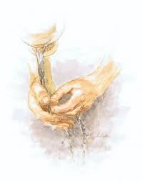
Different Categories of “Uncleanness”
According to Torah
In the Scriptures the expected “natural” state of humans was to be clean – including their clothes, homes and household items. But, because it was so easy to become contaminated (according to Torah guidelines), it was no small matter to achieve and remain in a state of cleanness everyday. (See Lev. 13:47-59; 14:33-57.)
If one did become unclean, there were various
provisions for cleansing, depending on the
seriousness of the contamination.
Sometimes remaining outside the camp until nightfall
and then washing was prescribed.
Other types of uncleanness involved certain sacrifices
as well as washing.
The priests were under very strict guidelines due to their ministry in the Tabernacle. They could attend the funerals of ONLY their immediate family members. But the High Priest who was in charge of Yom Kippur was not permitted to attend even these funerals (Lev 21:1-4, 11).
A) Unclean until
the “even” of
the same day.
B) Unclean for [7]
seven full days.
Reference: Robert K. McIver – Four Faces of Jesus, pgs 100-101

Slide 38
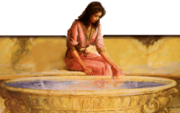
Why was it so important for Yahuah’s people to be clean?
Each viewed the system of washings
and sacrifices in accordance with
worship in the temple.
Each must ensure they were in a state of cleanness to safely approach divinity.
This is seen clearly in Yahuah’s command that the people cleanse themselves – today and tomorrow – in preparation for Shavuot
[or the 3rd day of this count] at Mt Sinai.
Death was/(is) the consequence of any defilement, thus exclusion from temple worship or permanent exclusion from
the camp. Or, finally, rejection of
Yahusha’s Ultimate sacrifice.
Reference: Robert K. McIver – Four Faces of Jesus, pgs 100-101

Slide 39
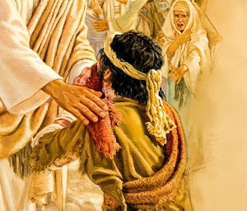
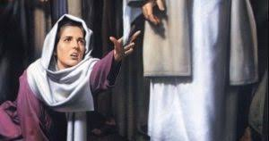
A) “Unclean” [and/or] “Unclean” till “even”
Categories of Simple “Uncleanness”
Consequences for Cleansing
Lev 11: Touching the dead body of an animal or touching the live body of an unclean animal, etc.
Lev 12: Giving birth.
Lev 13: Skin diseases.
Lev 13 & 14: Leprous clothes,
leprous items or dwelling places.
Lev 15: Bodily discharges.
Lev 11 & 15: Touching some-
one, or something, unclean.
Lev 21: Strict commands for the priesthood – especially death of family members, funerals, and entrance of tombs or cemeteries.
A basic rule of “uncleanness” for these categories: the individual
was “unclean until evening.”
Requirements for Cleansing
(Generally) Clothes had to be
washed; the person had to
wash/bathe; individual was
unclean ONLY until the evening.
Unclean earthen vessels must
be broken.

Slide 40
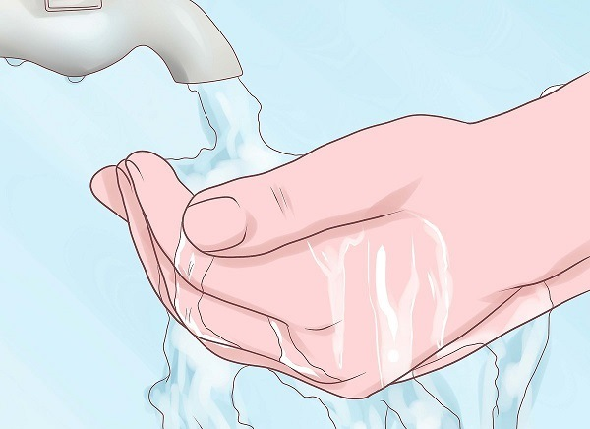
Why did “uncleanness” continue only to the “even”?
The instructions to take care of any “uncleanness” varied a bit between categories.
See the following example for touching of “unclean animals” (Lev 11:24-47) as given by
Matthew Henry's Commentary. Concerning the dead carcasses of all these unclean animals:
Every one that touched them [unclean animals] was to be unclean until the evening, Lev 11:24-28. This law is often repeated, to possess them with a dread of every thing that was prohibited, though no particular reason for the prohibition did appear, but only the
will of the Law-maker. Not that they were to be looked upon as defiling to the conscience, or that it was a sin against God to touch them [unclean animals], unless done in contempt
of the law: in many cases, somebody must of necessity touch them, to remove them; but
it was a ceremonial uncleanness they contracted, which for the time forbade them to come into the tabernacle, or to eat of any of the holy things, or so much as to converse familiarly with their neighbours.
But the uncleanness continued only till the evening, to signify that all ceremonial pollutions were to come to an end by the death of Christ in the evening of the world.
And we must learn, by daily renewing our repentance every night for the sins of the day, to cleanse ourselves from the pollution we contract by them [these sins], that we may not lie down in our uncleanness.
Even unclean animals they might touch while they were alive without contracting any ceremonial uncleanness by it, as horses
and dogs, because they were allowed to use them for service; but they might not touch them when they were dead, because they might not eat their flesh; and what must
not be eaten must not be touched, Gen 3:3.

Slide 41
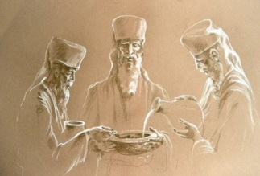
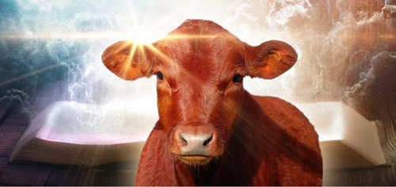
B) “Unclean” Seven [7] Days
Category of Serious “Uncleanness”
Category for Serious Issue
Requirements for Cleansing
Num 19: Touching a human dead body; being in the tent or tomb of the deceased; coming across a slain person in a field, or touching the bone of a dead human.
Numbers 19:17-20
And for an unclean person they shall take of the ashes of the burnt heifer of purification for sin, and running water shall be put thereto in a vessel:
And a clean person shall take hyssop, and dip it in the water, and sprinkle it upon the tent, and upon all the vessels, and upon the persons that were there, and upon him that touched a bone, or one slain, or one dead, or a grave:
And the clean person shall sprinkle upon the unclean on the third day, and on the seventh day: and on the seventh day he shall purify himself, and wash his clothes, and bathe himself in water, and shall be clean at even.
But the man that shall be unclean, and shall not purify himself, that soul shall be cut off from among the congregation, because he hath defiled the sanctuary of Yahuah: the water of separation hath not been sprinkled upon him; he is unclean.
Consequence for Cleansing
A basic rule of “uncleanness” for this category: the individual was unclean
for seven full days.

Slide 42

How does one become unclean until evening – or unclean for a full seven days?
Did Yahusha do something before His death that would have rendered Him “unclean” at His resurrection?
Or … Is this “uncleanness” only to the cross and the abolishment of certain laws fulfilled with Yahusha’s death?
Besides Enoch,
are there
others that hold similar views?

Slide 43
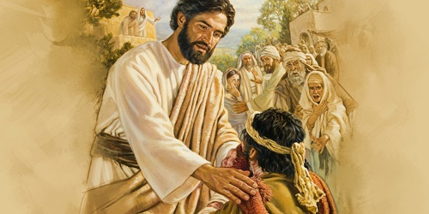

Was Yahusha “Unclean” by Touching an Unclean Person?
Some say Enoch teaches this belief, but there are others that teach Yahusha became “unclean” in various circumstances – according to the Book of the Law. These ideas are formulated like this:
#1 Mark 1:40-44 Healing of the Leper
Yahusha could have healed by a command. However He chose to give His healing touch.
In so doing, that touch made Yahusha ritually unclean. As a result Yahusha was forced to
stay out of populated areas because He was considered ritually unclean being in contact with the leper. Either Yahusha was “unclean” or at least near a violation of ritual custom
and the law.
Questions:
Was Yahusha breaking His own laws?
Did Yahusha become unclean by touching the leper?
Did the people keep their distance from Yahusha for fear of becoming unclean since they may have deemed Him unclean?
Ratzlaff, Sabbath in Christ ; 95-96

Slide 44
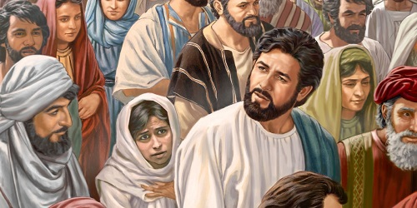
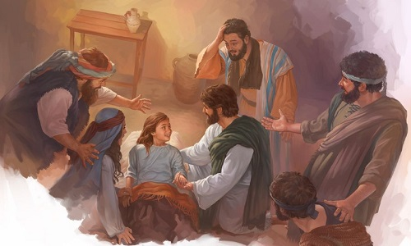
Was Yahusha “Unclean” by being Touched by an Unclean Person or Touching a Dead Person?
#2 Mark 5:21-43 Jairus’ Daughter;
Sick Woman with an issue of blood
Yahusha, in a crowd of people, is asked by Jairus to come and heal his daughter who is about to die. On the way, a ritually unclean woman touched His garment. According to custom this “touch” would make Yahusha unclean. By the time He arrived at the home of Jairus, the daughter was dead. However, instead
of speaking a Word to raise her to life,
He takes her hand and calls her to life.
Did Yahusha
break the ritual
law according to
Numbers 19?
  Num 19:11-13 He who touches the dead body of anyone shall be unclean seven days. 12 He shall purify himself with the water on the third day and on the seventh day; then he will be clean. But if he does not purify himself on the third day and on the seventh day, he will not be clean.
  13 Whoever touches the body of anyone who has died, and does not purify himself, defiles the tabernacle of Yahuah. NKJV
Ratzlaff, Sabbath in Christ ;96-97

Slide 45
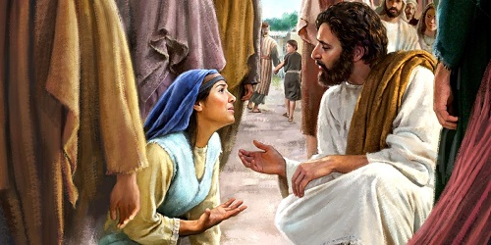
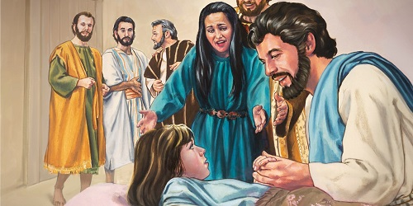
“Unclean” by “who” Touches “who”?
Questions:
Was Yahusha made “unclean” when He was touched by the woman with the issue of blood?
According to the Torah law did Yahusha make Himself unclean by touching the dead girl?
Did He defile the tabernacle of Yahuah?
Was Yahusha “unclean” before His Passover day?
Should He have been “cut off from Israel”?
If Yahusha broke His own Torah laws can
He still qualify as the true Messiah?

Slide 46

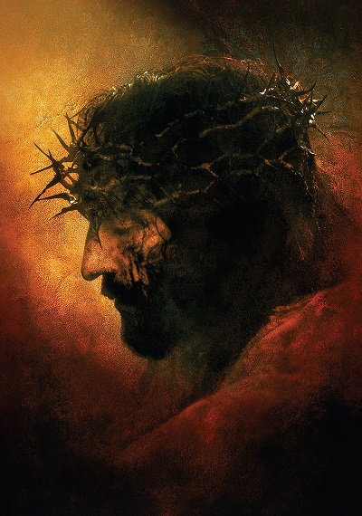
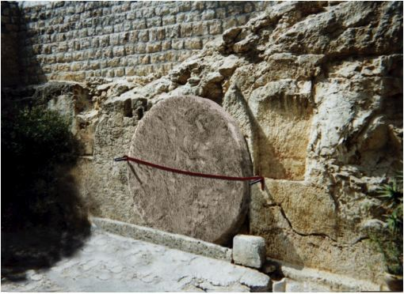
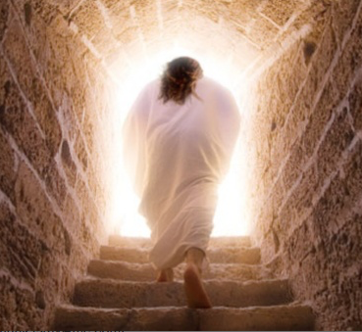
This ~
Or did Yahusha become “unclean” going from …
To this ~
To this?
46

Slide 47

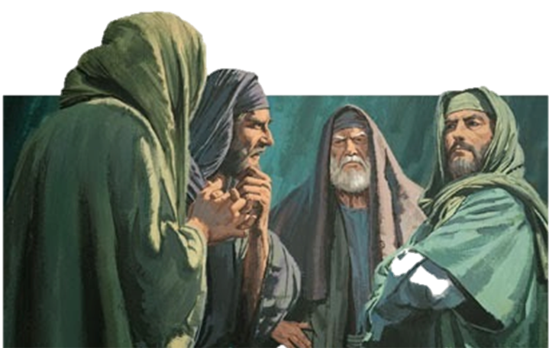
A Closer Look at Mark 5: The Pharisees
The Pharisees had the commendable aim of observing every detail of
the law.
A great part of their concerns would be tied up with the matter of “clean” and “unclean.”
They enforced the most stringent rules upon the priests concerning purity.
Avoiding contamination required continuous attention.
Therefore, it is no
surprise the Pharisees
were scrupulous in avoiding contact with things and/or people (dead or alive) who could convey uncleanness.

Slide 48

A Closer Look at Mark 5: Clean and Unclean
This chapter deals with Yahusha’s relationship to the various conditions of “unclean” through:
Man with an unclean spirit that entered a herd of pigs. Outcome: The man is rid of
the demon, and the whole neighborhood
was rid of these unclean animals!
Being touched by an unclean woman with an issue of blood. Outcome: The woman was not only healed, but saved by her faith.
Touching a dead girl [classed as unclean] bringing life. Outcome: By Torah Law a
dead body is unclean, and anything that touches it becomes unclean (Num 19:11, 16).
Instead of Yahusha becoming “unclean”
He always drives out the “uncleanness”
of all those who are suffering.
Yahusha does not become “unclean” but whoever He interacts with becomes clean!
McIver pgs 100-104.

Slide 49
Yahusha was “clean” from …
This ~
To this ~
To this!
49

Slide 50

If Yahusha was not “clean” He could not take our filthy sins to the stake!
Yahusha could not be laid in a filthy tomb. This was a new “clean” place to rest.
Yahusha’s clean Body saw no putrefaction. He arose in the purest form of spotlessness!
50

Slide 51
Yet many insist Enoch claims
Yahusha
became “unclean” somewhere between …
Here?
Here?
How did this happen?
Or here?!
51

Slide 52
IF?… If?… if?
IF Yahusha had died on
the “DATES” of Enoch’s
calendar count, then we would find:
Yahusha’s resurrection on the 18th;
Yahusha’s ascension on the 19th should by default be Wave Sheaf Festival.
Enoch claims Yahusha’s ascension had to be delayed to Abib 26.
Enoch’s 1st Month
1st | 2nd | 3rd | 4th | 5th | 6th | 7th
 |  |  | 1 | 2 | 3 | 4
5 | 6 | 7 | 8 | 9 | 10 | 11
12 | 13 | 14 | 15 | 16 | 17 | 18
19 | 20 | 21 | 22 | 23 | 24 | 25
26 | 27 | 28 | 29 | 30
Where’s the Gospel report
of Yahusha’s activities for
these very important, yet
unaccounted for, 7 days?
Enoch Week Questions!
When shall we investigate?
52

Slide 53

Must Yahusha wait for
7 cycles after His resurrection
to maintain His cleanliness before having contact with humans i.e. meeting the women at the tomb
on the first cycle of the week, just after sunrise??

Slide 54


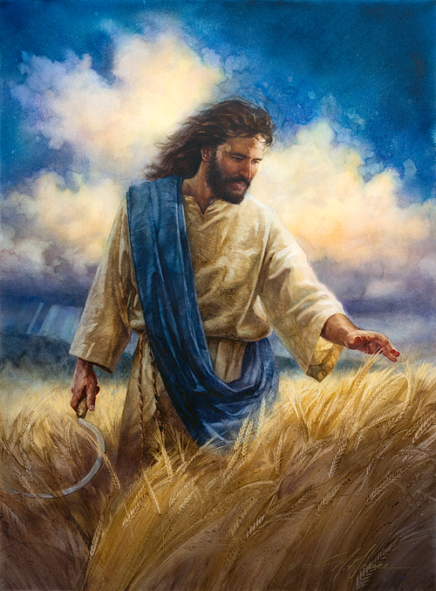
Where was Yahusha between His resurrection AND …
There are many more questions that will need
to be answered before all the evidence is exposed!
How about … “Would Yahusha be able to maintain cleanliness for 7 days – with no human contact”?
We shall see!
Enoch’s
Wave Sheaf
of Abib 26?
The End of Part 5

Slide 55

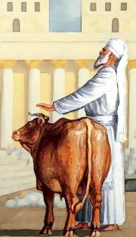


Future studies still to be addressed:
1) Does Enoch have any witnesses that Yahusha wasn’t
touched by humans until their Abib 26 Wave Sheaf
requirements were completed?
2) Would an investigation on the
Red Heifer have any answers?
3) Paul’s witness on the timing of Yahuah’s Pentecost Count?
Was his count on a “locked”
or “unlocked” calendar?
Note: There are still many witnesses for comparison and consideration!
And ~ what about…
The End!

Slide 56
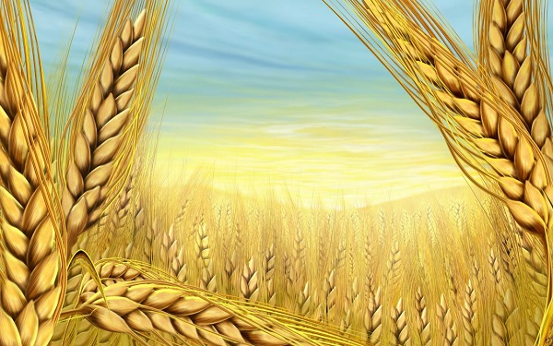

If you have Questions
&/or Comments
about this teaching,
please contact:
Timothy Astleford
tim@studythecalendar.com
calendar@torahtothetribes.com
Thank you!

Slide 57
The Mishnah describes several grades of uncleanness. The human corpse itself is the most severe of them all, known as the "Father of fathers of all uncleanness" (prime origin). The person who touches
a dead human body contracts a lower grade of uncleanness, known as the “Father of uncleanness.” Once he has been defiled, if he touches any other human being, or foods and drinks, he renders them unclean (defiled) …
Jewish priests were especially susceptible to contracting corpse uncleanness, due to the unmarked graves in foreign lands. Since they
were required by a biblical injunction
to eat their bread-offering in a state
of ritual purity, and they could hardly know if they had trampled upon an unmarked grave, this prompted the early rabbis to decree a general-state
of defilement upon all foreign lands.
A dead human's bone the size of a barley grain, and a dead human's severed flesh the size of an olive’s bulk are enough to convey corpse uncleanness when touched or carried.
During the time of the Second Temple, those persons who were defiled by the dead and who had not yet purified themselves by the ashes of the red heifer followed by an immersion in a ritual bath were prohibited from entering the Court of the Israelites (inner court), located on the Temple Mount. Today, in Jewish law, the same stringency is said to apply.
WIKI
PEDIA

Slide 58
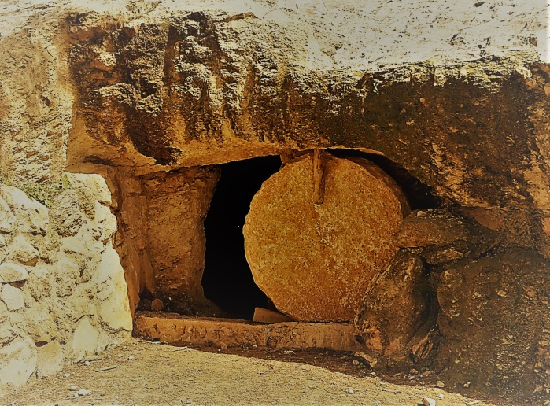
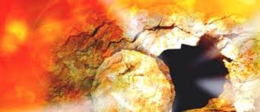
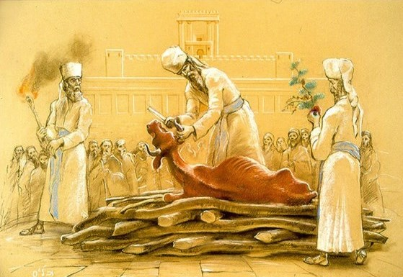
A dead human's bone the size of a barley grain, and a dead human's severed flesh the size of an olive’s bulk are enough to convey corpse uncleanness when touched or carried.
During the time of the Second Temple,
those persons who were defiled by the dead and who had not yet purified themselves by the ashes of the red heifer followed by an immersion in a ritual bath were prohibited from entering the Court of the Israelites (inner court), located on the Temple Mount. Today, in Jewish law, the same stringency
is said to apply.
WIKI
PEDIA

