Slide 1

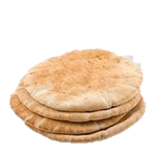
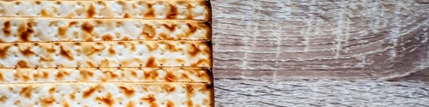
Unleavened
Bread
Consumption Schedule of Exo 12

Slide 2
Unleavened Bread
Consumption Schedule
Exodus 12:18
Under serious scrutiny!
References from The Scriptures
unless otherwise noted.

Slide 3

Would you agree?
Tradition is the Enemy of Truth!
Exodus 12:18 effectively reveals the chasm between “tradition” and “truth.”
In the first, on the fourteenth day of the month,
in the evening, [Abib 14 Passover]
you shall eat unleavened bread, until
the twenty-first day of the month in the evening.
HalleluYah Scriptures
3

Slide 4

An Appearance of Conflict with Exo 12:18
Questions regarding conflict for the following Scriptures:
1. Is the command to eat unleavened bread for 7 days,
or 8 days?
What is the “festival content” for Exo 12:18? Passover? Unleavened Bread Festival? Both?
Exo 12:18
Exo 12:15-16
Exo
13:6-7
Lev 23:5-8
What is the cause of this conflict?
The idea of the sunset day? OR
The day commencing at dawn?
4

Slide 5
Summary of Scriptures
Unleavened Bread Festival for 7 days. Eat unleavened bread for 7 days.
Count is given for: 7 days.
Passover: 14th day.
15th day: 1st ULB Sabbath
21st day: 2nd ULB Sabbath
Eat ULB 7 days. Count:
15-16-17-18-19-20-21!
Exo 12:18
Exo 12:15-16
Exo
13:6-7
Lev 23:5-8
Eat unleavened
bread for 7 days.
1st day & 7th day
are holy convocations.
Count the days for eating unleavened bread:
15-16-17-18-19-20-21!
Passover Sacrifice: 14th day at even.
Eat unleavened bread that night until the 21st day of the month at evening.
Count the days for eating unleavened bread: 14-15-16-17-18-19-20-21!
5

Slide 6
Summary of the Count for Eating ULB
Count:
7 days.
Exo 12:18
Exo 12:15-16
Exo
13:6-7
Lev 23:5-8
Count:
7 days.
Count:
7 days.
Count:
8 days!!
There definitely appears
to be a conflict!
6

Slide 7
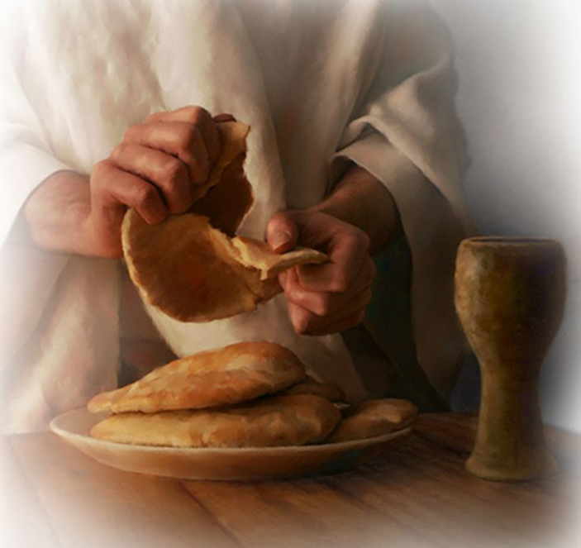
There is a Time to Eat and a Time to Praise
According to Exodus 12:18
Yahuah has determined very specific times for observing His
Mo-edim & consumption of unleavened bread.
Do man’s traditions align with His
Set-Apart instructions?
7

Slide 8
Have you considered the idea that there might be more
to the full Passover Festival?
More than just eating unleavened bread for 7 cycles
as most have been taught for many years?
Is there a possibility that many have been missing something BIG by following long time traditions?
If, on the final Atonement Day, you are accused of
removing one worship cycle or Torah command - or …
preventing Yahuah from receiving obedience from one or more statute requirements, what will your answer be?
8

Slide 9
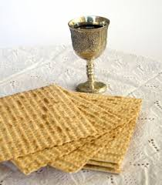
Do you know what the Scriptures declare about:
Yahuah’s Unleavened Bread Consumption Schedule??
Let’s start with: Definitions for Season & Cycle
This study tries to refrain from using the word “day” that has
been translated from the original Hebrew word <yowm>.
The word “day” has lost a massive amount of definitive
correctness through ambiguous definitions.
“Day” can indicate 12 or 24 hours, day or night, or both!
In this study, “Light Season” is generally used for the 12 hour “day.”
For the 24 hour “day” in this study – [as much as possible], preference
will be given to the word cycle in place of the word day.
When quoting Scripture, or citing the Sabbath Day, you will see it.
Otherwise cycle is the word of choice.
Notes:
The word “day” is inadequate for the accuracy demanded for these studies.

Slide 10
Understanding Important Definitions
The 24 hour cycle is further defined to pinpoint two seasons.
1. Cycle = 24 hours containing the
two seasons of: light - H216 <’owr> and night - H3915 <layil>.
2. Season = H6256 <‘eth>; twelve segments of time whether it is the
Light Season or Night Season [including
the twilights of ereb/evening and boqer/morning].
Jeremiah 33:20-26 uses the terms
“day season” and “night season.”
Light
Season
Night
Season
10
Notes:
The word “day” is inadequate for the accuracy demanded for these studies.

Slide 11
Jeremiah’s Definitions for Seasons
Jer 33:20, 25, 26 Thus saith Yahuah; If ye can break my covenant of the day, and my covenant of the night, and that there should not be
day and night in their season …
25 Thus saith Yahuah; If my covenant be not with day and night, and if
I have not appointed the ordinances of heaven and earth;
26 Then will I cast away the seed of Jacob, and David my servant … KJV
Light
Season
Night
Season
Does this sound like a serious covenant?
11
Notes:
The word “day” is inadequate for the accuracy demanded for these studies.

Slide 12
An “ereb/evening” Review
FIRST
Ereb - Evening - ע ר ב
To mix, mingle, be mingled, a mixture, mixed multitude, rabble, of flies or insects, the mixers, mixed ones, light and spirit mixed together, the heavens or celestial fluid consists of this MIXTURE, to be darkened, duskily obscured, [beyn ha arbayim] between the evenings or more literally - between the MIXTURES, at sunset when the cool dark air mixes or night air mixes with it. A Hebrew Lexicon - J Parkhurst 1762
12

Slide 13
An “arab/morning” Review
SECOND
All definitions for ereb/arab are descriptive action words.
Boqer [the noun] identifies a general portion of the
Light Season [a noun] that includes DAWN twilight.
Arab, (H6148 the 2nd primitive root) is APPLIED TO morning {boqer} – describing the mixing [the action/verb] of light and darkness occurring in the sky at that particular time.

Slide 14
One Focus of this Study
What time of the 24 hour cycle is it in this picture?
  Morning Twilight? – (Mixture of light and darkness)
  Evening Twilight? – (Mixture of light and darkness)
  Light Season of the Cycle? – (with sun light)
  The following graphic illustrates Yahuah’s perfect design of each cycle as given in Genesis 1.
  This will assist in understanding the study on the
  “days/cycles of consumption” for unleavened bread.
14

Slide 15
Please be sure you understand this graphic before moving on.
The Outline of Light and Darkness according to Genesis 1:
Boqer: Dawn’s First Light
Boqer: At Dawn, a New Cycle Begins
Morning action description - arab, twilight mixture
Sunrise
Sunset
Evening: ereb, twilight mixture
Direct Sunlight Rays
Darkness
Dawn, or Sunset?
Focus of the charts:
To correctly calculate the cycles unleavened bread is to be eaten, the correct day-start must be known first.
Twilight OT:5399 nesheph (neh'-shef); from OT:5398; properly, a breeze, i.e. (by implication) dusk (when the evening breeze prevails): KJV - dark, dawning of the day (morning), night, twilight.
Morning OT:1242 boqer (bo'-ker); from OT:1239; properly, dawn (as the break of day); generally, morning:
KJV - (+)day, early, morning, morrow.
Notes:
When speaking about Lev 23:32, many Sabbatarians place the an evening application before the sunset.

Slide 16

The Primary Question for this study about unleavened bread, is to find the Divine guidelines for “when” and “how long” unleavened bread is to be eaten.
1. Will there be a foundation for the format of Yahuah’s Dawn Design? AND …
2. Will we see any support for the Sunset Theory system of reckoning time?
All the facts will be examined so future decisions can be made according to Torah guidelines - and not traditions!
Fact: The blood-ratified Covenant Calendar documented between Gen 1:1 to Exo 24:11 proves Yahuah’s day-start begins with boqer/morning. This study will be laid out as:
Part 1 & Part 2: To count the days unleavened bread is eaten during the Festival of Unleavened Bread and the full Passover Festival according to the DAWN day-start.
Part 3: To compare the Sunset Theory with the closest and most searching scrutiny
from the Torah statute commands to find if there is any alignment.
What happens to the statutes when the Sunset Theory is used for the day count of eating unleavened bread at the Passover Festival?

Slide 17
Part 1: The Torah Count for ULB ~ 7 or 8 days?
This section will concentrate on the message of eating unleavened bread during the
“Festival of Unleavened Bread.”
An examination will be made of:
“when” is the timeframe for the eating of unleavened bread;
“where” are the designated “dates” for the eating of
unleavened bread during the “Festival of Unleavened Bread”?
Keep in mind many have accepted traditions and other
popular timings for the eating of unleavened bread.
But … many more believe these practices are Torah based!
Is it possible these beliefs do not exist in Torah?
Next: Texts from Exodus 12 & 13 about eating unleavened bread will begin this study.

Slide 18
A Torah Focus on Festival of ULB
Exodus 12:15 Seven days ye shall eat unleavened bread, and from the
first day ye shall utterly remove leaven from your houses: whoever
shall eat leaven, that soul shall be utterly destroyed from Israel, from the
first day until the seventh day.
Exodus 13:6 Six days ye shall eat unleavened bread, and on the seventh day
is a feast to [Yahuah].
Exodus 13:7 Seven days shall ye eat unleavened bread; nothing leavened shall
be seen with thee, neither shalt thou have leaven in all thy borders.
Leviticus 23:6 And on the fifteenth day of the same month is the feast of
unleavened bread unto [Yahuah] … KJV
Question: Will the Festival of Unleavened Bread commence with the DAWN day-start?
Two Separate Commands, Two substances!

Slide 19
Yahuah’s 24 Hours of Passover (Egypt)
Exo 12:6 And you shall keep it up until the fourteenth day of the same month. Then all the assembly of the congregation
of Yisra’el shall kill it between the evenings. [*See note.]
“between the evenings”
Boqer (arab)/Twilight Mixture
Dawn
Sunrise
Evening Ereb Twilight Mixture
Sunset
R
E
V
I
E
W
Abib 14 Light Season
Abib 14 Night Season
Exodus 12:8 And they shall eat the flesh on that night, roasted in fire, - with unleavened bread and with bitter herbs they shall eat it.
[*NOTE: The Exo 12 Passover Sacrifice “between the evenings” was during the Night Season as detailed in previous teachings.]

Slide 20
Using the last graphic for Dawn day-start, examine the Festival of Unleavened Bread from the 15th to the 21st and see how many cycles of eating
unleavened bread are accomplished according to Exodus & Leviticus.
In the first month “on the fifteenth day” begin eating unleavened bread…
Exo 12:18b & Lev 23:6
… for seven days UNTIL THE EVENING!
1
15
2
16
3
17
4
18
5
19
6
20
7
21
= 7!
All days begin at DAWN
The Scriptures reveal a SEVEN cycle schedule for consuming unleavened bread during “the” Festival of Unleavened Bread. This schedule is easily achieved when abiding by Yahuah’s Dawn “start of the day” format, from Creation!

Slide 21


Yahuah’s Covenant Count
for Feast of Unleavened Bread
When & how long? Begin at Dawn
on the 15th to the evening of the 21st:
15 – 16 – 17 – 18 – 19 – 20 – 21 =
7
Cycles

Slide 22
Part 2: Passover Festival Count for ULB
This section will concentrate on the message of eating unleavened bread during the
“Passover Spring Festival.” Will it be different?
The same examination will be made for:
“when” is the timeframe for the eating of unleavened bread;
“where” are the designated “dates” for the eating of
unleavened bread for the “Passover Spring Festival”?
Again, keep in mind there are many accepted traditions and other
popular timings for the eating of unleavened bread for Passover.
Many believe these practices are Torah based!
The question is: Do these beliefs exist in Torah?
Next: Texts from Leviticus 23:5-6 about eating unleavened bread for the Passover Festival begins Part 2.

Slide 23
Remember Exodus 12:15; 13:6-7 & Lev 23:6 – all mention the unleavened bread was to be eaten for 7 cycles. There was no reference there of other
cycles for eating unleavened bread! However new information will move into
an interesting situation. Further in Exodus 12, it appears as if there is a totally different number given. Let’s check further in Leviticus.
1
Leviticus 23:5 In the first month, on the fourteenth day of the month, between the evening times is [Yahuah’s] passover.
Leviticus 23:6 And on the fifteenth day of this month is the feast of unleavened bread to [Yahuah]; seven days shall ye eat unleavened bread.
2
Have you ever noticed the verses address two different Festivals with:
two - SEPARATE - Feast dates?
SEPARATE

Slide 24
Exodus 12:16 And in the first day there shall be an holy convocation, and in the seventh day there shall be an holy convocation to you; no manner of work shall be done in them, save that which every man must eat, that only may be done of you.
Question:
Is the Passover Festival a … “Holy Convocation”?
Exodus 12:16 And in the first day there shall be an holy convocation, and in the seventh day there shall be an holy convocation to you; no manner of work shall be done in them, save that which every man must eat, that only may be done of you.
Question:
Is the Passover Festival a … “Holy Convocation”?
Exodus 12:16 And in the first day there shall be an holy convocation, and in the seventh day there shall be an holy convocation to you; no manner of work shall be done in them, save that which every man must eat, that only may be done of you.
Question: What “feast” is verse 16 talking about? Passover? ULB Festival?
2nd Question: Is the Passover Festival a … “Holy Convocation”?
If it is, I know of no Scriptural support claiming that Passover is a “Holy Convocation” or a Sabbath of any kind. However in Leviticus 23:7,8 there is information affirming the Festival of Unleavened Bread as a “Holy Convocation” (H4744 <miqra>) on both 24 hour cycles at the beginning and the end.
Therefore, Exodus 12:16 cannot be referring to the Passover Feast Night Season as the first “day” of consuming Unleavened Bread. But instead, it is referring to the two Shabbaths of the Festival of Unleavened Bread for its commencement point of Unleavened Bread consumption.
This point is serious and will become extremely important very quickly.
If it is, I know of no Scriptural support claiming that Passover is a “Holy Convocation” or a Sabbath of any kind. However in Leviticus 23:7,8 there is information affirming the Festival of Unleavened Bread as a “Holy Convocation” (H4744 <miqra>) on both 24 hour cycles at the beginning and the end.
Therefore, Exodus 12:16 cannot be referring to the Passover Feast Night Season as the first “day” of consuming Unleavened Bread. But instead, it is referring to the two Shabbaths of the Festival of Unleavened Bread for its commencement point of Unleavened Bread consumption.
This point is serious and will become extremely important very quickly.
There is no Scriptural support claiming Passover as a “Holy Convocation” or a Shabbat of any kind. However in Leviticus 23:7-8 there is information affirming that indeed the Festival of Unleavened Bread has two “Holy Convocations” (H4744 <miqra>) on 24 hour cycles at the beginning and ending of the festival.
Therefore, Exodus 12:16 cannot be referring to the Passover Festival Night Season for the
1st “day” of consuming unleavened bread. But it is referencing the 1st Shabbat of the Festival of Unleavened Bread for its own commencement point of unleavened bread consumption.
This serious point is going to become extremely important very quickly.
Notes:
Read Leviticus 23:5 – 7 and compare which is Qodesh and which is not.

Slide 25
What About Lev 23:6 & Exo 12:18?
Leviticus 23:6
Exodus 12:18
And on the fifteenth day of the same month is the feast of unleavened bread unto [Yahuah]: seven days ye must eat unleavened bread. KJV
In the first month, on the fourteenth day of the
month at even, ye shall eat unleavened bread, until
the one and twentieth day of the month at even. KJV
Count:
7 cycles.
Count:
8 cycles!!

Slide 26
Thoughts to Ponder:
1. The Scriptures provide the DISTINCTION between the two different orders to consume unleavened bread during the Festival of Unleavened Bread and the Feast of Passover.
.
WILL THE SEPARATING DISTINCTION of unleavened bread consumption allow for the individual Festival dates of Passover and Unleavened Bread? And will that separation effect collectively indicate a total of MORE than seven cycles for consuming unleavened bread according to Exo 12:18?
IMPORTANT: Can point #2, indicate there really are EIGHT CYCLES
for eating unleavened bread as the count indicated in Exo 12:18?
Will this Scripture also enable us to fulfill ALL the required statutes for eating unleavened bread during these two Festivals?
Exodus 12:18 In the first month, on the fourteenth day of the month at even, ye shall eat unleavened bread, until the one and twentieth day of the month at even.
How many cycles are there — counting from the 14th cycle to the 21st cycle?
Where else do we read of eating unleavened bread on the 14th of the month?

Slide 27
The FIRST Scriptural instruction for eating Unleavened Bread - is found in Exodus 12:8
ten verses before Exodus 12:18. Verse 8 is very specific.
Exodus 12:8 And they shall eat the flesh in this night roast with fire, and
they shall eat unleavened bread with bitter herbs.
Fact: Unleavened bread was to be eaten that night. (Note: The Passover meal is always eaten at night.)
Not in the Light Season, but after the sun had set and the darkness had begun.
Question: For the timing context up to this point in Exodus 12,
what single cycle of the month has been indicated?
Exodus 12:6 And it shall be kept by you till the fourteenth of this month, and all
the multitude of the congregation of the children of Israel shall kill
it toward evening [“between the evenings”].
And verse 8 again –
Exodus 12:8 And they shall eat the flesh in this night roast with fire, and they shall eat unleavened bread with bitter herbs.
Does the TRADITIONAL SUNSET Day-Start AGREE with Torah?

Slide 28
Yahuah’s 24 Hours of Passover (Egypt)
ANO
T
H
E
R
R
E
V
I
E
W
Exo 12:6 And you shall keep it up until the fourteenth day of the same month. Then all the assembly of the congregation
of Yisra’el shall kill it between the evenings. [*See note.]
“between the evenings”
Boqer (arab)/Twilight Mixture
Dawn
Sunrise
Evening Ereb Twilight Mixture
Sunset
Abib 14 Light Season
Abib 14 Night Season
Exodus 12:8 And they shall eat the flesh on that night, roasted in fire, - with unleavened bread and with bitter herbs they shall eat it.
[*NOTE: The Exo 12 Passover Sacrifice “between the evenings” was during the Night Season as detailed in previous teachings.]

Slide 29

With the previous review of the Passover Day-start chart, next examine the
full Passover Festival to see how many cycles there are for eating
unleavened bread as it is written in Exodus 12:18.
Passover eaten “on that night roasted in fire with unleavened bread…”
Exo 12:8
Exo 12:18 – 21st day of the month, IN THE EVENING!
Cycle 1 Abib 14
+
1
15
2
16
3
17
4
18
5
19
6
20
7
21
= 8
The Scriptures do reveal an EIGHT cycle schedule for consuming unleavened bread during the Passover and Unleavened Bread Festivals. This schedule is easily achieved when abiding by Yahuah’s Dawn day-start format, from Creation!

Slide 30
Yahuah’s Covenant Count
for the Passover Festival
When & how long? Begin at “ereb/evening”
on the 14th to the evening of the 21st:
14 – 15 – 16 – 17 – 18 – 19 – 20 – 21 =
8
Cycles

Slide 31
Part 3: Sunset Theory Count for ULB
This section will challenge the message of consuming unleavened bread
for “EIGHT DAYS” of the full Passover Festival.
The same examination for Sunset Theory will be made between:
“when” is the timeframe for the eating of unleavened bread;
“where” are the designated “dates” for the eating of
unleavened bread according to “Sunset Theory day-start”?
There are many different scenarios for the false time of eating the Passover meal.
Only two very popular options are under scrutiny in this study:
Sunset Theory Option #1: To eat the lamb with unleavened bread on the
night of the 14th, (right after sunset of the 13th).
Sunset Theory Option #2: To eat the lamb with unleavened bread on the
night of the 15th, (right after sunset on the 14th).
Note: The charts will demonstrate what happens with the lamb - but remember the unleavened bread is connected to the lamb, both being eaten together.

Slide 32
Those accustomed to partaking of unleavened bread for the Passover meal
according to the sunset to sunset standards – will observe this statute:
either on sunset’s Abib 14th [right after sunset on the 13th] or
on sunset’s Abib 15th [right after sunset on the 14th].
The confusion that follows will verify that such Torah commands
cannot be found … for they do not exist!
At this time we will concentrate on the message of only the “EIGHT DAYS”
for eating unleavened bread during the full Passover Festival.
Questions:
Exactly “where & what date” will Sunset Theory place the Torah command
for the commencement of eating unleavened bread for the Passover Festival?
Will all “EIGHT DAYS” be accounted for?
Why are many taught to observe Passover in the Shabbat Night Season of Abib 15th (counting that time as part of the Unleavened Bread Feast)?
And - Where can we find a Scripture instructing this message?
Will any Sunset Theory options be able to fulfill the Torah command for “when”
to begin eating unleavened bread and for “how long”?

Slide 33
For this next section, remember the Dawn day timing based on the
very words of creation, as recorded in Genesis 1.
Next … we will consider the tradition most have been taught for many years and determine if the traditional system will also allow complete fulfillment of the Passover Festival statutes in Exodus 12.
The traditional system known as Sunset Theory starts the cycles of the week with the sunset moment before the Night Season. Sunset has an inherent problem with identifying the correct time of ereb/evening.
The Hebrew word for evening is often deficiently translated as
the – sunset. The base definition of ereb and its root word is – MIXTURE, MIXING, TO BE MIXED with no application to sunset.
Notes:
Please note that this chart is made in the Dawn Design format as seen in Genesis 1.

Slide 34
When the word – ereb – is applied to time, it designates the “segment of time” of the 24 hour cycle when the INDIRECT sunlight begins mixing with the darkness as
in the evening twilight.
In the morning twilight, the mixture of darkness decreases with the light until full direct rays of light are exposed.
In the evening twilight, the direct sunlight is gone after the sunset, and the darkness assumes dominant rule.
Notes:
Please note that this chart is made in the Dawn Design format as seen in Genesis 1.

Slide 35

Facts About Sunlight
The only time when INDIRECT sunlight can be seen
in the 24 hour cycle is either:
1. just before sunrise, or
2. just after sunset.
Note: Without Divine intervention,
the mixing of light and darkness cannot occur while the sun is visible in the blue sky.
Therefore, Ereb, (evening mixture) cannot occur when the sun is visible.
Let’s look at a graphic to be sure we understand this fully before we continue with our study in the Scriptures.
Notes:
Please note that this chart is made in the Dawn Design format as seen in Genesis 1.

Slide 36
Focus on the Light Structure as found in creation’s cycle 2 & forward.
Morning Arab Twilight Mixture, INDIRECT Light
Evening Ereb Twilight Mixture, Indirect Light
Boqer, Dawn’s first light.
Sunrise
Sunset
[or] - Dusk
Night Season |  | Night Season
Light Season
Focus: It is Dawn that starts Yahuah’s cycles. There is ample Scriptural proof!
Sunset tradition, (~450 BC start), changed the cycles as taught by the Pharisees!
Direct Sunlight
Is sunset theory directly linked to lunar based worship?
36
Notes:
Please be certain that you understand this graphic. If not, ask questions.

Slide 37
Why are we looking so intently at the twilight mixtures of the cycle?
Because it is the sunset ushering in the evening twilight that is
going to indicate to us, Yahuah’s true Word.
Question: What effect can the sunset possibly have on Passover, and the statute for the eating of unleavened bread?
Answer: “Sunset” will determine if Passover is being observed according to
Yahuah’s Will or if one is clinging to tradition.
Questions: What happens to the EIGHT CYCLE Unleavened Bread count,
as seen in Exodus 12:18, when utilizing sunset to determine
changing the cycles of the week?
Will sunset reckoning support the Scriptures, or will it destroy the possibility of fulfilling Yahuah’s statutes?

Slide 38
Remember - the previous graphics were formatted with Dawn twilight commencing the cycle.
The next graphic has sunset changing the cycle of the week, which in turn declares the Night Season arrives before the Light Season.
It must be stated quite emphatically this
simply cannot be supported from the Scriptures
and quite specifically - not from Genesis 1.
It’s now time to examine some comparisons for
the Exodus 12 pattern to find the truth!
We will consider a variety of “sunset” options.

Slide 39

Option #1: Sunset Theory’s Imposter Passover
Sunset changes the cycle from Abib 13 to Abib 14
Note: Whatever happens to the lamb – it always has a connection to the
unleavened bread.
Ereb: Evening twilight mixture
Passover meal eaten with U/B “that night”
Morning: arab, twilight mixture
Yahusha died here!
Sunrise
Abib 14 Night Season
Abib 14 Light Season
At the Last Supper the disciples received new Passover rites
in this Night Season before Yahusha was “captured!” They went to the Garden of Gethsemane in this night! It was NOT PASSOVER!

Slide 40

Next: - “Sunset’s” Sacrifice of Abib 14 Night Season
This slide is specifically intended to assist the next slide –
The partaking of the Passover lamb must include unleavened bread at the meal.
When their lamb was slain to facilitate authentic Passover Lamb flesh to be eaten with [ULB] at their Abib 14 NIGHT SEASON Passover meal;
WAS IT, or WAS IT NOT – A SACRIFICE?
Abib 14 Night Season
Abib 14 Light Season
Absolutely! Indeed any lamb slain for the Passover meal was a sacrifice! Why is this being questioned?

Slide 41


Sunset Theory: “A” Sacrifice – BEFORE - THE SACRIFICE?
Deut 16:4 declares the lamb slaughtered in the ereb (twilight) MUST NOT BE LEFT UNTIL THE MORNING (LIGHT)!
Can Yahusha successfully fulfill this TYPE (1400 years later), of slaying and roasting the Passover Lamb? This is approximately 21 hours
before He died on the tree – (on the AFTERNOON of Abib 14)!?
Slain here.
GONE BY HERE?
Yahusha was ALIVE HERE!
Abib 14 Night Season
Abib 14 Light Se ason
If the Passover Lamb was already slain here according to statute; WHY DO THE SCRIPTURES INDICATE THAT YAHUSHA WAS THE PASSOVER LAMB SLAIN?
9th Hour – Yahusha Died.

Slide 42


The sunset to sunset scenario shows the Passover lamb being
slain correctly during the Abib 14 <ereb> (twilight) {Deut 16:4}.
Yet it seems strange that the lamb was slain 21 hours
before Yahusha actually died on the tree!
Next: We have TRADITIONALLY been taught that the Passover Lamb must be slain in the 9th hour, or 3 PM on our present clock.
Hhmm…! Hundreds of thousands of Yisra’elites slaying
“the family lamb” at the temple {as per statute requirement},
within a 3 hour window, BEFORE SUNSET (as per mainstream teaching)? The word congestion comes to mind here.

Slide 43

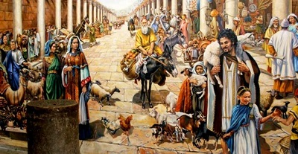
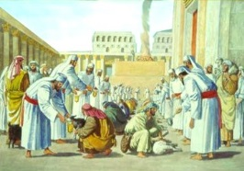
Historical Account From Josephus
"So these high priests, upon the coming of their feast which is called the Passover, when they
slay their sacrifices, from the ninth hour to the eleventh, [3 PM to 5 PM Roman time] but so that a company not less than ten belong to every sacrifice . . . and many of us are twenty in a company, found this number of sacrifices was
two hundred and fifty six thousand five hundred [256,500] which, upon the allowance of no more than ten that feast together, amounts to two million seven hundred thousand and two
hundred persons that were pure and holy."
(Josephus, Wars of the Jews, Book VI, 9:3; 75 AD.)
Next: What about the “lamb” according to Sunset Theory?

Slide 44


Imposter Lamb flesh!
Next: Sunset Theory’s -
Sunset changes the cycle from Abib 13 to Abib 14
Evening: ereb, twilight mixture
Sunset, A New Cycle Starts??
Can the Antitype Lamb be slain
18 hours
AFTER the
Passover Meal?
Passover meal eaten with U/B “that night” (Exo 12:6).
Morning: arab, twilight mixture
Sunrise
Abib 14 Night Season
Abib 14 Light Sea son
Passover Lamb to be slain at 3 PM?? Yet the Passover meal was eaten approximately 18 hours earlier!
Where did the Lamb’s flesh come from?

Slide 45



Sunset Theory & the already dead sacrifice?
Sunset changes the cycle from Abib 13 to Abib 14
Sunset, A New Cycle Starts??
Evening: ereb, twilight mixture
Passover meal eaten with U/B “that night” (Exo 12:6).
Was the Antitype Lamb already dead when put on the tree, having been slain approximately 21 hours earlier according to TRADITION?
Abib 14 Night Season
Abib 14 Light Sea son
Yahusha died here!

Slide 46

Option #2: Sunset Theory & the Abib 15 Passover Meal
Passover meal is eaten
on Abib 15 Shabbat night of Unleavened Bread?
Sunset, Starts A New Cycle??
Antitype Lamb slain
at the 9th hour from Dawn
(3 PM)
By statute, Passover Lamb remains were to be burnt
before morning of Abib 14!?
(See Exo 12:6-10.)
Abib 14 Night
Abib 14 Light Sea son
Abib 15 Shabbat??
A Passover meal placed on Abib 15 is TOTALLY RIDICULOUS!

Slide 47
With the varied Sunset Theory options we have just examined, how can Yahuah’s Statutes
declare 2 separate dates of
Abib 14 & 15 - for the Passover meal celebration?
What has happened to Yahuah’s separation?
Has MAN
THROUGH TRADITION, (tried to)
COMBINE YAHUAH’S TWO FESTIVALS????

Slide 48


Yahuah never intended the Passover meal
to be observed on Abib 15!
Exodus 12:6
And it shall be kept by you till the fourteenth
of this month …
Exodus 12:8 [Remember the eating of u/b.]
And they shall eat the flesh in this night roast with fire,
and they shall eat unleavened bread with bitter herbs.
Next, how about a look at the carnage to
Yahuah’s statutes that is caused by
observing the Passover day meal on
Abib 15, according to Sunset Theory?

Slide 49
This is the examination of both Festivals to see if Sunset Theory can accomplish fulfilling 8 cycles of eating unleavened bread as it is written in Exodus 12:18.
Sunset changes Abib 14,
to the 15th.
Passover eaten on Abib 15 night. {NO SCRIPTURE!}
Exo 12:18 – until 21st day of the month, IN THE EVENING!
Cycle 0 Abib 14
1
15
2
16
3
17
4
18
5
19
6
20
7
21
= 7
On Abib 14, there is no u/b eaten! 7 Cycles only, of eating unleavened bread is NOT Yahuah’s required 8 cycles of
eating unleavened bread for the full Passover Festival.
The abominable sunset system only allows 7 cycles for eating unleavened bread! ANOTHER SUNSET FAILURE!
??
7

Slide 50
This MALICIOUS PROBLEM IMPOSED UPON US, MUST BE IDENTIFIED!
Sunset changes Abib 14,
to the 15th.
By default of Abib 14 sunset changing the Passover meal to Abib 15 Shabbat night,(?) there is ZERO unleavened bread eaten on Abib 14! Exo 12:18????
Cycle 0 Abib 14
??
The ABOMINABLE SUNSET PROBLEM
exposes itself right here with the sunset
attempting to change the 24 hour cycle
according to Sunset Theory!
Exo 12:6-10 & Deut 16:1-8 are DESTROYED right here!

Slide 51

There is a SERIOUS DISCONNECT here somewhere.
In two locations the Scriptures declare the Passover is the 14th cycle & Unleavened Bread Festival begins on the 15th of the month.
The Book of Numbers also supports this same separation - again!
Num 28:16 And in the first month, on the fourteenth day of the month, is the passover to Yahuah.
Num 28:17 And on the fifteenth day of this month is a feast; seven days ye shall eat unleavened bread.
The Passover cannot be observed on the 15th of the month, ever!
Sunset Theory has FAILED AGAIN.
It’s obvious the Dawn Day is the only option that will
come into perfect Scriptural alignment!
The Yisra’elites did eat the Passover Lamb’s flesh with unleavened bread on Abib 14!

Slide 52
When examining the next slide, one must be acutely aware of the acclaimed change of cycle that occurs at the sunset.
What effect does the sunset have on the cycles of the week – according to man?
Are we within our allowances to remove cycles
of the week without Scriptural support?
Does Yahuah turn His face and accept such
re-adjustments of His statutes?
Can anyone justify the facts relating to the
omitted Scriptures on the next slide?
If not, what would be the next step?
52

Slide 53

Sunset Theory Summary thus far:
Exo 12 : 6 - 8 dismissed - (no lamb remains to burn on the 14th)
Exo 12: 12 - 14 destroyed - (imposter blood for the door)
Exo 12: 16 dismissed
Exo 12: 18 destroyed - (impossible to fulfill)
Exo 12: 24 destroyed
Exo 12: 42 critically confused
In the Passover feast alone, by a very quick glimpse of the Torah,
these texts have been rejected and trampled upon by human feet
all because of Sunset Theory!
Your Homework! Exo 12:24 & 42 have not been addressed here, therefore you may consider
looking at these verses on your own.
53

Slide 54
Let’s re-capture the Passover and Unleavened Bread Festivals in a - Dawn starts the day - type of graphic.
This is a reminder of the solution that
achieves complete fulfillment of all the
commands and statutes for the Passover
Festival and Unleavened Bread.
This is basically a repeat from slide #29.
54

Slide 55
The two Festivals of Passover & ULB [through “Dawn format”] do accomplish fulfilling 8 cycles of eating unleavened bread as it is written in
Exodus 12:18! Passover will be eaten on Abib 14 Night Season!
Passover eaten “on that night roasted in fire with unleavened bread…”
Exo 12:8
Exo 12:18 – until 21st day of the month, IN THE EVENING!
Cycle 1
Abib 14
+
1
1
2
16
3
17
4
18
5
19
6
20
7
21
= 8
The Scriptures reveal an EIGHT cycle schedule for consuming unleavened bread during both the Passover and Unleavened Bread Festivals. Under close scrutiny Sunset Theory cannot align with Yahuah’s Dawn start as implemented at Creation!

Slide 56
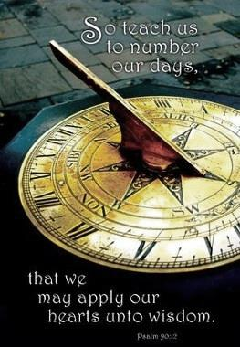
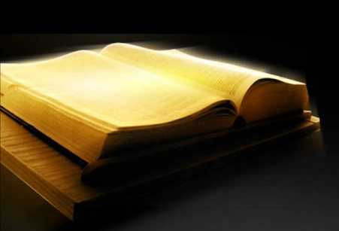
Learning to Count from the 14th to the 21st:
14 – 15 – 16 – 17 – 18 – 19 – 20 – 21!
Yahuah’s requirement for the
days of eating unleavened bread
is about learning to count the days beginning with only Dawn twilight.
Psa 90:12

Slide 57
A Quote of Significance:
The most important in this festival was the passover day, the 14th of Nisan … In it they
ate unleavened bread, probably like the Jews, eight days through… there is no trace of a yearly festival of the resurrection among them … the Christians of Asia Minor appealed in favor of their passover solemnity on the 14th Nisan to John.
(Gieseler, Johann Karl Ludwig. A Text-book of Church History. Translated by Samuel Davidson, John Winstanley Hull, Mary A. Robinson. Harper & brothers, 1857,
Original from the University of Michigan, Digitized Feb 17, 2006, p. 166).

Slide 58

Scriptural Conflict Resolution
3 Scriptures counted only 7 days to consume ULB.
During the spring festivals, Sunset theory reduced the statute count for eating ULB by one full day/cycle.
Count:
7 days.
Exo 12:18
Exo 12:15-16
Exo
13:6-7
Lev 23:5-8
Count:
7 days.
Count:
7 days.
Exo 12:18 included Passover for the full 8 days of eating ULB (only by DAWN design).
Count:
8 days!!
Only the DAWN design brings resolution!
58

Slide 59

Questions:
There was one single factor that made the difference in this comparison study to find the truth. What was it?
Answer: Choosing Dawn to start Yahuah’s cycles of the week.
2. Where did the concept of Dawn starting Yahuah’s cycles
come from?
Answer: The very basic format of creation exposed in Genesis 1
is the concept that makes the sunset theory (a kaleidoscope of confusion) transform into a beautiful picture of SALVATION!
This format is known as Dawn Design for the Covenant Calendar.
By accepting the Word as it is written, the confusion
is banished from Yahuah’s Word.
When choosing to worship Yahuah,
may it be according to His Words.
59

Slide 60
First sentence was:
The basic theme of this study has focused on the time near sunset and the fallacy attached to it for Spring Festivals.
Consider this picture for the Dawning of the day
as a Torah option to accomplish the needed paradigm shift to drop erroneous traditions
and start a new chapter.
To worship Yahuah according to His Plan is
HIS desire for each and every one who is willing.
Choose ye this day … Joshua 24:15.
60

Slide 61
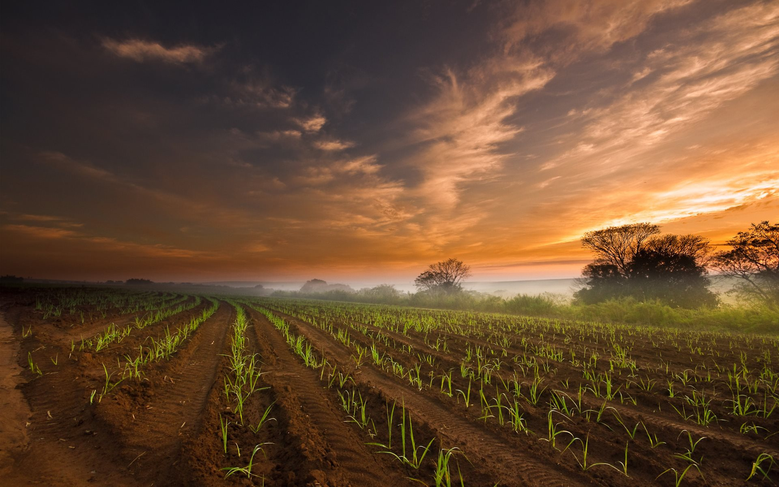
Next:
An investigation on the difference between DAWN and Sunrise as given in 2 more
Scripture examples.
Earlier the question was asked: Where do the Scriptures provide the DISTINCTION between the orders to consume unleavened bread during the Festival of Unleavened Bread and the Festival of Passover?
We discovered this DISTINCTION is given through the Genesis 1 reckoning of the commencement of each cycle at DAWN.
There is a difference between DAWN AND sunrise to be noted.

Slide 62
Genesis 19:15 – 23
And when morning [shachar] dawned, the messengers urged Lot to hurry saying, “Get up, take your two daughters who are here, lest you be consumed in the punishment of the city.”
Lot pleads for time …
Gen 19:20 – Look, please, this city is near enough to flee to, and it is small. Please let me escape there – is it not a small matter – and let my life be saved.
Twilight
mixture
Light Season
Gen 19:23 The sun had risen upon the earth when Lot entered Tso’ar.

Slide 63

Next witness

Slide 64
Genesis 32:24 – And Ya’aqob [Jacob] was left alone. And a Man wrestled with him until the breaking of the day (oluth shachar).
Gen 32:26 And said, “Let
me go, for the day breaks.” But he said, I am not letting you go until you have barak [blessed] me!”
Who said? -
He
Twilight
Mixture
Light Season
Elohim!
And Ya’aqob called the name of the place Peni’el, for I have seen Elohim face to face and my life is preserved. And the sun rose on him as he passed over Penu’el, and he limped on his hip. Gen 32:30, 31.

Slide 65


My friend, Yahuah has just told us with His own instruction
[in Gen 19:15 & 23 and Gen 32:26]
EXACTLY WHEN HIS 24 HOUR CYCLE STARTS, AND ENDS!
If you know this, you can easily calculate the number of days allotted for eating unleavened bread during Passover Festival!
There is no conflict!
The End
65

Slide 66



Questions/Comments for MelchiTzedek’s Schedule for Unleavened Bread?
tim@studythecalendar.com
www.studythecalendar.com
Thank-you!

