Slide 1
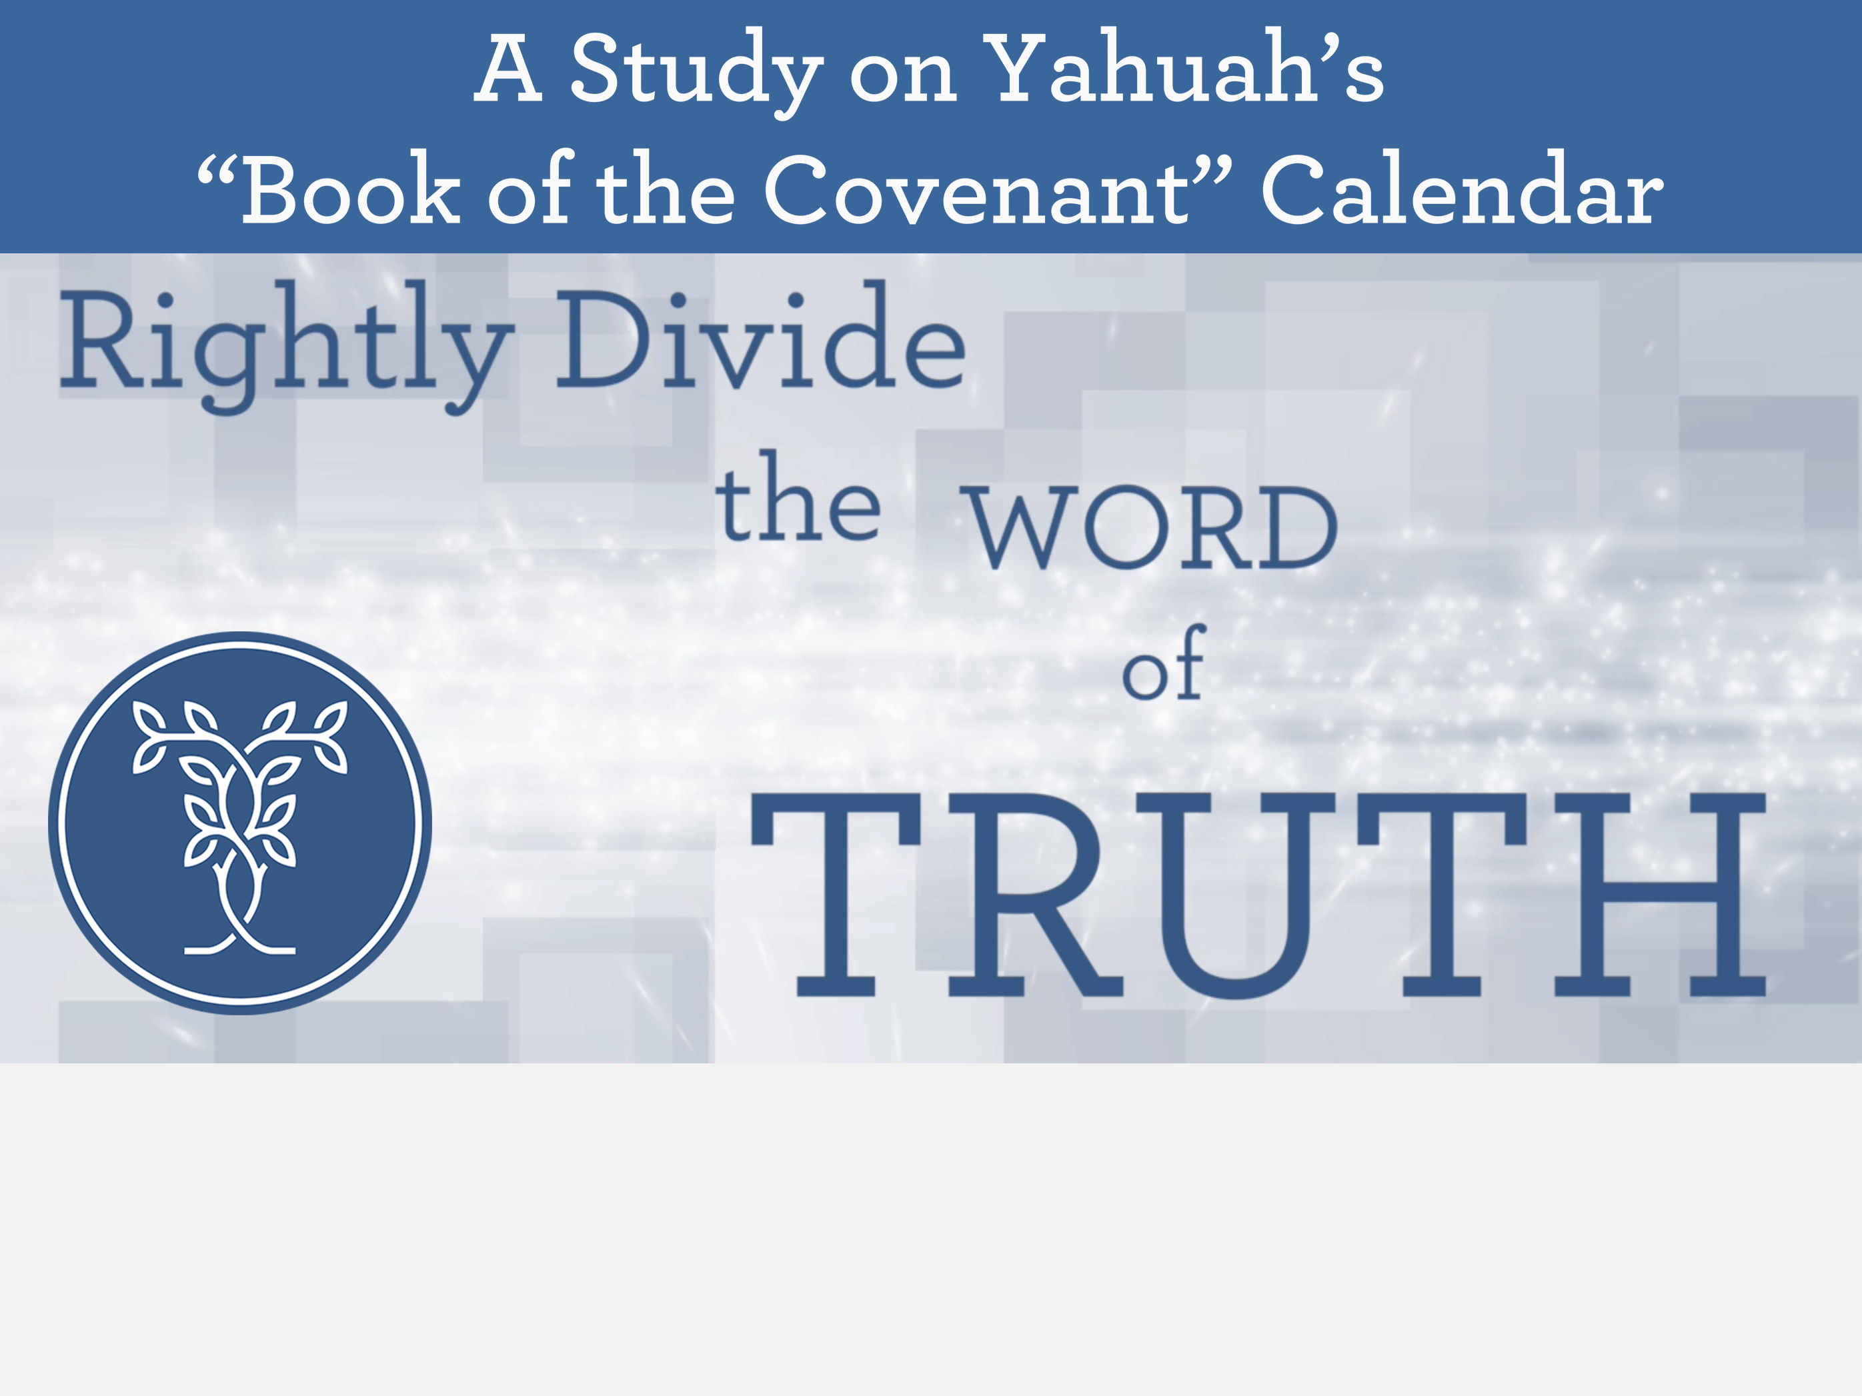

Part 1
The Last Supper

Slide 2

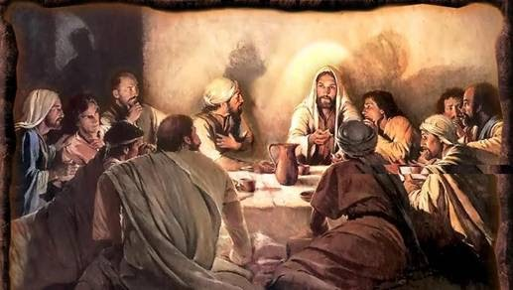
The Last Supper in the Gospel Account
Part 1 of 2

Slide 3

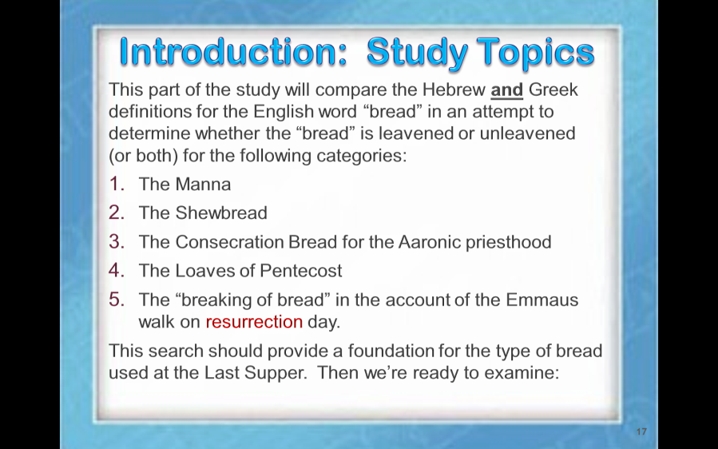
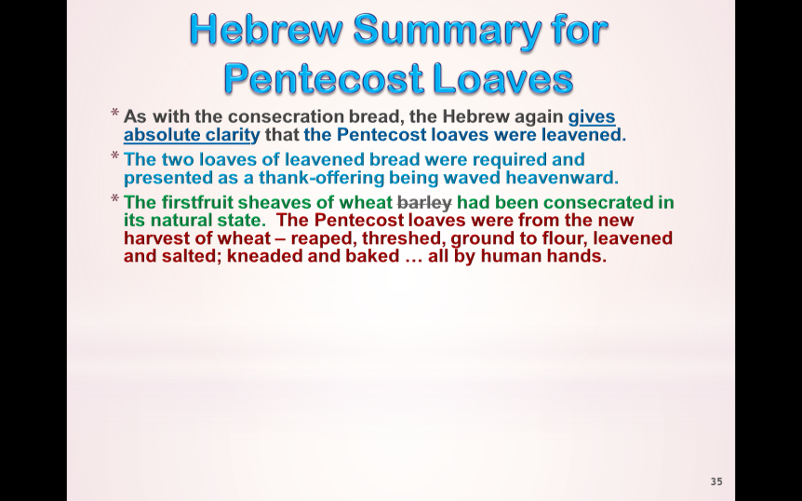
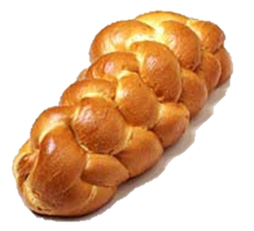
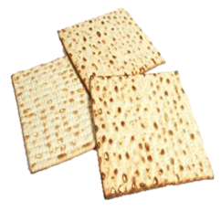

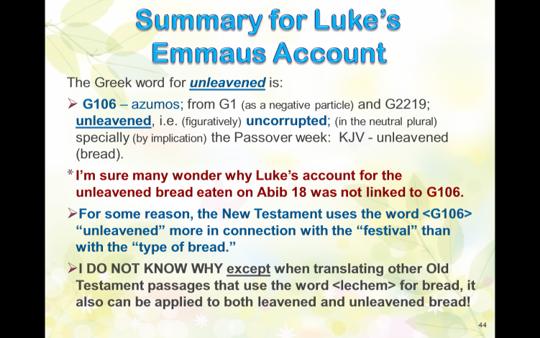
“The”
Last Supper
From: "Charlene Fortsch" <littlepines@telus.net>
To: "Tim Astleford" <railpilot@live.com>, "Jeanette Astleford" <jeanettekur@icloud.com>
Sent: Tuesday, May 21, 2019 7:59:25 PM
Subject: Short task: take a look at this attached picture of sanctuary bread
This is something that crossed my mind today -- not connected to anything we are doing, but maybe it is important.
Look at this artist's picture of sanctuary bread? It does not look unleavened!
I thought the holy bread was "baked" ... ULB is not baked ... it is done on a griddle.
And, it is flatter than a pancake! It is dry! It would easily keep without spoiling for 7 days in the Holy Place without having frankincense between each layer for a preservative. However that would not be the case for fresh baked leavened bread, stacked 6 loaves high for 7+ days.
The sanctuary bread were "loaves" ... not flat bread. Flat bread is not a loaf. UNL bread is never a loaf.
So ... a conclusion to me is the bread in the Holy Place had to be leavened. This could then represent "leavened" for the kingdom as one moves toward the most holy place. On the altar of burnt offering there was never any leavened allowed on that alter. It could be there was never any Unleavened in the holy place.
Just some thoughts that "dawned" <shachar - H7836> on me today!
-c-
Part 1
Part 2
The Controversy
Over the Bread
The Controversy
Over the “date”
?
Abib 13th
Abib 14th

Slide 4


Was the bread at
The Last Supper …
(Part 1)
1. Leavened?
2. Unleavened?
3. Or … Both?

Slide 5

There Will Be 3 Witnesses
#2 John
2nd Supper Table
#3 Patterns
“type” &
“antitype”
#1 Luke
Emmaus Account
First: A Thorough Examination of the Greek word for “bread.”
Notes:
Added this slide mar 24 800 am

Slide 6
What is the Controversy?
Part 1
Question: Can the type of “bread” used at the Last Supper
be the item that will settle the controversy of whether or not
the Last Supper was on Abib 13, or if indeed the Last Supper was eaten on Passover - Abib 14?
Arguments:
If the “bread” was leavened, then the meal cannot
qualify for the Passover meal eaten on Abib 14 where
it is commanded to eat unleavened bread.
If the “bread” is leavened then the last possible date
for the Last Supper would have to be Abib 13.
What if there is another option to be considered
that we don’t really know about?
That’s what we are going to explore today.
Notes:
Mar 23 954 am

Slide 7
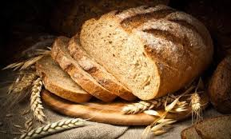
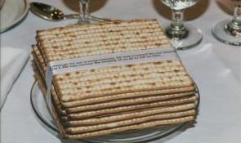
“bread” in Hebrew & Greek
The Hebrew word for “bread” is <lechem>.
  Strong’s – bread H3899 lechem; from H3898;
  food (for man or beast), especially bread, or grain
  (for making it): KJV - ([shew-]) bread, eat, food, fruit,
  loaf, meat, victuals. See also H1036.
The Greek word for “bread” is <artos>.
  Strong’s -- bread G740 artos; from G142; bread
  (as raised) or a loaf: KJV - (shew-) bread, loaf.
The Greek word for “unleavened” is <azumos>.
Strong’s – unleavened G106 azumos; from G1
(as a negative particle) and G2219; unleavened,
i.e. (figuratively) uncorrupted; (in the neutral plural)
specially (by implication) the Passover week:
KJV - unleavened (bread).
Note: In the Greek text, <azumos> is never used in
conjunction with “bread” but only when identifying
the Festival of Unleavened Bread.
The Hebrew portion of this study is important, because
the New Testament was translated from Hebrew into Greek
for the Gentiles that could not read the Hebrew text.
Notes:
Mar 23 1003 am

Slide 8
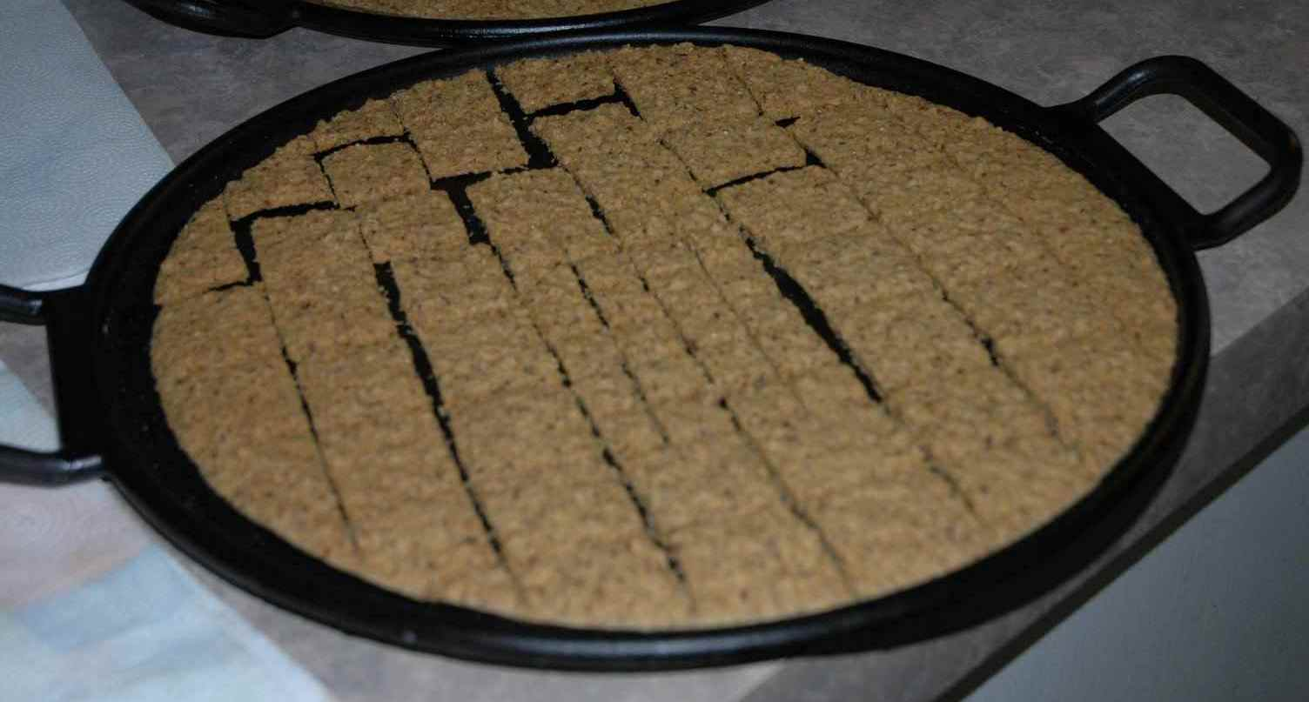

Types of Unleavened Bread in the Scriptures
Three different types of
unleavened grain products:
Unleavened Wafers
Unleavened Bread
This study addresses only the Unleavened Bread.
Unleavened Cakes
Notes:
Mar 23 1018 am

Slide 9
Different Qualities Between Leavened & Unleavened Bread
The account given through Matthew,
Mark and Luke says …
Yahusha “broke bread.”
This detail should not be overlooked.
Leavened bread is NOT broken. It must be torn to share with others, if you’re not cutting with a bread knife!
Unleavened bread (matstsah) CANNOT be torn.
It is broken.
For these three gospel passages, the context alone declares that Yahusha “broke” unleavened matstsah bread to serve all twelve disciples.
Notes:
P 2
1032 am mar 23

Slide 10
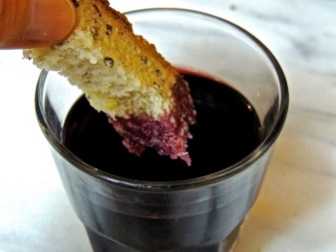
What About Breaking Bread?
Matthew, Mark and Luke all record
Yahusha “broke bread.”
John does not mention this detail.
He talks about “dipping sop” – a deliberate action to include only Judas who was sitting next to Him.
Was this a cultural courtesy?
C. Tenney in the Expositor’s Bible Commentary, page 140:
“For the host [such as Yahusha] to select such a tidbit from
the main dish and give it to a guest would be a mark of courtesy and esteem. The disciples,
seeing this, would conclude only that
Jesus [Yahusha] regarded Judas as a
friend he had confidence in.”
Notes:
Mar 23 1023 am
P 2

Slide 11
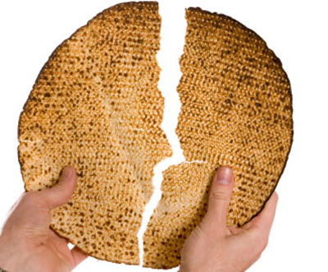
What About Dipping Bread?
The qualities of unleavened bread and leavened bread differ when it comes to “dipping,” and further to that (John records) this bread was – “dipped good until sopping wet.”
When unleavened bread is totally immersed in wine, oil or a sauce it
does not soak up, or absorb, too much
of the “dip.”
When leavened bread is totally immersed in wine, oil, or a gravy sauce, it absorbs the dip very quickly and gets “sopping wet” as we would say.
Notes:
P 2 mar 23 1036 am

Slide 12
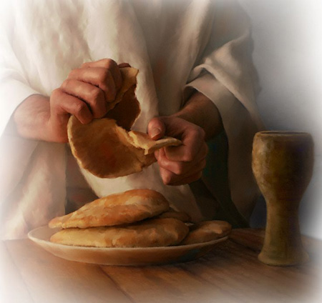
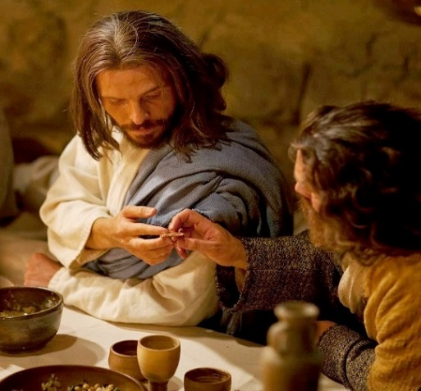
What Do We Know For Sure About This Night?
Matthew, Mark and Luke have clarity on 2 facts:
Yahusha “broke bread” at the table of the
Last Supper.
There was a betrayer amidst the group.
  Question: How is the betrayer identified?
There is more information that is of utmost
importance for this study. We will:
Gather ALL of the information;
Assemble the information in the correct order;
Form the conclusion.
Notes:
145 pm Thoughts from p 2 – enlarge in the PPT study. Mar 23 1042 am

Slide 13


Leavened versus Unleavened
In an attempt to determine whether the
Last Supper was a Passover meal or not,
many evangelicals today focus on
the issue of whether the bread of the
Last Supper was leavened or unleavened.
Some say:
If the bread was unleavened, then the
Last Supper qualifies for the Passover meal.
However, the opposite is also true:
If the bread was leavened, then the Last Supper
could not have been the Passover meal.
Most equate the “bread” with the “meal.”
What about equating the “bread” with Yahusha?
Notes:
P 13 2:23 Mar 22 …….. Mar 23 1050 am 1148am

Slide 14
Reviewing the Strong’s Definitions for Bread
Bread in Hebrew: lechem
  bread H3899 lechem; from H3898; food (for man or beast), especially bread, or grain (for making it): KJV - ([shew-]) bread, eat, food, fruit, loaf, meat, victuals. See also H1036.
Bread in Greek: artos
  bread G740 artos; from G142; bread (as raised) or a loaf:
  KJV - (shew-) bread, loaf.
Note: Nothing in either of these definitions indicates that the “bread” is always unleavened. In fact, both definitions lean towards the “leavened” type of bread.
Hebrew (lechem) Greek (artos)
Notes:
Mar 23 – add new slide – 1109 am

Slide 15

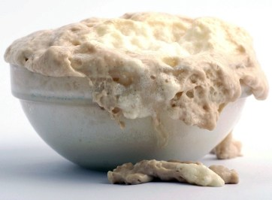

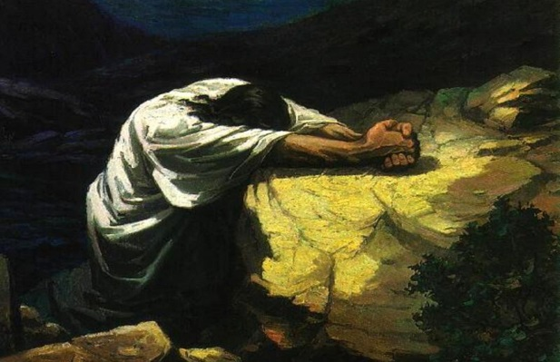
A Serious Question
Because leaven = sin most often -
how can leavened bread
represent our sinless Yahusha?
Notes:
P 14 243 pm …….. Mar 23 1144 am

Slide 16
Things to Remember for Study
Because the Greek and Hebrew definitions seem vague,
there cannot be absolute clarity through that single option.
A deeper study of Scripture is necessary to determine the answer for our question.
It is also necessary to:
Remember grammatical context of passages.
Remember Scriptural patterns for the terms “leavened”
and “unleavened” and how these terms would link to
“type” and “antitype” patterns, such as:
  “Leaven” in the Scriptures most often representing sin.
  “Leaven” also representing the change and growth necessary
  to be fit for the kingdom of heaven.
  “Unleavening” as representing the ridding oneself of sin.
Next: An examination of 5 different sections applying the Scriptural definitions; the grammatical content/context; and the patterns.
Notes:
P 13 mar 23 1103 am …… 1200pm

Slide 17

Introduction: Study Topics
This part of the study will compare the Hebrew and Greek definitions for the English word “bread” in an attempt to determine whether the “bread” is leavened or unleavened
(or both) for the following categories:
The Manna
The Shewbread
The Consecration Bread for the Aaronic priesthood
The Loaves of Pentecost
The “breaking of bread” in the account of the Emmaus walk on the Wave Sheaf day.
This search should provide a foundation for the type of bread used at the Last Supper. Then we’re ready to examine:
Bread used for the Last Supper.
Notes:
P 13 2:11 mar 22 …… mar 23 1200pm

Slide 18

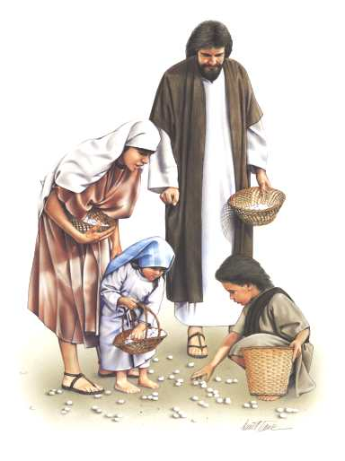
1. Manna: Bread from Heaven
The following information is based on the reasonable assumption that the manna given in the wilderness for 40 years was not leavened.
This bread represented the Messiah
that was to come.
His life would not be leavened with
any sin of His own.
All are to partake of His perfect life.
Therefore, it seems reasonable to assume the manna was completely unleavened.
But, can this assumption be really that final?
Notes:
P 13 234pm mar 23 1205 pm

Slide 19

Manna as Bread in the
Old Testament
Exo 16:4 Then said Yahuah unto Moses, Behold, I will rain bread [H3899: lechem] from heaven for you; and the people shall go out and gather a certain rate every day, that I may prove them, whether they will walk in my law, or no.
Exo 16:15 And when the children of Israel saw it, they said
one to another, It is manna [H4478: <man> for “what is it”?]: for they wist not what it was. And Moses said unto them, This is the bread [H3899: lechem] which Yahuah has given you to eat.
  manna H4478 mawn; from OT:4100; literally, a whatness
  (so to speak), i.e. manna (so called from the question about it): KJV - manna.
The Hebrew definitions for (1) H3899 “bread” and (2) H4478 for “manna”
do not specify if the manna is leavened or unleavened.
However, we know ordinary bread is leavened.
Notes:
P 14 247 pm

Slide 20
Hebrew Manna Summary
The Hebrew does not give absolute clarity if
the manna was unleavened.
Scriptural patterns may give clarity using “type” and “antitype” comparisons.
The manna [type] represents Yahusha [antitype] as the “Bread of Life” – having no
sin of His own.
Therefore, the Scriptural pattern for both “type and antitype” links to the “unleaven” concept.
This pattern allows for the reasonable assumption that the manna was unleavened.
Notes:
P 24 249 pm mar 23 1218 pm

Slide 21
Manna as Bread in the
New Testament
John 6:31 Our fathers did eat manna [G3131: <man>]
in the desert; as it is written, He gave them
bread [G740: artos] from heaven to eat.
  manna G3131 manna; of Hebrew origin [H4478]; manna
  (i.e. man), an edible gum: KJV - manna.
In John 6 the Greek word for bread (artos) is used when referring to manna from Heaven as the ‘lechem bread.’
Here the manna is definitely compared to a leavened type
of bread using the Greek. The comparison of manna to H3899 (lechem) was not that specific as the Greek word “artos” was for leavened bread.
Remember: There is no Greek term for “unleavened bread” – only “feast of unleavened bread.”
Notes:
Mar 23 1225 pm

Slide 22
Greek Manna Summary
The Greek appears to give absolute clarity that the manna
was leavened.
Would the Scriptural patterns for “type” and “antitype” in
the New Testament be different than the Old Testament?
The concept of “leavened manna” seems to break down here.
It appears the pattern has been severely disrupted.
Under this premise, is it safe to assume the manna was leavened, saying the New Testament Greek definitions take precedence over the “type” and “antitype” comparisons?
(Note: The New Testament is a translation of the Hebrew
into Greek. In many cases the Greek translation
fails to give the full Hebrew concept.)

Slide 23
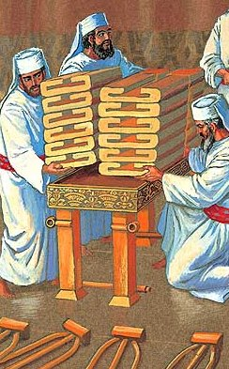
2. The Shewbread
From: "Charlene Fortsch" <littlepines@telus.net>
To: "Tim Astleford" <railpilot@live.com>, "Jeanette Astleford" <jeanettekur@icloud.com>
Sent: Tuesday, May 21, 2019 7:59:25 PM
Subject: Short task: take a look at this attached picture of sanctuary bread
This is something that crossed my mind today -- not connected to anything we are doing, but maybe it is important.
Look at this artist's picture of sanctuary bread? It does not look unleavened!
I thought the holy bread was "baked" ... ULB is not baked ... it is done on a griddle.
And, it is flatter than a pancake! It is dry! It would easily keep without spoiling for 7 days in the Holy Place without having frankincense between each layer for a preservative. However that would not be the case for fresh baked leavened bread, stacked 6 loaves high for 7+ days.
The sanctuary bread were "loaves" ... not flat bread. Flat bread is not a loaf. UNL bread is never a loaf.
So ... a conclusion to me is the bread in the Holy Place had to be leavened. This could then represent "leavened" for the kingdom as one moves toward the most holy place. On the altar of burnt offering there was never any leavened allowed on that alter. It could be there was never any Unleavened in the holy place.
Just some thoughts that "dawned" <shachar - H7836> on me today!
-c-
The twelve loaves [H3899 lechem] of shewbread
in the Holy Place of the sanctuary also represents the Messiah as “the Bread of Life” (continuously in the presence of the Father).
The week old bread was replaced on Sabbath
with freshly baked loaves.
To us, it seems the shewbread would have
to be unleavened – or spoil before it was eaten
a week later by the priests in a holy place.
However, the holy presence of the Father can easily preserve leavened bread in the Holy Place, just as the pot of manna was preserved for decades inside the Ark of the Covenant.
Do the Scriptures clarify the status of
the shewbread?
(Shewbread is a combination of two words.
There will be two Hebrew definitions.)
Did the shewbread look like this, or was it 12 flat matstsah to provide food for the full course of priests each week?
Notes:
P 15 238 pm mar 23 1238 pm

Slide 24

Shewbread in the
Old Testament
Exo 35:13 The table, and his staves, and all his vessels, and the shewbread [H6440: presence]; [H3899: lechem] …
shewbread H6440 paniym; plural (but always as singular)
of an unused noun [paneh (paw-neh'); from H6437]; the face
(as the part that turns).
shewbread H3899 lechem; from H3898; food
(for man or beast), especially bread, or grain (for making it):
KJV - ([shew-]) bread, eat, food, fruit, loaf, meat, victuals.
  Example: The shewbread “faces the presence” of the Holy One
  in the Sanctuary – or known as “Bread of the Presence.”
As with the manna, the shewbread links back to the same
Hebrew word H3899 (lechem) which can indicate either
leavened or unleavened bread.
Soon it will be shown that “lechem” (as a general term for
any kind of bread) has to be qualified with the specific term unleavened [H4682; matstsah] to actually be unleavened bread.
Notes:
P 15 254 pm ….mar 23 1246pm

Slide 25
Hebrew Shewbread Summary
The Hebrew does not give absolute clarity that the shewbread had to be unleavened.
Scriptural patterns may give clarity using “type” and “antitype” comparisons.
As with the manna, the shewbread [type] represents Yahusha [antitype] as the “Bread of Life” – having no sin
of His own, but being continuously in the presence of the Father.
Therefore, the Scriptural pattern for both “type
and antitype” seems to link strongly to the concept
of unleavened shewbread.
This pattern can allow for a reasonable assumption
that the shewbread was unleavened even though the definition for “lechem” leans towards leavened bread. (We’ll see if this assumption holds up or not.)
Notes:
P 15 255 pm mar 23 1250 pm

Slide 26
Shewbread in the
New Testament
Hebrews 9:2 speaks of the sanctuary shewbread as seen
in Exodus. As with the manna, the shewbread also links to G740 (artos) indicating either leavened or unleavened bread.
Even though “artos” can be leavened bread, this does not
mean the Sanctuary shewbread had to be leavened bread.
(There will be two Greek definitions.)
Heb 9:2 For there was a tabernacle made; the first, wherein was the candlestick, and the table, and the shewbread [G4286: prothesis and G740: artos]; which is called the sanctuary.
  shewbread G4286 prothesis; from G4388; a setting forth, i.e. (figuratively) proposal (intention); specifically, the show-bread (in the Temple) as exposed before Yahuah: KJV - purpose, shew [-bread].
  shewbread G740 artos; from G142; bread (as raised) or a loaf: KJV - (shew-) bread, loaf.
Notes:
P 16 257 pm …… mar 23 1257pm

Slide 27
Shewbread in the New Testament (con’t)
Just as leaven can represent either the “leaven of sin” or “leaven for the kingdom of heaven” so too the shewbread
could have represented the varied spiritual conditions of Israel.
Many times in the Old Testament Israel was in rebellion, completely leavened by the ways of the surrounding pagan nations.
Any bread/meal offerings that attended the blood sacrifices on the Altar of Burnt Offering had to be unleavened. However, the shewbread was never offered on the Altar of Burnt Offering, but always eaten by the priests in a holy place.
Beware of comparisons that use the example of “unleavened grain offerings upon the Altar of Burnt Offering” as the dictated rule that shewbread has to always be unleavened.
This would be an acceptable rule if shewbread was offered on the Altar of Burnt Offering. Note: the grain offerings were always in the courtyard; the shewbread was always contained in the Holy Place.
Question to Ponder: Could this Shewbread also represent two different mandates of Yahusha, not just Israel?
Notes:
Mar 23 102pm

Slide 28
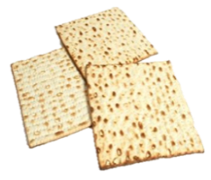
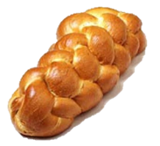
Greek Shewbread Summary
The Greek appears to give absolute clarity of leavened shewbread (just like the manna).
Again … would the Scriptural patterns for “type” and “antitype” in the New Testament be different than the
Old Testament?
The concept of “leavened shewbread” seems to break down here, if we hold to the idea that the shewbread was always unleavened because it represents the sinless life
of Yahusha.
It appears the pattern has been severely disrupted. Under this premise, is it safe to assume the shewbread was leavened, saying the New Testament Greek definitions take precedence over the Hebrew definitions, following the same pattern as the manna?
So far, there does not seem to be a specific scriptural guideline for the shewbread. It is quite possible and logical the shewbread was either leavened or unleavened
as can be understood from a further study.
Notes:
Appendix C has more information on the shewbread. Not included in this PPT.
P 16 258 pm ….mar 23 108pm

Slide 29
3. Consecration Bread for Priesthood
In Exodus 29 (and Leviticus 8) Moses was divinely directed to transfer his priestly duties to Aaron and his sons under the Aaronic Priesthood.
Part of the ceremony included the use of three different types of unleavened “bread” called: unleavened bread; unleavened cakes; unleavened wafers.
Anything to do with being “unleavened” is “matstsah.”
Exo 29:2 And unleavened [H4682: matstsah] bread [H3899: lechem], and cakes unleavened tempered with oil, and wafers unleavened anointed with oil: of wheaten flour shalt thou make them.
Exo 29:23 And one loaf of bread [H3899: lechem], and one cake of oiled bread, and one wafer out of the basket of the unleavened bread [H4682: matstsah] that is before Yahuah:
Exo 29:24 And thou shalt put all in the hands of Aaron, and in the hands of his sons; and shalt wave them for a wave offering before Yahuah.
Exo 29:25 And thou shalt receive them of their hands, and
burn them upon the altar for a burnt offering, for a sweet
savour before Yahuah …
Notes:
Mar 23 116 pm

Slide 30

Consecration Bread in the Old Testament (only)
(Consecration bread is mentioned only in the Old Testament.
It is ALWAYS Unleavened Bread every single time.)
  unleavened H4682 matstsah; from OT:4711 in the sense of greedily devouring for sweetness; properly, sweetness; concretely, sweet (i.e. not soured or bittered with yeast); specifically, an unfermented cake or loaf, or (elliptically) the festival of Passover (because no leaven was then used): KJV - unleavened (bread, cake), without leaven.
  bread H3899 lechem; from H3898; food (for man or beast), especially bread, or grain (for making it): KJV - ([shew-]) bread, eat, food, fruit, loaf, meat, victuals. See also H1036.
Notes:
P 17 302 pm MAR 23 119PM

Slide 31
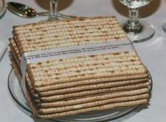
Note on Consecration Bread
All of the following were unleavened – or –
(H4682: matstsah) and all three types of unleavened product were in the one basket of unleavened bread.
    bread H3899 lechem; especially bread;
    cakes H2471 challah; a cake;
    wafers H7550 raqiyq; a thin cake [wafer].
Notes:
P 17 302 pm … mar 23 132pm

Slide 32
Note on Consecration Bread
All three grain products for the consecration of the priests are noted again as “H3899 lechem.”
The Hebrew definition seems to indicate none of the
grain items are unleavened unless qualified by the term unleavened [H4682 matstsah].
Subsequently, every reference to manna, bread, cakes, wafers, or shewbread, cannot be understood as
unleavened if “H4682 matstsah” is absent.
There is no New Testament counterpart for the use of unleavened bread, cakes and wafers for the consecration of priests to an earthly Sanctuary priesthood.
Yahusha is now our High Priest of the Melchizedek order. His sinless life links directly to, and fulfills, any unleavened item, be it grain or drink offerings.
Notes:
P 17 303 pm …mar 23 135pm

Slide 33

Hebrew Summary for Consecration Bread
The Hebrew gives absolute clarity that the consecration bread, cakes and wafers were unleavened, taken from the basket of unleavened bread.
These unleavened grain items were waved heavenward before being laid on the Altar of Burnt Offering.
Leaven of any sort was never placed on this altar.
Scriptural patterns do give clarity using “type” and “antitype” comparisons. As with the manna and shewbread, the unleavened consecration breads [type] once again represent Yahusha [antitype] as the “Bread of Life.”
Having no sin of His own, His perfect life was laid on the altar
at the cross as an offering of a sweet savor to His Father. Definitely, the Scriptural pattern for both “type and antitype” links strongly to the concept of unleavened consecrated breads.
There is no doubt regarding the leavening aspect, as the clarity
is completely verified through the use of “unleavened H4682 matstsah.” No assumptions are necessary.
Notes:
P 17 309 pm .. .mar 23 139pm

Slide 34
4. The Loaves of Pentecost
Notice: the Hebrew word for “loaves” is also H3899 (lechem) as with the manna, sanctuary shewbread and consecration bread.
However this time the “lechem” is leavened bread, qualified with the word “leaven.”
Lev 23:17 You shall bring out of your habitations two wave loaves [H3899: lechem] of two tenth deals: they shall be of fine flour; they shall be baken with leaven [H2557: chamets]; they are the firstfruits unto Yahuah.
  [review] bread H3899 lechem; from H3898; food (for man or beast), especially bread, or grain (for making it): KJV - ([shew-]) bread, eat, food, fruit, loaf, meat, victuals. See also H1036.
  leaven H2557 chamets; from H2556; ferment, (figuratively) extortion: -leaven, leavened (bread).
Notes:
P 18 311 pm …. Mar 23 144pm

Slide 35

Hebrew Summary for Pentecost Loaves
As with the consecration bread, the Hebrew again gives absolute clarity that the Pentecost loaves were leavened.
The two loaves of leavened bread were required and
presented as a thank-offering being waved heavenward.
The firstfruit sheaves of wheat had been consecrated in its natural state. The Pentecost loaves were from the new harvest of wheat – reaped, threshed, ground to flour, leavened and salted; kneaded and baked … all by human hands.
Scriptural patterns do give clarity using “type” and “antitype” comparisons. The “leaven type” represents Yahusha as the great Teacher. His life, mixed with the life of individuals represents truth and spirit-filled people preaching the gospel
for the kingdom of heaven. Only Yahusha’s spirit-filled leaven can change the sinner to reflect Him.
As with the consecration bread, there is no doubt regarding the leavening aspect, as the clarity is completely verified through the use of “leaven H2557 chamets.” No assumptions are necessary.
Notes:
p 18 312 pm … mar 149 pm

Slide 36

Hebrew Summary for Pentecost Loaves (con’t)
So far the Hebrew has shown H3899 (lechem) bread can be either leavened, or unleavened.
If the “lechem” is not qualified with the term(s):
a) H4682 matstsah for unleavened bread, or,
b) H2557 chamets for leavened bread, it cannot
be said with exact certainty what type the “lechem” (bread) would be.
At that point, one would have to carefully consider the Scriptural patterns [type & antitype] – and/or –
the context of a passage, which is exactly what
has to be done in the next section.
But, first let’s go back to the Shewbread to consider some other options.
Notes:
P 18 313 pm … mar 23 153pm

Slide 37
Back to the Shewbread Question
Review:
The consecrated loaves for the Aaronic priests were “unleavened” being qualified by the term H4682 <matstsah>.
The Pentecost loaves were “leavened” being qualified by the term H2557 <chamets>.
The twelve loaves [H3899] of shewbread in the Holy Place of the sanctuary represent
the Messiah as “the Bread of Life” [without sin] but His life was also given for the “leaven of the kingdom of heaven.”
He stands continuously in the presence
of the Father for this purpose.
Do the Scriptures clarify the status of the shewbread? NO!
There is no “qualifier” for this bread
to be either “leavened” or “unleavened.”
How would 12 flat matstsah provide food for the full coarse of the priesthood for a complete week?
Notes:
P 15 238 pm mar 23 1238 pm

Slide 38

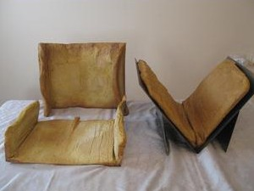
https://www.templeinstitute.org/baking-the-showbread.htm (Feb 2020)
It was also discovered that each time the Hebrew word "sollet" is used in Torah, it signified the method with which the flour was ground [Specifically as fine flour.] Since Torah forbids the use of yeast in the Holy Temple, [Notice what the article goes on to say!] other leavening agents were necessary. Forty minutes is required for the kneading process. [Does unleavened bread need this much kneading?]
The bread is baked in large ovens, forty centimeters by eighty centimeters, with eight centimeter thick walls. Gemara relates that a recurring miracle guaranteed that the show bread remained fresh for one week from the day it was baked, without the need for closed storage or refrigeration. [ULB doesn't spoil like this.]
Professor Amar's recipe has succeeded in maintaining freshness for the duration of one week.
The shape of the bread is achieved by using baking forms, as it was done in the Holy Temple. Two different shapes have been produced by Professor Amar, the "konos" shape, as depicted on ancient Chashmonean coins, (from the era of the Maccabis), and the shape known as "tava prutza," the shape of an inverted Hebrew letter chet. [Question: Requirements during Feast of Unleavened Bread?]
Notes:
Appendix C has more information on the shewbread. Not included in this PPT.
P 16 258 pm ….mar 23 108pm

Slide 39

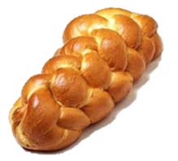

Conclusions for Shewbread?
The research that has been completed
thus far:
The Sanctuary Shewbread could have been “unleavened” or …
The Sanctuary Shewbread
could have been “leavened.”
Depending on Yahusha’s purpose, “leavened” or “unleavened” bread
would be determined by the context.
If that is so,
do ponder this question?
What kind of “bread” would be placed in the Holy Place during the 7 days of the Unleavened Bread festival which will usually include some cycles of
two weeks?
Raised bread?
Matstsah? Or:
Provision for both?
This completes the introduction for bread as used in Hebrew and Greek passages.
Notes:
P 15 238 pm mar 23 1238 pm

Slide 40

1st Witness for
<artos> Bread Study
Luke’s Gospel
Emmaus Account
Notes:
New slide mar 43 830 am

Slide 41

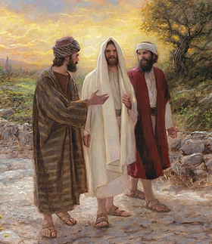
5. Bread in the Emmaus Account
Up to this point, there is no doubt that the
Greek word for “bread” [G740 artos] can be
used to describe either leavened,
or unleavened bread.
In the account from Luke, CONTEXT will be
the determining factor for either leavened,
or unleavened bread.
Two followers of Yahusha decided
to return to Emmaus the same day
they heard their Master had risen.
The events of this account occurred during
the Passover festival.
Let’s read the main verses before charting
the events.
Notes:
P 18 317 pm ……….. Mar 23 208 pm

Slide 42

Luke 24 Gospel Account
1 Now upon the first day of the week [Abib 18], very early
in the morning, they [the women with spices] came unto the
sepulchre, bringing the spices which they had prepared,
and certain others with them.
2 And they found the stone rolled away from the sepulchre.
3 And they entered in, and found not the body of Yahusha.
6 He is not here, but is risen: remember how he spake unto
you when he was yet in Galilee,
7 Saying, The Son of man must be delivered into the hands
of sinful men, and be crucified, and the third day rise
again.
8 And they remembered his words,
9 And returned from the sepulchre, and told all these
things [that He was risen] unto the eleven, and to all the rest.
Notes:
P 19 318 pm … mar 211 pm

Slide 43
Luke 24 Gospel Account
13 And, behold, two of them [followers included in the verse 9 group]
went that same day [Abib 18] to a village called Emmaus,
which was from Jerusalem about threescore furlongs.
[This 7 mile walk from Jerusalem would take about two hours.]
14 And they talked together of all these things which had
happened.
15 And it came to pass, that, while they communed together and
reasoned, Yahusha himself drew near, and went with them.
30 And it came to pass, as he sat at meat with them, he took
bread, [G740 artos] and blessed it, and brake, and gave to them.
31 And their eyes were opened, and they knew him; and he
vanished out of their sight …
35 And they told what things were done in the way, and how he
was known of them in breaking of bread [G740 artos].
Are you wondering about the use of
<artos> as leavened bread here?
Notes:
P 19 318 pm … mar 219pm

Slide 44
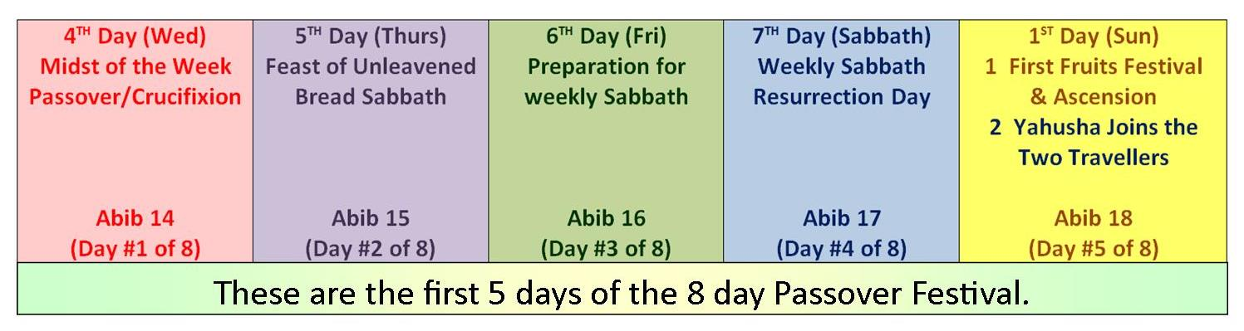
The 1st Five Days of Passover
Facts for the Passover Spring Festival of the Emmaus Account:
Abib 14 to Abib 21 represents the eight inclusive days for this festival.
(Only the first five days are charted.)
Abib 15 to Abib 21 represent the seven days of the Feast of Unleavened Bread. ONLY unleavened bread, cake or wafers are eaten during these days. This includes Abib 18, the 1st cycle of the week as Wave Sheaf.
The women, the disciples, and others, discover their Master is not
in the tomb on Abib 18.
Later on the same day in the evening, Yahusha meets up with the two disciples walking to Emmaus. Yahusha accepts their invitation
to dine with them for the evening meal.
Notes:
P 20 403 pm (stop for chimney clean) … mar 23 222pm

Slide 45
The 1st Five Days of Passover
Facts for the Passover Spring Festival of the Emmaus Account (con’t):
When Yahusha broke the bread, [G740 artos] they recognized Him.
This [G740 artos] bread was definitely NOT leavened bread, as Abib 18 is exactly the “midst” of the week of Unleavened Bread.
Any Torah keeper and follower of Yahusha would not be serving leavened bread to their guests during the week of Unleavened Bread.
However, the Greek word “artos” for “bread” in the
New Testament is defined as leavened bread. What happened?!
Notes:
P 20 403 pm (stop for chimney clean) … mar 23 229pm

Slide 46
The 1st Five Days of Passover
Did these 2 disciples of Yahusha REALLY serve Him leavened bread during the Week of Unleavened Bread?
We have already seen in previous examples that
artos can have the dual meaning of leavened
and/or unleavened bread.
In the Emmaus account, the artos was absolutely unleavened!
Notes:
P 20 403 pm (stop for chimney clean) … mar 23 232pm

Slide 47


Summary for Luke’s
Emmaus Account
The Greek word for unleavened is:
G106 – azumos; from G1 (as a negative particle) and G2219; unleavened, i.e. (figuratively) uncorrupted; (in the neutral plural) specially (by implication) the Passover week: KJV - unleavened (bread).
I’m sure many wonder why Luke’s account for the unleavened bread eaten on Abib 18 was not linked to G106.
The New Testament uses the word <G106 azumos> for “unleavened” more in connection with the “festival”
than with the “type of bread.”
There is a reason for this to be examined next.
Let’s return to the 4th day of the
Feast of Unleavened Bread.
Notes:
P 20 408 pm … mar 23 329 pm (call from kathleen 35 min)

Slide 48
What is “koine” Greek?
The Greek word for unleavened is G106 – azumos – matzah [Hebrew].
On the 4th day of the Feast of Unleavened Bread, the bread being broken by Yahusha is azumon.
There is very likely no leavened bread <artos> in the land of Israel for the entire seven day Feast of Unleavened Bread [asumon {Gk}; matzah {Heb}].
In Luke’s account, the surviving Greek texts read <artos> which is the common word for normal leavened bread.
This appears to be a simple oversight by those who copied or translated the original text.
There are many variations of the New Testament writings where the “best” Greek word was replaced with a very “similar” Greek word that was more in accord with the local language when the manuscript was copied.
The Greek dialect aimed at the common people is called koine. When there seems to be a conflict (as in this account with Luke), then the full and proper understanding must be taken back to the Torah and Hebrew definitions.
These variations in the Greek text do not always degrade the text but rather help us to understand why it is important to choose the definition that fits the context and content of each verse when there seems to be a discrepancy.
Notes:
P 20 408 pm … mar 23 329 pm (call from kathleen 35 min)

Slide 49

Summary for Luke’s Emmaus Account (concluded)
Even though the Greek word for “bread/artos”
holds the definition of leavened bread,
the CONTEXT of this passage
OVERRULES that definition.
Any follower of Yahusha would not be serving
leavened bread on a day in the midst of
the seven day Feast of Unleavened Bread.
We can be thankful for Luke recording this event
on the road to Emmaus.
This ONE testimony is the “RED FLAG” that sets everything straight.
Otherwise it would be so easy to say the leavened bread represented Yahusha’s flesh with our sins.
Remember, our sins do not make His flesh sinful.
Notes:
P 20 408 pm … mar 23 341 pm

Slide 50
Conclusions Regarding “Bread” in Both Hebrew & Greek
The Hebrew word for bread (lechem) is used for both leavened and unleavened bread.
The Greek word for bread (artos), also refers to both leavened and unleavened bread.
Therefore to understand if “bread” is leavened or unleavened:
Hebrew and Greek definitions cannot always stand alone;
Context must be given serious consideration;
Scriptural patterns of “type and “antitype” must be
in full alignment.
All three steps are important to find
the true definition of a passage.
Notes:
P 20 408 pm break for supper/search for backgrounds … mar 23 346pm – use this slide after the type and antitype section is completed.

Slide 51

General Summary for this Section
We have seen several times where the Greek word for bread (artos) is used to identify both leavened and unleavened bread. This very same word (artos) is mentioned in the account of the Last Supper.
So far it has been shown the Hebrew definition of the word “lechem” is not strictly unleavened bread unless it uses a “qualifier” combined with H4682 <matstsah>.
Likewise, “lechem” is not strictly leavened bread unless combined with H2557 <chamets>.
In Greek, ‘azumos’ is the best word to indicate unleavened bread IF the text would not use “koine” Greek.
We will consider the verifying factor of
“type” and “antitype” patterns after taking a careful look
at The Last Supper in the four Gospels.
Notes:
P 20-21 544 pm … mar 23 350pm & 420 pm

Slide 52
2nd Witness for
<artos> Bread Study
John’s Gospel
2nd Sitting at the Supper Table
Notes:
New slide mar 43 830 am

Slide 53
Connecting the Emmaus Testimony to the Last Supper
In Luke’s Emmaus Account the Hebrew word for bread was
not translated into the Greek as G106 ‘azumos’ to indicate unleavened bread.
The Greek used the word G740 ‘artos’ that can take on either definition of leavened or unleavened bread.
There was bread present at The Last Supper … but as to leavened or unleavened, this is not to be determined by observing only the Greek definitions used for bread.
With a careful look at the account given in John, perhaps this questionable area will reveal another clear answer by again considering the “context” and “Scriptural patterns.”
Notes:
P 21 545 pm … mar 23 354pm

Slide 54
Things to Watch For in the Gospels
Matthew, Mark and Luke record Yahusha “breaking and blessing” G740 “artos bread” which appears to be “leavened bread.”
John does not record Yahusha breaking or blessing G740 “artos bread.”
In fact John doesn’t record anything about the supper table where the “bread and wine” emblems were offered by Yahusha in remembrance of Him.
It is extremely important to note
this stark omission by John.
Notes:
P 21 546 pm … mar 23 840pm

Slide 55
John Has Other Information
Reminder: John records nothing about the event where “bread and wine” were given to the disciples.
After supper was ended, Yahusha washed the feet of all
the disciples.
THEN, He went back to the [supper] table and sat down again.
ONLY THEN does John record G740 “artos bread” in connection with giving it to Judas, who accepts.
This G740 “artos bread” was NOT blessed and broken by Yahusha!
John does not record that Yahusha ate any of it, but merely the fact that Judas was going to accept this G740 “artos bread” in His presence.
A few verses later, John connects the G740 “artos bread” with the SOP that was dipped in an interesting way.
Notes:
P 21 547 pm ……… mar 23 843 pm

Slide 56
Questions to Ponder First
Here’s some questions to think about “before, during and after” reading the four gospel accounts:
In Matthew, Mark and Luke – the G740 “artos bread” that Yahusha blessed and broke, and gave to all representing
His broken, perfect body. Was this really leavened bread (as the Greek definition suggests), or was it unleavened bread (according to Scriptural patterns)?
Did Judas eat of this bread at The Last Supper ordinance?
We will compare the synoptic gospels to John. He shows, the G740 “artos bread” (also described as a “sop” – or just a morsel of bread; a small bite or mouthful) was “dipped” by Yahusha until soaking wet, then given to Judas (without being blessed). Was this leavened bread (as the Greek definition suggests), or was it unleavened bread (& where are the Scriptural patterns for context)?
Why didn’t the other disciples get any of this “dipped” bread?
Notes:
P 21 548 pm … mar 23 845 pm

Slide 57
Questions to Ponder First (con’t)
After the foot-washing, which disciples in the group were spiritually clean, or spiritually unclean according to Yahusha’s words?
In other words, which disciples would be considered “unleavened from sin” or “leavened with sin” even though they had all taken part of the bread and wine emblems?
Remember the Scriptural “types and antitypes” when Yahusha compares the bread and wine emblems to Himself. What kind of bread would He have used for this divine comparison?
Remember, when it comes to the use of the Greek word G740 “artos bread” – CONTEXT MUST BE KING!
We are now ready to examine the 4 Gospels.
Notes:
P 21 548 pm … mar 23 858 pm

Slide 58
Matt 26:20-25 (11 vss)
20 Now when the even was come,
he sat down with the twelve.
21 And as they did eat, he said, Verily I say unto you, that one of you shall betray me.
22 And they were exceeding sorrowful, and began every one of them to say unto him, Master, is it I?
23 And he answered and said, He that dippeth his hand with me in the dish, the same shall betray me.
24 The Son of man goeth as it is written of him: but woe unto that man by whom the Son of man is betrayed! it had been good for that man if he had not been born.
25 Then Judas, which betrayed him, answered and said, Master, is it I? He said unto him, Thou hast said.
20 Yahusha sits down with 12 disciples.
21 “One of you will betray me.”
22 Everyone asked “is it I?”
23 “He who dips in the dish is the betrayer.”
25 Judas asked if he was the betrayer.
The answer is “yes.” (Question: Did
Yahusha answer in such a way as to
expose Judas to the whole group?)
Notes:
P 22 604 pm … mar 23 903pm

Slide 59
Matt 26:26-30 (11 vss)
26 And as they were eating, Yahusha took bread (G740), and blessed it, and brake it, and gave it to the disciples, and said, Take, eat; this is my body.
27 And he took the cup, and gave thanks, and gave it to them, saying, Drink ye all of it;
28 For this is my blood of the new testament, which is shed for many for the remission of sins.
29 But I say unto you, I will not drink henceforth of this fruit of the vine, until that day when I drink it new with you in my Father's kingdom.
30 And when they had sung an hymn, they went out into the mount of Olives.
26 Question: Would Yahusha really
use leavened bread to represent
His body that had absolutely no
leaven of sin?
27-29 Comment: Most understand
that the grape juice in “the cup”
was unfermented, or
unleavened to represent the
blood of our sinless Messiah.
No record of the foot washing.
Notes:
P 22 606 pm … mar 23 906pm

Slide 60

Mark 14:17-21 (10 vss)
17 And in the evening he cometh with the twelve.
18 And as they sat and did eat, Yahusha said, Verily I say unto you,
One of you which eateth with me shall betray me.
19 And they began to be sorrowful, and to say unto him one by one,
Is it I? and another said, Is it I?
20 And he answered and said unto them, It is one of the twelve, that dippeth with me in the dish.
21 The Son of man indeed goeth,
as it is written of him: but woe to
that man by whom the Son of man
is betrayed! good were it for that
man if he had never been born.
17 Yahusha sits down with 12 disciples.
18 “One of you will betray me.”
19 Everyone asked “is it I?”
20 “He who dips in the dish is the
betrayer.”
Notes:
P 23 608 pm

Slide 61
Mark 14:22-26 (10 vss)
22 And as they did eat, Yahusha took bread (G740), and blessed, and brake it, and gave to them, and said, Take, eat: this is my body.
23 And he took the cup, and when he had given thanks, he gave it to them: and they all drank of it.
24 And he said unto them, This is my blood of the new testament, which is shed for many.
25 Verily I say unto you, I will drink no more of the fruit of the vine, until that day that I drink it new in the kingdom of Yahuah.
26 And when they had sung an hymn, they went out into the
mount of Olives.
22 Questions: What kind of bread
would really represent the
unleavened, sinless body of
Yahusha?
23-25 What kind of drink in the cup
would represent the unleavened
blood of Yahusha’s body?
Leavened, or unleavened?
No record of the foot washing.
Notes:
P 23 609 pm … mar 23 913pm

Slide 62

Luke 22:14-18 (10 vss)
14 And when the hour was come, he sat down, and the twelve apostles with him.
15 And he said unto them, With desire I have desired to eat this passover with you before I suffer:
16 For I say unto you, I will not any more eat thereof, until it be fulfilled in the kingdom of Yahuah.
17 And he took the cup, and gave thanks, and said, Take this, and divide it among yourselves:
18 For I say unto you, I will not drink of the fruit of the vine, until the kingdom of Elohim shall come.
14 Yahusha sits down with 12
disciples.
17-18 Luke records “the cup”
being taken first …
Notes:
P 24 610 pm … mar 23 915pm

Slide 63
Luke 22:19-23 (10 vss)
19 And he took bread (G740), and gave thanks, and brake it, and gave unto them, saying, This is
my body which is given for you:
this do in remembrance of me.
20 Likewise also the cup after supper, saying, This cup is the new testament in my blood, which is shed for you.
21 But, behold, the hand of him that betrayeth me is with me on the table.
22 And truly the Son of man goeth, as it was determined: but woe unto that man by whom he is betrayed!
23 And they began to inquire among themselves, which of them it was that should do this thing.
19 … then the bread being taken
second.
Same Questions APPLY as before
for the bread and the wine.
Would only the fruit of the vine be unleavened to represent the sinless Saviour, and not the bread?
21 “One of you will betray me.”
23 Everyone begins to inquire as to
who the betrayer is.
No record of the foot washing.
Notes:
P 24 611 pm … mar 23 923pm

Slide 64

John 13:1-5 (31 vss)
1 Now before the feast of the passover, when Yahusha knew that his hour was come that he should depart out of this world unto the Father, having loved his own which were in the world, he loved them unto the end.
2 And supper being ended, the devil having now put into the heart of Judas Iscariot, Simon's son, to betray him;
3 Yahusha knowing that the Father had given all things into his hands, and that
he was come from Elohim, and went to Elohim;
4 He riseth from supper, and laid
aside his garments; and took a towel, and girded himself.
5 After that he poureth water into a bason, and began to wash the disciples' feet, and to wipe them with the towel wherewith he was girded.
Comment: John does not specifically mention the bread and wine at the first sitting of the supper table. He begins when The Last Supper event has ended!
It was “the supper” where the unleavened bread and wine emblems were given to the disciples!
2 Judas is specifically mentioned at the
very beginning of this account when
“The Last Supper” event was ended.
4 Yahusha rises from the supper table
to wash ALL the disciple’s feet.
Remember, Judas is there.
5 Yahusha will wash the feet of 12
disciples.
Only John records the foot washing!
Notes:
P 25 614 pm … mar 23 930 pm

Slide 65
John 13:6-10 (31 vss)
6 Then cometh he to Simon Peter: and Peter saith unto him, Master, dost thou wash my feet?
7 Yahusha answered and said unto him, What I do thou knowest not now; but thou shalt know hereafter.
8 Peter saith unto him, Thou shalt never wash my feet. Yahusha answered him, If I wash thee not, thou hast no part with me.
9 Simon Peter saith unto him, Master, not my feet only, but also my hands and my head.
10 Yahusha saith to him [Peter], He that is washed needeth not save to wash his feet, but is clean every whit: and ye are clean, but not all.
6-10 Yahusha washes Peter’s
feet.
10 1st Clue there is a betrayer
in the group.
Notes:
P 25 617 pm … mar 23 937pm

Slide 66
John 13:11-15 (31 vss)
11 For he knew who should betray him; therefore said he,
Ye [Judas] are not all clean.
12 So after he had washed their feet, and had taken his garments, and was set down again, he said unto them, Know ye what I have done to you?
13 Ye call me Teacher and Master: and ye say well;
for so I am.
14 If I then, your Teacher and Master, have washed your feet; ye also ought to wash one another's feet.
15 For I have given you an example, that ye should do
as I have done to you.
11 [Clue of betrayer.]
12 Second time Yahusha is at
the table. Note: This is likely
a round table, according to
how the following events are
recorded. Notice what happens.
14-15 Instructions for ordinance
of foot-washing.
Notes:
P 64 620 pm … mar 23 939 pm

Slide 67
John 13:16-20 (31 vss)
16 Verily, verily, I say unto you, The servant is not greater than his lord; neither he that is sent greater than he that sent him.
17 If ye know these things, happy are ye if ye do them.
18 I speak not of you all: I know whom I have chosen: but that the scripture may be fulfilled, he [Judas] that eateth bread (G740) with me hath lifted up his heel against me.
19 Now I tell you before it come, that, when it is come to pass, ye may believe that I am he.
20 Verily, verily, I say unto you, He that receiveth whomsoever I send receiveth me; and he that receiveth me receiveth him that sent me.
18 (The eating of this bread
was at the first supper
table.)
18 2nd Clue there is a
betrayer in the group.
Notes:
P 27 621 pm … mar 23 942 pm

Slide 68
John 13:21-26 (31 vss)
21 When Yahusha had thus said, he was troubled in spirit, and testified, and said, Verily, verily, I say unto you, that one of you [Judas] shall betray me.
22 Then the disciples looked one
on another, doubting of whom he spake.
23 Now there was leaning on Yahusha’s bosom one of his
disciples [John], whom Yahusha loved.
24 Simon Peter therefore beckoned
to him [John], that he should ask
who it should be of whom he spake.
25 He [John] then lying on Yahusha’s breast saith unto him, Master, who is it?
26 Yahusha answered, He it is, to whom I shall give a sop, when I
have dipped it. And when he had dipped the sop, he gave it to Judas Iscariot, the son of Simon.
21 3rd Clue there is a betrayer in the group.
22 No other gospel writer reports that the
disciples did not know who the betrayer
was.
23 Note: John’s position with Yahusha.
24 Note: Peter urges John to find out who
the betrayer is, since he’s the closest in
position. Peter must have been across
from the table to make eye contact with
John.
25 John does ask the question, but it is
silently, as will be noted shortly.
26 Yahusha answers John quietly to not
expose the betrayer by name. The
dipped ‘sop’ is involved. Judas must
have been sitting on the other side of
Yahusha.
Notes:
P 27 623 pm … mar 23 947 pm

Slide 69
John 13:27-31 (31 vss)
27 And after the sop Satan entered into him. Then said
Yahusha unto him, That thou doest, do quickly.
28 Now no man at the table knew for what intent he spake
this unto him.
29 For some of them thought, because Judas had the bag, that Yahusha had said unto him, Buy those things that we have need
of against the feast; or, that he should give something to the poor.
30 He then having received the sop went immediately out: and
it was night.
31 Therefore, when he was gone out, Yahusha said, Now is the Son of man glorified, and Elohim is glorified in him.
27 4th Clue there is a betrayer in
the group.
28 John is the only one that
records that none of the other
disciples know why Judas
leaves!
29 Yahusha still does not expose
Judas for who he really is, but
only tells him to act quickly.
30 5th Clue there is a betrayer in
the group. Judas leaves.
Notes:
P 27 624 pm … mar 23 950 pm

Slide 70
Luke 22:19 “bread” is <artos>
And he took bread (G740 artos), and gave thanks, and brake it, and gave unto them, saying, This is my body …
There are several issues that should be taken note of right here:
The definition of the Greek word ‘artos’ does indicate leavened bread, but we already know this word is also
used for unleavened bread.
There is a Greek word that could have been used for “unleavened bread” – G106 ‘azumos.’
The translators did not make that choice.
Part 2 of this study will determine that the Last Supper
is the day before the Passover festival.
At this point in time, everyone is still allowed to eat
leavened bread, if they want to.
Notes:
P 28 632 pm … mar 23 955 pm

Slide 71
Luke 22:19 “bread” is <artos>
However, with that being said, the Jews that were preparing for the Passover festival, (by arriving 6 days early), likely still had a good supply of leavened products in their dwelling places on Abib 13, including unleavened bread, cakes and wafers that would have been prepared or purchased for the Spring Festival.
A study on “leaven” most often represents the “leaven of sin” … however, “leaven” can also represent “leaven for the kingdom of heaven” (Matt 13:33).
Notes:
P 28 632 pm … mar 23 958 pm

Slide 72
Not ALL are Clean
There were two groups of people after the foot-washing – most in a “clean condition” [unleavened]; one in a “filthy condition” [leavened with sin].
  John 13:10-11 Yahusha saith to him,
  He that is washed needeth not save to
  wash his feet, but is clean every whit:
  and ye are clean, but not all.
  11 For he knew who should betray him; therefore said he, Ye are not all clean. KJV
    Even though all twelve disciples had their feet washed by Yahusha, the “betrayer” was still leavened with sin.
Notes:
P 28 637 pm … mar 23 1000pm

Slide 73
John Will Be Different
John’s account of the Last Supper is a bit different than Matthew, Mark or Luke. In John’s account of the Last Supper there is ONLY one verse that uses the word “bread” (G740: artos).
John 13:18 I speak not of you all: I know whom I have chosen: but that the scripture may be fulfilled, He that
eateth bread (G740: artos) with me hath lifted up his heel against me.
There is no written account that Yahusha “ate or drank anything that evening.” However, one of the disciples that was “with Him” “accepted this bread” and ate it. (Further documentation is forthcoming.)
  It is interesting that John has not given a detailed account of the actual “bread” that Yahusha gave to ALL of His disciples.
  In verse 18 He mentions the bread at the first supper table in connection with “the betrayer.”
  Matthew, Mark and Luke do not mention the “bread” given to the betrayer. However all three of them mention the bread that was eaten “in remembrance” of their Master.
Notes:
P 28 638 pm … mar 23 1004pm

Slide 74

Time to Remember:
The Greek word artos attempts to describe the unleavened bread of Torah.
In the synoptic gospels it appears artos is used to describe Yahusha’s body which was given/broken for us–which we know was without sin–without leaven.
Note: Just because it appears
the synoptic gospels are talking about leavened bread, do we dare question if this is really bread
with leaven?
Notes:
p 28 641 pm … mar 23 1012pm

Slide 75

Gospel Comparisons
Matthew, Mark and Luke write about Yahusha sitting at the supper table
just one time.
Matthew, Mark and Luke do not record the foot-washing ceremony.
In Matthew, Mark and Luke, Yahusha gives only one clue of who the betrayer is.
John records sitting at the supper table two distinct times.
  John records that Yahusha washes all of the disciples’ feet, including Judas.
  In John, five clues are given of the betrayer.
Notes:
p 29 653 pm …mar 23 1014 pm

Slide 76
Gospel Comparisons (con’t)
Matthew, Mark and Luke all record bread being broken at the supper table. None of them record the sop being dipped.
Matthew, Mark and Luke seem to indicate that all the disciples knew that Judas was the betrayer.
  John does not record bread being broken at the first supper table, but: he does mention the betrayer ate “bread” with Him at the
  first supper table.
  John does talk about the sop being dipped with the betrayer at the second sitting of the supper table after the foot-washing ceremony.
  John makes it clear that Yahusha did not expose, or embarrass, Judas to the whole group, but rather gave Judas every opportunity to confess and repent
  of his planned deed.
Notes:
p 29 653 pm … mar 23 1027 pm

Slide 77

A Closer Look at John
Now, let’s consider the details in John a little more closely and see
if there is another option to this controversy over the “bread.”
John 13:26 Yahusha answered, He it is, to whom I shall give a sop [G5596], when I have DIPPED [G911] it. And when he had DIPPED [G1686] the sop, he gave it to Judas Iscariot, the son of Simon.
sop G5596 psomion; diminutive from a derivative
of the base of NT:5597; a crumb or morsel
(as if rubbed off), i.e. a mouthful: KJV – sop.
dipped G911 bapto; a primary verb; to overwhelm, i.e. cover wholly with a fluid; in the N. T. only in a qualified or specially,
sense, i.e. (literally) to moisten (a part of one’s person), or
(by implication) to stain (as with dye): KJV – dip.
dipped G1686 embapto; from NT:1722 and NT:911; to whelm on, i.e. wet (a part of the person, etc.) by contact with a fluid: KJV – dip.
[Note: In other words, to dip long enough for the item to be soaking wet, not just moistened!]
Notes:
P 30 654 pm … mar 23 1033pm

Slide 78
Semi-Final Conclusions
In Part 2 of this Study we will see this Last Supper did indeed take place on Abib 13.
The disciples were asked to prepare for the Passover.
They would have purchased some unleavened bread for the Passover meal they were planning to eat on Abib 14.
The local homes could still be cleaned of leaven on Abib 14 before the Passover meal in the evening.
There was no command to rid unleaven products on Abib 13.
Therefore, having leavened bread at the “table” that was used by Yahusha to “dip the sop” for Judas was not an issue.
However, Yahusha would NOT, and did NOT, use leavened bread to represent His body in the first sitting at the table.
According to the definition for the sop that was “dipped” – it would have been a leavened morsel of bread that soaked up a lot of the “dip.” Only Judas received this sop, indicating he was indeed totally leavened with sin.
Notes:
P 30 659 pm … mar 23 1056 pm

Slide 79
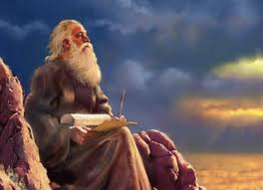
John Has the Final Word
John’s Gospel was written around 90-100 AD,
long after the synoptic Gospels.
John’s focus was to take the message of the Messiah to the Gentile world, under Roman rule.
His work would have been translated into Greek, as the majority [if not all] of the Gentile world did not read Hebrew.
The “koine” Greek was used to translate the Hebrew, often not supplying the words or terms for full and proper understanding. This is very evident through the use of <artos> to define both leavened and unleavened bread. While this may seem like a small detail, there are huge differences in final meanings.
John is very careful in his record of how he uses the word “bread.” By the time he compiled his gospel, he must have realized the problem in the synoptic writings. John uses terminology for the Last Supper that removes
any trace of linking leavened <artos> bread to his Master Yahusha.
John is the only one that records that not one of the rest of the disciples
knew exactly who the betrayer was except himself.
This is the sweet way of Yahusha … to gently give every opportunity to the erring one for repentance, and should that not happen, to not deliberately expose and embarrass the individual to a whole host of others.
Notes:
P 31 659 pm … mar 23 1127pm (done for tonight)

Slide 80
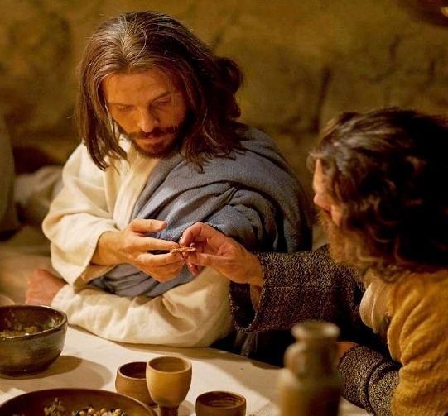
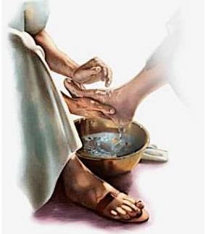
Two Supper Tables ~ Summary
Synoptic Gospels
1st Supper Table
John’s Account – The 2nd sitting at the Supper Table
Foot Washing Service
Connects the Events of the Two Separate Supper
Tables
Notes:
Mar 23 1139 pm begin mar 24 630 am

Slide 81
1st Supper Table
Synoptic Gospels
1st Supper Table
Matthew, Mark & Luke Record
Breaking of <artos> bread
Receiving the wine
One mention of a betrayer in the group
An appearance that all know who the betrayer is
No mention of leaving
the supper table for the foot-washing
Each
use an average of 10 verses to record the events of the 1st supper table.
Notes:
Mar 23 1139 pm begin mar 24 630 am – edit 805 am

Slide 82
2nd Sitting at the Supper Table
John’s Record is Very Different
John’s Account – The 2nd sitting at the Supper Table
John
uses 31 verses to record the events of the 2nd supper table.
Records this event is before the Passover.
Only records the [1st] supper is ended – no mention of the “breaking of the bread” or “receiving the wine.”
Mentions Judas specifically when the
1st supper is ended.
Only John records the foot-washing after the
1st supper.
THEN John records they all sat at the supper table again – the 2nd time.
Notes:
Mar 23 1139 pm begin mar 24 630 am

Slide 83
2nd Supper Table
John’s Gospel
2nd Supper Table
John’s Gospel uses 31 Verses to Record the 2nd Table Sitting
Five statements declare there is a betrayer in the group.
No one knows who the betrayer is
except John.
The disciples felt Judas had special regard as only “he” received the
dipped sop.
The only time John uses the term <artos> [leavened] bread is after the foot-washing at the 2nd supper table.
This <artos> [leavened] sop was thoroughly dipped and given to
ONLY Judas.
Only John records Judas removed himself from the group, leaving 11.
Notes:
Mar 23 1139 pm begin mar 24 630 am

Slide 84
Why is John’s Gospel so Different?
The following are just some thoughts and questions for further consideration that has brought about this study around the controversial “bread” in The Last Supper.
Fact: The synoptic gospels (and Acts) were written well in advance of John’s - varying from 40-69 AD.
  Matthew, Mark and Luke were trying to reach the
  unconverted Jews with the gospel of the true Messiah.
  Paul was the apostle chosen to take the gospel of the
  true Messiah to the Gentiles.
Fact: John’s gospel was written between 90-100 AD – over 20-30 years later.
  Of the disciples and apostles, John was the longest living
  eye-witness.
  By the time he wrote his gospel, he was focusing on the
  Roman and Gentile community. We know this, as he used
  Roman Reckoning of time for only the passion account.
  John was obviously determined his True Messiah was not
  to be confused with any other counterfeit messiah.
Notes:
Mar 24 new slide 840 am - 850

Slide 85

Could it be …?
John deliberately did NOT write about the events at the 1st supper table because:
the “koine” Greek word <artos> could not
properly describe the unleavened bread Yahusha used at the 1st seating of the supper table. Why?
<artos> is first understood as leavened bread by definition and by the Greek/Roman mindset;
<artos> leavened bread does not rightly represent the flesh of John’s perfect and true Messiah;
<azumos> is the best word to absolutely verify “bread” would be unleavened – but likely not the best word for the Greeks to understand the whole concept – as this was not a “common word.”
Could these be THE reasons John deliberately
chose to avoid recording the events around
the unleavened bread & wine?
Notes:
Mar 24 new slide 850 am – 915 am

Slide 86
3rd Witness for
<artos> Bread Study
#3 Patterns
“type” & “antitype”
Notes:
New slide mar 43 830 am

Slide 87

Leavened Bread Conflicts
There are some that feel leavened bread could also represent Yahusha’s body, as the wine represents His blood.
Yahusha said we are to partake of the bread as a representation
of His body, and the wine as a representation of His blood.
Some feel the bread can (or must) be leavened because
the Greek word <artos> is defined as leavened bread.
Does that mean the wine can also be leavened?
Or, is one leavened, and one unleavened?
Matthew’s Hebrew translation used the word <lechem> for bread. In Hebrew this <lechem> can also have dual definitions.
Is this likely the reason the Greek translation used <artos>
rather than <azumos>?
In this study we have discovered that both <lechem> and
<artos> easily can take on both meanings of either leavened
or unleavened. How can this conflict be settled?
Notes:
New thought mar 24 1010 am

Slide 88
Patterns: “type” and “antitype”
Would not the “type” and “antitype” have the last Word
on the final answer to this “bread” controversy?
Let’s dig a little deeper to find how the “type” must link to the “antitype” for complete fulfillment in Yahusha, the true Messiah.
Type
Lamb as Passover Sacrifice
(accompanied by)
Grain Offering
Drink Offering
The sacrifices were always accompanied with the:
Grain Offering and
Drink Offering on the
Altar of Burnt Offerings.
Antitype
Yahusha as the Lamb for Passover
(represented as)
Bread as Grain Offering (eg: body)
Wine as Drink Offering (eg: blood)
His pierced and striped flesh represents the Grain Offering.
His spilled blood represents the Drink Offering.
Yahusha’s cross was His
Altar of Burnt Offering.
Notes:
New thought – 900 pm – done 1022 am

Slide 89

Exo 34:25 Book of the Law Instructions for “leaven”
Note: In Exo 32, the people had just violated the Covenant with the Golden Calf offense. This verse is a very short, stern reminder (after
Moses’ last trip down Mt Sinai) of what “not to do” regarding leaven.
Idol worship links to paganism and sin. So does offering leaven
with blood sacrifices. Therefore this command was given before
the sanctuary was set up.
Ex 34:25 "You shall not offer the blood of MY
sacrifice with leaven, nor shall the sacrifice of the
Feast of the Passover be left until morning. NKJV
This command is for all blood sacrifices on any altar,
not just the Altar of Burnt Offerings.
More Details in Lev 2 from the Book of the Law!
Notes:
New slide mar 24 1145 am -1218pm

Slide 90
Scriptural Requirements for Grain Offerings – Lev 2
1 ‘When anyone offers a grain offering to Yahuah, his offering
shall be of fine flour. And he shall pour oil on it, and put
frankincense on it. [Salt is also a requirement.]
2 He shall bring it to Aaron's sons, the priests … And the priest shall burn
it as a memorial on the altar, an offering made by fire, a sweet aroma
to Yahuah.
3 … It is most holy of the offerings to Yahuah made by fire.
4 [Baked in oven] … it shall be unleavened cakes of fine flour
mixed with oil, or unleavened wafers anointed with oil.
5 [Baked in a pan] … it shall be of fine flour, unleavened,
mixed with oil.
The unleavened grain offering is:
a “type” to be fulfilled in Messiah.
Notes:
New slide mar 24 1027 am

Slide 91
Scriptural Requirements for Grain Offerings – Lev 2 (con’t)
6 You shall break it in pieces and pour oil on it; it is a grain offering.
7 [Baked in a covered pan] … it shall be made of fine flour with oil.
8 You shall bring the grain offering … to the priest, he shall
bring it to the altar.
9 Then the priest shall take from the grain offering a
memorial portion, and burn it on the altar. …
10 And what is left of the grain offering shall be Aaron's and his sons'.
It is most holy of the offerings to Yahuah made by fire.
The unleavened grain offering is
offered with the blood sacrifice.
Notes:
New slide mar 24 1027 am

Slide 92
Scriptural Requirements for Grain Offerings – Lev 2:11
11 ‘No grain offering which you bring to Yahuah
shall be made with leaven, for
you shall burn no leaven
nor any honey
in any offering to Yahuah made by fire.’ NKJV
These detailed instructions are found in the Book of the Law. However, they were first given in the Book of the Covenant.
Let’s examine Exo 23:18.
Notes:
New slide mar 24 1142 am

Slide 93

Exo 23:18 – Book of the Covenant
Instructions
For Leaven:
Exo 23:18 "You shall not offer the blood of MY sacrifice with leavened bread; nor shall the fat of My sacrifice remain until morning.
Notes:
New slide mar 24 1242 pm

Slide 94
What About the Law of Peace Offerings? Lev 7:11-14
Thanksgiving Offering / Heave Offering / Peace Offering
Lev 7:11-14 This is the law of the sacrifice of peace offerings which he shall offer to Yahuah:
12 If he offers it for a thanksgiving, then he shall offer, with the sacrifice
of thanksgiving, unleavened cakes mixed with oil, unleavened wafers anointed with oil, or cakes of blended flour mixed with oil.
13 Besides the cakes, as his offering he shall offer leavened bread with the sacrifice of thanksgiving of his peace offering.
14 And from it he shall offer one cake from each offering as a heave offering to Yahuah. It shall belong to the priest who sprinkles the blood of the peace offering. NKJV
The leavened bread offering
belonged to the priest.
Notes:
New slide mar 24 1142 am

Slide 95

Unique Peace Offerings
Thanksgiving Offering / Heave Offering / Peace Offering
This sacrifice was offered in times of: 1) Thankfulness 2) Peace
3) Joy 4) a Promise or Vow 5) Health 6) Safety 7) Redemption, etc.
A portion of the sacrifice was given to the priest along with several varieties of unleavened breads & cakes; the rest of the offering was
for the offerer, his family, neighbors, guests, and the poor.
It was to be eaten within 2 days enjoying the feast and fellowship, nothing lacking. Anything left over beyond the specified time was to be burnt.
“Being eaten” meant the majority of this sacrifice was NOT offered
upon the altar.
However, besides the unleavened requirements, the offerer was also to bring leavened bread (which is peculiar to only this offering), but never was this leavened bread offered upon the altar, for that was forbidden in Lev 2:11 (Book of the Law command).
The leavened bread was to be eaten with the flesh of the
sacrifice so the meal would be most pleasant for all.
Why? … Because leavened bread was more desirable.
Notes:
New thought – 900 pm – done 1022 am

Slide 96

Strict Requirement for
Grain Offerings on the
Altar of Burnt Offering
Let’s be sure that we realize the leaven requirement attached to the Peace Offering is unique, and that this “leaven” was never offered on the Altar of Burnt Offering according to:
Lev 2:11
No grain offering which you bring to Yahuah
shall be made with leaven, for
you shall burn no leaven nor any honey
in any offering to Yahuah made by fire. NKJV
These detailed instructions are found in the Book of the Law. However, they were first given in the Book of the Covenant.
Notes:
New thought – 900 pm – done 1022 am

Slide 97
Exo 23:18 – Book of the Covenant
Instructions
For Leaven:
Exo 23:18 "You shall not offer the blood of MY
sacrifice with leavened bread; nor
shall the fat of My sacrifice remain until morning.
Let us never assume that Yahusha would ever describe
His flesh
the same as leavened bread.
Notes:
New slide mar 24 1242 pm

Slide 98

Final Conclusions
Leavened Bread should never be used when celebrating the ordinances of The Last Supper. Three witnesses testify to this:
Luke 24:30 … the bread in this verse was definitely “unleavened” despite the fact the Greek term <artos>
was used – representing leavened bread.
Context was king!
John 13:18 … the bread in this verse used the Greek term <artos> as well, but this is correct, as the context is in connection with the <artos> sop given to the “leavened” Judas.
Patterns of “type” and “antitype” -
From both the Book of the Covenant, and Book of the Law, there are explicit instructions that no leaven is ever placed on the altar with the blood sacrifice to mar the identity of the true Messiah.
Luke
John
antitype
type
Choose ye this day!
The End
Notes:
New slide mar 24 1245pm

Slide 99


Questions & Comments
can be sent to:
Charlene Fortsch
(BC, Canada)
email: charlene@studythecalendar.com
Thank you!
Notes:
Done Mar 24 115 pm – Charlene’s end conclusions, that I did not do a slide for. Extra ending notes:
(Nov 24/15) For me, the study is very clear there were 2 types of bread at the Last Supper.
I don’t see Yahusha as taking on the leaven of our sins until He made that decision. (Seems to me this would have happened at noon when the day went dark – the load of sins upon Him darkened those daylight hours, and this darkness separated Him for His father, as Holiness cannot be in the presence of darkness
[Dec 14/13]. Some say there are 29 references of <artos> to Yahusa’s life, body, flesh, etc, so we are to eat leavened bread at the Lord’s Supper. They say that 29 verses have a weightier testimony than the 3 witnesses I have shown. I do NOT agree with either of these statements. The Luke account is definitely a RED FLAG for us to sit up and take notice. Also: our sins did not make Him sinful, or a sinner. So, no matter how many sins He carries, His body and blood are still pure and perfect … which is where I see the connection to the unleavened bread. We are to partake of this “unleavened” bread as taking on His unleavened flesh so we can be totally unleavened. We do not take on “his” “assumed” leavened flesh, ever, because there is no such thing.
The leavened bread was only connected to the leavened sinful Judas. Just as leaven is to be removed from our lives in the Feast of ULB, so the leaven had to be removed from the group of disciples.
I definitely saw where John is the one that settles the arguments of the synoptic gospels. Since doing the Dawn studies, we have seen this characteristic in John’s book over and over again. We may as well learn to expect it!

