Slide 1



Part 4
The Song of Joshua’s Sickle

Slide 2
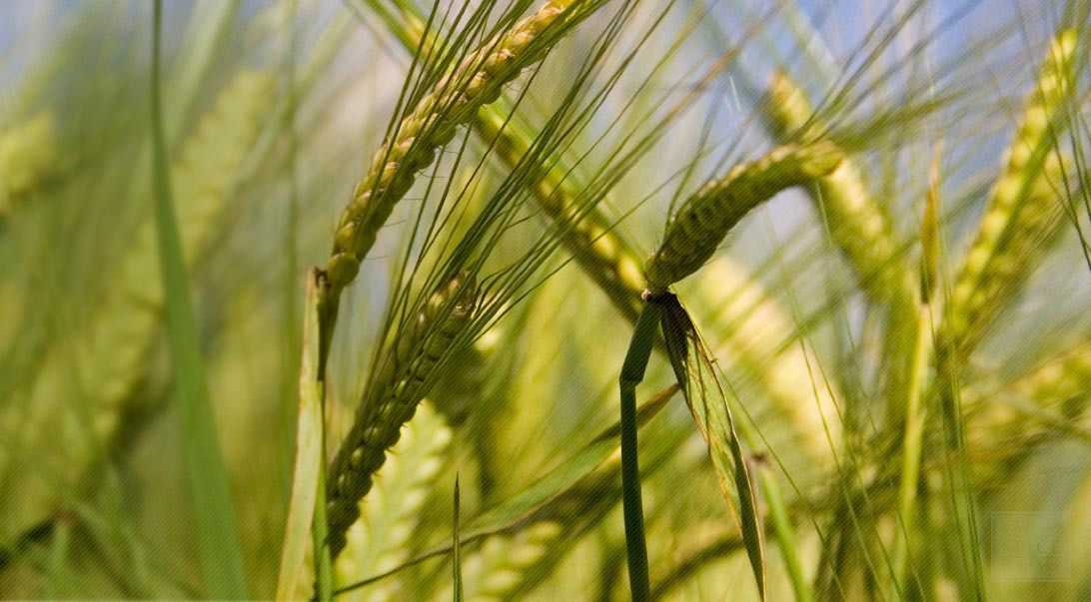

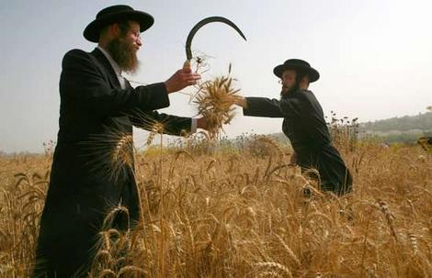
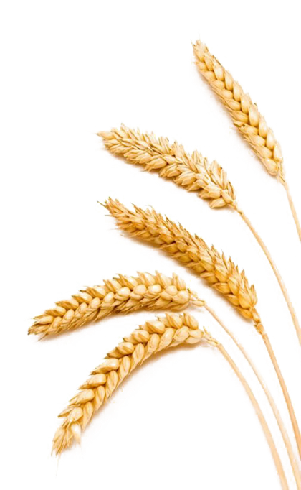
Exposing the Counterfeit Sickle
Whose Shavuot Connection?
(con’t)

Slide 3
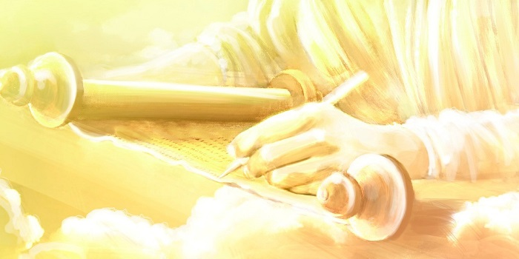


Covenant Calendar Studies Reveal Profound Secrets
Prov 25:2 It is the glory of Yahuah
to conceal a thing: but the honour of kings [Malki’s] is to search out a matter.
What is the secret to detecting a counterfeit?
Mark 4:22-23 For there is nothing hid, which shall not be manifested; neither was any thing kept secret, but that it should come abroad.
23 If any man have ears to hear, let him hear.
A truth must be found first!
Today’s study will reveal some interesting secrets for our ears to hear.
3

Slide 4
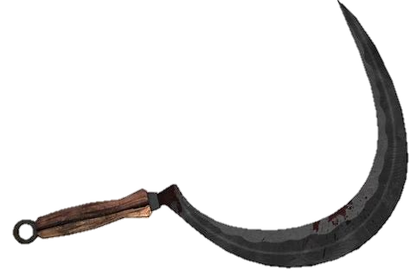
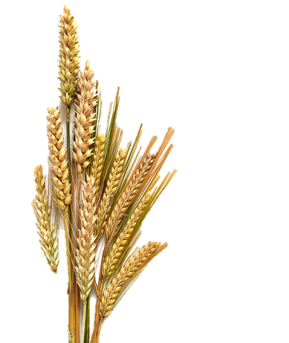
Part #4 Mapping the REVIEW Discussion Topics
Status | Slides | Content of Topic: Review from Joshua/Enoch Part 3
Review | 5-6 | a) Principle of a “day” and/or a “date”
New | 7 | b) New Principle of “locked” & “unlocked” Calendars
Review | 8-10 | c) Wheat vs Barley; Joshua vs Enoch on Omer Count
New | 11-12 | d) Lunar-Sabbath & Placement of Spring Festivals
New | 13-19 | [Bunny Trail #2] Lunar-Sabbath Connection to Lag B` Omer
Review | 20-38 | Exo 12 [Passover]; Exo 16 [Quail/Manna]; Exo 19 [Mt Sinai]
New | 39-61 | [Bunny Trail #3] Is the Manna 2nd Month in the Spring or Fall?
#11 | 62-78 | [Bunny Trail #4] Counterfeit Pentecost Count {49 days + ? days}
New | 79-93 | Hebrew Reveals a Covenant Calendar Secret for Omer Count
Review | 94-97 | Summary for Counterfeit Pentecost Count of “?” Days

Slide 5
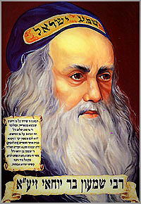
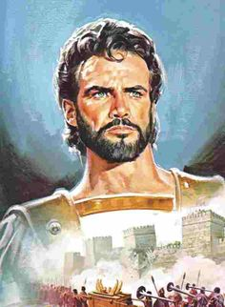


There is a striking difference between Counterfeit
Calendars &
Joshua’s
Calendar Count!
It’s the difference between
a “day” and/or a “date.”
REV
I
EW

Slide 6


A “day” and/or a “date” are usually not the same!
REV
I
EW
Random Example:
The 15th date of
the 1st month is
not always on the
4th day/cycle (Wed)
like this example.

Slide 7



A “day” and/or a “date” for
calendar studies is a principle comparable to a lock.
This principle will either:
Lock a calendar (or)
Unlock a calendar.

Slide 8

The sickle will harvest the
Wheat Wave Sheaf!
REV
I
EW
Only Wheat can be ground to fine flour for the altar!
Barley was only used in judgment of an adulterous woman!

Slide 9

Joshua’s “Omer Count”
REVIEW
Joshua’s 1st Month
Joshua’s 3rd Month
1st | 2nd | 3rd | 4th | 5th | 6th | 7th
1 | 2 | 3 | 4 | 5 | 6 | 7
8 | 9 | 10 | 11 | 12 | 13 | 14 P/O
15 W/S | 16 | 17 | 18 | 19 | 20 | 21 | Wk #1
22 | 23 | 24 | 25 | 26 | 27 | 28 | Wk #2
29 | 30
1st | 2nd | 3rd | 4th | 5th | 6th | 7th
 |  |  |  | 1 | 2 | 3 | Wk #7
4 50th | 5 | 6 | 7 | 8 | 9 | 10
11 | 12 | 13 | 14 | 15 | 16 | 17
18 | 19 | 20 | 21 | 22 | 23 | 24
25 | 26 | 27 | 28 | 29 | 30
4 Future Reference
Joshua’s 2nd Month
According to the Torah Statutes from Lev. and Deut., Joshua has fulfilled every requirement.
Note: The Torah Wave Sheaf and Shavuot (Pentecost) will fluctuate on
different “dates” of the month.
This specific year, it was on the 4th.
1st | 2nd | 3rd | 4th | 5th | 6th | 7th
 |  | 1 | 2 | 3 | 4 | 5 | Wk #3
6 | 7 | 8 | 9 | 10 | 11 | 12 | Wk #4
13 | 14 | 15 | 16 | 17 | 18 | 19 | Wk #5
20 | 21 | 22 | 23 | 24 | 25 | 26 | Wk #6
27 | 28 | 29 | 30
9

Slide 10



Enoch’s “Omer Count”
REVIEW
Enoch’s 1st Month
Enoch’s 3rd Month
1st | 2nd | 3rd | 4th | 5th | 6th | 7th
 |  |  | 1 | 2 | 3 | 4
5 | 6 | 7 | 8 | 9 | 10 | 11
12 | 13 | 14 | 15 | 16 | 17 | 18
19 | 20 | 21 | 22 | 23 | 24 | 25
26 | 27 | 28 | 29 | 30
1st | 2nd | 3rd | 4th | 5th | 6th | 7th
1 | 2 | 3 | 4 | 5 | 6 | 7 | Wk #6
8 | 9 | 10 | 11 | 12 | 13 | 14 | Wk #7
15 50th | 16 | 17 | 18 | 19 | 20 | 21
22 | 23 | 24 | 25 | 26 | 27 | 28
29 | 30
11 Days later than Joshua!
Enoch’s 2nd Month
On Enoch’s calendar,
“dates” and “days” of Sabbaths and feasts never change.
Enoch’s Pentecost is always on
the 15th day of the 3rd month. There are 2 distinct reasons for this.
1st | 2nd | 3rd | 4th | 5th | 6th | 7th
26 | 27 | 28 | 29 | 30 | 1 | 2 | Wk #1
3 | 4 | 5 | 6 | 7 | 8 | 9 | Wk #2
10 | 11 | 12 | 13 | 14 | 15 | 16 | Wk #3
17 | 18 | 19 | 20 | 21 | 22 | 23 | Wk #4
24 | 25 | 26 | 27 | 28 | 29 | 30 | Wk #5
10

Slide 11

Joshua’s 1st Month
Compare to -
Lunar 1st Month
1st | 2nd | 3rd | 4th | 5th | 6th | 7th
1 | 2 | 3 | 4 | 5 | 6 | 7
8 | 9 | 10 | 11 | 12 | 13 | 14 P/O
15 W/S | 16 | 17 | 18 | 19 | 20 | 21
22 | 23 | 24 | 25 | 26 | 27 | 28
29 | 30
1st | 2nd | 3rd | 4th | 5th | 6th | 7th
1 | 2 | 3 | 4 | 5 | 6 | 7
8 | 9 | 10 | 11 | 12 | 13 | 14 P/O
15 | 16 | 17 | 18 | 19 | 20 | 21
22 | 23 | 24 | 25 | 26 | 27 | 28
29 | 30
REV
I
EW
Sabbath Count
Sabbath Count
**Both calendars correctly place Passover on the 14th day of the month.
Joshua’s declares Passover
[the 14th] is on the
weekly Sabbath!
When the Lunar Sabbath calendar has Passover on the 7th cycle (to agree with Joshua), Sunday
the 15th is still the weekly lunar Sabbath.
This ONE error declares “lunar” as a counterfeit!
11

Slide 12

Joshua’s 1st Month
Again, compare to -
Lunar 1st Month
1st | 2nd | 3rd | 4th | 5th | 6th | 7th
1 | 2 | 3 | 4 | 5 | 6 | 7
8 | 9 | 10 | 11 | 12 | 13 | 14 P/O
15 | 16 | 17 | 18 | 19 | 20 | 21
22 | 23 | 24 | 25 | 26 | 27 | 28
29 | 30
1st | 2nd | 3rd | 4th | 5th | 6th | 7th
 |  |  |  |  |  | 1
2 | 3 | 4 | 5 | 6 | 7 | 8
9 | 10 | 11 | 12 | 13 | 14 P/O | 15
16 | 17 | 18 | 19 | 20 | 21 | 22
23 | 24 | 25 | 26 | 27 | 28 | 29
30
Sabbath Count
Sabbath Count
**Note: Both calendars still have Passover on the 14th day of the month.
Joshua’s Passover is on
the weekly Sabbath –
“the” 14th.
Lunar Sabbath calendar now has Passover on FRI with the 15th listed as the weekly Sabbath.
It takes only ONE error to declare a counterfeit!
12

Slide 13

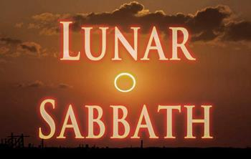


Next, we’re going on a …
#2

Slide 14
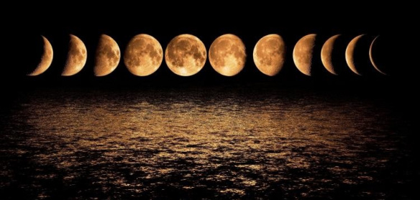
Does the lunar-Sabbath calendar have more errors?
N E W
I
NFORMAT
ION
New Information (with regards to only the Spring Festivals):
Many lunar-Sabbath observers do honor the DAWN day-start truth. Does this prove the whole lunar calendar as true?
Unfortunately the DAWN day-start truth is combined
with a lot of error around lunar worship statutes, because
this lunar-Sabbath calendar is tightly locked.
How dangerous can this be?
Tightly locked calendar!

Slide 15
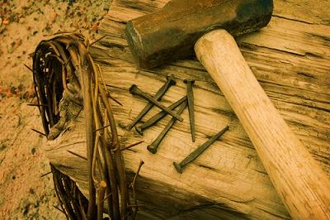
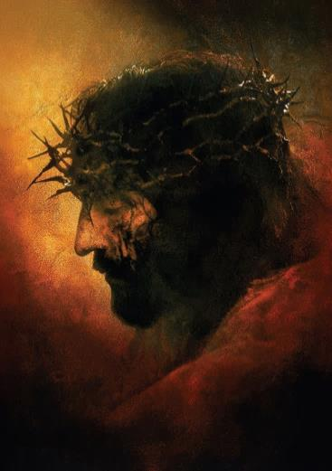
The Lunar-Sabbath Calendar is “locked” to the Moon Cycles for “days” and “dates.”
Lunar-Sabbath facts for Passover on the 14th:
There is never any allowance for Passover to be on the 4th cycle
of the week (Wed) unless the 15th is on the 5th cycle (Thurs).
WHEN the 15th must represent the UNLEAVENED BREAD
Sabbath AND the weekly Sabbath, there is:
  NEVER any allowance for the Roman guard to be asked for and granted (as the Rabbis certainly would not desecrate their weekly
  Sabbath with this activity);
  NEVER any allowance for the women to purchase and prepare
  spices according to the gospel records; (Mark 16:1)
  NEVER any allowance for the “3 days & 3 nights” Messianic
  prophecy to be fulfilled.
This calendar
is locked!

Slide 16
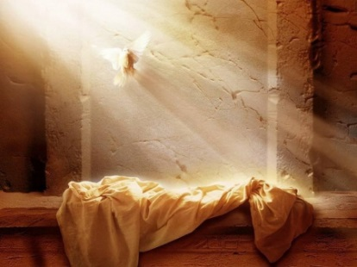


The next unusual “lock” for the
Lunar-Sabbath Calendar …
For the Spring Feasts, this in turn also means:
The 15th “lunar date” must also house the resurrection “day” every year.
THAT Means …
The 15th can NEVER be the Wave Sheaf Festival
as Joshua observed upon entrance into Canaan.
This is only the beginning
of the locked problems.
There are more!
More “locks” coming!

Slide 17
The Lunar-Sabbath Calendar has another “locked” problem connected to Wave Sheaf!
WHEN the 15th always houses the Unleavened Bread Sabbath
and the weekly Sabbath, THEN Wave Sheaf must be
celebrated on the 16th of the 1st month.
In turn this also means:
The Wave Sheaf is forever “locked/married” to the 16th just as many other counterfeit moon/month calendars. This now DIRECTLY links to:
Wave Sheaf Lock!
The death of Rabbi Shimon bar Yochai – on
On the day of Rashbi’s death, he revealed the mystical dimension of the Torah known as the Kabbalah
(a form of Jewish mysticism)!
The Occult!
&
Witchcraft!

Slide 18
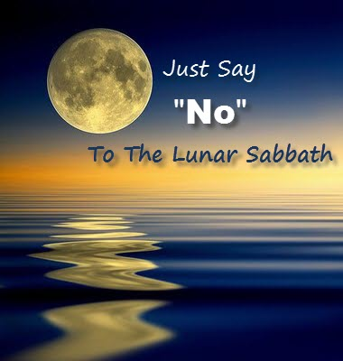
Many lunar-Sabbath keepers honour the DAWN day-start but that does not sanction the lunar-Sabbath calendar.
According to the
calendar year when Joshua,
entered Canaan these were
NOT weekly Sabbaths:
8th, 15th, 22nd, 29th
The Joshua study teaches the correct weekly Sabbath for those that will seek.
End of Review

Slide 19

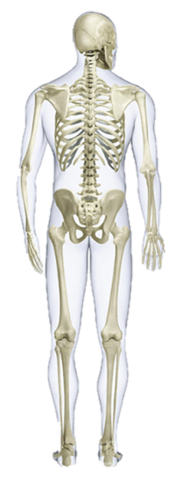
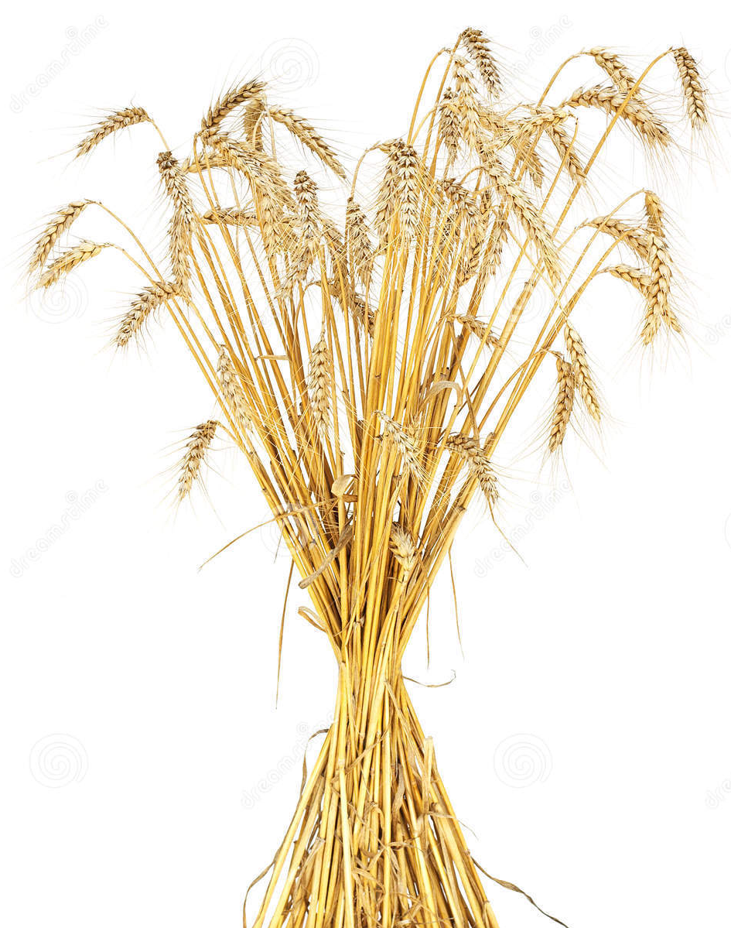
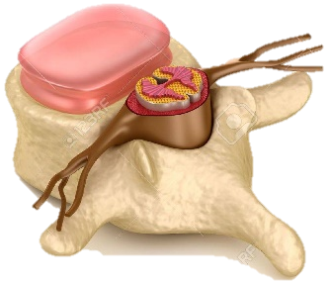
Serious Wave Sheaf Reminder from Part 3!
Remember: Enoch’s 1 week delay of Wave Sheaf removed the very “essence & substance”
for the anti-type event & man’s salvation!
If Wave Sheaf timing is misplaced in any way,
(our understanding of
the “essence & substance”)
stands without statute!
The
Eh-Tzem
There goes the celebrations!
Mo-edim

Slide 20
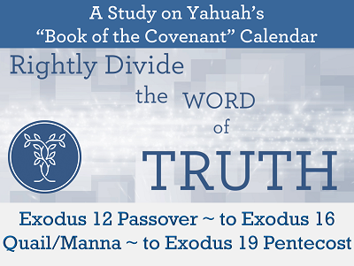
Mosheh & the Exodus- Covenant Calendar Club
Note: There are many details in this study that are necessary to fully understand today’s study.
The first Passover out of Egypt proves:
Abib 1 – New Year Day: 4th cycle [Wed].
Abib 14 Passover: 3rd cycle [Tues].
Red Sea Crossing: Abib 17th night [Fri - 6th cycle].
If the Wave Sheaf Festival Pattern would
have been celebrated, placement would have
been Abib 19th [Sun] – start of Omer count.
Quail & 1st Manna week: 2nd Month from
17th – 23rd [1st – 7th cycles / Sunday - Sabbath].
Pentecost at Mt Sinai: 3rd Month 8th day [Sun].
<www.studythecalendar.com>
<www.studythecalendar.com>
<www.studythecalendar.com>

Slide 21
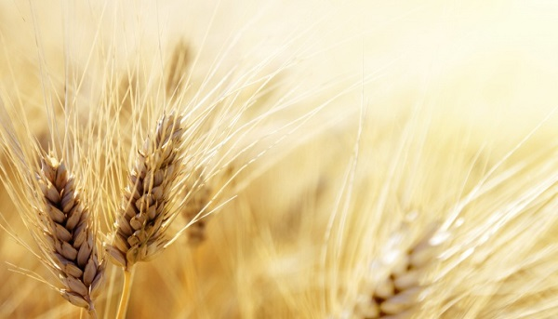
After a short review of Mosheh & the Exodus
today’s study will address:
Commentator Comments on the 2nd month of the civil year;
The Double Pentecost Count (True or Counterfeit?)
An “added” English letter and the lingering effects.
This information is important for the future studies of:
4) Enoch’s two main reasons for choosing Abib 26;
5) Paul’s witness on Yahuah’s Pentecost Count.
Note: There will be many calendar slides for comparison!

Slide 22


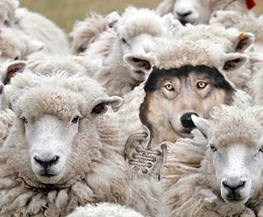
Knowing the End From the Beginning
Isa 46:9-10 Remember the former things of old: for I am Elohim, and there is none else; I am Yahuah, and there is
none like me, 10 Declaring the end from the beginning, and
from ancient times the things that are not yet done, saying,
My counsel shall stand, and I will do all my pleasure.
Will we find a wolf pretending to be a sheep?
JOSHUA has solidly exposed the correct feast “day and date”
for the Wave Sheaf and the beginning of the Omer Count.
This study will now compare
the evidence with Moshehs’
Omer Count to that of:
A popular Omer Count to 99.
Next: The Enoch Omer Count.
Findings will be compared to:
PAUL’S witness in the NT.
How many of these three examples will agree with what is found in the beginning? OR…
22

Slide 23
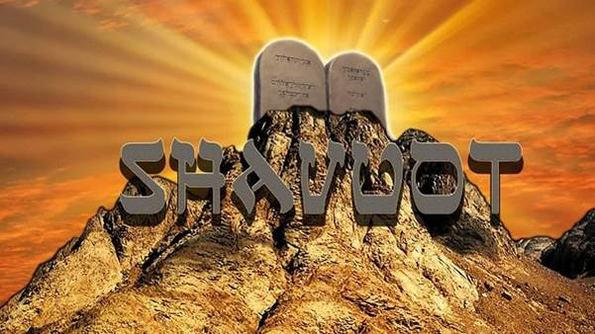
Reviewing the
Omer Count
from Egypt to Mt Sinai:
Exodus 12 - 16 - 20

Slide 24
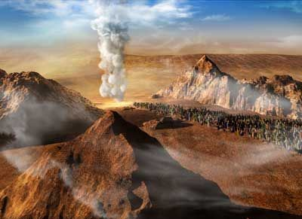
Three days’ journey into the wilderness ~
A command recorded three times in:
Exo 3:18; 5:3 & 8:27.

Slide 25

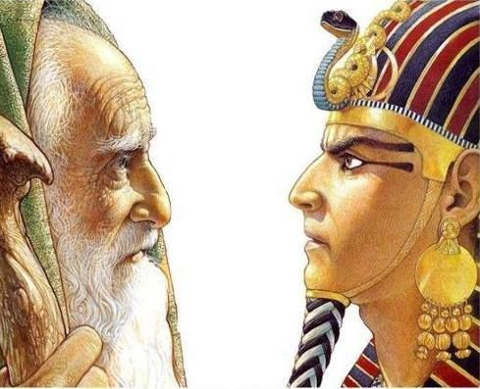
#1) Exo 3:18 The Elohim of the Hebrews hath met with us: and now let us go, we beseech thee, three days' journey into
the wilderness, that we may sacrifice to Yahuah our Elohim.
#2) Exo 5:3 The Elohim of the Hebrews hath met with us: let us go, we pray thee, three days' journey into the desert,
and sacrifice unto Yahuah our Elohim; lest he fall upon us
with pestilence, or with the sword.

Slide 26
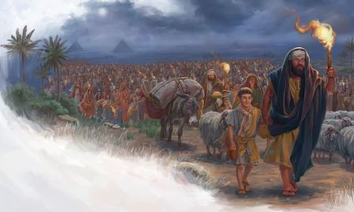
#3) Exo 8:27 We will go three days' journey into the wilderness, and sacrifice to Yahuah our Elohim, as He shall command us.
Yah’s Omer count begins in the wilderness!
As Yah does not change, neither does His Pattern of the Set-Apart Appointment – or Omer Count - to Shavuot.

Slide 27

Pentecost Torah Count of Yahuah
Lev 23:10-11, 15-16
10 When ye be come into the land which I give unto you, and shall reap the harvest thereof, then ye shall bring a sheaf of the firstfruits of your harvest unto the priest:
11 And he shall wave the sheaf before Yahuah, to be accepted for you: on the morrow after the sabbath [H7676] the priest shall wave it. (Note: Yahuah was keeping track of the count enroute to Mt Sinai.)
And ye shall count unto you from the morrow after the sabbath, from the day that ye brought the sheaf of the wave offering; seven sabbaths shall be complete: (7 completed weeks with
7 Sabbaths = 49 days.)
Even unto the morrow after the seventh Sabbath shall ye number fifty days; (The count after Wave Sheaf MUST reach to 50, which is the morrow after the 7th Sabbath.)
“Up to this point”
27

Slide 28


REV
I
EW
1st Month (Passover in Egypt)
1st [Sun] | 2nd [Mon] | 3rd [Tues] | 4th [Wed] | 5th [Thur] | 6th [Prep] | Sabbath
 |  |  | 1 New Year Day | 2 | 3 | 4
5 | 6 | 7 | 8 | 9 | 10 Lamb Chosen | 11
12 | 13 | 14 Passover | 15 [ULB #1] 1ST Day Journey | 16 [ULB #2] 2nd Day Journey | 17 [ULB #3] 3rd Day Journey | 18 [ULB #4] Day of Praise!
19 [ULB #5] WAVE SHEAF Omer #1 | 20 [ULB #6] #2 | 21 [ULB #7] #3 | 22 #4 | 23 #5 | 24 #6 | 25 #7
26 #8 | 27 #9 | 28 #10 | 29 #11 | 30 #12 | 1 | 2
Only IF Yahuah does not change!
Red Sea Night
Qodesh Omer Count PATTERN begins here!
1
Num 33:3 And they departed from Rameses in the first month, on the
fifteenth day of the first month; on the morrow after the passover …
There are 15 days of journey to the 30th day of the 1st month.

Slide 29
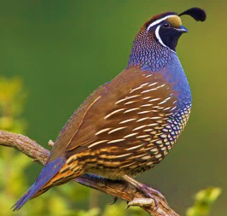
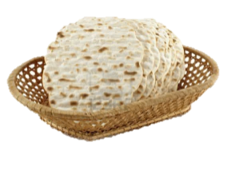

REV
I
EW
Please note which Cycle of the Week this was!
2nd Month (Quail & Manna)
1st [Sun] | 2nd [Mon] | 3rd [Tues] | 4th [Wed] | 5th [Thur] | 6th [Prep] | Sabbath
26 #8 | 27 #9 | 28 #10 | 29 #11 | 30 #12 | 1 #13 | 2 #14
3 #15 | 4 #16 | 5 #17 | 6 #18 | 7 #19 | 8 #20 | 9 #21
10 #22 | 11 #23 | 12 #24 | 13 #25 | 14 #26 | 15 Sin Wilderness #27 | 16 Murmuring #28
17 1st Manna Day #29 | 18 2nd Manna Day #30 | 19 3rd Manna Day #31 | 20 4th Manna Day #32 | 21 5th Manna Day #33 | 22 6th Manna Day #34 | 23 No Manna #35
24 #36 | 25 #37 | 26 #38 | 27 #39 | 28 #40 | 29 #41 | 30 #42
2
3
Exo 16:2
4
5
6
Exo 16:1 And they took their journey from Elim, and all the congregation of the children
of Israel came unto [travelled into] the wilderness of Sin, which is between Elim and Sinai,
on the fifteenth day of the second month after their departing out of the land of Egypt.

Slide 30


2nd Month (Quail & Manna)
1st [Sun] | 2nd [Mon] | 3rd [Tues] | 4th [Wed] | 5th [Thur] | 6th [Prep] | Sabbath
26 #8 | 27 #9 | 28 #10 | 29 #11 | 30 #12 | 1 #13 | 2 #14
3 #15 | 4 #16 | 5 #17 | 6 #18 | 7 #19 | 8 #20 | 9 #21
10 #22 | 11 #23 | 12 #24 | 13 #25 | 14 #26 | 15 Sin Wilderness #27 | 16 Murmuring #28
17 1st Manna Day #29 | 18 2nd Manna Day #30 | 19 3rd Manna Day #31 | 20 4th Manna Day #32 | 21 5th Manna Day #33 | 22 6th Manna Day #34 | 23 No Manna #35
24 #36 | 25 #37 | 26 #38 | 27 #39 | 28 #40 | 29 #41 | 30 #42
Huge important note for quail/manna:
Some claim this “quail/manna” event did NOT occur in the 2nd month of Yahuah’s Festal Year of Covenant Calendar. This is another “Fault Line” that will be addressed at the end of this section.
Exo 16:2

Slide 31

Moving to the 3rd Month - in CONTEXT!
Exo 19:1 In the third month -
after the children of Israel had come out of the land of Egypt …
on this [same] DAY [yowm] - [Not “DATE”]
REV
I
EW
The same 24 Hr. cycle of the week as the actual EXIT from Mitsrayim.
- The EXIT occurred on a 4th cycle of the week!
they came to the Wilderness of Sinai.
Now let’s apply this to some charts and see how it fits Scripture!

Slide 32
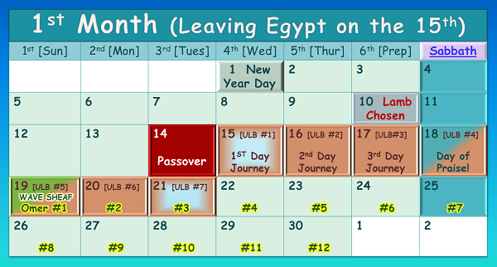

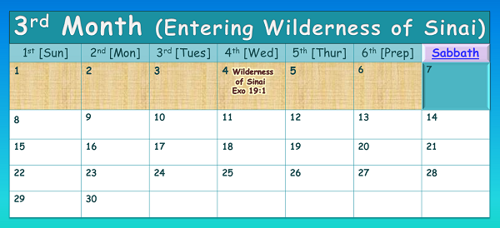


Which set of calendars demonstrate the SAME DAY?
#1
#2
The Exit!
#1 or #2 ??
The Same DAY!
Same DATE, different day!
REVIEW
32

Slide 33
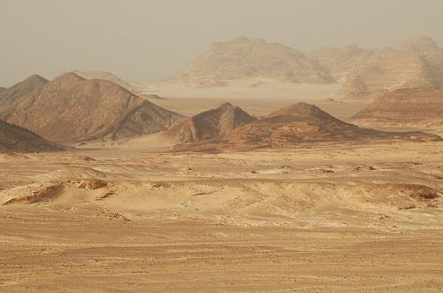
#1
REV
I
EW
This is the ONLY combination that will satisfy EVERY requirement of this calendar puzzle.
Israel entered the wilderness of Sinai on the same 4th cycle of the week as they left Egypt.
(It was not the same “date” of the month; specifically the 15th!)
The Exit!
The Same DAY!
33

Slide 34
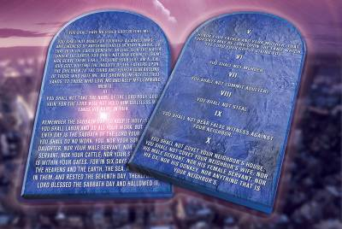
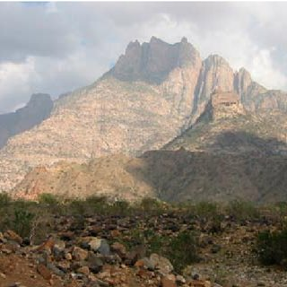


Exo 19:2 For they were departed from Rephidim, and come to the desert of Sinai, and had pitched in the wilderness; and there Israel camped before the mount.
Exo 19:1 In the third month after the children of Israel had come out of the land of Egypt, on this [same] DAY [NOT “DATE”] they came to the Wilderness of Sinai.
REV
I
EW
Note: Left Egypt on a 4th cycle; entered Wilderness of Sinai on a 4th cycle.
3rd Month (Pentecost at Mt Sinai)
1st [Sun] | 2nd [Mon] | 3rd [Tues] | 4th [Wed] | 5th [Thur] | 6th [Prep] | Sabbath
1 #43 | 2 #44 | 3 #45 | 4 Wilderness of Sinai Exo 19:1 #46 | 5 Trip #2 Mt Sinai Exo 19:2 #47 | 6 Trip #3 “today” Exo 19:10-11 #48 | 7 “tomorrow” #49
8 “3rd Day” & 50th Day! [Shavuot] | 9 | 10 | 11 | 12 | 13 | 14
15 | 16 | 17 | 18 | 19 | 20 | 21
22 | 23 | 24 | 25 | 26 | 27 | 28
29 | 30
Entering the Wilderness of Sinai &
Camping at the foot of Mt Sinai –
are 2 separate events on 2 different days!
Note the past tense
in vs. 2.
On the 5th cycle of the month, they camped before Mt Sinai.
Moses makes a trip up the mount; then delivers Yah’s message to the people.
Exo 19:3-6

Slide 35
Question: How can this 8th day be proven to be Yahuah’s Pentecost?
Answer: It links back to Torah’s Wave Sheaf according to Yahuah’s Omer Count.
Exo 19:1 In the third month after the children of Israel had come out of the land of Egypt, on this [same] DAY [NOT “DATE”] they came to the Wilderness of Sinai.
REV
I
EW
Note: Left Egypt on a 4th cycle; entered Wilderness of Sinai on a 4th cycle.
3rd Month (Pentecost at Mt Sinai)
1st [Sun] | 2nd [Mon] | 3rd [Tues] | 4th [Wed] | 5th [Thur] | 6th [Prep] | Sabbath
1 #43 | 2 #44 | 3 #45 | 4 Wilderness of Sinai Exo 19:1 #46 | 5 Trip #2 Mt Sinai Exo 19:2 #47 | 6 Trip #3 “today” Exo 19:10-11 #48 | 7 “tomorrow” #49
8 “3rd Day” & 50th Day! [Shavuot] | 9 | 10 | 11 | 12 | 13 | 14
15 | 16 | 17 | 18 | 19 | 20 | 21
22 | 23 | 24 | 25 | 26 | 27 | 28
29 | 30
7th Wk
1
2
50th Day
Exo 19:10-11 And Yahuah said to Mosheh, “Go to the people and set them apart today [6th day] and tomorrow [7th day].
And they shall wash their garments, [11] and shall be prepared by the third day.
3
For on the third day [8th day], Yahuah shall come down upon Mount Sinai before the eyes of all the people.

Slide 36

#1
The Torah Commands for the Omer count from:
Wave Sheaf [1st Month]
to Shavuot [3rd Month]
1st Month: Leave Egypt [Wed] 15th day.
2nd Month: Enter Wilderness of Sin on [Fri] 15th; Quail sent [Sabbath `ereb] 16th;
Manna sent [Sunday boqer] 17th.
3rd Month: Enter Wilderness of Sinai
on [Wed] 4th day [Omer #46].
50th Omer count & Shavuot: [Sun] 8th day.
This documented accuracy & precision as found in the EXODUS is the ONLY combination that will allow Mosheh to receive the 10 Debarim on Mt Sinai in full alignment with Torah.
50th
57th
Note: Using the combination
of the same date of the 15th for both months, does not work!
36

Slide 37
The 8th day of the 3rd month fulfills
the statute command for Shavuot!
Covenant Calendar is not “locked”
together with “days” and “dates”
for weekly Sabbaths and feasts/festivals.
Example #1: Wave Sheaf, Shavuot & the weekly Sabbath are fixed to a “cycle” but not to a “date.”
Example #2: Other festival commands are
fixed to a “date” but not to a “cycle.”
REV
I
EW
ENDS

Slide 38
Anything else is simply …
an UNAUTHORIZED MISPLACEMENT of
The
Eh-Tzem
Feast of Wave Sheaf (Day)
~ Salvation’s
“essence &
substance”!
Mo-ed & Chag
Wave Sheaf Lock!
A MISPLACEMENT includes any Wave Sheaf
celebration married to Abib 16 on “locked” calendars!

Slide 39



Back to the quail/manna
of the 2nd month:
#3
The Exodus 12 – 16 – 20 Torah witnesses demonstrate beyond a shadow of any doubt that the Quail/Manna event was in the 2nd month of Yahuah’s Festal calendar.
What does Exo 16 have to do with the flood account and what shall be done about comments like these next ones?

Slide 40

Scriptures of the Flood Under Examination
Gen 7:11 In the six hundredth year of Noah's
life, in the second month, the seventeenth
day of the month, the same day were all the fountains of the great deep broken up, and
the windows of heaven were opened.
Gen 8:3 And the waters returned from off the earth continually: and after the end of the hundred and fifty days the waters were abated.
Gen 8:4 And the ark rested in the seventh month, on the seventeenth day of the
month, upon the mountains of Ararat.
Adam Clarke’s Commentary:
Second month - The first month was Tisri, which answers to the latter half of September, and first half of October; and the second was Marcheshvan, which answers to part of October and part of November. After the deliverance from Egypt, the beginning of the year was changed from Marcheshvan to Nisan, which answers to a part of our March and April. But it is not likely that this reckoning [was] obtained before the flood.
Questions:
Where is Clarke’s documentation to determine:
1) the flood account is on this civil calendar?
the 1st month of the fall was changed to
the 1st month in the spring at the exodus almost 1000 years after the flood?
Was there absolutely no provision for
a festal calendar until ~1500 BC?
There are at least 11 calendar clues in the flood account.
Is it possible to determine if
these clues match Yahuah’s Festal calendar, or man’s civil calendar?
Mal 3:6 For I am Yahuah, I change not …

Slide 41

Comparing Clarke to Ellicott’s Commentary
Ellicott’s Commentary [on Gen 7]:
Vs 11) In the second month.—That is, of the
civil year, which commenced in Tisri, at
the autumnal equinox. The flood thus began towards
the end of October, and lasted till the spring.
The ecclesiastical year began in Abib, or
April; but it was instituted in remembrance of the deliverance from Egypt (Exo 12:2;
Exo 23:15), and can have no place here.
The year was evidently the lunar year of 360 days,
for the waters prevail for 150 days (Gen 7:24), and then abate for 150 days (Gen 8:3). Now, as the end of the first period of 150 days is described in Gen 8:4 as the seventeenth day of the seventh month, whereas the flood began on the seventeenth of the second month, it is plain that the 150 days form five months of thirty days each.
Where’s the documentation
this is a civil year?
Clark said there was no 1st month in the spring until the Exodus. Ellicott comments as
if the Festal year was always in place – but didn’t get instituted until the exodus. Who is right?
?
Notice the year is allotted 360 days, but called a “lunar year!
?
A second set of 150 days????

Slide 42
Ellicott’s Commentary on Exodus 12:2
The beginning of months.—Hitherto the Hebrews had commenced the year with Tisri, at or near the autumnal equinox. (See Exo 23:16.) In thus doing, they followed neither the Egyptian nor the Babylonian custom. The Egyptians began the year in June, with the first rise of the Nile; the Babylonians in Nisannu,
at the vernal equinox. It was this month which was
now made, by God’s command, the first month of the Hebrew year; but as yet it had not the name Nisan: it was called Abib (Exo 13:4), the month of “greenness.”
Henceforth the Hebrews had two years, a civil and a sacred one (Joseph., Ant. Jud., i. 3, § 3). The civil year began with Tisri, in the autumn, at the close of the harvest; the sacred year began with Abib (called afterwards Nisan), six months earlier. It followed that the first civil was the seventh sacred month, and vice versa.
How does Exo 23:16 document the fall equinox timeframe is the beginning of the year, when it says the Feast of Ingathering is at the “END” of the year”?
This comment of Ellicott’s does contain an element of truth.

Slide 43


Are You Amazed?
Are you amazed at how some of the most popular commentators actually believe the 2nd month was in the fall in Gen 7:11?
Why would they believe such, except they
are following a Judaic Civil calendar?
Do you think they were consulting Judaism and the Talmud, or is there another reason?
Would this have anything to do with
“taking away the key of knowledge
and understanding”?
#1
#2
The Exodus account is only one witness.
Is there
a 2nd witness that will remove all doubt?
#3
#4

Slide 44

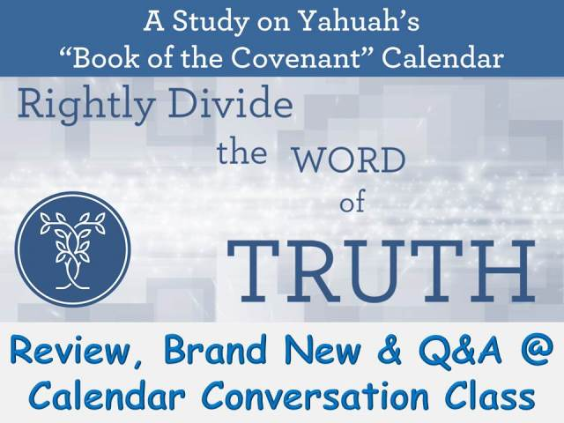

Season 2018: Study #1.10
A proper calendar study proves both events for the flood and the exodus were established on the same timing as the Festal Covenant Calendar, NOT man’s civil calendar. The following information on the timeframe of the flood account is given more
coverage in the original study thus noted.
The final witness to this Torah Truth is found in Yahusha’s Omer Count from His Wave Sheaf to the Shavuot festival of Acts. Next to be considered:
Calendar clues in the flood account.
Comparisons to several calendar options.
ONLY the Covenant Calendar year of
Yahusha’s death aligns with perfection.
<www.studythecalendar.com>

Slide 45
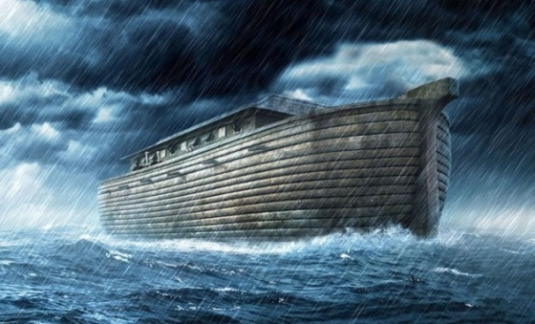

Question #1 About Noah:
Would Yahuah place calendar clues in
Noah’s flood account for a special reason?
YEAR | MONTH | DAY | TEXT | COMMENT
1. 600TH | 2ND | 10TH | Gen 7:10 | Enter the Ark
2. 600TH | 2ND | 17TH | Gen 7:11 | Flood waters arrive
3. 600TH | 3RD | 27TH | Gen 7:17 | 40 days of rain
4. 600TH | (Month | Length) | Gen 7:24 Gen 8:3 | 5 months = 150 days
5. 600TH | 7th | 17th | Gen 8:4 | Ark rests on Ararat
6. 600TH | 10th | 1st | Gen 8:5 | Mountain tops are seen
7. 600TH | 11th | 10th | Gen 8:6 | Raven sent out
8. 600TH | 11th | 17th | Gen 8:10 | Dove sent out
9. 600TH | 11th | 24th | Gen 8:12 | Dove sent out again
10. 601ST | 1st | 1st | Gen 8:13 | Waters dried up
11. 601ST | 2nd | 27th | Gen 8:14 | Noah leaves ark
Only the last Calendar Clue in the Flood account will be addressed in this study.

Slide 46
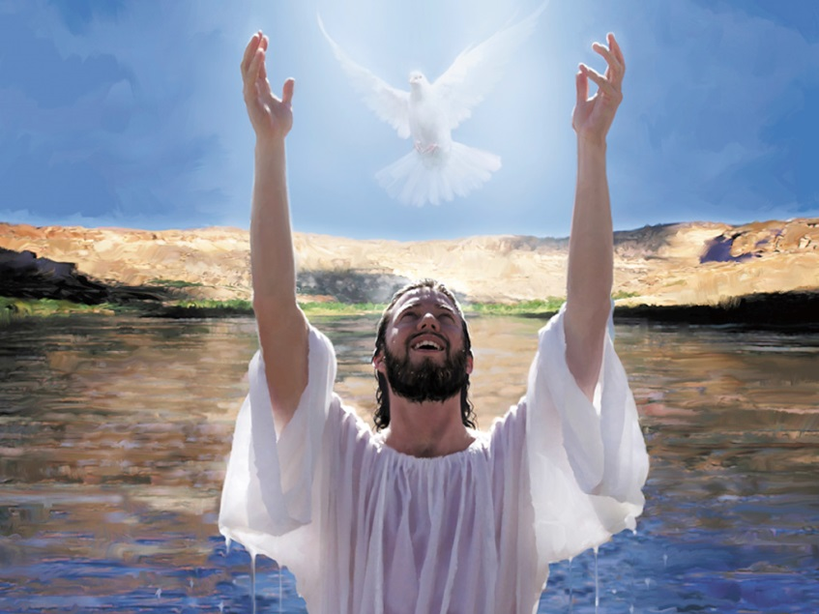
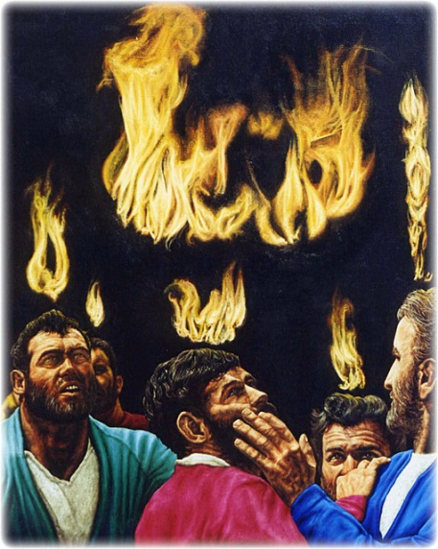

Question #2 About Yahusha:
Would Yahuah place calendar clues in the Scriptures to allow the discovery of Yahusha’s
70 week ministry, locking down important dates?
What about?
From “water” … to “fire”
in 70 weeks?!

Slide 47

Just another innocent – Question:
What reason did Yahuah have to inspire these seemingly insignificant details?
Gen 8:14 And in the second month, on the twenty - seventh day of the month, the earth was dry.
Gen 8:15 And Elohim spoke to Noaḥ, saying,
Gen 8:16 “GO OUT of the ark, you and your wife and your sons and your sons’ wives with you.”
Is it possible that we can positively identify the Mashiach AND the Blood Ratified Calendar
in one single swipe with this information?

Slide 48

The original study compared several
[true & false] calendars in great detail.
We will look quickly & specifically at these 6 calendars for the 40th day of the Omer Count
to see if “that day” will place on the
27th day of the 2nd month!
(You’ll see why later.)
40th Day
of Omer
2nd Mon.
27th Day
Will any of these
calendars declare the passion year of our true Mashiach?

Slide 49
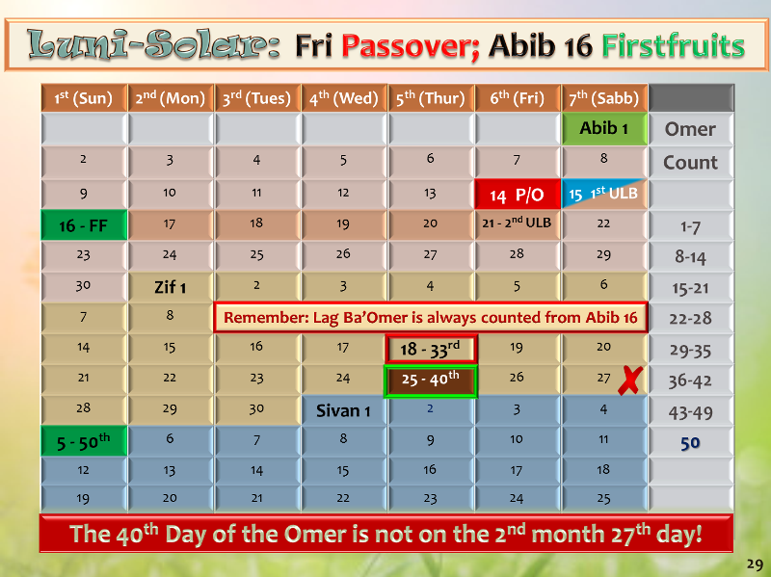
27th Day of 2nd Month:
[FALSE calendar]
Omer count #42.
Note: Slide numbers are from the original teaching for easy reference.

Slide 50
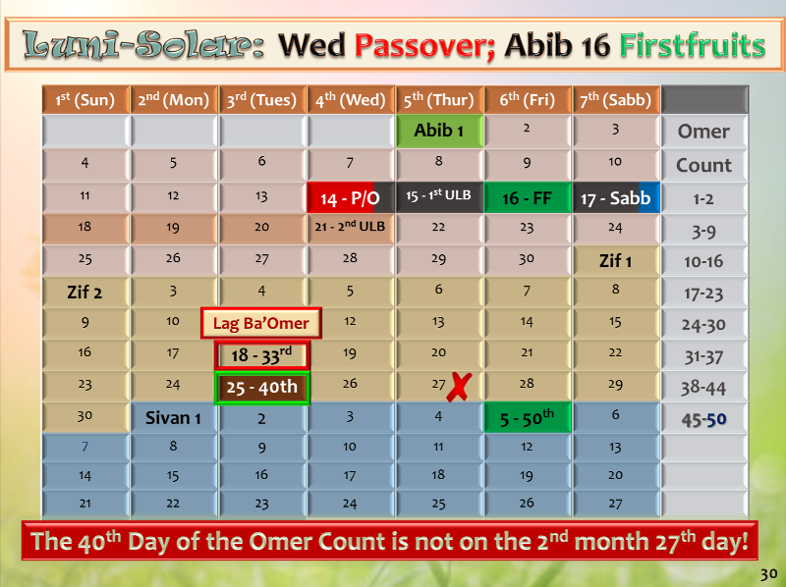
27th Day of 2nd Month:
[FALSE calendar]
Omer count #42.

Slide 51
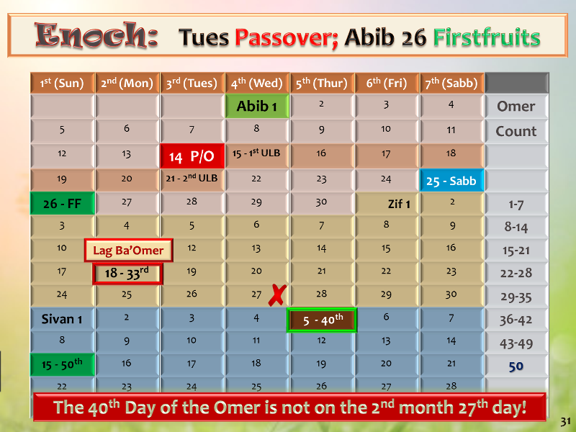
27th Day of 2nd Month:
[FALSE calendar]
Omer count #32.

Slide 52
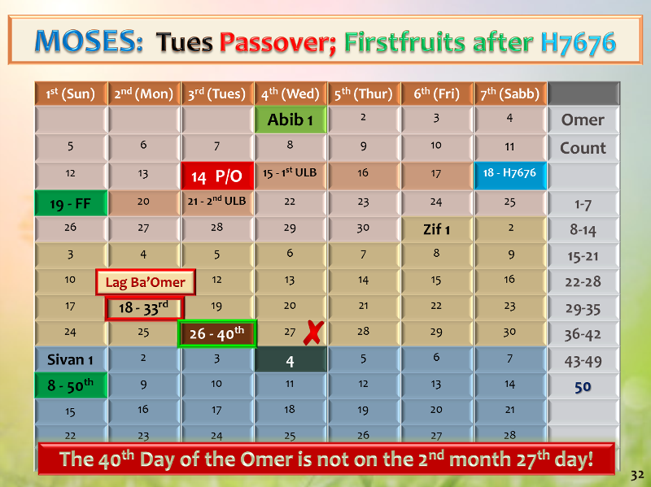
27th Day of 2nd Month:
[TRUE calendar]
Omer count #41.

Slide 53
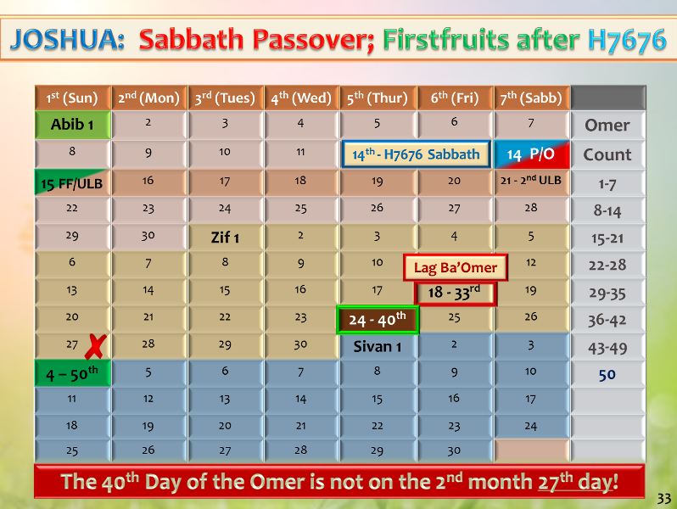
27th Day of 2nd Month:
[TRUE calendar]
Omer count #43.
Remember: Slide numbers on these slides are from the original teaching for easy reference.

Slide 54
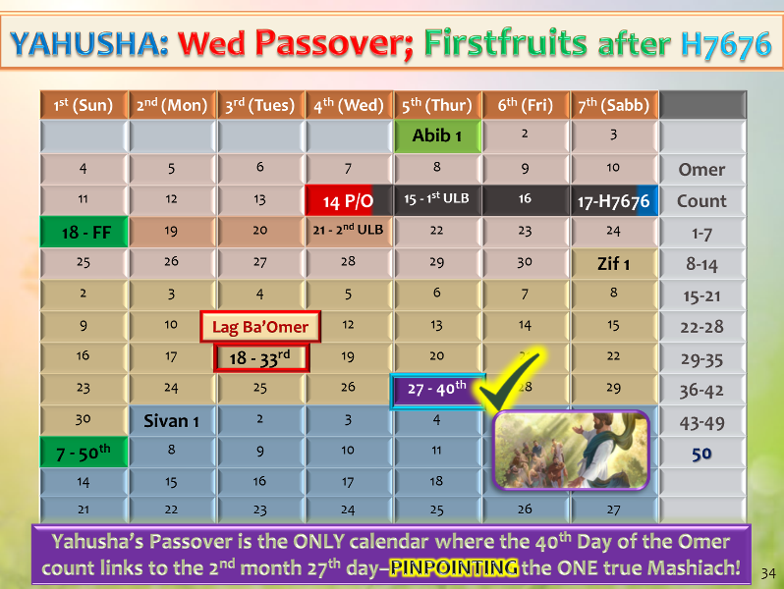

27th Day of 2nd Month:
[TRUE calendar]
Omer count #40.
27th Day of 2nd Month:
Omer count #40.

Slide 55
How does the 40th cycle of the Omer Count – SPECIFICALLY ON THE 27TH CYCLE OF THE 2ND MONTH -
have any connection to Yahusha Ha Mashiach?

Slide 56
Yahusha’s passion year on the Covenant Calendar is the ONLY combination that can satisfy ALL these requirements:
4th cycle cross;
3 days & 3 nights;
Sabbath Resurrection;
1st cycle Wavesheaf … and …
houses the 40th day of the Omer count on the 27th day of the 2nd month – the day of Yahusha’s 2nd ascension.

Slide 57

Why is the placement of this
40th day
so important, or is it
a secret?

Slide 58
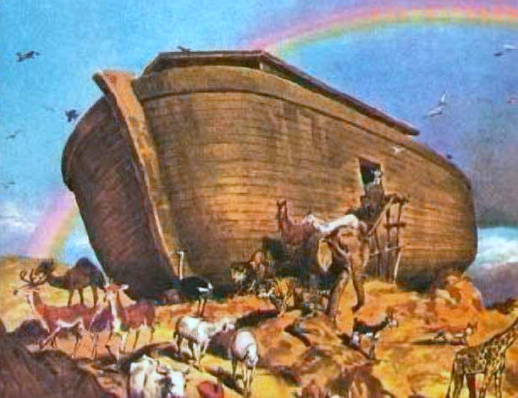
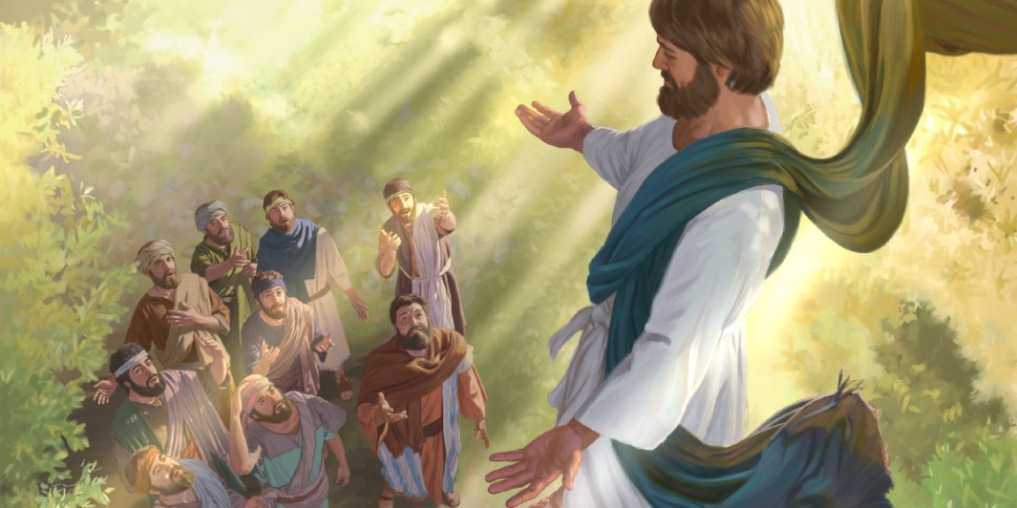
Gen 8:14-16 And in the second month, on the seven and twentieth day of the month, was the earth dried.
15 And [Yahuah] spake unto Noah, saying, 16 Go forth of the ark … KJV
What’s so special about the 27th day
of the 2nd month in Yahusha’s 2nd year?
Noah left the ark!
Acts 1:9-11 … while they beheld,
he was taken up; and a cloud received
him out of their sight.
10 And while they looked stedfastly toward heaven as he went up, behold,
two men stood by them in white apparel;
11 Which also said, Ye men of Galilee,
why stand ye gazing up into heaven?
this same Yahusha, which is taken up
from you into heaven, shall so come
in like manner as ye have seen him go
into heaven. KJV
It is no secret!
Yahusha left the earth!
When Noah EXITED the Ark, it was the TYPE pattern; this Qodesh Pattern was to be fulfilled by Yahusha in the Antitype!

Slide 59
Remember This Question About Noah?
Would Yahuah place calendar clues in Noah’s
flood account with alignment to Yahusha
?
2300 years before the cross
YEAR | MONTH | DAY | TEXT | COMMENT
1. 600TH | 2ND | 10TH | Gen 7:10 | Enter the Ark
2. 600TH | 2ND | 17TH | Gen 7:11 | Flood waters arrive
3. 600TH | 3RD | 27TH | Gen 7:17 | 40 days of rain
4. 600TH | (Month | Length) | Gen 7:24 Gen 8:3 | 5 months = 150 days
5. 600TH | 7th | 17th | Gen 8:4 | Ark rests on Ararat
6. 600TH | 10th | 1st | Gen 8:5 | Mountain tops are seen
7. 600TH | 11th | 10th | Gen 8:6 | Raven sent out
8. 600TH | 11th | 17th | Gen 8:10 | Dove sent out
9. 600TH | 11th | 24th | Gen 8:12 | Dove sent out again
10. 601ST | 1st | 1st | Gen 8:13 | Waters dried up
11. 601ST | 2nd | 27th | Gen 8:14 | Noah leaves ark
Do these clues solve the timeframe
for the Flood and the Exodus being in the spring
of the year?

Slide 60
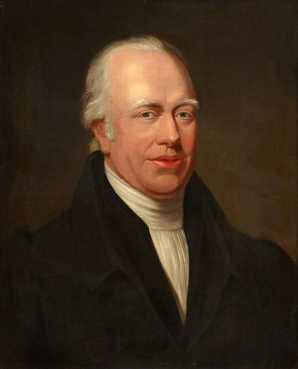
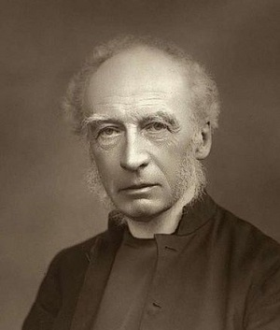
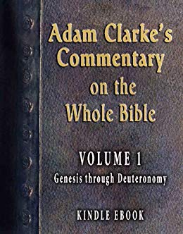

What is the verdict on Bible Commentators?
Every Bible Commentator
has to be aligned with Torah
for any calendar timeframes.
However, due to the strong influence of Judah’s counterfeit calendars and a reputation they are not worthy to have, many put their faith and trust in a variety of commentators.
Also remember, the Covenant Calendar
of the Gospels and Yahusha’s ministry
must align with Torah.
Covenant Calendar will continue to detect and reveal counterfeit teachings.

Slide 61

Conclusion: The manna week is indeed found in the 2nd month
of the Festal Calendar!
2nd Month (Quail & Manna)
1st [Sun] | 2nd [Mon] | 3rd [Tues] | 4th [Wed] | 5th [Thur] | 6th [Prep] | Sabbath
26 #8 | 27 #9 | 28 #10 | 29 #11 | 30 #12 | 1 #13 | 2 #14
3 #15 | 4 #16 | 5 #17 | 6 #18 | 7 #19 | 8 #20 | 9 #21
10 #22 | 11 #23 | 12 #24 | 13 #25 | 14 #26 | 15 Sin Wilderness #27 | 16 Murmuring #28
17 1st Manna Day #29 | 18 2nd Manna Day #30 | 19 3rd Manna Day #31 | 20 4th Manna Day #32 | 21 5th Manna Day #33 | 22 6th Manna Day #34 | 23 No Manna #35
24 #36 | 25 #37 | 26 #38 | 27 #39 | 28 #40 | 29 #41 | 30 #42
End of this Bunny Trail!
Exo 16:2

Slide 62
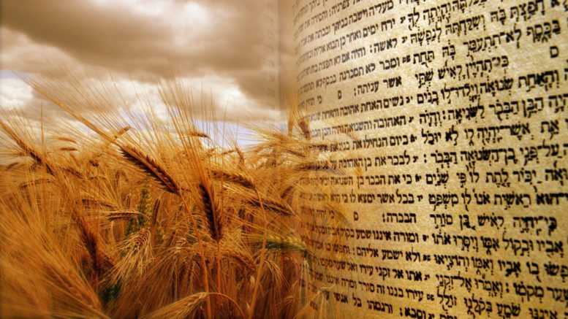
Next up: A comparison to an alternate Omer Count recognized as correct by some feast keepers
looking for a wheat harvest.
Are you ready
to go on a …
to examine another counterfeit Pentecost count?

Slide 63




Shall we count to 50 or 99 for Pentecost?
#4
Section #11

Slide 64


Campsite #11
Introduction
Mt Sinai is the 11th camping place out of
the 42 camp sites on the way to Canaan.
Israel was encompassed by pagan nations on every side – being held at bay by the divine protection of the Pillars of Cloud and Fire.
The root word for “Sinai” means
“tares, thorns and demons.”
In the Syric language, “Sinai” means
“to shine as the moon,” which was an
object of worship in this area.

Slide 65
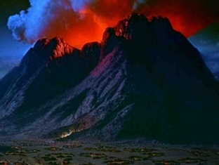
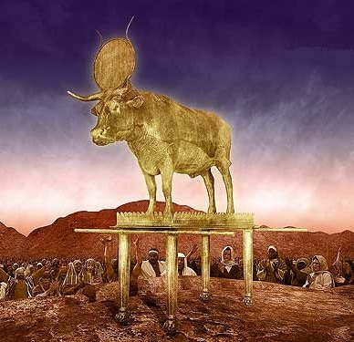
Campsite #11
In the New Testament these
root meanings link to “anti-christ.”
Yahuah chose this spot to proclaim Himself
as the highest Elohim with plans to bring
Israel into everlasting Covenant with Him –
to which they agreed, (for a very short time).
It was at this spot where His Pentecost Fire rained down upon Mt Sinai.
And it was at this spot where Aharon erected the Golden Calf idol on an altar (that still stands today) giving credit to the false trinity gods – most definitely including moon goddess worship!
Also in these very same verses of Exodus is where multiple COUNTERFEITS
are taught as the
TRUE Shavuot timing.

Slide 66
Alternate Pentecost Count In Torah?
Lev 23:10-11, 15-16
10 When ye be come into the land which I give unto you, and shall reap the harvest thereof, then ye shall bring a sheaf of the firstfruits of your harvest unto the priest:
11 And he shall wave the sheaf before Yahuah, to be accepted for you: on the morrow after the sabbath the priest shall wave it.
And ye shall count unto you from the morrow after the sabbath, from the day that ye brought the sheaf of the wave offering; seven sabbaths shall be complete: (Would that be 7 x 7 = 49 days for the “first part” of the count?)
Even unto the morrow after the
seventh Sabbath [The 49th day?] shall ye number fifty days ; (Add another
50 days? eg: Would that be: 49 + 50 = 99 days to the Pentecost count??)
66

Slide 67

Some say the Pentecost count
extends to 99 days ~ not 50 days!
COMPARE
1st Month (Passover in Egypt)
1st [Sun] | 2nd [Mon] | 3rd [Tues] | 4th [Wed] | 5th [Thur] | 6th [Prep] | Sabbath
 |  |  | 1 New Year Day | 2 | 3 | 4
5 | 6 | 7 | 8 | 9 | 10 Lamb Chosen | 11
12 | 13 | 14 Passover | 15 [ULB #1] 1ST Day Journey | 16 [ULB #2] 2nd Day Journey | 17 [ULB #3] 3rd Day Journey | 18 [ULB #4] Day of Praise!
19 [ULB #5] WAVE SHEAF Omer #1 | 20 [ULB #6] #2 | 21 [ULB #7] #3 | 22 #4 | 23 #5 | 24 #6 | 25 #7
26 #8 | 27 #9 | 28 #10 | 29 #11 | 30 #12 | 1 | 2
Keep in mind:
some counterfeit Wave Sheaf Omer Counts begin on
the 16th.
1
Where will this “99” teaching lead to?

Slide 68
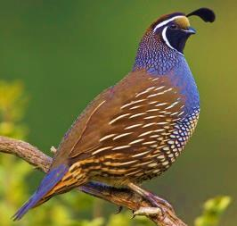
COMPARE
First we will count the 7 completed weeks including 7 weekly Sabbaths.
2nd Month (Quail & Manna)
1st [Sun] | 2nd [Mon] | 3rd [Tues] | 4th [Wed] | 5th [Thur] | 6th [Prep] | Sabbath
26 #8 | 27 #9 | 28 #10 | 29 #11 | 30 #12 | 1 #13 | 2 #14
3 #15 | 4 #16 | 5 #17 | 6 #18 | 7 #19 | 8 #20 | 9 #21
10 #22 | 11 #23 | 12 #24 | 13 #25 | 14 #26 | 15 Sin Wilderness #27 | 16 Murmuring #28
17 1st Manna Day #29 | 18 2nd Manna Day #30 | 19 3rd Manna Day #31 | 20 4th Manna Day #32 | 21 5th Manna Day #33 | 22 6th Manna Day #34 | 23 No Manna #35
24 #36 | 25 #37 | 26 #38 | 27 #39 | 28 #40 | 29 #41 | 30 #42
2
3
4
5
6
68

Slide 69
The 7 completed weeks & 7 weekly Sabbaths are now counted & = 49 days.
COMPARE
3rd Month (Doing “what” at Mt Sinai?)
1st [Sun] | 2nd [Mon] | 3rd [Tues] | 4th [Wed] | 5th [Thur] | 6th [Prep] | Sabbath
1 #43 | 2 #44 | 3 #45 | 4 #46 | 5 Trip #2 #47 | 6 Trip #3 “today” #48 | 7 “tomorrow” #49
Did Mosheh still need to make these trips up the mountain?
7 Wks
49 Days
1
2
What happened to counting “the 3rd day” that follows “tomorrow”?
The 3RD Day??
56 Days
8 #50 | 9 #51 | 10 #52 | 11 #53 | 12 #54 | 13 #55 | 14 #56
15 #57 | 16 #58 | 17 #59 | 18 #60 | 19 #61 | 20 #62 | 21 #63
22 #64 | 23 #65 | 24 #66 | 25 #67 | 26 #68 | 27 #69 | 28 #70
29 #71 | 30 #72 (~June 18) | 1 | 2 | 3 | 4 | 5
63 Days
70 Days
72 Days

Slide 70
We are now at 72 days
and still counting to the 99th day!
COMPARE
4th Month (~June 19th to July 19th)
1st [Sun] | 2nd [Mon] | 3rd [Tues] | 4th [Wed] | 5th [Thur] | 6th [Prep] | Sabbath
29 #71 | 30 #72 (~June 18) | 1 #73 | 2 #74 | 3 #75 | 4 #76 | 5 #77
6 #78 | 7 #79 | 8 #80 | 9 #81 | 10 #82 | 11 #83 | 12 #84
13 #85 | 14 #86 | 15 #87 | 16 #88 | 17 #89 | 18 #90 | 19 #91
19 #92 | 20 #93 | 21 #94 | 22 #95 | 23 #96 | 24 #97 | 25 #98
26 #99 (~July 15) | 27 | 28 | 29 | 30 | 1 | 2
77 Days
84 Days
91 Days
98 Days
99th Day
The 99th day is the 26th day of the 4th month (~July 15th) claimed to be the wheat harvest!

Slide 71
COMPARE
4th Month Review (~June 19th to July 19th)
1st [Sun] | 2nd [Mon] | 3rd [Tues] | 4th [Wed] | 5th [Thur] | 6th [Prep] | Sabbath
29 #71 | 30 #72 (~June 18) | 1 #73 | 2 #74 | 3 #75 | 4 #76 | 5 #77
6 #78 | 7 #79 | 8 #80 | 9 #81 | 10 #82 | 11 #83 | 12 #84
13 #85 | 14 #86 | 15 #87 | 16 #88 | 17 #89 | 18 #90 | 19 #91
19 #92 | 20 #93 | 21 #94 | 22 #95 | 23 #96 | 24 #97 | 25 #98
26 #99 (~July 15) | 27 | 28 | 29 | 30 | 1 | 2
77 Days
84 Days
91 Days
98 Days
99th Day
On the surface, this 99 day count may not seem to be a problem. Next we will overlay the events of Mosheh from Exo 24 & Exo 32 to see what happens.

Slide 72

Review of Events in Exodus 19 – 20:20 (3rd Month)
19:6 Yahuah proposes His covenant to the people.
19:8 The people agree to come into covenant –
this is the 1st acceptance.
19:10 Sanctify themselves “today & tomorrow” [6th & 7th days of the 3rd month] … wash & be ready by the 3rd day!
19:11 On the 3rd day [8th day of 3rd month] the people
are to meet around the base of Mt Sinai – clean!
20:1-17 People meet [on the 8th day of 3rd month] to hear
the first 10 “Words” of Yahuah’s Covenant.
20:18-20 [8th day] People are frightened and beg
Mosheh to “go up the mount” to get the remaining “Words of the Covenant.”

Slide 73

Review of Events in Exodus 20:21 – 24:11
20:21 - 23:33 [Still the 8th day – 1st cycle - Sunday]
  Mosheh “goes up the mount” [trip #5] to get the
  remaining “Words of the Covenant” for the people.
24:1-8 [Still the 8th day – 1st cycle - Sunday]
  Mosheh speaks the rest of the Words of the Covenant
  to the people – 2nd acceptance for Yahuah’s Covenant;
  Mosheh writes these laws in the Book of the Covenant;
  Moses reads the Covenant Words to the people;
  people give 3rd acceptance for Yahuah’s Covenant;
  the Book of the Covenant was then blood ratified;
  the people are sprinkled with blood.
24:9-11 [approx. 9th & 10th days – 2nd & 3rd cycle - Mon & Tue]
  a total of 75 elders journey part way up Mt Sinai
  to partake of the Covenant Confirming Meal.
(8th day; 3rd Month)
Shavuot [Pentecost]
50th Day from
Wave Sheaf
Appointment Pattern
Remember, this is the -
Let’s chart these events on the calendar months.

Slide 74


1st [Sun] | 2nd [Mon] | 3rd [Tues] | 4th [Wed] | 5th [Thur] | 6th [Prep] | Sabbath
1 #43 | 2 #44 | 3 #45 | 4 #46 1st day in the Wilderness of Sinai Exo 19:1 | 5 #47 Trip #2 Mt Sinai Exo 19:2 | 6 #48 Trip #3 “today” Exo 19:10 | 7 #49 “tomorrow” Exo 19:10
8 #50 Trips 4-5 “the 3rd Day” & Shavuot Exo 20:1 – 24:8 | #51 Trip 6a “75 elders meet in Mt Sinai” Exo 24:9-10 | #52 “75 elders eat covenant meal” Exo 24:11 | 11 #53 Trip 6b | 12 #54 | 13 #55 | 14 #56
15 #57 | 16 #58 | 17 #59 Trip 6c | 18 #60 | 19 #61 | 20 #62 | 21 #63
22 #64 | 23 #65 | 24 #66 | 25 #67 | 26 #68 | 27 #69 | 28 #70
29 #71 | 30 #72 (~June 18)
3rd Month (Detail of Events & Counting to 99)
50th Day
Mosheh gives instructions to Aharon. [Exo 24:14]
Together Mosheh & Joshua prepare to go further up Mt Sinai for the next 7 days. [Exo 24:12-16a]
Moses leaves Joshua on day 7 to ascend to the top. [Exo 24:16b-17]
Moses will be UP in Mt Sinai for the
next 40 days & 40 nights. Exo 24:18
4 Days
11 Days
13 Days
Mosheh was UP in the consuming fire of Mt Sinai for
the last 13 days of the 3rd month. [See Exo 24:17.]

Slide 75



1st [Sun] | 2nd [Mon] | 3rd [Tues] | 4th [Wed] | 5th [Thur] | 6th [Prep] | Sabbath
29 #71 | 30 #72 (~June 18) | 1 #73 | 2 #74 | 3 #75 | 4 #76 | 5 #77
6 #78 | 7 #79 | 18 #80 | 9 #81 | 10 #82 | 11 #83 | 12 #84
13 #85 | 14 #86 | 15 #87 | 16 #88 | 17 #89 | 18 #90 | 19 #91
20 | 21 | 22 | 23 | 24 | 25 | 26
27 #99 (~July 15) | 28 | 29 | 30
4th Month Events (~June 19th to July 18th)
13 Days
18 Days
Mosheh will be staying UP in the consuming fire of Mt Sinai
for the first 27 days of the 4th month. [See Exo 24:17.]
25 Days
In the meantime, Aharon is fashioning a golden calf for worship. [See Exo 32:1-6.]
32 Days
#98
#92
#93
#94
#95
#96
#97
39 Days
#99
27th day [4th month]: Mosheh completes the 40th day [Exo 24:18].
Mosheh [with the tablets] meets Joshua to return to camp –
only to find [on the 99th day of the counterfeit Pentecost count]
the camp is worshipping a golden calf!
40th Day!
99th Day

Slide 76


1st [Sun] | 2nd [Mon] | 3rd [Tues] | 4th [Wed] | 5th [Thur] | 6th [Prep] | Sabbath
29 #71 | 30 #72 (~June 18) | 1 #73 | 2 #74 | 3 #75 | 4 #76 | 5 #77
6 #78 | 7 #79 | 18 #80 | 9 #81 | 10 #82 | 11 #83 | 12 #84
13 #85 | 14 #86 | 15 #87 | 16 #88 | 17 #89 | 18 #90 | 19 #91
20 #92 | 21 #93 | 22 #94 | 23 #95 | 24 #96 | 25 #97 | 26 #98
27 #99 (~July 15) | 28 | 29 | 30
4th Month Events in Question
Exo 32:4 “These be thy gods, O Israel, which brought thee up out of the
land of Egypt!”
Is it feasible for a 99 Day Omer Count to be genuine for the giving of the Stone Tablets?
18 Days
25 Days
Aaron’s
Calf
32 Days
99th Day
39 Days
This ‘golden calf’ actually represents the full worship of the false trinity!
Round Disc = Nimrod/Baal [sun god];
Altar = Semiramis/Ashtoreth [moon goddess]; Calf = Tammuz [false messiah]!
40th Day!

Slide 77



The children of Israel fell into idolatry by worshipping the pagan trinity, while professing to worship Yahuah.
Many are temped by this same false worship today.
When rebellious worship is offered to Yahuah as the pagans worship their false gods, can Yahuah’s Ruach continue to dwell in
their “soul temple”?
Say “no”
to 99!

Slide 78

Reason #1 to say “no” to
the 99 day Omer count ~
~ it honors the
golden calf!

Slide 79

Is there another witness against this 99 day Omer Count that needs to be considered?

Slide 80




From the Words of the SEPTUAGINT
Lev 23:15-16
And ye shall number to yourselves from the
day after the Sabbath, from the day on which
ye shall offer the sheaf of the heave-offering, seven full weeks:
until the morrow after the last week ye shall number fifty days,
and shall bring a new meat-offering to Yahuah.

Slide 81

True Pentecost Count In Torah
Lev 23:10-11, 15-16
10 When ye be come into the land which I give unto you, and shall reap the harvest thereof, then ye shall bring a sheaf of the firstfruits of your harvest unto the priest:
11 And he shall wave the sheaf before Yahuah, to be accepted for you: on the morrow after the sabbath the priest shall wave it.
And ye shall count unto you from the morrow after the sabbath, from the day that ye brought the sheaf of the wave offering; seven sabbaths shall be complete: (Would that be 7 x 7 = 49 days for the first part of the count?)
Even unto the morrow after the seventh Sabbath [The 49th day?] shall ye number fifty days ; (Add another 50 days? eg: Would that be: 49 + 50 = 99 days to the Pentecost count??)
Let’s consider the Hebrew word for
UNTO, H5704 - “ad”
ע ד
81

Slide 82

~ UNTO ~
BLB
EDHL –
1. – to, unto, up to, even to,
2. – eternity, perpetuity
3. – booty, (to tear away)
4. – witness, testimony
5. – menstruation (the cloth)
preposition
as far as, even to, until, up to, while, as far as
  of space
    as far as, up to, even to
  in combination
    from...as far as, both...and (with 'min' - from)
  of time
    even to, until, unto, till, during, end
  of degree
    even to, to the degree of, even like
    conjunction
until, while, to the point that, so that even

Slide 83


~ UNTO ~
Gesenius’
Lexicon
Definitions must be chosen according to context!

Slide 84



Gesenius con’t
A limiting border is established at the referenced article!
Lev 23:15 SEVEN COMPLETED SABBATHS …

Slide 85


Gesenius con’t
AGAIN – AN ESTABLISHED REFERENCE
POINT with a RESTRICTION!
Lev 23:15 SEVEN COMPLETED SABBATHS …

Slide 86
What is the Divine Statute INSTRUCTION that we are to consider with this highly defined point of reference?
The SEVEN COMPLETED SABBATHS! [Lev 23:15].
Lev 23:16 UNTIL the MORROW AFTER …
(at the point of the subsequent 24 hour period following;
in other words – when your walk to Hawaii encounters the west coast of North America, your WALK stops!)
Lev 23:16 Until the morrow after the SEVENTH SABBATH …

Slide 87


Lev 23:16 … you count fifty day.
Hey Author! Don’t you know English requires an “S” here?
Oh Sure! But the original Hebrew does not indicate a plurality!
Lev 23:16 makes no mistake that this precise day after the 7th completed Shabbath is specifying ONLY ONE HIGHLY PARTICULAR
24 HOUR CYCLE!
YOWM! - Not Yowmim (plural)

Slide 88
What if the translators considered the singular Hebrew grammar effect and …
On the morrow after the 7th completed Sabbath …
Lev 23:16 … you count fifty day.

Slide 89




Lev 23:16 … you count
DAY FIFTY!
On the morrow after the 7th completed Sabbath …
One SPECIFIC YOWM!
Shavuot ~ Yahuah’s Harvest
according to (Hebrew) Torah statute.

Slide 90
Another Witness From the Words of Acts
Acts 1:3-4
To whom also He shewed Himself alive after His passion by many infallible proofs, being seen of them forty days, and speaking of the things pertaining to the kingdom of Yahuah:
And … commanded them that they should not depart from Jerusalem, but wait for the promise of the Father.
Acts 2:1-4
And when the day of Pentecost was fully come, they were all with one accord in one place. And suddenly there came
a sound from heaven as of a rushing mighty wind, and it filled all the
house where they were sitting.
And there appeared unto them cloven tongues like as a fire, and it sat upon each of them. And they were all filled with the Ruach ha Qodesh …

Slide 91

What does this
witness from Acts prove?
Absolutely Nothing … at this time!

Slide 92

The answer will be found in the
voyage of
a ship.
(Coming soon in a future study.)

Slide 93

Reason #2 to say “no” to
the 99 day Omer count ~
~ it does not honor the
original Hebrew intent!

Slide 94
The 99 Day
Summary
Count
… is also being taught by some Lunar-Sabbath feast keepers.
Why? Because most feel barley is the Wave Sheaf grain, so they are seeking a summer wheat harvest for Shavuot without realizing the wheat [fine flour] for Wave Sheaf is from the former year’s winter seeding. As a result there is wheat for the 50 day Shavuot Omer Count ~ no problem!
Moon
Locked
Calendar!

Slide 95




.
Yahusha as a Kernel of Wheat
1st (Sun) | 2nd (Mon) | 3rd (Tues) | 4th (Wed) | 5th (Thur) | 6th (Fri) | 7th (Sabb)
4 | 5 | 6 | 7 | 8 | 9 | 10
11 | 12 | 13 | 14 P/O | 15 ULB | 16 ULB | 17 Ress.
18 W/S | 19 ULB | 20 ULB | 21 ULB | 22 | 23 | 24
REV
I
EW
John 12:23-24
And Yahusha answered them, saying, The hour is come,
that the Son of man should
be glorified. 24 Verily,
verily, I say unto you, Except a corn of wheat fall into the ground and die, it abideth alone: but if it die, it bringeth forth much fruit.
70 weeks of ministry ~ He’s the Wheat of the 49th year, and the Wave Sheaf of the 50th year!

Slide 96

Reason #3 to say “no”
to the 99 day Omer count ~
~ it does not honor
the Wave Sheaf!
Wheat Harvest!

Slide 97


Reason #4 to say “no”
to the 99 day Omer count ~
The
It removes
Eh-Tzem
from the Wave Sheaf
~ by not honoring every Torah statute
Mo-edim
Rev 18:4 Come out of her my people!

Slide 98
Future studies still to be addressed:
Enoch’s two main reasons for choosing Abib 26
and the problems with this “locked” calendar.
How about a “2 Part” SURPRISE TEACHING
challenging Enoch and verifying an anti-type of Yahusha?
Paul’s witness for Yahuah’s Pentecost Count …
is Paul’s count on a “locked” or “unlocked” calendar?
Note: There are still many things for comparison and consideration!
The End!

Slide 99


If you have Questions
&/or Comments
about this teaching,
please contact:
Timothy Astleford
tim@studythecalendar.com
calendar@torahtothetribes.com
Thank you!

