Slide 1


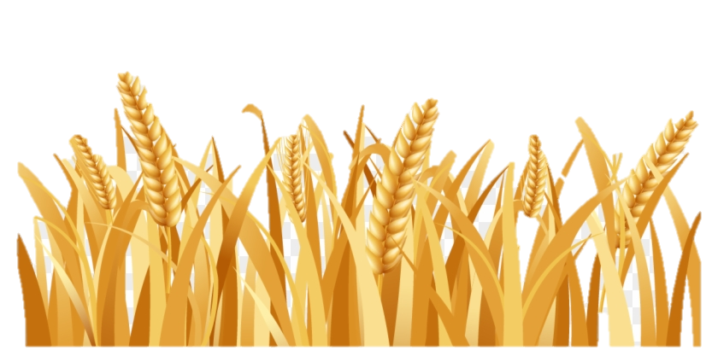
Part 3
The Song of Joshua’s Sickle
Pt 2 The Song of Joshua’s Sickle
Pt 3 The Song of Joshua’s Sickle

Slide 2
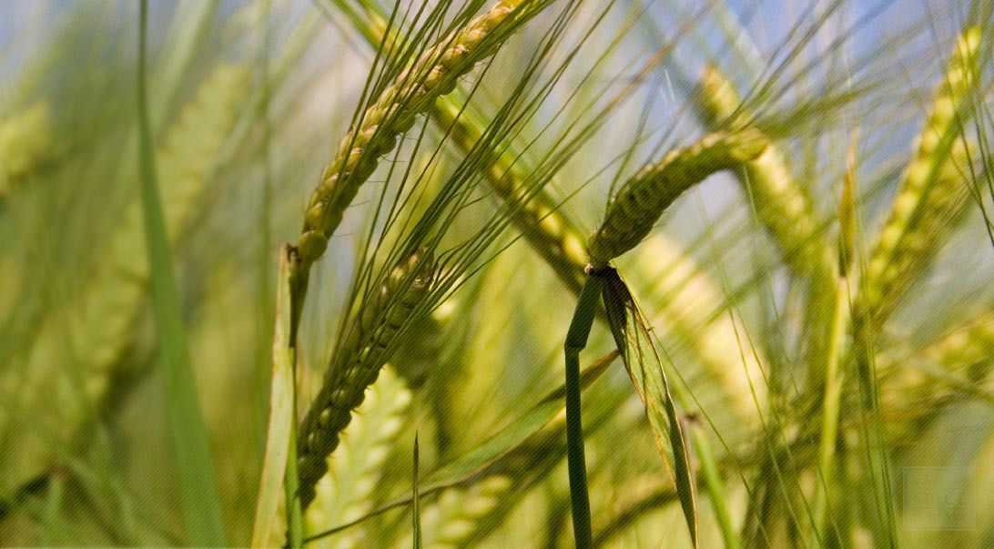

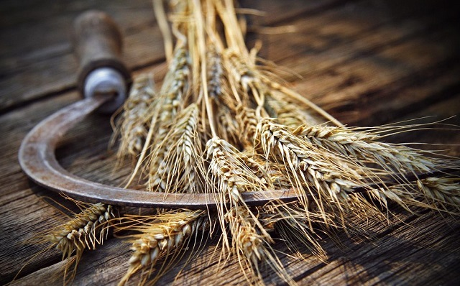
The Sickle’s of Harvest
Shavuot Connection
#2 The

Slide 3
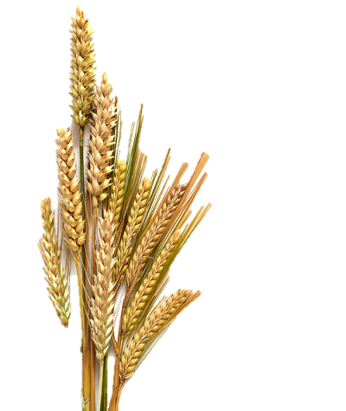
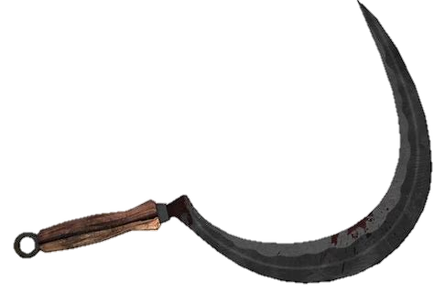



Part #3 Mapping the Discussion Topics
Section | Slides | Content of Topic
- | 4-7 | Short Review from Part 2
6 | 8-12 | Which Enoch Aligns with Yahuah’s Commands?
7 | 13-28 | What will the Sickle Harvest? Barley, or Wheat?
8 | 29-50 | The Harvest Sickle and “Typology” (?)
9 | 51-56 | Torah Statutes for the Omer Count
9.1 | 57-62 | Joshua and the Omer Count
9.2 | 63-68 | Enoch and the Omer Count
10 | 69-85 | [Bunny Trail #1] Lunar Count for Weekly Sabbath
There may be some interesting gems in today’s study!
From sickle,
to sheaves, to
counting 1–50!

Slide 4

Basic Pre-Summary From Parts 1 & 2
Yahuah’s requirements thus far:
1. Enter the land.
2. Observe Passover.
3. Cut the First Wheat - Wave Sheaf offering.
4. Roast & Grind Wheat; prepare a Flour and Oil Mixture.
5. Present the ascent offering (by fire) to Yahuah.
6. Bake Bread Dough for normal consumption.
7. Eat the Grain of the Land the day after Passover!
Fine
Only after the Wave Sheaf and the ascension offerings had been presented was it acceptable to Yahuah to consume the FIRST Grain of the Land! Josh 5:11 … AND THEY ATE …

Slide 5
YAHUAH’S EATING PROHIBITION COMMAND!
WHAT?
Lev 23:14 And you
DO NOT EAT
REVIEW
1
2
3
Timing?
bread or roasted grain or fresh grain
until the SAME DAY THAT YOU HAVE
BROUGHT AN OFFERING to your Elohim
Eh-Tzem
–a law forever throughout your generations in all your dwellings.
Yah’s Wave Sheaf: Abib 15th
Enoch’s: Abib 26th

Slide 6


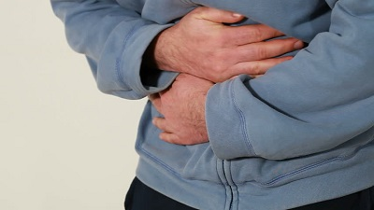
Yah’s Wave Sheaf: Abib 15th
1
No More Manna! Abib 16th
2
4
(… Wait 11 days!)
Enoch’s Wave Sheaf: Abib 26th
3
How hungry would Enoch’s people have been having to wait 11 days to eat & enjoy any of the harvest?!
REVIEW
Even MORE Serious:

Slide 7
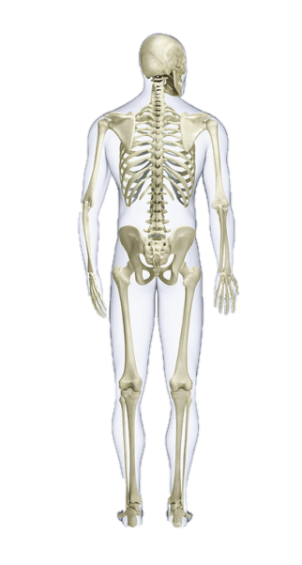
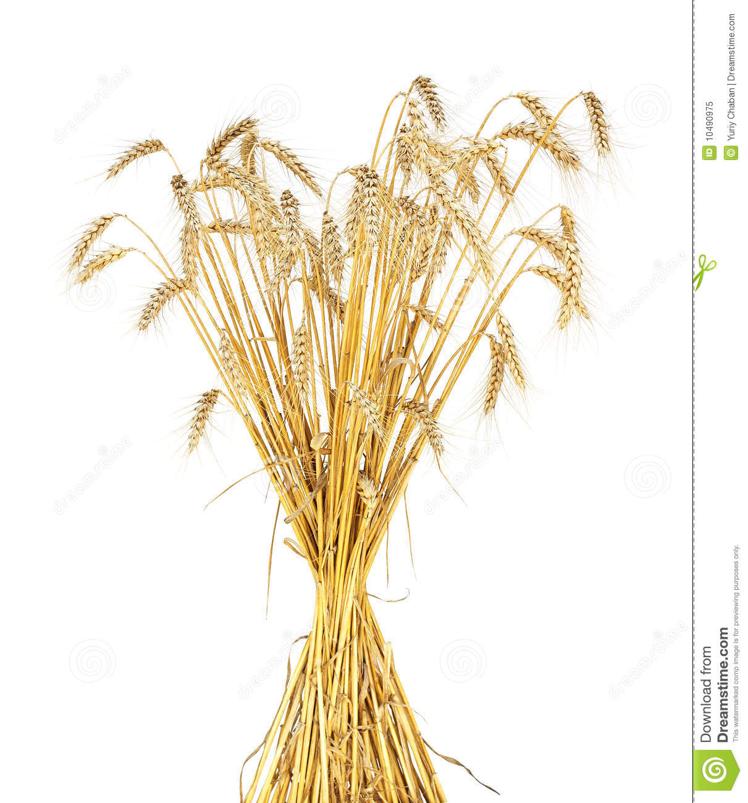
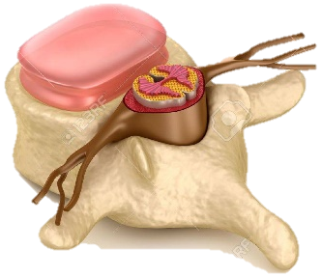
5
YES! ~ Even MORE Serious:
Even though Enoch’s 1st cycle of the week is the correct day for a Wave Sheaf – it’s just that Enoch is a week late for the anti-type event!
Enoch misplaces the very “essence & substance” of the Skeletal Structure of our Salvation!
The
Mo-edim
Eh-Tzem
Will there be more counterfeit witnesses exposing these Dead Sea Scroll calendars?

Slide 8
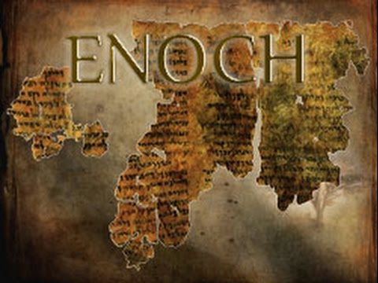
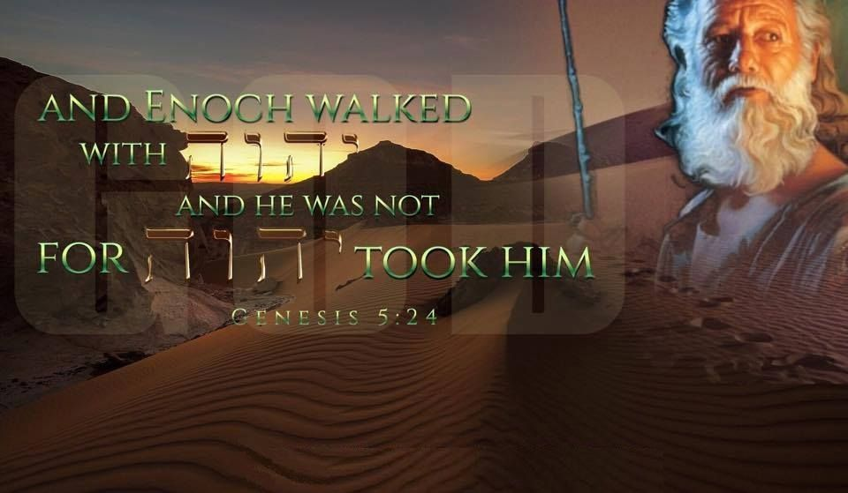
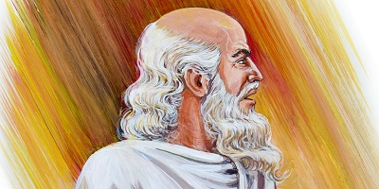

Section #6
Which Enoch is distinctly
in alignment with Yahuah?

Slide 9

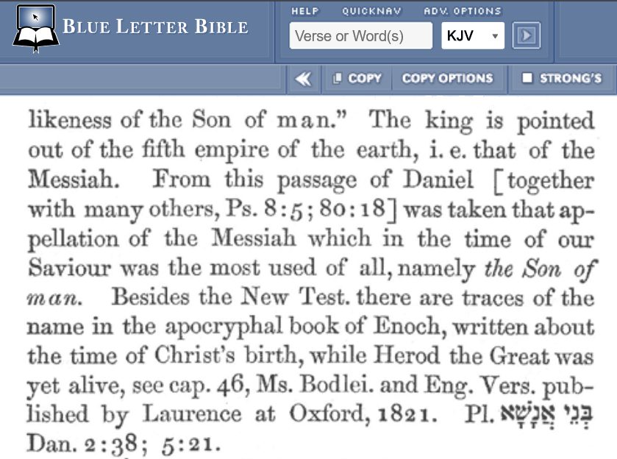
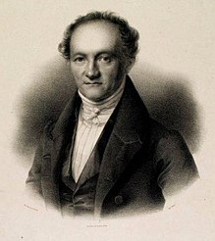
Before Moving Forward …
Some say the
Enoch that is the
7th from Adam is the author of the Book of Enoch.
Let’s compare this to
Gesenius’ Lexicon in
Blue Letter Bible.

Slide 10
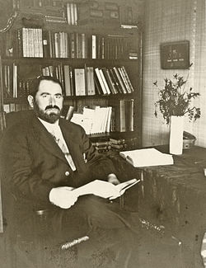
Still Moving Forward …
Julian Morgenstern has done incredible research in the area of “calendars.”
The Calendars of Ancient Israel, pg. 14
Hebrew Union College Annual Vol. X 1935
“Of the calendar of Enoch and Jubilees considerable is known, viz., that it was a theoretical and conventional solar calendar of three hundred and sixty four days to the year. Divided into quarters, each consisting of three months of thirty days each plus one additional, intercalary day, not reckoned to any one month; each such quarter year therefore consisted of ninety-one days or thirteen weeks …

Slide 11

Morgenstern [con’t] …
The Calendars of Ancient Israel, pg. 14
“Moreover, as is explicitly stated in Jubilees 6:23-38, this calendar was openly and aggressively non lunar in character and was designed to combat the program of those contemporary ritual authorities who sought to adjust the festivals to the conditions of a basically lunar calendar, undoubtedly Calendar III. But whether
this artificial and unreal solar calendar
of Enoch and Jubilees was likewise the calendar of these mandatory portions of P or of I & II Maccabees, is a question open to serious doubt.
“In all likelihood this calendar of Enoch and Jubilees was never actually observed; at least there is no definite evidence thereof. None the less the
very fact that such a calendar could have been seriously formulated, and
that not as a mere personal vagary but as a conscious attempt to combat the introduction, or at least the continued use of Calendar III, with its lunar system of dating the festivals, shows the extreme importance attached by the religious authorities of the late biblical and early post biblical periods …”

Slide 12
How Does “an” Enoch From “any” ‘Book of Enoch’
Have Alignment With Yahuah’s Calendar?
4000 | 3850 | 3550 | 3000 | 2550 | 2350 | 2000 | 1500 | 1000 | 500 BC
1-500 AD
Adam; Creation
Gen 4:17
Enoch?; “Seed” of Cain; 2nd from Adam
Three VERY DIFFERENT Enochs!
130 Yrs
622 Yrs
Enoch; “Seed” of Seth; 7th from Adam
Methuselah
687 Yrs
Gen 5:19
1056 Yrs
Noah; Flood Event
2000 Yrs
Abraham; Covenant
2550 Yrs
Moses; Exodus
3000 Yrs
Solomon
3300 Yrs
Hezekiah
Another
Enoch?
Which “Enoch” above could possibly be the author of the Book of Enoch?
Was this “Enoch” a follower of Yahuah’s Torah?
Does Enoch and his Book of Enoch have to be accountable to the
Calendar instructions as given by Moses in the Covenant portions of Torah?

Slide 13

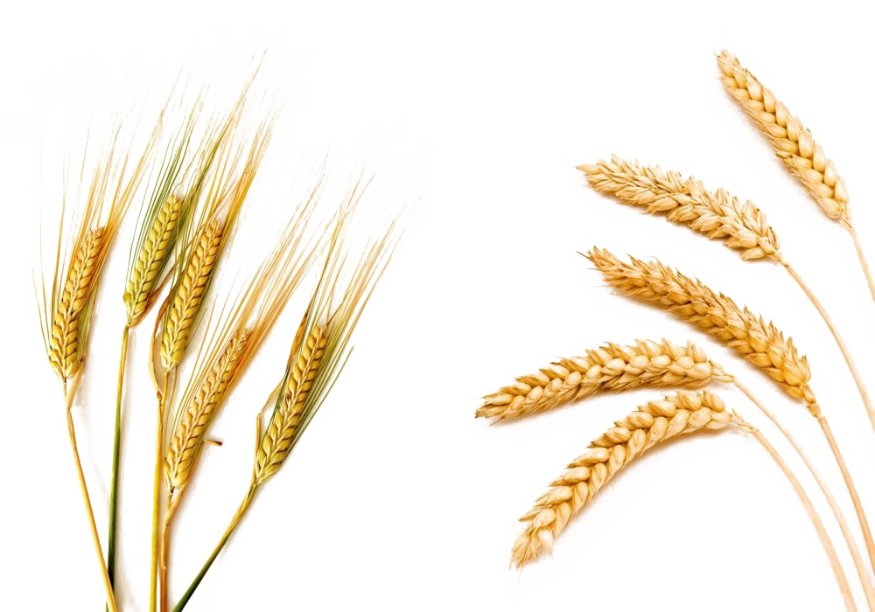
Section #7
The sickle will harvest the Wave Sheaf!
Barley?
or …
Wheat?
(The information in this section compliments of Avi ben Mordechai.)

Slide 14
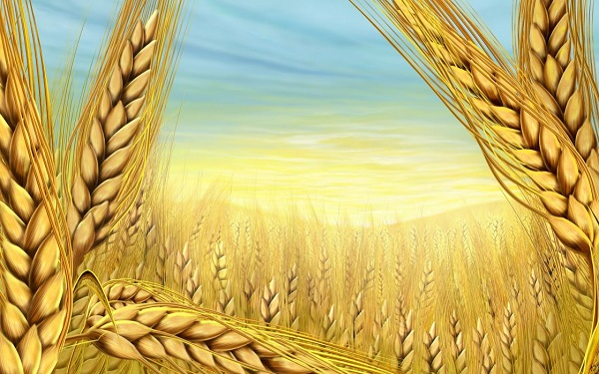
Many believe barley was the Wave Sheaf
grain according to Josephus. Is this correct?
Josephus writes in his compilation of Israelite history – Antiquities, Book 3, Chapter 10, Section 5 (Ant. 3.10.5), the following:
The feast of unleavened bread succeeds that of the Passover, and falls on the fifteenth day of the month, and continues seven days, wherein they feed on unleavened bread… But on the second day of unleavened bread, which is the sixteenth day of the month, they first partake of the fruits of the earth, for before that day they do not touch them. And while they suppose it proper to honor God, from whom they obtain this plentiful provision, in the first place, they offer the first fruits of their barley …

Slide 15

Question: Is so`leth barley?
Wave Sheaf grain according to Torah in Lev 23.
10 Speak unto the children of Israel, and say unto them, When ye be come into the land which I give unto you, and shall reap the harvest thereof, then ye shall bring a sheaf of the firstfruits of your harvest unto the priest:
13 And the meat [grain] offering thereof shall be two tenth deals of fine flour mingled with oil, an offering made by fire unto Yahuah for a sweet savour:
fine flour H5560 coleth (so'-leth); from an unused root meaning to strip; flour (as chipped off): KJV - (fine) flour, meal.
Answer: No!

Slide 16

Solet is not barley!
Solet is always finely crushed wheat.
Barley is se’orah, (solet’s antonym); rough and coarse!
Let’s have a look at Hebrew Scripture and identify the words that are connected to wheat: Solet and Chitah. First, let us look at solet:
2 Kings 7:1 Then Elisha said, “Listen to the word of Yahuah; thus says Yahuah, ‘Tomorrow about this time a measure of fine flour (solet) shall be sold for a shekel, and two measures of barley (se’orah) for a shekel, in the gate of Samaria.’ ”
So, what exactly is “solet”? Solet is what we would call today semolina. English translators use the phrase, “fine flour.”

Slide 17
Difference between solet and se’orah.
In the Septuagint (LXX), solet is semidalis.
In the Latin Vulgate, solet
is simila, both terms referring to finely ground wheat flour, not barley.
Solet is essentially what we would call “cream of wheat.
During wheat milling, the bran, germ and endosperm are separated and the endosperm breaks into grains of about 0.25mm – 0.75mm
in diameter.
These grains are further processed to produce fine wheat flour, also called
“choice flour” in the Bible.
Essentially, this is the best of the best
when it comes to the processing and breaking apart of the wheat kernel.

Slide 18
Solet is not se’orah and se’orah is not solet!
From the Scriptures it is clear to see that solet and se’orah
(wheat and barley) are two different varieties of flour.
They are different; and rightly, they should be.
Since solet is the fine flour of the processed wheat grain, then what
is the general term for “wheat” in Hebrew?
The biblical term is Chitah – Chet Tet Heh.
  wheat H2406 chittah (khit-taw'); of uncertain derivation; wheat,
  whether the grain or the plant: KJV - wheat (-en).

Slide 19
Chitah [Hebrew] for Wheat
The following passages specifically refer to chitah or wheat, in general:
2 Sam 17:27-28 Now when David had come to Mahanaim, Shobi the son of
Nahash from Rabbah of the sons of Ammon, Machir the son of Ammiel from Lo-debar, and
Barzillai the Gileadite from Rogelim, brought beds, basins, pottery, wheat (chitah), barley (se’orah), flour (kemach), parched grain, beans, lentils, parched seeds …
Deut 8:8 … a land of wheat (chitah) and barley (se’orah), of vines
and fig trees and pomegranates, a land of olive oil and honey …

Slide 20
Chitah is “Wheat” (not se’orah) and se’orah is not solet!
A summary of terms and their biblical definitions:
1. Chitah – Wheat
2. Solet – Wheat kernels ground up to make fine flour
3. Se’orah – Barley kernels
4. Kemach – Any kind of flour, specified if necessary in the biblical texts
by [either the use of “solet” or “se’orah”].
Solet is the chitah that has been broken up, ground up, and processed into fine flour.
Crushed barley is never fine, choice flour; barley is rough and coarse.
Solet is choice and creamy. It is this flour – the solet – that is always offered to, or is used in, the service and worship of Yahuah in the biblical texts …
There is one interesting exception …

Slide 21
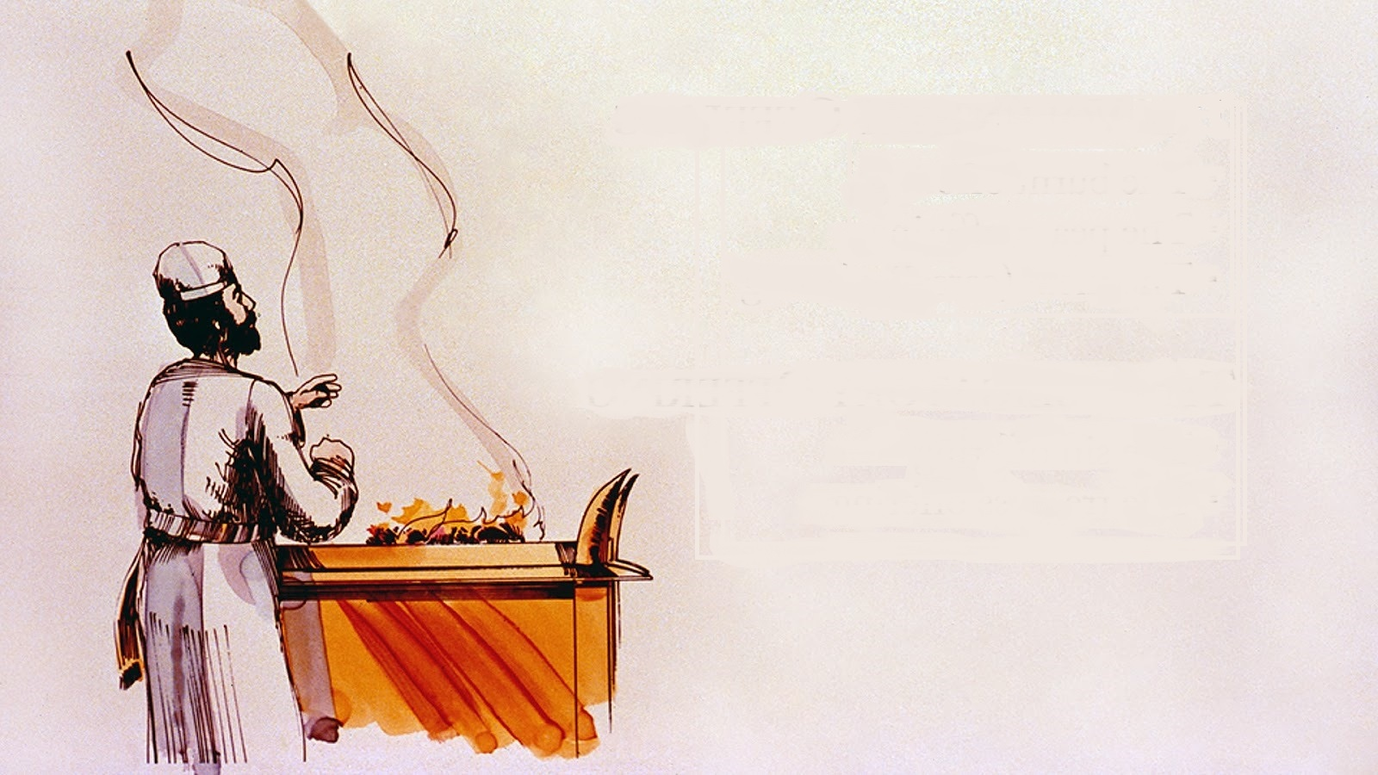

WHEAT for the Worship of Yahuah
When in the service
or worship of Yahuah
(Num 6:15, 7:13, 8:8; Exo 29:2), chitah (wheat) is the ordinance that stipulates
how we are to come before Yahuah when presenting a grain offering.
There is one exception in Num 5:15, where se’orah (barley) is chosen over chitah (wheat).

Slide 22
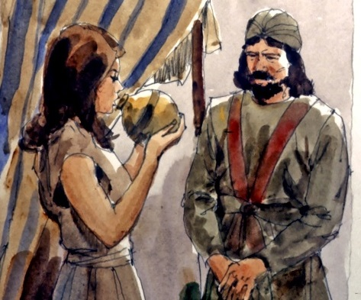
Barley and the Sotah (or Woman Suspected of Adultery)
The case where se’orah (barley) IS used in ancient Temple service and in the face of Yahuah, is in the instruction of the sotah; that is, the married woman that is suspected of committing adultery in Numbers 5:11-31.
Specifically, we learn that the mincha or grain offering for the sotah (the woman who is standing before Yahuah in the Temple, facing charges of adultery) is barley, and NOT wheat.
Numbers 5:15 … The man shall then bring his wife to the priest, and shall bring as an offering for her one-tenth of an ephah of barley meal (kemach se’orah); he shall not pour oil on it, nor put frankincense on it, for it is a grain offering (mincha) of jealousy, a grain offering (mincha) of a remembrance to make iniquity known.

Slide 23
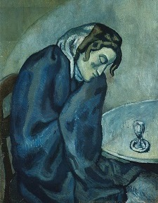
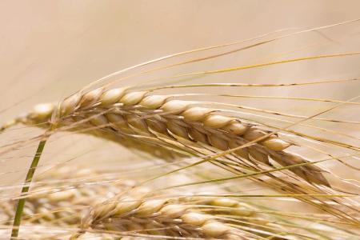
Barley and the Sotah (or Woman Suspected of Adultery con’t)
This barley grain offering was used to bring
the sin of the woman into the light; to make
it known; to cause Yahuah to remember it.
The woman – the sotah - was to stand in the face of Yahuah and his Kohen with barley because barley represents the flesh that does things “my way.”
The sotah’s se’orah (barley) offering appears
to symbolize the animal nature of the woman and not something that is offered in thanks to Yahuah for giving us the produce of
the Land.

Slide 24

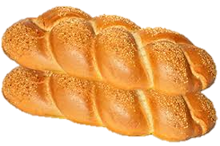
The Omer, which always starts the count to Shavuot, was supposed
to be taken from wheat (solet) and not barley (se’orah). At some point
in the halachic history of Israel, something changed and Judaism adopted barley as the offering to Yahuah and not wheat. But, beware! Why?
Some people will of course, say that the seven weeks of Shavuot – the Feast of Weeks – is metaphorically taking us from the waving of an Omer of Barley at Pesach (Passover)
to the waving of the two loaves
of wheat bread baked as bikkurim seven weeks
later at Pentecost.
[This is to say] that in Yahusha, our Kinsman Redeemer [at Passover], we are purchased and ostensibly “waved” before Yahuah as the first cutting or Raisheet K’tzir of se’orah (barley) and then with Pentecost, ostensibly [we are] presented as a “wave offering” of solet baked bikkurim – two wheat loaves.

Slide 25

Time to Get Rid of Confusion
Perhaps we are confusing the barley-to-wheat metaphor with the scriptural actuality of wheat-to-wheat and essentially hoping to preserve the doctrines of the east – Babylonian Judaism and its Oral Law.
Let’s preserve the p’shat – the
simple meaning of Scripture …
The se’orah mincha (barley grain offering) for the ceremony of the sotah was, “a remembrance to make iniquity known,” for an individual,
not a collective body.

Slide 26
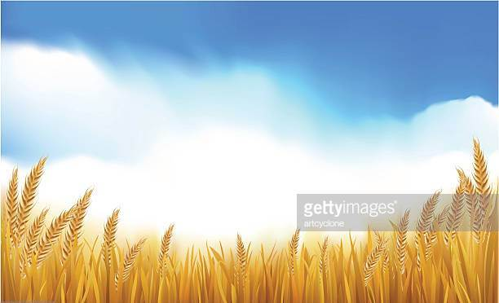
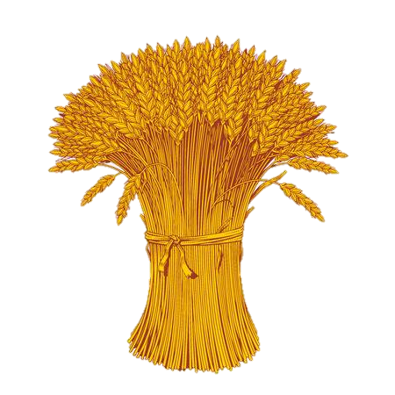
By continuing to offer an Omer of se’orah (barley) to Yahuah at the beginning of the count of the Omer, are we perhaps unknowingly agreeing to collectively give Yahuah something man-made?
Perhaps something inferior;
something that remembers the flesh?
Something that says to Him, “You get from us second best” – se’orah (animal food) and not fine, expensive wheat flour, so-to-speak?
Only our best for the master!
Wheat! Not barley!

Slide 27

Interesting Information from Avi ben Mordechai
With the declaration of Aviv barley behind us, we also would know that our wheat fields are also advancing towards the stage of Aviv, ripening
to their Aviv roughly in the next four or five weeks
that follows Aviv barley.
Hypothetically, this means that from about the middle of the twelfth month to
the middle of the new
first month, four weeks
will have gone by.
In that timeframe, Aviv wheat
could easily be ready for its
first cutting - Raisheet K’tzir.
Ostensibly, this means we could fulfill Deut 16:9 at about the time of Unleavened Bread and thus, there
would be no need to offer barley
to Yahuah.
Supposedly, there would be an
Omer of solet wheat (solet chitim) ready to offer in fulfillment of
Lev 2:1 and 23:13-14.
How would this information affect the barley calendar?

Slide 28
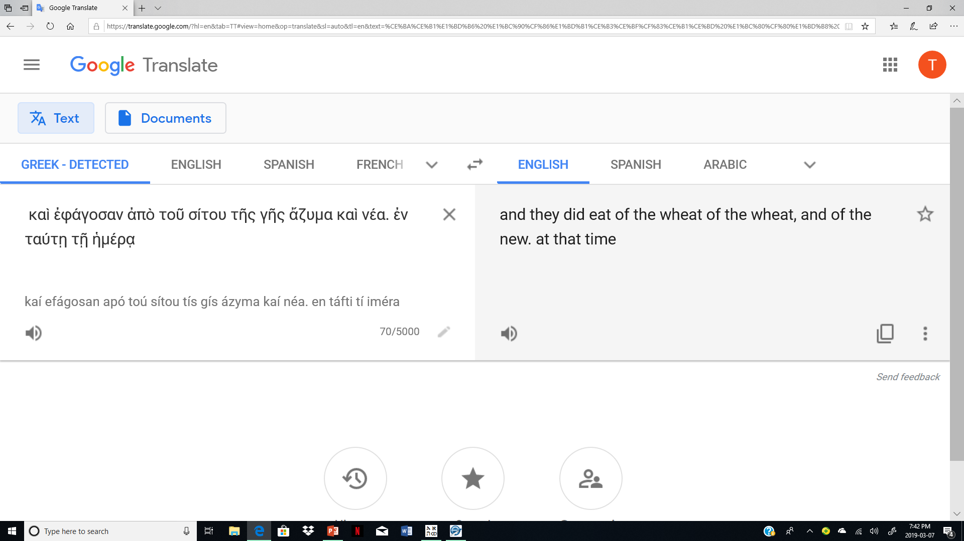
Isn’t it interesting that the Torah declares
“wheat” as the “fine flour” offering for Yahuah?
In Josh 5:11 the Septuagint also claims that Joshua ate WHEAT!
Not Barley, but WHEAT!
Let’s get back to the sickle!

Slide 29
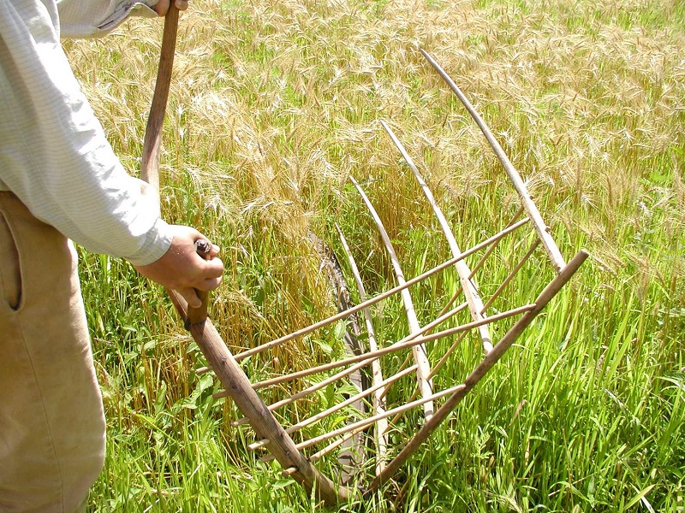
Section #8
What is the great Significance of the SICKLE & Shavuot?

Slide 30
Jer 50:16 “Cut off the sower from Baḇel, and him who handles the sickle at harvest time. From before the sword of the oppressor each one turns to his own people, and each one flees to his own land.”
Joel 3:13 “Put in the sickle, for the harvest
has grown ripe. Come, go down, for the winepress is filled,
the vats overflow, for their evil is great.”

Slide 31
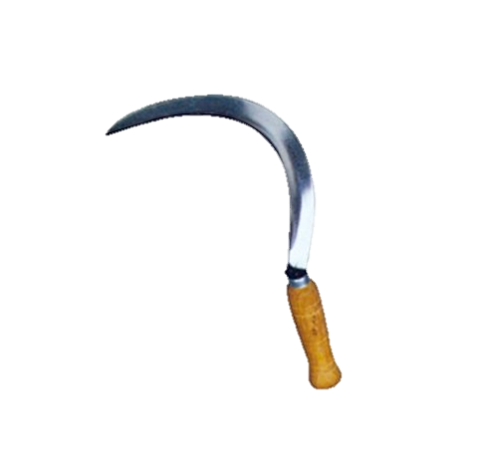
Mark 4:29 “And when the crop is ready, immediately he puts in the sickle, because the harvest has come.”
By 3 Scriptural witnesses, The Sickle is classified as
“part and parcel” with the harvest of a product.
Next … and of HIGH IMPORTANCE -
Will this OBSERVATION agree with the Torah
and explicitly - Joshua’s Wave Sheaf example??

Slide 32
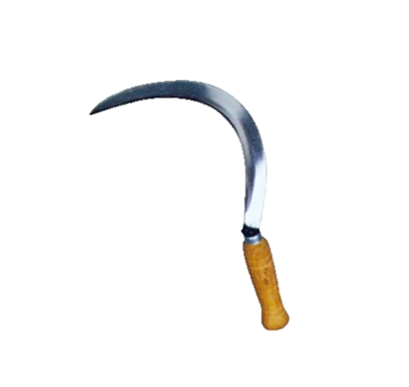


Lev 23:10 “Speak to the children of Yisra’ĕl, and you shall say to them, “When you come into the land which I give you, and shall reap its harvest, then you shall bring a sheaf of the first-fruits of your harvest to the priest.”
It is now time to ascertain the exact timing of the specific period ordained
by Yahuah for Joshua to BEGIN employing the sickle to the grain of the land.
The Qodesh Wave Sheaf offering of the First Cutting must be
submitted to Yahuah through the Wave Sheaf observation!

Slide 33
Two Witness Texts will be placed side by side, to expose a picture of explicit timing for Joshua to use the Sickle in Canaan – the FIRST TIME!
Lev 23:10 “Speak to the children of Yisra’ĕl, and you shall say to them, ‘When you come into the land which I give you, and shall reap its harvest, then you shall bring a sheaf
of the first-fruits of your harvest to the priest.’
Deut 16:9 Seven weeks shalt thou number unto thee; begin to number the seven weeks from such time as thou beginnest to put the sickle to the corn [grain].
What is the meaning of “begin” & “beginnest”?

Slide 34
Deut 16:9 Seven weeks shalt thou number unto thee; BEGIN to number the seven weeks …
The meaning of “begin” [H2490]:
ל
ח
ת
The word - tchal – BEGIN – Tov, Chet, Lamed – H2490.
The VERY START of a thing or action.
According to Yahuah’s command in Deut 16:9, WHEN the Yisra’elites started to
harvest the new standing grain of the land, at any day after arriving in Canaan,
THEY MUST THEN START the OMER COUNT! Hence it became ultra crucial for them to decide exactly when they were going to commence the of the standing grain.
HARVEST

Slide 35
Deut 16:9 Seven weeks shalt thou number unto thee; begin to number the seven weeks from such time as …
thou beginnest to put the sickle to the corn [grain].
The Hebrew word for “beginning” in Deut 16:9 is:
H2420 – Chalal – chet, lamed, lamed. It has many definitions.
The contextual definitions that apply here are –
    to begin, to be begun, to wound (fatally), bore through, bore, to be slain, pierce, to be wounded.
  A root word – H2470 Chalah – has a definition of – to be wounded.
The meaning of “beginnest” [H2420]:

Slide 36
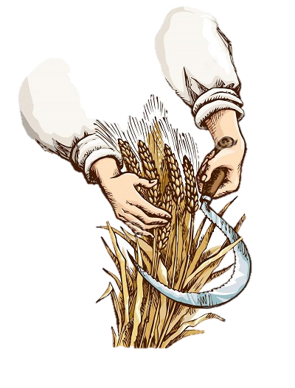
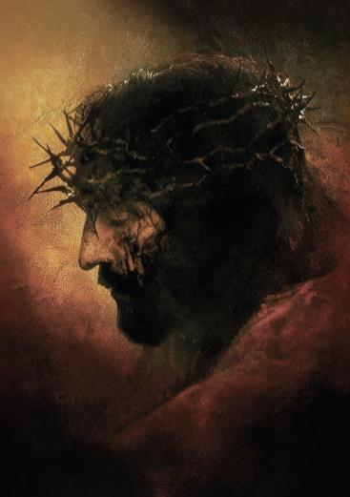
What RELEVANCE does “beginnest” [H2420] bear ~
WHEN … a SICKLE is applied to standing grain?
  The razor edge of the SICKLE imposes a
  fatal wound to the grain by piercing
  the outer protective layer of the stalks.
  Through the sharp edge of the SICKLE
  the grain is SLAIN.
  The LIFE in the stalks of grain is forcefully removed!

Slide 37
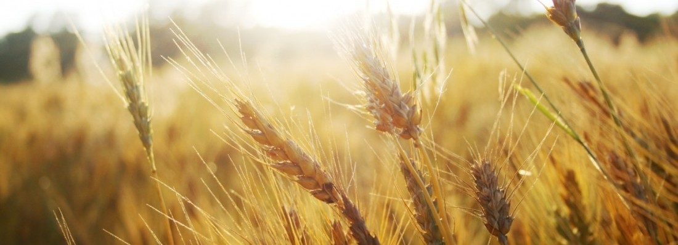
The PREMIER CUTTING of grain, the “First Fruit of Canaan” formed into a Wave Sheaf was “SLAIN.”
The LIFE was forcefully removed!
What did Yahuah require for this First Gathering of the Wave Sheaf?
Yahusha, THE WORD (the Torah) lived this
requirement in real time!
Yahusha was SLAIN; His LIFE removed!
Paul described Yahusha as THE FIRST FRUIT! [Rom 11:16]
Yahusha ascended on the cycle after the 7th day Sabbath to present Himself as the pure Wave Sheaf/First-Fruit offering.

Slide 38
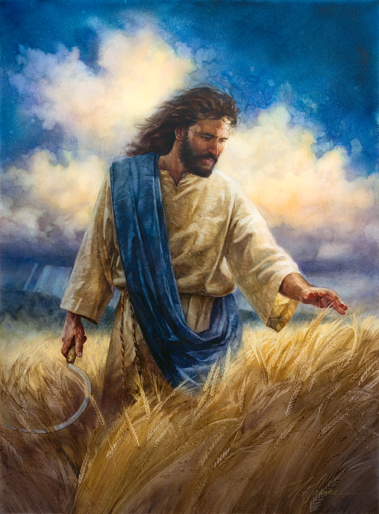
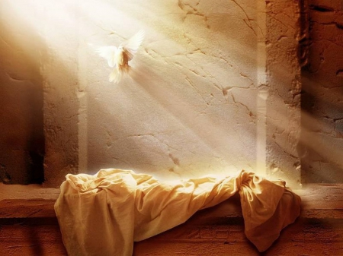
.
Yahuah’s Resurrection & Ascension
1st (Sun) | 2nd (Mon) | 3rd (Tues) | 4th (Wed) | 5th (Thur) | 6th (Fri) | 7th (Sabb)
4 | 5 | 6 | 7 | 8 | 9 | 10
11 | 12 | 13 | 14 P/O | 15 ULB | 16 ULB | 17 Ress.
18 W/S | 19 ULB | 20 ULB | 21 ULB | 22 | 23 | 24
REV
I
EW
John 12:23-24 And Yahusha answered them, saying, The hour is come, that
the Son of man should be glorified.
24 Verily, verily, I say unto you,
Except a corn of wheat fall into
the ground and die, it abideth alone:
but if it die, it bringeth forth much fruit.
These two very important events
did not occur on the same day!

Slide 39
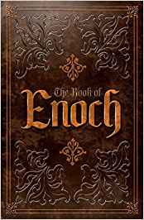
Can we safely accept the example of Yahusha’s living Passion Week
as the - ANTI-TYPE of Joshua’s
TYPOLOGY in Canaan?
Is this foundational concept also
rooted in Torah through Moses?
Thought to Ponder:
Will Enoch align with Torah’s typology?

Slide 40
Joshua’s “Typology”??
Merriam Webster Dictionary
  Typology
  noun ty·​pol·​o·​gy | \ tī-ˈpä-lə-jē \
  plural typologies
  Definition of typology
  1: study of or analysis or classification based on types or categories
  2: a doctrine of theological types especially: one holding that
  things in Christian belief are prefigured or symbolized by
  things in the Old Testament.

Slide 41
“Typology” Comparisons
 | [Some] Tanach “Types” | Yahusha’s “Anti-types”
1 | 10th day/1st month: Lamb is chosen. | 10th day/1st month: Yahusha’s triumphal entry as “the” chosen.
2 | Lamb is “fasted” until sacrifice to prevent explosion of sacrifice. | Yahusha fasted, not eating/drinking at the Last Supper.
3 | 14th day: Lamb sacrificed at either the day season; evening, or night season. | 14th day: Yahusha doomed to be sacrificed at break of day; cross at 3rd hour; death at 9th hour.
4 | Lamb was to be roasted whole, no bones broken. | Yahusha: no bones broken.
5 | Lamb was to be of the 1st year, between 1-2 years. | Yahusha’s ministry was between 1-2 years, comprising of 70 weeks from baptism to Pentecost fire.
6 | The people could eat the lamb all night long; none of the lamb was to remain until morning the 15th. | Yahusha’s friends (in burial) were with Him all night long, with burial completed (providing for Luke 23:54, 55) before morning of the 15th.
7 | Dan 9:27 Sacrifices/oblations cease the “midst of the week.” | Yahusha was our Passover on the “midst of the week.” All sacrifices/oblations and Book of the Law ended.
8 | The sign of the Messiah: 3 days & 3 nights. | Wed Passover to Sabbath Resurrection = 3 days/3 nights.
9 | Wave Sheaf is always on 1st cycle [Sun] after the weekly Sabbath within the Passover festival. | Wave Sheaf ascension [18th] followed the weekly Sabbath Resurrection of Abib 17.
10 | Canaan: grain could NOT be touched until waving of the Wave Sheaf. | Yahusha [as THE Wave Sheaf] was NOT be touched by humans until after His Wave Sheaf was presented.

Slide 42
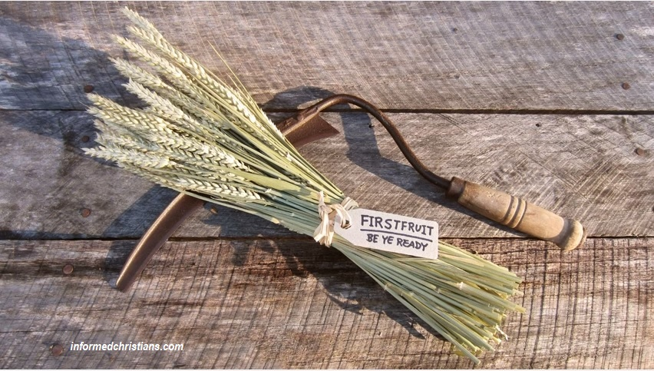

Let’s return to the study
of the sickle and its purposeful application.

Slide 43
Note:
To identify the true Mashiach, every Torah “type” of statute instruction must be
accomplished in Yahusha’s
“anti-type” fulfillment!

Slide 44

The Sickle Begins the Omer Timeline Count
What TIME-SETTING COURSE OF ACTION did Yahuah impose under statute that was to be initiated by the PREMIER CUTTING ACTION of the SICKLE on this specific event?
Deut 16:9 Seven weeks shalt thou number unto thee;
BEGIN TO NUMBER THE SEVEN WEEKS
from such time as thou beginnest to put the sickle to the corn [grain]. KJV

Slide 45
Wait!
Why is this information being stressed?
What does it have to do with the Enoch Calendar?
Through the Hebrew words, Deut 16:9 shows when Joshua’s sickle struck the standing stalks of grain the very FIRST time, to gather a Wave Sheaf offering, there were highly specific instructions that must be executed {ON THE SAME DAY – Lev 23:11, 12, 14, 15}!
What were Yahuah’s Priorities for Joshua?
Eh-Tzem

Slide 46
Yahuah’s Priority #1 - After the Sickle Cuts!
“Begin to count seven weeks from the time you
BEGIN to put the SICKLE to the grain” (Deut 16:9).
#1~ Count!
The command is - to START THE 7 WEEK COUNT at the very [FIRST] time the SICKLE strikes the
standing new grain!

Slide 47
Yahuah’s Priority #2 - After the Sickle Cuts!
Lev 23:9 And [Yahuah] spake unto Mosheh, saying,
Lev 23:10 Speak unto the children of Israel, and say unto them, When ye be come into the land which I give unto you, and shall reap the harvest thereof, then ye shall bring a sheaf of the firstfruits of your harvest unto the priest: KJV
Enoch can follow these instructions – but over 11 days late!!
#2~ Bring a Sheaf!
You can’t bring a sheaf
until the sickle BEGINS
to cut the grain!

Slide 48
Yahuah’s Conditions for Permission!
ONLY –
After the sickle’s FIRST CUTTING of wheat –
After the Wave Sheaf was bundled and offered –
After the Fine wheat flour was made into dough and offered with the drink offering –
Only then – could the Yisra’elites eat the grain of the land.
Let’s read it again!
REV
I
EW

Slide 49
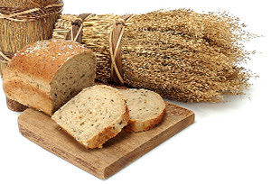
Yahuah’s Torah Instructions!
Lev 23:14 ‘And you do not eat bread - ם.ח.ל – lechem (H3899)
or roasted grain - י.ל.ק – qaliy (H7039)
or fresh grain - ל.מ.ר.כ – karmel (H3759)
1
2
UNTIL
3
until the SAME DAY that you have brought
an OFFERING to your Elohim – a law forever throughout your generations in all your dwellings.. ……………..
H5704 <`ad>
Once Joshua had accomplished all prior requirements, Yahuah provided His Permission to eat the grain of the land!
Does Enoch
accept this?

Slide 50
Summary for Joshua Section #8
Joshua’s sickle severed grain for a Wave Sheaf on Abib 15 the
1st cycle after the 7th day Sabbath.
Joshua presented the Wave Sheaf on Abib 15.
Joshua received permission via Lev 23:14 to begin eating the
grains of the land on Abib 15.
Joshua, on Abib 15, ate the grains of the land on
the day after the Passover (Josh 5:11).
Joshua observed the 1st Sabbath of Unleavened Bread on Abib 15!
Joshua began to count to Shavuot, on Abib 15!
That year – the “Eh-Tzem” fundamental bone structure
of Salvation - the TYPE - was on Abib 15!
Abib 15 – the One and Only – High Sabbath!

Slide 51
Section #9
Counting of the Omer according
to the Torah Statutes:
Joshua’s Omer Count
Enoch’s Omer Count

Slide 52
Joshua’s VERY FIRST CUTTING OF WHEAT !!
Specifically identifying the year Joshua entered Canaan.
Joshua observed Passover
(7th day Sabbath)
The SICKLE severed the FIRST
of the Harvest to accumulate
wheat stalks for a Wave Sheaf!
14 | 1st Cycle Josh 5:10-11 - Abib 15 - 1st Miqra - U/B
Joshua records that they ATE bread on the 1st cycle –
after the Passover.
Joshua fulfilled all Yahuah’s requirements prior to eating the grain!

Slide 53


On Joshua’s - Abib 15, (1st Cycle!) …
What is the significance of the Harvest having been initiated by the gathering of the Wave Sheaf?
14 | Abib 15 - 1st Cycle - 1st Miqra (Convocation) of U/B
7th Day Sabbath that year in Canaan!
Answer: The Omer Count begins! Will the Omer Count for Joshua
and Enoch be in agreement?

Slide 54
Sickle Begins the Omer Count in Canaan #1
1. Deut 16:9 "Count seven weeks for yourself. Begin to count seven weeks from the time you begin to put the SICKLE to the grain.
14 | Abib 15 - 1st Cycle - 1st U/B Miqra (Convocation)
It is the SICKLE that was used
to harvest the Wave Sheaf!

Slide 55
Joshua’s First Abib 15 Convocation in Canaan #2
1. Deut 16:9 "Count seven weeks for yourself. Begin to count seven weeks from the time you begin to put the SICKLE to the grain."
4. Lev 23:15 ‘And from the morrow after the Sabbath, from the day that you brought the sheaf of the wave offering, you shall count for yourselves: seven completed Sabbaths.’
14 | Abib 15 - 1st Cycle - 1st H4744 Miqra (Convocation)
2. ‘And he shall wave the sheaf before יהוה [Yahuah], for your acceptance. On the morrow
after the Sabbath the priest waves it.’ Lev 23:11
3. ‘And you do not eat bread
or roasted grain or fresh
grain until the same day that
you have brought an offering to
your Elohim …’ Lev 23:14

Slide 56
Joshua’s First Abib 15 -
Shabbat is where?
Lev 23:15 ‘And from the morrow after the Sabbath,
The Sabbath!
from the day that you brought the sheaf of the wave offering, you shall count for yourselves:
seven completed Sabbaths.’
14 | Abib 15 - 1st Cycle - 1st H4744 Miqra - U/B
2. ‘And he shall wave the sheaf before יהוה [Yahuah], for your acceptance. On the morrow after the Sabbath the priest waves it.’
Lev 23:11
ABIB 14!.... Weekly 7th Day Sabbath! H7676!

Slide 57
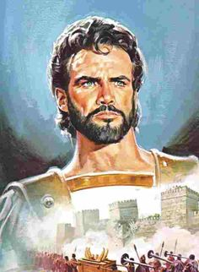
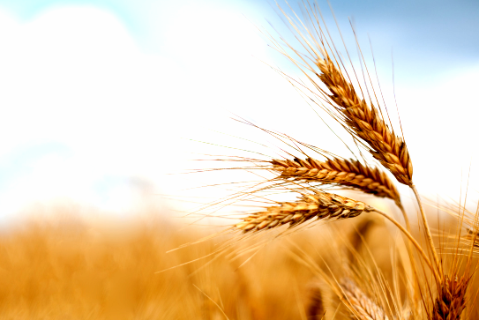
Section #9.1
Counting
the the Omer
with Joshua!

Slide 58
Yahuah stipulated by statute the Wave Sheaf & Pentecost ceremony must occur on the 1st cycle of the week,
the DAY after the 7th day Sabbath.
Note:
REV
I
EW
Surprise!
Enoch does abide by this stipulation with Joshua & Torah Truth for
both Wave Sheaf & Pentecost!
H7676
Sabbath
Wave Sheaf
1ST | 2ND | 3RD | 4TH | 5TH | 6TH | 7TH | 1ST
Pentecost follows the same pattern 50 days later.

Slide 59
The striking difference between Enoch &
Joshua!
It’s the difference between
a “day” and/or a “date.”
REV
I
EW

Slide 60


A “day” and/or a “date” are usually not the same!
REV
I
EW
Random Example:
The 15th date of
the 1st month is
not always on the
4th day/cycle
(or a Wed) like this example.

Slide 61

Joshua’s “Omer Count” ~ Wave Sheaf to Pentecost
Joshua’s 1st Month
Joshua’s 3rd Month
1st | 2nd | 3rd | 4th | 5th | 6th | 7th
1 | 2 | 3 | 4 | 5 | 6 | 7
8 | 9 | 10 | 11 | 12 | 13 | 14 P/O
15 W/S | 16 | 17 | 18 | 19 | 20 | 21 | Wk #1
22 | 23 | 24 | 25 | 26 | 27 | 28 | Wk #2
29 | 30
1st | 2nd | 3rd | 4th | 5th | 6th | 7th
 |  |  |  | 1 | 2 | 3 | Wk #7
4 50th | 5 | 6 | 7 | 8 | 9 | 10
11 | 12 | 13 | 14 | 15 | 16 | 17
18 | 19 | 20 | 21 | 22 | 23 | 24
25 | 26 | 27 | 28 | 29 | 30
4 Future Reference
Joshua’s 2nd Month
According to the Torah Statutes from Leviticus and Deuteronomy, Joshua has fulfilled every requirement. Note: The Torah Wave Sheaf will fluctuate on different “dates” of the month.
1st | 2nd | 3rd | 4th | 5th | 6th | 7th
 |  | 1 | 2 | 3 | 4 | 5 | Wk #3
6 | 7 | 8 | 9 | 10 | 11 | 12 | Wk #4
13 | 14 | 15 | 16 | 17 | 18 | 19 | Wk #5
20 | 21 | 22 | 23 | 24 | 25 | 26 | Wk #6
27 | 28 | 29 | 30
61

Slide 62
Torah’s Wave Sheaf was on “the day” after the
H7676 Sabbath ~ whatever “date” that may be.
“Enoch” demands that his wave sheaf ceremony
MUST BE on a certain DATE!
REV
I
EW
That DATE will also place Pentecost on a
very peculiar DATE in the third month.
Lets see how it plays out!

Slide 63
Section #9.2
Counting
the Omer
with Enoch!

Slide 64
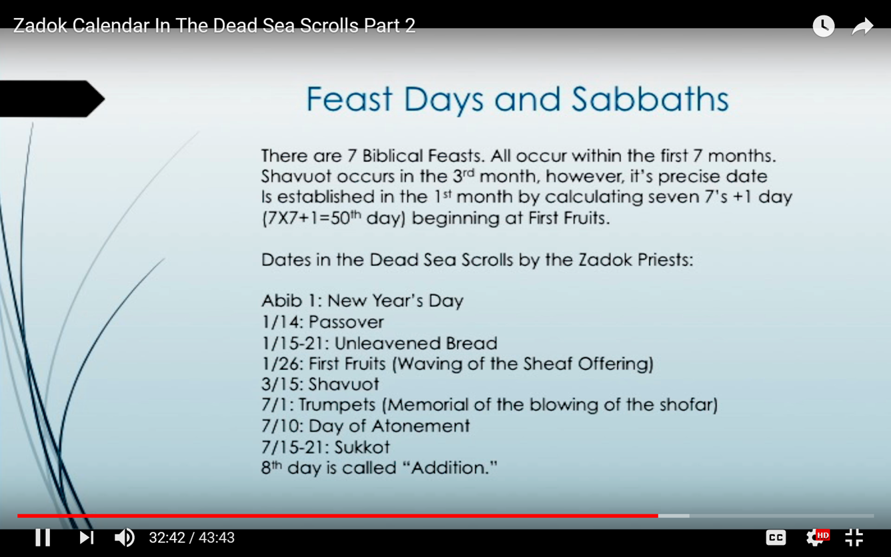
The Evidence
Review!
What timing effect will the 26th DATE have on Shavuot placement?
Enoch
Zadok

Slide 65
What about Enoch?
Will Enoch’s Omer Count align with Yahuah’s Typology? We shall see!
Enoch/Zadokite/Qumran Calendars claim they hold the Truth.
If this is so, then they should fulfill Yahuah’s requirements for ALL
the dating of Passover, Wave Sheaf and Omer counting statutes.
Next, an examination of Enoch’s testament will be challenged
in comparison to Yahuah’s statutes to see what occurs.

Slide 66


On the next slide, we must remember that the Enoch FIXED calendar up for comparison, is the exact format that is declared to occur for EVERY Biblical year including that of Joshua.
Will we find linear alignment?

Slide 67



Enoch’s “Omer Count” ~ Wave Sheaf to Pentecost
Enoch’s 1st Month
Enoch’s 3rd Month
1st | 2nd | 3rd | 4th | 5th | 6th | 7th
 |  |  | 1 | 2 | 3 | 4
5 | 6 | 7 | 8 | 9 | 10 | 11
12 | 13 | 14 | 15 | 16 | 17 | 18
19 | 20 | 21 | 22 | 23 | 24 | 25
26 | 27 | 28 | 29 | 30
1st | 2nd | 3rd | 4th | 5th | 6th | 7th
1 | 2 | 3 | 4 | 5 | 6 | 7 | Wk #6
8 | 9 | 10 | 11 | 12 | 13 | 14 | Wk #7
15 50th | 16 | 17 | 18 | 19 | 20 | 21
22 | 23 | 24 | 25 | 26 | 27 | 28
29 | 30
11 Days later than Joshua!
Enoch’s 2nd Month
On Enoch’s calendar, the “dates” and “days” of Sabbaths
and feasts never change.
Enoch’s Pentecost is always on the 15th date (& day)
of the 3rd month.
1st | 2nd | 3rd | 4th | 5th | 6th | 7th
26 | 27 | 28 | 29 | 30 | 1 | 2 | Wk #1
3 | 4 | 5 | 6 | 7 | 8 | 9 | Wk #2
10 | 11 | 12 | 13 | 14 | 15 | 16 | Wk #3
17 | 18 | 19 | 20 | 21 | 22 | 23 | Wk #4
24 | 25 | 26 | 27 | 28 | 29 | 30 | Wk #5
67

Slide 68
Enoch’s
First Fruits and Pentecost Festivals are always on the
same date of
their months.
Watch for 2 distinct reasons
for this “rule” forth-coming
in Part 4!

Slide 69




Section #10
#1

Slide 70


Whilst we are
viewing Joshua’s
7th Day Sabbath
of Abib 14,
can we
allow ourselves
a brief peek at the
lunar Sabbath requirements?

Slide 71
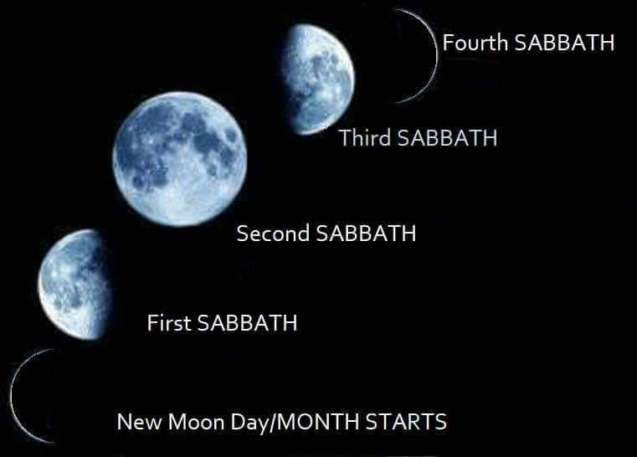
The most common method for reckoning the lunar weekly Sabbath is to begin the count from the New Moon day, which is not considered a Sabbath.
Each ¼ phase that follows, marks the weekly Sabbath, no matter which cycle of the week the crescent moon shows up.
One belief is:
The moon phases will always mark the weekly Sabbath
AND the worship feast days.
Also, you never need
to rely on a Gregorian calendar to know which
day is the moon’s weekly Sabbath.

Slide 72
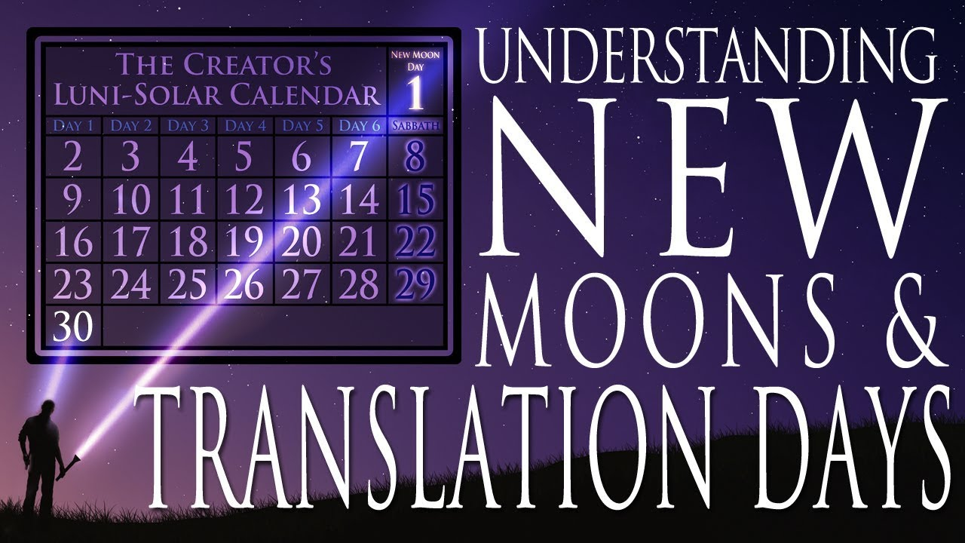
Sometimes the lunar phases align with
the weekly
[Saturday] Sabbath
found on the Gregorian Calendar.

Slide 73
Example:
The following lunar-phases mark the weekly Sabbaths on 8th, 15th, 22nd & 29th.
#s 1 & 30 are not counted
within the weekly 7 count!

Slide 74

Let’s test the lunar Sabbath concept using the calendar year
of Joshua.
WILL the lunar sabbaths align with the Sabbath in the year of Joshua?
Will Joshua agree to some aspect of the lunar calendar?

Slide 75
Joshua’s 1st Month
Lunar 1st Month
1st | 2nd | 3rd | 4th | 5th | 6th | 7th
1 | 2 | 3 | 4 | 5 | 6 | 7
8 | 9 | 10 | 11 | 12 | 13 | 14 P/O
15 | 16 | 17 | 18 | 19 | 20 | 21
22 | 23 | 24 | 25 | 26 | 27 | 28
29 | 30
1st | 2nd | 3rd | 4th | 5th | 6th | 7th
 |  |  |  |  |  | 1
2 | 3 | 4 | 5 | 6 | 7 | 8
9 | 10 | 11 | 12 | 13 | 14 P/O | 15
16 | 17 | 18 | 19 | 20 | 21 | 22
23 | 24 | 25 | 26 | 27 | 28 | 29
30
Sabbath Count
Sabbath Count
**Both calendars correctly place Passover on the 14th day of the month.
Joshua’s Passover is on the
weekly Sabbath –
“the” 14th.
Lunar Sabbath calendar has
Passover on FRI with the 15th
listed as the weekly Sabbath.
Does it take only ONE error to declare a counterfeit?
75

Slide 76

On the next slide we will examine
the same calendar charts.
However, this time the lunar calendar will have Abib 14 on the 7th day Sabbath exactly as Joshua’s account in
the first year of entering Canaan.
The question then is –
Will this lunar format agree
with the Scriptures?

Slide 77
Joshua’s 1st Month
Lunar 1st Month
1st | 2nd | 3rd | 4th | 5th | 6th | 7th
1 | 2 | 3 | 4 | 5 | 6 | 7
8 | 9 | 10 | 11 | 12 | 13 | 14 P/O
15 W/S | 16 | 17 | 18 | 19 | 20 | 21
22 | 23 | 24 | 25 | 26 | 27 | 28
29 | 30
1st | 2nd | 3rd | 4th | 5th | 6th | 7th
1 | 2 | 3 | 4 | 5 | 6 | 7
8 | 9 | 10 | 11 | 12 | 13 | 14 P/O
15 | 16 | 17 | 18 | 19 | 20 | 21
22 | 23 | 24 | 25 | 26 | 27 | 28
29 | 30
Sabbath Count
Sabbath Count
**Both calendars correctly place Passover on the 14th day of the month.
Joshua’s declares Passover
[the 14th] is on the
weekly Sabbath!
The Lunar Sabbath calendar has
Passover on the 7th cycle with the
15th listed as the weekly Sabbath.
Yes! It takes only ONE error to declare a counterfeit!
77

Slide 78

Joshua’s Abib 14 -
Passover in Canaan on
a 7th Day Sabbath
according to Torah statutes.
Abib 14 Passover Light Season | Abib 14 Passover Night Season | Abib 15 U/B Light Season | Abib 15 U/B Night Season
OOPS! What happened to the Luni - Solar Sabbath
requirement that the 7th Day Sabbath is ALWAYS on
the 15th of the month? A Definite Lunar Failure!

Slide 79
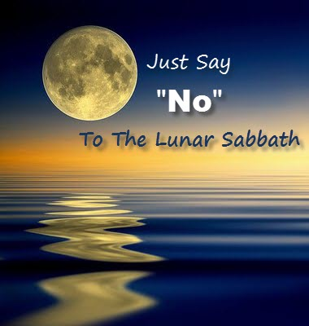
According to the
specific calendar year
of Joshua entering Canaan, these were
NOT weekly Sabbaths:
8th, 15th, 22nd, 29th

Slide 80
The lunar-Sabbath calendar claims that the moon defines how to find the weekly Sabbath, because the true Sabbath of Yahuah has been lost through the ages and no one knows how to find it. However, this concept is not found in Torah!
Question: What kind of Elohim do we serve if He cannot preserve for His people the understanding of how to find the true weekly Sabbath, that He commands is to be honored?

Slide 81


While the information in
this section may seem
it does not belong here,
just how serious is this?
For this answer we need to
go Back to the Beginning!

Slide 82

The day-start information was received in Feb 2010
in a set of
lunar-Sabbath teachings.
Presented by a
Lunar-Sabbath Teacher
Many sincere lunar-Sabbath keepers understand the DAWN day-start.

Slide 83
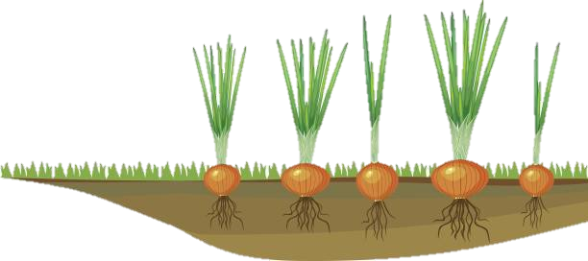
This day-start
message was
the tulip …
Presented by a
Lunar-Sabbath Teacher
in the
onion patch!

Slide 84

However: this message
was at first
difficult to examine because of the lunar message overshadowing the day start.
Presented by a
Lunar-Sabbath Teacher
Lesson: Never judge a message
by the messenger!

Slide 85

OBSERVATION!
Had this lunar-Sabbath presenter tackled a thorough research on the study of
day-start in the Joshua testimony, perhaps they would have recognized some other gems of truth such as:
The weekly Sabbath for Joshua’s 1st Passover in Canaan
was indeed on the 14th day of the 1st month – not the 15th.
The phases of the moon do not define the timing or placement of the weekly or annual Sabbath worship statutes.

Slide 86

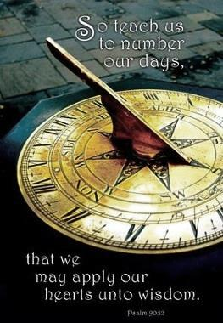


Yahuah’s Calendar is about counting days, months & years …
… not about
observing
moon phases.
Psa 90:12

Slide 87
When we learn to NUMBER
OUR DAYS,
we are then on
Yahuah’s blood ratified
Mo-edim schedule.
This factor promotes our KNOWLEDGE &
~ WISDOM!

Slide 88
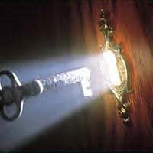

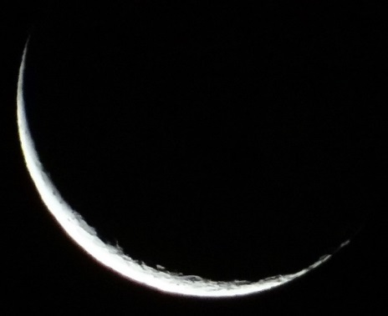
When Yahusha declared –
Luke 11:52 “Woe to you learned in the Torah,
because you took away
the KEY of knowledge.
You did not enter in yourselves, and those
who were entering in
you hindered.”
Tequfah
Yahuah’s Tequfah is LIGHT & Knowledge!
What was it that REPLACED
that which was REMOVED?

Slide 89
“You took away the Key of Knowledge”
Rejection of Yahuah’s Light radiating from the Tequfah, and the sun dial method of measuring it, resulted in allegiance to the
FORBIDDEN LUNAR IDEOLOGY; (worship erroneously bestowed upon a created identity that retains NO LIGHT of its own).
THAT is deemed –
a Purposeful Pagan
REPLACEMENT CONSTRUCT!
Man’s wisdom is
FOOLISHNESS!

Slide 90



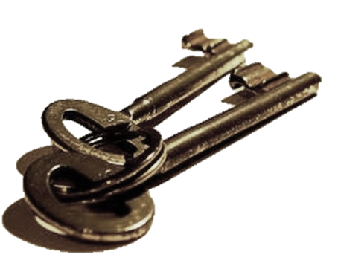

Many day-start studies of Covenant Calendar hold numerous keys to understanding the
different components of Yahuah’s calendar.
Claim
them!
These “keys”
detect counterfeits.
The End

Slide 91
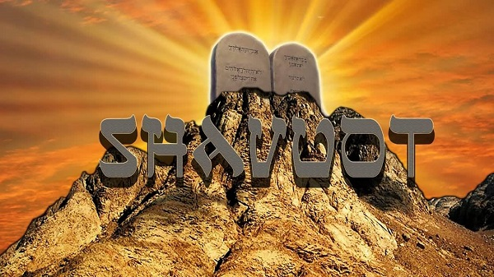
In Part 4:
Does Enoch’s
Abib 26 …
really reach to Shavuot?
Exodus 20

Slide 92
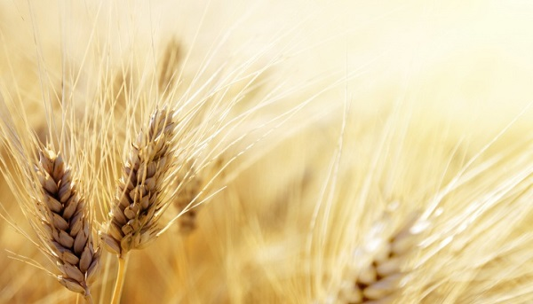
Part #4 will also address the issues of:
1) Enoch’s two main reasons for choosing Abib 26
2) New Pentecost Count (True or Counterfeit?)
3) Paul’s witness for Torah Pentecost Count
May you be blessed as you ponder
Yahuah’s Divine Count!

Slide 93

If you have Questions
&/or Comments
about this teaching,
please contact:
Timothy Astleford
tim@studythecalendar.com
questions@studythecalendar.com
Thank you!

