Slide 1
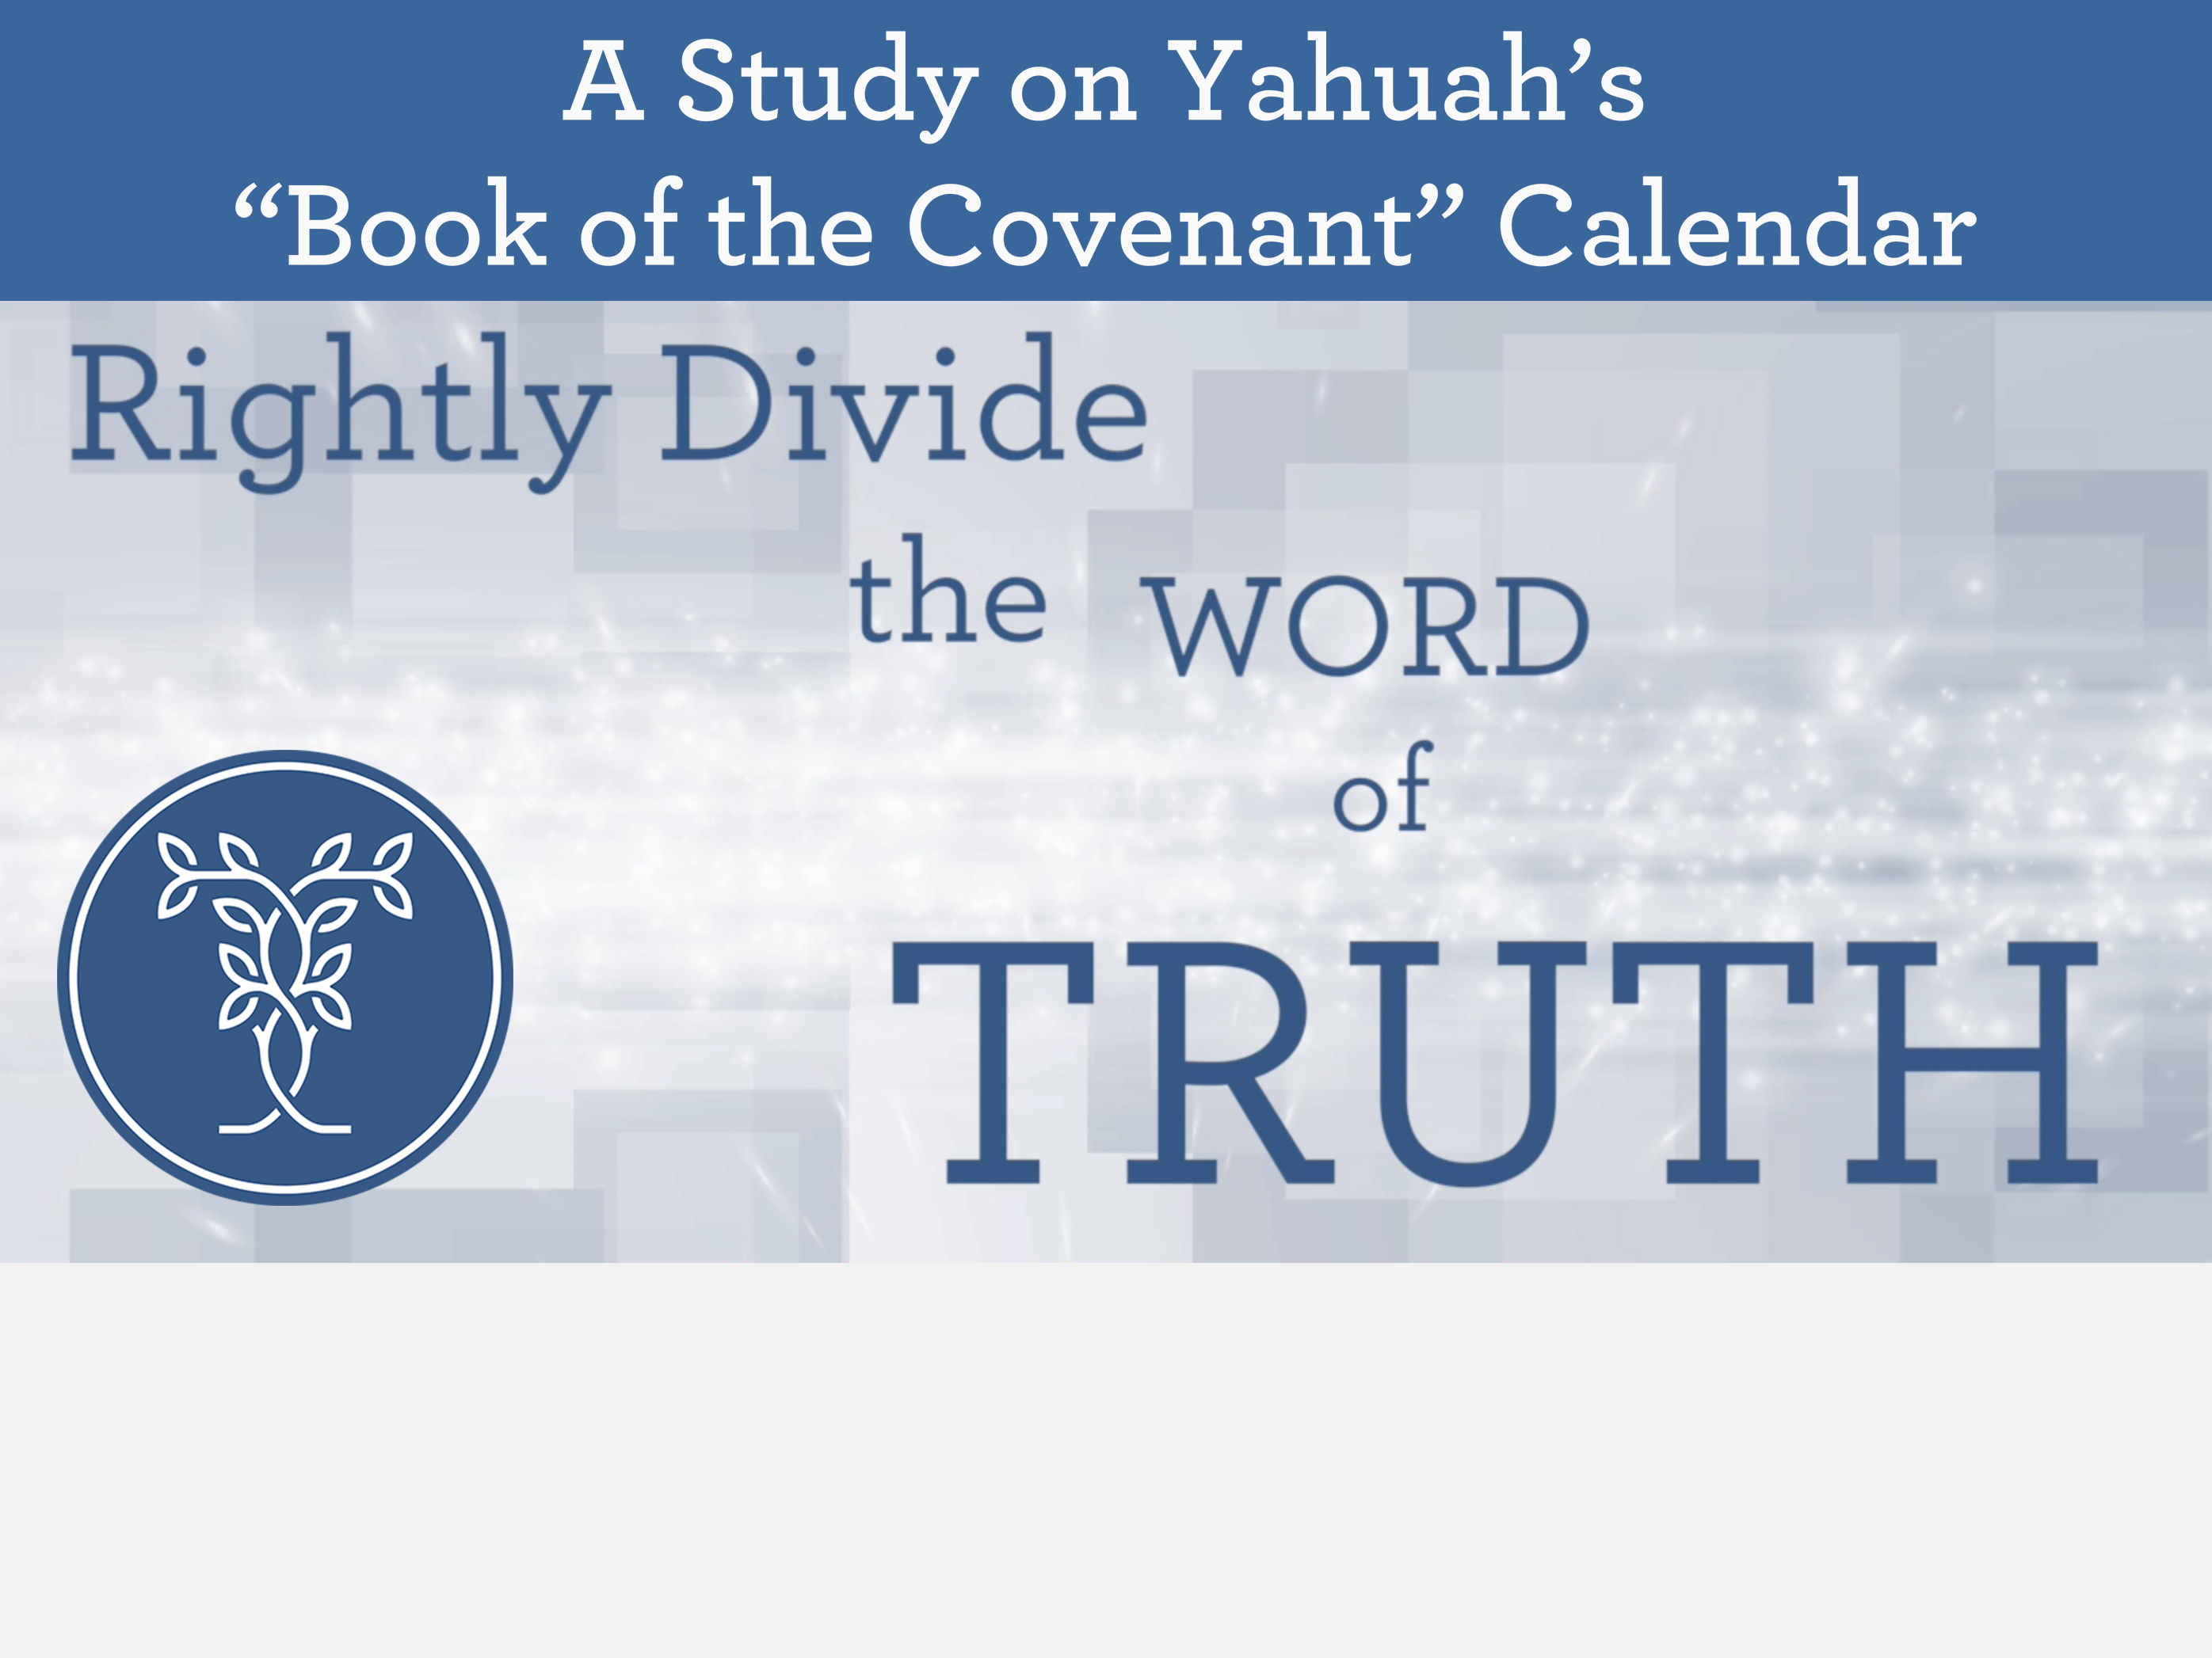
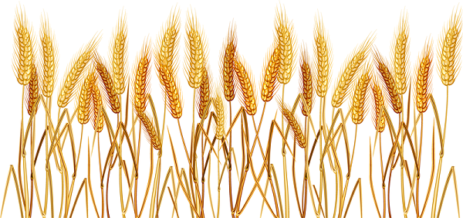
2.16 40+ hrs. of editing.
2.17crf Nov 11/19 Noon – 230; 330 – 930 (8.5) TA only edited to slide 20 11/12/19
Nov 12/19: 930 AM – 1100 [1.5] 1200 – 3.00 4.5 HRS. – TOTAL 13 HRS.
Nov 13/19: 530 AM-730 [2 hrs.] noon – 400 [total 6 hrs. – now at 19 hrs.] + 5-10 = 24 hrs.
Nov 14/19 845-345 = 7 hrs. 400-500 = 32 hrs. so far. 6-1 … 39 hrs. + 7 = 46 hrs
Nov 16th – Chris sent corrections for 33, 35 and 41 – done!
MASHIACH for spelling
48 slide still to do Nov 11th – huge error that should be fixed on other PPTs and PDF’s for enoch “after Sabbath” not ON Sabbath.
Part 2
Joshua’s First Observance of Wave Sheaf in Canaan
Notes:
Mar 2019 changes: took out 3rd hour Wave Sheaf for “early pre-sunrise moment” and covered some of the calendar boxes for teaching control.
To all of our Covenant Calendar members, we welcome you again this week. We had at least 6 new "calendar homes" visit us last week, which has to represent at least 6 new people, maybe even 12! The week before had several new people as well, so our Calendar Family is growing and is a very unique wonderful gathering on friday evenings. If you are reading this announcement, and have not joined a LIVE zoom meeting, please consider treating yourself soon.
We've try to lay out the plans for the weekly meetings as we go along, but sometimes the best plans (in our mind) need to be changed. So, here we are again with a slight change, and hopefully the best option for everyone.
The last presentation on the "6th Cycle Cruci-fiction" did announce that the next presentation would be Matt 28 addressing the "12 or 24 hour Sabbath" ... and had a date of Mar 15/19 ... which we announced before the study began, the Matt 28 study will be post-poned at least to May 3rd or thereabouts. But for any that saw that slide outside of the zoom meeting, we want to correct that timing in this announcement.
Now, here's the change for this week: Normally, the 2nd week is a "hangout" where we have been doing special things for testimonies, question, comments and answers addressing calendar material. Due to the fact that Passover is right around the corner, housing the Feast of Unleavened Bread ... AND ... the Festival of Firstfruits, we have decided this is the time to once again revisit the Joshua study originally given Mar 2/18. For those of you that have seen this already, we're sure this will be a good review, and for our newcomers, a real treat.
Since completing this study, we have realized that the Festival of Firstfruits is of such great importance - that it is time everyone knew about this. How many of us have been to a full 8 day Passover feast - we observe the Unleavened Bread Sabbaths, and the whole week -- without ever giving a thought to Firstfruits? Many feast camps we have been to never even mention Firstfruits, never mind teaching what meaning this day has for each and every follower. It is of extreme importance. Imagine finding this information in the early chapters of Joshua as he enters the land of Canaan? Yes, that was the command: to keep Firstfruits "when they entered the land." So, this feast was not honored in the 42 years of wilderness wanderings.
A few things that will be addressed in Joshua (besides the DAWN day) are:
Many place Firstfruits on Abib 16 every single year. In fact, they have married Firstfruits to Abib 16. Is this what Yahuah intended, and is this what Joshua commanded? Do you really want to know for sure which "cycle" of the week Firstfruits is to be observed?
Is there a Scriptural stipulation that any (or all) of the feasts and fesitvals can never be celebrated on a weekly Sabbath? What does Joshua have to say about that?
The weekly Shabbat is linked to the Hebrew number H7676. Have you been taught the annual Sabbaths are linked to H7677? Is that really true, and does it really matter? Why, or why not?
Does the traditional date for Firstfruits (of Abib 16) within Judaism today align with Torah? If not, what happened, and is there historical documentation to expose what has happened around this unique festival? Whose idea would it be to remove the true value and meaning of Firstfruits?
Should Firstfruits fall within the week of the Passover festival, or is it OK for Firstfruits to be found "outside" the week of the Spring Festivals? Will Joshua give us solid confirmation about this?
Firstfruits is the first day of the Omer count. If Firstfruits is not placed on the proper divine setting, how does this affect the count to Pentecost, and how would that cause a problem for the calendar timing of Exo 19:1?
How important is Firstfruits to you this day? Are you ready for a new experience ... one that will forever change your understanding of who your Messiah is, and actually pinpoints to ONLY the true Messiah?
These are just a few of the more important points in the Joshua study that are well to be reviewed on a regular basis. It is of great importance, as Joshua was appointed to fill the "big shoes" of Moses ... being at his side for 40 years of training. He did not make one mistake about calling the attention to the importance of Firstfruits for the people making this grand entrance into Canaan. If it is that important for them, it is of more importance to us today.
We hope you will be blessed with this teaching and that it will forever impress your mind with these awesome truths, and that you will have a "ready answer" for all that ask of you. Come and join us for fun and learning. This will not be recorded, so Tim & Charlene can teach at the pace of the group - especially for our newcomers.
See you on (Mar 8/19) the 23rd day of the 12th month (353 days of the 360 count) - at the zoom meeting for Covenant Calendar.

Slide 2
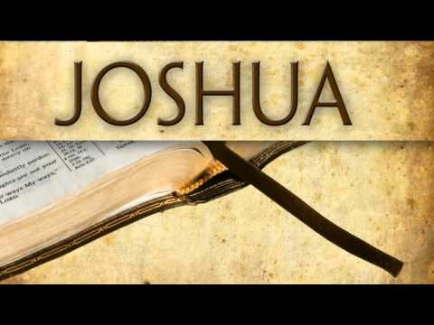
The First Passover in Canaan
Chapters 1 - 5
Part 2
& Observation of Wave Sheaf

Slide 3

The Intrigue of Part 2
#2 Joshua
#3
History
Part #2
Joshua has more information on Wave Sheaf and the Omer Count.
Part #1
#1
Leviticus
& Numbers
Plus a statement on the historical aspect from the Hebrew Union College in the USA!

Slide 4
Joshua’s statements have proven…
#2 Unleavened Bread Sabbath
on Abib 15
#3 Wave Sheaf is
placed on Abib 15 – NOT Abib 16!
#1 Passover & weekly Sabbath are on
Abib 14
There is more!

Slide 5


Joshua’s Wave Sheaf
Part 2
With Wave Sheaf & 1st Sabbath of Unleavened Bread both on Abib 15, which one will take priority?
Which Feast will be the “backbone”
of our salvation?
How shall the correct method for Counting the Omer be determined?
What is the tradition of how Wave Sheaf became married to Abib 16.
We Shall See!

Slide 6

Which Festival Secures First Place?
Wave Sheaf? ~ Unleavened Bread Sabbath?
R
E
V
I
E
W
Every Feast and Festival is
of utmost importance,
whether an annual Sabbath or not!
In Joshua’s account 2 festivals share Abib 15:
a. 1st Sabbath of Unleavened Bread
b. Wave Sheaf Festival
Will Joshua give priority to one of them?
Will Joshua make the right choice?
And … Does it matter?

Slide 7
The Wave Sheaf Grain Holds Clues
To understand the importance of Wave Sheaf and First Fruit, it is first helpful to investigate the grain in the land of Canaan.
  The grain holds clues to help understand how Wave Sheaf was fulfilled in Yahusha’s life. This is the first recorded time of Israel celebrating the full spring festival. Remember, there is no Scriptural account for the celebration of the Wave Sheaf Festival in the wilderness.
  Yahuah had promised the Israelites the grain of the land would be ready for harvest upon entering the land of Canaan. (Deut 6:10-11; Josh 24:13.)
  But ALL grain (whether old or new – wheat or barley) was declared “off limits” to eat, or use for personal purposes like preparing unleavened bread for Passover, until after the Wave Sheaf ceremony had been celebrated (Lev 23:14).

Slide 8
Special Instructions
for Wave Sheaf
There is one command that is extremely significant AND recorded twice:
The terms UNTIL – and –
ON THIS SAME DAY
are very important to understand.

Slide 9
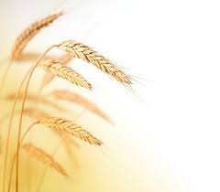
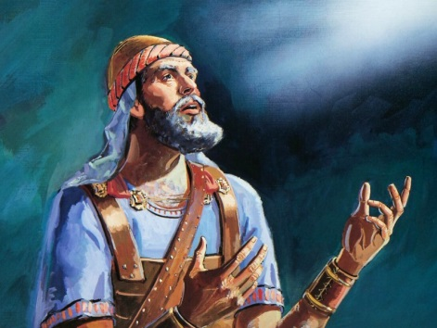
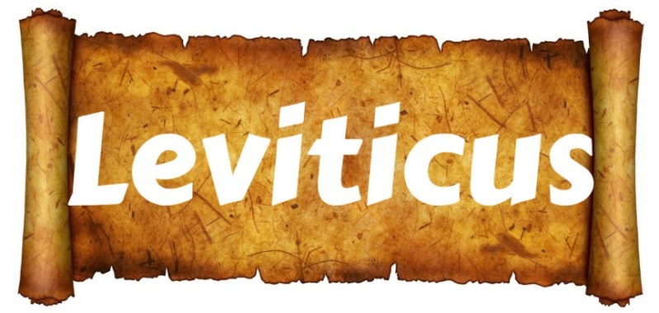
Josh 5:11 & Lev 23:14 Agree
Josh 5:11 And they ate of the stored grain of the land
on the morrow after the Passover,
unleavened bread and roasted grain ON THIS SAME DAY.
Lev 23:14 And you do not eat bread
or roasted grain or fresh grain UNTIL THE SAME DAY
that you have brought an offering to your Elohim – a law forever
throughout your generations in all your dwellings. HalleluYah Scriptures & The Scriptures
Joshua followed the Torah command:

Slide 10
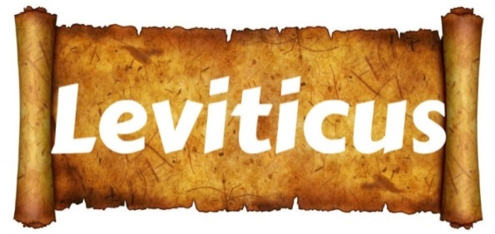
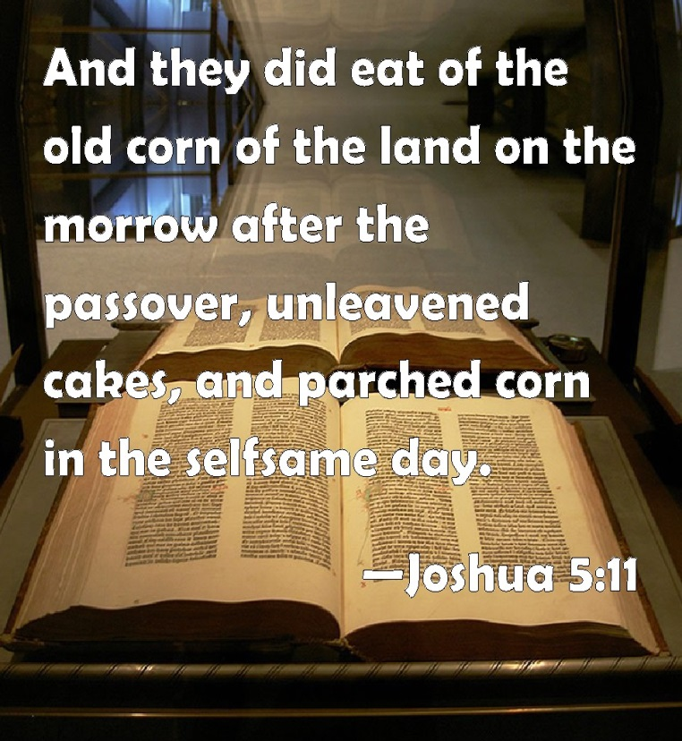
Joshua followed the Torah command:
“the same day”
“selfsame day”
KJV
H6106 `etsem (eh'tsem);
from H6105; a bone (as strong); by extension,
the body; figuratively,
the substance, i.e.
(as pron.) selfsame:
KJV - body, bone, life,
(self-) same, strength, very.

Slide 11
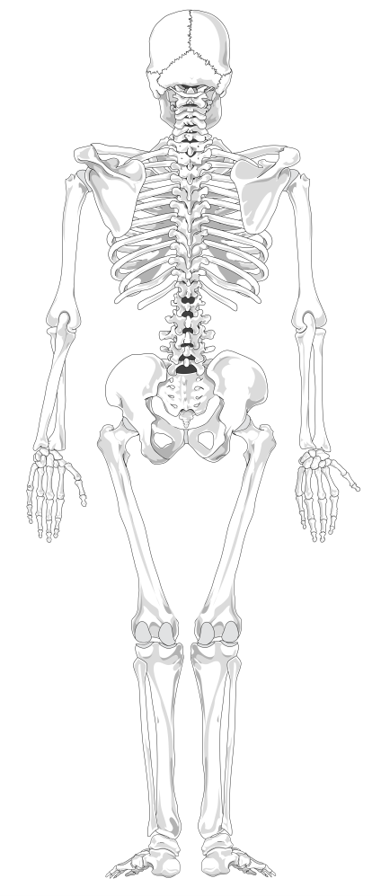
“ON THIS SAME DAY”
The primary point we need to pay attention to in the
Wave Sheaf ceremony of the Firstfruit are the words:
“UNTIL” THE SAME DAY
…translated from the Hebrew words - ehtzm zeh.
The main word meanings of ehtzm are:
firmness, solidity, bone
(as in basic skeletal structure),
essence and substance.
All definitions link the Wave Sheaf Firstfruit ceremony to:
THE SELF-SAME DAY
(“day” of the week; not “date” of the month),
to be fulfilled in the antitype.

Slide 12
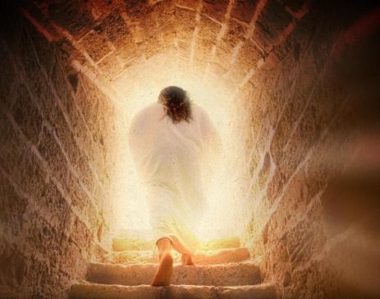
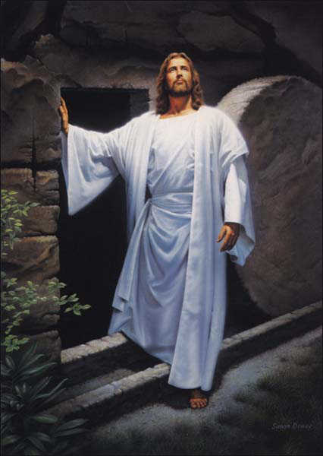
What about – Yahusha’s Life?
“We have often concentrated on – The Death – of Yahusha.
Might we submit a portion of our
thoughts to Yahusha’s Victory
of LIFE - over death?
AFTER Yahusha died, what single event, (that is commanded to be observed yearly),
was actually signed, sealed and forever etched into our Salvation for eternity?

Slide 13
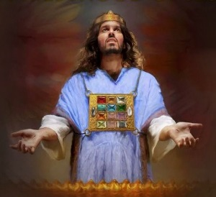

What about
His Life that was Accepted?
Another Melchi-zedek Covenant Connection& Fulfillment!
Yahusha’s death would have
no meaning had He not
Presented Himself
{Exo 23:16,17} before Yahuah.
It was here that
Yahusha’s Sacrifice was
ACCEPTED AS – PERFECTION !

Slide 14
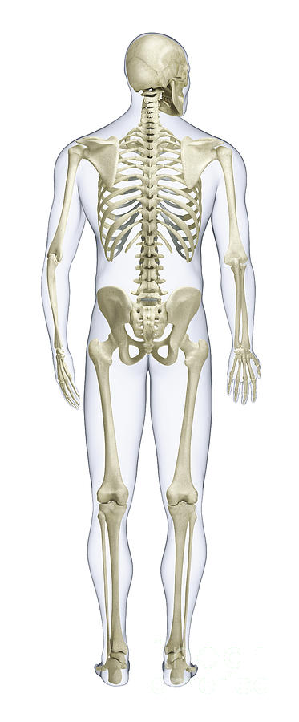
What is contained in this LIFE support system?
The Very Same
… Until - EH-TZEM – Day,
Lev 23:14
(Not - date!)
when the Wave Sheaf/First Fruit Presentation & ACCEPTANCE;
was fulfilled before Yahuah –
within the Melchizedek Covenant.
Lev 23:11
This event was THE EMBODIMENT,
THE – SKELETAL BONE STRUCTURE;
which was, and still is,
the quintessential
SUBSTANCE AND ESSENCE
of our Salvation!

Slide 15

What connects the skeletal bone concept to Yahuah’s - LIFE - support system?
Resh
Yahusha alone IS Salvation’s
Administration Center for LIFE!
This factor was finalized through YAHUAH’S ACCEPTANCE OF YAHUSHA the First-Fruit on the Feast of the Wave Sheaf,
the 1st cycle of the week
following the 7 ^{th} day Sabbath
during the Passover Festival!

Slide 16
Yahusha’s skeletal bone distribution system
has a purpose!
Resh
THE
The [Eh-Tzem] “BONE” spinal cord central nervous support structure -
Wave Sheaf/ First-Fruit Festival;
through Joshua,
conveys vital
SALVATIONAL SUBSTANCE;
YEARLY TIMNG & MASHIACH CHARACTER IDENTIFICATION to …

Slide 17
Yes (…to -) Us!
Resh
Yahusha’s EHTZEM bone notification system for the Body of Yahusha; identifies the ESSENCE of our Salvation through Yahusha’s Sacrificial ACCEPTANCE on-
the 1st cycle after the
7th day Sabbath!

Slide 18
The Ultimate Bone
Distribution System
Resh
“EHTZM” directs us to … Wave Sheaf
as the backbone, (Spinal Cord if you will)
- the base foundation -
of Yahusha’s Plan to bring Salvation
to His Body of people.
Yahusha, by dying, then observing the
Wave Sheaf, presented Himself to Yahuah
(as THE First-Fruit of victory over death).
Yahuah accepted Yahusha’s monumental sacrifice.
That ACCEPTANCE is – the Substance and Essence of the Plan for OUR Salvation.

Slide 19
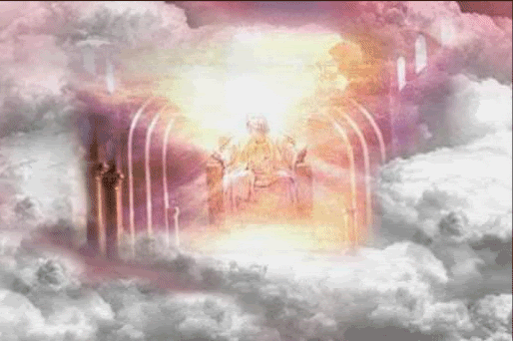
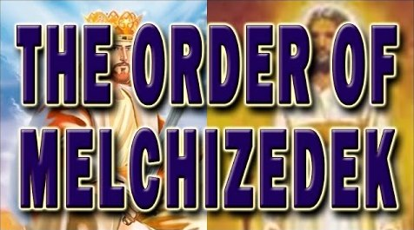
Wave Sheaf & Melchizedek
All feasts and festivals are “types” that have their complete fulfillment in our Messiah as the Highest Melchizedek Priest.
Through the premier “type” of the Wave Sheaf Festival, the first harvest purposely confirmed the standard for Yahusha as the “anti-type” on His “Wave Sheaf” presentation to be the Principal First-Fruit!
Wave Sheaf
Before the Throne
Canaan
Notes:
Remember, Yahusha had not ascended upwards yet when He met Mary in the garden on Sunday morning, as he gave her a command not to touch Him yet … until … after He came back.

Slide 20
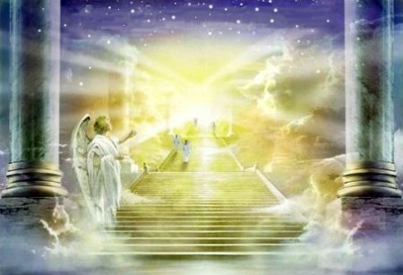
Melchizedek–The First-Fruit
This event looked forward to the time when Yahusha would ascend to receive Yahuah’s announcement of whether or not His blood Sacrifice fully paid the requirements of
our death penalty.
The actual cycle of the week where the Wave Sheaf “type” was truly fulfilled by the “antitype” was ONLY ON
the next 1st cycle of the
week (or Sunday) after
the Crucifixion event.
Wave Sheaf
Fulfilled
Notes:
Remember, Yahusha had not ascended upwards yet when He met Mary in the garden on Sunday morning, as he gave her a command not to touch Him yet … until … after He came back.

Slide 21
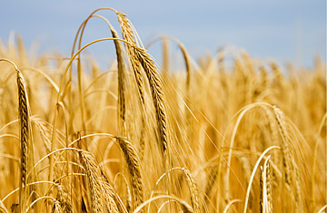
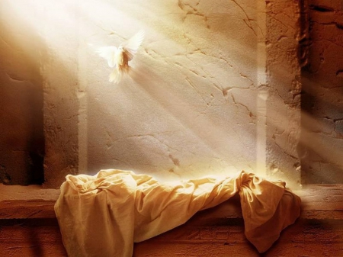
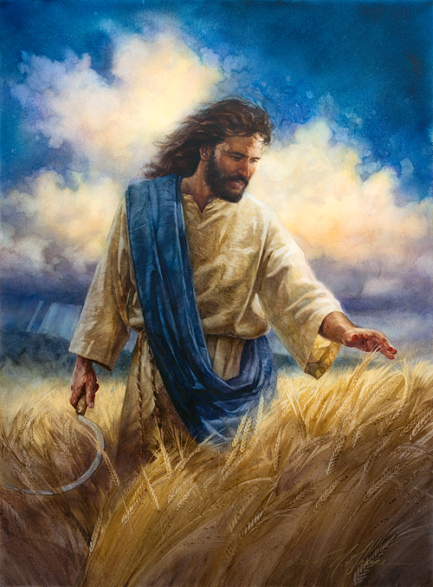
Timing of Resurrection & Ascension
Do not confuse these two facts:
Yahusha’s resurrection was
on the weekly Sabbath
(not Sunday).
Yahusha’s ascension was
perfectly timed so that His presence was before Yahuah
as the earthly Wave Sheaf was waved heavenward – at the
early dawn hours of that day.
(A study on the Wednesday crucifixion is
crucial if this fact is not recognized yet.
Ask for studies if you need more information.)
Notes:
This ascension is the fulfillment (antitype) of the “type.”

Slide 22
Charting Resurrection & Ascension
1st (Sun) | 2nd (Mon) | 3rd (Tues) | 4th (Wed) | 5th (Thur) | 6th (Fri) | 7th (Sabb)
4 | 5 | 6 | 7 | 8 | 9 | 10
11 | 12 | 13 | 14 P/O | 15 ULB | 16 ULB | 17 Ress.
18 W/S | 19 ULB | 20 ULB | 21 ULB | 22 | 23 | 24
These two very important events did not occur on the same day!
If Wave Sheaf is not observed at the exact correct time, numerous problems arise.
Notes:
This ascension is the fulfillment (antitype) of the “type.”

Slide 23
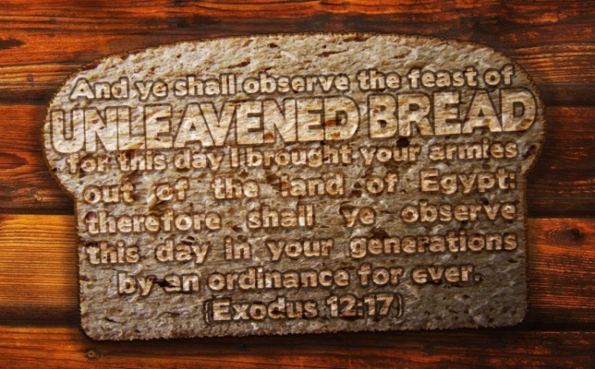
Which was Honoured First on Abib 15?
Wave Sheaf? ~ Unleavened Bread?
Joshua’s 1st honour was applied to:
the Wave Sheaf Festival event
(representing Yahusha’s
ascension during the early
pre-sunrise hours of this day).
Dawn - John 20:1-17
Joshua’s 2nd honour was bestowed upon:
The festival of the 1st Sabbath
of Unleavened Bread.
All else on Abib 15 pales in Comparison.

Slide 24


1st Honor: Wave Sheaf / Firstfruits
After the Wave Sheaf offering of the pre-sunrise hour,
the people were released from the command
to refrain from eating the yield of the land.
Interestingly. the people were also released from the bondage of the Book of the Law too! This was the final and deciding moment! - Tim
But now is Yahusha risen from the dead, and become the firstfruits of them that slept. 1 Cor 15:20 KJV
The significance of this Wave Sheaf prophecy of 1500+ years
(the presentation of the harvest
to Yahuah for acceptance)
should draw full attention to the
x
SKELETAL BONE STRUCTURE of the Plan of Salvation
through Yahuah’s Feasts and Festivals.

Slide 25
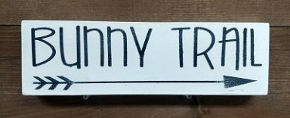

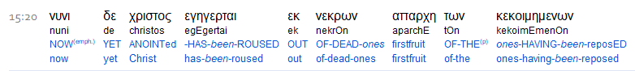

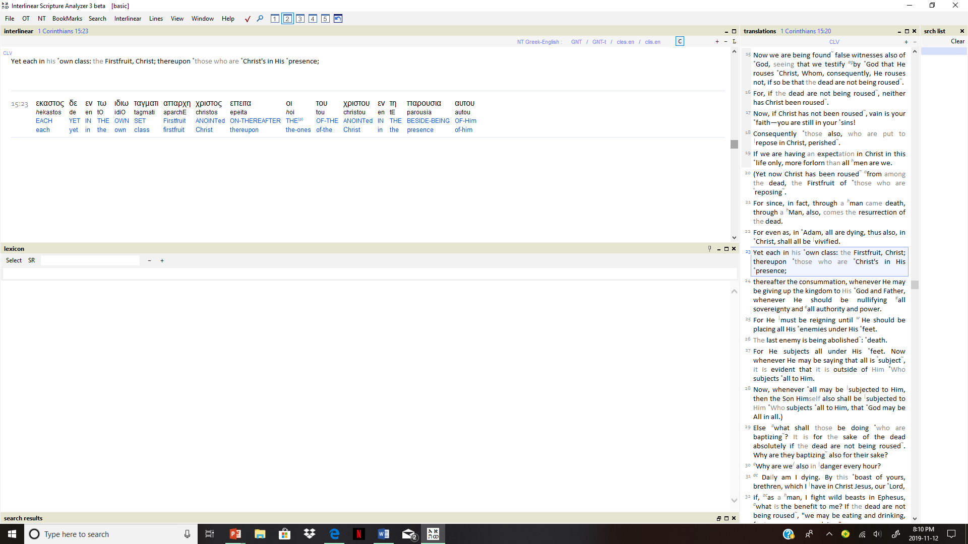
Is FirstfruitS (as plural) Correct?
But now is Yahusha risen from the dead, and become the firstfruitS of them that slept. 1 Cor 15:20 KJV
The Interlinear
Scripture Analyzer
Not plural, but – SINGULAR!

Slide 26
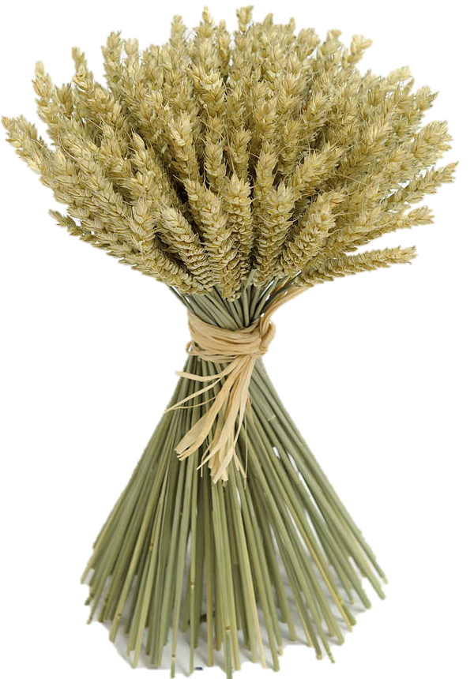
Some Qodesh Intricacies
#1 The Kohen Ha Gadol (High Priest) was the
only identity “approved and accepted” to
present the (singular) Wave Sheaf before Yahuah.
#2 Yahusha, as the Kohen Ha Gadol, presented
the Wave Sheaf before Yahuah according
to Lev 23:10, 11.
I still think this is an important point to be made. As the K/H/G Yahusha could only WAVE THE SHEAF that was GIVEN to Him. Lev 23:10. It was the first cutting and says nothing about fruit! Yahusha by set pattern and statute, could only wave the sheaf. What that sheaf consisted of is another matter. Conrad wants to eliminate this statute step fulfillment and go right to the First Fruit. Not so. Not by the statute pattern!
#3 Yahusha, first presented Himself as THE Wave Sheaf.
#4 Yahusha’s presentation CONSISTED OF THE FIRST-CUTTING
of Himself (the – “First-Fruit”) and His victory/power over death
{Lev 23:10}. Yahusha has the power to lay down His life and take it up again (John 10:17-18).
Note: Hebraically the word “fruit” is not seen in Leviticus 23 as Wave Sheaf. (Next: Two applications to be examined.)
Notes:
This ascension is the fulfillment (antitype) of the “type.”

Slide 27

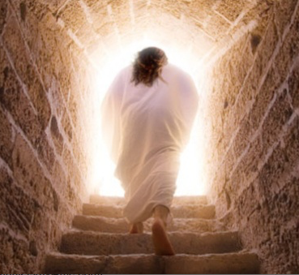
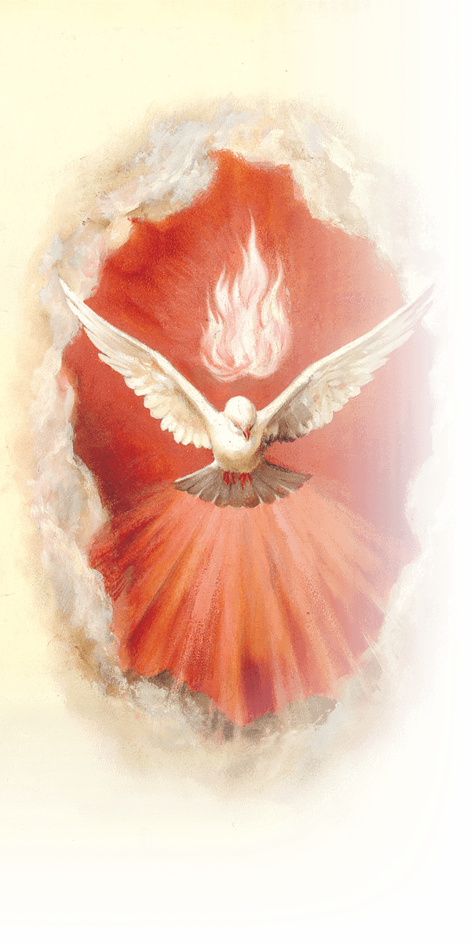
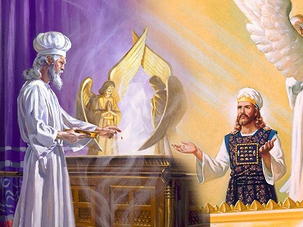
EH TZEM! Salvation’s Skeletal Structure!
Yahusha – THE Melchizedek
1st of 2 Applications
#1 Yahusha –
THE First-fruit
#2 Yahusha –
THE Wave Sheaf
#3 Yahusha –
THE Kohen Ha Gadol
High Priest In Every Function
#4 Yahusha –
The One
who sends the
Ruach
Ha Qodesh!
Notes:
This ascension is the fulfillment (antitype) of the “type.”

Slide 28
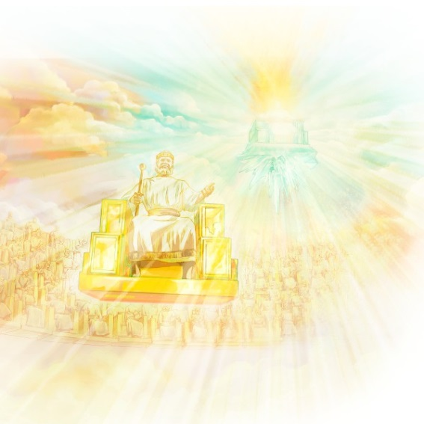
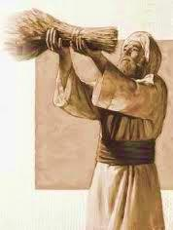
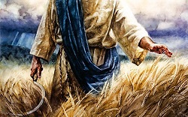
EH TZEM! The Skeletal Foundation!
2nd of 2 Applications
1 John 4:13 Hereby know we that we dwell in him, and he in us, because he hath given us of
his Spirit.
Yahusha - THE Kohen Ha Gadol WAVES HIS SHEAF CONTRIBUTION BEFORE YAHUAH! WHAT IS IT?
THIS Wave Sheaf consisted –
IN PLURALITY – many
individual stalks of wheat.
Yahusha presented each individual “stalk of wheat within the sheaf” (or the people raised at the earthquake
Matt 27:52) as HIS FIRST-FRUIT OFFERING to Yahuah!
Rev 5:12 … Worthy is the Lamb that was slain …
Notes:
This ascension is the fulfillment (antitype) of the “type.”

Slide 29



Yahusha – The “first”
First-Fruit
But now Messiah has been raised from
the dead, and has
become the firstfruit of those having
fallen asleep.
1 Cor 15:20 ISR
There are Scripture versions that have the correct wording – to be in alignment with the Torah commands.
Yahusha became the “Premier” FIRST-FRUIT
and the “Principal” WAVE SHEAF!
He is the One that offered His Personal “firstfruits” as one Wave Sheaf … once!

Slide 30
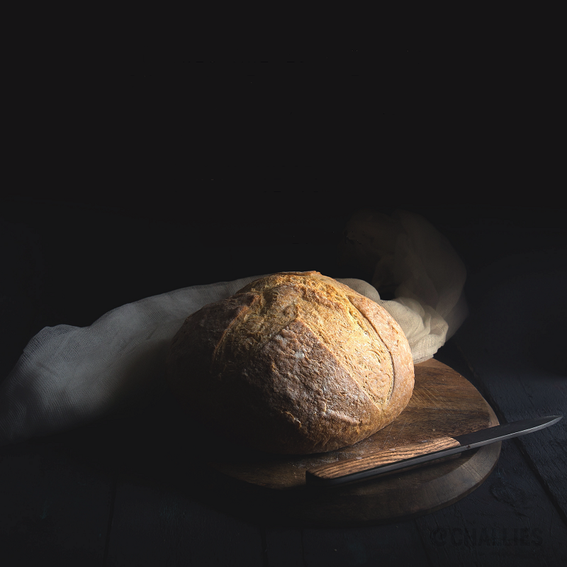
A Short Break: we will return to the Wave Sheaf topic after the events on Abib 16!
“What? No More Manna?”

Slide 31
Abib 16 ~ No More Manna!
Chart #7 of 7 (A change of diet in the land of milk and honey.)
Box 27 – Josh 5:12 And the manna ceased on the morrow after they had eaten of the old corn of the land; neither had the children of Israel manna any more; but they did eat of the fruit of the land of Canaan that year.
Box 25 – Abib 15 – Josh 5:11
1st) Celebrated Wave Sheaf Festival 2nd) For ULB they ate the stored grain of the land on the morrow after Passover.
NO MORE MANNA
H7676 Sabbath
H4744 ULB Convocation
Box 24 – Abib 14 Passover is preformed at even.
 | Abib 14 Passover 7th Cycle Sabbath |  | Abib 14 Night |  | Abib 15 – W/S & ULB 1st Cycle Sunday |  | Abib 15 Night |  | Abib 16 (No more Manna) 2nd Cycle Monday |  | Abib 16 Night
R
E
V
I
E
W
Box 26
Lev 23:11 ‘And he shall wave the sheaf before [Yahuah], for your acceptance. On the morrow after the Sabbath ^{[H7676]} the priest waves it.’
Lev 23:14 ‘And you do not eat bread or roasted grain or fresh grain UNTIL THE SAME DAY that you have brought an offering to your Elohim – a law forever throughout your generations in all your dwellings.’

Slide 32

Joshua has definitely confirmed Wave Sheaf is on Abib 15
in his calendar year.
That means Wave Sheaf is not “married” to the Abib 16 date.
Note: When Wave Sheaf is permanently placed and observed on Abib 16, it is always a “floating” Festival,
as this date floats through every cycle of the week in
7 years. It will ONLY occur on the 1st cycle of the week about once every 7 years. There are three major problems with a Floating Wave Sheaf married to Abib 16:
Wave Sheaf is seldom placed after the H7676 weekly Sabbath within the Passover week.
(Addressed in Part 1 of this study.)
Abib 16 Wave Sheaf Activities conflict with the Resurrection Account. (2nd Category – 5 examples.)
The Omer count is disrupted when Abib 16
is the designated “date” for the Wave Sheaf [First Fruit] placement. (3rd Category.)

Slide 33

Importance of Wave Sheaf
Following the Weekly Sabbath
1st (Sun) | 2nd (Mon) | 3rd (Tues) | 4th (Wed) | 5th (Thur) | 6th (Fri) | 7th (Sabb)
4 | 5 | 6 | 7 | 8 | 9 | 10
11 | 12 | 13 | 14 P/O | 15 ULB | 16 ULB | 17 Ress.
18 W/S | 19 ULB | 20 ULB | 21 ULB | 22 | 23 | 24
Category 2
When Wave Sheaf is celebrated after the weekly Sabbath, the “type” that is fulfilled in the “anti-type” is: The resurrection is always on Sabbath & the ascension always FOLLOWS the resurrection the next day!
There will be 5 examples to demonstrate Category 2 challenges with Wave Sheaf placed on Abib 16.
Notes:
This ascension is the fulfillment (antitype) of the “type.”

Slide 34


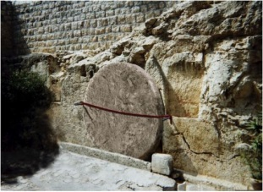
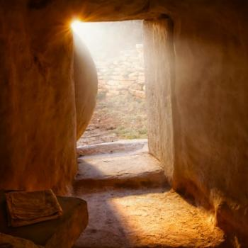

Conflict #1 SUN Passover & TUE Wave Sheaf
#1
1st (Sun) | 2nd (Mon) | 3rd (Tues) | 4th (Wed) | 5th (Thur) | 6th (Fri) | 7th (Sabb)
14 P/O | 15 ULB | 16 W/S? | 17 ULB | 18 ULB | 19 ULB | 20 Ress.
21 ULB | 22 | 23 | 24 | 25 | 26 | 27
Note: Every weekly H7676 Sabbath [during Passover Festival] also represents the
“anti-type” Resurrection Day
and will be noted as such.
Abib 16 [Tues] Wave Sheaf
Ascension is celebrated before
the Resurrection? No one will know the Wave Sheaf is to really occur on the 1st cycle.
ON Covenant Calendar!
#1
1st (Sun) | 2nd (Mon) | 3rd (Tues) | 4th (Wed) | 5th (Thur) | 6th (Fri) | 7th (Sabb)
14 P/O | 15 ULB | 16 W/S | 17 ULB | 18 ULB | 19 ULB | 20 Ress.
21 W/S | 22 | 23 | 24 | 25 | 26 | 27
In a Sunday Passover year, the 1st cycle Wave Sheaf Ascension is celebrated after the [H7676] weekly
Sabbath according to Torah statutes.
Notes:
This ascension is the fulfillment (antitype) of the “type.”

Slide 35
Conflict #2 TUE Passover & THUR Wave Sheaf
#2
1st (Sun) | 2nd (Mon) | 3rd (Tues) | 4th (Wed) | 5th (Thur) | 6th (Fri) | 7th (Sabb)
12 | 13 | 14 P/O | 15 ULB | 16 W/S? | 17 ULB | 18 Ress.
19 ULB | 20 ULB | 21 ULB | 22 | 23 | 24 | 25
Abib 16 Wave Sheaf Ascension is again celebrated before the Resurrection.
Abib 16 FAILS to prophesy the “day”
of Yahusha’s actual Wave Sheaf Offering!
ON Covenant Calendar!
#2
1st (Sun) | 2nd (Mon) | 3rd (Tues) | 4th (Wed) | 5th (Thur) | 6th (Fri) | 7th (Sabb)
12 | 13 | 14 P/O | 15 ULB | 16 W/S | 17 ULB | 18 Ress.
19 W/S | 20 ULB | 21 ULB | 22 | 23 | 24 | 25
In a Tuesday Passover year, the 1st cycle Wave Sheaf Ascension is also correctly celebrated after the
[H7676] weekly Sabbath according to Torah statutes.
Notes:
This ascension is the fulfillment (antitype) of the “type.”

Slide 36
Conflict #3 FRI Passover & SUN Wave Sheaf
1st (Sun) | 2nd (Mon) | 3rd (Tues) | 4th (Wed) | 5th (Thur) | 6th (Fri) | 7th (Sabb)
9 | 10 | 11 | 12 | 13 | 14 P/O | 15 Ress.
16 W/S | 17 ULB | 18 ULB | 19 ULB | 20 ULB | 21 ULB | 22
#3
Ascension is celebrated AFTER Resurrection!
In a Covenant Calendar year where Passover is observed on
Friday, Abib 16 will follow the weekly [H7676] Sabbath, and is
honored properly according to Torah statute.
However, this CANNNOT endorse the Scripture’s 4th cycle as Yahusha’s Passover. It represents the false Friday Cruci-fiction!
ON Covenant Calendar!
1st (Sun) | 2nd (Mon) | 3rd (Tues) | 4th (Wed) | 5th (Thur) | 6th (Fri) | 7th (Sabb)
9 | 10 | 11 | 12 | 13 | 14 P/O | 15 Ress.
16 W/S | 17 ULB | 18 ULB | 19 ULB | 20 ULB | 21 ULB | 22
#3
Ascension is celebrated AFTER Resurrection!
There are no changes between this example and the
one just given above. However, be sure to recognize
the 6th cycle Passover does not fulfill the requirements of Yahusha’s messianic prophecy of “3 days & 3 nights” before His weekly Sabbath Resurrection.
Notes:
This ascension is the fulfillment (antitype) of the “type.”

Slide 37
Conflict #4 WED Passover & FRI Wave Sheaf
1st (Sun) | 2nd (Mon) | 3rd (Tues) | 4th (Wed) | 5th (Thur) | 6th (Fri) | 7th (Sabb)
11 | 12 | 13 | 14 P/O | 15 ULB | 16 W/S? | 17 Ress.
18 ULB | 19 ULB | 20 ULB | 21 ULB | 22 | 23 | 24
#4
This is Yahusha’s Passion Week – notice how serious this is when Wave Sheaf is placed on Abib 16. How can the Abib 16 Wave Sheaf Ascension be celebrated before any possible Resurrection?
This is a serious impossibility!
ON Covenant Calendar!
#4
1st (Sun) | 2nd (Mon) | 3rd (Tues) | 4th (Wed) | 5th (Thur) | 6th (Fri) | 7th (Sabb)
11 | 12 | 13 | 14 P/O | 15 ULB | 16 W/S | 17 Ress.
18 W/S | 19 ULB | 20 ULB | 21 ULB | 22 | 23 | 24
Ascension is celebrated AFTER Resurrection!
Yahusha’s “mid-week” Passover is followed by “3 days &
3 nights” in death, terminating with the [H7676] Sabbath
Resurrection – then His Ascension on the 1st cycle Wave Sheaf celebration. (Abib 16 PALES in comparison and removes the Backbone!)
Only #4: EVERY DETAIL FOLLOWS TORAH STATUTES PERFECTLY!
Notes:
This ascension is the fulfillment (antitype) of the “type.”

Slide 38
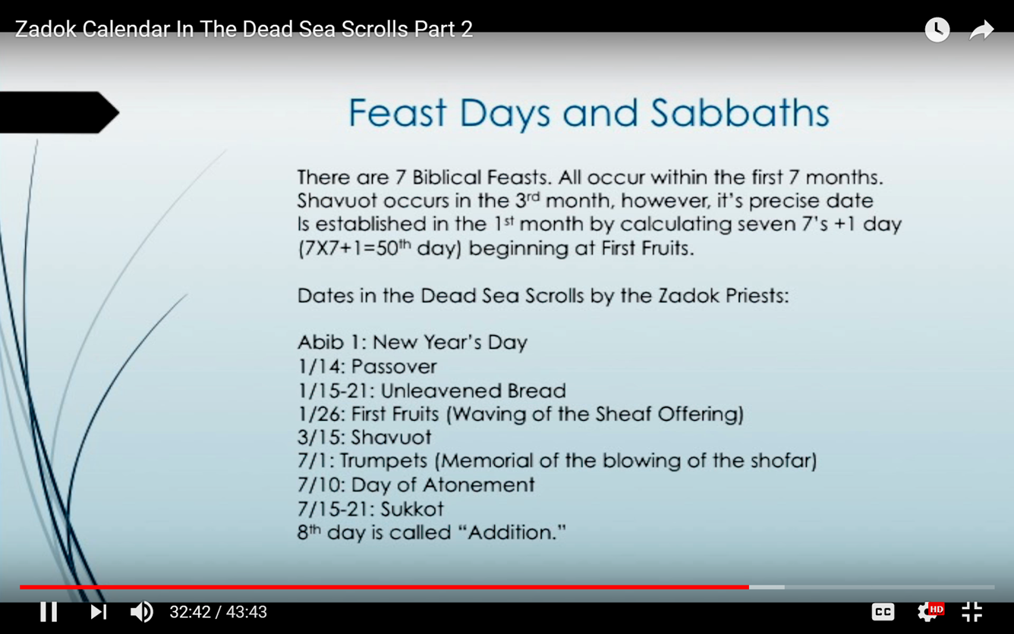

Enoch/Zadok Spring Festival Dates
Conflict #5
PARTIAL REVIEW
This evidence lists “dates” for Passover, ULB
and First Fruits.
(Side Note: Manna ends on Abib 16th. What does Enoch
offer for food
until Abib 26?)
There is nothing here to
indicate Resurrection timing!

Slide 39
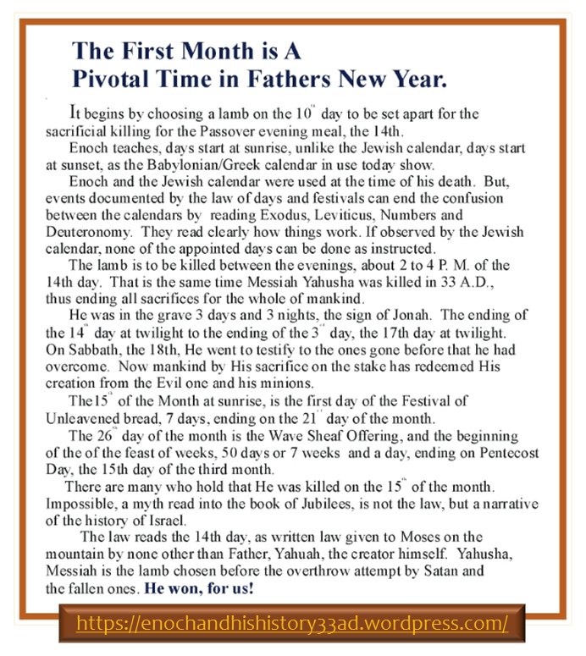

Enoch/Zadok
Spring
Festival Dates
This evidence lists the “3 days & 3 nights” beginning with “dawn twilight” on Abib 15th
to “dawn” of
Sabbath Abib 18th.
Remember, Joshua’s year had Wave Sheaf
& ULB on Abib 15!
Enoch’s Wave Sheaf on Abib 26th – with Pentecost on 15th day of the 3rd month!

Slide 40

Charting Enoch’s Evidence for:
Conflict #5 TUE Passover & ABIB 18 Resurrection
Huge Counterfeit Conflict
#5a
1st (Sun) | 2nd (Mon) | 3rd (Tues) | 4th (Wed) | 5th (Thur) | 6th (Fri) | 7th (Sabb)
 |  |  | 1 | 2 | 3 | 4
5 | 6 | 7 | 8 | 9 | 10 | 11
12 | 13 | 14 P/O | 15 ULB | 16 ULB | 17 ULB | 18
19 ULB | 20 ULB | 21 ULB | 22 | 23 | 24 | 25
26 FF | 27 | 28 | 29 | 30
START
RISEN
3 Days and 3 Nights
Serious Concerns with this Enoch calendar:
Tuesday Passover has no alignment with the “midst of the week” as documented in Dan 9:27.
Resurrection is s-t-r-e-t-c-h-e-d to the Sabbath morning twilight of Abib 18.
First Fruits does NOT follow the weekly Sabbath in the Passover festival week on Enoch’s Abib 19.
Notes:
This ascension is the fulfillment (antitype) of the “type.”

Slide 41

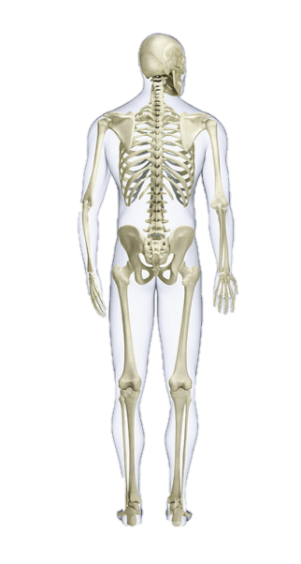
Charting Enoch’s Evidence for:
TUE Passover & ABIB 26 Wave Sheaf
1st (Sun) | 2nd (Mon) | 3rd (Tues) | 4th (Wed) | 5th (Thur) | 6th (Fri) | 7th (Sabb)
 |  |  | 1 | 2 | 3 | 4
5 | 6 | 7 | 8 | 9 | 10 | 11
12 | 13 | 14 P/O | 15 ULB | 16 ULB | 17 ULB | 18
19 ULB | 20 ULB | 21 ULB | 22 | 23 | 24 | 25
26 FF | 27 | 28 | 29 | 30
#5b
Huge Counterfeit
START
RISEN
3 Days and 3 Nights
WAIT …
AND WAIT, AND WAIT FOR THIS WHOLE WEEK TO PASS TO ARRIVE AT ASCENSION DAY.
THEN -
Other Serious Concerns with Enoch’s calendar:
Abib 26 Wave Sheaf Ascension is
on hold till another 8 days pass.
Yahusha must refrain from human touch to not contaminate His pure offering before Abib 26.
Enoch removes the Skeleton Structure of our Salvation!
The 1st cycle of the week is the correct day for a Wave Sheaf – it’s just that Enoch is a week late for the anti-type event!
Notes:
This ascension is the fulfillment (antitype) of the “type.”

Slide 42

As just illustrated Wave Sheaf was NEVER to be celebrated as a floating festival each year – because it places the TYPE “Ascension” before “Resurrection.”
The Wave Sheaf Yearly Prophecy
Every Wave Sheaf festival was prophetic of the exact day of the week that Yahusha would represent the Wave Sheaf ANTITYPE that had been rehearsed for ages.
The Prophecy was FULFILLED when Yahusha, as The Premier
WAVE SHEAF / FIRST-FRUIT, was PRESENTED BEFORE HIS FATHER after HE talked with Miriam at the tomb (John 20:17).
All this is the GOOD NEWS of Wave Sheaf!

Slide 43

Wave Sheaf Statute Placement
R
E
V
I
E
W
ABIB 15
1ST Unleavened
Bread Sabbath
Lev 23:6 And on the fifteenth day
of the same month is the feast of unleavened bread unto [Yahuah].
#1
ABIB 14
PASSOVER
Abib 15 “ULB” always follows Abib 14 Passover.
#2
7th Day SABBATH AFTER or ON PASSOVER
1st cycle Wave Sheaf always follows the 7th Day Sabbath.
1ST CYCLE
Wave Sheaf
Ceremony
Lev 23:11 ‘And he shall wave the sheaf before [Yahuah], for your acceptance. On the morrow after
the Sabbath^{[H7676]} the priest waves it.’
Josh 5:11 fulfills both Calendar Statutes in Absolute Perfection!
Two “Morrows”
(#1) 1ST CYCLE
Wave Sheaf
Ceremony
a) Wave Sheaf gave permission -
Josh 5:11 And they did eat of the old corn of the land on the morrow after the Passover, unleavened cakes, and
parched corn in the selfsame day.
ABIB 14 PASSOVER
ON 7TH DAY Sabbath
in Joshua’s year!
(#2) ABIB 15
1ST Unleavened
Bread Sabbath
b) To eat the grain of the land.

Slide 44
The Highlight of Wave Sheaf
Every Wave Sheaf ceremony was a prophecy!
This is what it meant for 1500+ years…
The “moment of pre sun-rise light” marks Yahuah’s
“skeletal bone structure” plan for every single person.
THEN … at that time Yahusha, (as the Wave Sheaf / First-Fruit),
would completely fulfill every requirement
for the whole plan of salvation on THAT day!
That is when our death penalty was fully satisfied
and recognized through Yahusha,
the Highest Priest of the Melchizedek Order.
Does this information illustrate how/why the
Wave Sheaf Festival is so important for us?

Slide 45

Beware of Error Giving Honour to Abib 16
Beware:
A Wave Sheaf festival that is married to Abib 16 has no Scriptural foundation.
Also beware of any suggestions that say:
Permission to eat the grain was not in effect until Abib 16.
If that were the case, this suggestion would eliminate
the word usage of “the same day.” Why?
Because Israel was given permission to eat the
grain of the land “on the same day”
the grain was used for the Wave Sheaf offering.
(Yes, the grain was harvested, threshed,
ground and baked for unleavened bread
that day – Abib 15! )
Understanding Wave Sheaf is a most
important part of Joshua’s study and
Torah Statutes to the end of time.

Slide 46

#11 Joshua Confirms:
Celebrating Wave Sheaf has priority before honouring the
1st Sabbath of Unleavened Bread.
It is way more significant because
Wave Sheaf is a prophecy given about 1500 years in advance of when Yahusha would ascend heavenward.
The celebration of Wave Sheaf
should never be a forgotten festival!
Question: When Abib 15 and the H7676 Sabbath share
the same date, which “Sabbath” has priority?

Slide 47
Many that honour the Feasts and Festivals understand the placement of
Wave Sheaf is always and ONLY on Abib 16.
In other words, WHEN Wave Sheaf is married to Abib 16, THEN it will float on
any day of the week from year to year. Why is this a problem?
Reviewing two of the reasons:
By statute - Wave Sheaf must follow the weekly H7676 Sabbath every year.
(It’s not possible for Abib 16 to follow the weekly Sabbath every single year!)
The correct prophetic “day of the week” as specified for the Wave Sheaf festival
of our Messiah’s “1st Ascension” is completely obliterated when tied to Abib 16
for all those years the Yisra'elites would have been practicing foolishness!
R
E
V
I
E
W
Another Abib 16 Floating Wave Sheaf …
… Problem Needs to be Addressed in Category 3:
WHEN the Wave Sheaf is placed on Abib 16 following the
1st annual Sabbath of Unleavened Bread …THEN the
Counting of the Omer will not be accurate or correct.
As a result, the Pentecost festival will be seriously misplaced.

Slide 48

Instructions for Counting the Omer
Lev 23:15-16 And you shall count for yourselves from the day after the Sabbath ^{[H7676]}, from the day that you brought the sheaf of the wave offering: seven Sabbaths shall be completed.
16 Count fifty days to the day after the seventh Sabbath ^{[H7676]}; then you shall offer a new grain offering to [Yahuah]. NKJV
Pentecost can only follow a 7th Day Sabbath ^{[H7676]}
because there are no other annual
Sabbaths, or holy convocations,
close to this point in time for the
50th cycle to follow “after”!
The next set of charts will illustrate the problem, and the solution. Abib 14th Passover is placed on the 7th Day Sabbath as seen in the book of Joshua.

Slide 49
Chart #1
The Problem of a Floating Wave Sheaf on Abib 16 & the Omer Count

Slide 50

Counting the Omer from
Abib 16 Wave Sheaf
1st Cycle [Sun] | 2nd Cycle [Mon] | 3rd Cycle [Tues] | 4th Cycle [Wed] | 5th Cycle [Thur] | Prep Day [Fri] | Sabbath [Sat]
Day 1 Month 1 | 2 | 3 | 4 | 5 | 6 | 7
8 | 9 | 10 | 11 | 12 | 13 | 14 Passover
15 | 16 Wave Sheaf #1 | 17 #2 | 18 #3 | 19 #4 | 20 #5 | 21 #6
22 #7 | 23 #8 | 24 #9 | 25 #10 | 26 #11 | 27 #12 | 28 #13
29 #14 | 30 #15
??
Does not count as a complete week!
1st
Only 1 Completed Omer Week in the Month of Abib.
There needs to be six additional completed Sabbath weeks to the 50th day.

Slide 51

[Con’t] Counting the Omer from
Abib 16 Wave Sheaf
1st Cycle [Sun] | 2nd Cycle [Mon] | 3rd Cycle [Tues] | 4th Cycle [Wed] | 5th Cycle [Thur] | Prep Day [Fri] | Sabbath [Sat]
29 #14 | 30 #15 | Day 1 [M2] #16 | 2 #17 | 3 #18 | 4 #19 | 5 #20
6 #21 | 7 #22 | 8 #23 | 9 #24 | 10 #25 | 11 #26 | 12 #27
13 #28 | 14 #29 | 15 #30 | 16 #31 | 17 #32 | 18 #33 Day | 19 #34
20 #35 | 21 #36 | 22 #37 | 23 #38 | 24 #39 | 25 #40 | 26 #41
27 #42 | 28 #43 | 29 #44 | 30 #45 | Day 1 [M3] #46 | 2 #47 | 3 #48
4 #49 | 5 #50
2nd
3rd
4th
5th
6th
This 50th day does not follow a
H7676 weekly Sabbath (Lev 23:16).
??
Problems! Only 6 Completed Omer Weeks. This method does not fulfill Lev 23:15-16. The Omer Count is Incorrect!

Slide 52
Chart #2
Proper Placement of Wave Sheaf Solves the Omer Count

Slide 53

Counting the Omer from
Wave Sheaf Following the Sabbath
1st Cycle [Sun] | 2nd Cycle [Mon] | 3rd Cycle [Tues] | 4th Cycle [Wed] | 5th Cycle [Thur] | Prep Day [Fri] | Sabbath [Sat]
Day 1 Month 1 | 2 | 3 | 4 | 5 | 6 | 7
8 | 9 | 10 | 11 | 12 | 13 | 14 Passover
15 Wave Sheaf #1 | 16 #2 | 17 #3 | 18 #4 | 19 #5 | 20 #6 | 21 #7
22 #8 | 23 #9 | 24 #10 | 25 #11 | 26 #12 | 27 #13 | 28 #14
29 #15 | 30 #16
1st
2nd
2 Completed Omer Weeks in Abib

Slide 54

[Con’t] Counting the Omer from
Wave Sheaf Following the Sabbath
1st Cycle [Sun] | 2nd Cycle [Mon] | 3rd Cycle [Tues] | 4th Cycle [Wed] | 5th Cycle [Thur] | Prep Day [Fri] | Sabbath [Sat]
29 #15 | 30 #16 | Day 1 [M2] #17 | 2 #18 | 3 #19 | 4 #20 | 5 #21
6 #22 | 7 #23 | 8 #24 | 9 #25 | 10 #26 | 11 #27 | 12 #28
13 #29 | 14 #30 | 15 #31 | 16 #32 | 17 #33 | 18 #34 | 19 #35
20 #36 | 21 #37 | 22 #38 | 23 #39 | 24 #40 | 25 #41 | 26 #42
27 #43 | 28 #44 | 29 #45 | 30 #46 | Day 1 [M3] #47 | 2 #48 | 3 #49
4 #50 | 5
3rd
4th
5th
6th
7th
7 Perfect Completed Omer Weeks

Slide 55
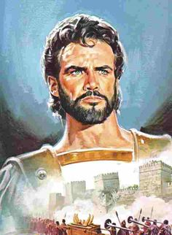
#12 Joshua Confirms:
When Wave Sheaf follows
the H7676 Weekly Sabbath,
(beginning Omer Count #1),
there will be 7 perfect
completed weeks to
the 50th Day of Pentecost.
Does Pentecost have anything to do with H7676?

Slide 56

Back to this Very Important Note
1st (Sun) | 2nd (Mon) | 3rd (Tues) | 4th (Wed) | 5th (Thur) | 6th (Fri) | 7th (Sabb)
Abib 1 | 2 | 3 | 4 | 5 | 6 | 7
8 | 9 | 10 | 11 | 12 | 13 | 14 H7676 & Passover
15 Wave Sheaf | 16 | 17 | 18 | 19 | 20 | 21
Note: This is a sample calendar year for Joshua 5.
Many feast camps place the Wave Sheaf following the
Unleavened Bread Sabbath on Abib 16 every year.
The Torah instructions (& Joshua’s testimony) show
Wave Sheaf follows the weekly Sabbath within the Passover Festival – not the ULB Sabbath. This was shown by the use of the Hebrew number H7676 for the weekly Sabbath. If we did not have these numbers how would we know that Wave Sheaf doesn’t follow the ULB Sabbath?

Slide 57
Torah Instruction for Pentecost Count Without Hebrew Numbers
Wave Sheaf
Lev 23:11 ‘And he shall wave the sheaf before [Yahuah], for your acceptance.
On the morrow after the Sabbath the priest waves it.’
Note: This “Sabbath” could be understood to follow the ULB Feast Sabbath
if there were no Hebrew numbers to designate it was a weekly Sabbath.
Pentecost
Lev 23:15-16 And ye shall count unto you from the morrow after the Sabbath from the day that ye brought the [wave] sheaf of the wave offering; seven sabbaths shall be complete:
16 Even unto the morrow after the seventh Sabbath shall ye number fifty days; and ye shall offer a new meat offering unto Yahuah.
Note: Can this Pentecost “Sabbath” be understood to follow a
Feast Sabbath if there were no Hebrew numbers to designate a
weekly Sabbath in verse 16?

Slide 58
There are no Feast Sabbaths in the 3rd month! When the Omer count begins with an Abib 16 Wave Sheaf date ~ Pentecost will not follow the weekly Sabbath as Lev 23:16 designates!
No!
1st Cycle [Sun] | 2nd Cycle [Mon] | 3rd Cycle [Tues] | 4th Cycle [Wed] | 5th Cycle [Thur] | Prep Day [Fri] | Sabbath [Sat]
29 #14 | 30 #15 | Day 1 [M2] #16 | 2 #17 | 3 #18 | 4 #19 | 5 #20
6 #21 | 7 #22 | 8 #23 | 9 #24 | 10 #25 | 11 #26 | 12 #27
13 #28 | 14 #29 | 15 #30 | 16 #31 | 17 #32 | 18 #33 Day | 19 #34
20 #35 | 21 #36 | 22 #37 | 23 #38 | 24 #39 | 25 #40 | 26 #41
27 #42 | 28 #43 | 29 #44 | 30 #45 | Day 1 [M3] #46 | 2 #47 | 3 #48
4 #49 | 5 #50
In 6 out of 7 years it is impossible for a Pentecost count from Abib 16 to follow the weekly Sabbath!

Slide 59

Back to this Very Important Note
1st Cycle [Sun] | 2nd Cycle [Mon] | 3rd Cycle [Tues] | 4th Cycle [Wed] | 5th Cycle [Thur] | Prep Day [Fri] | Sabbath [Sat]
29 #15 | 30 #16 | Day 1 [M2] #17 | 2 #18 | 3 #19 | 4 #20 | 5 #21
6 #22 | 7 #23 | 8 #24 | 9 #25 | 10 #26 | 11 #27 | 12 #28
13 #29 | 14 #30 | 15 #31 | 16 #32 | 17 #33 | 18 #34 | 19 #35
20 #36 | 21 #37 | 22 #38 | 23 #39 | 24 #40 | 25 #41 | 26 #42
27 #43 | 28 #44 | 29 #45 | 30 #46 | Day 1 [M3] #47 | 2 #48 | 3 #49
4 #50 | 5 | 6 | 7 | 8 | 9 | 10
Wave Sheaf Torah Instruction:
Lev 23:11 ‘And he shall wave the sheaf before [Yahuah], for your acceptance. On the morrow after the Sabbath ^{[H7676]} the priest waves it.’
3rd
4th
Pentecost Torah Instruction:
Lev 23:16 Even unto the morrow after the seventh Sabbath ^{[H7676]} shall ye number fifty days …
5th
6th
7th
Both Wave Sheaf & Pentecost Must Follow
the H7676 Weekly Sabbath Every Year!

Slide 60


3rd Witness to Settle the
Challenge of Wave Sheaf Placement is:
Is there history around Abib 16?

Slide 61
The Unscriptural Traditional
Command of Wave Sheaf on Abib 16
Truth:
Wave Sheaf is always celebrated on the morrow after
the weekly Sabbath during the Spring Festivals.
This is ‘day one’ for Counting the Omer.
Omer means “sheaf.”
The command for Counting the Omer originates in Lev 23:15.
It is a mitzvah (commandment) to count the Omer for the seven complete weeks between Wave Sheaf and Pentecost.
Tradition:
The Wave Sheaf Festival is always fixed to the Abib 16 date
(as a floating Wave Sheaf / Firstfruits Festival).
Counting the Omer is according to Jewish tradition.
R
E
V
I
E
W
BRAND
NEW

Slide 62


Jewish Tradition Leads the Way
The Jewish Omer Count from Wave Sheaf to Pentecost
always begins on the third day of the Passover spring festival. Wave Sheaf always follows the 1st Sabbath of Unleavened Bread with celebrations on Abib 16.
There are also a series of restrictions that arise during the period of the counting of the Omer up until Lag Ba’Omer, which translates as the 33rd day in the count of the Omer. The tradition is: to mourn the first 33 days
until the 34th day in the morning.
For the Jews, a large portion of the seven-week counting period is considered a mourning period that ends with:

Slide 63



Lag Ba'Omer is a minor Jewish holiday that falls between the festivals of Passover and Pentecost.
In Jewish tradition, the 33rd day of the Omer Count is regarded as a holiday that commemorates the death of “Rashbi” [Rabbi Shimon bar Yochai] (80-160 AD).

Slide 64


Hebrew letters may be used to express numbers.
"Lag" is a combination of two Hebrew letters: Lamed and Gimmel.
The word “Lag” is an acronym for 33 – derived from Lamed (30) and Gimmel (3).
The phrase “Lag Ba’Omer” indicates
the 33rd day of the Omer Count.
This day is always celebrated on the
18th day of the second month on the Jewish Calendar.

Slide 65
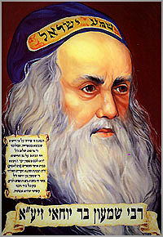
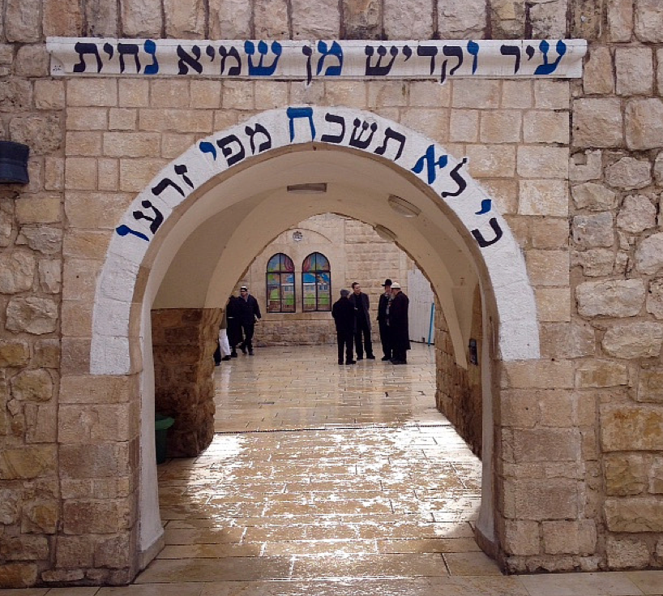
Who is Rabbi Shimon bar Yochai?
“RASHBI” [Rabbi Shimon bar Yochai] (80-160 AD), a disciple
of Rabbi Akiva (50-135 AD); is the author of the Zohar,
the most famous book of the Kabbalah.
Many Jews have witnessed miracles of all kinds after praying at his holy grave site.
On the day of Rashbi’s death, he revealed the mystical dimension of the Torah known as the Kabbalah
(a form of Jewish mysticism).

Slide 66
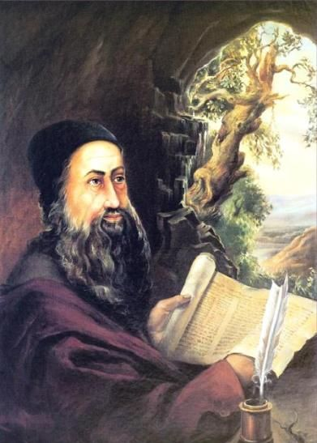

Rashbi’s Connection to Lag Ba’Omer
The day of his death was the 33rd day of the Omer Count.
Every anniversary celebrates this “hidden torah” or
the anniversary of the revelation of Kabbalah.
This Jewish holiday holds equal importance to Pentecost
[the giving of the written Torah to Moses].
Celebrations are held in the village of Meron, near Israel, at Rashbi’s supposed burial site.
Hundreds of thousands of Jews gather at
Mt Meron to pray and celebrate the Kabbalah.
MANY bonfires are lit at sunset on the 32nd
day of the Omer count to commemorate
the death of Rashbi.
(Remember: “sunset” on the 32nd ushers in the 33rd day according to Jewish tradition.)

Slide 67


May 2015 Posters

Slide 68

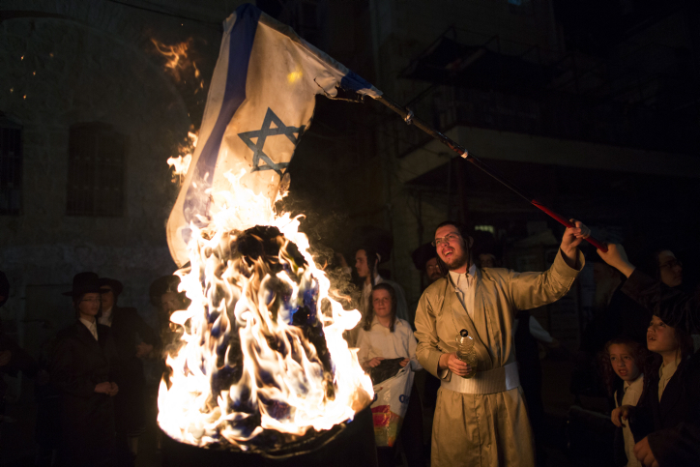
Lag Ba’Omer is a HUGE
Jewish Celebration
The internet is emphatic about this festive day on the Jewish calendar.
It’s amazing the amount of internet coverage there was for May 7, 2015, Lag Ba’Omer, [the 33rd day of the Omer Count for 2015].
Every year this celebration is
attended with much fanfare
for Rashbi, (the great mystic
sage), on the anniversary
of his death.

Slide 69
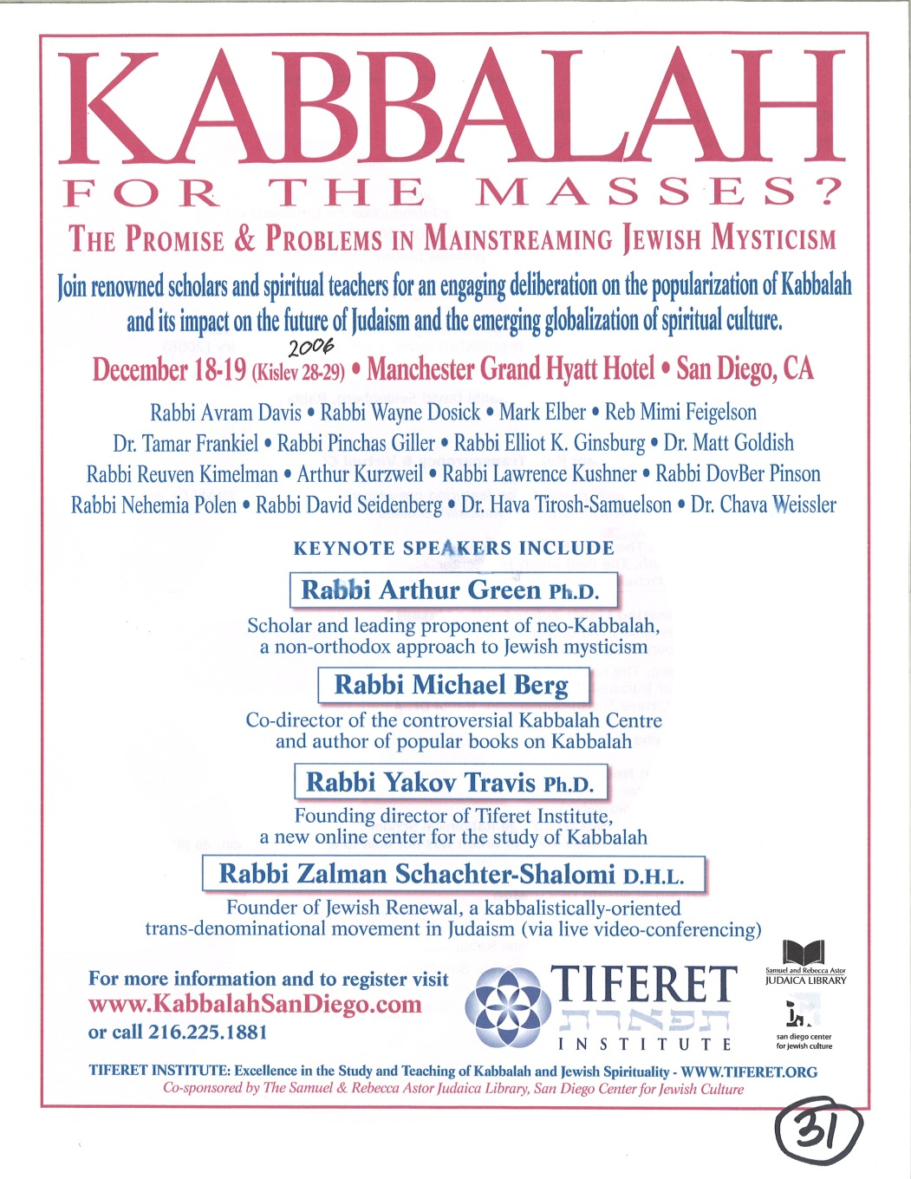

Lag Ba’Omer is Very Popular
New York City
2015
Excellence in the Study and Teaching of Kabbalah and Jewish Spirituality.

Slide 70

How Did Rashbi’s Death Get Connected to Wave Sheaf?
In the year Rashbi died the Jews could have been celebrating Wave Sheaf
(on the first day of the week),
according to the instructions in Lev 23.
(There is historical evidence of this.)
Therefore: The 33rd day of the Omer Count would be
the 18th day of the second month for THAT year only!
Remember: Rashbi died on the 33rd day of the Omer Count.
(That’s an interesting “mystical number.”)
For nearly 1860 years, RASBHI has been honoured
as a saint on every 33rd day of the Omer Count.
This day ALWAYS links back to Abib 16 as Wave Sheaf …
even if it is not the true Wave Sheaf!

Slide 71
Rashbi’s Death Changed the Correct Timing of Wave Sheaf!
This is how Wave Sheaf became permanently tied to Abib 16.
In THAT YEAR, Wave Sheaf could have been correctly located on Abib 16 – Sunday, the first day of the week. When Wave Sheaf
is married to Abib 16, it does not fall on the 1st cycle every year.
Since that time, the 33 days are always counted back to the date of Abib 16 so that the Rabbi’s death would always be celebrated on the 18th day of the second month.
However, this event not only became a problem,
but is now a widely accepted counterfeit,
just as sunset is a counterfeit for creation’s day-start.
Be willing to challenge every teaching
to see if it links to a tradition!
Notes:
Beware of traditions that creep in so shrewdly!

Slide 72

Should Covenant Torah-Keepers
Observe Lag Ba’Omer?
No!
The holiday is not a Torah command.
It is derived entirely from Rabbinic
and occultic tradition.
Everything about this celebration is linked to
the mystical writings of Kabbalah.
Rashbi did not acknowledge Yahusha as the Messiah.
“Kabbalah” is a deceptive system of thought that seduces people into denying that they are sinners in need of salvation.
The Kabbalist believes each of us are essentially divine beings.
There is no need of any Saviour.
Everyone is pure, and just needs to be enlightened
(through the mystical worship of Lucifer).

Slide 73

It is clear the traditional Wave Sheaf linked to only Abib 16 has strong ties to Kabbalistic ways including mysticism and all associated links
to the Jesuits and secret societies!
QUESTION:
Why are so many “so called”
Torah (Feast) Keepers
honoring Abib 16 when this date is
widely connected to such mysticism?
Maybe they just don’t know! Let’s tell them!

Slide 74

Lag Ba’Omer definitely counterfeits
the true meaning of Wave Sheaf!
Yahusha DID NOT ascend to heaven on any
day of the week except for the 1st cycle [Sunday]!
Should honest Torah Keepers
sever their connection to a yearly
Abib 16 Wave Sheaf?
Yes!
Absolutely!

Slide 75
Does that mean the Wave Sheaf Festival is NEVER on Abib 16?
R
E
V
I
E
W
There is no rule that Wave Sheaf
can never occur on Abib 16.
If Passover is on Friday Abib 14 …
THEN: Abib 15 is the 7th Day Sabbath AND
the Unleavened Bread Sabbath …
THEREFORE: Abib 16 celebrates Wave Sheaf
(on the “day after the weekly Sabbath”
as given in Scripture).
No!
Many Feast-keepers and ministries have Wave Sheaf married to Abib 16.
It behoves us to wonder how they missed the clear instructions
from the Torah. The result?
Wave Sheaf on Abib 16 becomes a floating date on the calendar
demanding Pentecost is also allocated to a floating date.
On the next slide: Let’s examine a calendar from a Christian Feast
ministry with their Wave Sheaf/Firstfruits Festival married to Abib 16.

Slide 76
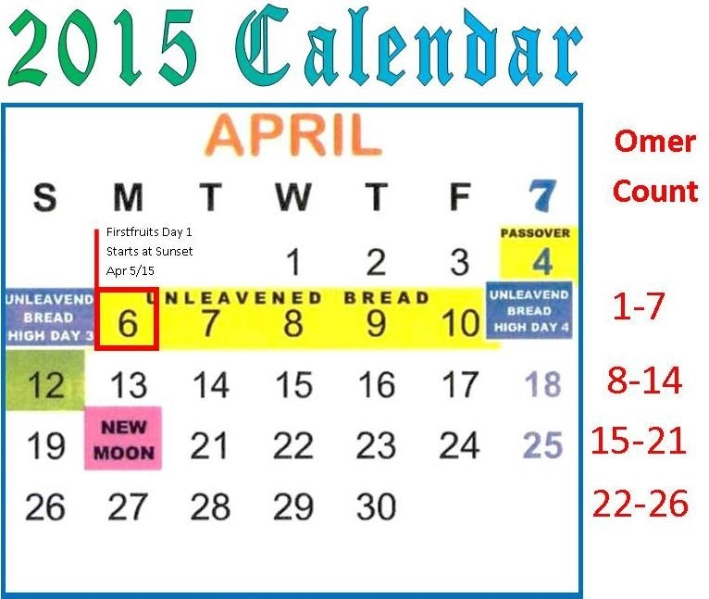
A Christian Calendar for Wave Sheaf
The Question is:
How will the following Christian Feast Calendar compare to the traditional Jewish calendar for 2015?
Day One of the Omer Count begins at sunset on Sunday Apr 5th. Wave Sheaf is Monday Apr 6th.
Will Day 33 of the Omer Count land on Thursday May 7, 2015 exactly like the Jewish calendar?

Slide 77
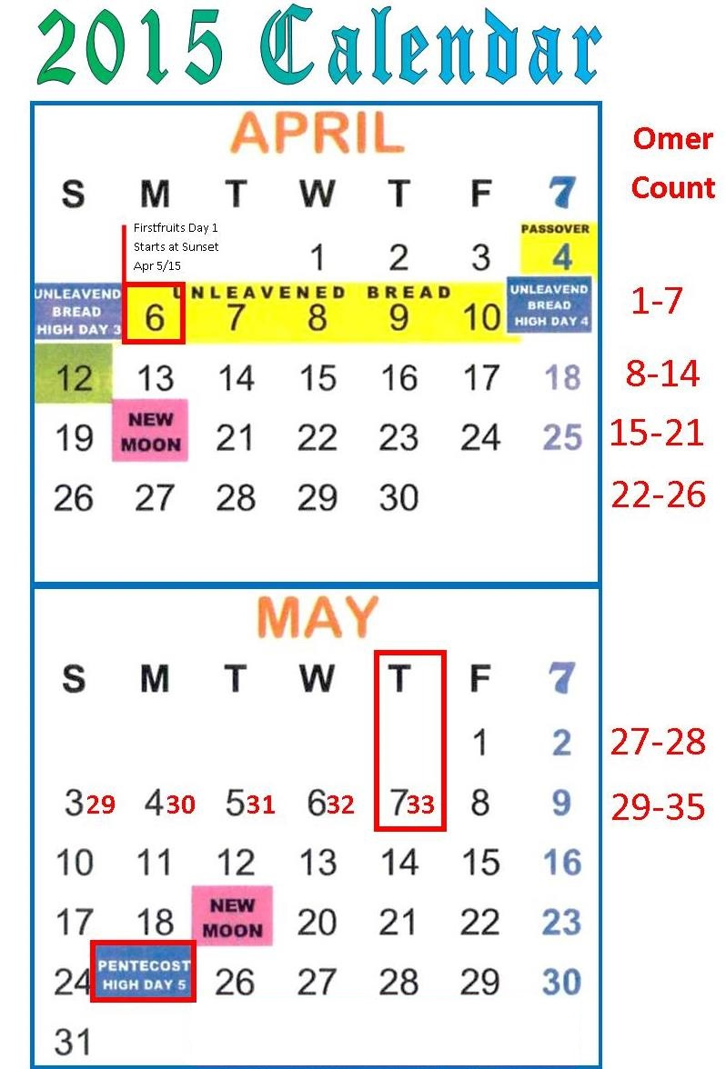
Answer:
Christian Feast Keepers that follow this Jewish calendar likely do not know the 33rd day of the Omer count pays respect to the great mystic sage Rashbi!
When they find out, perhaps they will celebrate the Wave Sheaf/Firstfruits festival according to the instructions of Moses and Joshua.
This Christian Feast
Calendar does
favor Lag Ba’Omer which begins at
sunset on May 6th!
May 7th is the 33rd day.

Slide 78
Endorsement from J. Morgenstern Hebrew Union College (Indiana)
“Actually the legislation for the bringing of the ‘Omer, the first sheaf of the new, annual crop, is recorded in only one passage of the entire Pentateuch, Lev. 23:9-16 … This legislation provides that the ‘Omer is to be waved before Yahweh by the priest upon the day following the Sabbath … The basic difficulty here is the determination of the precise dating implicit in the term, “the day after the Sabbath.” The customary interpretation, accepted by most present-day biblical scholars, is that the Sabbath here is the Sabbath which falls within the week of the Passover-Massot Festival. Such too was the interpretation given of old to this term by three quite ancient Jewish sects, the Samaritans, the Boethusians and the Karaites. This would imply, of course that the day of bringing the ‘Omer was always a Sunday, and also since the counting of the fifty days which intervened between the day of bringing the ‘Omer and the Sabu’ot Festival commenced upon a Sunday, the latter festival also would fall always upon a Sunday…”
(Hebrew Union College [Originally founded 1875; Besides Israel, 5 colleges in USA]
Annual – Article: ‘Lag ba’Omer – Its Origin and Import’ by Julian Morgenstern,
[a President of] Hebrew Union College -Jewish Institute of Religion, p. 81-90.)
Yes!

Slide 79
Besides “History,” Morgenstern’s
Testimony, and the witness
in the Exo 12-16-19 account
of Passover to Pentecost …
#13: Joshua also Confirms:
Wave Sheaf is not married to Abib 16 –
the day following the 1st Sabbath of Unleavened Bread;
Wave Sheaf is always placed
within the Passover Festival
contrary to Enoch’s teaching.

Slide 80

Counsel From the Apostle Paul
Ephesians 5:8-13
8 For you were once darkness, but now you are light in [yahuah]. Walk as children of light
9 (for the fruit of the Spirit is in all goodness, righteousness, and truth),
10 finding out what is acceptable to [Yahuah].
11 And have no fellowship with the unfruitful works of darkness, but rather expose them.
12 For it is shameful even to speak of those things which are done by them in secret.
13 But all things that are exposed are made manifest by the light, for whatever makes manifest is light. NKJV

Slide 81

It’s very possible many do not understand it is
“complete darkness” to consistently celebrate
Wave Sheaf on Abib 16.
Lev 23 along with Joshua, Exodus and the Gospel account expose the unfruitful works of darkness.
Once the evidence is brought forth,
everyone can make their choice.

Slide 82
Comparing the Evidence
R
E
V
I
E
W
Wave Sheaf by
Tradition
Wave Sheaf by
Scripture
When Wave Sheaf
is consistently celebrated on Abib 16, it links to a Rabbi that gravitated towards the darkness of mysticism and Kabbalah which has powerful ties to the “prince of darkness.”
When Wave Sheaf is celebrated
on the “Morrow after the weekly Sabbath” it links to our Messiah when He presented Himself as “THE leading First-Fruit” after His resurrection. Wave Sheaf links to that ascension event – a powerful victory for His children. This is extremely significant and important because it is one of
the most basic events known to man providing the foundational [bone] structure of the Plan of Salvation.

Slide 83

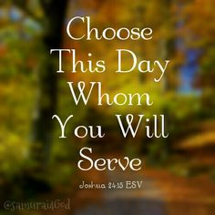
Wave Sheaf Festival Choices
The tradition of Abib 16 pales
in comparison
to the Torah Truth of the Wave Sheaf Festival!
Wave Sheaf Following H7676 Sabbath honoring Yahusha’s Ascension & Victory for US!
Wave Sheaf Following ULB Sabbath on
Abib 16 honoring
Rashbi & Kabbalah Mysticism?

Slide 84

1 Corinthians 14:33, 40
For Yahuah is not the author of confusion …
Let all things be done decently and in order.
May Yahuah
bless you abundantly
in your search
for His
Divine truth.
The End

Slide 85
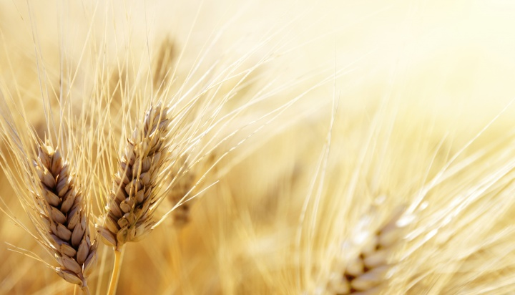


Questions/Comments
on the placement
of Wave Sheaf?
charlene@studythecalendar.com
shofar1owr@gmail.com
www.studythecalendar.com

