Slide 1
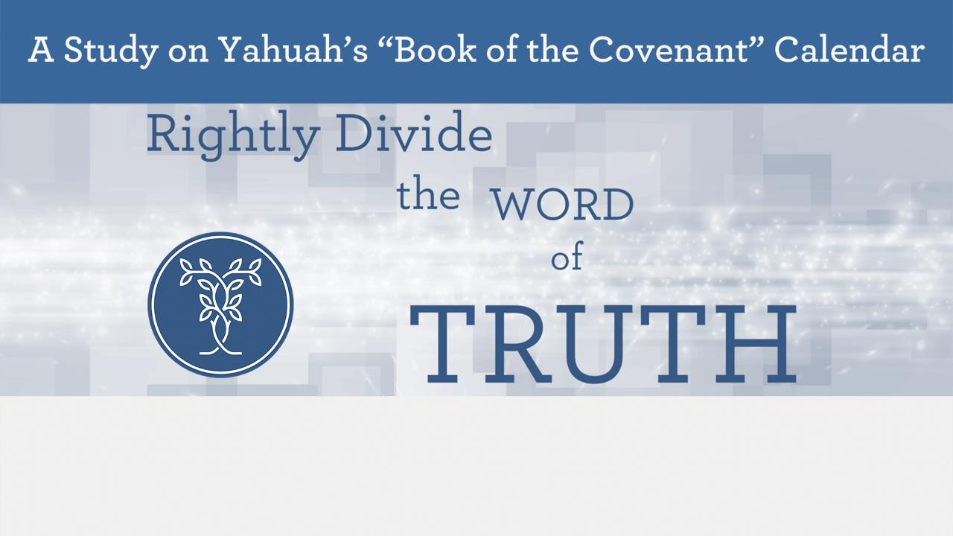


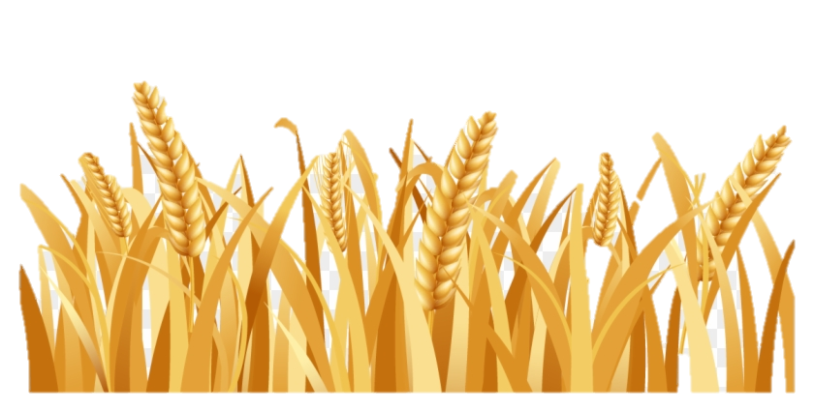
Nov 7/19: All errors of Mashiach were corrected on slides 44 – 48 – 57 (Not: Maschiach!!!!!) Tanach (with an “h” … no “k” …
Sept 17/22:
Corrected statues spelling error on #16.
#42 – wording changes too.
Part 2
The Song of Joshua’s Sickle
Notes:
Sickle #1: https://youtu.be/rRNT1bbmHYQ
Sickle #2: https://youtu.be/wO0jscCA4aU
Sickle #3: https://youtu.be/wF3fTceJTwQ
Sickle #4: https://youtu.be/iEN6c3chPyI
Sickle #5 https://youtu.be/GXuOtas-cHQ
Sickle #6 https://youtu.be/k0SXea7wNL0

Slide 2


Basic Pre-Summary From Part 1
Yahuah’s requirements thus far:
1. Enter the land.
2. Observe Passover. (Abib 14)
3. Cut the First Wheat Wave Sheaf offering.
4. Roast & Grind Wheat; prepare a Flour and Oil Mixture.
5. Present the ascent offering (by fire) to Yahuah.
6. Bake Bread Dough for normal consumption.
7. Eat the Grain of the Land!
Abib 15
Fine
Part 2
Only after the Wave Sheaf and the ascension offerings had been presented was it acceptable to Yahuah to consume the FIRST Grain of the Land! Jos 5:11 - … AND THEY ATE …

Slide 3



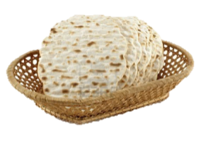
Order of Events for Yahusha’s Crucifixion
#4)
Abib 17,
7th day Shabbat
Resurrection;
4th Watch with Miryam
#7)
The Next
7th day Shabbat Outside of Passover Festival
This date
will be investigated
next!
#6)
The 2nd
Unleavened
Bread
Shabbat
(Passover Festival Ends)
#1)
Midst
of the
Week ~ Crucifixion
#3)
Prepare
for
Shabbat
14 | 15 | 16 | 17 | 18 | 19 | 20 | 21 | 22 | 23
24 | 25 | 26
#2)
The 1st
Shabbat
of
Unleavened
Bread
5) Wave Sheaf at Dawn ~ 1st cycle after the
7th day Shabbat. Yahusha ASCENDS to His
Father to fulfill the Wave Sheaf/First Fruit offering!
#8)
1st Cycle Outside
Passover Festival

Slide 4


Adding in Enoch’s Wave Sheaf Information!
IF – Enoch has a true calendar, does Yahusha still have to request a
9 cycle extension so He could offer Himself as another First Fruit offering (from Death), on Enoch’s 26th “DATE” of the month? NOTE: During Yahusha’s Passion week, THIS IS A – “MONDAY” ~ the 2nd cycle of the week! How is this in alignment with the Enoch Calendar – that submits Wave Sheaf must be on Sunday the 26th ~ not Monday the 26th?
Thoughts to
Question!
#1)
Midst of the
Week (Wed)
#3)
Time to Prepare
(Fri)
#4)
Shabbat
Resurrection & 4th Watch with Miryam
#7) 7th day
Shabbat
Outside the Festival
#6) The 2nd ULB
Shabbat (Wed)
(Passover Festival Ends)
#9) 2nd Cycle (Monday)
Outside the
Passover Festival
14 | 15 | 16 | 17 | 18 | 19 | 20 | 21 | 22 | 23
24 | 25 | 26
#2)
The 1st ULB
Shabbat (Tues)
5) Yahusha’s Wave Sheaf and ascension
was at Dawn ~ 1st cycle after the
H7676 7th day Shabbat.
#8)
1st Cycle (Sun) Outside the
Passover Festival

Slide 5
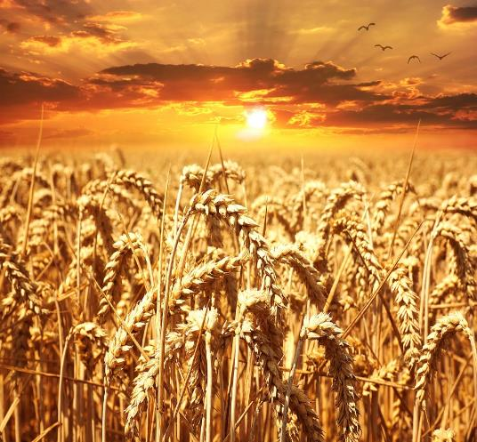
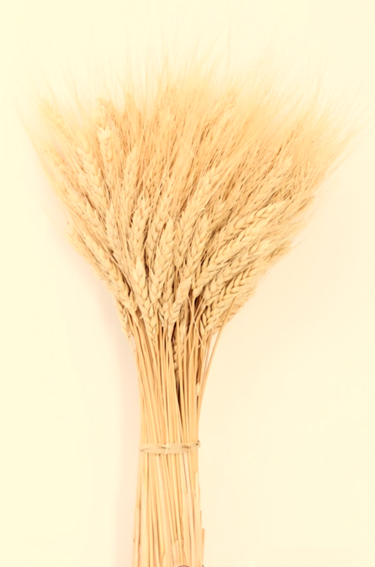
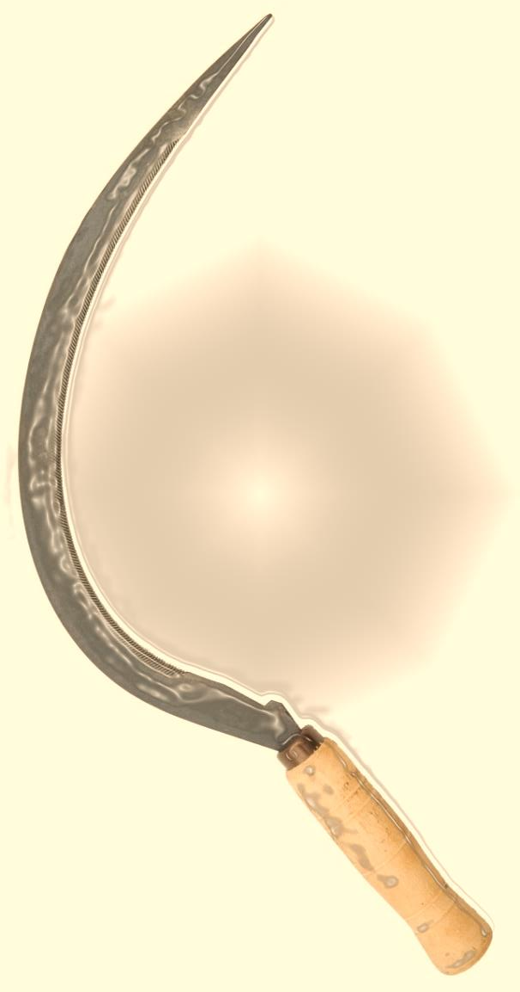
Yahusha’s “Anti-type”
Is it
Based on
Enoch’s
Sickle?

Slide 6


Part #2 Mapping the Discussion Topics
Section | Slides | Content of Topic
 | 2-11 | Review for Part #1 & Introduction for Part #2
3 | 12-16 | What About the Manna
4 | 17-33 | The Condition of Enoch’s Bread Offering!
4.1 | 24 | Divine Life of the Wave Sheaf Bread
5 | 33-53 | Yahusha and Wave Sheaf Placement (Torah or Enoch?)
5.1 | 41 | Yahusha - THE Perfect First-Fruit Offering

Slide 7
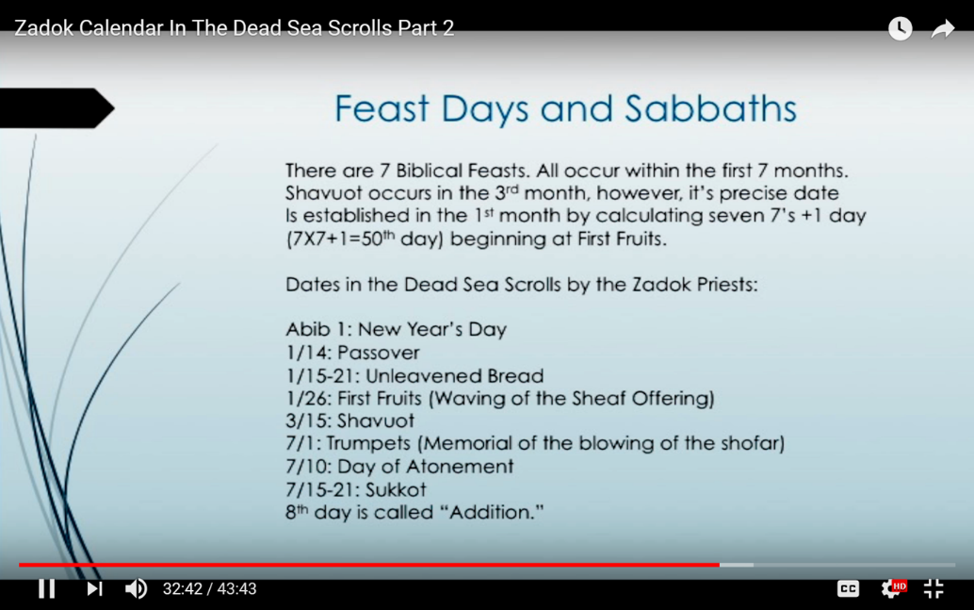
Review!
More on Enoch’s Wave Sheaf Date
Wave Sheaf offered on the 26 ^{th} of the 1st month????
Enoch
Zadok

Slide 8
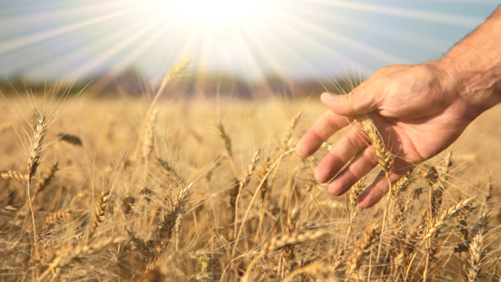


Introduction
Under Moses, only 2
Passovers were celebrated.
There was likely no grain in the desert those 40 years!
… what it must have been like to finally smell the
new grain and touch it!

Slide 9
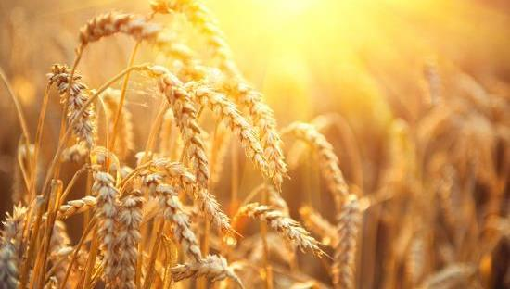
In Egypt, unleavened bread was to be eaten with the Passover meal.
Some feel Joshua allowed the people to process the old grain
in order to have unleavened bread for the Passover meal ~ saving the new grain for the Wave Sheaf!
Is this so?

Slide 10
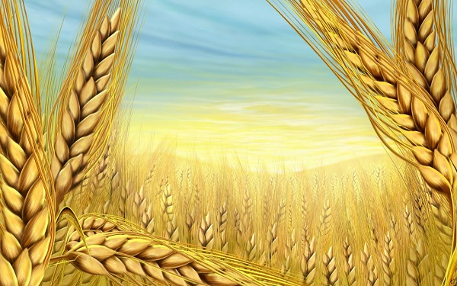
Remember the Command of Lev 23:14?!
WHAT?
And you
DO NOT EAT
How can you tell the difference between barley and wheat?
As far as appearance goes, barley has a long beard (the bristly material protecting the kernels) while wheat has a shorter one. When it is ready for harvesting, wheat is golden brown in hue, whereas barley is yellow-white.
1
2
3
bread or roasted grain or fresh grain …
This command includes
old & new grain ~
barley & wheat!

Slide 11
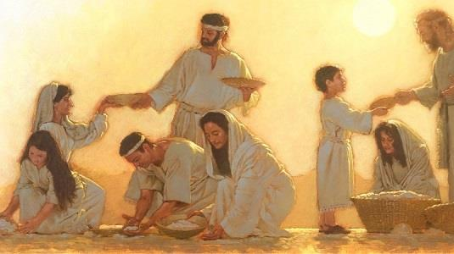
Manna for Passover …
… one more time!

Slide 12
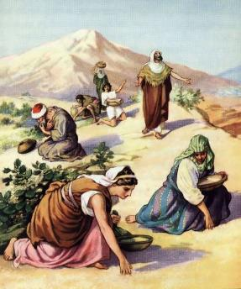

Section #3
Just when
did the
cease?

Slide 13

Review!
Yisra’el Enjoys The Grain!
And they ate of the stored grain of the land on the morrow after the Pesach, unleavened bread and roasted grain on the same day.
Josh 5:11
ABIB 15
No More Manna!
14 | Abib 15 - 1st Cycle - 1st Convocation of U/B | Abib 16
Josh 5:12 And the manna ceased on the day after
they had eaten of the stored grain of the land.
And the children of Yisra’el no longer had manna,
but they ate the food of the land in Kena’an that year.
N
E
W

Slide 14
For Israel, who ate the grain of the land on Abib 15, there would be NO reason to look for manna on Abib 16 – the 2nd cycle of the week!
What about Enoch’s calendar?
Remember Enoch’s quote?
The Sickle’s FIRST Harvest, as claimed by Enoch’s calendar, asserts the Wave Sheaf offering of First Fruits (for the count to Shavuot) cannot be performed until Abib 26 (hungry or not)!
1/26: First Fruits (Waving of the Sheaf offering)

Slide 15
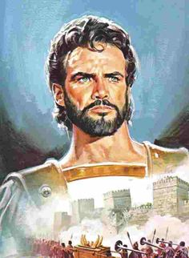



While Joshua was quite able to fulfill the
Torah’s requirements concerning the
Feast of Unleavened Bread;
the rules of Enoch’s Calendar would
have prevented Joshua from obedience
to Yahuah causing everyone to sin as well!
How hungry would they have been having to wait till Abib 26 to
eat & enjoy any of the harvest?!

Slide 16

This is Enoch’s Dilemma ~ not Joshua’s!
Enoch’s harvest could not begin until Abib 26!
Enoch’s people could not eat any grain until the Abib 26 harvest begins.
Enoch could not eat unleavened bread as commanded by Yahuah,
during the Feast of Unleavened Bread! NO GRAIN & NO MANNA!
Enoch could only claim Abib 15 for eating manna. (Then what? Hunger?)
Would that be one day of “Feast of Unleavened Manna” for ULB week?
Does Enoch believe the people should have been tempted by Yahuah to abstain from the coveted grain (which they had not eaten in 40 years) for 11 more days, (to Abib 26) before they could begin Enoch’s harvest and satisfy their hunger?
How many statutes have been broken?

Slide 17
Section #4
If Joshua observed the Wave Sheaf Festival
according to Enoch’s calendar,
what would be the condition of the bread
if not offered until Abib 26?
What kind of problem will this create?

Slide 18
We now know there was a restriction for eating
grain of any kind until after the Wave Sheaf
had been presented. That’s why …
Joshua performed the Wave Sheaf according to the statute, so they could eat the first batch of bread dough on Abib 15 – the morrow AFTER the H7676 Shabbat.
(Passover is not an “annual” Shabbat, but in this year Abib 14 was observed on the H7676 Shabbat.)
The People were then allowed to freely use the grain of the land!

Slide 19
Note:
Yahuah stipulated by statute the Wave Sheaf
ceremony must occur on the 1st cycle of the week,
the DAY after the 7th day Shabbat.
Surprise!
Enoch does abide by this stipulation with Joshua & Torah Truth …
to some degree!
H7676
Shabbat
1ST | 2ND | 3RD | 4TH | 5TH | 6TH | 7TH | 1ST
There is another problem to consider.
Wave Sheaf

Slide 20


What is the difference between Enoch &
Joshua?
It’s the difference between
a “date” and/or a “day.”

Slide 21

A “date” and/or a “day” are usually not the same!
Random Example:
1st Month
The 15th day of the
1st month is not always on
a 4th cycle (or a Wednesday)
like it is on Enoch’s calendar.

Slide 22

Joshua knew Torah’s Wave Sheaf was always on the “day” after the H7676 Shabbat ~
whatever “date” that may be.
“Enoch” demands that his wave sheaf ceremony
MUST be on a certain DATE!
That DATE being the 26th of the first month.
Let’s see how it plays out!

Slide 23
The Enoch calendar claims the Wave Sheaf
must be performed on Abib 26 - not any other date. Therefore: If Enoch follows the Torah guidelines, no grain can be touched until the Abib 26 Wave Sheaf.
Does this mean that Joshua broke the Torah statute by defiantly eating the grain of the land on Abib 15 (Josh 5:11)? Was Joshua really supposed to STORE A PORTION
of the FIRST batch of dough, until Abib 26 –
11 cycles later – to honor Enoch’s Wave Sheaf ceremony
?
Enoch!
?

Slide 24
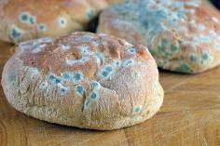
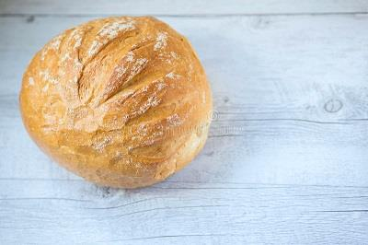

#4.1: Divine Life of the Wave Sheaf Bread
Would it really be acceptable to offer Yahuah bread dough that
was 11 days old?????
Or did Joshua perform a - 2nd Wave Sheaf ceremony so there could be
“acceptable bread?”
Where would that Scripture be??

Slide 25

What is with these
“11 days”????
Patience! It’s coming!
Also we must remember (Lev 23:13) that the – oil mixed with flour is a DOUGH!
A moist dough! It is not dry bread!
Moist dough - in the desert heat!

Slide 26


Where do we see Scriptural authority for Joshua’s actions?
Four Witnesses:
Lev 23:10-13
Num 15:19-21
Deut 18:3, 4; 26:1, 2

Slide 27
Yisra’el Cleared to Eat Grain!
Review
And you do not eat bread or roasted grain or fresh grain UNTIL the SAME DAY that you have brought AN OFFERING to your Elohim …
Lev 23:14 HalleluYah Scriptures
14 | Abib 15 - 1st Cycle - 1st Miqra (Convocation) U/B
The Wave Sheaf statute requirements before eating the grain of the land were accomplished; granting permission
to the Yisra’elites to eat the grain of the land!

Slide 28

The VERY FIRST BATCH of Bread Dough !!
Joshua observed
The VERY FIRST BATCH OF BREAD DOUGH HAD BEEN PRESENTED TO YAHUAH! Lev 23:14; Num 15:19-21.
Then: they ate bread on the
same day - the
day after the H7676 Shabbat Passover.
14 | Abib 15 - 1st Cycle - 1st Miqra (Convocation) U/B
Wave Sheaf had been presented according to statute. There is no provision for a second Wave Sheaf
ceremony according to Torah.
Abib 26th is a counterfeit from the Enoch calendar.
Review

Slide 29

The Scriptures tell us unequivocally that presenting the
Wave Sheaf and eating of grain of the land (bread)
must be done consecutively, and “on the same day.”
That’s exactly what Joshua did on Abib 15.
Enoch claims the Wave Sheaf and eating of the
bread is only performed on Abib 26!
Remember, Joshua declares:
By Torah Statute Abib 15 is always the Unleavened Bread Festival.
When Wave Sheaf is also on Abib 15,
the ULB Festival is always celebrated
AFTER the Wave Sheaf Festival.
How can –
“the same day”
be both
Abib 15, and 26?

Slide 30

Cutting Grain / Baking Bread / Eating
Did Joshua IGNORE the “SAME DAY” clause (Lev 23:14)
to align the Hebrew nation with the Enoch Calendar?
Joshua’s duty: 1) Wavesheaf
2) bread dough
from 1st grain
offering
3) eat bread
No! The FIRST PORTION of the cut grain supplied the required offering – allowing the baking and eating on
Abib 15! Does Enoch’s Calendar demand that a portion of this FIRST BREAD DOUGH must be retained for
11 cycles (days) to offer (wave sheaf) on Abib 26?
1
2
3
4
5
6
7
8
9
10
11
14 | 15 | 16 | 17 | 18 | 19 | 20 | 21 | 22 | 23
24 | 25 | 26 | 27
Do the Scriptures endorse bread
11 days old?
Week of Unleavened Bread

Slide 31
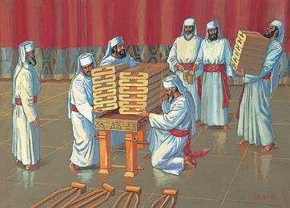

Or? … Will Yahuah accept bread 11 cycles old?
1 Chron 9:32 confirms Yahuah’s statute of limitations for the Sanctuary
Set-Apart Bread was 7 cycles.
The new shewbread was to be prepared every Shabbat to replace the former weeks 7 cycle old shewbread - Lev 24:8.
Is it reasonable that
Yahuah would accept
11 cycle old
stale, and/or moldy
bread dough as the
Wave Sheaf offering?
Remember: Bread Dough
is moist and very prone
to mold in a warm climate!

Slide 32

Huge Enoch Dilemma
Truth
Enoch rightly places the Unleavened Bread Festival on Abib 15-21.
Abib 15 is the last day the manna is given (Josh 5:12).
Enoch always places Wave Sheaf on Abib 26 – in this case 11 days late!
According to Torah, the grain of the land cannot be touched for any reason until after the Wave Sheaf ceremony.
How is Enoch supposed to celebrate the Feast of Unleavened Bread, (eating unleavened bread from Abib 15-21 as one of the statutes) –
and NOT be in violation of cutting the grain before Wave Sheaf cycle?
Is Enoch truthfully fulfilling the Torah “type” in preparation for THE “antitype” which represents the first heavenly ascension of Yahusha?
We Shall See!

Slide 33
Section #5
Did Yahusha observe the
Wave Sheaf/First-Fruit
requirements according to
Enoch’s Calendar stipulations?

Slide 34




Joshua’s Passover
Enoch’s Passover
1st | 2nd | 3rd | 4th | 5th | 6th | 7th
1 | 2 | 3 | 4 | 5 | 6 | 7
8 | 9 | 10 | 11 | 12 | 13 | 14
15 | 16 | 17 | 18 | 19 | 20 | 21
22 | 23 | 24 | 25 | 26 | 27 | 28
29 | 30
1st | 2nd | 3rd | 4th | 5th | 6th | 7th
 |  |  | 1 | 2 | 3 | 4
5 | 6 | 7 | 8 | 9 | 10 | 11
12 | 13 | 14 | 15 | 16 | 17 | 18
19 | 20 | 21 | 22 | 23 | 24 | 25
26 | 27 | 28 | 29 | 30
Enoch’s Abib
Joshua’s Abib
Very Important Note!
Yahusha’s Passover
1st | 2nd | 3rd | 4th | 5th | 6th | 7th
 |  |  |  | 1 | 2 | 3
4 | 5 | 6 | 7 | 8 | 9 | 10
11 | 12 | 13 | 14 | 15 | 16 | 17
18 | 19 | 20 | 21 | 22 | 23 | 24
25 | 26 | 27 | 28 | 29 | 30
This section will have Abib
calendar slides for Joshua,
Yahusha & Enoch.
A similar slide will return
at the end of this study.
Yahusha’s Abib

Slide 35
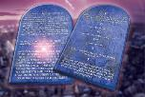

Approx. Date: 1450 BC
Every Year Dating
Joshua’s Passover
7th Cycle (Shabbat)
Enoch’s Passover
3rd Cycle (Tuesday)
1st | 2nd | 3rd | 4th | 5th | 6th | 7th
1 | 2 | 3 | 4 | 5 | 6 | 7
8 | 9 | 10 | 11 | 12 | 13 | 14
15 | 16 | 17 | 18 | 19 | 20 | 21
22 | 23 | 24 | 25 | 26 | 27 | 28
29 | 30
1st | 2nd | 3rd | 4th | 5th | 6th | 7th
 |  |  | 1 | 2 | 3 | 4
5 | 6 | 7 | 8 | 9 | 10 | 11
12 | 13 | 14 | 15 | 16 | 17 | 18
19 | 20 | 21 | 22 | 23 | 24 | 25
26 | 27 | 28 | 29 | 30
Enoch’s Abib
Joshua’s Abib
Torah Dates are Flexible
Enoch Dates not Flexible
Passover on: | Wave Sheaf on:
Sunday – 1st Cycle | Sunday – Abib 21st
Monday – 2nd Cycle | Sunday – Abib 20th
Tuesday – 3rd Cycle | Sunday – Abib 19th
Wednesday – 4th Cycle | Sunday – Abib 18th
Thursday – 5th Cycle | Sunday – Abib 17th
Friday – 6th Cycle | Sunday – Abib 16th
Passover is always
FIXED TO the 3rd cycle.
Wave Sheaf is always
Abib 26th – 1st cycle.
Wave Sheaf is always outside the week of ULB.

Slide 36
Yahusha’s Passover
4th Cycle (Wednesday)
Enoch’s Passover
3rd Cycle (Tuesday)
1st | 2nd | 3rd | 4th | 5th | 6th | 7th
 |  |  |  | 1 | 2 | 3
4 | 5 | 6 | 7 | 8 | 9 | 10
11 | 12 | 13 | 14 | 15 | 16 | 17
18 | 19 | 20 | 21 | 22 | 23 | 24
25 | 26 | 27 | 28 | 29 | 30
1st | 2nd | 3rd | 4th | 5th | 6th | 7th
 |  |  | 1 | 2 | 3 | 4
5 | 6 | 7 | 8 | 9 | 10 | 11
12 | 13 | 14 | 15 | 16 | 17 | 18
19 | 20 | 21 | 22 | 23 | 24 | 25
26 | 27 | 28 | 29 | 30
Yahusha’s Abib
Enoch’s Abib
Torah Dates are Flexible
Enoch Dates not Flexible
Yahusha died on a 4th cycle, not the 3rd.
Yahusha’s Wave Sheaf was on Abib 18th, not Abib 26th (or even Sunday Abib 25th).
R
E
V
I
E
W
Passover is always the 3rd cycle.
Wave Sheaf is always
Abib 26th – 1st cycle.
Wave Sheaf is always outside
the feast of Unleavened Bread!
Keep the information on
these last 2 slides in mind
for the rest of this section.
Period!

Slide 37

The Resurrection / First-Fruits View - #1
After His resurrection on Shabbat
Abib 17th Yahusha ascended the next
Dawn (Abib 18) to His Father.
What was His express mission?
As Shaul declares, in 1 Cor 15:20, 23,
Yahusha Ha Mashiach IS the
First-Fruit Offering of the Wave Sheaf Festival.
This is always the 1st cycle after the (H7676) Shabbat within the full 8 day festival!
1st | 2nd | 3rd | 4th | 5th | 6th | 7th
 |  |  |  | 1 | 2 | 3
4 | 5 | 6 | 7 | 8 | 9 | 10
11 | 12 | 13 | 14 | 15 | 16 | 17
18 | 19 | 20 | 21 | 22 | 23 | 24
25 | 26 | 27 | 28 | 29 | 30
Did Yahusha then (on His 1st ascension to Heaven – Abib 18) - request
a 9 cycle extension reaching to - Abib 26,
so He could return back to His Father to complete the Wave Sheaf offering as the First-Fruits from death - per the Enoch Calendar??

Slide 38

The Resurrection / First-Fruits View - #2
If Yahusha did in fact ask for a 9 cycle extension so He could observe the Wave Sheaf offering of the FIRST FRUIT
on Enoch’s Abib 26 ceremony,
what cycle of the week would that have been?
1st | 2nd | 3rd | 4th | 5th | 6th | 7th
 |  |  |  | 1 | 2 | 3
4 | 5 | 6 | 7 | 8 | 9 | 10
11 | 12 | 13 | 14 | 15 | 16 | 17
18 | 19 | 20 | 21 | 22 | 23 | 24
25 | 26 | 27 | 28 | 29 | 30
1st | 2nd | 3rd | 4th | 5th | 6th | 7th
 |  |  | 1 | 2 | 3 | 4
5 | 6 | 7 | 8 | 9 | 10 | 11
12 | 13 | 14 | 15 | 16 | 17 | 18
19 | 20 | 21 | 22 | 23 | 24 | 25
26 | 27 | 28 | 29 | 30
Yahusha’s Abib
Enoch’s Abib
The answer is forthcoming!

Slide 39
Crucifixion First-Fruits Extension View? - #2a
It’s time for a serious comparison!
1st | 2nd | 3rd | 4th | 5th | 6th | 7th
 |  |  |  | 1 | 2 | 3
4 | 5 | 6 | 7 | 8 | 9 | 10
11 | 12 | 13 | 14 | 15 | 16 | 17
18 | 19 | 20 | 21 | 22 | 23 | 24
25 | 26 | 27 | 28 | 29 | 30
1st | 2nd | 3rd | 4th | 5th | 6th | 7th
 |  |  | 1 | 2 | 3 | 4
5 | 6 | 7 | 8 | 9 | 10 | 11
12 | 13 | 14 | 15 | 16 | 17 | 18
19 | 20 | 21 | 22 | 23 | 24 | 25
26 | 27 | 28 | 29 | 30
Yahusha’s Abib
Enoch’s Abib
Did Yahusha request a 9 cycle extension to offer Himself as the First Fruit from Death, on Enoch’s Abib 26th … A “MONDAY”?
Or should the request be made for Abib 25th … Enoch’s “Sunday”?

Slide 40
Could Yahusha abide by either a Zadok or Enoch DATE for His ascension?
Abib 26 was the 2nd morrow
in the next week -
ABSOLUTELY NOT!
OUTSIDE OF THE
UNLEAVENED BREAD FESTIVAL!

Slide 41

Who then attempts to give Enoch/Zadok, the right to claim that the Wave Sheaf of First Fruits must be on Abib 26 …?
1. When for 1500+ years this statute was rehearsed according to Torah so the
people would know the PROPHETIC VALUE of this special festival, as a very
permanent marker for the True Messiah and His ascension.
2. For Joshua: His First Portion of Dough becomes seriously outdated by Abib 26?!
3. For Yahusha: Fulfilling Enoch’s claim for First Fruit offering on Abib 26th of the
month AND the 2nd cycle of the week (Monday), is surely -
BREAKING THE STATUTES of Yahuah!

Slide 42
#5.1: Yahusha - THE Perfect Firstfruit Offering
What about Yahusha being the PERFECT
offering of the Wave Sheaf fulfillment?
Yahusha the PERFECT First-Fruit,
the victory over death!?
Before His 1st ascension, Yahusha, in the darkness of the 4th watch,
restricted Mary Magdalene from touching Him when they met.
Yahusha could not be defiled by a human prior to presenting
Himself to Yahuah as the First–Fruit offering, the PERFECT (Exo 12:5) ULTIMATE SACRIFICE to fulfill the Wave Sheaf Feast offering.

Slide 43

Was Yahusha really a PERFECT
Wave Sheaf offering (NOT CONTAMINATED BY HUMANS)
Yes! PERFECTION is important to Yahuah!
Lev 23:12 ‘And on that day when you wave the sheaf, you shall prepare a male lamb a year old, A PERFECT ONE, as a burnt offering to יהוה [Yahuah],
Question:
Where in the Scriptures do we find that Yahusha took
specific action to preserve Himself as the
PURE First-Fruit offering for the Wave Sheaf presentation?
A second witness!

Slide 44
If a human had touched (CONTAMINATED – Num 19:11-16) Yahusha prior to presenting Himself as the Perfect Sacrifice –
THEN - He would have been DISQUALIFIED as
the PERFECT Sacrifice.
THEN - Yahusha would have FAILED Yahuah’s Plan of Salvation.
THEN - Yahusha would no longer qualify as The Mashiach!
THEN – consequently by default, upon the tree when Yahusha declared “It has been accomplished,” that would have been a TOTAL FALSEHOOD!
DISQUALIFIED? = No Mashiach & No Salvation!

Slide 45
Note: Yahusha having FULFILLED the First Fruit offering for Wave Sheaf at early Dawn, returned from His presentation before Yahuah.
He then readily accepted the adoration and worship
of His followers; willingly accepting their touch!
Mark 16:2 [The ladies with their spices came at sunrise to visit the tomb].
Matt 28:9 [The ladies departed after hearing the good news from the angel
that Yahusha had risen.]
Matt 28:9 And as they were going to report to His taught ones, see, יהושע met them, saying, “Greetings!” And they came and held Him by the feet and did bow to Him.

Slide 46
After returning from the courts of Heaven,
Yahusha could now accept physical contact from His children.
What Divine Event had occurred allowing Him human touch?
Had Yahusha already presented Himself in the courts of Heaven to Yahuah as, the PURE FIRST-FRUIT offering, fulfilling the “Anti-type” Wave Sheaf statute? (Lev 23:10-14)
Recall this: the date of the first cycle of the week
after His resurrection was Abib 18!
Zadok/Enoch, are you
paying attention?

Slide 47
What would be the situation with Enoch & Zadok Abib 26!
At this point of Abib 18, with Yahusha being “contaminated”
by human touch,
He would still have 9 cycles to complete before fulfilling the
Zadok proclaimed Wave Sheaf festival of the First-Fruit offering on Abib 26!
Question: As Yahusha did not find it acceptable to be “contaminated” by human touch before performing the Scriptural First-Fruit offering on Abib 18 …

Slide 48

Who then could possibly have qualified as the
PURE FIRST-FRUIT
offering on Enoch’s Abib 26 Wave Sheaf Festival?
No PURE OFFERING = NO MASHIACH!
No Mashiach = NO SALVATION!
Enoch - Zadok??
Or Zadok!

Slide 49
Also;
Ponder This –
When Yahusha mingled with society after His resurrection, {in the 9 “extra” days leading up to to Enoch’s supposed Abib 26 Wave Sheaf Festival}, is it even possible that Yahusha could have remained UNCONTAMINATED?

Slide 50

Could it be Lucifer
(the Father of Lies )
is promoting these evil
Zadok - Enoch Calendar deceptions
to disqualify our Salvation?
Is following Torah perfectly and completely
a “salvational issue”?

Slide 51

Summary Questions for Section #5
Can Zadok justify from the Scriptures, SEPARATING the Eating of the First bread dough, from the Waving action of the First Fruit Wave Sheaf offering – “ON THE SAME DAY”?
Can Zadok justify from the Scriptures using 11 day old bread dough as an offering to Yahuah (that is if it was not moldy,
stale and dried up yet)?
Can Zadok justify from the Scriptures how it is that Yahusha could observe the Wave Sheaf day on the 2nd cycle of the week?
& Enoch!

Slide 52
Summary Questions for Section #5 [Con’t]
Can Zadok justify breaking the statutes by using the grain to feed the Yisra’elite nation for 11 cycles until Abib 26? Why?
By reason of the manna ceasing the day after the Passover,
and the fruit and vegetables had only started to grow!???
Can Zadok justify breaking the statutes by using the grain
of the land to fulfill the statute for eating the unleavened bread
during the Feast from Abib 15 to 21?
& Enoch!

Slide 53
A Question for Enoch & Zadok!
Does Yahuah accept
breaking His statutes to fulfill
a counterfeit one?
And now for the FINAL and BRUTALLY IMPORTANT ENOCH discrepancy
of Part #2 -

Slide 54



Summary Questions for Section #5 [Concluded]
And the greatest challenge of all for Enoch and Zadok’s HUGE Scriptural challenges! … Can they find:
  a FULLY QUALIFIED,
  OF THE FIRST YEAR,
  PERFECT FIRST-FRUIT OFFERING
  to legally present to Yahuah
  on a NON-SCRIPTURAL Abib 26?
ARE THERE ANY
CANDIDATES?
Let’s re-visit the slide of
calendars one more time!

Slide 55
Approx. Date: 1450 BC
Every Year Dating
Joshua’s Passover
7th Cycle (Shabbat)
SUMMARY
Enoch’s Passover
3rd Cycle (Tuesday)
1st | 2nd | 3rd | 4th | 5th | 6th | 7th
1 | 2 | 3 | 4 | 5 | 6 | 7
8 | 9 | 10 | 11 | 12 | 13 | 14
15 | 16 | 17 | 18 | 19 | 20 | 21
22 | 23 | 24 | 25 | 26 | 27 | 28
29 | 30
1st | 2nd | 3rd | 4th | 5th | 6th | 7th
 |  |  | 1 | 2 | 3 | 4
5 | 6 | 7 | 8 | 9 | 10 | 11
12 | 13 | 14 | 15 | 16 | 17 | 18
19 | 20 | 21 | 22 | 23 | 24 | 25
26 | 27 | 28 | 29 | 30
Enoch’s Abib
Joshua’s Abib
Torah Dates are Flexible
Let’s pick up some facts
between Enoch and
Covenant Torah
Calendar Witnesses.
Passover on: | Wave Sheaf on:
Sunday – 1st Cycle | Sunday – Abib 21st
Monday – 2nd Cycle | Sunday – Abib 20th
Tuesday – 3rd Cycle | Sunday – Abib 19th
Wednesday – 4th Cycle | Sunday – Abib 18th
Thursday – 5th Cycle | Sunday – Abib 17th
Friday – 6th Cycle | Sunday – Abib 16th

Slide 56

Joshua’s Passover
7th Cycle (Shabbat)
Enoch’s Passover
3rd Cycle (Tuesday)
SUMMARY
1st | 2nd | 3rd | 4th | 5th | 6th | 7th
1 | 2 | 3 | 4 | 5 | 6 | 7
8 | 9 | 10 | 11 | 12 | 13 | 14
15 | 16 | 17 | 18 | 19 | 20 | 21
22 | 23 | 24 | 25 | 26 | 27 | 28
29 | 30
1st | 2nd | 3rd | 4th | 5th | 6th | 7th
 |  |  | 1 | 2 | 3 | 4
5 | 6 | 7 | 8 | 9 | 10 | 11
12 | 13 | 14 | 15 | 16 | 17 | 18
19 | 20 | 21 | 22 | 23 | 24 | 25
26 | 27 | 28 | 29 | 30
Enoch’s Abib
Joshua’s Abib
Torah Dates are Flexible
Enoch does not recognize ~
Passover on: | Wave Sheaf on:
Sunday – 1st Cycle | Sunday – Abib 21st
Monday – 2nd Cycle | Sunday – Abib 20th
Tuesday – 3rd Cycle | Sunday – Abib 19th
Wednesday – 4th Cycle | Sunday – Abib 18th
Thursday – 5th Cycle | Sunday – Abib 17th
Friday – 6th Cycle | Sunday – Abib 16th
… a Sabbath or 4th cycle
[Wed] Passover.
Wave Sheaf observances for:
Moses [19th]; Joshua [15th];
or Yahusha on Abib 18th;
Enoch’s Wave Sheaf is
never inside the week of ULB.

Slide 57


Enoch’s Passover
3rd Cycle (Tuesday)
W
I
T
H
O
U
T
T
O
R
A
H
They say,
“3 STRIKES and you’re out?”
Evidence declares Enoch has
had at least 6 STRIKES!
Question: “Enoch, is this Torah-less-ness?”
Answer:
“Enoch, Zadok and other 364 affiliates –
you are not within the guidelines
of Covenant Torah!
Torah judges you as practicing
Torah-less-ness!”
1st | 2nd | 3rd | 4th | 5th | 6th | 7th
 |  |  | 1 | 2 | 3 | 4
5 | 6 | 7 | 8 | 9 | 10 | 11
12 | 13 | 14 | 15 | 16 | 17 | 18
19 | 20 | 21 | 22 | 23 | 24 | 25
26 | 27 | 28 | 29 | 30
Enoch’s Abib
Torah Dates are Flexible
Passover on: | Wave Sheaf on:
Sunday – 1st Cycle | Sunday – Abib 21st
Monday – 2nd Cycle | Sunday – Abib 20th
Tuesday – 3rd Cycle | Sunday – Abib 19th
Wednesday – 4th Cycle | Sunday – Abib 18th
Thursday – 5th Cycle | Sunday – Abib 17th
Friday – 6th Cycle | Sunday – Abib 16th
Sabbath – 7TH Cycle | Sunday – Abib 15th
“Your errors are being exposed!
You simply cannot recognize or declare the True MelchiTzedek Mashiach!”

Slide 58
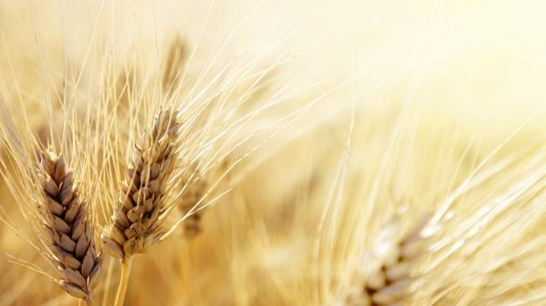

Part #2 exposed many more errors in Enoch’s calendar.
Some of the areas to be discussed in Part #3 are:
1) Does the Omer Count begin on Abib 15th or 26th?
The harvest on Abib 15 ~ Barley or Wheat?
What is Enoch’s Real Reason for adhering
to Abib 26 and his calendar counting error!
Will Enoch find justification without errors?
Would Enoch have made these mistakes
if he had studied Joshua’s testimony?
The End
We Shall See!

Slide 59

If you have Questions
&/or Comments
about this teaching,
please contact:
Timothy Astleford
tim@studythecalendar.com
Thank you!

