Slide 1


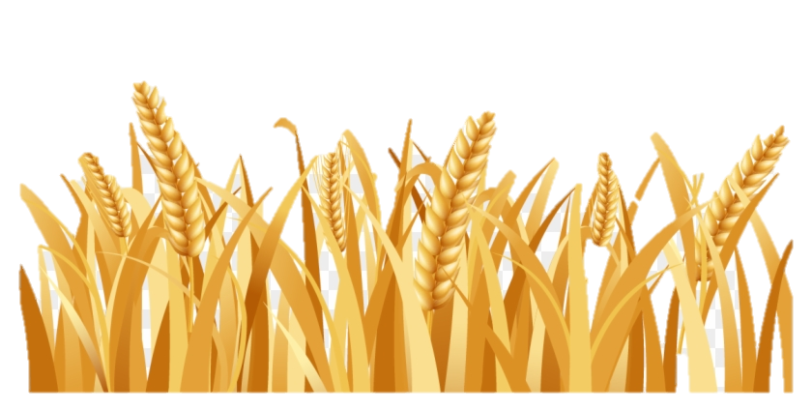
Oct 27/19: 800 AM Tim to do a PPTssw to see if animation is OK on the hebrew slides; and build a smaller PDF for Neil. If the SSH does not work I’ll have to do jpegs on all the slides 52-65.
Part 1
The Song of Joshua’s Sickle

Slide 2
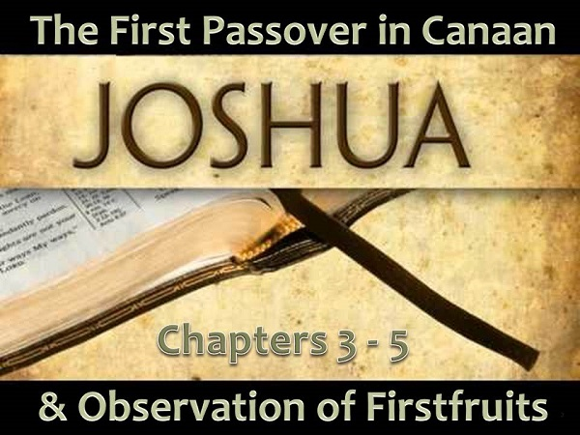
Joshua Enters Canaan - Covenant Calendar Club
<www.studythecalendar.com>
Note: There are many details in
this study that are necessary to
fully understand today’s study.
The first Joshua study proves:
Abib 14 Passover occurred on H7676 weekly Shabbat.
Wave Sheaf Festival celebrated first on the morning of Abib 15.
Unleavened Bread Festival celebrated second on Abib 15.

Slide 3
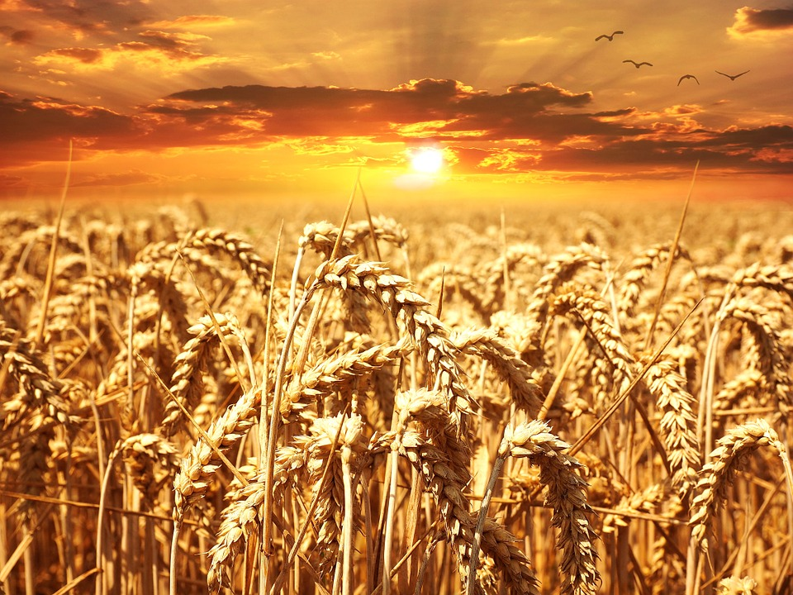
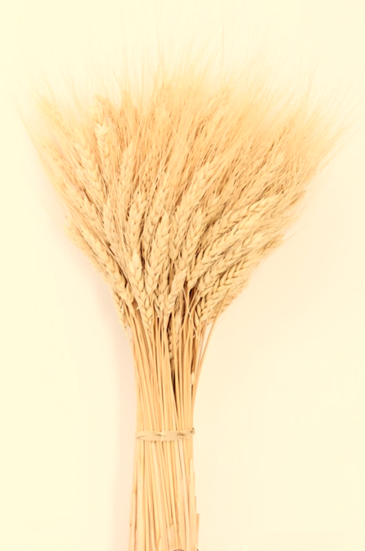
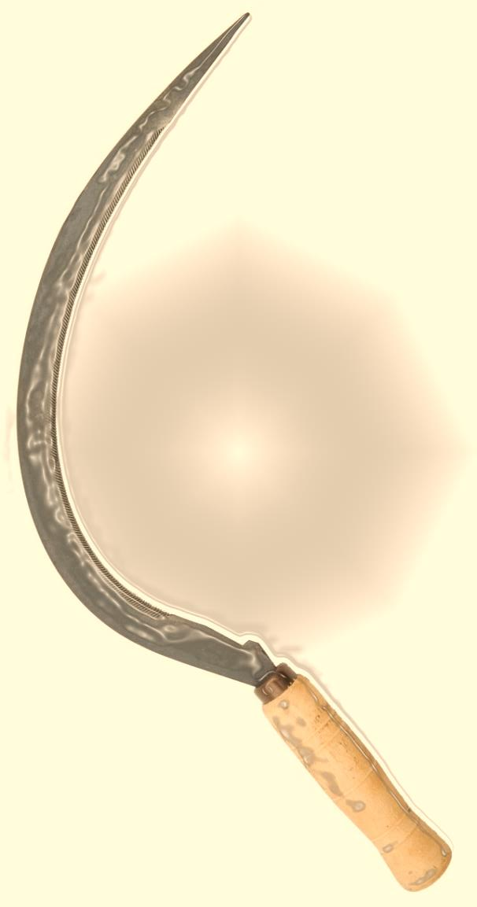
A Simple Sickle’s Eternal Authority
The Wave
Sheaf Sickle
Exposes the
Enoch Forgery

Slide 4
Part #1 Mapping the Discussion Topics
Section | Slides | Content of Topic
1 | 20-74 | Understanding Yahuah’s Instructions for Entering Canaan
1.1 | 20 | Passover in “which” month?
1.2 | 29 | Passover on “which” cycle?
1.3 | 34 | Day After Passover – Interlinear & Septuagint Support
1.4 | 37 | Yahusha’s Anti-type Aligns with Torah Types for Wave Sheaf
1.5 | 39 | Yahuah’s Eating Prohibition Command
1.6 | 52 | Hebrew Definitions for <rashith> (“first”)
1.7 | 59 | Hebrew Definitions for <iqtzr> (“cutting”)
1.8 | 64 | Summary of Hebrew Definitions for <rashith> & <iqtsz>
1.9 | 67 | The Wave Sheaf Grain Offering
2 | 75-93 | Why the Grain Cutting and Eating, Cannot Be Separated

Slide 5
Clarification of Terms for this Study
Corn: another term for grain of any kind;
(not to be confused with our traditional “corn on the cob.”)
Old Grain: grain from the year before, stored in a vessel.
Roasted Grain/Parched Grain: dried or cooked grain.
New Grain/Fresh Grain: grain harvested after Passover in
the new year – from a winter crop seeding.
Dough: a mixture of ground grain, oil and salt for Altar of Sacrifice “grain offerings” and also for consumption of
unleavened bread during the Unleavened Bread Festivals.
Fine Grain: Wheat flour.
(Barley can only be ground into coarse flour.)

Slide 6

Will Joshua accurately fulfill
Yahuah’s upon entering Canaan?
STATUTES

Slide 7
Will the Qumran Dead Sea Scroll
PRIESTLY COURSE based calendars, accurately reflect
Yahuah’s for entering Canaan?
STATUTES

Slide 8
The Qumran, Enoch, Zadokite and Essene Calendars are ALL based on the
Qumran Dead Sea Scrolls.
Each incorporate the 364 cycles/year format. THESE CALENDARS ARE BASED ON THE
24 (X 2) PRIESTLY COURSES found within the Book of the Law.

Slide 9


Note carefully; this three part study was derived from careful examination of Rachel Elior’s research into the Qumran Scroll base, and other various sources as well.
Rachel Elior is considered world wide as a very knowledgeable source when considering the Qumran Scrolls.
The PRIMARY INQUEST OF THESE STUDIES is to ascertain if
the 364 cycles/year, with the FIXED FEAST DATES as outlined in the
1. Enoch 2. Zadokite and 3. Essene calendars, will find any linear alignment with the tremendously accurate documentation
found in the Divinely Inspired Scriptures.
THESE STUDIES ARE NOT HERE TO DELINEATE EACH AND EVERY DIFFERENCE BETWEEN THESE 3 NAMED CALENDARS!
The strict focus is – the 364 cycle/year AND the FIXED DATES of their PRIESTLY COURSE BASED festal calendar
in comparison to the Scriptures.

Slide 10
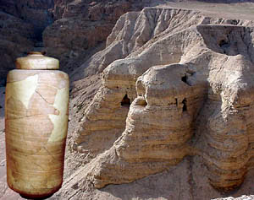
Other Qumran Documentation to Consider
Part 3 Collection of Articles p 168-216 by Stephen Pfann
[Titled] The Ancient “Library” or “Libraries” of Qumran:
The Specter of Cave 1Q
[Dating of the documents in Qumran Caves]
H. As to calendar, the 364-day solar calendar embedded in the Book of
Jubilees, found in caves 2Q and 11Q (and again, at Masada), and in the
Temple Scroll set the standard. This calendar disregards the moon and
has a pentecontad festal cycle that observes a number of non-biblical
feasts, more than doubling the total number [page 211].
C. Paleographically, the manuscripts date from the second century BCE
until the first half of the first century CE. The scripts are quite
varied in style and in execution [page 212].
Source for quotes:
The Dead Sea Scrolls at Qumran and the Concept of
a Library
Edited by
Sidnie White Crawford
& Cecilia Wassen
Does it appear these documents belong to the Enoch that was the 7th generation from Adam?

Slide 11

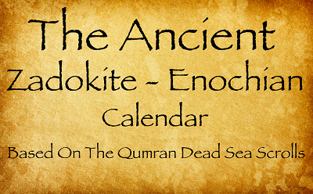

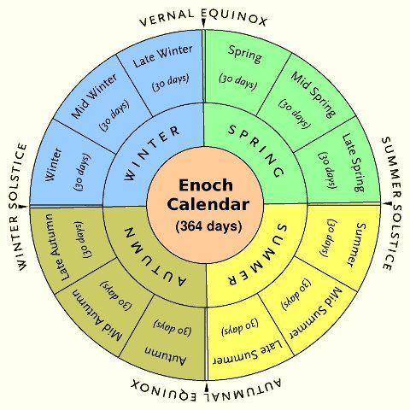
Note Carefully –
In your reading of either, and/or
Enoch, Zadokite or Essene,
remember they use the:
i) same priestly course basis,
ii) same 364 cycles per year,
iii) same FIXED feast calendar!

Slide 12
The next slide provides information from a
you-tube promoting the Zadok Calendar.
This is one of the calendars derived from the
Dead Sea Scrolls of the Qumran caves.
However, this study will use “ENOCH” as the “general term”
to include ALL three “364 cycles/year” calendars.
Joshua’s event of entering Canaan will be compared to the declarations
of the Calendars based upon the Qumran Dead Sea Scrolls.
The question is: Will the Zadokite Calendar find
Scriptural alignment within the –
event for Joshua entering Canaan?
Or will there be glaring discrepancies?
Hint: Joshua’s Passover will be on a weekly H7676 Shabbat as already proven in former research!

Slide 13
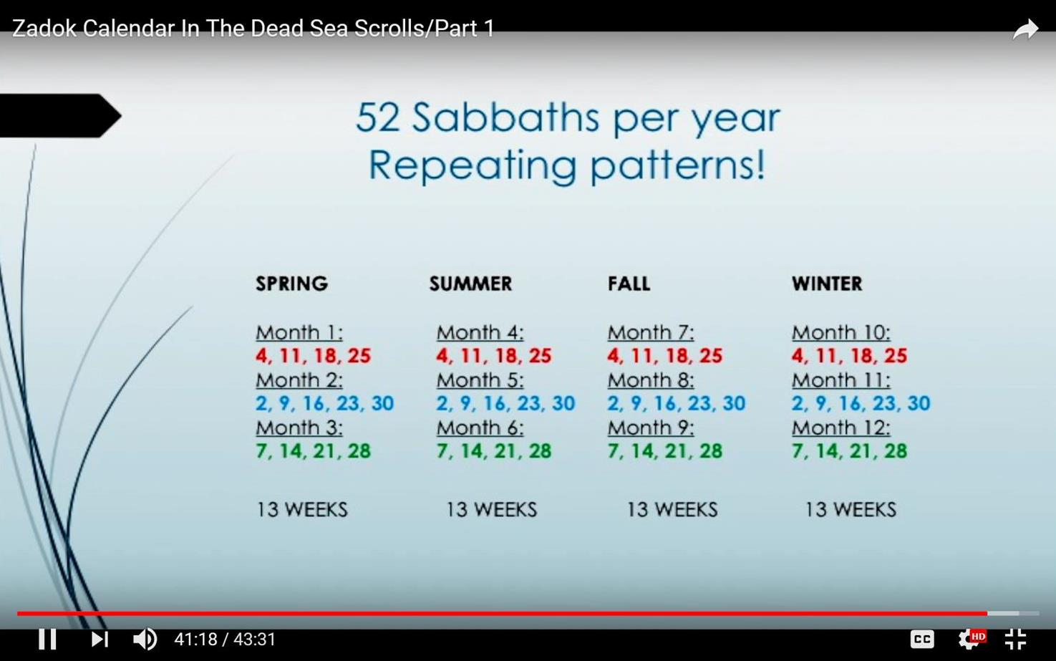
The actual original slide.
[Part 1 - Time: 41:18]
13

Slide 14
52 Sabbaths per year Repeating Patterns
“Enoch”
“Zadok”
[41 minute 18 second mark on Part 1 the you-tube.]
SPRING | SUMMER | FALL | WINTER
Month 1: 4, 11, 18, 25 | Month 4: 4, 11, 18, 25 | Month 7: 4, 11, 18, 25 | Month 10: 4, 11, 18, 25
Month 2: 2, 9, 16, 23, 30 | Month 5: 2, 9, 16, 23, 30 | Month 8: 2, 9, 16, 23, 30 | Month 11: 2, 9, 16, 23, 30
Month 3: 7, 14, 21, 28 | Month 6: 7, 14, 21, 28 | Month 9: 7, 14, 21, 28 | Month 12: 7, 14, 21, 28
Note the exact repeating nature of the dates!
This calendar is mathematically precise, but…
Are these Sabbath stipulations found in Covenant Torah?
Where is the 1st month that has a H7676 Shabbat on the 14th cycle of the month?

Slide 15
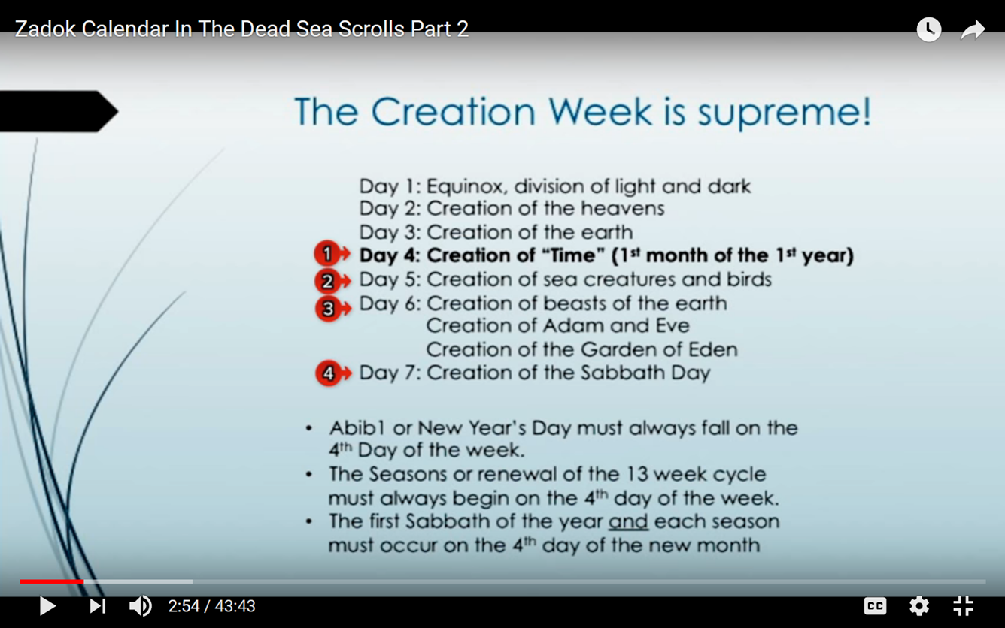
The actual
original slide.
[Part 2 - Time: 2:54]
Why are these bullets in red?
See comments
on next slide.
15

Slide 16
We will be comparing these Zadok calendar claims –
The Creation Week is supreme!
Day 1: Equinox, division of light and dark
Day 2: Creation of the heavens
Day 3: Creation of the earth
Day 4: Creation of “Time” (1st month of the 1st year)
Day 5 : Creation of sea creatures and birds
Day 6: : Creation of beasts of the earth
Creation of Adam and Eve
Creation of the Garden of Eden
Day 7: Creation of the Sabbath day
Abib 1 or New Year’s day must always fall on the 4th day of the week.
The seasons or renewal of the 13 week cycle must always
begin on the 4th day of the week.
The first Sabbath of the year and each season must occur
on the 4th day of the new month.
?
Non- accountable days?
Really?
1
2
Enoch is
the same!!!
3
4
Which week day is this Sabbath on?

Slide 17
The following points will be under close examination:
      (1) Joshua’s First Passover,
      (2) Wave Sheaf and -
      (3) Unleavened Bread Festival in Canaan.
The main purpose of this study is to ascertain –
Which cycle of the week did Joshua observe the Passover
in the land of Canaan?
What cycle of the week was New Year’s day in that same year?
Did Joshua abide by the Enoch, Zadokite, Essene or a
lunar based calendar? Or neither of them?

Slide 18
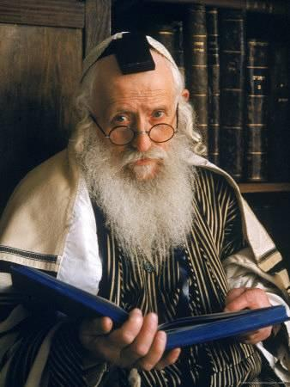
Why is it so important to know
which cycle of the week the Passover fell upon in the event of Joshua entering Canaan?
Because the rabbis say that certain Festivals
cannot land on the weekly H7676 Shabbath.
Passover is one of these festivals.
What do the Enochian calendars claim about this?
The priestly course based calendars claim the Festivals are ALWAYS on the exact same cycle (day) of the week EVERY YEAR!
Will Enoch try to claim Joshua’s Passover must be
in the 2nd month of the year?

Slide 19
The Investigation Begins Here
Primarily: A review of Yahuah’s commands that directly address
the entrance into Canaan by the Hebrew nation.
Secondly: Yahuah’s statute instructions will be placed like a translucent paper over these Priestly Calendar acclamations.
Final conclusive evidence will be gathered from this question:
Will these Priestly Calendar stipulations fulfill the commands of Yahuah
without deviating from Mosheh’s writings?
Or - from Yahuah’s statutes?

Slide 20
Section #1
Understanding Yahuah’s Instructions to Enter Canaan
#1.1: Passover in “which” month?
First, we are going to look at Yahuah’s provision for men
who were defiled and could not observe the Passover
in the first month of Abib.
Second, we’ll have a close look at the statute commands
that were “commanded” by Yahuah,
through Mosheh,
for Joshua to execute with extreme precision.

Slide 21
In Numbers 9: Certain men were inquiring of Mosheh why they could not
observe the Passover, and requested a solution to this problem.
Why? They were defiled by handling the dead body of a person.
Num 9:8 And Moses said unto them, Stand still, and I will hear
what [Yahuah] will command concerning you.
Num 9:9 And [Yahuah] spake unto Moses, saying,
Num 9:10 Speak unto the children of Israel, saying, If any man of you
or of your posterity shall be unclean [#1] by reason of a
dead body, or [#2] be in a journey afar off, yet he shall
keep the passover unto [Yahuah].
Also see:
Num 19:11-16.

Slide 22
What were Yahuah’s two points that would give permission to observe an alternate Passover in the second month?
If any man of you or of your posterity shall be unclean
by reason of a dead body,
or be in a journey afar off, yet he shall keep the
[alternate provision] passover unto [Yahuah].
Num 9:11 The fourteenth day of the second month between the evenings they shall keep it, and eat it with unleavened bread
and bitter herbs.
When?
Now, back to Joshua entering Canaan …

Slide 23
Was Joshua and all Yisra’el defiled by a dead body! NO!
Were they on a far off journey? No!
They were at the place of their new home.
The Tabernacle and family was near; their home was mobile.
They did not have any legal reason to observe the Passover in the second month - not according to the commands of Yahuah.
Remember: When a second month Passover was acceptable, the instructions are very clear! (See 2 Chron 30:2, 13, 15.)
Note: The Scriptures say NOTHING about Joshua observing
Passover in the second month!

Slide 24
It has been suggested that there is a one month time frame for Joshua staying in Gilgal prior to the Passover! This in turn would have moved the Passover to the alternate 2nd month.
Yet it is not written in the Scriptures!
Jos 5:10 And the sons of Israel encamp in Gilgal, and make the passover on the fourteenth day of the month, at evening, in the plains of Jericho.
Shall we add in a SUGGESTED 1 MONTH TIME FRAME or shall we accept - what is WRITTEN?
Yahuah said, “I have “rolled” away the reproach of Mitsrayim from you!” The word for “rolled” is H1556 גלל .Galal.

Slide 25
Is the 1st Month Really the 1st Month?
And the people came up from the Yarden [Jordan] on the tenth day of the FIRST MONTH, and they camped in Gilgal on the west side of Jericho (Josh 4:19.) HalleluYah Scriptures
In Exodus 12:2 the Yisra’elites were commanded to choose their lamb on
the 10th cycle of the first month. Here Yahuah Himself followed His own
set pattern and chose His people on the 10th of the FIRST month!
Yes, Joshua’s Passover was in the 1st Month!

Slide 26
52 Sabbaths per year Repeating Patterns
“Enoch”
“Review”
[41 minute 18 second mark on Part 1 of the you-tube.]
SPRING | SUMMER | FALL | WINTER
Month 1: 4, 11, 18, 25 | Month 4: 4, 11, 18, 25 | Month 7: 4, 11, 18, 25 | Month 10: 4, 11, 18, 25
Month 2: 2, 9, 16, 23, 30 | Month 5: 2, 9, 16, 23, 30 | Month 8: 2, 9, 16, 23, 30 | Month 11: 2, 9, 16, 23, 30
Month 3: 7, 14, 21, 28 | Month 6: 7, 14, 21, 28 | Month 9: 7, 14, 21, 28 | Month 12: 7, 14, 21, 28
?
Is there a weekly Shabbath on the …
14th cycle of the 2nd month of Enoch?
Where is the 1st month that has a H7676 Shabbat on the 14th cycle of the month?

Slide 27

52 Sabbaths per year Repeating Patterns
“Enoch”
“Review”
[41 minute 18 second mark on Part 1 of the you-tube.]
Looking at the 3rd month of the “364 Fixed Feast Calendar”, we see that the 3rd month is the first month to have a 7th day Sabbath on the 14th of the month.
This is a GREAT PROBLEM for the ones who desire to claim that Joshua’s Passover was not in the first month – but ON THE 2ND MONTH!
That argument has just been vaporized by their own calendar!
SPRING | SUMMER | FALL | WINTER
Month 1: 4, 11, 18, 25
Month 2: 2, 9, 16, 23, 30 | Month 2,
Month 3: 7, 14, 21, 28
?

Slide 28
What month/cycle did Yahuah allow for the harvest of the fresh grain to begin? Was this connected to circumcision?
Interestingly, Yahuah timed the circumcision of the men to immediately follow entering the land on the 10th with abundant grain ready to harvest!
  The men needing rest time to heal, would not be in any condition
  to harvest the wheat!
Yahuah knew that after eating manna for 40 years, the temptation
for consuming the wheat would be unbearable.
Was the circumcision a dual accomplishment which staved off their
great desire to harvest and eat the grain prematurely?
Yahuah knew the harvest would begin immediately following the healing
of the men! Yahuah, in compassion, had no intention to tempt them by
withholding wheat from them through the week of Unleavened Bread!

Slide 29
Section #1 Understanding Yahuah’s Instructions
#1.2: Passover on “which” cycle?
What unfaltering factor determines which cycle of the month the Passover must be observed on?
Lev 23:4 These are the feasts to [Yahuah], holy convocations, which ye shall call in their seasons.
Lev 23:5 In the first month, on the FOURTEENTH day of the month, between the evening times is [Yahuah’s] passover.
Lev 23:6 And on the FIFTEENTH day of this month is the feast of unleavened bread to [Yahuah]; seven days shall ye eat unleavened bread. Brenton’s Septuagint

Slide 30

Passover
Explained
Lev 23 stipulates
Passover on the 14th
cycle of the 1st month.
Num 9 allows for Passover on the
14th of the 2nd month if necessary!

Slide 31
Lev 23:5 is just one of numerous examples showing that Yahuah commands
the Passover to be observed on the 14th {of the first month – Abib}.
NOT ONCE in the Scriptures does Yahuah declare, or command,
a specific cycle of the week in which the Passover must be observed!
Yet – the question:
Passover the 14th is declared by Enoch/Zadok Calendar stipulations
to be permanently fixed to the 3rd Cycle of the week! (Tuesday)
Should we unquestionably accept such an IMPOSITION to the Scriptures?
To understand according to statute, upon which cycle of the week
the Passover occurred in Joshua’s account upon entering Canaan,
Yahuah’s statute commands involving the Wave Sheaf observance
will take pre-eminence and give clarity for Abib 14. {ALWAYS! ☺}
Should we deviate from these commands?

Slide 32

Joshua Enters Canaan
Why then does Enoch/Zadok demand a specific cycle of the week for Passover?
No Cycle documentation, but – A Date!
And the people came up from the Yarden [Jordan] on the tenth day of the first month, and they camped in Gilgal on the west side of Jericho. Joshua 4:19 HalleluYah Scriptures
As we study please consider: “Why did Yahuah NOT require specific cycles of the week documentation,
for Passover, but instead makes certain of the recording
of the DATES within the Shaneh years!?”

Slide 33
Again - Joshua refrained from documenting a specific cycle of the week, but confidently recorded the DATE!
Jos 5:10 And the sons of Israel encamp in Gilgal, and make the passover on the fourteenth day of the month, at evening, in the plains of Jericho;
Ereb! The Mixture of light and darkness!

Slide 34

#1.3: Day After Passover & Septuagint/Interlinear Support
Jos 5:11 And they eat of the old corn of the land on the morrow of the passover, unleavened things and roasted corn, in this self-same day;
Ultra Specific Note:
Yes the Yisra’elites were EATING the grain of the land on the cycle immediately following the Passover!

Slide 35
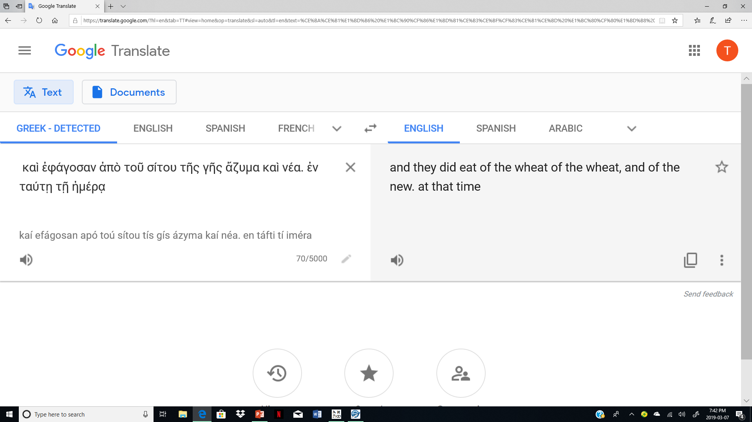
Joshua 5:10 has just mentioned the time context of the Passover on the 14th of the month. (The cycle of the week can now be easily determined.)
Many emphatically declare the Septuagint DOES NOT SAY in
Jos 5:11 JOSHUA ATE GRAIN ON THE DAY AFTER THE PASSOVER! Let’s view an Interlinear edition of the Septuagint.
Does it seem strange this Septuagint agrees with the many other translations in that Joshua indeed ate grain on the day after the Passover? Even this Interlinear of the Greek agrees! Hhmmm…!!

Slide 36
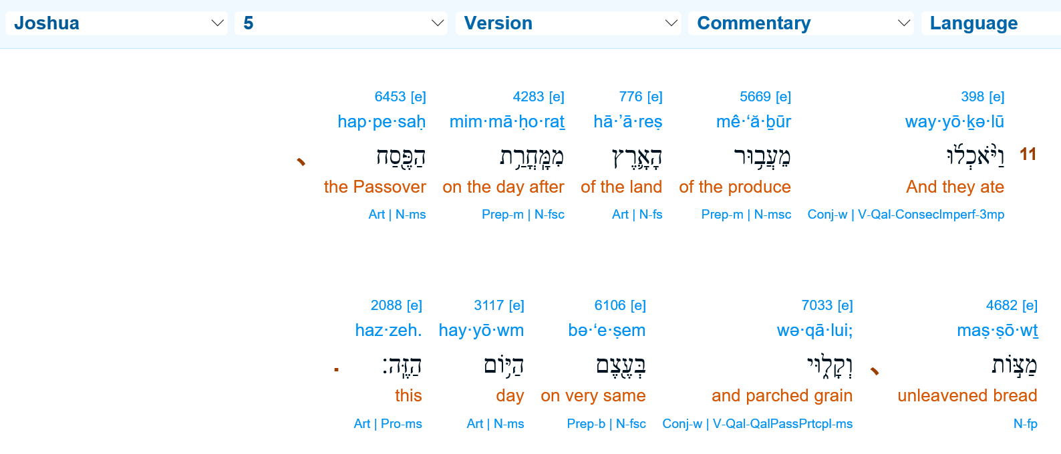


A Hebrew Interlinear version confirming
Joshua ate grain on the day AFTER the Passover.
(Bible Hub)
Review from original Joshua Study.
Eh-Tzem The base “bone structure” of the Plan of Salvation!

Slide 37
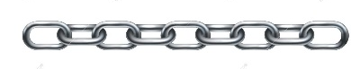
The DIRECT PATTERN LINKING to the exact 1st cycle of the week that
Yahusha observed the Wave Sheaf!
#1.4: Yahusha’s Antitype Aligns with Torah Types
for Wave Sheaf
Yahusha presented Himself as the First-fruit on the “day after the Sabbath”
(ref. Lev 23:11,15).
Eh-Tzem - the FOUNDATION of Salvation -
on the 1st cycle
of the week!
Linkage

Slide 38
1. What command concerning the eating of the grain of the land applies to this situation?
3. What pertinent detail makes Yahuah’s grain consumption command so vastly important to calendar timing?
2. Does this same command from Yahuah involve the cycle after the Passover (Abib 15)?

Slide 39
#1.5: YAHUAH’S EATING PROHIBITION COMMAND!
WHAT?
Lev 23:14 And you
DO NOT EAT
1
2
3
Timing?
bread or roasted grain or fresh grain
until the SAME DAY THAT YOU HAVE BROUGHT A [grain] OFFERING to your Elohim
–a law forever throughout your generations in all your dwellings.

Slide 40
No grain of the land whatsoever was to be consumed until they had performed certain obligations for Yahuah.
Let’s look at it closely.
Past Tense

Slide 41
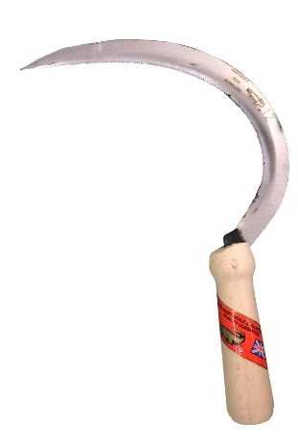
Yahuah’s PRECISE timing for the Wave Sheaf
Brenton’s English Septuagint
Lev 23:10 Speak to the children of Israel, and thou shalt say to them, When ye shall enter into the land which I give you, AND REAP
THE HARVEST OF IT, then shall ye bring a sheaf, the first-fruits
of your harvest, to the priest;
Lev 23:11 and he shall lift up THE SHEAF before [Yahuah], to be accepted for you. On the morrow of the first day the priest shall lift it up.
First Fruits – rashith qtzir - km = FIRST CUTTING of you.
Brenton’s English Septuagint
Another confirmation of Joshua’s Passover on a 7th day Sabbath!

Slide 42


Yahuah’s precise timing for the Wave Sheaf
Brenton’s English Septuagint
Con’t
Lev 23:12 And ye shall offer on the day on which ye bring the sheaf, a lamb without blemish of a year old for a whole-burnt-offering to [Yahuah].
Lev 23:13 And its meat-offering two tenth portions of fine flour mingled with oil: it is a sacrifice to [Yahuah], a smell of sweet savour to
[Yahuah], and its drink-offering the fourth part of a hin of wine.
This is definitive calendar lingo!
FINE flour mingled with oil = BREAD DOUGH -
the FIRST for the bread dough!

Slide 43

Can this offering contain anything else other than the very first of the harvest and very first bread dough
(of FINE flour) for Abib 15?

Slide 44

If the bread dough offering was made from the second or third cutting, would it properly qualify (or - fulfill) the statute requirement made by Yahuah?

Slide 45

Succinctly -
And Zadok!
“Enoch” requires the Wave Sheaf be performed on the 26th of Abib.
Would bread dough
11 days old -
[Abib 15-26] - be acceptable
to Yahuah?

Slide 46




In Numbers there is a straightforward view of the commands concerning the bread dough in Canaan!
CHECK OUT how this DOVETAILS with the
Qodesh PATTERN FOUND IN LEVITICUS 23:10-15.
Num 15:19 Then it shall be, WHEN YOU EAT OF THE BREAD OF THE LAND, that you present a contribution to
Num 15:20 Present a cake of THE FIRST of your dough as a contribution – as a contribution of the threshing-floor you present it.
[Yahuah].
Can “Enoch” separate these commands?

Slide 47
Num 15:21 Of the FIRST of your dough you are to give to יהוה [Yahuah] a contribution throughout your generations.
Bread dough of later batches for Wave Sheaf contributions would NOT be accepted. Only a portion from the very primary batch of dough would suffice as an offering to Yahuah.
Please note this as it becomes VERY IMPORTANT in this study!

Slide 48
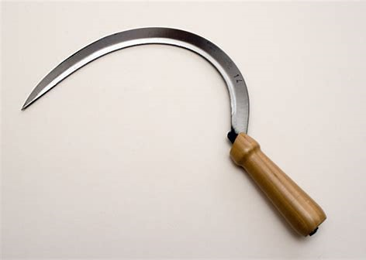
Let’s look closer at this phrase – (Lev 23:10)
… the first cutting of your harvest -
rashith qtzir – km –
The primary focus:
Is it possible this special offering required of Yahuah could be brought to Him after the Yisra’elites observed the Feast of Passover and AFTER the Feast of Unleavened Bread - as claimed by the Enoch/Zadok & Essene Calendars?
ק צ י ר כ ם
ר א ש י ת
Setting the Stage!

Slide 49
Enoch & Zadok’s Wave Sheaf in Question!
Joshua/Yisra’el ATE the grain of the land on Abib 15! (Josh 5:11 – slide 34.)
7 Days of Unleavened Bread
15 | 16 | 17 | 18 | 19 | 20 | 21 | 22 | 23 | 24
25 | 26
Joshua HARVESTED the FIRST grain.
The Enoch Calendar claims the Wave Sheaf must be performed on the 26th of Abib.
Bread Dough was OFFERED, GRAIN WAS EATEN on Abib 15!
The Question:
Is it acceptable in Yahuah’s eyes to separate the First Bread Dough from the Wave Sheaf offering?

Slide 50
The Enoch Question Emphasized!
Did Yahuah command that the Wave Sheaf offering was to trail by 11 full cycles after Joshua harvested and ate the grain of the land on Abib 15, - the cycle after the Passover?..
15 | 16 | 17 | 18 | 19 | 20 | 21 | 22 | 23 | 24
25 | 26
Joshua HARVESTED AND ATE of the FIRST SEVERED grain.
Again – Did Joshua save the First of the Bread Dough for 11 cycles so he could offer it to Yahuah on Abib 26 as Enoch demands?

Slide 51


Why do we keep seeing this picture?
Patience! The answer is coming!

Slide 52
#1.6: Hebrew Definitions for <rashith> (first)
Let’s dig in and look at some definitions for - rashith.
We find this same word at the very start of the Hebrew manuscript –
Gen 1:1 - In the BEGINNING … The FIRST!
Keep in mind the harvest of wheat upon entering into Canaan and the prohibition of eating grain of any kind, -
until the Wave Sheaf procedure HAD BEEN accomplished.
Etymological Dictionary of the Hebrew Language pg. 601
rashith - headship, primacy
The root word - rosh - head, chief, leader, top, summit, beginning, division, principal, foundation.
ר א ש י ת
ר א ש י ת
As in – FIRST cutting!
ר א ש

Slide 53
A Hebrew Lexicon by J Parkhurst 1762 pg. 480
The root word (rosh) denotes -
priority or precedence in respect of time, order, place, or dignity,
principal part, chief, most excellent.
J Parkhurst writes – It [rosh] is said of Wisdom. i.e. of the Messiah,
(Prov 8:22).
This word (rashith) is used in connection with the Wave Sheaf which represents Yahusha, for Yahusha was the First Fruit, the chief, the most excellent primary “fruit,” from victory over death!
ר א ש
ר א ש י ת
The word then has a rightful direct connection to the first sheaf; the Wave Sheaf offering by Joshua upon entering in to Canaan!
ר א ש י ת

Slide 54
J Parkhurst continues –
As a noun the head, of the animals, whether of men, beasts or birds, because first or highest in place, and, on account of the senses therein lodged, in dignity also.
J Parkhurst writes much more on this interesting word.
To summarize it, (rashith),
TAKES PRECEDENCE OVER ALL ELSE.
Remember, this word (rashith) is written in Lev 23:10 concerning the offering required by Joshua prior to eating
the grain of the land!
ר א ש
ר א ש י ת
ר א ש י ת

Slide 55
A Hebrew Lexicon by W. H. Barker 1776 pg. 202
[Root word -] head, top, principal, chief, captain, chief in place, beginning, first, fum [sum] total.
[rashith] beginning, principal, chief, firft [first],
firft fruit [first fruit].
A Hebrew Lexicon by Gesenius pg. 953
the head, for what is highest, uppermost, summit, the sum, amount, chief prince, highest place or rank, first, foremost beginning, the first of its kind, firstfruits.
Gesenius Lexicon pg. 964-5 describes in detail, basically the same information as we have already read concerning - (rashith) providing many Scriptural texts.
ר א ש
ר א ש י ת
ר א ש י ת

Slide 56
The Hebrew and Aramaic Lexicon of the Old Testament
by Koehler and Baumgartner pg. 1975
The root word (rosh) - the head - is explained as being the primary source of intelligence and leadership.
Samuel Bagster’s Analytical Hebrew and Chaldee Lexicon –
through Benjamin Davidson, Hebrew College, Britain pg. 773
The root word - (rosh) – head, chief, leader,
[in context] chief priest, high priest, principal of anything,
head stone of corner
[rashith] a beginning, former time, former state, the first of its kind, in respect to time, rank and worth, hence – firstling.
ר א ש
ר א ש
ר א ש י ת

Slide 57
Summary
- (rosh) and (rashith) carry the unmistakable notation of being the
PRIMARY KNOWN ENTITY of its kind.
Alignment Reminder: We are still investigating the first fruit - Wave Sheaf – grain offering required of Joshua to perform BEFORE they ate the grain of the land.
Let’s review the next slide from Lev 23, before continuing our examination of the Hebrew words.
ר א ש
ר א ש י ת

Slide 58
Review: – Is this correct?
Lev 23:10 Speak to the children of Israel, and thou shalt say to them, When ye shall enter into the land which I give you, and reap the harvest of it, then shall ye bring a sheaf, the first-fruits of your harvest, to the priest;
First Fruits – rashith qtzir - km = FIRST CUTTING of you.
Now let’s look at the Hebrew word translated as - “cutting”!

Slide 59
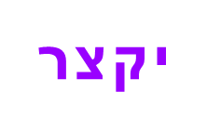
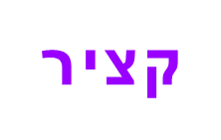
#1.7: Hebrew Definitions for <iqtzr> (cutting)
Samuel Bagster’s Analytical Hebrew and Chaldee Lexicon –
through Benjamin Davidson, Hebrew College, Britain pg. 765
iqtzr – (family word) – to cut down, reap
qtzir – (Tanach word) masc, fruits cut down; harvest, hence time of harvest,
Gesenius Hebrew Lexicon pg. 952
qtzir - …all words starting with [quf tzadi] have the notion of cutting, cutting off.
Gesenius Lexicon then goes on to list the numerous family of words that start with quf tzadi.
ק צ י ר
ק צ

Slide 60
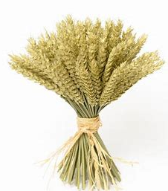
Gesenius Hebrew Lexicon pg. 954 continued
qtzir - … reaping, harvest of grain.
The Lexicon then goes on listing the many times
the harvest is referenced throughout the Tanach.
A Hebrew Lexicon by J Parkhurst 1762 pg. 540
qtzir - to cut off, reap or mow, as the fruits of the earth.
A Hebrew Lexicon by W. H. Barker pg. 198
qtzir - to cut, fhorten (shorten), to reap, cut mow, harveft (harvest); a harveft (harvest) bough which bears fruit is ufually (usually) cut off
ק צ י ר
ק צ י ר
ק צ י ר

Slide 61
The Etymological Dictionary of the Hebrew Language by Earnest Klein
qtzir - harvesting, reaping, 2. harvest time, harvest,
3. cut grain, 4. bough branch
Strong’s H7114 prim root, - to dock off, espec. to harvest (grass or grain) cut down, harvestman, reaper,
to shorten
Summary for qtzir – all research sources thus far agree that this word designates an action of CUTTING in some respect .
There is now one more word that needs examination. It is the Hebrew word - Omer - H6016, that we read in English as “sheaf.” We need to be certain exactly what type of product Joshua was required to present!
ק צ י ר
ק צ י ר
ק צ י ר

Slide 62

Strong’s H6016 – Omer
עֹמֶר ʻômer, o'-mer; from H6014; properly, a heap, i.e. a sheaf; also an omer, as a dry measure:—omer, sheaf.
H6014 עָמַר ʻâmar, aw-mar'; a primitive root; specifically (as denominative from H6016) properly, apparently to heap; figuratively, to chastise (as if piling blows); to gather grain:
bind sheaves, make merchandise of.
Gesenius Hebrew Chaldee Lexicon (BLB) Omer
to bind closely together: Piel, to bind sheaves together.
ע מ ר

Slide 63
A Hebrew Lexicon by J Parkhurst 1762 pg. 387
Omer - to press, squeeze, constipate into a narrow compass by pressure
to gather as corn into sheaves, to contract or press it into a narrow compass
A Hebrew Lexicon by W. H. Barker pg 143
to gather or prefs [press] together, to bind the fheaves [sheaves] i.e. to pick up handfuls after the reaper
Samuel Bagster’s Analytical Hebrew and Chaldee Lexicon –
through Benjamin Davidson, Hebrew College, Britain pg. 706
Omer - to bind sheaves
ע מ ר
ע מ ר
ע מ ר

Slide 64
#1.8: Summary of Hebrew Definitions for <rashith> & <iqtsz>
ע מ ר
Summary for Omer – it is quite apparent that the action necessary is to gather, or group the stalks of wheat for the very special offering.
Assessment for Part #1 –
1. By Hebrew definition we have determined that –
rashith is the prime factor, or first entity of its kind. There is nothing which comes prior to it.
2. By Hebrew definition we understand that –
qtzir describes the required CUTTING action for harvesting the grain of the land.
3. By Hebrew definition we realize that –
omer is the bundling action required to form a sheave.
ר א ש י ת
ק צ י ר
ע מ ר

Slide 65
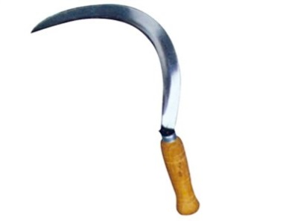
These are the definitions that pertain directly to this study.
Yes there are other definitions which do not apply here.
What is the reason for this close examination into rashith & qtzir?
We are going to review Lev 23:10 once again! ☺
Lev 23:10 Speak to the children of Israel, and thou shalt say to them,
When ye shall enter [cross the Jordan]
into the land which I give you, [Canaan]
and REAP [QTZIR - TO CUT OFF]
the HARVEST of it [QTZIR E AT] [please note the - Aleph Tav],
then shall ye bring a sheaf, [wheat bundle offering]
the first-fruits [THE PREMIER CUTTING OF GRAIN]
of your harvest, [Qtzir]
to the priest …

Slide 66
Are there more witnesses for the requirement to deliver
the FIRST CUTTING OF GRAIN to the priest?
Deut 18:3, 4 NASB
“Now this shall be the priests' due from the people, from those who offer a sacrifice, either an ox or a sheep, of which they shall give to the priest the shoulder and the
two cheeks and the stomach.”
“You shall give him the FIRST FRUITS of your grain, your new wine, and your oil, and the first shearing of your sheep.”
Deut 26:1, 2 NASB
“Then it shall be, when you enter the land which [Yahuah] your [Elohim] gives you as an inheritance, and you possess it and live in it, that you shall take some of the FIRST OF ALL the produce of the ground which you bring in from your land that [Yahuah] your [Elohim] gives you, and you shall put it in a basket and go to the place where [Yahuah] your [Elohim] chooses to establish His name.”

Slide 67
What is the Sickle’s Commission? Reaping!
Rev 14:14 And I looked and saw a white cloud, and sitting on the cloud was One like the Son of Aḏam, having on His head a golden crown, and in His hand a sharp sickle.
15 And another messenger came out of the Dwelling Place, crying with a loud voice to the One sitting on the cloud, “Send Your sickle and reap, because the hour has come for You to reap, because the HARVEST of the earth is ripe.”
16 And the One sitting on the cloud thrust in His sickle on the earth, and the earth was reaped.
17 And another messenger came out of the Dwelling Place which is in the heaven, and he too held a sharp sickle.
18 And another messenger came out from the altar, having authority over the fire, and he cried with a loud cry to him having the sharp sickle, saying, “Send your sharp sickle and gather the clusters of the vine of the earth, because her grapes are ripe.”
19 And the messenger thrust his sickle into the earth and gathered the vine of the earth, and threw it into the great winepress of the wrath of Elohim.
20 And the winepress was trodden outside the city, and blood came out of the winepress, up to the bridles of the horses, for about three hundred kilometres.
18 And another messenger came out from the altar, having authority over the fire, and he cried with a loud cry to him having the sharp sickle, saying, “Send your sharp sickle and gather the clusters of the vine of the earth, because her grapes are ripe.”
19 And the messenger thrust his sickle into the earth and gathered the vine of the earth, and threw it into the great winepress of the wrath of Elohim.
20 And the winepress was trodden outside the city, and blood came out of the winepress, up to the bridles of the horses, for about three hundred kilometres.

Slide 68
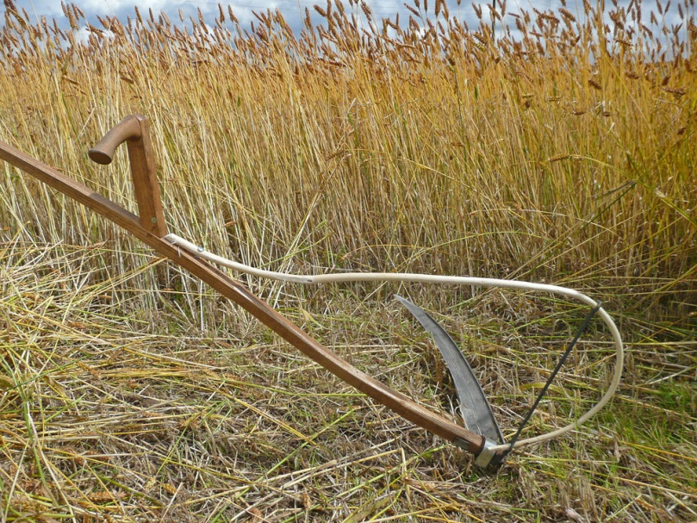
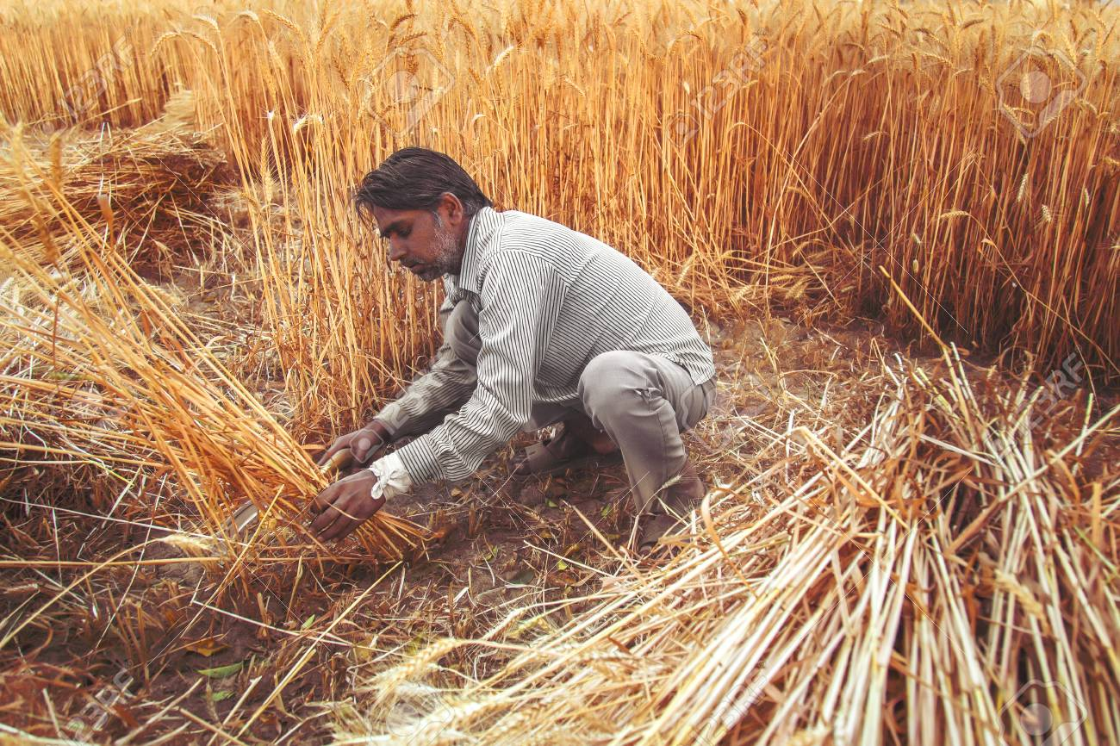
#1.9: The Wave Sheaf
Grain Offering
Will the –
FIRST CUTTING OF GRAIN
INCLUDE THE DOUGH
(which is required prior to creating bread)?

Slide 69


The CUTTING, mixing, presenting and EATING sequences.
Lev 23:12 And on that day when you wave the sheaf, you shall prepare a male lamb a year old, a perfect one, as an ascending offering to יהוה [Yahuah],
[Yahuah], a sweet fragrance, and its drink offering:
one-fourth of a hin of wine.
Sickle!
The Cutting (1st Harvest) Task (Wave Sheaf and sacrifice)!
This is the (FIRST) Bread Dough Mixing Task!
two-tenths of an ěphah of FINE FLOUR MIXED WITH OIL, an offering made by fire to יהוה
Lev 23:13 and its grain offering:

Slide 70
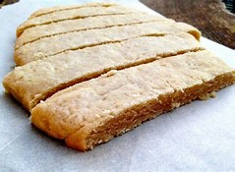
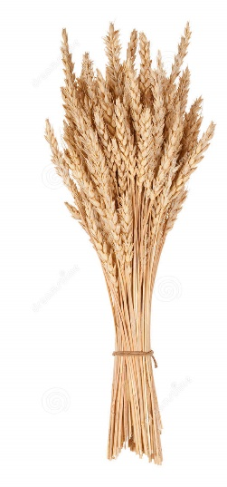

This very specific offering was TIMED!
Num 15:19 Then it shall be,
of the BREAD of the land,
WHEN YOU EAT
that YOU PRESENT A CONTRIBUTION
to יהוה[Yahuah].
{A Grain OFFERING}

Slide 71
The Bread Qualifier!
#1!
Num 15:20 Present a cake of the FIRST OF YOUR DOUGH as a contribution – as a contribution of the threshing- floor you present it.
Num 15:21 Of the you are to give to יהוה [Yahuah] a contribution throughout your generations.
Evidently it is VERY IMPORTANT to Yahuah to have the very first batch of wheat flour mixed with oil {which is - DOUGH}.
NOTICE WHAT THE VERY NEXT TEXT SAYS! (AGAIN!)
FIRST OF YOUR DOUGH

Slide 72
Bread Qualifier
#2!
Num 15:20 …a contribution of the threshing-floor
you present it.
Enoch,
Zadok, did you read this qualifier?? ☺
2. By stating that the offering must originate from the threshing floor, this clearly indicates a grain product.
This positively rules out dough made from manna.
Hence it cannot be said that Joshua made the dough
which they ate on Abib 15, from manna!
Joshua made and ate bread produced from grain dough -
FROM THE THRESHING-FLOOR!
These statements will be examined thoroughly. The plot thickens! ☺

Slide 73

Bread Qualifier
#3!
Lev 23:13 And its meat-offering two tenth portions of
FINE flour mingled with oil: …
3. By requiring FINE flour, Yahuah eliminates barley as the grain from which to form the FIRST dough offering.
Barley cannot be made into fine flour.
Barley makes coarse flour only!
Again! More Calendar Lingo!
The wheat was CUT OFF – SEVERED – BY THE SICKLE!
It was then prepared into a bread dough offering to Yahuah!
The remainder of the first portion of dough was baked into bread.
The Scriptures record the Yisra’elites ate it on the “selfsame day”
(H6106 ehtzem) after the Passover! {Abib 15 - day AFTER Passover!} (Jos 5:11)

Slide 74

Why is this point of the FIRST of the harvest including the freshly CUT wave sheaf and the FIRST of the bread dough – being directly emphasized?
Because the Enoch/Zadok calendars declare the Wave Sheaf was performed LONG AFTER Joshua’s Wave Sheaf Festival presentation – they claim - on Abib 26!
This is in spite of the Scriptures documenting that the Yisra’elites ATE THE GRAIN of the land on the cycle immediately after the Passover of Abib 14!
Enoch/Zadok calendars are allowed only
one statute error to be counted as counterfeit!

Slide 75
Section #2
This section examines the Scriptural reasons why the EATING of the grain of the land, and the action of CUTTING the wave sheaf cannot be separated
onto different dates of the month.

Slide 76

What type of activity was prohibited until the Wave Sheaf, bread dough, sacrifices and oblations had been performed FIRST?

Slide 77
YAHUAH’S EATING PROHIBITION COMMAND!
WHAT?
Lev 23:14 And you
DO NOT EAT
REVIEW
1
2
3
bread or roasted grain or fresh grain
Timing?
until the SAME DAY THAT YOU HAVE
BROUGHT AN OFFERING to your Elohim
Eh-Tzem
–a law forever throughout your generations in all your dwellings.

Slide 78
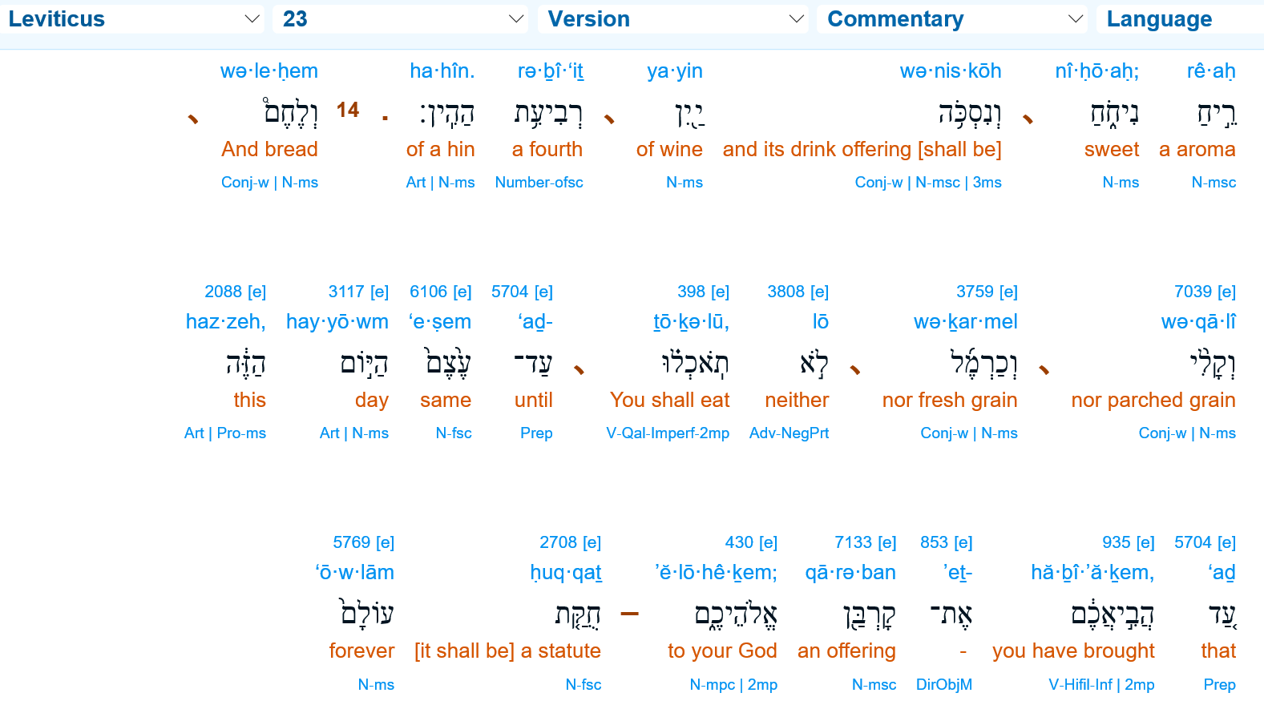


There it is!
Yahusha – The Central Head {Intelligence} of the Fundamental BONE STRUCTURE for Salvation

Slide 79
Nowhere in the Scriptures was Joshua commanded to refrain from eating the grain of the land {Jos 5:11} for 11 extra cycles to align with Enoch’s Wave Sheaf on Abib 26!
{Remember: Abib 26 is the Enoch/Zadok Wave Sheaf claim!}
The Abib 26 idea simply does not exist in the Scriptures.
If one desires to observe the Wave Sheaf on Abib 26,
one must go to a separate calendar source other than
the Scriptures for uninspired authority.
(Would that be Zadok and Book[s] of Enoch?)

Slide 80
WHEN??? Sequence Review! {1st Witness}
Lev 23:12 And when you wave the sheaf,
Lev 23:13 and its grain offering: two-tenths of an ěphah of
fine flour mixed with oil, an offering made by fire to יהוה [Yahuah], a sweet fragrance, and its drink offering:
one-fourth of a hin of wine.
Sickle!
The Cutting Task (Wave Sheaf and sacrifice)!
on that day
[…take careful note of the subsequent required actions and
the substance(s) that accompany it on the very same day] ...
you shall prepare a male lamb a year old, a perfect one, as an ASCENDING offering to יהוה [Yahuah],
Ascend? John 20:17

Slide 81
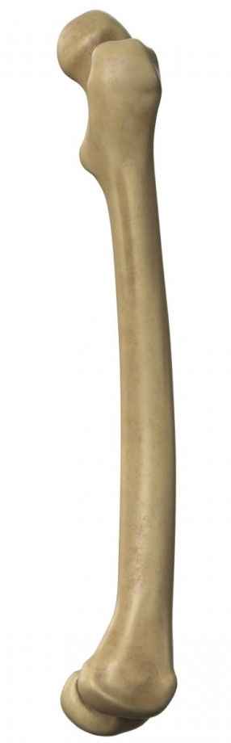

(The “Type”)
(The “Anti-type)
Ascension offering!
Ascend? John 20:17
THAT SAME DAY!!!!
Do we have another witness?
Eh-Tzem

Slide 82
Numbers Again! - ch 15:17 – 18 {2nd Witness}
Num 15:17 And יהוה [Yahuah] spoke to Mosheh, saying,
Num 15:18 “Speak to the children of Yisra’ěl, and say to them,
‘When you come into the land to which I bring you …’
Note: It is just as important to understand exactly
what the Scriptures do NOT say,
as it is to know exactly what they DO SAY.
“When you come into the land” – does not mean –
after you have been settled in the land for awhile!

Slide 83
The Two Interlocked Inseparable Steps
Lechem
Num 15:19 Then it shall be, WHEN YOU EAT of the bread of the land, that you present a contribution to יהוה [Yahuah].
Step One - When you eat the bread of the land …
Step Two - … that you present a contribution to Yahuah!
What is that “contribution”? According to Lev 23:13, it is an offering of wheat flour mixed with oil – or, prepared bread dough! The old grain of the land was already prepared for eating! Yet as per instruction in Lev 23:14, the old grain of the land was NOT TO BE EATEN, not until the Wave Sheaf (the new standing grain harvested with a SICKLE) had been presented before Yahuah by the High Priest!

Slide 84
Again: the 3 important categories of this grain consumption restriction-
The Yisra’elites were NOT TO EAT -
1. bread (prepared from dough)
2. roasted grain (cooked new or old grain)
3. or fresh grain (new from standing grain)
prior to the wave sheaf ceremony.
Also, the offering and oblation presentation (Lev 23:12, 13) must necessarily
be accomplished first –
PRIOR TO EATING THE GRAIN!

Slide 85
With these three descriptions of grain, Yahuah had placed
a blanket coverage on the different types of grain
not to be eaten.
Only after the Wave Sheaf, with the sacrificial offerings and oblation presentations, -
ONLY THEN could the Yisra’elites eat
ANY grain of the land.
Enoch,
DSS, Zadok????
This factor is poised to pounce, in Part #2! Look for it!

Slide 86
Is there any possibility of another type of contribution presented to Yahuah that would NOT include bread dough and a Wave Sheaf ?
(See SICKLE!)
Yahuah outlined the Set-Apart Peripheries ultra clearly in Lev 23:9 –15.
“When you come into the land … you do not eat bread, roasted grain or fresh grain until the same day that you have brought an offering to your Elohim …”
The specific outline of the offerings are written within these verses!
There are no other instructions for this FIRST CONTRIBUTION UPON ENTERING THE LAND which could side step the eating of grain and presenting a CUT Wave Sheaf at the outset.

Slide 87
Why is the cutting and eating of grain being stressed?
Remember that Joshua records the Yisra’elites ATE of the stored and roasted grain on the cycle immediately after the
Sabbath Passover!
(Joshua 5:10, 11)
Enoch,
Zadok,
Essene, & DSS at
Qumran
????

Slide 88
Review Confirmation & {3rd Witness}
Jos 5:10 And the sons of Israel encamp in Gilgal, and make the passover on the fourteenth day of the month, at evening, in the plains of Jericho;
Jos 5:11 and of the old corn of the land on the morrow of the passover, unleavened things and roasted corn, in this self-same day;
THEY EAT
H6106
Enoch, DSS, Essene, Qumran, Zadok ????
Ultra Specific Note: Yes the Yisra’elites were eating the grain of the land on the cycle immediately following the Sabbath Passover!

Slide 89
52 Sabbaths per year Repeating Patterns
“Enoch”
“Review”
[41 minute 18 second mark on Part 1 of the you-tube.]
SPRING | SUMMER | FALL | WINTER
Month 1: 4, 11, 18, 25 | Month 4: 4, 11, 18, 25 | Month 7: 4, 11, 18, 25 | Month 10: 4, 11, 18, 25
Month 2: 2, 9, 16, 23, 30 | Month 5: 2, 9, 16, 23, 30 | Month 8: 2, 9, 16, 23, 30 | Month 11: 2, 9, 16, 23, 30
Month 3: 7, 14, 21, 28 | Month 6: 7, 14, 21, 28 | Month 9: 7, 14, 21, 28 | Month 12: 7, 14, 21, 28
No Sabbath Passover on the 14 ^{th} of the 1st or 2nd month???
There is NO weekly Shabbath on the …
14th cycle of the 1st or 2nd month of Enoch!
Passover was never honored on the 14th cycle of the 3rd month!

Slide 90
Pertinent inquiry at this point!
Have you seen thus far, any CONTINUITY AND/OR ALIGNMENT
with the documentation of the Scriptures,
justifying the following Zadok and Enoch calendar claim:
That the Yisra’elites performed the Wave Sheaf FOLLOWING the
Feast of Unleavened Bread - on the 26th of Abib?

Slide 91
The Enoch Calendar timing format is virtually identical.
The Inquest
The next slide is a witness for the promotion of the
Zadok calendar under consideration.
Please be certain you understand the date of their claim
for when the Wave Sheaf MUST BE performed
to accomplish their inclusive calendar specifications!
Why? Because this Enoch/Zadok calendar date has been compared to the Scriptures with Joshua’s documentation!

Slide 92
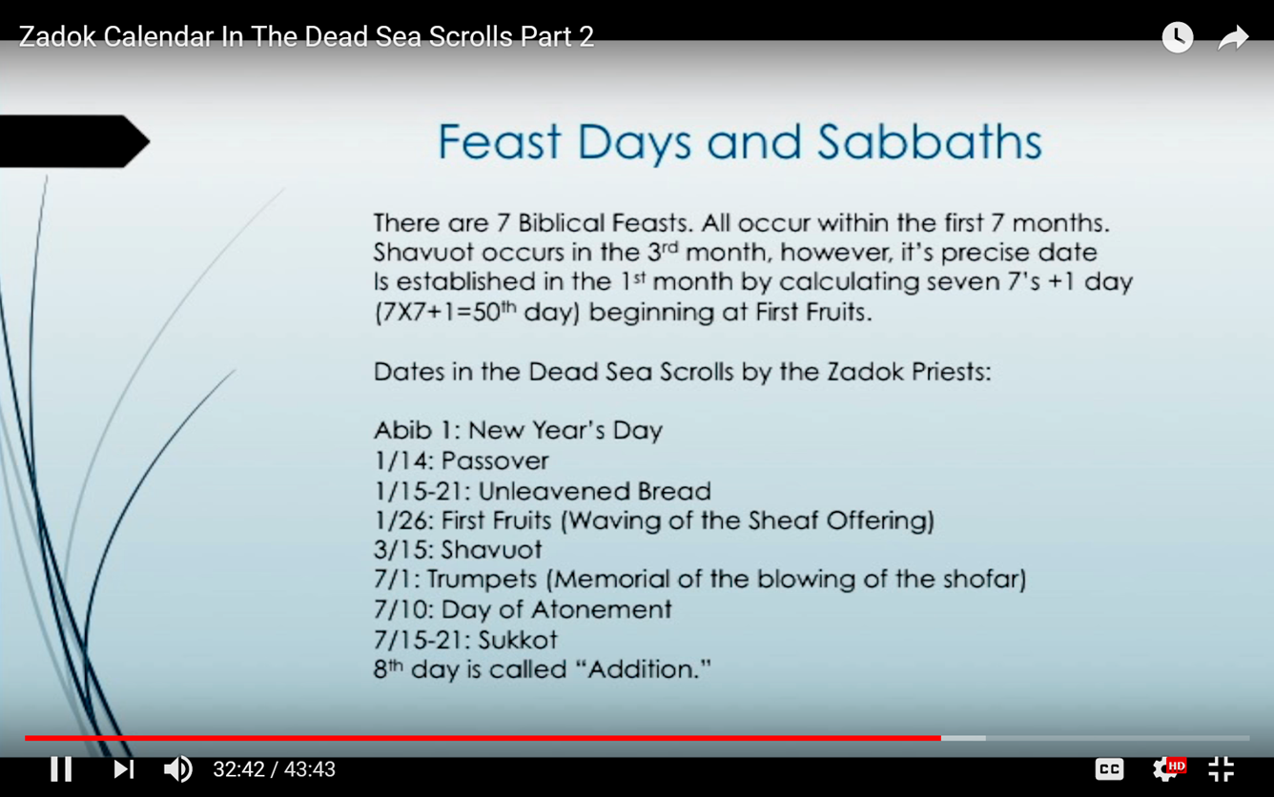
The Evidence
Wave Sheaf offered on the 26 ^{th} of the 1st month????
Enoch
Zadok

Slide 93
Pertinent Inquiry! #2
In context of the Zadok calendar -
IF the Wave Sheaf presentation did indeed follow
the Sabbath AFTER their completed week of Unleavened Bread …
What specific condition then must have been met
according to Yahuah’s Statute requirements?
Judging by Yahuah’s Inspired Word; can it be said that –
Yisra’el needed to refrain from eating any and all grain before Abib 26,
as claimed by the Zadok date of the Wave Sheaf presentation?
Will this dilemma be solved in the
Anti-type of our Messiah?
The End of Part 1

Slide 94
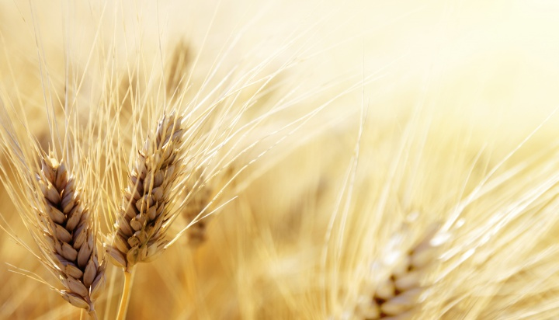
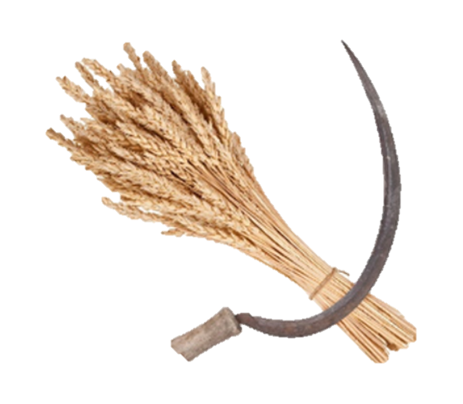
Part #1 exposed several errors/counterfeits of Enoch’s calendar.
Part #2 will address the issues of:
1) Torah’s “type”
2) Yahusha’s “anti-type”
3) Enoch’s Hunger Dilemma
over the placement
of Wave Sheaf.
How many more errors will be discovered?
May you be blessed as you ponder these thoughts!
Timothy Astleford Mar 25/19
Finished for presentation Oct 24/19

Slide 95
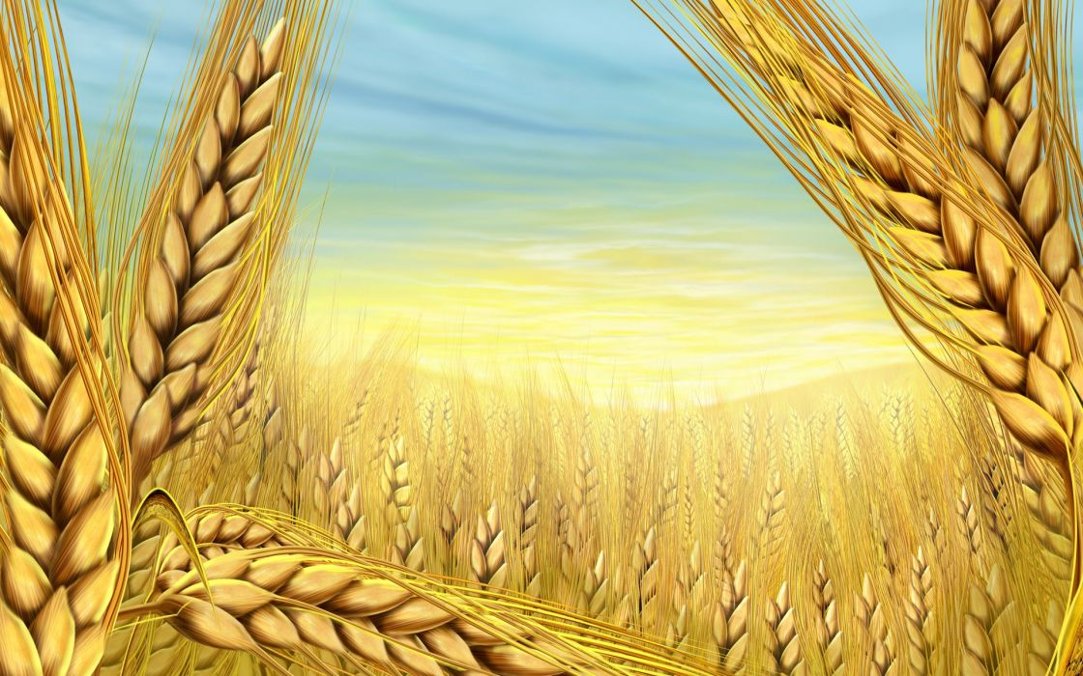

If you have Questions
&/or Comments
about this teaching,
please contact:
Timothy Astleford
tim@studythecalendar.com
calendar@torahtothetribes.com
Thank you!

