Slide 1

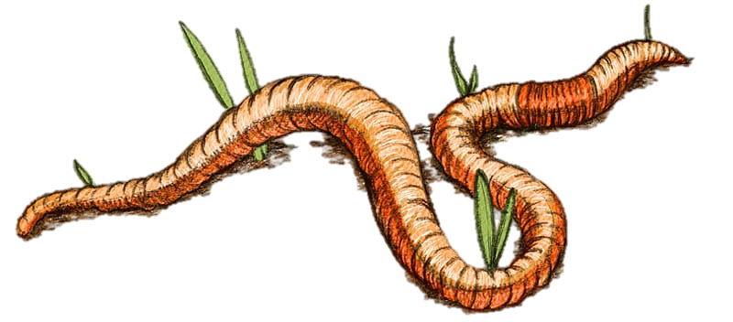

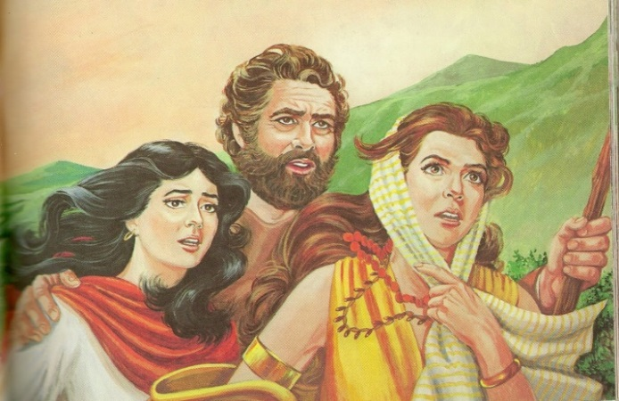
Lot’s
&
Jonah’s Worm
Daughters

Slide 2
The Timing Perspective Within Lot’s Liquid Error
Dawn to Dawn or
Sunset to Sunset?
Wine
Machar
Wine that beguiles
the mind!
& Evil Influences
1st Planned
Incest
2nd Planned
Incest
Lot’s events as recorded in the Scriptures …
Will they reflect the statements
of the
Creation week?
2

Slide 3

Will Yahuah’s
specific words
(recorded within
this event)
positively determine
with precision,
the start of
the new day?
Will Lot’s daughters contaminated
“planned parenthood”
expose the:
Dawn start to
Yahuah’s days?
~ OR ~
  2) Will Sunset Theory reign supreme?
All Scriptures are from The Scriptures - unless otherwise noted.

Slide 4
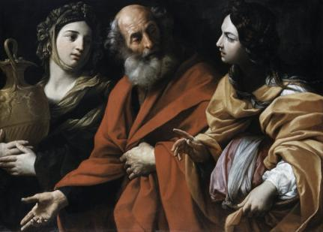
The Testimony is found in: Gen 19:30-35 And Lot went up out of
Tsoʽar and dwelt in the mountains, and his two daughters were with him, for
he was afraid to dwell in Tsoʽar. And he and his two daughters dwelt in a cave.
31 And the first-born said to the younger, “Our father is old, and there is no man on the earth to come in to us, as is the way of all the earth.
32 “Come, let us make our father drink wine and lie with him, so that we preserve the seed of our father.”
33 So they made their father drink wine that night. And the first-born went in and lay with her father, and he was not aware of it when she lay down or when she arose.
34 And it came to be on the next day that the first-born said to the younger, “See, I lay with my father last night. Let us make him drink wine tonight as well, and you go in and lie with him, so that we keep the seed of our father.”
35 So they made their father drink wine that night as well.
And the younger arose and lay with him, and he was not aware
of it when she lay down or when she arose.

Slide 5
Will this selection of verses provide a fleeting glimpse only, into
the Dawn to Dawn factor of starting the day, as from creation?
OR - will these verses become a BRILLIANT LIGHT that provides accurate perimeters pertaining directly to the start of Yahuah’s day?
Lot’s daughters erroneously perceived a problem! What was it?
31 And the first-born said to the younger, “Our father is old,
and there is no man on the earth to come in to us,
as is the way of all the earth.
Lot’s daughters erroneously understood no other way to preserve their family name and were wanting Lot to father children for them.

Slide 6
32 “Come, let us make our father drink wine and lie with him, so that we preserve the seed of our father.”
Owr (Light) | Layil (Night) | Owr (Light)
His daughters were devising a plan to get Lot “drunk enough” that he would not realize that he was being abused.
Deep down, they knew this was not a proper activity to do.

Slide 7
33 So they made their father drink wine that night.
And the first-born went in and lay with her father, and he was not aware of it when she lay down or when she arose.
32 “Come, let us
make our father drink wine
and lie with him,
so that we preserve
the seed of our father.”
Owr (Light) | Layil (Night) | Owr (Light)
Lot’s daughters caused him to drink intoxicating wine in the
night (layil) to the point of him being fully incoherent.
Daughter #1 pressed forward with the abominable event.

Slide 8
Mochoroth
34 (a) And it came to be on the next day [H4283] that the
first-born said to the younger … The Scriptures
NOTE:
It now becomes extremely important to know and understand
the Hebrew definitions, THEN apply them correctly, to the words we have received in English, specifically the words: next day!

Slide 9
Gen 19:34 – “on the morrow” [or the next day] H4283 <mochorath>
1) the morrow, the day after
Noah Webster’s: MOR'ROW, n.
1. The day next - after - the present.
Till this stormy night is gone,
And th' eternal morrow dawn.
This word is often preceded by on or to.
The Lord [Yahusha] did that thing on the morrow. Ex 9.
To morrow shall this sign be. Ex 8. So we say, to night, to day.
To morrow is equivalent to, on the morrow.
The next day subsequent to any day specified.
Emphasis Supplied

Slide 10
32 “Come, let us make our father drink wine and lie with him, so that we preserve the seed of our father.”
33 So they made their father drink wine
that night. And the first-born went in and lay with her father, and he was not aware of it when she lay down or when she arose.
34 (a) And it came to be on the
next day
that the first-born said to the younger …
Dawn
Owr (Light) | Layil (Night) | Owr (Light)
subsequent
[ˈsəbsəkwənt] ADJECTIVE
coming after something in time; following.

Slide 11
ORIGIN subsequent
late Middle English: from Old French, or from Latin subsequent-‘following after’ (from the verb subsequi).
To be able to follow something, it becomes necessary to realize a cut off point, or - ending perimeter, of a certain entity which enables something to –
follow!
The question then is:
Where is that - time reckoning - factor?

Slide 12
Next we see an important and decisive word.
34 (b)
“See, I lay with my father last night [H570/yesternight in KJV].
J. Parkhurst,
(A Hebrew Lexicon – (1762) pg 93)
Emesh - אמש . to recede, time past,
lately the LXX render it throughout by – yesternight.
Gen 29:34, 42; 2 Kings 9:26.
Amsh/Emesh

Slide 13
Amsh/Emesh
EDHL pg 37
1. Emesh - אמש . - last night
(= in the evening of yesterday)
(= in the night of yesterday)
2. to become dark, darken, it became dark
Barker pg 10
Emesh - אמש . - dark, gloomy, gloominefs, Job 30:3 yefternight [yesternight], late in the evening, lately
Strong’s Emesh - אמש . - time past, i.e. yesterday or last night,
former time, yesterday (-night)

Slide 14
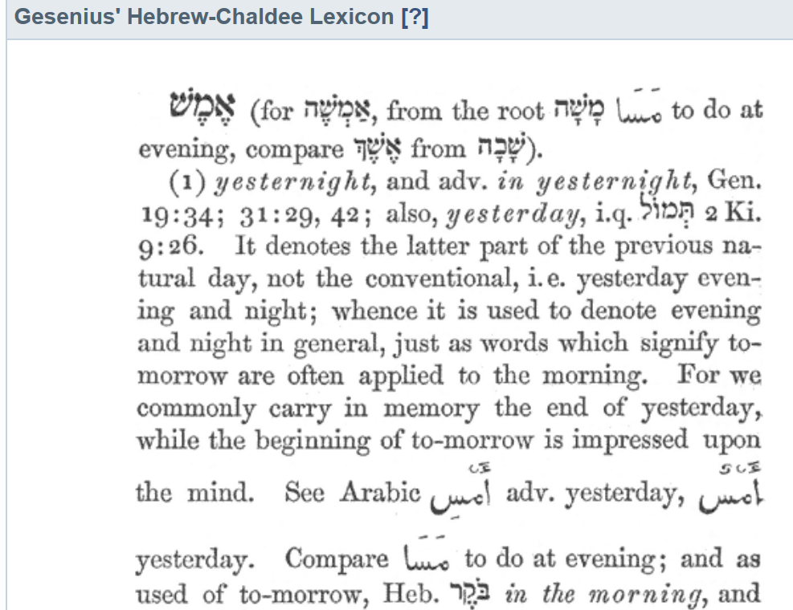

Slide 15
Amsh/Emesh [H570]
It becomes quite clear by Hebrew definition, that, when Lot’s
1st daughter declared that she had been with her father - אמש . – she was referencing the evening twilight and Night Season that PRECEDED the Light Season upon which she was speaking.
What natural event had occurred that reckoned a time division/separation which, in turn, provided a
reference point that could be followed?
DAWN!

Slide 16
32 “Come, let us make our father drink wine and lie with him…
33 So they made their father drink wine
that night. And the first-born went in and lay with her father, and he was not aware of it when she lay down or when she arose.
34 (a, b) And it came to be on the next day that the first-born said to the younger,
“See, I lay with my father
last night” …
Owr (Light) | Layil (Night) | Owr (Light)
We now see 2 witnesses of “Dawn to Dawn” in verse 34.
1. mochoroth – designates – a time frame identity subsequent to another.
2. emesh – a darkness which follows something previously established.
H4283 "on the morrow"
H570 "last night/yesternight"

Slide 17
This 1st Dawn, established the Light Season allowing the Night Season to be subsequent to it (followed.) This in turn permits the Mochoroth - (“next day”)
to be SUBSEQUENT –
to this 24 hour period!
34 (a, b) And it came to be on the next day that the first-born said to the younger,
“See, I lay with my father
last night” …
Owr (Light) | Layil (Night) | Owr (Light)
This established Layil darkness – CERTIFIES (correctly allows) AMESH the “yesternight” darkness; - within which the despicable act of darkness – (the abuse of a father/daughter relationship) - occurred.

Slide 18
The Dawn event establishes
the Light Season …
… which anchors the Night Season following!
This Dawn event establishes
the next 24 hour period which follows the former 24 hour period. The former being terminated at Dawn!
Owr (Light) | Layil (Night) | Owr (Light)
The celestial Dawn events are the “point of reckoning” or the central reference point of which the latter is to be determined by.

Slide 19
Does Yahuah give us
a 3rd WITNESS?
… In the same verse?
Gen 19:34 (c) … Let us make him drink wine tonight as well,
In this verse, the word – Layil – has the letterה .before it. This is translated as – “the.”
If the sunset changed the 24 hour periods,
WHY THEN WAS MOCHOROTH
(as NEXT DAY/NIGHT) not written here?
Layil

Slide 20
1
32 “Come, let us make our father drink wine and lie with him…
33 So they made their father drink wine that night. And the first-born went in and lay with her father, and he was not aware of it when she lay down or when she arose.
34 (a, b, c) And it came to be on the next day that the first-born said to the younger,
“See, I lay with my father
last night”, let us make him drink wine
2
3
tonight as well …
Not Mochoroth!
(as in next day or night)
Owr (Light) | Layil (Night) | Owr (Light) | Layil (Night)
We now see 3 WITNESSES of “Dawn to Dawn” in 1 verse!
The English translations declare – “THIS NIGHT” – includes the night with the former Light Season. They are indeed correct!

Slide 21
Layil
Interestingly, the attached letterה .“Heh” exposes that the
2nd Night Season of evil intention as directed by the 1st daughter,
was inclusive to the very Light Season upon which she was instructing her sister for the next abominable deed.
The sunset did not change the day according to the older sister.
Once again the Scriptures declare
ANOTHER SUNSET TO SUNSET FAILURE
has been recorded in the Scriptures!
Let’s view the last chart for Lot!

Slide 22
During the first Light Season, both daughters decide on their plan for the survival
of the human race.
Both daughters made their father drink wine that night. On the 1st night, the 1st daughter carried out the 1st part of their plan.
On the next day the first-born confirmed her actions of what she did “last night.”
Then both daughters agreed that day to get Lot inebriated again … when the second-born will carry out the final plans tonight.
Owr (Light) | Layil (Night) | Owr (Light) | Layil (Night)
Were any definitions of the Hebrew words ignored?
Are ALL events following a “forward progressive movement”?
Could a Sunset-theory day-start accomplish the same outcome?
Questions:

Slide 23
Lot’s daughters knew very well that the DAWN “twilight”
STARTS AND ENDS EVERY 24 HOUR PERIOD in Yahuah’s Kingdom!
We are told to test everything by the Torah.
Again, there is perfect linear alignment. ☺
On the remaining slides are Scriptural examples of the words we examined, (and more). Browse through them for better understanding of the Hebrew based Scriptures.
Please note the information on the word H8543 temowl and question – “would this word have exonerated the Dawn to Dawn day-start or destroyed Scriptural linear continuity”?
23

Slide 24
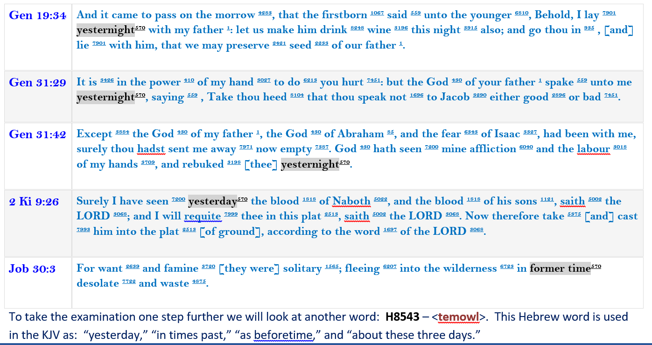
Here are 5 locations where H570 <emesh> is used.
Next, our examination will go one step further.

Slide 25
To take the examination one step further we will look at another word: H8543 – <temowl>. This Hebrew word is used in the KJV as: “yesterday,” “in times past,” “as beforetime,” and “about these three days.”
First, here is the definition of: H8543 <temowl>: before, before that time, beforetime, heretofore, of late,
of old, these days, time(s) past, yesterday, day before yesterday, recently, formerly
a) yesterday, recently, formerly (usual usage) (fig.)
b) as formerly, so more recently
c) from yesterday, already
Because we are considering the word “yesterday,” note how the translators of the KJV have also used the word “yesterday” for <temowl> in the following 3 Scriptures of the Old Testament. (Also see 1 Sam 20:27.)
Exo 5:14 > And the officers of the children of Israel, which Pharaoh's taskmasters had set over them,
were beaten, [and] demanded, Wherefore have ye not fulfilled your task in making brick both
yesterday ⁸⁵⁴³ and to day ³¹¹⁷, as heretofore ⁸⁰³² ⁸⁵⁴³?
2 Sam 15:20 > Whereas thou camest [but] yesterday ⁸⁵⁴³, should I this day ³¹¹⁷ make thee go up
and down with us? seeing I go whither I may, return thou, and take back thy brethren:
mercy and truth [be] with thee.
Job 8:9 > For we [are but of] yesterday ⁸⁵⁴³, and know nothing, because our days upon earth [are] a shadow.
Did you note the clear separation of “units of time” between “yesterday” and “today” in the first two texts?

Slide 26
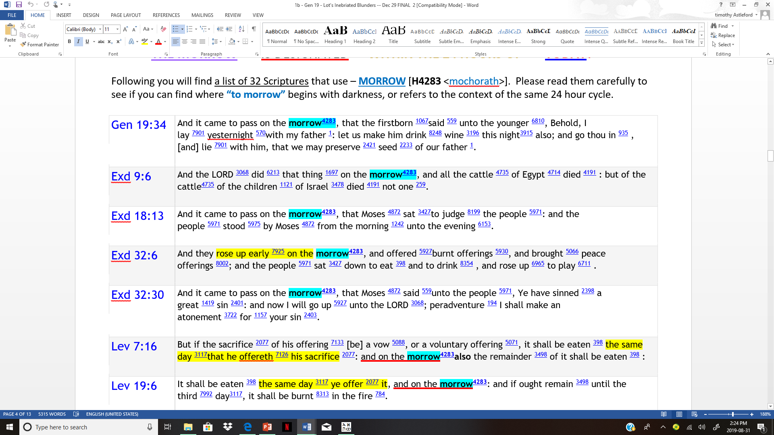
Now that we have seen Scriptural examples of a clear separation meaning for
the word translated into yesterday, let’s look at another set of Scriptures!
Lot Study
5th Plague
Judging
Golden Calf
Intervention

Slide 27
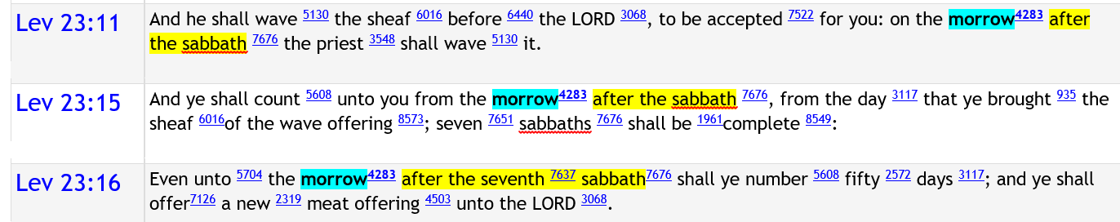
Peace Offerings & Vows
First Fruits & Wavesheaf

Slide 28
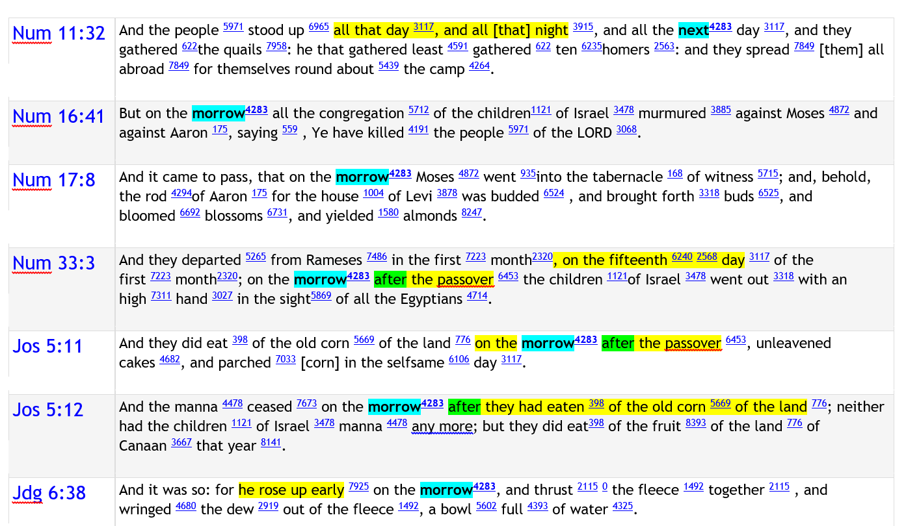
#2 Quails
Murmuring
Aaron’s
Rod
Leaving
Egypt
Passing
Over
Manna Ceases
Gideon

Slide 29
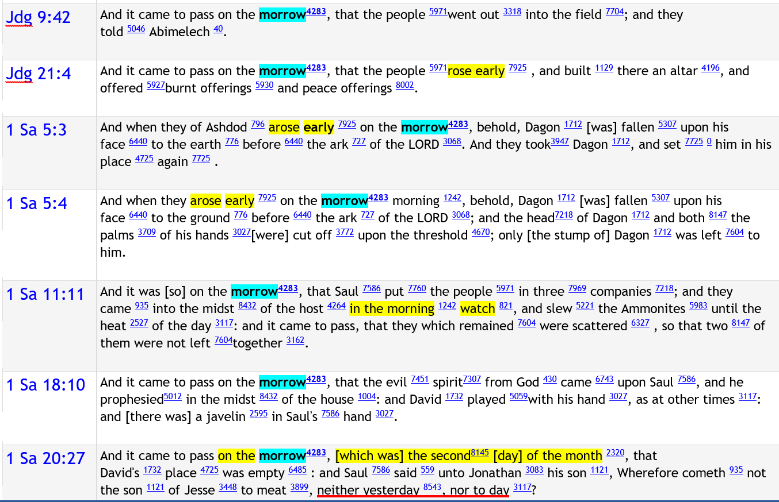
Strife!
Offerings
Dagon
Dagon
Saul’s Victory
Evil
Spirit
Saul & David

Slide 30
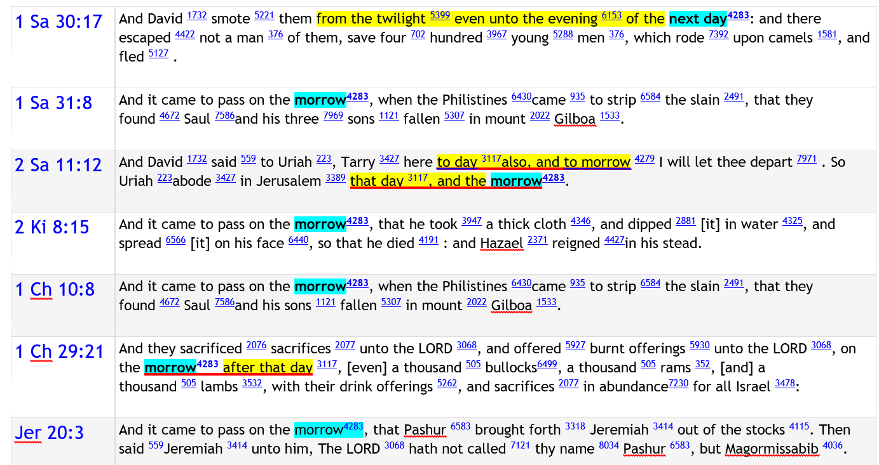
David’s Battle
Saul’s Demise
David’s Deed
Ben-Hadad’s Demise
Saul’s Demise
Solomon as King
Jeremiah

Slide 31

Sample #32 will be brought to us from Jonah and that worm.
Jonah’s Worm Instructor in 860 BC
for
A Vine with
SHADE!
Shachar
The
Gourd
Another Lesson
for Jonah!
A Hungry
Worm!
Dawn to Dawn or
Sunset to Sunset?
Jonah 4:6 And [Yahuah] prepared a gourd, and made it to come
up over Jonah, that it might be a shadow over his head, to deliver him from his grief. So Jonah was exceeding glad of the gourd.
31

Slide 32
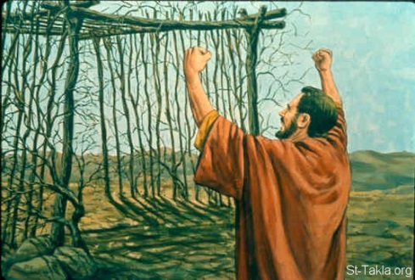
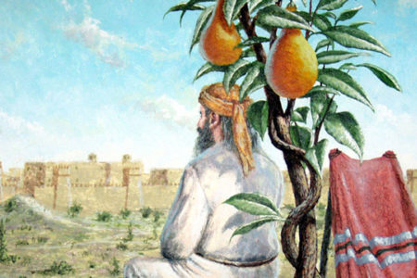
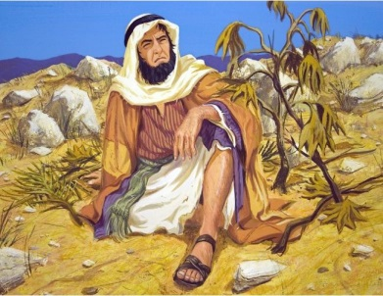
Jonah’s 40 Day Sermon to Nineveh
Jonah 4:5-11 Summary: (a) Jonah went out on the east side of the city … made a booth, and sat under its shadow, till he might see what would become of the city. He wondered if Nineveh would come under Yahuah’s wrath. (The rest of the events begin now with the 1st Light Season.)
1st Light Season | 1st Night Season | 2nd Light Season
(v 7) Yahuah prepared a worm when the morning rose the NEXT DAY; it smote the gourd.
MORNING
SUNSET
(v 5) Jonah
makes a booth.
(v 6) Yahuah prepares a gourd for
shade.

Slide 33
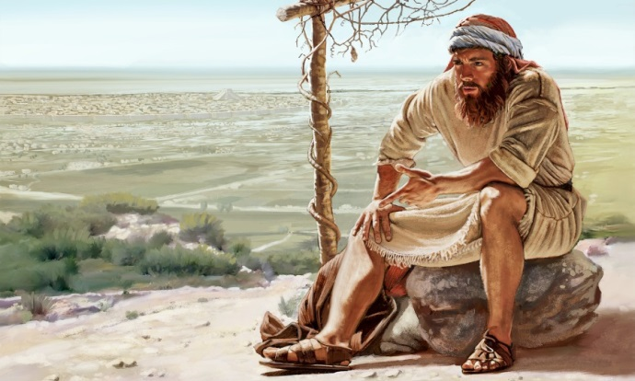
Jonah’s uses <shachar> for Dawn
1st Light Season | 1st Night Season | 2nd Light Season
The worm was introduced at
the NEXT DAY
with the morning [shachar H7837].
MORNING
SUNSET did not usher in a new cycle …
Note: This story spans a timeframe of part of the 1st day and also moves forward to the sunrise on the 2nd day.
Verse 7 is very clear that the
“next day” began with the
“dawn of morning.”
THEN …
(v 8) When the sun did rise [the 2nd day] Yahuah sent a strong east wind to beat on Jonah’s head; Jonah grumbles.
morning; H7837 shachar; from H7836; dawn (literal, figurative or adverbial): KJV - day
(-spring), early, light, morning, whence riseth.
Notice, verse 8 added what happened when the sun rose.
This should eliminate all doubt about a sunset beginning the 2nd cycle.

Slide 34

The Dawn Day really is this simple!
1st Light Season | 1st Night Season | 2nd Light Season
Jonah 4:7
Yahuah prepared a worm
when the morning ⁷⁸³⁷ rose ⁵⁹²⁷
MORNING
SUNSET
We have just examined the 32nd Scriptural example indicating
very clearly that the MORROW <mochoroth> is indeed the new
24 hour cycle which never begins at sundown or the darkness of night.
Once the “old” Night Season ends,
the “morrow” begins the next new cycle with the Light Season.
the next day ^{4283 <morrow>}…
Hhmm! Dawn, was accounted as –
THE NEXT DAY!
Dawn! (H7837) <shachar>
Genesis 1 is correct! Dawn always begins the cycles of Yahuah!

Slide 35
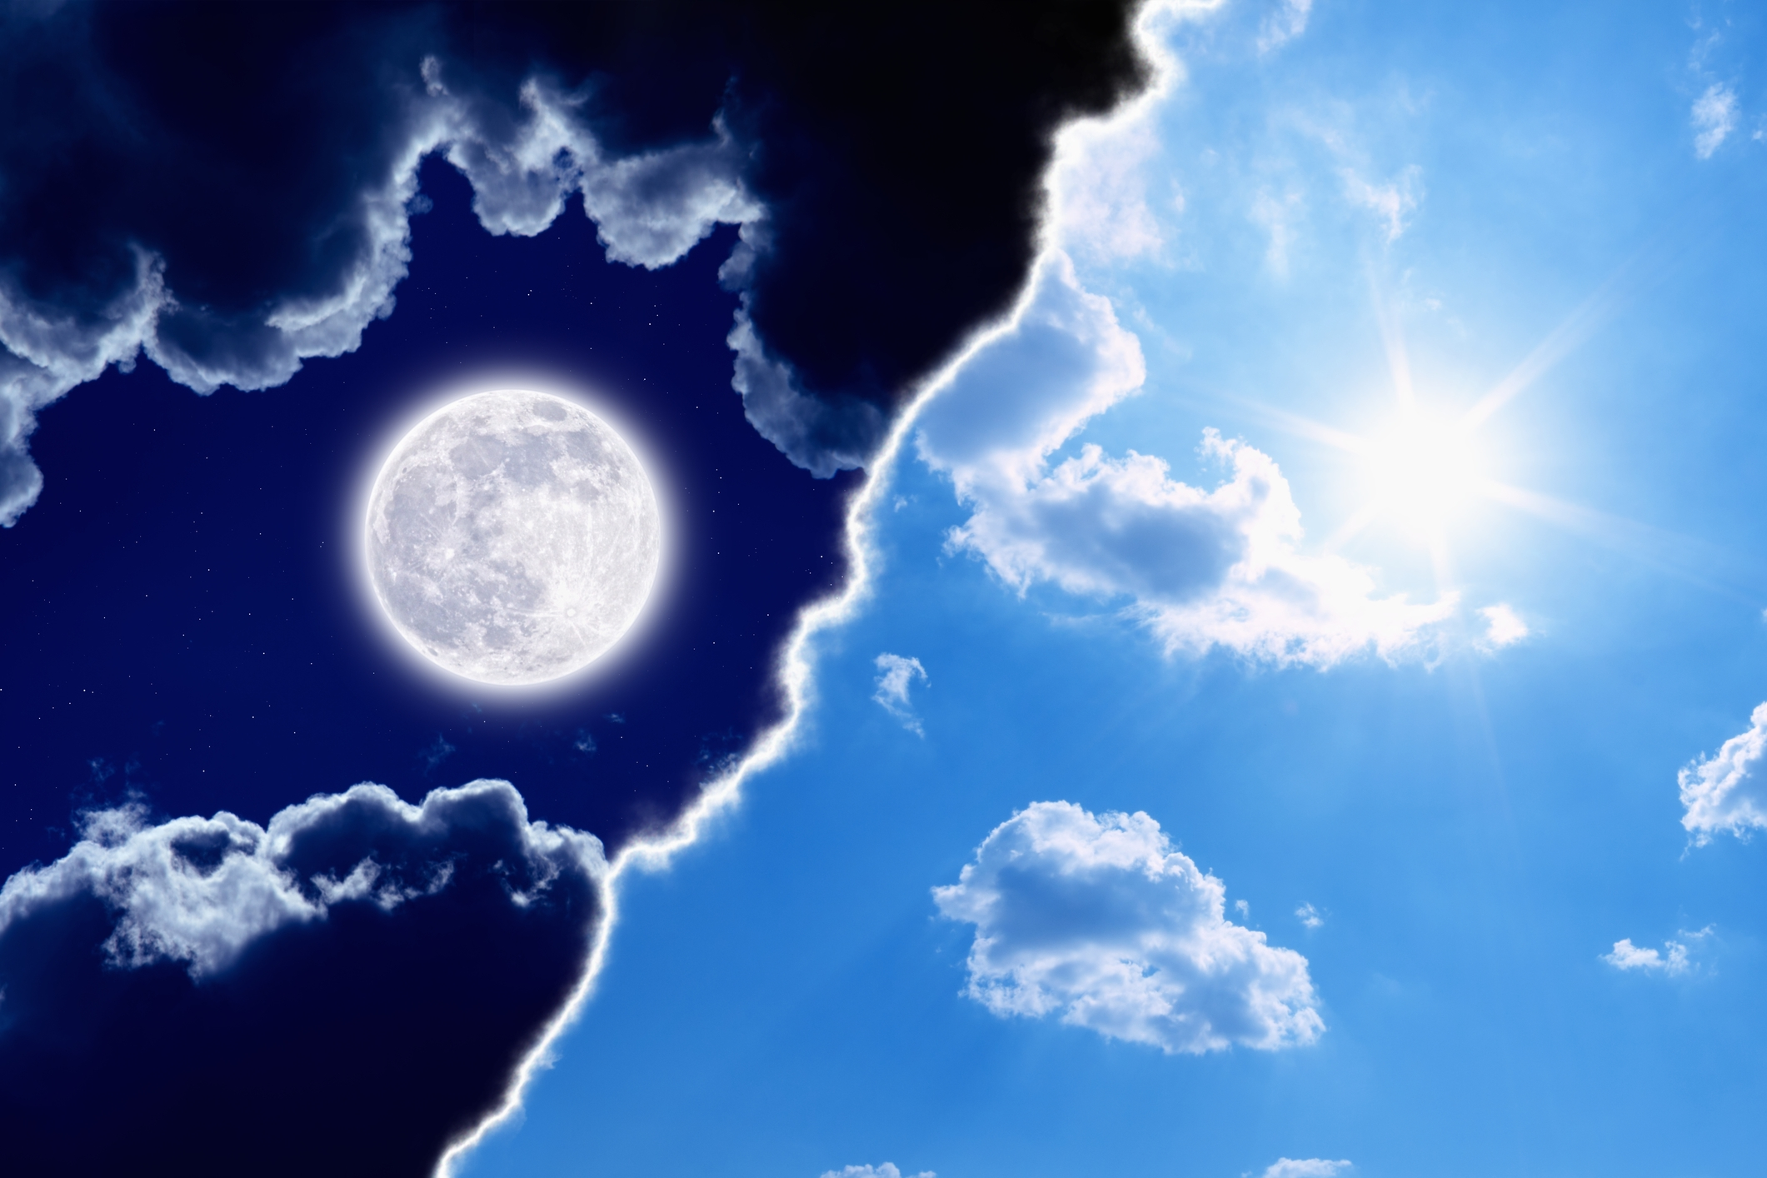


There are 2 words in Jonah that need special attention & mention:
Night
<layil>
Worm
<towla`>

Slide 36
Jonah 4:10 … “night” <layil H3915>
9 And Yahuah said to Jonah, Doest thou well to be angry for the gourd? And he said, I do well to be angry, even unto death.
10 Then said Yahuah, Thou hast had pity on the gourd, for the which thou hast not laboured, neither madest it grow; which came up in a night,
and perished in a night:
11 And should not I spare Nineveh, that great city, wherein are more than sixscore thousand persons that cannot discern between their right hand and their left hand; and also much cattle?
KJV
All “time related events” in the story are literal from verses 5-8.
The phrase about the “night” has no logical connection to verses 7 & 8 when considering the “literal time element.”
The expression – “coming up in a night and perishing in
a night” is only metaphorical to express speedy growth and speedy decay of the gourd that Jonah fretted over.
It was not so with Nineveh.
Nimrod raised up Nineveh about 2218 BC. Jonah is there as Yahuah’s missionary 1356 years later around 862 BC. Therefore, Yahuah has compassion on this huge city
that houses His children who have now repented.
With the perishing of the gourd so quickly Yahuah is basically teaching Jonah that Nineveh is not a young
city that rose up quickly in rebellion only to be snuffed out quickly like the gourd was.
Instead, Yahuah will continue to have compassion on His children as long as necessary, offering salvation.
How will Yahuah’s mercy connect to the “worm”?

Slide 37
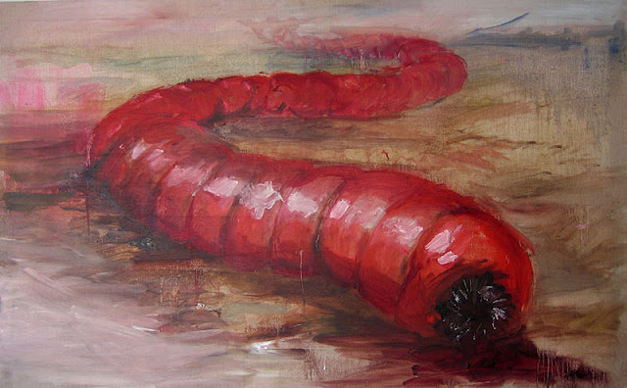
Jonah 4:7 “a prepared worm” <towla`H8438>
Jonah 4:7 Yahuah prepared
a worm when the morning rose the next day, and it smote the gourd that it withered.
WORM - H8438 towla`; [etc.]
from H3216; a maggot
(as voracious); specifically (often with ellipsis of H8144) the crimson-grub, but used only (in this connection) of
the color from it, and cloths dyed therewith: KJV - crimson, scarlet, worm.
Why would Yahuah destroy the gourd with a worm?
Is there a deeper meaning that is worth looking into?
Psa 22:1 has the well known words of:
My El, my El, why hast thou forsaken me? why art thou so far from helping me, and from the words of my roaring?
Psa 22:6 utters the words <towla`/worm> speaking
of Yahusha as a worm.
“I am a worm, [H8438] and [a] no man; a reproach
of men, and despised of the people.” KJV
The expression is speaking of Yahusha as “a prepared worm” or a “crimson worm” – like the deep red color of blood.
Note: The Hebrew <rimmah H7415> is another
word for “worm” that is not linked to Yahusha.

Slide 38
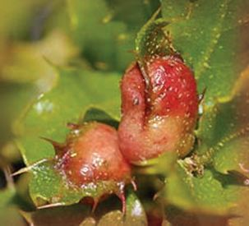
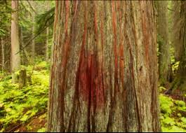
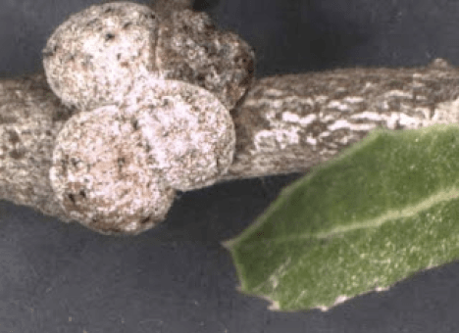
The “Crimson Worm” & the Gospel
The mother Crimson worm
gives birth to her young
only ONCE in her life.
She attaches her body to a TREE, fencepost or a stick – then she makes a hard CRIMSON shell.
This shell can not be removed without KILLING her.
The eggs are laid UNDER HER BODY and protective shell – giving PROTECTION to the young.
The young feed on the LIVING BODY of the mother.
When the young can survive on their own the mother DIES.
As Crimson mother worm dies, she oozes a crimson or scarlet red dye which not only STAINS THE WOOD SHE IS ATTACHED TO, but also her young are stained.
The young are colored SCARLET
for THE REST OF THEIR LIVES.
After THREE DAYS the dead mother loses its crimson color and TURNS into a WHITE wax which falls to the ground like snow.

Slide 39
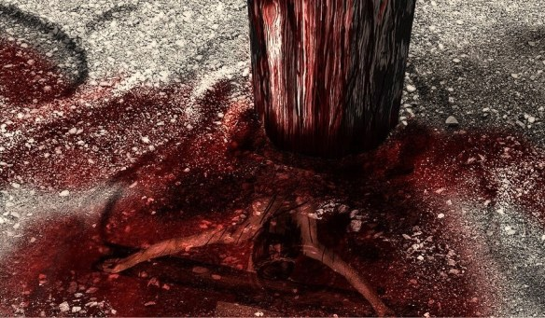
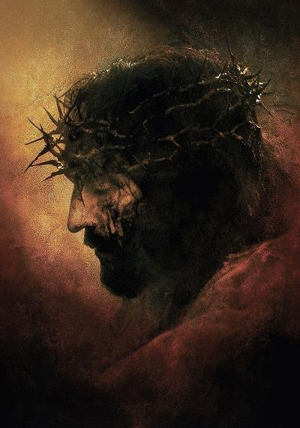

Yahusha and the “Crimson Worm”
How did Yahuah’s mercy
connect to the “worm”?
Yahusha gave up His life on a TREE ….
This sacrifice was given so His children
might be WASHED with His crimson blood.
Result? Their sins are cleaned up
white as snow.
Upon Yahusha’s resurrection, His children
feed on His Body, and are covered with
His CRIMSON blood.
The “wood” and the “young” are colored
SCARLET for THE REST OF THEIR LIVES.
Yahusha’s children are promised a WHITE ROBE
and eternal life because of this CRIMSON blood.
Isa 1:18 Come now, and let us reason together, saith Yahuah: though your sins be as scarlet,
they shall be as white as snow; though they be
red like crimson, they shall be as wool.
Did this worm, point forward to Yahusha’s Passover?
Was this worm giving a message to Jonah and Nineveh? Do you think it may have been …
?
at Nineveh

Slide 40


The Crimson Worm may have the reason why Covenant Calendar studies are important.
Instructions!
Instructions are Not
Suggestions!
Yahuah lovingly provided the Covenant Calendar instructions so His people would always know
when to meet with Him
on His weekly and annual
worship statutes.
Yahuah’s “Instructions” are NEVER merely suggestions for everyone to follow their own timing for any of the worship statutes.

Slide 41

Conclusion for Lot and Jonah
Through Jonah’s “worm” we understand Yahusha gave His living Crimson Blood so we would follow these instructions with Him!
When Yahusha advised that we are
to come to Him as a child, do you
think He would then give Calendar instructions and examples that are impossible for us to understand?
To understand the Dawn day-start, the examples of Lot and Jonah don’t get any more transparent, or trouble-free,
than this.
However, Yahusha made sure the Scriptures contain many testimonies, not just two or three.
Find them, enjoy them, and share
with others to come into Everlasting Covenant with Yahusha.
The End

Slide 42
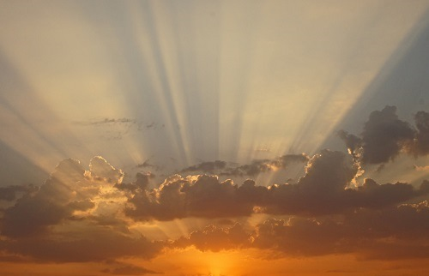



If you have Questions & Comments
about this teaching, please contact:
Tim Astleford or Charlene Fortsch
tim@studythecalendar.com
charlene@studythecalendar.com
calendar@torahtothetribes.com
Thank you!

