Slide 1

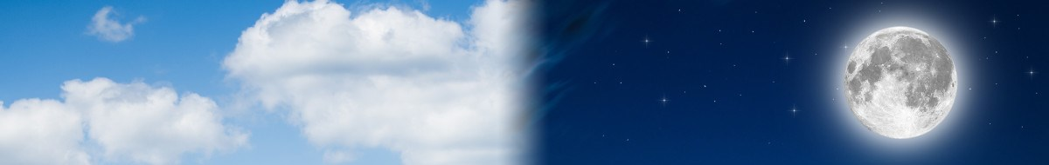
Chris Faifer edited 11/9/19 – removed descenders. Put Egypt in caps for the descender problem. #21: reworded the sentence to change Deut 16:6s issue; #36: split Wavesheaf; #42 changed grammar for punctuation with quote marks; #55 left the ! Mark inside the bracket; #64 added page number; #65 yes, baqer and not boqer;
#66 leave the?! As is.
July 22/20: slide 3 fix 966 to 996
“Between the
MixingS”
“Beyn Ha
Arbayim”
Grand
Finale

Slide 2





Mandate for “between the mixings”
Prov 25:2
It is the glory of Yahuah to conceal a thing:
but the honour of kings is to search out a matter.
In this study we’ll keep searching!
Knowing the End
from the Beginning
Isa 46:9-10
2

Slide 3
Beyn Ha Arbayim
ם
י
ב
ר
ע
ה
ן
י
ב
Arbayim
(plural for arab H6148)
R
E
V
I
E
W
<ereb>
H6153
Beyn
(Between)
H996
Arbayim
(mixtures)
H6148
Ha
(the)
Point #1:
There is only ONE “evening/ereb” in 24 hours!
Point #2:
There are always TWO “mixtures/arabs” in 24 hours!

Slide 4


#1 Placement of Both Daily Mixtures
Tim ... something just occurred to me! We have been saying "evening" is the foundation of calendar - or - ereb! Maybe that is not quite right. I'm beginning to see that ARAB (or the mixtures) are the foundation of calendar, with boqer ARAB's mixture as the day-start. THAT is why the word "evening" had to be studied and understood, not? evening/ereb is what leads one to the 2nd primitive root where the secret is hidden. It cannot be revealed UNTIL boqer is understood as one of the arabs (arbayim)! CF
I have held the thought that boqer is a mixture for a few years (2015), but now in agreement with you, now see that boqer and ereb are the foundation of CC.
I did however wrongly think that boqer included a few hours after the sunrise too. That has been eliminated.
Boqer – (Morning) DAWN twilight MIXTURE
Ereb – (Evening)
DUSK
twilight
MIXTURE
R
E
V
I
E
W
Dawn
Dawn
DAWN
DUSK
Sunrise
Sunset
Day-start at
twilight not
sunrise!
Direct Sunlight
Darkness
Mixtures [English] = Arbayim [Hebrew]
Foundation of Covenant Calendar
4

Slide 5
#2 Understanding <beyn ha arbayim>
The Hebrew phrase <beyn ha arbayim>
(“between the eveningS”)
is better understood in English as
“between the mixingS.”
“What mixingS”?
Dawn
Dawn
R
E
V
I
E
W
11
Torah
Scriptures
for
<beyn ha
arbayim>
Sunrise
DUSK
Sunset
#1 beyn ha arbayim
Day Season
(between two mixings)
#2 beyn ha arbayim
Night Season
(between two mixings)
Direct Sunlight
Darkness
The mixing of boqer [dawn] twilight &
the mixing of ereb [dusk] twilight.
No context
for day-start.
5

Slide 6
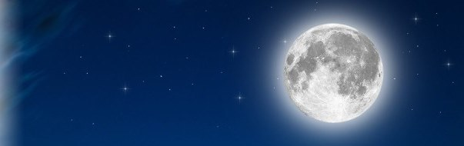

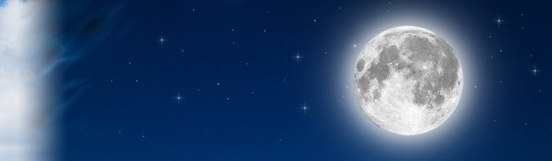

The 1st set of “between the mixingS” in Torah:
R
E
V
I
E
W
Narrative:
Exo 12:6 Night Season
Passover in Egypt
Exo 16:12 Night Season
Eating of Quail
The Night Season of
<beyn ha arbayim>
Dawn
Sunrise
Sunrise
Sunset
Dusk
#1
Dawn
Light Season | Night Season
In this study it is easier to relate to the Light Season as the 1st set of “mixings.” Why has Torah mentioned the
Night Season first?
<arab> Evening Twilight Mixture
<arab> Morning Twilight Mixture

Slide 7


The 2nd set of “between the mixingS” in Torah:
R
E
V
I
E
W
Commands:
Exo 29 & Num 28 Light Season
2nd Daily Sacrifice
Lev 23 & Num 9 Light Season
Passover Sacrifices
Exo 30 Light Season
Sanctuary Lamps
The Light Season of
<beyn ha arbayim>
Dawn
Sunrise
Sunrise
#2
Sunset
Dusk
#1
Dawn
Light Season | Night Season
<arab> Evening Twilight Mixture
<arab> Morning
Twilight Mixture
Dawn to Dawn!

Slide 8
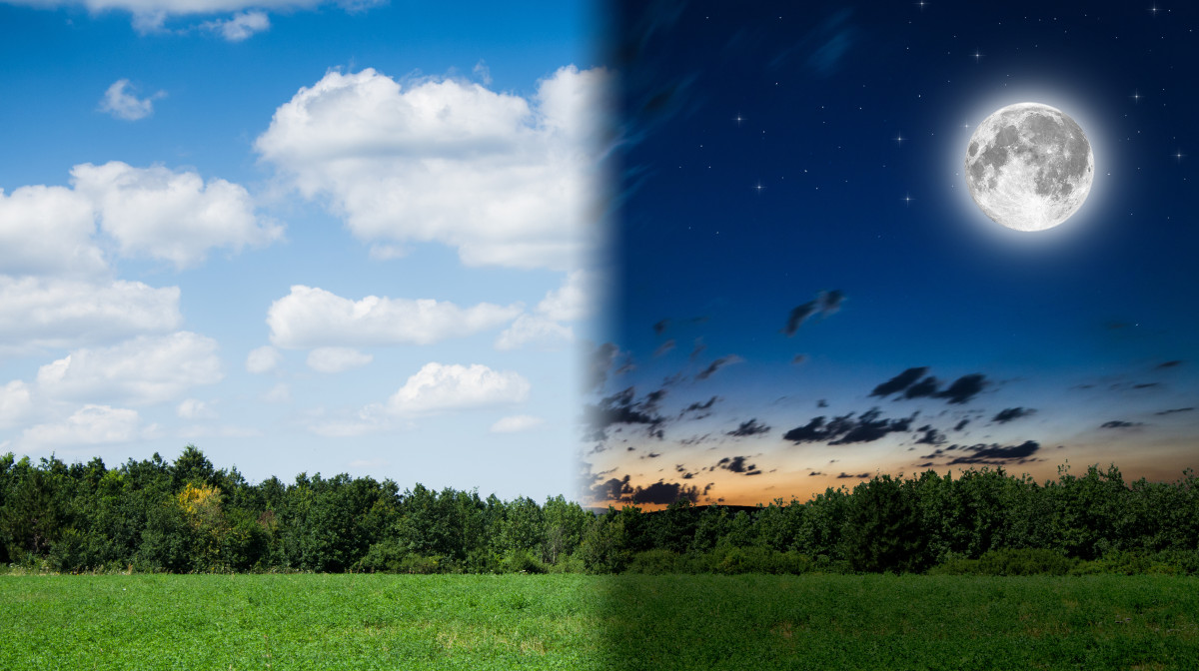


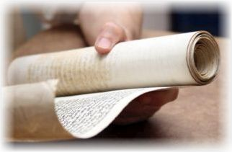
[2a] Lev 6:20 (Grain Offering)
Examination of [2b] Deut 16:6?
1. The Patterns for
“between the mixingS”
in the Torah had
alignment with
the Day Season
& Night Season,
NOT DAY-START!
(11 Torah References)
What about
Patterns for
“between the mixingS”
on Yahusha’s
Passover Day?
Part #2[b] will examine Deut 16:6 to see if there is any connection to “beyn ha arbayim” and if so, what is it?
8

Slide 9
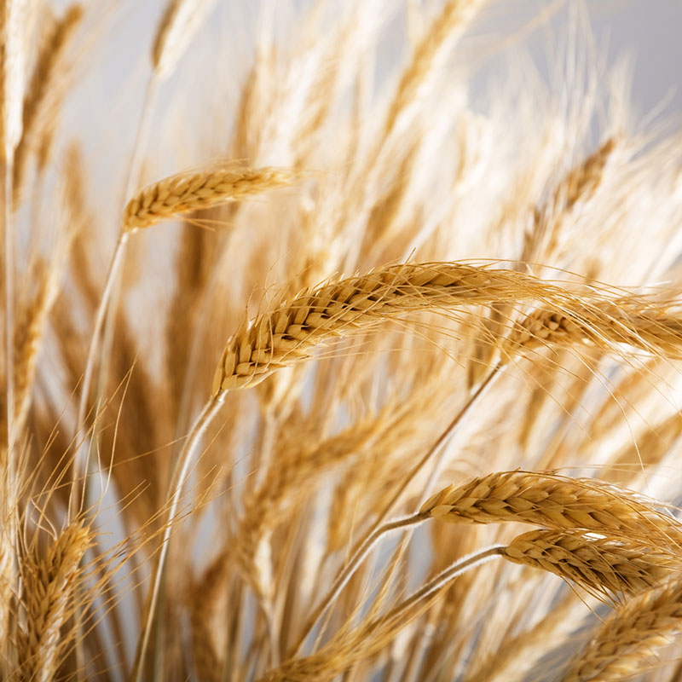

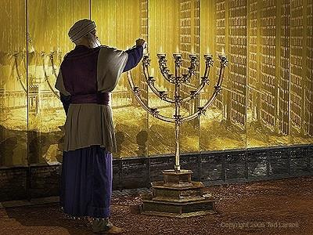
Grain Offerings & Lighting the Lamps
(Lev 6:20) (Exo 30:8)
R
E
V
I
E
W
#1 When the Grain Offering was tended to at
ereb/night [H6153], were the lamps trimmed:
AFTER the Grain Offering into the Night Season?
Somehow tended to during the Day Season or ereb?
The lamps did shed some light!
These puzzle pieces
do fit together!

Slide 10
Lighting the Lamps & Grain Offerings
Exo 30:8 uses “between the mixingS” for lighting
the sanctuary lamps.
  Therefore the lamps would be trimmed during the Day Season
  and AFTER the evening Daily Offerings (which included the
  Blood sacrifices, Grain & Drink Offerings).
Lev 6:20 does not link to “between the mixingS” for the Grain/[Drink] Offerings that are given up until the darkest part of the ereb/night [H6153].
  Therefore the lamps could be trimmed AFTER the ereb/night timeframe and AFTER the completion of the 2nd set of
  Daily Offerings.
R
E
V
I
E
W

Slide 11


Final Conclusion for the:
Grain Offerings & Lighting the Lamps
(Lev 6:20) (Exo 30:8)
R
E
V
I
E
W
When all the Sacrifices and Offerings were
completed for the “evening” requirements
(whether that was during the Day Season
or the ereb/night [H6153]),
only THEN were the
lamps trimmed!
Lamps are trimmed last!
Lev 6 & Exo 30
do fit together!

Slide 12
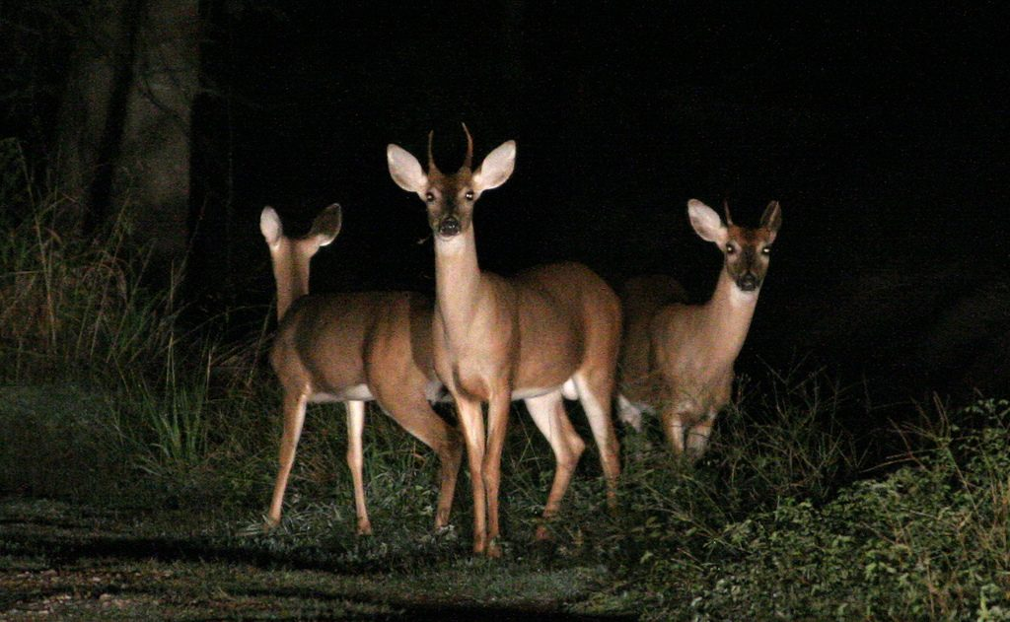
Utmost Challenges & Greatest Surprises
Lev 6:20 [Section 2a] had
a challenge to connect many ideas between the:
Grain Offerings
and the
Drink Offerings
… just how these offerings connected to the Daily Blood Sacrifices;
… and how all were
connected to
<beyn ha arbayim>.
Deut 16:6
[Section 2b] will
likely have the
most surprises.
This passage addresses only the Passover Sacrifice[s] upon “entrance
into the land.”
How does this connect to <beyn ha arbayim>?
It’s time to find
the connection
between
Lev 6:20 &
Deut 16:6?
12
Notes:
A mental state of high arousal caused by anxiety, fear, panic, surprise and/or confusion, or substance abuse. A person experiencing the "deer in headlights" syndrome often shows behavioral signs reminding those of a deer subjected to a car's headlights, such as widely opened eyes and a transcient lack of motor reactions. to be so frightened or surprised that you cannot move or think:
Covenant Calendar Hangout 9 Aug 2019 ... 22nd Day of the 5th month
Your Covenant Calendar teachers have assessed the study that was planned for this friday, and decided more time was needed before it can be presented. This is the continuation of the study for "between the evenings" (beyn ha arbayim). We are very thankful that each of you understand the amount of time needed for research, writing and building of power points. In order to keep the quality of presentation where it needs to be, the extra time will be appreciated so much.
However, do plan to join at the regular time to be with your Covenant Calendar family anyway. Every week we are having new people that are interested in these calendar studies, and they have so many questions. We are delighted to see the members of Covenant Calendar stepping forward to provide answers to these very important questions. This is such a valuable part of the learning of each individual. Your Covenant Calendar teachers are very proud of each one of you.
So, for those that are new, have your questions handy, as there will be time for discussion. We do appreciate this time that we can meet together for such a grand time - while it is still available. It truly is a wonderful blessing.

Slide 13
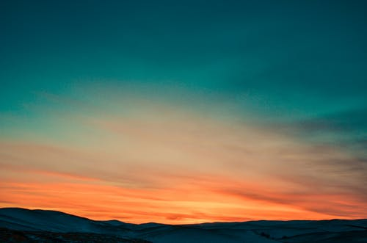
[Section 2b] Deut 16:6 (Passover Review)
During the conquest of Canaan, the main Israelite camp was at Gilgal (Joshua 4:19; 5:8–10) and the tabernacle was probably erected within the camp: Joshua 10:43ESV "…and returned into the camp" (seeNumbers 1:52–2:34 "…they shall camp facing the tent of meeting on every side").
After the conquest and division of the land among the tribes, the tabernacle was moved to Shiloh in Ephraimite territory (Joshua's tribe) to avoid disputes among the other tribes (Joshua 18:1; 19:51; 22:9; Psalm 78:60). It remained there during the 300-year period of the biblical judges (the rules of the individual judges total about 350 years [1 Kings 6:1; Acts 13:20], but most ruled regionally and some terms overlapped).^{[16][17]} According to Judges 20:26-28, the Ark, and thus possibly the tabernacle, was at Bethel while Phinehas, grandson of Aaron, was still alive.
The subsequent history of the structure is separate from that of the Ark of the Covenant. After the Ark was captured by the Philistines, King Saul moved the tabernacle to Nob, near his home town of Gibeah, but after he massacred the priests there (1 Samuel 21-22), it was moved to Gibeon. (1 Chronicles 16:39; 21:29; 2 Chronicles 1:2–6, 13). Just prior to David's moving the ark to Jerusalem, the ark was located in Kiriath-Jearim(1 Chronicles 13:5-6).
The Ark was eventually brought to Jerusalem, where it was placed "inside the tent David had pitched for it" (2 Samuel 6:17; 1 Chronicles 15:1), not in the tabernacle, which remained at Gibeon. The altar of the tabernacle at Gibeon was used for sacrificial worship (1 Chronicles 16:39; 21:29; 1 Kings 3:2-4), until Solomon finally brought the structure and its furnishings to Jerusalem to furnish and dedicate the Temple. (1 Kings 8:4)
Most Surprises!
Deut 16:1-8 Passover upon entrance of “the land of Canaan”
Deut 16:6 But at the place which Yahuah thy Elohim
shall choose to place his name in [at Jerusalem eventually],
there thou shalt sacrifice the passover
#1 at even, [twilight ?? ]
#2 at the going down of the sun, [afternoon ?? ]
#3 at the season that thou camest forth out of Egypt [night ?? ].
The words “at even” are commonly used to define creation’s day-start “at the going down of the sun” … as sunset!
13

Slide 14

Deut 16:6 ~ A Command of Moses
This is a popular verse used by many Sabbath keepers and theologians to verify beyond all doubt that the Sabbath begins with sundown. Is that what Moses has to say?
Have you ever wondered why the darkness at the cross arrived at the 6th hour and not the 3rd hour?
What do these questions have to do with a study on “between the mixingS”?
One Scripture ~ Many Surprises!
Knowing the End
from the Beginning
Isa 46:9-10
14

Slide 15
Deut 16 ~ Getting Started with Definitions
Many theologians claim: Deut 16:6 proves the new day commences
“at even, at the going down of the sun” … because verse 6 says so!
“… the passover at even (ereb/H6153; dusk twilight), at the going down of the sun …”
[Fact] 40 words in vs 6! A Problem? 9 words removed & used to define day-start ignoring the full passage of 280 words in Deut 16:1-8 for the proper context!
Context is completely removed; to the common person everything SEEMS correct!
Deut 16:6
Passover
Sacrifice
How is the word “Passover” to be defined?
Passover Festival: consists of Passover Day, 7 days of Unleavened Bread, and Firstfruits following the weekly Sabbath.
Passover Sacrifice: animal had to be a perfect male of the first year.
Passover Meal: was always to be eaten during the Night Season.
How many Passover definitions was Moses describing in Deut 16:1-8?

Slide 16
Deut 16:1-8 & Passover Definitions
1 Observe the month of Abib, and keep the passover [Festival] unto Yahuah thy Elohim: for in the month of Abib Yahuah thy Elohim brought thee forth out of Egypt by night.
2 Thou shalt therefore sacrifice the passover unto
Yahuah thy Elohim, of the flock and the herd, in the place which Yahuah shall choose to place his name there.
3 [For the Passover Meal] Thou shalt eat no leavened bread with it; seven days shalt thou eat unleavened bread therewith, even the bread of affliction; for thou camest forth out of the land of Egypt in haste: that thou mayest remember the day when thou camest forth out of the
land of Egypt all the days of thy life.
4 And there shall be no leavened bread seen with thee in
all thy coast seven days; neither shall there anything of the flesh [Passover Meal], which thou sacrificedst [Passover Sacrifice] the first day at even [ereb/H6153], remain all night until the morning.
5 Thou mayest not sacrifice the passover within any
of thy gates [different than when in Egypt],, which Yahuah thy Elohim giveth thee:
6 But at the place which Yahuah thy Elohim shall choose
to place his name in, there thou shalt sacrifice the passover at even [ereb/H6153], at the going down of the sun, at the season that thou camest forth out of Egypt.
7 And thou shalt roast and eat it [Passover Sacrifice] in
the place which Yahuah thy Elohim shall choose: and thou shalt turn in the morning, and go unto thy tents.
8 [Passover Festival] Six days thou shalt eat unleavened bread: and on the seventh day shall be a solemn assembly to Yahuah thy Elohim: thou shalt do no work therein.
Deut 16:6
Passover
Sacrifice
Note #1: Vss 4 & 6 do mention “at even” [ereb/H6153]. In both cases the context has to do with “timing” of the Passover Sacrifice NOT the timing of day-start.
Note #2: Vss 4 & 7 both mention “the morning” exchange regarding the Passover Sacrifice. Although this is the true beginning of the new day,
the context is not about day-start.
CF: Should split this into two slides, but then we lose the visual content to support the pink and blue boxes. Have to figure this out yet. Tim said to leave it.

Slide 17
Deut 16:6 & <beyn ha arbayim>
Very Important Point: The mandate of Deut 16:6 is not about “when the day begins.”
Question: Is Deut 16:6 about <beyn ha arbayim>?
But at the place which Yahuah thy Elohim shall choose to place his name in [Jerusalem eventually], there thou shalt sacrifice the passover
  [1] at even (ereb/H6153; dusk twilight),
  [2] at the going down of the sun,
  [3] at the season that thou camest forth out of Egypt.
Deut 16:6
Passover
Sacrifice
Context!
More Questions to think about:
Is the word “even” connected
to <beyn ha arbayim> in Deut 16?
Does the phrase: “at the
going down of the sun” mean
the new day begins at sunset?
Does this phrase mean that “when the sun goes down” …
“it is dusk twilight or evening”?
In which “season” was Egypt’s
Passover sacrifice offered?

Slide 18
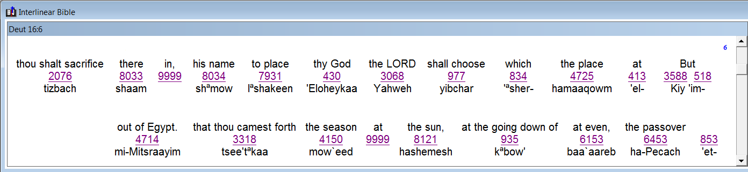
Deut 16:6 & <beyn ha arbayim>
The Interlinear will have some answers.
Answers:
Deut 16:6
Passover
Sacrifice
#1: The word “even”
is not connected to the
phrase <beyn ha arbayim>!
#2 & 3: The phrase: “at the going down
of the sun” appears to mean when the
sun goes down it is “evening twilight.”
Is this true for vs 6? (We shall soon see!)
The context of Deut 16:1-8 addresses
the timing around the Passover sacrifice,
not the timing for Passover day-start.
Note: vss 4 & 7 did align with day-start before the morning of Abib 15, for the
disposal of any left-over lamb (Exo 12:10).
#4: In which “season” was the Passover sacrifice offered in Egypt?
In Exo 12:6, the Passover sacrifice
was connected to the phrase
<beyn ha arbayim> which according to Exo 12 - context was designated as the Night Season.

Slide 19
Deut 16:6
More Concerns & Questions:
The content and context of Deut 16 is a reminder from Moses about the 3 yearly feasts – when and how they are to be celebrated.
Verses 1-8 review The Passover Festival with very specific instructions from Moses before he dies, of “when and where” the Passover sacrifice can be offered … the main context is not addressing day-start. However, vss 4 & 7 have a reminder that any meat left-over is not to remain until morning – following the “type” instructions in Exo 12:10 [cf. Exo 34:25; Deut 16:7]. Deut 16
must stay aligned with the “day-start” of Genesis and Exodus.
Despite this information Sunset Theory advocates still strongly suggest the context of Deut 16:6 is: the day-start begins with the “going down of the sun.” Unfortunately, their context of Deut 16 has not been carefully considered, neither has a proper day-start study been done in any of the Torah books for verification.
Deut 16:6
Passover
Sacrifice
So, now what?

Slide 20
What is the real purpose of Deut 16:6?
TA on Aug 20th … He didn’t think the 2nd banner was needed:
CF comment: I made a point of having this statement because most people don't think past the idea that this verse could mean anything else but the sunset day. The real purpose is now exposed - that of the timeframe of when the PO lamb could be offered. It was just a year ago that I asked you exactly what this verse meant as Tersia was also wondering because Adrian uses this verse as a main verse for sunset day. You said you had found some interesting things - and I don't remember them now, but, because of everything that is tied to this verse due to sunset nonsense (that had us confused too, and Tonya Dahl as well, since she specifically asked that question on the last CCC) … I would like to keep this emphasis here at the moment. There is a reason for my madness this time! Ha! Ha!
Maybe the animation will make a difference – which I have added. Crf Aug 20th
That is “THE” Question!
1451 BC Deut 16 (Command) – After 40 years in the wilderness, in the last days of Yahuah’s great leader,
Moses gives a reminder to the people in Deut 16:6 for the three “timing” options of sacrificing the Passover lamb when the Hebrews reside in the land of Canaan.
This is not just a “command” but a “prophecy” that must
satisfy the timing of every Passover sacrifice for the next 1500+ years, and ultra important - including that of Yahusha.
This verse is jam-packed with information that will be missed
if a proper study of <beyn ha arbayim> is not done.
Deut 16:6
Passover
Sacrifice

Slide 21


Moses outlines the real purpose of Deut 16:6!
Moses answers through the context!
The question on the purpose of Deut 16:6 can be answered with Moses because the research for <beyn ha arbayim> has been completed. Note Deut 16:6 again - as Moses clearly outlines 3 distinct timeframes for the sacrifice of the Passover:
But at the place which Yahuah thy Elohim shall choose
to place his name in, [in Jerusalem, eventually]
[a] there thou shalt sacrifice the passover at even,
(ereb/H6153; dusk twilight – NOT <beyn ha arbayim>),
[b] at the going down of the sun, [What does this really mean?]
[c] at the season that thou camest forth out of EGYPT.
Deut 16:6
Passover
Sacrifice
Does <beyn ha arbayim> qualify for any of these options?

Slide 22
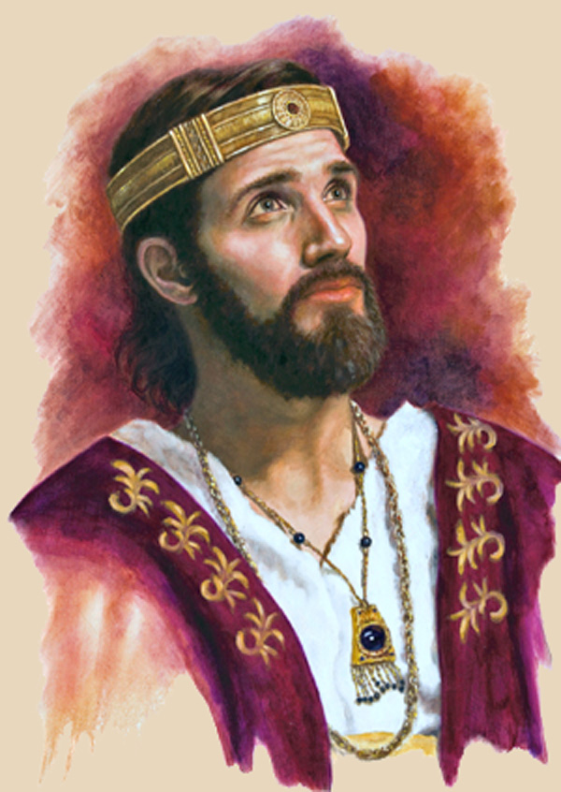
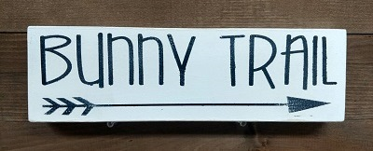
Deut 16:6 Passover Option #1 [Dusk]
CF (old comment): This has to be taken forward to the gospel charts to show that Josiah's passovers in the dusk twilight align with Yahusha's events when joseph & nicodemus are getting permission to have His body and purchasing linen during this dusk twilight ... then later fulfill the Ex 12:10<?> "type" of wrapping the body all night - being done before "morning.“
TA response: Yes! excellent slide.
I did not take this slide up to the gospel section, but added a comment about Josiah on slide 39 with the Josephus passover math ... Silently trying to make the point that maybe Josephus got his facts a bit mixed up, or certainly unrealistic -- UNLESS I don't have the right picture in my head. Maybe there really were 100,000 priests to do Passover sacrifices. I don't know. But, just think of the noise, the blood, the smell - basically a lot of filth for so much slaughtering in one small place. Yahusha fulfilled all of that too. My! My! I think we are really missing the big picture by a long shot.
[a] there thou shalt sacrifice the passover at even, (ereb/H6153; dusk twilight)
Dawn
The Passover can be sacrificed at “even” [twilight-part of the Day Season] – this is not “between the mixingS” during either the Day Season, or the Night Season.
Dawn
Deut 16:6
1ST
Provision
for the
timing
of every
DUSK
Passover
Sacrifice
Sunrise
“at even” has nothing to do with sunset beginning any new day!
Sunset
DUSK
No context
for day-start.
beyn ha arbayim
Day Season
(between two mixings)
beyn ha arbayim
Night Season
(between two mixings)
Direct Sunlight
Darkness
King Josiah (2 Chron 35:1-14) offered 41,400 Passover sacrifices right up to <layil> night [H3915] – these Passover sacrifices were still performed on “the” Passover cycle.
This definitely included the “ereb/evening” AFTER sunset – during the dusk twilight time.
22

Slide 23

Deut 16:6 Passover Option #2 [Light Season]
[b] at the going down of the sun …
CF to remember:
the study on this phrase "going down of the sun" really should have had some slides to prove this does not mean sunset. However, I'm going to skip the evidence this time and they can go and look for themselves. I did the research quite some time ago - don't remember the percentages, but it was NOT in favor of sunset, that's for sure.
Dawn
This Passover provision is during the Day Season, or “between the mixingS.” The phrase [in the OT] is seldom defined as the “moment of sunset.” Rather, the sun begins to “go down” once it passes High Noon, on its downward descent towards sunset. This is always during the Day Season long before sunset.
Dawn
Deut 16:6
2ND
Provision
for the
timing
of every
LIGHT
SEASON
Passover
Sacrifice
… has nothing
to do with sunset beginning any new day!
Sunrise
Sunset
The phrase “at the going down of the sun” …
DUSK
beyn ha arbayim
Day Season
(between two mixings)
beyn ha arbayim
Night Season
(between two mixings)
Direct Sunlight
Darkness
No context
for day-start.
Note:
There will be “anti-type” confirmation in the
Gospel study.
The phrase <beyn ha arbayim> aligns with 4 Torah verses for the Daily Sacrifices.
However, it also aligns with 5 Torah Scriptures in connection with the Passover Sacrifices.
There was a provision made for the evening Daily Sacrifice to be offered during the Day Season – opening the way for the Passover Sacrifice to also be offered during the Day Season.
23

Slide 24
Deut 16:6 Passover Option #3 [Night Season]
[c] at the [H4150/appointed] season that thou camest forth out of Egypt.
Dawn
Passover could also be offered at the same [Night] Season as when they came out of Egypt [or being delivered from Egypt’s bondage]. The Passover Sacrifice must be offered at Jerusalem – not “within their own gates” (Deut 16:5, 6) … but it was always eaten during the Night Season.
Dawn
“at the season of Egypt” has nothing
to do with sunset beginning any new day!
Deut 16:6
3RD
Provision
for the
timing
of every
NIGHT
SEASON
Passover
Sacrifice
Sunrise
Sunset
DUSK
beyn ha arbayim
Day Season
(between two mixings)
beyn ha arbayim
Night Season
(between two mixings)
Direct Sunlight
Darkness
Evidence of NIGHT SEASON Passover sacrifices:
(1) Moses & Egypt (2) King Josiah in Jerusalem [624 BC]
Question: Is there an anti-type for Yahusha in the Gospels?
No context
for day-start.

Slide 25
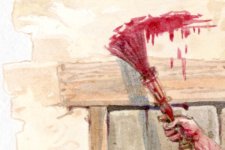
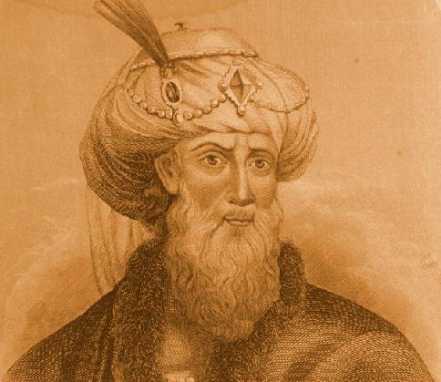
Deut 16:6 Passover Options
2 Chron 35 Witness #1: Josiah with 41,400 Passover Sacrifices during the Day Season [at the going down of the sun], continuing through the ereb/dusk twilight mixing until the layil/night.
Exo 12 Witness #2: Egypt’s Passover during the Night Season.
New Testament Witness #3: Josephus with 250,000+ Passover Sacrifices during the Day Season timeframe of “between the mixingS.”
Witnesses for 3 Passover Timing Options
Isa 46:9-10
Knowing the Gospels
from the Tanach
25

Slide 26

Deut 16:6 & Evening `ereb Definitions H6153
In a semi-conclusion for this section, the <ereb; H6153> definition will be considered one more time.
Will Deut 16:6 hold an interesting surprise in this search?
Evening
H6153
is a
corner
stone
for
Yahuah’s
Covenant
Calendar
Please note how the [previously examined] Scripture references align with each of the three distinct <`ereb; H6153> definitions with reference to
the Daily evening sacrifices and the Passover sacrifices.
evening H6153; `ereb (eh'-reb); from H6150;
[1st def.] dusk: [Deut 16:6; 2 Chron 35]
KJV - [2nd def.] day, [Deut 16:6; 2 Chron 35]
[same as 1st def.] even (-ing, tide),
[3rd def.] night [Exo 12:6; Lev 6:20; Deut 16:6].
Ereb/H6153 with
its many varied definitions allows provision for the timeframe of every Passover Sacrifice
listed in Deut 16:6!
No context
for day-start.
Deut 16:6 - nothing to do with day-start; everything to do with Passover sacrifice timing!
26

Slide 27
Deut 16:6 ~ The 3 Options for Passover Sacrifice
(No mention of the phrase <between the mixingS>).
R
E
V
I
E
W
#1 “at even”
(dusk after
sunset)
#2 “at the going
down of the sun”
(qualifies for
<between the mixingS.>)
#3 “at the season and
timeframe of Egypt’s Passover”
(qualifies for
<between the mixingS.>)
Dawn
Sunrise
DUSK
Sunrise
Sunset
Layil Begins
Dawn Breaks
PM: between the mixingS
<beyn ha arbayim> between the mixingS
<beyn ha arbayim> between the mixingS
Light Season | Night Season
<arab> Evening Twilight Mixture
<arab> Morning
Twilight Offerings

Slide 28
Lev 6 Offerings ~ Sacrifices ~ Trimming the Lamps
(Using the phrase <beyn ha arbayim / between the mixingS>.)
R
E
V
I
E
W
Exo 29:39, 41
Daily Evening Offerings optional timeframe of <between the mixingS>
in the afternoon.
Exo 30:8 Sanctuary Lamps
are trimmed after the
<ereb> Daily Offerings.
Lev 6:20 – Grain Offering at ereb/night. Lamps could be trimmed AFTER these offerings.
Dawn
Sunrise
DUSK
Sunrise
Sunset
Layil Begins
Dawn Breaks
PM: between the mixingS
<beyn ha arbayim> between the mixingS
Light Season | Night Season
<arab> Evening Twilight Mixture
<arab> Morning
Twilight Offerings

Slide 29
Utmost Challenges & Greatest Surprises
CF: Because the Passover Sac. was part of every other sacrifice, that means it also can take on the timeframes of all sacrifices, not? This would include the timeframes of boqer/morning Daily sacrifices AND the evening/BTE, or BTM sacrifices. Lev 6 made allowances for the regular Daily PM offerings to go to ereb/night. Deut 16 has allowances for P/O sacrifices from noon through the Night Season. The properties of the P/O sacrifices takes in all the properties of every other sacrifice/offering and individual timeframes.
Another box said (for points 1 & 2: My thoughts for the information that will be a conclusion between Lev 6:20 and Deut 16:6 to answer the gold question above (CF).
Neither Lev 6:20 or
Deut 16:6 use the phrase
<beyn ha arbayim>.
Lev 6:20 did not limit the ereb Offerings to be only “between the mixingS” but
also gave permission for the offerings to be at ereb/dusk.
Grain/Drink Offerings with the Daily Blood Sacrifices could be offered during the Day Season up to ereb/night.
King Josiah’s Passover Sacrifices were also connected to <beyn ha arbayim> & offered
until the layil/night.
Question:
What is the connection
between Lev 6:20
& Deut 16:6?
29
The connection is this, and it’s likely going to take another whole slide:
Neither Lev or Deut use BTE, but both references connect sacrifices and offerings from the dusk/ereb timeframe that are connected to BTE. (that is likely what Yah originally intended in the first place with the offerings at boqer and ereb) – The Exo 30 lamps are another verification, but I don’t think I’ll mention that again.
So, the connection is between Lev’s use of “ereb/night” and Deut’s declaration of PO sac at “even.”
Lev is talking about “everyday” sacrifices.
Deut is talking about only PO sacrifices – but the catch is THIS PO sac, is part and parcel of every other offering.
Honestly, how am I going to explain this so people get it … or am I in a panic about nothing? CF Aug 17th.
Notes:
A mental state of high arousal caused by anxiety, fear, panic, surprise and/or confusion, or substance abuse. A person experiencing the "deer in headlights" syndrome often shows behavioral signs reminding those of a deer subjected to a car's headlights, such as widely opened eyes and a transcient lack of motor reactions. to be so frightened or surprised that you cannot move or think:
Covenant Calendar Hangout 9 Aug 2019 ... 22nd Day of the 5th month
Your Covenant Calendar teachers have assessed the study that was planned for this friday, and decided more time was needed before it can be presented. This is the continuation of the study for "between the evenings" (beyn ha arbayim). We are very thankful that each of you understand the amount of time needed for research, writing and building of power points. In order to keep the quality of presentation where it needs to be, the extra time will be appreciated so much.
However, do plan to join at the regular time to be with your Covenant Calendar family anyway. Every week we are having new people that are interested in these calendar studies, and they have so many questions. We are delighted to see the members of Covenant Calendar stepping forward to provide answers to these very important questions. This is such a valuable part of the learning of each individual. Your Covenant Calendar teachers are very proud of each one of you.
So, for those that are new, have your questions handy, as there will be time for discussion. We do appreciate this time that we can meet together for such a grand time - while it is still available. It truly is a wonderful blessing.

Slide 30
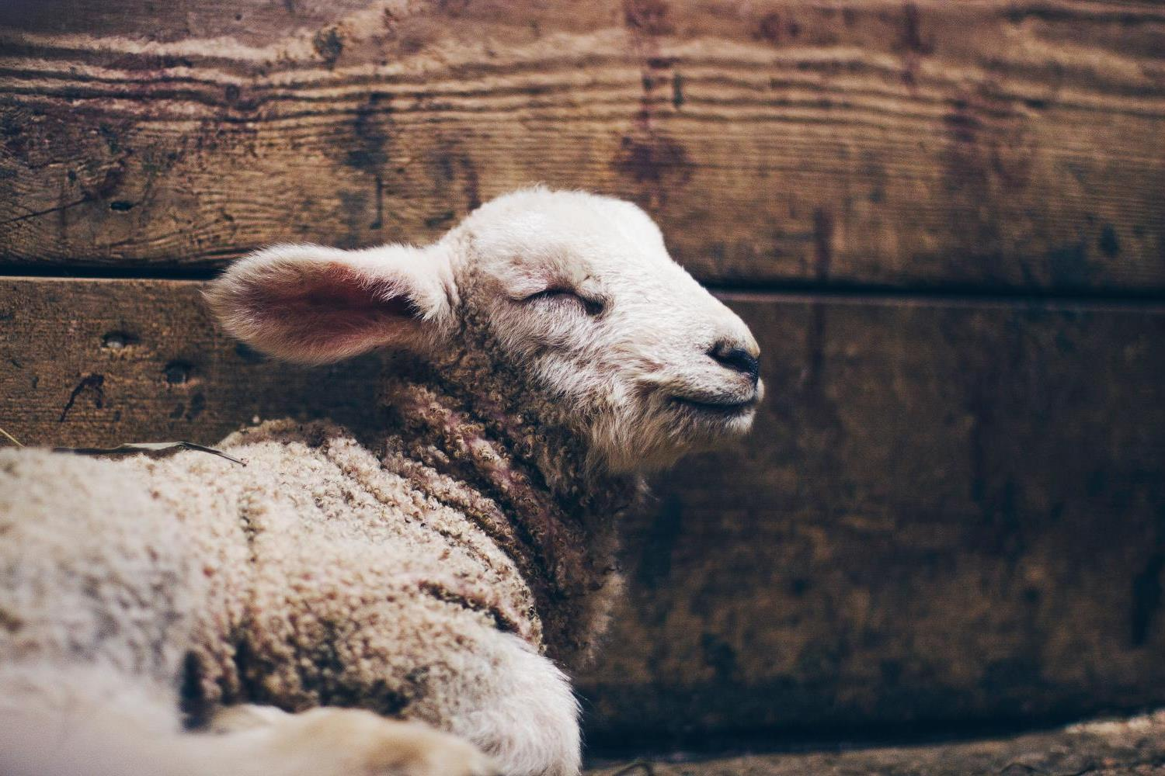
No Boundaries for the
Passover Lamb
Deut 16:6 does not limit the Passover Sacrifice to only “between the mixingS” because this sacrifice has components from all
other Offerings that could be presented at:
1. Boqer [dawn]
2. the Day Season of
<beyn ha arbayim>
3. the dusk and
4. the Night Season of
<beyn ha arbayim>.
It seems to me there is a correlation here about Yah giving His flesh [neat/grain/bread type] to the sacrifice at the 3rd hour, and He gives His blood (wine) at the 9th hour. This would include both the boqer and ereb Daily Sacrifices (type: Burnt & Peace) that were always attended with the grain & drink offerings. That was HIS part. For the people, they were eating ULB [the grain offering] and pouring out the blood of the lamb ON THE GROUND, or spilling it on the ground [as the drink offering].
Moses did not “write” in the Torah
the specific timeframe of boqer and forenoon for the Passover Lamb.
He didn’t need to because of the
linkage this sacrifice has with all other offerings, and the fulfillment of this
pattern on Yahusha’s Passover Day.
Will the Gospel Account give verification?
That’s Amazing!
30
The connection is this, and it’s likely going to take another whole slide:
Neither Lev or Deut use BTE, but both references connect sacrifices and offerings from the dusk/ereb timeframe that are connected to BTE. (that is likely what Yah originally intended in the first place with the offerings at boqer and ereb) – The Exo 30 lamps are another verification, but I don’t think I’ll mention that again.
So, the connection is between Lev’s use of “ereb/night” and Deut’s declaration of PO sac at “even.”
Lev is talking about “everyday” sacrifices.
Deut is talking about only PO sacrifices – but the catch is THIS PO sac, is part and parcel of every other offering.
Honestly, how am I going to explain this so people get it … or am I in a panic about nothing? CF Aug 17th.

Slide 31
2. [Lev 6:20 – ereb sacrifices]
Deut 16:6 offers permission for the Passover Sacrifice to have the full
24 hour spectrum for the
sacrificial timeframes.
1. The Patterns for
“between the mixingS”
in the Torah had
alignment with
the Day Season
& Night Season,
not day-start!
(11 Torah
References)
What about
Patterns for
“between the mixingS” on Yahusha’s
Passover Day?
Part #3 of this study will compare the Old Testament
patterns of “beyn ha arbayim” to the Passover in the Gospels!
31

Slide 32
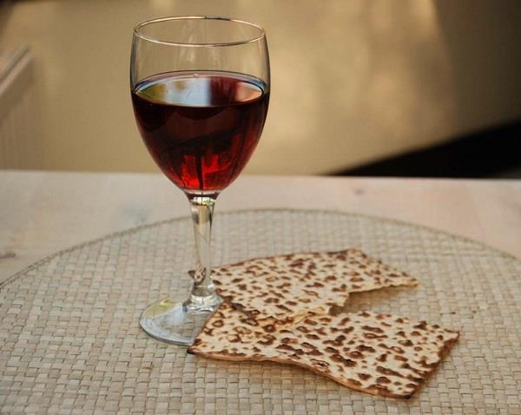
Gospel Passovers of Yahusha
This last section will directly
address the information for
the Gospel’s last Passover.
Many things have been
gleaned from Torah about
all sacrifices [especially Passover]
with regards to <beyn ha arbayim>.
Will the timeframes of Deut 16:6 have fulfillment in Yahusha’s final Passover as the “anti-type”?
Gospel Passovers to consider: Luke 2; John 2; John 19.
Passover
in the
Gospels

Slide 33
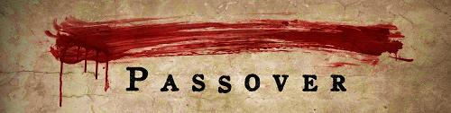
Prime Passover Examples: New Testament
NEXT!
Yahusha’s Passover Luke 2 (Narrative) – at age 12 in Jerusalem.
Yahusha’s Passover John 2 (Narrative) – at the beginning of His ministry.
Last Supper “Passover Instructions” in Synoptic Gospels
(Narrative & Command) – at the end of Yahusha’s ministry. In the last part
of this event, Yahusha also gives a command of when/where they will
celebrate the next Passover together. (Matt 26:29; Mark 14:25; Luke 22:15, 16.)
Crucifixion Day John 19 (Narrative) – Yahusha’s Passover
sacrifice at the end of His ministry. (This study will now focus on this Passover.)
REVI
EW
NEW!
What does the crucifixion Passover “day” and “events” have to do with <beyn ha arbayim>?

Slide 34
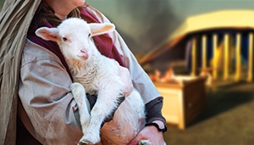
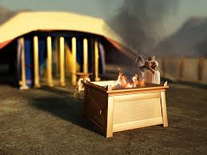

The Significance of Sacrifices
Before we can really understand the importance of the Passover sacrifice,
there needs to be a general
understanding of all sacrifices.
There are many kinds of sacrifices offered at various times throughout the year.
Out of all the sacrifices, will one
(or some) take priority over all?
Did the Feast of Tabernacles sacrifices
have the most sacrifices of any feast?

Slide 35

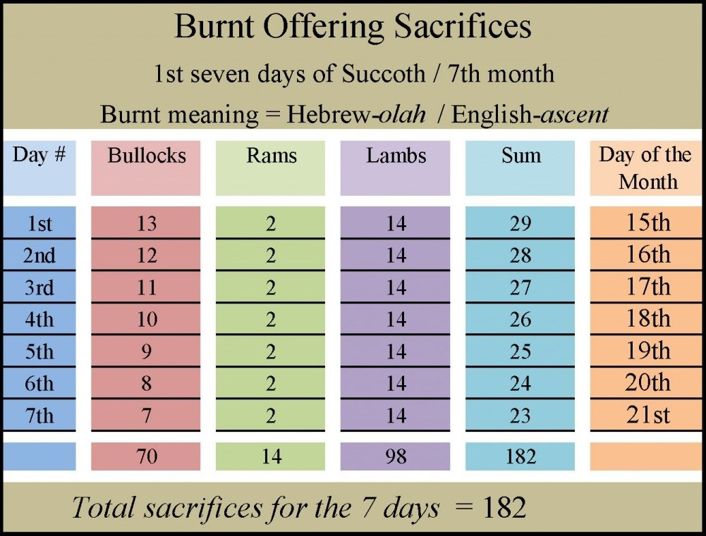
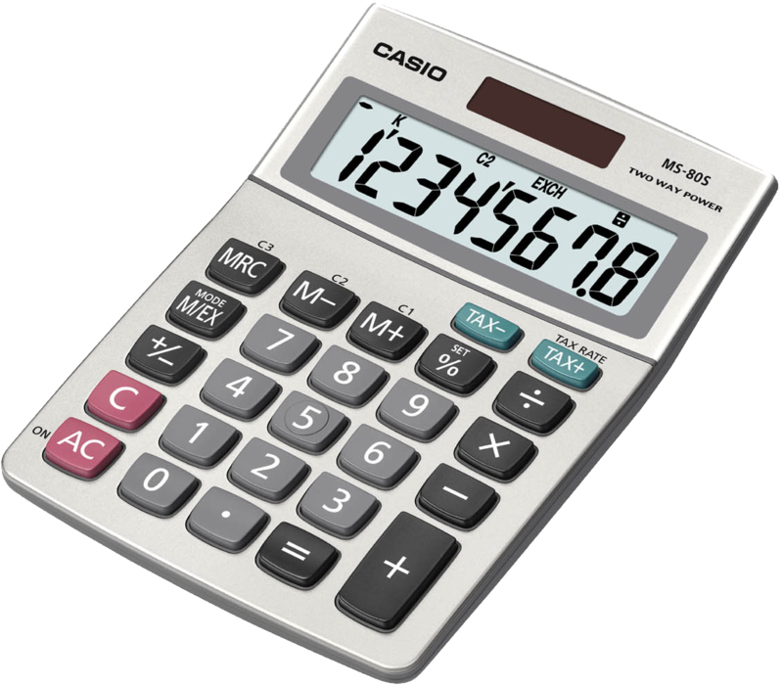
Total Sanctuary Sacrifices
for
Feast of
Tabernacles:
182!

Slide 36
Average Yearly Sanctuary Sacrifices
1. Daily Sacrifices / year (4 x 365) | 1460 Sacrifices
2. Extra weekly Sabbath Sacrifices | 104 | 9. 2nd Month: 1st – 7th ULB Feast | 77
3. Extra annual Sabbath Sacrifices | 28 | 10. Pentecost | 8
4. New Month Sacrifices (11 x 12) | 132 | 11. 1st Day of Trumpets | 10
5. 1st Month Passover Sacrifice | 1 | 12. Day of Atonement (Priest & People) | 6
6. Firstfruits/Wave Sheaf | 1 | 13. Day of Atonement Sanc. Sacrifices | 10
7. 2nd Month Passover Sacrifice | 1 | 14. 1st – 7th Days of Tabernacles | 182
8. 1st Month: 1st – 7th ULB Feast | 77 | 15. Last Great Day | 10
Total Average Yearly Sacrifices: 2107
What does this have to do with Passover
sacrifices and <beyn ha arbayim>?
Question:
36

Slide 37
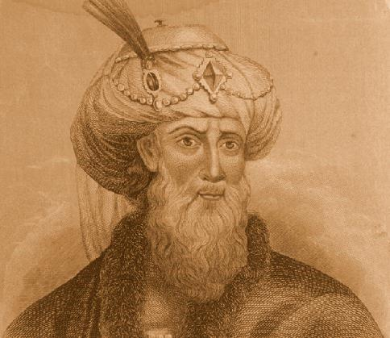

The Most Important Sacrifice is:
Assessment of Sacrifices in Comparison to
the 11 Torah Scriptures for <beyn ha arbayim>.
Out of the 11 Torah Scriptures … 9 verses are
connected to “sacrifices” during <beyn ha arbayim>.
82%
4 of the 9 Scriptures are connected to “Daily Sacrifices”
during <beyn ha arbayim>.
(Exo 29:39; Exo 29:41; Num 28:4; Num 28:8.)
45%
5 of the 9 Scriptures are connected to either the Passover sacrifice
or the Passover meal during <beyn ha arbayim>.
(Sacrifice: Exo 12:6; Num 9:3.)
(Meal: Lev 23:5; Num 9:5 [1st month]; Num 9:11 [2nd month].)
55%
Does it not appear very clear there is something
special happening around the Passover theme?
Let’s ask
Josephus!

Slide 38
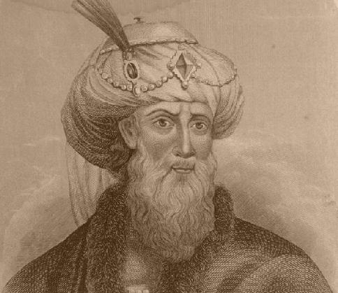
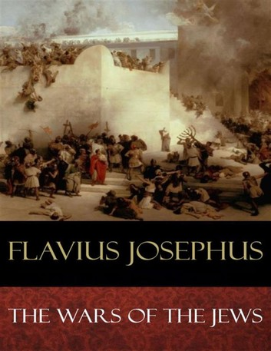
Historical Evidence From Josephus
Every year on Passover Day, in Jerusalem, there were many Passover
lambs slain, not just one.
Josephus, the Jewish historian, has some historical evidence
(Wars of the Jews, Book VI, 9:3).
This quote exposes his personal experience of just when the evening sacrifice was performed fulfilling
the prophetic guidelines
of Daniel.
  "So these high priests, upon the coming of their feast which is called
  the Passover, when they slay their sacrifices, from the ninth hour to the eleventh, [3 pm to 5 pm Roman time] but
  so that a company not less than ten belong to every sacrifice . . . and many of us are twenty in a company, found this number of sacrifices was two hundred and fifty six thousand five hundred [256,500] which, upon
  the allowance of no more than ten that feast together, amounts to two million seven hundred thousand
  and two hundred persons that
  were pure and holy."
(Note: Some historians quote 270,000 Passover sacrifices/day.)
REVI
EW

Slide 39
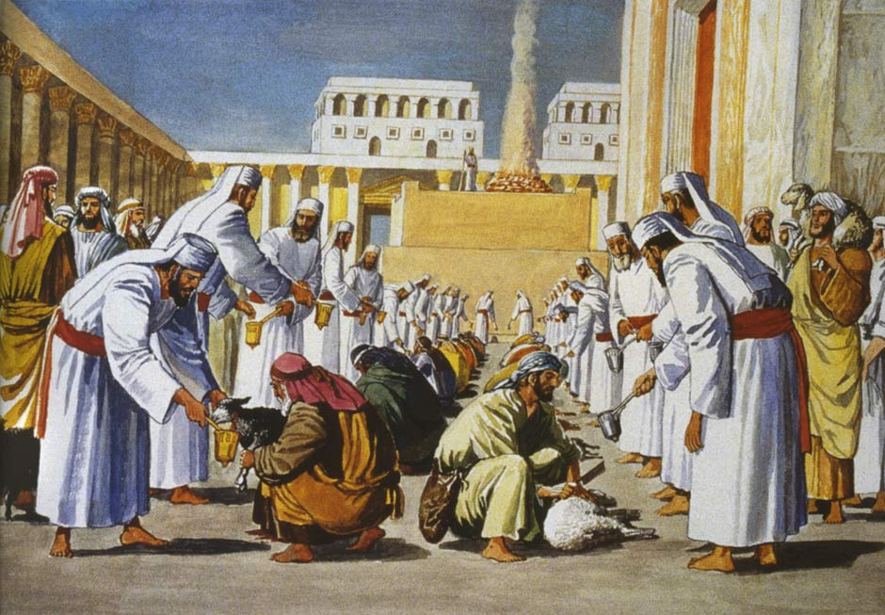
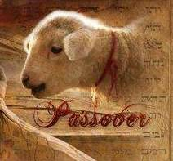
Passover Math (with Josephus)
According to Josephus there were 256,500 Passover sacrifices from the 9th – 11th hour (120 minutes).
256,500 / 120 min = 2137 lambs/min.
6th – 11th hour = 855 lambs/min.
3rd – 11th hour = 534 lambs/min.
Boqer – 11th hour = 389 lambs/min.
Josiah’s Passover Offerings were all day, through dusk, to night!
39

Slide 40
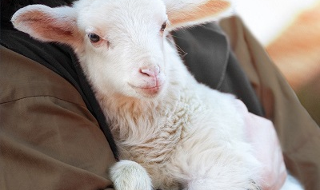
Average Yearly Sanctuary Sacrifices
Total 2107.
Average Yearly Passover Sacrifices
Total 256,000 ~ 270,000!
Without
exception…
… the Passover sacrifice is the MOST important sacrifice of all!

Slide 41
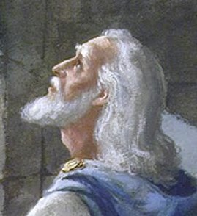
“What” determines the most important sacrifice for
?
  Dan 9:27 And he shall confirm the covenant with many for one week: and in the midst of the week [Passover Day] He [Yahusha] shall cause the sacrifice and the oblation to cease … KJV
When does this major event happen? The 4th cycle [Wed] is the exact middle day of the week. Because Yahuah’s day-start begins with dawn twilight, the exact “midst of the week” is marked at the “evening twilight” of the 4th cycle, about 6 PM Roman time in Jerusalem.
PROPHECY
OF
DANI
EL
D 1 | N 1 | D 2 | N 2 | D 3 | N 3 | D 4 | N 4 | D 5 | N 5 | D 6 | N 6 | D 7 | N 7
Indeed, Yahusha’s sacrifice was completely finished. All the thousands of (“type”) Passover sacrifices that had been offered in the previous 1500 years were also fulfilled, by His “anti-type” sacrifice no matter “when” or “what time” they were offered in the 24 hours of the day!

Slide 42
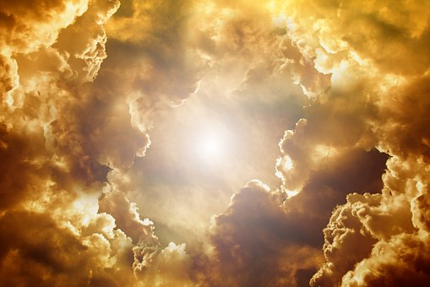
Final Moments Around
Yahusha’s Passover
This Passover Sacrifice is the most important of all sacrifices.
Yahusha as “the” Ultimate Passover Lamb Sacrifice
must fulfill every sacrifice and their timeframes.
How is the “anti-type” found in these many
sacrifices and timeframes according to the Torah?
Next: a very brief outline of Yahusha’s Passover Day and
how He fulfilled all “types” for sacrifices and timeframes.
42

Slide 43







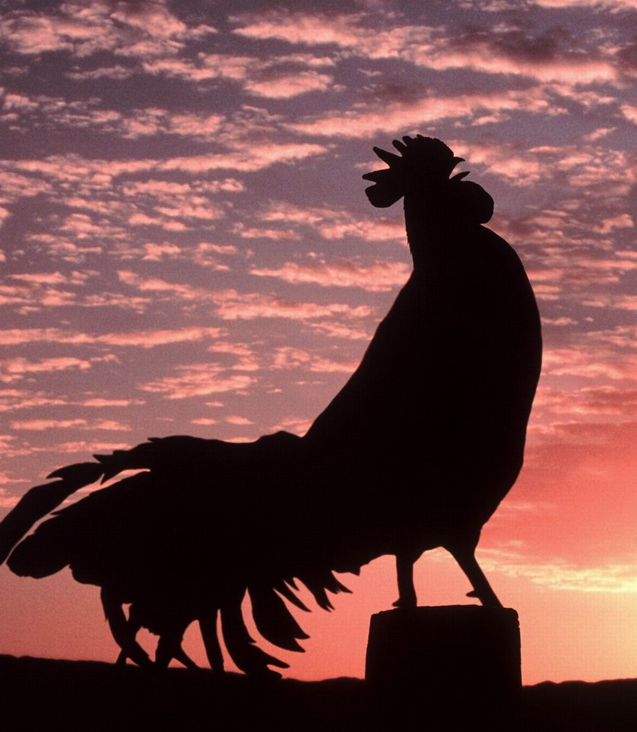
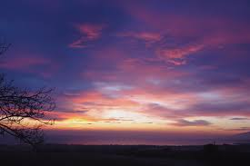
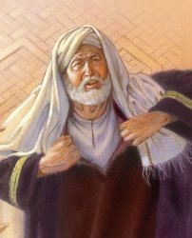

Although roosters may crow all through the night, this Gospel rooster fulfills Yahusha’s prophecy.
Peter’s 1st denial [Mk 14:68].
Rooster crows the 1st time [Mk 14:68].
Peter’s 2nd denial a little later [vs 70].
Peter’s 3rd denial about
an hour later [twilight time]
[Mk 14:71; Luke 22:59].
Rooster crows the 2nd time while Peter is speaking [Mark 14:72; Luke 22:60].
THEN Mark 15:1 records:
“Immediately, in the morning” [G4404; proi;
the daybreak watch], the Jewish leaders deliver Yahusha to Pilate.
6TH HR
9TH HR
3RD HR
boqer
ereb
Abib 13
Night
Season
Mark 14:72 (Abib 14)
Rooster crowed the 2nd time.
Mark 14:63 (Abib 13) High priest tore his robe
& condemned Yahusha “the” Sacrifice to die!

Slide 44

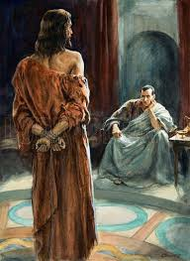

2 hrs. for chart 815-1015 boxes:
YAHUSHA’S New Testament
Exo 29 commands the
1st Daily Sacrifice to be “in the morning” (boqer H1242) – or the “dawn twilight.”
Remember, the Passover sacrifice had components
of both Daily Sacrifices.
Therefore, according to
the definition of “boqer”
the Passover sacrifice
does qualify.
During “boqer” the Jewish leaders delivered Yahusha to Pilate for permission
to have Him sacrificed quickly by the Romans.
6TH HR
9TH HR
3RD HR
Mark 15:1 (Abib 14) Immediately in the morning Yahusha is delivered to Pilate.
boqer
ereb
Night
Season
Mark 14:72 (Abib 14) Rooster crowed the 2nd time.
Mark 14:63 (Abib 13) High priest tore his robe & condemned Yahusha “the” Sacrifice to die!

Slide 45



TA: At this point, this is not important but I do believe it was a tree upon which the cross member was secured to which Yahusha was nailed.
Just as the Passover lamb was placed on a spit of wood, so Yahusha was “lifted up” on a wood stake. This 3rd hour event was the fulfillment of Yahusha’s prophetic sign:
John 8:28 Then said Yahusha unto them, When ye have lifted up the Son of man, then shall ye know that I am he…
John 12:32 And I, if I be lifted up from the earth, will draw all men unto me.
These are Yahusha’s prophetic statements that He is the true Messiah!
In Torah, the Passover sacrifice is definitely
linked to the phrase
<beyn ha arbayim>
for either the Day Season, or the Night Season.
(Exo 12:6; Lev 23:5; Num 9:3, 5, 10)
Mark 15:25 records Yahusha was placed
on the crucifixion stake
at the 3rd hour. This is where Yahusha gave His Body representing the Grain Offering with His Passover sacrifice.
This timeframe qualifies
for “between the mixingS” during the
Day Season.
6TH HR
Mark 15:25
Yahusha sacrificed
at the 3rd hour as a “Living Sacrifice.”
9TH HR
3RD HR
Mark 15:1 (Abib 14) Immediately in the morning …
boqer
ereb
Abib 14
Night
Season
Mark 14:72 (Abib 14) Rooster crowed the 2nd time.
Mark 14:63 (Abib 13) High priest tore his robe
& condemned Yahusha “the” Sacrifice to die!
45

Slide 46
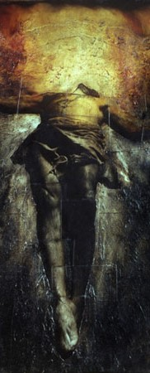

Mark 15:33 Darkness over the whole land.
In Deut 16:6 Moses gives special attention to the timeframe of the
Passover sacrifice “at
the going down of the sun.”
The 6th hour [high noon] marks the first instance where the sun begins its downward descent.
All synoptic Gospels
record there was
“darkness at
the sixth hour.”
This timeframe also qualifies for
“between the mixingS” during the Day Season.
6TH HR
Mark 15:25 Yahusha
sacrificed at the 3rd hour.
9TH HR
3RD HR
Mark 15:1 (Abib 14) Immediately in the morning …
boqer
ereb
Abib 14
Night
Season
Mark 14:72 (Abib 14) Rooster crowed the 2nd time.
Mark 14:63 (Abib 13) High priest tore his robe
& condemned Yahusha “the” Sacrifice to die!

Slide 47
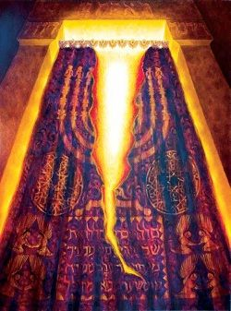

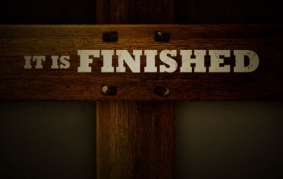

Mark 15:33 Darkness
over the whole land.
6TH HR
TA: Aug 22nd …Yes we focus on the death of Yahusha and FORGET that Jerusalem was presently trying to offer thier sacrifice which was messed up by the darkness ! The question is - was Yahuah, by causing the darkness, preventing them from offering their sacrifice on thier time? Thier preparations could not have been made in the darkness! Was He saying - THIS IS THE REAL SACRIFICE, and your timing and sacrifice are nothing?
Mark 15:25 Yahusha
sacrificed at the 3rd hour.
9TH HR
3RD HR
Mark 15:34 “… why
have You forsaken Me?”
Exo 29 specifies the evening Daily sacrifices could be offered <beyn ha arbayim> [during the Day Season]. Jerusalem was offering their evening sacrifice
at the 9th hour – especially the Passover sacrifice. Yahusha fulfills this with His death.
All synoptic Gospels record Yahusha’s death was at the
“9th hour.” This also qualifies
for “between the mixingS”
during the Day Season.
Mark 15:1 (Abib 14) Immediately in the morning …
boqer
ereb
Abib 14
Night
Season
Mark 14:72 (Abib 14) Rooster crowed the 2nd time.
47

Slide 48



Mark 15:33 Darkness
over the whole land.
6TH HR
Mark 15:25 Yahusha
sacrificed at the 3rd hour.
9TH HR
3RD HR
Mark 15:34 “… why
have You forsaken Me?”
John 19:34 Upon return from Pilate, the spear drew forth His blood and water.
Mark 15:1 (Abib 14) Immediately in the morning …
boqer
ereb
Some time later Pilate questions whether or not Yahusha has died.
The Roman spear “pours out” Yahusha’s “blood and water” as His Drink Offering that was always poured out at the altar.
Abib 14
Night
Season
Rooster crowing time.

Slide 49

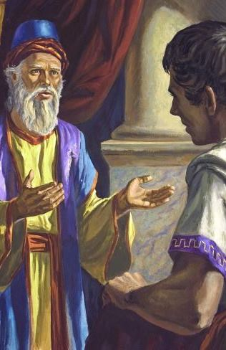
Mark 15:33 Darkness
over the whole land.
6TH HR
Mark 15:25 Yahusha
sacrificed at the 3rd hour.
9TH HR
3RD HR
Mark 15:34 “… why
have You forsaken Me?”
John 19:34 The spear drew forth blood and water.
Mark 15:42 When evening came Joseph went to Pilate for Yahusha’s Body.
Mark 15:1 (Abib 14) Immediately in the morning …
boqer
SUNSET
ereb
Rooster crowing time.
Abib 14 Night Season
THEN he bought fine
linen. [Mark 15:46]
Deut 16:6 records the Passover can be offered at “ereb/even.” (Lev 6:20 also has the Grain Offering at “ereb/night.”) It was during this dusk timeframe that Joseph was making arrangements to secure Yahusha’s Body.

Slide 50


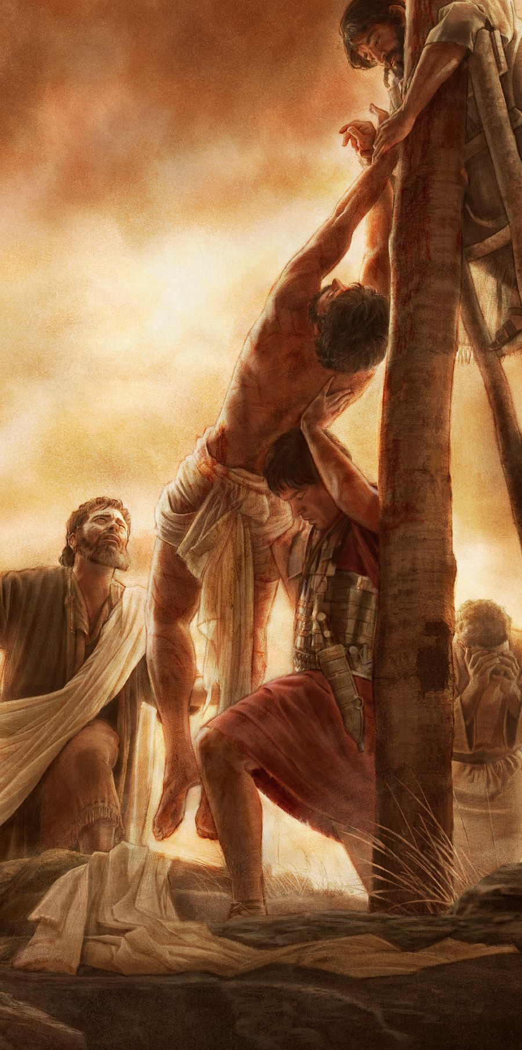
Mark 15:33 Darkness
over the whole land.
6TH HR
Mark 15:25 Yahusha
sacrificed at the 3rd hour.
9TH HR
3RD HR
Mark 15:34 “… why
have You forsaken Me?”
John 19:34 The spear drew forth blood and water.
Mark 15:42 Joseph asks
Pilate for Yahusha’s Body.
Mark 15:1 (Abib 14) Immediately in the morning …
boqer
SUNSET
ereb
THEN he bought fine
linen. [Mark 15:46a]
Rooster crowing time.
Abib 14
Night Season
Mark 15:46b THEN,
(AFTER THE SUNSET) Yahusha is removed from the stake for burial – as the custom was of the Jews [John 19:40].
Deut 16:6 also records the Passover can be offered at “the [night] season of Egypt.”
Exo 12:8 & 10 type allows for the handling
of the Passover Lamb all night long.
This was done for Yahusha’s burial.

Slide 51

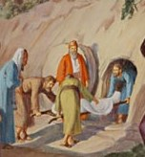
Mark 15:33 Darkness
over the whole land.
6TH HR
Mark 15:25 Yahusha
sacrificed at the 3rd hour.
9TH HR
3RD HR
Mark 15:34 “… why
have You forsaken Me?”
John 19:34 The spear drew forth blood and water.
Mark 15:42 Joseph asks
Pilate for Yahusha’s Body.
Mark 15:1 (Abib 14) Immediately in the morning …
boqer
SUNSET
ereb
Abib 14
Night
Season
THEN he bought fine
linen. [Mark 15:46a]
Rooster crowing time for 15th.
Luke 23:54 Yahusha is laid in the tomb; women inspect; High Sabbath (5th cycle) grows light.
Mark 15:46b THEN Yahusha is removed from the stake for burial – as the custom was of the Jews [John 19:40].
Exo 12:10 type: all uneaten Passover lamb shall not remain until boqer. Yahusha’s burial was completed as the ULB Sabbath daybreak arrived.

Slide 52
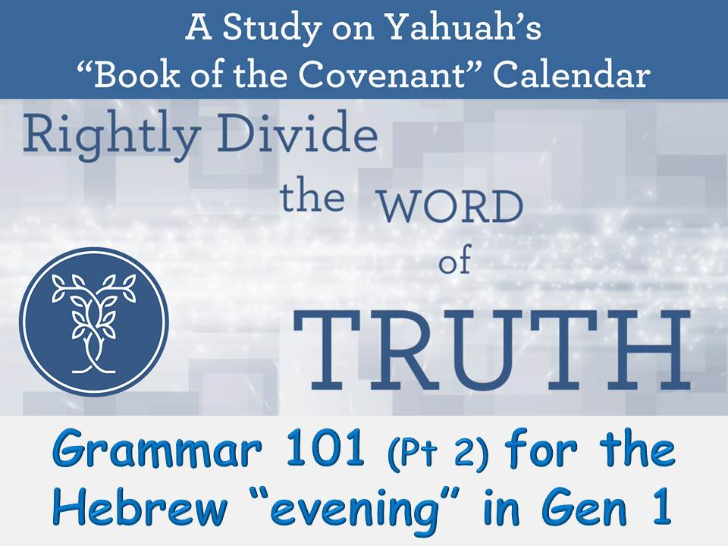
Extra Study Material
For a full explanation of the word “even/evening” in the Gospels,
see Study #5 from the 2018 series at Covenant Calendar Club Website.
Slides 31-44 (Pt 2)
will give extra detail
of how “even” is to be understood in the Gospel account
for Yahusha’s final Passover Day.
52

Slide 53
Summary for Yahusha’s
What can be gleaned from the multitude of Passover Sacrifices (during the days of the Tanach and Josephus) in conjunction with Moses’ command and prophecy for “when”
the Passover Sacrifices could be offered? The events of Yahusha’s Passover - when in full alignment with the Torah requirements - brings forth these facts:
Yahusha begins to fulfill Abib 14 as
THE Passover Sacrifice right from the
time when He stands before Pilate at boqer (the Torah time for the boqer sacrifice).
Yahusha’s body does not get “lifted up”
[as the Grain Offering & Living Sacrifice] until the 3rd hour – the beginning of the “sanctuary” morning sacrifice [which now qualifies for “between the mixingS.”]
The marker at NOON when it went dark, is the point where the Deut 16:6 prophecy
is fulfilled and also the 9th hour timing of when Yahusha as “THE” Passover Sacrifice dies – both timeframes qualify for “between the mixingS.”
Yahusha fulfills the “pouring out of the Drink Offering on the ground by the altar” when the spear is thrust into His side releasing blood and water, just as the lamb’s blood is spilled on the ground.
Deut 16:6 has a place for the Passover tasks at “even” when Joseph & Nicodemus receive permission to secure His Body.
Exo 12:8 & 10 is the type for the handling of Yahusha’s Body during the Night Season (or “between the mixingS”); for burial to be completed before the boqer daybreak ushers in Abib 15.
This is also the Deut 16:6 timeframe that linked to Egypt during the Night Season.

Slide 54
Final Summary for Yahusha’s
Conclusion: Yahusha’s “anti-type” sacrifice fulfilled “every” previous sacrifice of the sanctuary, including a multitude of sanctuary and individual Passover sacrifices in the previous 1500 years.
Every year at least 2107 Sanctuary Sacrifices were offered.
This pales in comparison to the 250,000+ Passover sacrifices at the sanctuary each year on one single day!
Because the Passover sacrifice had components of every sacrifice and offering, it was by far the most important sacrifice of all time! Yahusha, as the supreme Passover Sacrifice is even greater! He fulfilled every possible “type” in one 24 hour Passover Day when He offered Himself.

Slide 55
Thoughts & Questions to Consider
Did Yahusha fulfill every detail of the - what, when, where & how - of the Passover sacrifice?
Was it absolutely essential that Yahuah provided the Torah phrase <beyn ha arbayim>/“between the mixingS,” not only for the Daily evening Offerings, but for the Passover Sacrifices as well?
Because of Judah’s sunset day, the evening sacrifices - by necessity - were eventually moved to the 9th hour so their “morning and evening” sacrifices could be on the same day.
Because Yahuah knew Yahusha’s “sacrificial death” would be at the 9th hour, did He build in the <beyn ha arbayim> provision to accept the regular Daily Offerings?
Could this factor also be known as grace to the Levitical priests throughout history?
Remember: Yahusha’s Passover sacrifice qualifies as the anti-type no matter when it is given, according to the commands of Deut 16:6.
(Note: The priests could not corrupt that. Yahuah had all the bases well covered!)

Slide 56
More Thoughts & Questions (con’t)
Deut 16:6 But at the place which Yahuah thy Elohim
shall choose to place his name in, [in Jerusalem] there thou
shalt sacrifice the passover [a] at even [ereb/dusk],
[b] at the going down of the sun [<beyn ha arbayim> Day Season], [c] at the season that thou camest forth out of EGYPT
[<beyn ha arbayim> Night Season].
CF: Wow Tim ... I just realized with this comment, that even though the priests "messed with the timing" of the other Offerings, Yahuah did things different for THE Passover Sacrifice. nobody could mess up these instructions UNLESS they offered the lamb on another day other than the 14th. The passover instructions are a "built-in no-fail" plan BECAUSE it is the most important sacrifice of the whole universe. I'm adding this thought to the next slide.
TA: yes the "bases were covered!"
Is it now easier to see the context of Deut 16:6 is NOT about when the day begins, but about the many options of when the Passover sacrifice could be offered?
Yahuah’s provision eliminated any possible violation of
the people adding or subtracting to the instructions of
carrying out the most important sacrifice!

Slide 57
Final Thoughts & Questions
Is the Passover the most important sacrifice of them all?
Is this why it must have the highest priority?
Has the Torah, the Tanach and the Gospels given the Passover sacrifice its rightful recognition?
One more thing to think about: Even though the priests “adjusted the timing" of the other Offerings,
Yahuah did things different for THE Passover Sacrifice.
Nobody could alter these instructions UNLESS they offered the lamb on another day other than the 14th.
The Passover instructions are a "built-in no-fail" plan BECAUSE it is the most important sacrifice of the
whole universe.

Slide 58
2. Lev 6:20 & Deut 16:6 provide for the Passover Sacrifice to have placement
at several timeframes of the 24 hour cycle.
1. The Patterns for
“between the mixingS”
in the Torah had
alignment with
the Day Season
& Night Season,
not day-start!
(11 Torah
References)
The Patterns for
“between the mixingS” on Yahusha’s
Passover Day
did not violate
Torah instructions.
No context
for day-start.
Parts 1, 2 & 3 consistently linked <beyn ha arbayim>
to Sacrifices & Offerings, not day-commencement.
58

Slide 59
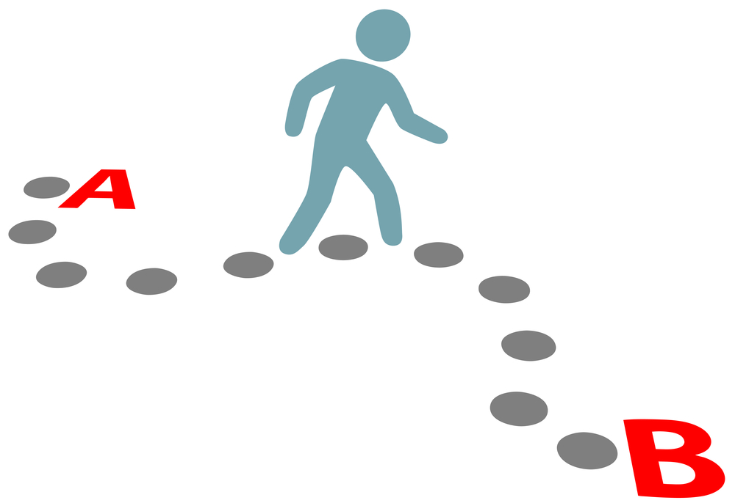

It is now time to revisit
the theologians with
these NEW discoveries!
59

Slide 60
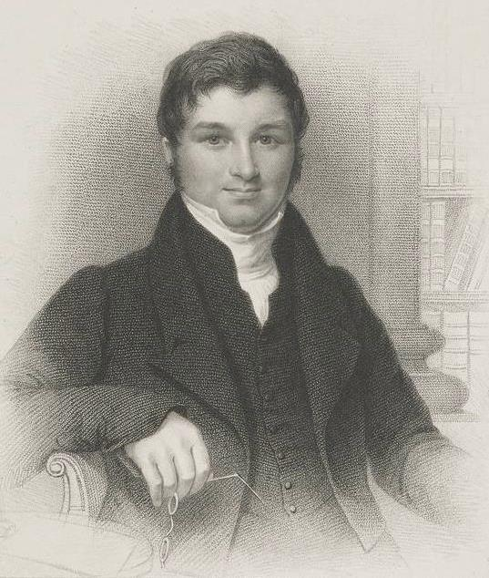
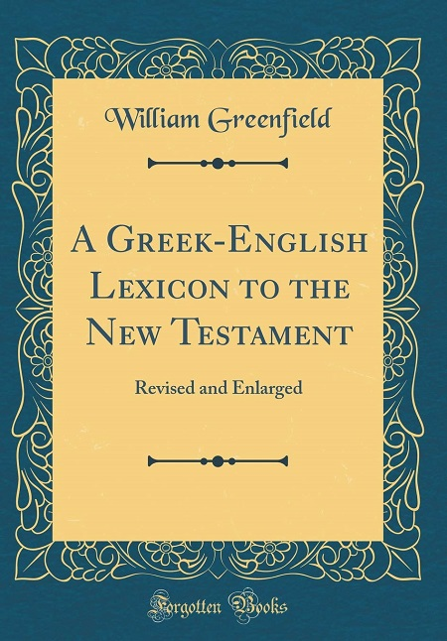
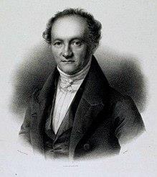
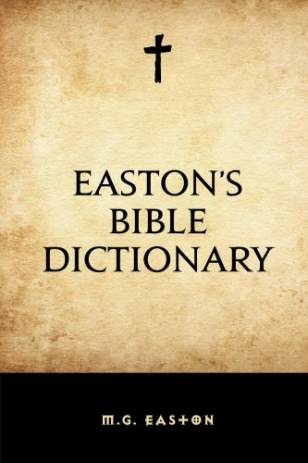
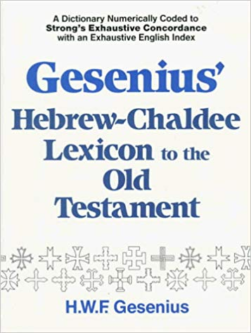
Wilhelm Gesenius
1786-1842
Matthew G Easton
1823-1894
William Greenfield
1799-1831
Theologian’s & <beyn ha arbayim>
Note: All three theologian’s declare <beyn ha arbayim> / “between the eveningS” absolutely means there are
two evenings in every 24 hour cycle mostly for the
purpose of declaring the sunset commencement.
Sabbath
Day-start?

Slide 61

A Challenge for the Theologian’s
 | Evening begins: | Noon 6th Hr | 9th Hr 3 PM | 11th Hr 5 PM | Sunset | Dusk [Ereb] | Deep Twilight | Explanation of Between the Evenings
1 | Gesenius |  |  |  |  |  |  | Just gives review for lines 1a and 1b.
1a | Karaites & Samaritans |  |  |  |  |  |  | Between sunset and deep twilight.
1b | Pharisees & Rabbinists | 1st Even |  |  | 2nd Even |  |  | Between noon and sunset.
2 | Greenfield (& the Jews) |  | 1st Even | 2nd Even |  |  |  | Between 3 PM to 5 PM. (9th Hr to 11th Hr)
3 | Easton (Claims Jews have two [2] evenings on each day!) | 1st Even |  |  | 2nd Even | [Period that follows sunset!] |  | Between noon and sunset.
REVI
EW
Every 24 hours has only one evening and two mixingS!
All three theologians are incorrect in saying every cycle has TWO evenings!
Did Torah agree with their concepts for the placement of “between the mixingS”?
Torah will never agree with contaminated study sources & their authors!
61

Slide 62
The term “between the eveningS” has nothing to do with Yahuah’s day-start as these theologians steadfastly claim! !
There is no question about this!
NO context
for day-start!
Of utmost importance:
<beyn ha arbayim> links to the timeframes of the Passover Sacrifice!
62

Slide 63


Covenant Calendar has been declaring
the word “evening/ereb” is
the foundation of Yahuah’s calendar.
Next: Huge & Very Important Question About Morning!
Why isn’t the word
“morning / boqer”
declared …
…the foundation of the calendar?
Has this got something to
do with <beyn ha arbayim>?

Slide 64


Only the word “ereb/even” can
connect the dots so the phrase
<beyn ha arbayim> can be understood
in its entirety demonstrating there are
2 mixingS in each cycle, not 2 evenings.
64

Slide 65
1) Without the phrase <beyn ha arbayim> being so dominant in the Torah, how many would think to look at the fact that boqer/baqer is also an arab/mixing?
2) Would most people conclude arab is really only connected to ereb – not baqer?
…the foundation of the calendar?
Do you see
the puzzle pieces
that provide the answer?

Slide 66


Audience Participation & Discussion
There is another reason why “ereb” for “between the mixingS” is so important.
Unlike boqer “evening/ereb” has two primitive roots to show morning is the
2nd “mixing” [of light & darkness] when dealing with “time” and “calendar.”
Boqer’s primitive root “baqar” does
not easily link to the generic “mixingS”
definition of “arab” [H6148].
The only possible way to understand how the early morning is an “arab/mixing” is through the words <beyn ha arbayim>.
COULD IT BE … these highly significant
and beautiful truths about the Passover Sacrifice would lay hidden and covered without understanding “arab/H6148”?!
Now we Know!
boqer
Is it worth our time and consideration to be thinking about these things?
66

Slide 67
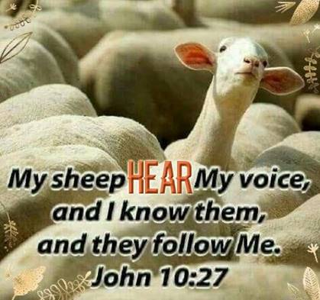
What is the Final Conclusion of the Matter?
Will we as humans ALLOW YAHUSHA to have THE FINAL WORD about <beyn ha arbayim> and day-start?
Will Yahuah’s people
follow His will to maintain
the correct interpretation for
Deut 16:6 and
<beyn ha arbayim>?
No context
for day-start.

Slide 68

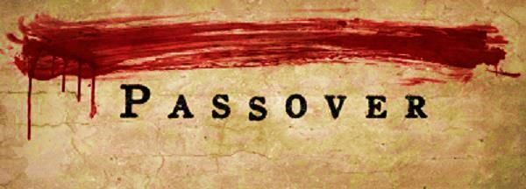
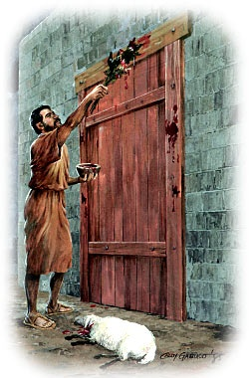
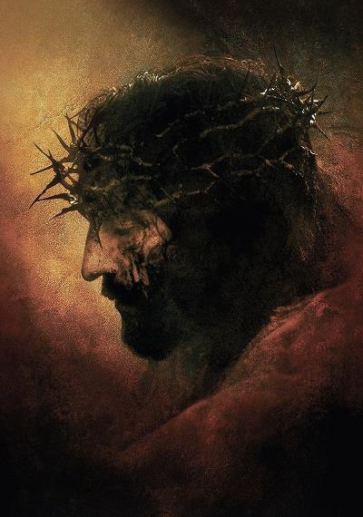

2nd Great (& Final)
<beyn ha arbayim>
Day Season
1st Great
<beyn ha arbayim>
Night Season
“IT Has Been Accomplished!”
John 19:30
in egypt
at CALVARY
Morning for
the day-start!
The ONLY time any living sacrifice went on the altar!
From a 3rd hour Living Sacrifice to the ULTIMATE Sacrifice in one Light Season, Yahusha has covered every requirement in perfection. …

Slide 69
It is the honor of kings to
search out a matter (Prov 25:2).
Luke 8:17 For nothing is secret that will not be
revealed, not anything hidden that will not be
known and come to light.
The End
If you search, you will find!
And you will know the
End from the Beginning!
Isa 46:9-10
69

Slide 70


If you have Questions & Comments
about this teaching, please contact:
Charlene Fortsch or Tim Astleford
charlene@studythecalendar.com
tim@studythecalendar.com
calendar@torahtothetribes.com
Thank you!
70

Slide 71


Grammar 101 Part 6
All secrets will be revealed
in one day!
at CALVARY
“IT Has Been Accomplished!”
John 19:30
Some questions
still need answers!

Slide 72

Kings search out a matter!
Grammar 101
Part 5

