Slide 1

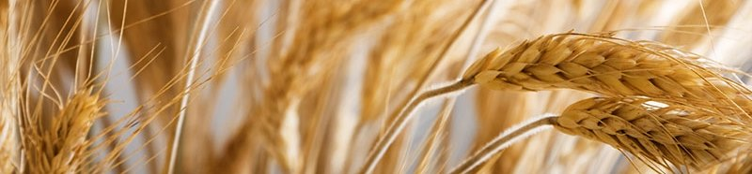
Is
Lev 6:20
“Between the
MixingS”?
“During the Mixing”?
~ OR ~

Slide 2


Mandate for “between the mixings”
Prov 25:2
It is the glory of Yahuah to conceal a thing:
but the honour of kings is to search out a matter.
In this study we’ll keep searching!
Knowing the End
from the Beginning
Isa 46:9-10
2

Slide 3
Beyn Ha Arbayim
ם
י
ב
ר
ע
ה
ן
י
ב
Arbayim
(plural for arab H6148)
R
E
V
I
E
W
<ereb>
Beyn
(Between)
H966
Arbayim
(mixtures)
H6148
Ha
(the)
Point #1:
There is only ONE “evening/ereb” in 24 hours!
Point #2:
There are always TWO “mixtures/arabs” in 24 hours!

Slide 4


#1 Placement of Both Daily Mixtures
Tim ... something just occurred to me! We have been saying "evening" is the foundation of calendar - or - ereb! Maybe that is not quite right. I'm beginning to see that ARAB (or the mixtures) are the foundation of calendar, with boqer ARAB's mixture as the day-start. THAT is why the word "evening" had to be studied and understood, not? evening/ereb is what leads one to the 2nd primitive root where the secret is hidden. It cannot be revealed UNTIL boqer is understood as one of the arabs (arbayim)! CF
I have held the thought that boqer is a mixture for a few years (2015), but now in agreement with you, now see that boqer and ereb are the foundation of CC.
I did however wrongly think that boqer included a few hours after the sunrise too. That has been eliminated.
Boqer – (Morning) DAWN twilight MIXTURE
Ereb – (Evening)
DUSK
twilight
MIXTURE
Dawn
Dawn
DAWN
DUSK
Sunrise
Sunset
Day-start at
twilight not
sunrise!
Direct Sunlight
Darkness
Mixtures [English] = Arbayim [Hebrew]
Foundation of Covenant Calendar
4

Slide 5
#2 Understanding <beyn ha arbayim>
The Hebrew phrase <beyn ha arbayim>
(“between the eveningS”)
is better understood in English as
“between the mixingS.”
“What mixingS”?
Dawn
Dawn
R
E
V
I
E
W
11
Torah
Scriptures
Sunrise
DUSK
Sunset
#1 beyn ha arbayim
Day Season
(between two mixings)
#2 beyn ha arbayim
Night Season
(between two mixings)
Direct Sunlight
Darkness
The mixing of boqer [dawn] twilight &
the mixing of ereb [dusk] twilight.
No context
for day-start.
5

Slide 6
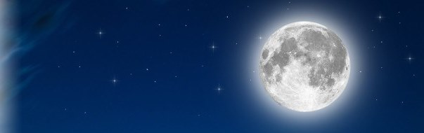

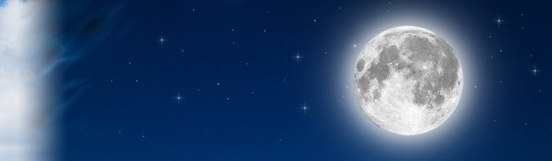

The 1st set of “between the mixingS” in Torah:
R
E
V
I
E
W
Narrative:
Exo 12:6 Night Season
Passover in Egypt
Exo 16:12 Night Season
Eating of Quail
The Night Season of
<beyn ha arbayim>
Dawn
Sunrise
Sunrise
Sunset
Dusk
#1
Dawn
Light Season | Night Season
In this study it is easier to relate to the Light Season as the 1st set of “mixings.” Why has Torah mentioned the
Night Season first?
<arab> Evening Twilight Mixture
<arab> Morning Twilight Mixture

Slide 7

The 2nd set of “between the mixingS” in Torah:
R
E
V
I
E
W
Commands:
Exo 29 & Num 28 Light Season
2nd Daily Sacrifice
Lev 23 & Num 9 Light Season
Passover Sacrifices
Exo 30 Light Season
Sanctuary Lamps
The Light Season of
<beyn ha arbayim>
Dawn
Sunrise
Sunrise
#2
Sunset
Dusk
#1
Dawn
Light Season | Night Season
<arab> Evening Twilight Mixture
<arab> Morning
Twilight Mixture
Dawn to Dawn!

Slide 8
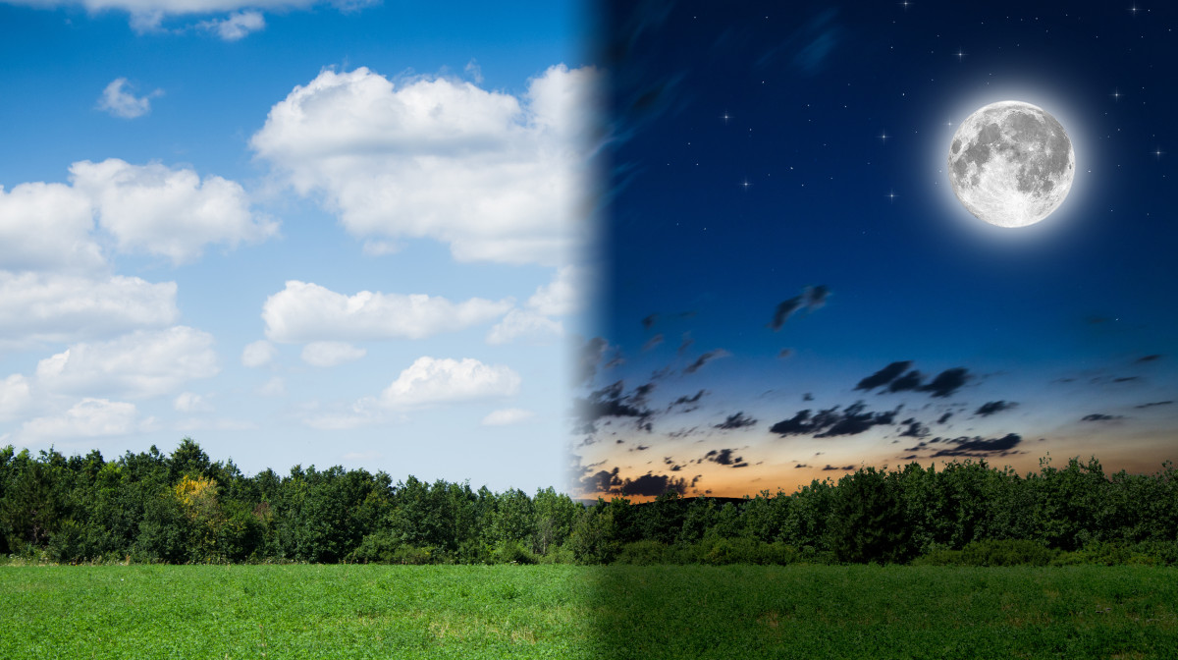

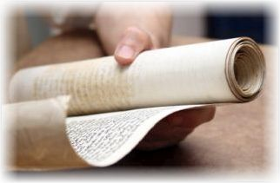
2. What about
[2a] Lev 6:20 &
[2b] Deut 16:6?
1. The Patterns for
“between the mixingS”
in the Torah had
alignment with
the Day Season
& Night Season,
NOT DAY-START!
(11 Torah References)
What about
Patterns for
“between the mixingS”
on Yahusha’s
Passover Day?
CF: one more use of this slide at the very end for the conclusion, likely stemming from this format. July 15th.
Place the answer with part #2 and massage the new box for part 3.
“eg:” Lev & Deut fully compliment BTM. Deut’s context is not about day-start at all!
Part #2 will examine Lev 6:20 to see if there is any
connection to “beyn ha arbayim” and if so, what is it?
8

Slide 9
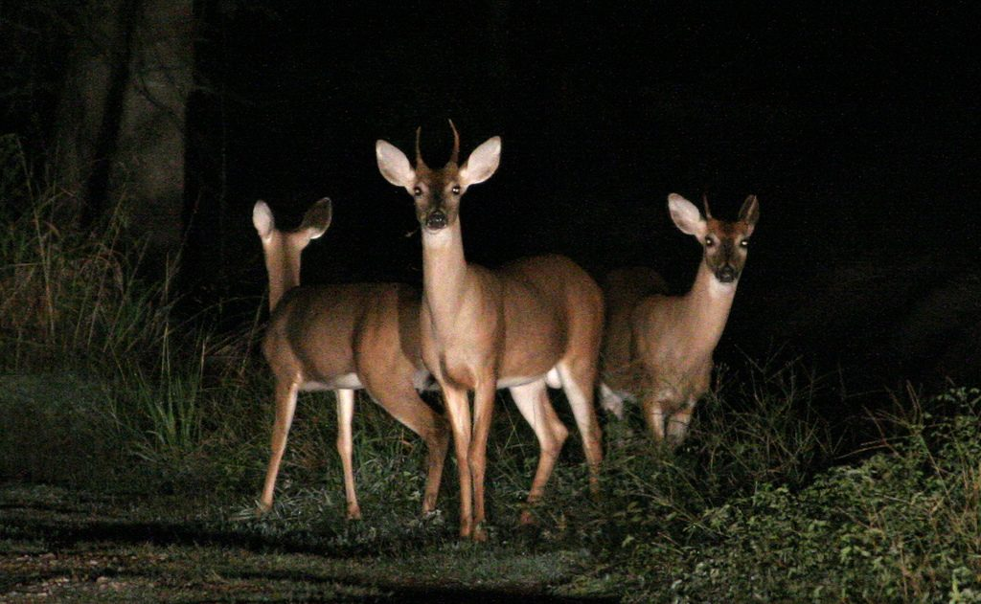
Deer and Headlights Scenario?
This is like getting a drink from
a fire hose!
Expect surprise, wonder & clarity!
Expect many
bunny trails!
Lev 6:20 [Section 2a]
will likely
be the most difficult.
Deut 16:6 [Section 2b] will likely have
the most surprises.
9
Notes:
A mental state of high arousal caused by anxiety, fear, panic, surprise and/or confusion, or substance abuse. A person experiencing the "deer in headlights" syndrome often shows behavioral signs reminding those of a deer subjected to a car's headlights, such as widely opened eyes and a transcient lack of motor reactions. to be so frightened or surprised that you cannot move or think:
Covenant Calendar Hangout 9 Aug 2019 ... 22nd Day of the 5th month
Your Covenant Calendar teachers have assessed the study that was planned for this friday, and decided more time was needed before it can be presented. This is the continuation of the study for "between the evenings" (beyn ha arbayim). We are very thankful that each of you understand the amount of time needed for research, writing and building of power points. In order to keep the quality of presentation where it needs to be, the extra time will be appreciated so much.
However, do plan to join at the regular time to be with your Covenant Calendar family anyway. Every week we are having new people that are interested in these calendar studies, and they have so many questions. We are delighted to see the members of Covenant Calendar stepping forward to provide answers to these very important questions. This is such a valuable part of the learning of each individual. Your Covenant Calendar teachers are very proud of each one of you.
So, for those that are new, have your questions handy, as there will be time for discussion. We do appreciate this time that we can meet together for such a grand time - while it is still available. It truly is a wonderful blessing.

Slide 10
Challenges and Surprises
Lev 6:20 [Section 2a] is difficult because there are so many dots to connect between the:
Grain Offerings
and the
Drink Offerings
… which in turn are connected to the
Daily Sacrifices;
… which are also
connected to
<beyn ha arbayim>.
Deut 16:6
[Section 2b] will
likely have the
most surprises.
This passage addresses only the Passover Sacrifice[s] upon “entrance
into the land.”
How does this connect to <beyn ha arbayim>?
How does
Lev 6
Connect to
Deut 16?
10
Notes:
A mental state of high arousal caused by anxiety, fear, panic, surprise and/or confusion, or substance abuse. A person experiencing the "deer in headlights" syndrome often shows behavioral signs reminding those of a deer subjected to a car's headlights, such as widely opened eyes and a transcient lack of motor reactions. to be so frightened or surprised that you cannot move or think:
Covenant Calendar Hangout 9 Aug 2019 ... 22nd Day of the 5th month
Your Covenant Calendar teachers have assessed the study that was planned for this friday, and decided more time was needed before it can be presented. This is the continuation of the study for "between the evenings" (beyn ha arbayim). We are very thankful that each of you understand the amount of time needed for research, writing and building of power points. In order to keep the quality of presentation where it needs to be, the extra time will be appreciated so much.
However, do plan to join at the regular time to be with your Covenant Calendar family anyway. Every week we are having new people that are interested in these calendar studies, and they have so many questions. We are delighted to see the members of Covenant Calendar stepping forward to provide answers to these very important questions. This is such a valuable part of the learning of each individual. Your Covenant Calendar teachers are very proud of each one of you.
So, for those that are new, have your questions handy, as there will be time for discussion. We do appreciate this time that we can meet together for such a grand time - while it is still available. It truly is a wonderful blessing.

Slide 11
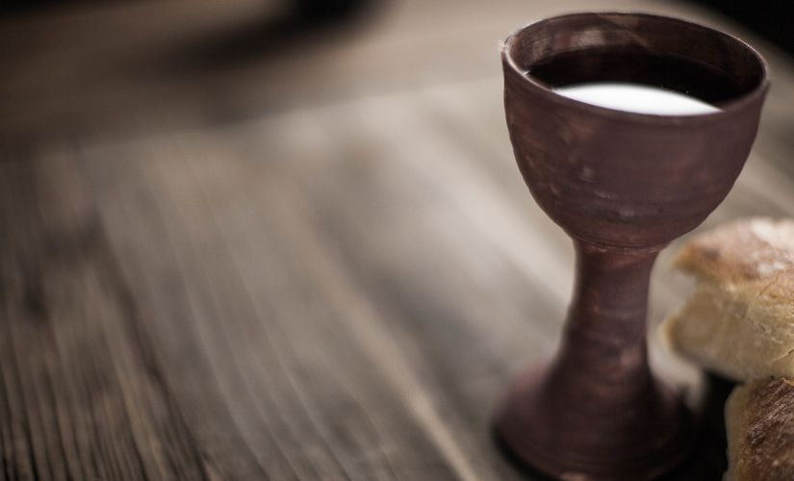
[Section 2a] Lev 6:20 (Grain Offering)
There is very little mention of drink offerings by themselves. If so, it is "a given" that the drink offering is never present without the grain offering. HOWEVER, when it came to pagan god worship, drink offerings are mentioned all over the place (esp. Jer.) ... remember some of them were drinking blood as part of the offering. Maybe that is why Yah's drink offering has lesser mention, as a contrast to the pagan problem. I also noticed that the pagan drink offerings did not have the grain offerings. Hhmmm.....
Also, I noticed that at the golden calf "they" were drinking the "drink offering" - something that the priests were never commanded to do. So, the drink offering had this special significance - pointing to when Yah's blood would be poured out in the "completeing" of His work, and the JOY of partaking of the drink offering in heaven when all work is complete - not until. But, He did give the wine as a "remembrance" that He gave His blood to "give us life."
Most Challenging!
(And the Drink Offering!)
Lev 6:14-23 The Law of the Grain Offering
Lev 6:20 This is the offering of Aaron and of his sons, which they shall offer unto Yahuah in the day when he is anointed; the tenth part of an ephah of fine flour for a [Grain] meat offering perpetual, half of it in
the morning, and half thereof at night.
Scriptures have less mention of the Drink Offering
even though it is connected to the Grain Offering.
“Once in the land of Canaan” the Drink Offering
accompanied the Grain Offering along with the
voluntary Daily Burnt / Peace Sacrifices.
The priests could partake of the Grain Offering, but
not the Drink Offering – it was always poured out!
11

Slide 12
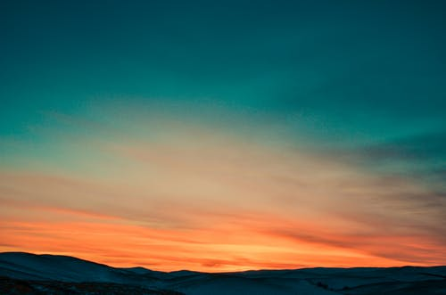
[Section 2b] Deut 16:6 (Passover Review)
During the conquest of Canaan, the main Israelite camp was at Gilgal (Joshua 4:19; 5:8–10) and the tabernacle was probably erected within the camp: Joshua 10:43ESV "…and returned into the camp" (seeNumbers 1:52–2:34 "…they shall camp facing the tent of meeting on every side").
After the conquest and division of the land among the tribes, the tabernacle was moved to Shiloh in Ephraimite territory (Joshua's tribe) to avoid disputes among the other tribes (Joshua 18:1; 19:51; 22:9; Psalm 78:60). It remained there during the 300-year period of the biblical judges (the rules of the individual judges total about 350 years [1 Kings 6:1; Acts 13:20], but most ruled regionally and some terms overlapped).^{[16][17]} According to Judges 20:26-28, the Ark, and thus possibly the tabernacle, was at Bethel while Phinehas, grandson of Aaron, was still alive.
The subsequent history of the structure is separate from that of the Ark of the Covenant. After the Ark was captured by the Philistines, King Saul moved the tabernacle to Nob, near his home town of Gibeah, but after he massacred the priests there (1 Samuel 21-22), it was moved to Gibeon. (1 Chronicles 16:39; 21:29; 2 Chronicles 1:2–6, 13). Just prior to David's moving the ark to Jerusalem, the ark was located in Kiriath-Jearim(1 Chronicles 13:5-6).
The Ark was eventually brought to Jerusalem, where it was placed "inside the tent David had pitched for it" (2 Samuel 6:17; 1 Chronicles 15:1), not in the tabernacle, which remained at Gibeon. The altar of the tabernacle at Gibeon was used for sacrificial worship (1 Chronicles 16:39; 21:29; 1 Kings 3:2-4), until Solomon finally brought the structure and its furnishings to Jerusalem to furnish and dedicate the Temple. (1 Kings 8:4)
Most Surprises!
Deut 16:1-8 Passover upon entrance of “the land of Canaan”
Deut 16:6 But at the place which Yahuah thy Elohim shall choose
to place his name in [at Jerusalem eventually], there thou shalt sacrifice
the passover [#1,] at even, [#2] at the going down of the sun,
[#3] at the season that thou camest forth out of Egypt.
The words “at even” are commonly used to define creation’s day-start “at the going down of the sun” … as sunset!
This verse does not use the phrase <beyn ha arbayim>.
Are Passover sacrifices disqualified from <beyn ha arbayim>?
12

Slide 13
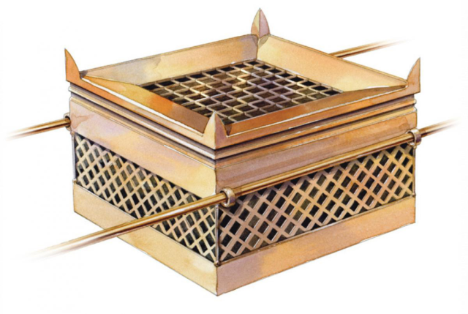

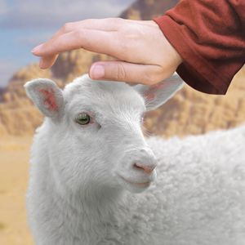
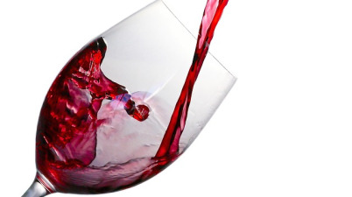
Mini-preview of the Sacrifices/Offerings
Voluntary Offerings
Offered by Priest at Sanctuary
Compulsory Offerings
of the Individual
Daily Offerings Morning & Evening
Burnt Offering
of DEDICATION
Peace Offering
of FELLOWSHIP
Sin Offering:
Sins against Yahuah or unintentional sins.
Grain/Meat Offering
of THANKFULNESS
Priests could partake.
Drink Offering is never included.
See
Lev 1-7 &
Num 28-29 for the Offering Requirements.
Trespass Offering:
Sins against others including restitution.
Always offered with the Burnt & Peace Sacrifices
Drink/Wine Offering
of VICTORY
Belonged
to Yahuah; always poured out!
Where does the Passover Offering belong?
Always offered with the Grain Offering
13

Slide 14
Sacrifices & <beyn ha arbayim>
Note: Out of the 11 Torah references 9 refer to sacrifices
attached to <beyn ha arbayim> / “between the mixingS.”
R
E
V
I
E
W
Four Torah references address Exo 29 Daily Sacrifices (with their Meat/Drink Offerings) using <beyn ha arbayim> / “between the mixingS.”
  Lev 6:14-23 specifically addresses the Law of the Meat [Grain] Offering which was always accompanied by the Drink [Wine] Offering.
Five Torah references, are directly related to Passover using the term <beyn ha arbayim> / “between the mixingS.”
  Deut 16:1-8 specifically addresses the Passover Sacrifice and does not use the phrase <beyn ha arbayim> / “between the mixingS.”
The rest of this study will begin to focus on the timeframe of sacrifices and offerings through the
lens of Lev 6:20; [then Deut 16:6 and the Gospel Account].

Slide 15


Addressing Lev 6:20 & Deut 16:6
Neither one
of these 2 verses use
the term
<beyn ha arbayim>.
Meaning what?
Will these Scriptures have anything to do with the Daily Sacrifices, or the Passover Sacrifices? If so, would these sacrifices be connected to the phrase
<beyn ha arbayim / between the mixingS>?

Slide 16

Peace Offering
Sin Offering
Trespass Offering
Burnt Offering
Meat/Drink Offering
?
Question:
How does
the Passover Sacrifice compare to:
Next: A Short Review on Offerings
Solving
Puzzles
16

Slide 17
Detail Comparisons of Offerings
Why was the Passover Sacrifice so Important? CF: somewhere the point has to be made that the Passover sacrifice is the Ultimate Sacrifice and why, and why there are so many variables that are acceptable, etc. Aug 5/19
Every sacrifice/offering had special requirements. Before consideration is given to Lev 6:20 and Deut 16:6, do note some of these details.
Name/Type | Basic Requirements
Burnt Sacrifice (1st blood offering of both Daily sacrifices) | Bull, ram/lamb 1st year; or bird (dove/young pigeon for the poor): wholly consumed; without defects; always a gift &/or dedication.
Peace Sacrifice (2nd blood offering of both Daily sacrifices) | Any animal without defect from herd or flock; variety of breeds. Voluntary act of worship with a banquet for thanks [eaten that night], and vows.
Sin Sacrifice (Blood offering for unintentional sin.) | High Priest: young bull; Leader: male goat; Common person: female goat; Poor: dove or pigeon; Very poor: 1/10 ephah of fine flour.
Trespass Sacrifice (Blood offering for intentional sin.) | Ram for intentional sin; had to be eaten within the court of the tabernacle.
Grain/Drink Offerings (Bloodless offerings attend all Daily Burnt/Peace sacrifices.) | Grain: ULB with oil & salt; (fine flour, bread, cakes or wafers); eaten in court. Drink: grape juice (no yeast or honey); poured out at altar base or on top of Peace Offering / Burnt Offering.
Why is the Passover not listed as one of the main sacrifices?

Slide 18

Details of the Passover Sacrifice/Offering
Why was the Passover Sacrifice so Important? 7/30
Compare the requirements of the Passover sacrifice as found in Exo 12:5, 8, 9, 22.
5 Your lamb shall be without blemish [like Burnt & Peace Offering], a male [Sin Offering] of the first year [Burnt Offering]: ye shall take it out from the sheep [like Peace Offering], or from the goats [like Sin Offering].
8 And they shall eat the flesh in that night [like Peace Offering, on the same day], 9 … but roast with fire his head with his legs, and with the purtenance thereof [like Burnt Offering, the whole animal had to be roasted] … 22 and none
of you shall go out at the door of his house until the morning [like Trespass Offering had to be eaten within the court].
Passover is the MOST important sacrifice because it includes components of every other sacrifice and offering all wrapped into one. Every individual was commanded to take part in this Passover sacrifice every Passover, unlike the other sacrifices that were mainly officiated through the priests and the sanctuary (except for the Peace Offering). What does the Passover sacrifice have in common with each of the following offerings?
Burnt Offering – the Passover sacrifice also had to be of the 1st year.
Peace Offering – The Passover sacrifice also had to be an animal without blemish; was not offered for confession of sin, but to remember the blessings received; sacrifice had to be eaten the same day. The Peace & Passover sacrifices were allotted to the people, not just the priesthood.
Sin Offering – The Passover sacrifice also a “male” – or female. It could be a lamb or goat.
Trespass Offering – was to be eaten within the court of the tabernacle; the Passover sacrifice was to be eaten within the home.
Grain/Drink Offerings – were always offered with every burnt & peace sacrifice mentioned above – but no drink offerings with sin/trespass offerings. These instructions are easy to locate in the Torah.
The Passover sacrificial ceremony was no different. Unleavened bread was eaten [grain offering]; the blood was poured on the ground [drink offering] (cf: Gen 35:24; 2 Tim 4:6).
Only the burnt & peace blood offering had the grain/drink offering as well. Nothing could be found in Torah to say the Passover sacrifice was accompanied with the grain/drink offering? Why not?
Type | Basic Requirements | Passover Offering
Burnt Offering | Bull, ram/lamb or bird (dove/young pigeon for the poor): wholly consumed; without defects; of first year. | Vs 5: of 1st yr; without blemish; Vs 9: whole animal is roasted.
Peace Offering | Any animal without defect from flock; variety of breads. Voluntary act of worship & meal for thanks eaten that night. | Vs 5: without blemish; Animal: lamb; vs 8: eat that night.
Sin Offering | High Priest: young bull; Leader: male goat; Common person: female goat; Poor: Dove/pigeon; Very poor: fine flour. | Vs 5: male; Animal: goat.
Trespass Offering | Ram for intentional sin; had to be eaten within the court of the tabernacle. | Vs 22: eaten within the court of the home.
Grain/Drink Offerings | Grain: Flour / unleavened bread with oil & salt; eaten in court; Drink: grape juice (no yeast or honey); poured out at altar.
No Information for the Passover Sacrifice
18
Why is the Passover not connected to meat & drink offerings?

Slide 19
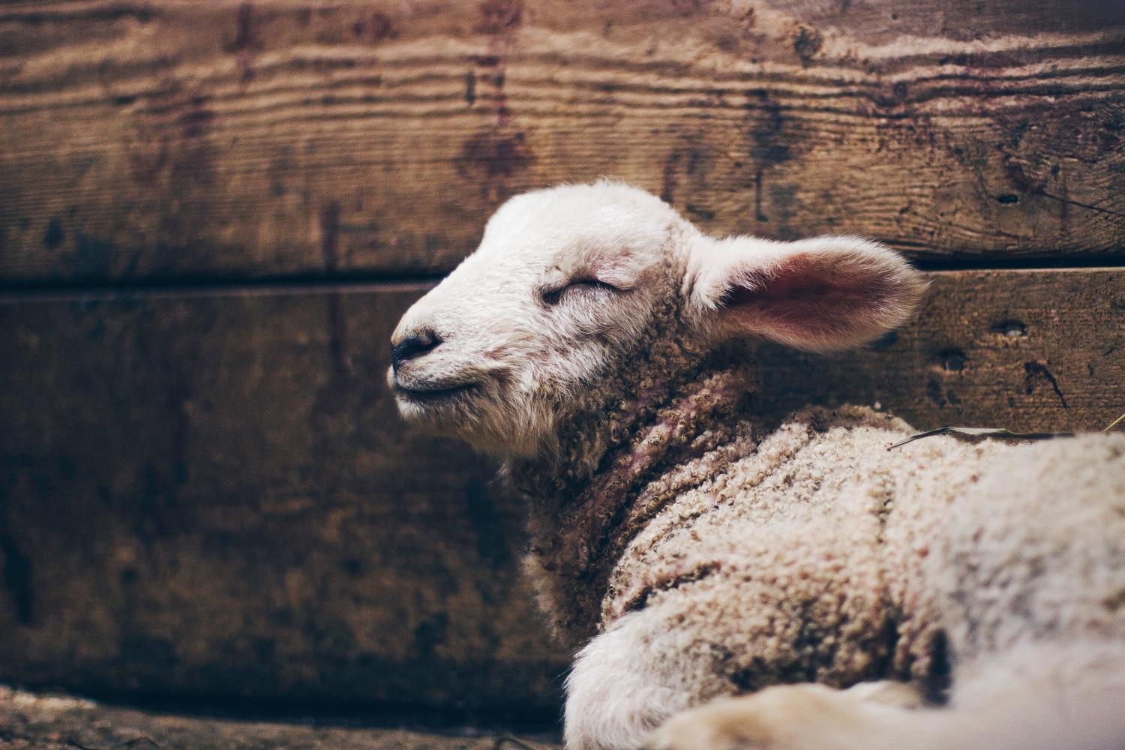
Is the Passover Lamb the Ultimate Sacrifice?
This sacrifice was uniquely special because it contained components from every
blood offering.
There’s no Scriptural account where the Passover Lamb was offered with
Grain & Drink offerings.
Why not?
Is there something
else to consider?
It seems to me there is a correlation here about Yah giving His flesh [neat/grain/bread type] to the sacrifice at the 3rd hour, and He gives His blood (wine) at the 9th hour. This would include both the boqer and ereb Daily Sacrifices (type: Burnt & Peace) that were always attended with the grain & drink offerings. That was HIS part. For the people, they were eating ULB [the grain offering] and pouring out the blood of the lamb ON THE GROUND, or spilling it on the ground [as the drink offering].
19

Slide 20
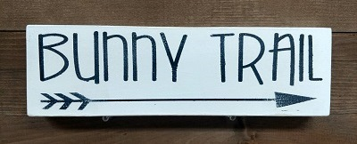
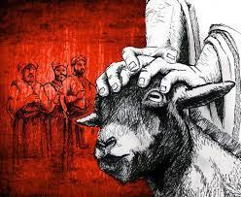
Sin & Trespass Offerings
Passover is the MOST important sacrifice because it includes components of every other sacrifice and offering all wrapped into one. Every individual was commanded to take part in this Passover sacrifice every Passover, unlike the other sacrifices that were mainly officiated through the priests and the sanctuary.
The Passover sacrificial ceremony included the Grain and Drink component a bit differently. Unleavened bread was eaten [grain offering]. There are no instruction for “wine” to be taken (in the Torah), but the blood of the animal was poured on the ground [as the Drink offering] (cf: Gen 35:24; 2 Tim 4:6).
Type | Basic Requirements | Description
Sin Offering | High Priest: young bull; Leader: male goat; Common person: female goat; Poor: Dove/pigeon; Very poor: fine flour. | Unintentional Sin (No Grain/Drink Offerings)
Trespass Offering | Ram for unintentional sin; had to be eaten within the court of the tabernacle. | Intentional Sin (No Grain/Drink Offerings)
Grain/Drink Offerings | Grain: ULB with oil & salt; eaten in court; Drink: grape juice (no yeast or honey); poured out at altar. Always offered with the Daily Burnt / Peace Offerings on altar. | Always offered together to approach Yahuah in worship.
R
E
V
I
E
W
Grain Offering:
expresses thanks for Yahuah’s provision
and good will.
Drink Offering:
expresses joy in the completion of “the” work.
The Grain Offering and
Drink Offering were never offered with the Sin and Trespass Offering, as the sinner is still “overcoming” and has not experienced the “joy” of total victory as yet.
20
Why is the Passover not connected to meat & drink offerings? We shall see!

Slide 21
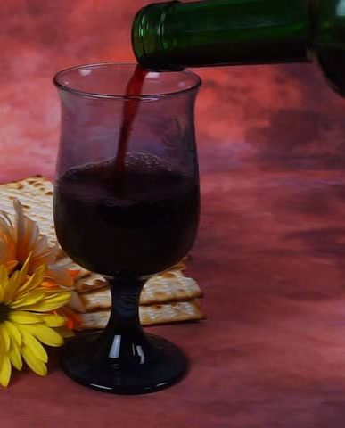

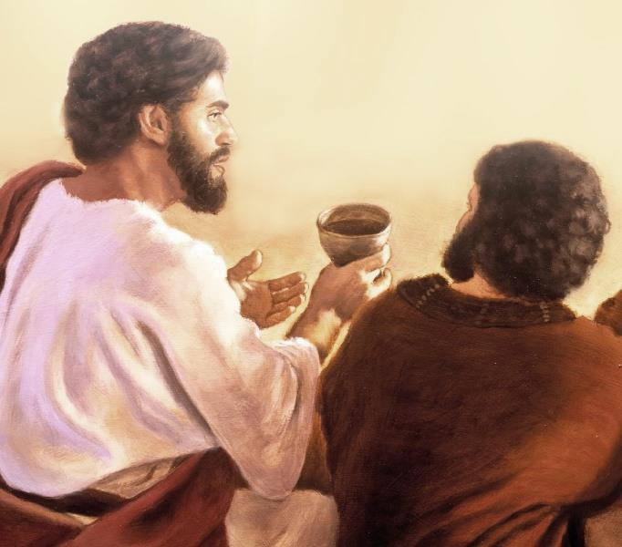
Uniqueness of the Drink/wine Offering
When is the wine poured out:
At the beginning of the day?
At the end of the day?
At the end of the day is when
the wine is poured out to relax and enjoy the fruit of the day’s labors.
Yahusha will drink the wine with us ~
with joy at
the completion of His work!
At the end of Yahusha’s earthly ministry:
Luke 22:17-18 And He took the cup, and gave thanks, and said, Take this, and divide it among yourselves:
18 For I say unto you, I will not drink of the fruit of
the vine, until the kingdom of Yahuah shall come.

Slide 22

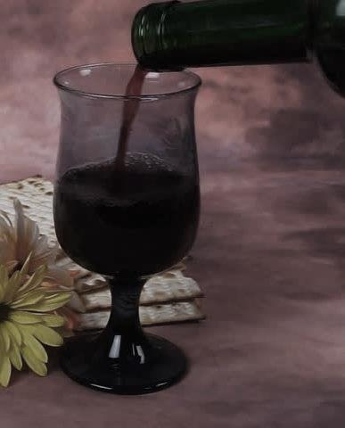
Torah’s Meaning of Drink/wine Offering
Why was the Passover Sacrifice so Important? 7/30
Mentioned only 3 times in Lev (only ch 23): Firstfruits, Pentecost & in connection with the Daily [Burnt & Peace] Offerings of each day.
More details for the Drink Offering in Numbers 15 & 28.
To be offered with all Daily Offerings & the Grain Offering.
Never to be offered except “in the land of promise.”
The Law of the Drink Offering is clear: Yahuah promised He would not “accept” the wine with the Grain Offering until His people entered the land after the 40 years in the wilderness.
Drinking wine is a sign meaning rest & celebration only after Yahuah defeated the enemies! THEN He gave these Drink Offering instructions and THEN He would accept the libation of wine where huge clusters of grapes grew.
Once in the Land
Yahuah provided grapes for the Drink Offering.
The Drink Offering was a sign of His victory for the people.
The priests were completely excluded from partaking of this Offering.
The people’s portion: they only brought the “works” of their labors.
At the end of the sin problem, Yahusha will have a “Victory Drink” with the redeemed!
22
Why is the Passover not connected to meat & drink offerings? We shall see!

Slide 23
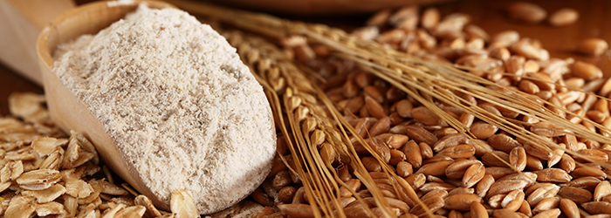
Lev 6:20 – the Law of the Grain Offering
Actually, the question here is also, how is BTE connected to the passover sacrifice. It seems to me the Passover Sacrifice was connected to the morning and evening sacrifice "in type" ... The Burnt offering with the Peace offering "in top" were always offered with the meat offering - sometimes the drink offering was oured on top, and sometimes it was poured at the base of the alter. The priests NEVER drank this offering. They did however partake of the meat/grain offering. The wine symbolized the blood - there was a command not to drink blood.
I have not sorted out yet why Yahusha told the disciples to drink the wine representing His blood, when there was no such command given in the Torah? Did He really tell them to drink it, because He said he would not drink it till "heaven." Everything I could find about the drink offering - was it was offered with joy (never offered with sin and trespass offerings, unless they were doing it pagan style - which happened a lot.) The drink/wine offering is the JOY of "entering the land" where we can relax and rest.
The Grain Offering is also known as the “Meat Offering.”
Lev 6:20 has content about the Grain Offering that is to be
offered with every blood sacrifice along with the Drink Offering.
Lev 6:20 does not contain the phrase <beyn ha arbayim>.
Question: What could be the connection of the Grain/Meat Offering to <beyn ha arbayim> … and does it matter?
Getting Started with Lev 6:20!
Another puzzle piece?
23
Notes:
You asked the question about "why in Canaan" when the corrupt priests changed the times for the sacrifices. My answer: The command from Moses in Deut 16 was "when they come into the land" ... remember there were no passovers in the wilderness after year #2, so these instructions are for "coming into the land" ... of what? ... of Canaan, right? Then, he said "at the place where Yahuah places His name, you go there for passover" ... well, that is Jerusalem, IN JUDAH by that time -- after the land of Canaan was split into 12 tribe divisions. I could say Jerusalem - but that's not totally correct, because Joshua celebrated Passover when he crossed the Jordan into "their" canaan. So, that is why I used canaan. Do you think another term is more correct to identify what Deut 16 is talking about - as this is coming up in part 2? But, trouble is: it has to be done correctly in part 1. So, I felt "canaan" was a safer term "all around" than "Jerusalem" which didn't come about for some time, nor the tribe of Judah. That all took time to divide up the land for the inheritances. Let me know if you want canaan changed out.

Slide 24
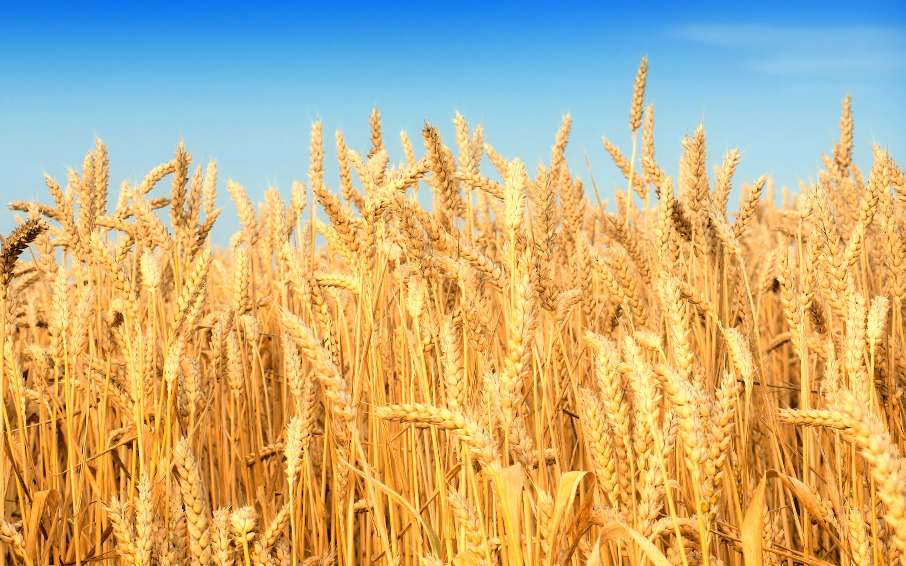

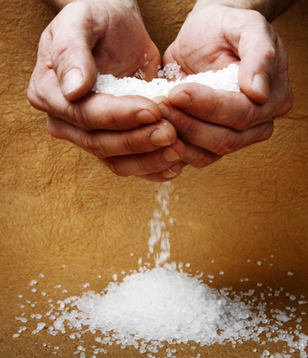
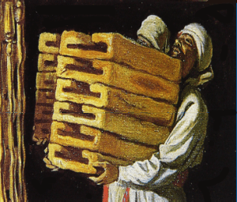
The Law of the Grain Offering
Lev 6:14-23 (Num 15:4-11) The laws of the Grain Offering (along with the Drink Offering) are given with specific instructions. Grain Offerings were to be presented as:
A Wave-sheaf on First Fruits
Two Loaves on Pentecost
The Offering of Jealousy
The Cleansing of a Leper
The Meal-sin Offering of a handful of Flour
The Shewbread
The Passover Cakes
A Grain Offering must accompany every morning & evening Daily Sacrifice.
(Note of Interest: Cain’s offering was unacceptable because it was not attended with a blood sacrifice. Likewise, Abel’s blood sacrifice was accepted because he also offered the required
Grain and Drink offerings. Remember these instructions are given in Lev 1-7 & Num 28-29.)
Burnt & Peace sacrifices were never acceptable without the Grain and Drink offerings.
(This study on Lev 6:20 is intricately combined with the evening Daily Sacrifices.)
Question: What does the Grain Offering of Lev 6:20 have to do with the term
<beyn ha arbayim> and the Daily Sacrifices for [boqer] and ereb?
Lev 6:20
Law of
the
Grain
Offering

Slide 25
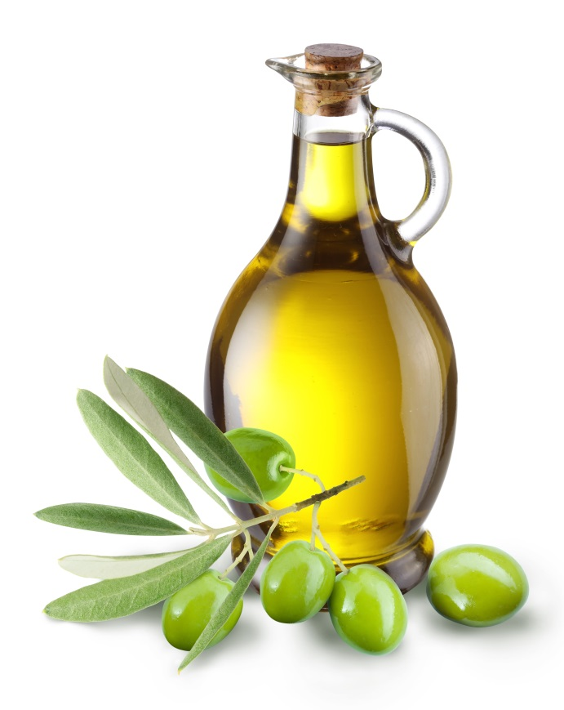
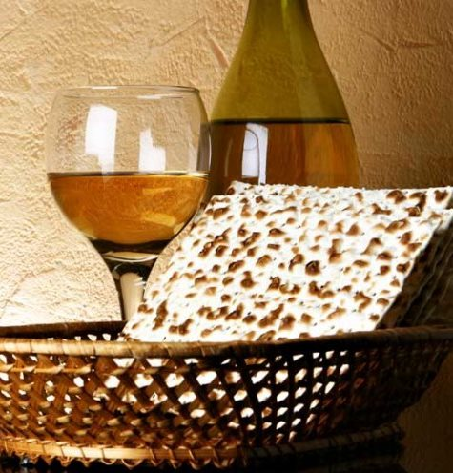
The Law of the Daily Offerings
Exo 29:39 One lamb thou shalt offer in the morning [H1242],
and the other lamb thou shalt offer at even
[H6153 “between the mixingS”]:
These 2 Daily Offerings always included:
Burnt Offering with the Peace Offering laid on top.
Grain/Meat Offering of oil, salt and frankincense always accompanied the two blood offerings.
(Sometimes priests partook of the Grain Offering.)
The Drink/wine Offering was always poured out, either on the altar or at the base of the altar.
(The priest never touched the Drink Offering.)
These “daily sacrifices” are connected to the
phrase <beyn ha arbayim> / “between the mixingS.”
Lev 6:20
Law of
the
Grain
Offering
I found it interesting, the Sin and Trespass offerings did NOT have Drink Offerings. Grain/meat offerings, yes, but not the wine ... as wine represents: 1) JOY due to 2) finished work, of which the sin and trespass offerings indicate the work is not finished yet. There is indication that Yah's people offered drink offerings along with pagan god worship ... somehow ... i didn't have time to dig through that too much. It's a huge study. The point I want to share is that the Grain/Drink offering always was with the 2 Daily Sacrifices even if through dusk, right up to the night - without using the term BTE.

Slide 26
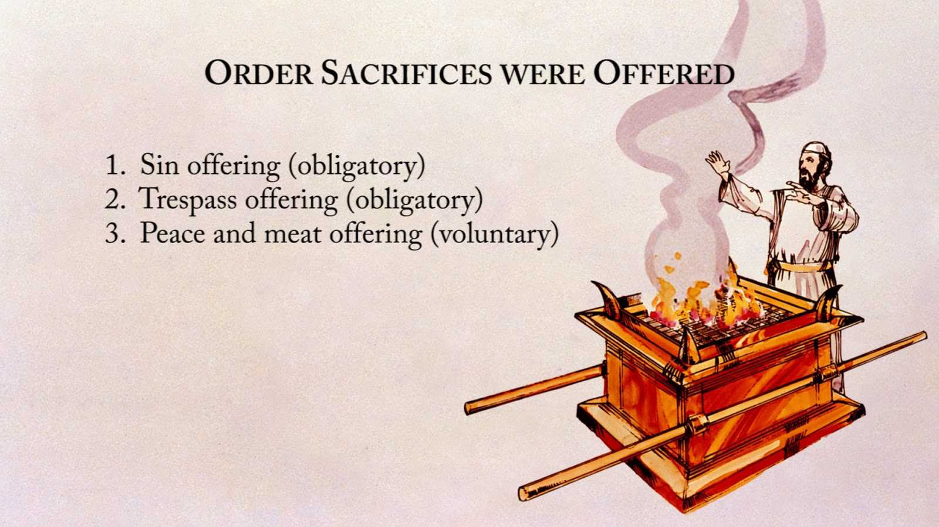
Num 28: The Law of the Daily Offerings
Now Yahuah spoke to Moses, saying,
"Command the children of Israel, and say to them, 'My offering, My food for My offerings made by fire as a sweet aroma to Me, you shall be careful to offer to Me at their appointed time.'
"And you shall say to them, 'This is the offering made by fire which you shall offer to Yahuah: two male lambs in their first year without blemish, day by day, as a regular burnt offering.
The one lamb you shall offer in the morning, the other lamb
you shall offer in the evening,
and one-tenth of an ephah of fine flour as a grain offering mixed with one-fourth of a hin of pressed oil.
It is a regular burnt offering which was ordained at Mount Sinai for a sweet aroma, an offering made by fire to Yahuah.
And its drink offering shall be one-fourth of a hin for
each lamb; in a holy place you shall pour out
the drink to Yahuah as an offering.
The other lamb you shall offer in the evening; as the morning grain offering and its drink offering, you shall offer it as an offering made by fire, a sweet aroma to Yahuah.' " NKJV

Slide 27
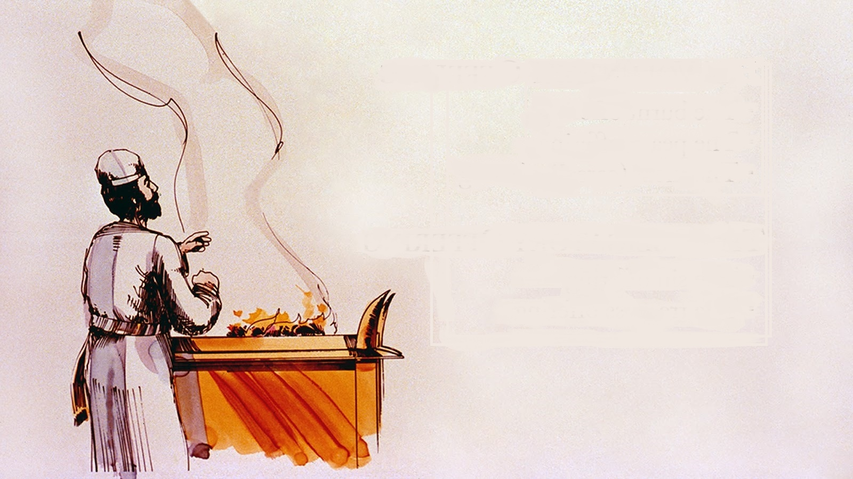
Num 6: Several Offerings Named Together
Num 6:17
And he shall offer the ram as
a sacrifice of a peace offering to Yahuah, with the basket
of unleavened bread;
the priest shall also offer
its grain offering and
its drink offering. NKJV
OLD comment - BUT - Num 10:10 is such an important verse - it was used in the moon study along with Ps 81:3
Num 10:10 Also in the day of your gladness, in your appointed feasts, and at the beginning of your months, you shall blow the trumpets over your burnt offerings and over the sacrifices of your peace offerings; and they shall be a memorial for you before your God: I am the LORD your God." This is for the monthly offerings – but basically every instruction had the burnt & peace offerings, even the golden calf did in Exo 32:6. But, as these 3 slides show, the grain & drink offerings were also included.
NKJV

Slide 28
Num 29: Several Offerings Named Together
Num 29:39
These you shall present to Yahuah at your appointed feasts (besides your vowed offerings and
your freewill offerings) as your
burnt offerings and your
grain offerings, as your
drink offerings and your
peace offerings. NKJV

Slide 29
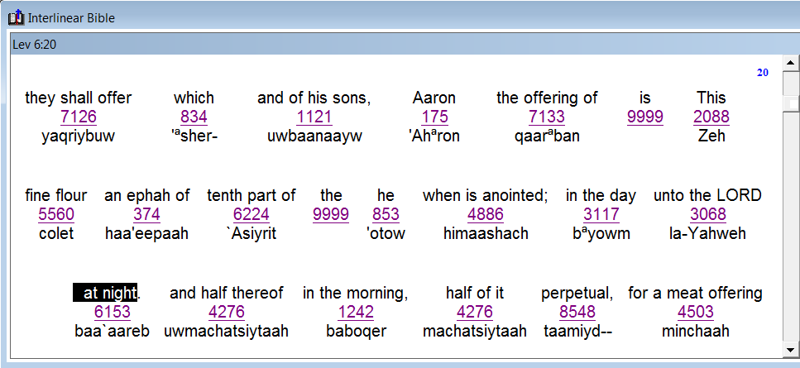
Lev 6:20 & the Grain Offering
Remember: The timeframe for the evening sacrifices from Exo 29 uses the phrase <beyn ha arbayim> placing them during the Day Season, which seems to avoid the possibility of the evening sacrifice taking place during the evening/ereb “twilight.” Is this notion correct?
Lev 6:20
Law of
the
Grain
Offering
In Lev 6:20, notice the English “word” and the “Hebrew word/number”
that is used for
the sacrificial timeframe of the
2nd Daily Sacrifice!
Timeframe = “night” as <ereb/evening> H6153.

Slide 30
Lev 6:20 uses <night/H6153>
Note: Most often when we read “night” we expect
(or suspect) this will be defined as <layil/H3915> -
the literal darkness during the Night Season.
Lev 6:20 This is the [Grain/Meat] offering of Aaron and of his sons, which they shall offer unto Yahuah … the tenth part of an ephah of fine flour for a meat offering perpetual [tamiyd/H8548/continually], half of it in the morning, and half thereof at night <ereb; H6153>.
H6153 `ereb; from H6150; [1st def.] dusk:
KJV - [2nd def.] day, even (-ing, tide [twlight]), [3rd def.] night.
Lev 6:20
Law of
the
Grain
Offering
The "day" and "night" definitions both apply for Day Season and Night Season. ereb is not "day" but part of the Day Season. Night is completely opposite. Pastor Louis says that ereb cannot use the definition of "night" but it sure is here in Lev 6 ... so I believe this is showing that the offerings proceeded through the whole dusk twilight right up to the night. There has to be a reason for this - there just ust be! Josiah uses Layil/night ... which is different than ereb//night.

Slide 31
Lev 6:20 The Daily Grain Offering
For the phrase “at night/H6153” …
where would that timeframe be placed
during each 24 hour cycle?
Dawn
Dawn
The ONLY allowed placement for <night/H6153> is up to the darkest part
of DUSK, just before <layil> night.
Lev 6:20
Timeframe
of the
Grain
Offering
with the
Blood
Sacrifice
Sunrise
Sunset
DUSK
beyn ha arbayim
Day Season
(between two mixings)
beyn ha arbayim
Night Season
(between two mixings)
Direct Sunlight
Darkness
The phrase “at night” does not qualify for the Night Season of
<beyn ha arbayim> because H6153 is a “mixing” of light and darkness.
This is where <ereb’s> 3rd definition of “night” can be used accurately.
No context
for day-start.

Slide 32
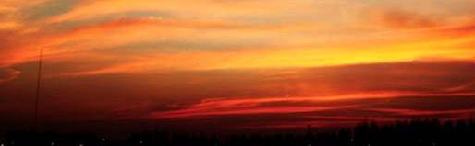
Lev 6:20 & 2nd Daily Sacrifice
#1
Conclusion: [ereb/night H6153]
Lev 6:20 has nothing to indicate any new day
begins with the “evening twilight.”
The context of Lev 6:20 is completely about the
Grain offering that always attends both daily
[Burnt / Peace] Offerings when they happen to occur.
Lev 6:20 bypasses the phrase <beyn ha arbayim> that is used in Exo 29 for the evening sacrifice.
The “evening” sacrifice was always to be offered
on “the same day” as the “boqer/morning” sacrifice.
According to Lev 6:20, the evening sacrifice
stretched to the ereb/night portion.
The sacrifice and bloodless offerings are still considered as being offered on “the same day.”
Sunset did not begin a new day!
This Grain Offering in Lev 6 is not precisely connected to any Passover sacrifice – specifically during dusk.
Lev 6:20 defines a bloodless offering “at night 6153” [same day]. This also provides for other sacrifices to be offered together at the brink of the Night Season.
No context
for day-start.
Will this pattern have any affect on the testimony of
King Josiah in 2 Chron 35?

Slide 33
Thoughts & Questions to Ponder before …
“between the mixingS” allows for the Daily evening sacrifices to be offered during the Light Season.
Lev 6:20 allows for the Grain/Meat offering to be
offered with the 2nd Daily blood sacrifice up until
the darkest {“night”} portion of <ereb/H6153>.
Therefore, the evening sacrifices were also allowed
to be offered during the dusk twilight which is neither
the Light Season or the Night Season.
Are there any witnesses for sacrifices being offered in the Light Season and up to the “night” portion of <layil/H3915>?

Slide 34
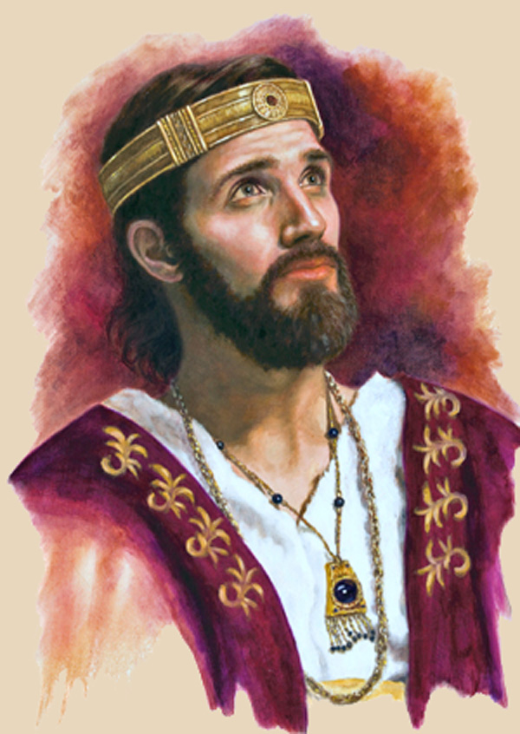
King Josiah’s Passover in Jerusalem
#2
King Josiah’s 41,400 Passover sacrifices were performed during the Light Season up to the night [H3915].
The phrase “between the mixingS”
would apply to the Day Season.
Dawn
Dawn
The ONLY allowed placement
for <night/H3915> begins with
the darkest part of DUSK,
ushering in <layil> night.
Sunrise
Sunset
DUSK
Josiah’s Passover sacrifices are during the Day Season & ereb.
beyn ha arbayim
Day Season
(between two mixings)
beyn ha arbayim
Night Season
(between two mixings)
Direct Sunlight
Darkness
2 Chron 35:14 … the sons of Aaron, were busy in offering burnt offerings and fat until night [layil] … NKJV
Context for day-start?
34

Slide 35

King Josiah’s Passover (624 BC)
#2b
Conclusion: [layil/night H3915]
All Passover sacrifices are to be offered on the Passover day cycle.
2 Chron 35:14 clearly states Burnt Offerings were offered until
layil/night (right after the context of Passover Offerings in vs 13).
Remember: Grain and Drink Offerings were
always offered with the Burnt / Peace Offerings.
The Passover in 2 Chron 35 completely bypasses
the phrase <beyn ha arbayim> [that is used in five Torah
Scriptures] designating offerings “during the dusk mixing.”
The “Passover” sacrifice was always to be offered
on “the same day” as the “boqer/morning” sacrifice.
According to 2 Chron 35, the Passover & evening
sacrifices also stretched to the Night Season.
This Josiah testimony contains a “key” for Covenant Calendar!
This slide will have to be brought forward again on another bunny trail for Moses and Deut 16:6, as he makes allowance for Passover to be "at even" 6153! It just never ends!
Sunset did not begin a new day!
What will Moses have to say about Passover Sacrifices being offered during the dusk twilight? Will
Deut 16:6 be able to qualify
for <beyn ha arbayim>?
Yes - context
for day-start.
Then, this aligns with the Josiah testimony about 41,400 sacrifices at that particular Passover – which is another day-start study with details that gives support and Biblical proof of Covenant Calendar guidelines. 7-29-19: Was ONLY the sanctuary Passover sacrifice accompanied by grain & drink offerings? The families would be eating UNL bread and wine with the lamb. L 6:20 may not prove anything for Passover sacrifices.
Exo 29 & Num 28 use BTM – so how does josiah’s passover have permission to be sacrificed during the mixing? Or, is there a special provision for ONLY the Passover sacrifice as commanded by Moses in Deut 16:6? [bunny trail to answer this at deut 16.]

Slide 36
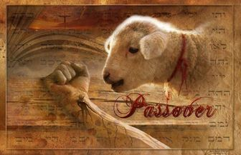
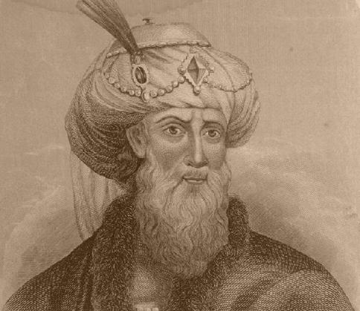
Passover Sacrifices in Jerusalem
The phrase “between the mixingS”
allowed for the Passover sacrifices
to be performed during
the full Light Season.
#3
Dawn
Dawn
Josephus
Secular
History
Josephus writes of many
Passover sacrifices
during the Light Season.
Sunrise
Sunset
beyn ha arbayim
Day Season
(between two mixings)
beyn ha arbayim
Night Season
(between two mixings)
Direct Sunlight
Darkness
Josephus states: 256,500 Passover sacrifices are slain from the ninth hour to the eleventh hour.

Slide 37
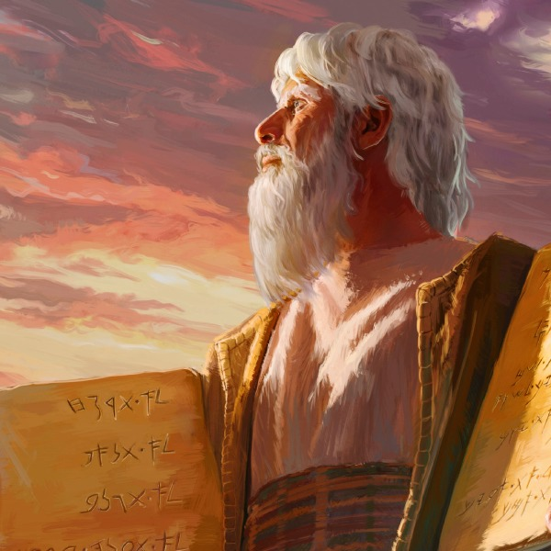
Commands of Moses
#4
Did Moses give alternate permission for Passover
sacrifices to be offered during “the dusk mixing”?
Dawn
Dawn
ONE allowed placement for “during the mixing” is this
DUSK twilight timeframe.
Sunrise
Sunset
DUSK
beyn ha arbayim
Day Season
(between two mixings)
beyn ha arbayim
Night Season
(between two mixings)
Direct Sunlight
Darkness
In the next study, will Moses give permission to offer the Passover sacrifice between sunrise & noon?
No context
for day-start.

Slide 38
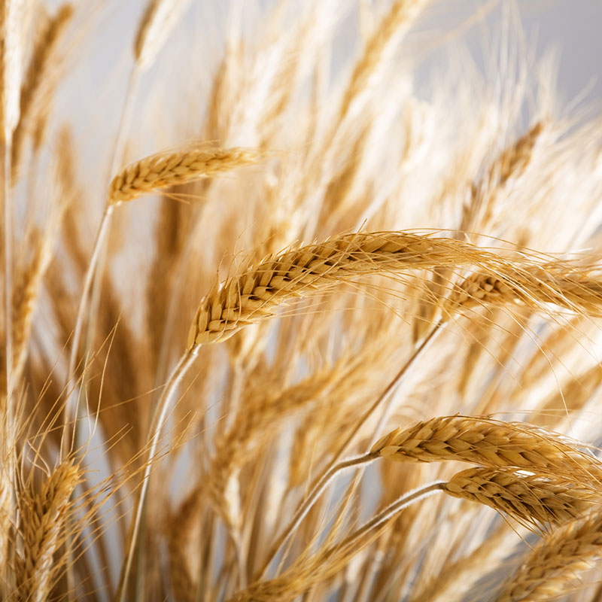

Lighting the Lamps & Grain Offerings
Exo 30:8 uses “between the mixingS” for lighting
the sanctuary lamps. Therefore the lamps would be trimmed during the Day Season and AFTER the evening Daily Offerings (which included the Grain & Drink Offerings).
Lev 6:20 allows for the Grain Offering to be given up until the darkest part of the ereb/night [H6153].
Some questions
still need answers!

Slide 39

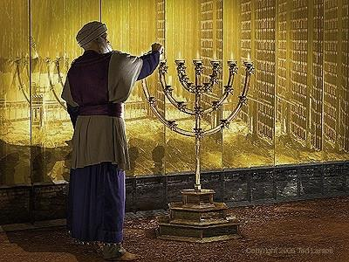
Grain Offerings & Lighting the Lamps
#1 When the Grain Offering was tended to at
ereb/night [H6153], were the lamps trimmed:
AFTER the Grain Offering into the Night Season?
Somehow tended to during the Day Season or ereb?
#2 Would the “tending of the lamps” be unusually later
on days when there were many festival sacrifices?
Will the lamps shed some light?
Will these puzzle pieces fit together?

Slide 40
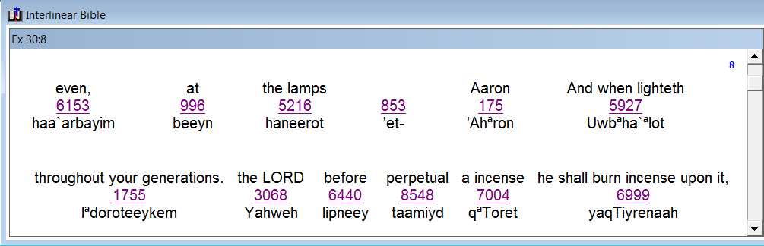
Aaron and the Sanctuary Lamps
#5
Exo 30:7 (The lamps were dressed in the <boqer> morning.)
Exo 30:8 And when Aaron lighteth the lamps at even
(H6153 between the mixingS / beyn ha `arbayim), he shall burn incense upon it,
a perpetual incense before Yahuah throughout your generations.
R
E
V
I
E
W
Note:
On a daily basis
the lamps were tended to AFTER
the Daily evening sacrifice with the Grain / Drink
Offerings during
the Day Season
(or beyn ha arbayim).
Lev 6:20 has the Grain Offering placed just before night (ereb/H6153) – not during the Day Season.
Is there a conflict here?

Slide 41
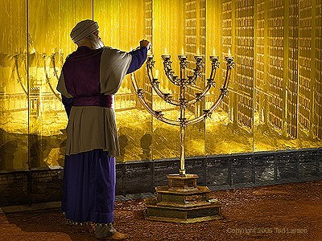
Sanctuary Lamps: Day Season or Dusk?
Contemplate: Because the lamps are tended to after the evening Burnt Offering – Peace Offering – Grain & Drink Offerings, the lamps (for Lev 6:20) will be trimmed after the dusk twilight into the Night Season – not during the Day Season of <beyn ha arbayim>.
#6
R
E
V
I
E
W
What does this mean?
On the days where there were several additional sacrifices being offered due to the extra requirements for certain feasts and festivals, it is very possible the sanctuary lamps were not trimmed until layil/night.
On the Passover Day when there were 1000s of lambs being slain, it is totally reasonable the lamps may not have been trimmed until the Night Season.

Slide 42

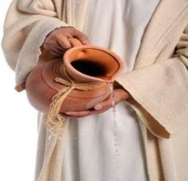
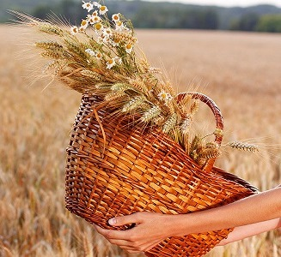
Lev 6:20’s Placement of the
Evening Sacrifice at Twilight
These facts have now been established:
The Grain/Meat Offering is always given with the
blood sacrifice along with the Drink Offering.
They are never separated.
Lev 6:20 places the Daily evening sacrifice and
Grain Offering during dusk twilight “up to” the
border edges of the Night Season.
(Question of “when” to be answered in Part 3.)
This Law of the Grain Offering allows for the ereb/evening sacrifice
to be during the dusk twilight – complimenting the boqer/morning twilight sacrifices and its Grain Offerings.
Fact to be established soon: There were many commands
for extra sacrifices to be offered throughout the year, on various special occasions. Does it appear the “ereb” timeframe allows
for an overflow of many sacrifices like it did for King Josiah?
Lev 6:20
Law of
the
Grain
Offering
at
Twilight
CF needs to take this question UP to the gospels when the 1000s of passover lambs are being sacrificed quite possible up to the night under the provisions made by Moses in Deut 16:6. Why? Because with all the demand for priests with the people and the sacrifices, the lamp trimming would more than likely have been delayed to the edge of night, or Night Season.

Slide 43

Lev 6:20 & Lighting the Sanctuary Lamps
Lev 6:20 provides for the Grain Offering to be offered
at the dusk twilight edges of layil/night
with the evening sacrifice.
Dawn
Dawn
#7
The trimming of the lamps followed the evening sacrifice. In such instances, the lamps would also be trimmed at the darkest part of DUSK, just before <layil> night.
Sunrise
Sunset
DUSK
beyn ha arbayim
Day Season
(between two mixings)
beyn ha arbayim
Night Season
(between two mixings)
Direct Sunlight
Darkness
Yes - context
for day-start.
The Exo 30:8 “lamps” cannot be fully understood unless the information is aligned with Lev 6:20 because the Grain Offering, evening sacrifices
and the lamp trimming are all bound together.
Now do we see?

Slide 44

#7
Audience Participation & Discussion
What we Know
Exo 30:8 – the lamps were trimmed
after the
evening sacrifices
were completed, whether that was in
the 1) Day Season of <beyn ha arbayim>,
or 2) dusk, or 3) night.
Exo 30:8
How does the trimming of the lamps link to Lev 6:20?

Slide 45
#7
Audience Participation & Discussion
What we Know
Lev 6:20 does not use
the phrase
<beyn ha arbayim>. However, it does show the Grain Offering
(that attends other offerings) is during the timeframe of ereb / night.
This in turn provides for the <beyn ha arbayim> sacrifices to also be offered during dusk.
Lev 6:20
Is Lev 6:20 actually connected to <beyn ha arbayim> after all?

Slide 46

Yes!
Lev 6:20 provides for dusk twilight sacrifices and offerings.
Lev 6:20 – Conclusion Question #1
Could it be … the evening sacrifice was supposed to always be offered during the dusk twilight on ordinary days?
Lev 6:20 might have a puzzle piece!
Is Lev 6:20 providing some options for the Gospel Account?
46
Notes:
You asked the question about "why in Canaan" when the corrupt priests changed the times for the sacrifices. My answer: The command from Moses in Deut 16 was "when they come into the land" ... remember there were no passovers in the wilderness after year #2, so these instructions are for "coming into the land" ... of what? ... of Canaan, right? Then, he said "at the place where Yahuah places His name, you go there for passover" ... well, that is Jerusalem, IN JUDAH by that time -- after the land of Canaan was split into 12 tribe divisions. I could say Jerusalem - but that's not totally correct, because Joshua celebrated Passover when he crossed the Jordan into "their" canaan. So, that is why I used canaan. Do you think another term is more correct to identify what Deut 16 is talking about - as this is coming up in part 2? But, trouble is: it has to be done correctly in part 1. So, I felt "canaan" was a safer term "all around" than "Jerusalem" which didn't come about for some time, nor the tribe of Judah. That all took time to divide up the land for the inheritances. Let me know if you want canaan changed out.

Slide 47

Lev 6:20 – Conclusion Question #2
Could it be … the Exo 29 commands
for the evening sacrifice during the
two optional <beyn ha arbayim>
(Day or Night Season) had something to do with another very important sacrifice?
Lev 6:20 could have a puzzle piece!
What would that “sacrifice” be?
47
Notes:
You asked the question about "why in Canaan" when the corrupt priests changed the times for the sacrifices. My answer: The command from Moses in Deut 16 was "when they come into the land" ... remember there were no passovers in the wilderness after year #2, so these instructions are for "coming into the land" ... of what? ... of Canaan, right? Then, he said "at the place where Yahuah places His name, you go there for passover" ... well, that is Jerusalem, IN JUDAH by that time -- after the land of Canaan was split into 12 tribe divisions. I could say Jerusalem - but that's not totally correct, because Joshua celebrated Passover when he crossed the Jordan into "their" canaan. So, that is why I used canaan. Do you think another term is more correct to identify what Deut 16 is talking about - as this is coming up in part 2? But, trouble is: it has to be done correctly in part 1. So, I felt "canaan" was a safer term "all around" than "Jerusalem" which didn't come about for some time, nor the tribe of Judah. That all took time to divide up the land for the inheritances. Let me know if you want canaan changed out.

Slide 48

Lev 6:20 – Conclusion Question #3
Could it be … Yahuah has a very special lesson to teach us through these supposed alarming discrepancies of Exo 29:39 & 41 with Lev 6:20?
Lev 6:20 must have a puzzle piece!
Is there a Torah discrepancy or not?
We shall see!
48
Notes:
You asked the question about "why in Canaan" when the corrupt priests changed the times for the sacrifices. My answer: The command from Moses in Deut 16 was "when they come into the land" ... remember there were no passovers in the wilderness after year #2, so these instructions are for "coming into the land" ... of what? ... of Canaan, right? Then, he said "at the place where Yahuah places His name, you go there for passover" ... well, that is Jerusalem, IN JUDAH by that time -- after the land of Canaan was split into 12 tribe divisions. I could say Jerusalem - but that's not totally correct, because Joshua celebrated Passover when he crossed the Jordan into "their" canaan. So, that is why I used canaan. Do you think another term is more correct to identify what Deut 16 is talking about - as this is coming up in part 2? But, trouble is: it has to be done correctly in part 1. So, I felt "canaan" was a safer term "all around" than "Jerusalem" which didn't come about for some time, nor the tribe of Judah. That all took time to divide up the land for the inheritances. Let me know if you want canaan changed out.

Slide 49
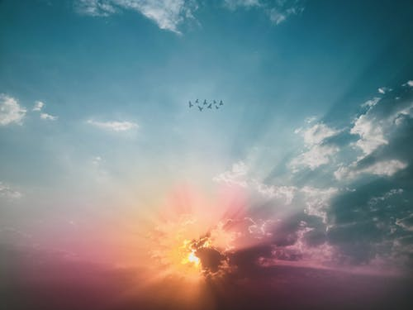
Covenant Calendar has been declaring
the word “evening/ereb” is
the foundation of Yahuah’s calendar.
Next: Huge & Very Important Question About Morning!
Why isn’t the word
“morning / boqer”
declared …
…the foundation of the calendar?
What puzzle pieces provide the answer?

Slide 50

2. [2a] Lev 6:20 complete.
What about [2b] Deut 16:6?
1. The Patterns for
“between the mixingS”
in the Torah had
alignment with
the Day Season
& Night Season,
NOT DAY-START!
(11 Torah References)
What about
Patterns for
“between the mixingS”
on Yahusha’s
Passover Day?
CF: one more use of this slide at the very end for the conclusion, likely stemming from this format. July 15th.
The End
Part #2[b] will examine Deut 16:6 to see if there is any connection to “beyn ha arbayim” and if so, what is it?
50

Slide 51
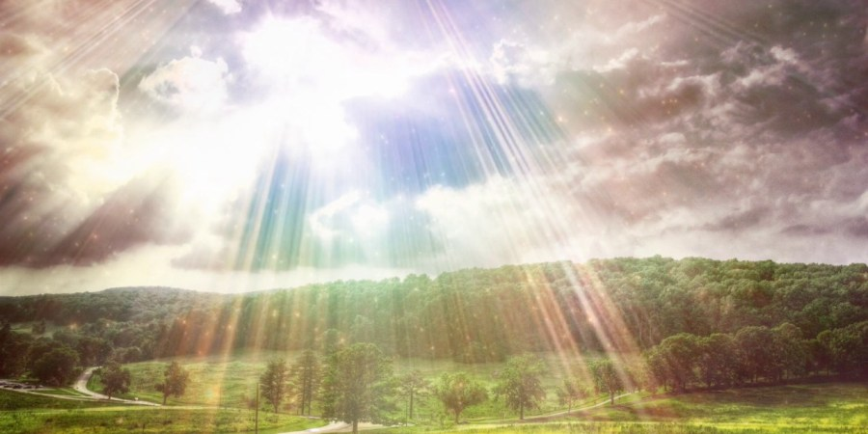

If you have Questions & Comments
about this teaching, please contact:
Charlene Fortsch or Tim Astleford
charlene@studythecalendar.com
tim@studythecalendar.com
calendar@torahtothetribes.com
Thank you!
51

