Slide 1
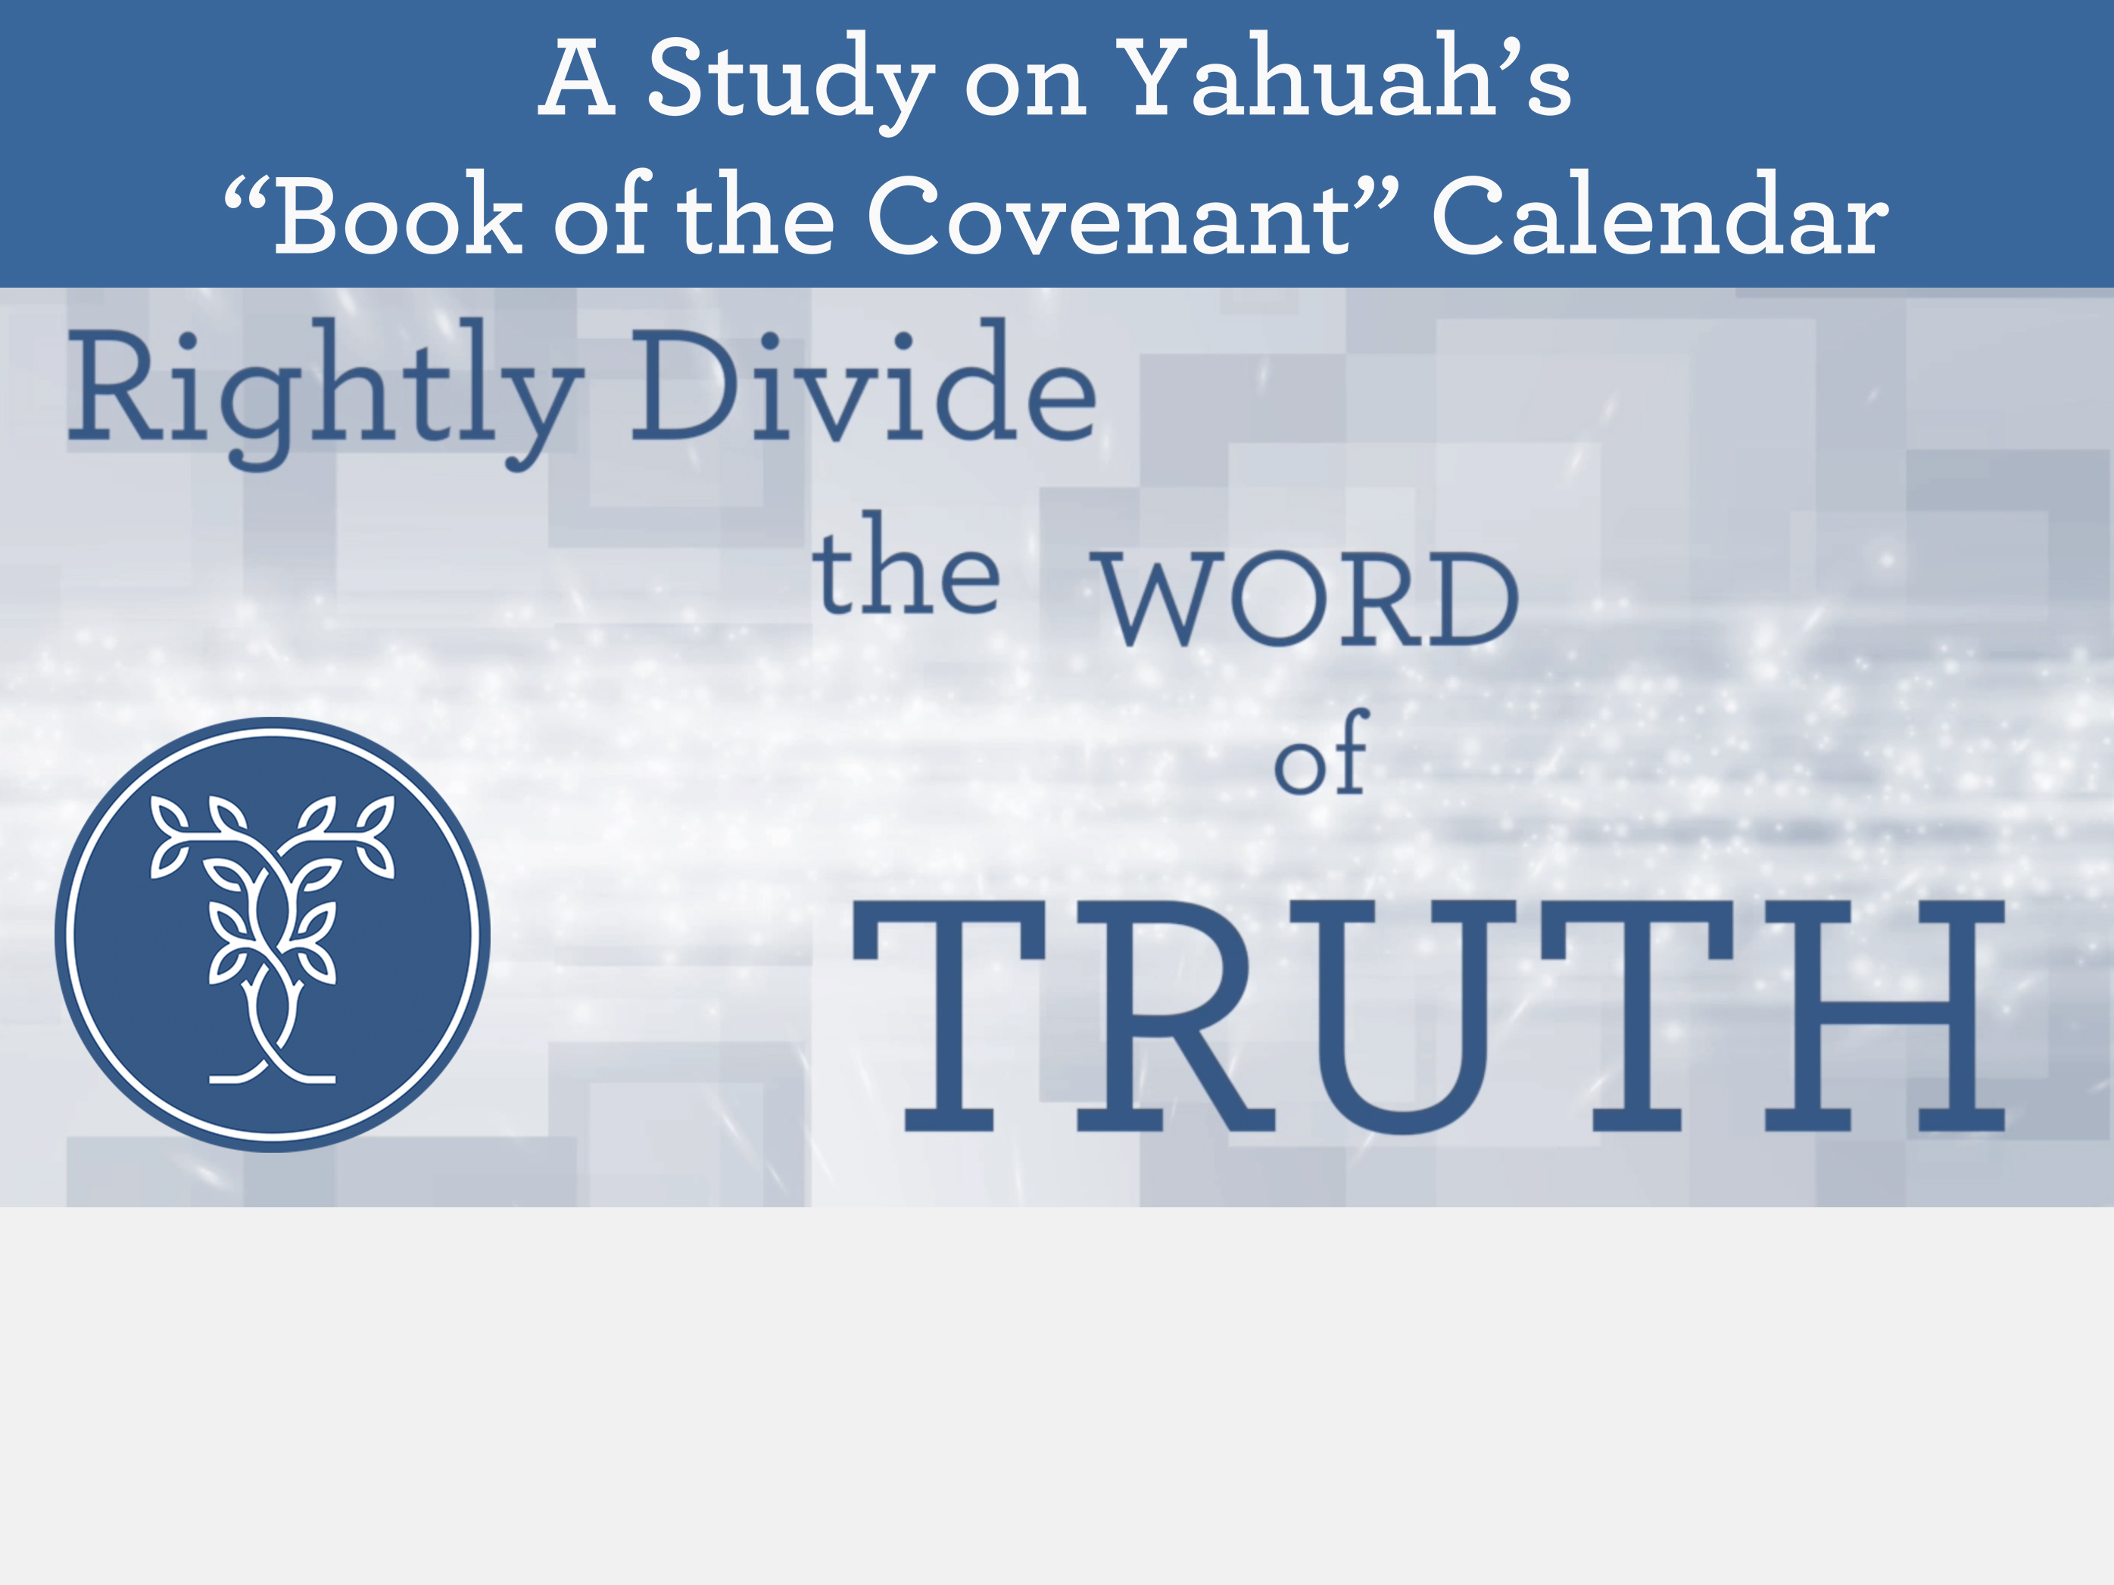
Grammar 101 (Pt 1) for the
Hebrew “evening” in Gen 1

Slide 2

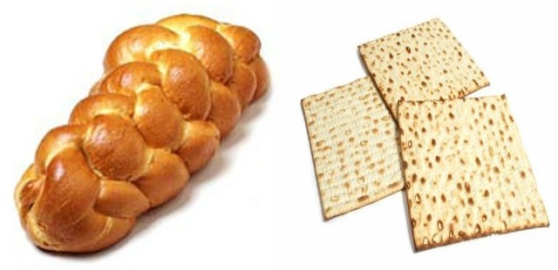
?
Stepping Stones for Bible Study
Examination
of the Term “Evening” in English & Hebrew
for Gen 1:5
?
By: Charlene Fortsch
3 May 2019
Notes:
LB and ULB is a picture to remind this ‘ereb’ puzzle is a lechem/artos problem. Both bread Heb and Gr Word #s need qualifiers for bread to be either LB or ULB. So too with the word ‘ereb’ … it “can” mean “day” ONLY when there is a qualifier such as we find in Exo 16 and in the gospel account addressed in this PPT study. It is a tricky study, but so important and needed.

Slide 3

Reviewing Simple Lessons Long Forgotten?!
How can a simple English word like “evening” pose such a confusing problem when linked to the proper commencement for the days of creation?
Could it be the Church Leaders, Pastors and Bible Workers
have not been diligent enough in their search?
Have they been misled by traditions, ignorantly passing along
what they have learned, to the nominal church member?
Can the nominal Bible Student really find out
what the truth is of this “evening” controversy?
See how this problem can be solved with simple grammar skills.

Slide 4


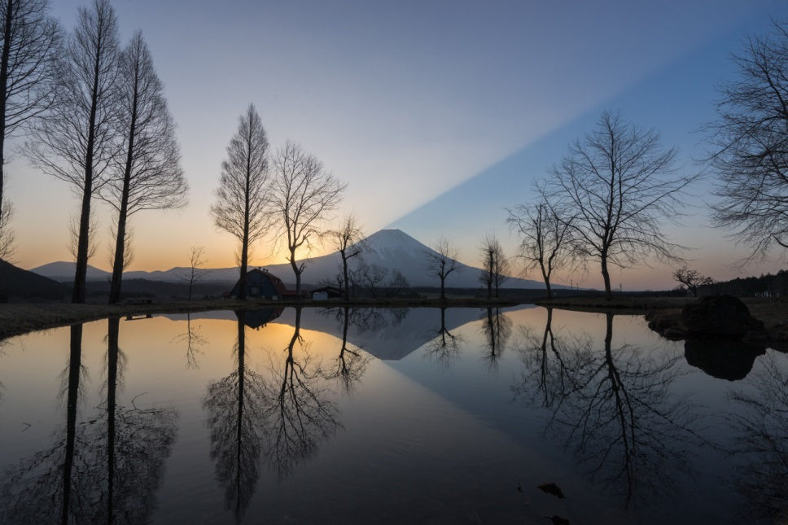
For understanding the phrase from the last part of Gen 1:5
“…and the evening and the morning were the first day.”
Does “evening” really mean
“sunset”?

Slide 5

INTRODUCTION
In this study we are going to learn how to study the Scriptures with some basic study tools including:
Review of basic high-school grammar classes;
Use of dictionaries and lexicons.
The sample topic of study will be “day-start” from:
  Gen 1: first day of creation (Grammar 101 - Part 1)
  Lev 23: Day of Atonement. (Grammar 101 - Part 2)
Of High Importance:
Read more than
10 words
to discern context!

Slide 6


Thanking Our Friends in Africa
Many have studied the “day-start” issue and understand this truth for themselves.
But understanding and teaching to others so they can understand is another story.
Their explanations are still prompting questions such as this:
Email from African “Dawn Day” Believer:
Hi Charlene: This question is from an ‘even to even’ person. How will you respond? [Their question follows:]
Hi everyone. I have a question. What does it mean that the knowledge of the Hebrew word “ereb,” which meant “even or evening,” which meant “afternoon” or “sunset” – is lost?
Do you have
similar
experiences?

Slide 7


The Question is
Always the Same
Since when does the day not begin with “evening” anymore?
Today we will attempt to sharpen our Bible study skills through finding the answer to the question on:
“When does Yahuah’s day really begin?”
It’s a Good Question!
There is an Answer!

Slide 8


Working Between Two Languages
To learn French, one has to learn that “such and such a word in French” means “such and such a word in English.”
We can’t say, "no, I don't want to learn the true meaning of the French words, I think I'll just guess at the meaning, and
hope I'm right ..."
You’ll likely be 100% wrong!
It works the same between
English and Hebrew.
When it comes to understanding the “day-start” teaching, we can’t say: “I'll just guess that the
Hebrew word for "evening“
means "afternoon” ... or sunset ... or “something else” ... whatever
I want."
Again, you’ll likely be 100% wrong!
Yet, this is exactly what has been happening with the word “evening.”
Many are still guessing!

Slide 9

There’s Another Problem
Many of us have been taught that "evening" means "sunset" or "afternoon" or whatever.
Few of us have thought about challenging this point, because
we really believed …
What we were shown was true.
We were taught this concept early.
Most of us have not been taught
to question the meaning of such a simple word? Why?
Because we were taught our leaders, teachers and pastors knew the truth and taught us the truth about such a matter.
Which is right?
To satisfactorily answer the “evening” question
we need to learn how to accept this controversial challenge by using better Bible study skills.

Slide 10

Responsibility of Teachers
Most of us just take for granted
(and really believe) our:
  Parents
  Teachers
  Pastors & Leaders
  Know the truth about the “day-start.”
The hardest part could be:
  Realizing the true definition of the word “evening” is not “sunset.”
  We may question why our teachers did not investigate the Hebrew definition by simply looking it up in an exhaustive concordance.
10

Slide 11
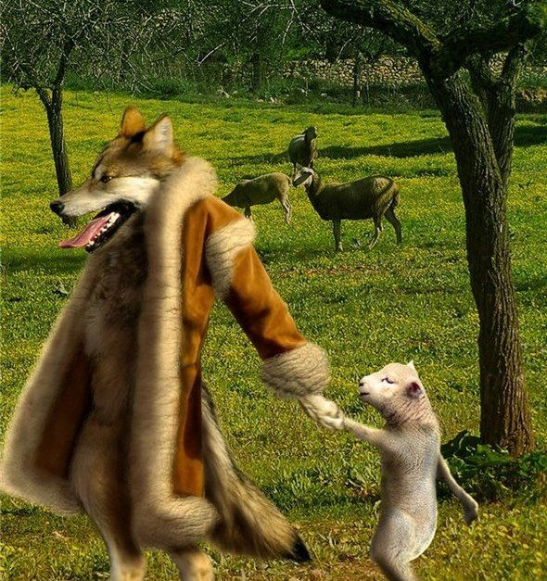
What Could Be The Reason
Tradition is Taught as Truth?
Many believe:
The Jews have preserved the correct day for the weekly Sabbath. (Can you prove the true weekly Sabbath?)
The Jews have preserved Friday sunset as the commencement for all Sabbaths. (Today’s challenge!)
The Jews hold many traditions. (How many can you name?)
As sheep, most of us have followed
what the Jews hold as truth, because
we believed they would know.
  .
Have the sheep been
following the wolf?
11
11

Slide 12
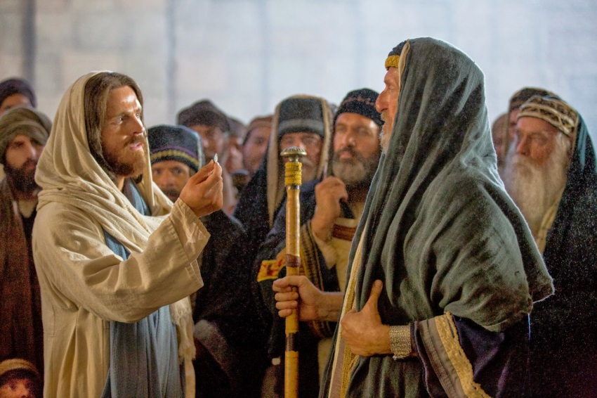
What About Traditions?
Yahusha – Paul - Timothy
Yahusha: Matt 15:3, 9
Why do ye also transgress the commandment of Yahuah by
your tradition?
9 But in vain they do worship
me, teaching for doctrines the commandments of men.
Paul: Col 2:8 Beware lest any man spoil you through philosophy and vain deceit, after the tradition of men, after the rudiments of the world, and not after Christ.
Timothy: 1 Tim 1:4 Neither give heed to fables …
12

Slide 13

A Restoration of Truth
Do you believe these words?
“In the time of the end every divine institution is to be restored.”
The Sabbath is a divine institution
and a worship statute.
Therefore, the commencement of the Sabbath will be most important.
If we believe this, let’s remove the
tradition with Scriptural evidence.

Slide 14



Ways to Remove Tradition
Do a careful, exhaustive research
of the topic from the Scriptures.
Know the Biblical history
around the topic.
Be prepared to use good
Bible study tools.
Remember your Grammar lessons from high school. Why?
  Because most of us
  have forgotten them!
14

Slide 15

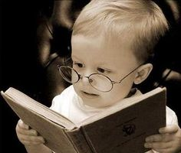
Reading? Study? Research?
Start with prayer. (Jer 33:3)
“Call to Me, and I will answer you, and show you great
and mighty things, which you do not know.” NKJV
Bible reading is different than
Bible study.
Bible study is different than
Bible research.
In research, you need to know how to ask a
lot of questions, and investigate a
wide territory for what the Bible
is saying from cover to cover.
Despite “ignorant or deliberate”
errors in the Word of Yahuah,
the truth will present itself.
Isa 28:13 [hermeneutic] … precept upon precept;
line upon line … here a little, and there a little …
Notes:
Jer 33:3 'Call to me and I will answer you and tell you great and unsearchable things you do not know.‘ NIV

Slide 16

1. Getting Started With Content
Read the content of the study material carefully.
In Bible study this could be several verses or chapters before and after the verse or word in question.
Many people make
a decision on the
content by reading
only 9-12 words
of a complete passage.
16

Slide 17
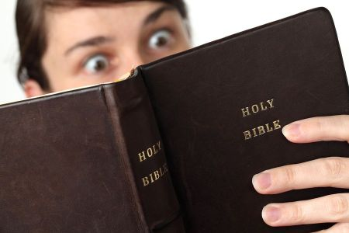
2. Getting Started With Context
Learn to read in context.
Know exactly what every verse or chapter is talking about.
You might be surprised
what you find?
17

Slide 18


2a. More on Context
Comparison of 2 studies:
Gen 1:1-5 (Day 1 of creation)
Lev 23:26-32 (Yom Kippur)
Two common mistakes are made to establish context in these 2 cases:
Gen 1: Only the last 10 words of verse 5 are read (out of a total of 89
words in verses 1-5).
Lev 23: Only the last 9 words of verse 32 are read (out of a total of 175
in verses 26-32).

Slide 19
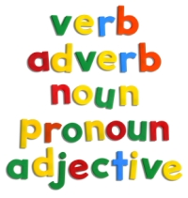
3. Getting Started with
Grammatical Terms
At least: know how to identify nouns, pronouns, adjectives, verbs, adverbs.
Knowing these are the absolute basics.
Our study today addresses only nouns.
Some words (like “day/daily”) can be used as nouns, adjectives and/or adverbs.
In such cases it is important to know the category of the word in question.
Why?
The context changes for words when
they act as a noun, adjective or adverb.
19

Slide 20
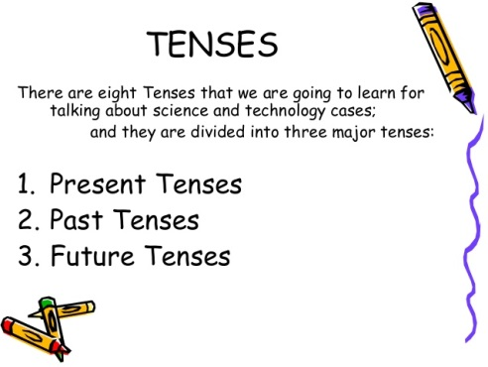
4. Getting Started With Tenses
Know how to identify "tenses" ... like:
1) past tense
2) present tense
3) future tense.
This is a difficult area for many students.
(Rev 13:1-5 is a good exercise to learn how to work with “tenses.” Using the proper tense
will bring forward the proper timeframe of the
42 month timeline.
The timeline will be misunderstood if the proper tense is not noted.)
20

Slide 21

5. Getting Started With Definitions
The Old Testament is translated from the original Hebrew language.
Sometimes the translators did NOT choose the best “word” or “phrase” to bring through the best meaning.
  Dan 7:25 “think to change times and laws”
    The English word “times” does not reflect the true meaning in this verse – referring to divinely set appointed statutes.
In both English and Hebrew, don’t assume you know the variety of definitions, and which one is listed first.
In this study “day” and “evening” are two of those tricky words that have several definitions, all different.
Definitions for some of the simplest words must be checked.
A shelf full of dictionaries and
concordances will be useful!

Slide 22
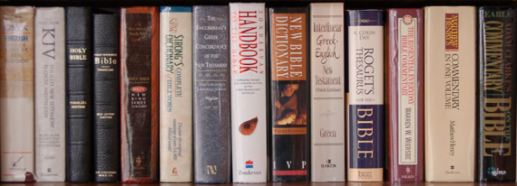
5a. Using Dictionaries
Word meanings do change over eons of time (especially from the 1600s to the present day).
Get used to using:
Strong’s Exhaustive Concordance
(definitions of Hebrew & Greek)
Noah Webster’s 1828 Dictionary (Meanings of words in the 1800s are closer to the Hebrew than today’s meanings.)
A variety of everyday dictionaries for comparisons
Lexicons and Commentaries
These extra tools do not take the place of comparing Scriptures!
22

Slide 23

6. First Definitions in Dictionaries
The very first definition of any word in the dictionary represents the way the word is
used the most in any language.
Everyday dictionary practice: will be on the word “star” to see how this works.
Hebrew dictionary practice: will be on the words “day, night, evening and morning.”
Learn how English and Hebrew Dictionaries compliment each other so the real meaning of the Hebrew can be understood.
23

Slide 24
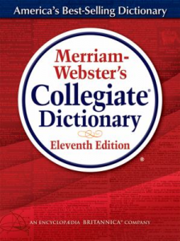
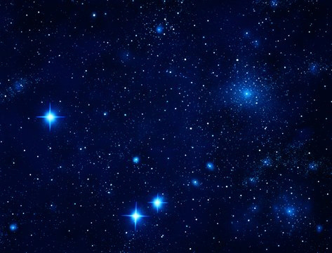
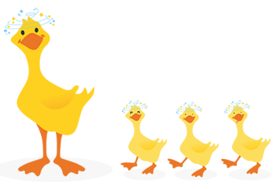

Finding Definitions for the Word ‘STAR’
Next, we will use the example of defining the word "star" to demonstrate how definitions are placed in a certain rank and order.

Slide 25
4a. Dictionary Practice: “Star”
1a: a natural luminous body visible in the sky especially at night
b: a self-luminous gaseous spheroidal celestial body of great mass which
produces energy by means of nuclear fusion reactions
2a (1): a planet or a configuration of the planets that is held in astrology to influence
one's destiny or fortune — usually used in plural
(2): a waxing or waning fortune or fame <her star was rising>; obsolete: destiny
3a: a conventional figure with five or more points that represents a star;
especially: asterisk [*]
b: an often star-shaped ornament or medal worn as a badge of honor, authority,
or rank or as the insignia of an order
c: one of a group of conventional stars used to place something in a scale of value
4: something resembling a star <was hit on the head and saw stars>
5a: the principal member of a theatrical or operatic company who usually plays
the chief roles
b: a highly publicized theatrical or motion-picture performer
c: an outstandingly talented performer <a track star>
d: a person who is preeminent in a particular field
25
25

Slide 26

“STARS in the sky” take the first definition.
If you told someone “the stars were great last night” they will likely think you are describing the night sky – the first definition for “star.”
Unless more information is given, the other person does not know you were talking about the Hollywood Stars and the rewards they receive.
More content would have to be given to understand the context.

Slide 27
Remember the Dictionary Rule
The first definition is determined by the way the “word” is used most.
That holds true for
all languages
including Hebrew!

Slide 28
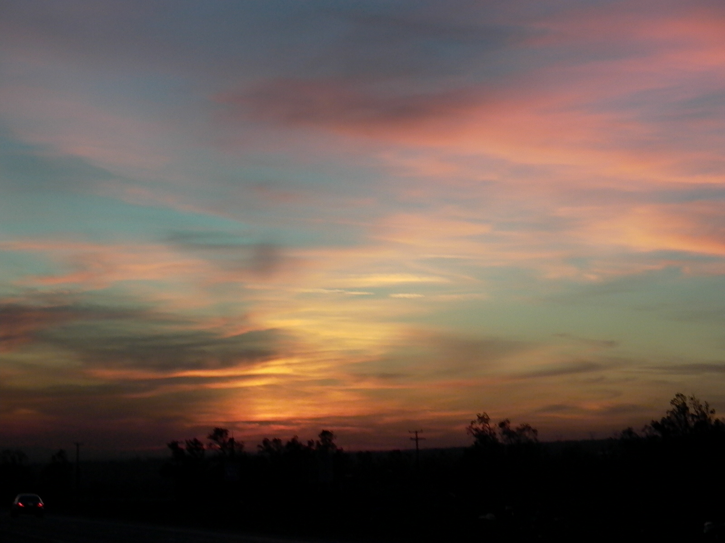
Hebrew Dictionary Rules are the Same
Many people are having the same problem
with the definition of the word “evening”
as some may have with “star.”
It’s important to choose the correct definition that aligns with the Bible content & context.
However:
Many assume they know the Hebrew definition without even checking to see if they are correct.
Over time, this is how “sunset” became
an incorrect definition for “evening.”

Slide 29

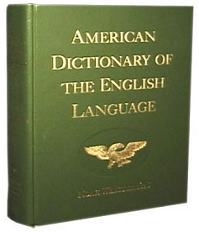
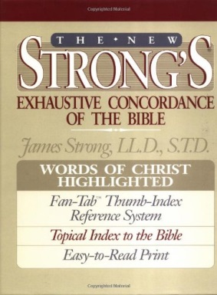
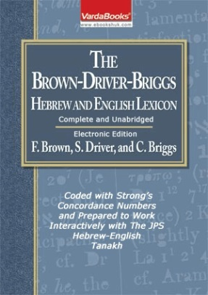
Applying Study Skills to Scripture Using the
We will examine
“first” definitions first!

Slide 30
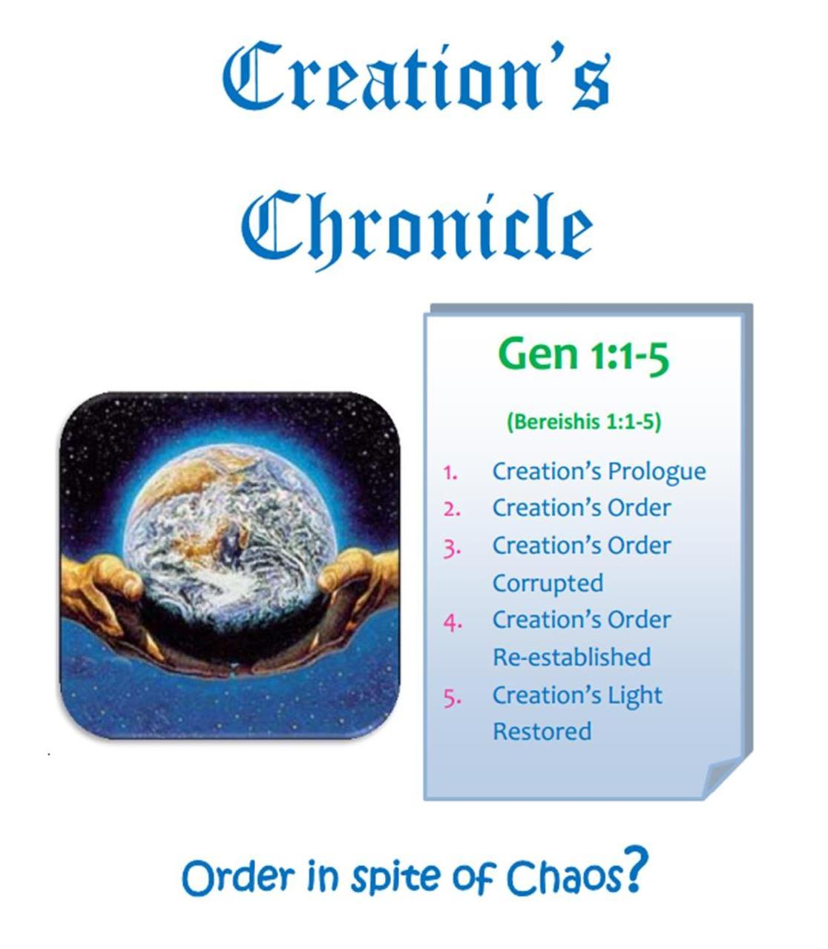
For the Full Study on
Gen 1:1-5
(Day 1 of Creation)
Creation’s Chronicle
includes all content and context for the first 5 verses.
To solve the “evening” problem, this study scrutinizes
four specific terms in Gen 1:5.
Today’s Section will begin with an:
Examination of only the 1st definitions for:
DAY NIGHT EVENING MORNING
30

Slide 31
Gen 1:5 - A Very Special Verse
Genesis 1:5 is the first place where any of these four
terms are found for the first time in the KJV.
And Yahuah called the light Day, (First usage of “Day”)
and the darkness he called Night. (First usage of “Night”)
And the evening (First usage of “evening”)
and the morning were the first day. (First usage of “morning”)
Let’s begin our examination
for only the first definition
of these four terms in the:
Notes:
)

Slide 32
1st Def: Day <yowm>
And Yahuah called the light Day
Strong’s day H3117; yowm;
from an unused root meaning to be hot;
a day (as the warm hours),
whether literal (from sunrise to sunset …[basically the 12 hours of light]) [or a more accurate explanation would be “from dawn to dusk.”]
Note: In a short time you’ll see how Mr. Strong’s wording will be corrected by the Hebrew definitions of “evening” and “morning.”
Brown-Driver-Brigg’s Hebrew Lexicon day H3117 yowm – day.
a) day (as opposed to night) [basically the 12 hours of light]

Slide 33
Only 1 Def: Night <layil>
Not to be confused with vs 2
“darkness” <H2822> <choshek>
… and the darkness he called Night.
Strong’s night H3915; layil;
from the same as H3883;
properly, a twist (away of the light),
i.e. night: KJV - night (season).
Brown-Driver-Brigg’s Hebrew Lexicon night
H3915; layil – night
a) night (as opposed to day)
Hebrew word numbers often refer to several other numbers, including the primitive root.

Slide 34
1st Def: Evening <ereb>
And the evening …
Strong’s evening H6153; ereb (eh'-reb);
from H6150; dusk:
H6150; `arab (aw-rab'); a primitive root
[identical with H6148 through the idea of covering
with a texture]; to grow dusky at sundown:
KJV - be darkened, (toward) evening.
H6148; `arab (aw-rab');
a primitive root; to braid, i.e. intermix.
Note: Mr. Strong’s has no mention of “sunset” in these definitions ~ only dusk!
Brown-Driver-Brigg’s Hebrew Lexicon evening
H6153; `ereb – evening …
Many times BDB lacks in their definitions!

Slide 35
Only 1 Def: Morning <boqer>
… and the morning were the first day.
Strong’s morning H1242; boqer;
from H1239; properly, dawn (as the break of day).
H1239; baqar; a primitive root;
properly, to plough, or (generally) break forth.
*Note: Mr. Strong’s has no mention of “sunrise”
in these definitions ~ only dawn!
(Review slide 32 again!)
Brown-Driver-Brigg’s Hebrew Lexicon morning
H1242; boqer – morning, the break of day
a) morning
1) used of end of night
2) used of coming of daylight
3) used of coming of sunrise
4) used of beginning of day
Occasionally
BDB has many definitions!

Slide 36
Confirming the Meanings of
“dusk” & “dawn”
Just to be sure the
1st definition of “evening” & “morning” in Hebrew has not changed in translation to English, we will check the Webster’s 1828 Dictionary for comparison.
The 1828 dictionary gives the most
accurate definition of English words as they connect to the Hebrew definitions.
Only the “noun” definitions will be considered.

Slide 37
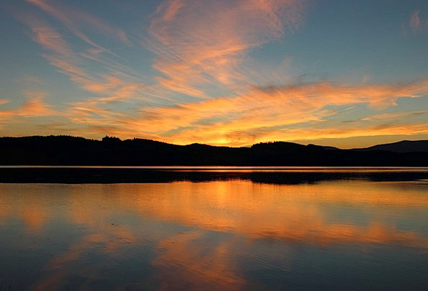
Dusk, noun [Webster’s 1828]
A tending to darkness; incipient or imperfect obscurity;
a middle degree between
light and darkness; [it goes on to say]
twilight;
as the dusk of the evening.
Tendency to a black color;
darkness of color.
[eg:] Whose dusk set off the
whiteness of the skin.
37

Slide 38

Dawn, noun [Webster’s 1828]
The break of day;
The first appearance of light, in the morning.
They arose about the dawn of the day. Josh 6:15.
The word may express the whole time from the first appearance of light to sunrise.
DAWNING, noun.
The first appearance of light in the morning.
“Dawn” is NOT “sunrise!”
38

Slide 39
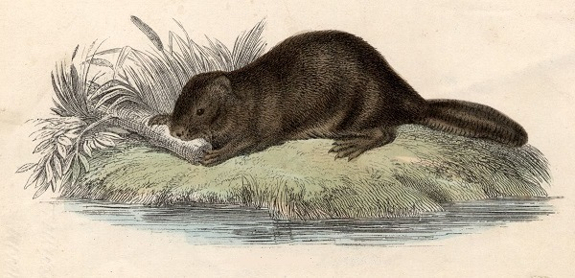
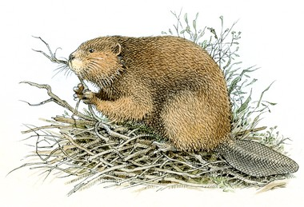
Determining the Meaning of “twilight”
Twilight was used by Webster
to define “dusk <ereb>.”
Surprise! Many people do not know what twilight is?
Do you?!
TWILIGHT, noun.
The faint light which is reflected upon the earth
after sunSET and before sunRISE; crepuscular light.
In latitudes remote from the equator, the twilight is of
much longer duration than at, and near, the equator.

Slide 40

How does
“crepuscular” connect to “twilight”
in nature?
This double ereb is also witnessed by - and declared from - Yahuah's creation, just like He promised.
Crepuscular animals are a natural witness to the two “ereb/mixture
time slots” for every 24 hour day.
They are active primarily during
the TWILIGHT – like the beavers.
This is distinguished from animals active during the daylight hours (diurnal behavior) or active during the hours of darkness (nocturnal behavior).
Amazing Fact!
The beavers are a witness to which day is Shabbat (at the following link):
https://www.youtube.com/watch?v=49T5unQEIbY&t=4s
(You-tube: Beavers that rest on Saturday.)

Slide 41
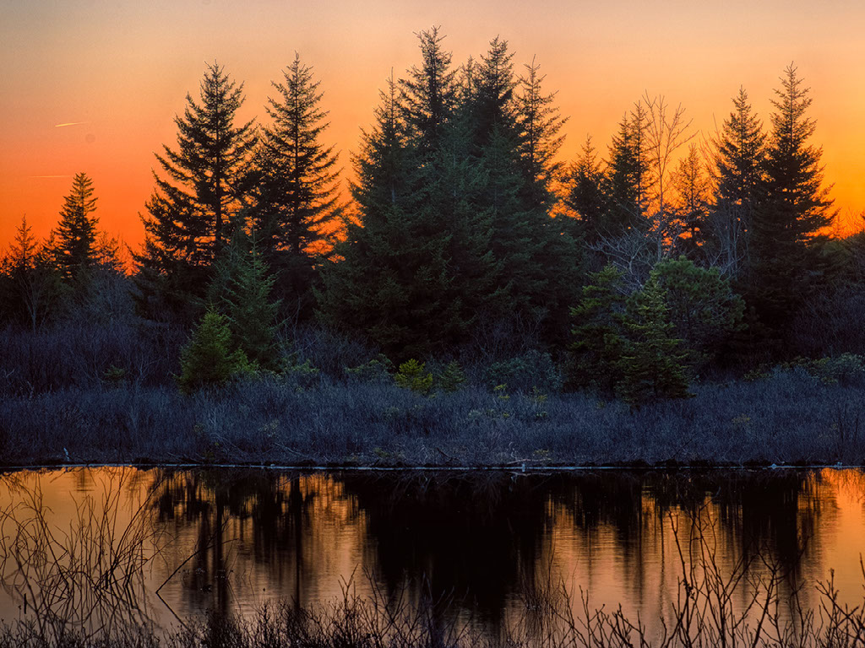
The plural word erebs has the same mis-appropriation of usage, like so many other words from the Hebrew.
Somehow ereb and evening have become mutually synonymous.
(eg: Some believe that ALL “mo`edim” are “appointed feasts” or ALL “erebs” are dusk twilights.)
However, these crepuscular events (twilights) are divinely designed as Yahuah’s “kingpin” for a “buffer zone” so His children know when the new day begins without looking to the sun!
How does
“crepuscular”
light
connect to “twilight”
for Yahuah’s
count?
How does Strong’s define “twilight”?

Slide 42
Twilight <nesheph>
Strong’s twilight H5399; nesheph; from H5398; properly, a breeze, i.e. (by implication) dusk [1st definition] (when the evening breeze prevails):
KJV - dark, dawning of the day [2nd definition]
(morning), night, twilight.
Brown-Driver-Brigg’s Hebrew Lexicon twilight H5398; nashaph –
(Qal) to blow [Qal = the most common literal message
for proper interpretation.]
For comparison & further information
note the vague definition from:
DUSK is the 1st definition; DAWN is the 2nd!

Slide 43
Twilight 1st Note
DUSK is the 1st definition; DAWN is the 2nd!
There are 14 “twilight” references in the
Tanach using H5398 & H5399.
H5398 twilight as the root word is first used in Exo 15:10 for the Red Sea crossing. This event originated with the evening winds that parted the water allowing the people to cross over during the following night hours.
H5399 twilight is first used in 1 Sam 30:17 (David in battle).
Question [& homework] for H5399 twilight: Will 1 Sam 30:17 take the definition of “dusk” or “dawn” for the word “twilight”?
And David smote them from the twilight even [H5704; <ad>] unto the
evening [H6153; <ereb>] of the next day: and there escaped not a
man of them, save four hundred young men …
In the other 12 references for “twilight/nesheph” – the content and context would have to be carefully examined to determine exactly
which twilight is being referred to – dawn, or dusk?

Slide 44
Twilight 2nd Note
Remember, both the “dusk twilight” and the
“dawn twilight” contain “a mixture of light and night.”
The first definition for the word “day” is the 12 hours of Day Season that has the presence of “light.”
Therefore, both twilights belong to the Day Season!
Twilight 3rd Note
“Night” is the absence of any [day] “light” that is naturally seen in the “day” sky – specifically, the absence of “sun light.”
By default neither twilight can belong to, or be part of, the Night Season!

Slide 45
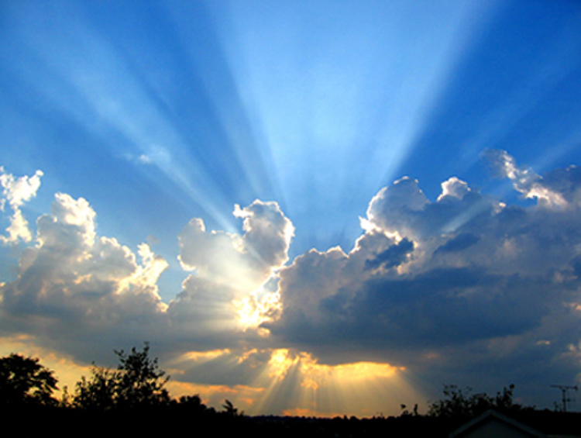
Twilights belong to the Day Season.
Each
Day Season Contains Light from the Sun
Evening
Morning

Slide 46
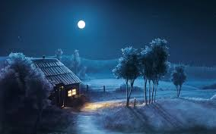
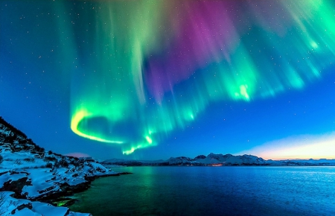
Twilights never belong to the Night Season.
Night Season Has no
Direct Light from the Sun
Question to ponder:
Do the northern lights
belong to the
Day Season or
the Night Season?

Slide 47
Applying the 1st Definitions of Hebrew to:
Day Night Evening Morning
Remember: The 1st usage of a
word most often takes
the 1st definition.
Let’s use this application on Gen 1:5.

Slide 48

Listing the 1st Definitions
R
E
V
I
E
W
Day <yowm> H3117
And Yahuah called the light Day,
meaning to be hot; (as the warm hours),
(from sunrise to sunset … ) [should be: dawn to dusk].
Note: Strong’s would have been more accurate using the terms …
“dawn” (not sunrise)
“dusk” (not sunset)
<yowm> as the
Day Season
has priority.

Slide 49

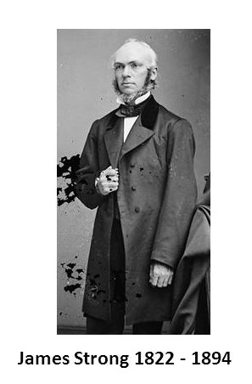

Question:
Where do you suppose
Mr Strong picked up the definition of “sunrise & sunset”
in place of “dawn & dusk”?

Slide 50
Night <layil> H3915
R
E
V
I
E
W
… and the darkness he called Night.
a twist (away of the light), night (season).
<layil> is the only term in Gen 1:5 that belongs to the Night Season.
* Not to be confused with vs 2
“darkness” <H2822 choshek>.

Slide 51
Evening <ereb> H6153
R
E
V
I
E
W
And the evening …
dusk; to grow dusky;
be darkened,
a primitive root; to braid, intermix
<ereb> has a
mixture of
“light” and “night.”
Therefore <ereb> belongs to the
Day Season.
Evening

Slide 52
Morning <boqer> H1242
… and the morning were the first day.
properly, dawn (as the break of day);
a primitive root; (generally) break forth.
R
E
V
I
E
W
<boqer> also has
a mixture of
“light” and “night.” Therefore <boqer> belongs to
the Day Season.
Morning

Slide 53
Assembling Gen 1:5 all Together
Day Night Evening Morning
And Yahuah called the light Day, as the warm hours for the
Day Season [including dawn and dusk],
and the darkness he called the Night Season or a twist
(away of the light);
[Then Yahuah gives more information for the Day Season saying:]
*And the evening dusk [came to be after the Day Season];
*[then] the morning ploughs forth; and dawn breaks out
the new day; [as part of the Day Season twilight];
were *and the morning and evening belong to the
Day Season.

Slide 54
But…
Most of us have been taught an
Incorrect Understanding For Evening and Morning
“… And the evening, and the morning
were the first day.”
These phrases have traditionally been taught to mean that the new <yowm> day/cycle begins
in the evening.
This is simply not true!

Slide 55

1st usage of a word in the Scriptures,
most often takes the 1st definition.
Light/Day
Evening/Morning
1st used in Gen 1:5a.
1st definition is the “warm hours” or 12 hours of the day.
Light is called DAY.
2nd use of DAY in
Gen 1:5b aligns with the two twilights,
linking them to the
Day Season.
1st usage in Gen 1:5b, after Day Season has been determined.
1st definition is correct as “dusk” and “dawn.”
Both terms are twilights.
Evening and Morning both belong to the Day Season.
Let’s chart this information.

Slide 56
#1 Large Components of the Day
Gen 1:5a
1st: there are 2 major divisions to divide the 24 hour cycle in half.
12 hrs. Day
12 hrs. Night
1. Light is
called DAY
2. Darkness is called NIGHT
Notice: Everything about
creation week started here
with Day-Light.

Slide 57
#2 Small Components of the Day
DAY
#2 Morning
twilight
#1 Evening
twilight
NIGHT
The twilight components are small slivers of transition between the light and night.
Evening twilight was placed 12 hrs.
before the Morning twilight.
The Gen 1:5 “order” is correct!

Slide 58
#3 Proper Order of the Components
Light came 1st (called: DAY)
4th Morning twilight
follows
[ends the 1st day & begins the 2nd day]
2nd Evening twilight follows
3rd Night follows
evening
In modern terms
Gen 1:5b would read this way:
And the dusk twilight, and the dawn twilight
belong to the [day] – the hot part
of the 12 hour Day Season.

Slide 59
#4 Night as Compared to Twilight
Light came 1st (called: DAY)
4th Morning twilight
2nd Evening twilight
3rd Night follows
evening
OH? …
OK!!
Night is the absence of LIGHT.
Twilight contains LIGHT.
That’s why twilights are reckoned
as part of the “day” or DAY Season!

Slide 60
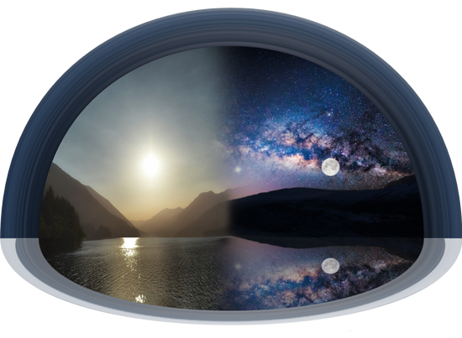
Here’s a True Definition
Any portion of the 24 hour cycle that has a “twilight mixture” belongs only to the Day Season – NOT the Night Season. (Therefore, the evening has nothing to do with how a day begins.)
The two “day season”
twilights are before sunRISE & after sunSET.
Neither twilight belongs to the Night Season.
But the morning is even more special.
The morning ends the former 24 hour cycle, and begins the new 24 hour cycle at the moment of daybreak.
In Gen 1:5 morning ends Day One and begins Day Two.

Slide 61


Something to Think About!
The phrase: “and the evening and the morning were the first day” …
… is NOT a definition of
when the day begins!
Gen 1:5b is confirming “where” the “evening” & “morning” twilights belong! They belong to ONLY
the Day Season!

Slide 62
Why Dusk Twilight Cannot Begin Any New Day
Dusk twilight is a mixture of light/night.
Light must be present first before a dusk/twilight can follow.
Light is mentioned 3 times in Gen 1 before evening is mentioned the first time.
Keep in mind, it is impossible for the dusk twilight (evening) to follow the Night Season!
Remember: the twilights have been purposely placed as a safeguard to “not look to the sun” for day-start.
62

Slide 63
It is crucial the 1st definition of “evening” is understood
before going further.
Why?
Because we are now going to examine “other” definitions for “evening”
that are very different.

Slide 64

Evening: 2nd Definition
The 2nd definition is: “day”
At this point
there should be
a huge question
as to why “day”
is ever listed as
a definition!
Why
Because “ereb” is defined as a “mixing
of light and night.”
There is no “mixing” during the Day Season!
This will be addressed in a later study through the term “between the evenings.”

Slide 65
Evening: 3rd & 4th Definitions
[The 3rd definition] even (-ing, tide) [‘eventide’ - in old English this is another term that means dusk "twilight.” This twilight is not to be confused with DAWN - morning twilight.]
[The 4th definition] night.
For ereb, and its 4th definition of night, the Scriptures would have to contain the context of the “evening” giving way to the Night Season as seen in Lev 6:20.
Note: Sunset is NOT one of the
definitions for <ereb>.
Sunset is a point of time that ushers in <ereb>.

Slide 66
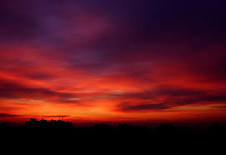
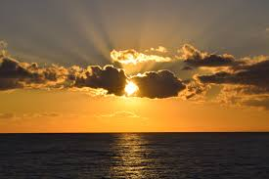
In Gen 1:5 “evening” <ereb> rightly claims
the 1st definition as dusk –
the mixing of light and night.
Evening <ereb> can only claim the
2nd definition of “day” [or no mixing] …
WHEN there is a “qualifier”!

Slide 67

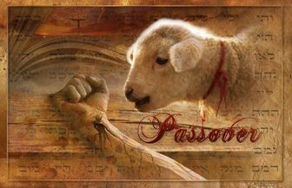
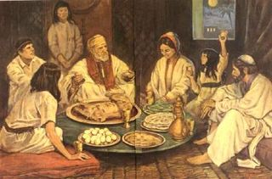
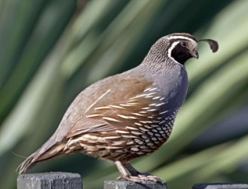
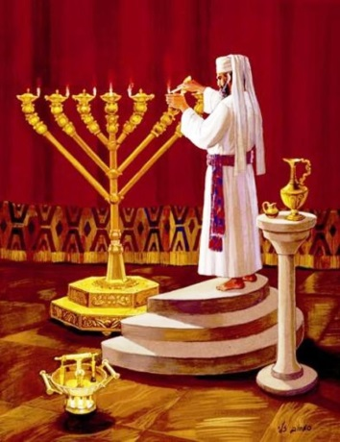

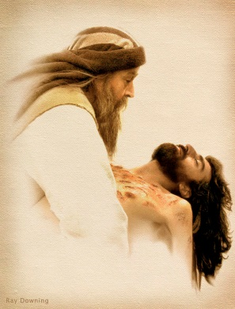
What does it mean to have a “qualifier”?
Several examples will be
considered in the study on
“between the evenings.”
Exo 12 Passover Sacrifice/Meal
Exo 16 Quail
Exo 30 Sanctuary Lamps
Gospels: Yahusha’s Passion

Slide 68

This describes the 1st definition of <yowm> as the
12 hour Day Season.
The 1st day
of creation
began with LIGHT.

Slide 69
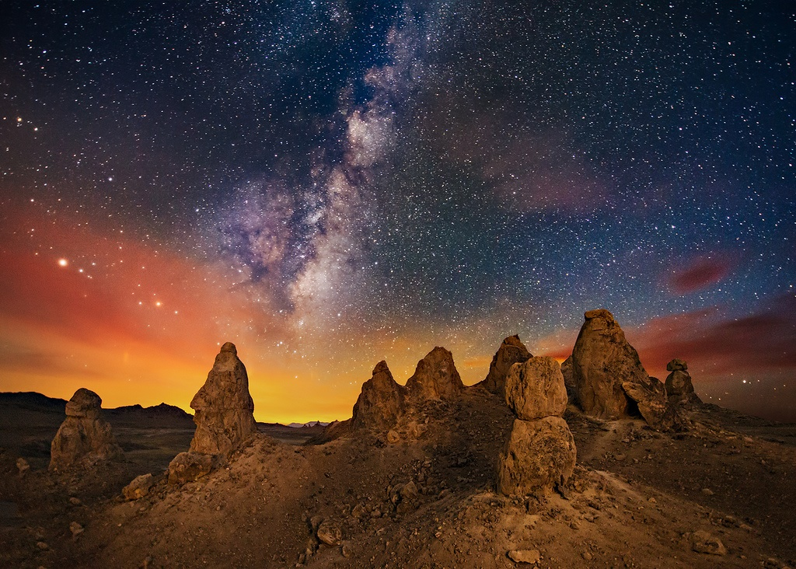
The 2nd definition
of day <yowm>
describes the 24 hour cycle from “dawn to dawn.”
Yahuah’s days do not begin at “evening” or “sunset.”

Slide 70
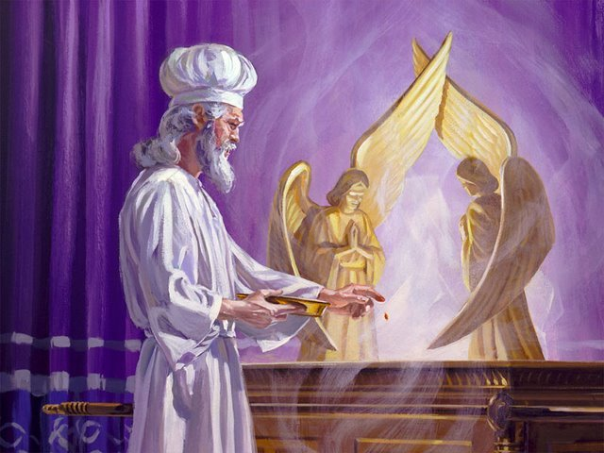
But…
What About …
Day of Atonement?

Slide 71

Grammar 101 (Part 2) will examine …
… the context of Lev 23:26-32
for the:
10th day of the 7th month
9th day of the 7th month

Slide 72
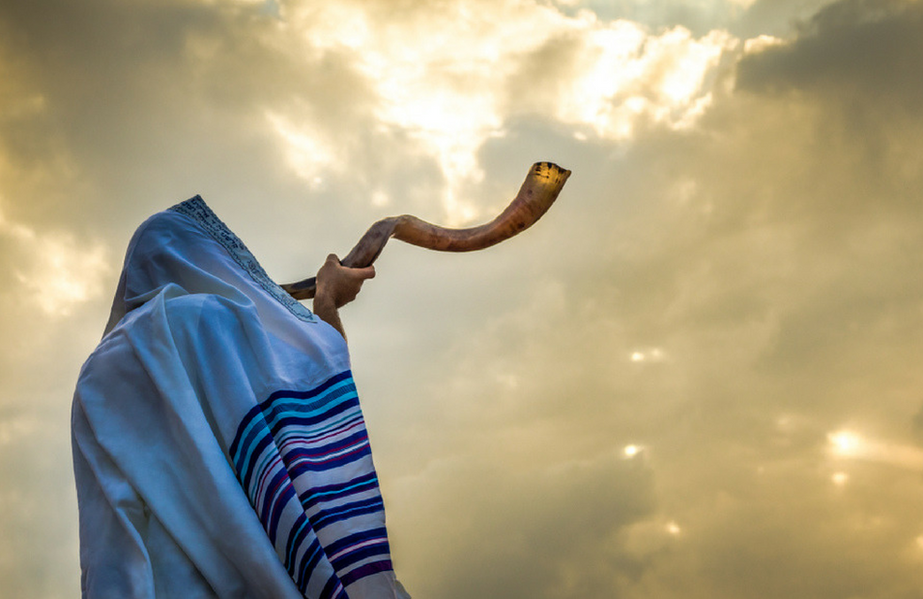
We will determine what the last
words of Lev 23:32 really mean:
“… in the ninth day
of the month at even,
from even unto even, shall ye celebrate
your Sabbath.”

Slide 73
One last question:
Will Leviticus 23:32 declare
that Day of Atonement
(and every other Sabbath day)
really does begin
in the evening - rather than
at dawn twilight?
The End of Part 1

Slide 74

The Next Study:
The Hebrew Evening
The word “evening” <ereb>
is the cornerstone for the
whole calendar study.
There must be clarity here.

Slide 75


Enjoy these beautiful mornings that usher in Yahuah’s original Covenant Day!
Send your questions/comments to:
charlene@studythecalendar.com
Notes:
Sept 23 final slide finished 200 pm … need to check and animate, etc.

