Slide 1

David’s Qodesh Lechem (1 Samuel 20 & 21)
& Scriptural Weekly Sabbath Placement
David’s Qodesh Lechem
(1 Samuel 20 & 21) & the Lunar Sabbath

Slide 2
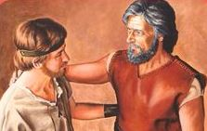
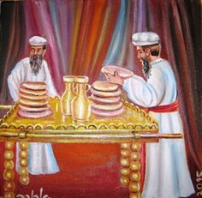

David’s
Qodesh
Lechem
{Set-Apart Bread}
Chap 20-21
How does the set-apart bread solve the riddle to this calendar puzzle?

Slide 3
Joshua 3-5 HAd confirmED the placement of weekly sabbaths
Some believe the weekly Sabbaths are set according to the Lunar Cycles.
However, the first day of the (particular) Lunar Cycle is merely the 1st day
of the month AND NOT COUNTED WITHIN THE 1-7 WEEKLY COUNT.
It then follows that the 8th, 15th, 22nd, and 29th days of the month are the weekly Sabbaths each and every month, until the Lunar Cycle resets everything.
For lunar sabbaths, this means Abib 15 is not only the 1st Unleavened Bread Sabbath, but also the weekly Sabbath.
Remember, Joshua 3-5 demonstrated the Abib 14th Passover was on the
7th cycle of the week. The Leviticus instructions show Firstfruits follows the H7676 Sabbath – which links to ONLY the weekly Sabbath.
Abib 15th was not included as “the” weekly Sabbath. (con’t)

Slide 4
Samuel will also confirm the placement of weekly sabbaths
Neither the 1st or 2nd Feast Sabbaths of Unleavened Bread connects to
the Hebrew word #H7676 designating the weekly Sabbath.
Therefore, Joshua disqualified the 15th of the month as ALWAYS BEING the weekly H7676 Sabbath as claimed by the Lunar calendar.
In Samuel’s Testimony: The weekly lunar sabbaths of the 8th, 15th, 22nd and 29th are counterfeits. Specifically related to this study - the
1st day of the month most certainly is counted as integral, and essential, with the weekly count of seven.
The Lunar Calendar is another very poor counterfeit calendar
against the true Covenant Calendar.
Today’s study is yet “another witness” against the counterfeit lunar calendar.

Slide 5
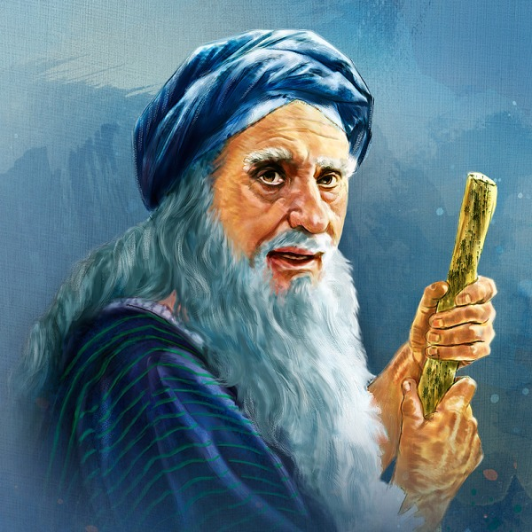
Something else to think about …
I wonder if Samuel realized that his book would take care of other calendar counterfeits ~ like the Enoch/Zadok calendar?
Let’s examine the lunar Sabbath calendar first.

Slide 6
Setting the stage! #1
The Controversy: There are several different belief systems that arrive at a specific pattern of dates for lunar calendars.
1. The lunar based calendar which uses the moon in any one of its phases to achieve these dates for the Sabbath.
2. The Aharonic priestly courses of the Levites which arrive at the same dated style of calendar (only without the moon).
The stipulations of these calendars both claim that the
1st day of the month is not counted as a normal week day.
Instead the 1st day is classified as an individual day
entirely separate from the weekly count of seven.
And –

Slide 7
The Mechanics of the lunar calendar!
For the very basics; the dates are as such:
1st day of the month – not counted [by some], but is a “Special day.”
2nd day of the month IS ALWAYS the 1st day of the lunar week which begins the weekly count of 1-7!
8th day of the month is a Sabbath. Consequently, the 15th , 22nd, and 29th are also considered “weekly Sabbaths.”
The 30th day (if, and when, there is one in the lunar based calendar) –
is not counted.
The month and the week then both reset, and restart anew,
with the weekly count starting on the 2nd day of the month.

Slide 8

A Sample Lunar Calendar
For the purpose of illustration, this lunar calendar month will begin with the 1st sliver
of the moon on the 4th cycle of the week (Wed).
Notice the dates where the weekly sabbaths place when they follow the lunar cycles.
1^{st Cycle} (Sun) | 2^{nd Cycle} (Mon) | 3^{rd Cycle} (Tues) | 4^{th Cycle} (Wed) | 5^{th Cycle} (Thur) | 6^{th Cycle} (Fri) | 7^{th Cycle} (Sabb)
 |  |  | Abib 1 New Year | 2 | 3 | 4
5 | 6 | 7 | 8th Sabbath | 9 | 10 | 11
12 | 13 | 14th Passover | 15th Sabbath & 1st ULB | 16 | 17 | 18
19 | 20 | 21st & 2nd ULB | 22nd Sabbath | 23 | 24 | 25
26 | 27 | 28 | 29th Sabbath | 30 | Zif 1 | Zif 2
1
2
3
7
4
5
6
1
2
3
6
7
4
5
The 30th & the 1st are not counted???

Slide 9
Setting the stage!
# 2
The Controversy:
The Enoch/Zadok Calendar.
On Enoch’s Dead Sea Scroll based Calendar, it is claimed that the Sabbaths, never once fall upon a 6th cycle of the month.
Also: the books of Rachel Elior verify this clearly with charts. The following chart is from a you-tube presentation promoting the same situation.
Please note on the next slide, the ABSENCE of ANY Sabbath days of any kind - landing upon a 6th cycle of the month.
Now compare this thought to what you are about to see in this study.

Slide 10
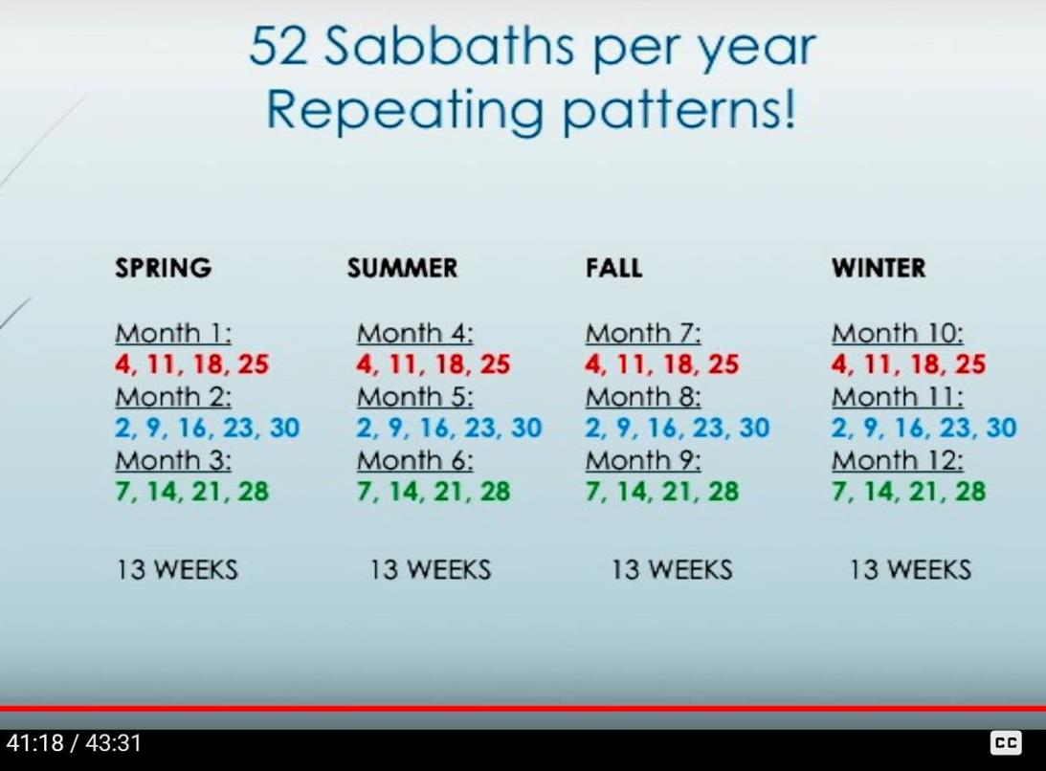
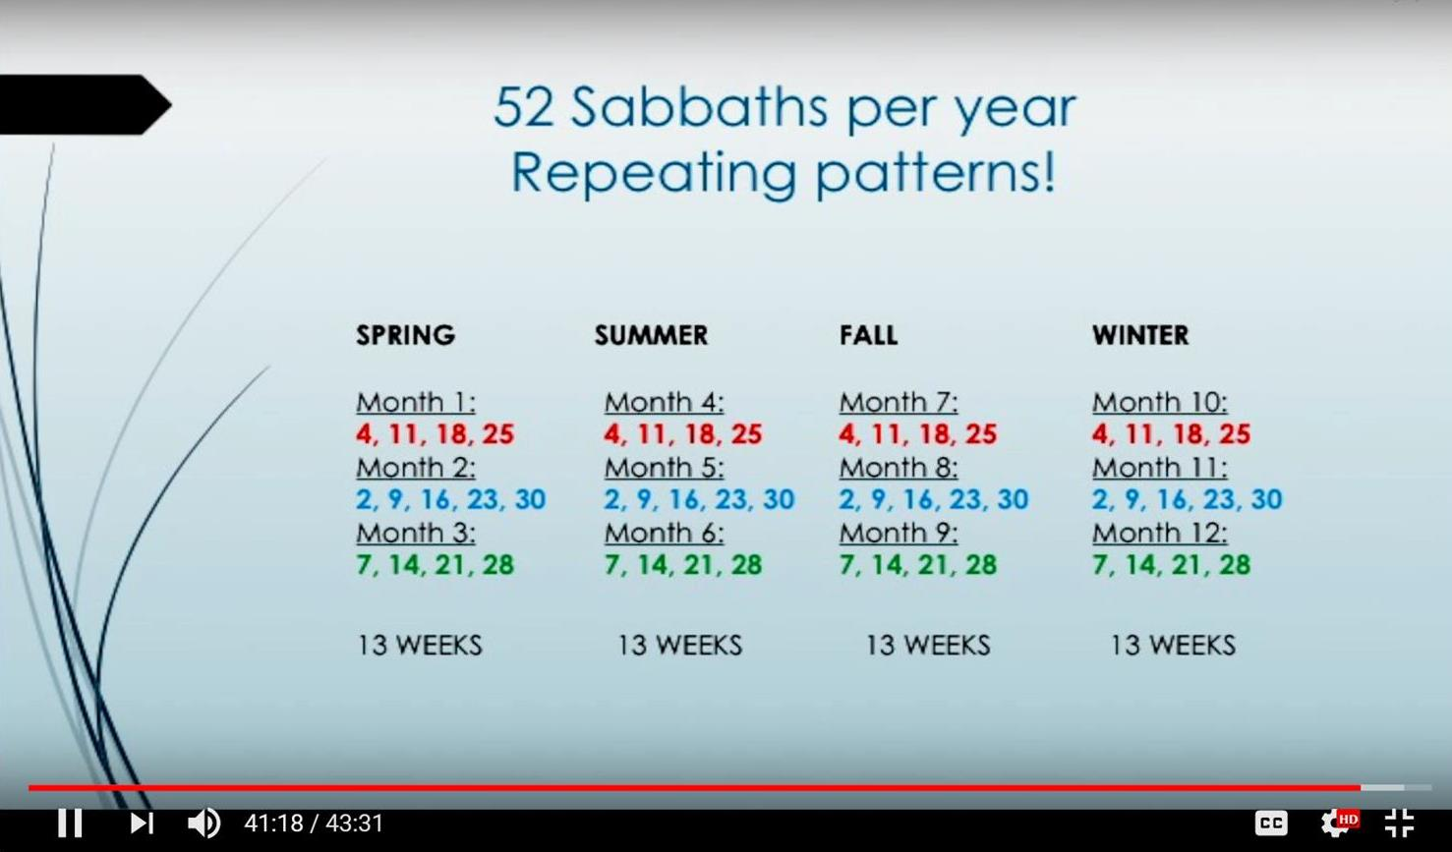
Try to find a Sabbath on the
6th of any month!
Enoch/
Zadok
6?
6?
6?
6?

Slide 11
In this study…
The conclusive dates and cycles will align like this:
Days of the Month as seen in 1 Samuel 20 & 21.
These are the days of the 1st week of the month as observed by David, Jonathan and Saul.
Please note very carefully that the 7th Day Sabbath places upon the
6th day of the month in this event recorded in the Scriptures!
The words of the Scriptures will prove this and expose why this is so.
Scriptures | 1st Cycle | 2nd Cycle | 3rd Cycle | 4th Cycle | 5th Cycle | Prepara- tion Cycle | Sabbath
Paganism | Sunday | Monday | Tuesday | Wednesday | Thursday | Friday | Saturday
29th | 30th | 1st | 2nd | 3rd | 4th | 5th | 6th

Slide 12

Purpose of this Study
Samuel places great emphasis upon the recording of events between David, Jonathan and Saul.
People who desire to see a Sabbath based on the 8th, 15th, 22nd, & 29^{th,} claim this selection from the Scriptures absolutely proves that the first day of the month is separate from the
7 days that form a week.
The of this study is to determine if this lunar understanding of the 1st cycle of the month is correct, or a mistake,
FULL PURPOSE
AND IF ENOCH’s CALENDAR IS CORRECT!

Slide 13
Note:
Extensive research on the Hebrew word – Chodesh has already been undertaken and accomplished.
Translators have deliberately mistranslated chodesh as – “new moon.”
The Hebrew language, (specifically Torah) does not promote this concept.
Chodesh is a verb. It is defined as the renewing and/or the rebuilding, of whatever concept to which it is applied.
When “yearly time” is the subject and Chodesh is applied to define this idea, a renewing and/or the rebuilding correctly applies to the first cycle of the month.

Slide 14
Note continued:
Chodesh cannot be linked in any way through the Hebrew language to the moon.
Chodesh has zero connection to the moon. There are many studies from the Scriptures to express this. Today’s study is prepared with this Scripturally sound belief in mind.
Attention: All Scripture will be taken from The Scriptures edition unless otherwise noted.

Slide 15
Questions for Focus:
Will the first 24 hour cycle of the month be counted as {Covenant Calendar}
Or: Will the first 24 hour cycle of the month be determined a
The test will be found in 1 Shemu’el [Samuel] 20 and 21:1-6.
Persistently inquire for every recorded event:
What are the correct dates of the month?
What are the coinciding cycles of the week for each event?
Will 1 Samuel 20 and 21:1-6 record a 7th Day Sabbath event?
one of the 7 cycles of the week?
separate identity from the weekly count of 7?

Slide 16
And another hyper important question:
Will 1 Samuel 20 and 21:1-6 record
a 7th Day Sabbath event?
If there is - a recorded
7th Day Sabbath in this account,
WHICH CYCLE OF THE MONTH IS IT ON? ?????

Slide 17
And, last but most certainly not least -
In circulation today, a proposed concept claims the weeks of the month must
re-set at the start of each lunar month.
Will this proposed Monthly Week-Reset Pattern find alignment in 1 Samuel 20?

Slide 18

29
30
1
2
3
“Helps” For This Study
This presentation requires a “sidebar calendar”
to get started in the study.
Comparisons using the visual aid of a familiar calendar
will be given throughout the study.
Try to make use of a worksheet for your
involvement in solving this puzzle.
Caution: Some Scripture translations will not give
enough specific details to solve this puzzle!
Date Selection to get started:
The 30th cycle of the month will be placed on the 1st cycle of the week.
The reason for this will be realized near the end of this study.
☺

Slide 19
David clearly identifies two separate dates.
What 2 dates does david isolate?
#1
Notes:
Break for breakfast! 950 am

Slide 20
Is David speaking on the 30th?
Scripture & the Sidebar Calendar
29
30
1
2
3
1 Sam 20:5 And Dawiḏ said to Yehonathan,
“See, tomorrow is the New Moon [Month], and I ought to sit with the sovereign to eat.
But let me go, and I shall hide in the field until the third day at evening.”
Yes! This will be solidly verified soon.
This is the 1st witness!

Slide 21

THE familiar Calendar view
  1st 2nd 3rd 4th 5th Prep Sabb
23
24
25
26
27
28
29
30
1 Sam 20:5 And Dawiḏ said to Yehonathan, “See, tomorrow is the New Moon [Month - chodesh], and I ought to sit with the sovereign to eat. But let me go, and I shall hide in the field
until the third day at evening.
1
2
3

Slide 22
Consider Carefully
Will jonathan become a 2nd witness
to David’s identification of
the new month cycle?
#2

Slide 23
The 30th & the same conversation
29
30
1
2
3
1 Sam 20:11 And Yehonathan said to Dawiḏ, “Come, and let us go out into the field.” And they both went out into the field.
1 Sam 20:12 And Yehonathan said to Dawiḏ, “יהוה [Yahuah] Elohim of Yisra’ĕl be witness! When I search out my father sometime tomorrow [chodesh/new month cycle],
or the third day, and see if there is good toward Dawiḏ, and I do
not send to you or disclose it to you,
Where does the count begin for the 3rd day?
On the 1st !

Slide 24
THE familiar Calendar view
29
30
1
2
3
  1st 2nd 3rd 4th 5th Prep Sabb
23
24
25
26
27
28
29
30
1 Sam 20:12 And Yehonathan said to Dawiḏ, “יהוה Elohim of Yisra’ĕl be witness! When I search out my father sometime
tomorrow [chodesh/new month cycle], or the
third day, and see if there is good toward Dawiḏ, and I do not send to you or disclose it to you,
1
2
3

Slide 25
Considering Carefully
regarding Saul’s wicked intent, does Jonathan count the
3 consecutive cycles the same as david?
#3

Slide 26
Familiar Calendar: Jonathan Answers
29
30
1
2
3
  1st 2nd 3rd 4th 5th Prep Sabb
23
24
25
26
27
28
29
Yes, Jonathan agreed with David!
30
1 Sam 20:12 And Yehonathan said to Dawiḏ, “יהוה Elohim of Yisra’ĕl be witness! When I search out my father sometime
tomorrow [chodesh/new month cycle], or the
third day, and see if there is good toward Dawiḏ, and I do not send to you or disclose it to you,
This is a 2nd Witness to the Covenant Calendar!
1
2
3

Slide 27
Time to Consider
Will Jonathan provide
an affirmation for
his 2nd witness
for the timing of the new month cycle?
Will this affirmation occur on the 30th?
#4

Slide 28

Yehonathan – reaffirms the new month cycle
29
30
1
2
3
1 Sam 20:18 So Yehonathan said to him,
“Tomorrow is the New Moon [Month],
and you shall be missed, because your seat shall be
empty.”
Jonathan’s conversation with David
was held on the last day of the month.

Slide 29
Familiar Calendar: Jonathan’s Reaffirmation
29
30
1
2
3
  1st 2nd 3rd 4th 5th Prep Sabb
23
24
25
26
27
28
29
30
1 Sam 20:18 So Yehonathan said to him, “Tomorrow is the New Moon [Month – chodesh], and you shall be missed, because your seat shall be empty.”
1
2
3

Slide 30
Familiar Calendar: Jonathan’s Reaffirmation
29
30
1
2
3
  1st 2nd 3rd 4th 5th Prep Sabb
23
24
25
26
27
28
29
Yes, again Jonathan agrees with David!
30
1 Sam 20:18 So Yehonathan said to him, “Tomorrow is the New Moon [Month – chodesh], and you shall be missed, because your seat shall be empty.
Vs. 18 is the 2nd Witness to David’s timing declaration!
1
2
3

Slide 31
Another Point to Consider
How did Jonathan count to 3?
From the second cycle of the month?
Or … From the new month cycle?
#5

Slide 32
Why the question about counting from the 2nd cycle of the month?
INS IGHT
Jonathan has an opportunity here to assert by solid categorization,where the new month cycle belongs!
Does Jonathan seize this opportunity to declare the new month cycle as being separated from the week?

Slide 33

Jonathan continues speaking
29
30
1
2
3
1 Sam 20:19 “And on the third day, go down quickly and you shall come to the place where you hid on the day of the deed, and shall remain by the stone Ětsel.”
The “3rd day” is not identified by a named week day designation, but is recognized as integral with the cycles of the month. Jonathan does not categorize the 1st cycle of the month as being separate!

Slide 34
Jonathan counts to three
New Month Day (New Moon Day) as day #1.
1 Sam 20:19 “And on the third day, go down quickly and you shall come to the place where you hid on the day of the deed,
and shall remain by the stone Ětsel.”
Jonathon is speaking here -
30
1
2
3

Slide 35
New Points to Analyze
What happened at the evening meal on the
new month cycle?
Where was David?
What did Saul say?
#6

Slide 36
David’s location; Saul is silent
1 Sam 20:24 And Dawiḏ hid in the field. And when the
New Moon [Month / chodesh] came, the sovereign sat down by the food to eat.
1 Sam 20:25 And the sovereign sat on his seat, as at other times, on a seat by the wall, with Yehonathan standing, and Aḇnĕr sitting by Sha’ul’s side,
1 Sam 20:26 But Sha’ul spoke not a word that day, for he thought, “It is an accident; he is not clean, for he has not been cleansed.”
1
2
3
but the place of Dawiḏ was empty.

Slide 37
Important Point
to Consider
Why is vs 27 of
1 Samuel 20 so important?
#7

Slide 38
While David was hiding
1
2
3
1 Sam 20:27 - (A) - And it came to be the next day,
the second day of the month, that Dawiḏ’s place
was empty.
A Squandered Opportunity?
Why has Yahuah disregarded this opportunity to declare, assert and define the 2nd cycle of the month as the 1st cycle of the 1st week of the (Lunar?) month?

Slide 39

Why - A “Squandered Opportunity”??
If Yahuah desired to supply us with a WITNESS to the second day of the month being the 1st day of the week, {as consistently required by these suggested calendar systems}, why is it recorded in the Scriptures like this –
1 Sam 20:27 - (A) - And it came to be the next day,
Also, why did the Sabbath then arrive only 4 days
later, on the 6th of the month?
NOT
1
2
3
the second day of the month, the first day of the week, that Dawiḏ’s place was empty.

Slide 40
Completing - 1 Sam 20:27
1
2
3
1 Sam 20:27 - And it came to be the next day,
the second day of the month, that Dawiḏ’s place was empty.
And Sha’ul said to Yehonathan his son,
“Why has the son of Yishai not come to eat,
1
2
3
either yesterday
or today?”

Slide 41
Summarizing it All Together on the Calendar
1 Sam 20:25 And the sovereign sat on his seat, as at other times, on a seat by the wall, with Yehonathan standing, and Aḇnĕr sitting by Sha’ul’s side, but the place of Dawiḏ was empty.
1 Sam 20:26 But Sha’ul spoke not a word that day, for he thought, “It is an accident; he is not clean, for he has not been cleansed.”
1 Sam 20:27 And it came to be THE NEXT DAY,
THE SECOND DAY OF THE MONTH,
that Dawiḏ’s place was empty. And Sha’ul said to Yehonathan his son, “Why has the son of Yishai not come to eat, either yesterday or today?”
29
30
1
2
3
1
2
3

Slide 42
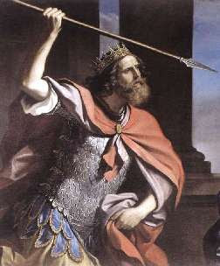
Next Point to Consider
What else happened on the 2nd cycle
of the month?
#8

Slide 43
Saul’s spear is hurled
In 1 Sam 20:28 – 32 is the explanation given by Jonathan to Saul for David’s absence which turned very ugly on the account of the jealousy
of Saul. Saul violently tried to impale Jonathan with a lethal spear!
1 Sam 20:33 At that, Sha’ul hurled a spear at him to smite him. Then Yehonathan knew that his father had resolved to put Dawiḏ
to death.
1 Sam 20:34 And Yehonathan rose up from the table in the heat of displeasure, and ate no food the second day of the month, for he was grieved for Dawiḏ, because his father put him to shame.
1
2

Slide 44
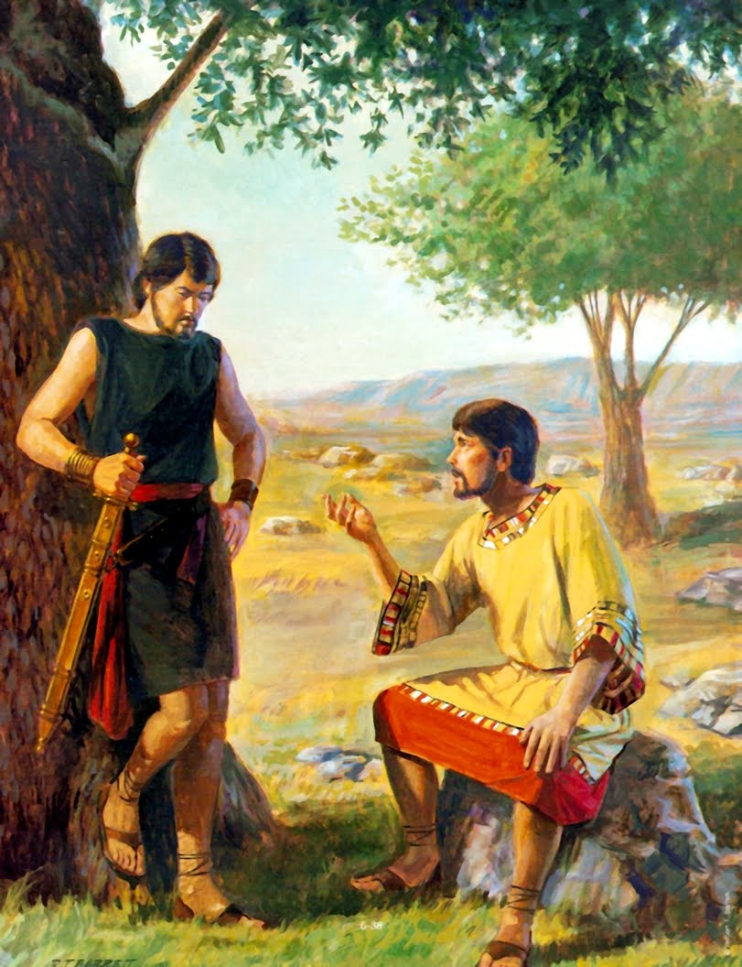
Consider Yahuah’s Command
wHat is recorded as Jonathan’s next move?
#9

Slide 45
Consider Yahuah’s Command
Point – 9 (con’t)
The Scriptures
record that
Jonathan
went out into
the field at the
appointed time
the next morning.

Slide 46
Question:
How many cycles from the New Month Cycle did Jonathan tell David he would return to the field?
1 Sam 20:19 –
And on the third day...

Slide 47

Morning after the second day …
1 Sam 20:34 And Yehonathan rose up from the table in the heat of displeasure, and ate no food the second day of the month, for he was grieved for Dawiḏ, because his father put him to shame.
1 Sam 20:35 And it came to be, in the morning [boqer, {the 3rd cycle of the month}], that Yehonathan went out into the field at the time appointed with Dawiḏ, and a small youth was with him.
1
2
3

Slide 48
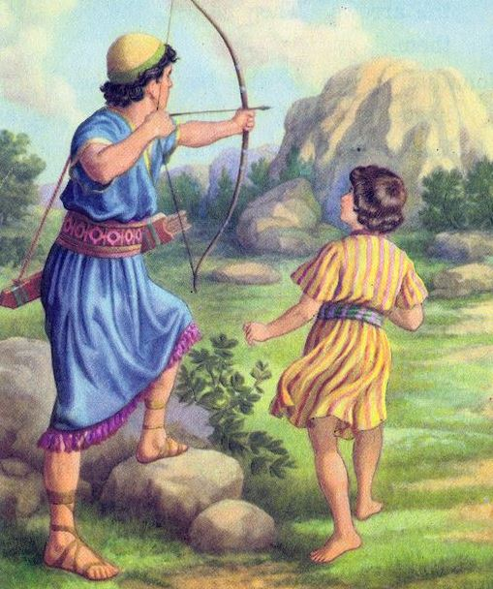
Consider Jonathan’s Response
Did Jonathan keep his promise to david to
meet him?
#10

Slide 49
3rd Day - Jonathan Keeps His Promise
1 Sam 20:38 And Yehonathan shouted after the youth,
And Yehonathan’s youth picked up the arrows and came to his master.
New Month Day. It was in the morning when Jonathan sternly directed David to flee! See 1 Sam 20:35 or slide 47.
“Make haste, hurry, do not stand still!”
1
2
3

Slide 50

Question -
How long do the Scriptures say it took for David to gather his personal items and flee??
Answer: The Scriptures say nothing about David gathering his personal belongings. It only records that David arose and left.
See 1 Sam 20:42.

Slide 51
David Flees Immediately
David and Jonathan said a very sorrowful good-bye.
David departed immediately! How do we know?
What man known as a fierce warrior travels without his weapons?
Yes, David left immediately after saying goodbye to Jonathan.
1 Sam 21:8 And Dawiḏ said to Aḥimeleḵ, “Is there not here on hand a spear or a sword? For I have brought neither my sword nor my weapons with me, because the matter of the sovereign
was urgent.”

Slide 52
David’s Hunger Exposes the Cycle of the Week
1 Sam 21:1 And Dawiḏ came to Noḇ, to Aḥimeleḵ the priest. And Aḥimeleḵ trembled when he met Dawiḏ, and asked him,
“Why are you alone, and no one is with you?”
1 Sam 21:2 And Dawiḏ said to Aḥimeleḵ the priest, “The sovereign has commanded me a word, and said to me, ‘Let no one know whatever of the word about which I send you, and which I have commanded you.’ And I have directed my young men to such and such a place.
1 Sam 21:3 “And now, what do you have on hand?
Give five loaves into my hand, or whatever is found.”

Slide 53
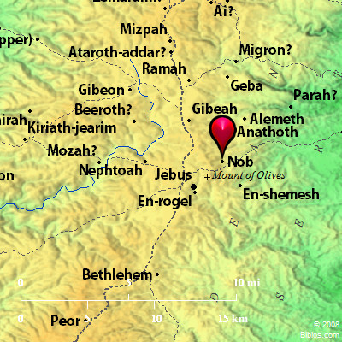
David is hungry in - Nob
David must have been hiding in the local area for the three days.
Why?
Because from Gibeah, the city of Saul’s home,
(1 Sam 10:26) to Nob is only 5 kilometers.

Slide 54
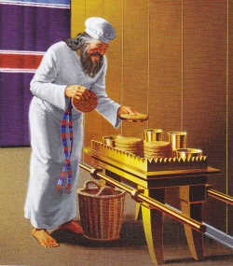
Considering David’s Request
A provision from the priest
in the sanctuary
#11

Slide 55

David’s request:
“Give five loaves unto my hand”...
What type of bread was available?
1 Sam 21:4 And the priest answered Dawiḏ and said, “There
is no ordinary bread on hand, but there is
set-apart bread – provided the young men have kept themselves from women.”
The “set-apart” bread was the shewbread of the Tabernacle.

Slide 56
Considering the Shewbread
What were the special conditions Requested of david before receiving the shewbread?
#12

Slide 57
David’s Conditions For Receiving Shewbread
Ahimelek, the Kohen (Priest), was demanding that the statutes pertaining to this specific qodesh (set-apart) bread would be upheld
with the greatest of care.
Had David, and/or the men with him, had intimate relations with a lady shortly before this time, they would have defiled the set-apart standard of purity required for this special bread. Only a person who was pure was permitted to eat the shewbread of the Tabernacle.
Lev 15:18 ‘And when a woman lies with a man, and there is an emission of semen, they both shall bathe in water, and be unclean until evening.’

Slide 58
Shewbread stipulation repeated
Prior to giving David the shewbread, Ahimelek the Kohen (priest) makes absolute certain that David knows about abstaining from intimate relations, by David’s men.
1 Sam 21:4 And the priest answered Dawiḏ and said, “There is no ordinary bread on hand, but there is set-apart bread – provided the young men have kept themselves from women.”
What was David’s response?

Slide 59
David Answers the Kohen
1 Sam 21:5 And Dawiḏ answered the priest, and said to him, “Truly, women have been kept from us about
And the vessels of the young men are set-apart, and it is an
ordinary mission, and also, it was set-apart in the vessel today.”
Note: David did NOT SAY – “this IS the 3rd day since
I came out.”
The words indicate clearly that David classified the 3 days since fleeing from Saul, as being past tense.
The 3 days were behind him, in history.
three days since I came out.

Slide 60

David’s 6th of the month reply
30
1
2
3
4
5
6
1 Sam 21:5 And Dawiḏ answered the priest, and said to him, “Truly, women have been kept from us about three days since I came out. And the vessels of the young men are set-apart, and it is an ordinary mission, and also, it was set-apart in the vessel today.”
Morning!
Jonathan: FLEE – IN HASTE!
David fled, these three days from Saul upon strong advice from Jonathan.
Chodesh - New Month Day
30
1
2
3 (1)
4 (2)
5 (3)
6

Slide 61
David was speaking to the Kohen – Ahimelek, on the
6th cycle of the month!
This is “hyper” important
information.
30
1
2
3 (1)
4 (2)
5 (3)
6

Slide 62
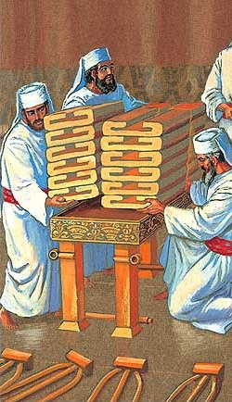
Considering the
Shewbread Instructions
Are there special instructions for renewing the shewbread?
#13

Slide 63
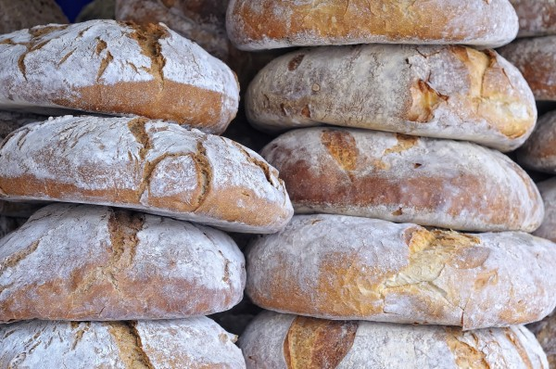
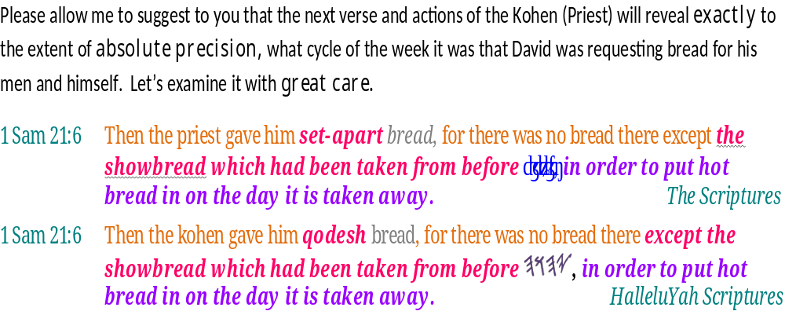
This study now transitions to critically important information.
It is super serious!
.

Slide 64
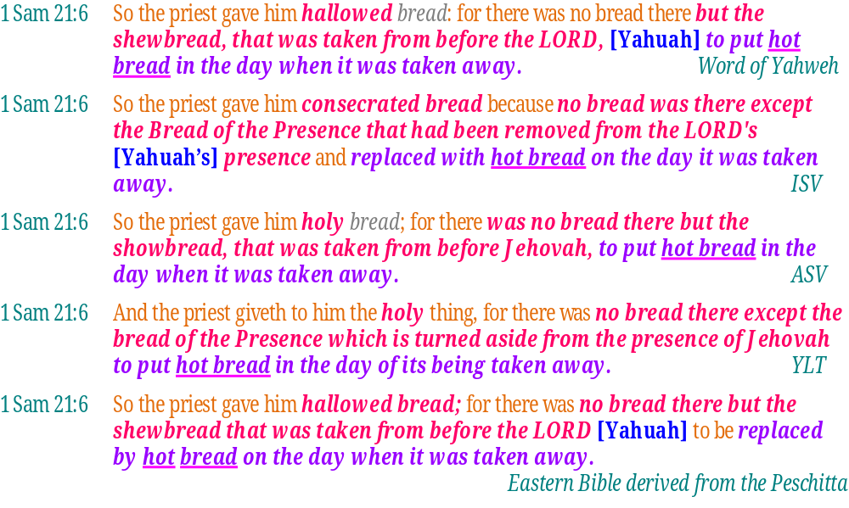

Slide 65
1 Sam 21:6 So the Priest gaue [gave] him [David] hallowed bread; for there was no bread there,
but the Shewbread that was taken
from before the Lord [Yahuah],
to put hote [hot] bread in the day
when it was taken away. KJV 1611
What are the instructions for Shewbread that has just been removed from the Tabernacle’s Set-Apart Place?
Answer: _____________________ & 1 Chron 9:32.
Now the brutally important question arises –
See - Lev 24: 5-9
Lev 24:5-9 And thou shalt take fine flour, and bake twelve cakes thereof: two tenth deals shall be in one cake.
6 And thou shalt set them in two rows, six on a row, upon the pure table before the LORD.
7 And thou shalt put pure frankincense upon each row, that it may be on the bread for a memorial, even an offering made by fire unto the LORD.
8 Every sabbath he shall set it in order before the LORD continually, being taken from the children of Israel by an everlasting covenant.
9 And it shall be Aaron's and his sons'; and they shall eat it in the holy place: for it is most holy unto him of the offerings of the LORD made by fire by a perpetual statute. KJV
1 Chron 9:32 And other of their brethren, of the sons of the Kohathites, were over the shewbread, to prepare it every sabbath. KJV
2 Commentaries:
1 Sam 21:5 from Jamieson, Fausset, and Brown Commentary
Yea, though it were sanctified this day in the vessel - i.e., though the hallowed bread had been but newly placed on the vessel, the ritual ordinance would have to yield to the great law of necessity and mercy (see the notes at Matt 12:3; Mark 2:25; Luke 6:3).
1 Sam 21:1-9 Verse 6-7. The priest then gave him (what was) holy, namely the shew-loaves "that were taken from before Jehovah," i.e., from the holy table, upon which they had lain before Jehovah for seven days (vid., Lev 24:6-9). (from Keil & Delitzsch Commentary on the Old Testament)

Slide 66
Considering the
Shewbread Replacement
What divine cycle of the week delegates new shewbread for the sanctuary?
#14

Slide 67
Lev 24:5 “And you shall take fine flour and bake twelve cakes with it, two-tenths of an ĕphah in each cake.
Lev 24:6 “And you shall set them in two rows,
six in a row, on the clean table before יהוה [Yahuah].
Lev 24:7 “And you shall put clear frankincense on each row,
and it shall be on the bread as a remembrance portion,
an offering made by fire to יהוה [Yahuah].
Why not 13?

Slide 68
Shewbread; The 7th Cycle!
Lev 24:8 “On every Sabbath he is to arrange it before יהוה [Yahuah] continually, from the children of Yisra’ĕl – an everlasting covenant.
Lev 24:9 “And it shall be for Aharon and his sons, and they shall eat it in the set-apart place, because it is most set-apart to him from the offerings of יהוה [Yahuah] made by fire – an everlasting law.”

Slide 69
Assembling Pertinent Points
David was speaking to the Kohen (priest) on the
4th cycle after he - “came out.”
The time frame of point #1 (above) is the
6th cycle of the month (not the week).
David is asking for the shewbread!
The shewbread is exchanged upon the
7th Day Sabbath.

Slide 70
Discerning david’s week
Since the shewbread is always exchanged upon the 7th Day Sabbath, upon which “day of the week” was the 6th cycle of the month in this account?
Answer: The 6th cycle of the month was the 7 ^{th} Day Sabbath!

Slide 71
Discerning david’s week
Is it possible that the bread was exchanged on another cycle of the week?
(Again) - What was the Kohen’s response to David –
1 Sam 21:6 So the priest gave him hallowed bread; for there was no bread there but the shewbread that was taken away from before [Yahuah] to be replaced by hot bread on the day when it was taken away. (Eastern Bible derived from the Peshitta.)

Slide 72
David requests bread from the kohen
1 Sam 21:3 “And now, what do you have on hand? Give five loaves into my hand, or whatever is found.”
1st 2nd 3rd 4th 5th Prep Sabbath
Jonathan: FLEE – NOW!
David referenced these three days since he fled from Saul,
upon intense advice from Jonathan.
David and his men are extremely hungry from fleeing, it is the 4th day since David talked with Jonathan by the stone “Etsel.”
Review
New Month Day
1
2
3 (1)
4 (2)
5 (3)
6 (4)

Slide 73
David requests bread from the kohen
1 Sam 21:3 “And now, what do you have on hand? Give five loaves into my hand, or whatever is found.”
1st 2nd 3rd 4th 5th Prep Sabbath
Jonathan: FLEE – NOW!
The three days of fleeing.
1 Sam 21:6 Then the priest gave him set-apart bread, for there was no bread there except the shewbread which had been taken from before יהוה [Yahuah], in order to put hot bread in on the [Sabbath] day it is taken away.
Review
New Month Day
1
2
3 (1)
4 (2)
5 (3)
6 (4)

Slide 74

Lev 24:5-9 And thou shalt take fine flour, and bake twelve cakes thereof: two tenth deals shall be in one cake.
6 And thou shalt set them in two rows, six on a row, upon the pure table before the LORD.
7 And thou shalt put pure frankincense upon each row, that it may be on the bread for a memorial, even an offering made by fire unto the LORD.
8 Every sabbath he shall set it in order before the LORD continually, being taken from the children of Israel by an everlasting covenant.
9 And it shall be Aaron's and his sons'; and they shall eat it in the holy place: for it is most holy unto him of the offerings of the LORD made by fire by a perpetual statute. KJV
1 Chron 9:32 And other of their brethren, of the sons of the Kohathites, were over the shewbread, to prepare it every sabbath. KJV
2 Commentaries:
1 Sam 21:5 from Jamieson, Fausset, and Brown Commentary
Yea, though it were sanctified this day in the vessel - i.e., though the hallowed bread had been but newly placed on the vessel, the ritual ordinance would have to yield to the great law of necessity and mercy (see the notes at Matt 12:3; Mark 2:25; Luke 6:3).
1 Sam 21:1-9 Verse 6-7. The priest then gave him (what was) holy, namely the shew-loaves "that were taken from before Jehovah," i.e., from the holy table, upon which they had lain before Jehovah for seven days (vid., Lev 24:6-9). (from Keil & Delitzsch Commentary on the Old Testament)
Considering Jonathan, David & Saul
Did any one of these three men decide to reset the days of the week to accommodate lunar standards?
#15

Slide 75
David, Jonathan & AhimElek did not “reset” their week!
Days of the Month
David flees in great haste on the morning of the 3rd day.
David announces to the Kohen his history of 3 days removed from Saul’s reach.
1 Sam 21:1 David (very hungry) seeks out Ahimelek the Kohen.
1 Sam 21:3 “And now, what do you have on hand? Give five loaves into my hand, or whatever is found.”
29
30
New Month Day 1
2
3 (1)
4 (2)
5 (3)
6

Slide 76
Yahuah’s Covenant Calendar is not reset
1 Sam 21:3 “And now, what do you have on hand? Give five loaves into my hand, or whatever is found.”
when David requested Shewbread!
The 6th of the month is when David asked for the shew- bread.
when David requested the shew- bread.
The Cycles of the MONTHS
29
30
New Month
Day 1
2
3 (1)
4 (2)
5 (3)
6
Cycles of the WEEK
Sab
1
New Month
Day 2
3
4 (1)
5 (2)
Prep (3)
Sab

Slide 77
Yahuah’s StatuteS ALWAYS determine the Covenant Calendar
The 6th cycle of the new month is when David asked for the shewbread.
The fresh shewbread – by statute – always indicates the 7th day Sabbath.
(See: Lev 24:5-9; 1 Chron 9:32.)
29
30
New Month
Day 1
2
3 (1)
4 (2)
5 (3)
6
Cycles of David’s WEEK
Sab
1
New Month
Day 2
3
4 (1)
5 (2)
Prep (3)
Sab

Slide 78
1ST Focal point of this study!
The weekly 7 cycle count was not reset in this account by either David, Jonathan or Ahimelek. (NOR - YAHUAH!)
David’s week, in this instance, started in the
previous month!
Dates of the Month
Flee!
Hiding!
29
Sabbath
30
New Month
Day 1
2
3 (1)
4 (2)
5 (3)
6
30
David & Jonathon’s Weekly 1-7 Count!
7
Sab
1ST CYCLE
New Month
Day 2
3
4 (1)
5 (2)
Prep (3)
Sab
AGAIN - The 1st of Ahimelek’s week was the 30th and last cycle of the previous month!

Slide 79
WAIT!
Did you catch that?
The 30th cycle of the month was integral with, and counted as one cycle of Yahuah’s week!
The 1st cycle of the week, on the 30th cycle of the previous month was determined by David, Jonathon and super significantly – by Ahimelek the High Priest as being counted WITHIN - Yahuah’s 1-7 weekly count!
The Lunar based calendar regulations OPPOSE this factor !

Slide 80
1ST Focal point (con’t)!
The weekly 7 cycle count was not reset in this account by either David, Jonathan, Saul or Ahimelek the High Priest!
David’s week, in this instance, started in the
Creation’s 7 cycles that form a week are a continuous, repetitive cycle operating in a unique manner
separate unto its own accord.
Neither the moon, nor the priestly duty cycles in the Tabernacle have a controlling connection to Yahuah’s Creation Week of 7 cycles.
What Yahusha set into motion at Creation will never cease.
previous month!

Slide 81
appropriate questions!
In this example taken from 1 Sam 20, the first cycle of the month was placed on the second cycle of the 1st week - (Monday/pagan terms.)
David, Jonathan and Saul all lived out the Covenant Calendar as seen throughout the Torah, the Prophets and the Messianic Testament.
How is it that proponents of the lunar Sabbath, and the perceived priestly course calendar with the same dates, can claim that -
1. The first cycle of the month is separate from the weekly
count of 7?
2. The first Sabbath of the month must always land on the
8th cycle of the month?
OR -
How?

Slide 82

2ND Focal point of this study!
The Enoch/Zadok Calendar claims there are ZERO Sabbaths (of any kind) that land upon the 6th cycle of any month in their calculated calendar!
It’s time to check out
the next slide -

Slide 83

Enoch should read
1 Samuel 20 & 21.
Enoch has no Sabbaths on the
6th date of any month!
6?
6?
6?
6?

Slide 84

2ND Focal point (cont’)!
THE
ENOCH/ZADOK CALENDAR –
CANNOT FIND ALIGNMENT
WITH THIS SCRIPTURAL EVENT!

Slide 85
The final question
What will Your Choice of Options be?
The Covenant Calendar of the Torah, Prophets
and Testimonies?
The Calendars of man - which require a Moon,
non-Covenant “Scroll” regulations, or obsolete Priesthood regulations in opposition to the Covenant Calendar as followed by Noah! The patriarchs never once referenced a Moon, Dead Sea Scrolls,
nor the Aharonic priestly courses to determine time!
OR -

Slide 86
Isa 2:22
Cease from man,
whose breath is in his nostrils, for in what is he to be
reckoned upon?
HalleluYah Scriptures

Slide 87
Isa 1:13 – 14
Stop bringing futile offerings, incense, it is an abomination to Me. New Moons, Shabbathoth, the calling of meetings – I am unable to bear unrighteousness and assembly.
My being your new moons and your appointed times, they are a trouble to Me,
I am weary of bearing them.
HalleluYah Scriptures
hates

Slide 88



The “Times” & “Seasons” are in Yahuah’s Hands – 1 Thess 5:1-8
1 But of the times and the seasons, brethren, ye have no need that I write unto you.
2 For yourselves know perfectly that the day of [Yahuah] so cometh as a thief in the night.
3 For when they shall say,
Peace and safety; then sudden destruction cometh upon them, as travail upon a woman with child; and they shall not escape.
4 But ye, brethren, are not in darkness, that that day should overtake you as a thief.
5 Ye are all the children of light,
and the children of the day:
we are not of the night,
nor of darkness.
6 Therefore let us not sleep,
as do others; but let us watch
and be sober.
7 For they that sleep sleep in the night; and they that be drunken are drunken in the night.
8 But let us, who are of the day, be sober, putting on the breastplate of faith and love; and for an helmet,
the hope of salvation.
KJV
May each
one of us
search out
Yahuah’s
“times and
seasons”
abiding in
His Hands!

Slide 89




The next Covenant Calendar Study will be:
Tequfah Unveiled (Arp 20/18)
  Addressing the proper year start for Yahuah’s Covenant Calendar
Questions/Comments on the
study of David & Jonathan?
calendar@torahtothetribes.com

