Slide 1
Joshua’s First Observance of Firstfruits (Joshua 3-5)
Notes:
850 am

Slide 2
The First Passover in Canaan
Chapters 3 - 5
& Observation of Firstfruits

Slide 3
Restoration of Yahuah’s Calendar
For those that wish to follow Yahuah in His footsteps, responding in worship and adoration … honoring the Sabbatical worship statutes and festivals is of utmost importance.
However, the enemy has been very clever. He has managed to get many of Yahuah’s sincere followers sidetracked when it comes to honoring Yahuah’s appointed times, giving homage to man’s pagan traditions that have replaced many/all Divine Appointments.
Restoration of Yahuah’s Divine Calendar is a huge task that has been in the search engines of many for a long time.
The good news is there are a few who believe Yahuah’s perfect Divine Calendar has been restored through a careful search of the Scriptures.
There’s even better news than this: Yahuah’s Divine calendar is simple, easy, logical and elegant. Yes … elegant and pleasing!

Slide 4
Restoration of Yahuah’s Firstfruits
However …even though:
The weekly Sabbath has been restored to commence at dawn rather than sunset, midnight, sunrise etc. …
The commencements of the new months has been restored by just counting to 30 instead of searching for the lunar crescent or the conjunction, etc. …
The commencement of the new year has been restored by waiting for the spring equinox to end the old year and then begin the new year “the day after the shadow sign” (instead of waiting for the confirmation of the moon phase, or the barley ripeness, etc.) …
There can still be confusion over the placement of Firstfruits, which ultimately affects the placement of Pentecost 50 days later.

Slide 5
Firstfruits Needs Restoration?
Confusion over the placement of Firstfruits? Could that really be so?
But, some may say: “Well, it doesn’t really matter, because Firstfruits isn’t that important anyway! My feast camp never pays too much attention to the Firstfruits Festival so it can’t be that crucial.”
If there is any question about the placement of Firstfruits and Pentecost, the best thing to do is check it out with Scripture.
Joshua will walk us through the proper placement of Firstfruits through the wonderful encounter Israel experienced when they finally entered the Land of Canaan after over 40 years.
This study addresses the Wavesheaf “Firstfruits” during the Passover festival.

Slide 6
Firstfruits Festival Options
This study is going to examine the two main ways to celebrate Firstfruits. No matter what day Firstfruits is celebrated on, the 50 day Omer Count establishes the placement of Pentecost on the same “day of the week” as Firstfruits.
Both are affected equally.
Firstfruits Follows Unleavened Bread Sabbath on Abib 16??
Firstfruits Follows H7676 Sabbath??

Slide 7
5 Testimonies for Proper Placement of Firstfruits
For a long time it seemed Leviticus 23 was the only witness for the proper placement of Firstfruits. There are now 3 very strong additional witnesses from Scripture, plus the secular historical account to help us understand the Divine placement of Firstfruits.
Leviticus 23:12-16; Num 15:18-19
Exodus 12 – 16 – 19 Study
Joshua 3-5
Gospel Account including: Wednesday Crucifixion Sabbath Resurrection 1st day Ascension
Secular History around “Rashbi” [Rabbi bar Yochai] & a quote from Julian Morgenstern
#3
#4
#5
#2
#1

Slide 8
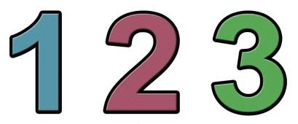
Today’s Study Covers:
#2 Joshua
#3 History
#1 Leviticus & Numbers
Joshua includes 3 sets of counting patterns for:
Plus a statement from Hebrew Union College in the USA!

Slide 9
Joshua’s Study Proves:
#2 Unleavened Bread Sabbath
on Abib 15
#3 Firstfruits is placed on Abib 15 – NOT Abib 16!
#1 Passover & weekly Sabbath are on Abib 14
Are you ready?

Slide 10
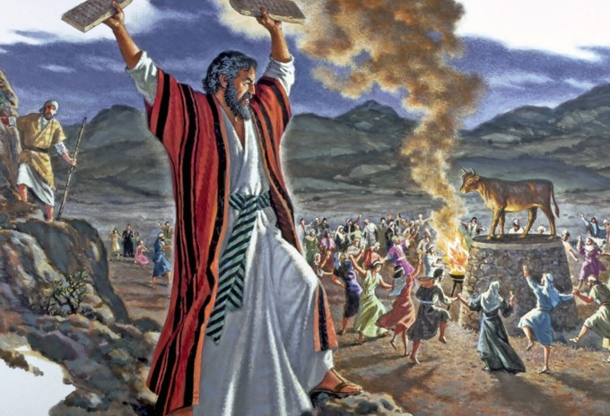
No Observance of Firstfruits in the Wilderness
Because Israel’s sin with the golden calf, a whole new set of laws for the Aaronic Priesthood, sacrificial laws and the sanctuary services were commanded upon the people.
Shortly after the sanctuary was raised up, Israel sinned again by refusing to enter Canaan based upon an evil report of the ten spies.
Since Moses would not be leading the children into the land of Canaan, Yahuah did give explicit instructions on how to observe the “first” Firstfruits upon their entrance. (Obviously there would not have been 40 years of rehearsals for the people to remember what to do.)
Israel is exempted from entering Canaan for 40+ years because of the golden calf violation.

Slide 11
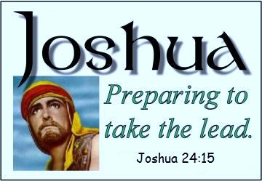
1st Observance of Spring Feasts (Canaan)
Joshua will show the exact day of the week for the observance of:
Passover: on Abib 14 - the 7th Day Sabbath!
Firstfruits: on Abib 15.
The 1st day of Unleavened Bread: on Abib 15.
This information is necessary to understand the following charts.
Note: This study is based on the day beginning with “dawn” … not “sunset.”

Slide 12
Joshua 1: Prepare the People
Joshua 1:1-9 Joshua’s book begins with the Divine commission to go in and take the land of Canaan. The promise is given in verse 3 that wherever the soles of their sandals tred, the land is reserved for Israel.
Joshua 1:10-22 Joshua gives commands to the officers for taking the land. Joshua 1:11
"Pass through the camp and command the people, saying, 'Prepare provisions for yourselves, for within three days you will cross over this Jordan, to go in to possess the land which [Yahuah your Elohim] is giving you to possess.'" NKJV
1st set of “Counting to 3.”
Notes:
Chart #1 of 7 Make sure you understand why the blue brackets are placed on this chart, as the next chart will also include a set of pink brackets. They are not the same.

Slide 13
#1: Joshua Will Confirm:
Abib 14 is the weekly Sabbath; therefore, Abib 1 is a 1st cycle [Sun.] in this year of “entering the land.” #1a: Enoch Calendar Claims:
Abib 1 is always on the 4th cycle [Wed.]
Aligning Enoch with Joshua would place Abib 14 on the 3rd cycle [Tues.] – not a Sabbath.
Only in Enoch months 3, 6, 9 & 12 will the 14th day of the month align with the 7th day Sabbath of the week.
Joshua is not following an Enoch calendar.

Slide 14
Joshua 2: Rahab & the Spies
Rahab gives the spies explicit instructions to hide 3 days in the mountain.
2nd set of “Counting to 3.”
It appears that Joshua fully expected the spies to complete this assignment on the Day Season of Friday and be back to camp before Sabbath. However, the plans were delayed due to suspicions from residents in Jericho. The three days for the spies commenced from the time they fled to the mountains – not from “dawn.” Rahab did not send them away until it was dark!

Slide 15
Joshua 3: Prepare to Cross Jordan
The Spies Return Abib 9 [Mon] Evening
Joshua 3:2 And it came to be, after three days, that the officers went into the midst of the camp,
Busy Abib 9 [Mon] Night
Joshua 3:3 and they commanded the people, saying, “When you see the ark of the covenant of [Yahuah your Elohim], and the priests, the Levites, bearing it, then you shall set out from your place and follow it.
Early on Abib 10 [Tues] Morning
Joshua 3:1 And Joshua rose early in the morning, and they set out from Shittim and came to the Jordan, he and all the children of Israel, and stayed there before they passed over.
The next chart picks up from Abib 9.

Slide 16
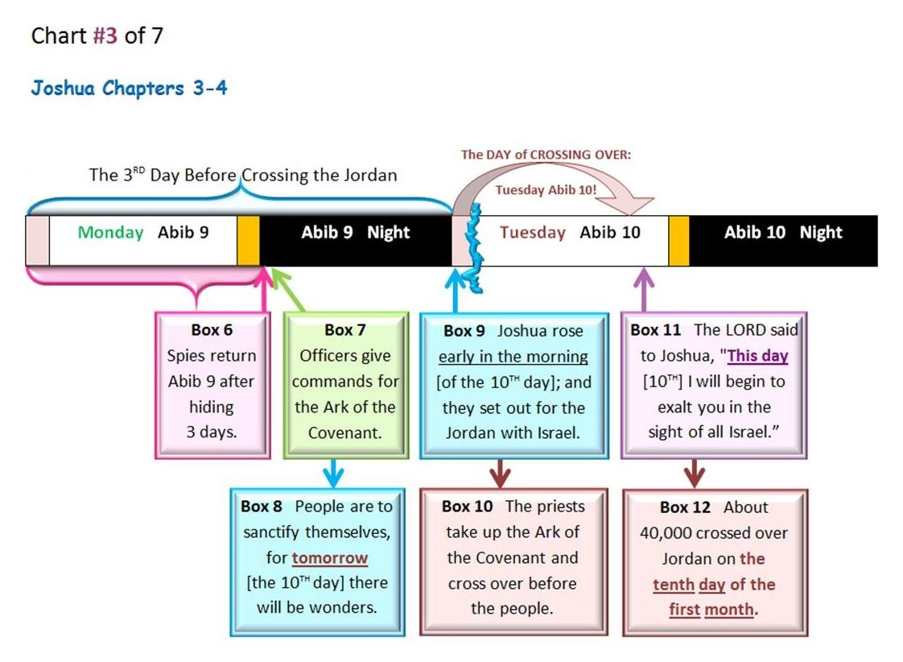
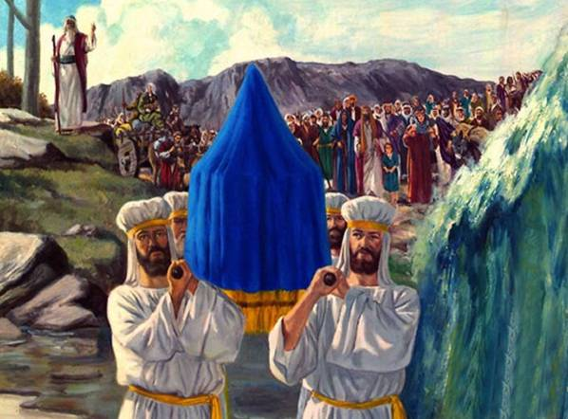
Joshua 3: Crossing the Jordan

Slide 17
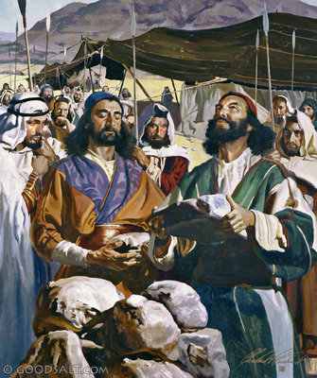
Joshua 4: Jordan Memorial Stones
When all of the people had completely crossed over the Jordan, the next Divine Command to Joshua was to select twelve men to represent every tribe.
They were to bring memorial stones back from the river bed of the Jordan to erect as an altar for a permanent sign of the “crossing of the Jordan” on the 10th day of the 1st month.

Slide 18
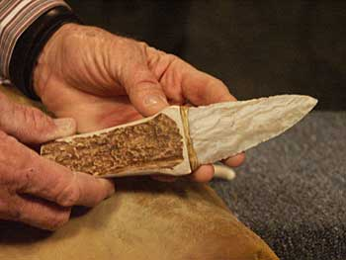
Joshua 5: Men Circumcised
Josh 5:2-3, 8-9
2 At that time [Yahuah] said unto Joshua, Make thee sharp knives, and circumcise again the children of Israel the second time.
3 And Joshua made him sharp knives, and circumcised the children of Israel at the hill of the foreskins.
8 And it came to pass, when they had done circumcising all the people, that they abode in their places in the camp, till they were whole.
9 And [Yahuah] said unto Joshua, This day have I rolled away the reproach of Egypt from off you. Wherefore the name of the place is called Gilgal unto this day. KJV
At this point the Scriptures bring the events to Abib 13.

Slide 19
Joshua 5: Men Circumcised
This event reaches to the day before Passover.
3rd set of “Counting to 3.”

Slide 20
#2: Joshua Will Confirm:
Abib 11 was the 4th cycle of the week [Wed.] (when the circumcising began).
#2a: Enoch Calendar Claims:
Abib 1 is always placed on the 4th cycle [Wed.]
On Enoch’s calendar, the 11th day of Abib always claims a weekly Sabbath.
Joshua will not agree with Enoch’s reckoning.
1st (Sun) | 2nd (Mon) | 3rd (Tues) | 4th (Wed) | 5th (Thur) | 6th (Fri) | 7th (Sabb)
Abib 1 | 2 | 3 | 4 | 5 | 6 | 7
8 | 9 | 10 | 11 | 12 | 13 | 14
1st (Sun) | 2nd (Mon) | 3rd (Tues) | 4th (Wed) | 5th (Thur) | 6th (Fri) | 7th (Sabb)
 |  |  | Abib 1 | 2 | 3 | 4
5 | 6 | 7 | 8 | 9 | 10 | 11

Slide 21
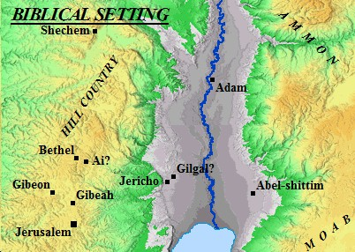
1st Passover Celebrated in Canaan
Josh 5:10 And the children of Israel encamped in Gilgal, and kept the Passover on the fourteenth day of the month at even in the plains of Jericho. KJV
Can the Passover and the weekly Sabbath share the same “day” without Scriptural conflict?
We are still assuming Passover will be on Sabbath Abib 14.
It will be exposed solidly later in the study.
Remember: No manna is sent on Sabbath.

Slide 22
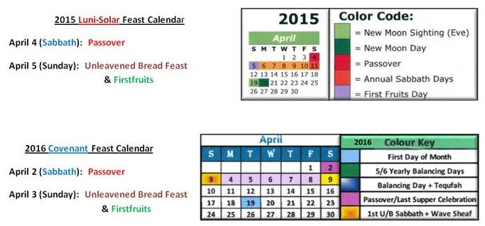
Passover on a 7th Day Sabbath?
Can Passover occur on the weekly Sabbath?
Should Passover ever be celebrated on the weekly Sabbath? Or …
Should the Feast Calendar be adjusted so Passover never lands on the weekly Sabbath? These are important questions.
Below are 2 calendars for 2015 and 2016 – the first is a 2015 Luni-Solar Feast Calendar; the next a 2016 Covenant Feast Calendar … both demonstrating the yearly Passover falling on the weekly Sabbath. What about a Jewish Calendar?
Notes:
It really is OK to have Passover on Sabbath. Sacrifices were offered every day; all the Sabbaths had extra sacrifices according to Num 28.

Slide 23
#3: Joshua will be celebrating Abib 14 Passover on the weekly Sabbath. There is no need to adjust the date.
#3a: Jewish calendars are: adjusted to avoid the celebration of certain feasts on the weekly Sabbath.
Passover & Day of Atonement are two of these feasts.

Slide 24
Does a Sabbath Passover Demand Servile Work?
Some feel if Passover lands on the Sabbath, it should be moved to Abib 15 so the commands of both the 7TH Day Sabbath and Passover can be honoured without conflict.
Even today some of the Jews’ calculations for Jewish festivals are arbitrary and set by men, not Scripture.
Their annual festivals can be off as much as two days from the original day ordained by their Jewish calendar commands especially IF the annual feasts occur on, or close to, the weekly Sabbath. There is no Scriptural command to exempt Passover from falling on the weekly Sabbath.
As has been noted, the preparations for Passover can be done on the Preparation day. The extra Passover sacrifice was not a Sabbath violation according to Scripture.
No! Passover does not need to be moved.
Notes:
It really is OK to have Passover on Sabbath. Sacrifices were offered every day; all the Sabbaths had extra sacrifices according to Num 28.

Slide 25
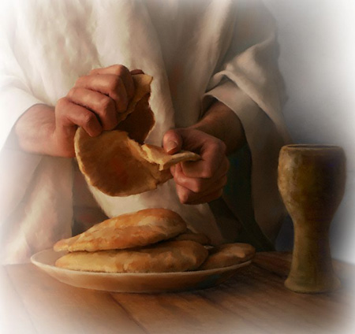
The Unleavened Bread for 1st Passover in Canaan
Even though Israel was in the land of Canaan with grain all around them, the scriptural command was firm: Israel was not allowed to touch the Old or New grain for their unleavened bread at the Passover meal on Abib 14.
The first partaking of unleavened bread (from grain) became part of the festival on Abib 15 after the Wavesheaf ceremony was completed.
Lev 23:6 And on the fifteenth day of the same month is the feast of unleavened bread unto [Yahuah].
We are still assuming Passover is on the 7th Day Sabbath.
Let’s place the 1st Sabbath of Unleavened Bread (Abib 15) on the chart.

Slide 26
Passover (14th) Unleavened Bread (15th)
We are still assuming Passover is on Sabbath.

Slide 27
Passover (14th) ~ Firstfruits (15th)
Josh 5:11 And they did eat of the old corn [grain] of the land on the morrow after the Passover, unleavened cakes, and parched corn in the selfsame day. KJV
morrow - Brown-Driver-Brigg’s - H4283 <mochorath>
the morrow
tomorrow
the day after
Hebrew Definition for “morrow”
None of these definitions are timed anywhere near sunset!

Slide 28
Passover (14th) ~ Firstfruits (15th)
Note: “morrow” begins in the “morning” with the arrival of daylight.
Therefore, Firstfruits begins at this point.
Josh 5:11 is specific: Israel ate the grain on the “morrow after the Passover.”
REMEMBER: They were not allowed to take any of the grain for their own use until the Wavesheaf ceremony was completed.
Firstfruits is established on Abib 15.
We are still assuming Passover is on the 7th Day Sabbath.

Slide 29
#4: Joshua Confirms Firstfruits occurred on Abib 15 – the morrow after Passover …
1st (Sun) | 2nd (Mon) | 3rd (Tues) | 4th (Wed) | 5th (Thur) | 6th (Fri) | 7th (Sabb)
Abib 1 | 2 | 3 | 4 | 5 | 6 | 7
8 | 9 | 10 | 11 | 12 | 13 | 14 P/O
15 FF | 16 | 17 | 18 | 19 | 20 | 21

Slide 30
Moses’ Instructions for Firstfruits
Num 15:18-19 “When ye come into the land whither I bring you, Then it shall be, that, when ye eat of the bread of the land, ye shall offer up an heave offering [the Wavesheaf] unto [Yahuah].” KJV
Lev 23:10 “Speak to the children of Israel, and you shall say to them, ‘When you come into the land [through the leadership of Joshua] which I give you, and shall reap its harvest, then you shall bring a sheaf of the first-fruits of your harvest to the priest.’ ” KJV
These two verses along with Josh 5:11 are very specific.
Firstfruits will be celebrated in Canaan (not the wilderness).
This next verse in Lev 23:11 is a prophecy of what will happen!

Slide 31
Prophecy of Lev 23:11
Lev 23:11 And he shall wave the sheaf before [Yahuah], for your acceptance. On the morrow after the Sabbath the priest waves it.
Morrow after the Sabbath? What type of Sabbath is this verse referring to?
The weekly Sabbath?
The 1st Sabbath of Unleavened Bread?

Slide 32
Which “morrow” is it?
In other words: Is Firstfruits established on:
the “morrow” after the Passover Sabbath?
the “morrow” after the ULB Sabbath?

Slide 33
“morrow” According to Moses
Lev 23:11 ‘And he shall wave the sheaf before [Yahuah], for your acceptance. On the morrow after the Sabbath ^{[H7676]} the priest waves it.
sabbath – Strong’s – H7676; shabbath (shab-bawth'); intensive from H7673; intermission, i.e. (specifically) the Sabbath: KJV - (+every) sabbath.
H7676 is specific noting the Lev 23:11 “Sabbath” is the weekly Sabbath as designated by the Hebrew word number H7676. However, that raises a question as most believe that the 1st day of Unleavened Bread is also a “sabbath.”
Are the Feast Sabbaths connected to the Hebrew number H7676?
NO! … and … Yes!

Slide 34
Comparison of H7677 to H7676
H7677; shabbathown; from H7676; a sabbatism or special holiday: KJV - rest, sabbath.
Some H7677 Feast Sabbaths are: 1st day of Feast of Trumpets (Lev 23:24); 1st and 8th days of Feast of Tabernacles (Lev 23:39).
There is one H7676 Feast Sabbath: Day of Atonement! (the most holy solemn Sabbath of the year).
Yes! The only Feast Sabbath connected to H7676 is Day of Atonement!

Slide 35
Question: Are the ULB Sabbaths connected to H7676 or H7677?
Note the Scriptural account:
Lev 23:5 In the fourteenth day of the first month at even is [Yahuah’s] Passover.
Lev 23:6 And on the fifteenth day of the same month is the feast ^{[H2282]} of unleavened bread unto [Yahuah]: seven days ye must eat unleavened bread.
Lev 23:7 In the first day ye shall have an holy ^{[H6944]} convocation:^{[H4744]} ye shall do no servile work therein. KJV
The Festival Sabbaths of the 1st and 7th days of Unleavened Bread (and Pentecost) are not numbered with either H7676 or H7677.
But …the Unleavened Bread Sabbaths are listed as “holy [qodesh] convocations.”

Slide 36
Important Hebrew Definitions
feast [of unleavened bread] – Strong’s – H2282; chag from H2287; a festival, or a victim therefor: KJV - (solemn) feast (day), sacrifice, solemnity.
holy – Strong’s – H6944; qodesh; from H6942; a sacred place or thing; rarely abstract, sanctity: KJV - consecrated (thing), dedicated (thing), hallowed (thing), holiness, (X most) holy (X day, portion, thing), saint, sanctuary.
convocation – Strong’s – H4744; miqra; from H7121; something called out, i.e. a public meeting (the act, the persons, or the place); also a rehearsal: KJV – assembly, calling, convocation, reading.

Slide 37
H7676/H7677 … H2282 … H6944 … H4744
These Hebrew Numbers are all linked to worship statutes, whether weekly or annual.
But please note: The phrases Feast ^{[H2282]} of Unleavened Bread and holy ^{[H6944]} convocation ^{[H4744]} are never listed as:
a weekly Sabbath with the Hebrew #H7676;
or an annual feast Sabbath with the Hebrew word #H7677.
There is a very good reason for this.

Slide 38
Hebrew Definitions Confirm Firstfruits Placement
Firstfruits does NOT follow the holy convocation of the 1st Unleavened Bread Sabbath!
In Joshua 5:11, Firstfruits follows ONLY the #H7676 weekly Sabbath on Abib 15. [Not Hebrew numbers of: ^{[H2282]} ^{[H6944] [H4744]}.]

Slide 39
#5: Joshua Confirms we must pay attention to which Sabbath days are understood as:
H7676 - Shabbaths
H7677 – Shabbathown
Firstfruits follows only the H7676!
#5a: Firstfruits never follows “days” linked to :
H2282 - Chag
H6944 - Holy [Qodesh]
H4744 - Convocation

Slide 40
Finally Passover is Confirmed on Sabbath
The Wavesheaf of Firstfruits can only be waved the day after the weekly Sabbath!

Slide 41
#6: Joshua Confirms:
Firstfruits follows Passover on Abib 15 …
Firstfruits follows the H7676 weekly Sabbath … Therefore, Passover was celebrated on the weekly Sabbath!
#6a: Enoch has every Passover celebration on the 3rd cycle of the week each year.

Slide 42
#7: Joshua Confirms:
The weekly Sabbath was on Abib 14th.
Lunar Sabbaths fall on the: 8th, 15th, 22nd, & 29th.
Joshua does not allow weekly Lunar Sabbaths to have recognition on Yahuah’s Calendar.

Slide 43
Finally Firstfruits is Understood
This discovery also eliminates two other false teachings:
The false teaching that Firstfruits must always be celebrated on abib 16!
The false teaching that Firstfruits always follows the 1st Unleavened Bread sabbath!
Joshua sets the record straight.

Slide 44
#8: Joshua Confirms:
Firstfruits will never follow the 1st Sabbath of Unleavened Bread on Abib 16.
Firstfruits must follow the weekly Sabbath during the Passover week.
Enoch places Firstfruits on the weekly Sabbath outside of the Passover Festival week.

Slide 45
Firstfruits Follows H7676 Sabbath
Josh 5:11 And they did eat of the old corn of the land on the morrow after the Passover, unleavened cakes, and parched corn in the selfsame day. KJV
Firstfruits follows Passover on Abib 15 within the Passover Festival week!

Slide 46
Joshua’s Witness is Easy to Understand
But this information raises another question!

Slide 47
#9: Joshua Confirms:
Firstfruits can be celebrated on Abib 16, IF Passover falls on the 6th cycle (Friday).
THEN: Sabbath is Abib 15 (& 1st Sabbath of Unleavened Bread);
Firstfruits follows on Abib 16th.
1st (Sun) | 2nd (Mon) | 3rd (Tues) | 4th (Wed) | 5th (Thur) | 6th (Fri) | 7th (Sabb)
Abib 2 | 3 | 4 | 5 | 6 | 7 | 8
9 | 10 | 11 | 12 | 13 | 14 P/O | 15 ULB
16 FF | 17 | 18 | 19 | 20 | 21 | 22

Slide 48
Which Festival Secures First Place? Firstfruits? ~ Unleavened Bread Sabbath?
Every Feast and Festival is of utmost importance, whether an annual Sabbath or not!
In Joshua’s account 2 festivals share Abib 15:
1st Sabbath of Unleavened Bread
Firstfruits Festival
Will Joshua give priority to one of them?

Slide 49
Special Instructions for Wavesheaf
To understand the importance of Firstfruits, it is first helpful to investigate the grain in the land of Canaan.
The grain holds clues that will help us understand Firstfruits as fulfilled in Yahusha’s life. This is the first recorded time Israel is ever celebrating the full spring festival. Remember, there is no Scriptural account for Firstfruits in the wilderness.
Yahuah had promised the Israelites the grain of the land would be ready for harvest upon entering the land of Canaan. (Deut 6:10-11; Josh 24:13.) But it was declared “off limits” to eat, or use for personal purposes like preparing unleavened bread for Passover, until after the Wavesheaf ceremony had been celebrated. (Lev 23:14)
There is one command that is recorded twice and extremely significant. The terms UNTIL – and – ON THIS SAME DAY – are very important to understand.

Slide 50
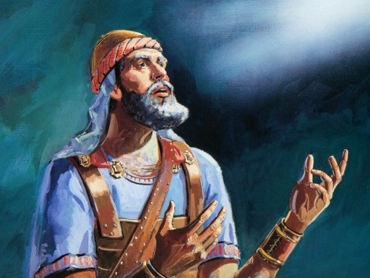
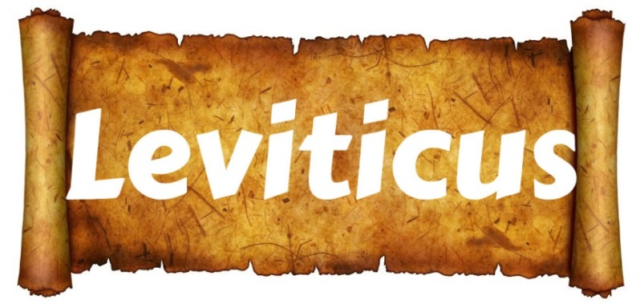
Josh 5:11 & Lev 23:14 Agree
Josh 5:11 And they ate of the stored grain of the land on the morrow after the Passover, unleavened bread and roasted grain ON THIS SAME DAY.
Lev 23:14 And you do not eat bread or roasted grain or fresh grain UNTIL THE SAME DAY that you have brought an offering to your Elohim – a law forever throughout your generations in all your dwellings. HalleluYah Scriptures & The Scriptures

Slide 51
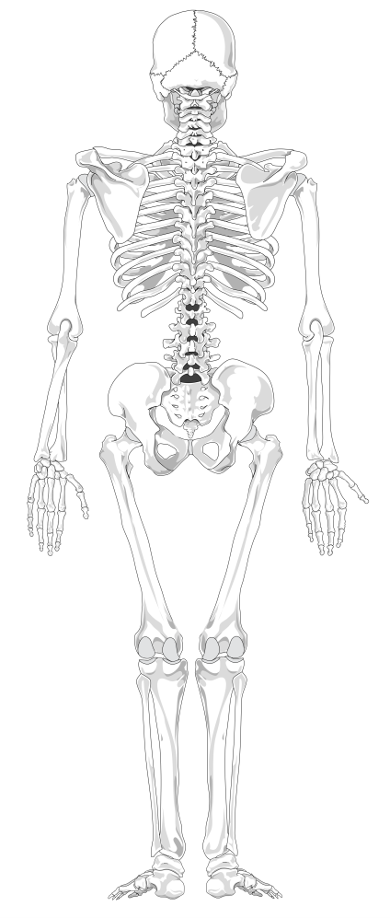
“ON THIS SAME DAY”
The primary point we need to pay attention to in the Wavesheaf ceremony of the Firstfruits are the words:
“UNTIL” THE SAME DAY
…translated from the Hebrew words - ehtzm zeh.
The main word meanings of ehtzm are:
firmness, solidity, bone (as in basic skeletal structure),
essence and substance.
All definitions link the Wavesheaf Firstfruits ceremony to: THE SELF-SAME DAY
(“day” of the week; not “date” of the month),
to be fulfilled in the antitype.

Slide 52
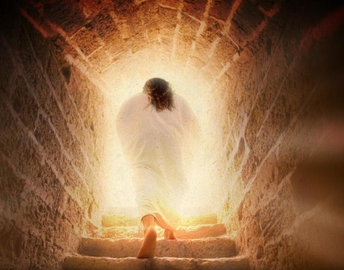
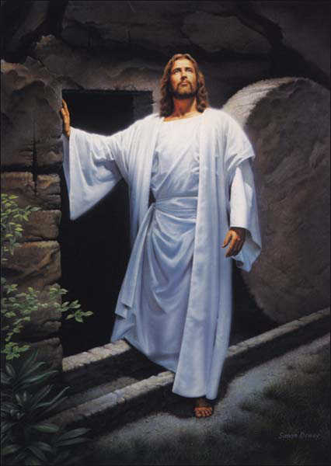
What about - The Life?
“We have always concentrated on – The Death – of Yahusha. Might we submit a portion of our thoughts to Yahusha’s Victory of LIFE - over death?
AFTER Yahusha died, what single event, (that is commanded to be observed yearly), was actually signed, sealed and forever etched into our Salvation for eternity?

Slide 53
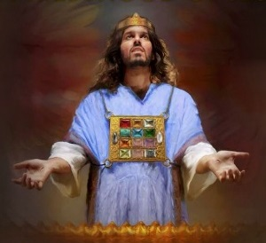
What about The Life that was Accepted?
Another Melchi-Tzedek Covenant Connection& Fulfillment!
“Yahusha’s death would have no meaning had He not Presented Himself {Ex 23:16,17} before Yahuah. It was here that Yahusha’s Sacrifice was
ACCEPTED AS – PERFECTION !

Slide 54
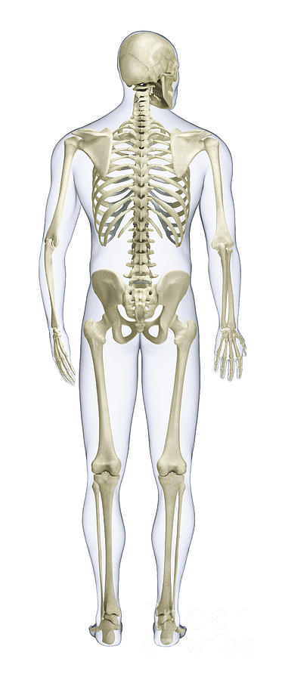
What contains this LIFE support system?
(“Until”) - EH-TZEM –
{First-Fruits/Wave Sheaf Presentation ACCEPTANCE; it was before Yahuah within the Melchi-Tzedek Covenant.}
It was the embodiment,the – SKELETAL BONE STRUCTURE;
which was and still is, the quintessential
SUBSTANCE AND ESSENCE of our Salvation!

Slide 55
What connects the skeletal bone concept to Yahuah’s - LIFE - support system?
Yahusha alone IS Salvation’s Administration Center for LIFE!
This factor was finalized through YAHUAH’S ACCEPTANCE OF YAHUSHA the First-Fruit on the Feast of the Wave Sheaf, the 1st cycle of the week following the 7th day Sabbath!

Slide 56
Yahusha’s skeletal bone distribution system purpose!
THE
The Eh-Tzem “BONE” spinal cord central nervous support structure -
Wave Sheaf/ First-Fruit Festival;
through Joshua,
conveys vital SALVATIONAL SUBSTANCE;
YEARLY TIMNG & MASHIACH CHARACTER IDENTIFICATION to -

Slide 57
(…to -) Us!
Yahusha’s EHTZEM bone notification system for the Body of Yahusha; identifies the ESSENCE of our Salvation through Yahusha’s Sacrificial ACCEPTANCE on- the 1st cycle after the 7th day Sabbath!

Slide 58
The Ultimate Bone Distribution System
“EHTZM” directs us to … Firstfruits as the backbone, - the base foundation – (Spinal Cord if you will) of Yahusha’s Plan to bring Salvation to His Body of people.
Yahusha, by dying, then observing the Wave Sheaf (being the First-Fruit of victory over death), presented Himself to Yahuah. Yahuah accepted Yahusha’s monumental sacrifice.
That ACCEPTANCE is – the Substance and Essence of the Plan of OUR Salvation.

Slide 59
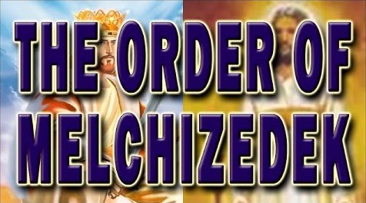
Firstfruits & Melchizedek
All feasts and festivals are “types” that have their complete fulfillment in our Messiah as the Highest Melchizedek Priest.
On the Festival of Firstfruits, the first harvest was to fulfill the “wavesheaf.”
This event looked forward to the time when Yahusha would ascend to receive the announcement of whether or not His blood Sacrifice fully paid the requirements of our death penalty.
The actual cycle of the week where the Firstfruits “type” actually fulfilled the “antitype” was ONLY ON the 1st cycle of the week (or Sunday).
Notes:
Remember, Yahusha had not ascended upwards yet when He met Mary in the garden on Sunday morning, as he gave her a command not to touch Him yet … until … after He came back.

Slide 60
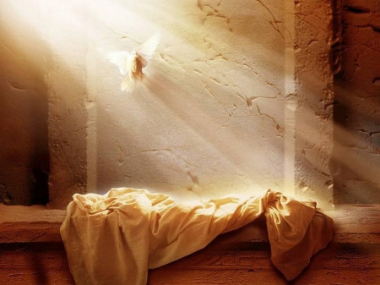
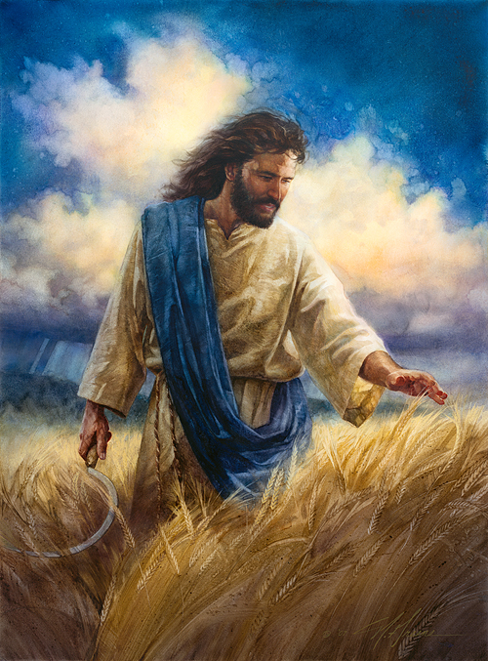
Timing of Resurrection & Ascension
Do not confuse these two facts:
Yahusha’s resurrection was on the weekly Sabbath (not Sunday);
Yahusha’s ascension was perfectly timed so that His presence was before Yahuah as the earthly Wavesheaf was waved heavenward – at the 3rd hour of the day.
(A study on the Wednesday crucifixion is crucial if this fact is not recognized yet. Ask for studies if you need more information.)
Notes:
This ascension is the fulfillment (antitype) of the “type.”

Slide 61
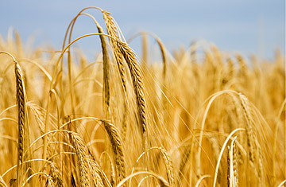
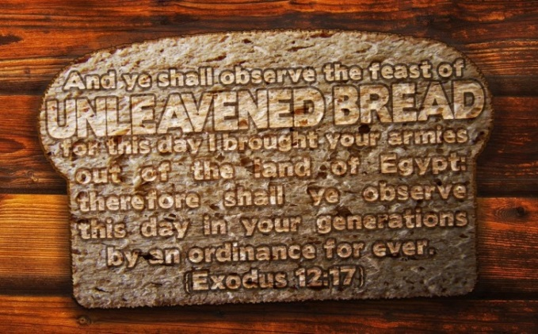
Which was Honoured First on Abib 15?
Firstfruits? ~ Unleavened Bread?
Joshua’s 1st honour was applied to:
the Wavesheaf Festival event (representing Yahusha’s ascension at the 3rd hour).
Joshua’s 2nd honour was bestowed upon:
The 1st Sabbath of Unleavened Bread.
All else on Abib 15 pales in Comparison.

Slide 62
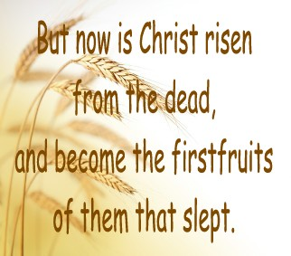
1st Honor: Firstfruits / Wavesheaf
After the Wavesheaf offering at the 3rd hour from Dawn the people were released from the command to refrain from eating the yield of the land.
The significance of this prophecy (the presentation of the harvest to Yahuah for acceptance) should draw full attention to the SKELETAL BONE STRUCTURE of the Plan of Salvation through Yahuah’s Feasts and Festivals. (Remember: There is also another antitype “harvest” at the end time.)

Slide 63
Beware of Error Giving Honour to Abib 16
Beware: A Firstfruits festival that is married to Abib 16 has no Scriptural foundation.
Also beware of any suggestions that say: Permission to eat the grain was not in effect until Abib 16. If that were the case, this suggestion would eliminate the word usage of “the same day.” Why? Because Israel was given permission to eat the grain of the land “on the same day” the grain was used for the Wavesheaf offering.
(Yes, the grain was harvested, threshed, ground and baked for unleavened bread that day. )
Understanding of Firstfruits is a most important part of Joshua’s study.
We are now ready for a summary of this section.

Slide 64
The Highlight of Firstfruits
Every Firstfruits was a prophecy!
The “3rd hour moment” marked Yahuah’s “skeletal bone structure” plan for every single person. For at that time Yahusha, as the Wavesheaf / Firstfruits, would one day completely fulfill every requirement for the whole plan of salvation! Our death penalty will then be satisfied and fully recognized through Yahusha, the Highest Priest of the Melchizedek Order.
Does this information illustrate how/why the Firstfruits Festival is so important for us?

Slide 65
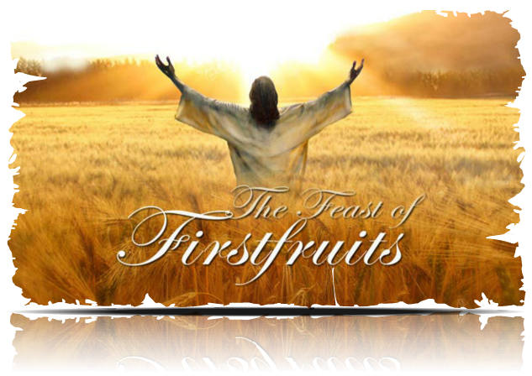
The Firstfruits Yearly Prophecy
This is why Firstfruits was NEVER to be celebrated as a floating festival each year. Every Firstfruits festival was prophetic of the exact day of the week that Yahusha would represent the Wavesheaf antitype that had been rehearsed for ages.
The Prophecy was FULFILLED when Yahusha, as the primary FIRSTFRUITS, was PRESENTED BEFORE HIS FATHER after HE talked with Miriam at the tomb (John 20:17).
All this is the GOOD NEWS of Firstfruits!

Slide 66
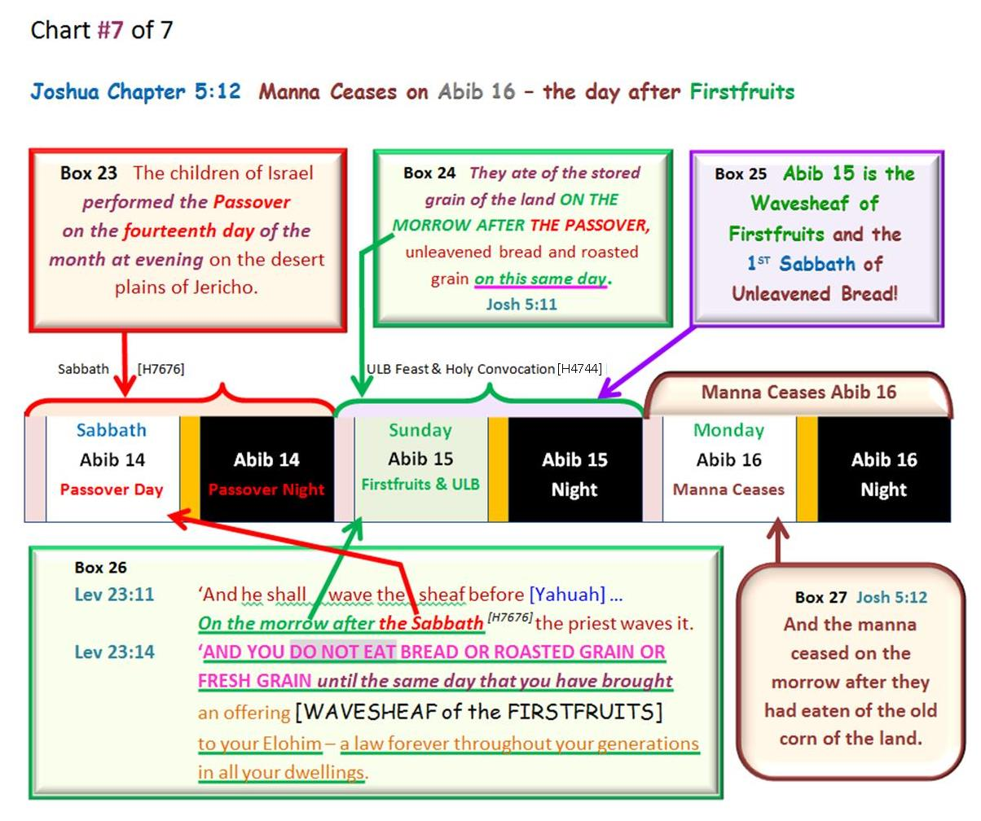
Abib 16 ~ No More Manna!
Joshua 5:12 And the manna ceased on the morrow after they had eaten of the old corn of the land; neither had the children of Israel manna any more; but they did eat of the fruit of the land of Canaan that year. KJV

Slide 67
#10: Joshua Confirms:
Celebrating Firstfruits has priority before honouring the 1st Sabbath of Unleavened Bread.
It is way more significant because Firstfruits is a prophecy given about 1500 years in advance of when Yahusha would ascend heavenward.
The celebration of Firstfruits should never be a forgotten festival!
Question: When Abib 15 and the H7676 Sabbath share the same date, which “Sabbath” has priority?

Slide 68
Another Floating Firstfruits Problem
Many that honour the Feasts and Festivals understand the placement of Firstfruits is always and ONLY on Abib 16.
In other words, Firstfruits married to Abib 16 floats on any day of the week from year to year. Why is this a problem?
Reviewing two of the reasons:
Firstfruits must follow the weekly H7676 Sabbath every year. (It’s not possible for Abib 16 to follow the weekly Sabbath every single year!)
The correct prophetic “day of the week” as specified for the Firstfruits “day of 1st Ascension” of our Messiah is completely removed when tied to Abib 16.
Another problem needs to be addressed:
If Firstfruits is placed on Abib 16 following the 1st annual Sabbath of Unleavened Bread … the Counting of the Omer will not be completely correct. As a result, the Pentecost festival will be seriously misplaced.
R E V I E W

Slide 69
Instructions for Counting the Omer
Lev 23:15-16 And you shall count for yourselves from the day after the Sabbath ^{[H7676]}, from the day that you brought the sheaf of the wave offering: seven Sabbaths shall be completed. 16 Count fifty days to the day after the seventh Sabbath ^{[H7676]}; then you shall offer a new grain offering to [Yahuah]. NKJV
Pentecost can only follow a 7th Day Sabbath ^{[H7676]} because there are no other annual Sabbaths, or holy convocations, close to this point in time for the 50th cycle to follow “after”!
The next set of charts will illustrate the problem, and the solution. Abib 14th Passover is placed on the 7th Day Sabbath as seen in the book of Joshua.

Slide 70
Chart #1
The Problem of a Floating Firstfruits on Abib 16.

Slide 71
Counting the Omer from Abib 16 Firstfruits
??
1st
Only 1 Completed Omer Week in the Month of Abib

Slide 72
Counting the Omer from Abib 16 Firstfruits
2nd
3rd
4th
5th
6th
Problems! Only 6 Completed Omer Weeks. The Omer Count is Incorrect!
??

Slide 73
Chart #2
Proper Placement of Firstfruits Solves the Omer Count.

Slide 74
Counting the Omer from Abib 15 Firstfruits
1st
2nd
2 Completed Omer Weeks in Abib

Slide 75
Counting the Omer from Abib 15 Firstfruits
3rd
4th
5th
6th
7th
7 Perfect Completed Omer Weeks

Slide 76
#11: Joshua Confirms:
When Firstfruits follows the H7676 Weekly Sabbath, (beginning Omer Count #1), there will be 7 perfect completed weeks to the 50th Day of Pentecost.

Slide 77
2nd Witness to Settle the Challenge of Firstfruits Placement is:
Is there history around Abib 16?

Slide 78
The Unscriptural Traditional Command of Firstfruits on Abib 16
Truth:
Firstfruits is always celebrated on the morrow after the weekly Sabbath during the Spring Festivals. This is ‘day one’ for Counting the Omer.
Omer means “sheaf.” The command for Counting the Omer originates in Lev 23:15 . It is a mitzvah (commandment) to count the Omer for the seven complete weeks between Passover and Pentecost.
Tradition:
Firstfruits Festival is always fixed to the Abib 16 date (as a floating Firstfruits).
Counting the Omer is according to Jewish tradition.
R E V I E W
BRAND NEW

Slide 79
Jewish Tradition Leads the Way
The Jews’ Omer Count from Firstfruits to Pentecost always begins on the third day of the Passover spring festival. Firstfruits always follows the 1st Sabbath of Unleavened Bread with celebrations on Abib 16.
There are also a series of restrictions that arise during the period of the counting of the Omer up until Lag Ba’Omer, which translates as the 33rd day in the count of the Omer. The tradition is: to mourn the first 33 days until the 34th day in the morning.
For the Jews, a large portion of the seven-week counting period is considered a mourning period that ends with:

Slide 80
Lag Ba'Omer is a minor Jewish holiday that falls between the festivals of Passover and Pentecost.
In Jewish tradition, the 33rd day of the Omer Count is regarded as a holiday that commemorates the death of “Rashbi” [Rabbi Shimon bar Yochai] (80-160 AD.)

Slide 81
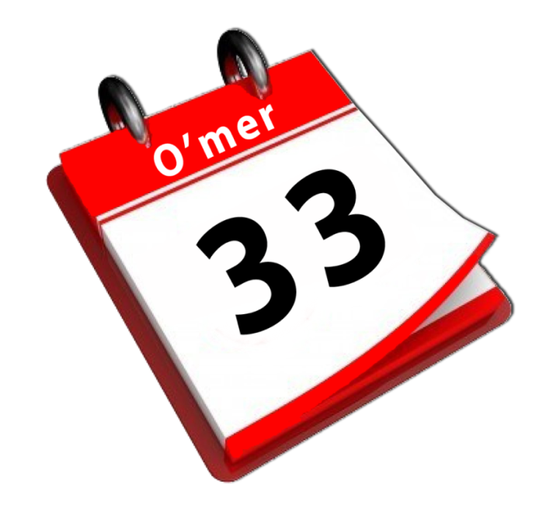
Hebrew letters may be used to express numbers.
"Lag" is a combination of two Hebrew letters: Lamed and Gimmel.
The word “Lag” is an acronym for 33 – derived from Lamed (30) and Gimmel (3).
The phrase “Lag Ba’Omer” indicates the 33rd day of the Omer Count.
It is always celebrated on the 18th day of the second month (Zif) on the Jewish Calendar.

Slide 82
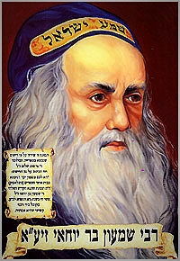
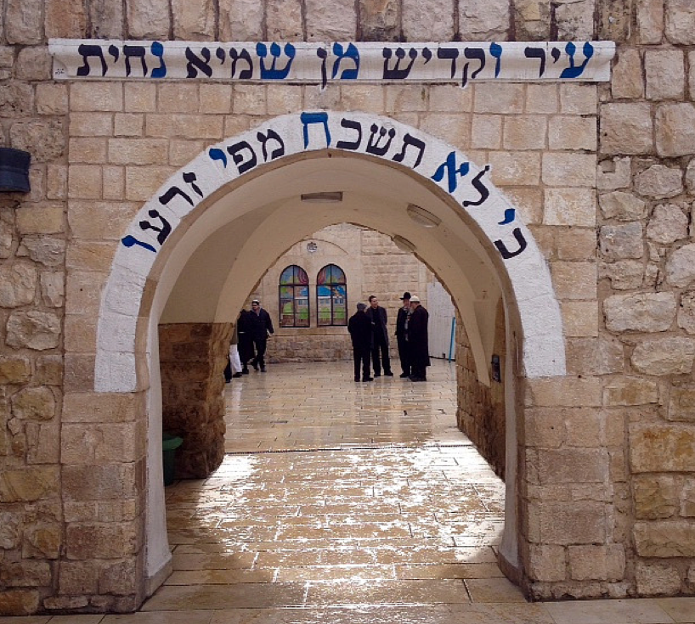
Who is Rabbi Shimon bar Yochai?
“RASHBI” [Rabbi Shimon bar Yochai] (80-160 AD), a disciple of Rabbi Akiva (50-135 AD); is the author of the Zohar, the most famous book of the Kabbalah.
Many Jews have witnessed miracles of all kinds after praying at his holy grave site.
On the day of Rashbi’s death, he revealed the mystical dimension of the Torah known as the Kabbalah (a form of Jewish mysticism).

Slide 83
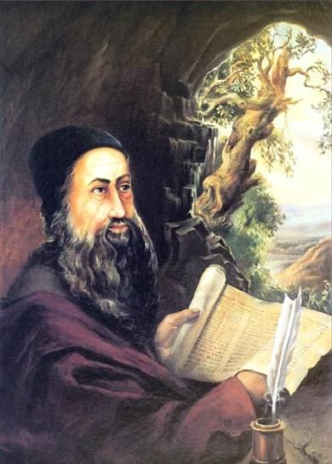
Rashbi’s Connection to Lag Ba’Omer
The day of his death was the 33rd day of the Omer Count.
Every anniversary celebrates this “hidden Torah” or the anniversary of the revelation of Kabbalah.
This Jewish holiday holds equal importance to Pentecost [the giving of the written Torah to Moses].
Celebrations are held in the village of Meron, near Israel, at Rashbi’s supposed burial site.
Hundreds of thousands of Jews gather at Mt Meron to pray and celebrate the Kabbalah.
MANY bonfires are lit at sunset on the 32nd Omer day count to commemorate the death of Rashbi. (Remember: “sunset” on the 32nd ushers in the 33rd day according to Jewish tradition.)

Slide 84
May 2015 Posters

Slide 85
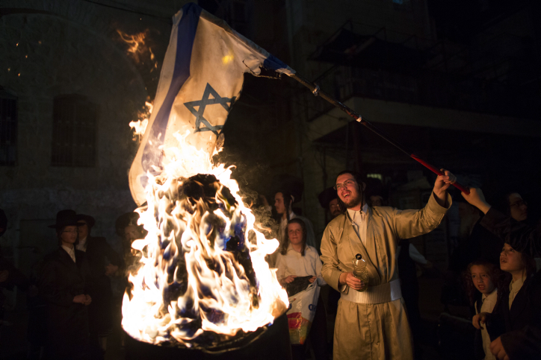
Lag Ba’Omer is a HUGE Jewish Celebration
The internet is emphatic about this festive day on the Jewish calendar.
It’s amazing the amount of internet coverage there was for May 7, 2015, Lag Ba’Omer, [the 33rd day of the Omer Count for 2015].
Every year this celebration is attended with much fanfare for Rashbi, (the great mystic sage), on the anniversary of his death.

Slide 86
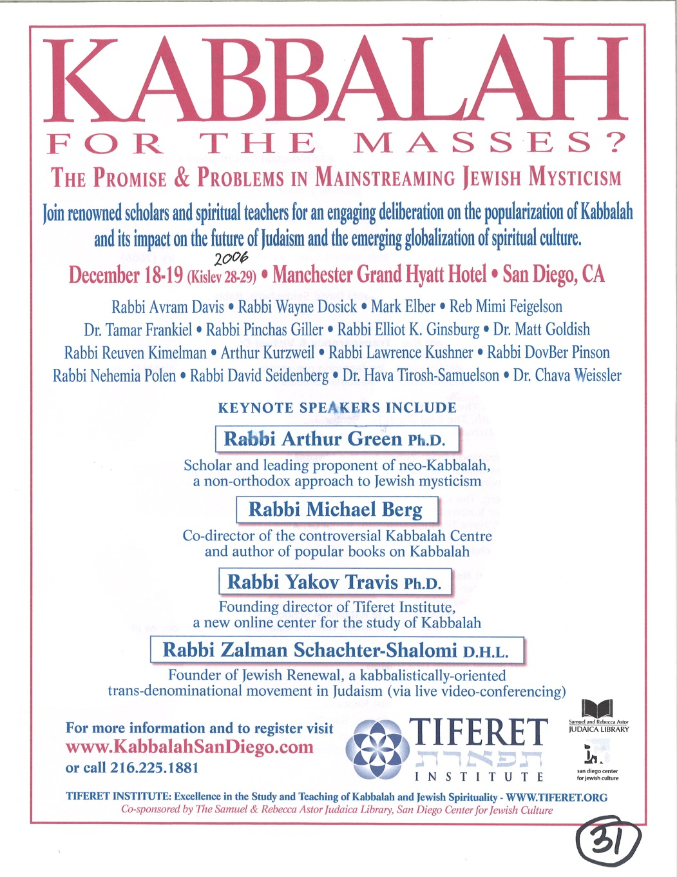
Lag Ba’Omer is Very Popular
New York City
2015

Slide 87
How Did Rashbi’s Death Get Connected to Firstfruits?
In the year Rashbi died the Jews could have been celebrating Firstfruits
(on the first day of the week), according to the instructions in Lev 23. (There is historical evidence of this.) Therefore: The 33rd day of the Omer Count would be the 18th day of the second month for THAT year only!
Remember: Rashbi died on the 33rd day of the Omer Count. (That’s an interesting “mystical number.”)
For over 1850 years, RASBHI has been honoured as a saint on every 33rd day of the Omer Count. This day ALWAYS links back to Abib 16 as Firstfruits … even if it is not the true Firstfruits!

Slide 88
Rashbi’s Death Changed the Correct Timing of Firstfruits!
This is how Firstfruits became permanently tied to Abib 16.
In THAT YEAR, Firstfruits could have been correctly located on Abib 16 – Sunday, the first day of the week. When Firstfruits is married to Abib 16, it does not land on the 1st cycle every year.
Since that time, the 33 days are always counted back to the date of Abib 16 so that the Rabbi’s death would always be celebrated on the 18th day of the second month.
However, this event not only became a problem, but also a widely accepted counterfeit, just as sunset is a counterfeit for creation’s day-start.
Be willing to challenge every teaching to see if it links to a tradition!
Notes:
Beware of traditions that creep in so shrewdly!

Slide 89
Should Covenant Torah-Keepers Observe Lag Ba’Omer?
No!
The holiday is not a Torah command. It is derived entirely from Rabbinic and occultic tradition.
Everything about this celebration is linked to the mystical writings of Kabbalah.
Rashbi did not acknowledge Yahusha as the Messiah.
“Kabbalah” is a deceptive system of thought that seduces people into denying that they are sinners in need of salvation. The Kabbalist believes each of us are essentially divine beings.
There is no need of any Saviour.
Everyone is pure, and just needs to be enlightened (through the mystical worship of Lucifer).

Slide 90
It is clear the traditional Firstfruits linked to only Abib 16 has strong ties to Kabbalistic ways including mysticism and all associated links to the Jesuits and secret societies!
QUESTION:
Why are so many “so called” Torah (Feast) Keepers honoring Abib 16 when this date is widely connected to such mysticism?
Maybe they just don’t know! Let’s tell them!

Slide 91
Lag Ba’Omer definitely counterfeits the true meaning of Firstfruits!
Yahusha DID NOT ascend to heaven on any day of the week except for the 1st cycle [Sunday]!
Should honest Torah Keepers sever their connection to a yearly Abib 16 Firstfruits?
Yes!

Slide 92
Does that mean the Firstfruits Festival is NEVER on Abib 16?
R E V I E W
There is no rule that Firstfruits can never occur on Abib 16.
If Passover is on Friday Abib 14 …
THEN: Abib 15 is the 7th Day Sabbath AND the Unleavened Bread Sabbath …
THEREFORE: Abib 16 celebrates Firstfruits (on the “day after the weekly Sabbath” as given in Scripture).
No!
Many Feast-keepers and ministries have Firstfruits married to Abib 16.
It behooves us to wonder how they missed the clear instructions from the Torah. The result?
Firstfruits on Abib 16 becomes a floating date on the calendar demanding Pentecost is also allocated to a floating date. On the next slide is a calendar from a Christian Feast ministry with their Firstfruits Festival married to Abib 16.

Slide 93
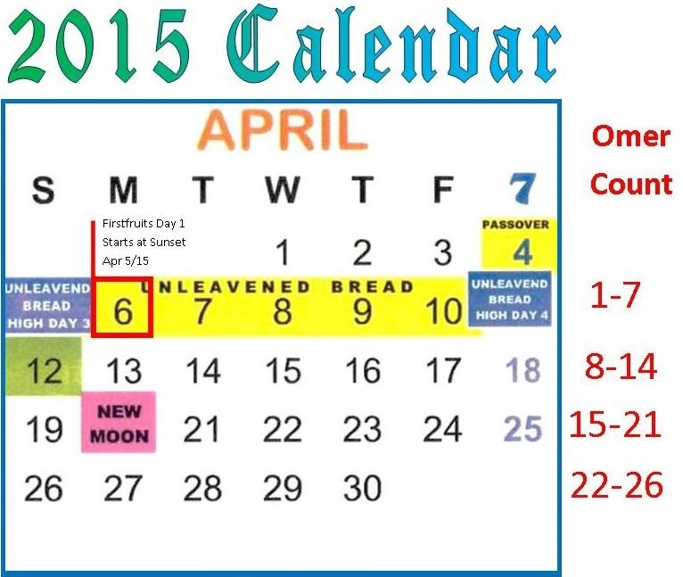
A Christian Calendar for Firstfruits
The Question is: How will the following Christian Feast Calendar compare to the traditional Jewish calendar for 2015?
Day One of the Omer Count begins at sunset on Sunday Apr 5th. Firstfruits is Monday Apr 6th.
Will Day 33 of the Omer Count land on Thursday May 7, 2015 exactly like the Jewish calendar?

Slide 94
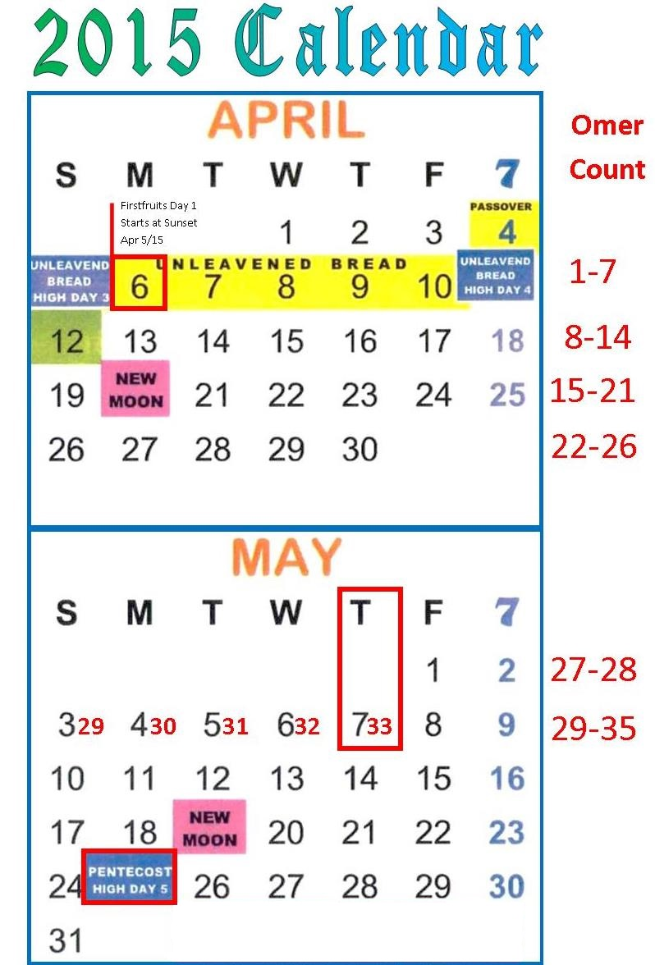
Answer:
Christian Feast Keepers that follow this Jewish calendar likely do not know the 33rd day of the Omer count pays respect to the great mystic sage Rashbi?
When they find out, perhaps they will celebrate the Firstfruits/Wavesheaf festival according to the instructions of Moses and Joshua.
This Christian Feast
Calendar does
favor Lag Ba’Omer which begins at sunset on May 6th!
May 7th is the 33rd day.

Slide 95
Endorsement from J. Morgenstern Hebrew Union College (Indiana)
“Actually the legislation for the bringing of the ‘Omer, the first sheaf of the new, annual crop, is recorded in only one passage of the entire Pentateuch, Lev. 23:9-16 … This legislation provides that the ‘Omer is to be waved before Yahweh by the priest upon the day following the Sabbath … The basic difficulty here is the determination of the precise dating implicit in the term, “the day after the Sabbath.” The customary interpretation, accepted by most present-day biblical scholars, is that the Sabbath here is the Sabbath which falls within the week of the Passover-Massot Festival. Such too was the interpretation given of old to this term by three quite ancient Jewish sects, the Samaritans, the Boethusians and the Karaites. This would imply, of course that the day of bringing the ‘Omer was always a Sunday, and also since the counting of the fifty days which intervened between the day of bringing the ‘Omer and the Sabu’ot Festival commenced upon a Sunday, the latter festival also would fall always upon a Sunday…”
(Hebrew Union College [Originally founded 1875; Besides Israel, 5 colleges in USA]
Annual – Article: ‘Lag ba’Omer – Its Origin and Import’ by Julian Morgenstern, [a President of] Hebrew Union College -Jewish Institute of Religion, p. 81-90.)
Yes!

Slide 96
Besides “History,” Morgenstern’s
Testimony, and the witness in the Exo 12-16-19 account of Passover to Pentecost …
#12: Joshua also Confirms:
Firstfruits is not married to Abib 16 – the day following the 1st Sabbath of Unleavened Bread;
Firstfruits is always placed within the Passover Festival contrary to Enoch’s teaching.

Slide 97
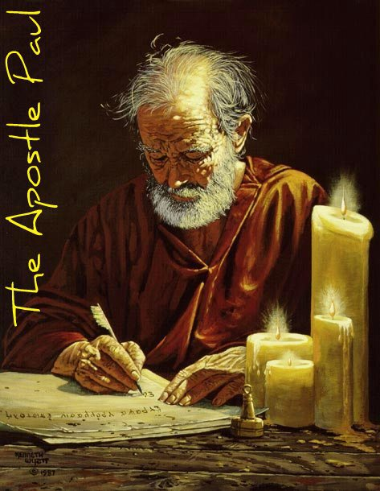
Counsel From the Apostle Paul
Ephesians 5:8-13
8 For you were once darkness, but now you are light in [yahuah]. Walk as children of light 9 (for the fruit of the Spirit is in all goodness, righteousness, and truth), 10 finding out what is acceptable to [Yahuah]. 11 And have no fellowship with the unfruitful works of darkness, but rather expose them. 12 For it is shameful even to speak of those things which are done by them in secret. 13 But all things that are exposed are made manifest by the light, for whatever makes manifest is light. NKJV

Slide 98
It’s very possible many do not understand it is “complete darkness” to consistently celebrate Firstfruits on Abib 16. Lev 23 along with Joshua, Exodus and the Gospel account expose the unfruitful works of darkness.
Once the evidence is brought forth, everyone can make their choice.

Slide 99
Comparing the Evidence
R E V I E W
Firstfruits by Tradition
Firstfruits by Scripture
When Firstfruits is consistently celebrated on Abib 16, it links to a Rabbi that gravitated towards the darkness of mysticism and Kabbalah which has powerful ties to the “prince of darkness.”
When Firstfruits is celebrated on the “Morrow after the weekly Sabbath” it links to our Messiah when He presented Himself as “THE leading Firstfruits” after His resurrection. Firstfruits links to that ascension event – a powerful victory for His children. This is extremely significant and important because it is one of the most basic events known to man providing the foundational [bone] structure of the Plan of Salvation.

Slide 100
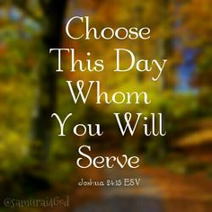
Firstfruits Festival Choices
The tradition of Abib 16 pales in comparison to the Torah Truth of the Firstfruits Festival!
Firstfruits Following H7676 Sabbath honoring Yahusha’s Ascension & Victory
for US!
Firstfruits Following ULB Sabbath on Abib 16 honoring Rashbi & Kabbalah Mysticism?

Slide 101
1 Corinthians 14:33, 40
For Yahuah is not the author of confusion …
Let all things be done decently and in order.
May Yahuah bless you abundantly in your search
for His Divine truth.
The End

Slide 102
The next Covenant Calendar Study will be:
David’s Qodesh Lechem
Another counting puzzle
Addresses the error of weekly Sabbaths that follow the lunar cycles
Questions/Comments on the placement of Firstfruits?
calendar@torahtothetribes.com

