Slide 1





The Creation Week (Part 2)
Gen 1:5 - Gen 2:3 (Days 1-7)
Notes:
Mar 21/21: corrections on slides 5 (grammar in column 2) and 6 (chg prefect – to – perfect) re: Chris Faifer. Printed new files today with new logo.

Slide 2
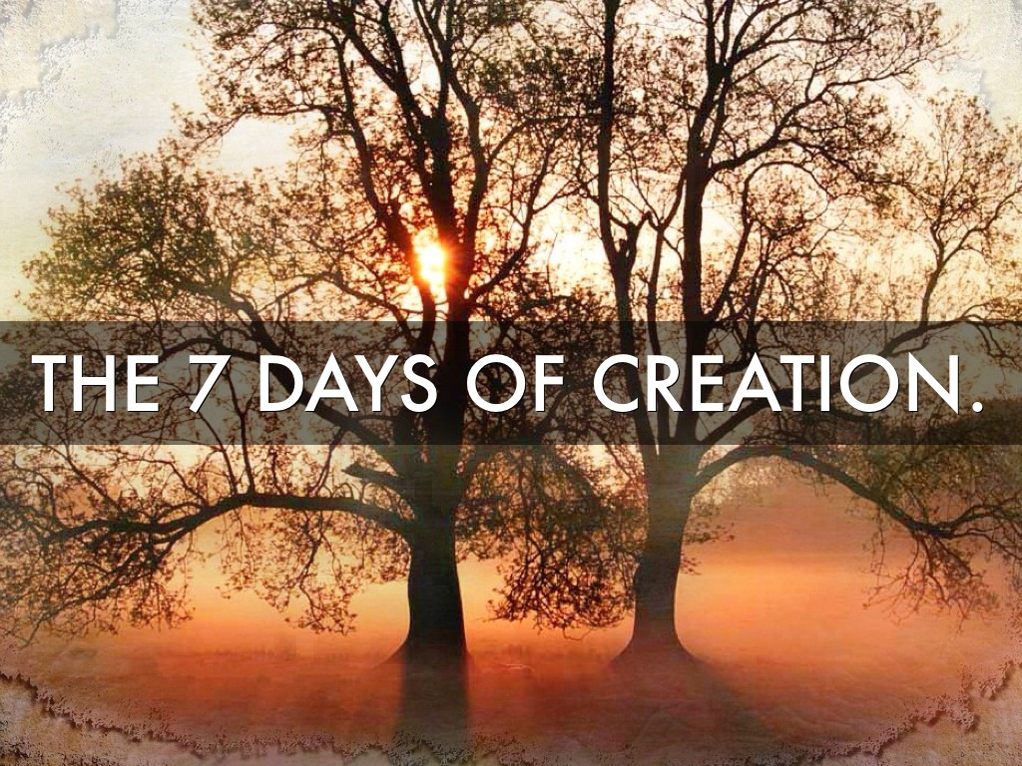
This study will complete
the investigation for the
Creation Week.

Slide 3

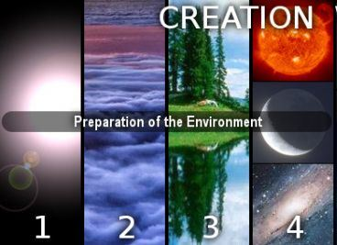
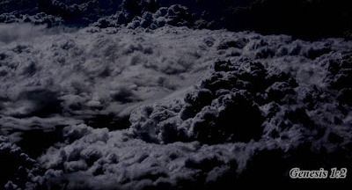
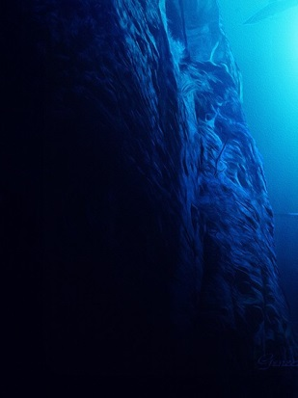
Review for Creation Week - Part 1
Gen 1:1
Gen 1:2 (a)
Gen 1:2 (b)
In the beginning Yahuah created the heaven and the earth.
And the earth
[came to be] without form, void, and darkness was upon the face of the deep.
And the Ruach
moved upon the
face of the waters.
Creation Vs 1!
Chaos & Darkness Vs 2a
Light Restored Vs 2b
Next: A “10 Point” review for Day 1 of Creation.

Slide 4



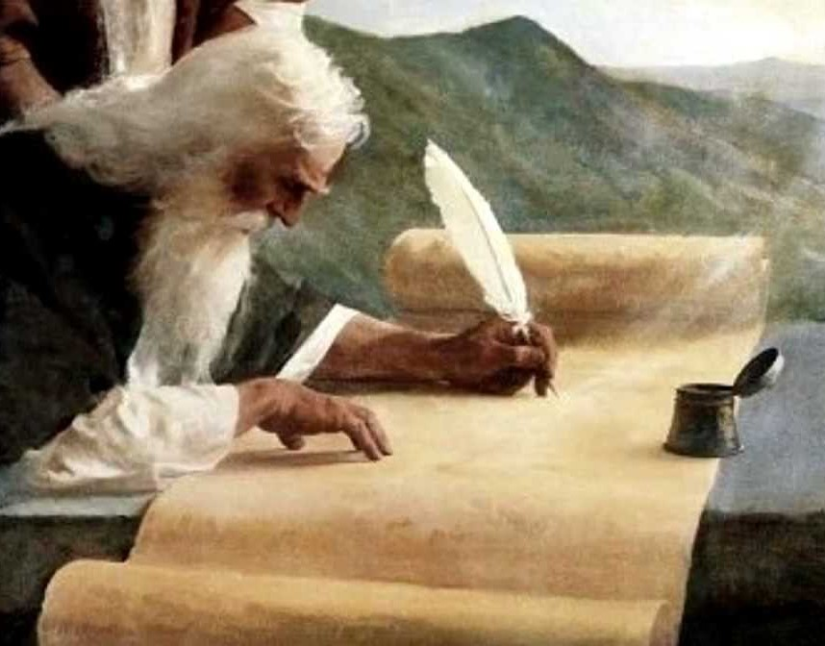
1. The Orderly “Narrative” of the Creation Story
The “narrative” of “the Creation story” is most definitely written in order.
  Thoughts to Ponder: Moses was inspired
  by Yahuah for all the words of Torah.
  Is it possible Moses did not develop the narrative of the Creation Week in order?
            And if the narrative is not in the correct order,
            who has the authority
            to decide what the
            correct order is?
            If there is a span of time more than 24 hours in Gen 1, should Moses
            have recorded it?
D
I
D
Y
O
U
K
N
O
W
The narrative of the
Creation Week is correctly understood only when all
the verses are kept
in perfect sequence.

Slide 5

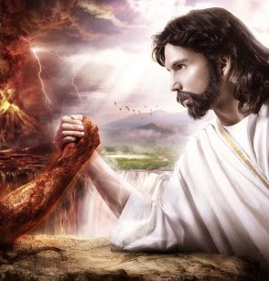
2. Yahuah Knows the “end” From the “beginning”
In order to understand
the first 2 verses of Gen 1, consideration must be
given to some things that happened before Gen 1:1.
  Yahuah made provision in advance should His “gift of choice” be exercised in a negative manner.
  Yahuah knew there would be “war in heaven” (Rev 12:7).
  Yahuah’s decisions for
  “what would be created”
  in Gen 1:1 were based
  upon His foreknowledge
  of what would happen in
  heaven, before creation.
  Yahuah knew there would be:
    3 days of creation;
    3 days of restoration and
    1 day for communion.
  Yahuah also knew when Satan would be
  cast out of the heavenly domain.
T
H
I
N
G
S
T
O
P
O
N
D
E
R

Slide 6

3. Yahuah is our Perfect Creator – Gen 1:1
Because Yahuah is our Perfect Creator:
  Is it possible for our perfect Creator to create anything that is imperfect?
    (True? or False? Are you sure?)
  Gen 1:1 includes the perfect creation
  of land, water, air, plants and the heavenly lights – all at once!
  Ps 33:9 For he spake, and it
  was done; he commanded,
  and it stood fast. KJV
Creation Vs 1!
R
E
V
I
E
W
Nothing was brought forth in
Gen 1:1 that would have injured
a “living soul” such as animals of the land and sea, or mankind.

Slide 7
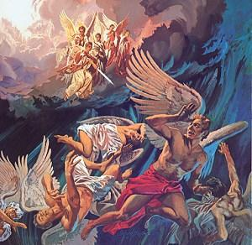
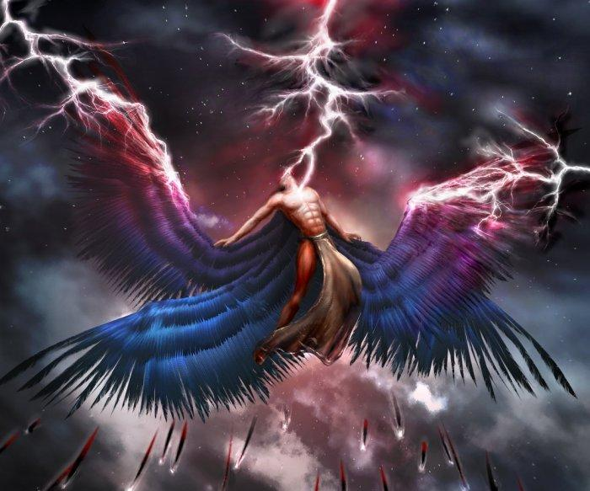
4. Yahuah, our Creator, is All-Loving
  The next events in this narrative occur
  between Gen 1:1 and 1:2.
When Satan and his angels rebelled against their Creator, this was labeled as “sin in heaven.” However, our loving Creator did not expel Satan from Heaven until he refused to repent. At that point, Satan and his host were cast to this earth.
  This is the puzzle piece of Day 1
  that is not written “in words” at
  this place in the Scriptures.
  The answer to the puzzle is found in
  Jer 4:23 and the final end time events – where the earth is described as being in total ruin and chaos (Rev 16).
And he [Yahusha] said unto them,
I beheld Satan as lightning fall from heaven.
Luke 10:18
R
E
V
I
E
W
IMPACT

Slide 8

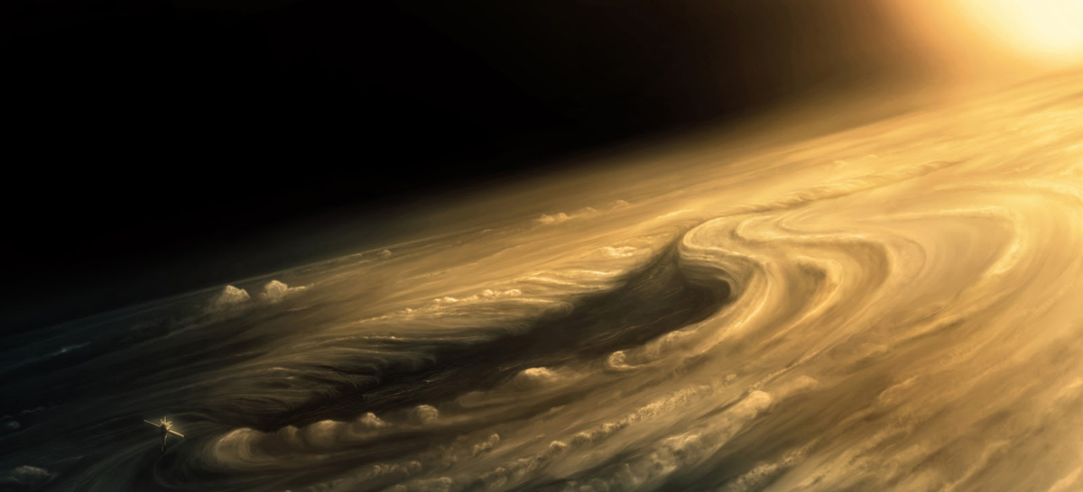
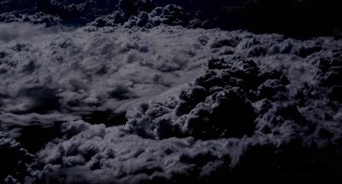
5. Satan Has Demolishing Power – Gen 1:2a
R
E
V
I
E
W
Satan demonstrates his vast demolishing
power against the newly created
heaven and earth.
  Beginning with vs 2, the earth “came to be” “without form” and “void” – [completely worthless and under utter chaos], followed by “<choshek> darkness on the face of the waters.”
  This <choshek> “darkness” was not “created” – it was the result of Satan and his host of angels being cast to this earth.
  Many of these angels were locked up in this <choshek> abyss at the beginning. [Rev 9:1-3]
  The <choshek> “darkness” of Gen 1:2 was not only a “literal darkness” such as can be felt, but it was also a chaotic darkness linked to Hades and the abyss or, an underground prison of the subterranean seas.
  This <choshek> darkness was allowed as Yahuah’s provision to make available a place for the consequences of the original sin.
Without form & void …
to chaos & darkness!
Isa 45:7 I form the light, and create darkness … KJV
Notes:
CERN, is the proof of the evil culture which also beliefs the evil angels are locked in the abyss. It is the prime mandate of CERN to create a 6th demension that will unlock the doors of the abyss and let the fallen angels out.
However we will be tarred and feathereed for bringing this up.
Yes, maybe in the name of moving forward, this slide should be removed.

Slide 9
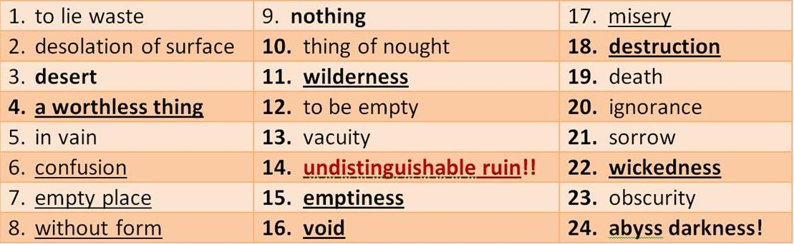
5a. Definitions for Satan’s Demolition – Gen 1:2a
Four Hebrew terms in Gen 1:2(a) include a host of negative definitions.
Without form & void …
R
E
V
I
E
W
& darkness upon the
face of the deep!

Slide 10


6. Yahuah Has Power Over Satan – Gen 1:2b
Yahuah is all-powerful and much more powerful than Satan.
He begins to restore His creation during
the remainder of the 12 hour Day Season.
Yahuah does not need a huge amount of time for restoration as man reckons.
  There is no allowance for a
  “gap theory” of 1000 years
  between verses 1 and 2 in the first application of the literal narrative.
  Day 2 does not begin until Gen 1:6.
R
E
V
I
E
W
Light is restored through the “fluttering action” of the Ruach cleansing the contaminated waters.
  (Man’s feeble attempts at bringing
  forth a flicker of light is called sonoluminescience.)

Slide 11
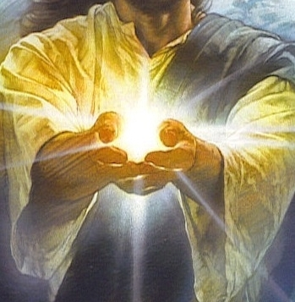
7. Yahuah Restores “LIGHT” First – Gen 1:3
That which cleanses
must be cleansed first!
  Everything started with LIGHT,
  as Yahuah is LIGHT. (John 1:5)
  1 John 1:5 This then is the message which we have heard of him, and declare unto you, that [Yahuah] is light, and in him is no darkness at all. KJV
  LIGHT is the most basic form of energy; more fundamental than
  the heavenly “light-givers.”
R
E
V
I
E
W
  Ps 104:30 Thou sendest forth
  thy spirit, they are created:
  and thou renewest the
  face of the earth. KJV
Notes:
the pattern for this is found in the preparations the Ahronic priest had to go through before being ready for office

Slide 12
8. Yahuah Separates LIGHT from DARKNESS – Gen 1:4
The <choshek> darkness came to encapsulated everything!
  Besides visible light, the “good components” include:
  “invisible light” such as shortwave radiations and
  long-wave radiations.
R
E
V
I
E
W
Yahuah separated His “LIGHT” components locked in this darkness.
Choshek darkness
Owr Light
Owr Light
BRAND
NEW

Slide 13

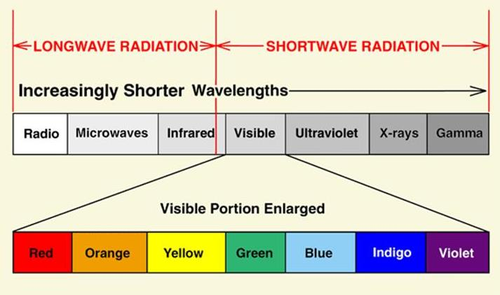
8a. The “Components” of LIGHT – Gen 1:4
BRAND
N
EW
  Long-wave Radiations
    Radio (TV, Cell Phone) waves
    Micro-wave
    Infrared
  Shortwave Radiations
    Ultra-violet
    X-rays
    Gamma rays
  LIGHT also includes components of:
  heat, sound, electricity, magnetism,
  and molecular interactions.
  These “invisible” components of “light” are constant through the
  Day Season and the Night Season
  of each day.
Where would we be today had Yahuah
not separated out these good components
of His “light” from <choshek> darkness?

Slide 14
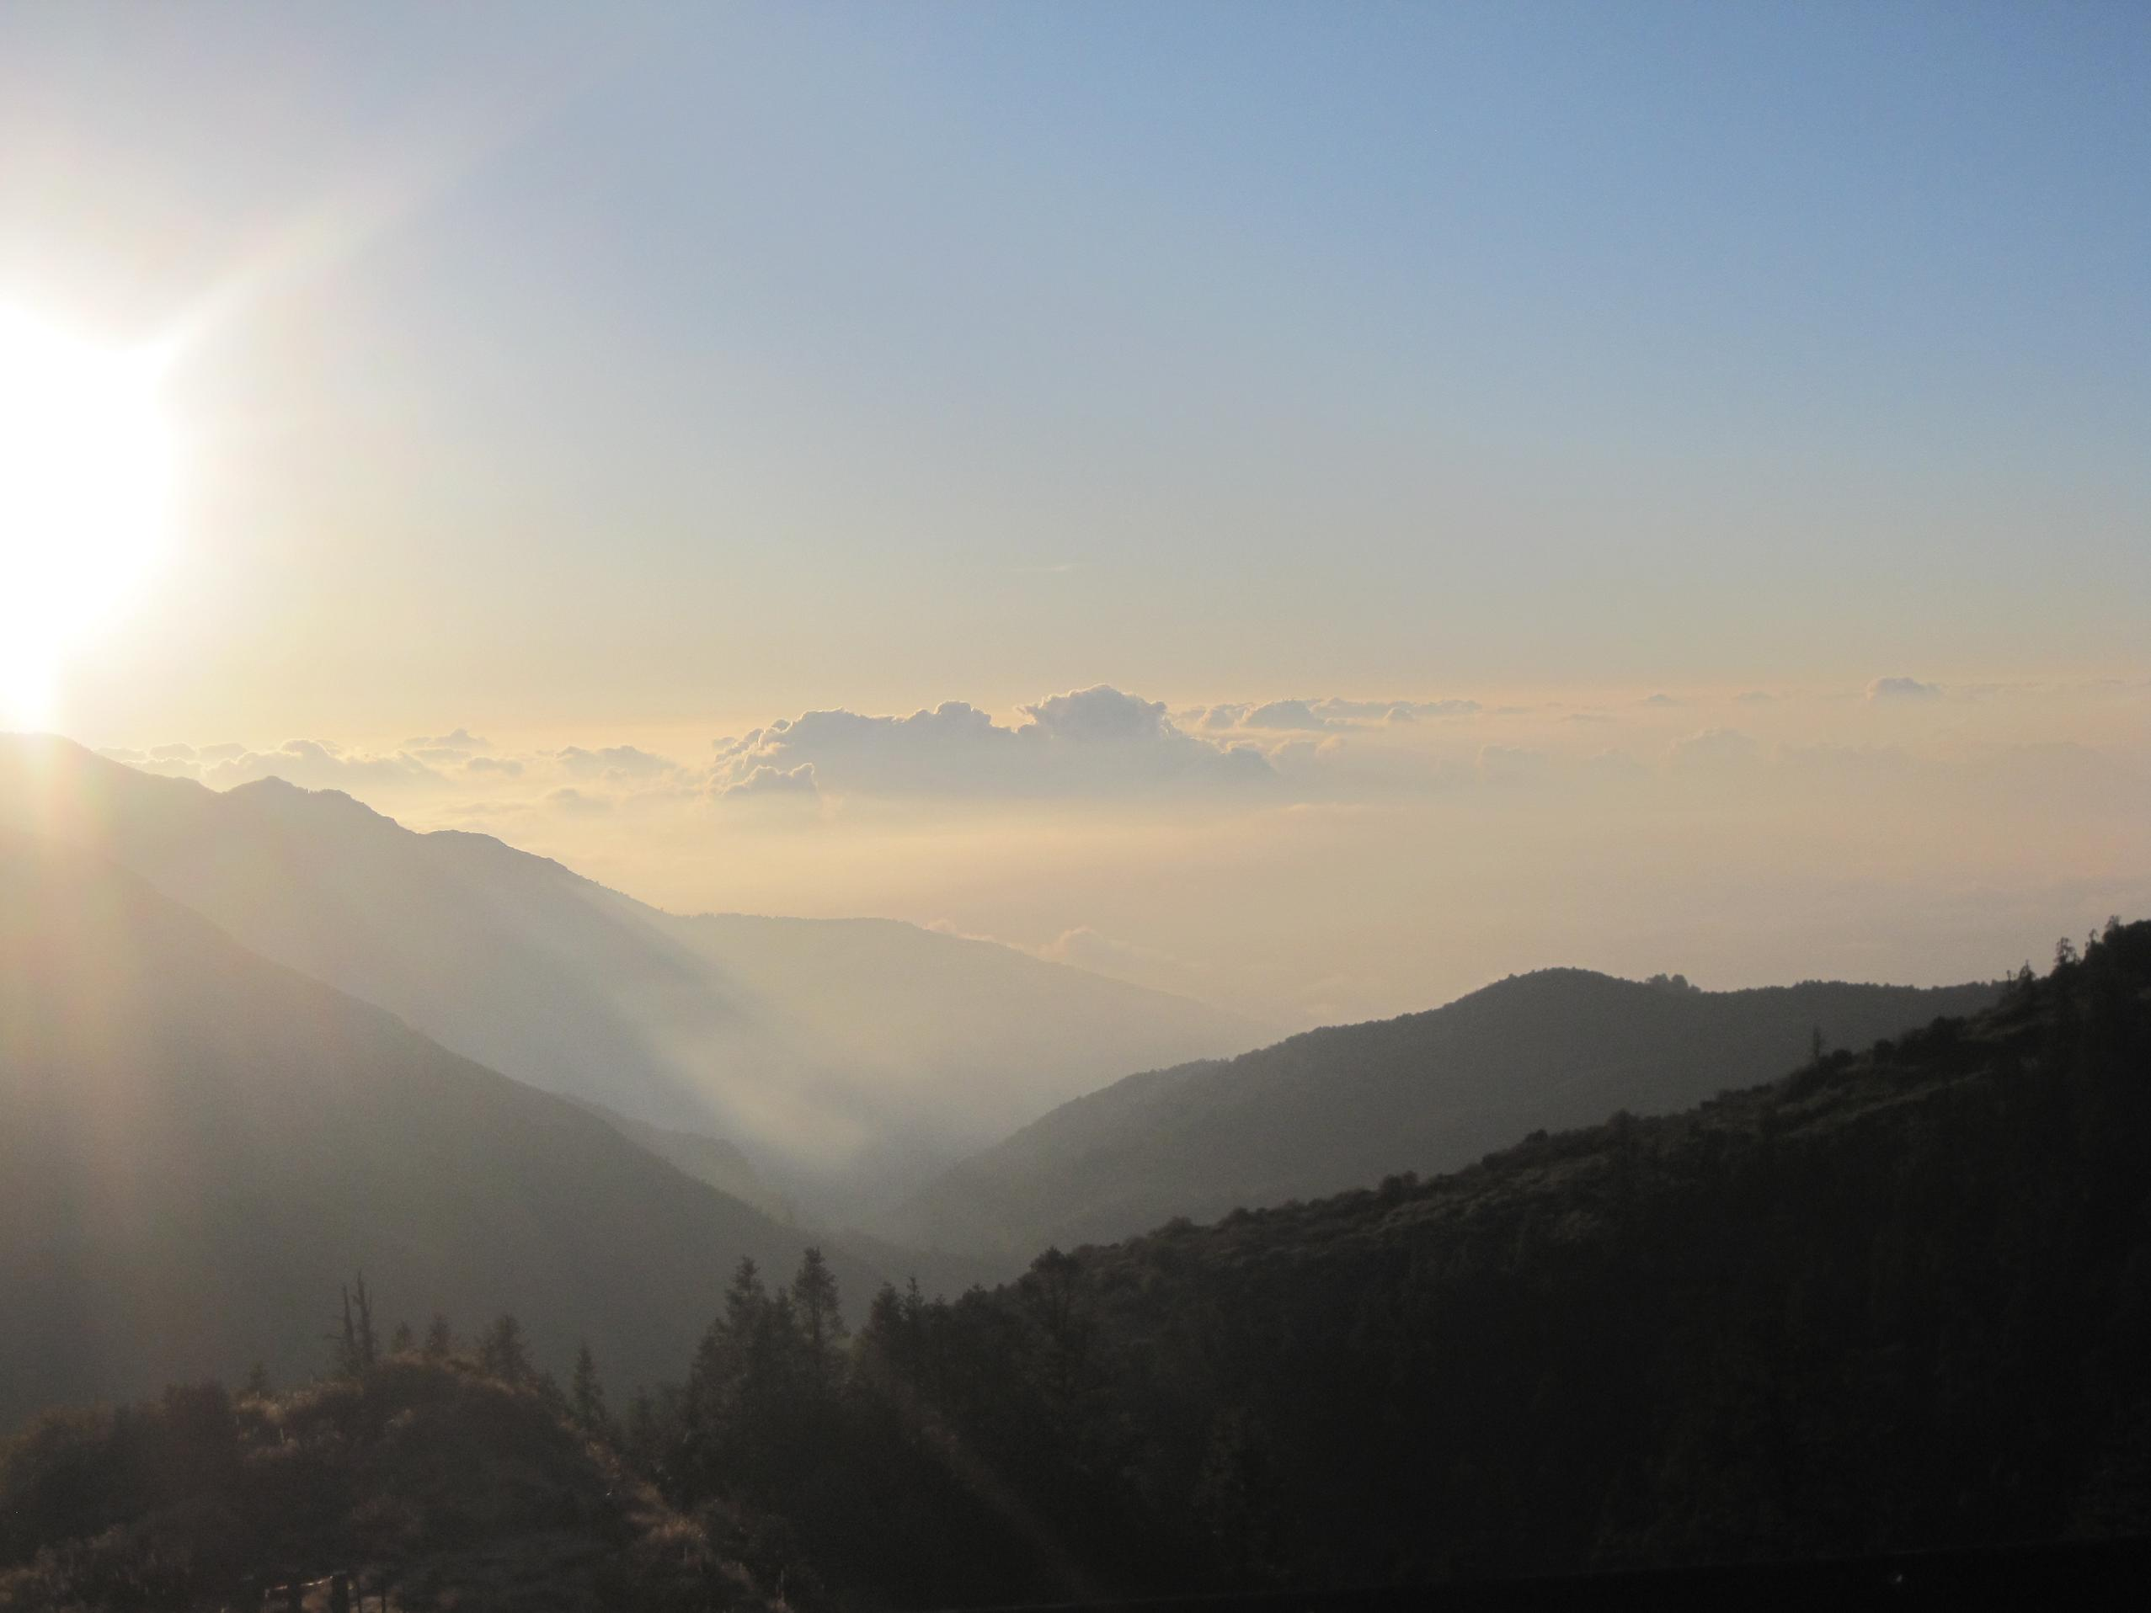

9. & 10. Important Hebrew Definitions – Gen 1:5a
Yahuah’s work for the Day Season is complete. Next, Yahuah provides definitions for the two major components of the 24 hour cycle.
Yahuah declares in Gen 1:5a the
first Hebrew definitions for the
1st “day” <yowm> H3117 to be:
  The Day Season is 12 literal hours [John 11:9].
  The Night Season is 12 literal hours.
  The full cycle length is 24 literal hours.
  Yahuah’s “days” in the Creation Week are not 1000 years long, nor is there a “gap of unaccounted time” between cycles. The
  many patterns of 7s throughout the Scriptures do not support a “gap theory” in any way!
R
E
V
I
E
W
1. Light is
called DAY
2. Darkness is called NIGHT
Notice: Everything about
creation week started here
with Day-Light.
Next: Gen 1:5b – a close review of “evening” and “morning.”

Slide 15
Moving forward to -
Gen 1:5b And there was evening and there was morning, one day [cycle].
(Stone Edition Tanach)
Question: In Gen 1:5b - What is - evening, and what is - morning?
Let us first identify these words in the Hebrew language.
Evening = <`ereb> ע ר ב - OT:6153
Morning = <boqer> בקר - OT:1242
As we have already seen:
Evening <`ereb> OT:6153 is seen first following the RESTORED <owr> Light Season of creating (and restoration).
The Evening occurs before the <boqer> morning. So let’s examine evening first.
Yahuah’s Safeguard: Two Twilights – Gen 1:5a

Slide 16
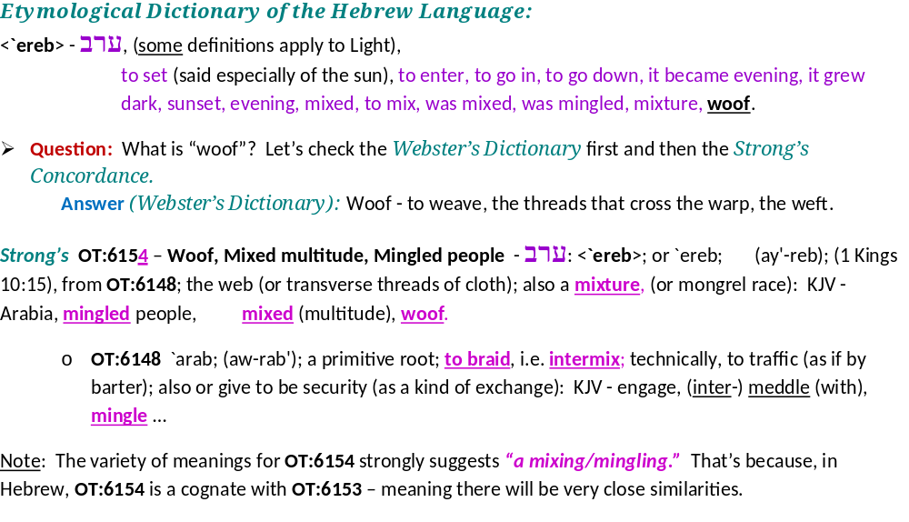
.
R
E
V
I
E
W

Slide 17
R
E
V
I
E
W
Hebrew and English Lexicon of the Old Testament
Based on the Lexicon of William Gesenius, translated by Edward Robinson (1906) (pg. 786)
Evening - ע ר ב
mix, mixture, woof; as mixed, interwoven, to take on pledge, give in pledge, exchange, mix (but quite uncertain), swarm (mixture, from incessant, involved motion).
We do not see that the <ereb> evening twilight verb can possibly be the
Night Season for the Night Season does not have light from the sun.
<ereb> requires a MIXTURE OF LIGHT AND DARKNESS
TO FORM THE EVENING TWILIGHT.

Slide 18
Question: How can the darkness come first when the requirement for the evening twilight mentioned in Genesis 1:5 (b) REQUIRES LIGHT for part of the
MIXTURE ?????
We will take what we have read and return back to Genesis 1:5(b).
The sequence of events is laid out quite well.
Yahuah has created and restored throughout the 1st Light Season of creation and then the evening arrives. This is the time when the Night Season <layil> (not <choshek>) begins to mix with the light of the first cycle of creation.
The light becomes infused with <layil>.
This is what we normally refer to as – twilight.
R
E
V
I
E
W

Slide 19
Here is a graphic of what the Hebrew language in the Scriptures have declared thus far.
Yahuah created and restored on the first half of cycle #1. The arrival of the twilight MIXTURE (ereb/evening) signals the full end of the direct Light Season only – NOT THE 24 HOUR CYCLE!
The first 12 hours of Earth’s History
Creation and restoration of Light
Yahusha – LIGHT – withdraws,
which initiated -
The arrival of <ereb> evening MIXTURE ––
which is – LIGHT BEING OVERTAKEN BY THE DARKNESS.
We now need to consider the word seen in Gen 1:5 (b) – morning or ב ק ר . <boqer>.

Slide 20
Your Refresher:
Gen 1:5b … And there was evening and there was morning, one day.
The full 24 hours of Cycle #1
Creation and restoration of Light
And there was morning [twilight], [BOQER]
HalleluYah Scriptures
Yahusha – {LIGHT}, withdraws!
Arrival of the Ereb/evening
twilight mixture.
Day One.
Layil
Layil, the acceptable night darkness passes by unannounced.
Why? Nothing occurred in the night darkness!

Slide 21
This word ב ק ר . <boqer> {morning} becomes ultra important.
Question to ponder: What on earth (pun intended) does an ox have to do with the start of Yahuah’s 24 hour cycle?
The answer will come soon! ☺
Brown-Driver-Briggs ב ק ר. <boqer> – (OT:1242)
1) morning, break of day
a) morning
1) of end of night
2) of coming of daylight
3) of coming of sunrise
4) of beginning of day
5) of bright joy after night of distress (fig.)
b) morrow, next day, next morning

Slide 22
Strong’s Exhaustive Concordance:
Morning - ב ק ר . <boqer> OT 1242, from OT:1239; properly, dawn (as the break of day); generally, morning: KJV - (+)day, early, morning, morrow.
OT:1239 baqar; a primitive root; properly, to plough, or (generally) break forth, i.e. (figuratively) to inspect, admire, care for, consider:
KJV - (make) inquire (-ry), (make) search, seek out.
To plough? Eric Bissell who teaches Paleo-Hebrew explains the connections from the Hebrew letters to - an ox ploughing a line in the soil. When the ox is shown the target on the other side of the field, it will walk forward ploughing the soil in a straight line. That line of partition is separating one side from another. There is still an underlying connection, but the soil surface has been segregated by a visible demarcation, one from another.

Slide 23
One side of the furrow belongs to one identity – the ploughed. The opposite side of the furrow, to the identity of - needing to be ploughed. Two separate objects are created by a separating action and a specific boundary.
Eric also explains ב ק ר . <boqer> by referring to a belt and buckle.
The ב ק ר . <boqer> being the buckle itself.
The belt goes full circle as in the 24 hours of a cycle (day) and the <boqer> provides the separation from one cycle to another.
Yet the (belt) buckle, (boqer) also supplies the connection of one cycle to the next cycle of the week.
The buckle effectively divides asunder the weekly cycles.

Slide 24
Etymological Dictionary of the Hebrew Language by Earnest Klein
Morning - ב ק ר . <boqer>
1. to cleave, to split, differentiate, to break forth (said of the dawn and of light), to abandon,
2. to cleave, to split, properly denoting the breaking through (of daylight)
3. to split, to plow,
4. the plowing animal
Hebrew English Lexicon by John Parkhurst (1762)
(quf resh) ק ר a hole through which white light appears [as in the first rays of Dawn]
[A two letter root word in older Hebrew Lexicons.]
ב ק ר <boqer> to look upon, survey, look accurately or diligently (the root meaning)
1. look search examine
5. the morning or morning light which springeth forth upon the earth, (surveys or searcheth out all things) Gen 1:5.
a) so in Luke 1:78 it is said of the spiritual day-spring or dawn of the gospel day

Slide 25
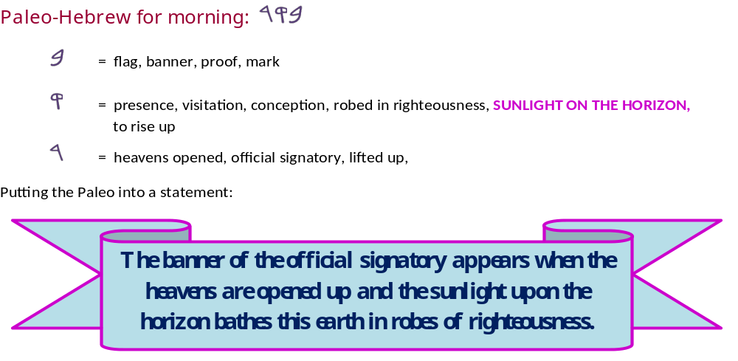
This is taken from a Paleo-Hebrew chart and some of the definitions. It is clearly pointing to the very initial time of Dawn when the first rays of distant sunlight are stretching above the horizon into the escaping darkness. Dawn, NOT SUNRISE!
Boqer
Beit, Quf, Resh

Slide 26

Hebrew and English Lexicon of the Old Testament
Based on the Lexicon of William Gesenius, translated by Edward Robinson (1906)
Morning - ב ק ר . <boqer>
split, penetrate as the dawn the darkness, light through cloud rifts, morning, end of night, coming of dawn even daylight, turn of the morning, beginning of day, coming of sunrise, time of prayer, morrow, next day, tomorrow morning,
inquire, seek, divide, discern, slit, split, rip, distinguish, cattle, ox, herd, ploughing
In this source there are MANY textual references for these definitions.
Once again we see the dividing concept that distinguishes one identity from another. Each weekly cycle is terminated by the arrival of the dawn’s rays of light, and the new weekly cycle is ushered in enveloped with LIGHT.
The deep inferences of LIGHT is a very extensive topic.

Slide 27
A Hebrew Lexicon by W. H. Barker (1776) (page 24)
Morning - ב ק ר . <boqer> to seek, search, examine; morning, an herd; horned cattle, oxen, either from their rising early to feed, or their lowing and searching for each other when separated, a scourging with a thing of ox hide; Lev 19:20.
Can we see the seek, and searching action in the first rays of light over the dark horizon? Absolutely!
What does a scourging with an ox hide thong produce?
Split and separated skin. The dividing action is seen once again.
Separating one item from another, yet ultimately with an underlying connection.

Slide 28
When Yahuah preserved the Hebrew nation in Egypt what presence did He use?
Ex 10:23 They did not see one another, nor did anyone rise from his place for three days, while all the children of Yisra’ĕl had LIGHT in their dwellings.
What does Yahusha tell us?
John 12:36 “While you have the LIGHT, believe in the LIGHT, so that you become sons of LIGHT.” These words יהושע [Yahusha] spoke, and went off and was hidden from them.
Eph 5:8 For you were once darkness,¹ but now you are LIGHT in the Master. Walk as children of LIGHT – Footnote: ¹See 2:2, 4:18, Col. 3:7.
1 Thess 5:5 For you are all sons of LIGHT and sons of the day.
We are not of the night nor of darkness.

Slide 29
And best of all –
Matt 11:30 “For My yoke is gentle and My burden is
LIGHT.”
Yahusha’s Shabbath starts with MORNING LIGHT, not in the darkness of twilight after the sun sets.
Yahuah provided Preparation evening and night, explicitly for us to PREPARE for the Shabbath!

Slide 30
The LIGHT is where Yahuah and Yahusha operate and conduct their life.
“As it is in Heaven, so shall it be on earth.”
Interesting ring isn’t it!
Nature gives us very good clues as to when the weekly cycles begin.
Maybe we should listen?
We have seen the outline for the first cycle of creation in the first 5 verses of the Torah. You probably noticed that in between “the evening and the morning,” there was no mention of a Night Season. Why? Because the Night Season was a non-activity season. There was nothing to record. With that in mind, let’s look at some graphics to help us understand.

Slide 31

As it is in Heaven,
so shall it be on earth.
Matthew 6:10
With the teaching from Yahusha on how to pray,
let’s look once again at the first cycle of creation, step by step,
and then compare it to the 4th cycle of creation.

Slide 32
Gen 1:5b … And there came to be ereb (evening) …
A Refresher on – the 1st cycle of Creation
The full 24 hours of Cycle #1
Creation and the restoration of Light
… and there was morning [BOQER]
HalleluYah Scriptures
Yahusha – {LIGHT}, withdraws!
Arrival of the Ereb/evening
twilight mixture.
Day One.
Layil
Layil, the acceptable night darkness passes by unannounced. Why? Nothing occurred in during the darkness of the Night Season!

Slide 33
We now see where the ב ק ר . <boqer> morning “belt buckle,” releases, splits, divides, separates, detaches, and distinguishes, between the former weekly cycle and the new 24 hour cycle. It is at this point that one full 24 hours at the beginning of creation had ended. It is at this point that the next (2nd) weekly cycle of creation began –
WITH THE LIGHT!
Boqer
“The eyelashes of Dawn!” Job 3:9
HalleluYah Scriptures
Light
Layil
This is the Night Season that follows -
ב ק ר . <boqer> (dawn/morning), the
Light Season, the sunset and the evening.
Ereb {evening} mixture
grows dark!

Slide 34
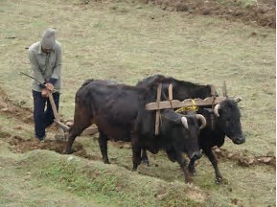
Boqer
Light
The Ox and Plow place their separating line of division on the earth!
Layil
Ereb {evening} mixture
grows dark!

Slide 35
Are we able to find a Scriptural patriarch that exposes the Dawn to Dawn pattern as found at Creation on day 1?
Scriptural Alignment!!!
Gen 15:9,10 - Abraham divides & places the sacrifices, chases away the vultures, then goes into an induced trance.
And it came to be, when the sun went down and IT WAS DARK, that see, a smoking oven and a burning torch passing between those pieces.
Dawn
Dawn
Light
Night
- To -
Gen 15:18 – On THE SAME DAY, Yahuah made a Covenant with Abram…
WITH 3 WITNESSES, THIS SUNSET DID NOT CHANGE THE DAY,
NOT EVEN FOR YAHUAH OR ABRAHAM!

Slide 36
Gen 1:8 b … And there came to be ereb (evening) …
2nd Cycle of Creation
The word – <bara`> {create} is not seen again
until the 5th day of creation!
Gen 1:6 And Elohim said, Let an expanse come to be in the midst of the waters, and let it separate the waters from the waters.
… and there was morning, … [BOQER]
Yahusha – {LIGHT}, withdraws!
Arrival of the Ereb/evening
twilight mixture.
Day Two
Completed.
Layil

Slide 37
Will another Scriptural patriarch expose the
Dawn to Dawn pattern as found at Creation on day 2?
MORE - Scriptural Alignment!!!
Ex 14:13 - … Do not be afraid. Stand still and see the deliverance of Yahuah, which
He does for you - TODAY…
Vs. 27 … And Mosheh stretched out his hand over the sea and the sea returned to its usual flow, AT THE BREAK OF DAY, WITH THE MITSRITES FLEEING INTO IT…
Dawn
Dawn
Light
Night
- To -
Ex 14:30 Thus Yahuah saved Yisra’el THAT DAY out of the hand of the Mitsrites (Egyptians) and Yisra’el saw the Mitsrites dead on the seashore.
The “SALVATION TODAY” did not arrive before sunset!

Slide 38
Gen 1:13 b … And there came to be ereb (evening) …
3rd Cycle of Creation
<bara`> {create} is absent until the 5th day of creation!
Gen 1:11 - Let the earth bring forth grass, the plant that yields seed, and the fruit tree that yields fruit according to its kind, whose seed is in itself, on the earth.
… and there was morning, [BOQER]
Yahusha – {LIGHT}, withdraws!
Arrival of the Ereb/evening
twilight mixture.
the Third Day.
Layil

Slide 39
Will Mosheh expose Dawn to Dawn (= to Creation’s day 3)?
MORE - Scriptural Alignment! ☺
Ex 16:14 – And the layer of dew went up,
and see, on the surface of the wilderness
was a small round substance, fine as frost
on the ground.
Ex 16:22 – And it came to be, on the sixth day, that they gathered twice as much bread…
V. 23 … This is what Yahuah has said, “Tomorrow is a rest, a Shabbath qodesh to Yahuah. That which you bake, bake; and that which you cook, cook. And lay up for yourselves all that is left over, to keep it until morning [Boqer]. .
Dawn
Dawn
Light
Night
- To -
Vs. 24 – And they laid it up till morning, as Mosheh commanded. And it did not stink and no worm was in it.
Why did the manna not stink at sunset?

Slide 40
Day 4 !
Light!

Slide 41
Note Carefully: It was on day 4
that Yahusha commissioned the Sun,
the Mazzaroth and the [other] stars with LIGHT - {which were all created on day #1}.
The midst of the week was demarcated with light making certain that mankind would always know precisely when the
“midst of the week” occurs
{Dan 9:27}.

Slide 42
Attention:
Yahusha supplied the light that withdrew: allowing the night darkness to mix – ereb – with the light, during the first 3 days.
On Day 4 - the two controlling lights were commissioned to service. It then was the sun which withdrew providing for the evening ereb – mixture!
Sunset! Look for it!

Slide 43
Gen 1:19 b … And there came to be ereb (evening) …
4th Cycle of Creation
<bara`> {create} is absent until the 5th day of creation!
Gen 1:16 - And Elohim made two great lights: the greater to rule the day, and the lesser to rule the night, and the stars.
… and there was morning, [BOQER]
The SUNLIGHT
withdraws!
Arrival of the Ereb/evening
twilight mixture.
the Fourth Day [completed].
Layil

Slide 44
Yonathon’s Battle = 4th Cycle Alignment! ☺
The Philistines are once again tormenting Yisra’el. Yonathon decides to take matters into his own hands after receiving authority from Yahuah.
The Time Frame - 1 Sam 14:1 – And it came to be ONE DAY…
vs. 12 – …And Yonathon said “Come up after me, for Yahuah has given them into the hand of Yisra’el.
vs. 13 – … And they fell before Yonathon, and his amour-bearer was putting them to death behind him.
vs. 23 – Thus Yahuah saved Yisra’el THAT DAY, and the battle passed over to
Beyth Awen.
The battle occurred within ONE 24 hour period.

Slide 45
Saul’s Evil Proclamation
Because of Saul’s foolishness, (below), Yisra’el’s warriors were waging war on empty stomachs!
1 Sam 14:24 … “Cursed be the man who eats food until evening, and I have taken revenge on my enemies.”…
vs. 27 – But Yonathon had not heard that his father had taken an oath of the people, and he stretched out the end of the rod that was in his hand and dipped it in a honeycomb, and put his hand to his mouth. And his eyes lit up.

Slide 46
Saul’s Evil Proclamation
The famished men were butchering animals and eating them raw
because of extreme hunger; see 1 Sam 14:32.
Saul, upon hearing of this transgression, commanded them to bring the animals, butcher and cook them according to the Torah before consuming them. It was in the Night Season at this point in time; vs: 34.
Saul had asked Yahuah that night for permission to go fight the Pelishtites (Philistines), vss: 35-36. Yahuah did not answer the request for direction.
Saul knew from Yahuah’s silence that there was a serious problem
in the camp; vs: 38.
Lots are thrown, to identify the offender -
Yonathon is identified as having disobeyed Saul’s order.

Slide 47
Visual Scriptural Alignment! ☺
1 Sam 14 - Yonathon eliminates some Pelishtites The battle ensues. Saul undertakes a serious mistake/oath. Expending massive amounts of energy through the day, the men in the army are famished for food. Yonathon innocently eats honey and is rejuvenated.
Night Season arrives –
1 Sam 14:34 … So everyone of the people brought his ox with him THAT NIGHT, and slaughtered it there.
in the morning.
Dawn
Light
Night

Slide 48
The Warriors Answer! ☺
1 Sam 14 –
Yonathon had eliminated some Pelishtites
vs. 39 – For as Yahuah lives, who saves Yisra’el, though it be in Yonathon my son,
he shall certainly die!
in the morning.
Dawn
- To -
Dawn
Light
Night
vs. 45 - “…Should Yonathon die, who has wrought this great deliverance in Yisra’el? Far be it! As Yahuah lives, let not one hair of his head fall to the ground, for he has wrought with Elohim THIS DAY.”

Slide 49
The Yisra’elite army, IN THE HEAT OF BATTLE, realize the threat of death to a highly respected leader – Yonathon! The Yisra’elite warriors witness that they too agree with the creation format of dawn to dawn for a 24 hour cycle.
Dawn to Dawn is written in the Torah concerning the 4th day of creation!

Slide 50
Back to the 4th Cycle of Creation!
What is the
Lesser Light?

Slide 51
Genesis 1:16 –
And Elohim made two great lights :
(1.) the greater light to rule the day,
The Sun.
(2.) the lesser light to rule the night,
The Mazzaroth - (constellations.)
(3.) and the stars.
The individual stars.

Slide 52
Briefly -
What brief sample of factors reveal that the Lesser Light of Gen 1 is the Mazzaroth?
Job 38: 31-33 Do you bind the bands of Kimah [Pleides], or loosen the cords of Kesil [Orion]?
It is a fact that the stars in the belt of Kesil (Orion) are extremely slowly, spreading apart.
Do you bring out the constellations [Mazzaroth (KJV)] in its season? Or do you lead the Bear [Arcturus] with its sons?
Context: - Mazzaroth constellations

Slide 53
Next verse –
Job 38: 33 - Do you know the laws of the shemayim? Or do you apply THEIR RULE over the earth?
Their Rule? Psalms 19:1-7 has testimony about the Mazzaroth.
What entity timed the birth of the Hebrew nation?
Gen 17:21 - “But my Covenant I establish with Yitshaq [Isaac], whom Sarah is to bear to you at this APPOINTED TIME next year.
Gen 18:14 - Is any matter too hard for [Yahuah]? At the APPOINTED TIME I am going to return to you, according to the time of life, and Sarah is to have a son.”
Gen 21:2 – So Sarah conceived and bore Abraham a son in his old age, at the APPOINTED TIME of which Elohim has spoken to him.

Slide 54
How are the Appointed Times ascertained?
The Tequfah (Equinox) depends directly upon the Mazzaroth to determine the accurate timing on Yahuah’s Covenant Calendar.
The Mazzaroth declares the full plan of salvation, in picture form (Gen 19:1-5), every 24 hours in the sky.
The Mazzaroth delivers the Light both physically and spiritually
to this earth.
The Mazzaroth is the LIGHT THAT RULES THE NIGHT SEASON.
The moon has no light! The moon does not rule the night!

Slide 55
Jer 31:35 -
Thus saith [Yahuah],
[Yahuah] of hosts is His Name.
1. who gives the sun for a light by day,
2. and the laws of the moon
light by night,
3. and the stars for a
4. who stirs up the sea, and its waves roar –
HalleluYah Scriptures

Slide 56
The Mazzaroth being the Lesser Light of Genesis 1:16 has been briefly covered here!
Moving onto the 5th cycle of Creation! ☺

Slide 57
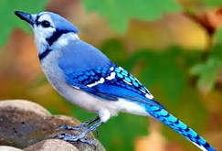
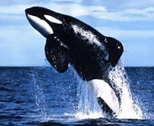
Yahusha had been assembling elements on the 2nd, 3rd and 4th days.
The word – <bara`> (to create) is not recorded there.
Now, on day 5 Yahusha
once again begins
His Creating activities.
Let’s look at it briefly.

Slide 58
Gen 1:23 b … And there came to be ereb (evening) …
5th Cycle of Creation
<bara`> {create} is once again, seen in the text (vs. 21)!
Gen 1:20 - And Elohim said, let the waters teem with shoals of living creatures,
and let birds fly above the earth on the face of the expanse of the shamayim.
… and there was morning, [BOQER]
The SUNLIGHT
withdraws!
Arrival of the Ereb/evening
twilight mixture.
the Fifth Day [completed].
Layil

Slide 59
A Decapitation provides more-Scriptural Alignment!
1 Sam 5:3 And the Ashdodites [Philistines] rose early in the morning [Boqer] and saw Dagon fallen on its face to the ground before the ark of Yahuah. So they took Dagon and put it in its place again.
1 Sam 5:2 And the Pelishtites took the ark of Elohim and brought it into the house of Dagon and put it by Dagon.
Dawn
Dawn
- To -
Light
Night
Dagon’s first 24 hour cycle completed beside the Ark of Yahuah!

Slide 60
A Decapitation provides more-Scriptural Alignment!
SAME MORNING: REPEATED FROM LAST SLIDE! 1 Sam 5:3 And the Ashdodites [Philistines] rose early in the morning [Boqer] and saw Dagon fallen on its face to the ground before the ark of Yahuah. So they took Dagon and put it
in its place again.
1 Sam 5:4 - And when they arose early on the MORROW MORNING, behold Dagon was fallen upon his face to the ground before the ark of [Yahuah], and the head of Dagon and both the palms of his hands were cut off upon the threshold: only the stump of Dagon was left to him. KJV
Dawn
- To -
Dawn
Light
Night
The very two Hebrew words – MORROW & MORNING - mochoroth & boqer – are used to pin point with absolute accuracy, the DAWN START of a new 24 hour cycle.
If you do not understand the definitions of these words, it is imperative to research them fully. Please, not just in Strong’s but also looking in other credible sources is just as important
as knowing the CORRECT, UNTAINTED definitions.

Slide 61
Who and what were created on the 1st Preparation Cycle –
the 6th day?

Slide 62

Thoughts to Ponder:
The 6th Cycle of Creation started at Dawn!
The first Preparation cycle of Creation
ended at DAWN!
2. Can we find Scriptural alignment in the
death and burial of Yahusha?
Hint! – Miryam of Magdala, Miryam of Ya’aqob and Shelomah bought a 2nd batch
of spices and ointments!

Slide 63
Gen 1:31 b … And there came to be ereb (evening) …
The 6th Cycle of Creation
And Elohim said, let the earth bring forth the living creature according to its kind: livestock and creeping creatures and beasts of the earth, according to its kind. And it came to be so. And Elohim created the man in His image, in the image of Elohim He created him – male and female He created them. Gen 1:24, 27
… and there was morning, [BOQER]
The SUNLIGHT
withdraws!
Arrival of the Ereb/evening
twilight mixture.
the Sixth Day [completed].
Layil

Slide 64
Let’s search for Scriptural alignment –
in the death and burial of Yahusha!
Was it also a 6th Cycle Preparation day when the ladies bought the 2nd batch of spices and ointments, intending to continue embalming the body of Yahusha - 1st cycle morning??
(Mark 16:1 - Luke 23:56/24:1)

Slide 65

The sacrifices and oblations ceased in the MIDST OF THE WEEK (Dan 9:27) which was the 4TH CYCLE MARKED BY — LIGHT — AT CREATION.
The following cycle was the 5th cycle, the first yearly Appointed Time of the Unleavened Bread Sabbath.
Luke 23:53-56 reveals that Yahusha was buried during
Abib 14 (Passover) night and the ladies returned home
before the Sabbath – G2020 – epiphosko – GREW LIGHT!
Luke also indicates rather positively that the ladies observed the Sabbath according to the Torah!

Slide 66
Since the 5th cycle of creation began & ended at Dawn, we know for certain that the 6th cycle also began at Dawn.
The ladies then would have kept the 1st Appointed Time (Sabbath, see Luke 23:54) of Unleavened Bread,
the 5th cycle, until Dawn.
It is at Dawn of the 6th cycle, the Preparation cycle, that the ladies were able to, according to the Commandments of Yahuah, purchase the 2nd batch of ointments and spices.

Slide 67
Luke 24:1 And on one of the shabbathoth, AT EARLY DAWN, they came to the tomb, bringing the
spices which THEY HAD PREPARED!
Shabbathoth – one of the seven days of the week – by definition & proven solid by Scripture.
Question: If the ladies rested the Sabbath, according to the commandments of Yahuah, how did they purchase the spices and ointments, arrive at the tomb at dawn, (on the 1st cycle of the week) and bring the 2nd batch of spices –
already prepared?

Slide 68

Quite simple! The ladies purchased spices and ointments on the 6th cycle — {the day after the first Sabbath of Unleavened Bread} — which was also the Preparation cycle for the following 7th Day Sabbath!
Is there any better day than a Preparation day to
purchase, mix and prepare the spices for a burial?
Is it possible that Yahuah had this planned
from the foundations of the earth?
HHHHMMMM!!!

Slide 69

Yes! The 6th cycle of creation has witnesses in the life and burial of Yahusha, showing alignment that Dawn
started and ended the 24 hour cycles of creation!
YAHUSHA LIVED AND DIED
WITNESSING TO THIS FACT!

Slide 70
Ok! Now it gets really interesting!
What about the 7th cycle of Creation – the 7th Day Sabbath?
When did (does) it start and end?

Slide 71
The Scripture’s documentation after the 6th cycle, starting with Genesis 2:1 –
“Thus the shamayim [heavens] and the earth were completed, and all their array,” —
including the building of man.
Questions:
1. Had man received the Ruach of Life at this point?
2. Scripture tells us that creation was completed;
what remained for Yahuah to finish?

Slide 72

Genesis 2:2 –
And on the seventh day Elohim COMPLETED His work which He had done, and He rested on the seventh day from all His work which He had made.

Slide 73
And there came to be ereb (evening)…
Yahuah’s Shabbath instituted at Creation!
Gen 2:3 – And Elohim bara`k [blessed] the seventh day and made it qodesh [set-apart], because on it He rested from all His work which Elohim in creating had made.
“I change not” Mal 3:6 -
… and there was morning, [BOQER]
The SUNLIGHT
withdraws!
Arrival of the Ereb/evening
twilight mixture.
the Sabbath Day [completed].
Layil

Slide 74
Do we have witnesses to a Dawn to Dawn Seventh day Sabbath at the time of the death of our Maschiach?
If Yahusha lived and died according to the Torah, and lived out a Dawn to Dawn pattern at His death, what do the Scriptures
declare about this situation?

Slide 75
For where a testament is, there must also of necessity be the death of the testator.
For a testament is of force after men are dead: otherwise it is of no strength at all while the testator liveth.
Heb 9:16, 17 KJV

Slide 76
What were some of the final words of Yahusha before He died?
So when [Yahusha] took the vinegar He said, “It has been accomplished!” And bowing His head, He gave up His spirit.
John 19:30 HalleluYah Scriptures

Slide 77
Yahusha had precisely fulfilled the Will of Yahuah without a flaw.
We saw where the creation account testified to a
Dawn to Dawn - Seventh Day Sabbath.
What witness did Yahusha leave for a legacy after His death?

Slide 78
Enjoying More Scriptural Alignment! ☺
Abib 14 Passover Light Season & the violence done to Yahusha Ha Mashiach.
Yoseph of Ramathayim asks for the lifeless body of Yahusha in the evening,
AFTER THE SUN HAD SET!
Matt 27:57; Mark 15:42
Luke 23:53, 54
And taking it down, he wrapped it in linen, and laid it in a tomb hewn out of rock,
where no one was yet laid.
AND IT WAS THE PREPARATION day,
and the SABBATH WAS APPROACHING.
And when evening came, when the sun was down … Mark 1:32
Dawn
- To -
Dawn
Abib 14 Light Season
Burial Night
= EPIPHOSKO =
Sabbath was APPROACHING
TO GROW LIGHT!

Slide 79
Enjoying More Scriptural Alignment! ☺
Yahusha testified by DYING, that His Passover, Abib 14, day of DEATH, started at Dawn!
See John 19:13, 14!
Yoseph of Ramathayim carried out the Torah Patterns by burying Yahusha during the Night Season hours of Abib 14 (see Ex 12:6-10) — making certain that the remains of the Passover Lamb was taken proper care of
and secured out of sight before the boqer (morning) light!
Dawn
- To -
Dawn
Abib 14 Light Season
Burial Night
= EPIPHOSKO =
Sabbath was APPROACHING
TO GROW LIGHT!

Slide 80
Even the first Sabbath of Unleavened
Bread began with a Dawn start.
Yahusha testified to His will and then DIED securing the Torah Pattern for eternity.

Slide 81
Please allow me to submit to you:
The Passover cycle started at Dawn, as announced by John.
The 1st Sabbath of Unleavened Bread started at Dawn, documented (most clearly in Luke) by the burial process.
The ladies were able to purchase spices and ointments on the Preparation day before the Sabbath; then by a multitude of witnesses, the 7th Day Sabbath started at Dawn also!
Will there be a supporting witness to this?

Slide 82
What does Matthew document?

Slide 83
Matt 28:1 In the of the sabbath, as it began to
Dawn:
G2020 –
Epiphosko – to grow light -
end
dawn
toward the first day of the week, came Mary Magdalene and the other Mary
to see the sepulchre.

Slide 84
The Sabbath in Matthew 28:1 is recorded as ending at Dawn.
Therefore it had to start at Dawn !
Question: Does Matthew 28:1 mirror Creation’s week Divine pattern of
Dawn to Dawn?

Slide 85




A Brief Summary
Six times it is recorded in Genesis 1 that the boqer (morning) stopped the previous 24 hour cycle and initiated the new 24 hour cycle.
There are many multiple witnesses throughout the Scriptures reflecting the Dawn to Dawn pattern of Yahuah’s cycles of the week.
On the 24 hour period that involved Yahuah and Abram, in the making of the Everlasting Covenant, the Dawn to Dawn pattern prevailed.
Yahusha lived out His Covenant Calendar while on this earth.

Slide 86

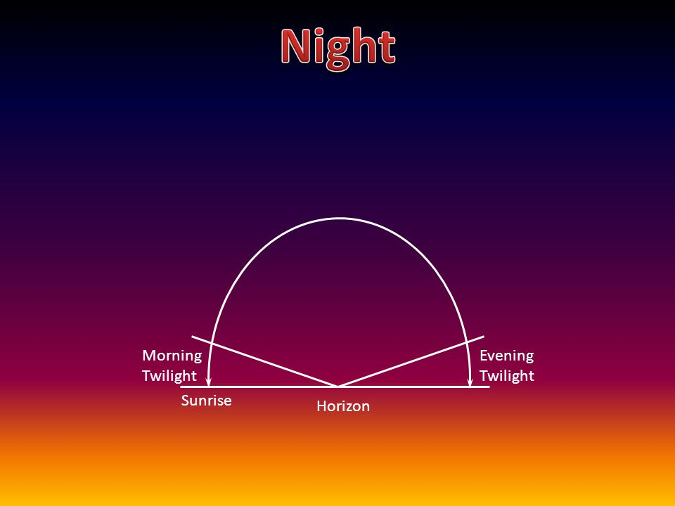

Internet Quiz #1
Questions:
The chart that is shown here, is it true or false?
Is the chart showing the twilights belong to the Night Season, or the Day Season?

Slide 87
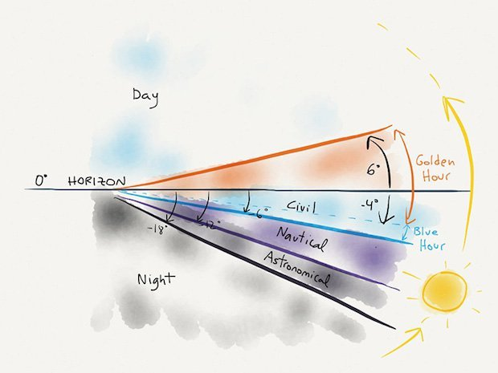
Internet Quiz #2
This chart is showing the three different degrees of twilight. They are:
Civil
Nautical
Astronomical
Question: Does the chart correctly show that the twilights belong to the Day Season?

Slide 88
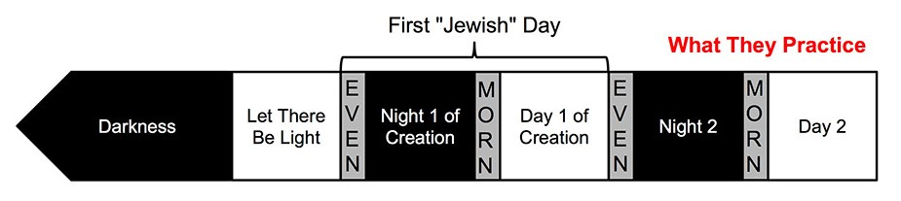
Internet Quiz #3
Question: Is this chart showing the correct
placement for day-start according to the Jews?
If not, what’s wrong with it?

Slide 89
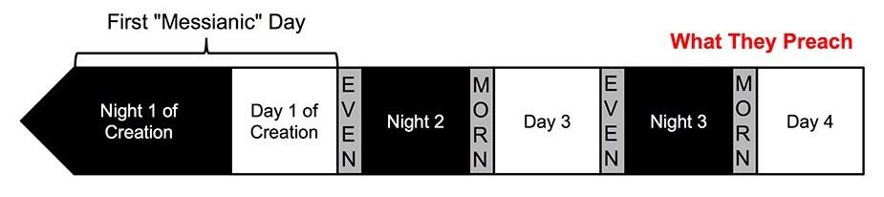
Internet Quiz #4
Question: Is this chart showing the correct
placement for “first Messianic” day-start?
If not, what’s wrong with it?

Slide 90
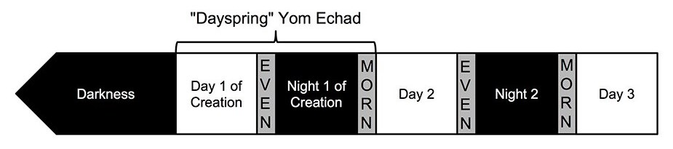
Internet Quiz #5
Does this “morn”
belong to Day 1?
Gen 1:2(a)
Gen 1:2(b)-3
Gen 1:4
Question: (1) Surely this chart is showing the
correct placement for day-start? (2) Yes? … or … No?
Did Yahuah’s 1st “day” begin in Gen 1:1, or in
Gen 1:2(b)-3 with the restoration of “light”?
Is the placement for the “1st Morn” correct?

Slide 91
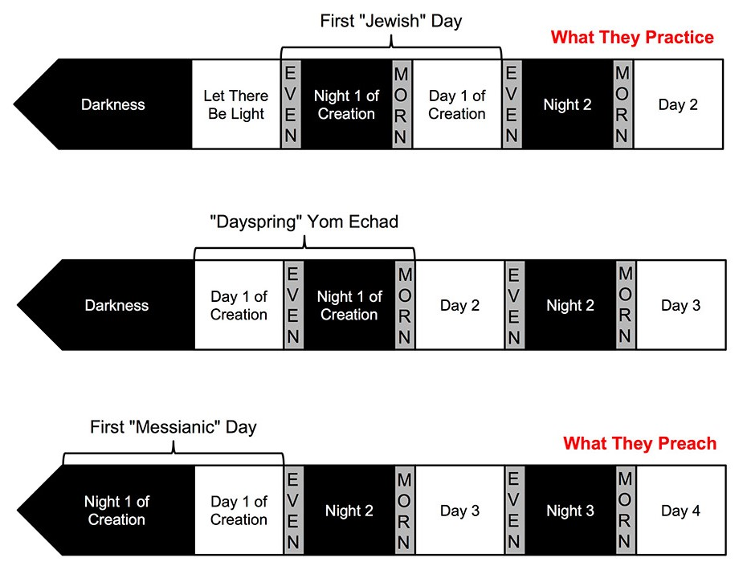

Internet Quiz #6
Question: All three charts have one thing in common that is not correct.
What is it?
Answer: The “darkness” [H2822] begins at Gen 1:2. Gen 1:1 is not represented on the chart.
Gen 1:2(a)
Gen 1:2(a)
Gen 1:2(a)

Slide 92


;Isa 48:3
I have declared the former things from the beginning; and they went forth out of my mouth, and I shewed them; I did them suddenly, and they came to pass. KJV
The 1st DAY SEASON of Gen 1:1-5
Next:
Ruach hovered
across the waters
in cleansing.
Creation Vs 1!
Next:
Satan expelled
from heaven.
Ps 104:30
LIGHT is
renewed.
Gen 1:1
Day break:
2nd Day
Gen 1:5
Evening Twilight
Everything is Perfect!
All things were made ready in the first Day Season for what is recorded on the first 4 days.
Result: destruction, ruin, chaos and utter darkness as the abyss.
Ruach
restores
LIGHT!
1st Night Season for 12 hours-Gen 1:5
Gen 1:1
Gen 1:2(a)
End of Day
Season
12 Hrs.
1st Dawn
Twilight
Day 2
Ps 33:9 For he spake, and it was done; he commanded, and it stood fast. Isa 48:3 I have declared the former things from the beginning; and they went
forth out of my mouth, and I shewed them; I did
them suddenly, and they came to pass. KJV
Gen 1:2(b)
Gen 1:3-4
Light is pronounced “good”
Chart Not to Scale
Notes:
KJV

Slide 93
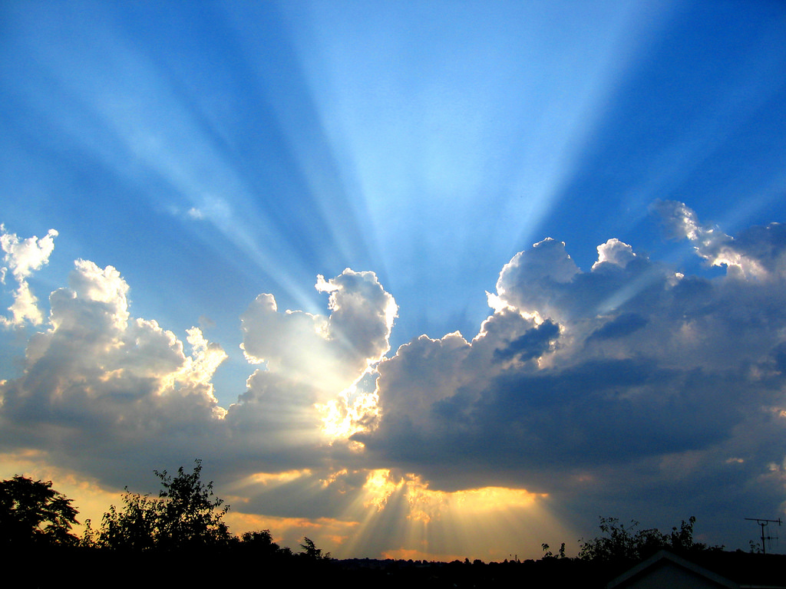
When it comes to
the Light of Dawn …
May Yahuah give you liberal amounts of wisdom, understanding and appreciation for His perfect design, and elegant calendar.

Slide 94
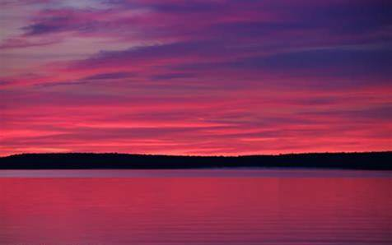
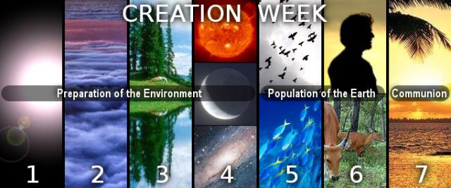



The next Covenant
Calendar Study
will attempt to cover:
Joshua's First Passover in Canaan (How did he celebrate the Wavesheaf?)
“3 days of Creating & 3 days of Restoring”
Questions/Comments on
the Creation Week of Gen 1?
calendar@torahtothetribes.com

