Slide 1




The Creation Week (Part 1)
Gen 1:1-5 (Day 1)

Slide 2
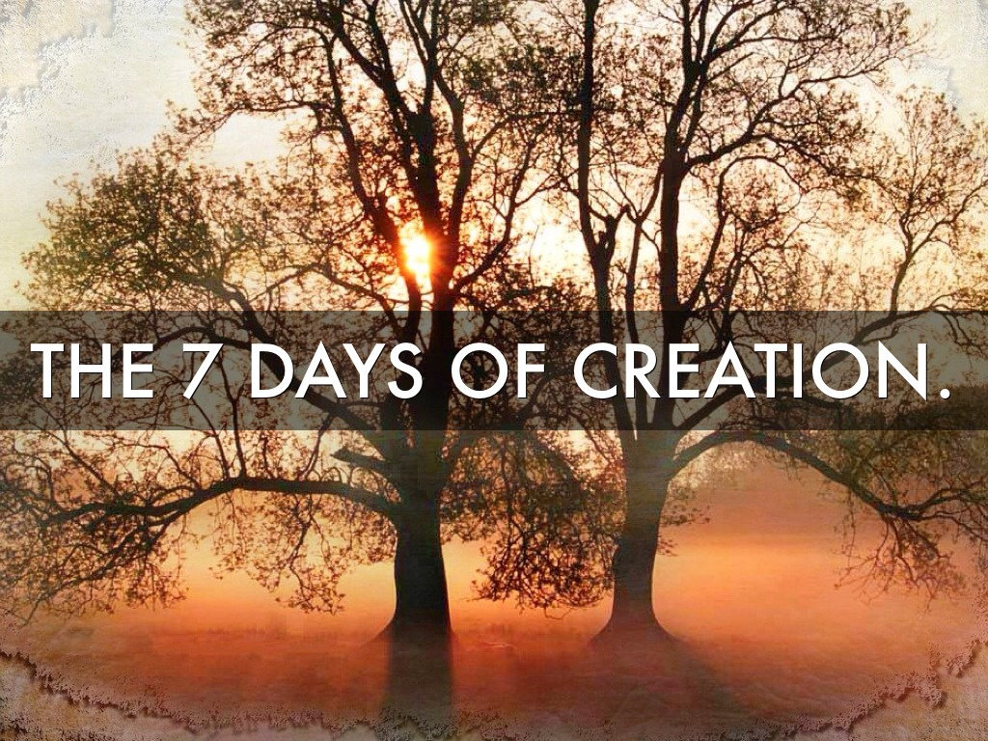
This study is another examination
of the 1st day of creation,
specifically verses 1 & 2.

Slide 3
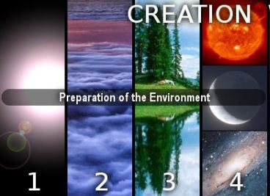

In the beginning Elohim created the heaven and the earth!
What you see here …
Creation Vs 1!
is what happened
in Verse 1.

Slide 4

Genesis 1
Are you ready?

Slide 5

Definitions for: Cycles & Seasons
This study will refrain from using the word “day,” translated from the original Hebrew word <yowm>. Why? The word “day” has:
lost a massive amount of definitive correctness
has many ambiguous definitions;
can indicate 12 or 24 hours, day or night, or both!
To understand the Calendar studies in Scripture correctly the term “day” must be much more accurate.
This study gives preference to:
Using the word cycle in place of the word day. (Note: When quoting Scripture, or citing the Sabbath Day, the word “day” will be used.)
Cycle = 24 hours containing the
2 seasons of: light – H216 <’owr>
and night H3915 <layil>.
The 24 hour cycle is further defined to pinpoint two seasons. They are:
Season = H6256 – <‘eth>;
12 segments of time whether it is
the Light Season or Night Season.
R
E
V
I
E
W

Slide 6
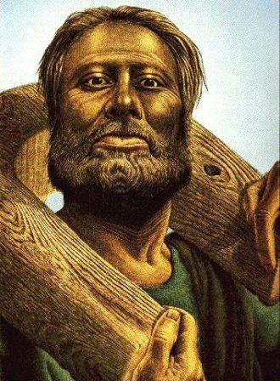
Words from Jeremiah 33:20-26
R
E
V
I
E
W
Jer 33:20, 21, 25 (KJV)
Thus saith [Yahuah]; If ye can break my covenant
of the day, and my covenant of the night … that there should not be day and night in their season;
21 Then may also my covenant be broken
with David my servant …
Verse 25 goes on to confirm Yahuah has a covenant of the day and night … this would be
the Day Season and the Night Season.
Day Season has light from the sun in the sky.
Night Season has no light from the sun in the sky.

Slide 7
Resources Used for Calendar Studies
Interlinear Scripture Analyzer (ISA)
Stone Edition Tanach
Etymological Dictionary of the Hebrew Language (EDHL)
A Hebrew English Lexicon by John Parkhurst (published in 1762)
A Hebrew Lexicon by W. H. Barker (published in 1776)
Paleo-Hebrew Chart by Eric Bissell and Associates
Brown- Driver-Briggs Hebrew Lexicon (noted as: BDB)
Strong’s Exhaustive Concordance
Gesenius’ Lexicon
The Scriptures edition of the Bible (used most often)
HalleluYah Scriptures, KJV plus many other editions.
Let’s get started!

Slide 8
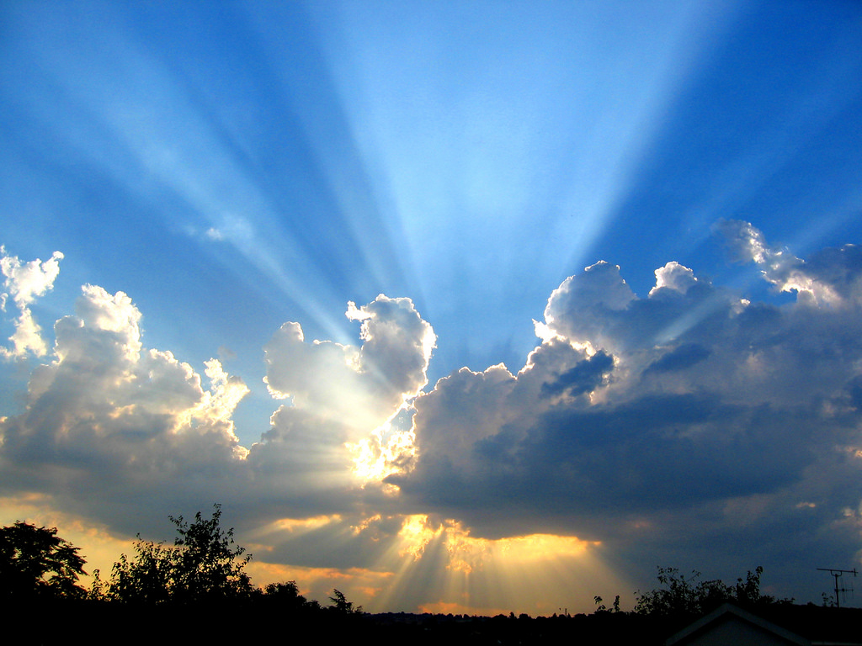
Genesis 1
In the Beginning
Elohim created

Slide 9
the heaven and
the earth.
1
2
And he shall set up an ensign for the nations, and shall assemble the outcasts of Israel, and gather together the dispersed of Judah from the four corners of the earth.
Isa 11:12
3
4

Slide 10
The Light and The Life
John 1:1 - 3
In the beginning was the Word, and the Word
was with Elohim, and the Word was Elohim.
He was in the beginning with Elohim.
All came to be through Him,¹ and without
Him not even one came to be
that came to be.
Footnote: ¹Eph. 3:9, Col. 1:16, Heb. 1:2, Heb. 11:3, 2 Peter 3:5, Ps. 33:6.

Slide 11
Yahusha – The Light
John 1:4,5
In Him was life, and the
life was the Light of men.
And the - Light - shines in the darkness,
and the darkness has not overcome it.

Slide 12
Yahusha, the life, and the light, was the initiating power behind the creation of this earth. When Yahusha arrived on the scene of our future earth — simply put — light was.
This light simply existed – hayah.
Ex 3:14 And Elohim said to Mosheh, “I am that which I am.”
And He said, “Thus you shall say to the children of Yisra’ĕl,
‘I am has sent me to you.’ ”
The Heḇrew text reads: ’eyeh ’asher ’eyeh, the word ’eyeh being derived from hayah which means to be, to exist …
but the Aramaic text here in v. 14 reads: ayah ashar ayah.
This is not His Name, but it is an explanation that leads up to
the revelation of His Name in v. 15, namely: יהוה (Yahuah).

Slide 13
The light radiating from Yahusha was the first visual light on the scene of creation.
Genesis 1 explains exactly what was created on that 1st Light Season.
How do we know this light was a physical / visual light as well as spiritual?
Remember: Moses went up onto Mt Sinai to commune with our Creator. When Moses came back down to the Hebrew people, he needed to cover his brilliantly glowing face to keep from harming the people who looked at him.
(See Ex 34:29-35.)

Slide 14
In earth’s premier Light Season provided by Yahusha, what was the very first recorded event of creation?
Gen 1:1 In the beginning Elohim created <bara`> the heaven and the earth.
Is there anything that can be excluded,
left out or not accounted for, (in the creation event)
by the words – “heavens and earth”?
No, this is an all inclusive complete statement that encompasses our complete universe. A closer look at the Hebrew word <bara`> reveals a much deeper revelation.

Slide 15
Brown-Driver-Briggs Lexicon <bara`>
created H1254 <bara`>
1) to create, to shape, to form (always with Yahuah as the subject)
a) (Qal) to shape, to fashion, to create
1) used of heaven and earth [found in Gen 1:1]
2) used of individual man [found in Gen 1:27]
3) used of new conditions and circumstances
[after day #1, the next usage of <bara`> after Gen 1:1 is found in Gen 1:21 with the creation of the breathing wildlife]
4) used of transformations
[not applicable to this study]

Slide 16
Study Tools Help Define <bara`>
Etymological Dictionary of the Hebrew Language
Earnest Klein pg. 82
Created H1254 <bara`> to create, to found, to build
[a structure], to bear a child.
A Hebrew Lexicon John Parkhurst
(1762) pgs. 59 - 60
Note: This Lexicon does not use the
Masoretic tainted vowel points.
(Only the references for creation are provided.)
ב ר א - <bara`> Denotes the production of either substance or form, the creation or accretion of substance or matter.
(Parkhurst con’t)
I. To create, produce into being.
Gen 1:1 In the beginning the Aleim [Yahusha] created the heavens and the earth.
This cannot relate to form, because as follows in the next verse the earth was ת ה וֹ - [tohu] without form, or in loose atoms.
So v. 27, The Aleim [Yahusha] created man in his own image, refers to the creation of the human soul, as well as the formation of the body; for the image of Aleim [Yahusha] eminently consists in righteousness and true holiness, seated in the spirit of the mind.
See Eph 4:24, Col 3:10.

Slide 17
A Hebrew Lexicon (Parkhurst) (Con’t)
Purpose,
or
“Haphazard”?
Accretion:
The act of accreting
or accrescing;
a growing to,
an increase by natural growth,
an increase by an accession of parts naturally separate,
a growing together of parts naturally separate,
as the fingers or toes;
the thing added by growth;
an accession.
II. To form by accretion or concretion of matter.
Gen 1:21 so the Aleim [Yahusha] formed the great aquatic monsters,
no doubt of pre-existent matter.
[Pre-existent from the first cycle
(day) of creation].
And v. 27, ב ר א – bara`, [created] formed man, male and female.
Note: Most people are not familiar
with the word – accretion.
The New Webster Encyclopedic Dictionary of the English Language (1952) defines accretion this way.

Slide 18
Understanding Parkhurst’s Definitions
With Parkhurst there is
NO ALLOWANCE for the
newly created earth to be
without form and void.
Every elemental substance that was needed to continue to fashion and create in order to purposely
form this universe was brought
forth at the first act of creation.
Let’s read Isa 45:18!
For thus saith [Yahuah]that created the heavens; [Yahuah] himself that formed the earth and made it; he hath established it, he created it
not in vain, he formed it to be inhabited: I am [Yahuah]; and
there is none else. KJV
How can this be understood?

Slide 19

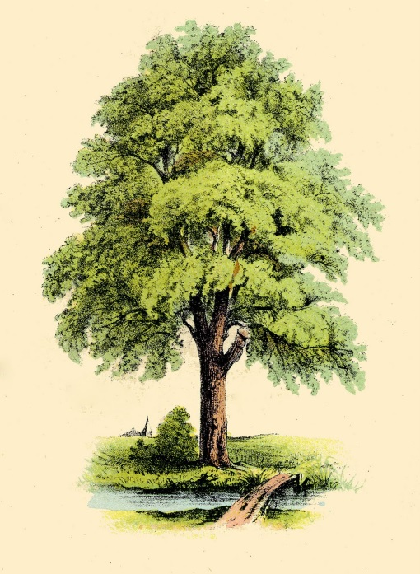
Understanding “accretion”
For example: a tree, was not standing with leaves. Yet the elements that required assembly for a tree to grow (accretion) were brought forth into the localized area. The final assembly and subsequent growth had yet to be accomplished. Our universe
was yet without final form.
Gen 2:4-6 KJV
4 These are the generations of the heavens and of the earth when they were created, in the day [Yahuah Elohim] made the earth and the heavens,
5 And every plant of the field before it was in the earth, and every herb of the field before it grew: for [Yahuah Elohim] had not caused it to rain upon the earth, and there was not a man to till the ground.
6 But there went up a mist from the earth, and watered the whole face of the ground.

Slide 20
Barker’s Hebrew Lexicon <bara`>
ב ר א - <bara`> – create to concrete, form anew by concretion, to create, choose.
Concretion is a different word than the definition of accretion.
Webster’s Encyclopedic Dictionary
of the English Language
Concretion; the act of concreting or growing together so as to form one mass, the mass or solid matter formed by growing together, a clot,
a lump, geol. a lump or nodule formed by molecular aggregation
as distinct from crystallization.
What is the meaning of - concretion?
This is an allowance for an elemental substance accumulation ready for final formation of this earth
into one inhabitable unit.

Slide 21
Hebrew & English Lexicon of the Old Testament <bara`>
ב ר א - <bara`> create; vb.
Shape, create, form, fashion by cutting, shape out, pare a reed for writing,
a stick for an arrow, but also create, found, build beget, a change of liquid, fashion, shape always of Divine activity.
Object: heaven and earth, mankind, the host of heaven, the heavens, ends of the earth, north and south, individual man.
[Based on the Lexicon of William Gesenius, translated by Edward Robinson (1906) pg. 135]
This definition gives recognition to
a liquid changing form.
This earth was enveloped
in water.
Gen 1:2 will demonstrate it was the Ruach (Spirit) of Elohim (Yahusha) hovering
above the waters.

Slide 22
Strong’s Exhaustive Concordance <bara`>
ב ר א <bara`> create; a prim root; (absolutely) to create, (qualified)
to cut down (a wood), select, feed,
(as formative processes): choose, create (creator), cut down, dispatch, do, make, fat.
“Strong’s” has stayed in agreement with the other sources. Interestingly it also cites a “formative process” which can align with the accretion growth system seen in the other sources as well.
A series of definitions have been accumulated that portray the idea of the creation process on the first cycle (day) of creation
as a: beginning state of creation.
This state of creation enlists a systematic approach of fine tuning for a final inhabitable product such as our earth and ultimately our full universe.

Slide 23
This has by no means been an exhaustive search but it is a good starting point from which you are able to begin your own research.
Please do not just accept what is written here, but take up the challenge and do your own research.
We are to be Bereans and prove ourselves worthy of consideration for salvation even though there is nothing we are able to do to accomplish that final goal. Our full dependence is
on the Light.
Yahusha !

Slide 24
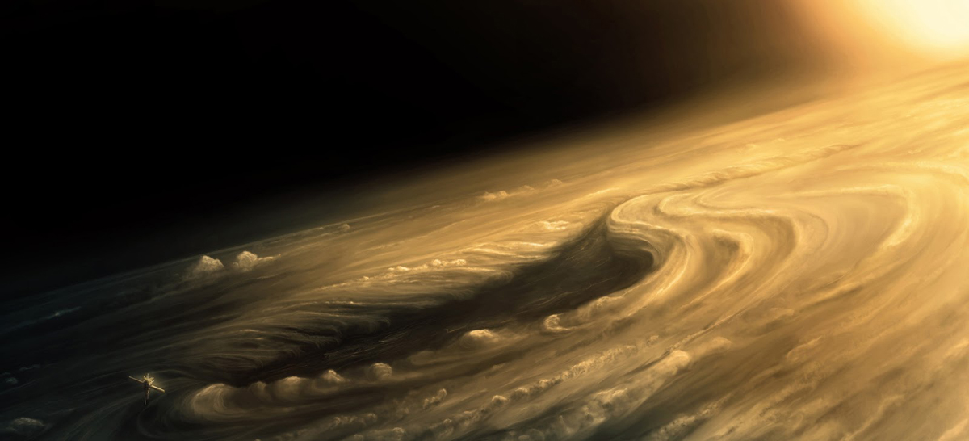
Gen 1:2(a) The Formless Earth
Summary thus far: the basic elemental substances for this earth had been accumulated into a localized zone known as the creation scene. Next …
came to be¹
Gen 1:2 And the earth formless and empty, and
and darkness was on the face of the deep.
And the Spirit of Elohim was moving on the face of the waters.
Footnote: ¹Or the earth
became.
Verse 2 will be broken down into sections and analyzed for its original meaning that was intended/desired by the author and Inspiration.
Next: a comparison of the KJV version …

Slide 25
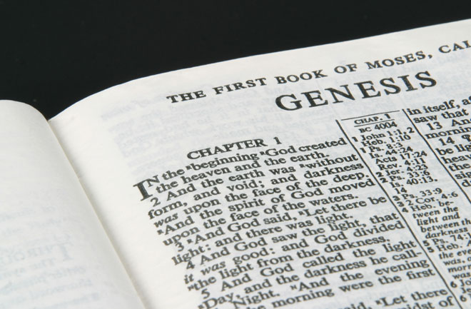
Special Attention for Gen 1:2
The question is: Does the KJV translation produce an
accurate meaning of the
original Hebrew language?
KJV Version
☺
Gen 1:2 And the earth without form, and void;
and darkness was upon
the face of the deep. And the Spirit of [Yahuah] moved upon the face of the waters.
was
Do not mistake this as
finding fault with the KJV.
Many [like me] have been raised studying the KJV EVERY morning before breakfast. It’s wonderful the KJV is used regularly, retaining its great value.

Slide 26
A Note about Bible Translations
Every translation has defects! Becoming familiar with the Hebrew language will aid each one in detecting these flaws.
Keeping this in mind for the KJV, a further investigation is needed for the real meaning of the word ה וֹ ת ה – eithe, very poorly translated as - “was.”
Below is a detailed break down of the first half of Gen 1:2.

Slide 27
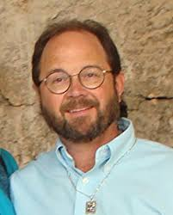
Brad Scott –Wildbranch Ministries <eithe>
Brad Scott is a teacher of Hebrew (including Paleo-Hebrew) for
25+ years. He writes - this word ה י ת ה – eithe (to become)
has a direct relation to the proper Name of י ה וֹ ה – Yahuah.
This should not surprise us as it was Elohim that was undertaking the creating!
Etymological Dictionary of the Hebrew Language By Earnest Klein
ה י ת ה– eithe (a derivative of ה י ה ) pg. 148
to exist, happen, become – Qal – 1. was, existed; 2. came into being, became; 3. he remained; 4. it came to pass, happened.
A Hebrew English Lexicon By John Parkhurst (1762)
to be, exist, denoting the state of condition of being.

Slide 28
Compare the first four words of Gen 1:2
And the earth … KJV and/or And the earth … The Scriptures
Defining <eithe> [was/came to be] (con’t)
was
came to be
What is the original Hebrew word for – was/came to be?
ה י ת ה – - became (Interlinear Scripture Analyzer)
This word is found in the various Hebrew translations online and in the Stone Edition Tanach.
Next: Verification of the meaning given for <eithe>.
eithe

Slide 29
Brown-Driver-Briggs lists several other definitions for the word “was” … ה .ת.י.ה - OT:1961; Please notice the implications:
1) to be, become, [became], come to pass, exist, happen, fall out a) (Qal) 1) a) to happen, fall out, occur, take place, b) to come about, come to pass
2) to come into being, a) to arise, appear, come
1) to become
2) to be instituted, be established
Defining <eithe> [was/came to be] (con’t)
TRANSITIONAL ACTION
Only the Qal
definitions
are considered.

Slide 30
Defining <eithe> [was/came to be] (con’t)
A Hebrew Lexicon Barker (1776)
נ ה י ה – neihe – is cognate with (same family of words as -)
ה י ת ה – eithe - become, be done, accomplished.
Hebrew and English Lexicon
of the Old Testament
Based on the Lexicon of William Gesenius,
translated by Edward Robinson (1906) pg. 135
H1961 – hayah – destruction, ruin disaster.
Please note: It is very common
for one Hebrew word to have
exact opposite meanings,
especially within the
same family of words.
Strong’s Exhaustive Concordance
H1961 – hayah – to exist,
be or become, come to pass, accomplished.

Slide 31
Summary for <eithe> [was/came to be]
ה וֹ ת ה – eithe – the transition from one state of being into
another different state of being
is very evident {the creation of the earth being the context here}.
If this word ה וֹ ת ה – eithe was to mean an existing state of being as opposed to a
of existence, then we have a much greater controversy.
That would mean we must accept that - Yahusha,
as the epitome of perfection above and beyond our human comprehension,
created a
highly imperfect creation which would be completely devastating
to His pure character.
transitional state

Slide 32
Gen 1:2(a) The Formless Earth without form OT:8414 - chaos <theu>
Summary thus far: the basic understanding for the terms “was/came to be” has been covered through the Hebrew word <eithe>. Next …
Gen 1:2 And the earth came to be formless …
Will the next part of Gen 1:2 expose a highly temporary
state of this earth’s existence?
Temporary! … considering Yahuah will be rebuilding
or restoring His creation, whereupon He deems it good!
(The “rebuilding” action will be addressed later.)

Slide 33
Defining <theu> [chaos]
without form OT:8414 – chaos <theu> ת ה וֹ
Some very important
questions must be asked:
With each and every definition
in Gen 1:2(a) …
Did our Creator [who is the epitome of perfection in every way],
create anything that will profess a “description of contamination”
on the first day of creation?
In other words, was the first day of creation by Yahuah (Yahusha) – A FAILURE?
We will define “form” first.
Interlinear Scripture Analyzer
emptiness, waste, desert, chaos, confusion, vanity, nothingness, worthlessness;
depth, deep, abyss, deep sea, primeval ocean.

Slide 34

Defining <theu> [chaos] (con’t)
Strong’s Exhaustive Concordance
form – OT:8414; tohuw (to'-hoo);
from an unused root meaning
to lie waste; a desolation (of surface), i.e. desert; figuratively, a worthless thing; adverbially, in vain.
KJV - confusion, empty place, without form, nothing, (thing of) nought, vain, vanity, waste, wilderness.
Our Question:
On creation’s first cycle,
did Yahuah create -
1. a waste
2. a desolation
3. a worthless thing
4. confusion
5. an empty place
6. a thing of nought
7. something in vain
8. waste and wilderness?
?!

Slide 35

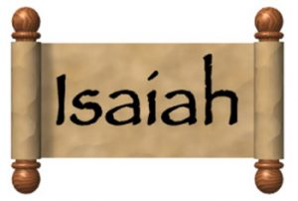
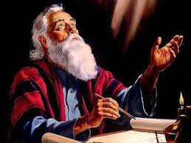
Isa 45:18 Provides
Understanding
For thus said [Yahuah], Creator of the shamayim, He is Elohim,
Former of the earth and its Maker. He established it.
I am [Yahuah], and there is none else.
HalleluYah Scriptures
HE DID NOT CREATE IT TO BE EMPTY,
HE FORMED IT TO BE INHABITED:
Moving on to
“more about chaos.”

Slide 36
Defining <theu> [chaos] (con’t)
without form OT:8414 – chaos <theu> ת ה וֹ
Etymological Dictionary of
the Hebrew Language Earnest Klein
emptiness, waste, desert, chaos, confusion.
vanity, nothingness, worthlessness.
A Hebrew English Lexicon
John Parkhurst (1762) pg. 563
1. confusion, without order, waste,
unconnected, unformed waste.
2. unprofitable thing, vanity
A Hebrew Lexicon W. H. Barker (1776)
to be without form, order, or irregularity,
as waste, chaos.
without form, vain, vanity, emptiness, nothing worth, and idol, barren wilderness.
Hebrew and English Lexicon
of the Old Testament [pg. 1026]
formlessness, confusion, unreality, emptiness, vaccuum. 1. formlessness, of primaeval earth (Gen 1:2) of land reduced
to primaeval chaos - Jeremiah 4.
The Brown-Driver-Briggs Lexicon mirrors the same definitions!

Slide 37
Jeremiah’s Vision for the End of Time
Have you noticed?
Jer 4:23 I beheld the earth, and, lo, it was without form, and void; and the heavens, and they had no light. KJV
With this study in Hebrew we have passed through:
hundreds of years and
through different translations
from different languages?!
The Hebrew language is firm on the meaning and idea of the word – chaos <theu> ת ה וֹ being translated as “without form” in Gen 1:2. This idea is consistent and ready to provide full alignment
within the Scriptures.
Interestingly, Jeremiah is looking in vision at the chaotic end of this earth’s allotment in time.
How does this relate to the beginning of the first cycle of creation?
Isaiah has told us 7 times, yes 7 times, that
if we would know the end, we must understand the beginning first. (See Isa 46:9-10.)
Jeremiah truly is an incredible witness!

Slide 38
Gen 1:2(a) The Formless Earth and void OT:922 - vacancy <bohuw>
Summary thus far: the term “without form” is defined as confusion, emptiness, formlessness and primeval choas. Next …
Gen 1:2 And the earth came to be formless and empty …
With the examination of the term “void” - will things get any worse than they already are?

Slide 39




Defining <bohuw> [vacancy]
and void OT:922 - vacancy <bohuw> וֹ ב ה וֹ
Etymological Dictionary of
the Hebrew Language Earnest Klein
emptiness, chaos.
A Hebrew English Lexicon
John Parkhurst (1762) [pg. 41]
empty, unconnected ruin, confused, mere void, desolation.
A Hebrew Lexicon
W. H. Barker (1776) [pg. 18]
empty, void.
Hebrew and English Lexicon
of the Old Testament [pg. 1026]
emptiness, of primaeval earth, [provides the same verse references as <theu>].
He formed it to be inhabited: for I am
Isa 45:18

Slide 40
Defining <bohuw> [vacancy] (con’t)
and void OT:922 - vacancy <bohuw> וֹ ב ה וֹ
Brown-Driver-Briggs
Lexicon
emptiness, void, waste.
Strong’s Exhaustive Concordance
from an unused root (meaning to be empty); a vacuity, i.e. (superficially)
an undistinguishable ruin:
KJV - emptiness, void, empty, unconnected ruin, confused,
mere void, desolation.
Is it possible this desolate waste of vanity as documented in Gen 1:2, which is preceded by a Hebrew term revealing a has derived from our Creator in
His Absolute Perfection?
Did Yahusha produce this contaminated failure?
Do these terms relate to an
inhabitable earth? (Isa 45:18)
TRANSITIONAL EVENT,

Slide 41
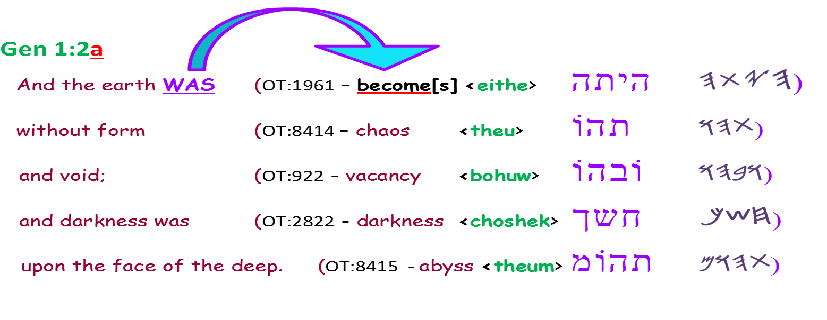
Review of: <eithe> <theu> <bohuw>
The first three Hebrew words translated to us as – was, form and chaos, have been covered through various translations.
Because of copyright rules, the different translations must use different words to show their separation.
The Hebrew text does not support this confusion. The Hebrew has been preserved by Yahuah for our advantage to study and decide for ourselves who it is that we want to give our allegiance to.
The next word under investigation is: DARKNESS CHOSHEK
.

Slide 42
Gen 1:2(a) The Formless Earth and darkness OT:2822 - darkness <choshek>
Summary thus far: the word <bohuw> reflects the definition of <theu>
very closely. Double emphasis means “pay attention”! Next …
Gen 1:2
And the earth came to be formless and empty, and darkness was on the face of the deep.
Because of the seriousness
of this study, it is
imperative to first
investigate the term
“face of the deep.”

Slide 43
Gen 1:2(a) The Formless Earth face of the deep OT:8415 - abyss <theum>
Short interruption: to examine “face of the deep” first. Next …
Gen 1:2
And the earth came to be formless and empty, and darkness was on the face of the deep.
“Abyss” must be scrutinized
first so that when
“darkness” is considered
we’ll know exactly what
kind of “darkness” it really is!

Slide 44
Brown-Driver-Briggs Lexicon
1) deep, depths, deep places, abyss, the deep, sea a) deep (of subterranean waters) b) deep, sea, abysses (of sea) c) primeval ocean, deep d) deep, depth (of river) e) abyss, the grave
Defining <theum> [abyss]
deep OT:5415 – abyss <theum> ת ה וֹ מ
Once again, traces of the beginning are seen in the ending, exactly as Yeshayahu (Isaiah) prophesied.
See Rev 9:1-3 and the “bottomless pit.”

Slide 45
You might notice that this word – deep – (OT:5415 – tehowm <theum> ת ה וֹ מ) has the same three letters as the Hebrew word for without form (OT:8414 – chaos <theu> ת ה וֹ ) but has a MEM מ letter added on to the end. Yes, Hebrew is read from right to left.
This word <theum> is of the same basic family of words and contains some of the root meanings but with the water substance added on.
I am not going to delve into the meanings of this word because we have already seen the basic meanings.
However one very interesting and very important word seen in this definition is the word – abyss. We are not going to look at the details here.
This word – abyss – at the beginning, has a direct connection to Revelation – at the end involving the domain of Satan.
To understand the connection of the abyss at Creation, to the word - abyss - in Rev 9:1-3
(where it is called the bottomless pit) consider the study titled –
Creation’s Chronicle.
It is now time to look at choshek – darkness!

Slide 46
Gen 1:2(a) The Formless Earth and darkness OT:2822 - darkness <choshek>
Summary thus far: the terms ‘subterranean waters’ and ‘abyss’ are very closely connected to the term ‘darkness.’ Next …
Gen 1:2
And the earth came to be formless and empty, and darkness was on the face of the deep.
There are two different
Hebrew word numbers
for “darkness” that
must be carefully
investigated.

Slide 47
and darkness was (OT:2822) – darkness
<choshek> ח ש ך
Two Different Hebrew Words for Darkness - They are:
1. <choshek> - which is the first word for “darkness”, as recorded in Gen 1:2.
2. <layil> - is the second word for “darkness” - as recorded in Gen 1:5.
We will certainly be looking at both terms and from where the, <layil> darkness derived. There is no disputing that Yahuah at one point also created this very type of affliction,
the <choshek> darkness, later on in the Scripture’s story events,
for it is most definitely recorded there.
However, the evil contamination portion of the <choshek> darkness was not there.
This study will be sticking very closely with Genesis 1:2
considering the context written in the first two verses,
at which time we will progress from there to verses 3 - 5.

Slide 48
Lets begin:
Brown-Driver-Briggs OT:2822; <choshek> ח ש ך
1) darkness, obscurity; a) darkness b) secret place
(Additional [information]) darkness, Genesis 1:2 seq: Exodus 10:21-21 etc.,
Hence spoken of as a dark place as of Hades, Ps 88:3; compare to Job 10:21, of an underground prison, Isa 42:7; 47:5; 49:9.
Let there be darkness over the land of Mitsrayim, even a darkness which is felt!

Slide 49

It would be good to inquire of yourself as we go through these definitions –
1. Did Yahuah create this state of affairs intending upon a perfect inhabitable creation?
2. Was Yahuah’s experiment of creation a disaster and/or a failure?
Strong’s Exhaustive Concordance
OT:2822; <choshek> is from the primitive root OT:2821 <chashak>.
(lit) – darkness, (fig) misery, destruction, death, ignorance, sorrow, wickedness
Etymological Dictionary of the Hebrew Language by Earnest Klein
OT:2822; <choshek> ח ש ך
1. darkness, obscurity, 2. secret place, 3. IGNORANCE, 4. EVIL, SIN
Hebrew English Lexicon by John Parkhurst (1762)
OT:2822; <choshek> ח ש ך
to impede action or motion, to refrain, restrain, keep back, stop.

Slide 50

A Hebrew Lexicon by W. H. Barker (1776) pg. 73
OT:2822; <choshek> ח ש ך to impede, keep back, refrain, restrain, spare, withhold: to be dark, darkened, darken, obscure - (Prov 22:29).
Hebrew and English Lexicon of the Old Testament
Based on the Lexicon of William Gesenius, translated by Edward Robinson (1906)
OT:2822; <choshek> ח ש ך withhold, refrain, keep back, keep for oneself, hinder, hold in check, reserve.
Question: How many of these definitions describe
the character of our Creator and Mashiach?

Slide 51
We must consider these definitions when reading the context of the next few verses to determine what this <choshek> darkness actually was.
Not just a few specifically chosen definitions to facilitate our present belief structure, but every definition must be considered carefully throughout.
Soon we are going to see, in Genesis 1:3, that Yahuah took some very specific actions that directly pertained to this <choshek> darkness;
the profound results will last through the remainder of eternity.
It is this <choshek> darkness that encapsulated the earth.
Creation TRANSITIONED from a perfect state [in vs 1] to a vile state [in vs 2]
as recorded by Mosheh in “tohu and bohu” (chaos and vacancy)
at the beginning of verse 2.

Slide 52

Summary thus far: between verses 1 & 2, the earth went from “perfection” to “undistinguishable chaos and ruin.” Next …
Gen 1:2(b) Restoration Begins
moving OT:7363 - flutter <rachaph>
waters OT:4325 - [dirty] waters <mayim>
Gen 1:2 (b) … And the Spirit of Elohim was moving on the face of the waters.
The action at the beginning of verse 2
was negative. The next action is positive!

Slide 53
Defining “terms” of Gen 1:2(b)
<rachaph> [flutter]
<mayim> [waste water]
The next words of Gen 1:2(b) are
very revealing and fascinating –
  And the Spirit [OT:7307]
  of Elohim moved [OT:7363] …
moved OT:7363 rachaph
(raw-khaf'); a primitive root;
to brood; by implication, to be relaxed: KJV - flutter, move, shake.
The remainder of Gen 1:2(b) …
  … upon the face [OT:6440]
  of the waters [OT:4325].
waters OT:4325 mayim
(mah'-yim); dual of a primitive noun (but used in a singular sense); water; figuratively, juice; …
KJV: wasting, water.
Action: The Ruach flutters over “waste water.”

Slide 54
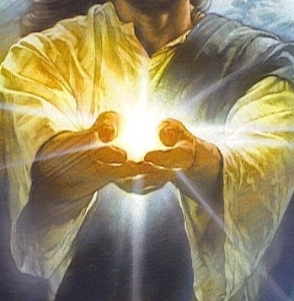
Defining the Action of the Ruach
In Gen 1:2(b) the action of the Ruach Ha Qodesh – was hovering or vibrating above the waters on the earth.
Young’s Literal Translation and the Ancient Hebrew Research Center calls this action – fluttering above the waters.
There is a scientific and proven fact named sonoluminescence that involves vibration applied directly to water.
This vibration induced action produces light!

Slide 55
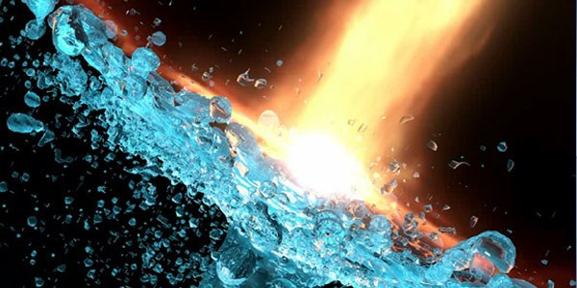
What About the Waters [mayim]?
Let’s briefly touch on “the waters.”
There are two words that are applicable to water. They are – by phonetics – shemayim and mayim.
The shemayim has the prefix “she” which directly refers to the heavens.
The waters on this earth are translated from the word “mayim.”
It is this word – “mayim” that is seen in Genesis 1:2. It is upon the earthly waters
that the Ruach Ha Qodesh was inducing
this vibrating/cleansing action.
Cleansing of
the “mayim”
on this earth.

Slide 56

Brad Scott Comments:
“Elohiym redeems creation beginning with the waters.
Water is a picture of cleansing in judgment, in purification, and salvation.”
Remember, the Ruach (Holy Spirit) was
“fluttering” above the waters!
Wildbranch
Ministries
Question: Why would Elohiym need
to begin redemption on the first cycle
of creation with water? Why?
Did the “waters” need
cleansing “that” day?

Slide 57
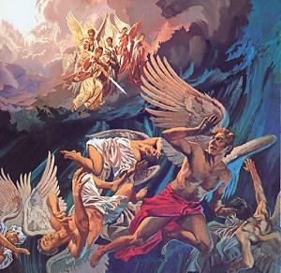
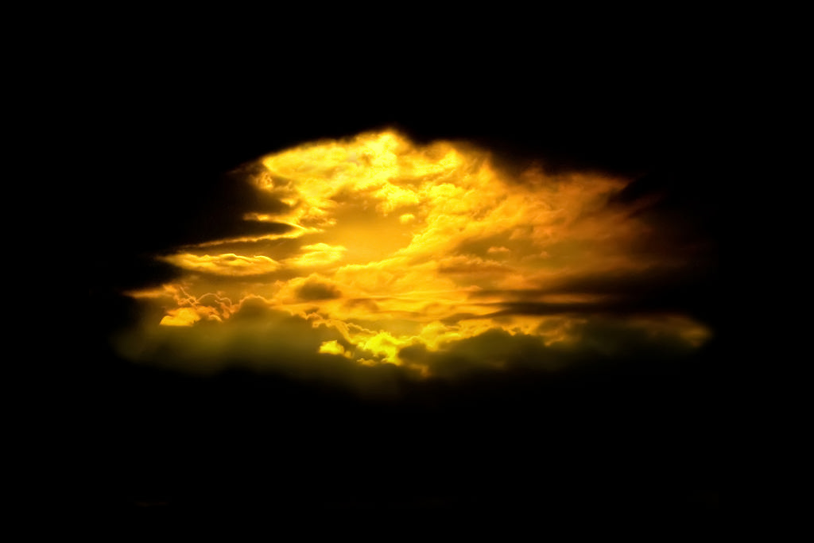
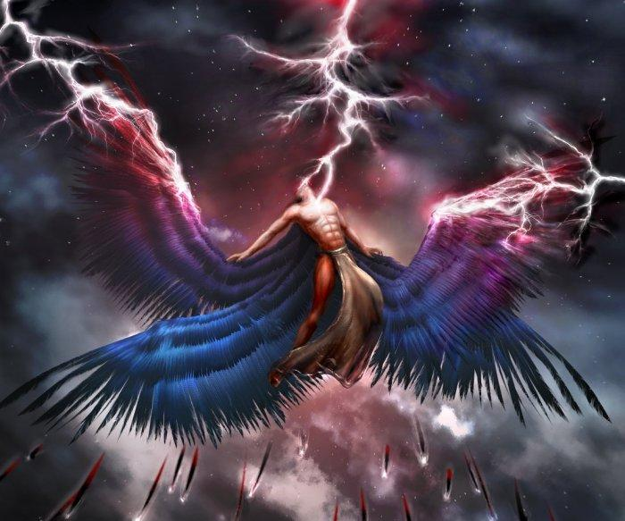
There is another very interesting aspect
to this water on the earth.
We have learned, from the previous definitions accumulated in this verse, that
it is highly possible the earth
was contaminated by violence of destruction
upon the arrival of Satan.
And he [Yahusha] said unto them,
I beheld Satan as lightning fall from heaven. Luke 10:18
(Also see Rev 12:4-9.)
IMPACT

Slide 58
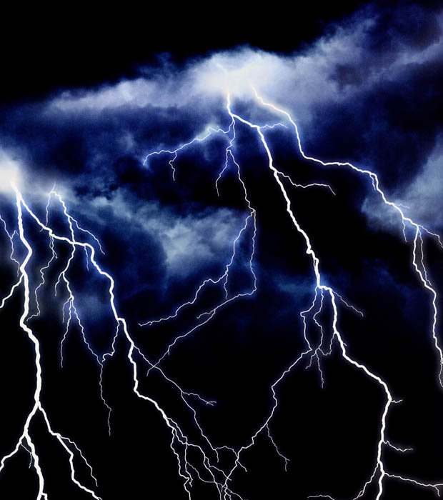
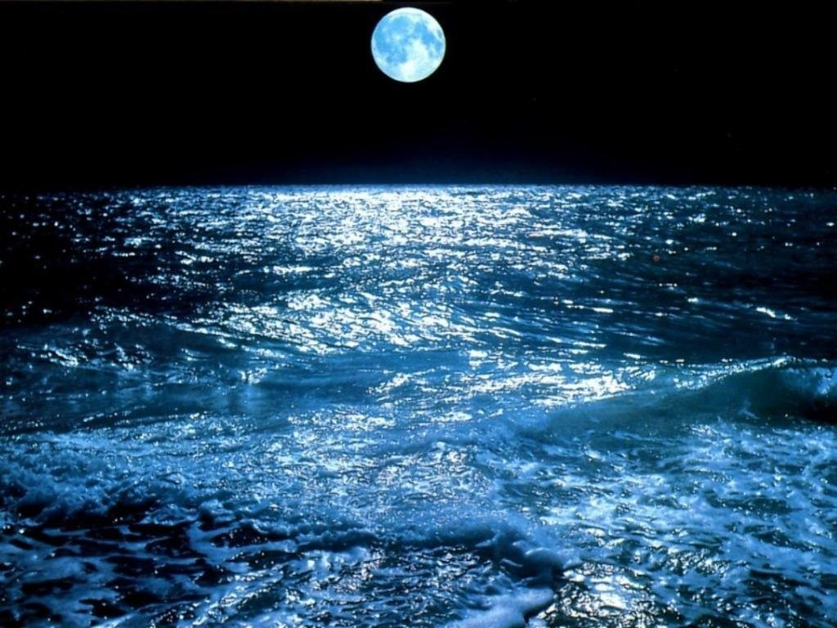
Questions:
Was Yahusha PRESENT
ON THE FIRST CYCLE
of creation?
Was Yahusha in a position to observe the Adversary fall from heaven and hit the earth with an impact described as – LIGHTNING?
HOW DESTRUCTIVE IS LIGHTNING?

Slide 59

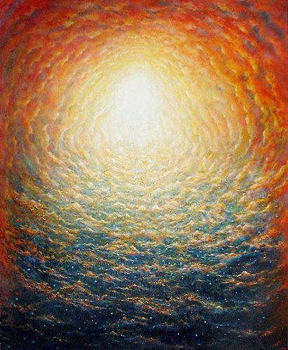
Is it possible that the waters could also have been contaminated at that time as well?
Interestingly enough, there is provision
within the Hebrew definitions for
very polluted and/or
contaminated water,
right in Gen 1 verse 2!

Slide 60
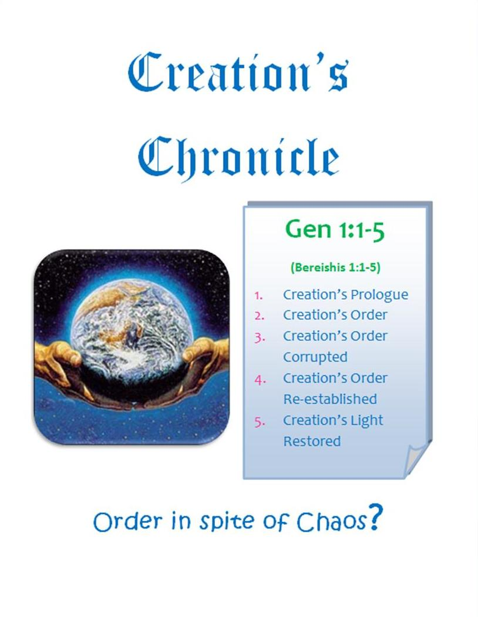
Because this is very much a skeleton study of Genesis 1:1-5, the details can be read in
where it is explored in an interesting way.
Creation’s
Chronicle

Slide 61
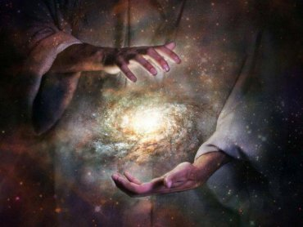
Summary thus far: from perfection to chaos to cleansing.
Next …
Gen 1:3 Restoration of Light
let there be light OT:216 <owr>
Gen 1:3
And Elohim said
let there be light:
and there was light.
Ps 104:30 Thou sendest forth thy spirit, … and thou renewest the face of the earth. KJV

Slide 62
We need to pay close attention here. Yahuah (Elohiym) has brought light to exist. However this time it was not created. Back in verse 1 we are clearly told that Yahuah CREATED <bara`>, the earth and the heavens.
Here, once again for a reminder, are the definitions of <bara`> for Genesis 1.
Brown-Driver-Briggs Hebrew Lexicon created H1254 <bara`>
1) to create, to shape, to form (always with Yahuah as subject) a) (Qal) to shape, to fashion, to create
1) used of heaven and earth [found in Gen 1:1]
2) used of individual man [found in Gen 1:27]
3) used of new conditions and circumstances
[the next usage after Gen 1:1 is found in Gen 1:21 with the creation of the breathing wildlife].

Slide 63
Question: Then what does this word -
(Let there be) – (become) י ה י - iei - mean?
If Yahuah did not create the light at this moment, WHAT DID HE DO?
. Brown-Driver-Briggs Lexicon – “let there be” [become]
1. to be, become, come to pass, exist, happen, fall out
1. (Qal) 1. to happen, fall out, occur, take place, come about, come to pass
2. to come about, come to pass
2. to come into being,
1. to arise, appear,
2. to become
1. to become
2. to become like
3. to be instituted, to be established
3. to be
1. to exist, to be in existence
2. to abide, remain, to continue (with word of place or time)
3. to stand, lie, be in, be at, be situated |(with word of locality)
4. to accompany, be with

Slide 64
Gesenius Lexicon י ה י - iei - as seen in the BLB.
2) to become, to be made or done, Absol. i.q. to exist, to come to pass.
Gen 1:3 let there be light and there was (came into existence) light.
There are many more explanations of this word and the cognate words, to be studied in this Lexicon and others. They all expose a gathering or assembly of substance already in existence to form something.
Only a few examples are printed here. The idea of the light being created
in verse 3 does not exist – not in the original Hebrew text.
The word for create <bara`>, does not exist in verse 3. In reality the word <bara`> – to create – is not seen again until verse 21 where the sea creatures and birds were created. <Bara`>, is the same word as seen in verse 1 where Yahuah created everything SUDDENLY. [Let’s read Isa 48:3.]

Slide 65
Yahuah did not take years of time to create this universe.
Every base element needed to give the final details of creation was <bara`> {created} on that very first day of creation in Gen 1:1.
Note: A finished product may have numerous “base elements” in its final make up. Again – refer to Gen 2:5; to understand the final state of existence was not yet achieved.
Isa 48:3 I have declared the former things from the beginning; and they went forth out of my mouth, and I shewed them;
I did them suddenly, and they came to pass. KJV
Isa 48:3 I have declared the former things from the beginning; and they went forth out of my mouth, and I made you hear them. Suddenly I acted, and they came to be.
HalleluYah Scriptures

Slide 66
Allow me to submit to you that the light was also contaminated, just as the primeval substances which were to ‘form the earth’ were contaminated.
We should recall that Lucifer was the bearer of light in Heaven. Lucifer had, and still has, control over light.
It is fully conceivable, through the original Hebrew manuscripts, that just as the earthly substance was polluted, Satan’s intent
and purpose was to also destroy the light (if he could).
Yahuah had to restore and/or rebuild the light. We are not told the details on how this was done, just that it was accomplished.

Slide 67
Moving forward to Genesis 1:4.
Gen 1:4(a) And Yahuah saw the light, - <owr> - ר.וֹ.א. that it was good:
Upon inspection, Yahuah found the rebuilt light ר.וֹ.א. - <owr> - to be excellent.
Gen 1:4(b) … and Elohim divided the light from the darkness [H2822].
darkness = choshek = ך.ש. ח
Yahuah separated –
Choshek darkness
Owr Light
The action is clear -
The question is – WHY must there be a wall of separation between
Yahuah’s perfect creation – Light – and this evil <choshek> darkness
that had insidiously enveloped the newly created earth?

Slide 68

Here are some questions that require answers:
What characteristic was encased within the <choshek> darkness that Yahuah rejected, not wanting it to be affiliated with His pure light?
If Yahuah had created this <choshek> darkness, as the very first act of creation, what then caused it to become (Gen 1:2a) more undesirable, if it had already been created by Yahuah as an undesirable entity?
Yahuah told us in Isaiah 45:18 that He created the earth to be in an habitable state … not to be a state of mass confusion and contamination!
Isaiah 45:18 - For thus said [Yahuah], Creator of the shamayim,
He is Elohim, Former of the earth and its Maker, He established it,
He did not create it to be empty, He formed it to be inhabited:
“I am [Yahuah], and there is none else.”
HalleluYah Scriptures

Slide 69

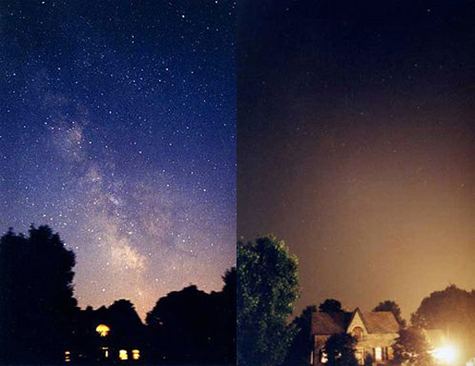
What transitional event placed this unsolicited envelope upon the earth?
Understanding that we experience a darkness at night; what is it about the darkness after dusk, that is acceptable to Yahuah?
From where and when did this acceptable darkness arrive?
When Yahuah separated His light from the darkness,
WAS THERE ANOTHER DEVELOPMENT
THAT WAS ALSO ACCEPTABLE?
Darkness
after Dusk

Slide 70


We are given the answers to these questions on condition of us accepting the Word as it is written.
Yahuah named the light that was restored in Gen 1:3, - <yowm>, or in English – THE LIGHT SEASON.
The cleansed <choshek> darkness, Yahuah named it <layil> or night as we know it.
Let’s continue with Gen 1:5 (a)
And Yahuah called the light
DAY
and the darkness
He called NIGHT.

Slide 71

Let’s take a real careful look again – before anyone jumps up
and down waving their hands in the air to exclaim –
“tHERE IT IS, SEE, GOD CREATED THE CHOSHEK DARKNESS.”
Yes, “a” god contaminated the earth and its atmosphere.
The question is, which god introduced this darkness that was not acceptable for the pure light of Yahuah to be joined with?
Amos 3:3 Can two walk together, except they be agree?
Let’s look at the example of Noah.
Gen 6:8 But Noaḥ found favour in the eyes of יהוה [Yahuah].
Gen 6:9 This is the genealogy of Noaḥ. Noaḥ was a righteous man, perfect in his generations. Noaḥ walked with Elohim.
Yahuah preserved Noah; He did not separate him from Life.

Slide 72
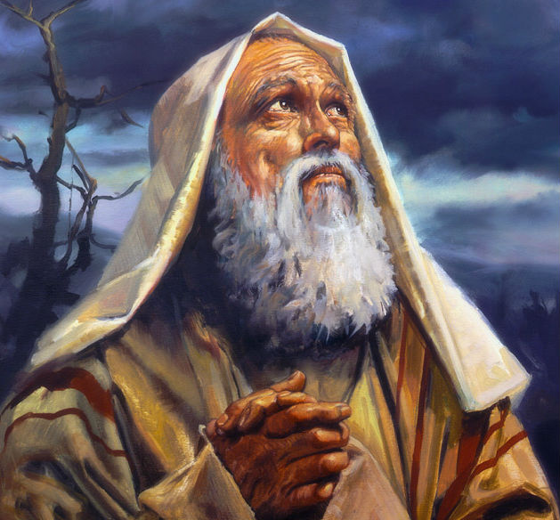
What About Abraham?
Gen 17:1 And it came to be when Aḇram was ninety-nine years old,
that יהוה [Yahuah] appeared
to Aḇram and said to him,
“I am Ěl Shaddai – walk
before Me and be perfect.
We clearly see a Scriptural example of a
righteousness requirement for being
connected with Yahuah.

Slide 73
What was it about the <choshek> darkness that caused Yahuah to separate it from His pure light?
On the graphic of slide 70, I hope you noticed the introduction of another entity of the absence of physical light, named <layil>.
If you will notice, <layil> - the acceptable darkness - was a product of having separated the pure light from the <choshek> darkness.
The <choshek> darkness does have, in the Hebrew language, provision within the definitions for the acceptable substance of <layil> darkness to be removed from inside of this contaminated <choshek> darkness.
We are going to look at the definitions once again for a reminder.

Slide 74
<Choshek> darkness has these positive components – literal physical darkness and obscurity, to be dark, darkened, darken, obscure - which is what we appreciate in our Night Seasons.
But it may ALSO CONTAIN - misery, destruction, death, ignorance, sorrow, wickedness, secret place, ignorance, evil,
sin, to impede action or motion, to refrain, restrain, keep back, stop, withhold, to impede, keep for oneself, hinder, hold in check, reserve.
Now we need to look at the definitions for the <layil> darkness. This will help us realize exactly what was separated from the <choshek> darkness at the exact same time that Yahuah
extracted His pure light from this evil contamination.

Slide 75
<Layil> - Notice, the darkness and obscurity has now been cleansed (by separating it from the <choshek> darkness) and renamed by Yahuah as - <layil>.
How is it even remotely possible that Yahuah would simply rename the <choshek> darkness to a fully acceptable <layil> without making some significant changes?
Here are the definitions for <layil>:
Brown-Driver-Briggs night – OT:3915; <layil> ל י ל ה 1) night a) night (as opposed to day) b) of gloom, protective shadow (fig.)
The EDHL (Etymological Dictionary of the Hebrew Language) pg. 300 night <layil> OT:3915 ל י ל ה 1. night 2. at night (derived from) יליל . nocturnal.
Interlinear Scripture Analyzer night <layil> OT:3915 ל י ל ה the night

Slide 76
Hebrew English Lexicon by John Parkhurst (1762)
night – OT:3915; <layil> ל י ל ה (pg. 273) pluriliteral word - ל ל
not as a verb, but the idea is evidently, to wind, to turn, or move round, or out of a rectilinear course. As nouns, ל י ל .and ל י ל ה, the night, the deviatrix.
We are informed by Moses, Gen. i. 3, Then God said, let light be, and light was. Ver. 4, And God saw the light, that (it was) good (proper to perform the important offices intended for it), and God divided between the light and between the darkness (reciprocally changed the conditions of the celestial fluid by his own immediate power, as the sun and moon afterwards mechanically did, and still do, ver. 18.)
A Hebrew Lexicon By W. H. Barker (1776)
night – OT:3915; <layil> (pg. 97) ל י ל ה the night

Slide 77
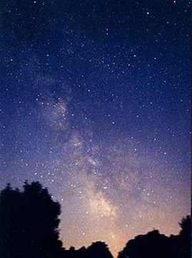
Hebrew and English Lexicon of the Old Testament
Based on the Lexicon of William Gesenius, translated by Edward Robinson (1906) (pg. 538)
night – OT:3915; <layil> ל י ל ה ל י ל
Night, opposite day, i.e. within one whole day; as in the close
of the day – 2 Chron 35:14; as time of sacred – Isa 30:29.
There are many more examples of night in this source.
Strong’s Exhaustive Concordance
night – OT:3915; <layil> ל י ל ה ל י ל
from the same as OT3883; prop. a twist (away from light),
i.e. night: fig. adversity; - night (season).
<layil>

Slide 78
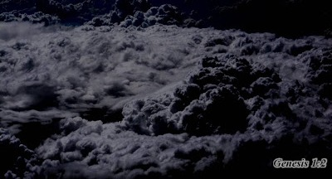
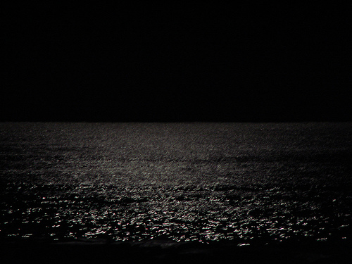
Differences between <layil> and <choshek>
OK! We have seen many definitions of <layil> ל י ל ה ל י ל .
Interestingly these definitions
have not reflected the idea of evil contamination seen in the word <choshek>: misery, destruction, death, ignorance, sorrow, wickedness, secret place, ignorance, evil, sin, to impede action or motion, to refrain, restrain, keep back, stop, withhold, to impede, keep for oneself, hinder, hold in check, reserve.
It is these evil contaminated characteristic traits of <choshek>
that Yahuah separated, in turn applying His purification to the newly formed identity – our Night Season known as - <layil> ל י ל ה ל י ל .
<layil>
<choshek>
This 2nd Hebrew word for night {which was purified
and extracted by purification of separation from <choshek>
as mentioned in Genesis 1:5(a)} is fully acceptable for our existence on this earth.

Slide 79
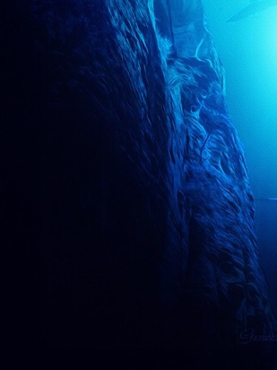

Day 1 of Creation Was an Eventful Day
Friends, I must remind you, many events had taken place
during the first Light Season of creation.
Creation Vs 1!
Chaos & Darkness Vs 2a
Light Restored Vs 2b
In Gen 1:5(a) the evening still had not arrived at this point, nor had the 1st Night Season come to fruition.
The <owr> Light was titled Day; the cleansed <choshek> “darkness” was titled <layil> Night.
Yes the Night Season was given a name, but the fruition had not yet been realized.
That information will be investigated in the next study.

Slide 80

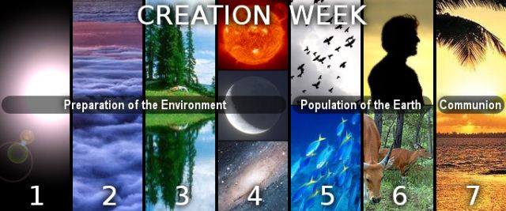


The next Covenant
Calendar Study
will attempt to cover:
Review of ereb
& boqer;
Examination
of the full
creation week.
Questions/Comments on
the verses of Gen 1:1 & 1:2?
calendar@torahtothetribes.com

