Slide 1

Exo 12 ~ Unleavened Bread
Consumption Schedule

Slide 2
Unleavened Bread
Consumption Schedule
Exodus 12:18
Under serious scrutiny!
References from The Scriptures
unless otherwise noted.

Slide 3

Would you agree?
Tradition is the Enemy of Truth!
Exodus 12:18 effectively reveals the chasm between “tradition” and “truth.”
In the first, on the fourteenth day [Abib 14 Passover]
of the month, in the evening,
you shall eat unleavened bread, until
the twenty-first day of the month in the evening.
HalleluYah Scriptures
3

Slide 4


An Appearance of Conflict with Exo 12:18
Questions regarding conflict for the following Scriptures:
1. Is the command to eat unleavened bread for 7 days,
or 8 days?
What is the “festival content” for Exo 12:18? Passover? Unleavened Bread Festival? Both?
Exo 12:18
Exo 12:15-16
Ex
13:6-7
Lev 23:5-8
What is the cause of this conflict?
The idea of the sunset day? OR
The day commencing at dawn?
4

Slide 5
Summary of Scriptures
Unleavened Bread Festival for 7 days. Eat unleavened bread for 7 days.
Count is given for: 7 days.
Passover: 14th day.
15th day: 1st ULB Sabbath
21st day: 2nd ULB Sabbath
Eat ULB 7 days. Count:
15-16-17-18-19-20-21!
Exo 12:18
Exo 12:15-16
Ex
13:6-7
Lev 23:5-8
Eat unleavened
bread for 7 days.
1st day & 7th day
are holy convocations.
Count the days for eating unleavened bread:
15-16-17-18-19-20-21!
Passover Sacrifice: 14th day at even.
Eat unleavened bread that night until the 21st day of the month at evening.
Count the days for eating unleavened bread: 14-15-16-17-18-19-20-21!
5

Slide 6
Summary of the Count for Eating ULB
Count:
7 days.
Exo 12:18
Exo 12:15-16
Ex
13:6-7
Lev 23:5-8
Count:
7 days.
Count:
7 days.
Count:
8 days!!
There definitely appears
to be a conflict!
6

Slide 7
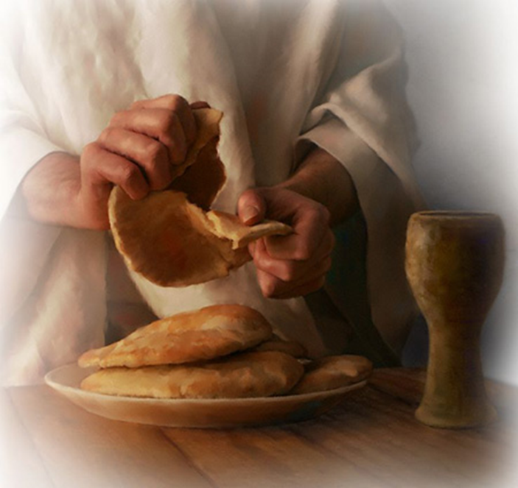
There is a Time to Eat and a Time to Praise
According to Exodus 12:18
Yahuah has determined very specific times for observing His Mo-edim.
Do man’s traditions align with His
Set-Apart Appointments?
7

Slide 8
Have you considered the idea that there might be more to the full Passover Festival than just eating unleavened bread for 7 cycles as we have been taught for many years?
Is there the possibility that we have been missing something BIG in our current worship traditions?
If, on the final Atonement Day, you are accused of removing one worship cycle, or preventing Yahuah from receiving worship from one or more statute requirements, what will your answer be?
8

Slide 9
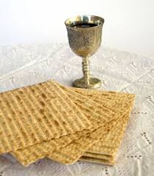
Do you know what the Scriptures declare about:
Yahuah’s Unleavened Bread Consumption Schedule??
Let’s start with: Definitions for Cycle/Season
This study refrains from using the word “day” that has been
translated from the original Hebrew word <yowm>.
The word “day” has lost a massive amount of definitive correctness
through ambiguous definitions.
“Day” can indicate 12 or 24 hours, day or night, or both!
To understand the Scriptures correctly such terms
need to be much more accurate.
In this study preference will be given to the word cycle in place of the word day.
When quoting Scripture, or citing the Sabbath Day, you will see it.
Otherwise cycle is the word of choice.
Notes:
The word “day” is inadequate for the accuracy demanded for these studies.

Slide 10
Understanding Important Definitions
The 24 hour cycle is further defined to pinpoint two seasons.
1. Cycle = 24 hours containing the
two seasons of: light - H216 <’owr> and night - H3915 <layil>.
2. Season = H6256 <‘eth>; twelve segments of time whether it is the
Light Season or Night Season.
Jeremiah 33:20-26 uses the terms
“day season” and “night season.”
Light
Season
Night
Season
10
Notes:
The word “day” is inadequate for the accuracy demanded for these studies.

Slide 11
Jeremiah’s Definitions for Seasons
Jer 33:20, 25, 26 Thus saith Yahuah; If ye can break my covenant of the day, and my covenant of the night, and that there should not be
day and night in their season …
25 Thus saith Yahuah; If my covenant be not with day and night, and if I have not appointed the ordinances of heaven and earth;
26 Then will I cast away the seed of Jacob, and David my servant … KJV
Light
Season
Night
Season
Does this sound like a serious covenant?
11
Notes:
The word “day” is inadequate for the accuracy demanded for these studies.

Slide 12
Focus of this Study
What time of the 24 hour cycle is it in this picture?
  Morning Twilight? – (Mixture of light and darkness)
  Evening Twilight? – (Mixture of light and darkness)
  Light Season of the Cycle? – (Direct Sunlight)
  To be sure we are all on the same page, consider the following graphic as given in Genesis 1.
  This must be understood for our study on the
  days of consumption for unleavened bread.
12

Slide 13
An “Ereb” Review
FIRST
Ereb - Evening - ע ר ב
To mix, mingle, be mingled, a mixture, mixed multitude, rabble, of flies or insects, the mixers, mixed ones, light and spirit mixed together, the heavens or celestial fluid consists of this MIXTURE, to be darkened, duskily obscured, [beyn ha arbayim] between the evenings or more literally - between the MIXTURES, at sunset when the cool dark air mixes or night air mixes with it.
A Hebrew Lexicon - J Parkhurst 1762
13

Slide 14
SECOND
Ereb is a Verb!
All definitions for ereb are descriptive action words.
Boqer [the noun] identifies a general portion of the light season [a noun] that includes - shachar - (Dawn’s Light).
Ereb, when it is applied to morning {boqer} –
describes the mixing [the action/verb] of light and darkness occurring in the sky at that particular time.

Slide 15
Please be sure you understand this graphic before moving on.
The Outline of Light and Darkness according to Genesis 1:
Boqer: (Shachar) Dawn’s first light
Boqer: At Dawn, A New Cycle Starts
Morning action description - ereb, twilight mixture
Sunrise
Sunset
Evening: ereb, twilight mixture
Direct Sunlight Rays
Darkness
Dawn, or Sunset?
Our Focus: Which Light entity changes the 24 Hr. cycle for Yahuah?
Twilight OT:5399 nesheph (neh'-shef); from OT:5398; properly, a breeze, i.e. (by implication) dusk (when the evening breeze prevails): KJV - dark, dawning of the day (morning), night, twilight.
Morning OT:1242 boqer (bo'-ker); from OT:1239; properly, dawn (as the break of day); generally, morning:
KJV - (+)day, early, morning, morrow.
Notes:
When speaking about Lev 23:32, many Sabbatarians place the an evening application before the sunset.

Slide 16
The Primary Question for this study about unleavened bread is to find the Divine guidelines for “when” and “how long” unleavened bread is to be eaten.
1. Will we see support for the Sunset Theory system of determining time, OR …
2. Will there be a foundation for the format of Yahuah’s Dawn Design?
This will be examined so everyone can make an informed decision!
Let’s begin by viewing some texts from Exodus 12 & 13 about eating unleavened bread.
Exodus 12:15 Seven days ye shall eat unleavened bread, and from the first day ye shall utterly remove leaven from your houses: whoever shall eat leaven, that soul shall be utterly destroyed from Israel, from the first day until the seventh day.
Exodus 13:6 Six days ye shall eat unleavened bread, and on the seventh day is a feast to [Yahuah].
Exodus 13:7 Seven days shall ye eat unleavened bread; nothing leavened shall be seen with thee, neither shalt thou have leaven in all thy borders.

Slide 17
Quite clearly from Exodus 12 & 13 Unleavened Bread is to be eaten for 7 cycles. There is no mention here of other cycles for eating Unleavened Bread.
However this will move into an interesting situation. Further in Exodus 12, it appears as if there is a totally different number given. Let’s check Leviticus.
1
Leviticus 23:5 In the first month, on the fourteenth day of the month, between the evening times is [Yahuah’s] passover.
Leviticus 23:6 And on the fifteenth day of this month is the feast of unleavened bread to [Yahuah]; seven days shall ye eat unleavened bread.
2
Have you ever noticed there are two Festivals with:
two - SEPARATE - Feast dates?
SEPARATE

Slide 18

Comparing Lev 12:6 & Exo 23:18
Leviticus 23:6
Exodus 23:18
And on the fifteenth day of the same month is the feast of unleavened bread unto [Yahuah]: seven days ye must eat unleavened bread. KJV
In the first month, on the fourteenth day of the month at even, ye shall eat unleavened bread, until
the one and twentieth day of the month at even. KJV
Count:
7 cycles.
Count:
8 cycles!!

Slide 19
If you are accustomed to observing Passover by sunset to sunset standards - on Abib 15 night - please consider the separate Festival dates for the moment.
At this time we will concentrate on the message of “SEVEN DAYS”
for eating Unleavened Bread.
Exactly “when & where” does this message apply for the eating of
Unleavened Bread a total of “SEVEN DAYS”?
Why have many of us been taught to observe Passover in the
Sabbath Night Season of Abib 15 (counting that time as part of the ULB Feast)?
And - Where can we find a Scripture instructing this message?
It cannot be found for it does not exist!

Slide 20
Exodus 12:16 And in the first day there shall be an holy convocation, and in the seventh day there shall be an holy convocation to you; no manner of work shall be done in them, save that which every man must eat, that only may be done of you.
Question:
Is the Passover Festival a … “Holy Convocation”?
Exodus 12:16 And in the first day there shall be an holy convocation, and in the seventh day there shall be an holy convocation to you; no manner of work shall be done in them, save that which every man must eat, that only may be done of you.
Question:
Is the Passover Festival a … “Holy Convocation”?
Exodus 12:16 And in the first day there shall be an holy convocation, and in the seventh day there shall be an holy convocation to you; no manner of work shall be done in them, save that which every man must eat, that only may be done of you.
Question: What “feast” is verse 16 talking about? Passover? ULB festival?
2nd Question: Is the Passover Festival a … “Holy Convocation”?
If it is, I know of no Scriptural support claiming that Passover is a “Holy Convocation” or a Sabbath of any kind. However in Leviticus 23:7,8 there is information affirming the Festival of Unleavened Bread as a “Holy Convocation” (H4744 <miqra>) on both 24 hour cycles at the beginning and the end.
Therefore, Exodus 12:16 cannot be referring to the Passover Feast Night Season as the first “day” of consuming Unleavened Bread. But instead, it is referring to the two Shabbaths of the Festival of Unleavened Bread for its commencement point of Unleavened Bread consumption.
This point is serious and will become extremely important very quickly.
If it is, I know of no Scriptural support claiming that Passover is a “Holy Convocation” or a Sabbath of any kind. However in Leviticus 23:7,8 there is information affirming the Festival of Unleavened Bread as a “Holy Convocation” (H4744 <miqra>) on both 24 hour cycles at the beginning and the end.
Therefore, Exodus 12:16 cannot be referring to the Passover Feast Night Season as the first “day” of consuming Unleavened Bread. But instead, it is referring to the two Shabbaths of the Festival of Unleavened Bread for its commencement point of Unleavened Bread consumption.
This point is serious and will become extremely important very quickly.
There is no Scriptural support claiming Passover as a “Holy Convocation” or a Shabbath of any kind. However in Leviticus 23:7-8 there is information affirming the Festival of Unleavened Bread has two “Holy Convocations” (H4744 <miqra>) on both 24 hour cycles at the beginning and ending of the festival.
Therefore, Exodus 12:16 cannot be referring to the Passover Festival Night Season as the first “day” of consuming Unleavened Bread. Instead, Exodus 12:16 is referring to two Shabbath's.
The 1st Shabbath is the commencement point for the consumption of Unleavened Bread.
This point is serious and will become extremely important very quickly.
Notes:
Read Leviticus 23:5 – 7 and compare which is Qodesh and which is not.

Slide 21
QUESTIONS:
1. Where do the Scriptures provide the DISTINCTION between the orders to consume Unleavened Bread during the Festival of Unleavened Bread and the Feast of Passover?
.
2. WILL THE SEPARATING DISTINCTION of Unleavened Bread consumption allow for the individual Festival dates of Passover and Unleavened Bread to collectively indicate a total of EIGHT cycles for consuming Unleavened Bread, according to Exo 12:18?
IMPORTANT: Can point #2, which indicates EIGHT CYCLES for eating Unleavened Bread, be substantiated from the Scriptures?
Will this Scripture also enable us to fulfill ALL the required statutes for eating Unleavened Bread during the two Festivals?
Exodus 12:18 In the first month, on the fourteenth day of the month at even, ye shall eat unleavened bread, until the one and twentieth day of the month at even.
How many cycles are there — counting from the 14th cycle to the 21st cycle?
Where else do we read of eating Unleavened Bread on the 14th of the month?

Slide 22
The FIRST Scriptural instruction for eating Unleavened Bread - is found in Exodus 12:8.
It is very specific.
Exodus 12:8 And they shall eat the flesh in this night roast with fire, and they shall eat unleavened bread with bitter herbs.
Unleavened Bread was to be eaten that night. Not in the Light Season, but after the sun had set and the darkness had begun.
Question: For the timing context up to this point in chapter 12,
what single cycle of the month has been indicated?
Exodus 12:6 And it shall be kept by you till the fourteenth of this month, and all the multitude of the congregation of the children of Israel shall kill it toward evening.
And reviewing verse 8 again –
Exodus 12:8 And they shall eat the flesh in this night roast with fire, and they shall eat unleavened bread with bitter herbs.

Slide 23
Yahuah’s 24 Hours of Passover
Ex 12:6 And you shall keep it up until the fourteenth day of the same month. Then all the assembly of the congregation of Yisra’el shall kill it between the evenings.
Ereb/Twilight Mixture
Dawn
Sunrise
Sunset
R
E
V
I
E
W
Abib 14 Light Season
Abib 14 Night Season
Exodus 12:8 And they shall eat the flesh on that night, roasted in fire, - with unleavened bread and with bitter herbs they shall eat it.

Slide 24
With the last graphic of Passover in our mind, let’s look at the Festivals
and see if this format can accomplish fulfilling 8 cycles of eating
unleavened bread as it is written in Exodus 12:18.
Passover eaten “on that night roasted in fire with unleavened bread…”
Ex 12:8.
Ex 12:18 – 21st day of the month, IN THE EVENING!
Cycle 1 Abib 14
+
1
15
2
16
3
17
4
18
5
19
6
20
7
21
= 8
Our Scriptures reveal an EIGHT cycle schedule for consuming unleavened bread during the Passover and Unleavened Bread Festivals. This schedule is easily achieved when abiding by Yahuah’s Dawn start of the day format, from Creation!

Slide 25
The chart you have just seen is a timing format based on the very words of creation, as recorded in Genesis 1.
Next … consider the tradition most of us have been taught for many years and see if the traditional system will also allow complete fulfillment of the Passover statutes in Exodus 12.
The traditional system labelled as Sunset Theory starts the cycles of the week with the sunset moment. Sunset has an inherent problem with identifying the correct time of evening.
The word ereb is the Hebrew word deficiently translated as - evening. The base definition of this word and its root word is – MIXTURE, MIXING, TO BE MIXED.
Notes:
Please note that this chart is made in the Dawn Design format as seen in Genesis 1.

Slide 26
When the word – ereb – is applied to time, it designates times of the 24 hour cycle when the INDIRECT sunlight begins mixing with the darkness as in the evening twilight.
In the morning twilight, the mixture of darkness decreases with the light until full direct rays of light are exposed.
In the late day twilight, the direct sunlight is gone after the sunset, and the darkness takes dominant rule.
Notes:
Please note that this chart is made in the Dawn Design format as seen in Genesis 1.

Slide 27

Facts About Sunlight
The only time when INDIRECT sunlight can be seen
in the 24 hour cycle is either:
1. just before sunrise, or
2. just after sunset.
Note: Without Divine intervention, the mixing of light and darkness cannot occur while the sun is visible in the blue sky.
Therefore, Ereb, (evening mixture) cannot occur when the sun is visible.
Let’s look at a graphic to be sure we understand this fully before we continue with our study in the Scriptures.
Notes:
Please note that this chart is made in the Dawn Design format as seen in Genesis 1.

Slide 28
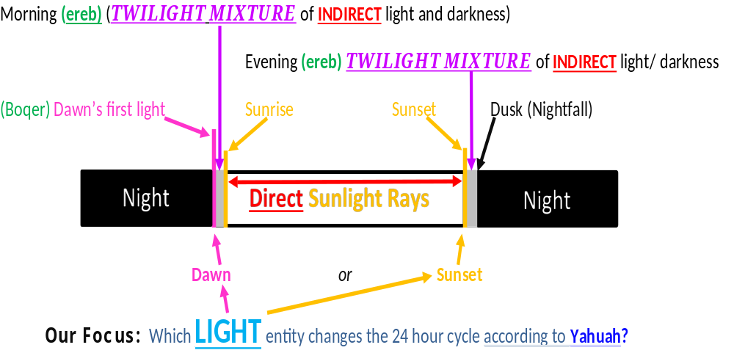
A Review of the Light Structure as found in Genesis 1
R
E
V
I
E
W
Notes:
Please be certain that you understand this graphic. If not, ask questions.

Slide 29
Why are we looking so intently at the twilight mixtures of the cycle?
Because it is the sunset ushering in the evening twilight that is
going to indicate to us, Yahuah’s true Word.
Question: What effect can the sunset possibly have on Passover, and the statute for the eating of Unleavened Bread?
Answer: It will determine if you observe the Passover according to Yahuah’s Will or if you choose to cling to tradition.
Questions: What happens to the EIGHT CYCLE Unleavened Bread count, as seen in Exodus 12:18, when utilizing sunset to determine changing
the cycles of the week?
Will sunset determination support the Scriptures, or will it destroy the possibility to fulfill Yahuah’s statutes?

Slide 30
As you probably noticed, the previous graphics were formatted with Dawn twilight commencing the cycle.
We will now look at a graphic that has sunset changing the cycle of the week – in turn – declaring the Night Season arrives before the Light Season.
Please allow me to state quite emphatically this
simply cannot be supported from the Scriptures
and quite specifically not from Genesis 1.
Let’s look at it specifically for comparison purposes only!
We will consider 3 “sunset” options.

Slide 31
A Preliminary Question (Or Two)!
Where are ha arbayim – {the ereb mixtures} on this depiction of Abib 14?
Evening: ereb, twilight mixture after sunset!
Morning: ereb, twilight mixture before sunrise!
Sunset
Sunrise
Abib 14 Dark Season
Abib 14 Light Season
Is the Passover Lamb to be killed beyn ha arbayim –(between the “sunset to sunrise” ereb twilight mixtures.) ?????

Slide 32
Sunset Theory & the “Lambless” Passover - Option #1
Sunset changes the cycle from Abib 13 to Abib 14
Eve ning: ereb, twilight mixture
Sunset, A New Cycle Starts??
Passover meal eaten with U/B “that night”
Morning: ereb, twilight mixture
Sunrise
Abib 14 Dark Season
Abib 14 Light Season
Consider the problem found on the next slide!
Passover Lamb to be killed beyn ha arbayim –(between the “sunset to sunrise” ereb twilight mixtures.)

Slide 33
Sunset Theory & the “Lambless” Passover - Option #1
Slide #2
Ex 12:6 commands by statute, that the Passover Lamb was to be slain between the 2 ereb twilight mixtures. Where are the 2 twilight mixtures of this Abib 14?
Out of the hundreds of thousands of Yisra’elites, how many were able to slay their lamb in the Tabernacle and cook it before they could not see for the darkness? Is there also a safety factor here to consider?
Abib 14 Dark Season
Abib 14 Light Season
Passover Lamb to be killed beyn ha arbayim ~
(between the “sunset to sunrise” ereb twilight mixtures.)

Slide 34
The last scenario saw them slaying and cooking the lamb in darkness of the night. Is this really logical?
On another note - we have been taught that the Passover Lamb must be slain in the 9th hour, or 3 PM on our present clock, to the sixth hour. This option has way too many lambs being slain
at one time at the Tabernacle for this to be remotely possible.
Plus: add the time for roasting the animal before the Passover meal on the evening before, does not make any sense.
Hhmm…! Hundreds of thousands of Yisra’elites slaying
“the family lamb” in the temple {as per statute requirement},
within a 3 hour window, BEFORE SUNSET ushers in Abib 15??
Let’s see if we can chart this information for Option #2.

Slide 35
Sunset Theory & the “Lambless” Passover - Option #2
Sunset changes the cycle from Abib 13 to Abib 14
Eve ning: ereb, twilight mixture
Sunset, A New Cycle Starts??
Passover meal eaten with U/B “that night” Ex 12:8.
Lamb slain 18 hours AFTER the Passover Meal!
Morning: ereb, twilight mixture
Sunrise
Abib 14 Dark Season
Abib 14 Light Sea son
Passover Lamb to be slain at 3 PM. Yet the Passover meal was approximately 18 hours earlier! Where did the Lamb’s flesh come from?

Slide 36
Sunset Theory & the Abib 15 Passover Meal
Option #3
Passover meal is eaten on Abib 15 Sabbath night of Unleavened Bread?
Sunset, Starts A New Cycle??
Lamb slain at the 9th hour from Dawn
(3 PM)
But Ex 12:6 says the 14th!
And in v.8, Yahuah commands
the lamb to be eaten
“that night” (Abib 14!)
Abib 14 Night
Abib 14 Light Sea son
Abib 15 Sabbath Night?
We will not go into the details for it will soon be seen how absurd
this proposition is – in view of Yahuah’s statutes!

Slide 37

With the three options we have just examined:
Yahuah’s Statutes must declare
2 separate dates –
Abib 14 & 15 - for these Festivals.
What has happened to Yahuah’s separation?
Has MAN
THROUGH TRADITION,
COMBINED YAHUAH’S TWO FESTIVALS????

Slide 38

Yahuah never intended Passover to be observed on Abib 15!
Exodus 12:6
And it shall be kept by you till the fourteenth of this month …
Exodus 12:8
And they shall eat the flesh in this night roast with fire, and they shall eat unleavened bread with bitter herbs.
We will now look at the carnage to Yahuah’s statutes that is caused by observing the Passover on Abib 15, according to Sunset Theory.

Slide 39
Let’s look at both Festivals and see if Sunset Theory can accomplish fulfilling the commanded 8 cycles of eating unleavened bread as it is written in Exodus 12:18.
Sunset changes Abib 14,
to the 15th!
The Passover meal has not been started yet. There has been no consumption of unleavened bread on Abib 14! Why?!
Abib 14 cannot be counted as one of the days for eating unleavened bread because
sunset changes the date to Abib 15
before the meal is eaten (after sunset)!
Is Exodus 12:1-11 going to be ignored?
Cycle 0 Abib 14
Let’s count the days for eating unleavened bread on the next slide and see if we are satisfied!

Slide 40
Continuing our attempt to fulfill all the verses of Exodus 12 completely.
Sunset changes Abib 14,
to the 15th!
Passover eaten on Abib 15 night. {NO SCRIPTURE!}
Ex 12:18 – until 21st day of the month, IN THE EVENING!
Cycle 0 Abib 14
1
15
2
16
3
17
4
18
5
19
6
20
21
= 6
With the 20th day stopping at the sunset, and the 21st day beginning at (evening) twilight, it is not necessary to eat unleavened bread after this point according to the words of the Scripture – according to Sunset Theory!
This contaminated system only requires 6 cycles for eating U/B!
??

Slide 41

Is it possible for the Yisra’elites to sacrifice the lamb approximately 21 hours after the Passover meal of Abib 14 Night Season and still eat the Passover Lamb with Unleavened Bread?
There is a serious disconnect here somewhere.
The Scriptures show in two locations the Passover is on the 14th cycle,
then the Unleavened Bread Festival begins on the 15th of the month.
Numbers documents the same separation as well!
Num 28:16 And in the first month, on the fourteenth day of the month, is the passover to [Yahuah].
Num 28:17 And on the fifteenth day of this month is a feast; seven days ye shall eat unleavened bread.
The Passover (any of it) cannot be observed on the 15th of the month!
Sunset Theory has failed. Now let’s look at the Dawn option and see if there is Scriptural alignment for this puzzle!
Question: Could the Yisra’elites eat the lamb with Unleavened Bread on Abib 14?
NO!

Slide 42
When looking at the next slide, I will ask you to be acutely aware of the acclaimed change of cycle that occurs at the sunset according to Sunset Theory.
What effect does the sunset have on the cycles of the week – according to man?
Are we within our allowances to remove cycles of
the week as we see fit?
Does Yahuah turn His face and accept our
re-adjustment of His statutes?
Can you justify the facts on the next slide relating the outright rejection and or contamination of the Scriptures?
If not, what is your next step?
42

Slide 43
Sunset Theory Summary thus far:
Ex 12: 6 - 8 rejected by - sunset theory
Ex 12: 12 - 14 rejected by - sunset theory
Ex 12: 16 rejected by - sunset theory
Ex 12: 18 rejected by - sunset theory
Ex 12: 24 rejected by - sunset theory
Ex 12: 42 incredibly convoluted by - sunset theory
In a very quick glimpse of the Torah, the above Scriptures
have been rejected and trampled upon by human feet
in just the Passover feast alone.
Your Homework! Ex 12:24 & 42 have not been addressed here, therefore you may consider
looking at these verses on your own.
43

Slide 44
What will happen when we begin to investigate the Sabbath topic? Will it expose the same results?
Let’s re-capture the Passover and Unleavened Bread Festivals in a “Dawn starts the day” chart.
This is a reminder there is a solution that achieves complete fulfillment of all the commands and statutes
for the Passover Festival and Unleavened Bread.
This is basically a repeat from slide #24.
44

Slide 45
Once again, compare the two Festivals. Will the “Dawn format” accomplish fulfilling 8 cycles of eating unleavened bread as it is written in Exodus 12:18? Passover will be eaten on Abib 14 night season!
Passover eaten “on that night roasted in fire with unleavened bread…”
Ex 12:8.
Ex 12:18 – until 21st day of the month, IN THE EVENING!
Cycle 1
Abib 14
+
1
15
2
16
3
17
4
18
5
19
6
20
7
21
= 8
The Scriptures reveal an EIGHT cycle schedule for consuming unleavened bread during both the Passover and Unleavened Bread Festivals. This schedule is easily achieved when abiding by Yahuah’s Dawn start of the day format - from Creation!

Slide 46

Scriptural Conflict Resolution
Count:
7 days.
Exo 12:18
Exo 12:15-16
Ex
13:6-7
Lev 23:5-8
Count:
7 days.
Count:
7 days.
Exo 12:18 includes the eating of ULB on Passover (only through DAWN design).
3 Scriptures count only the 7 days of ULB.
Count:
8 days!!
46

Slide 47

A “Proof” Quote of Significance
The most important in this festival was the passover day, the 14th of Nisan… In it they ate unleavened bread, probably like the Jews, eight days through… there is no trace of a yearly festival of the resurrection among them … the Christians of Asia Minor appealed in favor of their passover solemnity on the 14th Nisan to John.
(Gieseler, Johann Karl Ludwig. A Text-book of Church History.
Translated by Samuel Davidson,
John Winstanley Hull, Mary A. Robinson. Harper & brothers, 1857,
Original from the University of Michigan.
Digitized Feb 17, 2006, p. 166).

Slide 48

Questions:
There was one single factor that made the difference in this comparison study. What was it?
Answer: Choosing Dawn to start Yahuah’s cycles of the week.
2. Where did the concept of Dawn starting Yahuah’s cycles come from?
Answer: The very basic format of creation exposed in Genesis 1
is the concept that makes the sunset theory ~ a kaleidoscope of confusion ~ transform into a beautiful picture of SALVATION!
This format is known as Dawn Design for the Covenant Calendar.
By accepting the Word as it is written, the confusion
is banished from Yahuah’s Word.
When choosing to worship Yahuah,
may it be according to His Words.
48

Slide 49
The basic theme of this study has focused on the suggested time change from the sunset event and the fallacy attached to it.
This picture on this side can also be seen to depict Dawn just before sunrise.
Let’s look at this picture with the Dawning of the day in our minds, and adjust our minds so we can exchange our erroneous traditions to begin a new chapter.
To worship Yahuah according to His Plan is my desire
for each and every one who is willing.
49

Slide 50
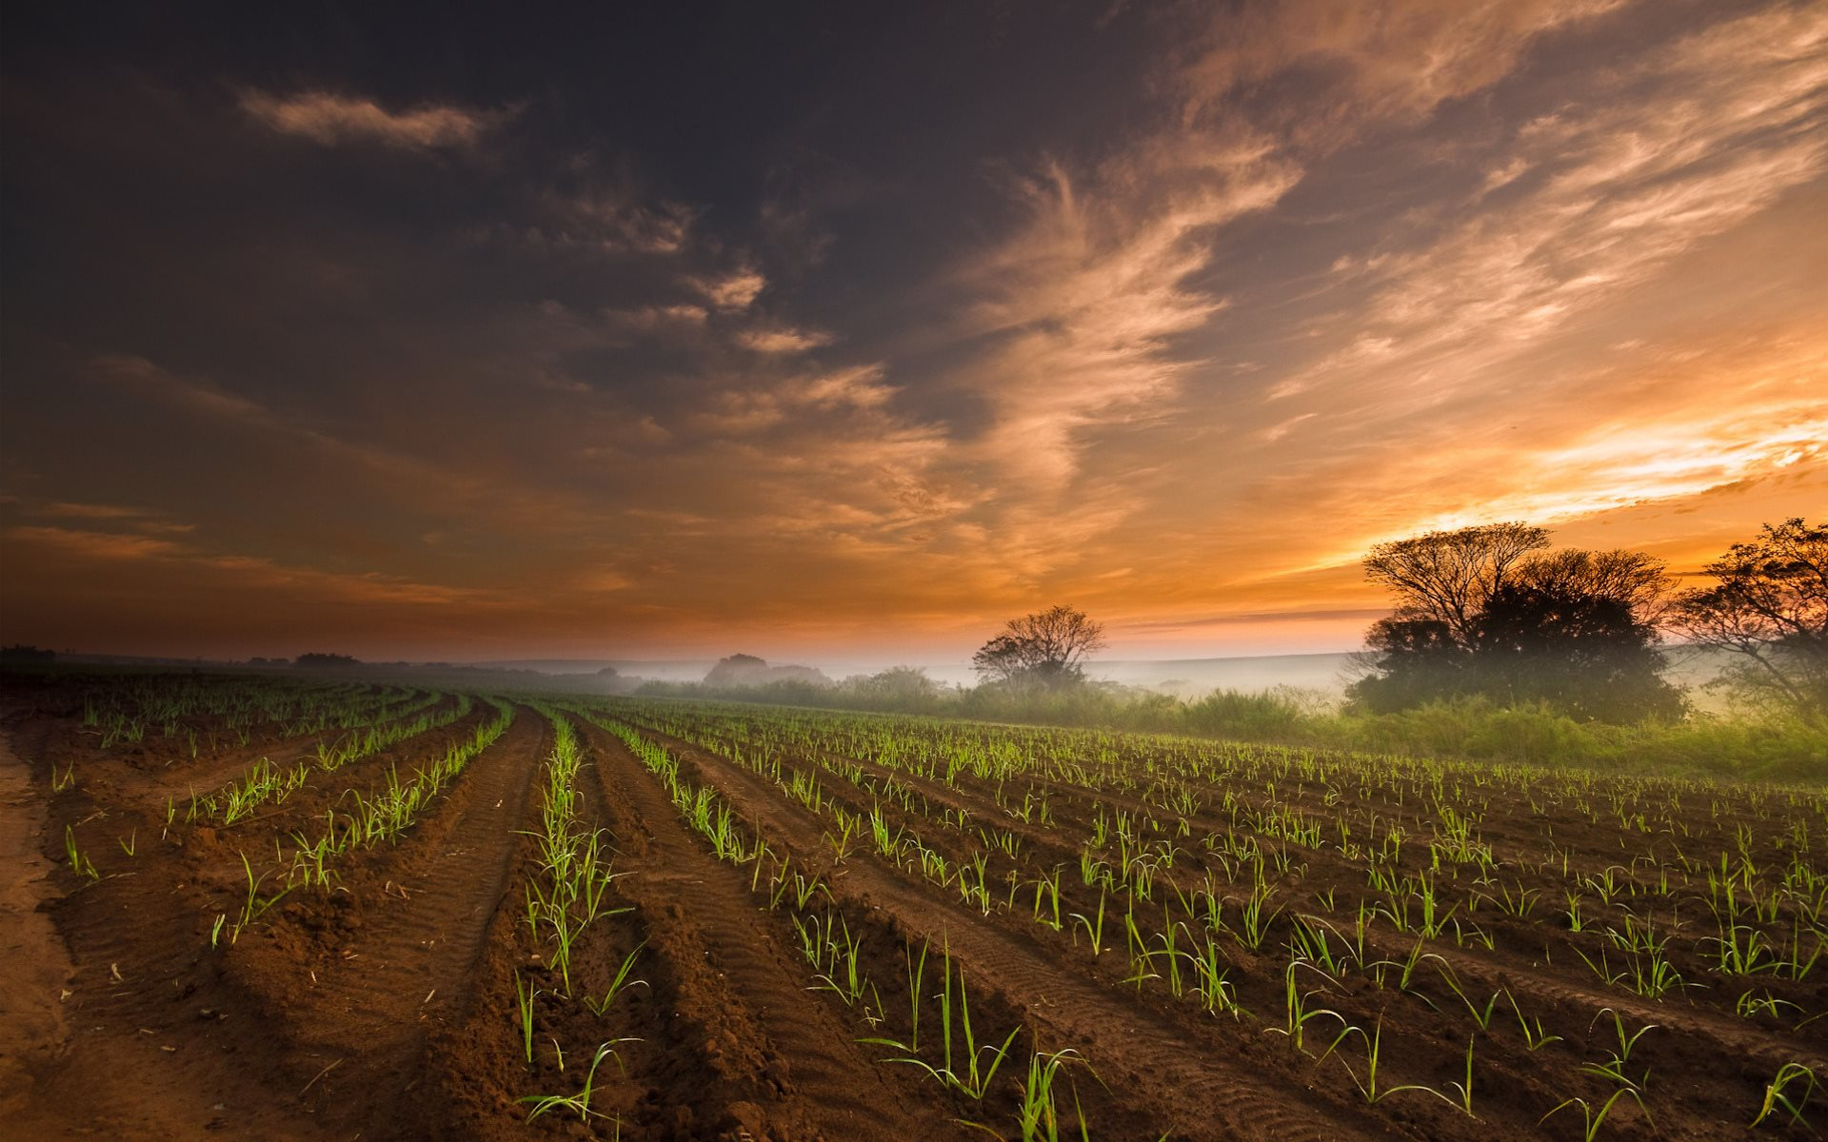
Let’s investigate the difference between
DAWN and Sunrise as given in the Scriptures.
Earlier the question was asked: Where do the Scriptures provide the DISTINCTION between the orders to consume Unleavened Bread during the Festival of Unleavened Bread and the Feast of Passover?
We discovered this DISTINCTION is given through the Gen 1 reckoning of the commencement of each cycle at DAWN.
There is a difference between DAWN and sunrise to be noted.

Slide 51
Genesis 19:15 – 23
And when morning [shachar] dawned, the messengers urged Lot to hurry saying, “Get up, take your two daughters who are here, lest you be consumed in the punishment of the city.”
R
E
V
I
E
W
Lot pleads for time …
Gen 19:20 – Look, please, this city is near enough to flee to, and it is small. Please let me escape there – is it not a small matter – and let my life be saved.
Twilight
mixture
Light Season
Gen 19:23 The sun had risen upon the earth when Lot entered Tso’ar.

Slide 52
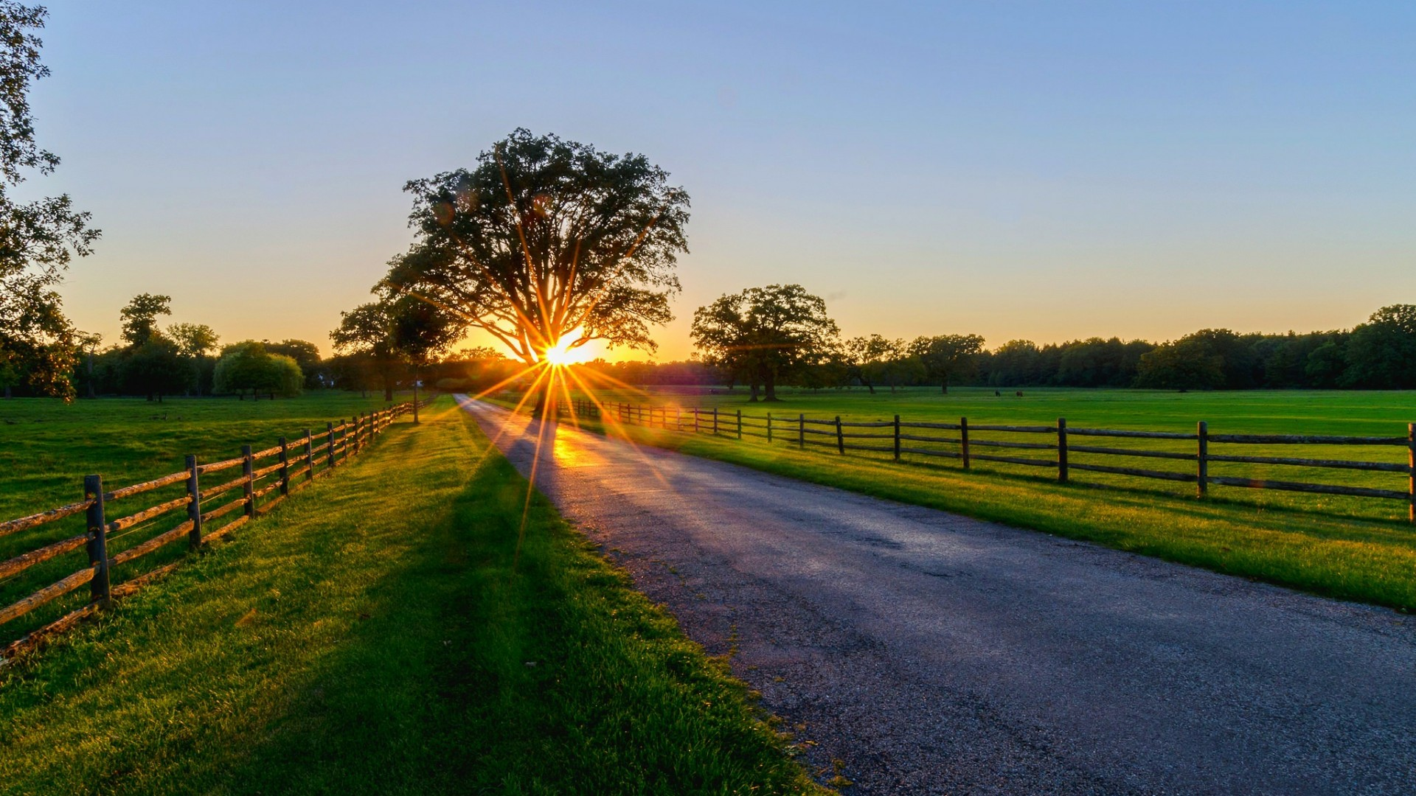
Next witness

Slide 53
Genesis 32:24 – And Ya’aqob [Jacob] was left alone. And a Man wrestled with him until the breaking of the day (oluth shachar).
R
E
V
I
E
W
Gen 32:26 And said, “Let
me go, for the day breaks.” But he said, I am not letting you go until you have barak [blessed] me!”
Who said? -
Elohim!
He
Twilight
mixture
Light Season
And Ya’aqob called the name of the place Peni’el, for I have seen Elohim face to face and my life is preserved. And the sun rose on him as he passed over Penu’el, and he limped on his hip. Gen 32:30, 31.

Slide 54


My friend, Yahuah has just told us with His own instruction
[in Gen 19:15 & 23 and Gen 32:26]
EXACTLY WHEN HIS 24 HOUR CYCLE STARTS, AND ENDS!
If you know this, you can calculate the number of days allotted for
eating unleavened bread during Passover Festival!
R
E
V
I
E
W
There is no conflict!
The End
54

Slide 55



Questions/Comments for Melchizedek’s Schedule for Unleavened Bread?
calendar@torahtothetribes.com

