Slide 1
Grammar 101 (Pt 1) for the Hebrew “evening” in Gen 1

Slide 2
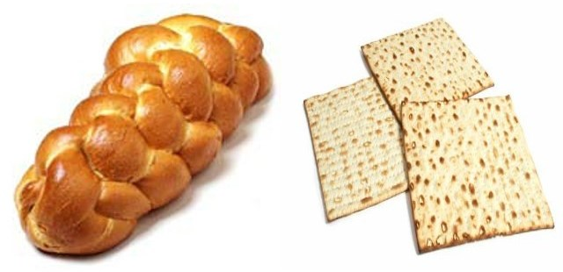
?
Grammar 101 for Bible Study of the Term “Evening” in English & Hebrew
?
By: Charlene Fortsch
January 2018
Notes:
LB and ULB is a picture to remind this ‘ereb’ puzzle is a lechem/artos problem. Both bread Heb and Gr Word #s need qualifiers for bread to be either LB or ULB. So too with the word ‘ereb’ … it “can” mean “day” ONLY when there is a qualifier such as we find in Exo 16 and in the gospel account addressed in this PPT study. It is a tricky study, but so important and needed.

Slide 3
Reviewing Simple Lessons Long Forgotten?!
How can a simple English word like “evening” pose such a confusing problem when linked to the proper commencement for the days of creation?
Could it be the Church Leaders, Pastors and Bible Workers have not been diligent enough in their search?
Have they been misled by traditions, ignorantly passing along what they have learned, to the nominal church member?
Can the nominal Bible Student really find out what the truth is of this “evening” controversy?
See how this problem can be solved with simple grammar skills.

Slide 4
For understanding the phrase from Gen 1:5b “…and the evening and the morning were the first day.”
Does “evening” really mean “sunset”?

Slide 5
INTRODUCTION
In this study we are going to learn how to study the Scriptures with some basic study tools including:
Review of basic high-school grammar classes;
Use of dictionaries and lexicons.
The sample topic of study will be “day-start” from:
Gen 1: first day of creation
Lev 23: Day of Atonement.
Of High Importance:
Read more than 10 words to discern context!

Slide 6
Thanking Our Friends in Africa
Many have studied the “day-start” issue and understand this truth for themselves.
But understanding and teaching to others so they can understand is another story.
Their explanations are still prompting questions such as this:
Email from African “Dawn” Believer:
Hi Charlene: This question is from an ‘even to even’ person. How will you respond? [Their question follows:]
Hi everyone. I have a question. What does it mean that the knowledge of the Hebrew word “ereb,” which meant “even or evening,” which meant “afternoon” or “sunset” – is lost?
Do you have similar experiences?

Slide 7
The Question is Always the Same
Since when does the day not begin with “evening” anymore?
Today we will attempt to sharpen our Bible study skills through finding the answer to the question on:
“When does Yahuah’s day really begin?”
It’s a Good Question!
There is an Answer!

Slide 8
Working Between Two Languages
To learn French, one has to learn that “such and such a word in French” means “such and such a word in English.”
We can’t say, "no, I don't want to learn the true meaning of the French words, I think I'll just guess at the meaning, and hope I'm right ..."
You’ll likely be 100% wrong!
It works the same between English and Hebrew.
When it comes to understanding the “day-start” teaching, we can’t say: “I'll just guess that the Hebrew word for "evening" means "afternoon” ... or sunset ... or “something else” ... whatever I want."
Again, you’ll likely be 100% wrong!
Yet, this is exactly what has been happening with the word “evening.”
Many are still guessing!

Slide 9
There’s Another Problem
Many of us have been taught that "evening" means "sunset" or "afternoon" or whatever.
Few of us have thought about challenging this point, because we really believed …
What we were shown was true. We were taught this concept early.
Most of us have not been taught to question the meaning of such a simple word? Why?
Because we were taught our leaders, teachers and pastors knew the truth and taught us the truth about such a matter.
Which is right?
To satisfactorily answer the “evening” question we need to learn how to accept this controversial challenge by using better Bible study skills.

Slide 10
Responsibility of Teachers
Most of us just take for granted (and really believe) our:
Parents
Teachers
Pastors & Leaders
Know the truth about the “day-start.”
The hardest part could be:
Realizing the true definition of the word “evening” is not “sunset.”
We may question why our teachers did not investigate the Hebrew definition by simply looking it up in an exhaustive concordance.
10

Slide 11
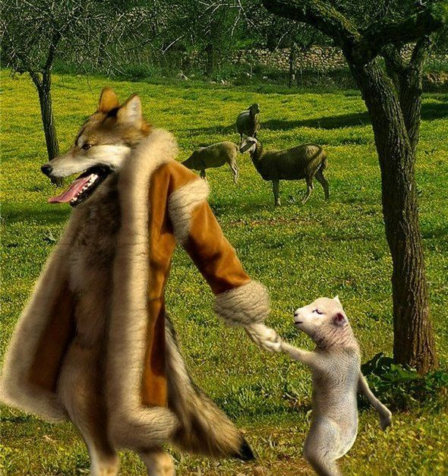
What Could Be The Reason?
Tradition Taught as Truth?
Many believe:
The Jews have preserved the correct day for the weekly Sabbath. (Can you prove the true weekly Sabbath?)
The Jews have preserved Friday sunset as the commencement for all Sabbaths. (Today’s challenge!)
The Jews hold many traditions. (How many can you name?)
As sheep, most of us have followed what the Jews hold as truth, because we believed they would know.
.
Have the sheep been following the wolf?
11
11

Slide 12
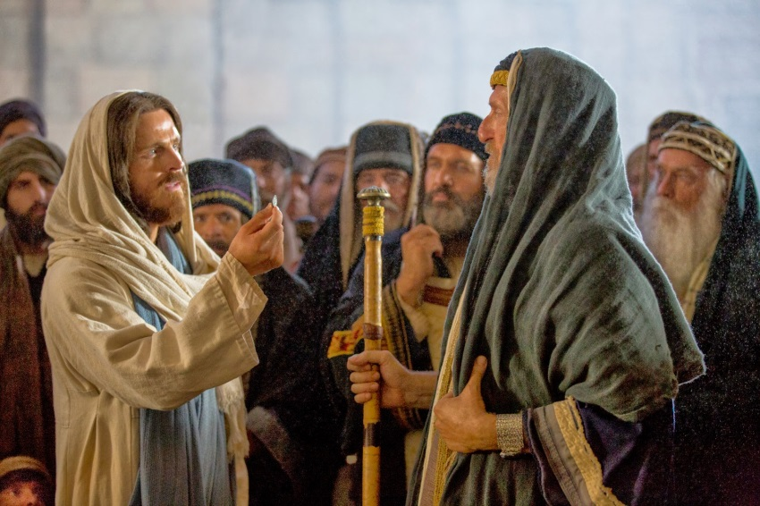
What About Traditions?
Yahusha – Paul - Timothy
Yahusha: Matt 15:3, 9 Why do ye also transgress the commandment of Yahuah by your tradition? 9 But in vain they do worship me, teaching for doctrines the commandments of men.
Paul: Col 2:8 Beware lest any man spoil you through philosophy and vain deceit, after the tradition of men, after the rudiments of the world, and not after Christ.
Timothy: 1 Tim 1:4 Neither give heed to fables …
12

Slide 13
A Restoration of Truth
Do you believe these words?
“In the time of the end every divine institution is to be restored.”
The Sabbath is a divine institution and a worship statute.
Therefore, the commencement of the Sabbath will be most important.
If we believe this, let’s remove the tradition with Scriptural evidence.

Slide 14
Ways to Remove Tradition
Do a careful, exhaustive research of the topic from the Scriptures.
Know the Biblical history around the topic.
Be prepared to use good Bible study tools.
Remember your Grammar lessons from high school. Why?
Because most of us have forgotten them!
14

Slide 15
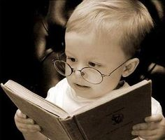
Reading? or Study?
Start with prayer. (Jer 33:3)
Bible reading is different than Bible study.
Bible study is different than Bible research.
In research, you need to know how to ask a lot of questions, and investigate a wide territory for what the Bible is saying from cover to cover.
Despite “ignorant or deliberate” errors in the Word of Yahuah, the truth will present itself.
Isa 28:13 … precept upon precept; line upon line … here a little, and there a little …
Notes:
Jer 33:3 'Call to me and I will answer you and tell you great and unsearchable things you do not know.‘ NIV

Slide 16
1. Getting Started With Content
Read the content of the study material carefully.
In Bible study this could be several verses or chapters before and after the verse or word in question.
Many people make a decision on the content by reading only 9-12 words of a complete passage.
16

Slide 17
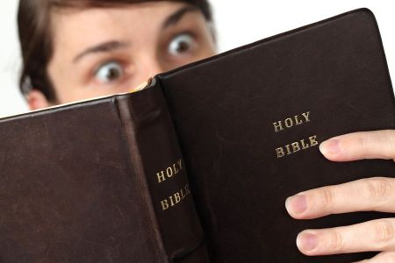
2. Getting Started With Context
Learn to read in context.
Know exactly what every verse or chapter is talking about.
You might be surprised
what you find?
17

Slide 18
2a. More on Context
This assignment includes:
Gen 1:1-5 (Day 1 of creation)
Lev 23:26-32 (Yom Kippur)
These two common mistakes are made to establish context:
Gen 1: Only the last 10 words of verse 5 are read (out of a total of 89 words in verses 1-5).
Lev 23: Only the last 9 words are read (out of a total of 175 in verses 26-32).

Slide 19
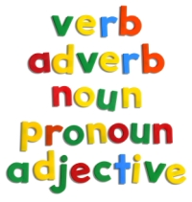
3. Getting Started with
Grammatical Terms
At least: know how to identify nouns, pronouns, adjectives, verbs, adverbs. Knowing these are the absolute basics. Our study today addresses only nouns.
Some words (like “day/daily”) can be used as nouns, adjectives and/or adverbs. In such cases it is important to know the category of the word in question.
Why?
The context changes for words when they act as a noun, adjective or adverb.
19

Slide 20
4. Getting Started With Tenses
Know how to identify "tenses" ... like:
1) past tense
2) present tense
3) future tense.
This is a difficult area for many students. (Rev 13:1-5 is a good exercise to learn how to work with “tenses.” Using the proper tense will bring forward the proper timeframe of the 42 month timeline. The timeline will be misunderstood if the tense is not noted.)
20

Slide 21
5. Getting Started With Definitions
The Old Testament is translated from the original Hebrew language.
Sometimes the translators did NOT choose the best “word” or “phrase” to bring through the best meaning.
Dan 7:25 “think to change times and laws”
The English word “times” does not reflect the true meaning in this verse – referring to divinely set appointed statutes.
In both English and Hebrew, don’t assume you know the variety of definitions, and which one is listed first.
In this study “day” and “evening” are two of those tricky words that have several definitions, all different.
Definitions for some of the simplest words must be checked.
A shelf full of dictionaries and concordances will be useful!
21

Slide 22
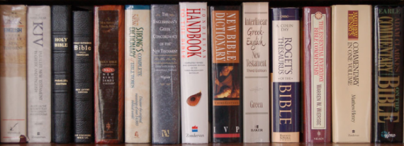
5a. Using Dictionaries
Word meanings do change over eons of time (especially from the 1600s to the present day).
Get used to using:
Strong’s Exhaustive Concordance (definitions of Hebrew & Greek)
Noah Webster’s 1828 Dictionary (Meanings of words in the 1800s are closer to the Hebrew than today’s meanings.)
A variety of everyday dictionaries for comparisons
Lexicons and Commentaries
These extra tools do not take the place of comparing Scriptures!
22

Slide 23
6. First Definitions in Dictionaries
The very first definition of any word in the dictionary represents the way the word is used the most in any language.
Everyday dictionary practice: will be on the word “star” to see how this works.
Hebrew dictionary practice: will be on the words “day, night, evening and morning.”
Learn how English and Hebrew Dictionaries compliment each other so the real meaning of the Hebrew can be understood.
23

Slide 24
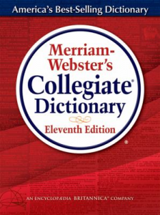
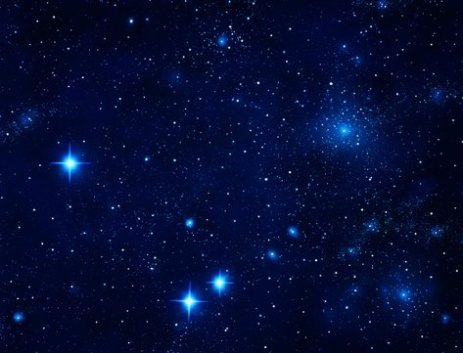
Finding Definitions for the Word ‘STAR’
Next, we will use the example of defining the word "star" to demonstrate how definitions are placed in a certain rank and order.

Slide 25
4a. Dictionary Practice: “Star”
1a: a natural luminous body visible in the sky especially at night b: a self-luminous gaseous spheroidal celestial body of great mass which produces energy by means of nuclear fusion reactions
2a (1): a planet or a configuration of the planets that is held in astrology to influence one's destiny or fortune — usually used in plural (2): a waxing or waning fortune or fame <her star was rising>; obsolete: destiny
3a: a conventional figure with five or more points that represents a star; especially: asterisk [*]
b: an often star-shaped ornament or medal worn as a badge of honor, authority, or rank or as the insignia of an order c: one of a group of conventional stars used to place something in a scale of value
4: something resembling a star <was hit on the head and saw stars>
5a: the principal member of a theatrical or operatic company who usually plays the chief roles b: a highly publicized theatrical or motion-picture performer c: an outstandingly talented performer <a track star> d: a person who is preeminent in a particular field
25
25

Slide 26
“STARS in the sky” take the first definition.
If you told someone “the stars were great last night” they will likely think you are describing the night sky – the first definition for “star.”
Unless more information is given, the other person does not know you were talking about the Hollywood Stars and the rewards they receive.
More content would have to be given to understand the context.

Slide 27
Remember the Dictionary Rule
The first definition is determined by the way the “word” is used most.
That holds true for all languages including Hebrew!

Slide 28
Hebrew Dictionary Rules are the Same
Many people are having the same problem with the definition of “evening” as some may have with “star.”
It’s important to choose the correct definition that aligns with the Bible content & context.
However:
Many assume they know the Hebrew definition without even checking to see if they are correct.
This is how “sunset” became an incorrect definition for “evening.”

Slide 29
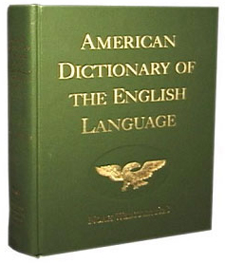
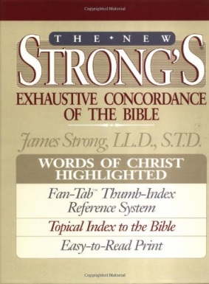
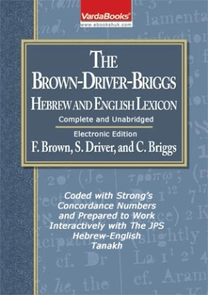
Applying Study Skills to Scripture Using the
We will examine “first” definitions first!

Slide 30
Full Study of Gen 1:1-5 (Day 1 of Creation)
Creation’s Chronicle
includes all content and context for the first 5 verses.
To solve the “evening” problem, this study scrutinizes four specific terms in Gen 1:5.
This Section:
Examination of only the 1st definitions for:
DAY NIGHT EVENING MORNING
30

Slide 31
Gen 1:5 - A Very Special Verse
Genesis 1:5 is the first place where any of these four terms are found for the first time in the KJV.
And God called the light Day, (First usage of “Day”)
and the darkness he called Night. (First usage of “Night”)
And the evening (First usage of “evening”)
and the morning were the first day. (First usage of “morning”)
Let’s begin our examination for only the first definition of these four terms in the:
Notes:
)

Slide 32
1st Def: Day <yowm>
And God called the light Day
Strong’s day H3117; yowm; from an unused root meaning to be hot; a day (as the warm hours), whether literal (from sunrise to sunset …[basically the 12 hours of light]) [or a more accurate explanation would be “from dawn to dusk.”]
Note: In a short time you’ll see how Mr. Strong’s wording will be corrected by the Hebrew definitions of “evening” and “morning.”
Brown-Driver-Brigg’s Hebrew Lexicon day H3117 yowm – day.
a) day (as opposed to night) [basically the 12 hours of light]

Slide 33
Only 1 Def: Night <layil>
Not to be confused with vs 2 darkness <H2822> <choshek>
… and the darkness he called Night.
Strong’s night H3915; layil;
from the same as H3883;
properly, a twist (away of the light),
i.e. night: KJV - night (season).
Brown-Driver-Brigg’s Hebrew Lexicon night H3915; layil – night
a) night (as opposed to day)
Hebrew word numbers often refer to several other numbers, including the primitive root.

Slide 34
1st Def: Evening <ereb>
And the evening …
Strong’s evening H6153; ereb (eh'-reb);
from H6150; dusk:
H6150; `arab (aw-rab'); a primitive root
[identical with H6148 through the idea of covering
with a texture]; to grow dusky at sundown:
KJV - be darkened, (toward) evening.
H6148; `arab (aw-rab');
a primitive root; to braid, i.e. intermix.
Brown-Driver-Brigg’s Hebrew Lexicon evening
H6153; `ereb – evening …
Many times BDB lacks in their definitions!

Slide 35
Only 1 Def: Morning <boqer>
… and the morning were the first day.
Strong’s morning H1242; boqer;
from H1239; properly, dawn (as the break of day).
H1239; baqar; a primitive root;
properly, to plough, or (generally) break forth.
Brown-Driver-Brigg’s Hebrew Lexicon morning H1242; boqer – morning, the break of day
a) morning
1) used of end of night
2) used of coming of daylight
3) used of coming of sunrise
4) used of beginning of day
Sometimes BDB has many definitions!

Slide 36
Confirming the Meanings of “dusk” & “dawn”
Just to be sure the 1st definition of “evening” & “morning” in Hebrew has not changed in translation to English, we will check the Webster’s 1828 Dictionary for comparison.
The 1828 dictionary gives the most accurate definition of English words as they connect to the Hebrew definitions.
Only the “noun” definitions will be considered.

Slide 37
Dusk, noun [1828]
A tending to darkness; incipient or imperfect obscurity; a middle degree between light and darkness; [it goes on to say]
twilight; as the dusk of the evening.
Tendency to a black color; darkness of color.
[eg:] Whose dusk set off the whiteness of the skin.
37

Slide 38
Dawn, noun [1828]
The break of day; The first appearance of light, in the morning.
They arose about the dawn of the day. Josh 6:15.
The word may express the whole time from the first appearance of light to sunrise.
DAWNING, noun.
The first appearance of light in the morning.
38

Slide 39
Determining the Meaning of “twilight”
Twilight was used in the “dusk” definition.
Surprise! Many people do not know what twilight is?
Do you?!
TWILIGHT, noun.
The faint light which is reflected upon the earth after sunset and before sunrise; crepuscular light. In latitudes remote from the equator, the twilight is of much longer duration than at, and near, the equator.

Slide 40
Twilight <nesheph>
Strong’s twilight H5399; nesheph; from H5398; properly, a breeze, i.e. (by implication) dusk [1st definition] (when the evening breeze prevails): KJV - dark, dawning of the day [2nd definition] (morning), night, twilight.
Brown-Driver-Brigg’s Hebrew Lexicon twilight H5398; nashaph –
(Qal) to blow [Qal = the most common literal message for proper interpretation.]
For comparison & further information note the vague definition from:
DUSK is the 1st definition; DAWN is the 2nd!

Slide 41
Twilight 1st Note
DUSK is the 1st definition; DAWN is the 2nd!
There are 14 “twilight” references in the Tanakh using H5398 & H5399.
H5398 twilight as the root word is first used in Ex 15:10 for the Red Sea crossing. This event originated with the evening winds that parted the water allowing the people to cross over during the following night hours.
H5399 twilight is first used in 1 Sam 30:17 (David in battle).
Question [& homework] for H5399 twilight: Will 1 Sam 30:17 take the definition of “dusk” or “dawn” for the word “twilight”?
And David smote them from the twilight even [H5704; <ad>] unto the evening [H6153; <ereb>] of the next day: and there escaped not a man of them, save four hundred young men …
In the other 12 references for “twilight/nesheph” – the content and context would have to be carefully examined to determine exactly which twilight is being referred to – dawn, or dusk.

Slide 42
Twilight 2nd Note
Remember, both the “dusk twilight” and the “dawn twilight” contain “a mixture of light and night.”
The first definition for the word “day” is the 12 hours of Day Season that has the presence of “light.”
Therefore, both twilights belong to the Day Season!
Twilight 3rd Note
“Night” is the absence of any [day] “light” that is naturally seen in the “day” sky – specifically, the absence of “sun light.”
By default neither twilight can belong to, or be part of, the Night Season!

Slide 43
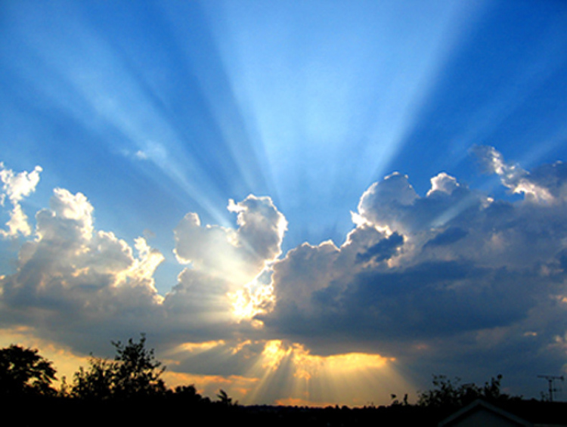
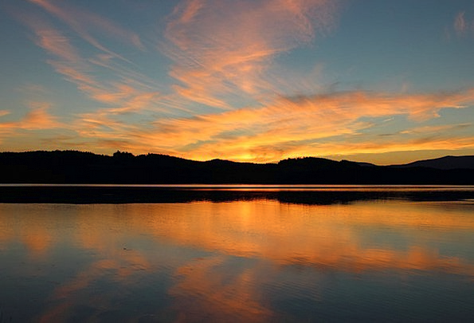
Twilights belong to the Day Season.
Each
Day Season Contains Light from the Sun
Evening
Morning

Slide 44
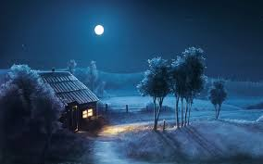
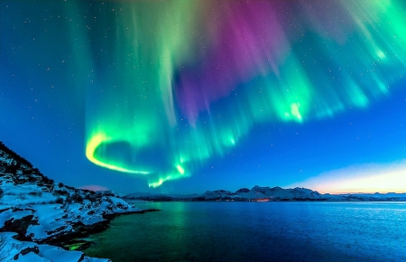
Twilights never belong to the Night Season.
Night Season Has no Direct Light from the Sun
Question:
Do the northern lights belong to the Day Season or the Night Season?

Slide 45
Applying the 1st Definitions of Hebrew to: Day Night Evening Morning
Remember: The 1st usage of a word most often takes the 1st definition.
Let’s use this application on Gen 1:5.

Slide 46
Listing the 1st Definitions
R E V I E W
Day <yowm> H3117
And Yahuah called the light Day,
meaning to be hot; (as the warm hours),
(from sunrise to sunset … ) [dawn to dusk].
Note: Strong’s would have been more accurate using the terms …
“dawn” (not sunrise)
“dusk” (not sunset)
<yowm> as the Day Season has priority.

Slide 47
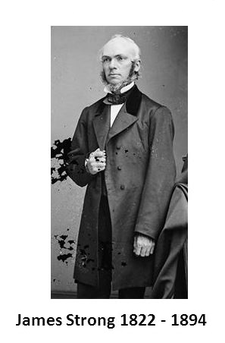
Question:
Where do you suppose Mr Strong picked up the definition of “sunrise & sunset” in place of “dawn & dusk”?

Slide 48
Night <layil> H3915
R E V I E W
… and the darkness he called Night.
a twist (away of the light), night (season).
<layil> is the only term in Gen 1:5 that belongs to the Night Season.
* Not to be confused with vs 2 darkness <H2822 choshek>.

Slide 49
Evening <ereb> H6153
R E V I E W
And the evening …
dusk; to grow dusky;
be darkened,
a primitive root; to braid, intermix
<ereb> has a mixture of “light” and “night.” Therefore <ereb> belongs to the Day Season.
Evening

Slide 50
Morning <boqer> H1242
… and the morning were the first day.
properly, dawn (as the break of day);
a primitive root; (generally) break forth.
R E V I E W
<boqer> has a mixture of “light” and “night.” Therefore <boqer> belongs to the Day Season.
Morning

Slide 51
Assembling it All Together Day Night Evening Morning
And Yahuah called the light Day, as the warm hours for the Day Season [including dawn and dusk],
and the darkness he called the Night Season or a twist (away of the light); [Then Yahuah gives more information for the Day Season saying:]
*And the evening dusk [came to be after the Day Season];
*[then] the morning ploughs forth; and dawn breaks out the new day; [as part of the Day Season twilight];
were *and the morning and evening belong to the Day Season.

Slide 52
Most of us have been taught an
Incorrect Understanding For Evening and Morning
And the evening, and the morning
were the first day.
The phrases have traditionally been taught to mean that the new <yowm> day/cycle begins in the evening.
This is simply not true!

Slide 53
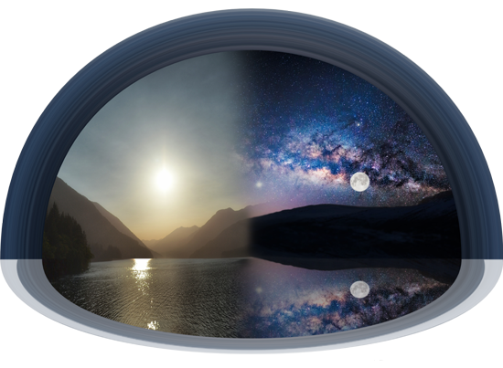
True Definition
Any portion of the 24 hour cycle that has a “twilight mixture” belongs only to the Day Season – NOT the Night Season. (Therefore, the evening has nothing to do with how a day begins.)
The two “day season” twilights are before sunrise & after sunset. Neither twilight belongs to the Night Season.
But the morning is even more special. The morning ends the former 24 hour cycle, and begins the new 24 hour cycle at the moment of daybreak. In Gen 1:5 morning ends Day One and begins Day Two.

Slide 54
Why Dusk Twilight Cannot Begin Any New Day
Dusk twilight is a mixture of light/night.
Light must be present first before a dusk/twilight can follow.
Light is mentioned 3 times in Gen 1 before evening is mentioned the first time.
Keep in mind, it is impossible for the dusk twilight (evening) to follow the Night Season!
Remember: the twilights have been purposely placed as a safeguard to “not look to the sun” for day-start.
54

Slide 55
Are there any questions?
It is crucial the 1st definition of “evening” is understood before going further.
Why? Because we are going to examine “other” definitions for “evening” and “day.”

Slide 56
Evening: 2nd Definition
[2nd definition] day
At this point there should be a huge question as to why “day” is ever listed as a definition!
Why
Because “ereb” is defined as a “mixing of light and night.”
There is no “mixing” during the Day Season!
This will be addressed soon for both the Hebrew and Greek definitions.

Slide 57
Evening: 3rd & 4th Definitions
[3rd definition] even (-ing, tide) [‘eventide’ - in old English this is another term that means dusk "twilight.” This twilight is not to be confused with DAWN - morning twilight.]
[4th definition] night.
For ereb, and its 4th definition of night, the Scriptures would have to contain the context of the “evening” giving way to the Night Season.
Note: Sunset is NOT one of the definitions for <ereb>.
Sunset is a point of time that ushers in <ereb>.

Slide 58
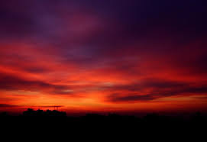
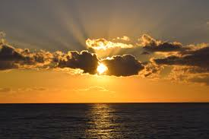
Evening <ereb> rightly claims the 1st definition as dusk – the mixing of light and night.
Evening <ereb> can only claim the 2nd definition of “day” [or no mixing] …
WHEN there is a “qualifier”!

Slide 59
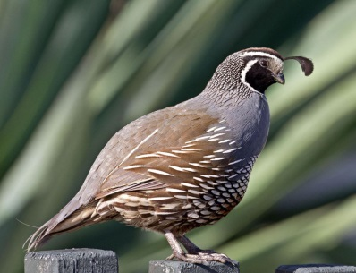
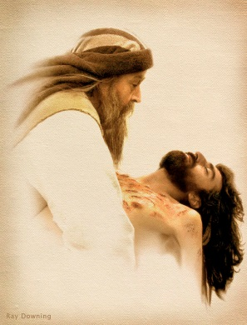
What does it mean to have a “qualifier”?
We will look at two examples:
The Quail in Exodus 16
Joseph’s request for the Body of Yahusha

Slide 60
The Quail of Exodus 16
Exo 16:13 And it came to be that quails came up at evening [H6153-dusk?] and covered the camp… The Scriptures
Location of Ereb(s)!
Dawn Sunrise Sunset Dusk
One (single) ereb, light & darkness mixture;
Pre-Sunrise
One (single) ereb, light & darkness mixture; . Post-Sunset
Light Season
Night
60
60

Slide 61
Ereb & Arbayim are Family Words
Dawn Sunrise Sunset Dusk
Arbayim (Plural)
One (single) ereb, light & darkness mixture;
Pre-Sunrise
One (single) ereb, light & darkness mixture; . Post-Sunset
Light Season
Night
At which “ereb” do the quails arrive?

Slide 62
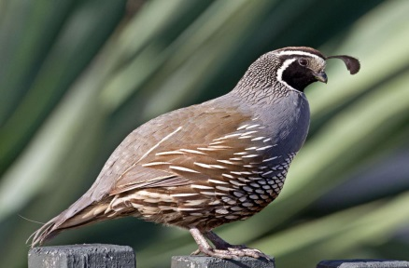
The Hebrew phrase Beyn ha Arbayim only means one thing:
Between -
Dawn Sunrise Sunset Dusk
the Light and Darkness mixtures
cannot mean -
after sunset!
Light Season
Do the quail arrive Beyn ha Arbayim?

Slide 63
The Quail’s Qualifying Statement is Exodus 16:12
Exo 16:12 I have heard the grumblings of the children of Yisra’ĕl. Speak to them, saying, Between the evenings [between sunrise & sunset] you are to eat meat … The Scriptures
Exo 16:13 And it came to be that quails came up at evening [H6153 – before sunset to dusk] and covered the camp … The Scriptures
Quail only come in to roost in the evening, but vs 12 is qualifying they arrived before sunset – “between the two mixings.”

Slide 64
Understanding Evening
Review: Gen 1:5b takes the 1st definition for the first use of evening:
Strong’s evening H6153; ereb; from H6150; dusk:
H6150; `arab; a primitive root [identical with H6148 through the idea of covering with a texture]; to grow dusky at sundown: KJV - be darkened.
H6148; `arab; a primitive root; to braid, intermix.
R E V I E W
In the phrase: “And the evening,” - EREB’S 2nd definition of “day” does not fit the context of this passage.
Proper Definition: “And the evening, and the morning [came to be] the first day” means these twilight terms belong to the Day Season. They are not definitions for the day-start!

Slide 65
Evening: Opposite Definitions
[2nd definition] day, and [4th definition] night are opposites.
Note: The 2nd def. for Evening [meaning part of the “day” season] can be used to mean any part of the Day Season AFTER sunrise to sunset IF the qualifying phrase “between the evenings” [beyn ha arbayim] is present.
Evening never takes the definition of an AFTERNOON time without a qualifying verse.

Slide 66
“Afternoon” H5186 <natah>
“Afternoon” is used only once in the KJV.
Judg 19:8 And he arose early in the morning on the fifth day to depart: and the damsel's father said, Comfort thine heart, I pray thee. And they tarried until afternoon, [H5186] and they did eat ...

Slide 67
H5186: Afternoon Definition
Strong’s afternoon H5186; natah; a primitive root; to stretch or spread out; by implication, to bend away; used in a great variety of application (as follows): KJV - afternoon… bow (down, -ing)… decline… go down, be gone … outstretched, overthrown … stretch (forth).
Note: The Strong’s definition for “afternoon” is attempting to show that the shadows of the “light of the day” begin to stretch, spread out, bend away and go down in the afternoon when the sun passes the meridian. These afternoon shadows continue to do so until they are overtaken by dusk.

Slide 68
H5186: Afternoon <natah> and
H6153: Evening <ereb>
In Hebrew, these words are not connected:
Through the same Hebrew Root (H5186/H6153)
Through phonetics (<natah/ereb>)
Through 1st definitions (afternoon/dusk)

Slide 70
Enjoy these beautiful mornings that usher in Yahuah’s original Covenant Day!
The End
Send your questions/comments to:
calendar@torahtothetribes.com
Notes:
Sept 23 final slide finished 200 pm … need to check and animate, etc.

