Slide 1


Slide 51: changed shekinah glory to pillar of fire due to shekinah hoax – see word document in the folder.
Per Vivian Scramstead July 2019
Nov 19/19:
Chris, go ahead and edit on this PPT by Tim.
Rec’d Nov 29th – corrected by CF Dec 23/19 – sent to Neil Dec 23/19. Mostly underscores; 365’s on slides 12,25,32. good now.
Nov 25/20: redid the title slide and sent new files to Neil.
Creation’s
Shaneh
Part #2
First Tequfah Witness
Notes:
For Jan 18/19: written by Charlene for Tim …
Last week at CCC hangout (on the 20th day of the 10th month for Cov. Cal.) we had a very short teaching on "Shaneh" (Yahuah's year start) to answer some questions from the Shaneh teaching on Jan 4th. This sparked some very interesting comments and questions ... by far one of the best "hang outs" CCC has ever had. But for those of you that missed that teaching, it will be included as an introduction to the Tequfah Part 2 teaching this week.
In Part 2 Tim will be continuing our investigation around Yahuah's year-start ... known as Shaneh (H8141) in Hebrew. Part 1 and Part 1a have already demonstrated where the Shaneh begins each year for Yahuah's Elegant Covenant Calendar. So by default alone, the 1st day of the Shaneh year really begins the 1st day of the year, and the 1st day of the 1st Festal month. There is no need to search for any phase of the moon (ever again) to figure out the 1st day of the Festal months. (That's good news for those of us that could never sight the moon to begin with!)
The 10 studies on "The Moon! Oh, the Moon!" already had confirmed the Festal months do not begin with the moon, but isn't it interesting that the Shaneh year was a strong 2nd witness to the same Covenant Calendar Torah truth?! However, in Part 2 there is more information to contemplate.
These are some questions that Part 2 hopes to answer for you:
Did Yahuah really identify the year to Mosheh in Exodus 12?
Is it possible that Ezekiel exposed a 13th lunar month in Yahuah's Shaneh year ... this would have been about 110 years AFTER the sundial event?
Is it possible the Enoch calendar qualifies for Yahuah's Shaneh year?
We've learned in past presentations that Yahuah has His own set of divine numbers. We also noted that the sidereal month of 27.3 days/lunation cycle and the synodic month of 29.5 days/cycle were NOT numbers that fit into Yahuah's numbering system. But the question is this: Will the Shaneh year be able to demonstrate "divine numbers" so we can know for sure Covenant Calendar has discovered the true Shaneh year? If so, what would those "numbers" be?
Is it possible for the Shaneh year to completely and totally disqualify the concept of a festal moon month calendar ... forever?
Can we trust the Scriptures to have all the proof without going to outside sources?
If any of these questions are intriguing to you, we'll be sure to see your faces at CCC on friday Jan 18/19 ... or on the 4th day of the 11th month for Covenant Calendar counting (Ps 90:12).
Thought to Ponder from one of our CCC panel members: "Condemnation without investigation is the height of ignorance." ~ Albert Einstein
Charlene (for Tim this time).

Slide 2
Notice: For those new to these studies –
The word – Cycle – is used to designate one 24 hour period, Dawn to Dawn, within a week of 7.
There are 7 - 24 hour cycles in a week.
The word “day” causes too much confusion within its ambiguous inaccuracy.
i.e. Is “day” the Light Season? Is it the Night Season,
or does it reference both?
Cycle - effectively eliminates all this confusion. ☺

Slide 3
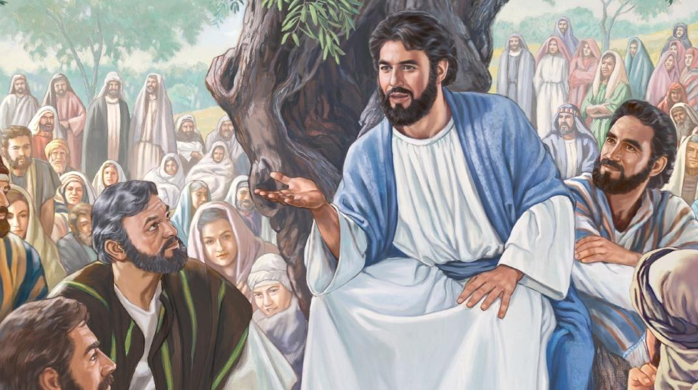
Remembering a Question:
In Power Point #9 of
The Moon! Oh, the Moon!
a question was asked with the promise
of the answer in upcoming studies.
The next two slides will be a short review.
This presentation will have a very specific answer for a clear understanding.
A Short Introduction
3
3

Slide 4

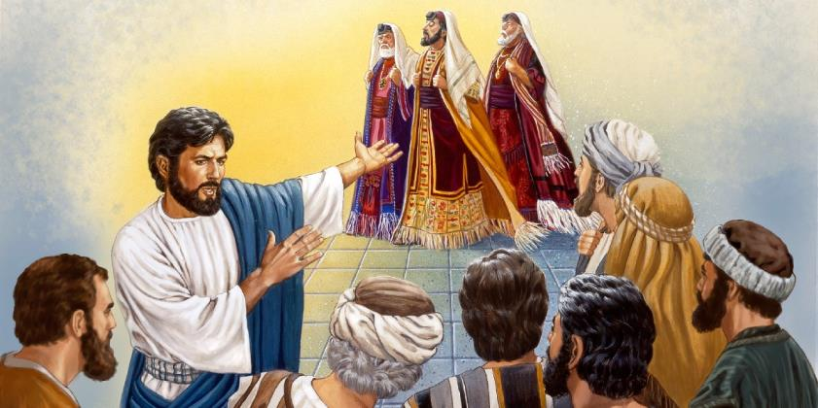
Matt 23:13 Shutting up the Kingdom
In Matt 23, Yahusha speaks to the multitudes in the hearing of the scribes and Pharisees.
In verse 13 he begins to address the leaders with many “woes.”
  “But woe unto you, scribes and Pharisees, hypocrites! for ye
  shut up the kingdom of heaven against men: for ye neither go in yourselves, neither suffer ye
  them that are
  entering to go in.”
4

Slide 5

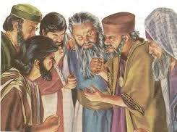

Removing the Key of Knowledge
These leaders, who should be unlocking the meaning of Yahuah’s word, are instead taking away the opportunity for people to know and understand it.
Luke 11:52 Woe unto you, lawyers!
For ye have taken away the key of knowledge: ye entered
not in yourselves, and them that were entering in ye hindered.
“A key is made to open a lock or door. By their false
interpretation of the old testament they had taken away the true
key or method of understanding it. They had hindered the people
from understanding it aright... If there is any sin of special magnitude,
it is that of keeping the people in ignorance.” (Barnes' notes)
What is the “key” for understanding the truth of Yahuah’s Calendar?
5

Slide 6
SHANEH
Tequfah
Yahuah’s
Key
of knowledge!
Functioning in unison, they are -

Slide 7
A Hebrew Lexicon – by J. Parkhurst
(1762 – uses no Masoretic vowel influences) –
H8141 - shaneh:
In Kal, - to iterate, repeat, do again, or a second time
In Niph – to be repeated
As a N. masc. The word is first applied to the grand iteration
of light at the formation. (Gen 1:14)
also adverbially, secondly, the second time.
Question: Do the LUNATIONS sequentially duplicate after like kind –
time after time returning to the original place of commencement?
Answer: No, a lunation does not sequentially repeat its pattern, not even close.
Review
shaneh
7

Slide 8
Review
shaneh
The Etymological Dictionary of the Hebrew Language records
H8141 shaneh as;
change, period of changing seasons, to repeat, do again.
Strong’s records H8141 shaneh, as having the root word of
H8138 “shanah” with the definitions of –
repeat, return, do the second time.
Remember, it is imperative to examine the root words to achieve
a better foundational meaning of words.
Let’s look at the root word – H8138 – Shanah – of H8141 Shaneh.

Slide 9
The primary root word for SHANEH … It is H8138 SHANAH.
The verses are – Gen 41:32 (doubled), 1 Sam 21:13 (changed),
1 Sam 26:8 (second time), 2 Sam 20:10 (again), 1 Kings 14:2 (disguise),
1 Kings 18:34 (2x – a second time), Neh 13:21 (again), Est 1:7 (diverse),
Est 2:9 (preferred), Est 3:8 (diverse), Job 14:20 (changest), Job 29:22 (again),
Ps 34:1 (changed), Ps 89:34 (alter), Prov 17:9 (again), Prov 24:21(change),
Prov 26:11(returneth), Prov 31:5 (pervert), Jer 2:36 (change),
Jer 52:33 (changed), Mal 3:6 (change).
Strong’s
שָנָה shânâh, shaw-naw'; a primitive root; to fold, i.e. duplicate (literally or figuratively); by implication, to transmute (transitive or intransitive):—do (speak, strike) again, alter, double, (be given to) change, disguise, (be) diverse, pervert, prefer, repeat, return, do the second time.

Slide 10

The fundamental base structure of
AN H8141 – shaneh’s – characteristic
is that it inherently
REPEATS ITSELF AUTOMATICALLY -
DUPLICATING ITS OWN LIKE KIND!
Once again we see
Creation’s Pattern exemplified.

Slide 11
Yahuah’s Shaneh Will - Will Be Done!
Shaneh - 360 cycles - Tequfah to Tequfah.
With a Tequfah
as your ...
PLUMBLINE, Yahuah’s Shaneh Year Alignment is always consistent.
Will the lunar comparison be similar?
Shaneh - 360 cycles - Tequfah to Tequfah.
Shaneh - 360 cycles - Tequfah to Tequfah.
Shaneh - 360 cycles - Tequfah to Tequfah.
Shaneh - 360 cycles - Tequfah to Tequfah.
Shaneh - 360 cycles - Tequfah to Tequfah.
Shaneh - 360 cycles - Tequfah to Tequfah.
Shaneh - 360 cycles - Tequfah to Tequfah.
Shaneh - 360 cycles - Tequfah to Tequfah.
Shaneh - 360 cycles - Tequfah to Tequfah.
Shaneh - 360 cycles - Tequfah to Tequfah.
Shaneh - 360 cycles - Tequfah to Tequfah.
Shaneh - 360 cycles - Tequfah to Tequfah.
Shaneh - 360 cycles - Tequfah to Tequfah.
Shaneh - 360 cycles - Tequfah to Tequfah.
Shaneh - 360 cycle year – CONSISTENTLY REPEATS THROUGH ETERNITY!
11

Slide 12
Yahuah’s Shaneh – Established!
Ayah Ashar Ayah..
(I Am, that, I Am) does not break His patterns! Shaneh (duplicating from oneself) is the pattern established for this earth - AT CREATION.
“Your desire be done on earth as it is in the shamayim (heaven) !”
Shaneh - 360 cycles - Tequfah to Tequfah.
Shaneh - 360 cycles - Tequfah to Tequfah.
Shaneh - 360 cycles - Tequfah to Tequfah.
Shaneh - 360 cycles - Tequfah to Tequfah.
Shaneh - 360 cycles - Tequfah to Tequfah.
Shaneh - 360 cycles - Tequfah to Tequfah.
Shaneh - 360 cycles - Tequfah to Tequfah.
Shaneh - 360 cycles - Tequfah to Tequfah.
Shaneh - 360 cycles - Tequfah to Tequfah.
Shaneh - 360 cycles - Tequfah to Tequfah.
Shaneh - 360 cycles - Tequfah to Tequfah.
Shaneh - 360 cycles - Tequfah to Tequfah.
Shaneh - 360 cycles - Tequfah to Tequfah.
Shaneh - 360 cycles - Tequfah to Tequfah.
Shaneh - 360 cycles - Tequfah to Tequfah.
Shaneh - 360 cycle year - CONSISTENTLY REPEATS THROUGH ETERNITY!

Slide 13
Yahuah linked 5 Additional Cycles onto the end of Shaneh!
Shaneh - 360 +5 cycles - Tequfah to Tequfah.
Concerning Yahuah’s offer, Hezekiah requested the sun dial to regress 10 degrees!
The result was a lengthening of the year from 360 cycles to 365.2425 cycles (Gregorian).
Also at this time, this miracle shortened the moon’s lunation cycle from 30 days to 27.321661days of the lunation cycle for the first time since creation!
Shaneh - 360 +5 cycles - Tequfah to Tequfah.
Shaneh - 360 +5 cycles - Tequfah to Tequfah.
Shaneh - 360 +5 cycles - Tequfah to Tequfah.
Shaneh - 360 +5 cycles - Tequfah to Tequfah.
Shaneh - 360 +5 cycles - Tequfah to Tequfah.
Shaneh - 360 +5 cycles - Tequfah to Tequfah.
Shaneh - 360 +5 cycles - Tequfah to Tequfah.
Shaneh - 360 +5 cycles - Tequfah to Tequfah.
Shaneh - 360 +5 cycles - Tequfah to Tequfah.
Shaneh - 360 +5 cycles - Tequfah to Tequfah.
Shaneh - 360 +5 cycles - Tequfah to Tequfah.
Shaneh - 360 +5 cycles - Tequfah to Tequfah.
Shaneh - 360 +5 cycles - Tequfah to Tequfah.
Shaneh - 360 +5 cycles - Tequfah to Tequfah.
Shaneh - 360 +5 cycles - Tequfah to Tequfah.

Slide 14
Yahuah’s Shaneh Mo-edim dates - up to Hezekiah’s Option Request!
Passover Festival – Abib 14
Unleavened Bread Festival – Abib 15 – 21
Pentecost – Wave Sheaf plus 50 cycles
Festival of Trumpets – Tishri 1
Festival of Atonement – (Solemn) Tishri 10
Festival of Tabernacles – Tishri 15 – 22
This is Yahuah’s Shaneh year - 360 cycles –
The “Way” (Worship Festival Calendar)
before Hezekiah’s sun dial miracle !!!

Slide 15
The “Shaneh Way” – AFTER Hezekiah’s Sun Dial Miracle!
Passover Festival – Abib 14
Unleavened Bread Festival – Abib 15 – 21
Pentecost – Wave Sheaf plus 50 cycles
Festival of Trumpets – Tishri 1
Festival of Atonement – (Solemn) Tishri 10
Festival of Tabernacles – Tishri 15 – 22
This is Yahuah’s Shaneh year - 360 cycles –
The Way (Worship Festival Calendar)
AFTER Hezekiah’s sun dial miracle !!!
Yahuah does not change! The Worship year cycles DID NOT CHANGE!
So WHAT CHANGED?

Slide 16
5.2425 NEW CYCLES
WERE LINKED
ONTO THE END OF THE SHANEH 360 CYCLE YEAR!
Yahuah’s Covenant Calendar …
WAS and STILL IS – a 360 cycle Shaneh year;
with 5.2425 cycles linked onto the end.
This is the exact format that Yahusha (as “changing not”)
lived out the Torah before and after His death, ON THIS EARTH!

Slide 17
It was the Julian Calendar which dominated the world when
Yahusha lived out his Life on this earth. So let’s look at it!
Secular history documents: The Metonic Cycle (lunar calendar) was “discovered” by Meton the Greek around the 5th century BC! In 432 BC
he introduced it into the lunisolar Attic Calendar. The Romans adapted characteristics of numerous calendars based on the moon, for their own.
See the Julian calendar
Replaced Lunar Calendar
The Julian calendar's predecessor, the Roman calendar, was a very complicated lunar calendar, based on the moon phases. It required a group of people to decide when days should be added or removed in order to keep the calendar in sync with the astronomical seasons, marked by equinoxes and solstices.

Slide 18
Overview
The Julian calendar, proposed by Julius Caesar in 46 BC
(708 AUC), was a reform of the Roman calendar. It took effect
on 1 January 45 BC (709 AUC), by edict. It was the predominant calendar in the Roman world, most of Europe, and in European settlements in the Americas and elsewhere, until it was refined and gradually replaced by the Gregorian calendar, promulgated in
1582 by Pope Gregory XIII.
The Julian calendar is still used in parts of the Eastern Orthodox Church, in parts of Oriental Orthodoxy,
and by the Berbers. Time and Date.com

Slide 19
Note: The Ethiopian economy operated on the Julius calendar until recently! The Orthodox church still does!
It is said that the Ethiopian calendar has 13 months as well.
An Ethiopian/Orthodox man I work with confirms the 13th month concept, yet he declares the 13th month of the Julian calendar has only 5/6 days in the 13th month. This fact has been searched out and confirmed. Please note that the extra days over the 360 were not interspersed by the quarters! They were added onto the end of the year, preserving the integrity of the 360 day year.
The Julian calendar also has strict 30 day months with March 1 as new years day!! This was the calendar in all the countries that were ruled by Rome, when Yahusha was on this earth.

Slide 20
The Julian calendar
was not determined
by the Tequfah!
It was determined by
the lunar phases
of the moon!

Slide 21
Who removed the TEQUFAH?
Luke 11:52 – “Woe to you learned in the
Torah because you took away the key of knowledge,
you did not enter in yourselves and
those entering in you hindered.”

Slide 22
Was it the system of the 2nd Temple hierarchy that removed the tequfah?
The same imposter system of priests that Yahusha reprimanded as – blind scribes, hypocrites, blind guides, fools, blind Pharisees, sons of Gey-Hinnom,
SERPENTS & BROOD OF ADDERS!
What calendar format REMOVED PEOPLE
from observing Yahuah’s “Way”
{the Old Paths which are presently being restored}?

Slide 23
On the next slide, an attempt has been made to match the
lunar full moons, as close as possible to
Yahuah’s Tequfah based 360 degree completed circuit of the sun.
The full moons a “year” apart, in the months of January
are recorded in an attempt to view a
“point of departure with a return to the same” (Eccl 1:5),
360 degree circuit.

Slide 24
Luni-SolaR years (Full moon to full moon - repeating like - “The Wanderer”)
Jan 1 1999 – 2000 -- 384 days!
New Moon – Apr 5
These are the closest New Moons after Mar 20
(normally the Tequfah.)
Another factor is – what if someone decides to use …the deceptive Equilux?
Jan 20 2000 – 2001 -- 354 days!
New Moon – Apr 4
Jan 9 2001 – 2002 – 384 days!
New Moon – Mar 24
Jan 28 2002 – 2003 – 355 days!
New Moon – Apr 12
Jan 18 2003 – 2004 – 354 days!
New Moon – Apr 1
Jan 7 2004 – 2005 – 383 days!
New Moon – Mar 20
Jan 25 2005 – 2006 – 354 days!
New Moon – Apr 8
Jan 14 2006 – 2007 – 356 days!
New Moon – Mar 29
Jan 3 2007 – 2008 – 384 days!
New Moon – Apr 17
Jan 22 2008 – 2009 – 353 days!
New Moon – Apr 5
Jan 10 2009 – 2010 – 384 days!
New Moon – Mar 26
Is it actually necessary to chart Abib 14 Passover on a lunar chart to see the variations?
Jan 29 2000 – 2011 – 354 days!
New Moon – Apr 14
Jan 19 2011 – 2012 – 354 days!
New Moon – Apr 3
Jan 9 2012 – 2013 – 382 days!
New Moon – Mar 22
Jan 26 2013 – 2014 – 354 days!
New Moon – Apr 10
Jan 15 2014 – 2015 – 354 days!
New Moon – Mar 30
Jan 4 2015 – 2016 – 384 days!
New Moon – Mar 20
Jan 23 2016 – 2017 – 354 days!
New Moon – Apr 7
Jan 12 2017 – 2018 – 354 days!
New Moon – Mar 27
Jan 1 2018 – 2019 – 384 days!
New Moon – Apr 15

Slide 25

Compare Yahuah’s Simplicity in Shaneh Consistancy!
Shaneh - 360 cycles - Tequfah to Tequfah.
Tequfah: + 14 cycles = Passover!
Shaneh - 360 cycles - Tequfah to Tequfah.
Shaneh - 360 cycles - Tequfah to Tequfah.
Shaneh - 360 cycles - Tequfah to Tequfah.
Shaneh - 360 cycles - Tequfah to Tequfah.
Shaneh - 360 cycles - Tequfah to Tequfah.
Shaneh - 360 cycles - Tequfah to Tequfah.
Shaneh - 360 cycles - Tequfah to Tequfah.
Shaneh - 360 cycles - Tequfah to Tequfah.
Shaneh - 360 cycles - Tequfah to Tequfah.
Shaneh - 360 cycles - Tequfah to Tequfah.
Shaneh - 360 cycles - Tequfah to Tequfah.
Shaneh - 360 cycles - Tequfah to Tequfah.
Shaneh - 360 cycles - Tequfah to Tequfah.
Shaneh - 360 cycles - Tequfah to Tequfah.
Shaneh - 360 cycle year – CONSISTENTLY REPEATS THROUGH ETERNITY!

Slide 26
Why then does Yahuah adamantly and emphatically despise the lunar calendars?
Isa 1:12 When you come to appear
before Me, who has required this from
your hand, to trample My courtyards?
Isa 1:13 Stop bringing futile offerings, incense, it is an abomination to me.
New moons, Sabbaths, the calling of meetings – I am unable to bear unrighteousness and assembly.
Isa 1:14 My being hates your new moons and your appointed times, they are a trouble to Me, I am weary of bearing them.
Isa 1:15 And when you spread out your hands, I hide my eyes from you; even though you make many prayers, I do not hear.
Your hands have become filled
with blood.
Isa 1:16 Wash yourselves,
make yourselves clean; put away the evil of your doings from before my eyes.
Stop doing evil!

Slide 27
Replacing the Tequfah with aNY lunar phase, to Operate on a lunar calendar removes worshippers from Yahuah’s PRECISE
SHANEH/TEQUFAH MO-EDIM DATES!

Slide 28

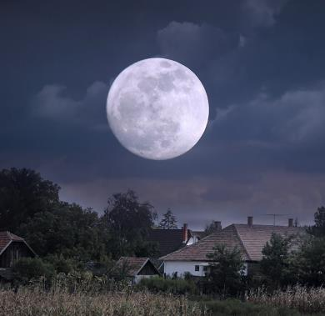
<yareach>
The moon is not
Chodesh, ever!
Why?
The moon’s lunation cycle is not found in the Mazzaroth – the only place the Tequfah can be found!
Therefore, the moon can never determine a Chodesh month!

Slide 29

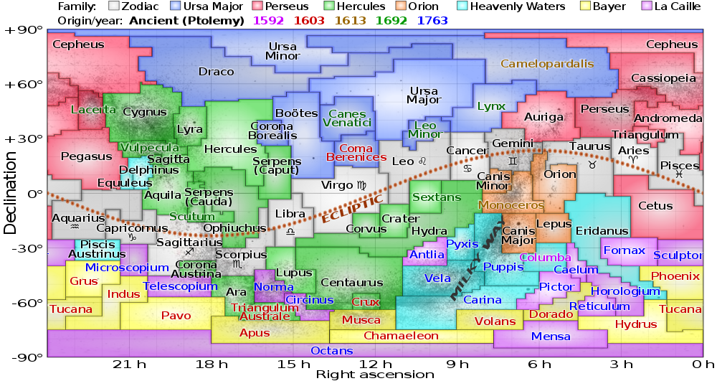
The Tequfah is found only as the sun moves through a perfect circuit every year within the Mazzaroth producing the 1st Chodesh month of the year!
The moon has nothing to contribute.
It’s a
fact …
The Tequfah is established when the sun returns to Aries at the Spring Equinox. Then the sun repeats the circuit by rebuilding a new Chodesh year.

Slide 30
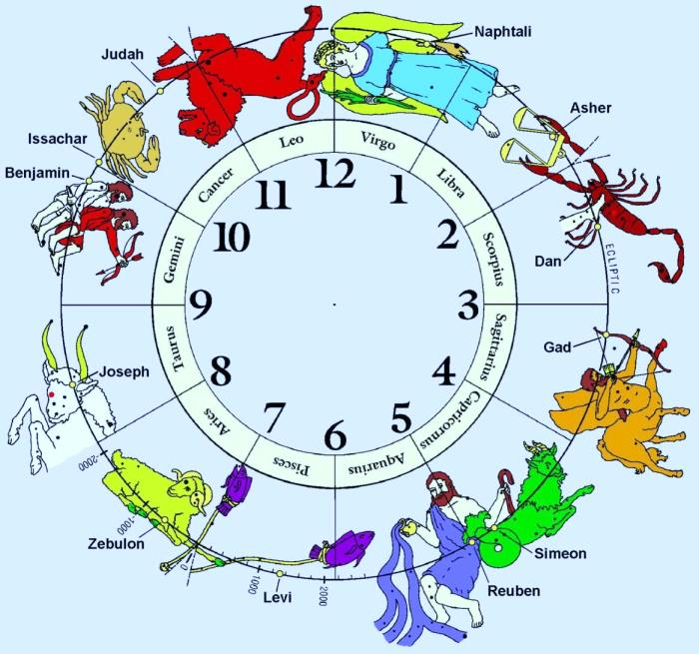
Your Homework!
Aires is connected
to Zebulon!
Bethula is linked
with Naphtali!
Both tribes were linked to the
“Light” in Galilee!
Is there something
to be noted here?
(This may be an interesting topic for further study.)

Slide 31
The Lunacy of Lunar Cycles!
Horrific Lunar inconsistency
Jan 1 1999 – 2000 -- 384 days!
New Moon – Apr 5
Jan 20 2000 – 2001 -- 354 days!
New Moon – Apr 4
Jan 9 2001 – 2002 – 384 days!
New Moon – Mar 24
Jan 28 2002 – 2003 – 355 days!
New Moon – Apr 12
Jan 18 2003 – 2004 – 354 days!
New Moon – Apr 1
Jan 7 2004 – 2005 – 383 days!
New Moon – Mar 20
Jan 25 2005 – 2006 – 354 days!
New Moon – Apr 8
Jan 14 2006 – 2007 – 356 days!
New Moon – Mar 29
Jan 3 2007 – 2008 – 384 days!
New Moon – Apr 17
Jan 22 2008 – 2009 – 353 days!
New Moon – Apr 5
Jan 10 2009 – 2010 – 384 days!
New Moon – Mar 26
cannot compare to
Jan 29 2000 – 2011 – 354 days!
New Moon – Apr 14
Jan 19 2011 – 2012 – 354 days!
New Moon – Apr 3
Jan 9 2012 – 2013 – 382 days!
New Moon – Mar 22
Jan 26 2013 – 2014 – 354 days!
New Moon – Apr 10
Jan 15 2014 – 2015 – 354 days!
New Moon – Mar 30
Jan 4 2015 – 2016 – 384 days!
New Moon – Mar 20
Jan 23 2016 – 2017 – 354 days!
New Moon – Apr 7
Jan 12 2017 – 2018 – 354 days!
New Moon – Mar 27
Jan 1 2018 – 2019 – 384 days!
New Moon – Apr 15

Slide 32

Yahuah’s Simplicity in Shaneh Consistency!
Shaneh - 360 cycles - Tequfah to Tequfah.
Tequfah: + 14 cycles = Passover!
Shaneh - 360 cycles - Tequfah to Tequfah.
Shaneh - 360 cycles - Tequfah to Tequfah.
Shaneh - 360 cycles - Tequfah to Tequfah.
Shaneh - 360 cycles - Tequfah to Tequfah.
Shaneh - 360 cycles - Tequfah to Tequfah.
Shaneh - 360 cycles - Tequfah to Tequfah.
Shaneh - 360 cycles - Tequfah to Tequfah.
Shaneh - 360 cycles - Tequfah to Tequfah.
Shaneh - 360 cycles - Tequfah to Tequfah.
Shaneh - 360 cycles - Tequfah to Tequfah.
Shaneh - 360 cycles - Tequfah to Tequfah.
Shaneh - 360 cycles - Tequfah to Tequfah.
Shaneh - 360 cycles - Tequfah to Tequfah.
Shaneh - 360 cycles - Tequfah to Tequfah.
Shaneh - 360 cycle year – CONSISTENTLY REPEATS THROUGH ETERNITY!

Slide 33
Consequently When, Yahudah (the nation to be in charge of preserving the ordinances of Yahuah), agreed to
capitulate to the pagan lunar based calendar to determine the Feasts of the Yahudim, they were not on YAHUAH’S Covenant Mo-edim calendar!
That is why yahusha was found 3 days after the Feast of the Yahudim, presenting Himself in accordance with Ex 23:15-17, in His Father’s Tabernacle at 12 years old. (The age of accountability.)
It is also why Yahusha joined the Jewish Tabernacles feast in the middle of their week. Prior to this, Yahusha’s Covenant Calendar Feast of Tabernacles had been fully completed.

Slide 34
SHANEH
Yahusha said –
“MY TIME IS NOT YET!”
(But Judah’s lunar based calendar was
always ready; through human formatting
and documented manipulation!)

Slide 35

Yahuah’s incredible simplistic system based on the Tequfah, at first site, seems difficult to understand, simply because it is so simple!
Our minds are conditioned to think it should be difficult!
The Tequfah is the
key of knowledge
that was removed!
(This ends the introduction.)

Slide 36
Creation’s First Tequfah
Who are Yahuah’s Shaneh Witnesses?
Part #2

Slide 37
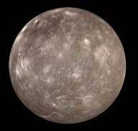
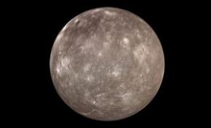
Yareach - The Wanderer
When Ha Satan proclaimed –
“Let me sit in the Mount of Congregation…” (Isa 14:13), was Yahuah’s lunar orb,
MISREPRESENTED, and
covertly RECOMMISSIONED
as the ADVERSARY’S
KEY OF DECEPTION?

Slide 38

Can we question Yahuah’s Accuracy?
Did Yahuah indicate – I will return on an appointed time of which the moon will
determine it - SOMETIME by an UNDEFINED lunar phase?
Remember:
1. The moon phases can fluctuate nearly one month from year to year.
2. Scriptures document Abraham as living Shaneh (years) that fully repeat a
second time sequentially for EACH AND EVERY YEAR of his life. (Next slide.)
Did Yahuah allow the moon to dictate the birth of the Hebrew nation (Isaac)?
OR
Did Yahuah abide by (no changing/Mal 3:6) the type of year
identified and imposed on this earth (Shaneh/Tequfah)
at creation found in Genesis 1:14?

Slide 39
The Mazzaroth & the Moon - a SPIRITUAL LIGHT presence?
The Mazzaroth –
Let’s look at the Scriptural witnesses of years repeating IN A SEQUENTIAL MANNER.
Deut 14:22 Thou shalt truly tithe all
the increase of thy seed, that the field bringeth forth year ^{H8141}
by year ^{H8141}.
See also – Deut 15:20; 1 Sam 1:7; 1 Kings 5:11; 10:25
2 Kings 17:4; 2 Chr 9:24; Neh 10:34, 35.
The Moon –
does provide an agricultural contribution
connection to the harvest.
The growing seasons controlled by the moon produce in part, the increase of the seed!

Slide 40
The Mazzaroth or the Lunar Moonth?
Shaneh H8141 is used a total of 875 times in its various word formats.
There are approximately 840 witnesses to the EVENLY DIVISIBLE – SEQUENTIALLY REPEATING – YEAR that Yahuah identified in
Genesis 1:14 as being for SIGNS and APPOINTED TIMES!
Isaiah told us 7 times that if we want to know the ending,
we must understand the BEGINNING. (See Isa 46:9-10.)
Genesis has been exposed (very basically) as recording the MelchiTzedek Priests and other Patriarchs lives as specifically and exquisitely operating on the H8141 – shaneh/year which thoroughly eliminates the moon!

Slide 41
A Collection of Various Verses
Let’s look at more verses that contain the word shaneh - H8141 - year.
When you see this word, just apply the definitions and think what that might mean.
Gen 15:13 And he said to Aḇram, “know for certain that your seed are to be sojourners in a land that is not theirs, and shall serve them, and they shall afflict them FOUR HUNDRED YEARS. (See also acts 7:6.)
(That is: 400 Shaneh years without the moon guiding them!)
Exo 12:40 And the sojourn of the children of Yisra’ĕl who lived in Mitsrayim was FOUR HUNDRED AND THIRTY YEARS. (See also Gal 3:17.)
Exo 12:41 And it came to be at the end of the FOUR HUNDRED AND THIRTY YEARS, on that same day it came to be that all the divisions of יהוה [Yahuah] went out from the land of Mitsrayim.

Slide 42
A Collection of Various Verses (con’t)
Exo 12:41 (review) – “on that same day it came to be…”
Is it even possible to calculate the odds of this event occurring on the exact same day 430 years later on the lunar calendar with its extreme variations?
Interestingly, it would be a simple understanding when considering
Yahuah’s Covenant Calendar has an EXTREMLY ACCURATE FORMAT!
Exo 23:17 Three times in the YEAR [Shaneh] all your males are
to appear before the master יהוה [Yahuah].
Was yahusha bound by statute to also attend the lunar based feast of the yahudim ??? – see John 7:14!

Slide 43
A Collection of Various Verses (con’t)
On the last question’s note: What about when Yahusha was at the accountable age of 12 years, He was found 3 days after the Feast of the Yahudim ended?
What type of year was Yahusha then following? Was Yahusha WITNESSING?
ALSO:
Would this same type of year – SHANEH – [in which all males are required to appear before Yahuah]
contain an Atonement Day? (Next slide !!!!)
Why do these particular events require a Tequfah/Mazzaroth based format?
Could punctuality and accuracy somehow figure into Yahuah’s timing?

Slide 44

Exo 30:10 “And Aharon shall make Atonement upon its horns
once a YEAR [Shaneh] with the blood of the sin offering of atonement – ONCE A YEAR [Shaneh] HE MAKES ATONEMENT UPON IT THROUGHOUT YOUR GENERATIONS. It is most set-apart to יהוה [Yahuah].”
Since Atonement Day comes every Tishri 10th, does this verse indicate positively that EVERY year that contains an Atonement day is – SHANEH –
with an EVEN 12 MONTHS,
which REPEAT A SECOND TIME BY - A MIRROR IMAGE,
and is a SEQUENTIALLY
DUPLICATING – YEAR?

Slide 45
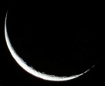
If … years that contain an Atonement Day appear in this format –
Year #1: 12 months
Year #2: 12 months
Year #3: 13 months (?)
Yes, the 19 year Metonic Cycle demands a 13th month approximately every 3rd year to re-align with the seasons.
Would this 3rd year with 13 months be any different?
Could a 13th month year possibly be a FOLDED OVER (DUPLICATION) EXACT SECOND COPY of
THEN … has year #3 shown an exact mirror image (a SHANEH duplication) of years 1&2?
Or is year #3 a “rogue” year?
NEXT!
YEARS 1 & 2????

Slide 46
Jubilees – Shaneh?
Lev 25:4 But in the seventh YEAR the land is to have a Sabbath of rest, a Sabbath to יהוה [Yahuah]. Do not sow your field and do not prune your vineyard.
Lev 25:8 And you shall count seven sabbaths of YEARS for yourself, seven times seven YEARS. And the time of the seven sabbaths of YEARS shall be to you forty-nine YEARS. [49 SEQUENTIAL YEARS!]
Lev 25:10 And you shall set the FIFTIETH YEAR apart, and proclaim release throughout all the land to all its inhabitants, it is a jubilee for you; and each of you shall return to his possession, and each of you return to his clan.
Shaneh

Slide 47

Jubilees – Shaneh?
Lev 25:11 The fiftieth YEAR is a jubilee to you. Do not sow, nor reap what grows of its own, nor gather from its unpruned vine.
We have just read verse 8 that informs us of 49 successive years that “SHANEH” is applied to EACH and EVERY ONE without exception! Now – the 50th too!
That is – 12,12,12,12,12,12,12,12,12,12,12,12,12,12,12,12,12,12,12,12,12,
12,12,12,12,12,12,13,
Can anyone see the year that is NOT SHANEH? The year that does not perfectly duplicate a second time? If only ONE lunar year is insidiously mixed into the count, will the Scripture’s statute requirement of 50 SHANEH years be fulfilled?
12,12,12,12,12,12,12,12,12,12,12,12,
12,12,12,12,12,12,12,12,12,12. 50 years! ?
The Metonic Cycle cannot duplicate with perfection!

Slide 48

Time is Eliminated??
Yahuah at Creation established His Shaneh year format that inherently replicates automatically. When man inserts a lunar month/(period),
the mirror image replication factor immediately terminates!
THEN WHICH GOD HAS THE AUTHORITY TO COMMAND IRREGULAR TIME
TO CONTINUE?

Slide 49
How many LUNAR BASED years in a Jubilee?
0
Until when does the Jubilee cycle occur?
Deut 7:9 Know therefore that [Yahuah] thy Elohim, he is Elohim, the faithful El, which keepeth covenant and mercy with them
that love him and keep his commandments to
A THOUSAND GENERATIONS.
Word of Yahweh

Slide 50
Let’s look at the Hebrew word & definition
for a Scriptural LUNAR YEAR.
A Black Hole only!?
OK, let’s move forward.

Slide 51
Did the Moon Lead out in the Wilderness?
Amos 2:10 Also I brought you up from the land of Egypt, and led you FORTY YEARS [SHANEH] through the wilderness, to possess the land of the Amorite.
The Wilderness YEARS were ALL an even number of months, and were fully able to – each one – repeat itself in PERFECT DUPLICATION.
Really it is no wonder, because the Pillar of Fire was there 24/7 – for 14,400 days (40 YEARS x 360 days)!

Slide 52

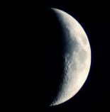
What happened with Abram’s Seed?
Gen 15:13 And He said unto Abram, know of a surety that thy seed shall be a stranger in a land that is not theirs, and shall serve them; and they shall afflict them FOUR HUNDRED YEARS [SHANEH].
Point of Interest – Abraham’s seed was to be afflicted for 400 SEQUENTIALLY DUPLICATING years that relied on the movement
of the sun within the Mazzaroth for leadership!
What does 400 Shaneh years multiplied by 360 days of
the Covenant Calendar Shaneh year add up to?
144,000!
13

Slide 53

And Enoch’s year – with 364 days/year?
What does 400 x 364 (Enoch year) =
145,600?!
Did Yahuah’s perfect synchronicity just fly out the window?

Slide 54
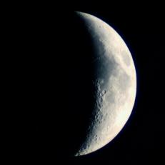
The Earth made New – The Worship Years!
Zech 14:16 And it shall come to pass, that every one that is left of all the nations which came against Jerusalem shall even go up from
YEAR TO YEAR
[SHANEH to SHANEH]
to worship the King, [Yahuah] of hosts, and to keep the
Feast of Tabernacles.
Adam lived this !
Yahuah’s people will AGAIN live according to His Torah!
13
End from the Beginning.

Slide 55
797 times the word Shaneh is translated as – year.
3 times Shaneh is translated as – yearly.
That is approximately 800 times Shaneh references a year that is multiplied by a mirror duplication effect.
Within those 800 times, how many references indicate a segment of successive years? i.e. Jubilees!?

Slide 56
800 times the Tanach points to Revelation 12:1.
There Bethula the Bride of Yahusha will
receive victory over observing pagan lunar traditions while worshipping Yahuah!
Rev 12:1 - The moon is under Bethula’s feet in a position of
VANQUISHED AUTHORITY!
See study – Rev 12 – Woman Standing On The Moon

Slide 57


Yahuah’s Mo-edim
Let’s look at this in simplicity –
Gen 1:14 – SHANEH H8141 – YEARS –
for APPOINTED TIMES!
Yahuah’s Moed-im
13

Slide 58
The Mazzaroth - a SPIRITUAL LIGHT presence!
Throughout the Tanach are 800 witnesses to the year that requires the sun to leave its home base and hurry back to its ORIGINAL PLACE – See Eccl 1:5 –
The sun also ariseth, and the sun goeth down, and hasteth to his place where he ariseth.
Does this fulfill the completed CIRCLE definition found within the Hebrew word - Shaneh?
What about Psalms?
Ps 19:4 Their line has gone out through all the earth, and their
words to the end of the world. In them he set up a tent for the sun,
Ps 19:5 And it [the sun] is like a bridegroom coming out of his room,
it rejoices like a strong man to run
the path.
Ps 19:6 Its [the sun’s] rising is from one end of the heavens, and its circuit to the other end; and naught is hidden from its heat.
Let’s look closer at it!

Slide 59
Yahuah has declared His Parameters within the Mazzaroth!
Mazzaroth Stars
Yahuah’s “home base”
for the SUN.
Psa 19:4 Their line is gone
out through all the earth, and
their words to the end
of the world. In them
hath he set a TABERNACLE
for the sun.
Tequfah
(Spring Equinox)
Originally
360 cycles.
Temporarily 365 cycles!

Slide 60
Yahuah’s parameters define a 360 degree revolution.
Mazzaroth Stars
360 degrees! Not 364 (Enoch), nor 375(?) Metonic Cycle!
Yahuah’s
outline for a completed cycle – point of commencement to original point – is here, based in the Mazzaroth STARS.
See also Ps 19:6.
Eccl 1:5 The sun also ariseth, and the sun goeth down, and hasteth to his place where he arose.
Recall that one of the definitions of - Shaneh – references A CIRCLE! (Not a sphere!)

Slide 61
Question:
Sidereal
Month
Does man recognize Yahuah’s 360 degree revolution of the moon’s
SIDEREAL {27.321days} MONTH?
61

Slide 62
Here is man’s documentation that exposes how the moon must
EXCEED Yahuah’s parameters of a full 360 degree circle!
#1 Synodic Month [29.53 days]
This is the average period of the Moon's revolution with respect to the line joining the Sun and Earth.
The synodic month is the period of the Moon's phases, because the Moon's appearance depends on the position of the Moon WITH RESPECT TO THE SUN as seen from the Earth.
#2 Sidereal Month [27.321 days] While the Moon is orbiting the Earth, the Earth is progressing in its orbit around the Sun [?]. After completing a sidereal month [360°] the Moon MUST MOVE A LITTLE FURTHER to reach the new position having the same angular distance from the Sun. This longer period is called the synodic month (Greek: συνοδικός, sunodikos, meaning "pertaining to a synod, i.e., a meeting" [in this case of the Sun and the Moon]).
Yahuah’s MAZZAROTH
has been ignored!

Slide 63
Man’s Imposed Synodic Manipulation
The Moon must move further for a Synodic Month
Yahuah’s 27.321 cycle 360° Sidereal Month
The Metonic Cycle’s 29.5 day lunar month is an ARTIFICIAL extension from man. This is Satan’s ABOMINABLE attempt to duplicate Yahuah’s 30 day Covenant Calendar month by using the moon.
+ 2.2
days
27.321 plus
2.2 days =
29.521

Slide 64
Who is THIS “god”?
The Moon must move further for a Synodic Month
Yahuah’s 360° Sidereal Month
The Creator’s decree is not good enough for me.
I will be “the god” and make my own parame ters.
+ 2.2
days
27.321
+ 2.2 days
29.521
Isa 14:13 … Let ME go up to the shamayim, let ME raise my throne above the stars of El, and let ME sit in the Mount of Meeting on the sides of the north.
Mount of Meeting:
the Qodesh Appointed Times
or Mo-edim of Yahuah!

Slide 65
Where do the Scriptures say ANYTHING about determining time by a line connecting the earth, moon and the SUN?
Has anyone heard of the concept of placing the SUN at the
center of everything in life? (Heliocentric earth?)
See Deut 4:19 for a stern warning not to serve the sun,
moon and stars!

Slide 66
Who has declared he will control the
Appointed Times of Yahuah?
Is it the same character that controls this earth’s calendars?
When man declares a whole set of different parameters from which is in the Scriptures, what is our choice?
Should this “physical synodic light” from the moon
actually be considered our spiritual light to determine
our worship practices to our Creator?
How many “Great Lights” did He really create?

Slide 67



LIGHT
MOON
SUN
Yahuah declared
TWO
GREAT LIGHTS!
Mazzaroth!
Are man’s
lunar “geometry”
ideas found to be seriously deficient?

Slide 68

Man’s lunar “geometry” ideas (that the moon has light and is the ruler of the night) produces too many serious gaps in view of the Scriptures.
MOON
Yahuah declared
TWO
GREAT LIGHTS!
Some Notable Gaps:
No mention of a “new Moon.”
No instruction to regard the moon.
Commands to NOT worship or regard the moon!
Yahuah DESPISES man’s
lunar months!
MOON
Not Three!

Slide 69
In observing the lunation cycles of the moon, is it possible to declare the moon returns
to its exact location within a one year rotation?
Please consider when we used to look to the moon to determine when Passover occurred!
Do you recall that the moon month demands from 1 - 4
weeks difference for the Passover from year to year?
Does the moon adhere to Yahuah’s outline for CONSISTENTLY completing a 360° circle –
POINT OF ORIGIN, THEN RETURNING TO POINT OF ORIGIN?
Can the Shaneh (repeat a second time) – possibly be associated with the moon?

Slide 70
Mosheh and the moon?
??
Yahuah spoke to Mosheh identifying and commanding the exact timing of the start of His Worship Cycles – The Way.
In Exodus 12:2, did Yahuah identify the Moon as being the guiding LIGHT for timing the Mo-edim?
Is it possible that Yahuah identified the Tequfah/Mazzaroth based year to Mosheh with BLINDING SPECIFICS right there in Exodus 12:2?
OR,

Slide 71
Yahuah’s Words
13
Exo 12:2 This moneth shalbe vnto you the beginning of moneths: it shalbe to you the first moneth of the YERE.
Geneva
Exo 12:2 This month shall be to you the beginning of months: it is the first to you among the months of the YERE.
Brenton’s Septuagint
SHANEH 8141 – YEARS

Slide 72
  SHANEH 8141 – YEARS
13
In effect, Yahuah told Mosheh –
Yisra’el’s years
Yisra’el’s years
3. Yisra’el’s years
sequentially repeat in exactness.
maintain an even number of months in which
there are no remainder months (i.e. – a 13th month) !
mirror by exact duplication the pattern laid out
by the Tequfah/Mazzaroth based cycle which maintains a
Teshuva {a turning, to return} of the Sun within the Mazzaroth.

Slide 73
13
Yisra’el’s year is initiated by the Tequfah (equinox)
each and every year. Period.
Yisra’el’s year
Yisra’el’s WORSHIP year
will maintain the format of a perfect
360° circle, nothing more, nothing less!
will maintain perfect symmetry WITHOUT CHANGE - EVER !
Question to ponder:
Can prophecy be fulfilled in any other type
of year than a 360 day Shaneh year?

Slide 74
13
In Deut 11:10-12 Mosheh is describing to the Yisra’elites
of the type of land that they were going to inherit. Mosheh
then tells them of the yearly condition that Yahuah has for them.
Deut 11:12 A land which יהוה [Yahuah] your Elohim looks after. The eyes of יהוה [Yahuah] your Elohim ARE ALWAYS ON IT, from the beginning of the year [SHANEH – h8141] to the latter end of the year [SHANEH – h8141].
Question: is it strange that yahuah’s – “ALWAYS” – Does not commit HIM to watching over the land in a lunar calendar’s
13th month, nor on the “noN-accountable” Lunar month days?

Slide 75
13
What does the MelchiTzedek Covenant declare for
the time a servant must be freed?
Exo 21:2 “When you buy a Heḇrew servant, he serves SIX years [SHANEH 8141], and in the seventh he goes out free, for naught.
A lunar calendar must of necessity adjust the calendar approx. every 3rd year to be as close as possible to the seasons. This adjustment demands a 13th month be added onto the 12th month. The Jews have given this 13th month the same name as the 12th month [named Adar the 12th],
as Adar the 13th month, approximately EVERY THREE YEARS!
No 13th month here!

Slide 76
13
Yet the MelchiTzedek Covenant declares a Hebrew slave
must work 6 Shaneh years and the 7th Shaneh year that
slave goes free! What does this mean in terms of timing?
Each of those 7 years must support the concept of being
REPEATABLE the second time in absolute exactness.
The sum of months in each year within the 7 years the slave must serve, will be divisible by 2 and have zero remainder months left over! “13” cannot be divided evenly!
The Hebrew and Aramaic Lexicon of the Old Testament by Koehler & Baumgartner – pgs 1597 – 1602 portrays Shaneh – double, to make double, fold, repeat, to do a second time – definition view.

Slide 77

13
According to the MelchiTzedek Covenant a Hebrew slave was never required to work in
a lunar year of any type!
m
Think about that for a moment and consider the deep ramifications
this brings to the lunar based calendar platform!
Is it even possible that Satan could impose his lunar years on a Hebrew slave?

Slide 78
13
For some reason Yahuah does not recognize nor accept that
man requires a 13th month every 3rd year [or so] to re-align
his lunar calendar with the seasons.
Will this change with a testimony from Jeremiah?
Jer 32:1 The word that came to Yirmeyahu from יהוה [Yahuah]
in the tenth YEAR [Shaneh – 8141] of Tsiḏqiyahu sovereign
Yehuḏah, which was the eighteenth YEAR [Shaneh – H8141]
of Neḇuḵaḏretstsar.
Tsidqiyahu (Zedekiah) was in his 10th year that contained an even 12 months – no more, no less! Even Nebukadretstar’s life mirrored a - Tequfah based, “repeatable the second time” – calendar!

Slide 79
What about the persistent suggestion that Ezekiel portrays a 13th month
in the Scriptures? Could it possibly be true?
Here are the verses that have “year” in our Scriptures as seen in Ezekiel.
Remember - each word – “year” – has come from SHANEH.
Ezekiel 1:1,2; 4:6; 8:1; 20:1; 24:1; 26:1; 29:1,17;
30:20; 31:1; 32:1,17; 33:21; 40:1; 46:13,17.
These are the verses within which Ezekiel has referenced a TEQUFAH ACTIVATED, Mazzaroth based, sequentially repeating mirrored pattern of perfect duplication, “year”! There are - 17 verses that demand a Tequfah based 12 month year!

Slide 80
A quote from an article trying to establish a 13th month by Ezekiel.
Now, in Ezekiel 4:1-11 he is given instructions by YHVH to lay on his left side 390 days and when he accomplishes this he is to then lay on his right side 40 days; equaling a total of 430 days. The next time reference in Ezekiel is found in chapter 8:1 where we see that Ezekiel was sitting in his house in the sixth year (of king Jehoiachin’s captivity) on the 5th day of the sixth month. This shows that Ezekiel had finished his instructions given in chapter 4 because he was sitting in his house not lying on either his left or right side. If Ezekiel was using a strictly solar calendar he could not have possibly obeyed YHVH’s instructions by the time reference given in Ezekiel 8:1.

Slide 81
Let’s take a close look at the texts in Ezekiel.
The claim is that a lunar based calendar is what guided Ezekiel
to perform his duties commanded by Yahuah.
Again, here are the texts from Ezekiel that have the word SHANEH translated into the English word – year.
SHANEH
Lunar word for year?? Ezekiel – Lunar –Years?
Texts????????????
Where is the lunar year proof?
Ezekiel – Years
1:1,2; 4:6; 8:1; 20:1;
24:1; 26:1; 29:1,17;
30:20; 31:1; 32:1,17; 33:21; 40:1; 46:13,17.

Slide 82

Let’s review the primary root word for SHANEH.
It is H8138 SHANAH. The verses are – Gen 41:32 (doubled),
1 Sam 21:13 (changed), 1 Sam 26:8 (second time), 2 Sam 20:10 (again),
1 Kin 14:2 (disguise), 1 Kings 18:34 (2x – a second time), Neh 13:21 (again), Est 1:7 (diverse), Est 2:9 (preferred), Est 3:8 (diverse), Job 14:20 (changest), Job 29:22 (again), Ps 34:1 (changed), Ps 89:34 (alter), Prov 17:9 (again),
Prov 24:21 (change), Prov 26:11 (returneth), Prov 31:5 (pervert), Jer 2:36 (change), Jer 52:33 (changed), Mal 3:6 (change).
R
E
V
I
EW
Strong’s
Next - Why are the opposite word meanings emphasized?
שָנָה shânâh, shaw-naw'; a primitive root; to fold, i.e. duplicate (literally or figuratively); by implication, to transmute (transitive or intransitive):—do (speak, strike) again, alter, double, (be given to) change, disguise, (be) diverse, pervert, prefer, repeat, return, do the second time.

Slide 83
Questions: H8138 also has the definitions showing
a change, a transmute or alteration.
Can these primitive root definitions also be applied to Yahuah’s year?
If one looks carefully at these verses the only time a change is applicable
is when the context is DIRECTLY concerning a human.
However the “change” or “alteration” is most certainly used and highly important when Yahuah declares He DOES NOT CHANGE nor ALTER HIS WAY! See Ps 89:34 & Mal 3:6!
Since we see that prophecy is accounted for in 360 day DUPLICATEABLE YEARS, which of NECESSITY MUST REPEAT OVER TIME AND TIME AGAIN,(Jubilee cycles), a definition of change and transmute simply cannot be applied to Yahuah’s Covenant Year.
What primitive root definition then remains compatible?

Slide 84
To repeat a second time!
Does this mean the year needs to only duplicate itself once making a total of 2 years? At this point will the duplication restriction be lifted providing grounds for change in the length of the year (i.e. lunar 13th month)?
No! Each Shaneh Scriptural year accounted for has the duplication, repeatable format applied to it!
When Scripture tells us the Jubilee cycle years are Shaneh; then each of those
50 years must be able to duplicate itself sequentially in a perfect mirrored format.
The Lunar year with the 13th month is simply and fully incapable
of this perfect symmetrical sequentially duplicating format.

Slide 85
To repeat a second time!
The Jubilee year sequences –
At which point in time did Yahuah declare that
the JUBILEE sequence would terminate?
Or – DO THEY EVER TERMINATE?
How often does the SHANEH year repeat itself?
(Just some thoughts to ponder.)

Slide 86
Back to Ezekiel!
Ezekiel 1:1,2 gives us a definite outline of a Shaneh sequentially repeating year.
The lunar based year cannot produce duplicated sequentially repeating years.
Hence it becomes quite standard to understand the type of year format that
Ezekiel was referencing, is a Mazzaroth/Tequfah based 12 month year.
The only type of year that can possibly duplicate perfectly is the one that produces 12 types of fruit – one for each month – EVERY month. (Rev 22:2)
Ezekiel is telling us that he accounted these verses as timed by the Tequfah.
That means the following year ALSO must be a duplicate of the primary year.
The next year ALSO had a perfect 12 month format which duplicated itself a second time making a succession of 3 years, (or a perfect 36 months governed by
the position of the sun), within the Mazzaroth determined as the Tequfah!

Slide 87
Then we reach Ezekiel 8:1 WHERE IT IS SUGGESTED that this verse indicates
a clear 13th month has been revealed.
In ch. 8:1, what does the Hebrew word for “Year” reveal?
Eze 8:1 And it came to be in the sixth year (Shaneh), in the sixth month, on the fifth of the month, as I sat in my house with the elders of Yehuḏah sitting before me, that the hand of the master יהוה [Yahuah] fell upon me there.
Ezekiel 8:1 positively identifies 6 Tequfah/Mazzaroth based,
duplicating, (repeating a second time), type of year.
The lunar based calendar year simply cannot fulfill the Hebrew definitions
for a Mazzaroth/Tequfah governing year!

Slide 88

By Hebrew definition and a massive amount of solid evidences in many Scriptures, it is absolutely impossible that Ezekiel was portraying a 13th month.
By Ezekiel’s own testimony, a 13th month is just not possible.
The Tequfah/Mazzaroth calendar has a Hebrew word that
perfectly describes it - SHANEH.
What is the Scriptural Hebrew word that by definition,
perfectly describes a lunar year of 13 months?

Slide 89
shaneh:
What LIGHT can Malachi shed on this topic?
Mal 3:2 “And who is able to bear the day of His coming,
and who is able to stand when He appears?
For He is like the fire of a refiner, and like the soap of a launderer.
Mal 3:3 “And He shall sit as a refiner and a cleanser of silver.
And He shall cleanse the sons of Lĕwi, and refine them as gold and silver, and they shall belong to יהוה [Yahuah],
bringing near an offering in righteousness.
Mal 3:4 “Then shall the offering of Yehuḏah and Yerushalayim be pleasant to יהוה [Yahuah], as in the days of old, as in former YEARS.
89

Slide 90
shaneh:
Malachi 3.
YEARS
Without going into the meaning of the whole verse, let’s FOCUS on the TYPE of year that Yahuah declares as the FORMER YEARS.
They - 1. duplicated in perfect mirrored symmetry
2. had 12 months in full alignment with the 12 fruits for 12 months (Rev 22:2)
3. had even number months divisible without a remainder month left over
4. started with the Tequfah abiding by the Hebrew Scripture definitions
5. depended squarely on the Mazzaroth – the “grand time piece” of Yahuah
6. show full alignment with Solomon’s 12 captains, one for each month
90

Slide 91

shaneh:
(Malachi 3)
Yahuah’s future YEARS
have everything a lunar year cannot contain NOR FULFILL!
13
Is there more evidence?
Does a bear walk in the woods?
91

Slide 92
Yeshayahu 61:2 {ISAIAH}
Isa 61:1 The spirit of the master יהוה [Yahuah] is upon me, because יהוה [Yahuah] has ANOINTED ME to bring good news to the meek. He has sent me to bind up the broken-hearted, to proclaim release to the captives, and the opening of the prison to those who are bound,
Isa 61:2 to proclaim the acceptable YEAR of
יהוה [Yahuah], and the day of vengeance of our Elohim,
to comfort all who mourn.
shaneh

Slide 93

Emphasizing - Yeshayahu 61:2
Isa 61:1 The SPIRIT of the master יהוה [Yahuah] is upon me, because יהוה [Yahuah] has ANOINTED ME to bring good news
Isa 61:2 to proclaim the acceptable YEAR of
יהוה [Yahuah],
13
shaneh
Yes, we are only considering the actual physical portion of this text right now.

Slide 94
Let’s view - Malachi 3:6 & 4:4
The acceptable YEAR of יהוה [Yahuah] …
shaneh
Mal 3:6 “For I am יהוה, I shall not change¹, and you,
O sons of Yaʽaqoḇ, shall not come to an end. Footnote: ¹Jas. 1:17
Mal 4:4 “Remember the Torah of Mosheh,
My servant, which I commanded him in Ḥorĕḇ
for all Yisra’ĕl – laws and right-rulings.
.

Slide 95
A Refresher for - James 1:17
The acceptable YEAR of יהוה [Yahuah],
shaneh
James 1:17 Every good gift and every perfect gift is from above,
coming down from the Father of lights, with whom there is
no change, nor shadow of turning.¹ Footnote : ¹See Mal. 3:6.
James 1:17 - shadow of TURNING – trope – G5157 – a turning of heavenly events – feminine noun – {sits well beside shemesh the feminine noun for the sun, for it is the sun which does the teshuva!}

Slide 96
The acceptable YEAR of יהוה [Yahuah],
shaneh
Tequfah
Mazzaroth!

Slide 97
13
Deut 7:9 Know therefore that [Yahuah] thy Elohim,
he is Elohim, the faithful El, which keepeth covenant and mercy with them that love him and keep his commandments to
A THOUSAND GENERATIONS.
Word of Yahweh

Slide 98
13

Slide 99
Is it possible that Shaneh can describe ETERNITY?

Slide 100
This box below symbolizes one full Shaneh year, Tequfah to Tequfah.
By the inherent definition characteristic of – repeat a second time, it must consistently repeat itself through PERFECT DUPLICATION.
Because the first Shaneh (that you see) existed, the second Shaneh must be generated. It too, through perfect duplication IS ALSO Shaneh.
1
2
Shaneh
Shaneh
Shaneh
Shaneh
The 2nd is Shaneh, and then it too must - by
inherent characteristic, duplicate itself!
Shaneh #1 – From where did it derive?
Would there not have been a Shaneh prior to it?

Slide 101
What if Shaneh was occurring in Yahuah’s Kingdom, and …
… then Yahusha created the earth here -
Genesis 1 – In the beginning Elohim created the shamayim and the earth.
Yahuah also established the Yisra’elite nation - timed by the Shaneh;
it was the birth of Isaac.
Shaneh
Shaneh
Shaneh
Shaneh
Shaneh
Shaneh
Shaneh
Shaneh
Shaneh
Shaneh
Shaneh
Shaneh
Shaneh
Shaneh
Shaneh
Shaneh
Shaneh
Shaneh
E
E

Slide 102
Shaneh continues to repeat after its own kind as the pattern imprinted in Genesis 1:14 … Mosheh in Exodus 12:2 was listening …
This month is the beginning of months for you, it is the first month of the [Shaneh] year for you.
Rev 12:1 Bethula receives victory over lunar traditions of man!
Shaneh
Shaneh
Shaneh
Shaneh
Shaneh
Shaneh
Shaneh
Shaneh
Shaneh
Shaneh
Shaneh
Shaneh
Shaneh
Shaneh
Shaneh
Shaneh
Shaneh
Shaneh
S
S

Slide 103
Shaneh replicates itself! Why?
Because Yahuah declared it!
Shaneh
Shaneh
Shaneh
Shaneh
Shaneh
Shaneh
Shaneh
Shaneh
Shaneh
Shaneh
Shaneh
Shaneh
Shaneh
Shaneh
Shaneh
Shaneh
Shaneh
Shaneh

Slide 104
Rev 22:13 “I am the ‘Aleph’ and the ‘Taw’, the beginning and the end, the first and the last.
Rev 22:14 “Blessed are those DOING His commands, so that the authority shall be theirs unto the
tree of life, and to enter through the gates into the city.
Rev 22:17 And the Spirit and the Bride say, “come!” and he who hears, let him say, “come!” and he who thirsts, come! and he who desires it, take the water of life without paying!
Acknowledgement alone does not qualify!
The Scriptures

Slide 105

The layers of deception & unbelief run deep and are many, just like the layers of this rose.
Somehow we must dig into the center and find the firm root.
The first petal (if you will.)

Slide 106

What about “Unbelief”?

Slide 107


From “Day by Day on the Best of Spurgeon” by Dolores Coupland, Jan 2 devotional reading.
?
What
about
“Unbelief is always questioning. …
She [unbelief] does not know what she wants.
Unbelief has a very attentive ear to every new notion.
When this man over here has a novel doctrine and someone over there has another fresh idea, unbelief goes helter-skelter ... - ...this way or that!
She hears voices crying, "Lo here, and lo there!"
and like a silly bird she is lured and snared.”

Slide 108

THAT is exactly what we are finding with the moon people, the sunset people, the enoch people ... need I say more. They go everywhere to find truth -- now these days it is the internet, as if the truth is there. I had over 3 hrs of calendar phone calls to 2 people today, and they go everywhere looking for calendar truth except for in the scriptures. It seemed difficult to impress upon them they have to find the truth in Yah's book, not every other book.
?
Which
road
That is exactly what is happening with many connected to counterfeit calendars. They battle with unbelief, not knowing what to do.
Most go here, there and everywhere to find truth – especially to the internet, as if all the truth will be found there in one packaged document.
Seeking everywhere … except a thorough search of the Scriptures.
Let us base our beliefs for Covenant Calendar in the Scriptures!

Slide 109

The End
May your name be found among
the numbers of those that
his commands.

Slide 110
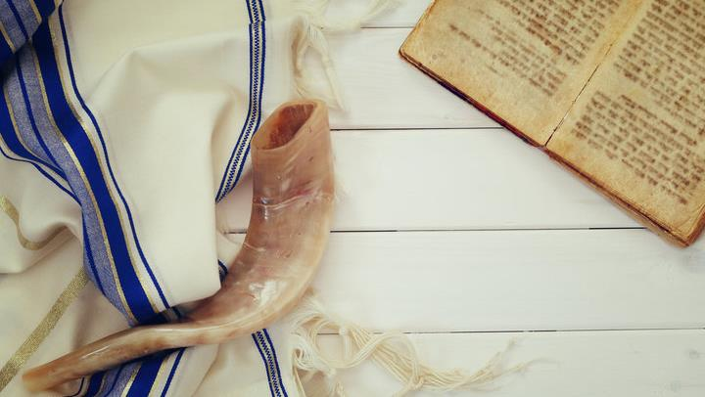


Save the date!
Atonement
Feb 1/19
What characteristic of starting the Atonement Sabbath by the evening of Tishri 9 causes it to take part on two days?
When does the actual Sabbath day of Atonement begin
and when does it end??
What are we commanded to begin on the evening of Tishri 9?

Slide 111


If you need assistance with this information, please send your
questions to Timothy Astleford:
tim@studythecalendar.com
www.studythecalendar.com

