Slide 1

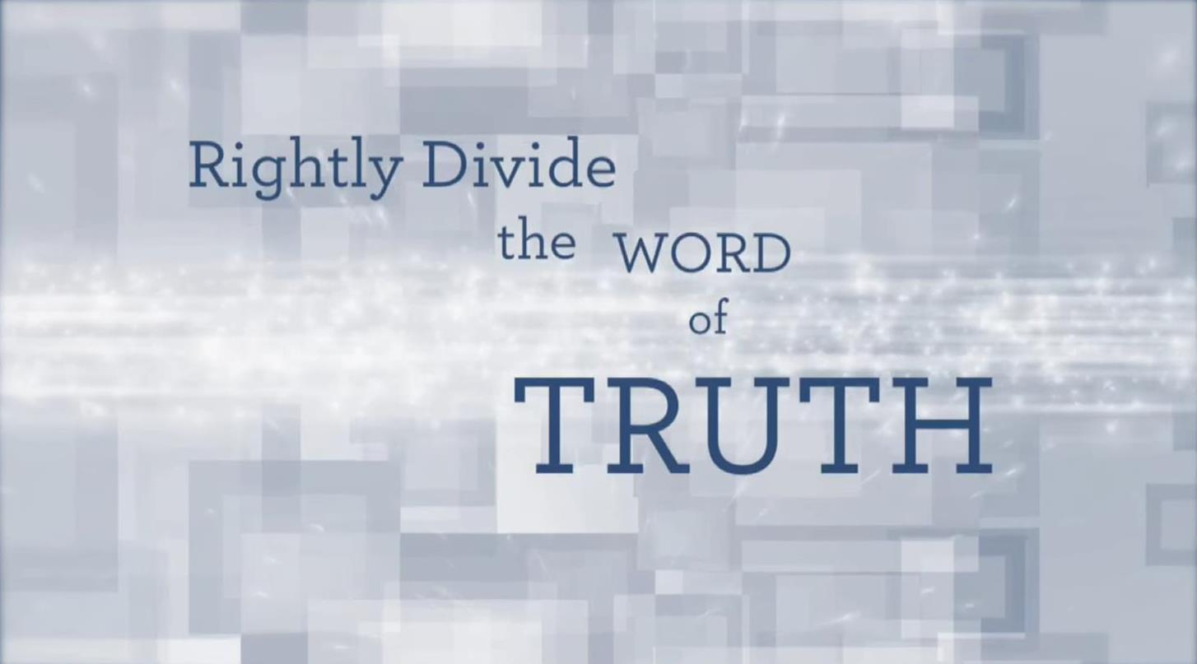
Jan 28/17
Fixed title slide and final slide for new email address.
Email new PDF to Mario for upload to website.
Beyn ha Arbayim
(A study on: “Between the Evenings”)

Slide 2
BeYn Ha Arbayim
Between the Ereb - Mixtures -(Evenings?)

Slide 3
Beyn Ha Arbayim
ם
י
ב
ר
ע
ה
ן
י
ב
Beyn
(Between)
Arbayim
mixtures
(evenings?)
Ha
(the)

Slide 4
Beyn Ha Arbayim
Ereb
ם
י
ב
ר
ע
ה
ן
י
ב
The base word is
Ereb.
ב
ר
ע
Hebrew; MIXTURE
English translation:
Evening!?

Slide 5
Beyn Ha Arbayim
Ereb
ם
י
ב
ר
ע
ה
ן
י
ב
ב
ר
ע
Between the Evenings – Exodus 12:6!

Slide 6
The phrase – beyn ha arbayim – is found 10 times in the Scriptures.
The verses are: Exodus 12:6/ 16:12/ 29:39,41/ 30:8/ Lev 23:5/ Num 9:3,5,11/ 28:4.
This phrase is mistakenly considered controversial and needs attention so it can be understood according to the Hebrew language definitions.
In the PPt study – The Hebrew Evening – we have seen the definitions that profoundly expose the meaning of – mixture – which applies directly to the word ereb (evening).
This same exact word – ereb – provides the base word for the plural – arbayim (mixtures – {evening and morning}.)

Slide 7
The – beyn – provides the meaning of - in between, betwixt, asunder, within, out of, from. (Brown Driver Briggs)
John Parkhurst, in his 1762, A Hebrew Lexicon - gives subtle credence to the Jewish concept of the evening starting at noon but then adds this interesting comment –
“or more literally, between the mixtures.”

Slide 8
Quite interestingly, J Parkhurst is directly indicating the authentic Hebrew meaning to be taken from the actual verb event – mixing – and apply it to time.
There are two times when this mixing of light and darkness (as applied to time) is found. The light and darkness mixtures are found early in the boqer (morning) before Sunrise, and after the sun has set and the indirect light from the sun is allowed to mix/mingle, with the ensuing darkness – called ereb.
According to J Parkhurst, if we then take the very literal meaning of
the mixing action, the real meaning of the Hebrew words will then be – between the light mixtures of pre-sunrise [boqer] and post sunset [ereb].
To see if this concept will be welcomed by Scriptural alignment, we will need to look closely at the cited verses.
Let’s first look at an illustration to be sure we are on the same page.

Slide 9
Location of Ereb(s)!
Dawn Sunrise Sunset Dusk
One (single) ereb,
light & darkness mixture;
Pre-Sunrise
One (single) ereb,
light & darkness mixture;
.
Post-Sunset
Light Season
Night

Slide 10
Dawn Sunrise Sunset Dusk
Arbayim (Plural)
One (single) ereb,
light & darkness mixture;
Pre-Sunrise
One (single) ereb,
light & darkness mixture;
.
Post-Sunset
Light Season
Night
Notes:
SAME SLIDE

Slide 11
Here are some more observations - ☺
#1 Between -
                Sunrise Sunset
        Dawn Dusk
Of the 10 verses in the Scriptures cited earlier, it should be possible to apply this statement without any conflict - from the Word.
the Light and Darkness mixtures
cannot mean -
after sunset!
Light Season

Slide 12
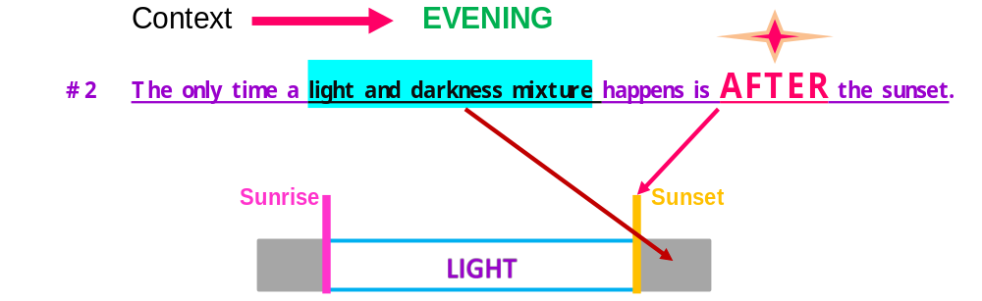
This statement will become extremely important further on.
Or, conversely, prior to sunrise!

Slide 13
Let’s be certain of where the word – between – points to –
Between
Dawn Sunrise Sunset Night
          “Between” indicates after sunrise, and/or, prior to - the sun set!
Ok, let’s look at some Scriptures and apply this concept to them. ☺
the “ereb,” Light and Darkness mixtures - {or, twilights}.
Light Season

Slide 14
Exo 12:3 “Speak to all the congregation of Yisra’ĕl, saying, ‘On the tenth day of this month each one of them is to take for himself a lamb, according to the house of his father, a lamb for a household.
Exo 12:4 ‘And if the household is too small for the lamb, let him and his neighbour next to his house take it according to the number of the beings, according to each man’s need you make your count for the lamb.
Exo 12:5 ‘Let the lamb be a perfect one, a year old male. Take it from the sheep or from the goats.
Exo 12:6 ‘And you shall keep it until the fourteenth day of the same month. Then all the assembly of the congregation of Yisra’ĕl shall kill it between the evenings.
Judging by what we have been studying, the precious animal’s life must have been taken sometime after the sunrise and before the sunset.
There is no problem here. The Scriptural and historical records show full compliance with this concept.
Dec 15th: Instead of using the word “destroyed” how about saying this: “… the precious animal’s life must have been taken some time after the sunrise …” The word “destroyed” is on the verge of animal cruelty – a crime against covenant torah.

Slide 15
The ultra special lamb {PASSOVER OF EXODUS 12} was:
1. To be slain on Abib 14 (Exodus 12:6)
2. Slain - Beyn ha arbayim, (between the twilight mixtures) (Exodus 12:6)
3. Roasted in a fire (Exodus 12:8)
4. Eaten precisely “on that {Abib 14} night” (Exodus 12:8)
5. With unleavened bread and bitter herbs (Exodus 12:8)
6. The remains were to be burned with fire before Dawn! (Exodus 12:10)
7. Your loins girded, your sandals on, your staff in hand (Exodus 12:11)
8. It is the Pesach [Passover] of Yahuah! {Abib 14} (Exodus 12:11)
What does Yahuah then declare?
9. And I shall pass through the land of Mitsrayim on that night …(Exodus 12:12)
on – Passover Night!!! – Abib 14!
Pass-over

Slide 16
Contrary to what many of us have been taught since childhood;
Passover is not to be observed on the Abib 15 Unleavened Bread
Night Season!
No where in the Scriptures is there a claim to be found declaring Passover to be on Abib 15, -
day or night, of Unleavened Bread!
NO WHERE!
Dec 15th: I changed the wording a bit to take out the redundancy to 2 “Scripture words’ so close together. Does it sound ok to you?

Slide 17
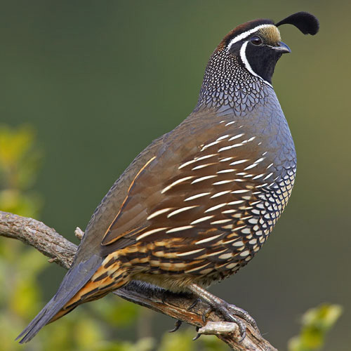
Moving on to the next Scripture
selection with – beyn ha arbayim;
Exodus 16 –

Slide 18
Exo 16:11 And יהוה [Yahuah] spoke to Mosheh, saying,
Exo 16:12 “I have heard the grumblings of the children of Yisra’ĕl. Speak to them, saying, ‘Between the evenings you are to eat meat, and in the morning you are to be satisfied with bread. And you shall know that I am יהוה [Yahuah] your Elohim.’
The Scriptures
Yahuah is promising the Hebrew nation that they will be eating meat before the light and darkness mixture of evening. We read in the very next text –
Exo 16:13 And it came to be that quails came up at evening and covered the camp… The Scriptures
What gives? I thought (in verse 12) Yahuah had promised quail before the evening mixture ?
i-iei - A transitional period.

Slide 19
Maybe we need to look a little more closely to the actual Hebrew text!
Exo 16:13 וַיְהִ֣י בָעֶ֔רֶב וַתַּ֣עַל הַשְּׂלָ֔ו וַתְּכַ֖ס אֶת־הַֽמַּחֲנֶ֑ה וּבַבֹּ֗קֶר הָֽיְתָה֙ שִׁכְבַ֣ת הַטַּ֔ל סָבִ֖יב לַֽמַּחֲנֶֽה׃
Do you see the first word on the right, highlighted in green?
The word is to be written vav, yod, hey, yod.
It is pronounced “i-iei” according to the Interlinear Scripture Analyzer.
וַיְהִ֣י is used in Genesis 1:2 where it is translated as – is becoming.
This shows a TRANSITIONAL STATE OF BEING. וַיְהִ֣י .is used a total of 709 times in the Scriptures.
וַיְהִ֣י - From one state of being, transforming into another state of being
over a period time.

Slide 20
The Etymological Dictionary of the Hebrew Language (by Earnest Klein) assigns the meaning of – “and let him be” – to this word … וַיְהִ֣י (i-iei.)
This allows for a future event to unfold. That future event in this instance and text of study, has been named as – ereb – evening. *
A Hebrew English Lexicon of the Old Testament (originally by Gesenius translated by Edward Robinson - 1906) has some very interesting comments on the vav letter used in the וַיְהִ֣י word.
#1A - וֹ demonstrative adverb and conjunction… The use in Hebrew shows that originally וֹ .was not merely a copulative conjunction but that it possessed a demonstrative force …

Slide 21
B – it [וֹ] introduces an idea that so exceeds or adds to what has preceded,
that it is nearly equivalent to – also.
C – it [וֹ] connects alternative cases so that it = [is equivalent to] - or.
D – it [וֹ] connects contrasted ideas, where in our idiom the idea would be
expressed explicitly by – but; …
E – attaching a fresh subject (or object) to a clause already grammatically
complete …when the idea is thus attached is subordinate, or not logically
embraced in the predominate [subject]…
F – in circumstantial clauses [וֹ] introduces a statement of the concomitant
conditions under which the action denoted by the principal verb takes
place ... page 253

Slide 22
This information quite easily provides allowance for the “becoming action” of ַ וַיְהִ֣י - vav, yod, hey, yod to understand that the evening period close to when the quail arrived was fast approaching and even near.
The transition period changing from afternoon to the evening mixture of light and darkness was being achieved as the quail arrived.
We have not been given a definite time of arrival.
We are however given enough information to
understand that the quail arrived very close to the evening mixture of light and darkness.

Slide 23
A Hebrew Lexicon by W H Barker 1776 provides this insight –
It is (7) [וֹ] paragogic, where it connects the fenfe [sense] with fomething [something] preceding and is added 1ft [1st] to a verb...
Once again we see the ability to connect two different thoughts into one concept.
Through Hebrew language indications, the arrival of the quail was timed just before the sunset. The quail would be at this time flying low looking for a place to settle for the Night Season.
The Yisra’elites had time to eat quail in between the mixtures of light and darkness as the quail continued to arrive while the sun set and the (ereb) evening mixture of light and darkness replaced the direct sunlight.

Slide 24
Looking to the next selection in the Scriptures with –
Beyn Ha Arbayim !
Between the evenings (of Exodus 29, etc.)!

Slide 25
Exo 29:39 “Prepare the one lamb in the morning, and the other lamb you prepare between the evenings, [literally – between the light and darkness mixtures]
Exo 29:40 and one-tenth of an ĕphah of flour mixed with one-fourth of a hin of pressed oil, and one-fourth of a hin of wine as a drink offering, with the one lamb.
Exo 29:41 “And prepare the other lamb between the evenings [literal – between the light and darkness mixtures]. And with it prepare the grain offering and the drink offering, as in the morning, for a sweet fragrance, an offering made by fire to יהוה [Yahuah].
The first lamb was to be prepared EARLY MORNING – boqer.
What about the second lamb?

Slide 26
Exo 29:41 “And prepare the other lamb between the evenings [literal – between the light and darkness mixtures]. And with it prepare the grain offering and the drink offering, as in the morning, for a sweet fragrance, an offering made by fire to יהוה –
And prepare the other lamb – beyn ha arbayim – or, between the evenings …
Sunrise Sunset
Dawn
Yahuah gave the Hebrew nation, a full light season for preparation of the second lamb! This was for the inauguration of the Aharonic priesthood.
Light Season

Slide 27
Exo 30:8 “And when Aharon lights the lamps between the evenings [literal – between the light and darkness mixtures], he shall burn incense on it – a continual incense before יהוה [Yahuah] throughout
your generations.
Aharon was to be prepared for the darkness by lighting the lamps before the darkness even began.
There was no specific time indicated for the lamps to be burning as long as it was before the sun had set allowing the light and darkness to mix.
Are we also advised to be PREPARED BEFORE THE DARKNESS ARRIVES? “Oil in your lamps???
Next selection -

Slide 28
Lev 23:5 In the first month, on the fourteenth day of the month,
between the evenings, is the Passover to יהוה [Yahuah].
Some desire to teach that Yahusha exchanged “the Law” for an easier set!
Yahusha claimed that He came to fulfill the Torah!
Matt 5:17 Do not think that I came to destroy the Torah or the Prophets. I did not come to destroy but to complete.
Did Yahusha live up to that claim?
Yahusha voluntarily delivered up His life – beyn ha arbayim – between the evenings. Sunrise Sunset
Light Season

Slide 29
Num 9:2 “Now, let the children of Yisra’ĕl perform the Passover at its appointed time.
Num 9:3 “On the fourteenth day of this month, between the evenings [literal – between the light and darkness mixtures], perform it at its appointed time. According to all its laws and right-rulings you perform it.”
Num 9:5 So they performed the Passover on the fourteenth day of the first month, between the evenings [literal – between the light and darkness mixtures], in the Wilderness of Sinai. According to all that יהוה [Yahuah] commanded Mosheh,
so the children of Yisra’ĕl did.
Num 9:11 ‘On the fourteenth day of the second month, between the evenings [literal – between the light and darkness mixtures], they perform it – with unleavened bread and bitter herbs they eat it.
It will be very good to read verse12 at this point too.
Clearly the remaining statutes pertaining to the Passover were not to be forgotten. They also must be fulfilled according to Scripture specifications.

Slide 30
And for the last entry of – beyn ha arbayim - between the evenings –
Num 28:4 ‘The one lamb you prepare in the morning, and the other lamb you prepare between the evenings [literal – between the light and darkness mixtures],
Once again, there is no problem with understanding the phrase –
between the evenings – as the original Hebrew definitions indicate –
between the light and darkness mixtures.
With this knowledge “under our hat,” is there a possibility of other problems using the phrase – between the evenings?
What could possibly cause any problem from relying on this phrase that is written in our Scriptures?
The real questions will be:
Did the Scriptures define this particular time as - when the sun was going down as in the timeframe from after noon until sunset?

Slide 31
The Mixing of Light on the
First 3 Cycles of Creation
Was “the sun going down” a positive determining factor documented in Genesis 1, and foundational platform for determining time in the first 3 cycles of creation?
How is it that there was an ereb (mixture of light and darkness) in
the first 3 cycles of creation and the orb of the sun had still not been commissioned with light?
My friend: Is it the orb of the sun which determines an evening mixture or is it the residual light which emanates from the sun? Yes, Yahusha provided the light for the first 3 cycles of creation and possibly some on the 4th too! ☺

Slide 32
Yes some may say this is “splitting hairs” but the fact is, there was
no sun light on the first 3 cycles of creation and there was still light
to cause a light and darkness mixture to be named – ereb.
So tell me, how is it that – TODAY - the orb of the sun is identified as being
the determining factor for identifying when an ereb (evening) light
and darkness mixture can exist?
Where is the light and darkness mixture during a hot afternoon when
the sun is directly overhead and at about 45 degrees Celsius?
It seems clear there is an agenda for declaring “an evening” in the afternoon. Is the sun going down from the noon mark on? Well yes from our miniscule vantage point the sun definitely appears to “go down.”

Slide 33
However, technically it is not going down one iota but is continuing forward in its commission to deliver heat and light to other places on the earth. The sun does not actually go down.
What does occur is that with excessive distance, the direct sunlight is prevented from traveling forever. Did not Yahuah declare in Genesis 1:4 that He divided the light from the darkness?

Slide 34
How did Yahuah divide that light from the darkness?
Is it possible that He at that time, put a limitation of sorts
on light itself?
Why does the light from a flashlight not shine forever through eternity?
Is it possible that there is an unknown limitation on the light?

Slide 35
So in reality, today follows the exact same pattern as the first few cycles of creation! The light having been gradually removed, forms the light and darkness evening mixture. The darkness overtakes the light that is moving on.
There is really no direct influence from the sun orb itself!
A direct effect from the sun would be an eclipse of the sun where
the direct light is blocked from covering the earth.
Yahuah did not give us a blank command instructing us to not worship the sun. Yahuah also supplied the vital guidelines to automatically protect us from that abomination!
We are not to look to the orb of the sun, but are constantly reminded to look to the LIGHT!

Slide 36
But yet we are taught to accept – WITHOUT QUESTION -
“because the Pharisee derived TALMUD said” –
that immediately after the point of high noon, -
“the sun has begun to go down, so therefore that part of the day is the first
evening!”
Read – Talmudic Pharisee Tradition!
Luke 7:13 – Nullifying the Word of Elohim through your tradition which you have handed down. AND MANY SUCH-LIKE YOU DO. HalleluYah Scriptures

Slide 37
When else are we told the sun is “going down”? “The first evening”?????
Dawn Sunrise Noon Sunset Dusk
Question:
How many times have you heard of “the two evenings,” with the first one starting at noon as “the sun begins to go down in the sky”?
Did you ever question the origin of this concept?
Is there a darkness to provide a mixture here?
mixture
Light Season
mixture
Note on slide 34: DO YOU ADDRESS THIS VERSE ANYWHERE? ADRIAN IN AUSTRALIA USES THIS AS HIS FIRST SCRIPTURE FOR CALENDAR STUDIES TO SMACK DAWN – AFTER 7 PAGES OF PIONEER FIRST.
Deut 16:6 But at the place which the LORD thy God shall choose to place his name in, there thou shalt sacrifice the passover at even, at the going down of the sun, at the season that thou camest forth out of Egypt.
KJV

Slide 38

ATTENTION: Now we come to a crossroads. A choice is before us.
Are we going to accept the information we have been taught that the
sun going down in the afternoon allows for a light and darkness mixture before sunset?
2nd: Can darkness really invade the sky while the sun is there?
3rd: Is it really true that the sun actually and physically – “goes down”!?
CHOICES! Will we abide by the Hebrew words and original meaning that the authors intended them to mean? … Where the only place a light and darkness mixture can occur following the middle of the cycle is - after the sun has travelled on its endless journey, out of our sight!
Let’s look at a graphic to be sure we are on the same page!

Slide 39
Does this make any sense to you?
Dawn Sunrise
19. A brilliant yellow orb called the sun is high in the sky, and the blackness of night overtakes - {mixture} - the light causing a darkened twilight condition before the sun sets.
18. The sun has disappeared after sunset, causing an ereb twilight light and darkness mixture to occur.
MOST CERTAINLY EVERY FRIDAY! ?
Noon
Sunset
Morning
Twilight
Light Season
What advantage does religion assume by claiming an evening in the afternoon? (i.e. two afternoons.)
Notes:
Same slide.

Slide 40

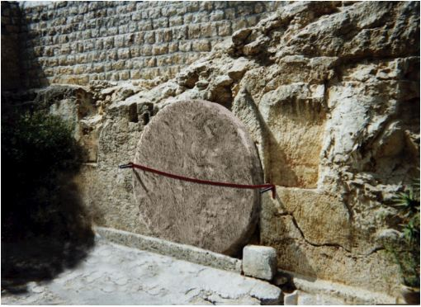
A mis-understanding of this phrase:
“between the evenings”
can (and will)
cause huge problems
with the passion events of Yahusha’s burial!

Slide 41
What if “Christianity” was bent on showing a Friday “before evening burial” of “Jesus” so they could have an inclusive “3 days” allowing
“Jesus” to be resurrected on SUNday morning?
When Matthew 27:57 claims Yoseph requested the body of “Jesus” when the evening had arrived, it now becomes ultra easy to say “Jesus” was buried before sunset. There was enough time to casually to wrap Him!
Oh yes, that might mean “Jesus” was buried before the sunset Sabbath too!
What about Mark 15:42, 43?
Mark 15:42 And when evening had come,
because it was the Preparation Day, that is, the day before the Sabbath,
Mark 15:43 Yosěph of Ramathayim, a prominent council member, who was himself waiting for the reign of Elohim, came, boldly went in to Pilate and asked for the body of יהושע [Yahusha].

Slide 42
What evening was it when after it had occurred, that Yoseph of Arimathea asked for the body of Yahusha?
Was it the “afternoon evening” when the darkness was mixing with the light causing a twilight effect, before sunset? Please think carefully about this for a minute. Was it the evening that has no Hebrew definition background?
Was it the type of TRADITIONAL evening that has no Hebrew definition background, nor Scriptural foundation?
Or conversely, was it the ereb (evening mixture) that has a light and darkness quotient that by Hebrew definition occurs only before sunrise and after sunset?
If one traditional evening is from noon to 6 PM and the second evening is from 6 PM until darkness (3 stars); HOW DOES ONE DETERMINE IF YAHUSHA DIED AS PER PASSOVER LAMB TYPE INSTRUCTIONS –
BEYN HA ARBAYIM - (between the evenings?)

Slide 43
Did Yahusha die here, fulfilling the type pattern of the Passover Lamb –
BEYN HA ARBAYIM – BETWEEN THE EVENINGS?
Please be sure you are familiar with the time frame concept of the sunset – between the two evenings.
Sunset!
1st evening
- light & darkness mixture(?)
Noon
2nd evening(?)
Abib 14 Light Season
Luke 23:44 … darkness came over the land until the ninth hour.
46 … “Father into your hands I command My Spirit.”
And having said this He breathed His last.

Slide 44
The Death and Burial all before the Sabbath at sunset?
It depends on your sources.
All one has to do is ignore the original meanings!
It’s easy! No need to study!
Please do not study very deeply because all this Sunday morning resurrection dogma will collapse very quickly if one pays attention to what is actually written!
Are you ready for another vital point?

Slide 45




Where were the Yisra’elites commanded to slay the Pesach Lamb?
Deut 16:2 – And you slaughter the Pesach to [Yahuah] your Elohim from the flock and the herd, in the place where [Yahuah] chooses to put His Name. HalleluYah Scriptures
Question: At what location did Yahuah declare His name would abide?

Slide 46
Where did Yahuah claim His Name would dwell?
1 Kings 8:18 - 21
2 Sam 7: 5 – 7, 12-14
1 Chron 17:4-14 / 28:6
Solomon built the Tabernacle for the
Name of Yahuah to dwell there.
What does this mean for the Yisra’elites
who were to slay the Pesach Lamb?
It means massive amounts of sacrificial lambs
were to be slain in the Tabernacle on the day of Pesach.

Slide 47
What time frame did Yahuah give them to accomplish this laborious effort?
Exodus 12:6 – And you shall keep it up until the
fourteenth day of the same month. Then all the
assembly of the congregation of Yisra’el shall kill it
BETWEEN THE EVENINGS.
I was taught from a child that the Passover lambs
were to be slain at the 3 PM (9th HR) mark
of the afternoon until sunset!

Slide 48
The Hebrew definitions of the original recorded words gives us a whole different aspect! “Between The Evenings” – tells me they had from sunrise until sunset to sacrifice their lambs.
12 full hours – not 3!
Morning Twilight (Ereb) Mixture
Evening Twilight (Ereb) Mixture
Sunrise
Sunset
Dawn
……..Abib 14 Light Season ..9TH Hr .
3 HOURS
Did Yisra’el really have only 3 hours to sacrifice tens of thousands or more Pesach lambs -
ALL WITHIN THE HOUSE WHERE YAHUAH’S NAME RESIDES?

Slide 49
Were Yahuah’s Divine Provisions Set Aside?
Jan 16/18: I added some information to this slide that is in our Dan 9 paper … so you don’t want to have a conflict with this PPT. However, it seems to me that Yah made provision for 12 hrs. for all the sacrificial lambs to be slain, but could it be that the priests were “doing their own thing” to actually give “between the evenings” their own definition. Josephus is a pretty accurate eye-witness of what they were doing – whether right or wrong. Remember, ALL the priests were on duty to slay these lambs. Decide what you want to do with this slide.
It seems to me that the Temple would be very busy slaying lambs in the whole twelve hours of “between the evenings.”
I can not imagine if it were only 3 hours to slay all those lambs
within the Temple!
Let’s see what Josephus has to say as an eye witness:
"So these high priests, upon the coming of their feast which is called the Passover, when they slay their sacrifices, from the ninth hour to the eleventh, [3 pm to 5 pm Roman time] but so that a company not less than ten belong to every sacrifice . . . and many of us are twenty in a company, found this number of sacrifices was two hundred and fifty six thousand five hundred [256,500] which, upon the allowance of no more than ten that feast together, amounts to two million seven hundred thousand and two hundred persons that were pure and holy." (Wars of the Jews, Book VI, 9:3.)

Slide 50
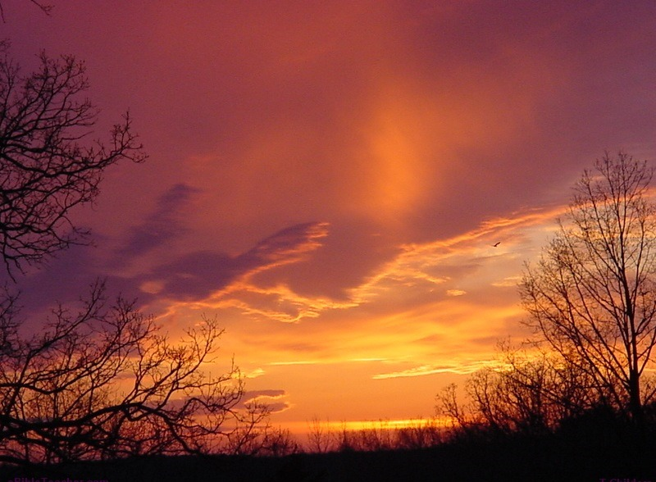


Questions or Comments for Melchizedek’s meaning of
Beyn Ha Arbayim
(“between the evenings”)?
calendar@torahtothetribes.com

