Slide 1


Yahuah’s
Chosen Captain
Noah:

Slide 2

Why Did
Yahuah’s Ark NOT need a Periscope?
Question:

Slide 3
Which Calendar guided Noah’s Ark?
Who was the actual Captain of the Ark?
Was Noah in charge of the Ark itself?
Or, was Noah only in charge of the animals within the Ark?
Ultimately, who was in charge of guiding the Ark’s paths throughout the raging waters?
Will this episode of turbulence on the earth expose the true calendar of El Shaddai (The Almighty)?

Slide 4
Who was Guiding the Ark?
Yahuah was Guiding Commander of the Ark.
Gen 8:1 And Elohim remembered Noaḥ, and all the beasts and all the cattle that were with him in the ark. And Elohim made a wind to pass over the earth, and the waters subsided.
Do you think it would be wise to consider the timeframes recorded in the Scriptures while searching out the calendar topic?
Let’s look at the timeline from start to finish of this watery trial for Noah and his offspring. The highly accurate details were recorded for our advantage. We need to KNOW them!

Slide 5

A Solar Oriented Calendar?
Other PPts have delved into the lunar based aspect of examining the flood account. There has been a solid record of non-alignment with the Scriptures in these attempts to correlate the flood account with a lunar based calendar.
Taking the cue from prophetic time and hundreds of hours of study on the solar light based Covenant Calendar, we will be examining the Tequfah based calendar. We will be comparing the lunar based systems after viewing the Scriptural documentation.
The solar light based Covenant Calendar uses the (vernal equinox) to start Yahuah’s year as recorded in the Scriptures. It also incorporates a strict 30 cycle (day) month. Nothing less, nothing more.
tequfah

Slide 6
Noah’s Solar Oriented Flood Experience – (# 1)
The tequfah (vernal equinox) initiates the start of the new year.
1st month of 30 - 24 hour days. Methushelah (Enoch’s son) dies.
10th day of the 2nd month, (seven days before the flood). Gen 7:4
Flood begins, 17th day, 2nd month. Gen 7:11
1st – 30
2nd - 30
Up to where the flood begins, we see a total of 47 days in this year.

Slide 7
Noah’s Solar Flood Experience – (# 2)
The flood has begun on the 17th day of the 2nd month. Gen 7:11
There are 14 Days of rain (including the 17th) to the end of the 2nd month.
The rain ends after 40 days & 40 nights, (Gen 7:12), on the 26th day of the 3rd month.
1st – 30
2nd – 30 3rd - 30

Slide 8
Noah’s Solar Flood Experience – (# 3)
We begin to look at the timeline of 150 days that the water was on the earth.
Month #s 4,5 and 6 occur. (30 days each)
1st – 30
2nd – 30 3rd – 30 4th – 30 5th – 30 6th - 30

Slide 9
Noah’s Solar Flood Experience – (# 3)
We begin to look at the timeline of 150 days that the water was on the earth.
Month #s 4,5 and 6 occur. (30 days each)
There has now accumulated 134 days since the waters began on the earth = the 17th of the 2nd month, to the end of the 6th month.
1st – 30
2nd – 30 3rd – 30 4th – 30 5th – 30 6th - 30

Slide 10
Noah’s Solar Oriented Flood Experience – (# 4)
PLEASE NOTE ULTRA CAREFULLY –
The acclaimed first two quarterly markers of the year.
Some claim we are supposed to add 1 day after each quarter to help account for the 5 days over the 360 day count.
1st – 30
2nd – 30 3rd – 30 4th – 30 5th – 30 6th - 30
?
2nd Quarter
1st Quarter

Slide 11

Noah’s Solar Oriented Flood Experience – (# 5)
Questions:
Did Mosheh add a single day
onto, or after, each quarter?
Have the Scriptures revealed
this as Yahuah’s instruction?

Slide 12
Noah’s Solar Oriented Flood Experience – (# 6)
Genesis 8:3 indicates to us that the waters were on the earth for 150 days.
From the 17th day of the 2nd month up until the last day of the 6th month we have seen 134 days of water on the earth.
Question: How many more days of the 7th month are needed to to achieve the full 150 days of water on the earth?
Answer: We need in the 7th month to achieve the
Scripture’s 150 days of water on the earth.
134 days
1 2 3 4 5 6
16 days
Does this mean the ark rested on the 16th cycle of the 7th month?
7

Slide 13
Exactly what event is it that the Scriptures record as occurring on the 16th cycle of the seventh month?

Slide 14

The 16th! Really?
... I thought the ark landed on the 17th of the month! Genesis says –
Gen 8:4 And in the seventh month, the
day of the month, on the mountains of Ararat.
Please pay attention here. This next portion will point out very explicitly to the HIGH CALIBER of Yahuah’s accuracy within His Covenant Calendar.
seventeenth
the ark rested
Not the 16th!

Slide 15
What is so important about the 16th of the seventh month?
.
What intricate details make the 16th cycle so important?

Slide 16
Yahuah - the Ultimate Choreographer #1
This is Scriptural description of circumstances the 150th day on the 7th month –
Gen 8:3 (A) And the waters receded^{H7725} steadily from the earth,
H7725 - shuwb. Without going into the many sources and definitions, the waters on the earth were gradually and consistently decreasing from the surface of the earth.
Shuwb describes the physical condition over many weeks.
Let’s look now at Genesis 8:3 (B) and see if you are able to detect in Yahuah’s action designed to “ground” the ark.
nearing
a direct and intentional change

Slide 17
Yahuah - the Ultimate Choreographer #2
Gen 8:3 And the waters receded steadily from the earth, and at the END of the hundred and fifty days the waters
Note: The Scriptures declare in writing that at the END of the 150 days.... Not before or during the 150 days, but at the END, the waters
H2637 – chacer. The definitions show Yahuah’s concerted effort with an intentional purpose to withdraw the waters rapidly.
That intentional purpose was to allow the ark to touch stable ground.
Yahuah very specifically made provision for the day AFTER the 150 days of water on the earth, to allow the ark to rest on hard ground.
Diminished^{H2637}.
diminished.

Slide 18
Before we go further, there are some extremely pertinent questions to ask.
Please pay attention to the very specific wording of each one.

Slide 19

Questions:
Was it possible for the ark to touch down upon any other day the 151st day of the 7th month?
Yes, I am being very specific in asking this question, and for very
good reason!
prior to

Slide 20
2nd Question:
If we as humans, claim that the ark touched down on hard ground on the 7th month, are we then denying the Word of Yahuah and blaspheming our Creator?
AFTER THE 151st DAY

Slide 21
Yes, sadly there are extremely specific reasons for asking each of those questions. You may want to read them again.
We will be addressing each question.
What calendar do you follow?
Let’s continue to discover what calendar Noah was on! ☺

Slide 22

Noah’s Solar Flood Experience – (# 7)
40 Days and 40 Nights of rain.
Gen 8:3 And the waters from the earth,
1/30 2/30 3/30 4/30 5/30 6/30 7/30
16th of the 7th mon.
receded steadily
Rain
150 days from 17th, 2nd month to 16th of the 7th month

Slide 23

The Many Weeks of Shuwb!
Gen 8:3 And the waters from the earth,
1/30 2/30 3/30 4/30 5/30 6/30 7/30
16th of the 7th mon.
receded steadily
H7725 - Shuwb.
Receded!
150 days from 17th, 2nd month to 16th of the 7th month

Slide 24

Yahuah’s Precision Examined
Gen 8:3 And the waters receded steadily from the earth, and at of the hundred and fifty days the waters
the END
DIMINISHED.
Gesenius – H2637 Chacer - to diminish, to cut short, to be devoid of anything, to lack, to be without.

Slide 25
Yahuah’s Concerted Effort –
When?
The End of the 150 days!
Not nearing the END. Not close to the END, but –
AT THE END!
The waters fulfilled the complete 150 days on the earth!

Slide 26
Do we understand the serious difference in these words for their importance?
H7725 Shuwb – Strong’s – generally to retreat – shows a lengthy process over many weeks.
H2637 Chacer – to be devoid - reveals Yahuah’s direct intense action effort at the end of the final 150th cycle!
Let’s remember the difference as we continue.

Slide 27
Noah’s Flood Experience – (# 8)
Gen 8:3 And the waters receded steadily from the earth, and at of the hundred and fifty days the waters DIMINISHED.
The after the rain began is when the ark rested on hard ground.
The 17th day of the 7th month is when Yahuah executed a
concerted effort to have the ark rest.
The END of the 150 days is the 16th of the 7th month.
1/30 2/30 3/30 4/30 5/30 6/30 7/30
the end
17th day of the 7th month, the 151st day
150 days from 17th, 2nd month to 16th of the 7th month

Slide 28


Water Levels on the Earth
Last of the 150 days, the 16th day of the 7th month
Gen 8:3 (A) And the waters receded steadily from the earth, ...
1/30 2/30 3/30 4/30 5/30 6/30 7/30
H7725 - Shuwb
Receded!
150 days from 17th, 2nd month to 16th of the 7th month

Slide 29
Yahuah actively withdraws the Water
the 150 days, the 17th day of the 7th month
Gen 8:3 (B) ... and at of the hundred and fifty days the waters DIMINISHED.
1/30 2/30 3/30 4/30 5/30 6/30 7/30
AT THE END {AFTER}
the end
H2637- chacer concerted effort for an intentional purpose
150 days from 17th, 2nd month to 16th of the 7th month

Slide 30

The Equation
For those that require a simple equation, here it is.
14 + 30 + 30 + 30 + 30 +16 (days) = 150 days
2nd month, 3rd, 4th 5th & 6th months 7th month
Please remember that the 150th day – MUST land on the 16th day of the 7th month, to allow for the precise effort of the water rapidly diminishing
Now it begins to get ULTRA INTERESTING! ☺ ?????
permitting the ark to rest – exactly on the 17th of the 7th month.

Slide 31
We will now view the acclaimed “Hebrew Calendar.”

Slide 32
The Lunar Based Hebrew Calendar
1. Nisan – 30 days
2. Iyyar - 29 days
3. Sivan - 30 days
4. Tammuz - 29 days
5. Av - 30 days
6. Elul - 29 days
7. Tishri - 30 days
8. Heshvan - 29/30 days
9. Kislev - 29/30 days
10. Tevet - 29 days
11. Shevat - 30 days
12. Adar 1 – 30 days
intercalary month
13. Adar 2 - 29 days
Note these 3 months with 29 days.

Slide 33
The Ark - Lunar Drifting? #1
We have just viewed the “Hebrew Calendar.” This is a lunar based calendar promoted as “the Scriptural Calendar.” Let’s see how it rates!
We will begin by plugging in the number of days seen in each month. The first month does not count, but the second month begins the count with 29 days! Let’s add them up -
Rain begins 17^{th.}
1/30 2/29 3/30 4/29 5/30 6/29 7/30
Can we agree that when the rain is recorded as starting on the 17th, we then need to count it as the first cycle of rain?
Then - What about Creation’s 1st day …?

Slide 34
Lunar Drifting RESTART! #2
We will restart by plugging in the number of days seen in each month. The first month does not count, but the second month begins the count with 29 days! Let’s add them up -
Rain begins 17^{th.}
1/30 2/29 3/30 4/29 5/30 6/29 7/30
Rain begins on the 17th day & continues to the 29th of the 2nd month. 17 - 29 is 13 days of rain.
13
16th/7th month

Slide 35
Lunar Drifting Continued #3
Let’s keep adding up the remaining months!
1/30 2/29 3/30 4/29 5/30 6/29 7/30
13
+ 30 + 29 + 30 + 29 =
131 days
to the end of the 6th month.
Rain begins 17^{th.}
16th/7th month

Slide 36

Lunar Drifting? #4
The Scriptures tell us the ark landed on the of the 7th month. Genesis 8:4.
We now have 131 lunar based days at the end of the 6th month.
17 ^{th}
From the 7th month,
Scriptures will now require more days
19
to fulfill the 150 days of water on the earth.
(Genesis 8:3)

Slide 37


Lunar Drifting – 7th Month Alignment Problem!
Gen 8:3 – ... AT THE END of the hundred and fifty days the waters diminished.”
Gen 8:4 - And in the seventh month, the of the month, the ark rested on the mountains of Ararat.
To complete the full 150 lunar based days, the 19th day of the 7th month – Tishri - must be achieved!
seventeenth day
Months 2 – 6, 131 days
Tishri - the 7th Month

Slide 38

The “Lunar” Ark – Was It A Submarine?
Yahuah did not withdraw the waters in a substantial way until the end of the 150 days; that being the 19th (?) of Tishri
?
?
The Scriptures declare the end of the 150 days, here on the 16th!
Months 2 – 6, 131 days
17TH
19 days of Tishri
Tishri - the 7th Month

Slide 39
The “Lunar” Ark – With a Periscope?
The waters were intentionally withdrawn at the end of the “150 lunar days”; on the 19th of the 7th month?
Scriptures document that the Ark rested on
Mt Ararat on the 17 ^{th} day of the 7th month!
Months 2 – 6, 131 days
Water Level ABOVE Mt Ararat!
150 Lunar based days achieved on the 19th of Tishri!
19 days of Tishri
Tishri - the 7th Month

Slide 40
The “Lunar” Ark – A “Failure”?
The Lunar based 150 days ends on the 19th of Tishri.
Scriptures claim Noah’s Ark settled on Mt Ararat on Tishri 17!
“Lunar” Water Level Over Mt Ararat!
Yahuah’s purposeful CONCERTED EFFORT to RAPIDLY DIMINISH the waters at the END of the 150 Covenant Calendar days!
Months 2 – 6, 131 days
The waters receded SLOWLY UP TO AND ON THE 16TH OF THE 7TH MONTH!
Tishri - the 7th Month

Slide 41
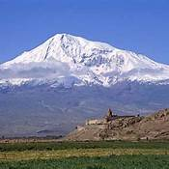
The Lunar Water “Diminishing”!
The Lunar based 150 days ends on the 19th of Tishri and according to the Scriptures, the waters did not DIMINISH UNTIL THE END OF THE 150!
Water Level Over Mt Ararat!
The Scriptures declare the end of the 150 days, here on the 16th!
17TH
Tishri - the 7th Month

Slide 42
Yahuah declares …
The Lunar Calendar’s 19th cycle
Water Level Over Mt Ararat!
Noah’s Ark rested upon Mt Ararat on the 17th of the 7th month!
17TH
Tishri - the 7th Month

Slide 43
On Yahuah’s 17th of the 7th month…
NOAH NEEDED AN ARK WITH A PERISCOPE!
Lunar 19th Water Level Over Mt Ararat!
Tishri - the 7th Month

Slide 44
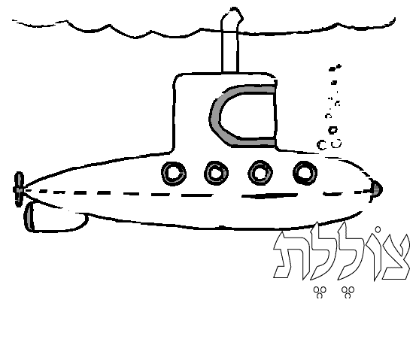
The Lunar - Ark-Marine !!
Tishri 17 -
For the Ark to rest on the Mount, the Ark needed a PERISCOPE!
The 19th Lunar Water Level Over Mt Ararat!
17TH
Tishri - the 7th Month

Slide 45
Seems that the
Lunar Calendar
has a serious
Periscope Problem!
Noah did not receive instruction to build a Periscope!
Neither did Mosheh follow a
Lunar Calendar!

Slide 46
7th Month Lunar Drifting
Another Lunar Based Problem;
If indeed the Ark rested on the 17th day of Tishri (the 7th month), then the 150 days of water on the earth (Gen 8:3) was not fulfilled according to documentation.
Question:
If indeed Noah was sailing according to a lunar based guide, was he then -
DRIFTING OFF YAHUAH’S COURSE
BOTH PHYSICALLY AND SPIRITUALLY?

Slide 47
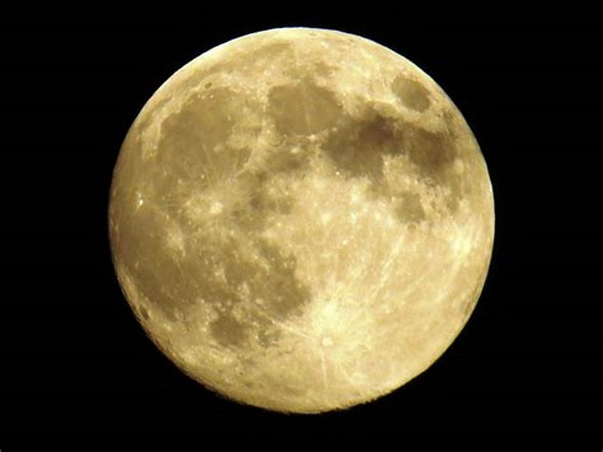
Yahuah’s Ark did not need a Periscope because Noah was on the Blood Ratified Covenant Calendar!
Answer!

Slide 48
Does the Enoch Calendar have a better solution?
Let’s consider Enoch’s Solar Calendar.

Slide 49
What about the “Quarterly Drifters”
Do you recall on slides #8 & 9 your attention was brought to the concept of adding one “marker” day after each quarter? {Enoch’s “Seasonal Markers”!}
Noah was permitted to be the captain inside the ark.
Yahuah was the The Captain for outside the ark.
By discerning the Ultimate Captain’s course, we will understand His Covenant Calendar.
Did Yahuah add quarterly markers after each quarter in the year?
Where do we find this instruction in the Scriptures?

Slide 50
“More Per Quarter”???
Secular history documentation supports the concept that the yearly days were changed from 360 days, to 365+ days.
There is some controversy if the secular history records of 30 credible civilizations are not considered.
People who choose to elevate the book of Enoch (above the Scriptures), tell us that Enoch wrote this factor of adding quarterly marker days in his book.
As with everything else, we must go back to the Torah for our original instruction. Isaiah told us this fact - 7 times!
Questions: Will Noah’s flood account uphold the book of Enoch? Or will Noah show that the book of Enoch came long after the Torah?

Slide 51
“More Per Quarter”???
Notice the 14 in the equation below, it is the 14 days of rain in the last half of the 2nd month. Same as the solar based calendar previously seen in the beginning of this PPt.
In this flood account, there are two quarterly points within the flood itself – the end of the 3rd and 6th months.
Two months might have the equivalent of 31 days in Noah’s flood story!
14 + 31 + 30 + 30 + 31 = 136 days at the end of the 6 ^{th} month.
Rain begins 17th The 16th of the 7th month.
1/30 2/30 3/30+1 4/30 5/30 6/30+1 7/30

Slide 52



“More Per Quarter”???
Rain begins 17th
1 2 3 4 5 6 7 8
30 30 30+1 30 30 30+1 30
The first quarter accomplished;
- add one day.
(Book of Enoch)
The second quarter accomplished;
add one day.
(Book of Enoch)
End of the 150 days as written in the Scriptures - the 7th month, the 16th day.

Slide 53
Testing Enoch’s “More Per Quarter” Theory
The two quarters – at the end of the 3rd and 6th month have had their one day each added to their number.
With 136 days from the 17th of the 2nd month, to the 31st of the 6th month, we now have accumulated a total of 136 days from the start of the rain.
This number 136 leaves us needing only days to accomplish the 150 days of rain by the of the 7th month.
14 + 31 + 30 + 30 + 31 = 136 days at the end of the 6th month.
Rain begins 17th, 2nd month. The 16th of the 7th month.
1/30 2/30 3/30+1 4/30 5/30 6/30+1 7/30
14
16 ^{th}
136 days

Slide 54
Enoch’s “More Per Quarter” - Crash!
the book of Enoch claims that the 150 days ended on the 14th of Tishri!
The Scriptures claim by extreme accuracy throughout, that the 150 days of water on the earth, ended on the 16th of the month. After the 16th, the waters diminished rapidly allowing the ark to rest.
This allows the ark to rest on Mt Ararat on the 17th day of the 7th month – Gen 8:3.
16th 17th
By default,
Months 2 – 6, 136 days
14th
Tishri - the 7th Month

Slide 55
Quarterly Choices
Let’s add up the days now.
14 + 30 +1 + 30 +30 + 30 +1 + 14 (7 ^{th} month) = 150
Apparently Enoch needed only 14 days of the 7th month, to achieve the 150 days of water on the earth! Shall we simply assume that Yahuah fully intended a 2 day space of low water to be absolutely certain that the ark would touch hard ground on the 17th of the 7th month?
Was it possible that Yahuah had to go searching for a lump of hard ground to set the ark on during those two “low water” days?
Could we liken this to a “plan B” system in case of a miscalculation and consequently a failure?
Is it possible that Mosheh had his numbers wrong when he wrote the Torah?

Slide 56
Questions For You
Enoch counts out 14 days, arriving at the 14th of the 7th month.
This leaves 2 full days of a lower water level for Yahuah to search for a lump of hard ground for the ark to rest upon.
end of 150 days 14th ???
End of 6th month 17th Ark lands here.
136 days
Questions: Does this inaccuracy sound like the Creator who simply spoke the earth into existence? The One who split the Red Sea in a matter of minutes?
From whom does this confusion of the Scriptures derive?

Slide 57
The Underachiever!
Did it occur to you that the same problem occurred in both the lunar based system and the quarterly addition system proposed by the Book of Enoch?
They both had serious underachievement problems. Accounting accurately is just not within the scope of the deviser of these two systems.
Who is the UNDERACHIEVER? Who creates carnage with Yahuah’s Word by convoluting, twisting and warping the message?

Slide 58
One last question -
Which Enoch is the likely father of such confusion?
Or –
2. Enoch the son of Cain? (Gen 4:17)
Is it:
1. Enoch the man who walked with Yahuah?
(Gen 5:24)

Slide 59
Appeal
My friend, you the reader:
Set before you are 3 choices.
Two have serious Scriptural alignment problems that cannot be overcome and still stay within the Torah guidelines.
Two choices can be discarded permanently.
Only one system aligns perfectly with
the Scriptural documentation.
While I will not tell you what to decide, I will definitely tell you my personal decision.

Slide 60
For myself, I choose the Covenant Calendar
that aligns with the Scriptures starting with Genesis 1, through Noah, Abraham, Isaac, Jacob, Joseph, Mosheh, Joshua, Samuel,
Ezra, Nehemiah, and the list goes on.
This Covenant Calendar exposes with
brilliant clarity the details of
Yahusha living out the Torah,
word for word, no detail left untouched.
May Yahuah bless you always, giving you wisdom overflowing.

Slide 61


If you need assistance with this information, please send your
questions to Timothy Astleford:
tim@studythecalendar.com
questions@studythecalendar.com

