Slide 1

The Moon! Oh, the Moon! Pt 7

Slide 2



Pointers to Remember When
Using Computer Study Tools

Slide 3

Popular Bible Study Tools
This short lesson will demonstrate some points of interest between three popular study tools for the calendar study.
E-Sword
Blue-Letter-Bible
PC Study Bible
Will these study tools agree with each other?

Slide 4
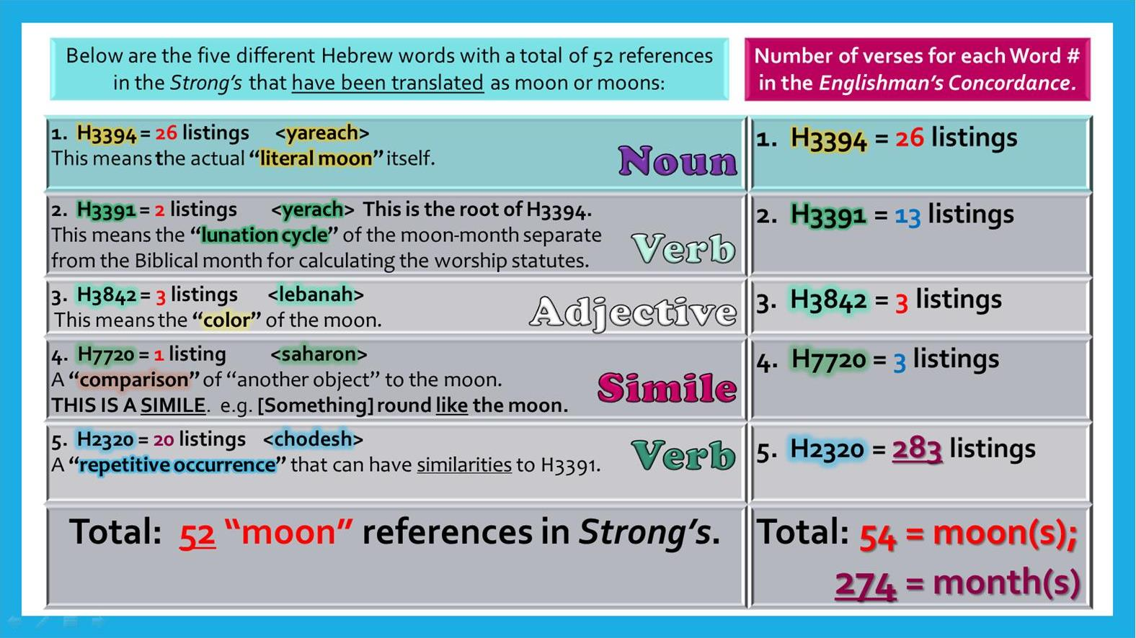
The Moon Study Book Mark
This “Moon Study Sheet” is a tool to understanding and remembering the basics of this important study.
The “listings” given are from the
PC Bible Study Program.
Some explanation is necessary so each one will know how to use this bookmark efficiently.
#2
#1
#1
#2
We will examine several areas.

Slide 5
Possible
Discrepancy #1
The
Moon Study Book Mark
#1
1. When searching Strong’s for “moon[s]” a total of 52 references are found.
2. When searching Englishman’s for “moon” Hebrew word numbers, a total of
54 references are found.
3. Why are these numbers different?

Slide 6
SOLVING
Discrepancy #1
The
Moon Study Book Mark
#1
1. In Strong’s H7720 <saharon> had one listing for “moon” in Isa 3:18.
2. When searching Englishman’s for “H7720” two other references were found as
similes for the word “moon.” (See Judg 8:21 & 8:26.)
3. This increases the final total (for Englishman’s) from 52 to 54 “moon matches.”

Slide 7
Possible
Discrepancy #2
The
Moon Study Book Mark
#2
1. In Strong’s H3391 <yerach> had two listings for “moon.”
2. When searching Englishman’s for “H3391” eleven [11] other references were
found as using the word “month[s]” for a total of 13 matches for H3391.
3. How does this affect the final total given as 274 months? (Let’s continue to see.)

Slide 8
Finally
SOLVING
Discrepancy #2
Moon Study
Book
Mark
#2c
#2a
#2b
#2d
[2a] In Strong’s H2320 <chodesh> has 20 listings for “moon.”
[2b] When searching Englishman’s for “H2320” - 283 matches are found
using the words moon[s]; month[s]; monthly, etc.
[2a] Removing the 20 “moon” matches leaves [2b] 263 matches using “month[s].”
[2c] H3391 has 11 matches for “month” [that must be added to the 263 months] bringing the total
[2d] to 274 [263+11] matches for “month[s] and monthly” in Englishman’s Concordance.

Slide 9

Building Charts with Bible Study Tools
This book mark was designed using the
PC Study Bible.
There is one more area on the Moon Study Book Mark that may appear as another discrepancy for those using either E-Sword or Blue-Letter-Bible Study tools.

Slide 10
SOLVING Book Mark Discrepancy #3
The number in question is “283” listings for H2320 chodesh.
Question:
Will E-Sword & Blue Letter Study Bible agree with the PC Bible Study tool?
Is there something important to learn from this exercise?

Slide 11

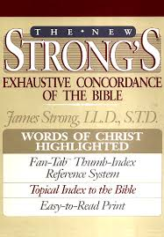

What About Strong’s?
Will the different Bible Study tools represent the work of Strong’s as it is found
in book form?
Should
they?

Slide 12
Comparisons of Three Study Tools
Search | E-Sword | Blue Letter | PCSB-Strong’s | PCSB-Engl.
Moon | 41 vs / 41 hits | 41 vs / 41 hits | 41 vs / 41 hits
Moons | 11 vs / 11 hits | 11 vs / 11 hits | 11 vs / 11 hits
H3394 yareach | 26 vs / 26 hits | 26 vs / 26 hits |  | 26 vs / 26 hits
H3391 yerach | 13 vs / 13 hits | 13 vs / 13 hits | (2: moon; 11: month/s) | 13 vs / 13 hits
H3842 lebanah | 3 vs / 3 hits | 3 vs / 3 hits |  | 3 vs / 3 hits
H7720 saharon | 3 vs / 3 hits | 3 vs / 3 hits | (1: moon; 2: ornament) | 3 vs / 3 hits
Month | 183 vs / 246 hits | 183 vs / 246 hits | N/A / 246 hits
Months | 41 vs / 43 hits | 41 vs / 43 hits | 41 vs / 43 hits
Monthly | 1 vs / 1 hit | 1 vs / 1 hit | 1 vs / 1 hit
Another/H2320 | 1 vs / 1 hit | 1 vs / 1 hit | 1 vs / 1 hit
H2320 chodesh | ? | ? | ? | ?
So far there are no discrepancies!

Slide 13
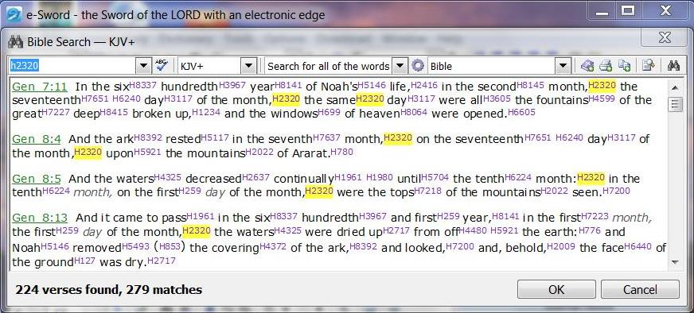
E-Sword: H2320 Chodesh Matches
Search | E-Sword | Blue Letter | PCSB-Strong’s | PCSB-Engl.
H2320 chodesh | 279 | ? |  | ?

Slide 14
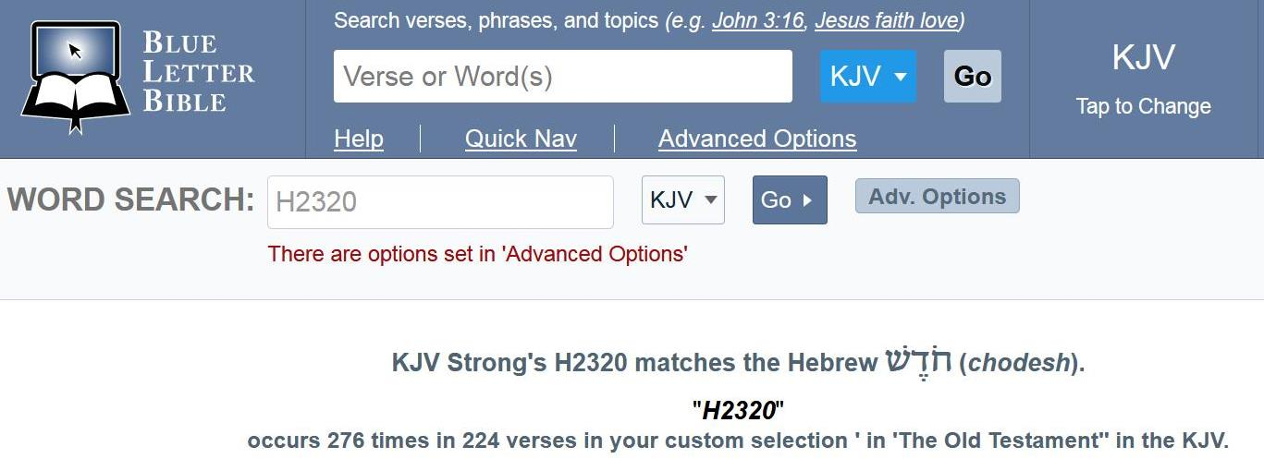
Blue Letter Bible: H2320 Chodesh Matches
Search | E-Sword | Blue Letter | PCSB-Strong’s | PCSB-Engl.
H2320 chodesh | 279 | 276 |  | ?
2 Discrepancies!

Slide 15
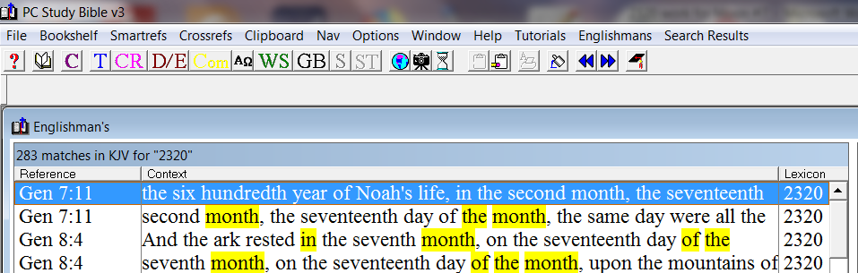
PC Study Bible: H2320 Chodesh Matches
Search | E-Sword | Blue Letter | PCSB-Strong’s | PCSB-Engl.
H2320 chodesh | 279 | 276 |  | 283
3 Discrepancies!

Slide 16

What About Study Tool Discrepancies?
Search | E-Sword | Blue Letter | PCSB-Strong’s | PCSB-Engl.
H2320 chodesh | 224 vs / 279 hits | 224 vs / 276 hits |  | 224 vs / 283 hits
H2320 as Moon | 9 non-Torah vs.
H2320 as Moons | 11 non-Torah vs.
Total:
Percentage: | 20/279 = 7.1% | 20/276 = 7.2% |  | 20/283 = 7.0%
 | E-Sword | Blue Letter |  | Englishman’s
Discrepancies seem to appear!
The reason is unknown.
20 non-Torah verses mis-translate <chodesh> as moon, not month.
These three study tools agree only 7% of the H2320 <chodesh> listings are translated as “moon” instead of “month”!

Slide 17
Things to Remember When
Using Computer Study Tools
This small exercise has demonstrated there can be discrepancies between different Bible study tools. If so, ask questions!
Does the discrepancy affect the overall outcome of the study?
(In this case it didn’t.)
Be watchful for other types of discrepancies that may affect
the final outcome.

Slide 18

What about italicized words?
Italicized words in the
KJV have been added.
All words should be examined for
content & context accuracy.
What about
Strong’s?

Slide 19

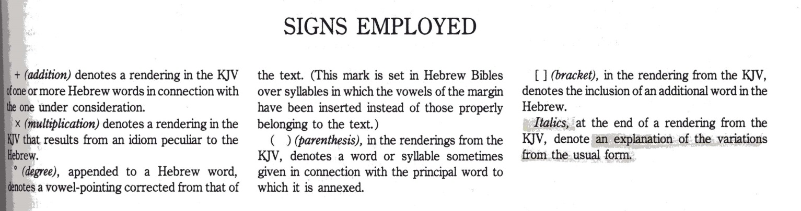
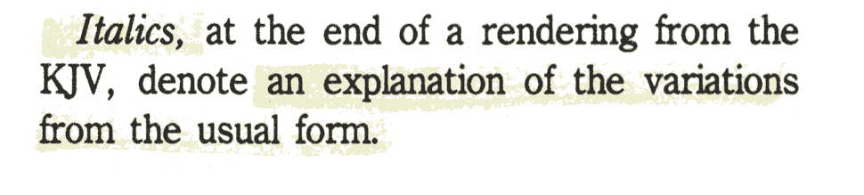
Strong’s Italicized Words
Not all Bible study tools show exactly what is printed in the original books.
Strong’s notes:
In other words: “italicized” words have been added.

Slide 20
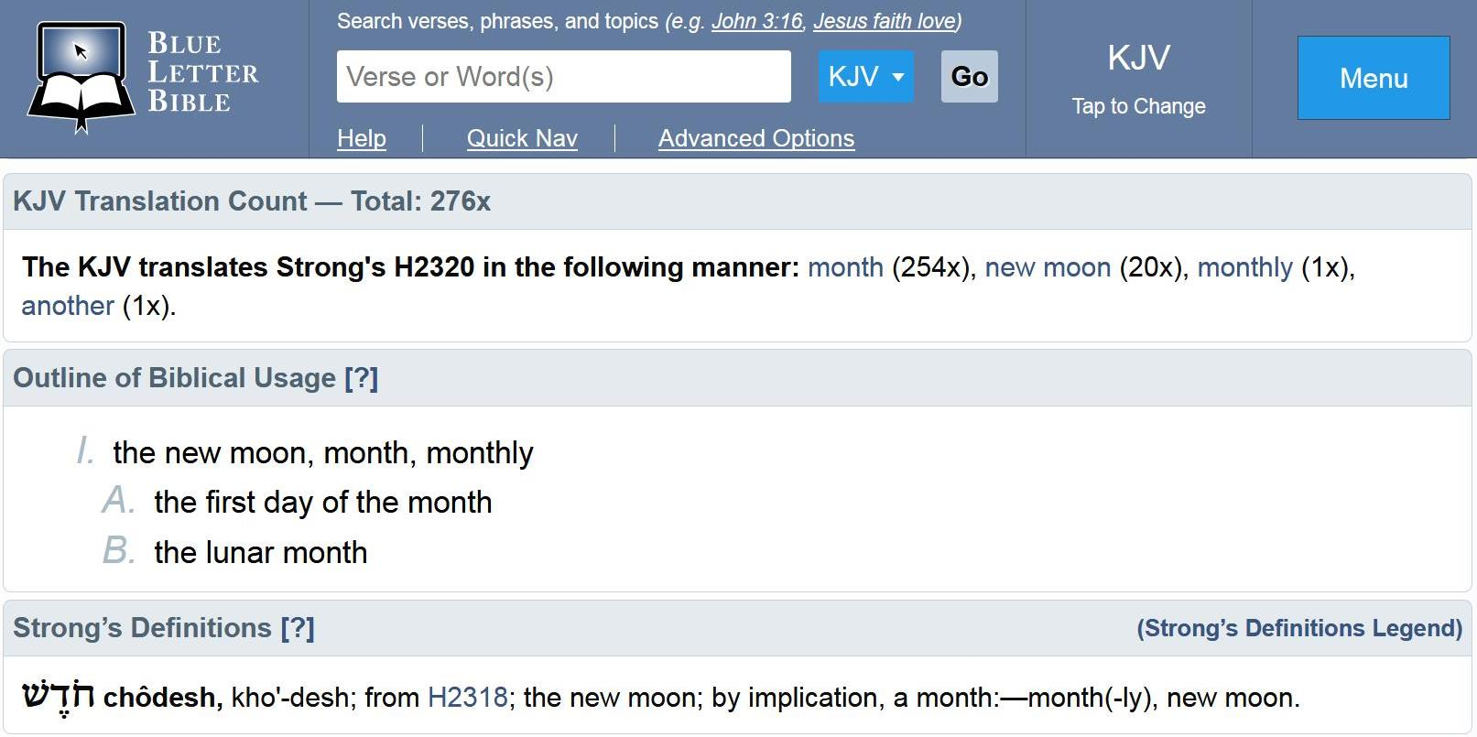
<Chodesh> in Blue Letter Bible
No italics is used to indicate what
words may have been added.

Slide 21
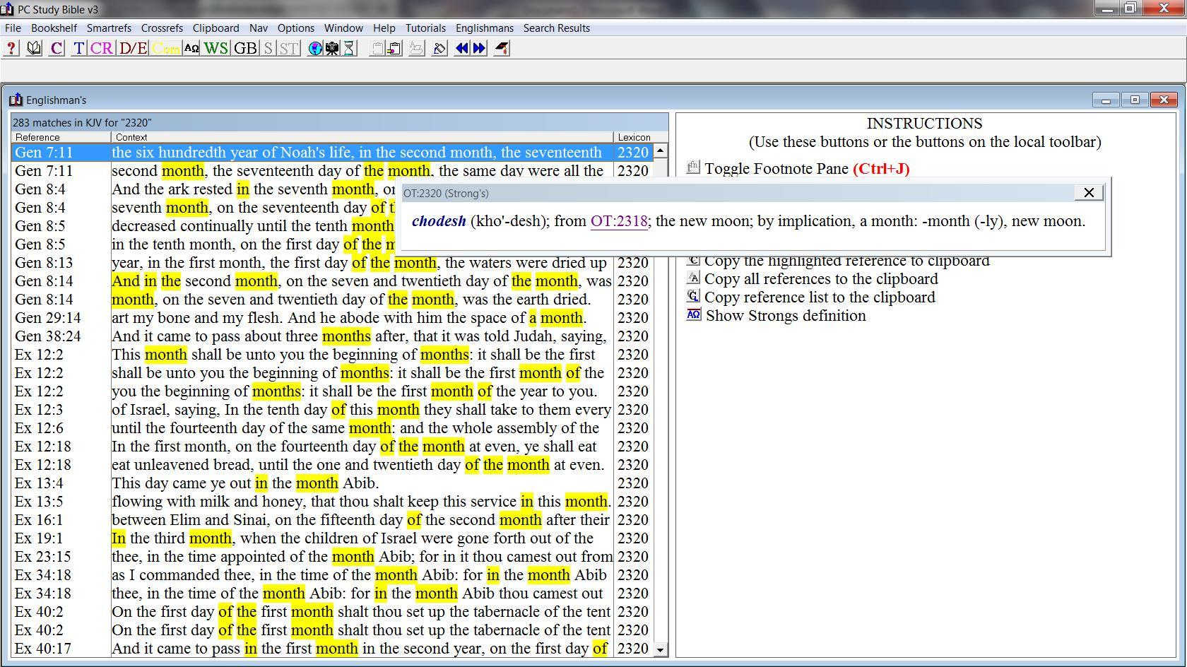
<Chodesh> in PC Study Bible
No italics is used to indicate what
words may have been added.

Slide 22
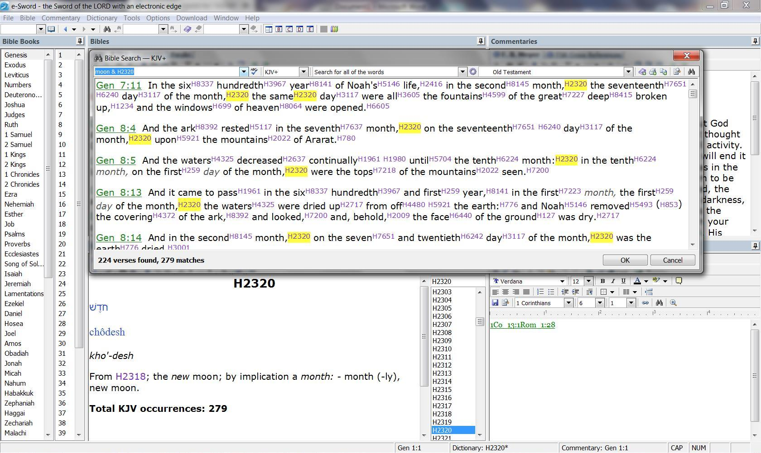
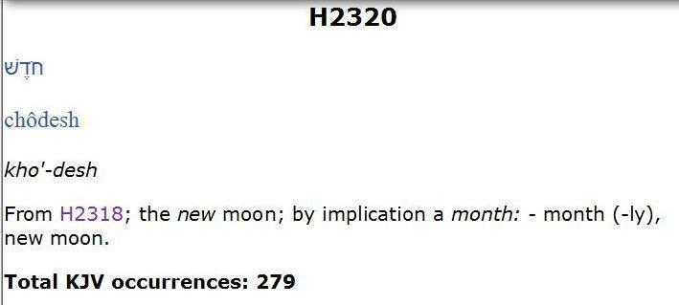
<Chodesh> in E-Sword
This study tool shows exactly the
same as what is printed in Strong’s
original book.
However, further study is still
very necessary.
Let’s compare
E-Sword to
Strong’s book.

Slide 23
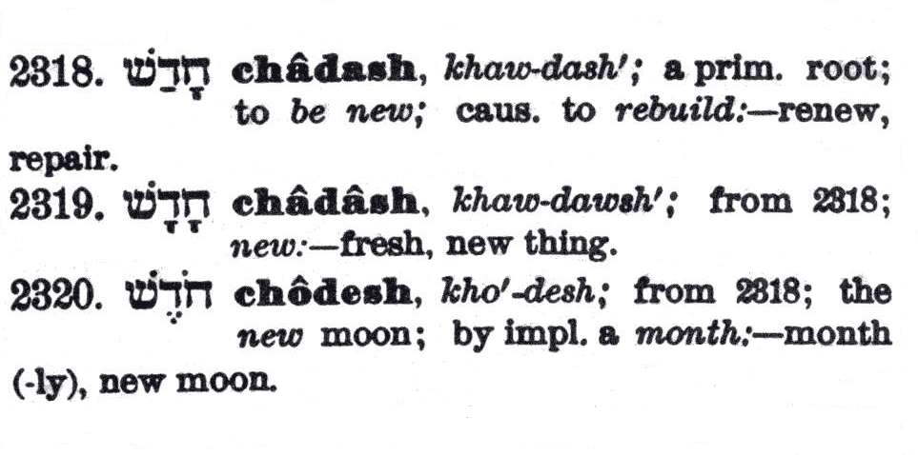
H2320 <Chodesh> Strong’s Book
Remember the note from Mr. Strong:
For H2320, E-Sword &
Strong’s are identical.

Slide 24
H2320 <Chodesh> in the Book of Strong’s
We have also learned that just because italicized words are removed from the definitions does not
necessarily mean “what is left” provides a
correct interpretation and definition.
The definition must align with Moses and Torah.
Moses never uses H2320 <chodesh> in Torah to define
any new moon as commencing the new festal month.

Slide 25
What are the Hebrew Numbers for “New”?
In the Old Testament, there are 89 matches for “new” (PC Study Bible).
36 of these matches are linked to:
  H1278: feminine of create
  H2961: to be moist
  H2323: new timber
  H8492: expulsion of new wine
  H1069: new fruit to burst forth
  H6071: trodden juice
The other 53 matches are linked to H2319 to define a: “new” king, offering, house, wife, gods, wine, cords, ropes, sword, garment, court, song, instrument, new name, gate, spirit, new heavens and new earth.
“new” H2319 chadash (khaw-dawsh'); from H2318; new:
KJV - fresh, new thing.

Slide 26
Are there any Hebrew Numbers for “New Moon”?
“new” H2319 chadash (khaw-dawsh'); from H2318; new: KJV - fresh, new thing.
“moon” [noun] H3394 yareach (yaw-ray'-akh); from the same as H3391;
the moon: KJV - moon.
“moon” [verb] H3391 yerach (yeh'-rakh); from a unused root of uncertain signification; a lunation, i.e. month: KJV - month, moon.
If the “new moon” is in charge of the “new festal month” then we should find the appropriate Hebrew word numbers linked together in at least 2-3 Scripture references to designate the “new moon” as part of this worship statute.
New | Moon | # vs.
H2319 | H3394 | none
H2319 | H3391 | two
There are only 2 verses to investigate.

Slide 27
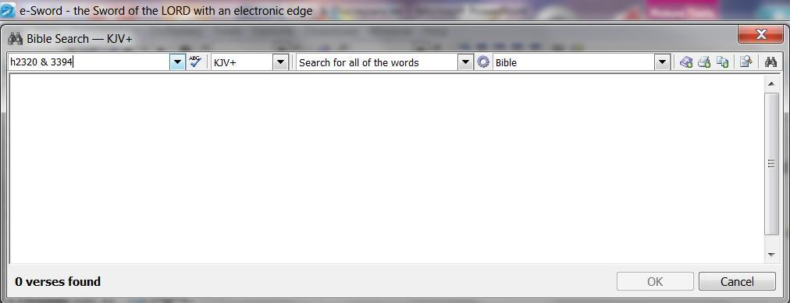
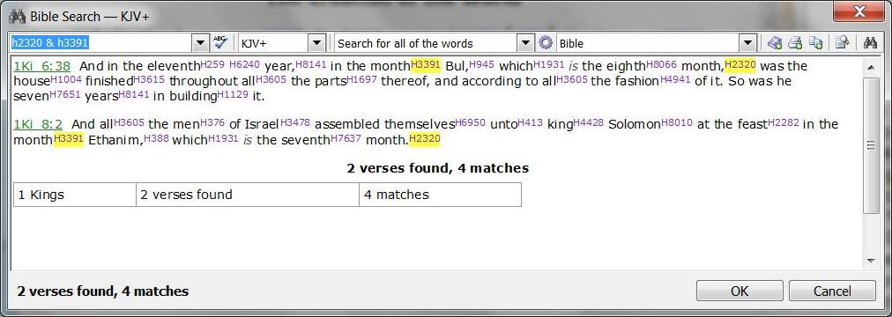
No Hebrew for “New Moon”!
No verses link H2320 chodesh & H3394 yareach together in the context of ”new month.”
New | Moon | # vs.
H2319 | H3394 | none
H2319 | H3391 | two
Neither one of these 2 verses in 1st Kings has any context for new moons beginning festal months – especially with an H2282 <chag> feast in the 7th month.

Slide 28
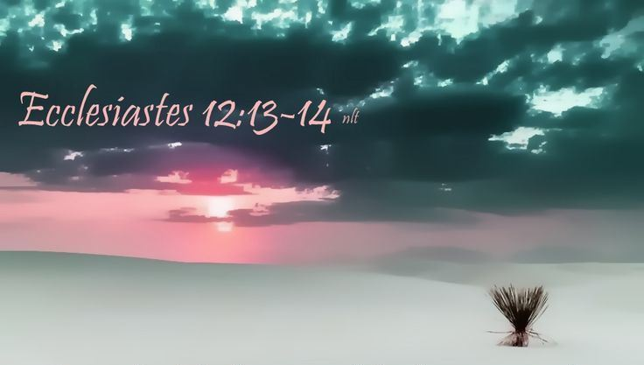
Conclusion of the Matter
Study tools can assist us tremendously,
but we must be sure to choose correct
definitions according to content & context.
AND, the conclusion must align with Moses and Torah.

Slide 29

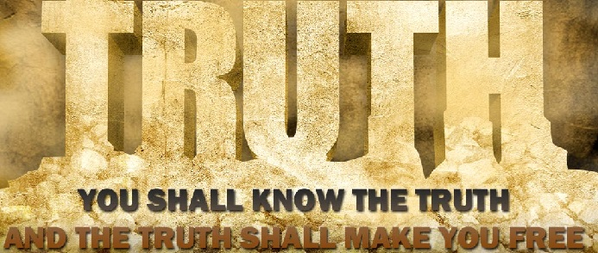

Everyone Wants to KNOW the
The Moon! Oh, the Moon!
Part 7: “Tampering with Yahuah’s Calendar Keys and Definitions!”
Our Question: Oh <chodesh> H2320!
Who tampered with your definition to read “moon” instead of “month”?

Slide 30


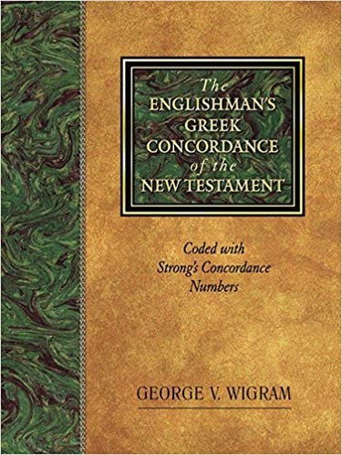
What have
we learned
so far about
H2320/2318?
H2320 <chodesh>
(the noun) and
H2318 <chadash>
(the verb) have
nothing to do with
“new moon months” according to the
Laws of Moses.

Slide 31

hey, mr. graduate, last time we finished the teaching on all 20 verses that have bundles of moons, feasts & Sabbaths in non-Torah books.
yes, I understand from many that now they know these verses do not support a “moon month” according to the Laws of Moses.
so, somebody
really has removed
very important
calendar keys!
today we are going
to find out who some
of those people were!
let’s start with a review.

Slide 32
Moon Hebrew Word #s & Grammar
Hebrew #
Part of speech
R
E
V
I
E
W
1. H3394 = 26 listings <yareach>
2. H3391 = 2 listings <yerach>
3. H3842 = 3 listings <lebanah>
4. H7720 = 1 listing <saharon>
5. H2320 = 20 listings <chodesh>
Total of 52 references.
Noun – literal moon
verb – lunation cycle
Adjective – color
Simile – comparison
NOUN/Verb – repetition
Question: are there really 2 verbs
& 2 Nouns for ONE “moon”?

Slide 33
Comparing the Listings
# Strong’s
# Englishman’s
R
E
V
I
E
W
1. H3394 = 26 listings <yareach>
2. H3391 = 2 listings <yerach>
3. H3842 = 3 listings <lebanah>
4. H7720 = 1 listing <saharon>
5. H2320 = 20 listings <chodesh>
Total of 52 references.
Noun – 26 exact matches
Verb – 13 matches
Adj. – 3 exact matches
Simile – 3 matches
Noun ~ 283 /279 /276
?
Question: Why are there
263 extra listings for H2320

Slide 34

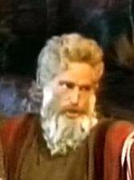
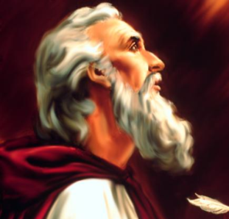
Moses to Nehemiah
721 Assyria
606 Babylon
701 Sundial
1450
1350
1250
1150
1050
950
850
750
650
550
450
The last teaching
examined the
20 “new moon”
non-Torah verses.
King Saul 1062
King David 1030
Elisha 895
Amos 787
Ezekiel 574
R
E
V
I
E
W
Hosea 785
Nehemiah 445
King Solomon 1015
Zerubbabel 536
King Solomon 1004
Isaiah 760
Hezekiah 726
Isaiah 698
This Chart: General Historical Review of ~ 1000 Years

Slide 35

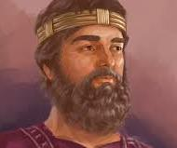

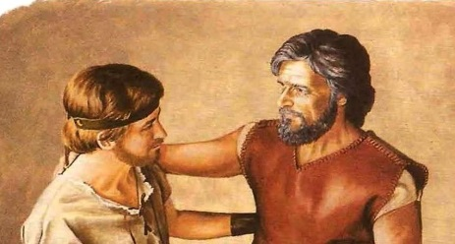
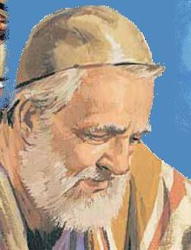
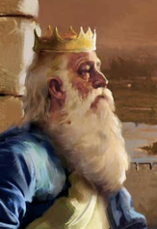
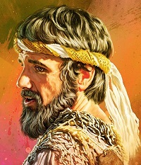
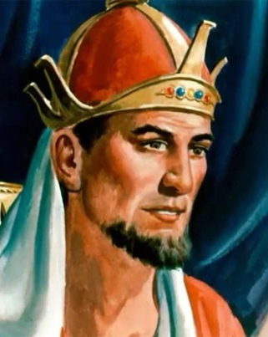
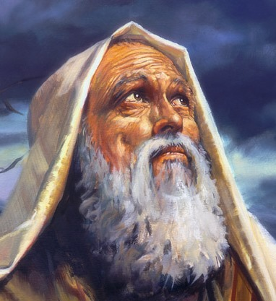
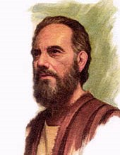
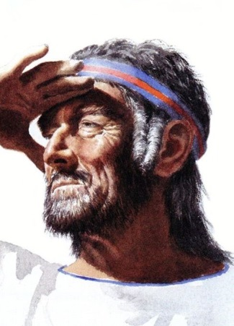
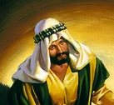
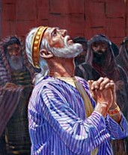
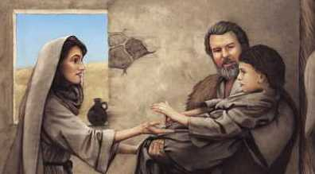
For 1000 years, not one of
these great men of Yahuah
made one single mistake.
Nehemiah
King Saul Jonathan/David
ALL of them followed Yahuah’s Laws as given to Moses because there are no “new moon” worship statutes in Torah!
Every leader beckoned the people to forsake pagan ways.
Ezra
King David
Zerubbabel
King
Solomon
Ezekiel
King
Hezekiah
Amos
Hosea
Isaiah
Elisha
Notes:
New slide … June 30/17 … new slide …
805

Slide 36
Part 6 answered this Question:
Are there really 2 verbs & 2 nouns for ONE “moon”?
36
Hebrew #
Part of speech
R
E
V
I
E
W
1. H3394 = 26 listings <yareach>
2. H3391 = 2 listings <yerach>
3. H3842 = 3 listings <lebanah>
4. H7720 = 1 listing <saharon>
5. H2320 = 20 listings <chodesh>
Total of 52 references.
Noun – literal moon
verb – lunation cycle
Adjective – color
Simile – comparison
noun/Verb – repetition
Answer: No!
Neither H2320 chodesh /2318 chadash align with any moon month!

Slide 37

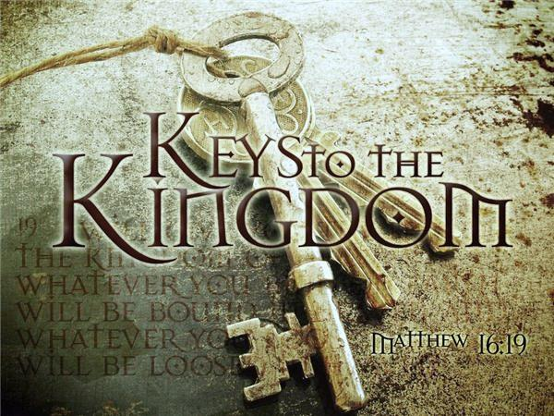
Question: Who really took away
the Keys to Yahuah’s Covenant Calendar?
Luke 8:17-18
For nothing is secret that will not be revealed, nor anything hidden that will not be known and come to light … For whoever has, to him more will be given …
So far we have investigated the Hebrew Lexicon writers and their
part in tampering.
Matt 23:13 & Luke 12:56

Slide 38



A thorough investigation
must continue.
Who else may be responsible for taking away the Keys to Yahuah’s Covenant Calendar?
It wasn’t only the Hebrew Lexicon writers!
Today we will investigate
the 1611 Translators!

Slide 39
The next question will be
“what happened”?
How did the “new moon”
words find their way into
20 non-Torah Scriptures
through H2320 <chodesh>?

Slide 40
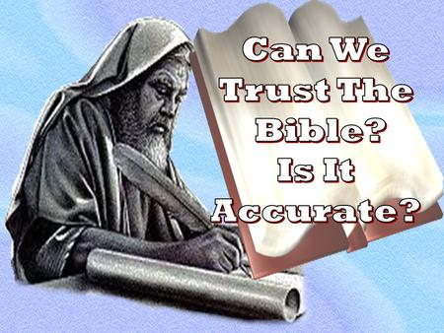
Remembering the 1611 KJV Translators
The 1611 KJV was completed less than 100 years after Luther.
The translators did their best.
It’s likely they were highly influenced by traditional teachings during their time.
Was the new moon month one
of those traditional teachings?
Isa 28:10
For precept must be upon precept, precept upon precept;
line upon line, line upon line; here a little, and there a little.
Notes:
June 22nd

Slide 41

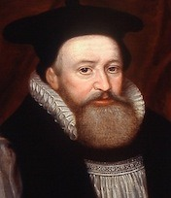
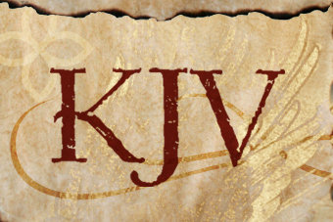
There are some things that could have happened with the 1611 KJV translation to cause such a problem in only 7% of the Scriptures to establish the
“new moon” over the “new <chodesh> month”!
Two possibilities
must be considered.
The translators ignorantly made a mistake by following
the Jewish traditions of their “new moon.”
The translators deliberately erred causing allegiance
and sacred regard to be given to the moon month in place of
Yahuah’s festal month start.

Slide 42
Mapping the Topics for H2320 <chodesh>
R
E
V
I
E
W
H2320 <chodesh> must come into alignment with Moses & Torah as Yahuah’s “new [chodesh] month” not Yahuah’s “new moon” or man’s agenda.
1. H2320 Definition
Examination of Theologians of Hebrew Lexicon Study Tools: Strong’s; Brown-Driver-Briggs; Gesenius; Theological Wordbook of the Old Testament (TWOT).
2. Lexicon Challenges
From 1450 BC [2550 years after creation]: The Torah Calendar Instructions were for all Kings, Prophets and Leaders, up to and including Yahuah’s people today.
R
E
V
I
E
W
3. Counsel from Moses
All 20 “new moon” verses are NON-Torah references mis-translating <chodesh> as “moon” instead of “month.” Not one aligned with Torah instructions!
4. New Moon Verses

Slide 43
Mapping the Topics for H2320 <chodesh>
NEW
L
ESSON
1611 KJV Translators and their treatment
of H2320 <chodesh> in Isaiah 47:13.
Did they make a mistake or not?
5. 1611 KJV Translators
Examination of 10 different translations (of many) that clearly give the true context for
Isaiah 47:13.
6. Bible Translations
Examination of 3 Bible Commentators for their insight into the proper meaning and history of
Isaiah 47:13.
7. Bible Commentators
In Part #8 for the next Moon Study, the Old Testament history of Yahuah’s people will be thoroughly examined.
8-11. Ancient History

Slide 44
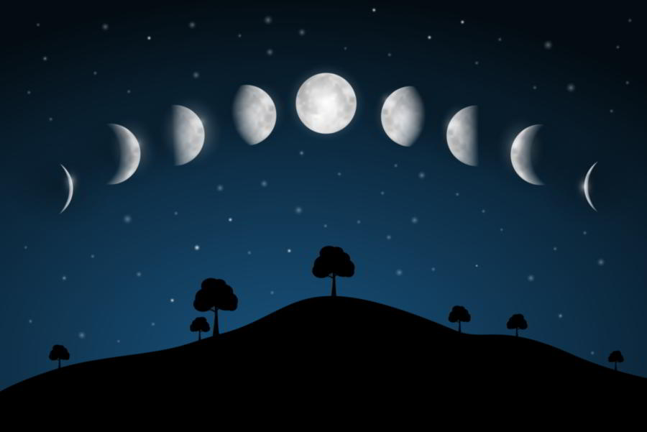
Does it seems strange that …
Only 7% of the KEY verses
for worship statutes would be
incorrectly translated as “moon(s)”
when the proper translated term for H2320 <chodesh> can only be “month(s)”?
Notes:
June 22nd

Slide 45

The prophet Isaiah in Chapter 47:13 talks about the “monthly prognosticators.”
This is a verse using “qualifiers.”
The context of the verse “qualifies”
the meaning of monthly prognosticators.
Let’s examine that term!
Notes:
June 22nd

Slide 46
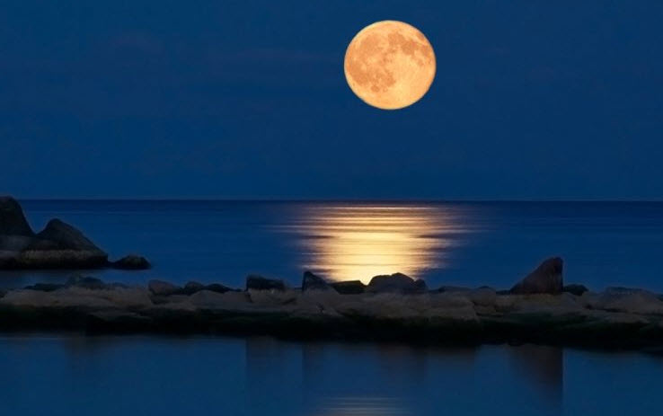
Isaiah 47:13 KJV [~712 BC]
Thou [Babylon] art wearied in the multitude of thy counsels.
Let now the astrologers, the stargazers, the
monthly [H2320] prognosticators [H3045],
stand up, and save thee
from these things that shall come upon thee.
Monthly here [as H2320] is translated correctly!

Slide 47

Isaiah 47:13 KJV
The meaning of
monthly [H2320]
prognosticators [H3045]:
Those that ascertain
by “seeing.”
Or:
Every month the
astrologers are gazing
at the heavenly bodies.
Is the KJV the best translation?
Notes:
June 22nd

Slide 48

Other Translations of Isaiah 47:13
#1 English Standard Version
You [Babylon] are wearied with your many counsels; let them stand
forth and save you, those who divide the heavens, who gaze at the stars,
who at the NEW MOONS make known what shall come upon you.
#2 New American Standard
… Those who prophesy by the stars,
Those who predict by the NEW MOONS …
#3 International Standard Version
… those who conjure the heavens and gaze at the stars,
predicting at the NEW MOONS …

Slide 49

Other Translations of Isaiah 47:13 (con’t)
#4 Jubilee Bible 2000
… Let now those that contemplate the heavens,
those that speculate regarding the stars,
those that teach the courses of the MOON ...
#5 Darby Bible Translation
… Let now the interpreters of the heavens,
the observers of the stars,
who predict according to the NEW MOONS …
Notes:
June 22nd

Slide 50

Other Translations of Isaiah 47:13 (con’t)
#6 New World Translation
… the lookers at the stars, those giving out knowledge
at the NEW MOONS …
#7 Revised Standard Version
… who gaze at the stars, who at the NEW MOONS predict what shall befall you.
#8 Common English Bible
… let the astrologers stand up and save you, those who gaze at the stars, and predict what will happen to you at each NEW MOON.
Notes:
June 22nd

Slide 51

Other Translations of Isaiah 47:13
#9 Lexham English Bible
You struggle with your many consultations; let them stand, now, and save you - those who see the stars, divide the celestial sphere, who inform by NEW MOONS - from those things that are coming upon you.
#10 New Century Version
… those who tell the future by looking at the stars and the NEW MOONS.
Notes:
June 22nd

Slide 52
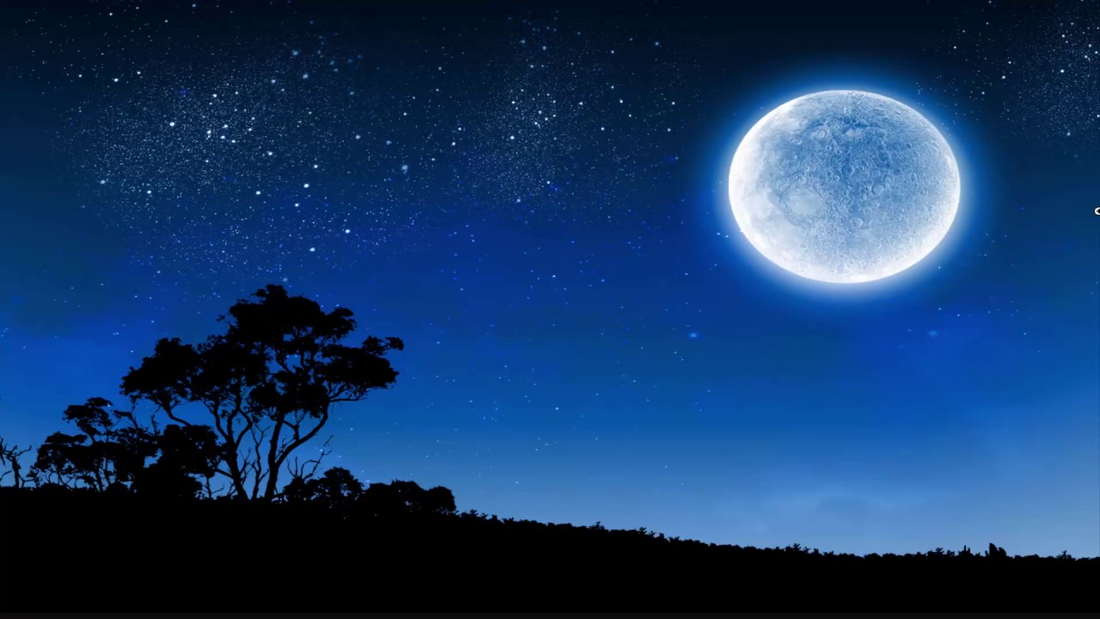
Isaiah 47:13 KJV
We’ll examine:
Barnes’ Notes
Jamieson, Fausset & Brown
Keil & Delitzsch
Let’s check out what other Bible Commentators have
to say about these monthly prognosticators!
Notes:
June 22nd

Slide 53
Isaiah 47:13 ~ Barnes’ Notes
The thing referred to in the passage before us, and which was practiced in Babylon, was, probably, that of forecasting future events, or telling what would occur by the observation of the positions of the heavenly bodies.
[The star-gazers] Those who endeavor to tell what will occur by the contemplation of the relative positions of the stars.
[The monthly prognosticators] 'That give knowledge concerning the months.' That is, at the commencement of the months they give knowledge of what events might be expected to occur during the month; perhaps from the dip of the moon, or its riding high or low, etc. … This whole passage would have been more literally and better translated by preserving the order of the Hebrew.
'Let them stand up now and save thee, who are astrologers; who gaze upon the stars, and who make known at the new moons what things will come upon thee.'
Notes:
June 22nd

Slide 54
Isaiah 47:13 ~ Jamieson, Fausset & Brown
Let ... the monthly prognosticators ... save thee from (these things) that shall come upon thee - those who at each new moon profess to tell thereby what is about to happen.
Maurer joins, not as the English version, 'Let them that give knowledge concerning the months (margin) save thee from those things that shall come upon thee; but, 'They that at new moons make known part of the things that shall come upon thee, let them (also) save thee (from them).' If they can foretell calamities, they ought also to be able to save from them; because both are the work of God.
Notes:
June 22nd

Slide 55
Isaiah 47:13 ~ Keil & Delitzsch
… to look with pleasure or with interest at anything; hence Luther has rendered it correctly, die Sternkucker
(Eng. ver. star-gazers).
They [Babylon’s star-gazers] are described still further as those who make known with every new moon, … things which, … is used in a partitive sense: out of the great mass of events they select the most important, and prepare a calendar or almanac … for the state every month.
Notes:
June 22nd

Slide 56

Summary for
Isa 47:13
1. There are many other Bible translations that translate Isa 47:13 according to the ways of Babylon – that of star-gazers and those that watch for every new moon –
a monthly event.
Notes:
June 22nd

Slide 57
Summary for
Isa 47:13
2. There are several other Bible Commentaries that also interpret Isaiah 47:13 according to what was really happening in Babylon.
Notes:
June 22nd

Slide 58
Summary for
Isa 47:13
3. Because the translators for the KJV used the term “monthly prognosticators,” rather than
“those who predict by the new moons,” did they actually remove important context from this verse?
Notes:
June 22nd

Slide 59
hey, mr. graduate, that is a good question. why didn’t the translators use the word “moon” for H2320 <chodesh> this time like all the
other times?
well, around 712 BC Yahuah’s festal month and the lunar month still were both 30 days in length.
remember, the
action definition
for the H2320 chodesh
month is still a
rebuilding, renewing
& repetitive occurrence.
these words also describe
different moon phases
observed by pagan Babylon
for horoscope purposes.
The context was not altered.

Slide 60
mr. graduate, could I ask you something else? I hear there are some secular historical quotes that verify some of these traditional discrepancies!
yes, there are more and more historical quotes coming to the forefront all the time. we should examine a few of these.
the changes of
Yahuah’s
day-start and
month-start are
closely linked
together. as time moves
forward, i believe we will
see more & more of these quotes.

Slide 61
Quote #1 linking to Isaiah 47:13
Morris N. Kertzer, What is a Jew, p. 108
“When the Jews returned to Palestine
after their Babylonian exile (516 BCE) they brought back with them the Babylonian astronomy and way of reckoning time …”
Notes:
June 22nd

Slide 62
Quote #2 linking to Isaiah 47:13
New Catholic Encyclopedia – Vol. 11, p. 1068
“… especially after the Babylonian exile a number of significant and enduring changes occurred in the Israelite calendar showing that the Jews gradually adopted the Babylonian calendar of the time … the seven day week persisted despite its failure to divide evenly either the month or the year. The day however, was counted from evening to evening, after the Babylonian fashion …”
Notes:
June 22nd

Slide 63
mr graduate, if the Jews adopted the sunset day from Babylon, do you think they also adopted Babylon’s month start according to the moon?
it certainly sounds logical doesn’t it? we should consider another quote on this.
in this next quote,
watch to see which
type of calendar
gave rise to the
new viewpoint of the
sunset day, which no
doubt affected the
crescent moon month start.

Slide 64
Quote #3 linking to Isaiah 47:13
Encyclopedic Dictionary of the Bible, p. 497
[besides the conception] “… the twenty-four hour day begins at sunrise … there arose another idea of the twenty-four hour day, according to which this daily period began at sunset. It was no doubt the lunar calendar of the Jews which gave rise to this viewpoint …”
Notes:
June 22nd

Slide 65
Summary for
Isa 47:13
4. Remember, this ONE verse wasn’t tampered with at all even though in this case H2320 could have been incorrectly translated
as “new moon” (as the other 20 verses were) …
and …
Notes:
June 22nd

Slide 66
Conclusion for
Isa 47:13
A mis-translation using “moon” would still have been in alignment with the context and the truth of the pagan cultures and their worship practices!
Yet, this verse was left untouched!
Why?
Notes:
June 22nd

Slide 67

Why? That’s the Point!
There are 20 key “feast and festival” verses in the
Old Testament that have been manipulated and tampered with
to lead one to believe the
Feast Months really do begin
with the “new moon.”
We must recognize this glaring counterfeit.
Non-Torah Verses must be in alignment with Torah Truths.
67
Notes:
June 22nd

Slide 68

Alignment of Psalm 81:3 & Numbers 10:10
Scripture Facts
Comparison
[1450 BC] Num 10:10 … in your solemn [feast] days, and in the beginnings of your months [H2320], ye shall blow with the trumpets …
[1030 BC] Ps 81:3 Blow up the trumpet in the new moon month [H2320], in the time appointed, on our solemn feast day.
The Book of Numbers dates at least
420 years before Psalms.
Numbers is Torah; Psalms is not.
King David taught according to Torah.
Psalm 81:3 must come into alignment with Numbers 10:10.
The mis-translation of H2320 chodesh
in Psalm 81 [KJV] (seen as “new moon”) should be translated as “new month.”
R
E
V
I
E
W
Remember this question: Has there been a deliberate attempt by the 1611 translators to save the new moon?
Notes:
June 22nd

Slide 69
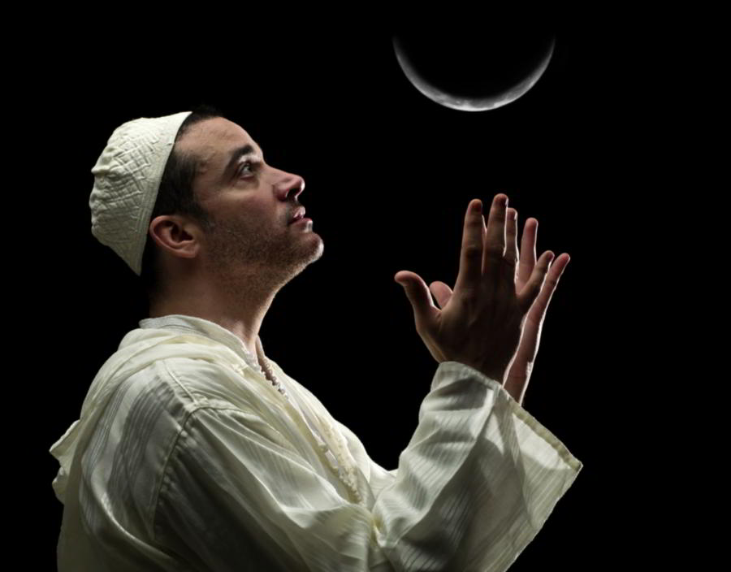
Comment:
Because the exiled Jews were indoctrinated with the Babylonian calendar beginning the day with sunset and the month with the crescent moon,
one can see how these two concepts go together.
Once the sun sets - the new day begins;
Once the crescent moon is sighted, the new month begins the next day!
Despite what Yahuah’s Covenant Calendar teaches, this new pagan calendar was eventually declared as a Torah truth.

Slide 70
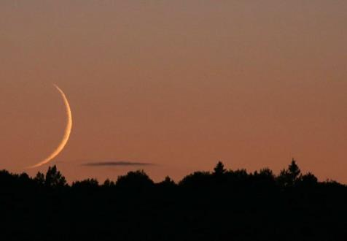
There are NO New Moons for Yahuah’s Festal Months!
This error has been accepted as a
“Torah truth” likely because most people examined only these 20 verses.
The majority of these verses are
set in the context of Sabbaths,
new moons, along with Feasts and Festivals.
Problem: they are ALL non-Torah verses!
As mentioned before 20 verses represent only 7% of the 283
[PC Study Bible] references that must be searched out.
(Note: H2320 references may differ with study tools.
E-Sword = 279; Blue Letter Bible = 276.)
Notes:
232cf … July 2/17

Slide 71
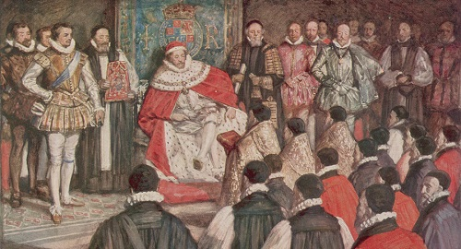
These things are certain:
The 1611 Translators absolutely mis-translated the 20 non-Torah verses using “new moons” instead of “new months.”
Isa 47:13 is the “red flag”
verse showing the Translators
could have mis-translated this verse without altering the context. However, in this case they left H2320 as “monthly” rather than specifying the moon context.

Slide 72

Audience Participation
What are your thoughts on why the Translators of 1611 would succumb to such a final decision?

Slide 73

There are 2 things that can be considered:
  A prevalent Papal Roman influence, less than 100 years from Luther;
  1500+ years of Jewish Traditional influence
  with roots in Babylon.
Question:
Were these mis-translations done deliberately to remove Covenant Calendar keys in non-Torah books?

Slide 74


Something else to consider:
Torah has 86 matches for H2320 all noted as “month.”
Not ONE Torah verse using H2320 <chodesh> was tampered with to read “moon” rather
than “month”!
Did Yahuah
hold His hand
over Torah to
preserve His
calendar keys?
Amazing!

Slide 75
Question:
If the translators would have translated H2320 as
“new month” instead of “new moon” for the 20 verses
under examination, would that have made a difference
for understanding the commencement of
Yahuah's festal month today?
There should be NO question about this!

Slide 76
now we know, right mr. graduate?!
yes, we now know a little
more of what happened for
Yahuah’s Covenant Calendar
Keys to be lost.
However:
the Lexicon writers
and 1611 translators
are not the only ones
that have tampered
with the
Covenant Calendar Keys!
There’s more to this story.

Slide 77
Read Genesis 49:21. Just a simple innocent verse! ???? No! Galilee is within the land inheritance of Naphtali. Galileeans kept Dawn! Yahusha’s 11 disciples were from Galilee. The people living in the land of Galilee spoke (lived) out Yahuah’s Word in truth! That is why the Galileeans were hated and despised by Judah! Yet Genesis 49:21 tells us where to find truth! My Bible says – “he gives words of eloquence” or in other words Naphtali speaks Yahuah’s Word! Whenever there is opposition to Yahuah’s will, it seems Judah is always involved.
We must search for the answer to our original question!
Israel?
Galilee?
Samaria?
Judah?
Others?
Who else may be responsible for taking away the Keys to Yahuah’s Covenant Calendar?

Slide 78
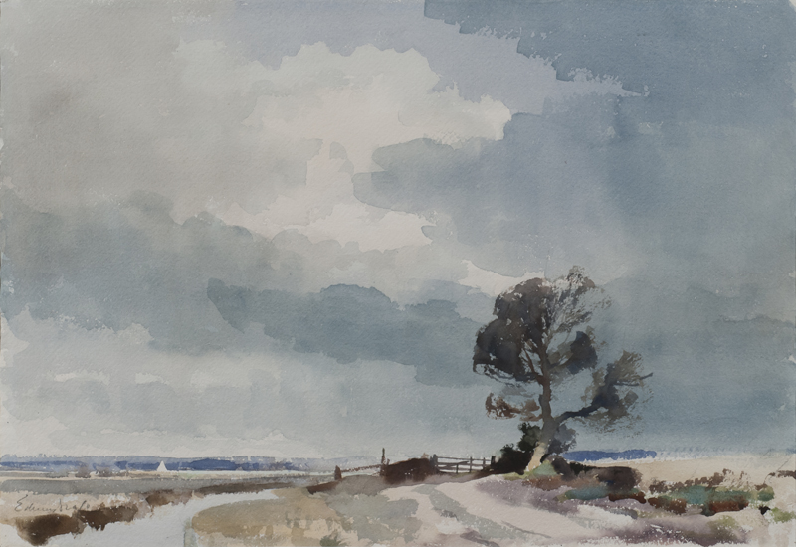
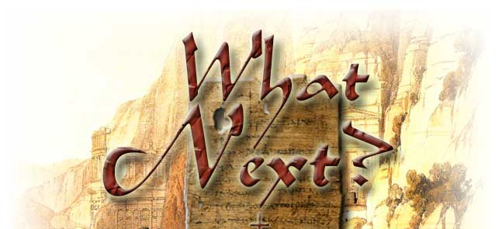


To find out who else is guilty and what
happened to Yahuah’s
Covenant Calendar
Keys …
Part 8:
The Moon! Oh, the Moon!
“My People Have Forsaken
Me for the Moonth?”
(on Nov 2/18)
The End
78

Slide 79



If you need assistance with this information, please send your questions to
Charlene Fortsch or
Timothy Astleford:
Info@t4study.com
charlene@torahtothetribes.com
or
Shofar1owr@gmail.com
www.t4study.com/resources

