Slide 1

Determining the 2018 Spring Equinox

Slide 2
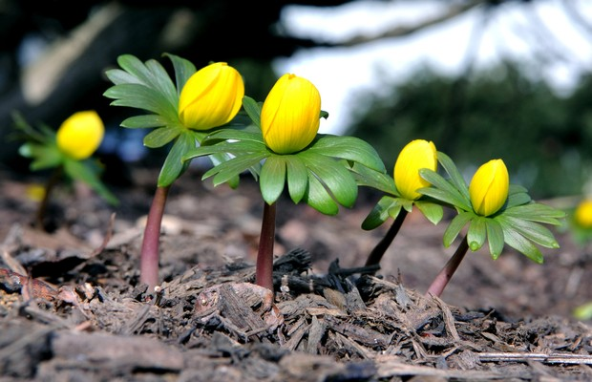

This study will
attempt to answer
a very important
question:
How do we determine the
spring equinox to then find
the 1st day of the year
on Covenant Calendar?

Slide 3
An equinox, sometimes called an even night, is commonly regarded as the moment when the plane (extended indefinitely in all directions) of
Earth's equator passes through the center of the Sun, which occurs twice each year: around
20 March and 22–23 September.
In other words, it is the point at which the center of the visible Sun is directly above the Equator.
The Equator of earth is an imaginary line/circle
that divides the earth into two halves.
Celestial pole: the point on the celestial sphere directly above either of the
earth's geographic poles, around which the stars and planets appear
to rotate during the course of the night.

Slide 4
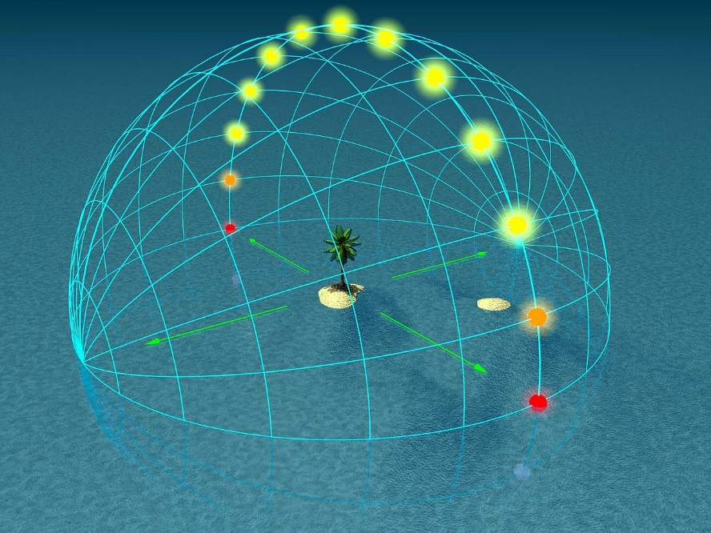
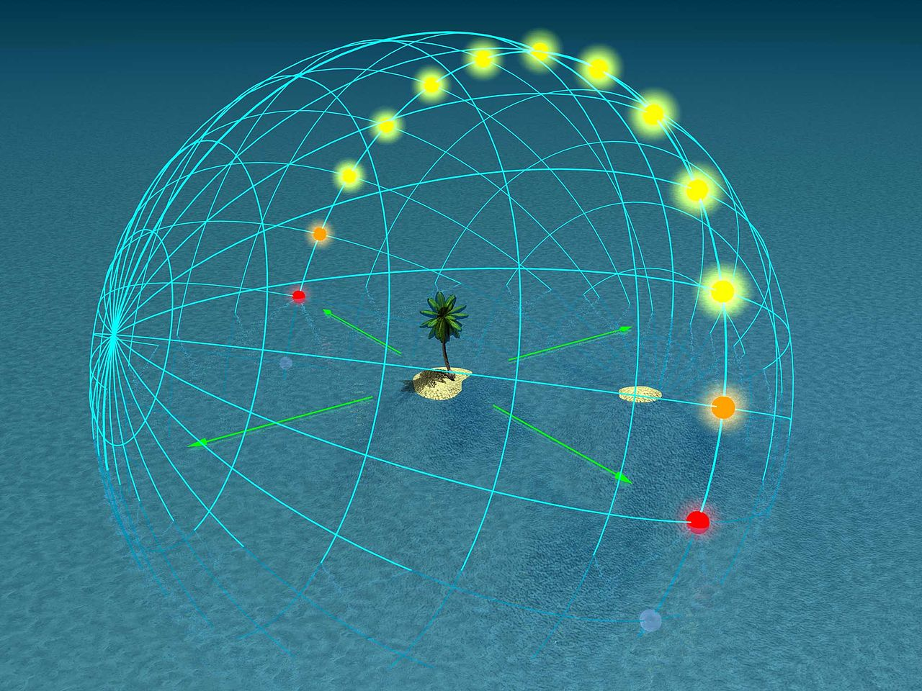
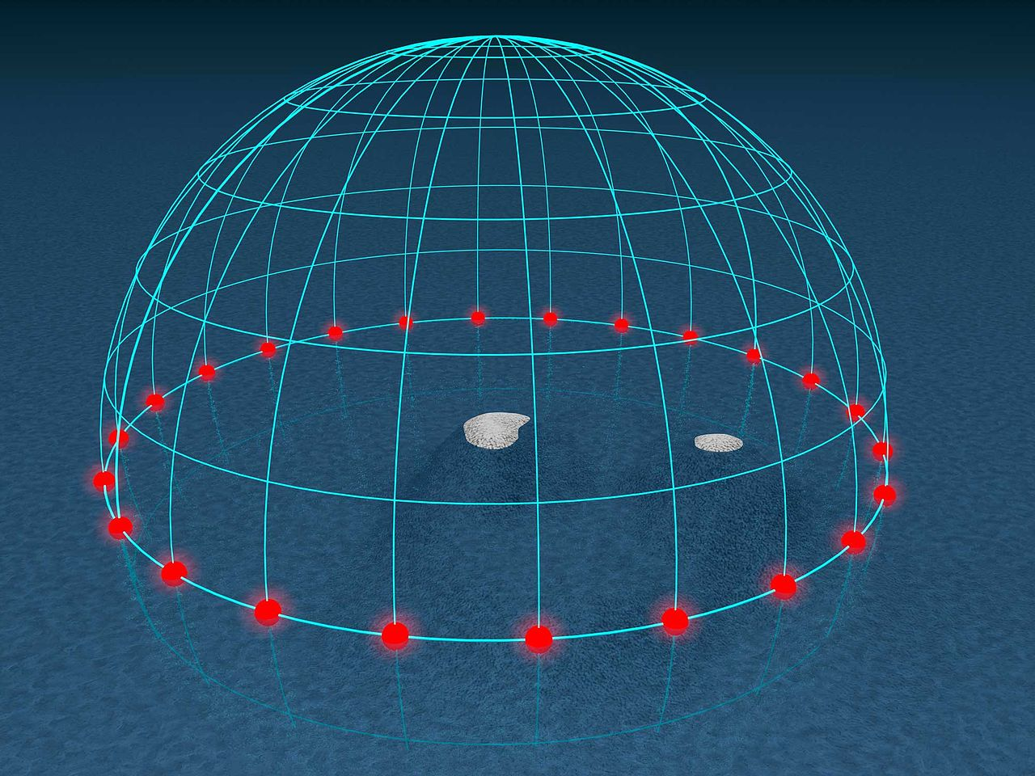
APPEREANCE OF EQUATOR AT VARIOUS PLACES
Day arc at 0° latitude (equator)
The arc passes through the zenith,
resulting in almost no shadows
at high noon.
Day arc at 20° latitude
The Sun culminates at 70° altitude and its path at sunrise and sunset occurs at a steep 70° angle to the horizon.
Day arc at 90° latitude (pole)
If it were not for atmospheric
refraction, the Sun would be
on the horizon all the time.

Slide 5
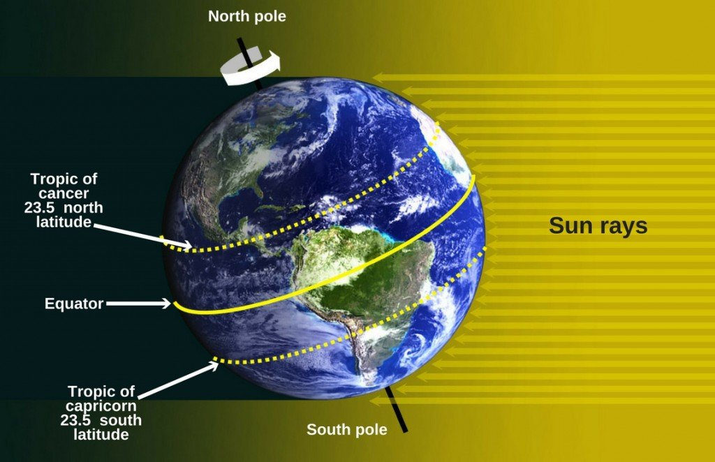
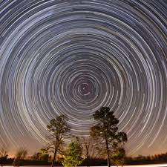
CELESTIAL POLE AND EQUATOR
North Celestial Pole
NORTH POLE STAR

Slide 6
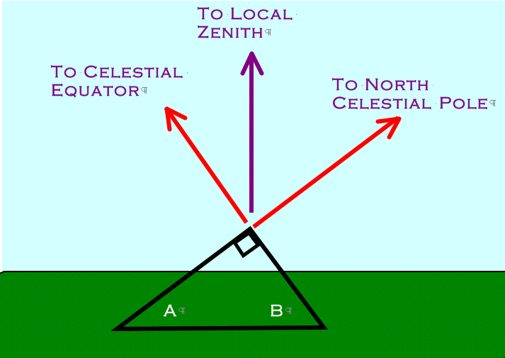
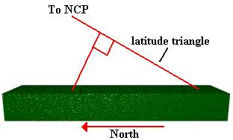
Many might wonder what’s with this celestial equator. Was it discovered in ancient times ??
People may or may not have figured out the celestial equator but one thing for sure is that celestial equator and north celestial pole are related .
In the night sky the North pole star would always be constant at particular place .
So people would look to this star and construct an imaginary line as in the below figure .
Using this north pole star, we can determine the equator.
The Equator and the north pole star are at an angle of 90 degrees .
This principle is involved in the construction of an equatorial sundial .
Equator

Slide 7
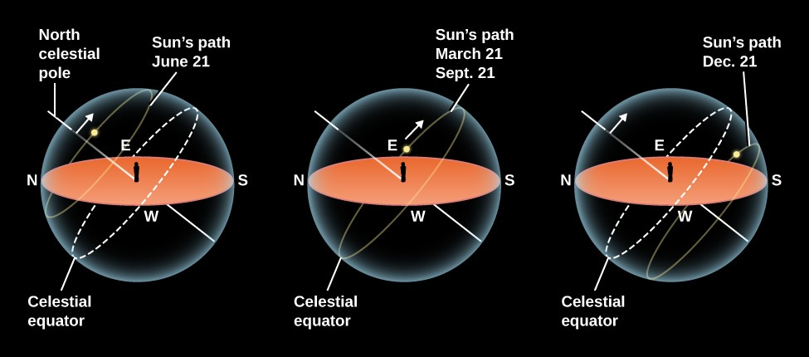
Now we know what an equator is. Coming back to the definition of equinox ,
it says it’s an event wherein the sun crosses the celestial equator .
The figure below illustrates how this event happens. On Sept 21 or March 21 we see the sun’s path matching with the Earth’s equator. The yellow circle is the sun’s path; the dotted line is equator.
We can see the sun’s path moving from left to right when we observe the three figures .

Slide 8
Location | Local Time | Time Zone | UTC Offset
Australian Eastern Time | Wed, 21 Mar 2018 | AET | (UTC +11)
Bangalore (India - Karnataka) | Tuesday, 20 March 2018, 21:45:00 | IST | UTC+5:30 hours
Jerusalem (Israel) | Tuesday, 20 March 2018, 18:15:00 | IST | UTC+2 hours
Corresponding UTC (GMT) | Tuesday, 20 March 2018, 16:15:00
Calgary (Canada - Alberta) | Tuesday, 20 March 2018, 10:15:00 | MDT | UTC-6 hours
The Tekufah time which NASA gave was the mean/average time from the beginning of Tekufah to the ending of Tekufah.

Slide 9
Now we are going to use the Stellarium software for the equinox study.
I have taken IST (Indian standard time) as an example to determine the Tekufah. As per NASA, the peak Tekufah time is Tuesday, 20 March 2018, 21:45:00 [9:45 PM].
For this time I have the day as found on the table below:
ROMAN RECKONING | TUESDAY
GOD’S DAY | 3rd cycle (Tuesday)

Slide 10
Going through the Stellarium software I was able to search for the
beginning of Tekufah time ,where the sun is just about
to cross the equator line – and the ending of Tekufah time where
the sun leaves the equator line.
The beginning of Tekufah time is Tuesday, 20 March 2018, 5:22:00 [5:22 AM].
ROMAN RECKONING | TUESDAY
GOD’S DAY | 2nd cycle (Monday)
At this time, [the mixing of light and darkness], Tekufah hasn’t happened yet.
The ending of Tekufah time is Wednesday, 21 March 2018, 13:52:00 [1:52 PM].
ROMAN RECKONING | WEDNESDAY
GOD’S DAY | 4th cycle (Wednesday)

Slide 11
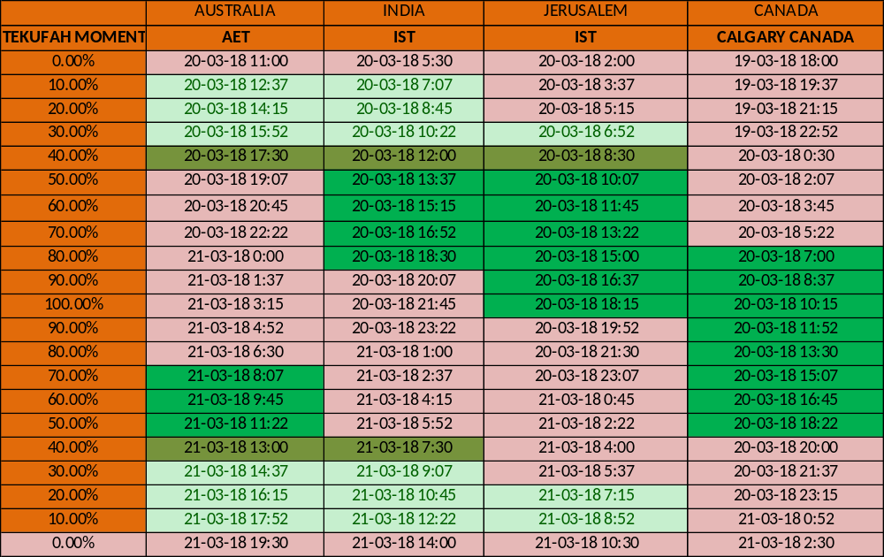
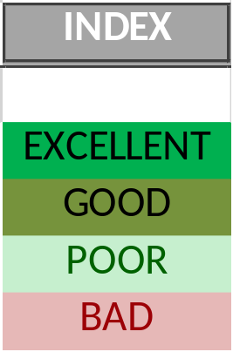
Based on the beginning and ending of the Tekufah event, I was able to calculate the time ranges for the entire event at various places.

Slide 12
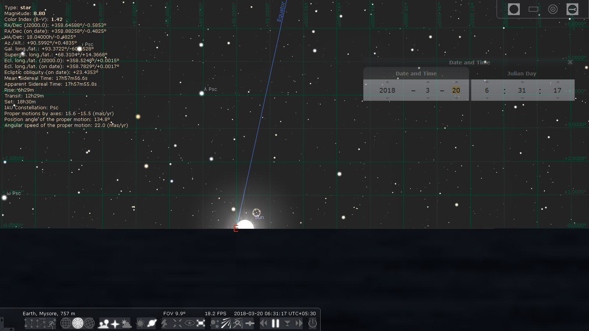
In this software, the Stellarium blue line indicates the equator of the earth.

Slide 13
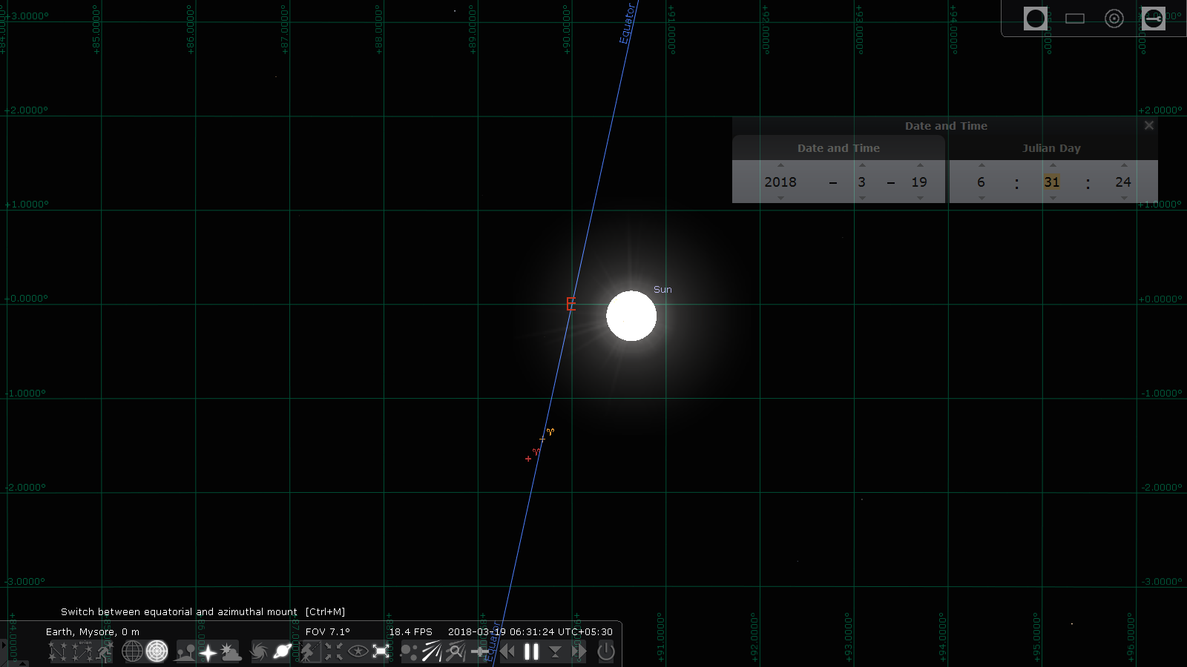
The BLUE line is the equator line and
the green line is the direction in which sun crosses the Equator.
Note: this is not to be confused with sun’s actual movement in the sky from east to west.
ON 19th Monday, the sun hasn’t touched the equator line and Tekufah hasn’t begun yet.
Altitude +
Horizon
Altitude -

Slide 14
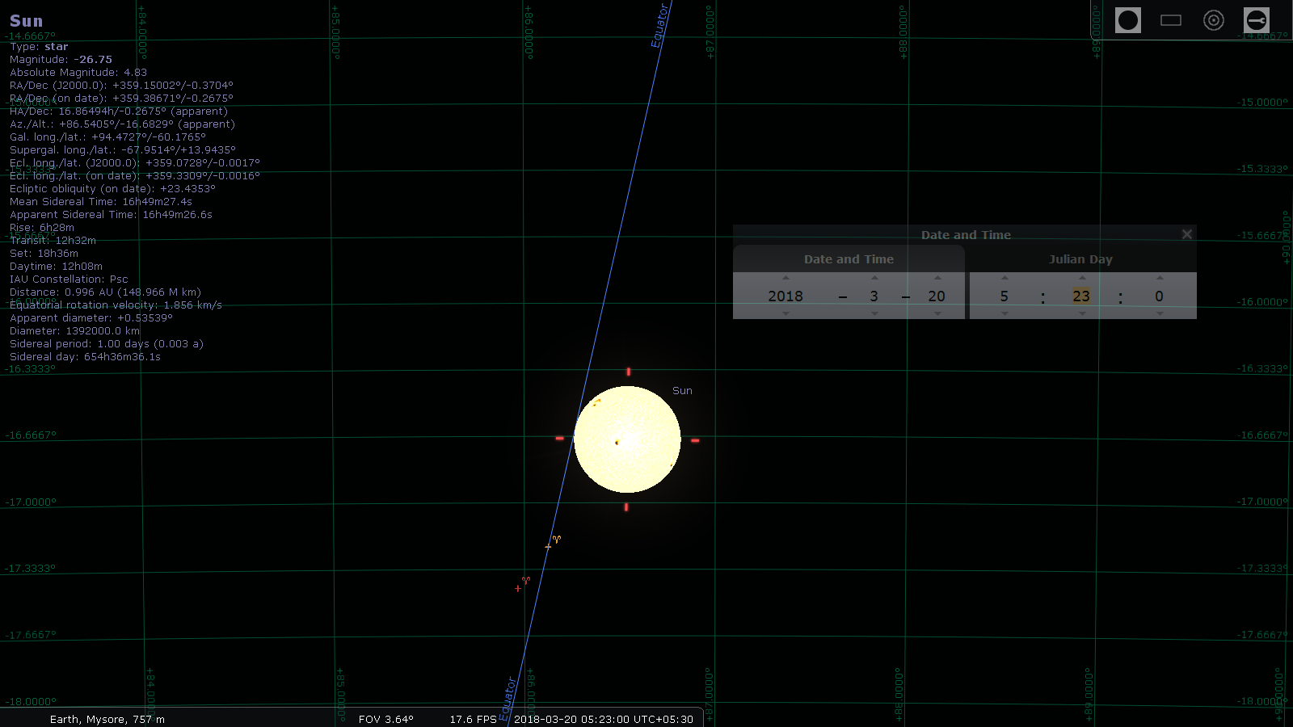
At the beginning of Tekufah, Tuesday, 20 March 2018, 5:22:00 [5:22 AM], the sun is just about to touch/cross the equator line.
ROMAN RECKONING | TUESDAY
GOD’S DAY | 2nd cycle (Monday)
Altitude - ve

Slide 15
On Tuesday, 20 March 2018, 6:31:00 [6:31 AM], we have the chance to watch for the shadow arc. It will be only 5% as it has just begun.
ROMAN RECKONING | TUESDAY
GOD’S DAY | 3rd cycle (Tuesday)
At this time the
“mixing
of light
and darkness”
has happened.
Altitude +
Horizon

Slide 16
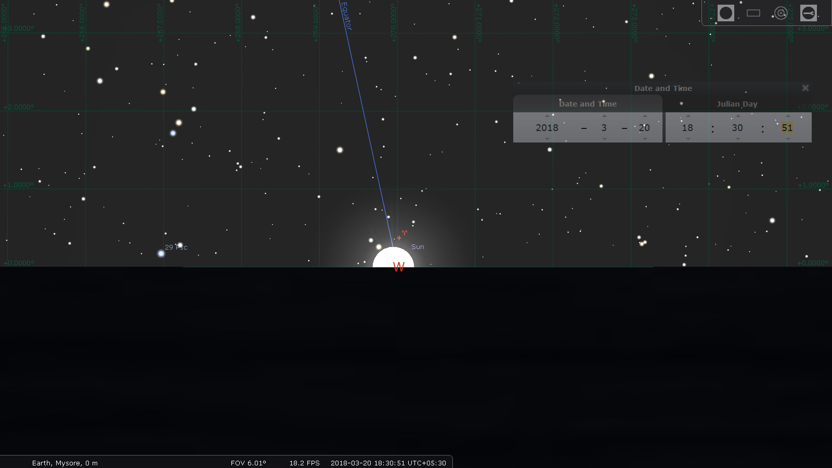
Tuesday, 20 March 2018, 18:30:51 [6:30 PM], we have another chance to watch for the shadow arc. It is getting more accurate.
At this moment the Tekufah observed will be 80%.
Altitude +
Horizon

Slide 17
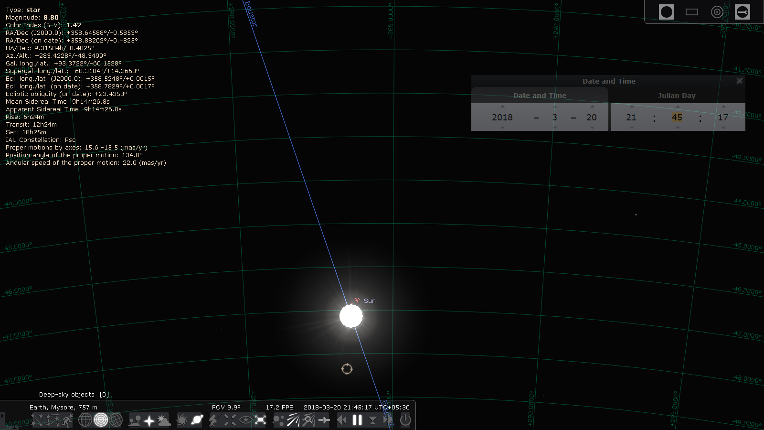
Tuesday, 20 March 2018, 21:45:00 [9:45 PM], we have the peak time.
Tekufah seen at this moment is 100%. In India we won’t be able to see this event because we have entered the night season. This is the NASA time.
Altitude -ve

Slide 18
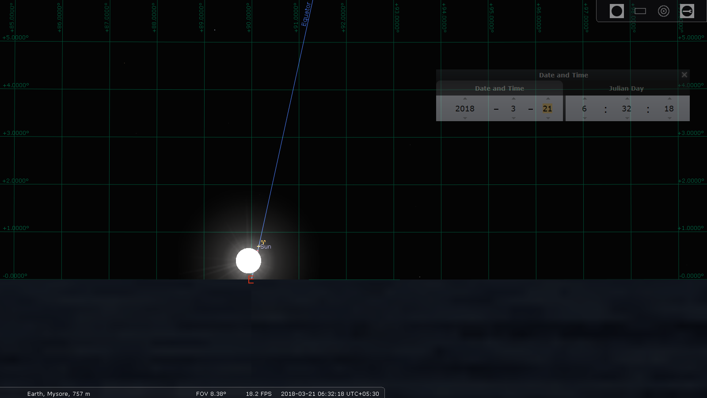
Tekufah at this moment of time, Wednesday, 21st March 2018, 06:30:00 [6:30 AM] the accuracy is
43-36%, as Tekufah is beginning to fade away.
Altitude +
Horizon

Slide 19
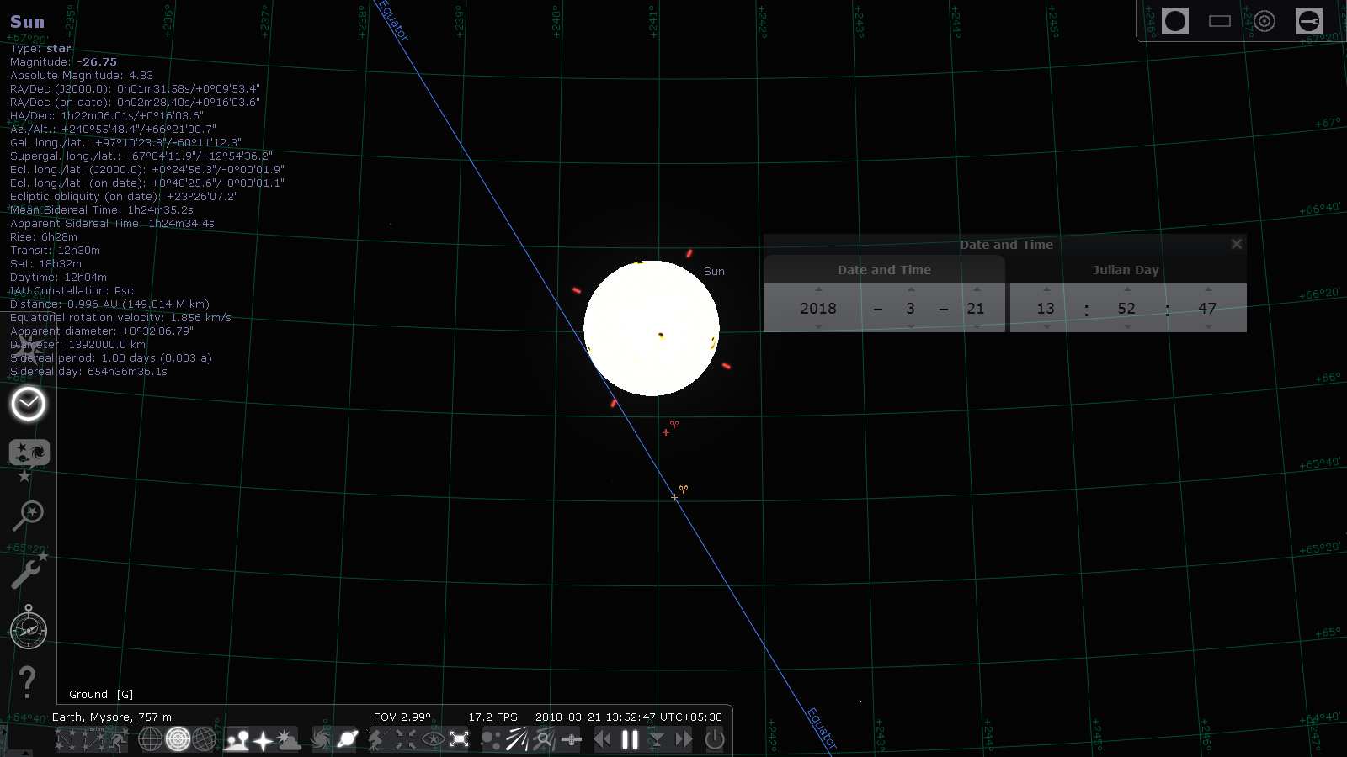
At this time Wednesday, 21 March 2018, 13:52:00 [1:52 PM],
Tekufah has ended as it has passed through the equatorial line.
Probability of watching Tekufah is now 0%.
Altitude +

Slide 20
CONDITION | REASON | Tekufah MOMENT | DATE AND TIME
BAD | NO LIGHT | 0.00% | 20-03-2018 05:30
OBSERVABLE | LIGHT | 10.00% | 20-03-2018 07:07
OBSERVABLE | LIGHT | 20.00% | 20-03-2018 08:45
OBSERVABLE | LIGHT | 30.00% | 20-03-2018 10:22
OBSERVABLE | LIGHT | 40.00% | 20-03-2018 12:00
EXCELLENT | LIGHT | 50.00% | 20-03-2018 13:37
EXCELLENT | LIGHT | 60.00% | 20-03-2018 15:15
EXCELLENT | LIGHT | 70.00% | 20-03-2018 16:52
EXCELLENT | LIGHT | 80.00% | 20-03-2018 18:30
BAD | NO LIGHT | 90.00% | 20-03-2018 20:07
BAD | NO LIGHT | 100.00% | 20-03-2018 21:45
BAD | NO LIGHT | 90.00% | 20-03-2018 23:22
BAD | NO LIGHT | 80.00% | 21-03-2018 01:00
BAD | NO LIGHT | 70.00% | 21-03-2018 02:37
BAD | NO LIGHT | 60.00% | 21-03-2018 04:15
BAD | NO LIGHT | 50.00% | 21-03-2018 05:52
OBSERVABLE | LIGHT | 40.00% | 21-03-2018 07:30
OBSERVABLE | LIGHT | 30.00% | 21-03-2018 09:07
OBSERVABLE | LIGHT | 20.00% | 21-03-2018 10:45
OBSERVABLE | LIGHT | 10.00% | 21-03-2018 12:22
BAD | ENDED | 0.00% | 21-03-2018 14:00
From this table , there is a better chance of watching Tekufah on 20th March
than 21st March.
So we can now say that Tekufah has happened
on 20th March.
Therefore 21st March will be day 1 of the new year. Why? Because the shadow casted by the device would have already surpassed,
or crossed, the equinox marking (NASA time).

Slide 21
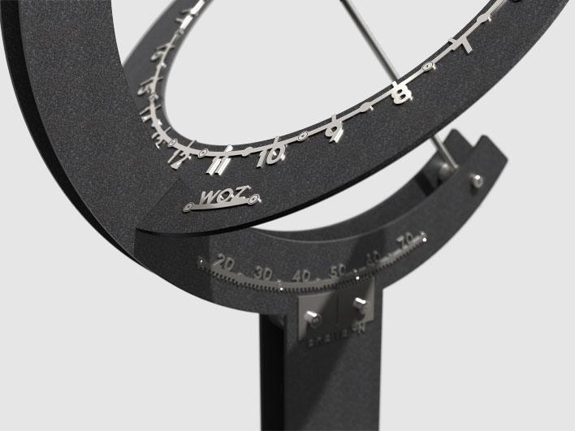
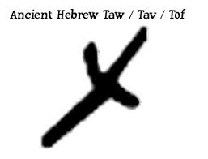
So we know we always have to watch for the mark or sign. Assuming the fact that the Equinox measuring device has markings on it, we can come to conclusions regarding the beginning of the day.

Slide 22
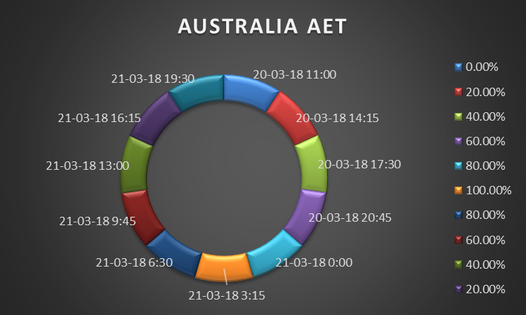
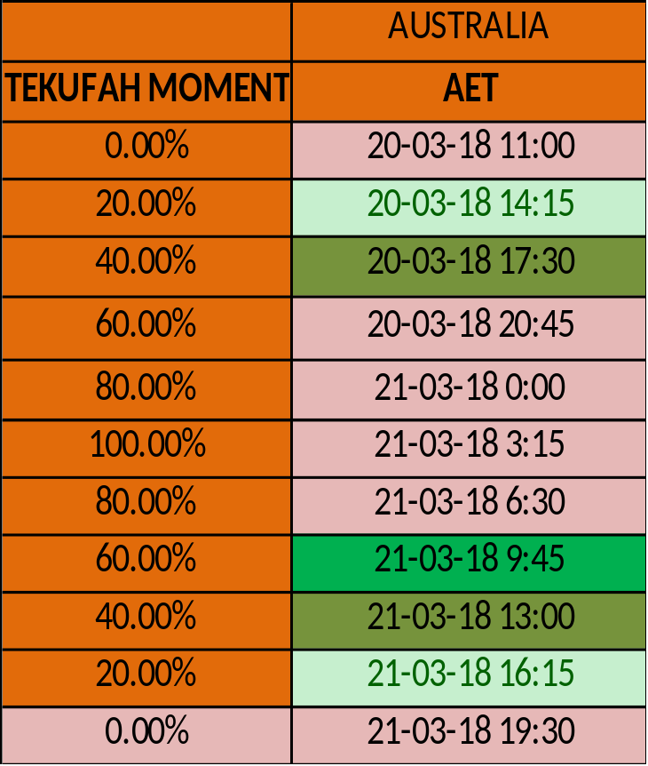
Let us use an example from Australia.

Slide 23
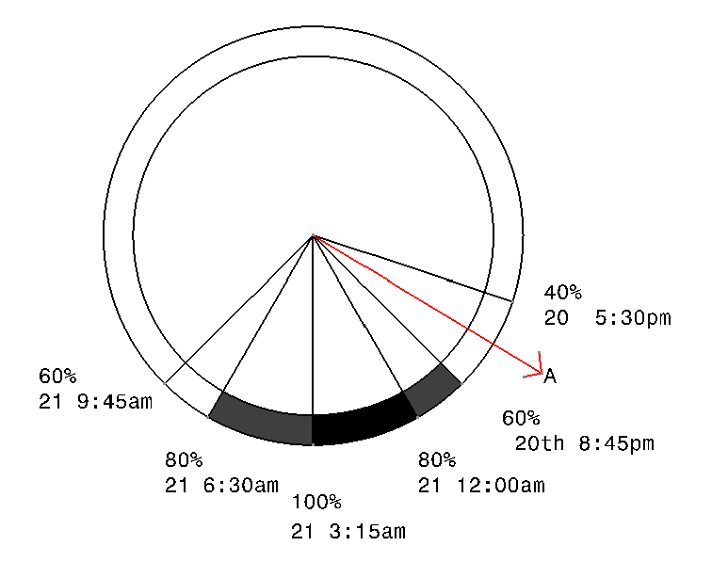
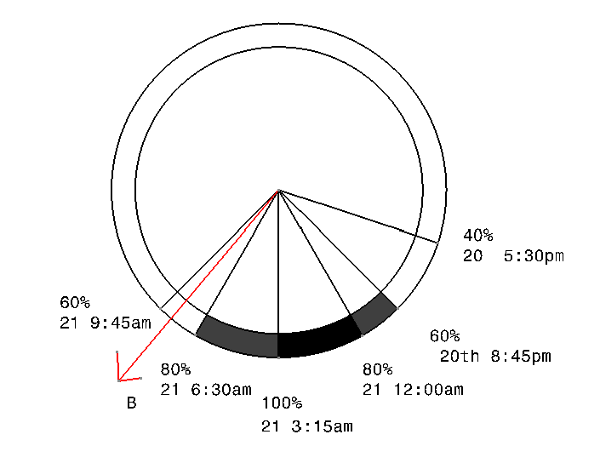
In Australia, Tekufah seems to happen on both day 21 and 22.
On day 20, in FIG 1, at the observation of the time around 5:30 to 6:30 PM,
one can witness a 40-50% Tekufah .
On day 21 in FIG 2, at the observation of the time around 6:30 to 9:45 AM,
one can witness a 70% Tekufah moment .
From the above scenario, a person can decide the 21st as day 1 because,
they will have seen the shadow marker would have already surpassed the equinox markings on the device (Tekufah time as per NASA).
FIG 1
FIG 2

Slide 24
Closing Remarks:
I came to this conclusion by using only Stellarium
software and assuming the size of sun and equatorial line
is well designed and relative to real objects.
I trust the time taken for the sun to cross the equatorial line
is true as per the software.
I came to realize the Tekufah
event happens for approx.
33 hours from beginning to
end as per this software.
The End

Slide 25


If you need assistance
please email your
questions to:
Info@t4study.com
www.t4study.com/resources

Slide 26

Thank you!
Presented by Nuthan G Nuthu ~ 21 Sept 2018

