Slide 1
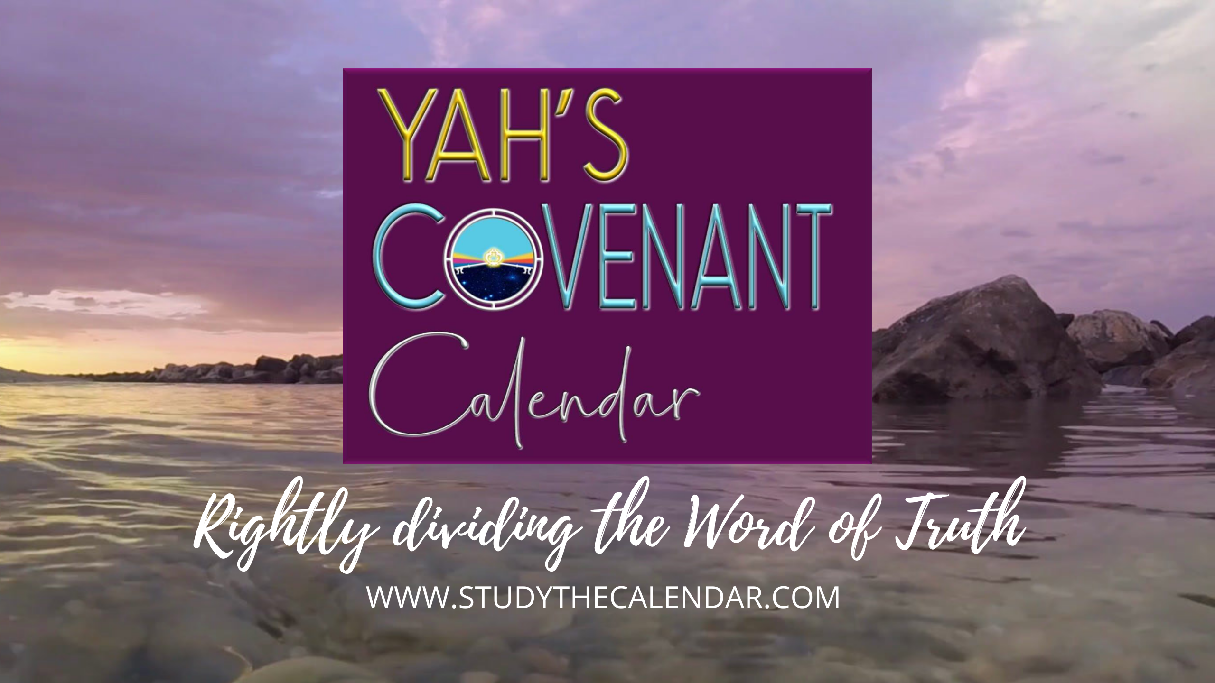
The Moon! Oh, the Moon! Pt 6

Slide 2



Everyone Wants to KNOW the
Part 5
About the Moon! Oh, the Moon!
Part 6: “Yahuah’s Month in non-Torah Scriptures!”
Our Question: Oh <chodesh> H2320!
Will the H2320 “new moon” verses align with Moses & Torah?

Slide 3

hey, mr. graduate, I just heard some interesting calendar news from our friends in france.
yes, I did too. i think we should share the news with everyone because it really
is exciting.
you know,
different cultures
see different things
in the calendar study
than we do.
let’s read about what
they are doing with a new
you-tube trailer for
Covenant Calendar.
in english, it
reads like this …

Slide 4

Calendar Update from France
TIME! ... most people overlook it.
However, it is one of the first things Yahuah established.
All His creation works with time: years, seasons, months, weeks, days!
And it's even truer when it comes to humanity.
The one who controls time controls the world.
(See Isa 14:13-14.)
That's why, through history, men wanted to redefine time according to their terms, being at the origin
of many liturgical calendars, modifying the Sabbath and the
holy convocations.
They have counterfeited the prophecies, thus blurring the reading of the events of the end times, erasing the landmarks left by a Creator full of love for His creation.

Slide 5


Calendar Update from France
It's important to start asking the right questions, to review the basics and ignore religious traditions and pagan influences in order to reveal the Divine Covenant Calendar.
Some of these questions could be:
It’s About Time …
How to synchronize on YHWH’s time?
Should the stars, the sun and the moon be
taken into account in the formation of the Covenant Calendar?
What event determines the beginning of the day?
Are the months really based on lunar cycles?
What is the role of the vernal equinox?
Do the constellations have something to teach us?
… for the fiancée to be synchronized with her Beloved! The fiancée must discover the true Calendar of her
Lord of the lords and King of kings ..."

Slide 6

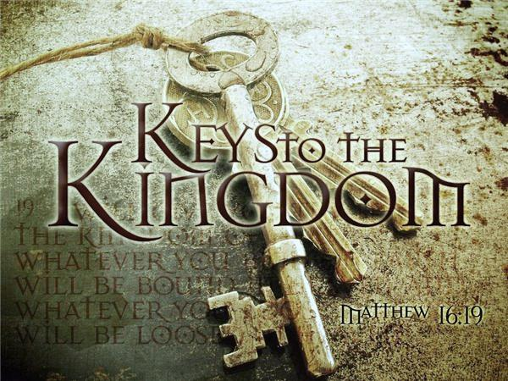
TA comment: We already had thie Matt 23:13verse in the former study. What about 2 verses further - verse 15? What is it that makes converts sons of Gey-Hinnom?
CF: How about this?
Luke 12:54-56 And he said also to the people, When ye see a cloud rise out of the west, straightway ye say, There cometh a shower; and so it is.
55 And when ye see the south wind blow, ye say, There will be heat; and it cometh to pass.
56 Ye hypocrites, ye can discern the face of the sky and of the earth; but how is it that ye do not discern this time? KJV
Time: NT:2540 kairos; of uncertain affinity; an occasion, i.e. set or proper time:
KJV - always, opportunity, (convenient, due) season, (due, short, while) time, a while. Compare NT:5550.
About “discerning
the time …”
Luke 12:56
Question: Who really took away
the Keys to Yahuah’s Covenant Calendar?
Ye hypocrites,
ye can discern the face
of the sky
and
of the earth; but how is it that ye do not discern
this time?
Israel? Galilee?
Samaria? Judah?
1611 Translators?
Hebrew Lexicon writers??
Matthew 23:13
Notes:
Luke 12:54-56 And he said also to the people, When ye see a cloud rise out of the west, straightway ye say, There cometh a shower; and so it is.
55 And when ye see the south wind blow, ye say, There will be heat; and it cometh to pass.
56 Ye hypocrites, ye can discern the face of the sky and of the earth; but how is it that ye do not discern this time? KJV

Slide 7


The KEYS of secular historical quotes
are also being restored!
These quotes assist in understanding the truth as it is in Torah.

Slide 8


"Moon-worship was dominant in the Mesopotamian world from which the patriarchs emerged, around 1800 B.C.E., with Abraham
the key Scripture figure.
At that time and in succeeding centuries, moon-worship in Mesopotamia centered on a large pantheon of assorted gods whose images proliferated in
the temples...
MOON
worship
Myths die hard, and the
Bible is full of graphic detail showing how the ancient Hebrews slipped readily
from time to time into celebrations that bore the mark of the original pagan practices...
8

Slide 9
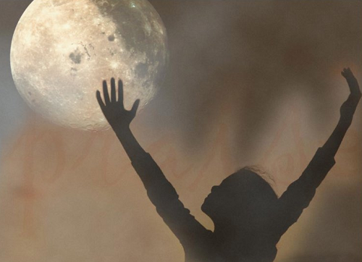
MOON
worship (con’t)
“The reason is an ECHO of the way the BABYLONIANS AND THE ASSYRIANS ASSIGNED THE RESPECTIVE ROLES OF THE TWO GREAT LUMINARIES,
THE SUN AND THE MOON."
(Chaim Raphael, Festival Days: A History of Jewish Celebrations, p. 55, 57, 58.)
“...Many hitherto PUZZLING aspects of the Jewish TRADITION were illuminated in this process. A notable example is the way in which ALL FESTIVALS, including the SABBATH, start with MOON-RISE ON THE NIGHT BEFORE.

Slide 10

MOON worship
W. F. Albright also writes:
“... Ur was a major center of moon god
worship with a famous temple, the ruins
of which are still visible today. Historical records do
in fact indicate that in ancient times the two major centers of the pagan moon god were at Haran and Ur of Chaldees.
The family of Abram [and Terah, his father] originally worshipped the moon god in their pagan state before
Elohim revealed Himself to them.”
(The Role of Canaanites in the History of Civilization, p. 333.)

Slide 11


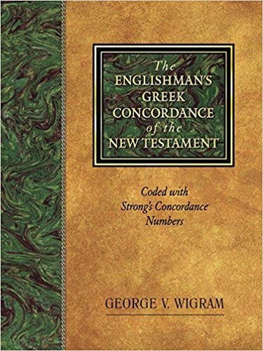
What have
we learned
so far about
H2320/2318?
H2320
<chodesh>
(noun)
[primitive root:]
H2318
<chadash>
(verb)

Slide 12
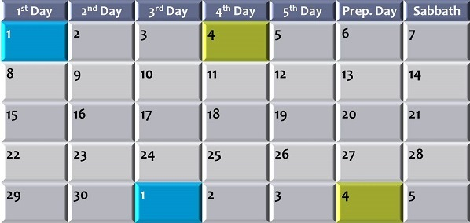
Creation’s Proper Placement of Definitions
H2320
<chodesh>
H3394
<yareach>
Noun
Creation
Month
Noun
Moon
Month
Verb
Verb
H2318
<chadash>
“renew”
H3391
<yerach>
“rebuild”
Both ‘new months’ renew, & rebuild when their 30th day ends.
Notes:
Aug 12/18

Slide 13

Start here:
Properly understand the H2320 <chodesh> definition.
Discernment when Lexicon definitions do not align with Torah.
Careful consideration of content and context with Torah.
Plan to study the “new moon” Scriptures in order of date.
Any ancient/secular history
must align with Torah.
Keys to Understanding the <chodesh> Study

Slide 14
Moon Hebrew Word #s & Grammar
Hebrew #
Part of speech
R
E
V
I
E
W
1. H3394 = 26 listings <yareach>
2. H3391 = 2 listings <yerach>
3. H3842 = 3 listings <lebanah>
4. H7720 = 1 listing <saharon>
5. H2320 = 20 listings <chodesh>
Total of 52 references.
Noun – literal moon
verb – lunation cycle
Adjective – color
Simile – comparison
noun/Verb – repetition
Question: are there really 2 verbs
& 2 Nouns for ONE “moon”?

Slide 15

For Consideration:
Because of wrong preconceived ideas based on an allegiance
to false religion, physical and spiritual Jews today use a calendar based on pagan premises!
As a result, people are trying
to keep Yahuah’s Feast days according to pagan reckoning.
By inserting the word “moon” for the translation of the word “chodesh,” Satan has deviously focused the attention onto the moon to calculate the months!
Whenever the word “chodesh” is translated as “moon” (instead of month) it is a gross mistranslation!
Satan has used this gross error to mislead Judaism and Christianity with regards to the Truth about Yahuah's calendar and the beginning of His month.
Satan has led people to wrongly focus on the various phases of
the moon to determine Yahuah’s months and His Feast days!
R
E
V
I
E
W
This has led to the calendar being built on a false premise!

Slide 16
Mapping the Topics for H2320 <chodesh>
R
E
V
I
E
W
H2320 <chodesh> must come into alignment with Moses & Torah as Yahuah’s “new [chodesh] month” not Yahuah’s “new moon” or man’s agenda.
1. H2320 Definition
Examination of Theologians of Hebrew Lexicon Study Tools: Strong’s; Brown-Driver-Briggs; Gesenius; Theological Wordbook of the Old Testament (TWOT).
2. Lexicon Challenges
From 1450 BC [2550 years after creation]: What were his Calendar Instructions to all Kings, Prophets and Leaders including Yahuah’s people today?
3. Counsel from Moses
4. New Moon Verses
All 20 “new moon” verses are NON-Torah references. How will these align with the Torah instructions?
16

Slide 17
Moses’ Use of “moon” in Torah
The word “moon” is used only 4 times in the Books of Moses.
REVIEW
<yareach> [H3394]
<yerach> [H3391]
Gen 37:9 And he [Joseph] dreamed yet another dream … and, behold, the sun and the moon [H3394] and the eleven stars made obeisance to me. (Moon as prophetic sign.)
(2 Warnings to NOT worship the Moon.)
Deut 4:19 And lest thou lift up thine eyes unto heaven, and when thou seest the sun, and the moon [H3394], and the stars, even
all the host of heaven, shouldest be driven
to worship them, and serve them …
Deut 17:3 And hath gone and served other gods, and worshipped them, either the sun, or moon [H3394], or any of the host of heaven, which I have not commanded.
Deut 33:14 And for the precious fruits brought forth by the sun, and for the precious things put forth by the moon [H3391]. (Moon given for ordinances.)
Not once does Torah
designate any phase
of the moon to
commence the month.
That is a default Law of MOSES!
Notes:
New slide June 26/17.

Slide 18
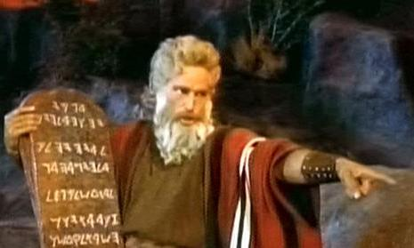

Counsel From Moses 1450 BC
For about 400 years after Moses the people were led by prophets and judges.
Prophets taught and judges counseled until
the people clamored for a king.
Moses gave instructions for all future
kings, including worship statutes regarding
Yahuah’s calendar.
Did these instructions include the “new moon” as the marker for the “new month”?
Moses gave Yahuah’s inspired and explicit commands about the type of year His people were to live their lives by.
Notes:
129/139 cf June 26/17 – work up for introduction to the 20 questionable verses. Many new slides.

Slide 19
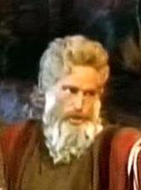
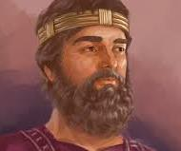
Torah Instructions For Leaders in Deut 17
Every “king” of Yahuah’s people were to make a copy of Torah, read it, govern/judge by it - never departing from its Words.
14 When you come to the land which Yahauh
your Elohim is giving you … and say,‘ I will set a king
over me like all the nations that are around me,'
15 you shall surely set a king over you whom Yahuah your Elohim chooses …
18 Also it shall be, when he sits on the throne of his kingdom, that he shall write for himself a copy of this law in a book … [obtained from the Levitical priests]
19 And it [Torah] shall be with him, and he shall read it all the days of his life, that he may learn to fear Yahuah his Elohim and be careful to observe all the words of this law and these statutes,
20 … that he may not turn aside from the commandment to the right hand or to the left, and that he may prolong his days in his kingdom … NKJV
Notes:
139/149 cf Jun3 27/17 … new slide

Slide 20
20 Non-Torah Controversial Verses
In this section we are going to address the 20 controversial verses
from non-Torah Old Testament books that promote the “new moon” …
as the commencement of the Biblical month
as being affiliated with the weekly Sabbath and annual festivals.
We’ll examine approximately 1000 years of history for these
non-Torah verses in accordance with the leadership of:
4 Kings (Saul, David, Solomon, Hezekiah)
5 Prophets (Elisha, Amos, Hosea, Isaiah, Ezekiel)
3 Prominent Leaders (Zerubbabel, Ezra, Nehemiah)
Moses gave specific instructions in Deut 17 to all future kings, prophets and leaders for every worship statute on Yahuah’s calendar.
Moses said:
“After I die,
you will worship other gods
that are strictly forbidden.”
Question: Did these leaders teach according to the “Laws of Moses”?
Notes:
New slide … June 27/17 … new slide
1100

Slide 21
Leaders, Dates & “new moon” Verses
1450-1060=390 – Moses to Saul – all approx. dates
1450-450=1000 Moses to Nehemiah
1060-700=360 Saul to Hezekiah
1060-445=615 Saul to Nehemiah
1062-895 BC
787-726 BC
701 BC
701-445 BC
S
U
N
D
I
A
L
King Saul [1062 BC]
1 Sam 20:5; 20:18; 20:24
King David
[1030 BC]
Psalm 81:3
King Solomon
[1017-1004 BC]
1 Chron 23:31;
2 Chron 2:4; 8:13
Elisha [895 BC]
2 Kings 4:23
Amos [787 BC]
Amos 8:5
Hosea [785 BC]
Hosea 2:11
Isaiah [760 & 698 BC]
Isa 1:13, 14; Isa 66:23
King Hezekiah
[726 BC]
2 Chron 31:3
Ezekiel [574 BC]
Ezekiel 45:17; 46:1, 3, 6
Zerubbabel
[538-516 BC]
Ezra 3:5
Ezra [458 BC]
Ezra 7:1, 5, 6, 10;
Neh 8:1-3, 9
Nehemiah
[445 BC]
Neh 10:33
Notes:
New slide June 27/17 … new slide
1200

Slide 22

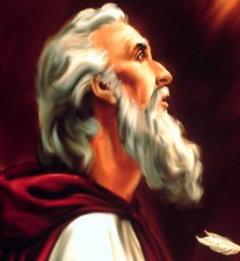
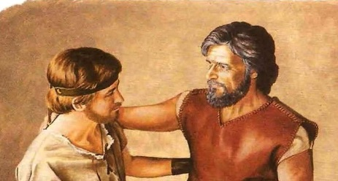
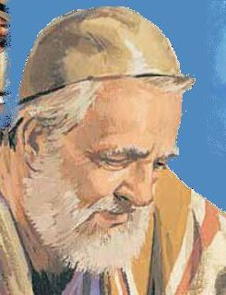
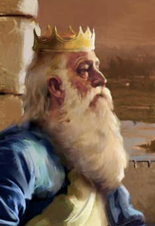
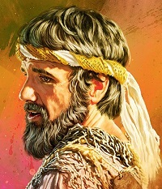
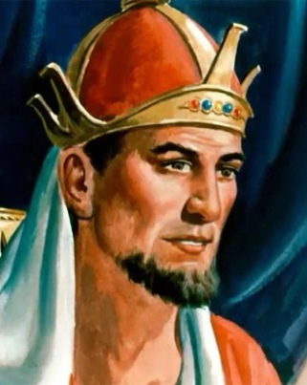
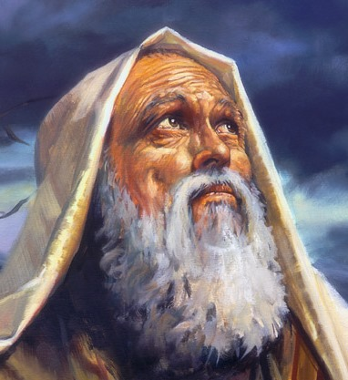
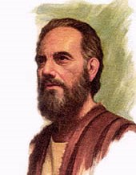
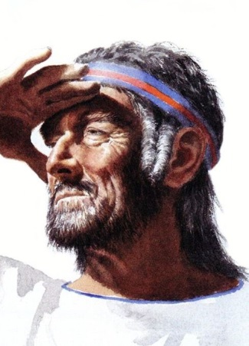
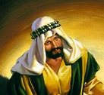
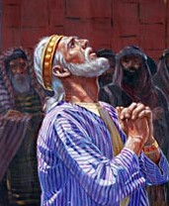
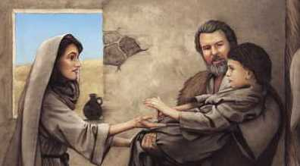
Nehemiah
King Saul Jonathan/David
In the complete study:
We will investigate
12 Great Leaders around
the 20 “new moon” verses
to see if they taught from
Torah or other books!
Ezra
King David
Zerubbabel
King
Solomon
Ezekiel
King
Hezekiah
Amos
Hosea
Isaiah
Elisha

Slide 23
An Important Question
Nehemiah
King Saul Jonathan/David
Would/Could 12 Great Leaders
ALL Make the Same Mistake of
Teaching the “new moon”
to begin the “new month”?
Ezra
King David
Zerubbabel
King
Solomon
Ezekiel
King
Hezekiah
Amos
Hosea
Isaiah
Elisha
Notes:
New slide … June 27/17 … new slide

Slide 24


Investigating What is True & What is False
20 Questionable Scriptures
H2320
<chodesh>
H3394
<yareach>
Why are 7% (or 20 verses) of the H2320 Scriptures translated as
“new moon(s)” [H3394] instead of “new month(s)” [H2320]?
Notes:
126-135cf June 25th … beginning section to go over the 20 controversial verses using “new moons” rather than H2320 new months. Changed thee wording on the bottom box.

Slide 25
yes! all dates are approximates!
mr graduate … is there anything we need to know before getting started?
Ps 81:3
Isa 1:13
Isa 1:14
Isa 66:23
Ezek 45:17
Ezek 46:1
Ezek 46:3
Ezek 46:6
Hos 2:11
Amos 8:5
1 Sam 20:5 1062 BC
1 Sam 20:18
1 Sam 20:24
2 Kings 4:23
1 Chron 23:31
2 Chron 2:4
2 Chron 8:13
2 Chron 31:3
Ezra 3:5
Neh 10:33
Right here show the list of 20 vss and the dates they are connected to. 8-22 1025 am
Should the research include the problems with judah after sundial event? Aug 12th.
and … do pay attention to the date of each verse and how many years have passed from the death of moses!
that’s important!
25

Slide 26


King Saul, David & Jonathan
721 Assyria
606 Babylon
701 Sundial
1450 MOSES
1350
1250
1150
1050
950
750
550
450
850
650
1 Sam 20:5
1 Sam 20:18
1 Sam 20:24
King Saul 1062
Moses to King Saul ~ 390 Years
1450-1060=390 – Moses to Saul
1450-450=1000 Moses to Nehemiah
1061-701=360 Saul to Hezekiah
1061-445=616 Saul to Nehemiah

Slide 27

1062 BC Preparations for 1 Samuel 20
Every king must carefully study the law of Yahuah;
Make that his rule;
Have a copy of the Scriptures in his own writing;
Must read therein all the days of his life.
The following 3 Scriptures in 1st Samuel revolve around one event.
David is expected to be present at the King’s table.
David’s life is in danger.
He tells Jonathan he chooses not to attend for 3 days.
IF King Saul is leading according to Torah,
would the first day of the new month
be on the “new moon” day?
All Leaders, Including Saul, are to Follow the Commands
in Torah
as Given by Moses.
Notes:
Aug 23rd new slide 1040 am – 205 pm

Slide 28
Again: nowhere in Torah does Moses command the “new moon” to be observed.
1062 BC King Saul (with Jonathan & David)
1 Sam 20:5 And David said unto Jonathan, Behold, to morrow is the new moon month [H2320 <chodesh>], and I should not fail to sit with the king at meat: but let me go, that I may hide myself in the field unto the third day at even.
1 Sam 20:18 Then Jonathan said to David, To morrow is the new moon month [H2320] <chodesh>: and thou shalt be missed, because thy seat will be empty.
1 Sam 20:24 So David hid himself in the field: and when the new moon month [H2320 <chodesh>] was come, the king sat him down to eat meat.
1 Sam 20:27 And it came to pass on the morrow, which was the second day of the month [H2320 <chodesh>] …
[According to Torah, was it really the NEW MOON or not - on that first day?]
[See study on David’s Qodesh Lechem for a thorough review of calendar events.]
Notes:
142 cf June 27/17 … new slide
125

Slide 29

King David
721 Assyria
606 Babylon
701 Sundial
1450 MOSES
1350
1250
1150
1050
950
850
750
650
550
450
4) Psalm 81:3
King Saul 1062
King David 1030
Moses to King David ~ 420 Years

Slide 30
Is there a Torah verse that gives clear instructions?
1030 BC King David and Torah Commands
David is called “man of Yahuah” three times in the Old Testament.
Do you think he would have written the following verse this way if there is no Torah command?
Psalms 81:3 Blow up the trumpet in the NEW MOON [H2320 <chodesh>], in the time appointed, on our solemn feast day.
(No Date; approx. 1000 BC)
King David Also Had to Abide by Moses’ Laws for Calendar
Notes:
142 cf June 27/17 … new slide (David, a man of God’s heart … 3 times: 2 Chr 8:14; Neh 12:24 & 36)
400 (Moses, a man of God’s heart … 5 times: Deut 33:1; Josh 14:6; 1 Chron 23:14; 2 Chron 30:16; Ezra 3:2 … & Ps 90:1)

Slide 31
Why? Because nowhere in Torah does Moses command the trumpet to be blown for the “new moon.”
1030 BC King David (A Man After Yahuah’s Heart)
Remember: Both Moses & King David were men of Yahuah. King David followed the “Laws of Moses.”
Therefore, he would have honored Yahuah’s “festal month” according
to the creation week, as recorded by Moses.
Because Num 10:10 says to “blow the trumpet in the new month,”
[H2320 <chodesh>], King David would have written Psalms 81:3 like this:
Blow up the trumpet in the new month [H2320 <chodesh>],
in the time appointed, on our solemn feast day.
Notes:
142 cf June 27/17 … new slide (David, a man of God’s heart … 3 times: 2 Chr 8:14; Neh 12:24 & 36)
400 (Moses, a man of God’s heart … 5 times: Deut 33:1; Josh 14:6; 1 Chron 23:14; 2 Chron 30:16; Ezra 3:2 … & Ps 90:1)

Slide 32

King Solomon
721 Assyria
606 Babylon
701 Sundial
1450 MOSES
1350
1250
1150
1050
950
850
750
650
550
450
King Saul 1062
1 Chron 23:31
2 Chron 2:4
2 Chron 8:13
King David 1030
King Solomon 1015
King Solomon 1004
Moses to King Solomon ~ 435-445 Years

Slide 33

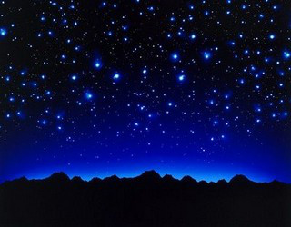
The Practices of King Solomon
By the way ~ we must examine …
If the “new moon” declares the beginning of the festal month
would not Solomon [as the wisest man in the world]
tell us about it?
Notes:
Sept 18 new slide 1120 pm

Slide 34
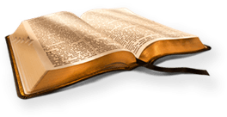

King Solomon – the Wisest Man
The following information is from King Solomon, the wisest man on earth. He did not make provision during his
40 years as king for there ever to be
a 13th month in any year – which is exactly what happens approx. every
3rd year when following the moon.
It is time to take a serious
look at the evidence.
Date: 1015 BC
Notes:
Sept 18th new slide 722 pm 1055 pm

Slide 35
1015 BC Preparation for 1 Chron 23
King David [a man of Yahuah] gives instruction to
King Solomon on:
Building of the temple
Levitical instructions for the sacrifices and offerings
[according to Moses, a man of Yahuah].
1 Chron 22:5> David begins to make preparations for the building of the Temple as Solomon is inexperienced.
1 Chron 22:12> Solomon is commanded to observe the laws Yahuah gave to Moses, a man of Yahuah.
1 Chron 22:13> … David repeats to observe the laws
Yahuah gave to Moses.
King David’s Instructions for the Temple were to Follow Moses’ Laws
Notes:
Aug 22nd new slide 1035 am

Slide 36
1015 BC King David’s Instructions to Solomon
King David [a man of Yahuah] also instructed King Solomon to follow the statutes, commandments and judgments [according to Moses, a man of Yahuah].
1 Kings 2:1,3 [a reminder from King David]
Now the days of David drew near that he should die, and he charged Solomon his son, saying:
3 And keep the charge of Yahuah your Elohim:
to walk in His ways, to keep His statutes, His commandments, His judgments, and His testimonies, as it is written in the Law of Moses … NKJV
King David’s Instructions to Solomon to Rule/Reign by Torah
Notes:
Aug 23rd new slide 1210 pm

Slide 37
Nowhere in Torah does Moses give instructions for sacrifices on the “new moons”!
1015 BC King Solomon (Instructed by King David)
Solomon is made king by David. How would the instructions in 1 Chron 23:31, read using new months?
1 Chron 23:31 And to offer all burnt sacrifices unto Yahuah in the sabbaths, in the new MOONS months [H2320 <chodesh>], and on the set feasts, by number, according to the order commanded unto them, continually before Yahuah.
Notes:
142 cf June 27/17 … new slide
615

Slide 38

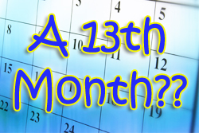
Did Moses make provision for in any year?
1015-1014 BC King Solomon’s Kingdom
Solomon’s kingdom was well organized with “chief fathers and captains of thousands and hundreds, and their officers that served the king in any matter of the courses, which came in and went out month by month [H2320 <chodesh>] throughout
all the months of the year, of every course were twenty and four thousand.”
See
1 Chron 27:1-15
Solomon names 12 captains for each year!
Notes:
142 cf June 27/17 … new slide
500

Slide 39



1015 BC King Solomon’s 12 Captains of 1 Chron 27
1. Now the children of Israel after their number, to wit, the chief fathers and captains of thousands and hundreds, and their officers that served the king in any matter of the courses, which came in and went out month by month [H2320 <chodesh>] throughout all the months of the year, of every course were twenty and four thousand [24,000].
2. Over the first course for the first month [H2320 <chodesh>] was Jashobeam …
4. And over the course of the second month was Dodai …
5. The third captain of the host for the third month was Benaiah …
7. The fourth captain for the fourth month was Asahel …
8. The fifth captain for the fifth month was Shamhuth …
9. The sixth captain for the sixth month was Ira …
10. The seventh captain for the seventh month was Helez …
11. The eighth captain for the eighth month was Sibbecai …
12. The ninth captain for the ninth month was Abiezer …
13. The tenth captain for the tenth month was Maharai …
14. The eleventh captain for the eleventh month was Benaiah …
15. The twelfth captain for the twelfth month was Heldai …
Solomon’s
Seal
Flower
Notes:
Sept 18th new slide 735 pm

Slide 40
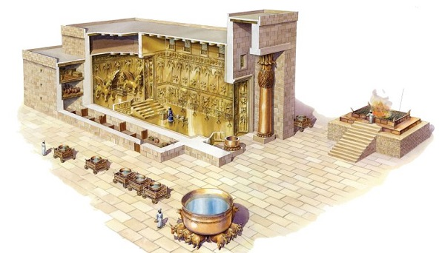
1015 BC Preparation for 2 Chron 2
Solomon prepares to build the temple according to King David’s instructions.
Everything is set in place according to
the ordinances given through the
Laws of Moses.
Both Moses and David are called “a man of Yahuah” several times in Scripture.
King Solomon Carried Out the Plans for Building the Temple
Notes:
Aug 22nd new slide 1030 am

Slide 41
1015 BC King Solomon (Follows David’s Words)
King Solomon would have supported the
“new month [H2320 <chodesh>]” as given in Hebrew.
2 Chron 2:4 Behold, I build an house to the name of Yahuah my Elohim, to dedicate it to him, and to burn before him sweet incense, and for the continual shewbread, and for the burnt offerings morning and evening, on the sabbaths, and on the new MOONS months [H2320 <chodesh>], and
on the solemn feasts of Yahuah our Elohim.
This is an ordinance for ever to Israel.
Solomon
did not
honor any
“new moon.” Hebrew does not use H3394.
Notes:
145/156 June 27/17 new slide
830

Slide 42
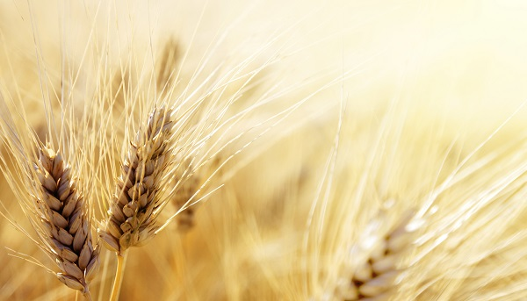
1004 BC Preparation for 2 Chron 8 & <chodesh>
Again, Solomon carries out the plans of King David exactly as instructed according to the Laws of Moses.
2 Chron 8:14 And he [Solomon] appointed, according to the order of David his father, and the Levites to their charges, to praise and minister before the priests, as the duty of every day required: the porters also by their courses at every gate:
for so had David the man of Yahuah commanded.
2 Chron 8:15 And they departed not from the commandment of the king unto the priests and Levites concerning any matter, or concerning the treasures.
King Solomon Followed all the Laws of Moses for the Temple
Notes:
149/158 cf June 27/17 … new slide
610

Slide 43
This event is 9 years after 1 Chron 23:31.
Solomon is still following the Torah commands for offerings on the new month [H2320 <chodesh>].
1004 BC King Solomon (Regards Worship Statutes)
2 Chron 8:13 Even after a certain rate every day, offering according to the commandment
of Moses, on the sabbaths, and on the new MOONS months [H2320 <chodesh>], and on the solemn feasts, three times in the year, even in the feast of unleavened bread, and in the feast of weeks,
and in the feast of tabernacles.
Notes:
149/158 cf June 27/17 … new slide
610

Slide 44

Elisha & the Shunammite Woman
721 Assyria
606 Babylon
701 Sundial
1450 MOSES
1350
1250
1150
1050
950
850
750
650
550
450
8) 2 Kings 4:23
King Saul 1062
Elisha 895
King David 1030
King Solomon 1015
King Solomon 1004
Moses to Elisha ~ 555 Years

Slide 45

Timeframe: 550 years after Moses. Hebrew does not use H3394 for “moon.”
895 BC Elisha (and the Shunammite Woman)
The Shunammite woman knew Elisha was a great prophet according to the testimony in:
2 Kings 4:22 And she called unto her husband,
and said … that I may run to [Elisha] the man of Yahuah.
2 Kings 4:23 And he [husband of the Shunammite woman] said, Wherefore wilt thou go to him [Elisha] to day? it is neither [the] new MOON month [H2320 <chodesh>], nor sabbath.
Elisha trained under Elijah; both were great men
of Yahuah.
Notes:
144cf June 28/17 … new slide
100

Slide 46

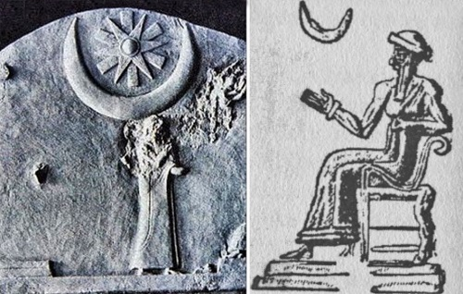
The following four verses need “qualifiers” to show us the context is talking about Yahuah’s people following the pagan moon festivals!
Their (or “her”) “new months” were actually a following after the pagan new moon months
as a replacement for Yahuah’s Festal month.
Amos 8:5
Hos 2:11
Isa 1:13
Isa 1:14
“New Moon” Apostasy Needs Qualifiers

Slide 47

Amos & Israel’s Apostasy
721 Assyria
606 Babylon
701 Sundial
1450 MOSES
1350
1250
1150
1050
950
850
750
550
450
650
9) Amos 8:5
King Saul 1062
Elisha 895
Amos 787
King David 1030
King Solomon 1015
Apostasy Sets In
King Solomon 1004
Moses to Amos ~ 663 Years

Slide 48
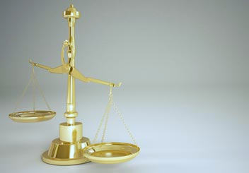
Who was Amos?
A shepherd from Judah, and a servant of Yahuah.
787 BC Amos (Deals with Apostate Israel)
Yahuah tells Amos that Israel will long for the NEW MOONS and SABBATHS to be over to follow their pagan ways and immorality.
They were led away by false gods [Amos 2:4], most likely honored on the day of the pagan new moon.
Notes:
145cf June 28/17 … new slide
110

Slide 49
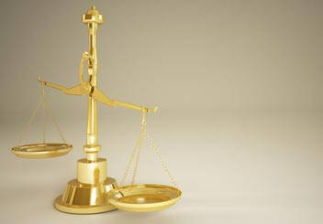

Israel is admitting to their apostasy!
They were celebrating the H3394 “new moon” instead of the H2320 <chodesh> “new month”!
787 BC Amos (Deals with Apostate Israel)
This “new month” [qualified in the verse
by those following pagan ways], is definitely
referring to the pagan “new moon” month.
Amos 8:5 Saying, When will the new MOON month [H2320 <chodesh>], be gone, that we may sell corn? and the sabbath, that we may set forth wheat, making the ephah small, and the shekel great, and falsifying the balances by deceit?
660 years after Moses, Amos is faced with Israel’s apostasy of the pagan “new moons.”
Notes:
145cf June 28/17 … new slide
110

Slide 50


Hosea & Israel’s Apostasy
721 Assyria
606 Babylon
701 Sundial
1450 MOSES
1350
1250
1150
1050
950
850
750
650
550
450
10) Hosea 2:11
King Saul 1062
King David 1030
Elisha 895
Amos 787
Hosea 785
King Solomon 1015
King Solomon 1004
Apostasy Sets In
Moses to Hosea ~ 665 Years

Slide 51
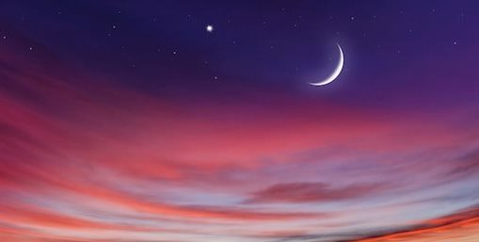
785 BC Hosea (Deals with Apostate Israel ~ 2 years later)
Yahuah gives Hosea counsel for Israel about 84 years before Hezekiah’s sundial miracle.
There is definitely a huge problem with apostasy in Israel.
Will Yahuah’s people heed Hosea’s warning about
her new moons – the “qualifier” in this verse?
Hosea
Also Has a Warning About
Worship Celebrations
Hosea 2:11 I [Yahuah] will also cause all
her mirth [joy] to cease, her feast days,
her NEW MOONS [H2320 <chodesh>], and
her sabbaths, and all her solemn feasts.
Notes:
159-160cf June 28/17 … new slide

Slide 52
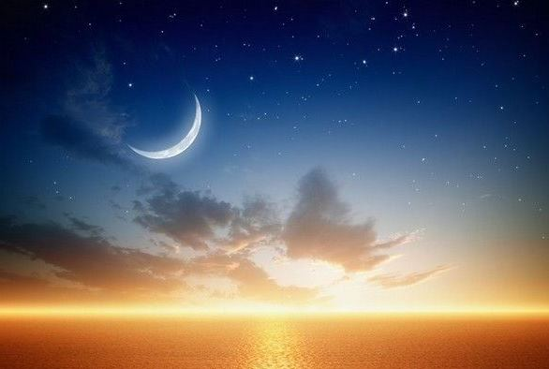
785 BC Hosea (Apostate Israel’s “new moons”)
In Hosea 2:11 “her new moons”
is in full opposition with the
Calendar Laws of Moses.
Is this a gross mis-translation?
Hosea 2:11 I [Yahuah] will also cause all her mirth [joy] to cease, her feast days, her NEW MOONS [H2320 <chodesh>], and her sabbaths, and all
her solemn feasts.
R
E
V
I
E
W
Notes:
159-160cf June 28/17 … new slide
200

Slide 53

Isaiah & Israel’s Apostasy
721 Assyria
606 Babylon
701 Sundial
1450 MOSES
1350
1250
1150
1050
950
850
750
550
450
650
Isa 1:13
Isa 1:14
King Saul 1062
King David 1030
Elisha 895
Amos 787
Hosea 785
King Solomon 1015
Isaiah 760
King Solomon 1004
Apostasy Sets In
Moses to Isaiah ~ 690 Years

Slide 54
760 BC Isaiah (Deals with Apostate Israel ~ 25 years later)
Only 25 years after the writings of Hosea, Isaiah gives another warning about the
apostasy of Israel before they were taken into captivity by Assyria [about 721 BC].
However, they kept running after the pagans ways of worship, ignoring the covenant
commands of Yahuah including His 30 day festal month.
As you will note on the next slide, verse 14 says very emphatically Your NEW MOONS [H2320 <chodesh>] and your appointed feasts in comparison to Hosea’s wording of: her NEW MOONS [H2320 <chodesh> – not H3394 <yareach>], and her sabbaths, and all her solemn feasts.
Isa 1:13-14 should have been translated as Your NEW MONTHS.
Even so, it does not matter if the verse said NEW MOONS or NEW MONTHS
– the point is – neither their MOON or MONTH was sacred and
did not belong to Yahuah for it was all reckoned according to
paganism and moon worship.
Isaiah’s record is very
worthy
of careful
notice.
Notes:
161-162cf June 28/17 … new slide

Slide 55
Isa 1:13 Bring no more vain oblations; incense is an abomination unto me;
the NEW MOONS [H2320 <chodesh>] and Sabbaths, the calling of assemblies,
I cannot away with; it is iniquity, even the solemn meeting. (760 BC)
Isa 1:14 is quite an incredible verse.
It should say NEW MONTHS, which are the “new months” according to how the pagans calculated
their pagan festivals.
Isa 1:14 Your NEW MOONS [H2320 <chodesh>] and your appointed feasts my soul hateth: they are a trouble unto me; I am weary to bear them.
Question: Is it not interesting that the real problem of calculating the “pagan months” is actually called
“new moons” in Isa 1:14 using H2320/chodesh?
Did the KJV translators know it was the apostate “appointed feasts” that were fixed to the “new moons”?
Yahuah’s “appointed times” were
never fixed to the “new moons.”
55
Notes:
161-162cf June 28/17 … new slide

Slide 56
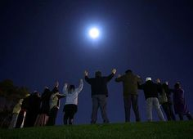
Because the Pagans were looking to the
Moon for their pagan feast Calculations,
they were on a Different Month ~
not Creation’s Festal Month!
Yahuah’s people were following this pagan style of “reckoning the month” according to the moon phases.
There are many who still hold tenaciously to this teaching today!
Notes:
166 … June 28/17 … new slide
425

Slide 57

REVIEW …Which came first?
Yahuah’s Creation Festal Month?
OR
Yahuah’s Moon Month?
57
Notes:
164cf … June 28th …. New slide

Slide 58
Rebuilding <2318/chadash> the 30 Day Month <2320/chodesh>
H2320
<chodesh>
H3394
<yareach>
R
E
V
I
E
W
Noun
Creation
Month
Noun
Moon
Month
Verb
Verb
H2318
<chadash>
“renew”
H3391
<yerach>
“rebuild”
Yahuah’s New Festal Month still renews, & rebuilds when the 30th day ends.
Notes:
Aug 12/18

Slide 59
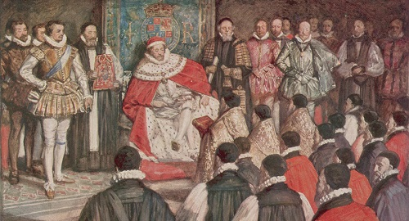
The Hebrew uses H2320 <chodesh> for month, NOT H3394 <yareach> for moon.
So did the translators give Amos, Hosea and Isaiah
the best translation … or not?
We shall see in the next study!
Notes:
Aug 10th p 24 711 pm

Slide 60

King Hezekiah
721 Assyria
606 Babylon
701 Sundial
1450 MOSES
1350
1250
1150
1050
950
850
750
650
550
450
13) 2 Chron 31:3
King Saul 1062
King David 1030
Elisha 895
Amos 787
Hosea 785
King Solomon 1015
Isaiah 760
King Solomon 1004
Hezekiah 726
Moses to King Hezekiah ~ 725 Years

Slide 61
726 BC King Hezekiah (Reformation & Restoration)
Remember: All kings and leaders were responsible to know Torah; teach it and have their own written copy. [Deut 17]
King Hezekiah would have observed the 30 day month like this:
Count 1-30, then start over – a repetitive occurrence!
In 726 BC, Hezekiah invited Israel & Judah to celebrate the Passover in the 2nd month. (Why? Priests were not sanctified for the 1st month.)
The heathen altars in Jerusalem were destroyed.
A 2nd Passover was a grand reformation and restoration.
There was a massive campaign against all idol worship.
Hezekiah absolutely followed the Torah guidelines
for celebrations of Sabbaths, Appointed Times, and
New Months.
**Coming into Covenant Yields Reformation and Restoration!
Notes:
168-169cf June 28/17 … new slide

Slide 62
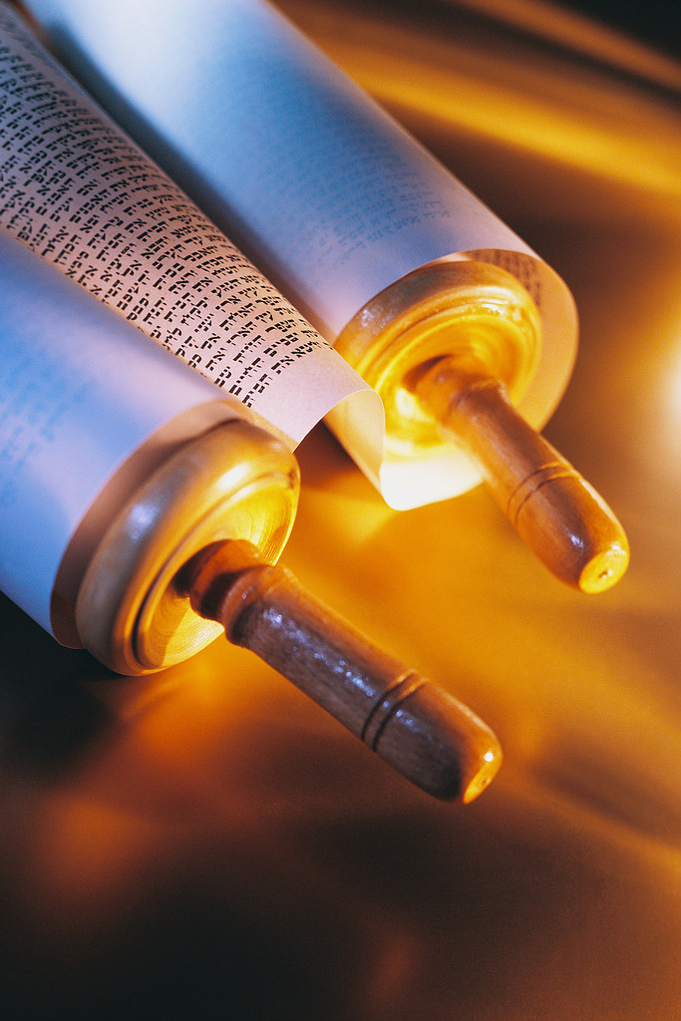
726 BC King Hezekiah (Reformation & Restoration)
2 Chron 31:3 He [King Hezekiah] appointed
also the king's portion of his substance for the burnt offerings, to wit, for the morning and evening burnt offerings, and the burnt offerings for the sabbaths, and for the
new MOONS months [H2320 <chodesh>], and for
the set feasts, as it is written in the law
of Yahuah.
[H2320 <chodesh>] should be
translated as new months.
Yahuah’s King would NOT have been following the pagan new moon!
Hezekiah absolutely followed Torah guidelines for celebrations of Sabbaths, Appointed Times and Yahuah’s NEW months.
Notes:
168-169cf June 29/17 … new slide
100

Slide 63
King Hezekiah & Sundial
721 Assyria
606 Babylon
701 Sundial
1450 MOSES
1350
1250
1150
1050
950
850
750
650
550
450
13) 2 Chron 31:3
Hezekiah 701
King Saul 1062
Assyria scattered the 10 northern tribes of Israel about 20 years before.
King David 1030
Elisha 895
Amos 787
Hosea 785
King Solomon 1015
King Solomon 1004
Isaiah 760
Hezekiah 726
Moses to King Hezekiah ~ 750 Years

Slide 64
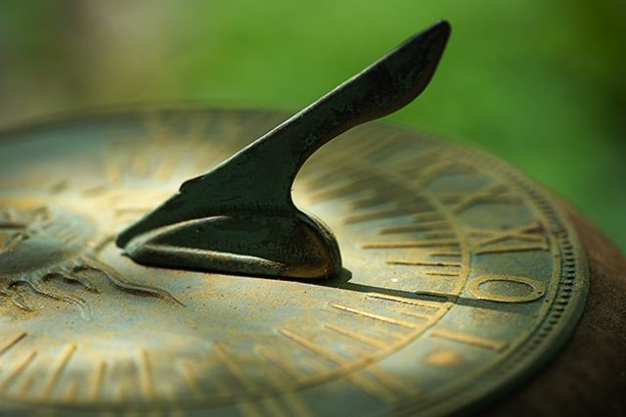
701 BC
This is an extremely important
event!
King Hezekiah’s Sundial Miracle

Slide 65

The Sundial Miracle: Historical Turning Point
No Other Bible Testimony is Recorded 3 Times
2 Chron 32:24 In those days Hezekiah was sick to the death, and prayed unto Yahuah: … and he gave him a sign.
2 Kings 20:9-11 … shall the shadow go forth ten degrees,
or go back ten degrees?
10 And Hezekiah answered, It is a light thing for the shadow to go down ten degrees: nay, but let the shadow return backward ten degrees.
11 And … he brought the shadow ten degrees backward …
Isa 38:7-8 And this shall be a sign unto thee …
8 Behold, I will bring again the shadow of the degrees …
ten degrees backward …
This will be studied out in a future lesson.
Notes:
211cf June 29/17 … new slide
430

Slide 66
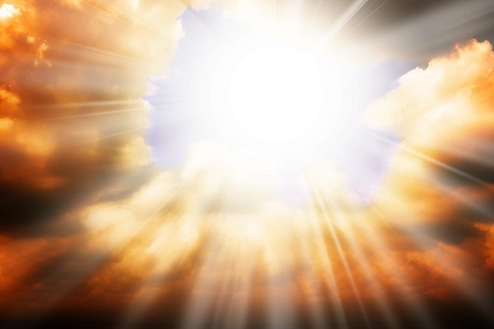
Isaiah & the Holy City
721 Assyria
606 Babylon
701 Sundial
1450 MOSES
1350
1250
1150
1050
950
850
750
650
550
450
14) Isa 66:23
in combination
with: Isa 60:20
Hezekiah 701
King Saul 1062
The date of this prophecy is about 3 years after the sundial event.
King David 1030
Elisha 895
Amos 787
Hosea 785
King Solomon 1015
King Solomon 1004
Isaiah 760
Hezekiah 726
Isaiah 698
Moses to Isaiah ~ 752 Years

Slide 67
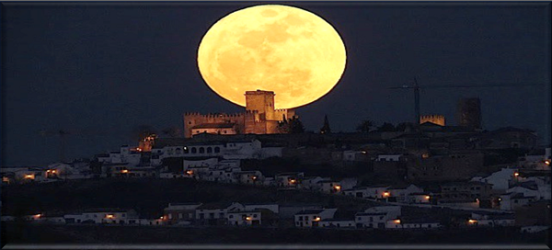

Have you heard this:
“the MOON will not withdraw itself?”
What does Isaiah 60:20 mean by
“the moon will not withdraw itself”?
Isaiah will be addressing a prophecy;
not events connected to the apostasy of Judah.
67

Slide 68
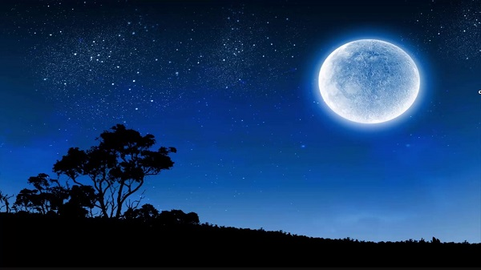
Will there be a time that the moon as we see it
will eventually never withdraw itself?
Or is there another concept?
We’ll consider two options.
Notes:
306cf … july 3/17 … new background so the moon would not be so squashed.

Slide 69
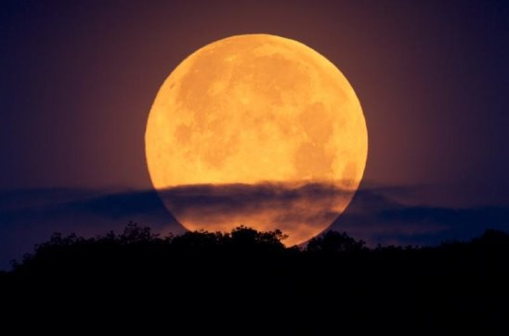
#2:
Review of
Isa 60:20 -
A Prophetic Reference to H3391 <yerach>
(or the lunation cycle & phases of the moon).
#1:
The verse under consideration is Isa 66:23
[H2320 <chodesh>], which needs to be addressed along with
Isaiah 60:20.
Notes:
309cf … july 3/17 … changed the background so moon would not be squashed. The verse is on the next slide, so no need to have it here as well.

Slide 70

Isa 60:20 - Prophetic Reference of H3391 MOON
Isa 60:20 Thy sun shall no more go down; neither shall thy MOON withdraw itself
[H3391; lunation cycle]: for Yahuah shall be thine everlasting light …
Context of verse: Yahuah’s people are in His Glory.
Could the phrase “the moon will no longer withdraw
itself” mean … no longer changing the H3391 phases?
  If there is no ‘withdrawing process’ there will be ‘no changing phases
  of the moon.’
  This would make it very difficult to observe any worship statutes with Yahuah "from new moon to new moon" (Isa 66:23). Therefore any understanding of a new moon in this context would be an impossibility!
Notes:
312cf … july 3/17

Slide 71
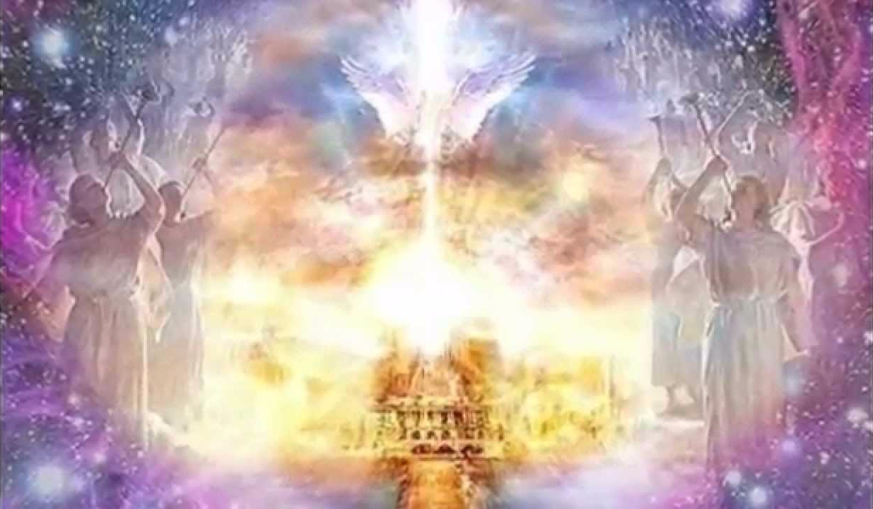
What does Isaiah 60:20
have to do with Isaiah 66:23?
Isa 60:20 Thy sun shall no more go down; neither shall thy MOON [H3991 <yareach>] withdraw itself [H622]: for Yahuah shall be thine everlasting light …
H622 'acaph; a primitive root; to gather for any purpose; hence,
to receive, take away, i.e. remove (destroy, leave behind, put up, restore, etc.).
Isa 66:23 And it shall come to pass, that from one new moon [H2320 <chodesh>] to another [H2320 <chodesh>], and from one sabbath to another, shall all flesh come to worship before me, saith Yahuah.

Slide 72
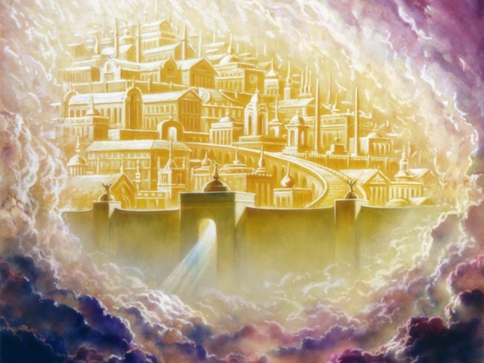
How do Isa 60:20 and Isa 66:23
link to James 1:17?
James 1:17 Every good gift and every perfect gift is from above, and cometh down from the Father of lights,
with whom is no variableness, neither shadow of turning.
shadow G5157 trope; from an apparently primary trepo (to turn);
a turn ("trope"), i.e. revolution (figuratively, variation): KJV - turning.
turning G644 aposkiasma; from a compound of G575 and a derivative
of G4639; a shading off, i.e. obscuration [a darkening]: KJV - shadow.

Slide 73


Isaiah 66:23 Worship in the Holy City
    “And it shall come to pass, that from one New Moon
    [H2320 <chodesh>] to another, and from one Sabbath to another,
    shall all flesh come to worship before me, saith Yahuah.”
    Did not Isaiah 60:20 just inform us that the moon will no longer withdraw itself, indicating the strong possibility of completely eliminating the phases of the moon forever?
    How can Isaiah first tell us the moon will no longer go through the phases of being renewed, and then six chapters later, tell us
    we will be worshipping according to the “new moon”?
Notes:
313cf … july 3/17

Slide 74
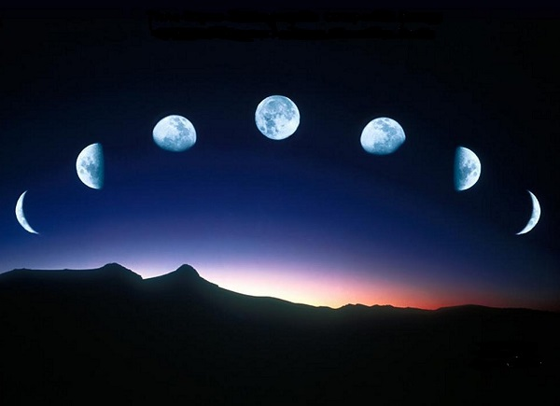
This also means the moon should not receive any sacred regard to appoint worship statutes.
All the problems are eliminated, when we realize we are not to be following any phase of the moon in the first place.
74
Notes:
314cf … july 3/17

Slide 75
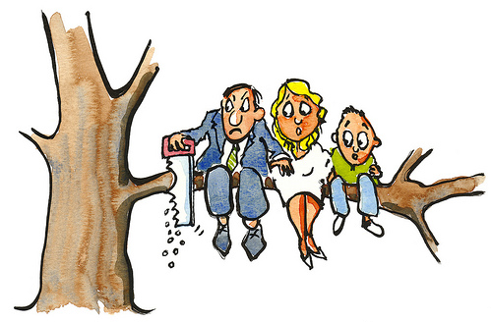

Review: Jeremiah tells us about consequences for Judah
“Turning Away From
Torah Commands.”
Jeremiah 8:2 “… and [Babylon] shall spread them [Judah] before the sun and the moon and all the host of the heavens, which they have loved and which they have served and after which they have walked, which they have sought, and to which they have bowed themselves. They shall not be gathered nor buried, they shall be for dung on the face of the earth.” The Scriptures
Notes:
315cf … july 3/17

Slide 76


Isaiah 1:4-5, 10-17 documents
the traditions that insidiously infiltrated and contaminated the worship services
of the Hebrew nation.
Paying allegiance to the Moon as the marker for feasts & festivals is the
TOP ALARM
OF THE LIST!
Many other prophets sounded the same message!
Notes:
318cf … july 3/17

Slide 77


Ezekiel & the Temple
721 Assyria
606 Babylon
701 Sundial
1450 MOSES
1350
1250
1150
1050
950
850
750
650
550
450
Eze 45:17
Eze 46:1
Eze 46:3
Eze 46:6
Hezekiah 701
King Saul 1062
King David 1030
Elisha 895
Amos 787
Ezekiel 574
Hosea 785
King Solomon 1015
King Solomon 1004
Isaiah 760
Hezekiah 726
Isaiah 698
Moses to Ezekiel ~ 875 Years

Slide 78
574 BC Ezekiel (A Levite, Prophet & Priest of Torah)
Ezekiel would have taught the strict laws of the Torah for the observance of the feasts, Sabbath(s) and the new month requirements.
His instructions in the following passages were for services to be conducted in the new temple at Jerusalem, after the return of the exiles from Babylon. However, this temple was never built.
The following passages are well after Hezekiah’s sundial miracle and about 38 years before the first exiles returned to Jerusalem.
Ezekiel Had Authority to Teach the Covenant Instructions Correctly
Notes:
170-171CF … June 29th … new slide
500

Slide 79
574 BC Ezekiel (Will his prophecy follow the Torah?)
Would Ezekiel’s prophecy follow the words of the 1611 translation for the Hebrew term of <chodesh> H2320 for a NEW temple ?
Eze 45:17 And it shall be the prince's part to give … offerings …
in the feasts, and in the NEW MOONS [H2320], and in the sabbaths …
Eze 46:1 Thus saith Yahuah; … on the sabbath it shall be opened, and in the day of the NEW MOON [H2320 <chodesh>] it shall be opened.
Eze 46:3 Likewise the people of the land shall worship … before Yahuah in the sabbaths and in the NEW MOONS [H2320 <chodesh>].
Eze 46:6 And in the day of the NEW MOON [H2320 <chodesh>] …
Ezekiel’s Temple was Never Built to Provide
a Witness
for a
New Moon
Day.
Notice the KJV 1611 translation does not give recognition to Yahuah’s “new festal month.”
Notes:
147, 170-171CF … June 29th … new slide
515

Slide 80
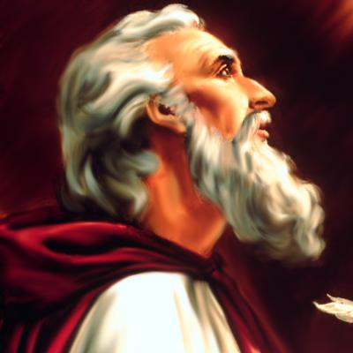
Zerubbabel, Ezra & Nehemiah ~ Great Reformers
Zerubbabel
Nehemiah
Ezra
Before we examine the last two controversial Scriptures,
let’s do a review on some of the history around these men
who led exiles back from Babylon.
Notes:
Aug 19th new slide 1130 am – 1155 am

Slide 81
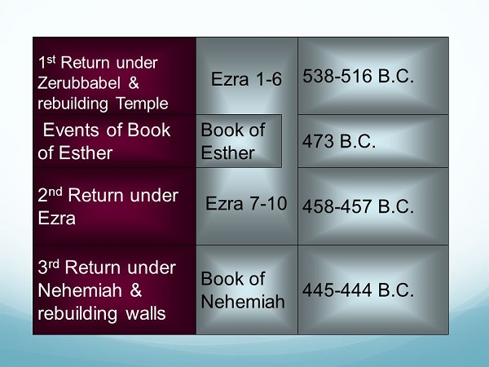

Timeline From 538 - 444 BC
Remember: All dates are approximates.
Notes:
Aug 19th new slide 1205 pm

Slide 82

Zerubbabel & Ezra
(1st & 2nd Return of Exiles)
721 Assyria
606 Babylon
701 Sundial
1450 MOSES
1350
1250
1150
1050
950
850
750
650
550
450
19) Ezra 3:5
Hezekiah 701
King Saul 1062
King David 1030
Elisha 895
Amos 787
Hosea 785
Ezekiel 574
Ezra 458
King Solomon 1015
Zerubbabel 536
King Solomon 1004
Isaiah 760
Hezekiah 726
Isaiah 698
Moses to Zerubbabel/Ezra~ 915-995 Years

Slide 83
538-516 BC Zerubbabel (1st Return of Babylonian Exiles)
Chapters 1-6 record the history of Zerubbabel
80 years before Ezra arrives with the 2nd group of exiles.
Ezra 3:2 Then stood up Jeshua … and his brethren
the priests, and Zerubbabel … and builded the altar of Yahuah of Israel, to offer burnt offerings thereon,
as it is written in the law of Moses the man of Yahuah.
Ezra tells us how the
Law of Moses
is still first priority almost 1000
years later.
We already know that Moses did not command any offerings on the NEW MOON, but only on the NEW <chodesh> MONTH.
Now, notice the following Scripture:
Notes:
174-176cf… June 29th … new slide
530

Slide 84

538-516 BC Zerubbabel (1st Return of Babylonian Exiles)
Ezra 3:5 And afterward offered the continual burnt offering, both of the new MOONS month [H2320 <chodesh>], and of all the set feasts of Yahuah that were consecrated, and of every one that willingly offered a freewill offering unto Yahuah.
Is it possible that Ezra would have
written verse 5 with “new moons”?
No! Ezra recorded exactly what Zerubbabel did
“as it is written in the law of Moses.”
Notes:
174-176 … JUNE 30TH … NEW SLIDE
610

Slide 85
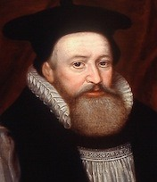

The Ezra 3:5 burnt offerings did NOT
align with the pagan “new moon”!
IF the first exiles were following the pagan new moons,
would Ezra not have recorded the event as
“your” NEW MOONS or “her” NEW MOONS?
Remember:
Hosea 2:11 [785 BC] and Isaiah 1:14 [760 BC]
had this exact apostasy documented more than 300 years earlier.
The KJV 1611 translators did not
give recognition
to Yahuah’s
H2320 <chodesh> “new festal month.”
George Abbot
KJV Translator
Could this be a problem of translating for the KJV?
Notes:
aug 19th new slide 335 pm

Slide 86
Who Was Ezra?
458 BC Ezra (2nd Return of Babylonian Exiles)
Ezra led the 2nd group of captives to
Jerusalem about 80 years after Zerubbabel.
He was an Aaronic Priest, Skilled Scribe & Teacher
of the Law of Moses! (See Ezra 7:1, 5, 6 & 10; 8:1-3, 9.)
Between the books of Ezra and Nehemiah,
Ezra is called a priest 8 times and a [skilled] scribe 7 times.
This confirms his well-qualified credentials.
Yahuah made sure Ezra’s credentials were the best for another reformation & restoration in Judah!
Notes:
174-175 … JUNE 30TH … NEW SLIDE
640

Slide 87
Ezra:
A Strong Leader
458 BC Ezra’s Commitment
Ezra 7:10 For Ezra [a skilled scribe and Aaronic priest] had prepared his heart to seek the law of Yahuah, and to do it, and to teach in Israel statutes and judgments.
Ezra taught the statutes and ordinances to Israel along with Nehemiah and the Levites according to Yahuah’s Everlasting Covenant.
Ezra would never have written anything about “new moons” nor taught the people such things!
Take careful note of the next set of Scriptures.
Notes:
178 … JUNE 30TH … NEW SLIDE
700

Slide 88
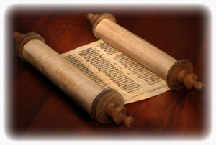
Torah Instructions With Ezra
Neh 8:1 And all the people gathered themselves together as one man into the street that was before the water gate; and they spake unto Ezra the scribe to bring the book of the law of Moses,
Neh 8:2 And Ezra the priest brought the law before the congregation both of men and women, and all that could hear with understanding, upon the first day of the seventh month.
Neh 8:3 And he [Ezra] read therein before the street … from the morning until midday … and the ears of all the people were attentive unto the book of the law.
Neh 8:9 And Nehemiah … and Ezra the priest the scribe, and the Levites that taught the people, said unto all the people, This day is holy unto Yahuah your Elohim; mourn not, nor weep. For all the people wept, when they heard the words of the law.

Slide 89
Who earns your trust? Ezra or the 1611 Translators?
We must recognize that Yahuah was watching over the
leaders of His people – especially through His prophets:
Amos, Hosea, Hezekiah, Ezekiel, Isaiah, Ezra, Nehemiah.
Ezra (and others) as priests, scribes, kings and prophets
were instructed and accountable to teach Torah truths.
Therefore, their actions and instructions must default back to teaching the Creator’s festal 30 day month according to accurate and proper definitions for H2320 <chodesh>.
Ezra
Or, do you think it’s more likely the translators
[influenced by Jewish tradition] interpreted H2320 <chodesh> incorrectly using the inaccurate words of
“new moons” rather than “new months”?
Abbot of 1611 KJV
Notes:
180-181cf … June 30th …
730

Slide 90


Nehemiah
(3rd Return of Exiles)
721 Assyria
606 Babylon
701 Sundial
1450
1450 MOSES
1350
1250
1150
1050
950
850
750
650
550
450
20) Neh 10:33
Hezekiah 701
King Saul 1062
King David 1030
Elisha 895
Amos 787
Hosea 785
Ezekiel 574
Ezra 458
King Solomon 1015
Zerubbabel 536
King Solomon 1004
Isaiah 760
Nehemiah 445
Hezekiah 726
Isaiah 698
Moses to Nehemiah ~ 1005 Years

Slide 91


445 BC Nehemiah (3rd Return with Exiles)
Date of Event: This is about 12+ years after Ezra had returned with the 2nd set of exiles.
Under Nehemiah the people had confessed and repented for their sins with the pagan nations (Neh 9).
The people agree to:
  separate themselves from the heathen people
  support a Temple tax that would supply the needed funds
  for necessary supplies for:
    the Sabbath(s)
    set feasts and the
    new month celebrations
Nehemiah led the 3rd group of exiles
back to Jerusalem.
Notes:
182-183… JUNE 30TH … NEW SLIDE
745

Slide 92
434 BC Nehemiah (2nd Return to Jerusalem in 11-12 Years)
Date of Event: On Nehemiah’s 2nd return to Jerusalem he found the people had fallen back into their evil ways – even conducting business on Sabbath.
Non-Jews were being permitted to conduct business inside Jerusalem on the Sabbath and to keep rooms in the Temple.
Greatly angered, he [as governor], purified the Temple.
Then Nehemiah instructed the Levitical
priests to implement the observance of the
Laws of Moses. Is there proof?
**Nehemiah
led out in another campaign for reformation and restoration!
Notes:
182-183… JUNE 30TH … NEW SLIDE
745

Slide 93

445-434 BC Nehemiah’s Faithfulness
Nehemiah 10:33 For the shewbread, and for the continual meat offering, and for the continual burnt offering,
of the sabbaths, of the new MOONS months [H2320 <chodesh>], for the set feasts, and for the holy things, and for the sin offerings to make an atonement for Israel, and for all the work of the house of our Elohim.
[H2320 <chodesh>] must be translated as new months.
Reminder: Moses’ Laws do not say anything about observing the “new moon [<yareach> H3394].”
Nehemiah taught the people the same laws as Ezra did.
This was another reminder so the people would not repeat their backsliding patterns. How long did it last?
Nehemiah’s efforts are the final witness
in the
Old Testament
for observing the Covenant Worship Statutes.
Notes:
184… JUNE 30TH … NEW SLIDE
800

Slide 94
For 1000 years, not one of
these great men of Yahuah
made one single mistake.
Nehemiah
King Saul Jonathan/David
ALL of them followed Yahuah’s Laws as given to Moses because there are no “new moon” worship statutes in Torah!
ALL of them beckoned the people to forsake pagan ways.
Ezra
King David
Zerubbabel
King
Solomon
Ezekiel
King
Hezekiah
Amos
Hosea
Isaiah
Elisha

Slide 95
Answering our Question:
Are there really 2 verbs & 2 nouns for ONE “moon”?
C ONC
LUS
I
ON
Hebrew #
Part of speech
1. H3394 = 26 listings <yareach>
2. H3391 = 2 listings <yerach>
3. H3842 = 3 listings <lebanah>
4. H7720 = 1 listing <saharon>
5. H2320 = 20 listings <chodesh>
Total of 52 references.
Noun – literal moon
verb – lunation cycle
Adjective – color
Simile – comparison
noun/Verb – repetition
Answer: No!
Neither H2320 chodesh /2318 chadash align with any moon month!

Slide 96


So what happened?
How did the “new moon”
words find their way into
20 non-Torah Scriptures
through H2320 <chodesh>?

Slide 97
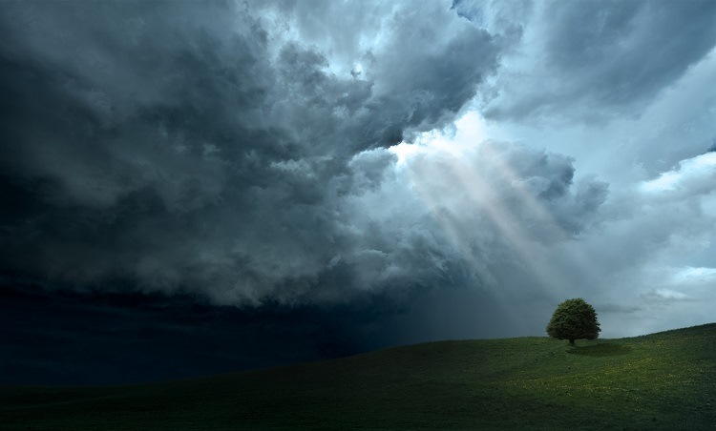
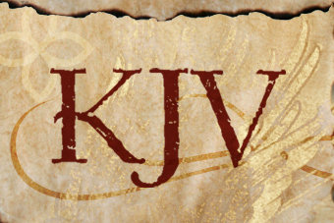
There are some things that could have happened with the 1611 KJV translation to cause such a problem in only 7% of the Scriptures to establish the
“new moon” over the “new <chodesh> month”!
Two possibilities
must be considered.
The translators ignorantly made a mistake by following
the Jewish traditions of their “new moon.”
The translators deliberately erred causing allegiance and sacred regard to be given to the moon in place of Yahuah’s festal month start.
Notes:
180cf … June 30th … WT slide
815

Slide 98

But … Let’s go back to
our original question!
Who really took away the Keys to Yahuah’s Covenant Calendar?
Was it only the 1611 Translators?
Hebrew Lexicon writers??
Israel?
Galilee?
Samaria?
Judah?

Slide 99
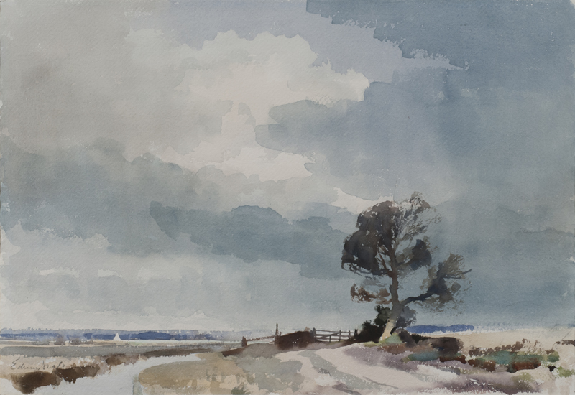
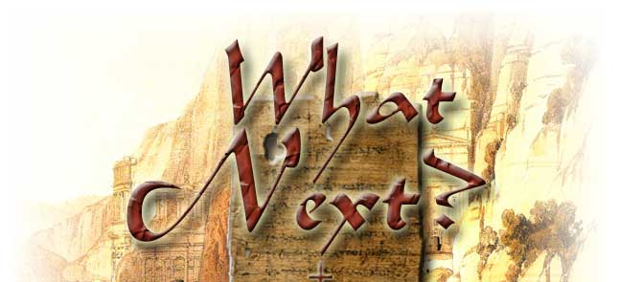


To find out who’s guilty and what
happened to Yahuah’s
Covenant Calendar
Keys …
Plan to enjoy Part 7:
The Moon! Oh, the Moon!
“My People Have Forsaken
Me for the Moonth?”
(on Oct 19/18)
The End
99
The End

Slide 100




If you need assistance with this information, please send your questions to
Charlene Fortsch or
Timothy Astleford:
questions@studythecalendar.com
charlene@torahtothetribes.com
or
Shofar1owr@gmail.com
www.studythecalendar.com

