Slide 1
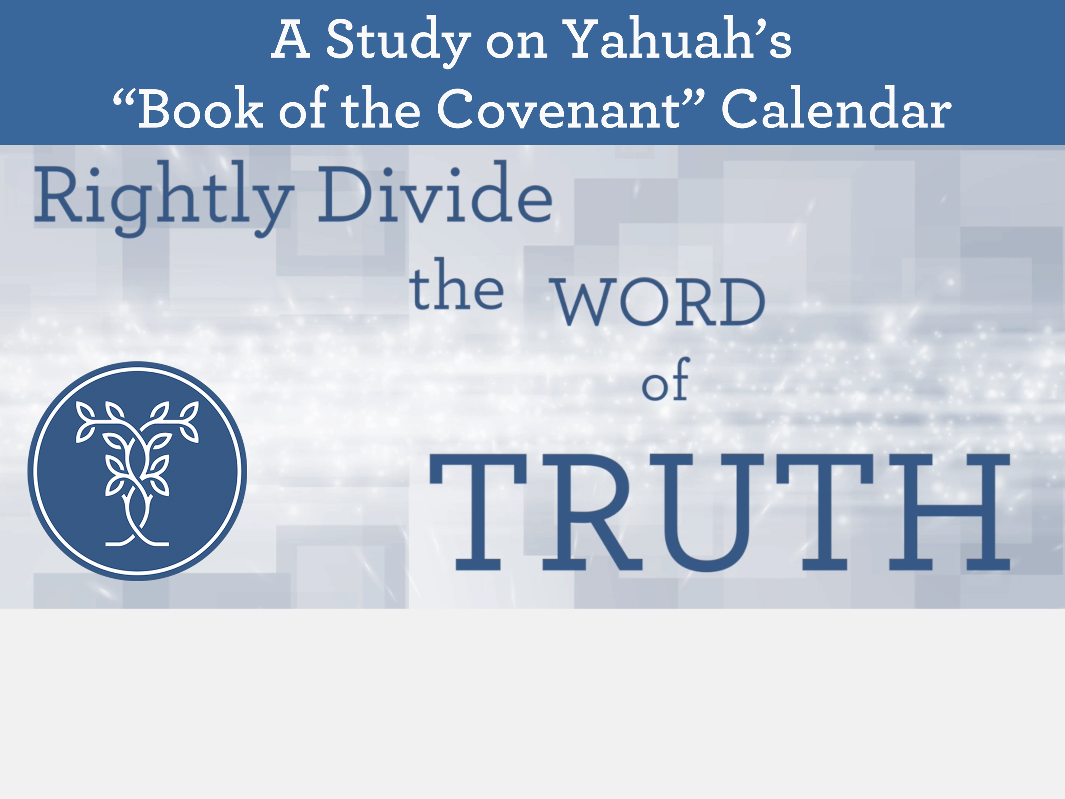
Commencement for Yom Kippur
(Day of Atonement)

Slide 2
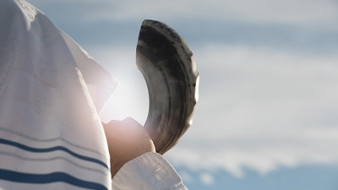


Grammar 101 Study on the commencement of
(Day of Atonement)
By: Charlene Fortsch
7 September 2018
Notes:
Sept 19th 2 hrs. to start up ppt with format start at 145 pm slide 1-

Slide 3
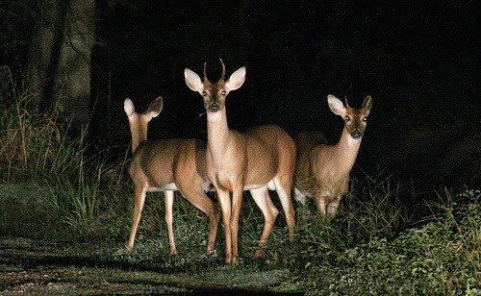
A “Deer & Headlights” Presentation!
Yahuah’s Covenant Calendar is used to illustrate the day-start for today’s topic.
Some will be new to this information and
may feel the information is blinding.
Notes:
Sept 23 added new slide for introduction for whole week’s worth of material

Slide 4
Will your eyes adjust to the new light?
When our eyes have been shielded by wearing counterfeit glasses, truth can be blinding when these blinders come off.
May Yahuah grant you the eye-salve to
see His glorious truth regarding the true &
easy commencement for Yom Kippur!
4
Notes:
Sept 23 added new slide for introduction 1045 am

Slide 5



Popular Verses used for Sunset Distortions
Two Torah Usages:
Gen 1:5b “And the evening and the morning were the first day.”
Lev 23:32c “… from even unto even, shall ye celebrate your sabbath.”
Two Non-Torah Usages:
Neh 13:19 “… when the gates of Jerusalem began to be dark before
the Sabbath …”
John 20:1 “The first day of the week cometh Mary Magdalene early, when it was yet dark, unto the sepulchre …”
There are 35+ Scripture witnesses for the Dawn Day that are easy to understand with proper study skills.
Notes:
Sept 23 new slide p 20-21 1100-1115 am

Slide 6

Reviewing Simple Lessons Long Forgotten?!
How can a simple English word like “evening” pose such a confusing problem when linked to the proper commencement for Day of Atonement?
Could it be the Church Leaders, Pastors, Bible Workers &
Feast Teachers have not been diligent enough in their search?
Have they been misled by traditions, ignorantly passing along what
they have learned from the Jewish culture or Hebrew Roots movements?
Can the nominal Bible Student really find out what the truth is of this “evening” controversy for the most solemn, qodesh feast day of the year?
See how this problem can be solved with simple grammar skills
as we take a good look at Yam Kippur from Lev 23:26-32.
Notes:
Sept 19th 530 pm pg 0

Slide 7



For understanding the phrase from Lev 23:32
“…from even unto even shall ye celebrate your Sabbath.”
Is this phrase
defining when
Yom Kippur
begins, or not?
Notes:
Sept 19 p1 600 pm

Slide 8


When it comes to “day-start”
the Question is
Always the Same
Since when does the day not begin with “evening” anymore?
This study we will attempt to sharpen our Bible study skills through finding the answer to
the question on:
“When does Yahuah’s day really begin?” … especially Day of Atonement.
It’s a Good Question!
There is an Answer!
Notes:
Sept 20 100 pm

Slide 9

INTRODUCTION
In this study we are going to learn how to understand exactly when to begin Yom Kippur (Day of Atonement), and what to do with the other mandated requirements.
The Grammar 101 study is the foundation.
Tonight each one will be relying on their previous study skills for our topic of discussion – especially the definition of “evening.”
Lev 23:26-32 This passage for Yom Kippur is one of the most controversial Scriptures used by many to demand all “Sabbath(s)” begin in the evening at sunset!
Of High Importance:
Read more than
10 words
to discern context!
Notes:
Sept 20 1145 am

Slide 10

Scripture Deals With Confusion Best
For the Covenant Calendar study,
is Yom Kippur the only Sabbath that begins at “even”?
Many of us have been taught that "evening" means "sunset" which begins the new day for “Sabbath(s).”
Few of us have thought about challenging this point, because
we really believed …
What we were shown was true.
We were taught this concept from age 2.
Most of us have not been taught to question the meaning of such a simple word as “even/evening”? Why?
Because we were taught our leaders & teachers did instruct us on the truth about such a matter …
To satisfactorily answer the “evening” question
we need to learn how to accept this controversial challenge by using better Bible study skills.

Slide 11
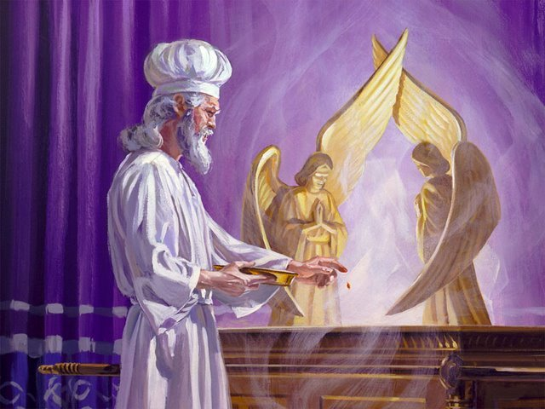
Yom Kippur (Day of Atonement)
The most solemn, quodesh
Sabbath of the year!

Slide 12

Day of Atonement Challenge
Scenario:
You just invested a lot of time and effort to understand the day-start beginning with the first day of creation.
You can even explain it really well the day begins at dawn.
Then:
Along comes your Sabbath pastor.
He is not interested in your new understanding.
Next you hear these words from him:
“… from even unto even, shall ye
celebrate your sabbath.” (Lev 23:32c)
Well, you certainly know all about
“even” from your Genesis 1 study.
BUT … you don’t know how to
answer this challenge!
Now what?
Scripture has an easy answer by following a few simple rules.
Notes:
Sept 22 p 19 getting started with yom kippur. 810 pm

Slide 13

Simple Study Techniques
Remember the basics from Gen 1;
Read all the content carefully;
Read in context – very carefully.
Notes:
Sept 22 p 19 work up 820 pm

Slide 14

Two Strict Requirements
Pay attention to Yahuah’s
2 strict requirements for
Day of Atonement.
Both are repeated 3 times;
Note where both requirements are found;
Determine the timeframe of each requirement.
Let’s examine the Day of Atonement verses very carefully.
Notes:
Sept 23 p 19 new slide 630 am

Slide 15

Lev 23:26-27
 | Content of Verse | Context of Verse
26 | And the LORD spake unto Moses, saying, | A command is being given to Moses. It will be regarding the Day of Atonement.
27 | Also on the tenth day of this seventh month there shall be a day of atonement it shall be an holy convocation unto you; and ye shall afflict your souls, (through humbling and/or total fast of no food or drink.) and offer an offering made by fire unto the LORD. | Date: 10th Day of the 7th Month. (Gen 1 declares the commencement moment for this day as “dawn.”) Name: Day of Atonement (Yom Kippur). Status: Holy Sabbath just as the weekly Sabbath. *1st Requirement for Observation: “afflict your soul” *This is the 1st mention. Sacrifices Required: (Will not be addressed as the sacrifices have been fulfilled.)
Notes:
Sept 22 p 19 start at 840 pm
Sept 23 detailed 615 am

Slide 16
Lev 23:28-29
 | Content of Verse | Context of Verse
28 | And ye shall do no work in that same day: for it is a day of atonement, to make an atonement for you before the LORD your God. | *2nd Requirement for Observation: “shall do NO work” *This is the 1st mention. Context is: 10th Day of the 7th Month - Day of Atonement. Purpose: Atonement for man’s sins.
29 | For whatsoever soul it be that shall not be afflicted in that same day, (through humbling and/or total fast of no food or drink.) he shall be cut off from among his people. | *1st Requirement for Observation: “afflict your soul” **This is the 2nd mention the 1st requirement is emphasized! Consequence for disobedience to the 1st requirement: that person would not be part of the genealogy of the Messiah.
Notes:
Sept 22 p 19 start at 855 pm
Sept 23 detailed 620 am

Slide 17
Lev 23:30-31
 | Content of Verse | Context of Verse
30 | And whatsoever soul it be that doeth any work in that same day, the same soul will I destroy from among his people. | *2nd Requirement for Observation: “shall do NO work” **This is the 2nd mention the 2nd requirement is emphasized! Consequence for disobedience to the 2nd requirement: that soul will be destroyed.
31 | Ye shall do no manner of work: it shall be a statute for ever throughout your generations in all your dwellings. | *2nd Requirement for Observation: “shall do NO work” ***This is the 3rd mention the 2nd requirement is emphasized! Status of Requirement: a statute to be observed forever in all generations.
Notes:
Sept 22 p 19 start at 900 pm

Slide 18
Lev 23:32 (a, b, c)
 | Content of Verse | Context of Verse
32 a. b. | It shall be unto you a sabbath of rest, | Date: Context of “IT” from vs 27 is the 10th Day of the 7th Month. Context: “IT” refers to the qodesh Day of Atonement Sabbath Day.
 | Slight Change of Context Right Here!
c. | and ye shall afflict your souls: (through humbling and/or total fast of no food or drink.) | *1st Requirement for Observation: “afflict your soul” ***This is the 3rd mention. So far in verse 32 the context is a required “affliction” on Day of Atonement, but there’s more!
Notes:
Sept 22 p 19 start at 900 pm

Slide 19
Lev 23:32 (d, e)
 | Content of Verse | Context of Verse
32 d. e. | in the ninth day of the month at even, (<ereb> H6153) (of the 9th day the “affliction of one’s soul” begins.) | When? The affliction begins on the 9th day (of the 7th month); [The context for this phrase is STILL “affliction” in preparation for Day of Atonement.] What time on the 9th day? The context for affliction – begins at “even” – the time of dusk twilight.
Notes:
Sept 22 p 19 start at 900 pm

Slide 20
Lev 23:32 (f, g)
 | Content of Verse | Context of Verse
32 f. g. | from even unto even, shall ye celebrate your Sabbath. | Length of time for “affliction requirement”: The context has not changed from affliction – it lasts 24 hours from the “even” of the 9th day until the “even” on the 10th Day of Atonement. Declaration: affliction of one’s soul begins 12 hours in advance being named as a celebration for the Yom Kippur Sabbath.
Notes:
Sept 22 p 19 start at 900 pm
Sept 23 p 19 850 am … finish all table slides at 910 am

Slide 21

Two Strict Requirements
Repeated 3 Times Each
“the soul shall do no work”
Found in:
vs 28, 30, 31.
Timeframe: 24 hrs.
on the full 10th day,
7th month;
(dawn to dawn).
“afflict your soul”
Found in:
vs 27, 29, 32.
Timeframe: 24 hrs.
12 hrs. 9th day (dusk to dawn);
12 hrs. 10th day
(dawn to dusk).
Obedience to both requirements was named as
“celebrating Yom Kippur (the Day of Atonement).”
Notes:
Sept 23 p 19 new slide 700 am … or last note: Affliction does not sound like an Atonement celebration
to us, but that’s what the Bible calls it.

Slide 22
Day of Atonement (Dawn)
Fasting Timeframe
8th day |  |  |  | 9th Day of Preparation |  |  |  | 10th Day of Atonement |  |  |  | 11th Day
With the DAWN Format:
The 9th day of the month begins at “dawn” on the 9th day!
The “affliction” begins at “even on the 9th day.”
The “affliction” continues to the “even” of the 10th day to fulfill the requirement.
The “affliction of one’s soul” has been in process 12 hours upon the arrival of “dawn” ON the “Day Season” of the Yom Kippur Sanctuary services!
Absolutely “no work” on the 24 hours of Yom Kippur reaching to dawn on the 11th day.
The Most Important Requirement for “Affliction of One’s Soul”
ON the Day of Atonement is now Completely Fulfilled!
No Work Timeframe
Notes:
Sept 23 p 19 new slide 705-805am … complete animation

Slide 23
Day of Atonement (Sunset)
Sunset
Fasting Timeframe
8th day |  |  |  | 9th Day of Preparation |  |  |  | 10th Day of Atonement |  |  |  | 11th Day
No Fasting Done
(Do Not Work)
With the Sunset Theory:
The 9th day of the month begins at sunset, or “even” on the 8th day.
The “affliction” would then begin at the “even on the 8th day.”
The “affliction” continues to the “even” of the 9th day.
The “affliction requirement” is fulfilled before Yom Kippur even begins.
No “affliction of one’s soul” occurs ON Yom Kippur as per the requirement!
Notes:
Sept 23 p 19 new slide 725-740-805 am … complete animation

Slide 24
Day of Atonement (Sunset)
24 Hour Sunset
Fasting Timeframe
8th day |  |  |  | 9th Day of Preparation |  |  |  | 10th Day of Atonement |  |  |  | 11th Day
With the Sunset Theory day-start:
If one wishes to fast to the end of Yom Kippur –
one must begin at even on the 8th day of the month.
The result: the fast will be a duration of 48 hours!
The Most Important Requirement for
“Affliction of One’s Soul” ON Yom Kippur
will be Completely Disregarded!
The Statute is Broken!
Notes:
Sept 23 p 19 new slide 725-740-805 am … complete animation

Slide 25

Day of Atonement Solution
The New Scenario:
Next time you are in a similar situation, you will have the simple, truthful answer to the commencement time for Day of Atonement.
Then:
You can practice your study skills by:
Looking up those definitions!
Reading enough content!
Reading in context very carefully.
Learning by teaching!
Taking careful note that the 9th day
of the month has only ONE
“evening, not two as Sunset Theory
requires!
That’s great!
Yahuah’s ways are always simple, easy and orderly!
Notes:
Sept 23 p 19 conclusion 740-800 am

Slide 26
With your Bible, an exhaustive concordance and good study skills,
you will be able to answer
most challenges easily.
May Yahuah Bless You Abundantly!
Notes:
Sept 22 p 19 work up 820 pm

Slide 27

End of
Part 2
We have now landed
from our study!
Questions/Comments?

Slide 28


Enjoy these beautiful mornings that usher in Yahuah’s original Covenant Day!
The End
Charlene Fortsch, BC Canada
Info@t4study.com 7 Sept 2018 Nov 2016
Notes:
Sept 23 final slide finished 200 pm … need to check and animate, etc.

