Slide 1

Yahusha’s Birth

Slide 2
Yahusha’s Birth:
When was it?

Slide 3
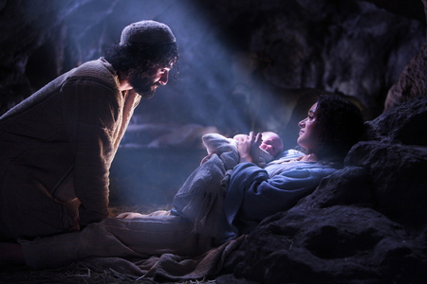
The intention of this study is to help people understand the fallacy of the December 25th tradition of man.
Born on
Dec 25th?
Is it possible this
blessed event
happened on
December 25th?
(which is the 9th day of
the 10th month??)

Slide 4

NOTE: The Scriptures and the
HalleluYah Scriptures
are the Scriptures of
choice unless otherwise
noted.
4

Slide 5
Our Salvation
Luke 2:11 “Because there was born
to you today in the city of Dawiḏ a Saviour, who is Messiah, the Master.
Luke 2:12 “And this is the sign to you:
You shall find a baby wrapped up,
lying in a feeding trough.” The Scriptures
5

Slide 6

Zekaryah the Kohen, (Priest)
To ascertain the correct time of the birth of Yahusha Ha Mashiach, we must first find the details of the birth of John the Baptist. This takes us directly to his parents –
Zekaryah and Elisheba.
Luke 1:5 There was in the days of Herodes, the sovereign of Yehuḏah, a certain priest named Zeḵaryah, of the division of Aḇiyah.
And his wife was of the daughters of Aharon,
and her name was Elisheḇa.

Slide 7
Zekaryah’s Priestly Duties
Zekaryah (Zacharias) was a priest within the Aharonic Priesthood.
Luke 1:5, in the last slide, informed us that Zekaryah belonged to the Abijah division of priests.
We also see that Zekaryah belonged to the eighth division, and they, as the others, would serve in the Tabernacle two times within a year, not including the mandatory “Set-Apart Appointed Times” that each Priest must serve.
1 Ch 24:10 the seventh to Haqqots, the eighth to Aḇiyah,
Zekaryah, the Kohen Ha Gadol (High Priest) was preforming the sanctuary service at the altar of incense in the Tabernacle.

Slide 8
Zekaryah’s - Kohen Ha Gadol Duties
Zekaryah would serve in the 8th individual week after the Tequfah (vernal equinox) had initiated Yahuah’s new year.
He would also serve during the weeks of: Passover/Unleavened Bread and Shavuot, when all priests must perform service duty together during the Mo-edim (Appointed Times).
Zekaryah (while serving at the Altar of Incense – Luke 1:8, 9) was burning the incense — roughly, in the week prior to Shavuot (Pentecost).

Slide 9
A Messenger from י ה וֹ ה.(Yahuah), visits Zekaryah
Luke 1:11 And a messenger of יהוה [Yahuah] appeared to him, standing on the right side of the altar of incense.
This is the Messenger’s communication to Zekaryah:
Luke 1:13 But the messenger said to him, “Do not be afraid, Zeḵaryah, for your prayer is heard. And your wife Elisheḇa shall bear you a son, and you shall call his name Yoḥanan.

Slide 10
The Messenger’s Timeframe
Did the Messenger of Yahuah provide a timeframe of when
Zekaryah might expect this miraculous event to occur?
Luke 1:20 “But see, you shall be silent and unable to speak until the day this takes place, because you did not believe my words which shall be filled in their appointed time.”
Note: Yahuah’s message clearly indicated that the words the Messenger spoke were to be fulfilled on a mo-ed (appointed time).
Question: Was this specific appointed time a – Mo-ed (Set Apart Appointed Time) or was it simply a – mo-ed, an appointment?

Slide 11

Was that - Mo-ed (4150)? mo-ed (4150)?
or
In Leviticus we see the status of the Mo-edim.
Lev 23:4 These are the appointed times of יהוה [Yahuah], set-apart gatherings which you are to proclaim at their appointed times.
In 1 Samuel there is an example of a simple mo-ed.
1 Sam 20:35 And it came to be, in the morning, that Yehonathan went out into the field at the time appointed with Dawiḏ,
and a small youth was with him.

Slide 12
APPOINTED TIME? … or appointed time?
What is the difference between the two appointed times?
One - Appointed Time, is a Qodesh (Set-Apart) Appointed Time which can only be deemed Qodesh by Yahuah.
The other appointed time is just a normal set time to assemble for a normal reason. Yahuah can appoint this type of appointment also, as well as man.

Slide 13
Zekaryah’s mo-ed, (appointed time)
The Messenger of Yahuah had informed Zekaryah of the time frame when he could expect a newborn son, and, when his voice would be returned to him. This specific time frame was deemed, by the Messenger, as an appointed time.
Questions: Was this highly important event to occur on a Set-Apart Appointed Time as seen when the Feasts and Festivals are observed?
Or – was this child, the one to herald the coming Mashiach to the world, to be born on just an ordinary appointed day?

Slide 14
Elisheba’s Repose
Luke 1:23 And it came to be, as soon as the days of his [Zekaryah] service were completed, he [Zekaryah] went away to his house.
Luke 1:24 And after those days his wife Elisheḇa conceived.
And she hid herself five months …
Elisheba became pregnant as promised by the Messenger.
Elisheba then took 5 months repose time preparing to be a mother.
Question: When the Scriptures say - after Zekaryah’s service time was finished – does that include the time of Shavuot where the High Priest must do service also?
Note: Elisheba’s 5 months of repose takes this time frame into the 8th month which is around the end of October mark.

Slide 15

Let’s take a bit of time to summarize what we know thus far on a basic calendar format.

Slide 16


Abib – 1st Month
Aharonic Weekly Priest’s Courses
1 | 2 | 3 | 4 | 5 | 6 | 7
8 | 9 | 10 | 11 | 12 | 13 | 14
15 | 16 | 17 | 18 | 19 | 20 | 21
22 | 23 | 24 | 25 | 26 | 26 | 28
29 | 30
1
2
3
4
Passover
Unleavened Bread
Zekaryah of the Abiyah course (1Chron 24:10, Luke 1:5), which placed in the
8th course of the year,
was performing his
first week of
individual service.
2nd Month
 |  | 1 | 2 | 3 | 4 | 5
6 | 7 | 8 | 9 | 10 | 11 | 12
13 | 14 | 15 | 16 | 17 | 18 | 19
20 | 21 | 22 | 23 | 24 | 25 | 26
27 | 28 | 29 | 30 | (1) | (2) | (3)
4
5
6
7
8

Slide 17
Abib – 1st Month
Aharonic Weekly Priest’s Courses
1 | 2 | 3 | 4 | 5 | 6 | 7
8 | 9 | 10 | 11 | 12 | 13 | 14
15 | 16 | 17 | 18 | 19 | 20 | 21
22 | 23 | 24 | 25 | 26 | 26 | 28
29 | 30
1
2
3
4
Passover
Unleavened Bread
Stop!
Why does the one brown square not contain a #?
That brown space represents the week that EVERY Aharonic priest was scheduled to serve simultaneously. That space during the Feast of Unleavened Bread is not classified as an individual weekly course
for just one priest.

Slide 18

The Messenger Contacts Zekaryah
The Scriptures do not inform us if it was during this week of service in the Mishkan, or if it was during the week of Shavuot (Pentecost) that the Messenger of Yahuah related the incredible news of a son to – Zekaryah.
It is quite likely, depending upon how the week days of the year landed, that this 8th course was the very course prior to Shavuot!
2nd Month
 |  | 1 | 2 | 3 | 4 | 5
6 | 7 | 8 | 9 | 10 | 11 | 12
13 | 14 | 15 | 16 | 17 | 18 | 19
20 | 21 | 22 | 23 | 24 | 25 | 26
27 | 28 | 29 | 30 | (1) | (2) | (3)

Slide 19
Zekaryah Returns Home to Elisheba
Zekaryah, being the Kohen Ha Gadol (High Priest), was also required to serve during the Feast of Shavuot.
The Scriptures declare that Zekaryah returned home to Elisheba after his service duty in the Tabernacle had been fulfilled. Let’s read from the Scriptures of this account.
Luke 1:23 And it came to be, as soon as the days of his service were completed, he went away to his house.
Luke 1:24 And after those days his wife Elisheḇa conceived. And she hid herself five months ...
This 5 months of hiding reaches, at the least, into the 8th month of the year!

Slide 20


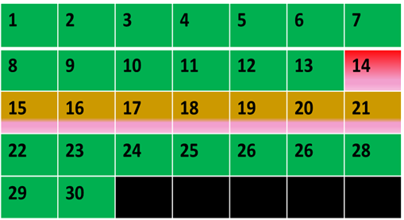

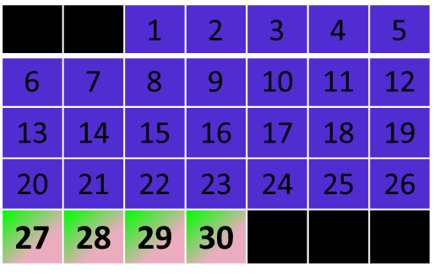


When Does Zekaryah Return Home?
Courses 1 & 2 of priestly rotations.
Unleavened Bread Festival every priest assists.
After the Feast, the priest’s rotation resumes.
Courses 4 - 7 priestly rotations are fulfilled.
Zekaryah completes course 8 of service in the Tabernacle, and fulfills the Shavuot week also. He then returns home to Elisheba, making plans for a family.
8th course
 |  |  |  | 1 | 2 | 3
4 | 5 | 6 | 7 | 8 | 9 | 10
11 | 12 | 13 | 14 | 15 | 16 | 17
18 | 19 | 20 | 21 | 22 | 23 | 24
25 | 26 | 27 | 28 | 29 | 30

Slide 21
Side Note:
The full week wherein Pentecost occurs is highlighted in the previous slide. This is seen in the recorded fact from the Scriptures that the kohenim (priests) started their weekly service on a Sabbath, and ended on a Sabbath. See 2 Kings 11:9 and 2 Chronicles 23:8.
Now let’s return and look at the first 5 months of Elisheba’s pregnancy.

Slide 22
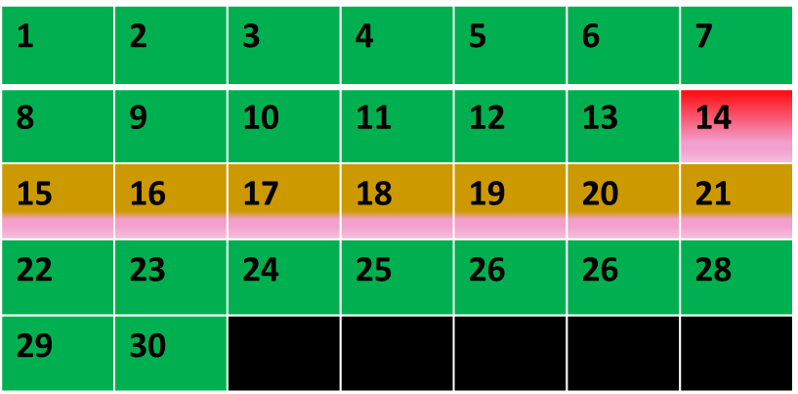
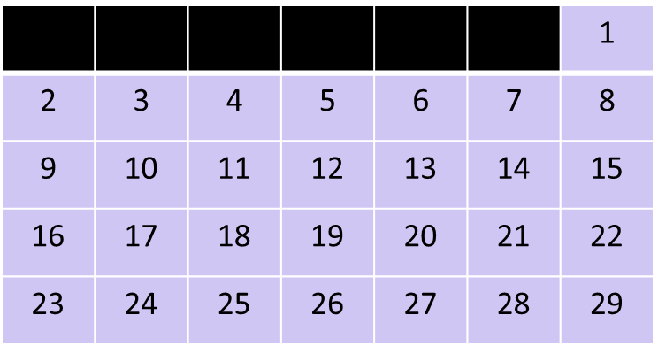



The First Month of Pregnancy/Hiding for Elisheba
1
Abib
4
Elisheba’s first month of pregnancy ended somewhere in the middle of the 4th month of the year.
1
2
3
4
2
 |  | 1 | 2 | 3 | 4 | 5
6 | 7 | 8 | 9 | 10 | 11 | 12
13 | 14 | 15 | 16 | 17 | 18 | 19
20 | 21 | 22 | 23 | 24 | 25 | 26
27 | 28 | 29 | 30
4
5
6
7
Zekaryah’s 8th course prior to Shavuot.
3
Zekaryah serves in the Temple during Shavuot.
 |  |  |  | 1 | 2 | 3
4 | 5 | 6 | 7 | 8 | 9 | 10
11 | 12 | 13 | 14 | 15 | 16 | 17
18 | 19 | 20 | 21 | 22 | 23 | 24
25 | 26 | 27 | 28 | 29 | 30
Starting the following week, Zekaryah returns home with family plans on his mind.

Slide 23
The Five Months of Elisheba’s Pregnancy
1
Abib
4
7 [Tishri]
(1)
(4)
 |  |  |  |  | 1 | 2
3 | 4 | 5 | 6 | 7 | 8 | 9
10 | 11 | 12 | 13 | 14 | 15 | 16
17 | 18 | 19 | 20 | 21 | 22 | 23
24 | 25 | 26 | 27 | 28 | 29 | 30
1
2
3
4
5
2
 |  | 1 | 2 | 3 | 4 | 5
6 | 7 | 8 | 9 | 10 | 11 | 12
13 | 14 | 15 | 16 | 17 | 18 | 19
20 | 21 | 22 | 23 | 24 | 25 | 26
27 | 28 | 29 | 30
4
5
6
7
8
(2)
 | 1 | 2 | 3 | 4 | 5 | 6
7 | 8 | 9 | 10 | 11 | 12 | 13
14 | 15 | 16 | 17 | 18 | 19 | 20
21 | 22 | 23 | 24 | 25 | 26 | 27
28 | 29 | 30
1 | 2 | 3 | 4 | 5 | 6 | 7
8 | 9 | 10 | 11 | 12 | 13 | 14
15 | 16 | 17 | 18 | 19 | 20 | 21
22 | 23 | 24 | 25 | 26 | 27 | 28
29 | 30
5
3
6
 |  |  | 1 | 2 | 3 | 4
5 | 6 | 7 | 8 | 9 | 10 | 11
12 | 13 | 14 | 15 | 16 | 17 | 18
19 | 20 | 21 | 22 | 23 | 24 | 25
26 | 27 | 28 | 29 | 30
 |  |  |  | 1 | 2 | 3
4 | 5 | 6 | 7 | 8 | 9 | 10
11 | 12 | 13 | 14 | 15 | 16 | 17
18 | 19 | 20 | 21 | 22 | 23 | 24
25 | 26 | 27 | 28 | 29 | 30
(3)
These are the 5 months of Elisheba’s hiding, within the first 8 months of the year.

Slide 24
Note:
We are expecting that Elisheba became pregnant fairly quickly, around the middle of the 3rd month. That brings the first month of pregnancy, ENDING during the middle of the 4th month, and so on through the pregnancy!
The 5th month of pregnancy would then have ended in the middle of the 8th month!

Slide 25

Yahuah’s Respect for a
Lady With Child
Yahuah has provided a brilliant display of His high respect for a lady carrying a child within.
Note that He did not tell Miryam of Elisheba’s condition until her time of hiding had passed!
It was on the LAST HALF OF THE 8th month of the year,
INTO the 6th month of pregnancy for Elisheba (Luke 1:26), before Yahuah sent a messenger to Miryam.

Slide 26

Miryam Enters into the Picture
6th Month of Pregnancy starting around the 15th(?)
Luke 1:26 And in the sixth month the messenger Gaḇri’ĕl was sent by Elohim to a city of Galil named Natsareth,
Luke 1:27 to a maiden engaged to a man whose name was Yosĕph, of the house of Dawiḏ. And the maiden’s name was Miryam.
Luke 1:36 And see, Elisheḇa your relative, she has also conceived a son in her old age. And this is now the sixth month to her who was called barren …
.
1 | 2 | 3 | 4 | 5 | 6 | 7
8 | 9 | 10 | 11 | 12 | 13 | 14
15 | 16 | 17 | 18 | 19 | 20 | 21
22 | 23 | 24 | 25 | 26 | 27 | 28
29 | 30
8th Month of the Year
Look up Luke 1:5. There we see that Miryam being a relative of Elisheba, was also of the blood line of Aharon.

Slide 27
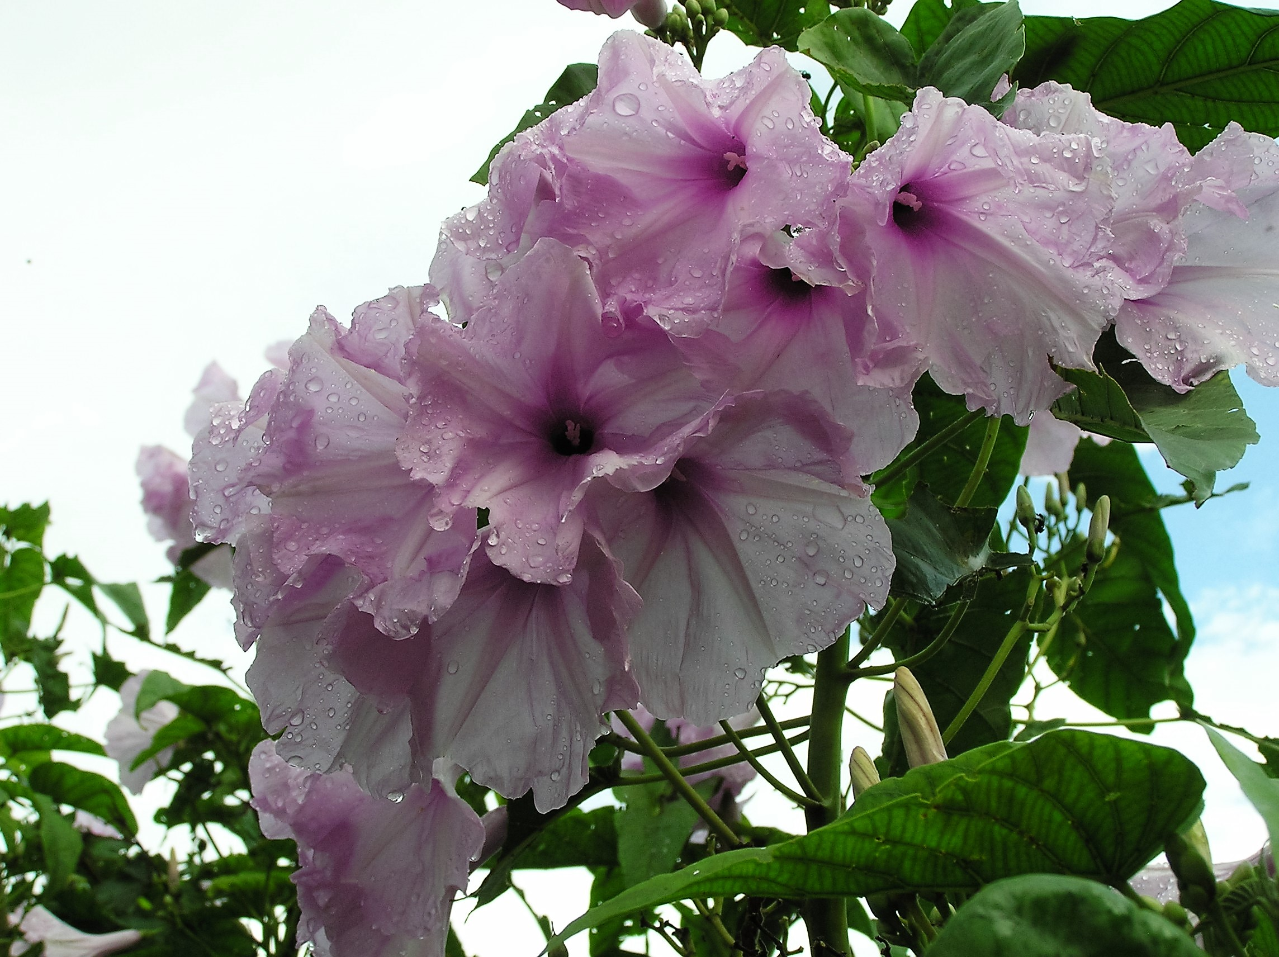
For those wishing texts to show that Miryam was of the blood line of Aharon, please look up:
Jer 33:15,
Zech 3:8,
Zech 6:11-13.

Slide 28
Miryam Dwells With Elisheba
Miryam immediately accepted the supreme responsibility of providing
a womb and mothering Yahusha; she then took immediate action.
Luke 1:38 And Miryam said, “See the female servant of יהוה [Yahuah]! Let it be to me according to your word.”
And the messenger went away from her.
Luke 1:39 And Miryam arose in those days and went into
the hill country with haste, to a city of Yehuḏah,
Luke 1:40 and entered into the house of Zeḵaryah and
greeted Elisheḇa.
Luke 1:56 And Miryam stayed with her about three months, and returned to her home.

Slide 29

Miryam’s Significance
Luke 1:30 And the messenger said to her, “Do not be afraid, Miryam, for you have found favour with Elohim.
Luke 1:31 “And see, you shall conceive in your womb, and shall give birth to a Son, and call His Name יהושע [Yahusha]. ¹ Footnote: ¹Mt. 1:21.
Luke 1:32 “He shall be great, and shall be called the Son of the Most High. And יהוה [Yahuah] Elohim shall give Him the throne of His father Dawiḏ.
Luke 1:33 “And He shall reign over the house of Yaʽaqoḇ [Jacob] forever, and there shall be no end to His reign.” ¹ Footnote: ¹Verses 32 and 33 confirm the prophecies Ps. 2, Ps. 89:14-34, Isa. 9:7, Isa. 16:5, Jer. 23:3-6, Jer. 30:9, Ezek. 37:24, Dan. 2:44, Dan. 7:18-27, Mic. 5:2-4, Acts 1:6-7, Rev. 11:15.

Slide 30
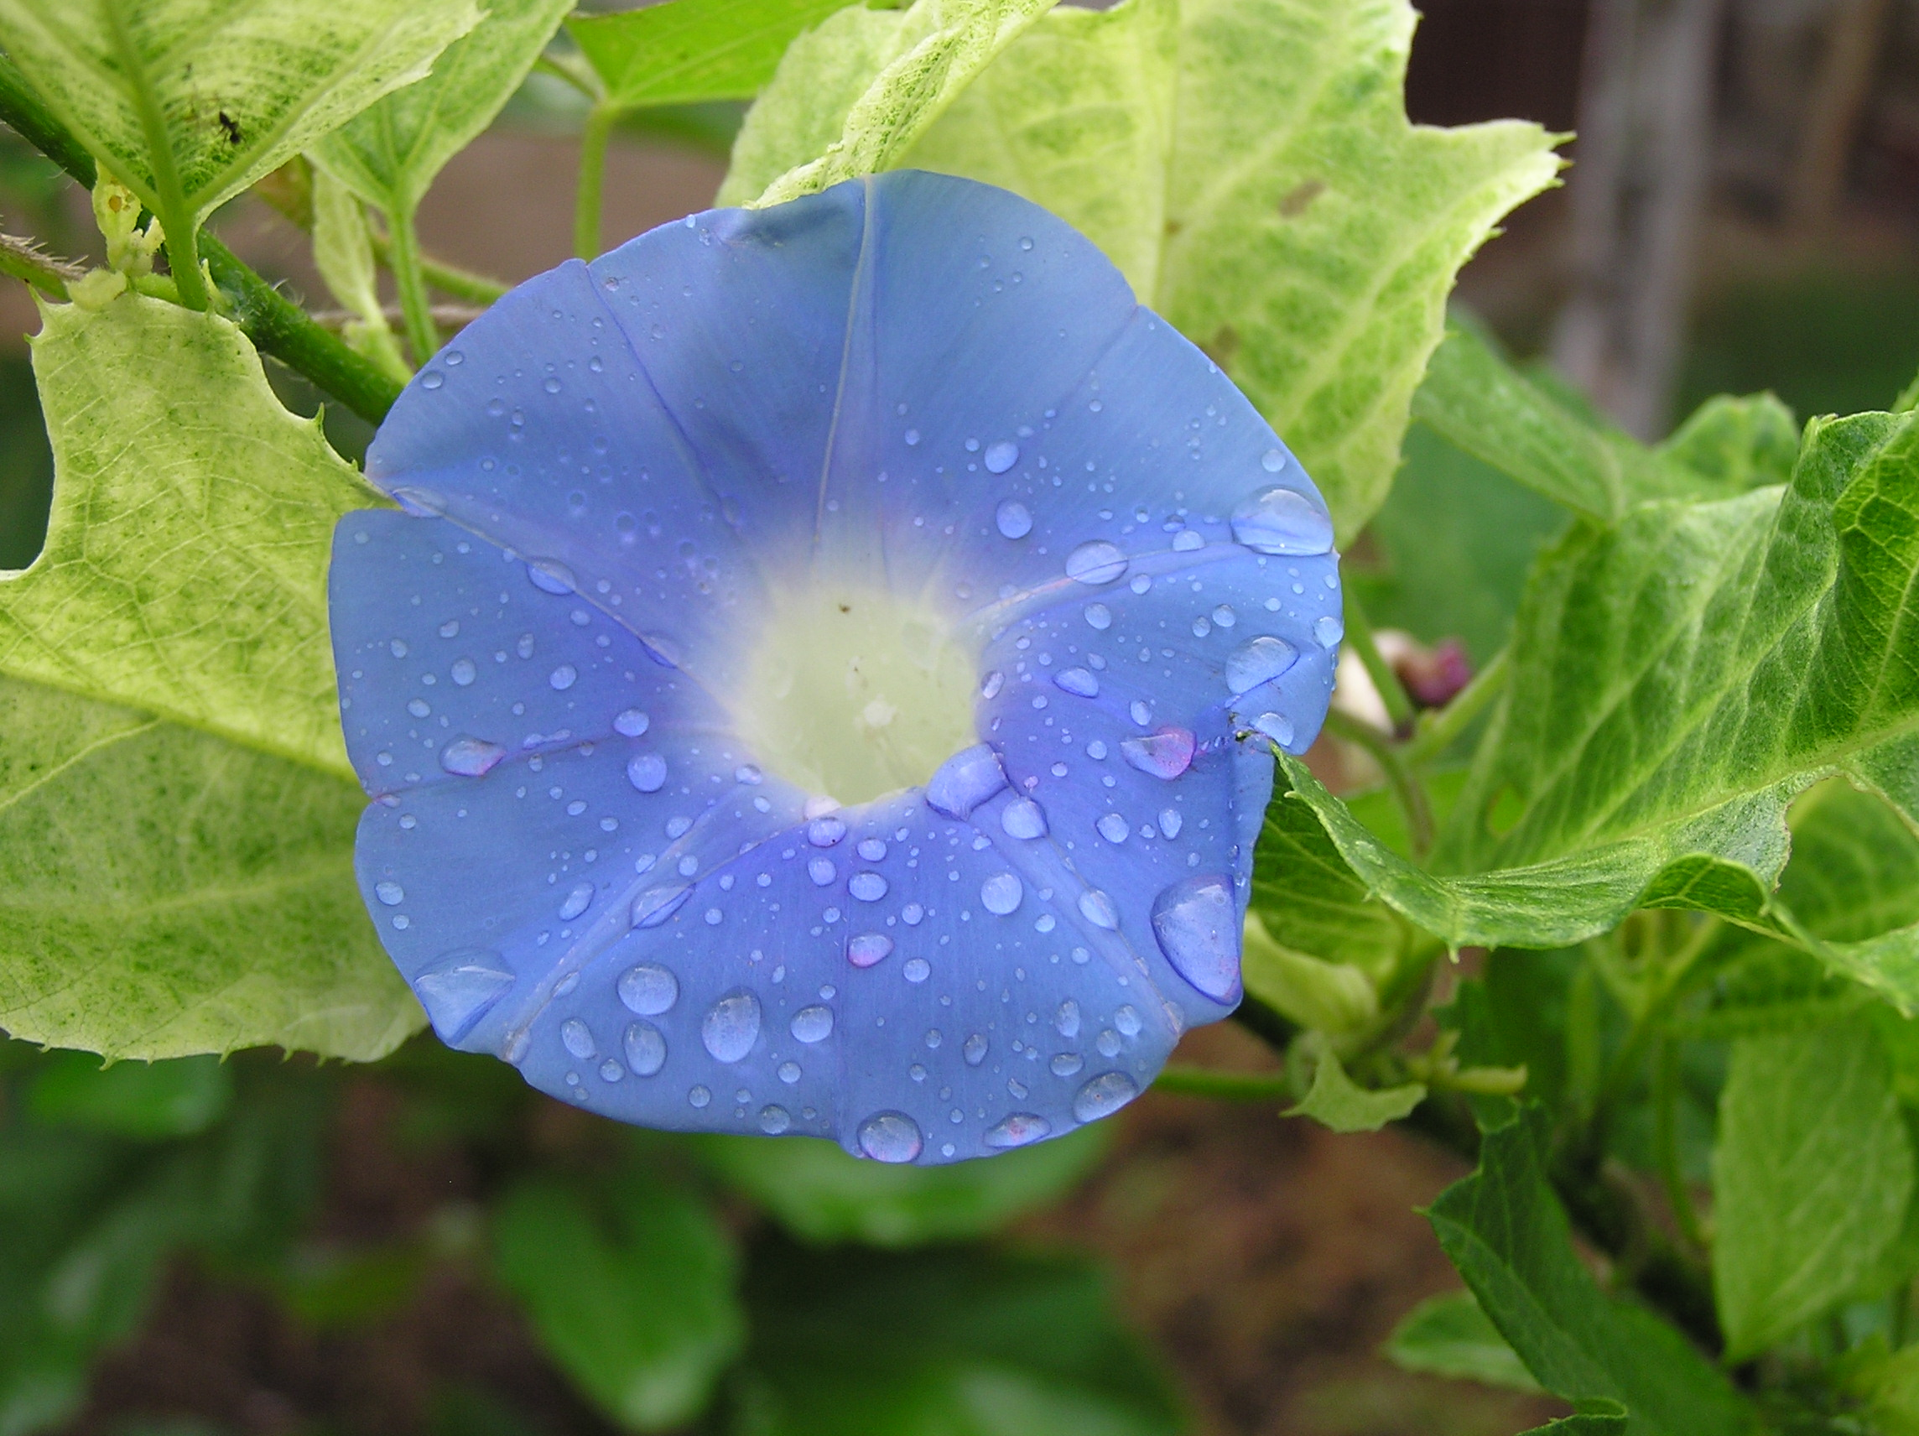
Let’s look at the next 3 months of Miryam’s visitation. Starting halfway into the 8th month, we count three more months. This brings time to midway through the 11th month!
These 3 months saw Miryam staying with Elisheba, caring for her and most likely assisting with the chores around the house.

Slide 31
The Grand Meeting
What highly significant event occurred when Miryam met and greeted Elisheba?
Luke 1:41 And it came to be, when Elisheḇa heard the
greeting of Miryam, that the baby leaped in her womb.
And Elisheḇa was filled with the Set-Apart Spirit,
Luke 1:42 and called out with a loud voice and said, “Blessed are you among women, and blessed is the fruit of your womb!
Luke 1:43 “And who am I, that the mother of my Master should come to me?
Luke 1:44 “For look, when the sound of your greeting came to my ears, the baby in my womb leaped for joy.

Slide 32

When Does Life Begin?
When the baby Yochanon (John), at approximately 6 months in the womb, realized the early beginnings of life at the point very near to conception, in the womb of Miryam, he leapt with joy!
Yochanon, while still in the womb, realized that life begins at conception!
Should we also accept this as a very important lesson for our lives?

Slide 33
Back to Luke & The Three Months
Luke 1:56
And Miryam stayed with her about three months, and returned to her home.

Slide 34
Miryam Spends About 3 Months With Elisheba
Miryam has entered the house of Zekaryah and Elisheba. It is halfway into the 8th month of the year and she stays for about 3 months according to Luke’s account.
Luke 1:56 And Miryam stayed with her about three (pregnancy) months, and returned to her home.
Months 8.5 9.5 10.5
1 | 2 | 3 | 4 | 5 | 6 | 7
8 | 9 | 10 | 11 | 12 | 13 | 14
15 | 16 | 17 | 18 | 19 | 20 | 21
22 | 23 | 24 | 25 | 26 | 27 | 28
29 | 30
 |  | 1 | 2 | 3 | 4 | 5
6 | 7 | 8 | 9 | 10 | 11 | 12
13 | 14 | 15 | 16 | 17 | 18 | 19
20 | 21 | 22 | 23 | 24 | 25 | 26
27 | 28 | 29 | 30
 |  |  |  | 1 | 2 | 3
4 | 5 | 6 | 7 | 8 | 9 | 10
11 | 12 | 13 | 14 | 15 | 16 | 17
18 | 19 | 20 | 21 | 22 | 23 | 24
25 | 26 | 27 | 28 | 29 | 30

Slide 35
Miryam departs well into the 3rd month of visitation!
Miryam entered the house of Elisheba; and then returned home in the 11th month of the year. She stayed about 3 months according to Luke’s account.
Luke 1:56 And Miryam stayed with her about three [pregnancy] months, and returned to her home.
Month 11
Miryam stayed about 3 months starting from the middle of the 8th month, and left around the middle of the 11th month of the year.
 |  |  |  |  |  | 1
2 | 3 | 4 | 5 | 6 | 7 | 8
9 | 10 | 11 | 12 | 13 | 14 | 15
16 | 17 | 18 | 19 | 20 | 21 | 22
23 | 24 | 25 | 26 | 27 | 28 | 29
30

Slide 36
It is good to carefully note that we have not been given solid dates to define the exact timing of Miryam’s return to her home.
We have been given only approximation times of this event.
We cannot say for absolute certainty just when it was that Miryam returned to her home.
We do know it was sometime before the Passover.

Slide 37
Assuming Elisheba’s pregnancy began very shortly after Zekaryah returned home, the months of her pregnancy would look like this:
  Pregnancy Month #1 Yearly Months 3.5 to 4.5
  Month #2 Yearly Months 4.5 to 5.5
  Month #3 Yearly Months 5.5 to 6.5
  Month #4 Yearly Months 6.5 to 7.5
  Month #5 Yearly Months 7.5 to 8.5
  Month #6 Yearly Months 8.5 to 9.5
  Month #7 Yearly Months 9.5 to 10.5
  Month #8 Yearly Months 10.5 to 11.5
  Month #9 Yearly Months 11.5 to 12.5

Slide 38
Elisheba Gives Birth to Yochanon (John)
Luke 1:57 And the time was filled for Elisheḇa to give birth,
and she bore a son.
The time frame established from the time Zekaryah served in the Tabernacle presents the position that Yochanon (John) was born
very close to the Passover season.
Many people say it was on Passover; this author cannot go there.
So what does this information of Yochanon’s birth do for us?

Slide 39
When was Yahusha Born?
By understanding the 6th month message during Elisheba’s pregnancy, and establishing Yochanon’s approximate birth date, we can come very close to understanding about when our Mashiach was born.
Luke 1:26 And in the sixth month the messenger Gaḇri’ĕl was sent by Elohim to a city of Galil named Natsareth,
Luke 1:27 to a maiden engaged to a man whose name was Yosĕph, of the house of Dawiḏ. And the maiden’s name was Miryam.
The Messenger delivered the Divine Proposal and gave Miryam this next bit of timing information.

Slide 40

What was the TIME separation?
Luke 1:36 “And see, Elisheḇa your relative, she has also conceived a son in her old age. And this is now the sixth month to her who was called barren,
When Miryam agreed to be the mother of Yahusha, and she conceived through the Ruach Ha Qodesh, there was approximately a 6 month difference separating Yochanon and Yahusha.
What then is the next step?

Slide 41
Was Yahusha Born on December 25?
How many months from Pesach (Passover) to Succoth (Tabernacles)?
Six! 6 Months from early Abib brings us to the beginning of Tishri, the 7th month (approx. the middle of Sept).
This study was not created to pinpoint a day upon which Yahusha was born. Having seen many theories and angles on this (with all of them attempting to pinpoint a different day of birth), that will not be attempted here.
Because of the absence of solid facts available to point to one specific day, this author will refrain from the effort.

Slide 42
Was Yahusha Born the 1st day of Tabernacles?
What is important, is the fact that Yahusha was born near the
beginning of Succoth. A LOOOOOOONG way from December 25!
Looking at Luke we see the allowance for numerous days there in Bethlehem before Yahusha was born, quite likely, before Succoth.
Luke 2:6 And it came to be, that while they were there,
the days were filled for her to give birth.
This shows that Joseph and Mary were in Bethlehem for a short elapse
of time before Yahusha was born.
Declaring a certain specific birth date beyond any shadow of doubt,
is just not possible from the information we have.

Slide 43
What is Yisra’el’s weather like in December?
Would there be weather complications for a December birth for - Yahusha?

Slide 44
Yisra’el in December!
Ezra 10:9 Then all the men of Yehuḏah and Binyamin gathered at Yerushalayim within three days. It was the ninth month, on the twentieth of the month. And all the people sat in the open space of the House of Elohim, trembling because of the matter and because of showers of rain. [9th month, approx. – early December]
Ezra 10:13 “But the people are many, and it is the season of showers of rain, and we are not able to stand outside. And the work not of one or two days, for we have greatly transgressed in this matter.
Song of Songs 2:11 “For look, the winter is past, the rain is over, gone.

Slide 45
Winter in Yisra’el!
The Scriptures have just given us a clear concept of the weather in Yisra’el during the 9th month which coincides loosely with December. It is RAINY. This is the wet season. Do they receive snow? ABSOLUTELY!
Do you expect your Loving Father would cause Miryam to be travelling with a child {Yahusha Ha Mashiach} within, in this type of weather? Rain, snow, mud, wind etc.!
What about the shepherds who were tending to the sheep that were destined for slaughter as sacrifices for the Tabernacle? Would they have kept the sheep out in the fields, extended 2 months beyond the normal times of bringing them to shelter, on this particular year just to fulfill the Torah? (See Luke 2:8.)
Or is it possible that the shepherds had their flocks in a protected environment prior to the arrival of the difficult winter season; exactly as they do today?

Slide 46
A Jewish Perspective
An interesting perspective is seen when listening to a Jewish person who has lived in Yisra’el. When Christians try to tell them about “Jesus” being born at Christmas and they see everyone celebrating the 25th of December as His birthday, they just shake their heads in dismay.
They wonder if Christians have taken a serious fall and if they are no longer able to comprehend the Scriptures, or, if they are just plain intentionally ignorant of what is recorded within the Scriptures pertaining to the birth of Ha Mashiach.
They marvel at the thought of Yahuah, the loving Father, causing Joseph to travel during the rainy winter season in the cold and mud, with a very pregnant wife.

Slide 47

Remember: The intention of this study was to help people understand
the fallacy of - the December 25th tradition of man – not His actual birth date.
It is hoped that we will realize the immense importance that Yahuah places upon the Mo-edim for timing of this universe. Also, that this importance will be understood and transferred in view of the final period of this earth. It is then, the Mo-edim will have tremendous prominence in determining Yahuah’s events.
We are commanded to remember Yahusha’s death, not to celebrate birthdays as kings did!
If we were commanded to celebrate His birth, would there not have been a Mo-ed established for that purpose? Sukkot gives us an approximate time, (not an “exactness”) for us to celebrate His coming to DWELL with us on this earth.

Slide 48
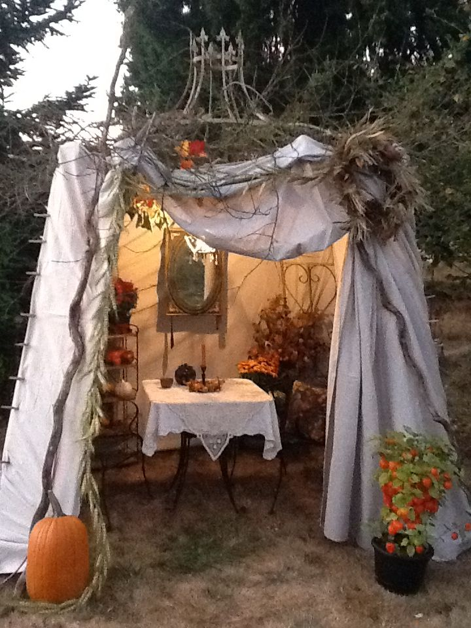
Part #2
What is the connection of Yahusha’s birth, to the Feast of Sukkot, for our assembly plans today?

Slide 49
Mosheh climbed up Mt Sinai many times – 8 times for sure.
The Everlasting Covenant that was re-established – were the spoken words also written on tablets, by Yahuah.
Abraham was already living this same Everlasting Covenant when he was given the Covenant for possession of the land.
This Everlasting Covenant given to Mosheh was understood, agreed upon and ratified by not only Mosheh but also by Aharon, Nadab, Abihu and the 70 elders.
What was the time frame and significance of it all in terms of our belief structure today?

Slide 50
Exodus 24:3 –
And Mosheh came and related to the people all the Words of יהוה [Yahuah] and all the Right-Rulings. And all the people answered with one voice and said, “All the Words which יהוה [Yahuah] has spoken we shall do.”
The Hebrew nation then sacrificed animals to Yahuah, and Mosheh took the blood and sprinkled it on the altar. (Ex 24:4-6)
Exodus 24: next slide -

Slide 51
Exodus 24:7, 8 –
And he took the Book of the Covenant and read in the hearing of the people. And they said, “All that יהוה [Yahuah] has spoken we shall do, and obey.”
And Mosheh took the blood and sprinkled it on the people,
and said, “See the blood of the Covenant which יהוה [Yahuah] has made with you concerning all these Words.”
The sacrifices and the sprinkling of blood had been accomplished.
What was the final necessary act to complete a full ratification of the Everlasting Covenant?

Slide 52
The sealing meal must be eaten!
Who ate this ultra significant sealing meal? - Exodus 24:9-11
And Mosheh went up, also Aharon, Nadab, and Abihu, and seventy of the elders of Yisra’el.
And they saw the Elohim of Yisra’el, and under His feet like a paved work of sapphire stone, and like the shamayim for brightness.
Yet He did not stretch out His hand against the chiefs of the children of Yisra’el! And they saw Elohim, and they ate and drank.

Slide 53
OK! The Everlasting Covenant was signed, sealed and ratified.
What weight should that have on our lives – RIGHT NOW - TODAY?

Slide 54

In terms of our assembly here today, what statutes were included within the agreement that all Yisra’el accepted
and vowed to stand by?
Exodus 23:14–17 forthcoming!

Slide 55
Exodus 23:14-15
Three times in the year you are to celebrate a Festival to Me:
Guard the Festival of Matstsoth. Seven days you eat unleavened bread, as I commanded you, at the time appointed in the month of Abib – for in it you came out of Mitsrayim – and do not appear before me empty-handed;
HalleluYah Scriptures

Slide 56
Exodus 23:16, 17
And the Festival of the Harvest, the first-fruits of your labours which you have sown in the field; and the
Festival of Ingathering at the outgoing of the year, when you have gathered in the fruit of your labours in the field.
Three times in the year all your males are to appear before the Adon [Yahuah]. HalleluYah Scriptures

Slide 57
Some of us here today have voluntarily chosen to obey the statutes of Yahuah, and will present ourselves before Him in accordance with the blood ratified Everlasting Covenant.
It is the very same Everlasting Covenant that Mosheh and the Hebrew nation agreed to obey.
Let us choose to assemble on Yahuah’s Qodesh (Set-Apart) Appointed Time. It is the final Qodesh Appointed Time of the yearly worship cycles!
What then is the reasoning, or purposeful theme, of Sukkot?

Slide 58
What is the meaning of the Hebrew word – Sukkot?
The Hebrew and Aramaic Lexicon of the Old Testament
Koehler & Baumgartner pg. 753
[suka] – 1. a lion’s lair 2. hut – made from twigs and matting
[sukkot] – 1. on the Feast of Tabernacles a person lives for seven days in [a sukkot] made from leafy branches, on roofs and in courtyards.
A Hebrew Lexicon by John Parkhurst 1776 pg. 351
[suk], plural – [sukkot] a pavilion, booth, bower, tabernacle, covert, or the like.
Little booths or huts are still usually erected in the eastern gardens for the sake of watching them
1 Kings 20:12 & 16 – pavilions, but it probably means no more than slight temporary booths made with the bows of trees…

Slide 59
Yahusha became visible [born] on this earth possibly immediately prior to Sukkoth/Tabernacles.
A sukkah is a dwelling place of sorts.
Yahusha - in birthing, came to with us.
Starting with the feast of Sukkot, Yahusha lived on this earth fulfilling the will of Yahuah, the Torah guidelines, word for word, without discrepancy.
What then is the reasoning for observing and rehearsing future Festivals of Sukkot?
“dwell”

Slide 60
What were the words of Yahusha in
Matthew 26:29? KJV
But I say unto you, I will not drink henceforth of this fruit of the vine, UNTIL THAT DAY when I drink it new with you in my Father's kingdom.

Slide 61
And, the words of Yahusha in Mark 14:25! KJV
Verily I say unto you, I will drink no more of the fruit of the vine, UNTIL THAT DAY that I drink it new in the kingdom of [Yahuah].

Slide 62
Also, the words of Yahusha in Luke 22:18! KJV
For I say unto you, I will not drink of the fruit of the vine, until the kingdom of [Yahuah] shall come.

Slide 63
Considering that Yahuah does not change, (Malachi 3:6) –
What will be established once again
in the kingdom of Yahuah?

Slide 64
What has Yahuah asserted that He will do at this particular time? Ezekiel 37:26 (HalleluYah Scriptures)
And I shall make a Covenant of peace with them - an EVERLASTING COVENANT it is with them. And I shall place them and increase them, and shall place My Miqdash [sanctuary] in their midst, forever.

Slide 65
And - Ezekiel 36:27 - (KJV)
And I will put my spirit [ruach] within you, and CAUSE YOU TO WALK IN MY STATUTES, AND YE SHALL KEEP MY JUDGEMENTS, AND DO THEM.
What Everlasting Covenant, and it’s contents, will be established in the Kingdom of Yahuah?

Slide 66
This kingdom of Yahuah, will realize the very same Everlasting Covenant as given to Abraham, re-iterated to Mosheh which he then ratified by blood; and re-established with the life and death of Yahusha Ha Mashiach.
Question: What, conditions does the Everlasting MelchiTzedek Covenant contain?

Slide 67
Exodus 23:14-15
Three times in a year you are to
celebrate a Festival to me:
Guard the Festival of Matstoth. Seven days you eat unleavened bread, as I have commanded you, at the time appointed in the month of Abib – for in it you came out of Mitsrayim – and do not appear before me empty handed. HalleluYah Scriptures

Slide 68
Exodus 23:16-17
And the Festival of the Harvest, the first-fruits of your labours which you have sown in the field; and the Festival of Ingathering at the outgoing of the year, when you have gathered in
the fruit of your labours in the field.
Three times in the year all your males are to appear before the Adon [Yahuah] . HalleluYah Scriptures

Slide 69
The same Everlasting Covenant with the Feasts and Festivals will also be celebrated in Yahuah’s kingdom.
We will be rehearsing for that momentous time when we will be - fully - Yahuah’s people.

Slide 70
Rev 2:26, 27 –
And he who overcomes, AND GUARDS MY WORKS until the end, to him
I shall give authority over nations and he shall shepherd them with a rod of iron, as the potter’s vessels shall be broken to pieces, as I also have received from My Father.
HalleluYah Scriptures

Slide 71
When Does The Festival of Sukkot End ?
Zekaryah 14:9 (For full context – start reading from vs. 1.)
And יהוה [Yahuah] shall be Sovereign over all the earth. In that day there shall be one יהוה [Yahuah], and His Name one.
Sukkot Timing information - Zekaryah 14:16–21
16. And it shall be that all who are left from the gentiles which
came up against Yerushalayim shall go up from year to year to
bow themselves to the Sovereign, יהוה [Yahuah] of hosts,
and to celebrate the Festival of Sukkoth.

Slide 72
When Does The Festival of Sukkot … End ?
And it shall be, that if anyone of the clans of the earth does not come up to Yerushalayim to bow himself to the Sovereign, יהוה [Yahuah] of hosts, on them there is to be no rain.
And if the clan of Mitsrayim does not come up and enter in, then there is none. On them is the plague with which יהוה [Yahuah] plagues the gentiles who do not celebrate the Festival of Sukkoth.
This is the punishment of Mitsrayim and the punishment of the gentiles that do not come up to observe the Festival of Sukkoth.

Slide 73
When Does The Festival of Sukkot … End ?
We are commanded to observe Yahuah’s Word for a thousand generations. Deut 7:9; 1 Chr 16:15; Ps 105:8 (three witnesses).
That command projects obedience to Yahuah’s Word well beyond the time frame brought to view in Rev 21 & 22, when the earth will be made new — when sin will be no more."
Interestingly, this obedience time projection, fits perfectly with the information of those who will, and will not, observe the Festival Sukkoth (Tabernacles), which we received from Zekaryah (Zechariah).

Slide 74
When Does The Festival of Sukkot … End ?
The final Sukkot on this contaminated earth will be after –
Rev 12:14 – And the woman was given two wings of a great eagle, to fly into the wilderness to her place, where she is nourished for a time and times and half a time, from the presence of the serpent.
That is – 3.5 years, or – 4 full cycles of the Mo-edim (Feasts), ending with the Festival of Sukkot.

Slide 75
Daniel identifies this earth’s final
Festival of Sukkot !
And I heard the man dressed in linen, who was above the waters of the river, and he held up his right and his left hand to the shamayim, and swore to Him who lives forever, that it would be for an appointed time, appointed times, and a half. And when they have ended scattering the power of the qodesh people, then all these shall be completed. Dan 12:7 HalleluYah Scriptures

Slide 76
Let’s deeply consider the idea of Yahusha arriving on this earth before Sukkot to DWELL with us!
Let’s look forward to the Festival of Sukkot with plans to REJOICE because –
YAHUSHA HA MASHIACH – LIVES!
And … may Yahuah bless you immensely!
Thank you!

Slide 77


If you need assistance
with this information,
please send your
questions to
Timothy Astleford:
questions@studythecalendar.com
Sept 9, 2018

