Slide 1
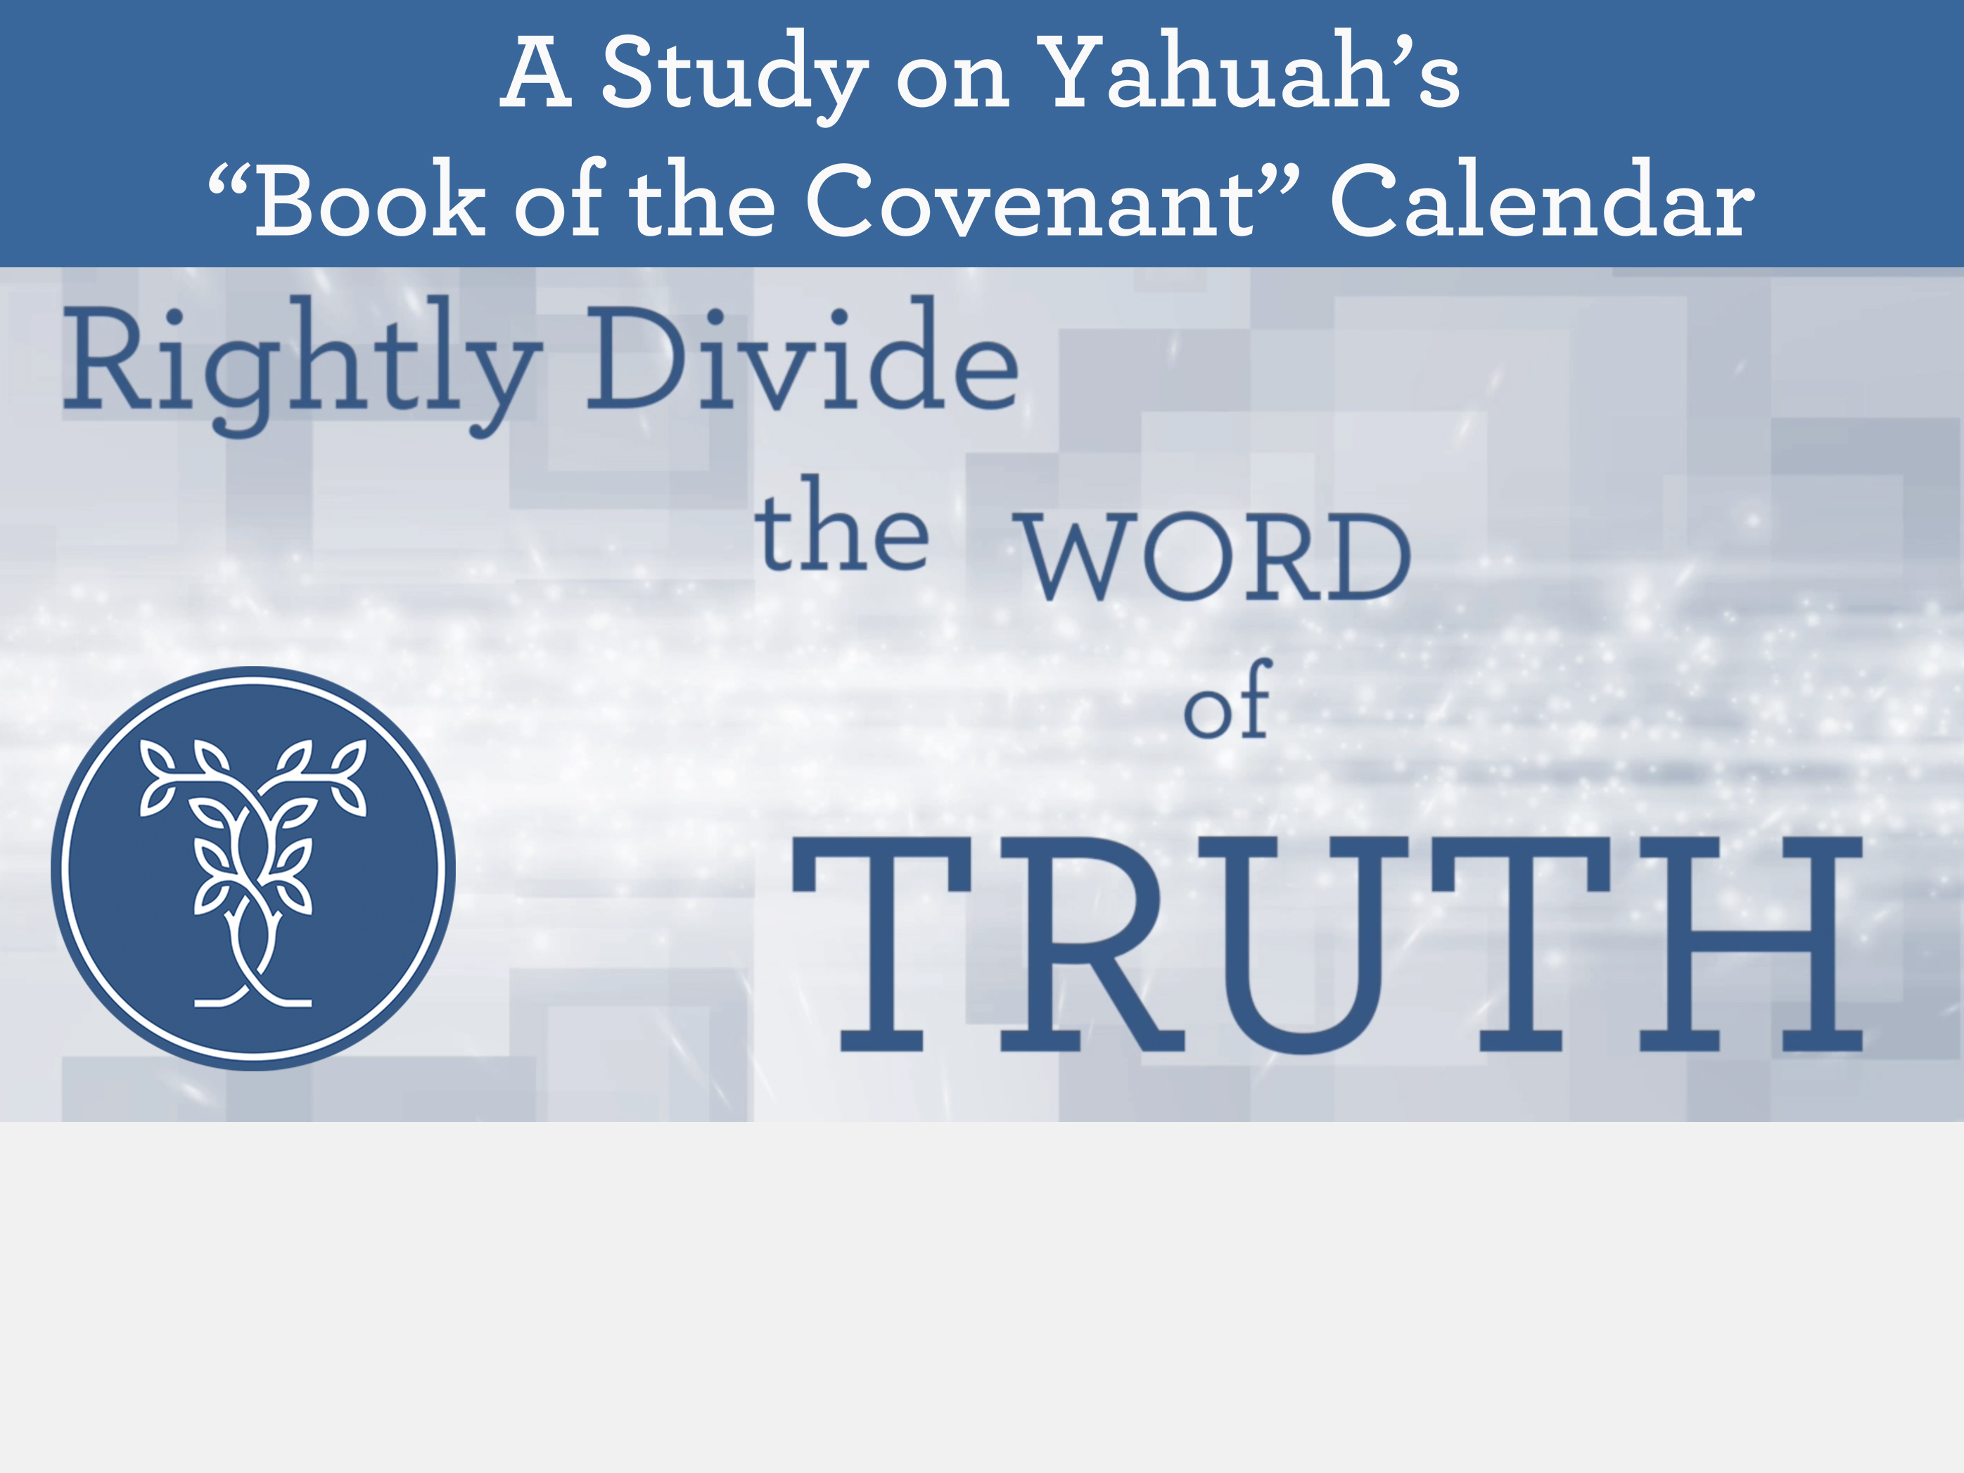
Jan 28/18
Redid the title slide and the final slide with the new email address.
Emailed the PDF to Mario for upload to website.
The Hebrew Evening
of Genesis 1

Slide 2
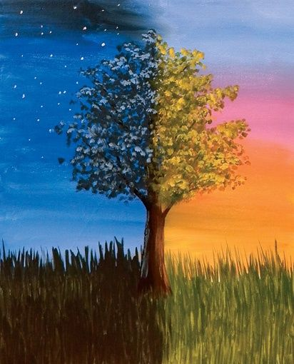
Are you ready for the next paradigm shift about evening?
A Study on the
True Meaning of
“evening” …
… According to Hebrew Definitions
Notes:
Tim Astleford is going to present about 15 slides right here about the true meaning of “evening” – as most people believe it is “sunset” and most people believe every Sabbath begins with “evening.” So, this section will be another paradigm shift too.

Slide 3

When is ThE Hebrew Evening?
In order to understand the word “ereb” or “evening” there are several other terms
that must be understood as well.
This will be a brief examination of five separate units given on Day 1 of Creation.
3

Slide 4
Have you been interested in when the Hebrew evening occurs, as seen and proven by example in the Scriptures?
Have you ever considered
going to the original Hebrew language
for the definitions of <ereb>,
the Hebrew word that has been
translated into English as
“EVENING”?
4

Slide 5
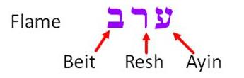
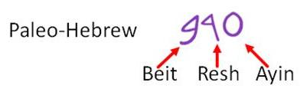
Comparisons of Hebrew Letters
The word ereb (evening) consists of 3 Hebrew letters:
Ayin, Resh Beit – and it looks like this:
Hebrew is read from right to left, the opposite of English.
We must be very aware of this.
This word – ereb - is used 136 times in 129 verses in the Hebrew Concordance of the KJV.
Personally I equate the level of importance on this word, equal to oxygen.
No, I am not exaggerating here. It really is that important.
Strong’s Concordance has given ereb the number of H6153, and it seems everyone has accepted that designation.

Slide 6

The “UNITS” on Day 1 of Creation
The 1st day of creation houses
5 separate “units” (or components)
found within the first 24 hour cycle.
            They are:
            1. light^{H216}
            2. darkness^{H2822}
            3. darkness^{H3915}
            4. ereb^{H6153}
            5. boqer^{H1242}

Slide 7
First mention of <ereb> in Genesis
The first usage of this word <ereb> is found in Gen 1:5.
We need to look at this very carefully, because there are those who desire to place the <ereb> evening in a location where Yahuah has not placed it.
We will not go into detail here as
that will be seen in another study
on Genesis 1.

Slide 8
First “two” units identified
Let’s examine verse 4 first as it sets the foundation for this interesting word <ereb>:
Gen 1:4 And [Yahuah] saw the light^{H216} that it was good, and God divided between the light^{H216} [owr] and the darkness^{H2822} [choshek].
The First “2” UNITS are:
Light^{H216} [Owr]
Darkness^{H2822} [Choshek]

Slide 9
Gen 1:5: First division of
<light^{H216}> and <darkness^{H2822}>
Gen 1:4 And God saw the light^{H216} that it was good,
and God divided between the light^{H216} [owr] and the darkness^{H2822} [choshek].
Note carefully that Yahuah divided the
light (owr) and the darkness (choshek).
This (choshek) darkness^{H2822} is first mentioned in Gen 1:2.
(It is an “evil contaminated atmosphere” that resulted from a very momentous event to be discussed later.)

Slide 10
<darkness> GIVEN ANOTHER DEFINITION
Upon this division of light^{H216} and darkness^{H2822} in
verse 4, another identity is brought forth called: <layil ^{H3915}>.
Gen 1:5a And God called the light^{H216} Day,
and the darkness^{H2822} [choshek]
he called Night^{H3915}, [layil] …
This <layil^{H3915}> is likened to the
night darkness we see during our
Night Season today.

Slide 11
3rd UNIT BROUGHT FORTH
Note carefully that we have seen 3 separate
UNITS given at this point in Day 1 of creation.
They are:
1. light^{H216}
2. darkness^{H2822} (evil contaminated atmosphere)
3. darkness^{H3915} (night) (3rd Unit)
Gen 1:5a And God called the light^{H216} Day,
and the darkness^{H2822} [choshek]
he called Night^{H3915} [layil] …
Note: The choshek darkness is also a part of our cycles (increasingly so in these latter times).
We will not be concentrating on the choshek darkness
(in this study) for that is another topic altogether.

Slide 12
GEN 1:5b: 4th & 5th UNITS GIVEN
In Gen 1:4 & 5, there are a total of 5 UNITS named by Yahuah as being fully part of the first cycle of the week.
Having already identified 3 UNITS of the 24 hour cycle, we need to look closely at “the last part” of Genesis 1:5 to identify the last 2 UNITS.
Gen 1:5 And God called the light Day,
and the darkness he called Night,
and there was evening [ereb]
and there was morning, [boqer] the first day.
Here we see the last two UNITS: ereb (evening) and boqer (morning).
Another generic term for both evening and morning is twilight.
This is the final list of 5 UNITS for Day 1 of Creation:
1. light^{H216}
2. darkness^{H2822} (evil contaminated atmosphere)
3. darkness^{H3915} (night) (3rd Identity)
4. ereb^{H6153} (evening)
5. boqer^{H1242} (morning)
(Boqer is not discussed until another study.)

Slide 13
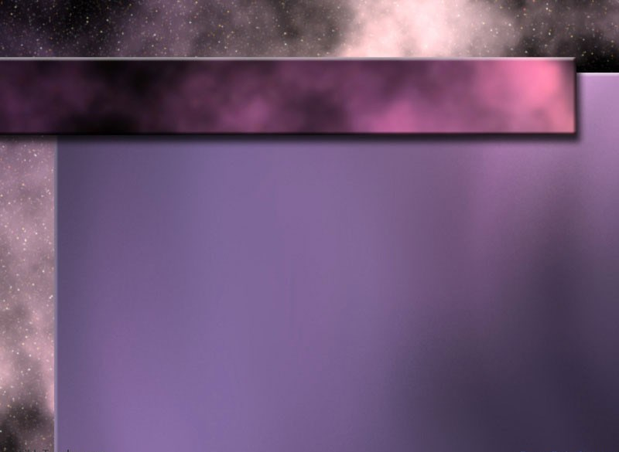
Addressing Possible Confusion
darkness^{H2822} & darkness^{H3915}
Gen 1:5 And God called the light^{H216} Day,
and the darkness^{H2822} he called Night^{H3915} …
Perhaps you have noticed on Day 1 of Creation, the word “darkness” is listed with two different Hebrew word numbers as:
a. darkness^{H2822}
b. darkness^{H3915}
Why does Yahuah apply two different units with the same “word” to one phase of this cycle? Would this not be confusion?
Answer: Yes, to us it could be confusion. However, in Hebrew, H2822 & H3915 are two very different words, with two very different meanings. Therefore this area needs more clarification because there is a lack of word choices when translating from one language to another – especially to English.
13

Slide 14
There is NO Confusion in Hebrew!
(between) darkness^{H2822} & darkness^{H3915}
Gen 1:5 And God called the light Day,
and the darkness he called Night …
There is no need for confusion between these two Hebrew word numbers that have the same word of “darkness” in the English language. They have completely different word definitions.
a. darkness^{H2822} is basically an evil contaminated atmosphere that came about due to a disastrous event which happened between verses 1 and 2.
In simple terms, this “H2822 darkness” needed cleansing to establish the unit Yahuah calls:
b. darkness^{H3915} – or – what we now call night.
14

Slide 15

FIRST THINGS FIRST!
Gen 1:5 And God called the light Day,
and the darkness he called Night …
In the first part of Gen 1:5, the Light Season that is named “DAY” is direct light – or for us today – actual direct SUNlight when the sun is above the horizon.
Darkness (night-H3915) is the total absence of LIGHT”
- or for us today the total absence of “SUNlight.”
So what are these other two identities:
ereb and boqer [twilights]?
15
15

Slide 16

Time to Examine <ereb>!
The reason for this study is because some feel the two units of – ereb and boqer – (or twilights) have nothing in common with the Night Season. But, do these twilights of – ereb and boqer – HAVE ANYTHING IN COMMON with the Light Season where there is direct sunlight? For clarification, direct sunlight is … when the sun is above the horizon.
Because of these questions, we must examine some Hebrew definitions to arrive at concrete conclusions.
Our concentration will be on the word – ereb.
Unlike the word “darkness” the definitions for ereb are tied directly to boqer!
Because Strong’s is so common, let’s start looking at H6153, where the root word is declared to be H6150.
We will then compare to several other sources.

Slide 17

Strong’s: <ereb> H6150
H6150 ע ר ב ereb – with 6148 through the idea of covering, with a texture; to grow dusky at sundown: be darkened (toward) evening.
H6151 ע ר ב ereb – to commingle; - mingle (self) mix,
H6153 ע ר ב ereb – from 6150 dusk: -+day, even(ing), tide), night
H6151 ע ר ב ereb – from 6148 the web (or transverse threads of cloth); also a mixture,(or mongrel race) Arabia, mingled people, mixed (multitude), woof.
Note: the base theme of this word is: mixture/mingling.

Slide 18

Etymological Dictionary of the
Hebrew Language: <ereb> H6150
<`ereb> - ע ר ב, [some definitions apply to Light], to set [said especially of the sun], to enter, to go in, to go down,
it became evening, it grew dark, sunset, evening, mixed,
to mix, was mixed, was mingled, mixture, woof.
Question: What is “woof”?
Let’s check the Webster’s Dictionary:
Answer: Woof = to weave, the threads that cross the warp, the weft. [In other words: a mixing!]

Slide 19
Hebrew English Lexicon
By John Parkhurst (1762): <ereb>
Evening - ע ר ב
To mix, mingle, be mingled, a mixture, mixed multitude, rabble, of flies or insects [J Parkhurst then gives texts where flies apply] the mixers, mixed ones, light and spirit mixed together, the heavens or celestial fluid consists of this mixture, to be darkened, duskily obscured, [beyn ha arbayim] between the evenings or more literally between the mixtures, at sunset when the cool dark air mixes or night air mixes with it.
The evening air from the western or darkened part of the heavens begins to mix with the day, which mixture continues till night, when the day is overpowered the darkness prevails and the mixture of daylight ceases.
Gen i.5, xxiv.11.
19

Slide 20
Gesenius Lexicon:
(Blue Letter Bible online) <ereb>
1. According to the opinion of the Karaites and Samaritans, (which is favoured by the words of Deut 16:6) the time between sunset and deep twilight. The Pharisees, however (see Joseph Bellum Jud.vi:9,3) and the Rabbinists, considered the time when the sun began to descend to be called the first evening (Arab – little evening, when it begins to draw toward evening); and the second evening to be the real sunset. [Emphasis supplied.]

Slide 21
The Pharisees and the Rabbinists (Talmud) do not consider the original Hebrew definitions of the word ereb.
Instead they declare (manipulate) that “ereb” (evening) has the meaning of – when the sun starts to lower itself in the sky.
Thus they declare that the start of the
1st evening is at the point of noon when the
sun appears to descend in the sky.
Lets look at a graphic and determine if there is any possibility of darkness arriving to begin the mixture with the light of day, at this time.

Slide 22
The Pharisees and Rabbinists tell us that when the sun starts to “go down at noon,” – THAT IS the first (ereb) - evening”?
Dawn Sunrise Noon Sunset Dusk
Questions:
How many times have you heard of “the two evenings,” with the first one starting at noon as “the sun begins to go down in the sky”?
Did you ever question the origin of this concept?
From whence cometh the darkness to mix with the direct sunlight of the day?
Rabbinical 1st ereb (evening)
mixture
Light Season
mixture
22

Slide 23

Further Comment for Gesenius Lexicon:
2. Foreigners, strangers, hence foreign kings who made alliance with the Israelites.
Note: On the #2 definition, we see once more the theme of a mixture/mingling.
I find the comment made about the Pharisees and Rabbinists concept of the ereb evening beginning at noon, extremely interesting to say the least.
I will comment by asking a question.
Yahuah named the time of direct sunlight owr (light/day). Are the Rabbi’s and Pharisees placing themselves on Yahuah’s Throne when they overrule Yahuah’s declaration by naming this specific time of
[owr^{H216} - (light)] as “evening”??
By the first usage in the Scriptures,
the “afternoon evening”
does not align to any Divine example!

Slide 24
Hebrew Lexicon:
(W H Barker 1776) <ereb>
Evening to mix, mingle, the evening, when darkness mixes with light; to be darkened, obscured, to intermeddle with, surety, to engage for another, to mortgage – Neh 5:3, the woof, intermixed with the warp, a mixed multitude, swarm, to trade, intermix in dealing, to be sweet and pleasant, where the mixtures are agreeable, the willow, it being of a mixed colour, pale on one side and green on another, a wilderness, where vegetables are mixed and confused, the weft, evening, the heavens or mixtures.

Slide 25
A Hebrew & English Lexicon of the
Old Testament (1906): <ereb>
Based on William Gesenius,
translated by Edward Robinson
“Mix, mixture, mixed company, interwoven, swarm, pledge to give in exchange, a surety for exchange, token, in the phrase – between the evenings probably between sunset and dark, for all combinations with boqer [morning] become evening, grow dark, 1 Sam 17:16 – doing it at morning and at evening, west – place of sunset, be black, black as a raven.”
Again, there is a heavy emphasis on a mixing of the sunset to darkness period when considering time.
Question: Is there a mixing of light and darkness before the sun sets?

Slide 26
The Hebrew & Aramaic Lexicon
of the Old Testament: <ereb>
Koehler & Baumgartner: ereb
  To participate in, get involved with someone, to turn into evening, metaph. to go down, descent of the sun, sunset, at evening, between the two evenings i.e. between sunset and nightfall, together with, a type of weaving, woven material, mixing, mixed race, a willow.
Comments:
After reading the definitions from a variety of different sources, the central theme of “mixings of separate substances” or “units” is very distinct! It is only in these two [twilight] portions of the 24 hour cycle, (the morning <boqer> twilight and the evening twilight), that the
mixing of light and darkness occurs and the word ereb can apply.
However this word is only used in conjunction with boqer when referencing the morning twilight.
Yahuah has broken down the 24 hour cycle into 4 separate segments so we
are able to conduct our lives accordingly.
Let’s examine a linear graphic first and then a circular one to be sure we
are all on the same page.

Slide 27
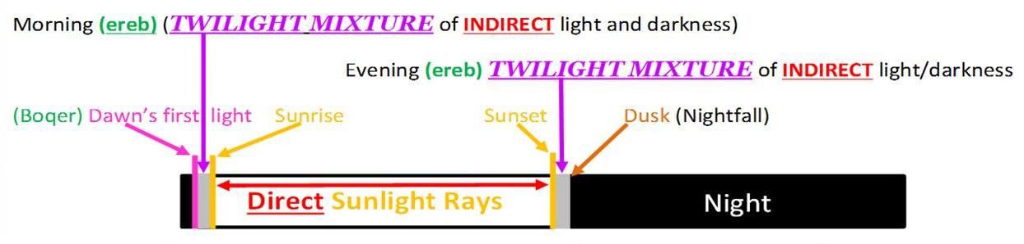
Light, Darkness, Evening & Morning
According to Genesis 1
Most of us are Greek linear minded people
so this chart should be easy to relate to.
1. The grey boxes are the areas where a mixing of light and
darkness occurs.
2. These locations for evening are according to the Hebrew
language definitions.
3. These twilights cannot be found before the sun sets, nor after
the sun has risen [beginning with Day 4’s sunlight].
4. Direct sunlight does not allow for any mixing action to occur.

Slide 28
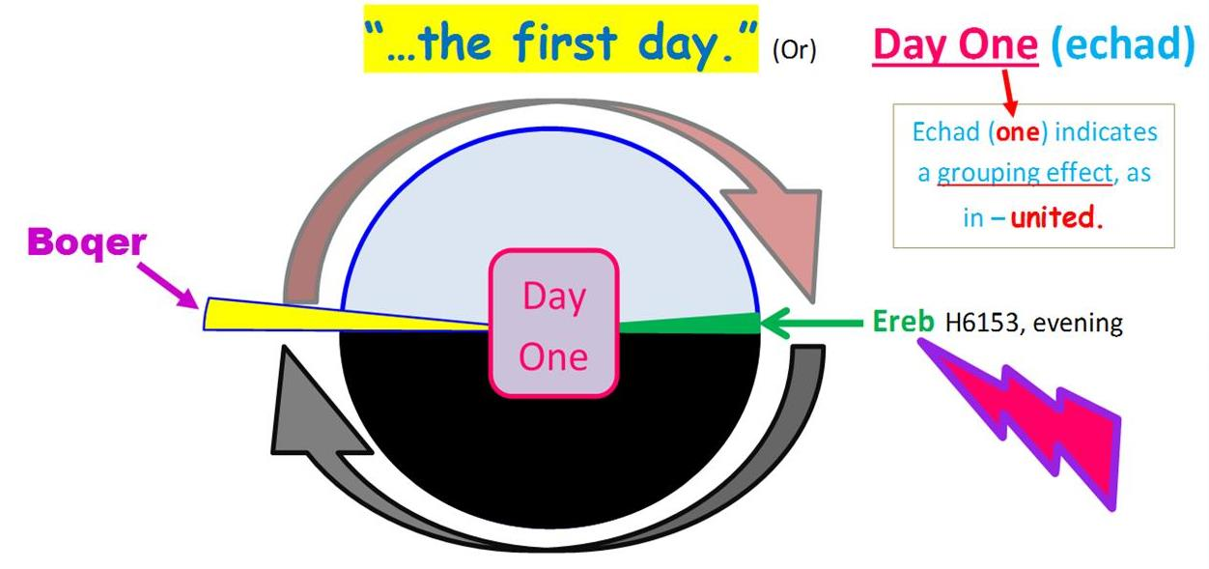
Genesis 1:1-5 Order & Alignment
Yahuah brought forth LIGHT first;
Evening mixture follows second;
next, the Night Season passes;
last, Boqer morning twilight arrives … finishing …
28

Slide 29
On days 1 to 6, we see that Yahuah is busy during the Light Season with the events of creation.
Then we read that the evening (ereb) came to be.
To fulfill the mixing definition & description
of ereb (evening) the light must be present first
to provide a base for the ensuing darkness mixing action with the light.
Ereb
Evening
And there came to be evening.

Slide 30
After the ereb (evening) darkness occurred, the
Night Season darkness (layil) passed by unannounced.
Then the boqer (DAWN / morning) light triggers the termination of the previous 24 hour period.
Day 1 (through 6!) No work was done on Day 7!

Slide 31
Yahuah’s Days of Creation - Dawn to Dawn
Dawn
☺
to
Dawn

Slide 32
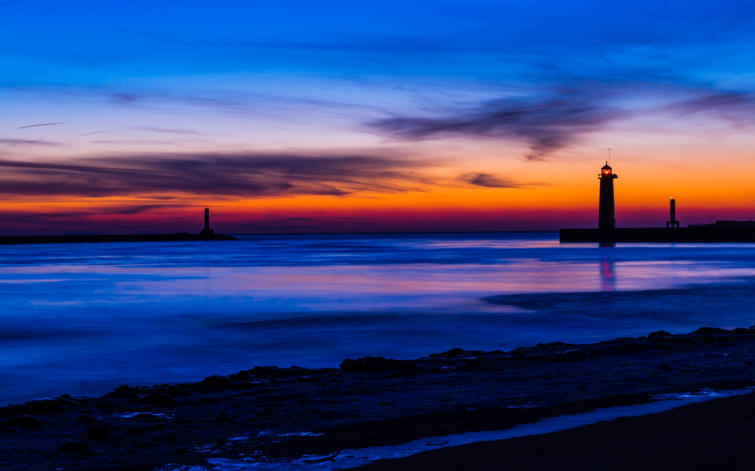
Conclusion for <ereb>
Not one “day” can begin with evening <ereb> because the evening contains “light” received from the Day Season.
It is impossible for
evening to begin any “new day”
because “light” must be present first.
LIGHT begins everything. Have you noticed that Yahuah does not even mention the sun, neither in rising nor in setting for the 1st day of creation? Why?
Because, the sunLIGHT could not begin the “day” until it was commanded too. But, from the beginning, the “evening unit” always belonged to the “Light Season” because it has the mixing of “light” with the “night.”

Slide 33

Conclusion for <ereb>
Why do you suppose Yahuah did not begin
the 1st day of creation
with light from a created sun?
  Could it be: this is His planned system,
  (or His built-in preventative method),
  to restrain us from worshipping the sun?
  Let’s always look to the “light” for the beginning of each new day – the first “light” that breaks the day before
  any sun is seen above the horizon.

Slide 34

All truth passes through three stages:
First: it is ridiculed;
Second: it is violently opposed, and
Third: it is accepted as self-evident.
Arthur Schopenhauer – Philosopher
Sponsored by
Torah to the Tribes
Covenant
Calendar
Club
2
0
1
8
Questions & Comments
for Melchizedek’s “evening”
on the 1st day of creation?
calendar@torahtothetribes.com Jan 12 2018

